Slide 1
Voter Registration and Engagement for People Experiencing Homelessness
Joseph Benson
Community Health Worker
Health Care for the Homeless Houston
HCH2024
PHOENIX, AZ • MAY 13-16, 2024

Slide 2
VOTER REGISTRATION AND ENGAGEMENT FOR PEOPLE EXPERIENCING HOMELESSNESS
Joseph Benson
Community Health Worker
Health Care for the Homeless Houston

Slide 3
OBJECTIVES
Know ways that individuals and organizations can participate in voter registration
Understand legal and logistical limitations of voter registration activities
Locate resources that will help plan and implement voter registration activities

Slide 4
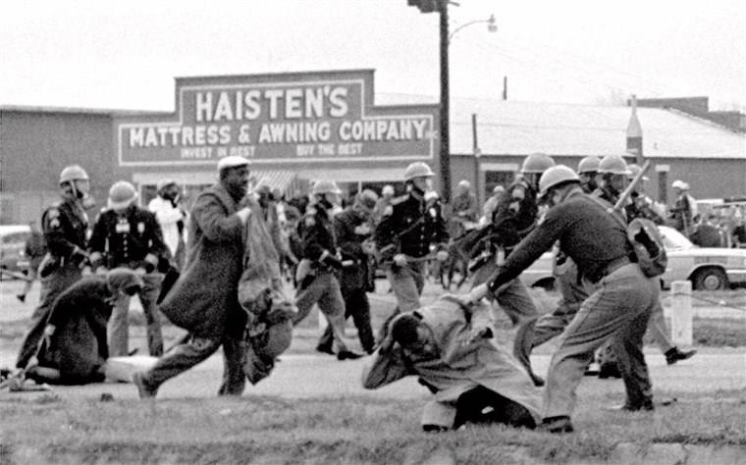
A QUICK HISTORY
1776- DECLARATION OF INDEPENDENCE
1788- THE CONSTITUTION
15th Amendment (1870)- African-Americans
19th Amendment (1920)- Women
24th Amendment (1964)- Poll Taxes
26th Amendment (1971)- Voting Age 18
1965- VOTING RIGHTS ACT
2013- SHELBY V. HOLDER
“This is Selma, Alabama. There are more negroes in jail with me than there are on the voting rolls”
- Martin Luther King Jr. (1965)

Slide 5
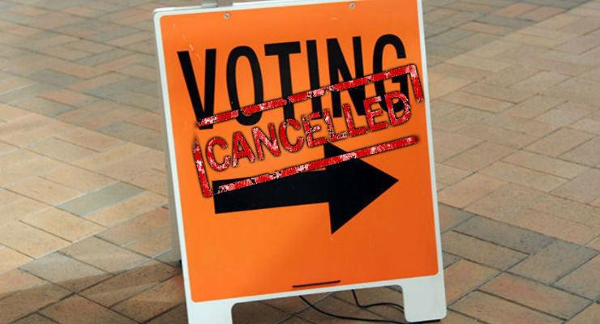
TODAY…
Banning of people convicted of a felony
Requiring photo ID
Requiring proof of citizenship
Reducing early and absentee days
Misinformation campaigns
US Territories

Slide 6
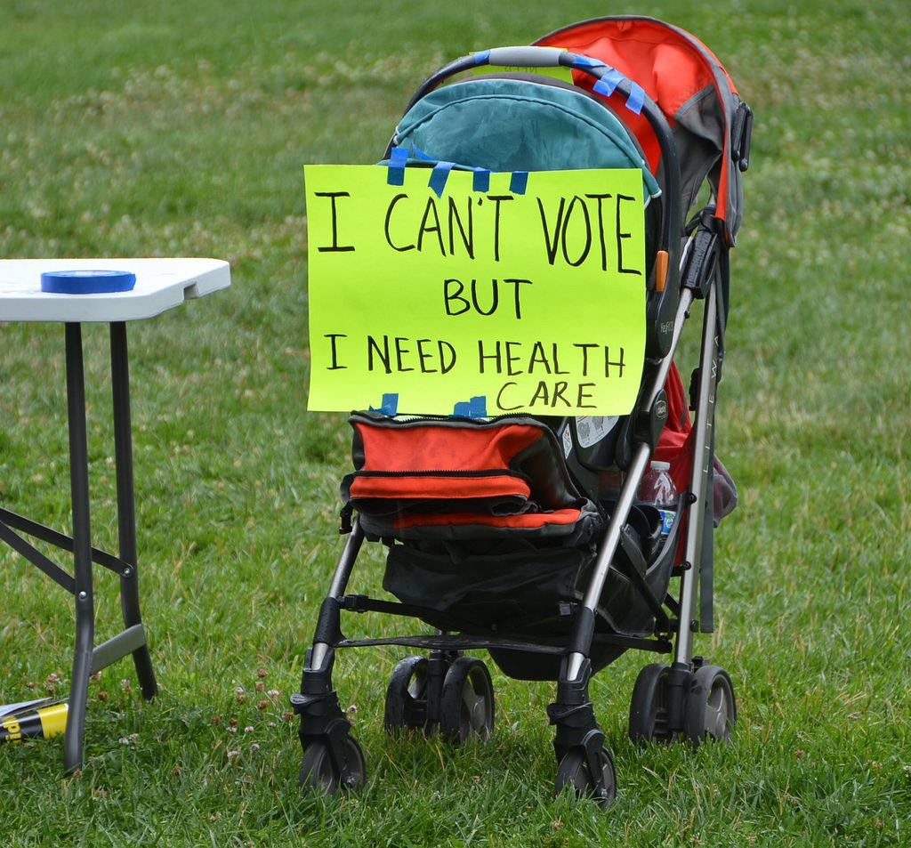
VOTING IS IMPORTANT
It is our mission.
It is empowering.
We are all impacted by the
decisions of who we vote (or don’t
vote) for.
People experiencing homelessness are underrepresented.
And yes… it is legal!

Slide 7
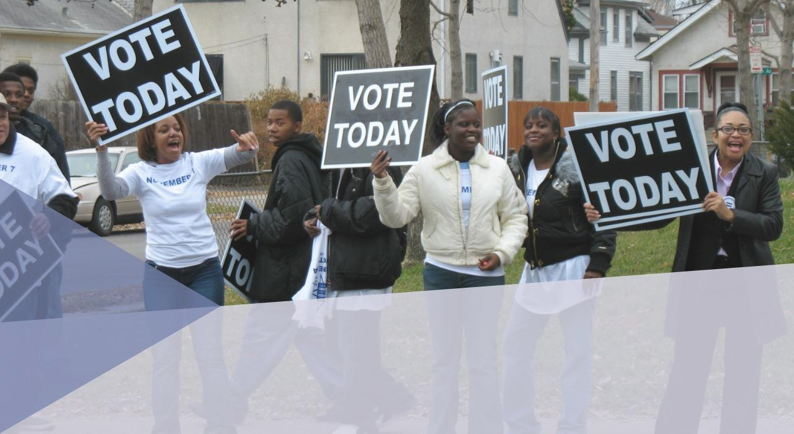
Why voter registration?

Slide 8
Community Health Centers play an important role
Community reach: Community Health Centers already engage with disenfranchised communities and can have an impact on voter turnout
Non-partisan voter education: HRSA allows health centers to conduct nonpartisan voter education and registration
Trusted agents: Health Centers are uniquely positioned to support people experiencing homelessness, non-citizens eligible to vote, and special populations engage in the electoral process

Slide 9
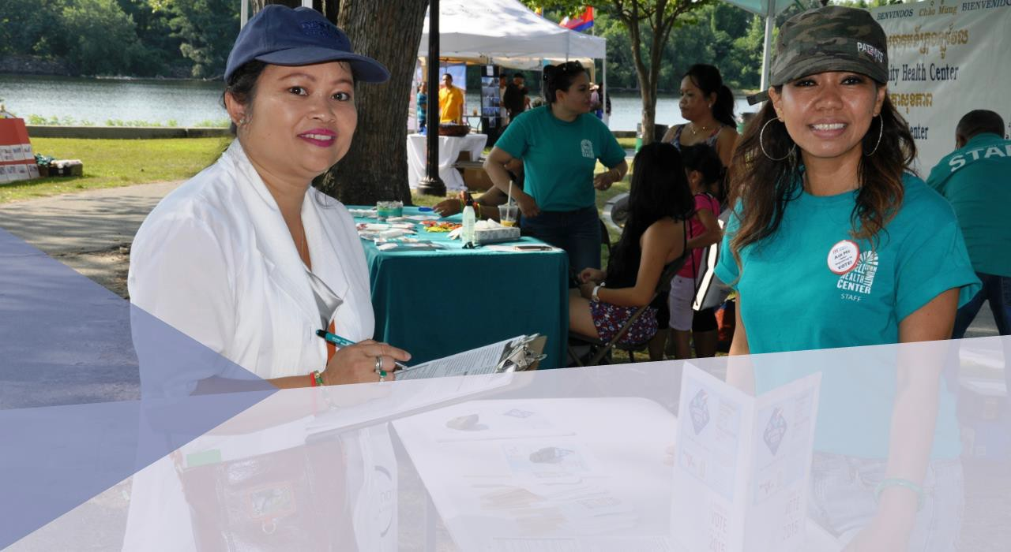
From theory to action

Slide 10
Whether you are a health center or a nonprofit train your staff
Learn about the state-to-state registration laws, guides to voter engagement, and voter registration forms at: Voting In Your State
Educate staff engaged in registration efforts to understand rules regarding remaining nonpartisan and eligibility requirements. Invite Bolder Advocacy from Alliance For Justice to provide training or connect with local election commission.
Learn your deadlines, early voting periods, and how to secure absentee/mail in ballots.

Slide 11
Best practices for successful voter engagement
Get buy-in from your board, leadership &staff on the benefits of turning out your constituency to vote.
Designate a person that can lead voter registration drives & voter turnout efforts on election day. Voter registration can be done during intakes, or simply by having a voter registration booth in your lobby.
Depending on your circumstances, you can register people online or through paper. Make sure to turn in your voter registration forms on time

Slide 12
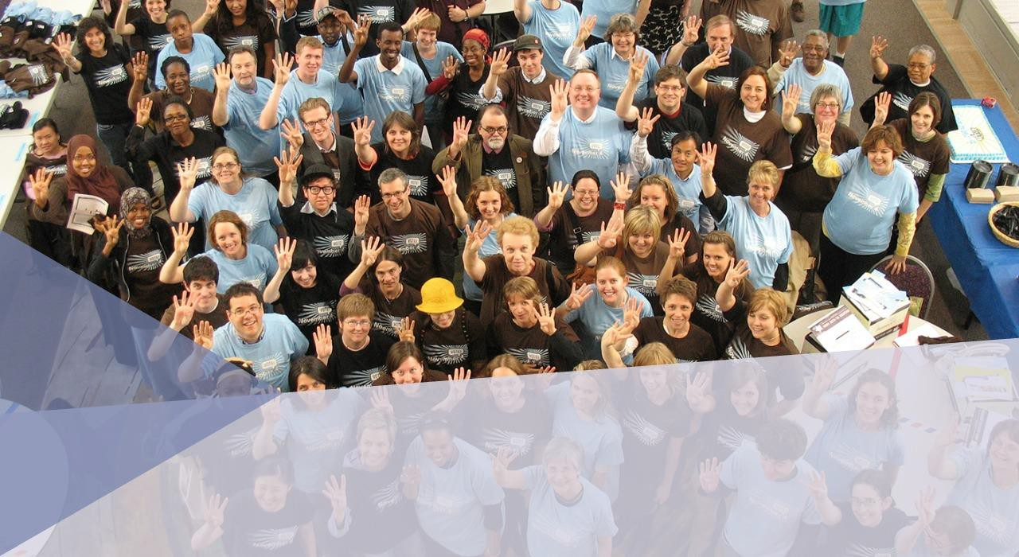
Beyond registration

Slide 13
Get Out the Vote (GOTV)
Getting voters to the polls requires transportation and coordination:
Provide transportation (you cannot have partisan bumper stickers/signs in your organization’s vehicle) or collaborate with community groups offering rides
Remind people to bring their ID to the polling location
Provide reminders the night before and the morning of Election Day
Educate voters about WHERE to vote but not WHO to vote for:
You can share information about who is on the ballot
You cannot tell people WHO to vote for

Slide 14
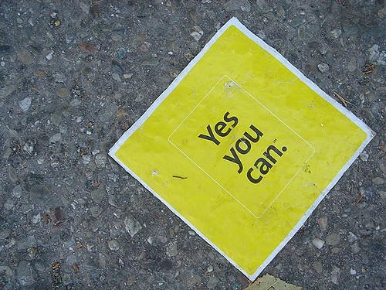
OPTIONS FOR INTEGRATING VOTER REGISTRATION
Materials in lobby
Registering during intake
Include in case management
Voter registration drives
CAB sponsorship
Find community partners

Slide 15
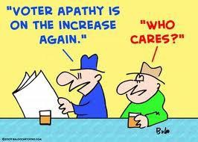
PLAN FOR COMMON BARRIERS
No Time
No ID
No Home
Criminal Record

Slide 16
CHECK LOCAL LAWS FOR REQUIREMENTS
→Mailing Address
→Photo Identification
→Citizenship
→Criminal Background

Slide 17
REGISTRATION DOS AND DON’TS
DO DON’T
Assist with forms
Educate about voting process
Offer the HCH project as a mailing address
Discuss importance of policy
Offer to mail in forms
Check state/county law
Refuse anyone the
opportunity to register
Attach information to the registration forms
Discuss the candidates’
positions on issues
Have any materials endorsing
candidates or parties

Slide 18
OTHER ELECTION ACTIVITIES
Leading up to the election
Early voting
Absentee ballots
Locating polling places
Sample ballots, voting machines
Non-partisan issue education
On election day
Transportation to the polls
Go the polls together
Get out the vote rally
Volunteers at polling places

Slide 19
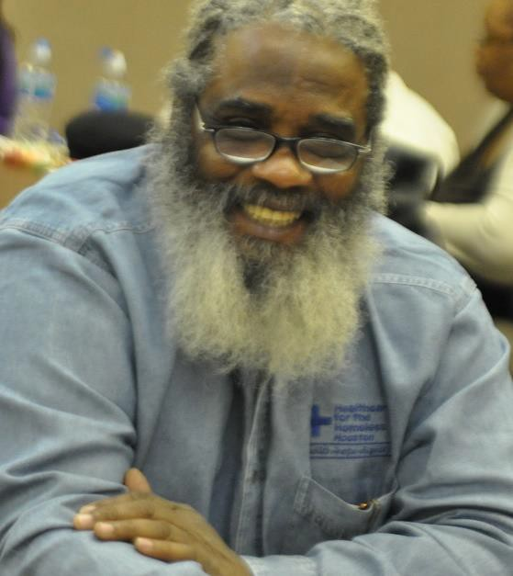
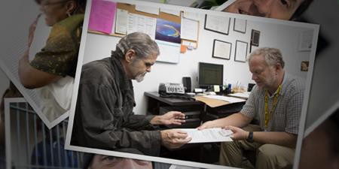
VOTER REGISTRATION AT HOUSTON HCH
Consumer Driven
Every Monday year-round
Extensive work with local election board
Get out the vote campaign

Slide 20
RESOURCES
National Alliance to End Homelessness Toolkit for People Experiencing Homelessness→ https://endhomelessness.org/wp-content/uploads/2024/02/NAEH_EveryOneVotes_2024.pdf
Voting in Your State→ https://www.nonprofitvote.org/voting-in-your-state/
Election Dates and Deadlines → https://www.usvotefoundation.org/vote/state-elections/state-election-dates-deadlines.htm
Voter ID Laws → http://www.ncsl.org/research/elections-and-campaigns/voter-id.aspx
Felon Voting Rights → http://www.ncsl.org/research/elections-and-campaigns/felon-voting-rights.aspx
Nonprofit Guide to Nonpartisan Activities → https://www.nonprofitvote.org/nonprofits-voting-elections-online/voter-registration/
How to Register to Vote→ https://www.usa.gov/register-to-vote
League of Women Voters→ https://www.lwv.org
2024 National Voter Registration Day Sign Up: → https://nationalvoterregistrationday.org/

Slide 21
QUESTIONS?
The vote is the most powerful nonviolent tool we have.
-John Lewis
Joseph Benson
Board Member
National HCH Council
Community Health Worker
Health Care for the Homeless Houston
JosephJr.Benson@bcm.edu
713-286-6064

