Slide 2
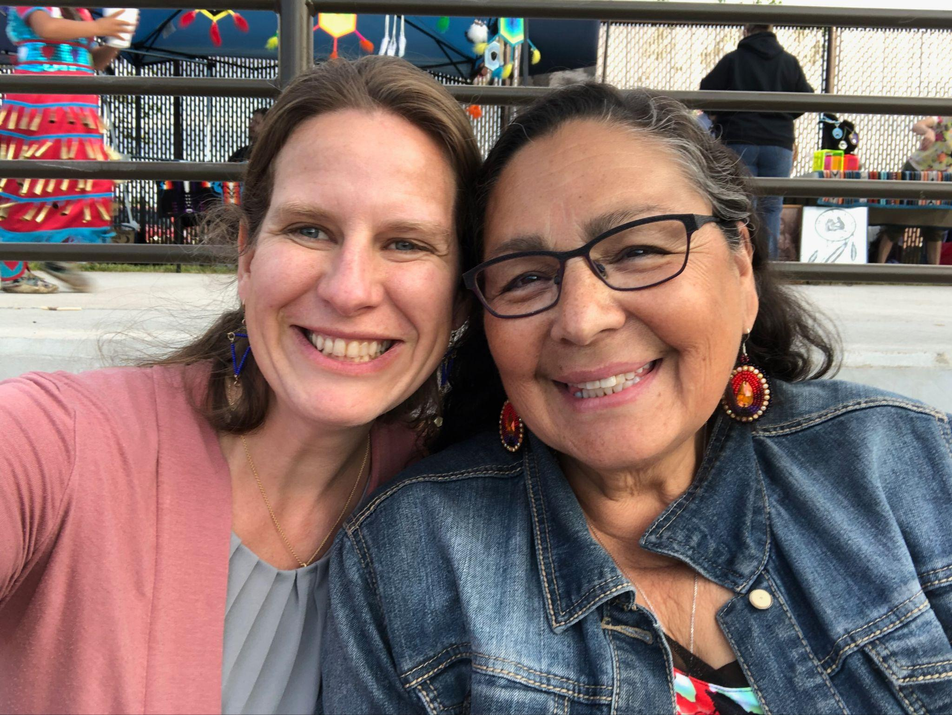
Indigenous Lens: Providing
Culturally Safe care
Dr. Erin Tenney & Dorene Waubanewquay Day
Notes:
Dorene to lead us in an opening prayer
Introductions-
Dorene
Erin

Slide 3
Agenda
8:30-8:45 Introduction & Opening words
8:45- 9 Traditional Knowledge Protocols (Dorene)
9- 9:45 Cultural Safety Overview (Erin)
9:45-9:55 Stretch break (10 min)
9:55- 10:20 Relaxation (shorter version) Creation Story Visualization (Dorene)
10:20-10:30 Personal exploration- Each person actively engages in reflection on their
cultural roots; identity, ancestors, land and language
10:30-10:45 Break
10:45- 11:15 Improving patient & provider trust within contexts of collective &
Intergenerational Trauma (Dorene)
11:15- 11:50 What does culturally-safe patient care and education look like? Doula and
birthworker training & community engagement (Dorene)
11:50- 11:55 Stretch break (5 min)
11:55- 12:10 Take homes (Erin)
12:10-12:20 Q&A
12:20-12:30 Closing circle
Notes:
Who?
What have we been taught about our history?
Whose story have we been taught?
We know Indigenous people experience significantly worse health outcomes that white folks in the U.S.. Health inequity is a major problem in the U.S. but… do we know why?
How did we get here?

Slide 4
Learning Objectives
Learn how Indigenous care can be improved through learning and applying key tenets of cultural safety
Health care providers reflect upon their own cultures and identities; reflecting upon how these impact the patient/ provider relationship and quality of care
Understand how collective and intergenerational trauma in Indigenous communities impacts health and interactions with western medical systems
Learn what differentiates a culturally safe approach and what this looks like in practice
Notes:
Who?
What have we been taught about our history?
Whose story have we been taught?
We know Indigenous people experience significantly worse health outcomes that white folks in the U.S.. Health inequity is a major problem in the U.S. but… do we know why?
How did we get here?

Slide 5
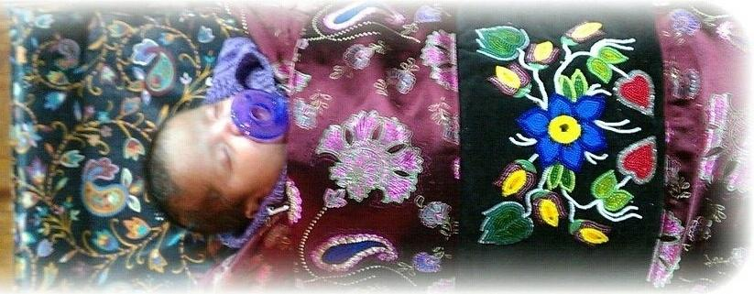
Oondaadiziikewin (Birth work) Protocols for Sharing Traditional Knowledge
Notes:
Dorene
I have been taught that knowledge sharing should be done, foremost, with consent of the Elders/Knowledge keepers. Sharing must be done thoughtfully and carefully. The exploitation of Indigenous spiritual ways and intellectual property for commercial and/or scientific purposes, and personal gain has had many destructive consequences for Anishinaabe and other Indigenous communities throughout the world.
To protect these knowledges/teachings there are natural laws and protocols that we must respect and adhere to. These protocols are as important as the teachings they protect and are inextricably tied to the spiritual foundations of the knowledge and the knowledge keeper. The purpose of these protocols is to provide spiritual and intellectual Indigenous guidance in the sharing of traditional birthing and medicinal knowledge. Specifically, the relevant protocols revolve around:
Indigenous, Anishinaabe specific, spiritual teaching, which provide opportunities to learn about traditional birthing, and traditional medicines;
Appropriately documenting and sharing knowledge/wisdom regarding traditional birth teachings, life knowledge, traditional medicines and practices in particular; and
Developing mechanisms for sharing and developing the capacity of traditional learning that is appropriate and guards against exploitation.

Slide 6
Assumptions
Many of us are nurses
We are “good” people and want to help people, not hurt them
Many of us grew up and were educated in the U.S.
Do we really understand the health inequities of the Indigenous people in this country ?
Notes:
Who?
What have we been taught about our history?
Whose story have we been taught?
We know Indigenous people experience significantly worse health outcomes that white folks in the U.S.. Health inequity is a major problem in the U.S. but… do we know why?
How did we get here?

Slide 7
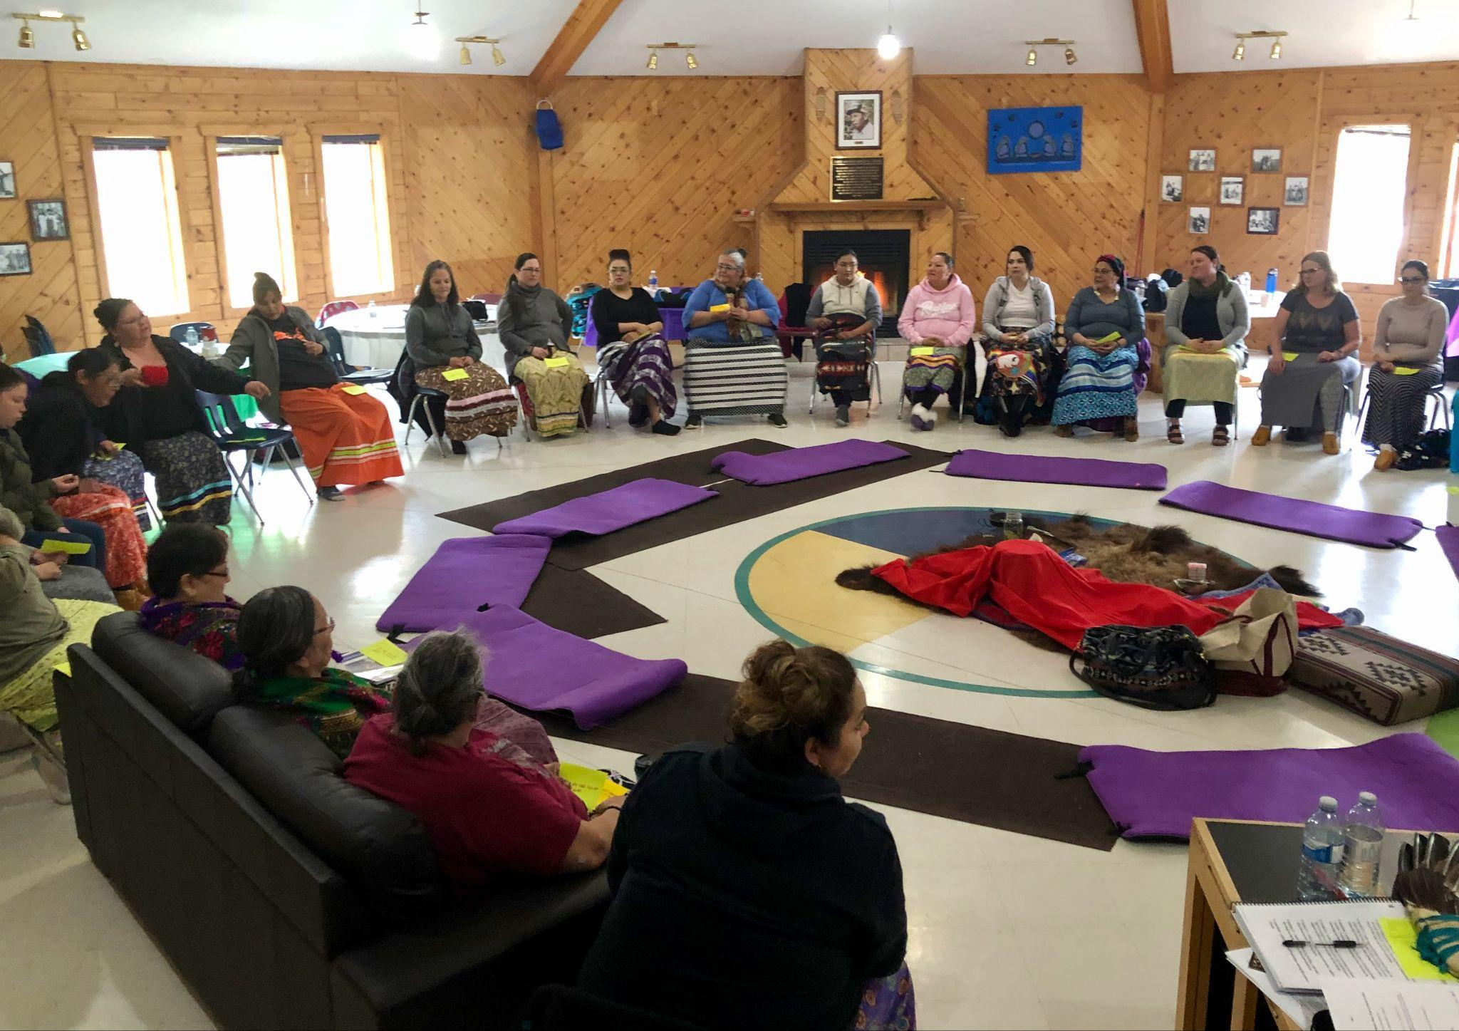
Cultural differences:
Western vs. Indigenous worldviews
Notes:
You
It’s important to understand - that we have differing worldviews.
This photo is of Indigenous birthworker training in Sturgeon Lake, Saskatchewan, taken several years ago when Dorene and I went to work with the community.
This shows so many aspects of what is ‘normal’ in the Indigenous worldview: sitting in a circle, ceremony/ medicine in the center. Women wearing skirts and facilitators in the circle. This is inside their healing lodge; used frequently for community gatherings and is the location of their traditional healers and plant medicines.

Slide 8
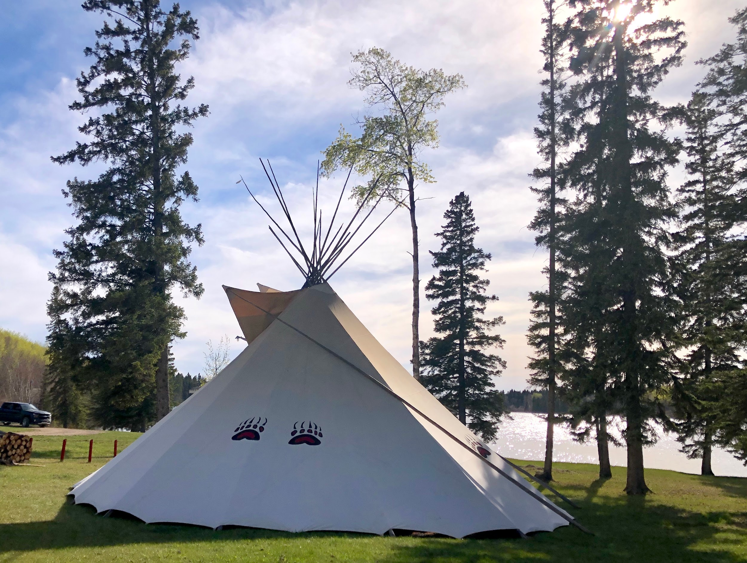
Indigenous vs. Western worldviews
Spirituality Scientific
Many truths One truth
Relatedness Compartmentalized
Sacred Land Land is resource
Cyclical Time Structured Time
Comfort-Relational Comfort-Success
Important Creation Important Human being
Wealth=Community Wealth=personal
Notes:
Me
Slide credit to Dorene Day
Let’s consider these generalized differences of Indigenous vs. Western worldviews.
As you read them- think about your own worldviews. What have you come to believe, based on how you were raised?
Do you think of your worldview as “normal” or “just the way it is”?
In terms of our roles as nurses:
What worldview does our medical system conform to and uphold?
How might it feel to enter a health care system that does not align with your worldview?

Slide 9
Erin’s lens/ perspective
Socialized as a white woman
Educated in public schools in the U.S.
Grew up in a middle-class family in a liberal city in the Midwest of the U.S.
Only child
Benefited from generational wealth
Did not grow up in a religion but came into community with Unitarian Universalists
Have lived in or worked within Indigenous communities in the U.S. & Canada since age 18
Notes:
Socialized as a white woman
Educated in public schools in the U.S.
Grew up in a middle-class family in a liberal city in the Midwest of the U.S.
Only child
Benefited from generational wealth (grew up in a 4th generation home we were gifted, had help paying for college and buying my first home, was able to buy land from my parents)
Did not grow up in a religion but came into community with Unitarian Universalists
Have lived in or worked within Indigenous communities in the U.S. & Canada since age 18 (for almost 30 years)
Have raised my children primarily as a single mother
Divorced; currently polyamorous in relationships with women and men
My ancestors are Odawa (sliver) and North-Western European from the Celtic regions of Norway, Great Britian and Ireland.
I am highly educated and hold a title with status attached to it (Dr.)
I am a healer, artist, teacher, mother and midwife
Also a lover, dancer, adventurer, writer and photographer
I value being physically fit, financially independent, in right relationships with people
I value social justice, traditional ways of knowing and healing, and beauty
I identity with Indigenous worldviews more than Western/ colonizer
I aim to unlearn damaging narratives and learn the truth in the name of liberation and equity

Slide 10
Dorene’s lens/ perspective
Socialized as Anishinaabe
Educated in Indigenous survival school and colleges
Grew up Up North (Minnesota) in a large family and in St. Paul in the Native community
One of 17 children (youngest)
Struggled through discrimination & poverty
Grew up in Native Lifeways (the Lodge)
Have lived in worked for my people through several careers
Notes:
Socialized as a white woman
Educated in public schools in the U.S.
Grew up in a middle-class family in a liberal city in the Midwest of the U.S.
Only child
Benefited from generational wealth (grew up in a 4th generation home we were gifted, had help paying for college and buying my first home, was able to buy land from my parents)
Did not grow up in a religion but came into community with Unitarian Universalists
Have lived in or worked within Indigenous communities in the U.S. & Canada since age 18 (for almost 30 years)
Have raised my children primarily as a single mother
Divorced; currently polyamorous in relationships with women and men
My ancestors are Odawa (sliver) and North-Western European from the Celtic regions of Norway, Great Britian and Ireland.
I am highly educated and hold a title with status attached to it (Dr.)
I am a healer, artist, teacher, mother and midwife
Also a lover, dancer, adventurer, writer and photographer
I value being physically fit, financially independent, in right relationships with people
I value social justice, traditional ways of knowing and healing, and beauty
I identity with Indigenous worldviews more than Western/ colonizer
I aim to unlearn damaging narratives and learn the truth in the name of liberation and equity

Slide 11
Realizing the practice of
Cultural Safety
Notes:
ERIN
As we begin the presentation about cultural safety we want to make it clear that our goal is show you what culturally safe care looks like and to experience moments of it together during the next several hours. We’ll start with an overview of what cultural safety IS and how it is different.
This is not cultural competency or cultural sensitivity. It is different, and it’s important that we learn about it, but also that we experience it, so we can all truly enact it in our lives.
We show this slide again to emphasize that cultural safety is not just about what we know about “others”, it’s how we ARE that impacts the experience for those we serve.
To make this more concrete; think about if you were invited into this circle.
As a white woman, would having studied the culture of the Cree Nation prepared me for this experience?
On day 3 as I was preparing to start teaching about breastfeeding support, the elder grandmothers started telling their stories about growing up in the boarding schools. They shared how it was and how when they became parents they didn’t know how to parent their children, or love their partners. They only knew abuse and the religion that was forced on them. They spoke quietly and we all listened. They cried; feeling safe in this circle of women to share their stories and deep sorrows.
Cultural safety is an approach that takes us beyond an academic exercise and into the realm of being able to relate respectfully across cultures, so that true healing can happen.
By the end of the day, I think you’ll understand what I mean.
But first, we need the background and theory.

Slide 12
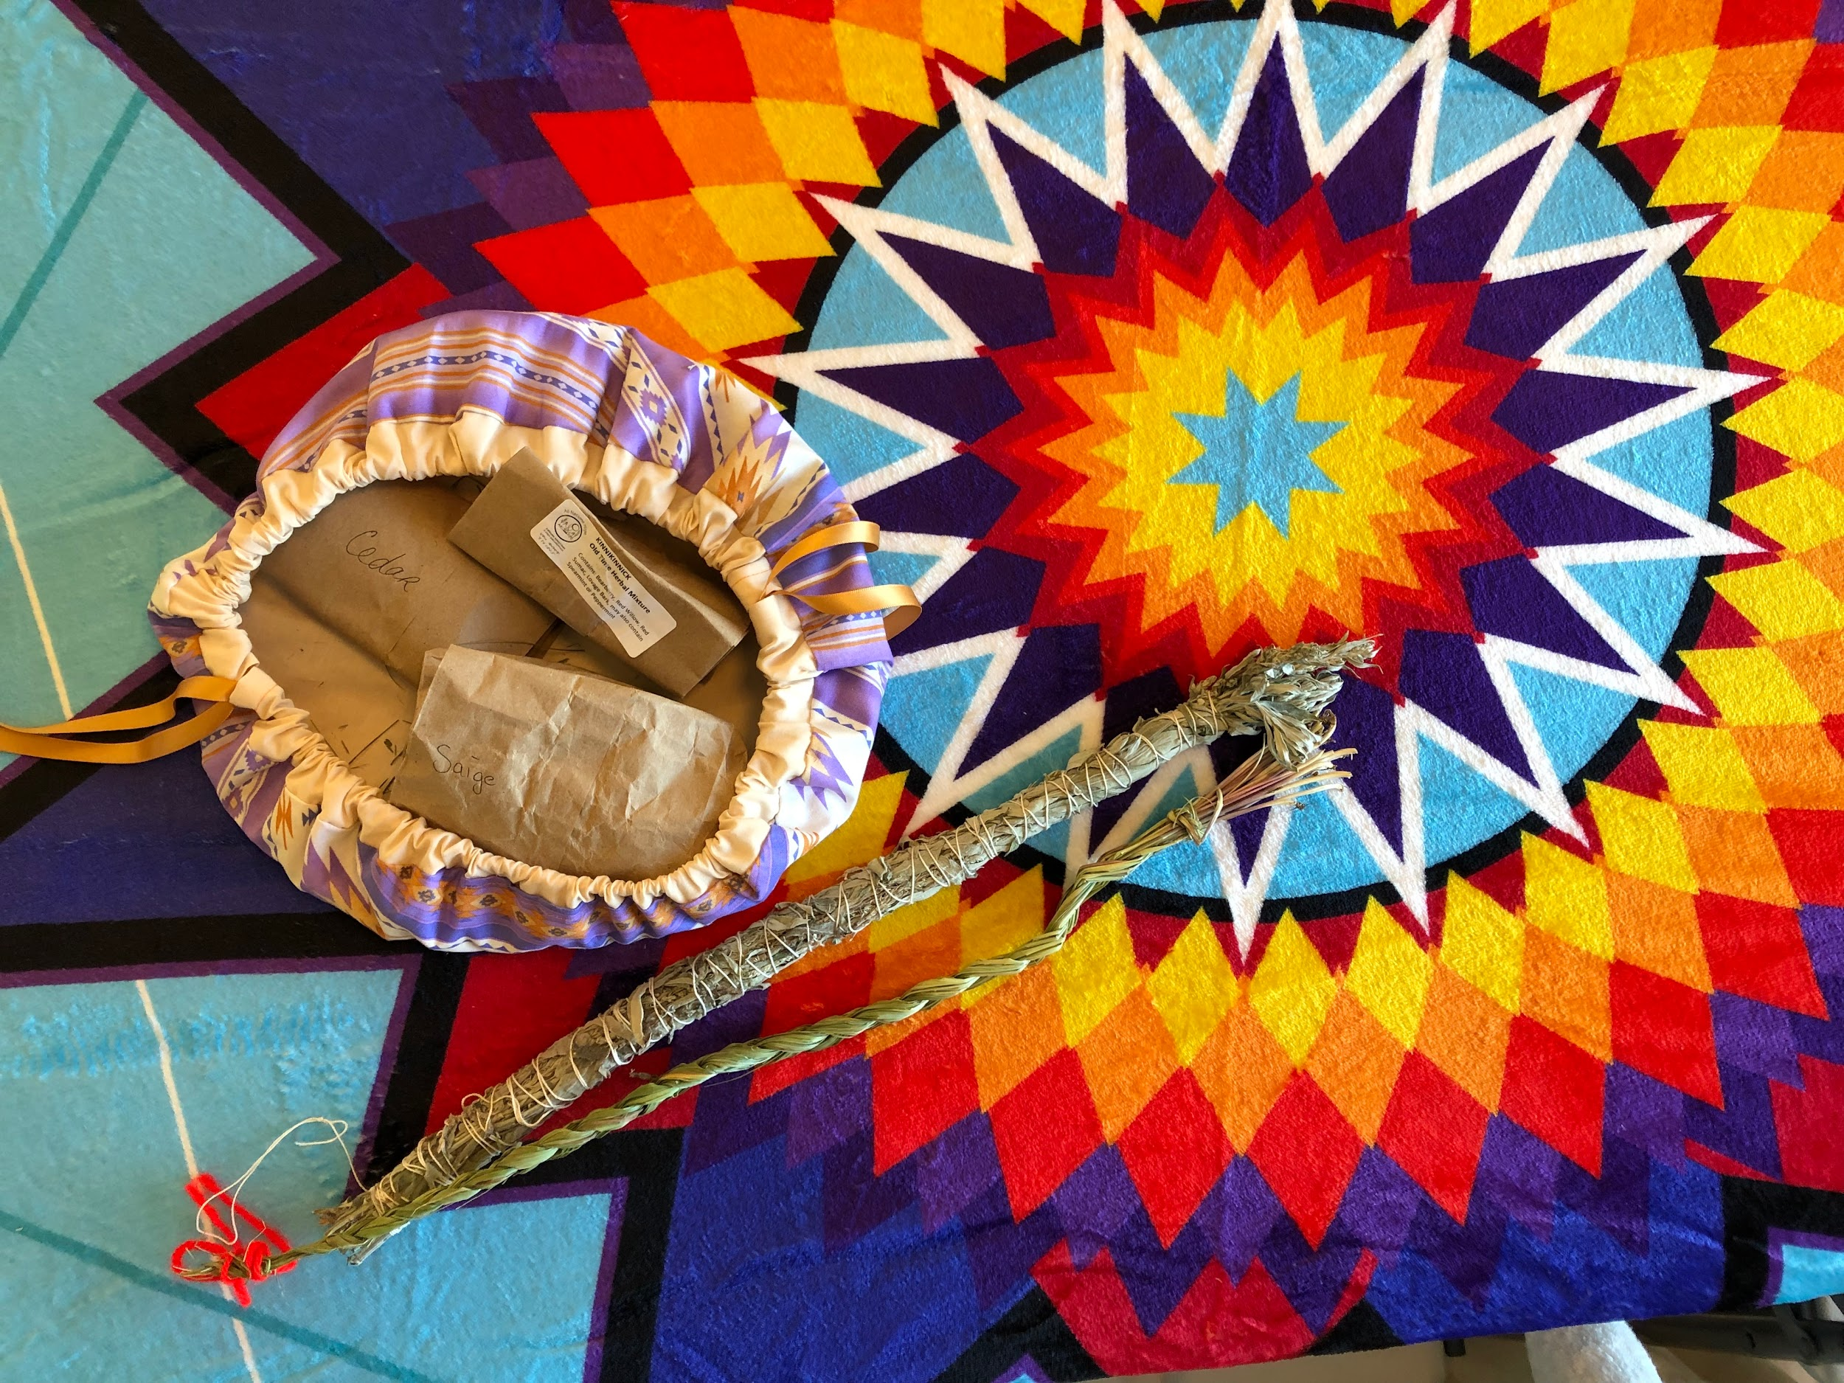
The theory of cultural safety
Developed by Irihapiti Ramsden, a Maori nurse researcher
Presented by
Dr. Erin Tenney
Notes:
The theory of cultural safety was developed by a Maori nurse researcher in the 1980’s to address persistent health inequities in New Zealand between the local Indigenous and the white non-Indigenous populations.
I was thrilled to discover this theory during my doctoral research. Since I had already been studying w Dorene and was learning about midwifery within Indigenous communities, I knew I needed a theoretical foundation that centered the Indigenous worldview/ experience. I was amazed to learn that it was a perfect “fit” for us since it also centers the social context of colonization.
Like the U.S., Canada and Australia; New Zealand have large Indigenous populations which were healthy and whole prior to colonization.
Let’s take a little time out and talk about colonization. We may not be familiar with this term, or at least as familiar as we should be. Colonization (according to the Merriam-Webster dictionary) is:
“... the subjugation of a people or area especially as an extension of state power”
The U.S. shares a long and dark history of colonization. In our country, over the past 500 years, that looked like (in a nutshell) genocide and land theft supported by papal bulls of the catholic church and the doctrine of discovery. Later, further erasure policies turned to cultural assimilation via boarding schools (in which Native children were kidnapped and sent away; disallowed to speak their language and abused; emotionally, mentally, physically and sexually) and sterilization procedures performed on Native women without their consent.
While the specifics of colonization vary between countries and over time; the impacts are deeply traumatic and have created the significant health inequities that we see today in Indigenous populations throughout the world.
When Ms. Ramsden developed the theory of cultural safety in New Zealand, she did so for the purpose of training (non-Indigenous) health care providers to understand WHY these health inequities exist so that they (we) would avoid blaming our patients for their struggles, and so that we would be self-aware of our own positionality in the bigger picture.
She highlighted the overarching effects of social position, power imbalances and structural processes which continued to marginalize Indigenous peoples and cause negative health effects from colonization.
This theory was adopted by the Nursing Council of New Zealand and they define it as “the effective nursing practice of a person or family from another culture which is determined by that person or family, as opposed to unsafe cultural care which is any that includes action which demeans or disempowers the cultural well being of an individual”. This theory promotes the consideration of historical, economical and social contexts that affect not just health outcomes, but also the experience of care provided.
In the U.S., we have not adopted this theory (yet) as primary, but frankly, we should.

Slide 13
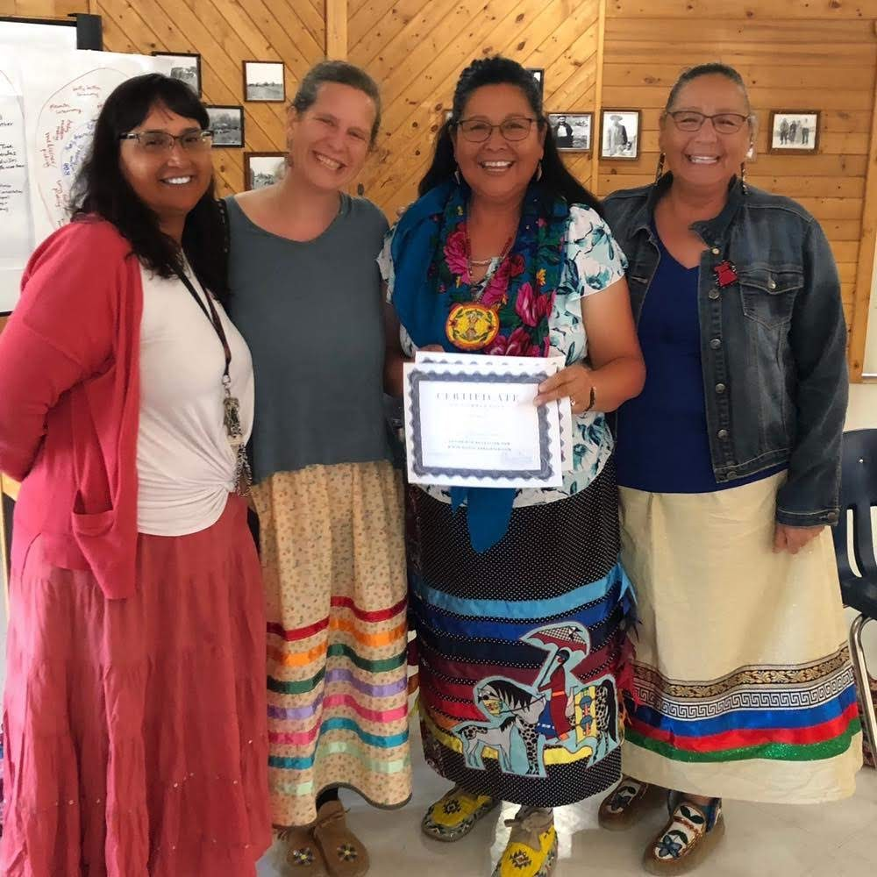
Goals of cultural safety
Notes:
The goals of cultural safety are inform and enable the provision of health care that is safe not just physically, but also emotionally, spiritually and socially and to ensure that patients are free from any kind of threat or challenge to their identity while receiving care.
This offers a framework for an approach to redressing the systemic racism that exists in health care and being able to rebuild trust, where it has been lost.
This picture really exemplifies what it looks like when we achieve cultural safety.
You can see by our smiles that are all happy and connected. During that week together we had all learned so much, and had built strong, trusting relationships.
As an ally and someone who practices cultural safety, I was welcomed into this community and circle of women to be a part of their healing.

Slide 14
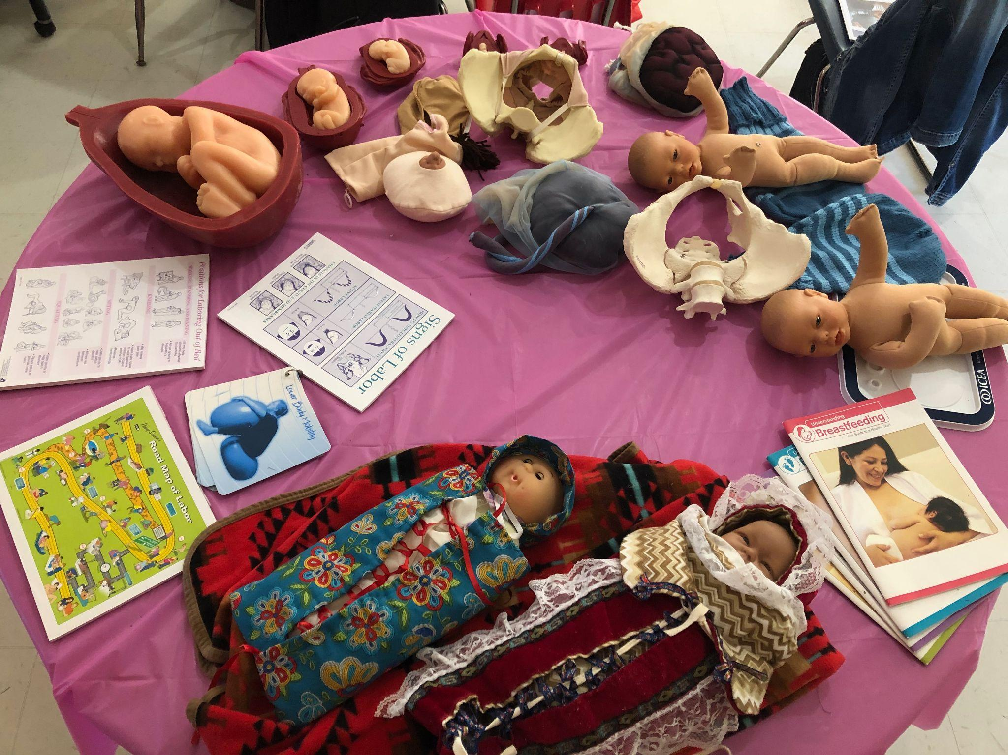
Overview
Notes:
There are 3 key tenets to this theory.
This theory can also be considered a framework.
When applying it on a personal level; I think of it as a journey.

Slide 15
1st core tenant
We understand the history & context of Indigenous people and appreciate that colonization is the origin and cause of health inequity
Notes:
The first core tenant of cultural safety is that we, the nurses and health care providers need to understand **the TRUE
history and context of Indigenous (and African American) people and appreciate that colonization (and slavery) are the origins and cause of the health inequities between Indigenous and African American and white people.
Understanding how these deeply damaging social constructs have operated (and continue to do so) is key to understanding contemporary health challenges.
The trouble is that most of us were not taught this history in school.
Instead of learning the truth about colonization and slavery, we were taught an untrue & whitewashed narrative of our history.
[Quick poll- raise your hands if:
You were educated in the U.S. public school system
You learned that Christopher Colombus discovered America in 1492?
You learned that in 1492 there were about 60 million (?) Indigenous people living here comprised of hundreds of distinct tribes with their own languages?
You learned that the model for democracy in the U.S. and the constitution was not actually developed by our “founding fathers” but was adopted from the Iroquois confederacy?
You learned that pilgrims heading west in covered wagons to find and settle new land were the courageous and rugged (the true/ unsung heros)?
You learned that the land they settled was was essentially stolen and a pre-requisite was genocide of the people and animals who had previously lived there?
The point is that many of us were not taught the truth of how our country was developed, nor the truth of how white supremacy as a social construct upheld colonization.
If we are people of color, we have learned the truth much earlier and out of necessity.
If we are white however, (and the majority of nurses in the U.S. are still white), we probably did not.
We have a lot of re-learning to do.
We have to know what what we’re dealing with and in order to do that, we have to understand where we’ve come from.
In this case we’re talking about our collective- historical/ political context.

Slide 16
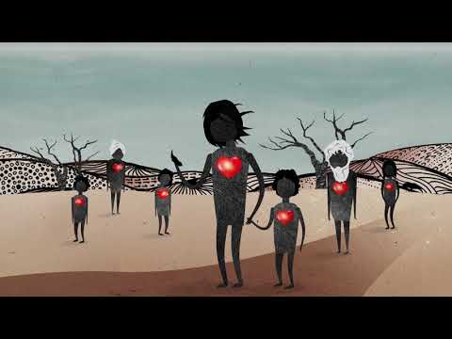
1st core tenant
We understand the history & context of Indigenous people and appreciate that colonization is the origin and cause of health inequity
https://www.youtube.com/watch?v=vlqx8EYvRbQ
Notes:
Colonization => Intergenerational trauma => health inequity
This story is from Australia but is synonymous with that of Indigenous people in the U.S.

Slide 17
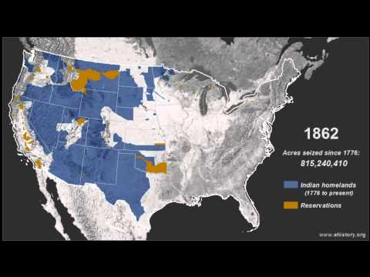
Colonization in the U.S.
Land Theft
https://www.youtube.com/watch?v=pJxrTzfG2bo
Notes:
Loss of life:
North America was fully inhabited when Colombus arrived in 1492 and at the time of colonial settler arrival. There are estimated to have been between 50-90 million people living in a sophisticated society complete with democratic governance structures, health and wellness practices, infrastructure for travel, and commerce, sustainable forestry etc.
The next 500 years of conquest and attempted genocide resulted in the loss 90% of the approximately 60 million Indigenous people living here.
Loss of land:
of 1.5 billion acres after 1776. This map shows the impact of the U.S. invasion of Indigenous lands and how small current reservation allotments are.

Slide 18
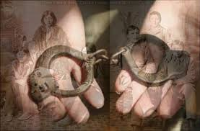
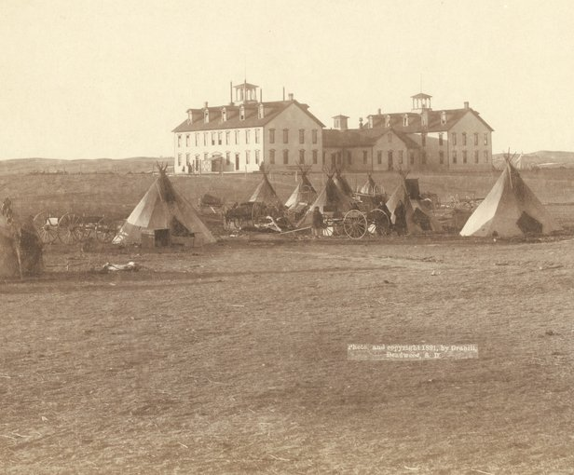
Colonization in the U.S.
Boarding Schools
Notes:
These photos–
Boarding school era (the lost generations):
"Beginning with the Indian Civilization Act Fund of March 3, 1819 and the Peace Policy of 1869 the United States, in concert with and at the urging of several denominations of the Christian Church, adopted an Indian Boarding School Policy expressly intended to implement cultural genocide through the removal and reprogramming of American Indian and Alaska Native children to accomplish the systematic destruction of Native cultures and communities. The stated purpose of this policy was to “Kill the Indian, Save the Man.”
Between 1869 and the 1960s, tens of thousands of Native American children were removed from their homes and families and placed in boarding schools operated by the federal government and churches. Though we don’t know precisely how many children were taken in total, by 1900 there were 20,000 children in Indian boarding schools, and by 1925 that number had more than tripled. The U.S. Native children that were voluntarily or forcibly removed from their homes, families, and communities during this time were taken to schools far away where they were punished for speaking their native language. They were banned from acting in any way that might be seen as representing traditional or cultural practices. They were stripped of their traditional clothing, had their hair cut and were not allowed to keep their personal belongings. They suffered (often extreme) physical, sexual, cultural and spiritual abuse and neglect. Many children never returned home and their fates have yet to be accounted for by the U.S. government.
According to Dunbar-Ortiz, "The experience of generations of Native Americans in on-and off-reservation boarding schools, run by the federal government or Christian missions, contributed significantly to the family and social dysfunction still found in Native communities. Generations of child abuse, including sexual abuse... traumatized survivors and their progeny."

Slide 19
Colonization in the U.S.
Reproductive Health Abuses of Indigenous Women- forced sterilization
Notes:
In the U.S. during the 1960’s and 1970’s Native American women of reproductive age were forcibly sterilized in at least 4 out of 12 Indian Health Service clinics. Estimates include approximately 3500 women were sterilized without consent.
A study by Dr. Connie Pinkerton-Uri, a Chocktaw/Cherokee physician, found that at least one in four American Indian women had been sterilized without consent. Dr. Pinkerton-Uri concluded that the Indian Health Service appeared to have “singled out full-blooded Indian women for sterilization procedures.” Some experts estimate that the percent of American Indian women who were sterilized might even approach 50 percent.
This photo is not of the Indigenous women who were sterilized, but those who had been called in as a result of forced sterilization as recently as 2017 in a public hospital in Saskatoon, Saskatchewan. As a result of the rulings when this case favored the women who testified, the hospital had to bring in First Nations “Advocates” to be with First Nations women & families when they birthed at this hospital. Dorene and I were invited by a Metis organization to train a group of Indigenous doulas to support women in this manner. This group of trained doulas were passionate about their work, but unfortunately, they also were not treated well in the hospital system, and the program seems to have ended.

Slide 20
2nd core tenant
Health providers need to have a critical self- awareness of bias toward their patients and positionality & power imbalances.
Self-reflection is key to culturally safe care.
Notes:
The second core tenant of cultural safety is that we- the health care providers need to have a critical self awareness of ourselves.
(Pulling it in to a personal level)
We need to be self-reflective and do the work to become aware of our biases
and our positionality; including how this leads to power imbalances.
Let’s take a moment and think about bias. We may think we’re not biased, after all, we’re nurses. We live to help people. :)
And also, we live in the U.S. where whiteness is centered and normalized, anyone not white are “othered”. Our society upholds stereotypes to maintain the status quo and biases are embedded into our way of thinking and acting. We are usually not conscious of them and they’re hard to recognize until we really work at it.
Now how about positionality.
But first, … Identity.
Health providers need to know who we are (as a precursor to understanding our positionality and biases at the very least)
I’m going to ask a few questions.
Trigger warning for all the white folks in the room: some of these questions might be uncomfortable.
What is your racial identity?
What is your cultural identity?
What are the aspects of your culture you take the most joy in?
[I’m going to tell a little story]
I was at a diversity in higher education conference in Philidelphia before the pandemic. I was sitting around a table with about 6 other health related/ diversity professinals and were playing a game designed to help us explore issues related to diversity. The questions I asked you are the ones that were asked of us. We went around the table and each person shared about their racial and cultural identities and what they were most proud of. There was a LatinX woman who took the most joy out of the dancing in her culture. An African-American man spoke about the joy of his extended family connections and so on. When it came to me (the only white person at the table) I already had a lump in my throat as I said: I’m white. I don’t have a cultural identity and I don’t take joy in my culture & heritage. I’m ashamed of it actually. I didn’t want to cry, but of course I did and asked that we move to the next person.
It’s rare, that as a white person, I am in a position of such intense discomfort due to my identity. In fact, this is the only time in my life that I can think of.
Stil, the most difficult part of giving a presentation or training, is the introduction.
I’m guessing that I’m not alone in feeling a void around identity of whiteness.
Especially if we’re socially conscious, there are also probably feelings of guilt and shame, related to what our relatives did (or didn’t do) to uphold and benefit from the oppressive structures we’re talking about.
AND- we need to choose to be uncomfortable (a luxury we have) in order to do the work of learning who we truly are and undoing the colonial mindset we’ve been enculturated into.
We need to understand and continually reflect on our own identity and culture and consider how this contributes to our positionality
and power within the inequitable society we live in. These dynamics impact our relationships with patients and the quality of care we provide.
Our positionality refers to how we relate to others given our various social positions and whether they are associated with privilege or marginalization in society.
We all hold multiple, intersecting identities, so this is nuanced and complex.
There are power differentials based on our intersectional identities and we need to be aware of these.
For instance, in the U.S., men have more power than women. White people have more power than people of color. Doctors have more power than nurses. Nurses have more power than patients. Straight people have more power than trans people. Adults have more power than children. etc.
When we are unaware of these dynamics, there is a good chance we will unknowingly uphold a power differential in which our patient is disempowered (in any number of ways) and is actually harmed, rather than helped by their experience of care with us.
This is culturally unsafe care, which perpetuates ill-health and inequitable health conditions.

Slide 21
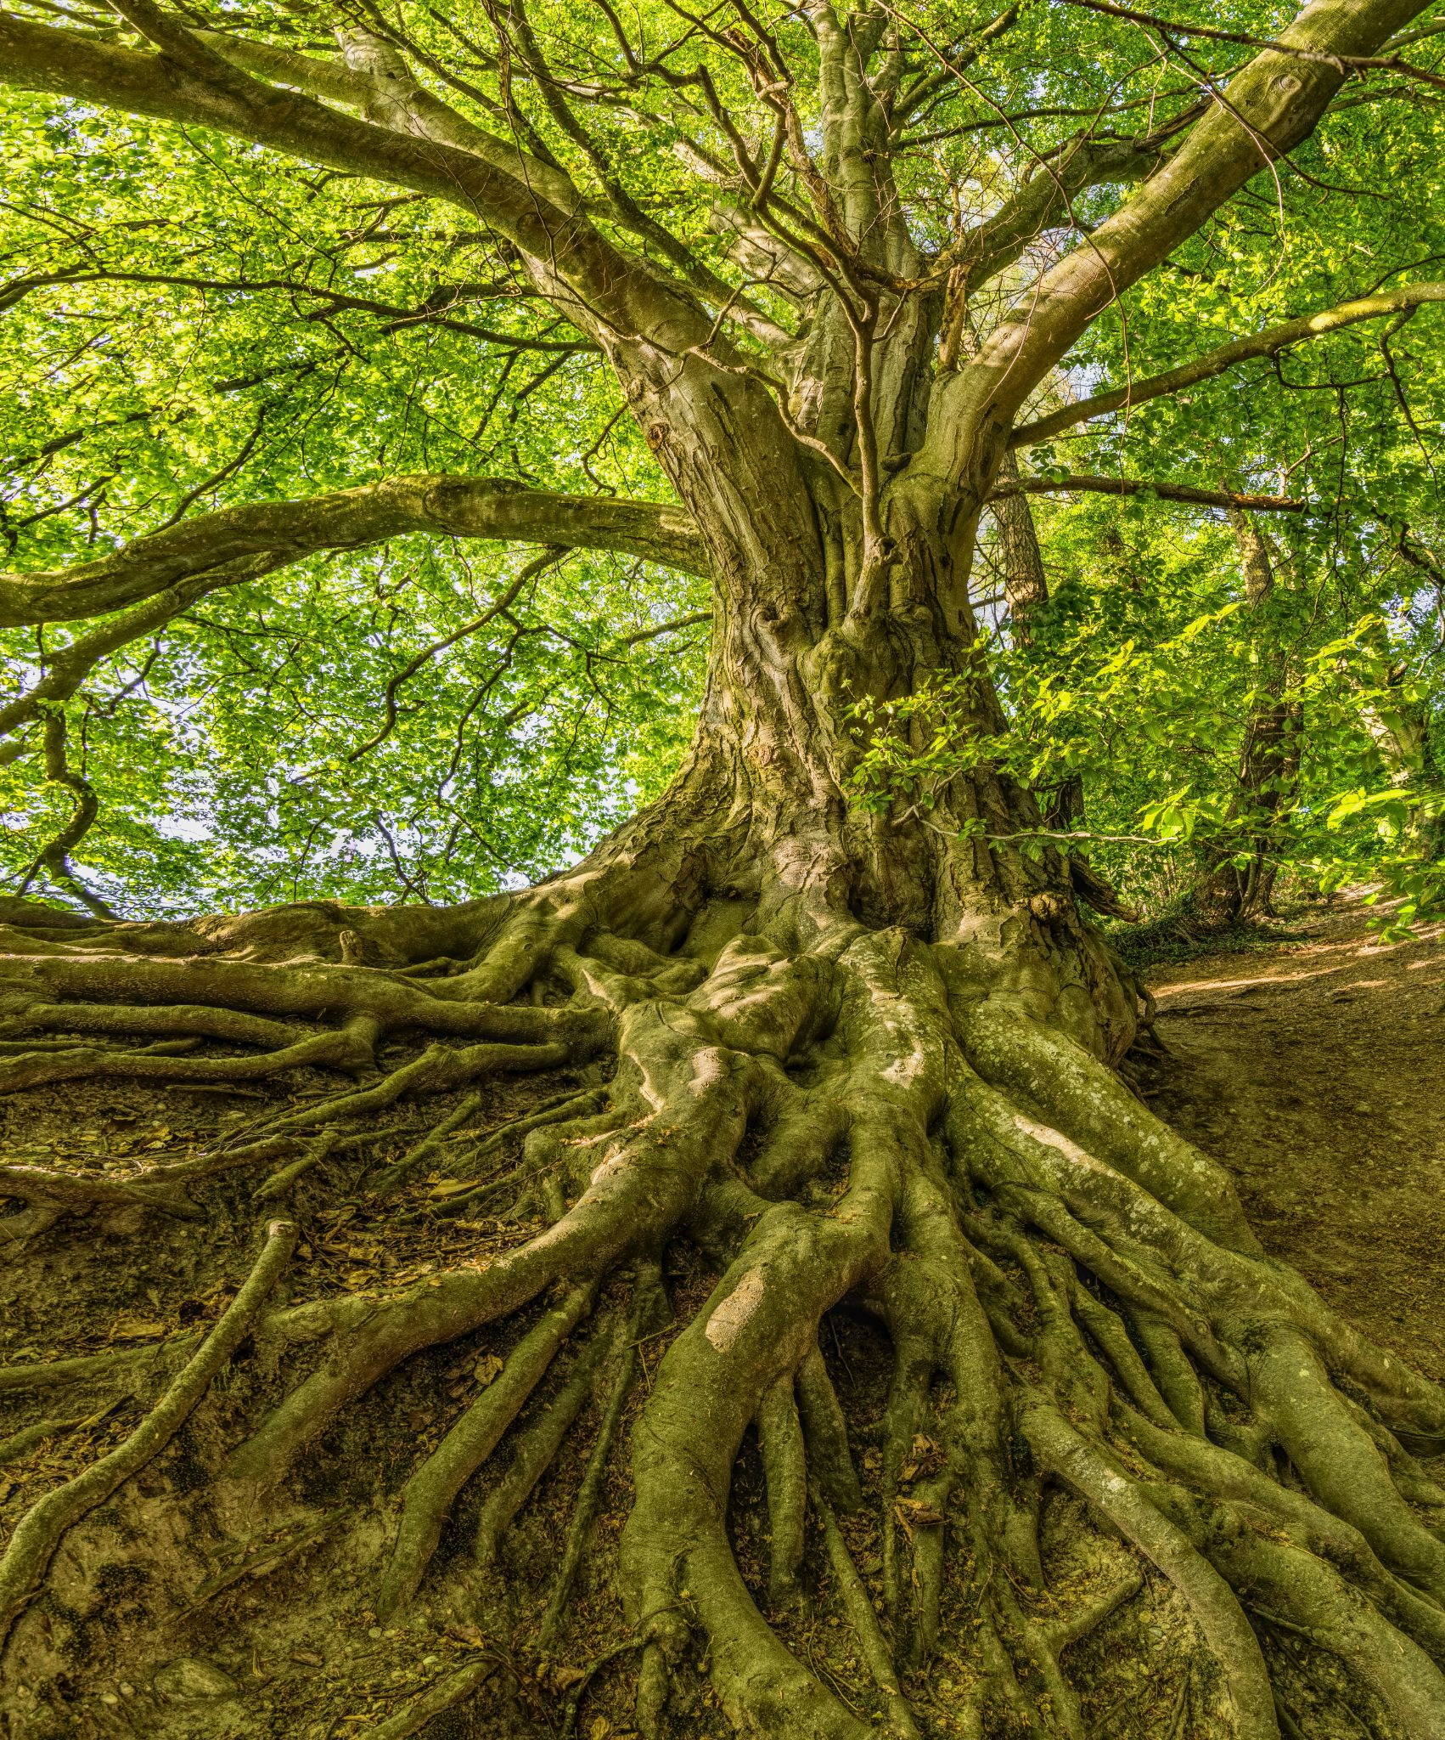
Self-reflection: Identity
Notes:
Who am I and where do I come from?
In a little bit, Dorene will lead us in an exercise where we can explore this.
Let’s also consider some questions related to positionality:
Since we live in a racialized, hierarchical society that is not equitable, or identities impact our life experiences.
We may or may not be conscious of that.
What are the various, intersectional identities I have and how do they intersect?
How does this position me in society? In what ways am I privileged? In what ways am I marginalized?
In the health equity course I teach, the first module asks students to list all the social, personal and cultural aspects of their identities, and then indicate whether they experience marginalization or privilege with each one.
Then they write a reflection on the experience of completing that.
Almost universally, those students who experience society as a person of color are well aware of how they experience marginalization (and sometimes surprised by areas where they experience privilege) and white folks are almost always surprised when they realize how much privilege we have.
One of the characteristics of white privilege is that we are not aware of it, since whiteness is centered and normalized.

Slide 22
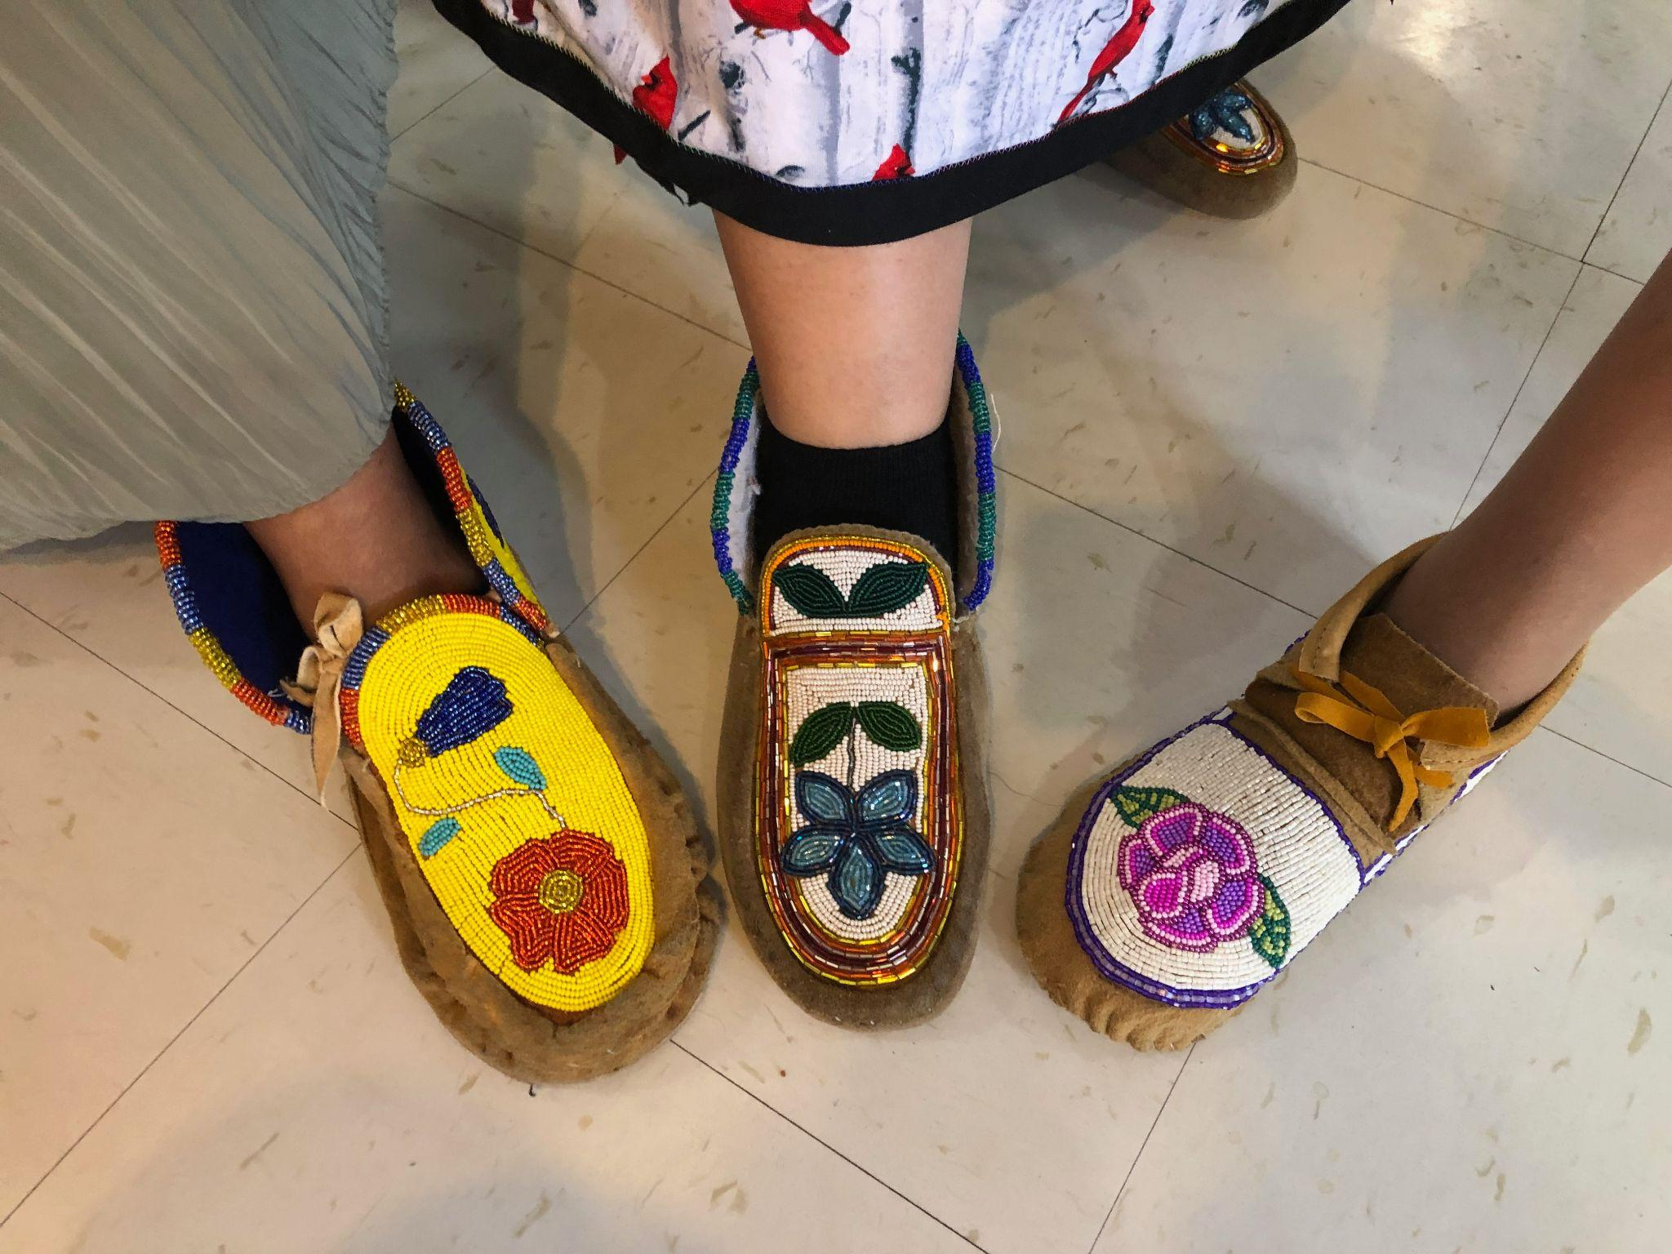
3rd core tenant
The patient is the one who defines whether the care they received is culturally safe
(not the health care provider)
Notes:
The third core tenant is that the patient is the one who defines whether the care they received is culturally safe (not the health care provider).
This represents a paradigm shift from our current healthcare environment in which the provider and administrative bodies determine the safety and quality of care provided.
We talk about patient-centered-care but the reality is that the patient only has a few choices, within a standard set of options that are strictly upheld within a dense health care system reflecting western medical values and mediated via their care provider.
The exceptions I’ve seen are Tribal health centers that actually do center their own community members as patients and have community member leadership and incoporate cultural values and practices. These clinics are integrated and can be models for culturally safe health care.
It’s important to recognize here that even though we are talking about health care, this term, cultural safety, encompases more than the just physiological safety (which is clearly the focus within the dominant western medical paradigm).
It also includes emotional, spiritual and social elements of safety, which of course are personal and unique to each patient, and deeply connected with culture.
These are very important aspects of the health care experience and have great impacts on outcomes. Unfortunately, they are often overlooked in the current healthcare system.

Slide 23
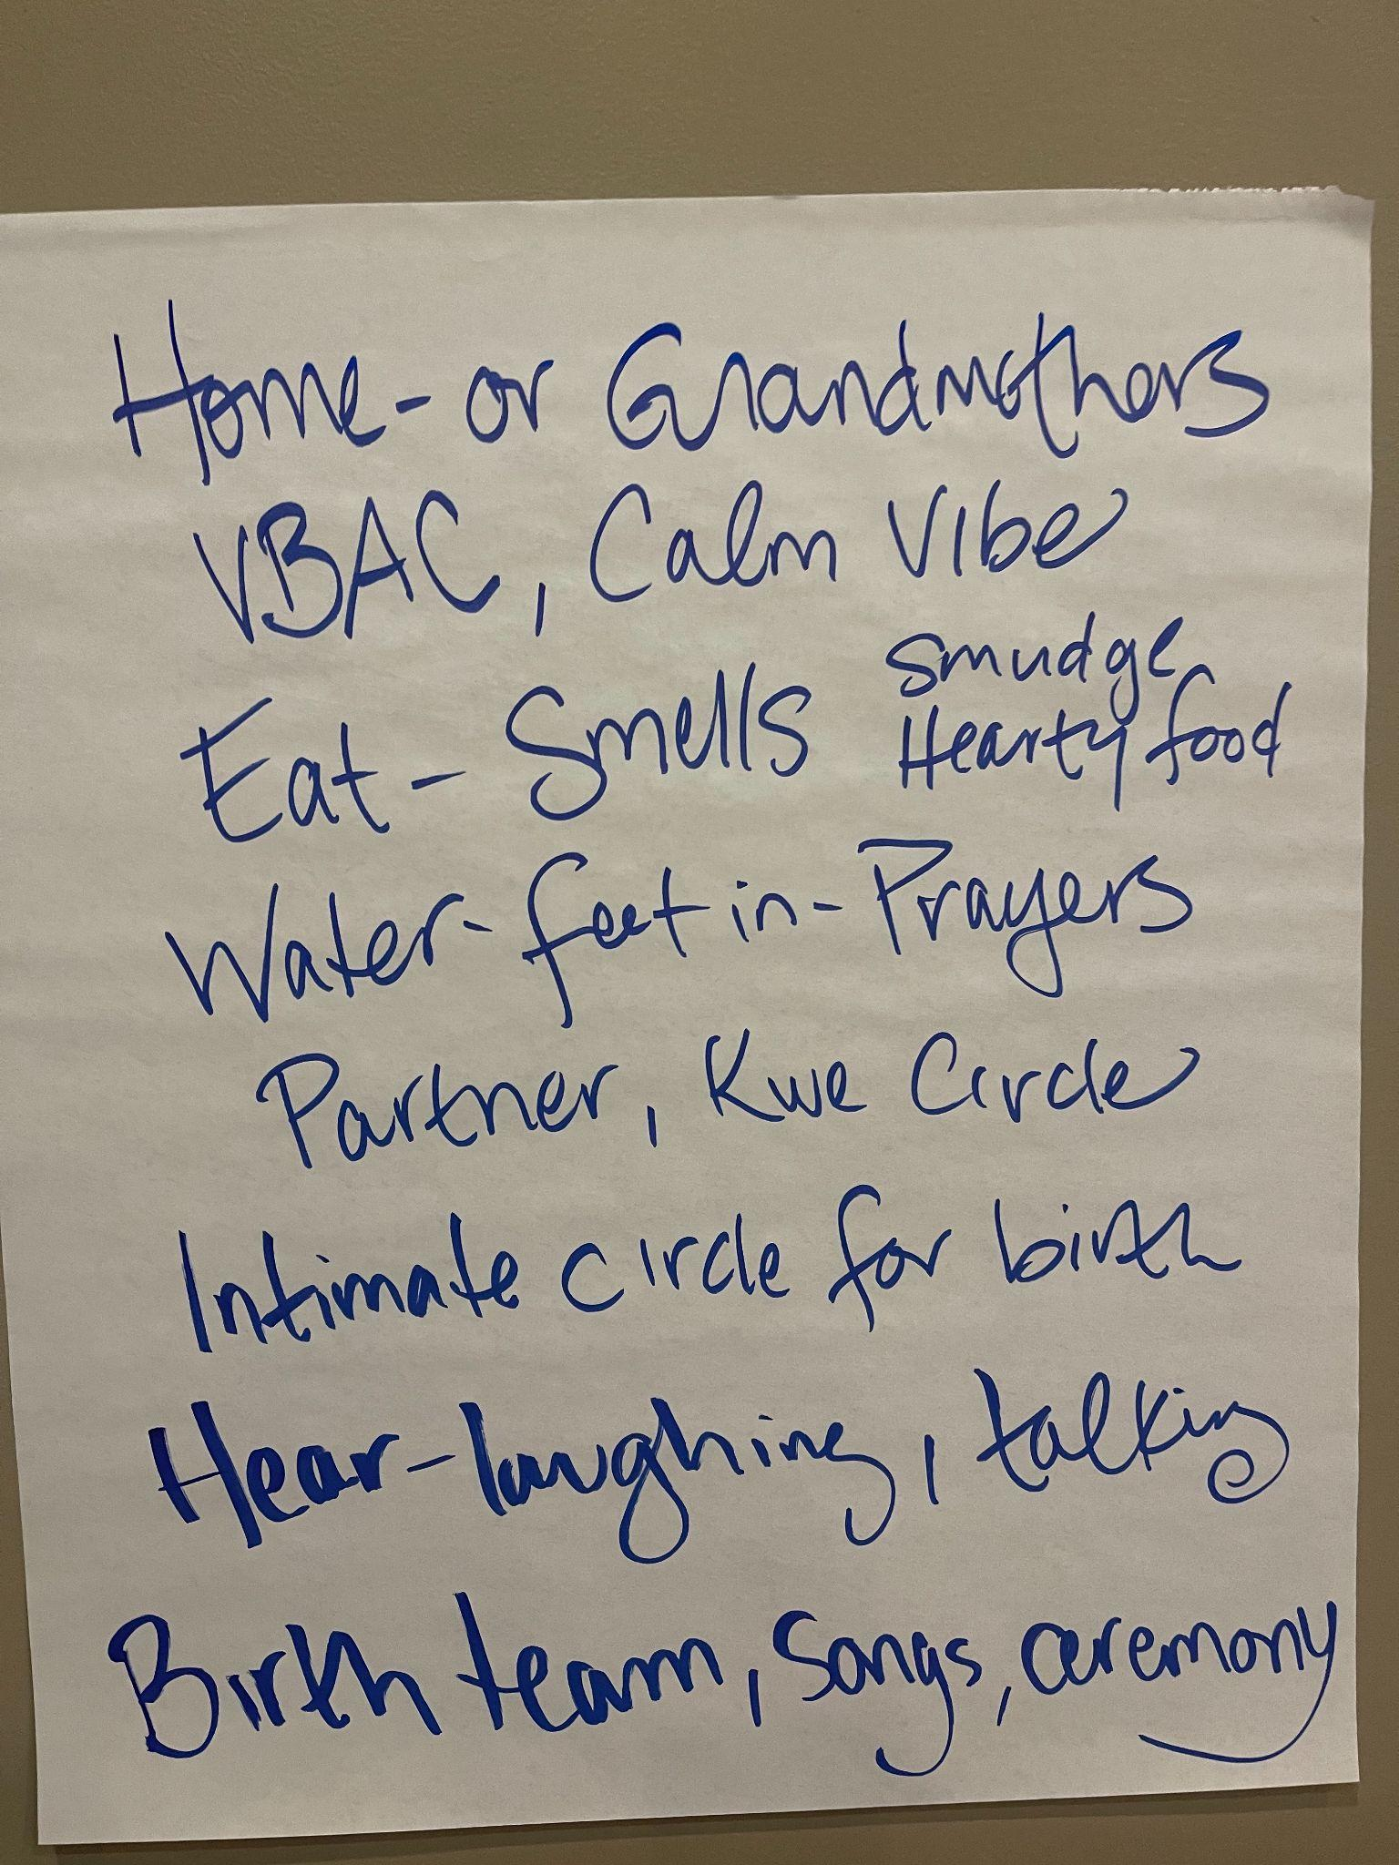
The argument for moving beyond
cultural competency
Notes:
This photo shows part of a list that doula students made during one of our trainings; sharing what they think of with their “Ideal Birth”
Since cultural safety has not been widely adopted in the U.S. (yet), we don’t hear the term very often (probably never). More often we hear about cultural competency.
Let’s talk about why we want to move beyond cultural competency.
We have a growing awareness of the importance of culture in health care in the U.S. and there are a number of theories that aim to address the opportunities and challenges in intercultural care experiences. These have been incorporated into health care education to varying degrees, but unfortunately, we are not seeing an improvement in health equity as a result.
Cultural awareness, cultural sensitivity and cultural humility are all popular terms with similar but varied meanings. One of the most popular approaches in health care education is cultural competency, the definition of which is:
A set of congruent behaviors, attitudes, and policies that come together in a system, agency or among professionals and enable that system, agency, or those professionals to work effectively in cross-cultural situations.
Now that sounds pretty good, but
Curtis et. al (2019) makes a solid case for moving beyond cultural competency and embracing cultural safety instead.
The author states: “.. it is not a lack of awareness about ‘the culture of other groups’ that is driving health care inequities- inequities are primarily due to unequal power relationships, unfair distribution of the social determinants of health, marginalisation, biases, unexamined privilege, and institutional racism. Health professional education and health institutions therefore need to address these factors through health professional education and training, organizational policies and practices, as well as broader systemic and structural reform.”

Slide 24
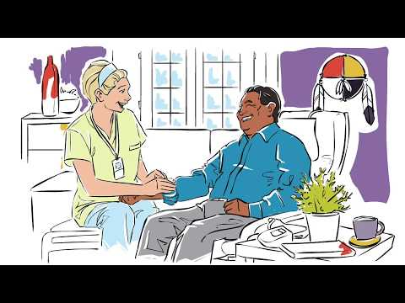
The patient’s experience of health care
And shifting the colonial narrative
https://youtu.be/cLDkA2RIeCM
Notes:
This video is from British Colombia, Canada
They use the word “Aboriginal” where we would use “Native American” or Indigenous”
This explains cultural safety well, and provides examples of what it would look life if our health system also adopted this framework.

Slide 25
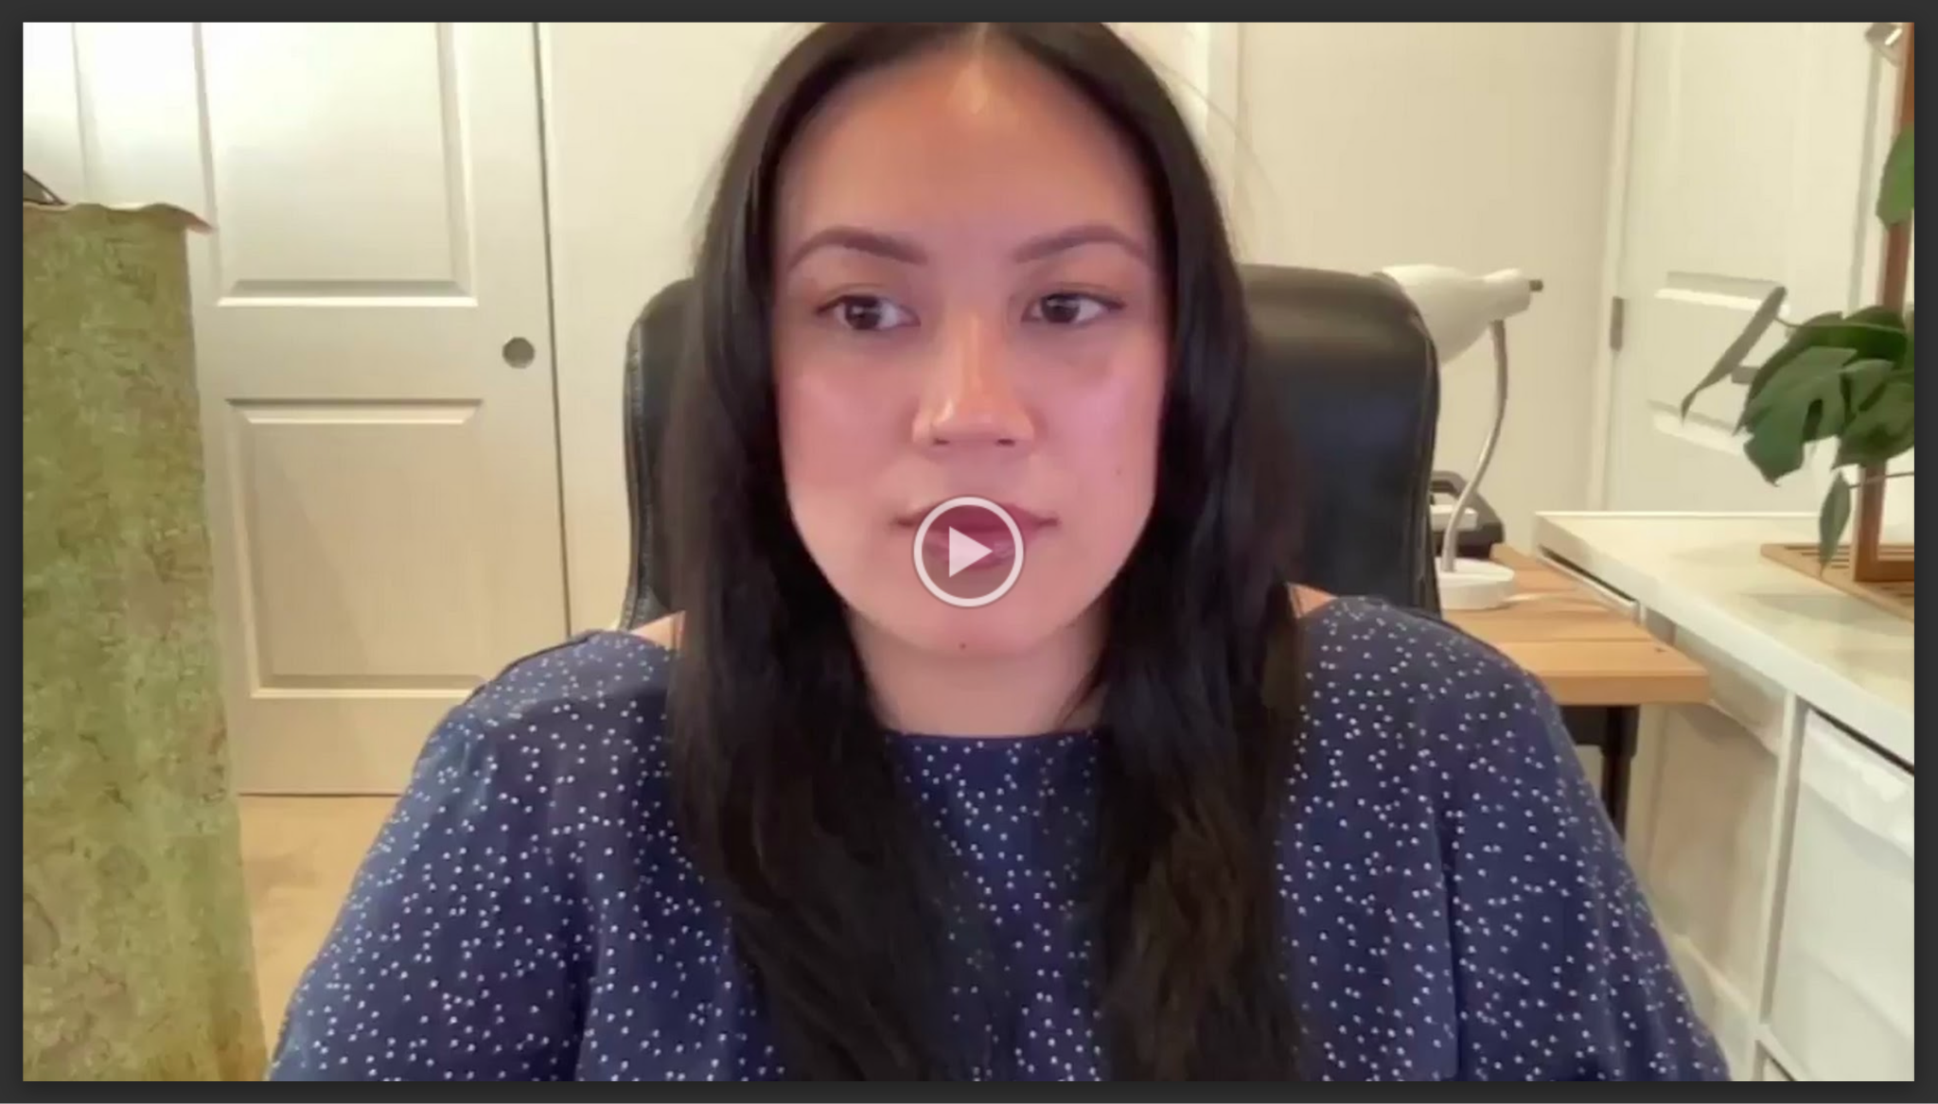
Student reflection
Melissa Manuel
https://drive.google.com/file/d/1SLlX12wrjG93dk5nMhXBsvb6P-TnCXGp/view?usp=share_link
Notes:
One of the best ways to see if you taught something well, is to hear how your students have learned it.
That’s why we’ll complete this section with a video reflection from one of my students, after taking our Introduction to Cultural safety course that Dorene and I created.

Slide 26
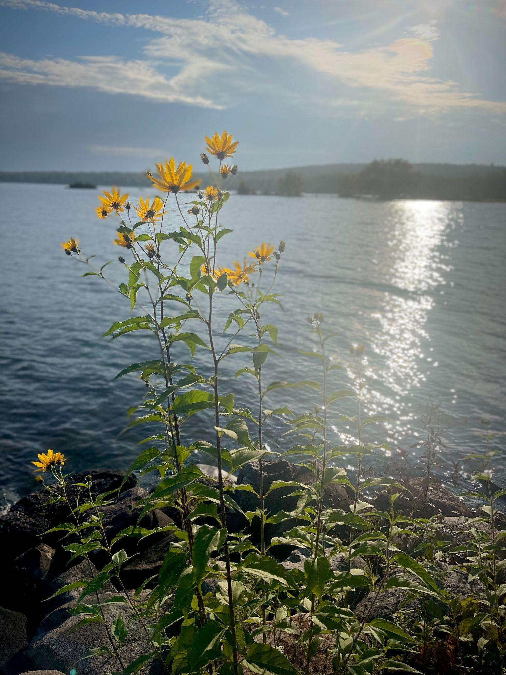
Movement/ Stretch break

Slide 27
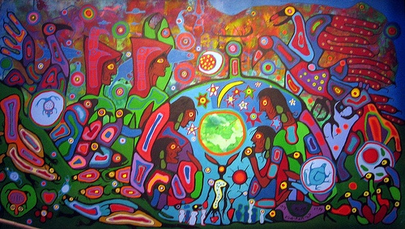
CREATION ~ The interconnectedness of all living things
A Sacred Vessel that carries the Seed of Humankind… Regulation from our Grandmother Moon
Our birth is the evident truth of our Creation story, just as it unfolded long ago..
Notes:
Introduce the relaxation and visualization exercise..

Slide 28
Personal exploration
What did you experience during the visualization?
Reflect on your cultural roots: identity, ancestors, land & language
10 min for personal reflection
10 min for group sharing
10 min for share back to the larger group

Slide 29
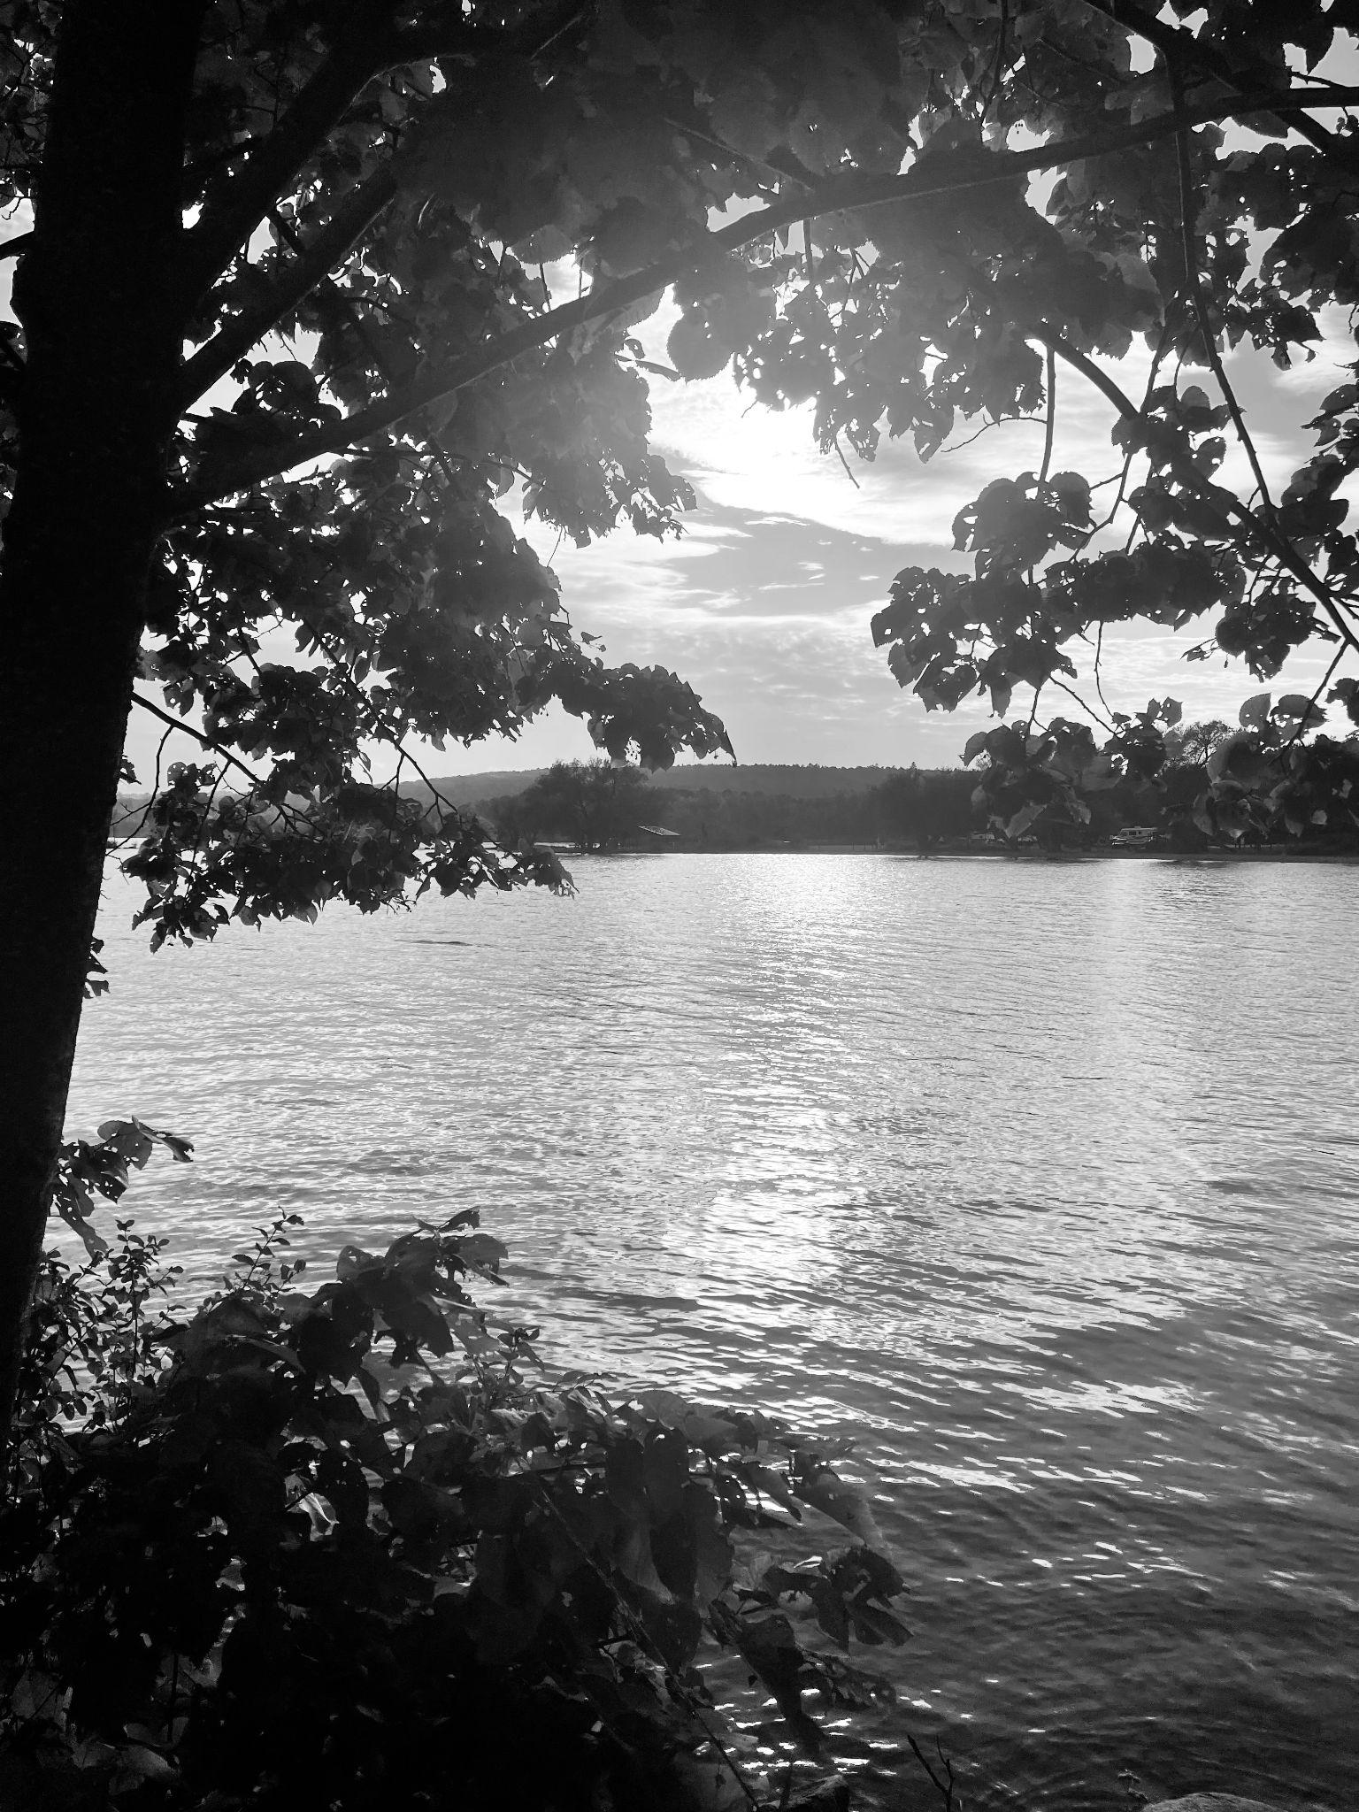
15 Min. Refreshment Break

Slide 30
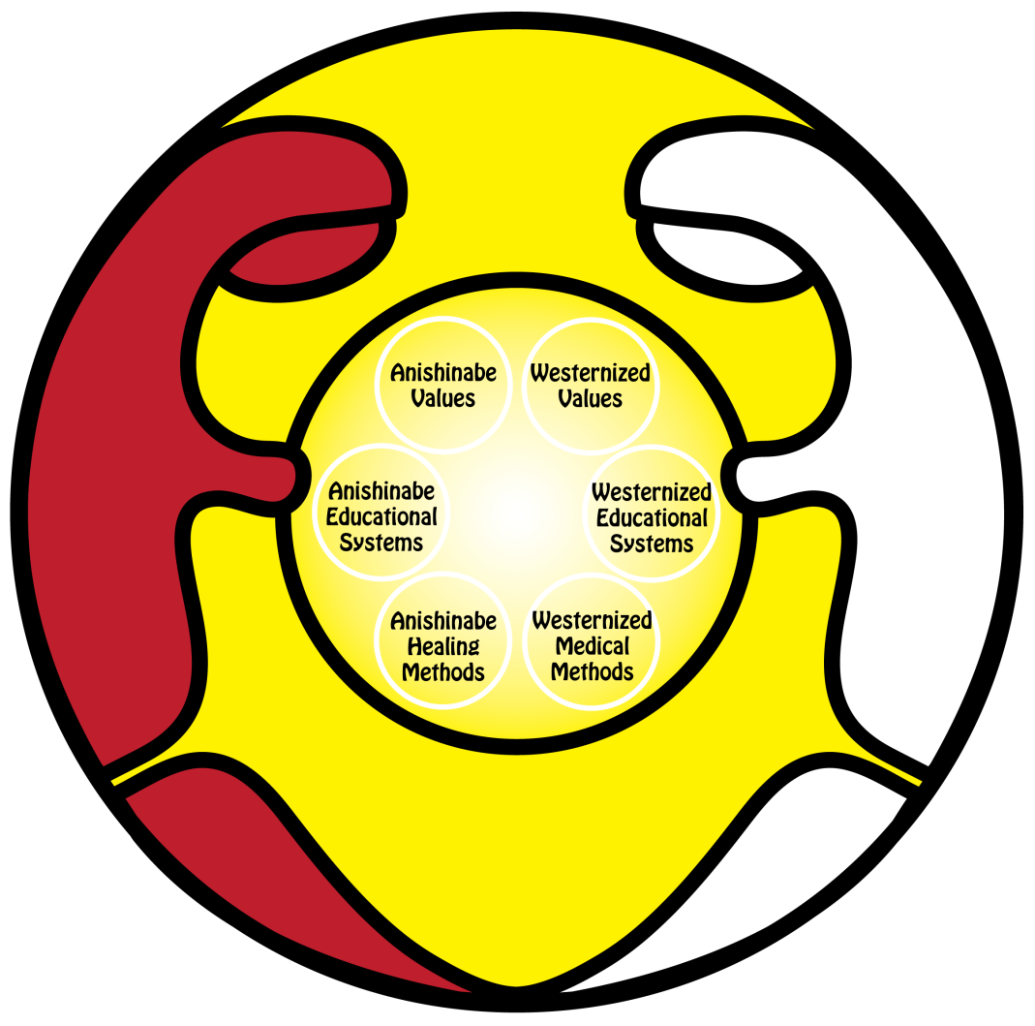
Improving patient & provider trust within contexts of collective & Intergenerational Trauma
Notes:
Dorene

Slide 31
A Continuum of Cultural Safety
Affecting attitudes, values and ways of relating to each other
In Spirit
Valuing Diversity
Intercultural Teaching
Free from discrimination
Re-humanization
Spirit ~ Respect~ Life way
Status Quo
Cultural Dictionary
Transformation
Cultural safety lays in our ability to demonstrate respect and
understanding, to effectively communicate and work together

Slide 32
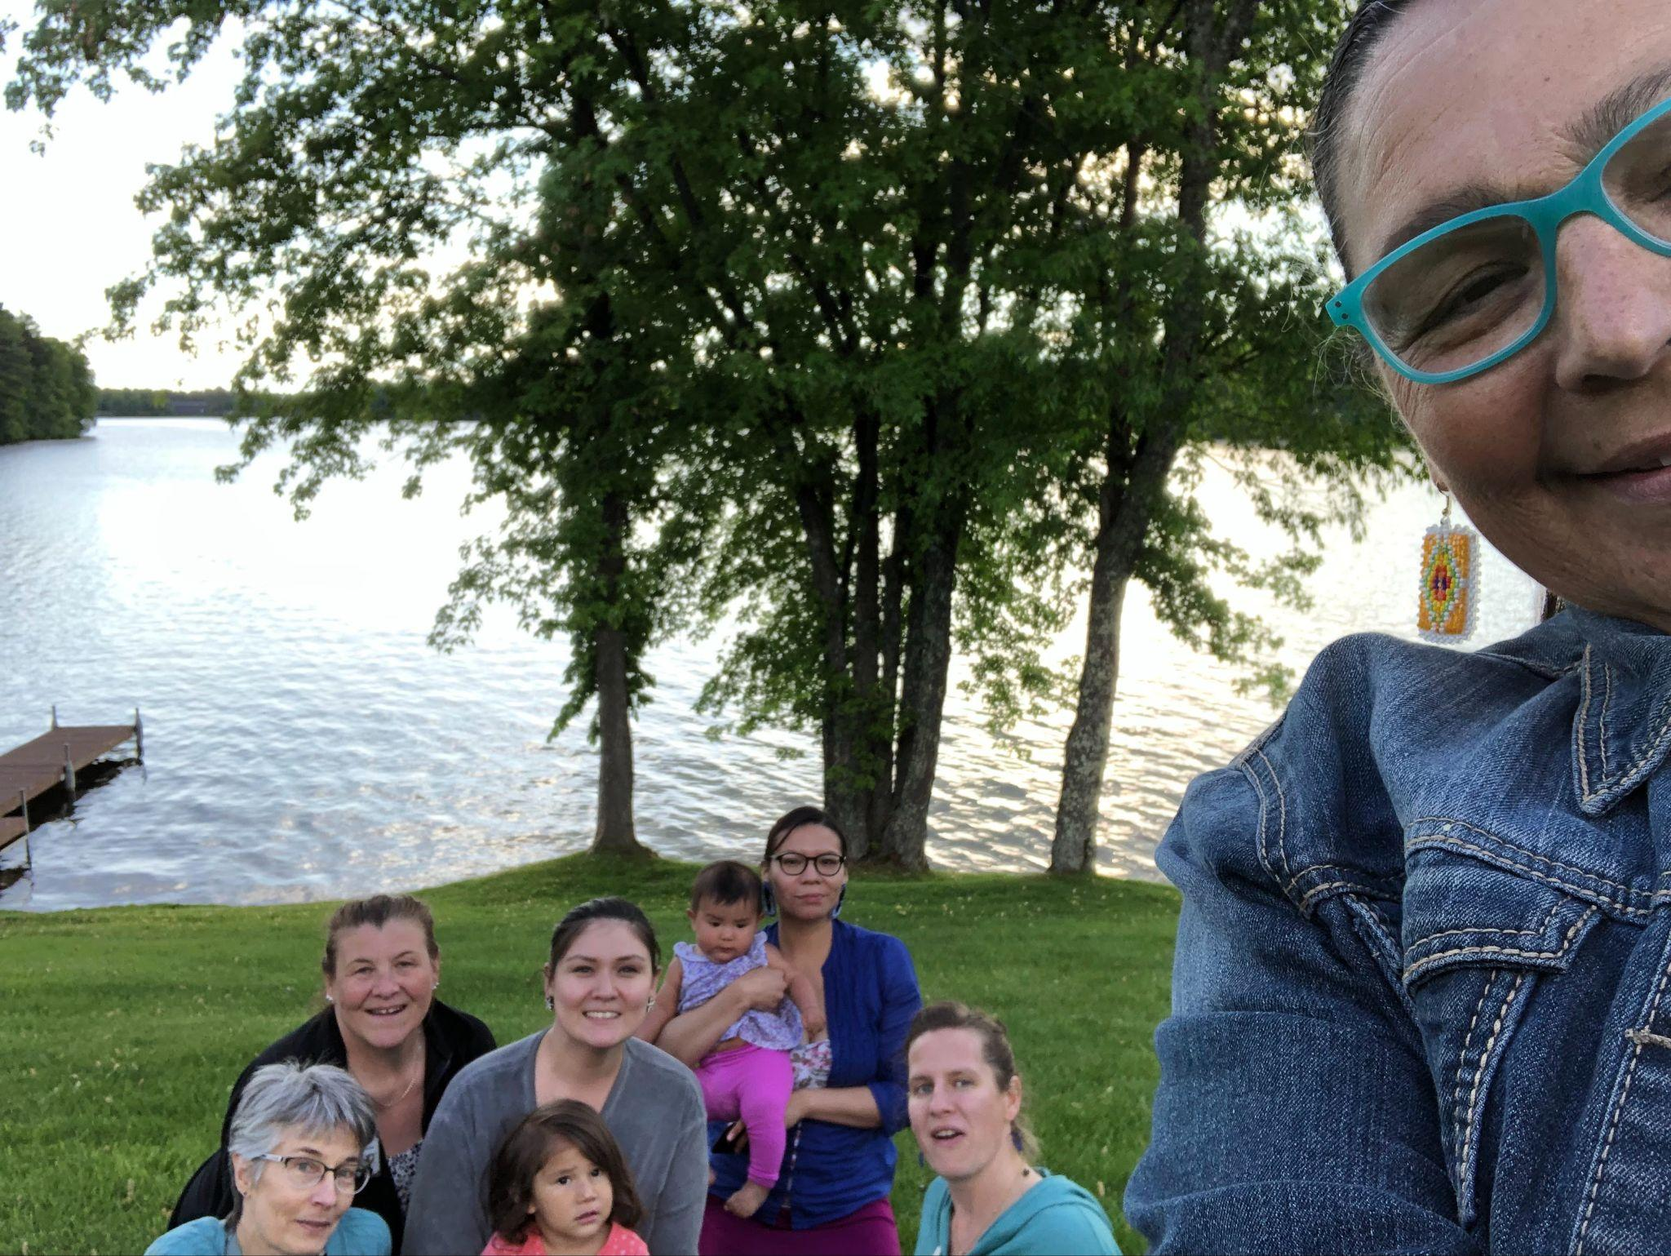
Cultural safety while working in community
What does it look like?

Slide 33
Centering Indigenous worldview
Acknowledging painful history
Re-learning and leaning into cultural strengths & practices
Tobacco first: Ceremony to start
Being self-reflective & humble
Connection with nature
Reclaiming women’s wisdom
Respect for elders
Community connections
Valuing Indigenous Healing Modalities

Slide 34
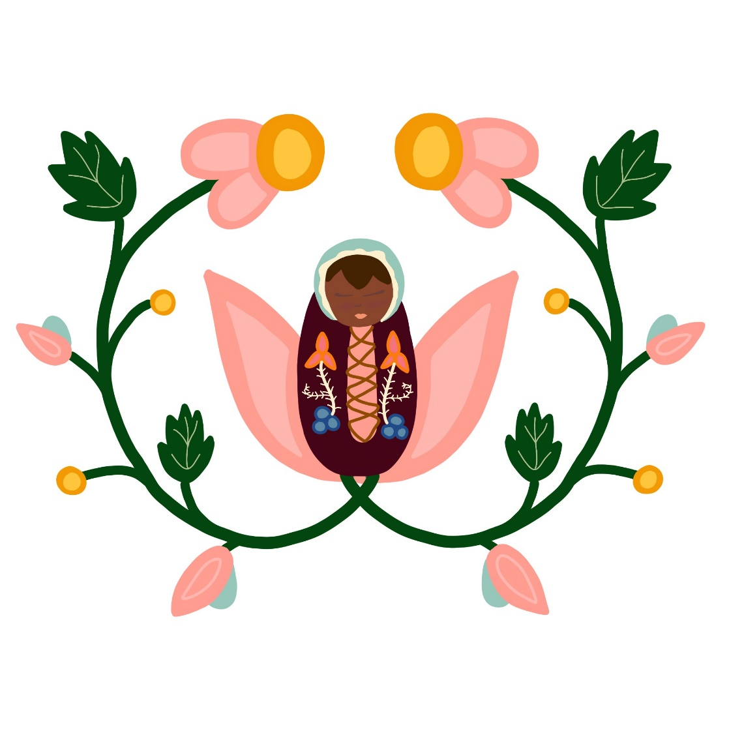
Ondaadiziikewin bagosendam azhigwa
Notes:
Birth-work, wishing for this time, the time is now!

Slide 35
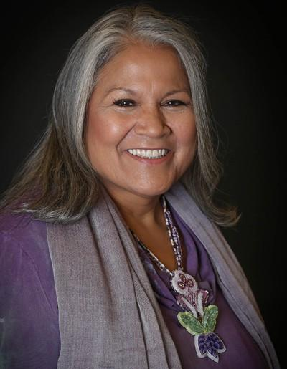
Katsi Cook
Trained in 1978-1980 by Katsi, Mohawk Midwife
Formed Women’s Dance Health Project
Addressed Community Health Issues
Had children at Home
Archie Mose’si’bun message from the Midewiwin Lodge
”As a Mohawk midwife, time is everything in the course of care, military time, obstetrical time, physiological time and then there is also sacred time that is all part of that ceremony and medicine space of time…theory of three in the cycle “ –Katsi Cook, 2014
Notes:
My Teacher, trained in traditional midwifery by Katsi Cook, 3rd generation Mohawk midwife. Among the Grandmother Society in my lodge, i also acknowledge many grandmothers that taught me, and my main teacher, my Mother, Miizhukiibainsii’ibun

Slide 36
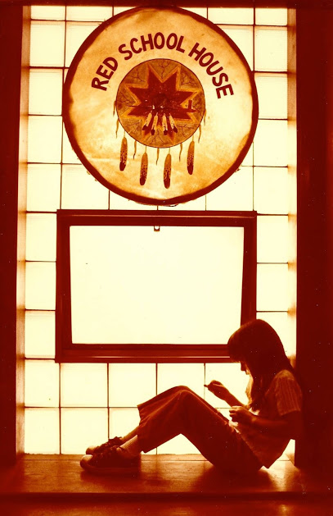
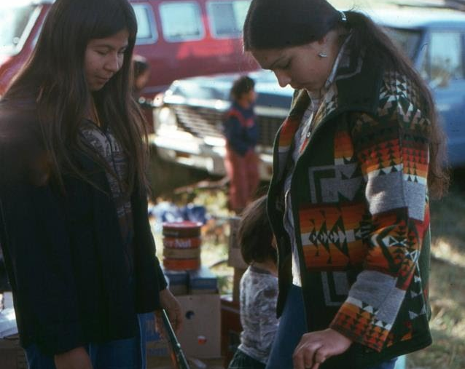
Red School House St. Paul, MN
RSH 1970-1977 Indigenous grounded education began with the survival schools. The RSH was second in the nation. The building that housed the RSH, also had the St Paul AIM office, Indian Country Press, and a native clinic, the St. Paul Urban Indian Health Clinic. This clinic is where we began talking about birth to the Indigenous community.
Notes:
This is one source of where I began my lifelong journey in learning our powerful Indigenous knowledges

Slide 37
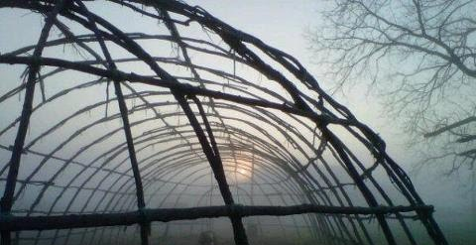
Midewiwin Lodge – The Heart Way This is where a received my most valuable education. I Learned about our Creation Story, and how we came to be here on Turtle Island.
Notes:
My learning journey of learning my ways continued here... In our Mide lodge. There was a time when we couldn’t speak openly about our ways of being in the world.. But since 1978, when congress passed the American Indian Religious Freedom Act, we don’t have to hide anymore.

Slide 38
CREATION ~ The interconnectedness of all living things
A Sacred Vessel that carries the Seed of Humankind… Regulation from our Grandmother Moon
Our birth is the evident truth of our Creation story, just as it unfolded long ago..
Notes:
Our elders say that all Creation stories are true. We know our Creation story, it takes 7 days and nights to tell, with 64 songs.. The information doesn’t change in our oral tradition.

Slide 39
Traditional Birthing Practices
Sacred – space It is important to use sacred Medicines~Miishkiki for delivery, Sweat grass, cedar, sage to cleanse the birthing space.
Songs are song, prayers are said
Preparing – nutrition and exercise and rest, and making Dikinaagan
Tobacco – Asemaa offerings throughout pregnancy, and before delivery
Water - Niibii Carries whole history-memory-thoughts-prayers.. healing energy.. An acknowledging the life-giving force of the womb water is in order.
Placenta – Bury the placenta, returning it to the Earth, Me-gwech for nurturing new life.
Cord – Odiseyaabiin Take great care of it, when it falls off, place it in a leather pouch, and after baby walks, bury it close to home.
Medicines - Common teas – Mashkiki, that can be used for pregnancy and delivery. Sturgeon broth after delivery.. White fish broth to bathe baby..
Offerings - after the birth to express thanksgiving.
Naming Ceremony Receiving an Anishinaabe name allows our ancestors to see us, and it is announced to the Four Directions, binding us to Creation.
Notes:
The Standard of Indigenous Care in an Indigenous birth experience, Even this first goal is sometimes unattainable

Slide 40
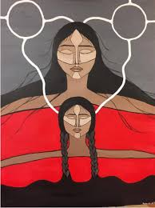
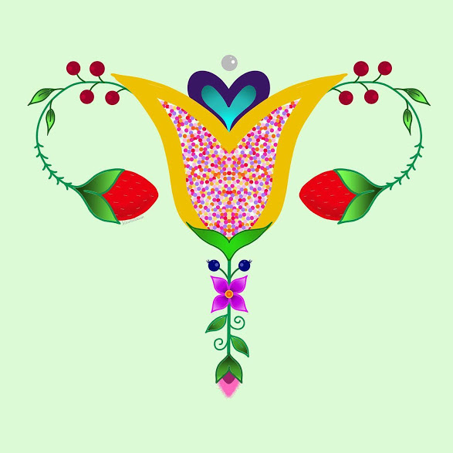
MMIW Sacred Reproductive Organs, Artists, unknown
Notes:
Why does the rape and pillaging of the Earth, relate to the maternal and infant mortality rates of Indigenous nations, and Missing and Murdered Indigenous Women?

Slide 41
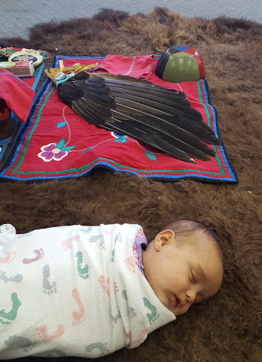
Birth-work
Healing for the next generations
Indigenous Midwifery, birth and women’s lifeways are a retrieving of ceremony. We need to holistic approaches, that address Body-Mind-Spirit-Heart, and greater access to ceremony in order to heal and become the hollow bone to do the work.
Healing the trauma impact begins when we reclaim our cultural and spiritual practices; Our births, rites of passage, feasting, full moon, fasting, cedar and flower ceremony, untying ceremony, baby loss ceremony.
All these ceremonies were intact before. As women participate in their own healing, they help to bring this back.
Community involvement and commitment are needed as the work is ongoing.

Slide 42
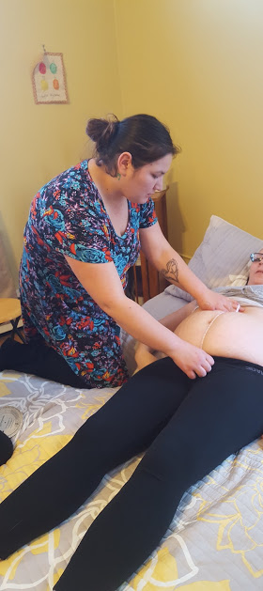
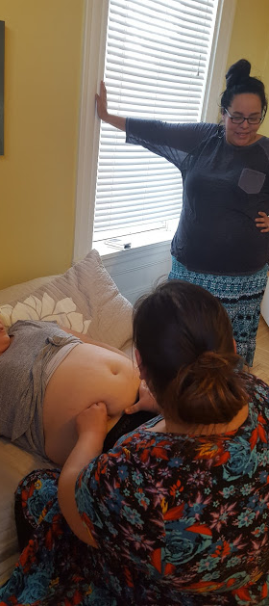
Red Cliff, WI. Birth-Work
Notes:
I wanted to show some of the movement toward reclaiming birth practices. These next slides will show what is happening around birth. The young women are standing up! My daughter is learning, My grandmother, my mother, myself and now she is birthing at home.. I am happy to be part of a movement. Many young women are learning and taking the initiative to do this work.. But, like our elders before us, we need to take time to learn our protocols.

Slide 43
Birth Teachings Presentation at Maternal Health Conference – White Earth, MN
Notes:
The work goes out from birth work groups.

Slide 44
Modern Day Prophecy
In 1990, a leading elder in our lodge fasted, and came with a message about return of Traditional Birthing.
“Twins,Niizhoodewag would come to the Lodge, bringing birthing back to the Anishinabeg”.
Birthing is encouraged by the Grandmothers. They met and shared all the teachings that they could remember.
Notes:
Bawdwaywedun banaise ibun is the elder that fasted 30 some years ago, from LCO, Wisc.

Slide 45
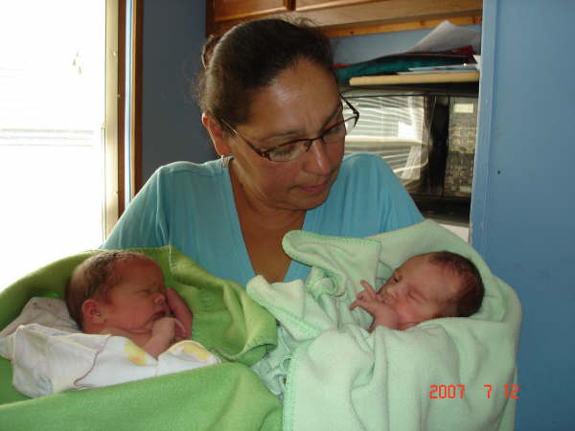
Niizhoodewag-Twins Charlie and Maddie Born on Peshawbestown reservation, in a birth lodge on the shore of Traverse Bay, on July 12, 2007. They are now 13 yrs. old
Kris-Bedwayway Banais: “The birth lodge was full of love: Little boy water drums, my Mide family, my mom and my brother. I was told that people from the community was sitting and listening to the singing and the drum. There were spiritual songs being sung..”
Notes:
The birth of these twins put more into motion, regarding the prophecy..

Slide 46
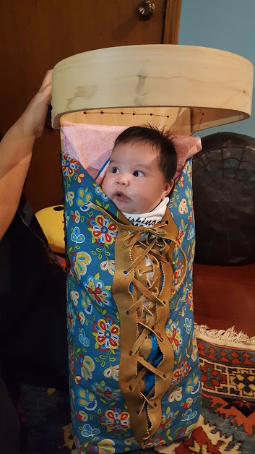
Home birth babies in Dikinaagan - Resurgence of the Dikinaagan Sagkeeng, Manitoba, Mille Lake, MN., Minneapolis, MN., Red Cliff, Wisc., Gun Lake MI., Sturgeon Lake, Saskatchewan, CA, Saskatoon, Saskatchewan, CA

Slide 47
Sturgeon Lake Cradleboards 2019-20

Slide 48
Doula Trainings
Red Cliff, Wisconsin - 2007
Bemidji, MN - 2016
Fond Du Lac, MN - 2018
Sturgeon Lake, Saskatchewan 2018
Lac Du Flambeau, Wisconsin - 2019
Saskatoon, Saskatchewan - 2019
Minneapolis, MN 2019/20

Slide 49
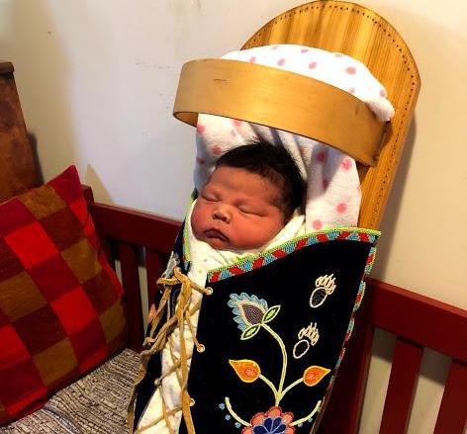
This is really what it’s about: The ceremony of birth, safe births, healthy babies, indigenous birth songs and lullabies, moccasins, cradleboards and swings and nooni-breastfeeding for our babies.. Reclaiming our practices for the health of our communities.
Notes:
This is really what its about, safe births, healthy babies, reclaiming our practices for the health of our communities.

Slide 50
Movement/ Stretch break

Slide 51
Working to enact
culturally safe care:
Be open
Be respectful
Lifelong journey
Un-learning is required
Be self-reflexive & humble
Acknowledge the world views we hold (personal & professional) are not universal nor are they superior
Ask & learn from others with respect and an open mind
Adopt a relational approach (working collaboratively with patients & families)
Notes:
Erin 67-69
These are written from a non-Indigenous perspective

Slide 52
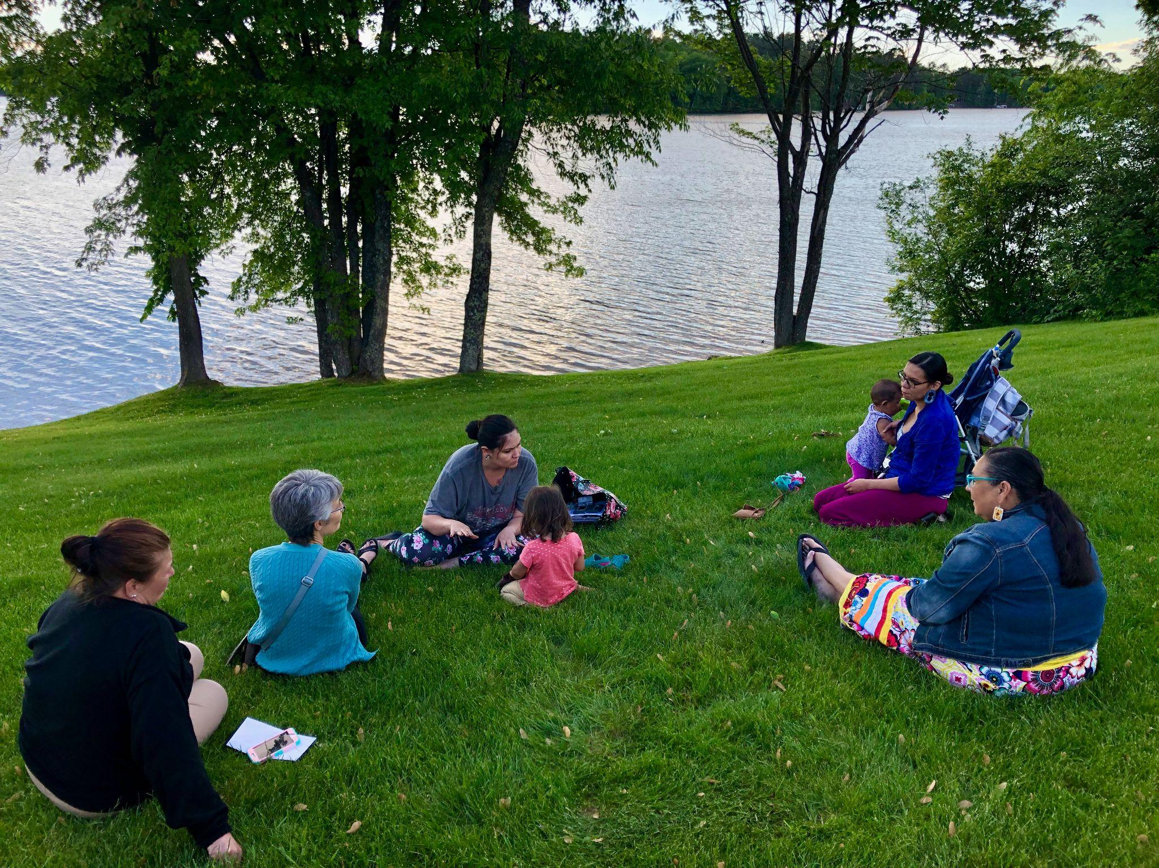
Listen
Do The Work to reduce bias
Build trust & form safe
relationships
Make changes

Slide 53
What is The Work?
Know ourselves (identity, positionality, bias)
Learn the history, culture & context (U.S. & populations we serve)
Understand the oppressive structures we live in and work to dismantle them so that ALL can be safe and thrive

Slide 54
Cultural safety course link here:
https://ceu.catalog.instructure.com/courses/introduction2cultural-safety

Slide 55
Contact Info:

Slide 56
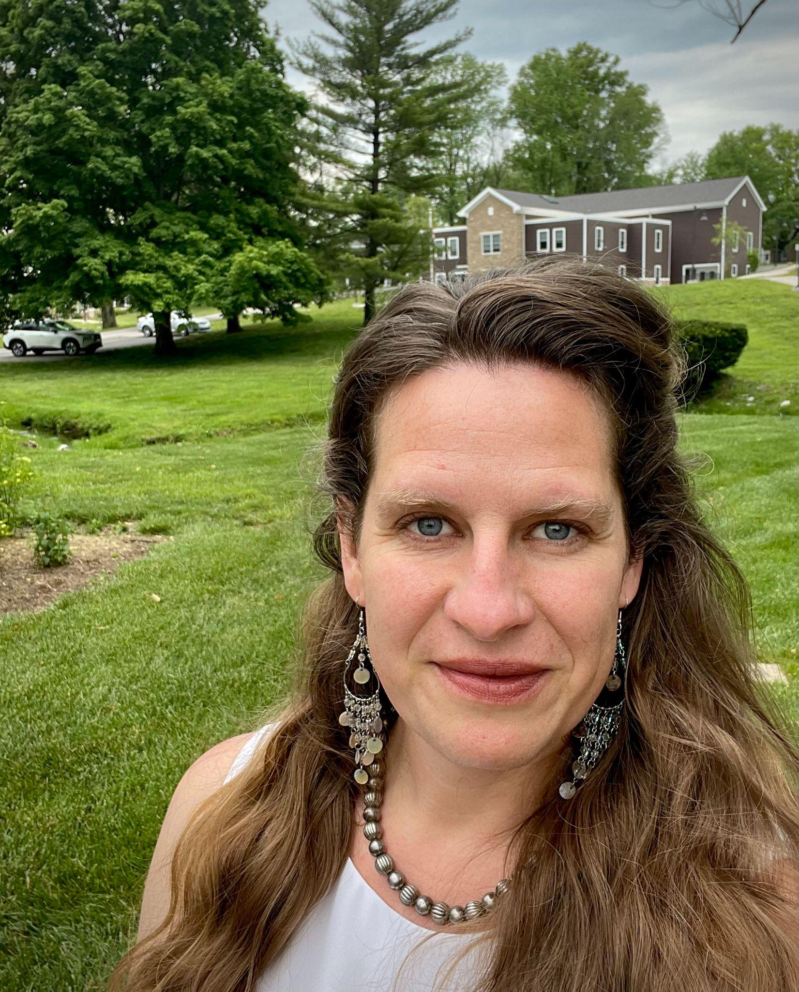
Contact Info:
Dr. Erin Tenney
erin.tenney@frontier.edu

Slide 57
References
Baldwin, L. M., Grossman, D., Murowchick, E., Larson, E., Hollow, W., Sugarman, J., Hart, G. (2009, April). Trends in perinatal and infant health disparities between rural American Indians and Alaska Natives and rural Whites. American Journal of Public Health, 99, 638-646. Retrieved from http://dx.doi.org/10.2105/AJPH.2007.119735
Curtis, E., Jones, R., Tipene-Leach, D. et al. Why cultural safety rather than cultural competency is required to achieve
health equity: A literature review and recommended definition. International Journal of Equity Health 18, 174
(2019). https://doi.org/10.1186/s12939-019-1082-3
Davis-Floyd, R., Barclay, L., Daviss, B., & Tritten, J. (Eds.). (2009). Birth models that work London, England: University of California Press
Downing, R., & Kowal, E. (2011, March). A postcolonial analysis of Indigenous cultural awareness training for health workers. Health Sociology Review, 20(1), 5-15.
Fleming, T., Creedy, D. K. & West, R. (2019). Cultural safety continuing professional development for midwifery academics:
An integrative literature review. Women and Birth (32), 318- 329. https://doi.org/10.1016/j.wombi.2018.10.001

Slide 58
References
Josif, C., Barclay, L., Kruske, S., & Kildea, S. (2013, March 17). ’No more strangers’: Investigating the experiences of women, midwives and others during the establishment of a new model of maternity care for remote dwelling aborigial women in northern Australia. Midwifery, 30, 317-323. Retrieved from http://dx.doi.org/10.1016/j.midw.2013.03.012
Kornelsen, J., & McCartney, K. (2015). System enablers of distributed maternity care for Aboriginal communities in British Colombia: Findings from a realist review. British Colombia, Canada: Applied Policy Research Unit.
Lu, M., & Johnson, K. (2014). Toward a national strategy on infant mortality []. American Journal of Public Health, 104(S1), S13-S16.
McEldowney, R., & Connor, M. (2011). Cultural safety as an ethic of care: A praxiological process. Journal of Transcultural Nursing, 22, 342-349. Retrieved from http://dx.doi.org/10.1177/1043659611414139
Merriam Webster (2023). Colonization. Retrieved September 7, 2023. https://www.merriam-webster.com/dictionary/colonization
Mkandawire-Valhmu, L. (2018). Cultural safety, Healthcare & Vulnerable populations. Routlage.

Slide 59
As we conclude:
Please think of one word that summarizes your learning, or how you are feeling about this session
Notes:
Dorene - Have everyone stand up and stand in a circle – and say one word?
Putting their action & sacred voice- setting into action
Actualize it by saying it

