Slide 1
Implementing a One Health Clinic
Vickie Ramirez, Program Manager/One Health Clinic University of Washington
Katie Kuehl, DVM, Director of Animal Health/One Health Clinic
Washington State University
HCH2024
PHOENIX, AZ • MAY 13-16, 2024

Slide 2
Land & Labor ● About Me

Slide 3
What does our audience look like?
Lived Experience with Homelessness
Healthcare Providers (Human)
Homeless Service Providers (non-shelter)
Shelter Support Services
Housing Support Services
Veterinary Healthcare Providers
Other

Slide 4
What does our audience look like?
Lived Experience with Homelessness
Healthcare Providers (Human)
Homeless Service Providers (non-shelter)
Shelter Support Services
Housing Support Services
Veterinary Healthcare Providers
Other
Are currently benefitting/Have benefited from pet companionship or support

Slide 5
Background
www.everythingtome.org

Slide 6
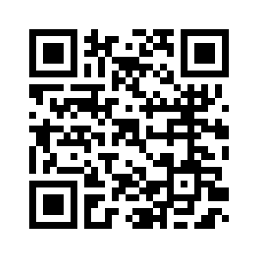
Background
www.everythingtome.org

Slide 7
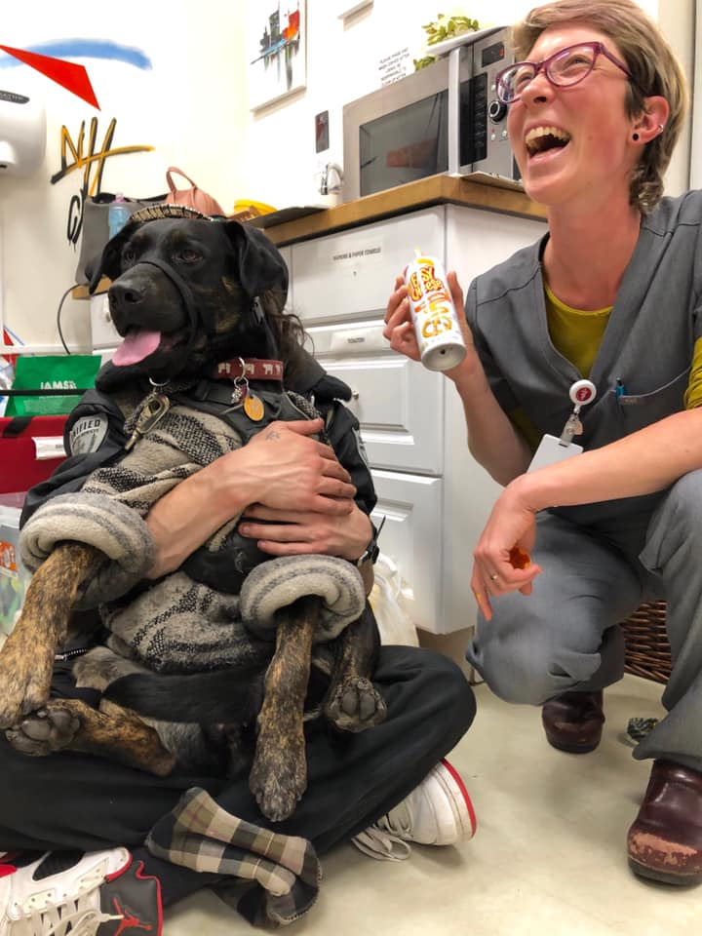
The One Health Clinic

Slide 8
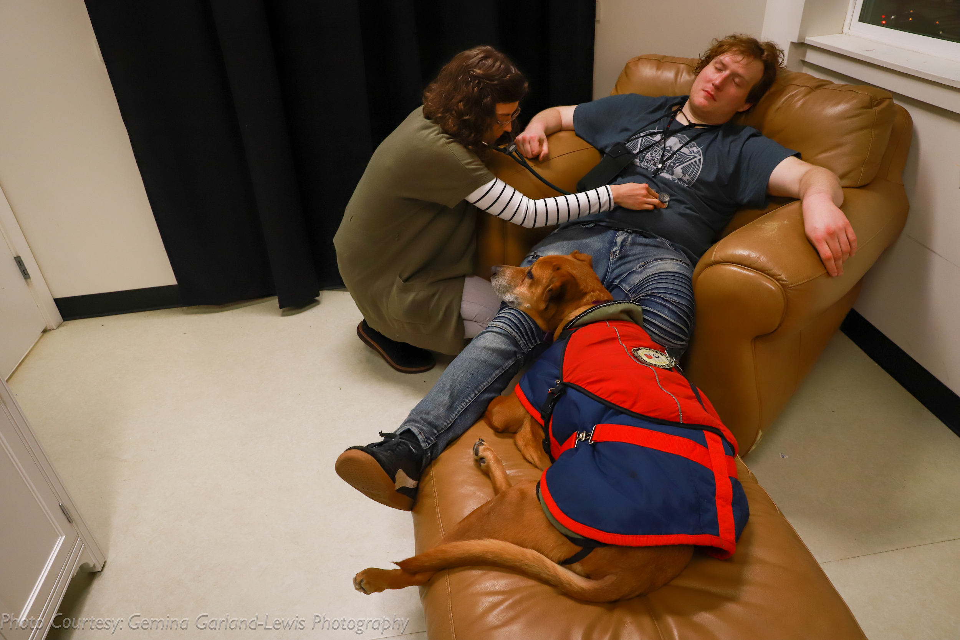
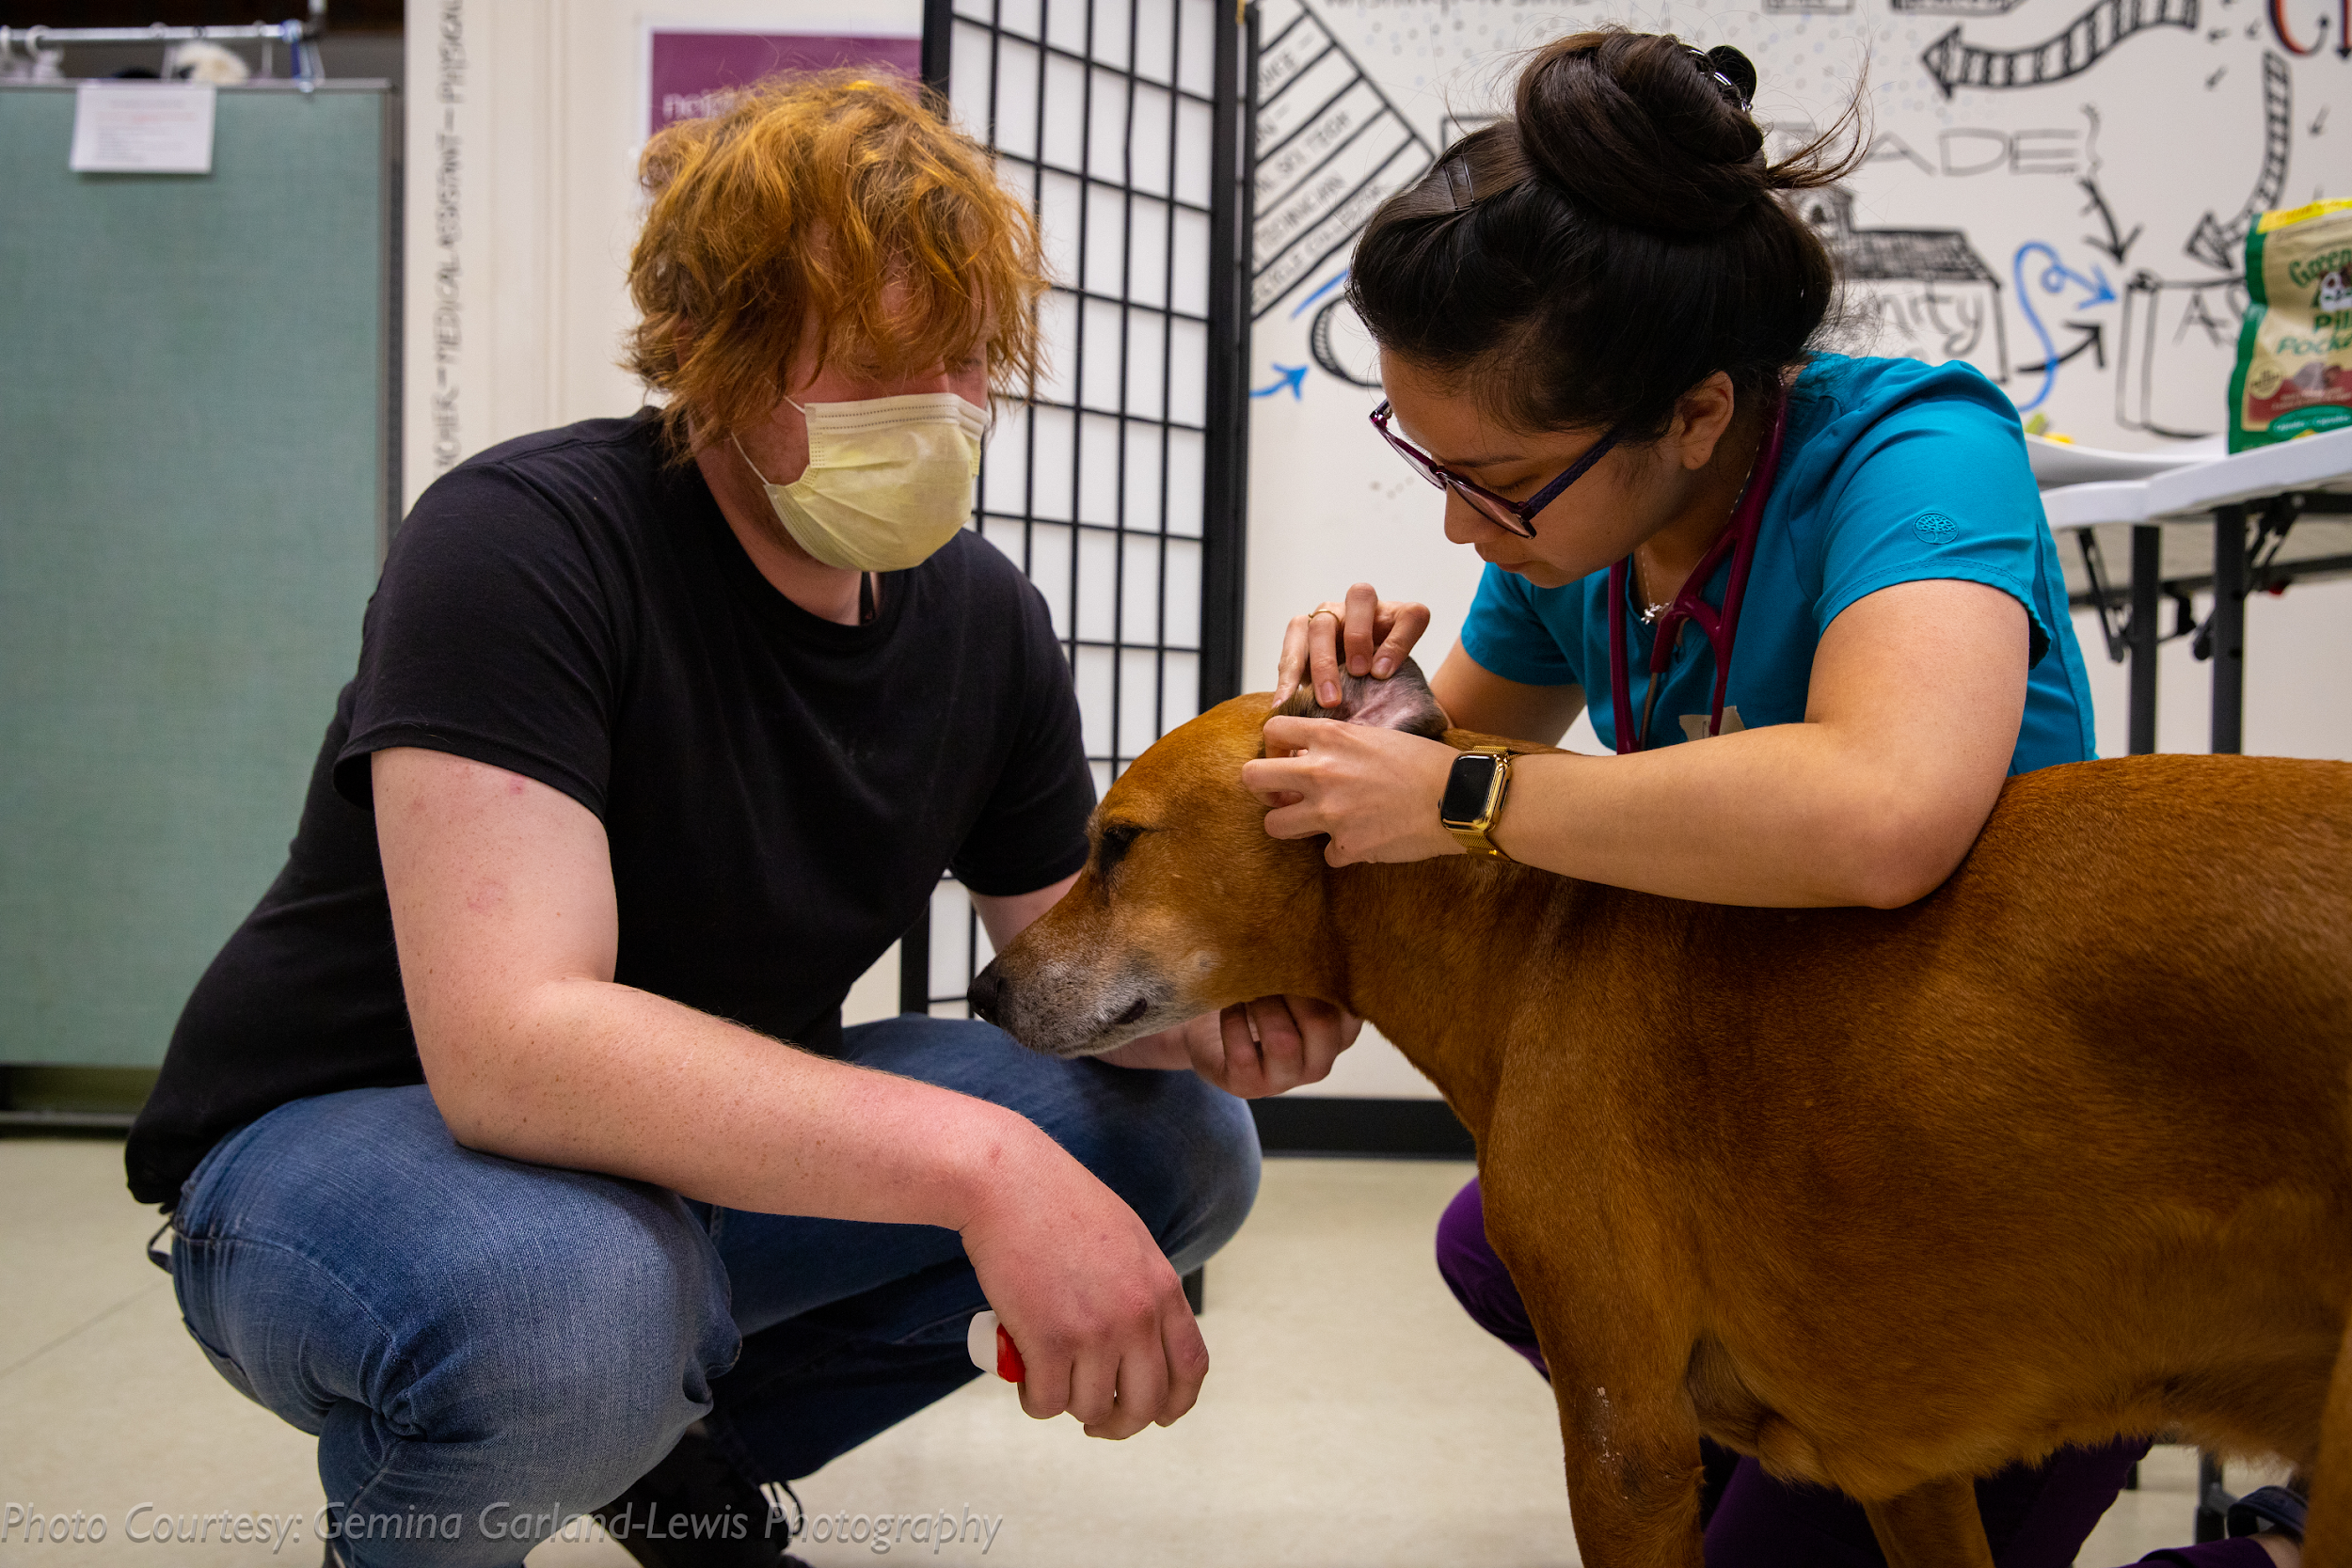
Integrated Care ● Beyond Co-Location

Slide 9
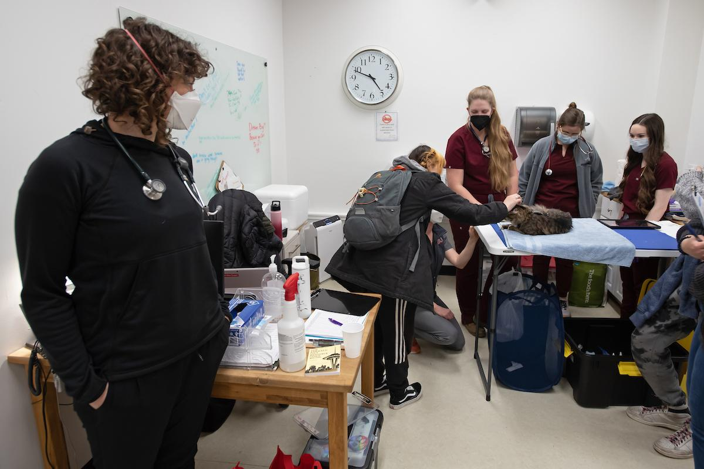
Interprofessional Education

Slide 10
Grace & Nugget
https://www.youtube.com/watch?v=NULvYIN-vSs

Slide 11
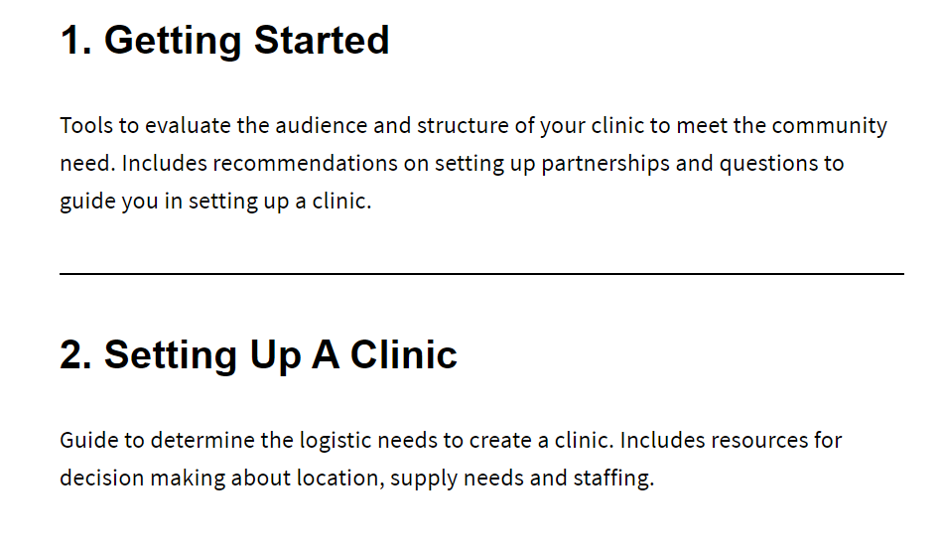
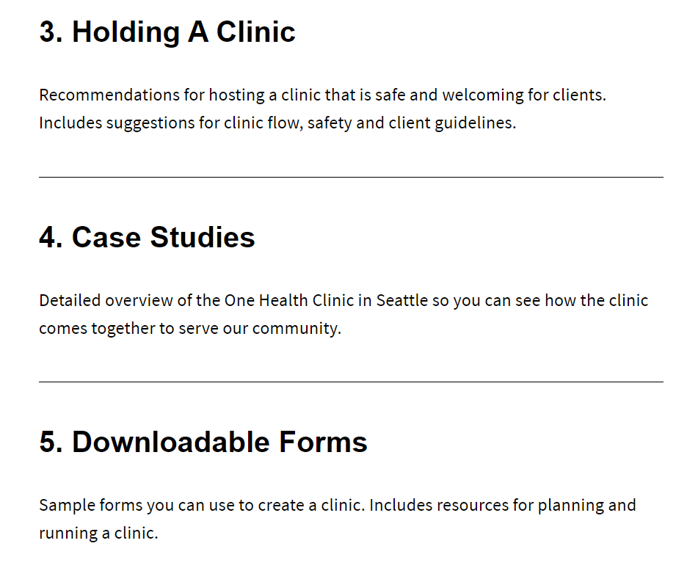
The Toolkit
Notes:
Over 180 followers. 22:50 states but 81 gmail-type users. + Canada, Spain, Australia, Brazil and Argentina. mostly vet contacts, meet quarterly as a group but also support as needed, Modify to fit needs of community

Slide 12
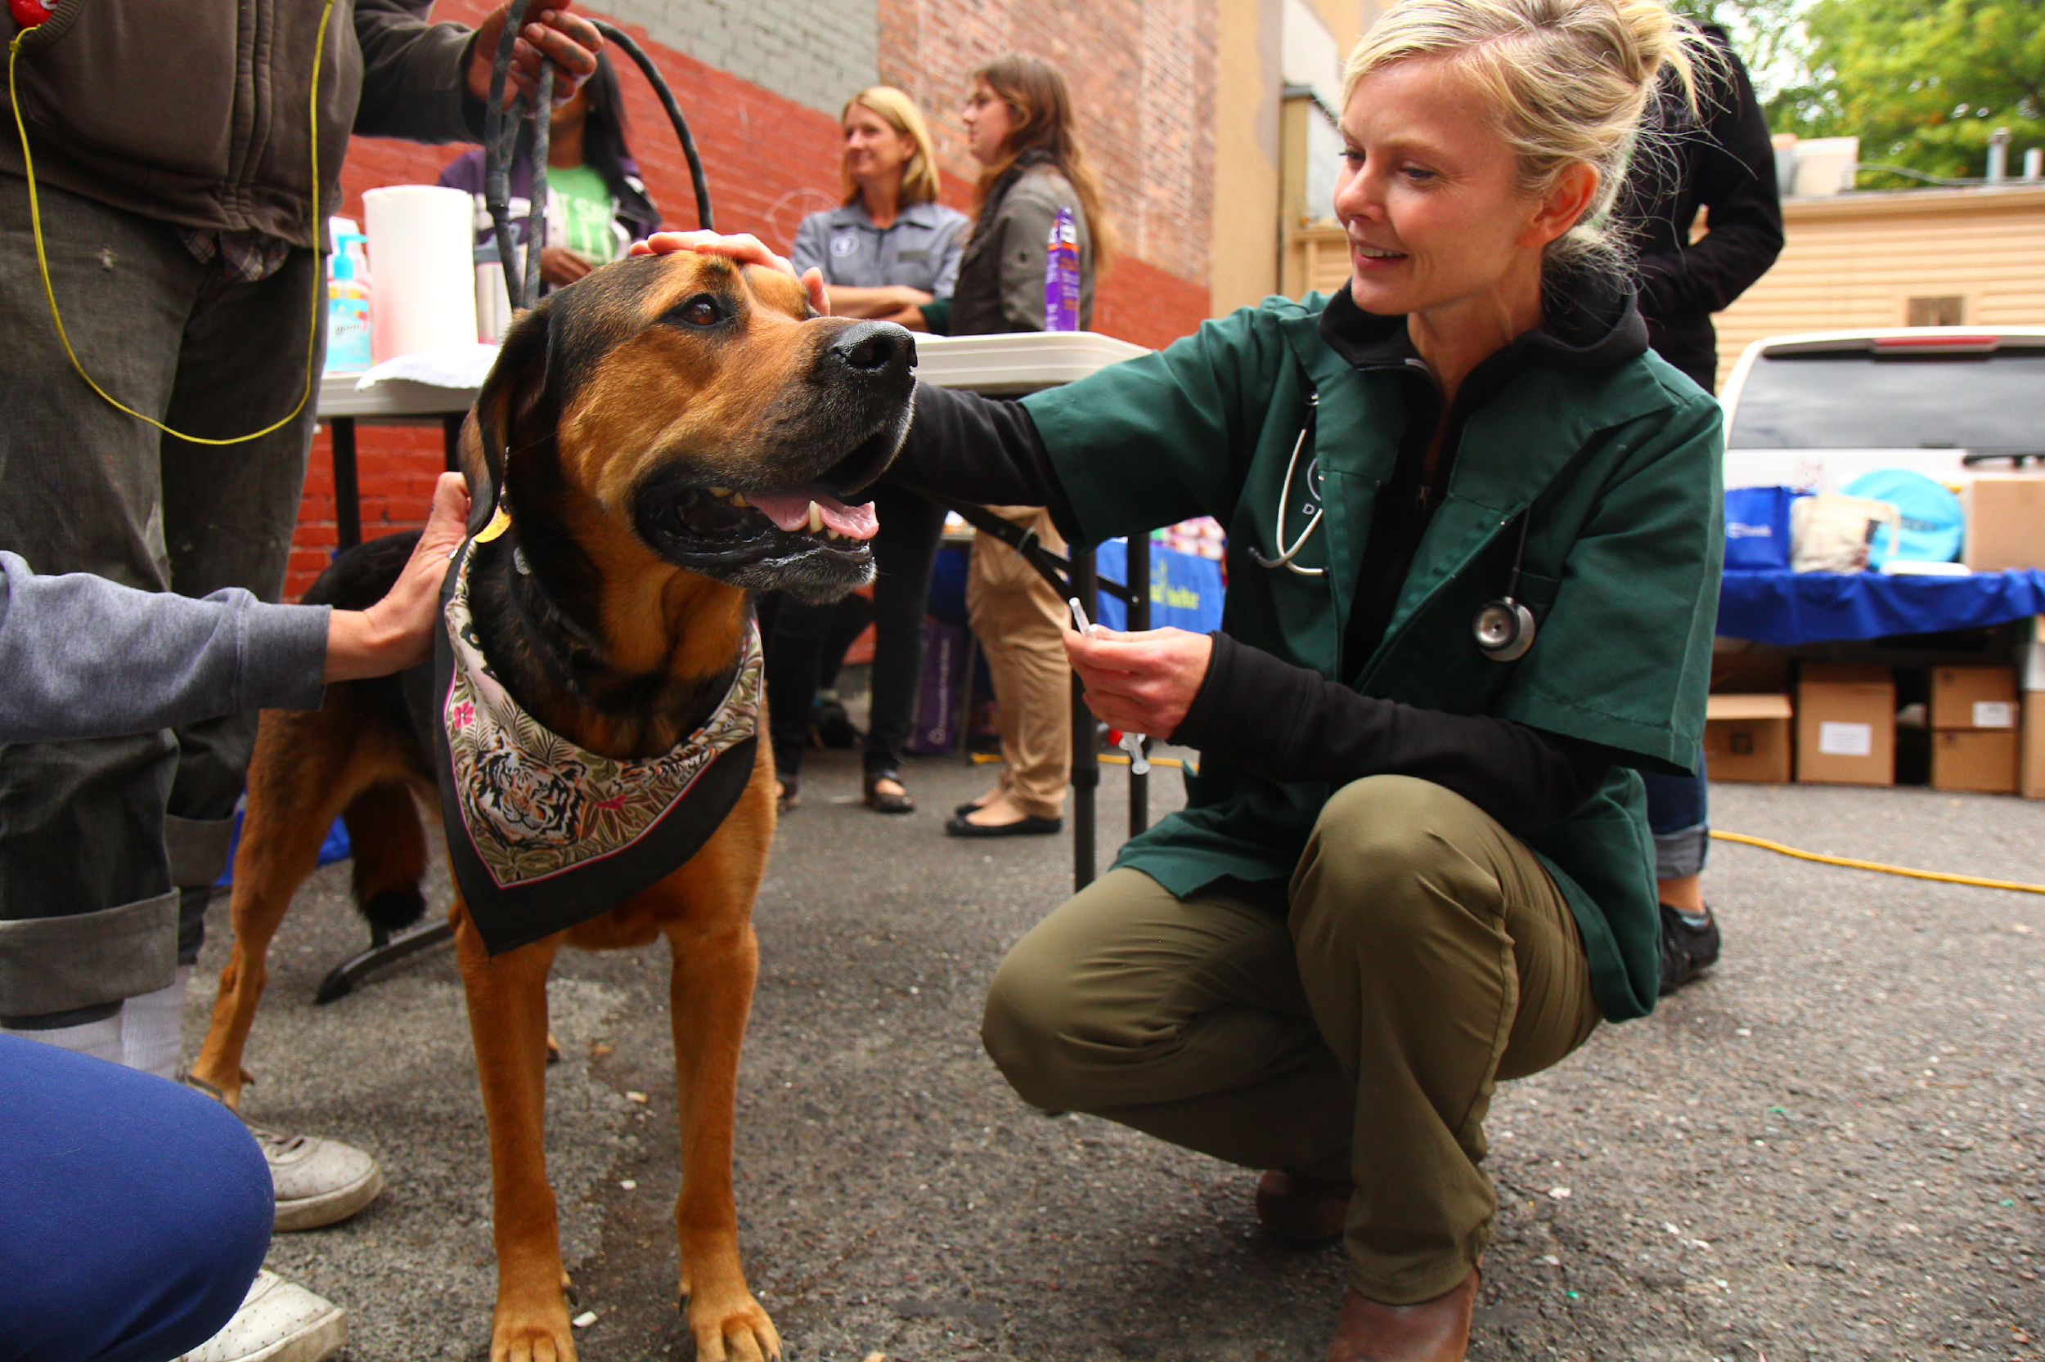
NYC, NY ● OHC
+
+
Notes:
John betts, 8:30 May 15th Providing Support to High-Needs Clients in Transitional Housing
Amanda 3:30 May 15th TBI and homelessness

Slide 13
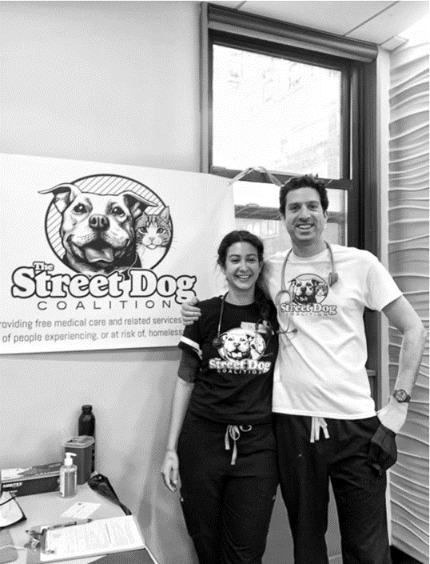
NYC, NY ● OHC
+
+
+
Notes:
John betts, 8:30 May 15th Providing Support to High-Needs Clients in Transitional Housing
Amanda 3:30 May 15th TBI and homelessness

Slide 14
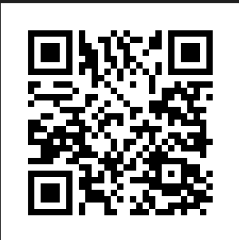
Greg & Coffee

Slide 15
Tucson, AZ ● PCOHC

Slide 16
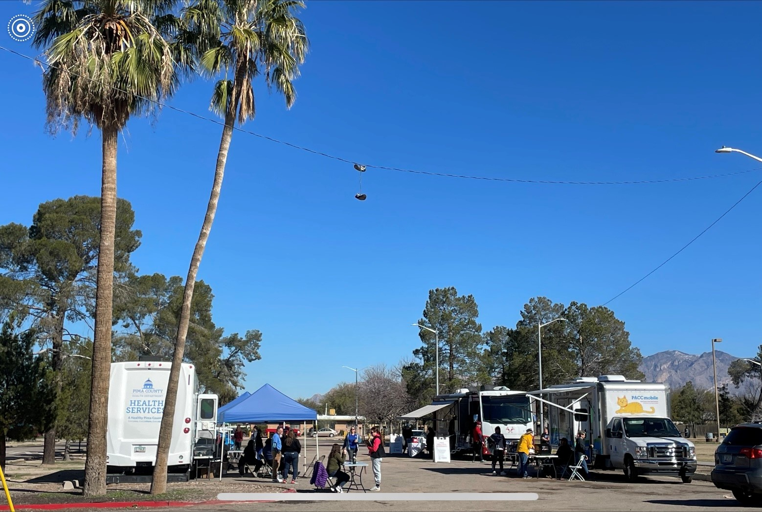
Tucson, AZ ● PCOHC

Slide 17
Survey of Toolkit Users ● Barriers
Lack of time
Lack of known resources
Lack of resources in general
Lack of space
Competition for resources
Funding for administration, evaluation, etc
Notes:
“We have significant support from local human health care and homeless advocacy, but competing with other funding priorities of local foundations is the main obstacle.”

Slide 18
Survey of Toolkit Users ● Successes
I'm always surprised to see how nicely the services flow together. People seem to really enjoy working with a navigator. I'm also surprised at how many people are interested in utilizing vet services and ensuring their pets are in good health.
I have heard anecdotally how people who are homeless value their pets, and in talking to people this seemed to be true across the board. And people who were hesitant to get services for themselves sought out care for their pets - and then often changed their minds about getting services for themselves.

Slide 19
Survey of Toolkit Users ● Lessons Learned
Patients are so proud of their pets.
It's a great way to engage human patients. It's a very positive environment.
The variety of services that are available for people who are homeless. There is of course, not enough services for the demand, but there were more types of services available than I was aware of.
That there is only one homeless shelter in our jurisdiction which allows pets and it is a female only shelter
How excited people are to volunteer
It was surprising how many people did not want healthcare services for themselves.

Slide 20
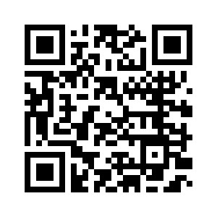
Thank you!
onehealthclinicseattle@gmail.com
Meet Up?

