Slide 1
Nurse Call Line (NCL) Pilot in Homeless Shelters in NYC
Presenter:
Shaili Gandhi, NYU Langone Health
HCH2024
Co-Authors:
Amy Freeman, Kelly Doran, Fabienne Laraque, Eve Cleghorn, Nirah Johnson, Giselle Routhier
PHOENIX, AZ • MAY 13-16, 2024

Slide 2
About Us

Slide 3
Health x Housing Lab
Conducting research to build the evidence base for initiatives, programs, and policies at the intersection of health and housing
Informing policy and programs related to health and housing through evidence-based advising and research dissemination
Providing education to expand the reach of practice-relevant evidence on health and housing
Notes:
Background
Launched in early 2021
Situated within the department of population health at NYU School of Medicine
Focus on housing insecurity, homelessness and health
Main focus areas: research, policy, and education (read slide)
Values:
Housing and healthcare are human rights
Healthcare, housing, and homeless services should do no harm
Housing and homeless services should foster health and wellness across the lifespan
People who have experienced homelessness are experts by experience and need to be at the table when decisions around research, policy, and advocacy are being made
Embedded across all our work is inclusion of PWLE of homelessness and housing insecurity
advisory committee: brings together people who work in housing, people who work in healthcare, and people with lived experience of homelessness
community-engaged research (such as the study I will be talking about today)
community-engaged events

Slide 4
Background & NCL Program Overview
Notes:
I’m going to provide some background about the Nurse Call Line

Slide 5
People experiencing homelessness…
Have high prevalence of chronic health conditions
Face challenges establishing and maintaining connections to care
Utilize ED at higher rates
Notes:
PEH have higher prevalence of chronic medical conditions and behavioral health conditions than housed counterparts
Despite elevated healthcare needs…
Barriers establishing connections to primary care
Visit ED at higher rates

Slide 6
The Collaborative for Homeless Healthcare
Launched in January 2019 by Helmsley Charitable Trust to improve healthcare access and continuity of care for homeless New Yorkers
Comprised of NYC Department of Homeless Services (DHS) and three homeless services organizations that provide healthcare
Developed 3 pilot programs to improve healthcare access in NYC shelters
Notes:
response to challenges faced by PEH
Launched in January 2019 by Helmsley Charitable Trust to improve healthcare access and continuity of care for homeless New Yorkers
composed of Department of Homeless Services (DHS) and 3 healthcare providers that serve homeless patients: Care for the homeless, project renewal, center for urban community services
3 pilot programs to improve healthcare access and continuity of care for New Yorkers residing in shelter

Slide 7
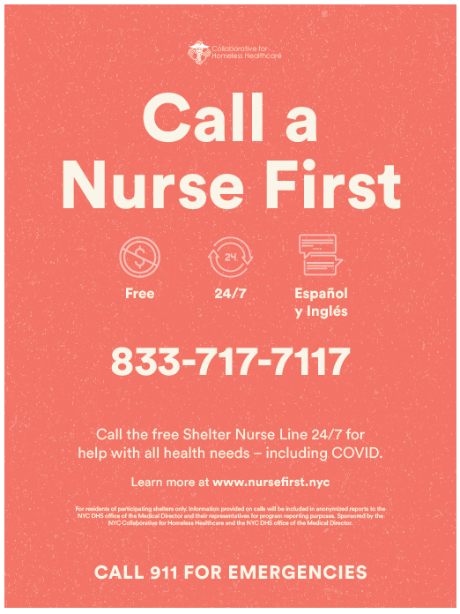
NYC Department of Homeless Services (DHS) Nurse Call Line
2020
DHS developed 24/7 Nurse Call Line (NCL) pilot with Collaborative to address high rates of 9-1-1 utilization in shelters
2022
Approximately 46,000+ New Yorkers resided in DHS shelters nightly
DHS operated 300+ shelters across NYC
Notes:
Program Launch
NYC has a robust shelter system, which is managed by the Department of Homeless Services (DHS)
Response to elevated rates of 9-1-1 utilization in their shelters
Developed 24/7 Nurse Call Line (NCL) with collaborative as one of the pilot programs
launched in April 2020
Context stats
In 2022 DHS operated 300+ shelters, with approximately 46,000 residents nightly
now the shelter census is higher (influx of migrants) - DHS serving 85,000 New Yorkers nightly across over 550 shelters

Slide 8
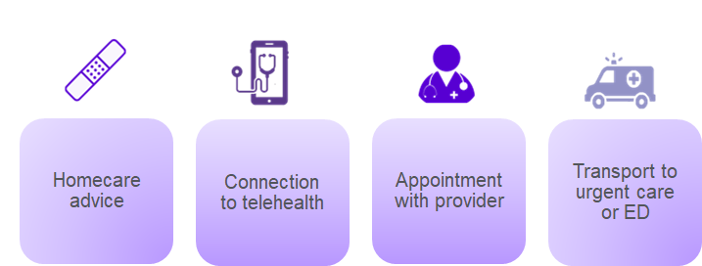
NCL connects callers with:
Notes:
The NCL is available 24/7 for shelter staff or residents to call about their health concerns or questions
NCL staffed with nurses who use a standardized script to assess shelter residents’ symptoms
NCL nurses can…
Provide Homecare advice
Connect callers immediately to telehealth
Provide referrals and schedule appointments with specialists
Arrange no-cost car transportation to urgent care or ED
Purpose
Originally designed to reduce 9-1-1 utilization for non-emergent concerns
Evolved to provide residents with options when in-person care is not available

Slide 9
Program History
January – May 2023
Study data collection
April: NCL launched in 9 shelters. August: NCL available in 40 shelters
New shelters onboarded regularly
Prioritizing single-adult shelters and shelters with high 9-1-1 use
Expansion system-wide (550+ shelters)
2020
2021
2022
2023
Notes:
Timeline
Launched in April 2020 in 9 DHS shelters
By August 2020, fully operational in 40 shelters
2021 – 2023: program expansion. Prioritization of shelter with high 9-1-1 use (primarily single adult shelters), eventually expanded system-wide
CLICK FOR ANIMATION
Data collection from January – May 2023
NCL in 80 shelters at beginning of data collection, just before system-wide expansion (550+ shelters)
Study looking at early implementation of pilot
About
During early implementation: shelter onboarding, outreach, & training done by a program coordinator at selected shelters
Since expansion: more centralized promotion & outreach within DHS
Consistent messaging sent out system-wide (not just initial pilot shelters)

Slide 10
1. How do shelter residents and staff perceive, experience, and interact with the NCL? 2. What are barriers and facilitators to the NCL’s implementation and use?
Notes:
QUALITATIVE examination of early stages of NCL pilot
larger evaluation including quant analysis NYU Wagner Graduate School of Public Service which will look at emergency department use & other quant outcomes
Does not include data on health outcomes (that will come with quant analysis)
This QUALITATIVE inquiry focuses on user perceptions & experiences
(read questions)

Slide 11
Methods
Notes:
Now I’m going to tell you about the methods we used

Slide 12
In-depth interviews with shelter residents & staff
Focus group with NCL vendor
Notes:
In-depth interviews with shelter residents & staff who had used NCL
People who were currently living in shelter or working at shelter
Focus group with reps from NCL vendor
NCL vendor = agency with experience providing nurse hotline services to variety of populations/groups. contracted to provide the NCL service in shelters
Audio recorded & professionally transcribed

Slide 13
Study Materials
Developed with key stakeholders
Refined with feedback from advisors with lived experience of homelessness
Interview guides (Shelter residents & staff)
Focus group guide
Adapted from interview guide
Informed by conversations with key stakeholders
Notes:
Interview Guides
Interviews & FG were semi-structured & conducted with guides
2 different interview guides: shelter residents and shelter staff
Developed based on study aims, review of literature on healthcare access in PEH, & input from DHS staff and PWLEH
Garnered feedback from health x housing lab AC members with lived experience of homelessness & refined accordingly
FG guide
FG guide derived from staff interview guide & informed by convos with key stakeholders (NCL program coordinator, DHS, & Collaborative)
Guide content
Participants’ experiences, perceptions, and interactions with NCL
Barriers and facilitators of NCL implementation and use
Program recommendations

Slide 14
Shelter Selection
Categorization of Single Adult Shelters by call volume
(high, inconsistent, low)
1
Initial round
Random sampling within each category
2
Iterative rounds
Purposive sampling based on population type
3
Notes:
only sampled from shelters serving single adults, as these were (initially prioritized for onboarding in the program)
Wanted to make sure we captured a range of experiences from shelters with varying levels of NCL use, so sorted shelters into high use, low use, and inconsistent use categories and randomly selected within those groups
From there, purposive sample of shelters that served different populations (men, women, specialty services, general population)

Slide 15
Recruitment & Screening
Shelter Residents (across 4 shelters)
Total contacts: 25
18
16
15
13
12 Interviews
7 ineligible
2 no shows
1 excluded (target enrollment reached)
2 screen failures
1 no response
Shelter Staff (across 5 shelters)
Total contacts: 14
12
9 Interviews
2 ineligible
3 excluded (target enrollment reached)
NCL Vendor
1 vendor, 3 representatives
1 Focus Group
Notes:
Shelter residents
Recruited from 4 different shelters
Contact with 25 potential participants
Recruitment primarily via self-selection from study flyers, some referrals from shelter directors
Exclusion due to ineligibility and other reasons (listed) → 12 total interviews
Shelter staff
Recruited from 5 shelters
Contact with 14 potential participants
Recruitment via referral from shelter directors
9 total interviews
NCL vendor
Vendor identified 3 representatives to participate
All had worked on NCL pilot in some capacity since inception (answering calls or supervisory roles)

Slide 16
Final Sample
 | Shelter Staff | Shelter Resident | Focus Group/Key Stakeholder | Total
High Use Shelter 1 | 2 | 4 | 0 | 6
High Use Shelter 2 | 3 | 4 | 0 | 7
High Use Shelter 3 | 1 | 3 | 0 | 4
Inconsistent Use Shelter | 2 | 0 | 0 | 2
Low Use Shelter | 1 | 1 | 0 | 2
NCL Vendor | 0 | 0 | 3 | 3
Total | 9 | 12 | 4 | 25
Notes:
Outreach to 8 shelters in total, recruitment from 5 of them (3 high use shelters, 1 inconsistent use, and 1 low use)
17 from high use
2 from inconsistent
2 from low use
3 from vendor
Majority of sample from high use shelters because of difficulty recruiting people who knew of the service at low and inconsistent use shelters

Slide 17
Demographics
Notes:
Here you can see the demographic breakdown of the folks we spoke to
Residents: diverse along racial/ethnic and gender lines
Staff: diverse along racial/ethnic lines, less so in gender

Slide 18
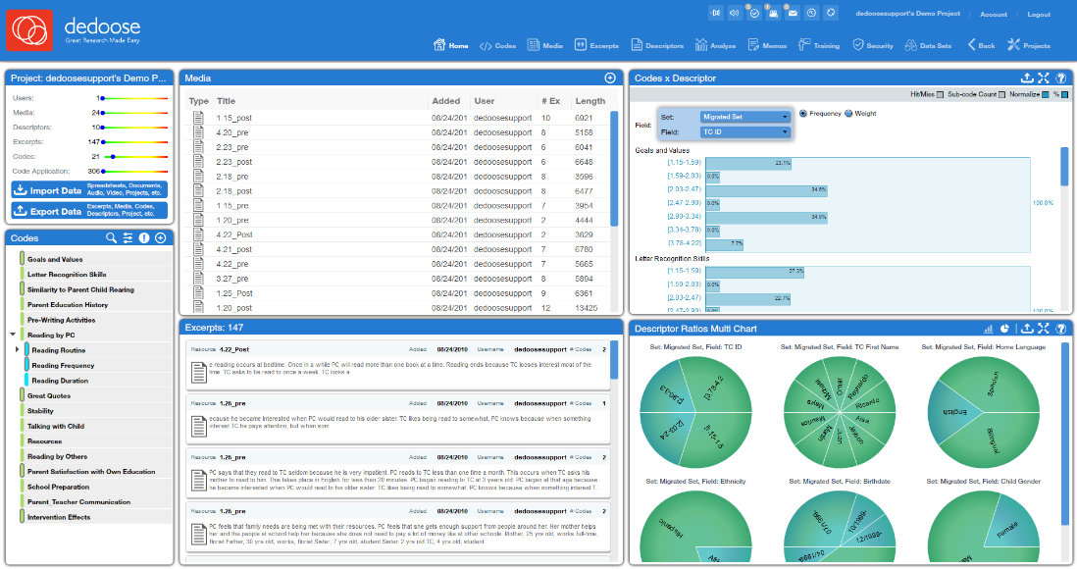
Line by Line Analysis
Codebook development (deductive & inductive codes)
Line-by-line coding in Dedoose
2 independent coders per transcript
Notes:
The findings I am sharing with you today are based on line-by-line analysis of the interview transcripts
Codebook was developed through inductive and deductive processes, tested and refined through preliminary rounds of coding 6 transcripts
All de-identified transcripts as well as the final codebook were uploaded to Dedoose, a secure web-based qualitative coding platform, for line-by-line analysis (FYI this is a generic screenshot of dedoose not actual data)
All transcripts well coded by two independent coders who met to discuss & reconcile any differences in their codes

Slide 19
Results
Notes:
Now I’m going to tell you about our findings

Slide 20
Key Themes
Role of staff in program success
Provision of transportation
Technology & telehealth
Accessing care
Notes:
Our findings fell into four main themes:
the role of staff
provision of transportation
technology & telehealth
accessing care
Findings within all of these themes touch on experiences with the NCL as well as barriers and facilitators to its use

Slide 21
Role of Staff
Staff played integral role in introducing NCL to clients and, at times, facilitating communication with nurse
NCL vendor found staff to be helpful for communicating with clients and providing essential context for their concerns
Staff who had good rapport with clients were more successful in engaging them to use NCL
Staff found preparing clients for the call made for more successful interactions
Notes:
Our first theme is the role of staff
Staff were key to program success
Staff played an integral role in introducing the NCL to clients and, at times, facilitating communication with the nurse
During calls: staff helped their clients communicate their concerns & provided useful context about their client’s situation to the nurse
Representatives from NCL vendor also emphasized that staff were helpful for communicating with clients and providing essential context for their concerns
During our focus group, the NCL representatives found shelter staff to be an invaluable resource on the call, recognizing that staff are the people who are on the ground with shelter residents day in and day out, and have a more holistic understanding of their clients’ situation and needs
Staff who had good rapport with clients were more successful in engaging them to use the NCL
Conversations with shelter staff also revealed that preparing shelter residents for the NCL call made for more successful interactions
Since the NCL was initially posed as an alternative to 9-1-1, shelter staff found it useful to manage client expectations by letting them know that, unlike with emergency services, they would have to answer a certain amount of questions before getting connected to services

Slide 22
Role of Staff
I think it’s an easy process for the [shelter] client because before we give the Nurse Line a call, we speak to the client about what’s about to happen. So, they're pretty much prepared to answer questions. We advise them it could take a little minute, and just to be patient, and to answer all questions as clearly and as honest as possible so that they can get the service.
…if you know about [the NCL], you make the call yourself. Okay, cool. But at some point in time, you should have your [shelter] case manager there… [the case manager] basically was my advocate.
Staff 8
Resident 11
Notes:
Staff member 8: I think it’s an easy process for the [shelter] client because before we give the Nurse Line a call, we speak to the client about what’s about to happen. So, they're pretty much prepared to answer questions. We advise them it could take a little minute, and just to be patient, and to answer all questions as clearly and as honest as possible so that they can get the service.
Resident 11: …if you know about [the NCL], you make the call yourself. Okay, cool. But at some point in time, you should have your [shelter] case manager there… [the case manager] basically was my advocate.

Slide 23
Provision of Transportation
Study participants reported a high degree of satisfaction with the provision of no-cost car transportation
Car service allowed shelter residents to access emergency services discreetly when desired
The ability to get a free ride to urgent care, the hospital, or a new appointment acted as an incentive to get shelter residents to use the NCL
Popularity of transportation services led to requests for no-cost transport to non-urgent healthcare appointments
Notes:
Our second theme is the provision of transportation
unique aspect of the NCL that sets it apart from other existing phone-based triage services that serve different populations is the ability to arrange for no-cost car transportation to and from urgent care, the ED, or new appointments scheduled through the line.
Study participants reported a high degree of satisfaction with the provision of no-cost car transportation
Shelter staff and residents alike highlighted this as a major selling point of the line
Car service allowed shelter residents to access emergency services discreetly when desired
In the case of non-emergent issues where shelter residents still preferred to be seen immediately in a hospital, the car service was a more convenient way to access emergency services than an ambulance.
The ability to get a free ride to urgent care, the hospital, or a new appointment acted as an incentive to get shelter residents to use the NCL
Multiple staff members described using the ability to get a free car ride to select services as a way to get the conversation started about the NCL
Popularity of transportation services led to requests for no-cost transport to non-urgent healthcare appointments
A number of participants mentioned recommendations for the NCL to expand their transportation services to include rides to pre-existing PCP appointments. While this is out of scope for this particular service, which aims to address urgent needs, this points to a larger issue of transportation remaining a challenge for people experiencing homelessness from accessing necessary services

Slide 24
Provision of Transportation
…A lot of our [shelter] clients are very reserved and avoidant of going to the hospital, so with calling the nurse …it took away from the excitement of EMS and being shipped to a hospital
I was in a fearful state of mind and people on the nurse line were really helpful. They helped me find a dermatologist and provided transport for me to get there. So, all in all it was just a thank-God experience
Staff 5
Resident 9
Notes:
Staff member 5: …A lot of our [shelter] clients are very reserved and avoidant of going to the hospital, so with calling the nurse …it took away from the excitement of EMS and being shipped to a hospital
Resident 9: I was in a fearful state of mind and people on the nurse line were really helpful. They helped me find a dermatologist and provided transport for me to get there. So, all in all it was just a thank-God experience

Slide 25
Technology & Telehealth
Participants found connecting with a nurse over the phone to be a convenient way to access services
Clients without their own device were mostly able to access NCL via staff personal phones, office phones, or personal phones of other residents
Comfort with virtual/telephonic service modality varied
Connection to a provider via telehealth was especially useful for medication refills
Phone-based telehealth connection with a provider was more successful than video-based telehealth due to complex tech-related challenges
Notes:
Our 3rd theme was regarding technology and telehealth
Overall, participants found connecting with a nurse over the phone to be a convenient way to access services
The question of access to the necessary technology (in this case a phone) did come up, but Clients without their own device were mostly able to access NCL via staff personal phones, office phones, or personal phones of other residents
Comfort with the virtual or telephone-based service modality also varied.
Some participants highlighted the convenience of connecting with someone on the phone, while some shelter staff also mentioned some clients, especially those who may be older or less tech-savvy, needed extra assistance
The NCL is integrated with telehealth services provided by Health + Hospitals, NYC’s public hospital system. Participants found immediate connection to a provider via telehealth to be especially helpful for accessing medication refills without having to be seen in person.
especially useful at one shelter that had an in-house medical technician because shelter residents could get connected to telehealth for medication refills via NCL and get the prescription filled on site (so at this particular site shelter residents could access their medication without even having to leave the shelter).
While the ability to connect to a provider via telehealth was perceived to be an asset of the NCL service, Phone-based telehealth connection with a provider was more successful than video-based telehealth due to complex tech-related challenges
access to appropriate technology (such as tablets, smartphones) and necessary infrastructure (such as strong, stable wifi, data) – more on this later

Slide 26
Technology & Telehealth
Some [shelter] clients like it; others are used to doing in person stuff. Like the elderly [would] rather speak to somebody in person. They don’t want to deal with the phone; they don’t trust it.
…[you can] get the help that you need immediately and have someone go over your symptoms with you who knows what to do... You could just pick up the phone and call a number, and they’re right there available to you. It’s very necessary.
Staff 1
Resident 10
Notes:
Staff member 1: Some [shelter] clients like it; others are used to doing in person stuff. Like the elderly [would] rather speak to somebody in person. They don’t want to deal with the phone; they don’t trust it.
Resident 10: …[you can] get the help that you need immediately and have someone go over your symptoms with you who knows what to do... You could just pick up the phone and call a number, and they’re right there available to you. It’s very necessary.

Slide 27
Accessing Care
Utilizing NCL facilitated decision-making process for what type of healthcare a shelter resident should seek
NCL helped to filter emergent from non-emergent concerns
Consulting NCL prior to getting in-person care helped some clients better advocate for themselves in healthcare settings
Notes:
Our final theme was centered on accessing care
Utilizing NCL facilitated decision making process for what type of healthcare a shelter resident should seek
In some cases, the NCL suggested a lower level of care such as urgent care or telehealth instead of emergency services. In other cases, the NCL encouraged clients to seek care when they needed it when they were hesitant to do so.
NCL helped to filter emergent from non-emergent concerns and helped both shelter staff and residents respond more effectively to their immediate needs
Finally, a few shelter residents noted that consulting NCL prior to getting in-person care helped them better advocate for themselves in healthcare settings

Slide 28
Accessing Care
[The nurses] tell you good advice. Like you don’t know, if the doctor doesn’t give you [your medicine], they tell you to go to the supervisor.
The convenience when you’re sick. You don’t really know if you need to go to a hospital or if you don’t. [The nurse call line is] a third party that will kind of give you an informed decision.
Resident 7
Resident 5
Notes:
Resident 7: [The nurses] tell you good advice. Like you don’t know, if the doctor doesn’t give you [your medicine], they tell you to go to the supervisor.
Resident 5: The convenience when you’re sick. You don’t really know if you need to go to a hospital or if you don’t. [The nurse call line is] a third party that will kind of give you an informed decision.

Slide 29
Limitations
Sample did not capture people with serious mental illness or substance use
Due to recruitment methods, sample may have been biased towards users with more positive experiences with the NCL
Sample did not include residents who knew about the NCL but chose not to utilize it
Some participants’ accounts may have been subject to recall bias
Findings are based on interviews collected from January – May 2023 and do not capture NCL user perceptions regarding subsequent changes to the program
Notes:
Our study had a few limitations that are important to mention
Sampling:
Because our primary recruitment method was through study flyers and referrals from shelter staff, it is likely that we did not end up speaking to folks with serious mental illness or substance use.
It is possible that these populations have had different experiences with the NCL that we can’t speak on
Our recruitment methods may have also led to a sample biased towards folks who had more positive experiences with the NCL
self selection bias, referrals could be biased towards clients with positive feedback
We initially had hoped to also speak to folks who knew about the NCL service but deliberately chose not to use it. Because of varying levels of awareness of the NCL as an available service, we were only able to speak to people who had used the line – also potentially biasing our results towards more positive experiences
Some participants’ accounts may have been subject to recall bias
Participants were asked to think back to their last interaction with the NCL, which was a relatively short phone call that may have occurred months ago
In these cases their accounts could be subject to recall bias, which is when a participant may not accurately recount their experiences because of the amount of time that has passed between the interview and the event discussed
Finally, findings are based on interviews collected from January – May 2023 and don’t necessarily reflect user perceptions of the service as it operates today. These interviews also do not take into account user perceptions of changes made to the program made over time

Slide 30
Lessons Learned & Recommendations
Notes:
Now I’m going to move on to discuss some of the lessons we learned in the process of conducting the NCL study and through conversations we have had with the collaborative, the NCL program coordinator, and DHS; as well as some recommendations

Slide 31
Lessons Learned
Staff turnover greatly impacted resident awareness and use of NCL
Scale of pilot limited ability of project coordinator & DHS to promote the program broadly and consistently
Widespread accessibility of video-based telehealth was ultimately not feasible
NCL vendor faced a learning curve adapting to specific needs of shelter residents
Collaboration between all stakeholders facilitated a continuous quality improvement process
Department of Population Health
31
Notes:
staff turnover, and especially changes in leadership, impacted resident awareness and use of the NCL because it took some time for new staff to become aware of the service and effectively share it with clients.
Because staff turnover can be fairly common in shelter settings, these changes may have affected the number of calls made to the NCL over a given period of time.
Scale of pilot limited ability of project coordinator & DHS to promote the program broadly and consistently
DHS’s ability to now promote the service system-wide may temper some of the effects of staff turnover on awareness of the line, though these results cannot speak to that.
widespread access to video-based telehealth was ultimately not feasible
shelters onboarded early on to the NCL were given tablets to facilitate connection to video-based telehealth; however because of challenges with storage and connection, this practice was discontinued. Participants got around this by opting for phone-based connection to providers via telehealth instead.
NCL vendor faced a learning curve adapting to specific needs of NYC shelter residents
While the NCL vendor had experience implementing nurse triage services for different populations, they had to adapt their services to understand and better serve the NYC homeless population. In order to do this, they implemented trainings to familiarize their call operators to the specific experiences of people experiencing homeless in nyc.
The collaborative, DHS, and the Nurse Line vendor worked together closely, facilitating a continuous quality improvement process
For example, after receiving complaints about the length of the NCL call, stakeholders worked together to shorten the number of intake questions to maintain engagement of the line

Slide 32
Recommendations
Conclusions
Promoting awareness of existing transportation services may help improve access to non-emergent care for shelter residents
Fostering shelter staff support & buy-in can help boost utilization
Consistent outreach and education about the program is necessary to promote awareness and use of NCL
Overall, shelter staff and residents found the NCL to be a useful and welcome resource for addressing immediate health needs
Quantitative analysis necessary to get a better understanding of program effectiveness
Department of Population Health
32
Notes:
Recommendations
We have three main recommendations
As mentioned during the results section, transportation was a key asset of the NCL service. The NCL is not intended to be a transportation service, but interviews with participants revealed the extent to which transportation concerns continue to be a salient barrier for folks seeking services.
Promoting awareness of existing transportation services (access a ride, free metrocards) may help improve access to non-emergent care for shelter residents
Fostering shelter staff support & buy in can help boost utilization
Shelter staff play a critical role in the success of the program, are key to maintaining program awareness among their clients and facilitating communication on both ends of the call. It will be important to continue to tap into staff as an integral resource for the success of the program (and make sure they are recognized for their work)
Consistent outreach and education about the program is necessary to promote awareness and use of NCL
Because of high staff turnover and a complicated landscape of services offered to shelter residents, consistent outreach is necessary, and so is continued clarification of the services offered through the NCL and guidelines for its use (for example, when to use NCL vs 9-1-1)
Conclusions
Overall satisfaction with NCL for addressing immediate health needs
Quant analysis to come to better understand effects on health outcomes, emergency department use, etc.

Slide 33
NYC Department of Homeless Services
Health x Housing Lab Summer scholars
Eden Okopedeghe-Wetzel, Esin Bulut, Corey Bhowmik & Gabe Fuligni
NYU Wagner School of Public Policy
John Billings & Renata Howland
Helmsley Charitable Trust
Study participants
Shelter directors
Health x Housing Lab advisory committee
Notes:
Thank you to:
DHS – who allowed us to recruit from their shelters, facilitated introductions with program directors, and engaged in numerous conversations with us through the study process. Nirah Johnson, director of special populations at DHS has graciously joined us today to answer any questions about implementation of the Nurse Call Line
Helmsley (funder)
Health & housing lab summer scholars
Partners at NYU Wagner
Shelter directors
Advisory committee
Study participants

Slide 34
Questions?
Department of Population Health
34

