Slide 1






Gender Affirming Care for Transgender and
Gender Diverse People Experiencing Homelessness
Alex Keuroghlian, MD, MPH
HCH2024
PHOENIX, AZ • MAY 13-16, 2024

Slide 2
Care for Transgender and Gender Diverse People
Alex S. Keuroghlian, MD, MPH
Michele and Howard J Kessler Chair and Director, MGH Division of Public and Community Psychiatry
Associate Chief, Public and Community Psychiatry, MGH Department of Psychiatry
Associate Professor of Psychiatry, Harvard Medical School
Principal Investigator, National LGBTQIA+ Health Education Center at The Fenway Institute

Slide 3
Continuing Medical Education Disclosure
Program Faculty: Alex S. Keuroghlian, MD, MPH;
Current Position: Michele and Howard J Kessler Chair and Director, Division of Public and Community Psychiatry at Massachusetts General Hospital; Director, Division of Education and Training at The Fenway Institute; Associate Professor of Psychiatry, Harvard Medical School
Disclosure: Royalties as editor of McGraw Hill Education textbook on transgender and gender diverse health care and an American Psychiatric Association textbook on gender-affirming psychiatric care

Slide 4
Educational Objectives
1. Explain health inequities among transgender and gender diverse (TGD) people
2. Describe culturally responsive tailoring of evidence-based clinical practices for TGD people
3. Apply strategies for building affirming care environments to optimize outcomes for TGD people

Slide 5
LGBTQIA+ Health Education and Training
The National LGBTQIA+ Health Education Center offers educational programs, resources, and consultation to health care organizations with the goal of providing affirmative, high quality, cost-effective health care for lesbian, gay, bisexual, transgender, queer, intersex, asexual, and all sexual and gender minority (LGBTQIA+) people.
Training and Technical Assistance
Grand Rounds
Online Learning
  Webinars, Learning Modules
  CE, and HEI Credit
ECHO Programs
Resources and Publications
www.lgbtqiahealtheducation.org

Slide 6
Health Considerations for Transgender and Gender Diverse People
From NASEM Consensus Study Report: Understanding the Well-Being of LGBTQI+ Populations (2020)

Slide 7
Understanding Gender Affirmation
The process of undergoing changes to live in greater alignment with one’s own gender identity and/or expression, rather than with society’s expectations based on the sex assigned at birth. This process can vary widely across the community, but it can include:
  Psychological affirmation
  Social affirmation
  Legal/document changes
  Medical affirmation
  Surgical affirmation

Slide 8
Gender Minority Stress Framework
General Psychological Processes
External Stigma-Related Stressors
Physical
Health
Problems
Behavioral Health Problems
Internal Stigma-Related Stressors
Adapted from Hatzenbuehler (2009)

Slide 9
Minority Stress Care Principles for Clinicians
Normalize adverse impact of minority stress
Facilitate emotional awareness, regulation, and acceptance
Empower assertive communication
Restructure minority stress cognitions
Validate unique strengths of TGD people
Foster supportive relationships and community
Affirm healthy, rewarding expressions of gender
Adapted from Pachankis (2015)

Slide 10
Training All Staff To Mitigate Implicit Bias Against TGD People
McDowell et al. (2015)

Slide 12
Prevalence of Status Quo Interventions
Turban et al., 2019

Slide 13
Gender Identity Conversion Efforts Across the United States
Turban et al., 2019

Slide 14
Conversion Efforts Associated with Increased Odds of Suicide Attempts
Lifetime exposure associated with:
  lifetime suicidal attempt (aOR 2.27; 95% CI 1.09 to 2.24; P<.001)
Exposure before age 10 associated with:
  lifetime suicide attempt (aOR 4.15; 95% CI, 2.44-7.69; P<0.001)
No difference in outcomes between conversion efforts by religious advisors versus secular-type professionals
Turban et al., 2020

Slide 15

Take Two: Asking Communities What Health Care They Want
Plan and Act for Transgender Health

Slide 16
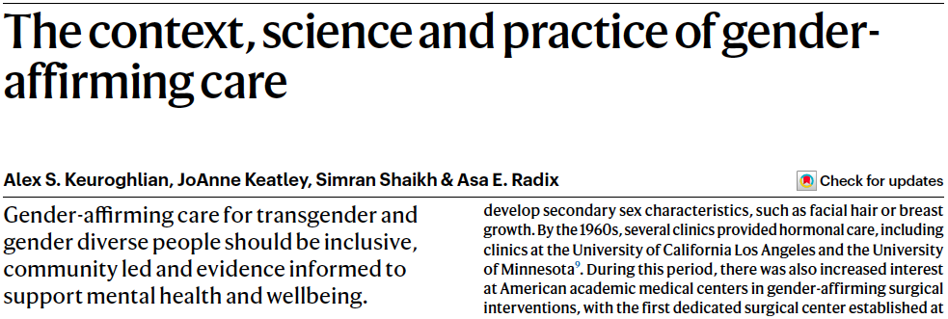


Slide 17
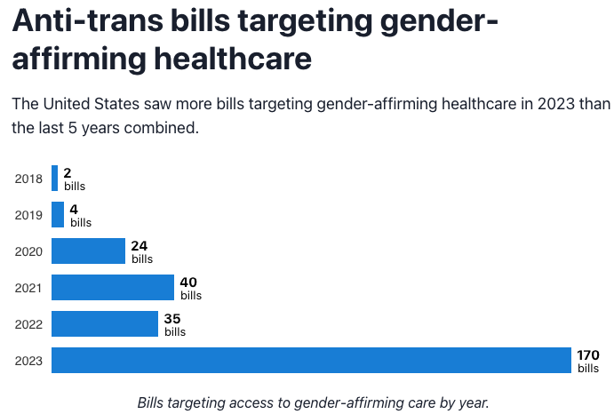
https://translegislation.com/learn

Slide 18

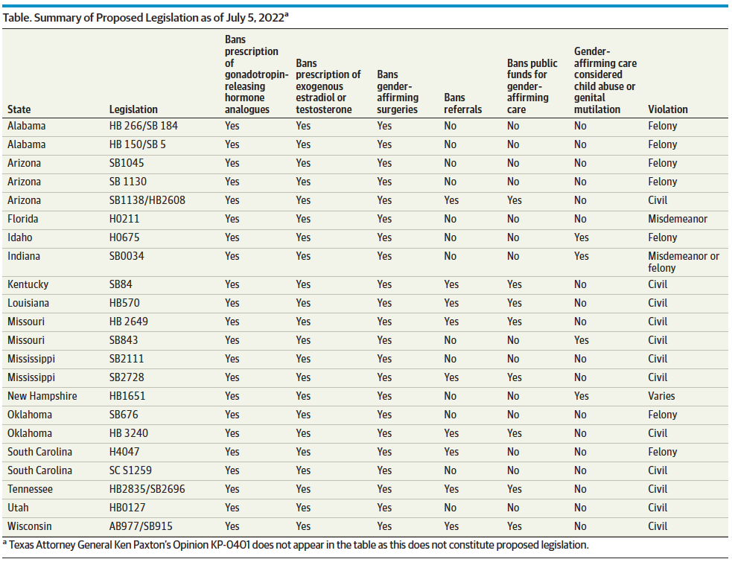

Slide 19
Social Gender Affirmation for Youth Associated with Good Adult Mental Health

Slide 20
Pubertal Suppression Associated with Decreased Lifetime Suicidal Ideation

Slide 21
Gender-affirming Hormones in Adolescence Associated with Better Adult Mental Health

Slide 22
Gender-affirming Surgeries Associated with Decreased Odds of Suicide Attempts

Slide 23
Gender-affirming Hair Removal Associated with Decreased Suicidal Ideation

Slide 24
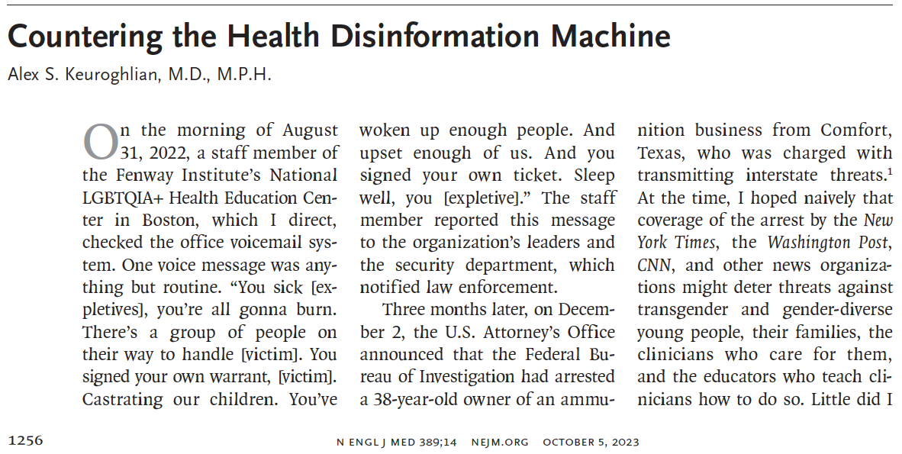
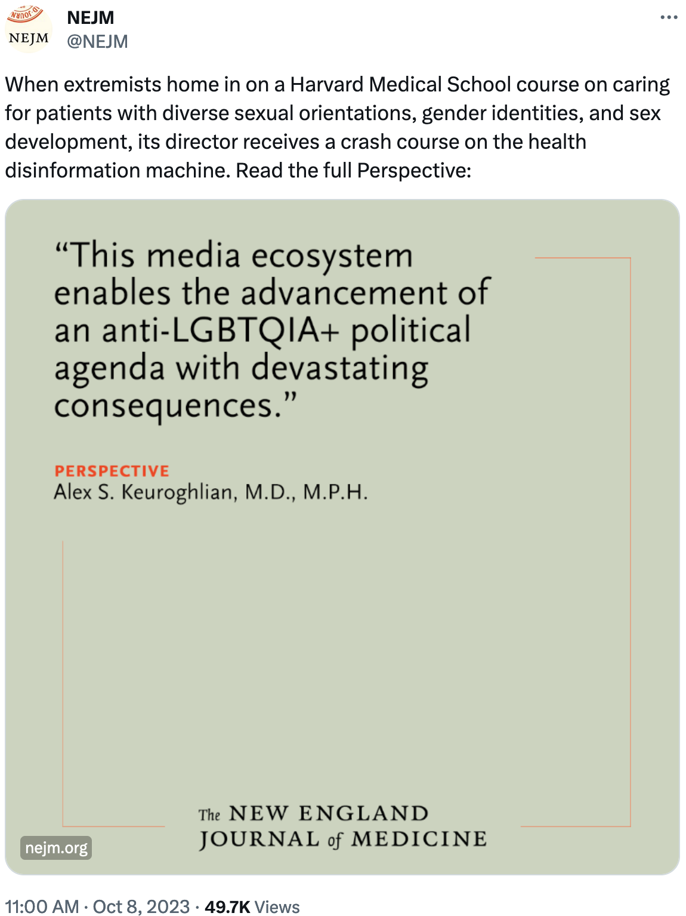

Slide 25






2023 IND510M.3 Disinformation Campaign

Slide 26

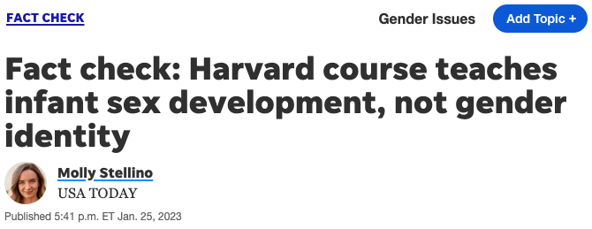


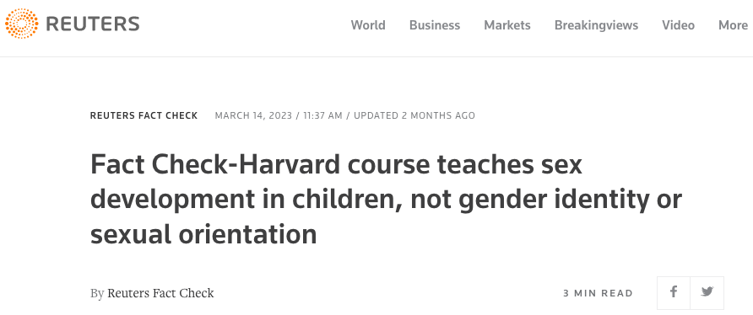

Fact-checking Response by Reputable Journalists

Slide 27
Understanding “Detransition” and Dynamic Gender Presentations

Slide 28
Understanding “Detransition” and Dynamic Gender Presentations

Slide 29
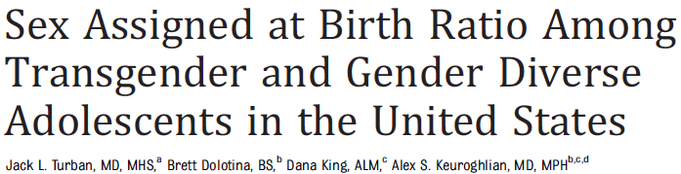
Debunking “Social Contagion” Narrative

Slide 30
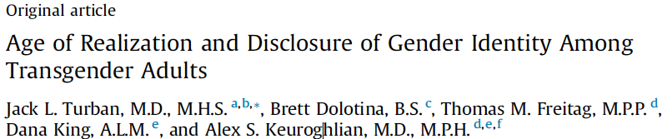

Adolescent Realization of Gender Identity Is Common among Transgender Adults; Disclosure Usually Takes Years

Slide 31
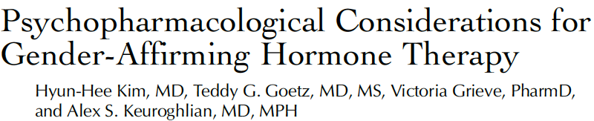
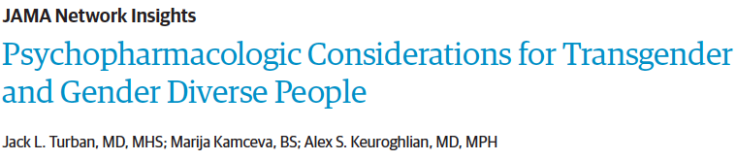
Developing Guidelines for Gender-affirming Health Care

Slide 32
Substance Use Disorders among TGD Adults
Among 452 TGD adults, increased odds of SUD treatment history plus recent substance use were associated with:
  intimate partner violence
  PTSD
  public accommodations discrimination
  unstable housing
  sex work
Higher SUD prevalence increasingly viewed as downstream effects of chronic gender minority stress
Keuroghlian et al. (2015)

Slide 33
Alcohol Research with TGD Populations
Recommendations:
  Being explicit as to whether and how sex assigned at birth, current sex-based physiology, and/or social gender are operationalized and relevant for research questions
  Expanding repertoire of alcohol measures to include those not contingent on sex or gender
  Testing psychometric performance of established screening instruments (e.g., AUDIT) with TGD populations
  Shifting beyond cross-sectional study designs
  Shared decision-making in counseling
Gilbert et al. (2018)

Slide 34
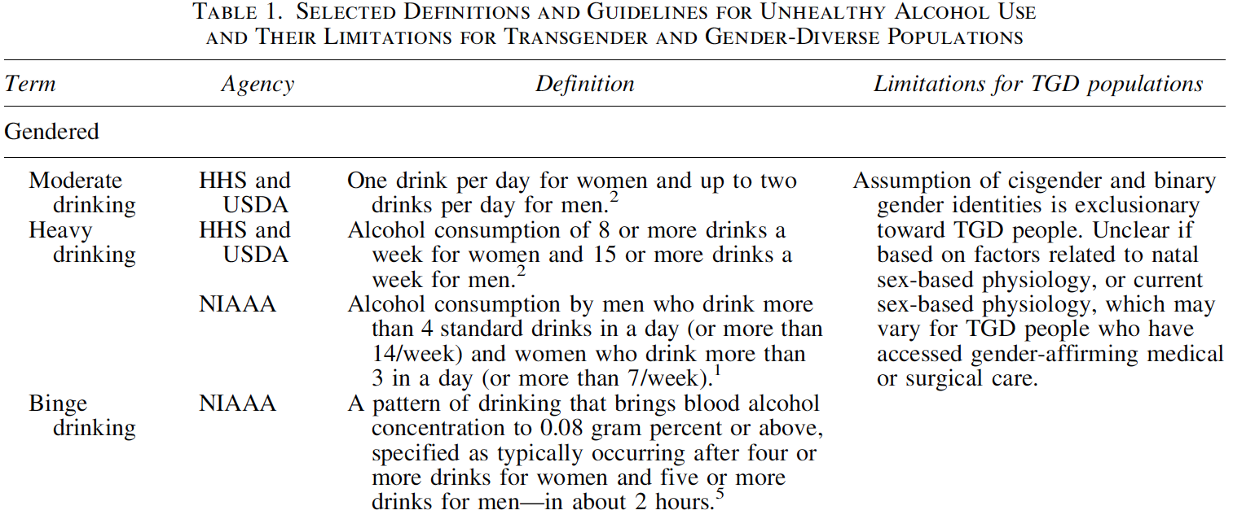
Unhealthy Alcohol Use Guidelines Often Exclude TGD People
Arellano-Anderson and Keuroghlian (2020)

Slide 35
Opioid Use Disorders among TGD People
Transgender middle school and high school students more than twice as likely to report recent prescription pain medication use compared to other students
Transgender adults on Medicare have increased prevalence of chronic pain compared to cisgender (non-transgender) adults.
Transgender patients may be at increased risk post-operatively of developing an opioid use disorder.
                De Pedro et al. (2017); Dragon et al. (2017)

Slide 36
Cognitive-behavioral Therapy for Substance Use Disorders
Adapting selected topics and practice exercises from the manual by Carroll
Focus:
  Coping With Craving (triggers, managing cues, craving control)
  Shoring Up Motivation and Commitment (clarifying and prioritizing goals, addressing ambivalence)
  Refusal Skills and Assertiveness (substance refusal skills, passive/aggressive/assertive responding)
  All-Purpose Coping Plan (anticipating high-risk situations, personal coping plan)
  HIV Risk Reduction
Girouard et al. (2019)

Slide 37
Cognitive-behavioral Therapy for Substance Use Disorders
Possible tailoring for TGD people:
  Minority stress-specific triggers for cravings (e.g., gender identity-related discrimination and victimization, expectations of rejection, identity concealment, and internalized transphobia)
  SUDs as barriers to personalized health goals
  Assertive substance refusal with sex partners; HIV risk from hormone and silicone self-injections; SUDs as barriers to personalized goal of successful gender affirmation
                Girouard et al. (2019)

Slide 39
Body Image Dissatisfaction
TGD people have greater body dissatisfaction than cisgender counterparts
Trans masculine people have comparable body dissatisfaction scores to cisgender boys/men with eating disorders
Drive for thinness greater among trans feminine participants than trans masculine participants
Trans masculine and trans feminine people report greater dissatisfaction not only for gender-identifying body parts but also body shape and weight
              Witcomb et al. (2015); Testa et al. (2017)

Slide 40
Weight-related Disparities and Discussing Body Image
Compared to cisgender peers, TGD students more likely underweight or obese; less likely to meet recommendations for strenuous physical activity, strengthening physical activity, and screen time
In discussing weight loss or gain with TGD patients, messages should be framed to affirm a patient’s gender identity
Asking what words people use to describe their body parts and then using those words with them can help improve rapport and enhance engagement in treatment
                Vankim et al. (2014); Goldhammer et al. (2019)

Slide 41
Affirming Gender Identity in the Setting of Serious Mental Illness
Psychiatric disorders often impede gender identity exploration and alleviation of distress
Need to stabilize psychiatric symptoms for facilitation of gender identity discovery and affirmation
Informed consent-based care
Smith, Goldhammer and Keuroghlian (2019)

Slide 42
Cognitive Processing Therapy for PTSD
Adapting selected components of cognitive processing therapy for PTSD by Resick
Focus:
  Education about posttraumatic stress;
  Writing an Impact Statement to help understand how trauma influences beliefs;
  Identifying maladaptive thoughts about trauma linked to emotional distress;
  Decreasing avoidance and increasing resilient coping.
  Girouard et al. (2019)

Slide 43
Cognitive Triad of Traumatic Stress
SAMHSA (2014)

Slide 44
Cognitive Processing Therapy for Minority Stress
Possible tailoring for TGD people:
  Focus on how gender identity-specific stigma causes posttraumatic stress (e.g., avoidance, mistrust, hypervigilence, low self-esteem);
  Attributing challenges to minority stress rather than personal failings;
  Impact Statement on how discrimination and victimization affect beliefs (e.g., expecting rejection, concealment needs, internalized transphobia);
  Decreasing avoidance (e.g., isolation from TGD community or medical care);
  Impact of minority stress on health behaviors and goals.
                Girouard et al. (2019)

Slide 45
Role of Clinicians in Gender Affirmation Process
Fostering gender identity exploration, discovery and affirmation
Presenting appropriate non-medical and medical strategies for gender affirmation
Assistance in making fully informed decisions regarding personalized gender affirmation process:
  Relevant options
  Benefits/risks
  Capacity for medical decision making/informed consent
  Arranging suitable referrals to care

Slide 46
Focus Areas in Gender-affirming Care
Explore gender identity, expression, and role
Focus on reducing internalized transphobia
Help improve body image
Facilitate adjustment through affirmation process (physical, psychological, social, sexual and reproductive considerations; economic and legal challenges)

Slide 47
Psychopharmacologic Considerations
Gender-affirming hormones
Spironolactone and other vasodilators
Antipsychotics
Mood stabilizers
Serotonergic agents and spontaneous erections
Turban, Kamceva, Keuroghlian (2022)

Slide 48
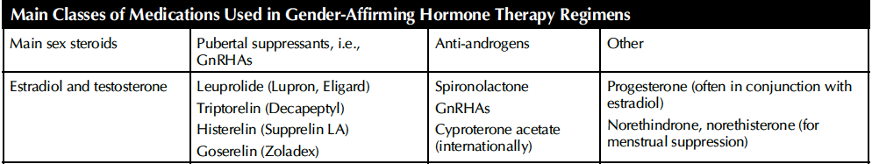
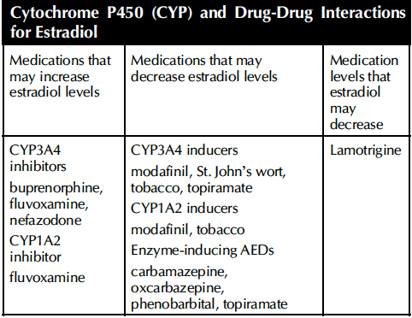
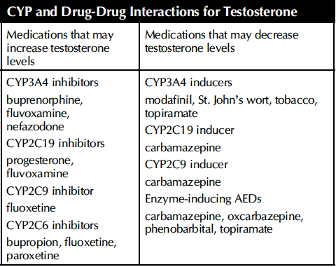
Kim, Goetz, Grieve & Keuroghlian (2023)

Slide 49
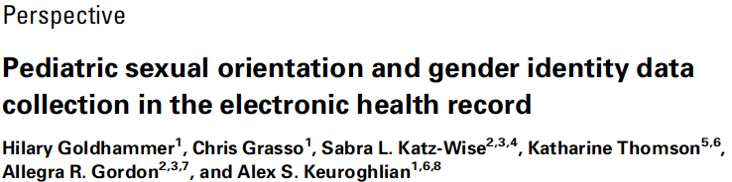
Harnessing Patient Gender Identity Data in Electronic Health Records

Slide 50
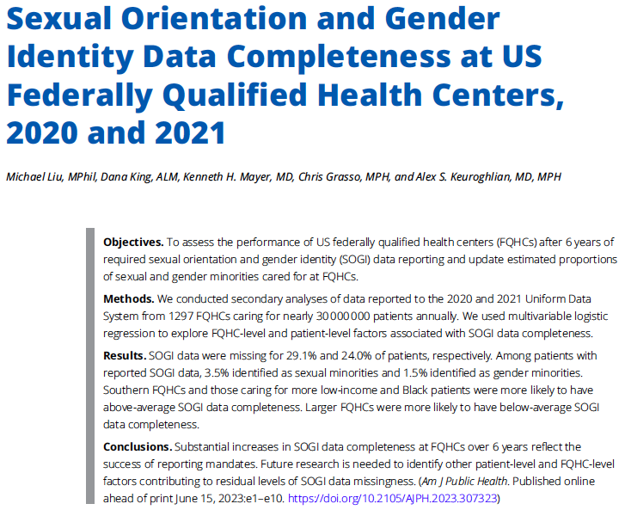

Slide 51

Arabic
Brazilian Portuguese
English
Farsi
Russian
Simplified Chinese
Spanish
Tagalog
Haitian Creole
Polish
Tigrinya
Somali
Vietnamese
SOGI Patient
Pamphlet Translations
Notes:
Link: https://www.lgbtqiahealtheducation.org/publication/sexual-orientation-and-gender-identity-questions-information-for-patients/
Talking Points:
These pamphlets on sexual orientation and gender identity (SOGI) questions can be handed out to patients in waiting rooms or exam rooms.
The pamphlets explain: why your organization is asking about SOGI, what each SOGI term means, and how the information will be kept confidential. The pamphlet comes in several languages.

Slide 52
Pronouns
She/Her/Hers
She is picking up a chart
That chart is hers
They/Them/Theirs
(singular usage)
They are picking up a chart
He/Him/His
He is picking up a chart
Ze/Hir/Hirs
No Pronouns
Her chart is ready now
Their chart is ready now
That chart belongs to them
His chart is ready now
That chart is his
Ze is picking up a chart
Hir chart is ready now
That chart is hirs
[Name] is picking up a chart
[Name’s] chart is ready now
That chart is [Names]

Slide 53
Staff Pronouns
Introducing your pronouns
  This is an important first queue to indicate that you are offering inclusive services
  “Hello, my name is [NAME], my pronouns are [PRONOUNS], my role here is [ROLE].”

Slide 54
Avoiding Assumptions
You cannot assume someone’s gender identity or sexual orientation based on how they look or sound.
To avoid assuming gender identity or sexual orientation:
  Instead of: “How may I help you, Ma’am/Sir?”
  Say: “How may I help you?”
  Instead of: “She/He is here for the visit.”
  Say: “The new patient is here for the visit.”

Slide 55
Anticipating and Managing Expectations
TGD people have a history of experiencing stigma and discrimination in diverse settings
Don’t be surprised if a mistake results in a patient becoming upset
Don’t personalize the reaction
Apologizing when patients become upset, even if what was said was well-intentioned, can help defuse a difficult situation and re-establish a constructive dialogue

Slide 56
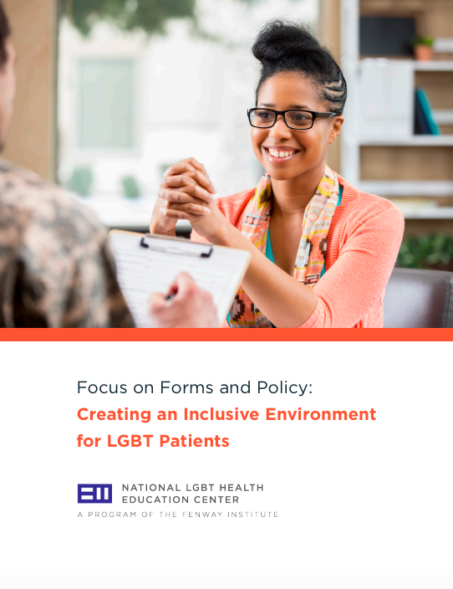
Inclusive Registration and Health History Forms
Avoid these terms… | Replace with…
Mother/Father | Parent/Guardian
Husband/Wife | Spouse/Partner(s)
Marital Status | Relationship Status
Family History | Blood Relatives
Nursing Mother | Currently Nursing
Female Only/Male Only | Allow patients to choose not applicable.

Slide 57
Accountability
Creating an environment of accountability and respect requires everyone to work together
Don’t be afraid to politely correct your colleagues if they make insensitive comments
  “I wanted to let you know that Jesse’s pronouns are they/them. I heard you say she/her, and I wanted to make sure you know for the future.”
  “Those kinds of comments are hurtful to others and do not create a respectful work environment.”
Remember your organization’s mission and vision

Slide 58
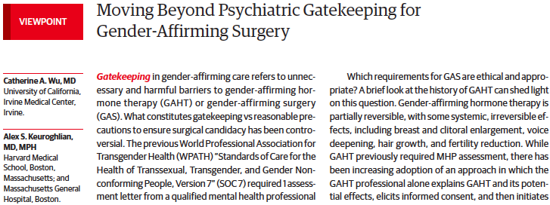

Moving Beyond Psychiatric Diagnosis Requirements

Slide 59
Moving Beyond Psychiatric Gatekeeping of Gender-affirming Care
Uncoupling gender diversity from the stigma of diagnostic classification in clinical practice
Non-diagnosis codes (Z-codes in ICD-10 or Q-codes in ICD-11) that specify “factors influencing health status” may allow reimbursement by third-party payers
Seeking reimbursement for services without a diagnosis (e.g., “evaluation preceding gender-affirming surgical intervention”) and without assumption of distress or psychopathology
                Perlson et al. (2020)

Slide 60

The National LGBTQIA+ Health Education Center provides educational programs, resources, and consultation to health care organizations with the goal of optimizing quality, cost-effective health care for lesbian, gay, bisexual, transgender, queer, intersex, asexual, and all sexual and gender minority (LGBTQIA+) people.
The Education Center is part of The Fenway Institute, the research, training, and health policy division of Fenway Health, a Federally Qualified Health Center, and one of the world’s largest LGBTQIA+ focused health centers.
THANK YOU!
 617.927.6354
education@fenwayhealth.org
8 www.lgbtqiahealtheducation.org
www.acponline.org/fenway

