Slide 1
Next Steps in Addressing Encampments: New CDC Work on Homelessness and Health
Caroline Waddell (she/her), PhD & Jessica Sherman (she/her), PhD, RN
National Health Care for The Homeless Conference and Policy Symposium
May 16th, 2024

Slide 2
Session Objectives
Overview of Denver encampment health and hazard assessment
Sharing successful strategies and approaches when conducting similar work in encampments
Key findings from encampment-related work
Broader implications and interventions
Notes:
We are going to start by giving a general overview of our work in Denver, we will review our methods and show some results, we will end by discussing strategies that were key to our success in the field and how data like these can be used to inform local responses to homelessness.

Slide 3
Background & Methods
Notes:
-Caroline

Slide 4
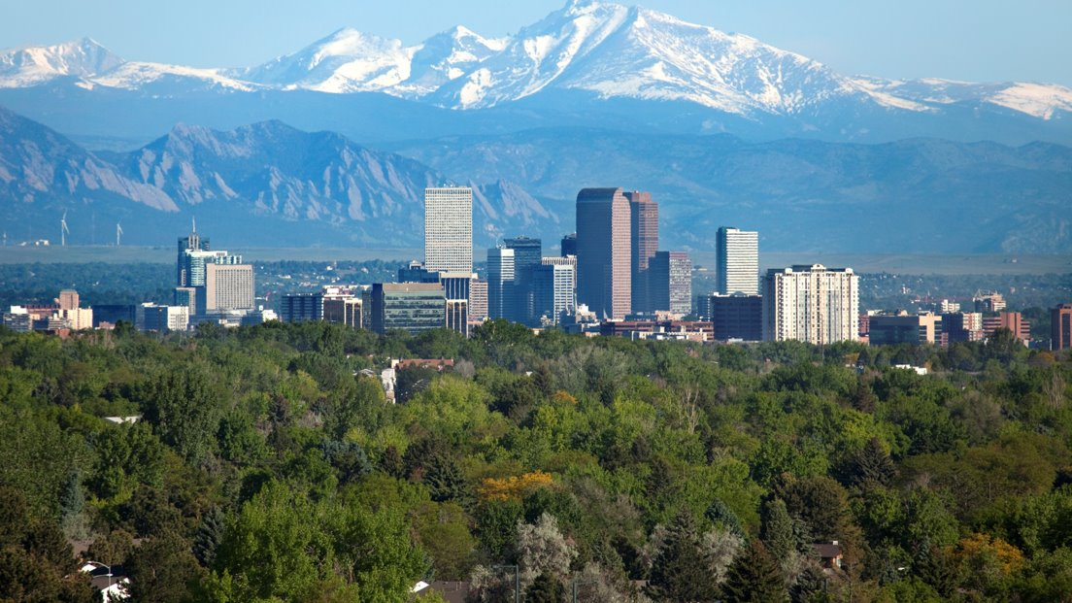
In 2023 Denver, Colorado saw a 31.7% increase in the number of people experiencing homelessness
Notes:
In Denver, Colorado, the number of people experiencing homelessness from 2022-2023 increased by 31.7% according to the annual Point-in-Time count, indicating a need for urgent response.

Slide 5
In 2023 Denver, Colorado saw a 31.7% increase in the number of people experiencing homelessness
This prompted the mayor to declare a state of emergency related to homelessness and housing instability
Notes:
This prompted the mayor to declare a state of emergency related to homelessness and housing instability

Slide 6
In 2023 Denver, Colorado saw a 31.7% increase in the number of people experiencing homelessness
This prompted the mayor to declare a state of emergency related to homelessness and housing instability
The Denver and Colorado Departments of Public Health and Environment requested assistance from the CDC to conduct an epidemiological assessment on the health of and hazards faced by people experiencing homelessness
Notes:
The Denver and Colorado Departments of Public Health and Environment requested assistance from the CDC to conduct public health surveillance on the health of and hazards faced by people experiencing homelessness

Slide 7
Aims
Assess the demographics, health conditions, and barriers to housing among people experiencing homelessness in Denver in fall 2023
Notes:
The aims of this surveillance activity related to assessing the demographics, health conditions, and barriers to housing of PEH in Denver

Slide 8
Aims
Assess the demographics, health conditions, and barriers to housing among people experiencing homelessness in Denver in fall 2023
Describe the characteristics of encampments in Denver and report the health hazards faced by people living in encampments
Notes:
2. To describe the characteristics of encampments and report the health hazards faced by people living in encampments

Slide 9
Aims
Assess the demographics, health conditions, and barriers to housing among people experiencing homelessness in Denver in fall 2023
Describe the characteristics of encampments in Denver and report the health hazards faced by people living in encampments
Provide recommendations for potential health and support interventions and to inform the local response to homelessness
Notes:
And 3, to provide recommendations for potential health and support interventions and to inform the local response to homelessness

Slide 10
Approaches to Conducting Encampment Assessments
Notes:
So we were invited, we had our objectives, and we had about 2 weeks to pull this together and we knew that having the right approach was vital for success. Before beginning the work these are the considerations and ways we went about getting it up and going to be successful, trauma-informed, and helpful not hurtful for PEH

Slide 11
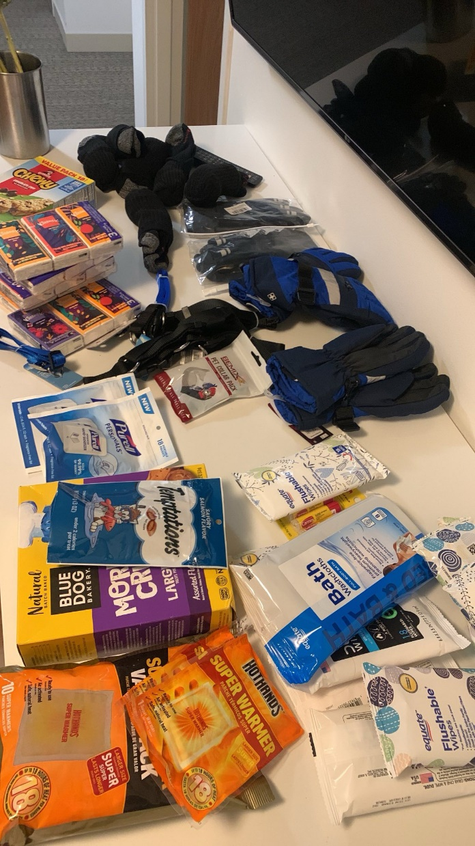
Our Approach
Trained in trauma informed interviewing
Gave participants control over the environment
Handed out supplies, and people could take supplies without participating in survey
Conducted surveys where people experiencing homelessness were staying or accessing services
Compensated participants for time and expertise
Notes:
What were some of the approaches our team took to ensure we using a trauma informed approach?
First the entire team underwent training on trauma informed interviewing and de-escalation. We used active and empathetic listening techniques.
When possible, we gave participants as much control over the environment as possible. We asked where they wanted to sit, we let them tell us where we should sit, we ensured their basic physical needs were met and that they were comfortable
We handed out supplies – and we didn’t hand out just any supplies, we asked people experiencing homelessness and local expert what supplies would be most helpful. We handed out things like tissues, body wipes, pet supplies.
We went to PEH and worked around their schedule. If they had an appointment for services or an other obligation that took precedence
Lastly, we compensated participants for their time and expertise.

Slide 12
Our Approach
Collaborated with local partners to ensure data collected was useful
Interpretation services available
Included check-ins and trigger warnings
Used established, well-validated questions when available
Survey was at a 6th grade reading level
Included visual aids and large print
Notes:
In our work we took a lot of steps to maximize accessibility - our survey was at a 6th grade reading level, we had the CDC interpretation phone available for people who wanted to do the survey in a language other than English. We incorporated visual aids into the survey and used large print.
-Jess

Slide 13
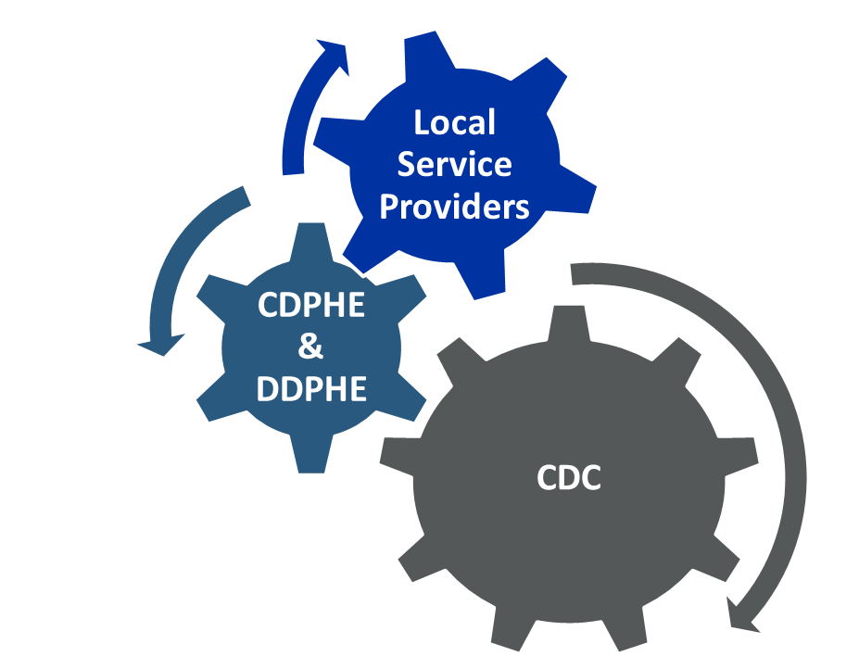
Partnerships were key
Partners:
Community-based homeless service providers
Denver Department of Public Health and Environment (DDPHE)
Colorado Department of Public Health and Environment (CDPHE)
Denver Mayor’s Office
U.S. Interagency Council on Homelessness & Housing and Urban Development
People experiencing homelessness
CDC
CDPHE
&
DDPHE
CDC
PEH
PEH
Notes:
-Jess

Slide 14
Methods and Survey Sites
Notes:
-Caroline

Slide 15
Methods – Health Survey
The CDC field team and health department volunteers interviewed participants at shelters and at encampments
The questionnaire typically took 45 minutes to complete
We asked survey questions verbally
Recorded answers on either printed surveys or on a tablet
Participants were offered a $60 gift card as compensation
Notes:
The questionnaire typically took 45 minutes to complete. Data collectors asked survey questions verbally for all participants and recorded answers on printed surveys or on tablets. We offered use of an interpretation phone line for participants who preferred to take the survey in a language other than English. We also printed visual aids, lists and scales that were referenced in the survey to accommodate different types of information processing and literacy levels.

Slide 16
Methods – Health Survey
The CDC field team and health department volunteers interviewed participants at shelters and at encampments
The questionnaire typically took 45 minutes to complete
We asked survey questions verbally
Recorded answers on either printed surveys or on a tablet
Participants were offered a $60 gift card as compensation
Notes:
The questionnaire typically took 45 minutes to complete. Data collectors asked survey questions verbally for all participants and recorded answers on printed surveys or on tablets. We offered use of an interpretation phone line for participants who preferred to take the survey in a language other than English. We also printed visual aids, lists and scales that were referenced in the survey to accommodate different types of information processing and literacy levels.

Slide 17
Methods – Health Survey
The CDC field team and health department volunteers interviewed participants at shelters and at encampments
The questionnaire typically took 45 minutes to complete
We asked survey questions verbally
Recorded answers on either printed surveys or on a tablet
Participants were offered a $60 gift card as compensation
Notes:
The questionnaire typically took 45 minutes to complete. Data collectors asked survey questions verbally for all participants and recorded answers on printed surveys or on tablets. We offered use of an interpretation phone line for participants who preferred to take the survey in a language other than English. We also printed visual aids, lists and scales that were referenced in the survey to accommodate different types of information processing and literacy levels.

Slide 18
Health Survey Topics
Demographics
Housing status & barriers to housing
Self-reported hazards
Physical & mental health
Forced Displacement
Experience with law enforcement & incarceration
Notes:
Lastly, we collected information about participants experience with law enforcement and history of incarceration and also ascertained their experience of camp sweeps and the impacts of those sweeps.
Just to note – we did also ask about substance use and experiences of violence – but we are not presenting that data here today.

Slide 19
Methods – Hazard Assessment Tool
We created a tool to objectively record the presence of health hazards within encampments
Purpose is to pair observed and resident self-reported hazards to have a more complete understanding of the existing hazards that can be mitigated
Notes:
The questionnaire typically took 45 minutes to complete. Data collectors asked survey questions verbally for all participants and recorded answers on printed surveys or on tablets. We offered use of an interpretation phone line for participants who preferred to take the survey in a language other than English. We also printed visual aids, lists and scales that were referenced in the survey to accommodate different types of information processing and literacy levels.

Slide 20
Methods – Hazard Assessment Tool
Observational only
~1 hour per assessment
Provided supplies (water, wipes, snacks, hand warmers, etc.) while assessing hazards
Interactions with encampment residents provided additional hazard information
Assessor recorded notes back at a stationary point away from the encampment to avoid being intrusive or appearing to take notes about individuals

Slide 21
During the observational hazard assessment, we assessed:
Encampment location & characteristics
Sanitation (organic waste, trash, debris)
Fire hazards (heat sources, flammable materials)
Animals (pets, pests, bugs)
Substance use
General and structural safety
Other hazards (weapons, chemical waste)

Slide 22
During the observational hazard assessment, we assessed:
Encampment location & characteristics
Sanitation (organic waste, trash, debris)
Fire hazards (heat sources, flammable materials)
Animals (pets, pests, bugs)
Substance use
General and structural safety
Other hazards (weapons, chemical waste)

Slide 23
During the observational hazard assessment, we assessed:
Encampment location & characteristics
Sanitation (organic waste, trash, debris)
Fire hazards (heat sources, flammable materials)
Animals (pets, pests, bugs)
Substance use
General and structural safety
Other hazards (weapons, chemical waste)

Slide 24
During the observational hazard assessment, we assessed:
Encampment location & characteristics
Sanitation (organic waste, trash, debris)
Fire hazards (heat sources, flammable materials)
Animals (pets, pests, bugs)
Substance use
General and structural safety
Other hazards (weapons, chemical waste)

Slide 25
During the observational hazard assessment, we assessed:
Encampment location & characteristics
Sanitation (organic waste, trash, debris)
Fire hazards (heat sources, flammable materials)
Animals (pets, pests, bugs)
Substance use
General and structural safety
Other hazards (weapons, chemical waste)

Slide 26
During the observational hazard assessment, we assessed:
Encampment location & characteristics
Sanitation (organic waste, trash, debris)
Fire hazards (heat sources, flammable materials)
Animals (pets, pests, bugs)
Substance use
General and structural safety
Other hazards (weapons, chemical waste)

Slide 27
During the observational hazard assessment, we assessed:
Encampment location & characteristics
Sanitation (organic waste, trash, debris)
Fire hazards (heat sources, flammable materials)
Animals (pets, pests, bugs)
Substance use
General and structural safety
Other hazards (weapons, chemical waste)

Slide 28
Survey Sites
Notes:
Now, I’ll go over some information about the survey sites we visited during the 3-week deployment.
-Caroline

Slide 29
We conducted 20 site visits across Denver.
Notes:
We conducted 24 site visits at 20 sites across Denver.

Slide 30
10
We conducted 20 site visits across Denver.
3 Safe Outdoor Spaces (SOS) 7 Public encampments
10
Shelter
Encampment
Notes:
We conducted 24 site visits at 20 sites across Denver.
We did observations assessments at these 10 encampments
SOS is a temporary supported community

Slide 31
We interviewed 356 participants.
Sheltered = 167
Unsheltered = 189
SOS = 59 Encampment = 130
Notes:
59 people who unsheltered were staying at an SOS site. 128 of those were staying outside

Slide 32
Participant Demographics
Notes:
-Jess

Slide 33
Range: 15-83 years old
Age
46 mean 46 median
Notes:
We spoke with people between the ages of 15 to 83 years old. The average participant was 46 years old.

Slide 34
Gender Identity
32% (n = 113)
64% (n = 230)
3% (n = 11)
⚧
Notes:
Regarding gender identity,
Females = 113 (32%)
Male = 230 (64%)
Transg. Or gender diverse= 11 (3%)
Other = 2

Slide 35
Sexual Identity
Straight/heterosexual
LGBTQ+
Other/Unknown
85.0% (n = 303)
10.5% (n = 37)
4.5% (n = 16)
*LGBTQ+ includes people who identified their sexual identity as lesbian, gay, bisexual, transgender, queer or questioning
Notes:
For sexual identity, the majority of participants identified as strain or heterosexual at 85%, followed by LGBTQ+ at 10.4% and 4.5% of people reporting “other or unknown” as their sexual identity. In further analyses we will analyze sexual identity in a more granular way than just these 3 categories.

Slide 36
Non-Hispanic (NH) race and Hispanic ethnicity
of participants
H
All categories are mutually exclusive. *Of the 105 participants who reported Hispanic/Latinx ethnicity, 16% reported that they are Hispanic and American Indian/ Alaska Native. There were < 5 participants who reported their race as Asian or Native Hawaiian/ Pacific Islander and they are grouped with “other” in this figure. Denver population estimates can be found at Denver County, Colorado - Census Bureau Profile
Notes:
Here we have the breakdown of participants by reported non-Hispanic race and Hispanic ethnicity on the left in blue

Slide 37
Non-Hispanic (NH) race and Hispanic ethnicity
of participants compared to Denver census
Denver Census
Our Sample
All categories are mutually exclusive. *Of the 105 participants who reported Hispanic/Latinx ethnicity, 16% reported that they are Hispanic and American Indian/ Alaska Native. There were < 5 participants who reported their race as Asian or Native Hawaiian/ Pacific Islander and they are grouped with “other” in this figure. Denver population estimates can be found at Denver County, Colorado - Census Bureau Profile
Notes:
Those percentages are compared to the population of Denver on the right in red. We compare the two percentages because sometimes just looking at the base proportions of PEH in your area might not tell the who story. In comparison to the Denver census, we see telling differences in the disproportionate impact of homelessness by race and ethnicity.

Slide 38
Racially and ethnically minoritized populations were disproportionately represented among survey participants
Denver Census
Our Sample
All categories are mutually exclusive. *Of the 105 participants who reported Hispanic/Latinx ethnicity, 16% reported that they are Hispanic and American Indian/ Alaska Native. There were < 5 participants who reported their race as Asian or Native Hawaiian/ Pacific Islander and they are grouped with “other” in this figure. Denver population estimates can be found at Denver County, Colorado - Census Bureau Profile
Notes:
What I want to highlight here is that racially and ethnically minoritized populations were overrepresented in our sample compared to the This trend is reflective of exactly what the plenary speaker discussed – it reflects social and structural inequities that contribute to and perpetuate homelessness, as we think about how to respond to and end homelessness – we have to address these inequities.

Slide 39
Collecting demographic information can help identify disparities that need to be addressed
We interviewed young adults (15 years) through older adults (83 years)
Youth and elderly are becoming increasingly affected by homelessness
Around 15% of participants were sexual or gender minorities, consistent with national data
Racially and ethnically minoritized persons were disproportionately represented among survey participants (higher than Denver census population proportions)

Slide 40
Barriers to Shelter
Notes:
We asked participants if they would be willing to share reasons they prefer not to stay in the shelter and the answer provided rich data that really dispel a lot of the myths about homelessness in general and unsheltered homelessness
-Caroline

Slide 41
Myth: “People just need to get to a shelter”
“Crowding, busy, chaotic, no direction, emotional experience”
“I didn't qualify - some are full. There's not very many, some have waiting list, especially for women…”
“Can't stay with partner. You don't know who's in there and never know what's going to happen. You're bound to get into an altercation.”
“Don't have an ID and they require an ID at the shelter”

Slide 42
Myth: “People are homeless because they want/chose to be”
“Nobody ever thinks you'll end up here... Grief led me to this - lost parents, brothers, fiancé…”
“I wish people were kinder, more gentle, more compassionate, and less judgmental. Not assuming it will never be them. I never thought I'd get here, I worked hard and had what I needed and I'm still here. Many people don't have that, and they have to stay in toxic situations. You have to learn you are still worthy and you're human. Every person should be able to have a roof over their head…”

Slide 43
Myth: “People experiencing homelessness don’t care about their health”
“Having health insurance is a life-or-death situation. If you get judged, you're not going back to a doctor. People will die on the streets to avoid this."
“Mental health services [are] hard to get ahold of and hard to access through the government. It would be helpful to have people you know helping. Have peer support.”
Notes:
Now keeping with the topic of health were going to look at the results of the health survey and the conditions participants face and the health services that are important to them

Slide 44
Health Conditions and Needs
Notes:
Now on to some of the preliminary findings related to self-reported health status. We collected this information to be able to make recommendations about the immediate health needs of the local community of PEH to support the local response.
-Jess

Slide 45
Top new or worsening chronic conditions after experiencing homelessness
None: n = 129 (36.3%)
Chronic Pain: n = 61 (17.1%)
Dental Problems: n = 60 (16.9%)
Back Problems: n = 48 (13.5%)
Hypertension: n = 43 (12.1%)
Mobility Problems: n = 36 (10.1%)
Self-reported conditions; top 5 selected by participants; multiple selections allowed
Denominator is total number of participants (n = 356)
Notes:
Around 64% of participants reported that they had a new or worsening chronic conditions after experiencing homelessness. The most reported chronic condition after experiencing homelessness were chronic pain followed by back problems, dental problems, hypertension & mobility issues

Slide 46
There were no differences in chronic health conditions reported by homelessness setting
None: n = 129 (36.3%)
Chronic Pain: n = 61 (17.1%)
Dental Problems: n = 60 (16.9%)
Back Problems: n = 48 (13.5%)
Hypertension: n = 43 (12.1%)
Mobility Problems: n = 36 (10.1%)
Self-reported conditions; top 5 selected by participants; multiple selections allowed
Denominator is total number of participants (n = 356)
Notes:
Around 64% of participants reported that they had a new or worsening chronic conditions after experiencing homelessness. The most reported chronic condition after experiencing homelessness were chronic pain followed by back problems, dental problems, hypertension & mobility issues

Slide 47
Top new or worsening mental health conditions after experiencing homelessness
None = 149 (41.9%)
1. Depression: n = 123 (34.6%)
2. Anxiety: n = 109 (30.6%)
3. PTSD: n = 69 (19.4%)
4. Substance Use Disorder: n = 34 (9.6%)
5. Bipolar Disorder: n = 33 (9.3%)
Self-reported conditions; top 5 selected by participants; multiple selections allowed; denominator is the total number of participants (n = 356). PTSD = Post-traumatic Stress Disorder.
Notes:
Around 58% of participants reported that they had at least one NEW or WORSENING mental health conditions after experiencing houselessness. Depression and anxiety were the two most commonly, followed by PTSD, substance use disorder, and bipolar disorder.

Slide 48
Unsheltered participants reported anxiety and substance use disorder at higher rates than people who were sheltered
None = 149 (41.9%)
1. Depression: n = 123 (34.6%)
2. Anxiety: n = 109 (30.6%)
3. PTSD: n = 69 (19.4%)
4. Substance Use Disorder: n = 34 (9.6%)
5. Bipolar Disorder: n = 33 (9.3%)
Self-reported conditions; top 5 selected by participants; multiple selections allowed; denominator is the total number of participants (n = 356). PTSD = Post-traumatic Stress Disorder.
Notes:
Around 58% of participants reported that they had at least one NEW or WORSENING mental health conditions after experiencing houselessness. Depression and anxiety were the two most commonly, followed by PTSD, substance use disorder, and bipolar disorder.

Slide 49
Top types of infections in the past year
% n
Respiratory Infection 38% (134)
General Skin Infection 21% (76)
Ears/Nose/Throat Infection 16% (57)
Gastrointestinal Infection 10% (37)
Ectoparasite Infection 10% (37)
*Denominators: total number of participants (n = 356)
Notes:
We asked participants about any infections they had in the past year. We offered options including general infection categories if they didn’t know the specific pathogen or diagnosis. In total, 65% of participants had some form of infection in the past year. The most reported type of infection was respiratory, with over 30% participants reporting a general respiratory infection, followed by skin infection, ENT infection, GI illness and ectoparasite infection.

Slide 50
People who were sheltered were more likely to report ectoparasite infection compared to unsheltered people
% n
Respiratory Infection 38% (134)
General Skin Infection 21% (76)
Ears/Nose/Throat Infection 16% (57)
Gastrointestinal Infection 10% (37)
Ectoparasite Infection 10% (37)
*Denominators: total number of participants (n = 356)
Notes:
We asked participants about any infections they had in the past year. We offered options including general infection categories if they didn’t know the specific pathogen or diagnosis. In total, 65% of participants had some form of infection in the past year. The most reported type of infection was respiratory, with over 30% participants reporting a general respiratory infection, followed by skin infection, ENT infection, GI illness and ectoparasite infection.

Slide 51
Top requested medical services and supplies
n (%)
Eye Care 131 (37%) Dental Care 95 (27%)
Mental Health Care 56 (16%)
Pain Management 54 (15%)
Over the Counter Medications 49 (14%)
Notes:
The top requested medical services and supplies were related to eye care and dental care… followed by mental health care, pain management and over-the-counter medications.

Slide 52
Collecting health information can help identify immediate needs or gaps for intervention and support
Similar health conditions by homelessness setting
Around a quarter of participants reported chronic pain and dental problems
Over half of participants experienced depression or anxiety
Respiratory infections were the most common infections reported
Dental care and pain management were in the top requested medical services (in line with top chronic conditions)

Slide 53
Incarceration
Notes:
We asked about incarceration history knowing that this can sometimes impact someone’s eligibility for services or employment which can lead to housing loss.
-Jess

Slide 54
In our sample, 73.3% (n = 261) people reported a history of incarceration in their lifetime
%
n
Jail 83% (217)
Prison 42% (109)
Youth Detention 15% (39)
Psychiatric Hold 9% (24)
ICE Detention 1.5% (4)
*ICE is Immigration and Customs Enforcement; denominator is the total number of participants that reported a history of incarceration (n = 261); categories are not mutually exclusive
Notes:
I don’t need to tell anyone in this room that this is not a coincidence. In the US context of mass incarceration and sentencing and policing policies that are rooted in white supremacy, this is one the social and structural inequities that contribute to racially and ethnically minoritized individuals disproportionately experiencing homelessness this is one of them.

Slide 55
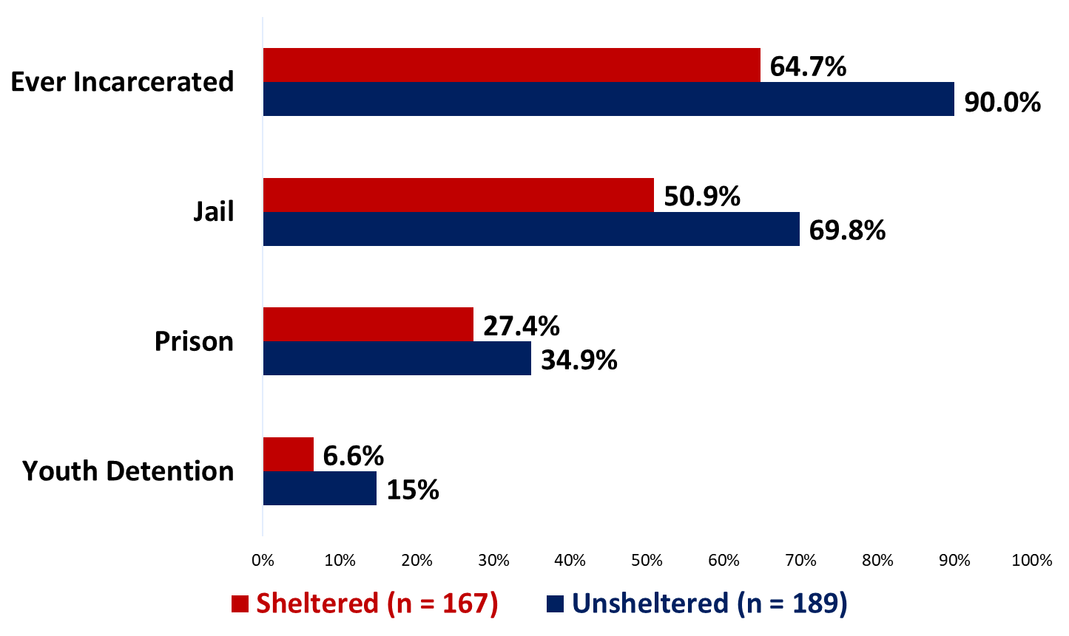
Participants who were unsheltered were more likely to report a history of incarceration
aOR = 3.27
95% CI = 1.82 – 6.02
aOR = 2.31
95% CI = 1.45 – 3.70
aOR = 2.44
95% CI = 1.18 – 5.40
*Models adjusted for age, time since experiencing homeless, and demographics
Notes:
Over 70% of participants reported a history of incarceration in their lifetime. Most reported being held in a jail facility, followed by prison. 10% of people reported being held in a youth detention facility at one point in their life and a smaller percentage reported either being previously put on a psychiatric hold or in and ICE detention facility.

Slide 56
Self-reported incarceration history was a commonly reported barrier to accessing housing services
“…Criminal background 5 years ago, good credit. But criminal history made it so people don't want to rent to me…”
“Filled out DHA housing, was on waitlist and denied based on criminal record. Waiting on appeals to expunge record.”
“Incarceration history excludes me from housing assistance.”
Notes:
22 people self-reported that incarceration history was a barrier to permanent supportive housing services. We are currently analyzing the qualitative findings and will know more details about the overall themes related to barriers to housing soon.

Slide 57
Why collect information about housing status and incarceration history?
Highlights intersectionality of these topics
Can provide evidence about the need for better systems to support people exiting incarceration

Slide 58
Preliminary Data: Encampment Sweeps
Notes:
In this last section, I’ll review some of the early information we have analyzed related to encampment closures, sweeps or involuntary displacements. This refers to the forced disbanding of homeless encampments on public property and the. removal of both homeless individuals and their property from that area. I will refer to all of these by the term “sweep(s)”
-Caroline

Slide 59
Proportion of participants who experienced an encampment sweep while living in Denver
Sheltered: 20%
*Denominator is all those that were experiencing sheltered homelessness (n = 167)
Notes:
20% of participants who were staying in a shelter when they were interviewed had experienced a sweep during their time in Denver.

Slide 60
Proportion of participants who experienced an encampment sweep while living in Denver
Sheltered: 20%
Unsheltered: 58%
*Denominators are all those that were experiencing sheltered (n=167) or unsheltered (n=189) homelessness
Notes:
58% of participants who were unsheltered when they were interviewed had experienced a sweep during their time in Denver.

Slide 61
Average time since last encampment sweep experienced
Sheltered: 1 year
Notes:
The last encampment sweep experienced by most participants who were sheltered at the time of the interview was around 1 year prior.

Slide 62
Average time since last encampment sweep experienced
Sheltered: 1 year
Unsheltered: 3 weeks
Notes:
The last encampment sweep experienced by most participants who were unsheltered at the time of the interview was around 3 weeks prior.

Slide 63
Percent of law enforcement interactions related to encampment sweeps
Sheltered: 12%
*Denominators are all those that were experiencing sheltered (n=34) or unsheltered (n=74) homelessness AND had law enforcement contact in the last month.
Notes:
We asked participants if they had any interaction with law enforcement in the past 3 months. Of the participants who DID report police interaction…
12% of those interactions were related to an encampment sweep for people who were sheltered at the time of the survey

Slide 64
Percent of law enforcement interactions related to encampment sweeps
Sheltered: 12%
Unsheltered: 45%
*Denominators are all those that were experiencing sheltered (n=34) or unsheltered (n=74) homelessness AND had law enforcement contact in the last month.
Notes:
45% of those interactions were related to an encampment sweep for people who were unsheltered at the time of the survey
sheltered at time of survey & law enforcement contact = 34 (4 due to sweeps)
Sheltered at time of survey & law enforcement contact = 74 (33 due to sweeps)

Slide 65
Impacts reported from experiencing a sweep
Notes:
Finally, we asked participants if they could share the impacts from experiencing an encampment sweep. The treemap here shows themes reported by participants. The larger boxes represents topics that were most reported. The six most commonly reported impacts of sweeps included losing survival items, important documents, sentimental items or a phone. Also, participants reported experiencing emotional distress and commonly being separated from family or community.

Slide 66
Comparing Hazards Between SOS’s and encampments
Notes:
Shifting gears, a little – I will share some information on self-reported hazards faced by people experiencing homelessness in Denver Co.
-Caroline

Slide 67
We asked all individuals experiencing unsheltered homelessness to rate their concern level about different types of hazards related to living outside
Weather
Pests
Injuries
Waste and Debris
Emergency Preparedness
Interpersonal
Notes:
We asked all individuals experiencing unsheltered homelessness to rate how concerned they were about different types of hazards related to living outside including… [list topics on the slide]

Slide 68
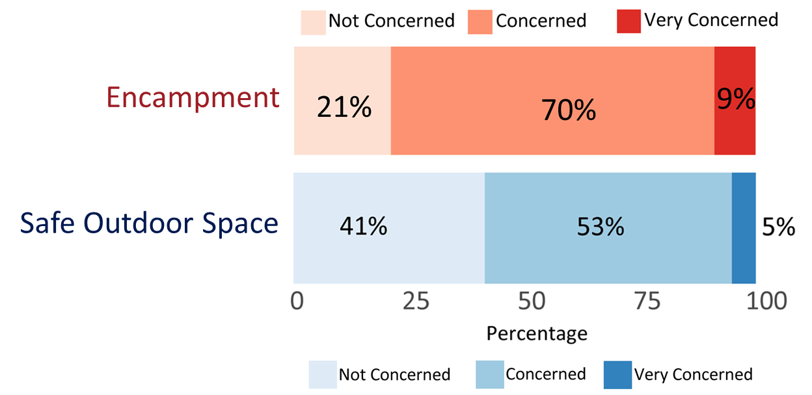
A lower percentage of people living in Safe Outdoor Spaces (SOS) reported being concerned about hazards
χ² = 6.8, p < 0.001
n = 128
n = 59
N = 189
Notes:
The different shades of red are the responses from people staying in encampments, and on the different shades of blue will be responses from people staying at SOS sites. This is the overall hazard score – so the total from all the different sections of the hazard score I showed you a few minutes ago. You can see here that 21% of people in encampments were not concerned about hazards compared to 41% in the safe outdoor space

Slide 69
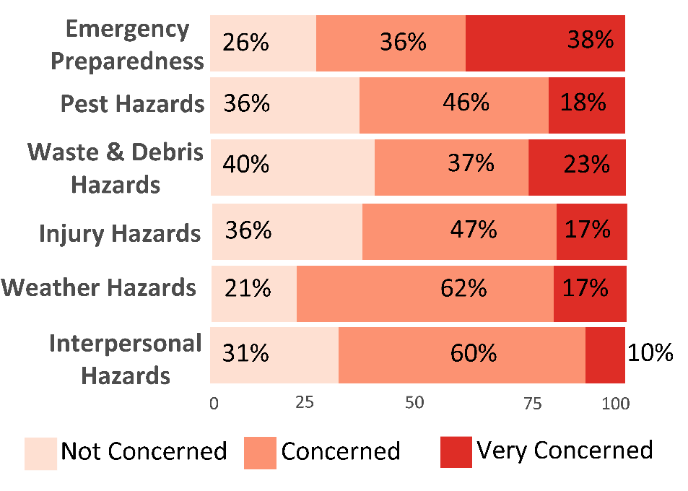
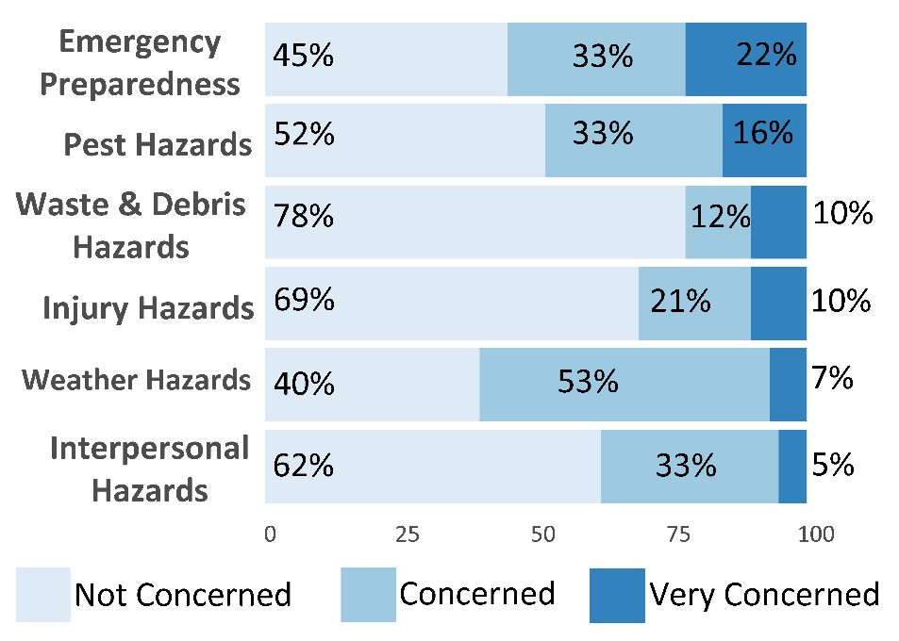
People living in Safe Outdoor Spaces (SOS) reported lower average concern for hazards from all categories (except pests and bugs)
Encampments
SOS
(n = 128)
(n = 59)
*
*
*
*
*
*
*
*
*
*
*Two sample t-test or Mann-Whitney U test: p < 0.05
N = 189
Notes:
And we saw this same pattern in all parts of the hazard assessment, and that’s what your seeing here. on the left in different shades of red will be responses from people staying in encampments and on the right in different shades of blue will be responses from people staying at SOS sites. Now I want to take you through a specific example.

Slide 70
Preliminary Data: Observed Hazards
Notes:
Shifting gears, a little – I will share some information on self-reported hazards faced by people experiencing homelessness in Denver Co.

Slide 71
Observational hazard assessment summary (N = 10)
We observed Safe Outdoor Spaces to have LESS or FEWER compared to encampments
Trash & debris
Obstructed walkways
Substance use-related materials
Damaged tents or structures at risk of collapse
Fire-starting materials
Weapons (only knives observed)

Slide 72
Participant quote about staying at the SOS:
Have to meet criteria for shelters to be accessible. If married, you have to separate to have anywhere to stay. Staff are apathetic and treat you like a child and a nuisance. Lots of thievery and cannot be safe for a woman alone [at shelters]. I love it here [at the SOS]. The staff genuinely want to help you.
Notes:
Ask audience member to read off quote:

Slide 73
Temporary Supported Communities ≠ Permanent Housing

Slide 74
Participant quote about staying at the SOS:
Now that [I’m] in an SOS space, feels like [I’ve] been forgotten about. Would rather be at the next stage, especially inside, with health concerns.
Notes:
Ask audience member to read off quote:

Slide 75
Wrap-Up
Notes:
-Jess

Slide 76
Long-term Areas for Focus
Address disparities among populations impacted by homelessness
Particularly, socially and historically marginalized populations
Increase access to and provision of mental health services and substance use treatment for people experiencing homelessness
Ensure infection prevention and control measures are offered including recommended vaccines – especially through mobile medicine

Slide 77
Long-term Areas for Focus
Coordinate clinic services to include eye care, dental care, and pain management
Increase opportunities for people exiting incarceration to participate in effective re-entry programs
Mitigate health hazards that may be present in encampments
Reduce the negative effects of encampment closures

Slide 78
We need YOU!
You all have the additional perspective and experience supporting people experiencing homelessness
Connect with us so we can partner in future initiatives
We know that this work takes interdisciplinary and multilevel partnerships and CDC is only a piece of the puzzle
Email us:
specialpopulations@cdc.gov
jsherman@cdc.gov
Notes:
You’re perspective is invaluable

Slide 79
Acknowledgements
CDC Field Team
Caroline Waddell
Jessica Sherman
Cara Drehoff
Perri Callaway
Liesl Hagan
CDC HQ Support
Jay Butler
Katie Pugh
Ian Williams
Emily Mosites
HUD
Richard Cho
Norm Suchar
USICH
Katie Jennings
Notes:
Lastly, I want to highlight the CDC field team, our headquarters support and thank our partners at HUD and USICH who offer incredible subject matter expertise in our work.

Slide 80
Acknowledgements - DDPHE
Jenny Loth Hill
Ella Keenan
Julian Wolff
Chris Christiansen
Jeff Biggs
Jules Wilson
Lizzie Friend
Danica Lee
Leslee Warren
Grace Nelson
Matthew Wilmes
Notes:
We want to thank our partners at the Denver Department of Public Health and Environment for their support, expertise and assistance.

Slide 81
Acknowledgements - CDPHE
Rachel Herlihy
Alexis Burakoff
Briana Sprague
Kristen Marshall
Nicole Comstock
Lauren Duval
LaKia Thomas
Libby Harris
Daiszha Cooley
Natalie Thomas
Morgan Metzger
Robert McGoey
Radhika Ratnabalasuriar
Nick Laramee
William Calawerts
Kaitlin Harame
Leslie Smith
Deniece Waruinge
Sophie Feffer
Haley Klein
Notes:
We would also like to thank our partners at the Colorado Department of Public Health and Environment for the many volunteers who came out in the field with us, for the partnership on this project as well as your incredibly generous support with participant compensation!!

Slide 82
Thank you!

Slide 83
Notes:
This is the skyline of Denver, Colorado

Slide 84
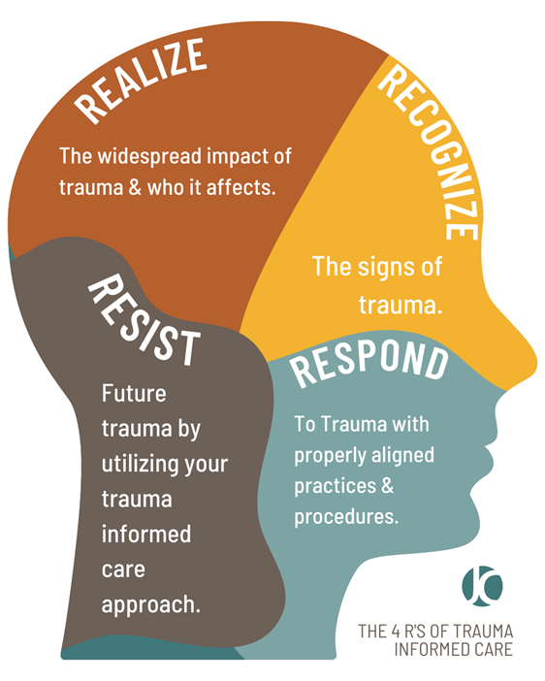
Trauma Informed Approach
The Four R’s
Realize the widespread impact of trauma and who it affects
Recognize signs of trauma
Respond to trauma with properly aligned practices and procedures
Resist future trauma
Image by Michael Fries: https://post-traumatic-stress-disorder-103206.weeblysite.com/product/what-is-ptsd/2?cs=true&cst=custom
Notes:
“Four R’s”:
Realization about trauma and how it can affect people and groups- in this population specifically acknowledging that experiencing homelessness can be a constant trauma
recognizing the signs of trauma,
having a system which can respond to trauma, and that incorporates a trauma-informed approach at all levels
resisting re-traumatization.

Slide 85
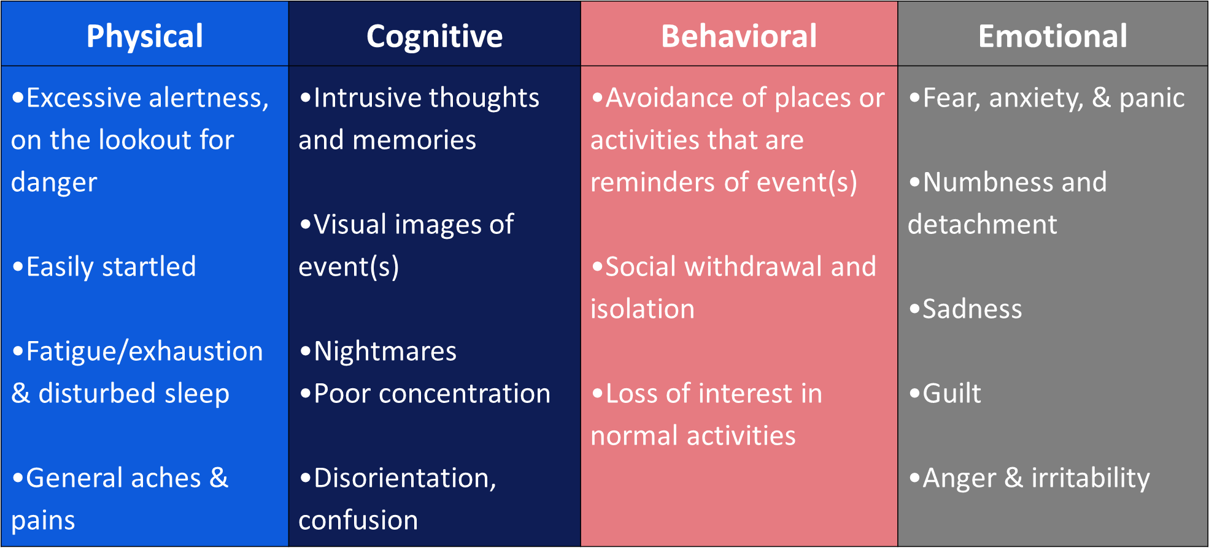
Know the effects of trauma and be prepared to respond appropriately in the field
Notes:
A shout out to our colleague in Denver, Jenny Loth for putting this figure together.
Lots of different ways that trauma can manifest
Be aware of how these may affect your interactions whether you’re conducting interviews or outreach
recognize these as trauma responses and do not take anything personally
It is vital to ensure that all staff/researchers are trained in trauma informed interviewing, escalation techniques, and are aware of the various ways trauma can manifest.

Slide 86
Consent and Agency
Obtain consent
Ensure confidentiality
Build in check points
Maximize choice
Tranparency
Notes:
In general it is best practice to ensure confidentiality, but we also recognize that there may be certain situations that preclude this – such as situations that require mandatory reporting. If you are a mandated reporter it is best to be transparent about this from the beginning.
Make sure participants know they do not have to answer questions, include check-ins prior to discussing sensitive topics and ask if the participant is ok talking about that particular topic. Make sure you also give space for people to talk if they need it.

Slide 87
Keys to successfully integrating a trauma informed approach
Notes:
6 principles of trauma informed approaches
Safety – physical safety, psychological safety
Trustworthiness/transparency – transparent about goal of response, where the data will go, build a relationship
Peer support- support from family or peers
Collaboration and mutuality – working together should be a partnership, level power differentials bw staff and clients
Empowerment – individuals strengths and experiences are recognized and built upon, empowering them to make their own health decisions
Cultural /historical/gender issues – move beyond stereotypes/biases

Slide 88
Survey and Interview Considerations
Acceptable and inclusive language
Avoid jargon
Offer options in multiple languages
Include visual aids
Consider reading level
Consult subject matter experts and those with lived experience
*Scale was made based on the SPARQtool Self-Rated Health Question, Ware, JE. & Sherborne, CD. (1992)

Slide 89
10
3 Safe Outdoor Spaces (SOS) 7 Public encampments
Encampment
Notes:
We visited 10 encampments where two or more people are staying together outside or “unsheltered” in total including 3 safe outdoor spaces and 7 encampments in public spaces around Denver. Safe outdoor spaces are sanctioned camps that can accommodate around 60-70 people in 50 ice fishing tents raised on pallet structures. Residents have to be referred and then accepted to stay at and SOS.

Slide 90
3 Safe Outdoor Spaces (SOS) 7 Encampments
We completed 10 observational hazard assessments.
Notes:
We completed 10 observational hazard assessments. 3 of them were at safe outdoor spaces and 7 were at encampments in public spaces around Denver.

Slide 91
We interviewed 356 participants.
Sheltered = 167
Notes:
We interviewed 356 participants. We talked with 169 people who were staying in the 10 shelters we visited.

Slide 92
We interviewed 356 participants.
Sheltered = 167
Unsheltered = 189
Notes:
We talked with 187 people who reported sleeping outdoors, in a vehicle or in an encampment, at the 10 different encampments we visited.

Slide 93
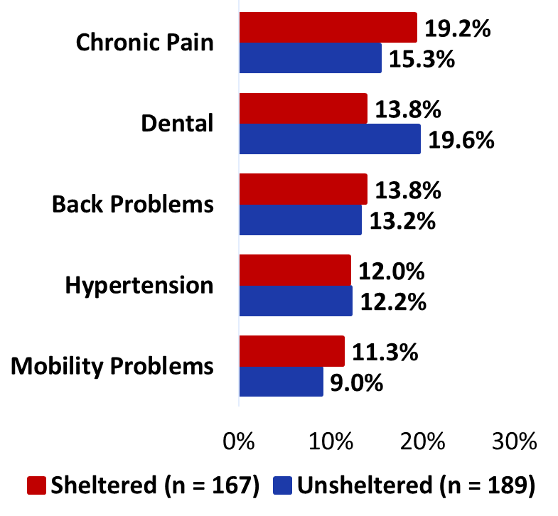
Majority of sheltered (63%) and unsheltered (65%) participants reported a new or worsening physical health condition
GI
GI
Notes:
The survey covered a wide variety of topics. For the rest of the presentation, I’ll focus on results related to infectious diseases reported by participants, specifically skin and soft tissue infections.
A total of 233 people (65%) reported an infection in the last year. Of those, the most commonly reported were respiratory infections, followed by skin infections.
Most illnesses we asked about (including skin infections) were more commonly reported among people who were unsheltered (red bars); ectoparasite and respiratory infections were the exceptions, more commonly reported among people who were sheltered. However, most of these differences were not statistically significant. The only statistically significant difference by housing status was for ectoparasites. People living unsheltered had 4.6 times the odds of reporting an ectoparasite infestation in the last year compared with people who were sheltered.

Slide 94
There were no differences in chronic health conditions reported by homelessness setting
GI
GI
Notes:
The survey covered a wide variety of topics. For the rest of the presentation, I’ll focus on results related to infectious diseases reported by participants, specifically skin and soft tissue infections.
A total of 233 people (65%) reported an infection in the last year. Of those, the most commonly reported were respiratory infections, followed by skin infections.
Most illnesses we asked about (including skin infections) were more commonly reported among people who were unsheltered (red bars); ectoparasite and respiratory infections were the exceptions, more commonly reported among people who were sheltered. However, most of these differences were not statistically significant. The only statistically significant difference by housing status was for ectoparasites. People living unsheltered had 4.6 times the odds of reporting an ectoparasite infestation in the last year compared with people who were sheltered.

Slide 95
Majority of sheltered (55%) and unsheltered (61%) participants reported a new or worsening mental health condition
PTSD = post-traumatic stress disorder

Slide 96
Unsheltered participants reported anxiety and substance use disorder at higher rates than people who were sheltered
aOR = 1.63
95% CI = 1.03 – 2.60
aOR = 2.68
95% CI = 1.25 – 6.23
PTSD = post-traumatic stress disorder

Slide 97
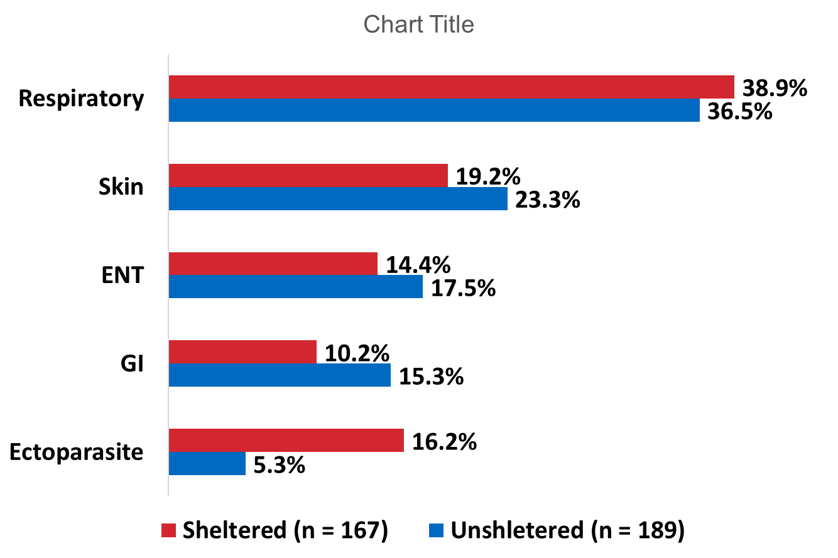
Majority of sheltered (64%) and unsheltered (68%) participants reported an infection in the past year
GI
N = 356; ENT = ear, nose or throat infection; GI = gastrointestinal infection
Notes:
As I said, the survey covered a wide variety of topics. For the rest of the presentation, I’ll focus on results related to infectious diseases reported by participants, specifically skin and soft tissue infections.
Most illnesses we asked about (including skin infections) were more commonly reported among people who were unsheltered (red bars); ectoparasite and respiratory infections were the exceptions, more commonly reported among people who were sheltered. However, most of these differences were not statistically significant. The only statistically significant difference by housing status was for ectoparasites. People living unsheltered had 4.6 times the odds of reporting an ectoparasite infestation in the last year compared with people who were sheltered.

Slide 98
People who were sheltered were more likely to report ectoparasite infection compared to unsheltered people
GI
aOR = 4.5
95% CI = 2.0 -10
ENT = ear, nose or throat infection; GI = gastrointestinal infection
Notes:
As I said, the survey covered a wide variety of topics. For the rest of the presentation, I’ll focus on results related to infectious diseases reported by participants, specifically skin and soft tissue infections.
Most illnesses we asked about (including skin infections) were more commonly reported among people who were unsheltered (red bars); ectoparasite and respiratory infections were the exceptions, more commonly reported among people who were sheltered. However, most of these differences were not statistically significant. The only statistically significant difference by housing status was for ectoparasites. People living unsheltered had 4.6 times the odds of reporting an ectoparasite infestation in the last year compared with people who were sheltered.

Slide 99
Number of encampment sweeps experienced by participants
# of Sweeps | % of participants
≤ 5 | 67%
6-10 | 15%
11-20 | 5%
> 20 | 13%
Notes:
Of the 127 people who reported the number of encampment sweeps they have experienced, a majority had experienced 5 or fewer sweeps, 15% had experienced 6-10 sweeps, 5% experienced 11-20 sweeps and 13% had experienced over 20 sweeps.

Slide 100
Future Hazard Assessment Tool
Goals:
To help jurisdictions assess hazards and needs of people living in encampments
To increase the health and safety of encampment residents, neighbors and workers
To pair identified hazards with potential mitigation solutions
Use an intuitive format that is easy to use in the field
Can be completed either observationally or by incorporating interactions with encampment residents.

