Slide 1
Cluster Care in Safe Havens:
ADL Support in Low-Barrier Shelter
Erin Madden, Breaking Ground
John Betts, Breaking Ground
Kevin Hines, Breaking Ground
HCH2024
PHOENIX, AZ • MAY 13-16, 2024

Slide 2
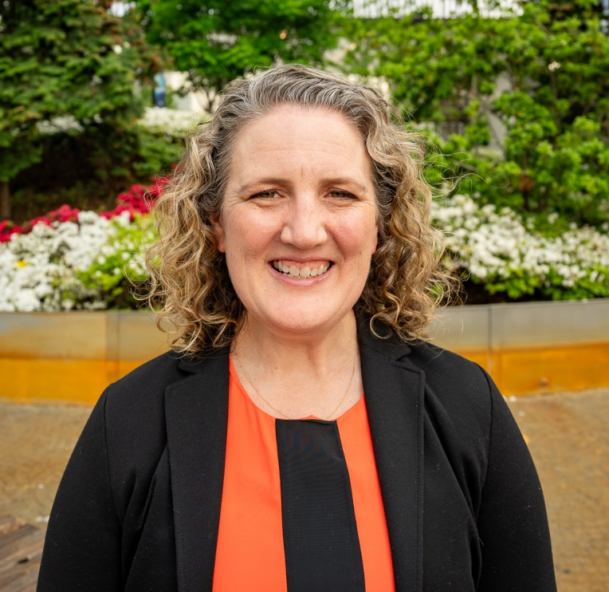
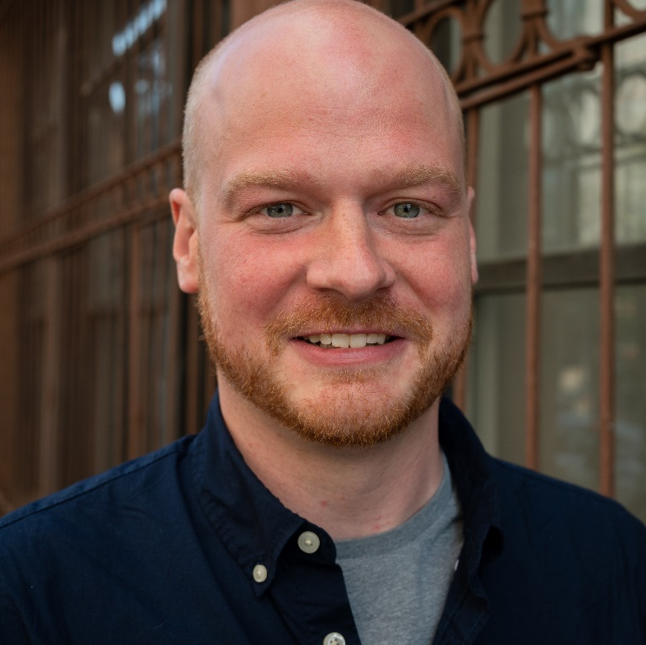
Session Presenters
Erin Madden, LCSW
Vice President, Programs
she/her
John Betts, LMSW
Assistant Vice President, Program Development & Innovation
he/him
Kevin Hines
ADL Team Lead, Cluster Care
he/him

Slide 3
Agenda
Breaking Ground Overview
Homeless Services in New York City
Addressing a System Gap
Cluster Care vs. Traditional HHA Care
Model Development
Implementation/Current State
Success Stories
Outcomes
Successes & Challenges
Future/Next Steps
Q&A

Slide 4
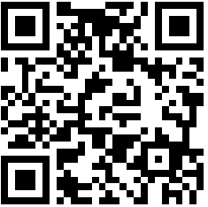
Join at slido.com #2334111
ⓘ Start presenting to display the joining instructions on this slide.

Slide 5
Breaking Ground
Founded in 1990 to acquire and renovate the dilapidated Times Square Hotel into the largest supportive housing site in the country
Today, the largest provider of street outreach, transitional housing, and permanent supportive housing for people experiencing unsheltered homelessness in New York City
700+ staff members
Serving 16,000 vulnerable New Yorkers annually

Slide 6
Breaking Ground
WHAT WE DO AND HOW
Permanent Supportive Housing
Street Outreach
Drop-In Center
Transitional Housing
24/7 in Brooklyn, Queens and Midtown Manhattan
Queens
24/7
6 buildings
600 beds
23 buildings
4,616 homes

Slide 7
A story to get us started…

Slide 8
How familiar does this sound?
Join at slido.com #2334111
Notes:
This doesn’t serve the client, the program, or the system well.

Slide 9
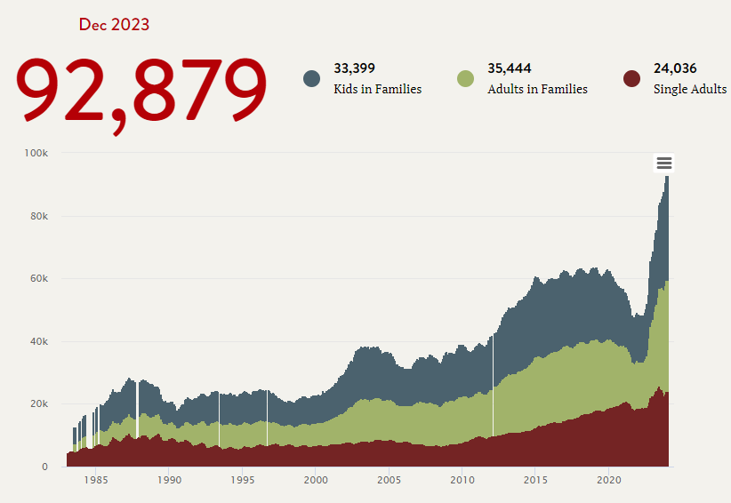
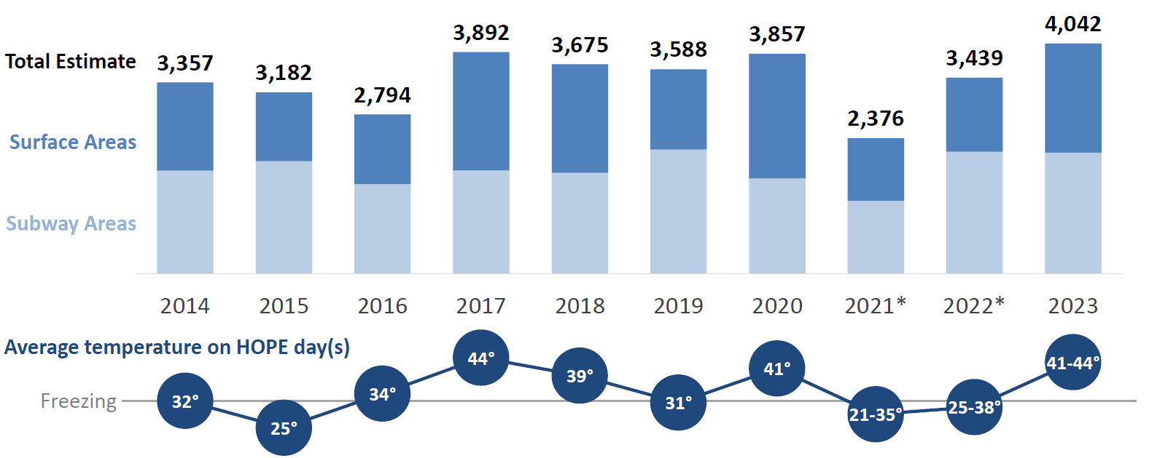
Homelessness in a Right to Shelter City
Sheltered (~95%)
Unsheltered (~5%)
Homeless Outreach Population Estimate (HOPE)
annual count of unsheltered individuals in winter

Slide 10
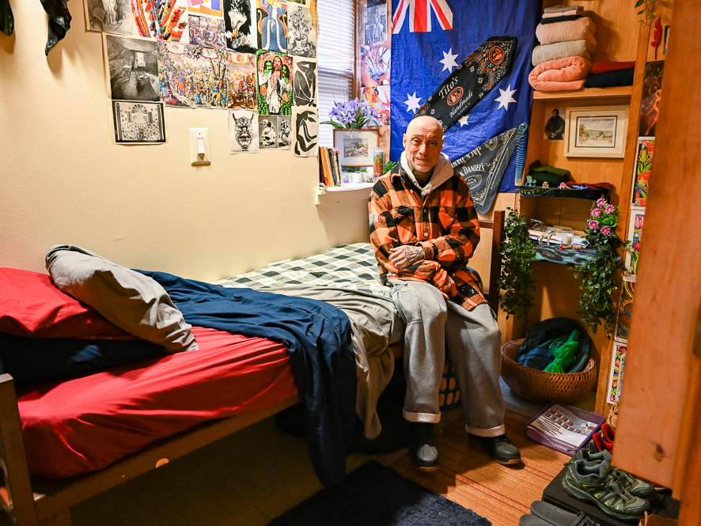
What is a Safe Haven?
Low-Barrier
Private/semi-private rooms
No curfew
Harm reduction model
Allow companion animals
More intensive services (lower client-to-staff ratio)
Only non-negotiable: No violence

Slide 11
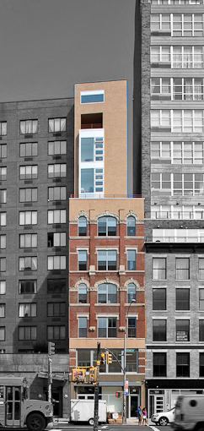
The Andrews Safe Haven
Opened in 2009 (converted from Bowery “flophouse”)
Still the largest safe haven in New York City, providing 146 single rooms for men (and male-identifying individuals) with histories of long-term unsheltered homelessness
Referrals are made by Breaking Ground outreach teams and peer outreach providers
One of just a few safe havens in the city with an elevator (many are in retrofitted walk-ups)
Owned, operated, and maintained by Breaking Ground (unusual for Safe Haven)
Notes:
Services: with vital documents, benefits and entitlements, income and employment, harm reduction and substance use referrals, primary and mental healthcare, and more
Housing specialists work with each individual toward finding appropriate permanent housing that will meet their desires and needs, including affordable housing, permanent supportive housing, and higher levels of care
Staff facilitate therapeutic groups and educational and recreational activities to assist with community-building, skill development, and socialization
Onsite psychiatric care is provided through a partnership with Janian Medical.
Case managers and clinical staff make referrals to medical care in the community and facilitate regular visits from mobile care providers

Slide 12
Comparing Service Settings
Safe Havens
Medical Respite
Chronically homeless, unsheltered
Eligibility Criteria
Does not require hospital care, but needs more care than available in other settings
NYC Department of Homeless Services and associated outreach teams
Referral Source
Usually hospitals or community providers
Social workers, case managers, operations staff, and contracted medical staff
Staffing
Medical and social services staff
Case management, benefits/housing application assistance, psychosocial support, harm reduction, medical/psychiatric care
Medical and social services staff varying in intensity
Services Onsite
13 months
Average Length of Stay
30-90 Days
Permanent (supportive) housing,
higher level of care
Discharge Plan
Family/friend, shelter, (supportive) housing,
higher level of care
Notes:
Undocumented folks basically stay permanently.
Medical respite: if you’ve seen one, you’ve seen one. Medical respite is what those who are not unhoused would get recovering at home.

Slide 13
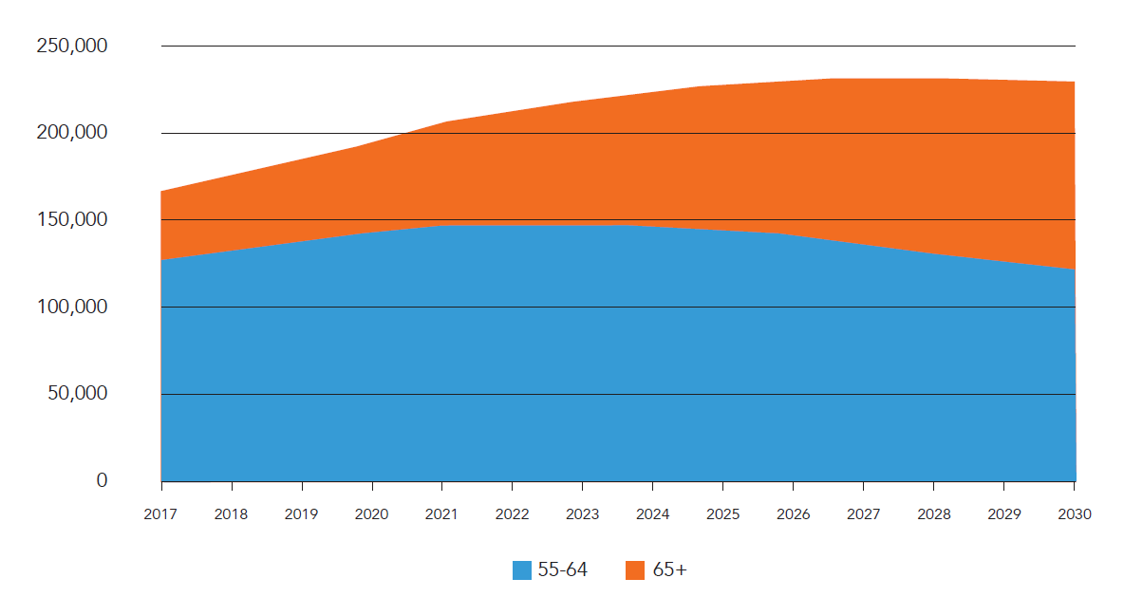
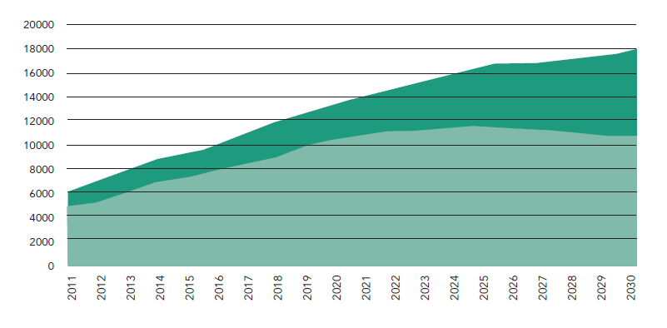
Aging of People Experiencing Homelessness
National
National Projections of Older Homeless Adults: 2017-2030
New York City
Age 55+, 2011-2030
Source: Culhane et al. (2019). The emerging crisis of aged homelessness. Actionable Intelligence for Social Policy. https://aisp.upenn.edu/aginghomelessness/

Slide 14
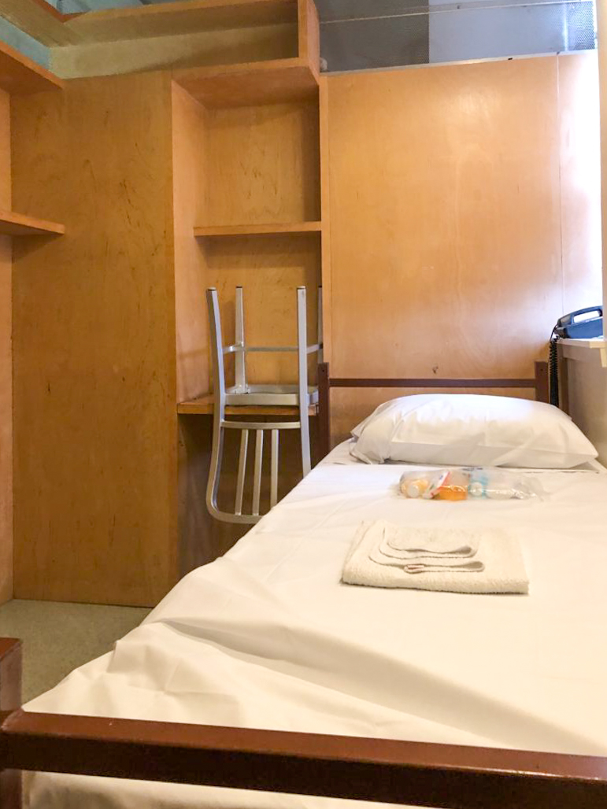
Mind the Gap
Needs greater than shelter, but less than assisted living/nursing home
“Higher levels of care” generally do not follow harm reduction model
Shelter as harm reduction (vs. unsheltered)
Premature aging of people experiencing homelessness
ADL needs that are typically in age 60+
Fluctuating functioning between hospital and outpatient (substance use, medication adherence, supports)
Staff burden and impact on overall community
Regulations vs. reality
What can we do to support people who fall into this gap while not running afoul of regulatory standards?
Notes:
As a form of emergency shelter, Safe Havens are subject to New York State Office of Temporary and Disability Assistance (OTDA) Part 491 regulations. Safe Havens and other emergency shelters are independent settings that are not licensed to provide nursing home or assisted living levels of care. OTDA Part 491 Regulations (18 CRR-NY 491.9) explicitly state that no client may be placed (“without the approval of the office [OTDA]”) who: (1) has a mental or physical condition that makes such placement inappropriate or otherwise may cause danger to himself/herself or others; (2) requires services beyond those that the shelter is authorized to provide by law and regulation, and by an operational plan approved by the office; (3) is likely to substantially interfere with the health, safety, welfare, care or comfort of other residents; (4) is in need of a level of medical, mental health, nursing care or other assistance that cannot be rendered safely and effectively by the facility, or that cannot be reasonably provided by the facility through the assistance of other community resources; (5) is incapable of ambulation on stairs without personal assistance, unless such a person can be assigned a room on a floor with ground level egress or the facility is equipped with an elevator; (6) has a generalized systemic communicable disease or a readily communicable local infection which cannot be properly isolated and quarantined in the facility. In practice, these lines are not as clear. Many residents have a range of chronic medical conditions, serious mental illness, and/or substance use disorder, impacting their ability to care for themselves adequately. However, these residents are often reluctant to enter traditional higher-level care settings (nursing homes or assisted living), despite potentially qualifying, due to perceived loss of freedom and abstinence requirements. Others are in a paradoxical limbo: they do not qualify for nursing home or assisted living care, but they need a higher level of care than traditional shelter services may provide. After falling through gaps in other systems, these folks often end up in Safe Havens. Such a placement is seen as a harm reduction measure: better to be inside than living on the street, even if it is not an ideal setting.

Slide 15
Traditional Care vs. Cluster Care
Traditional Care
Cluster Care

Slide 16
Other Considerations
Traditional (HHA) Model
New Model
Determined by MCO/Medicaid (medical model)
Eligibility Criteria
Holistic assessment of need
Difficult: Administrative burden, eligibility, continuity concerns
Ease of Access
On-site, low-threshold, integrated into service setting, staff referral
Support current level of functioning
Service Goals
Support skill development and prepare for permanent housing
Private residence
Service Setting
Congregate setting
Basic medical skills, medication administration, transfers, safety
Staff Skills
Engagement, person-centered care, motivational interviewing, de-escalation
Implementation Gap
Administrative barriers and model alignment
Time
SOLVEABLE
Notes:
1. The goal for transitional housing settings such as Safe Havens is to prepare clients for independent living. 2. Provision of Home Health Aide services would be dependent on Medicaid coverage. This is a potential barrier to services for the following reasons: a. Undocumented clients (19% of those identified) would not qualify for services. b. Clients in transitional housing often have lapses in Medicaid coverage due to challenges or barriers in the application/recertification processes. 3. Breaking Ground does not provide medical services directly. Long-term HHA services at DHS facilities would be classified as Reasonable Accommodations that require formal approval by DHS. This creates an administrative and procedural hurdle that could interfere with timely connection to services. 4. Many of the services of a Home Health Aide cross a line of client privacy (e.g., dressing and undressing a client, showering, or bathing a client) that Breaking Ground does not otherwise cross in our service provision. 5. While not explicitly captured in the needs assessment, program staff have anecdotally indicated that a significant portion of ADL/IADL issues are worsened by substance use (more than half of identified clients use substances). Frequently, clients are capable of ADLs during periods of forced sobriety (i.e., hospitalization) and are therefore discharged but then require more support once they return to the Safe Haven and start using substances again. Home Health Aide services are not designed to address substance use through a harm reduction model that is consistent with the Safe Haven model. 6. The two domains identified as highest need (housekeeping and laundry) can be addressed through non-medical supports.

Slide 17
Needs Assessment Findings
Programmatic Issues
Cohort
Service disruption creates barrier to housing placement
Early nursing home/assisted living placement
Additional housekeeping due to ADL issues
Use of EDs for ADL issues
~20% of census (n=69)
Average/Median Age: 55.7/59.8
Age Range: 25-81
19% undocumented
29% on internal vulnerability lists
Only 25% had active housing package
56.5% SUD (plurality of alcohol)
Only 15% had refused additional support
Notes:
PDs identified five people in the past year who were placed in Nursing Home/Assisted Living because they could not be accepted back at Safe Havens after hospital discharge. However, the PDs indicated that 80% of these clients could have returned to the Safe Haven with additional support from HHA or assistance with ADLs.
All PDs indicated that staff have provided clean-up services for clients unable to care for themselves.
This occurs at least once a month at all sites.
Toileting, wound issues, general room care issues, and pest infestation were indicated as most common issues that necessitate clean-up services for clients
One PD noted: "Housekeeping staff must complete weekly deep cleaning for clients who do not manage their ADLs properly. We have also experienced a dramatic increase in rat, mice and roach infestations. Our extermination costs have increased as a result.”
All PDs reported that some of their clients use hospital emergency departments to address an ADL or other medical issue created by an inability to care for oneself.
This occurs more than once per month at one site and more than once per week at two other sites
Common reasons for these visits include GI issues, wound care, difficulty breathing, incontinence, difficulty ambulating/falls, and infestation
Age Breakdown
Average Age (for those with available DOBs; n=67/69): 55.7
Median Age (for those with available DOBs; n=67/69): 59.8
Age Range: 25-81
Documentation Status: 19% (n=13) of those identified are undocumented
Vulnerability: 29% (n=20) are on a vulnerability list, developed and maintained by Breaking Ground, of clients at highest risk of death or serious harm to self or others
Impacts on Housing: PDs said that frequent hospital trips and/or other issues created by challenges in caring for oneself interrupted the person's progress toward housing for 42% (n=29) of clients on the list.
Housing Readiness: Nearly 25% (n=17) have an active housing package to facilitate placement in permanent housing.
Substance use: 56.5% (n=39) have an active substance use disorder, with a plurality of these indicating alcohol use
Willingness to engage in services: Of the 34 individuals who responded to the question, only 15% (n=5) had refused additional support. This indicates there is room for engagement around cluster care.

Slide 18
Barthel Index (Shah Version)
Selection
Domains
Present-focused
User friendly
Short
Guide to scoring
Admittedly imperfect for this use case
Chair/Bed Transfers
Ambulation
Stair Climbing
Toilet Transfers
Bowel Control
Bladder Control
Bathing
Dressing
Personal Hygiene (Grooming)
Feeding
Laundry
Housekeeping
For more about the Barthel Index, see:
Nedea, D. (2020). Modified Barthel Index for activities of daily living. MDApp. https://www.mdapp.co/modified-barthel-index-for-activities-of-daily-living-calculator-362/
Physiopedia. (n.d.). In Physiopedia. https://www.physio-pedia.com/Barthel_Index
Notes:
The Barthel Index for activities of daily living was first published in 1965 by Barthel and Mahoney in the Maryland State Medical Journal. The scale and its subsequent modification are meant to be used in the assessment of patient performance (or degree of assistance required) with respect to self-care, sphincter management, transfers and locomotion.
Originally, the index was designed to be used in scoring improvement during rehabilitation of patients with chronic neuromuscular or musculoskeletal disorder and continues to be used so but has also been validated in studies on patient populations with: primary brain tumors and brain metastases (4-7).
Concerns about the Barthel Index mostly revolve around its interpretability as there are several versions of the index and scorings available.
Collin et al. introduced a modification of the index where each domain was scored in 1-point increments with scores ranging from 0 to 20, under the argument that the original scoring system gave a disproportionate impression of accuracy. Collin et al. also reordered the 10 items and clarified the instruction.
Shah et al. retained the original 10 items but proposed five-point rating scales for each item to improve sensitivity to detecting change.
The original Barthel Index scale and the modified versions have been used for in-patient rehabilitation assessments, as a means of monitoring functional changes, mostly in populations recovering after stroke. (https://www.mdapp.co/modified-barthel-index-for-activities-of-daily-living-calculator-362/)
Typically, the assessment takes only minutes to complete and can be a part of a rehabilitation evaluation.
The Barthel Index measures the degree of assistance required by an individual on ten mobility and self-care ADL items
The time taken and physical assistance required to perform each item are used to determine the assigned value of each item
The ten items are scored with a number of points, and then a final score is calculated by summing the points awarded to each functional skill. This allows the examiner to measure a patient’s functional disability by quantifying their performance.
Scores can be assigned either via direct assessment / observation or from reliable interviews with the patient, family, or staff. Research also suggests that the examiner’s “common sense” and clinical experience can be used to assign scores.
The higher the score, the more independent the patient is in completing the measured ADLs. Higher scores also indicate the patient is more likely to return home, with varying degrees of assistance, following hospital discharge.
The lower the score, the more dependent the patient is with ADL completion, and the more skilled care will be required at discharge.
Intended Population
While the Barthel Index is used in many populations, its use is highly recommended in the assessment of individuals with stroke,^{[7]} Parkinson’s,^{[8]} brain injury, cancer,^{[9][10]} COVID-19,^{[11]} patients admitted to the intensive care unit,^{[12]} and with older persons.^{[13]}
Guidelines when completing the Barthel Index include:
Assess and record what a patient actually does, not what you believe they can do.
Allow the patient to complete the functional skills with as much independence as possible, and avoid providing physical or verbal assistance as patient safety allows.
The use of assistive devices or aides is allowed and can be scored as independent.
If the patient requires supervision (e.g. for safety) they cannot be scored as independent.
The best level of data collection, direct testing and/or observation, should be utilised. However, the examiner can also ask the patient, a family member, or other staff for information if needed.
The Barthel Index is not meant to be used as a stand-alone assessment to predict functional outcomes but rather to be part of a complement of assessments to create a full picture of a patient’s ability and rehabilitation potential.
The examiner should also record the amount of time and assistance a patient requires for each of the ten functional skills.
(https://www.physio-pedia.com/Barthel_Index#cite_note-:4-13)

Slide 19
Barthel Index Needs Assessment Scoring
Average score: 88.9/100
Average score with additional domains: 103.2/125
88% (n=61) required regular housekeeping assistance
15 of these had a high need for assistance
Domain | Average Score (Domain Max) | Average Score as % of Domain Max
Housekeeping | 7.97 (15) | 53.1%
Laundry | 6.45 (10) | 64.5%

Slide 20
Needs Assessment | Hospital Perspective
65 hospital staff completed electronic survey
65% (n=42) reported that they had patients who fell into this service gap
Collectively: 130 patients/month (average of 3/month/respondent)
93% of respondents (n=39) had opinion that if additional supports were available, the patient could have been discharged safely to shelter
74% (n=48) reported having to keep someone in the hospital longer simply because of lack of HHA or similar services at shelter
Notes:
Key Findings A total of 65 hospital staff completed the needs assessment survey. Below are a few key findings from that survey: ● 65% of respondents (n=42) reported that they have referred a patient to a homeless shelter, but the shelter or the Department of Homeless Services said the patient was inappropriate for shelter due to medical needs ○ Collectively, respondents indicated that this happens to a total of 130 patients per month, with an average of three patients per month per respondent ○ Of these respondents, 93% (n=39) had the opinion that if long-term home health services had been available in the shelter, some of these patients would have been able to be discharged safely to shelter ● 74% of respondents (n=48) reported having to keep someone in the hospital simply because long-term home health or similar services were not available at the shelter where they were living The survey provided a list of common ADL and IADL needs and asked hospital staff to indicate what their patients typically need support with to be discharged safely. Figure 1 provides a list of those needs and the percentage of staff who indicated that their patients typically need support for each ADL need.

Slide 21
Notes:
Golant, S. (2000). Housing the poor and vulnerable elderly. Shelterforce. Retrieved January 28, 2022, from https://shelterforce.org/2000/01/01/housing-the-poor-and-vulnerableelderly/

Slide 22
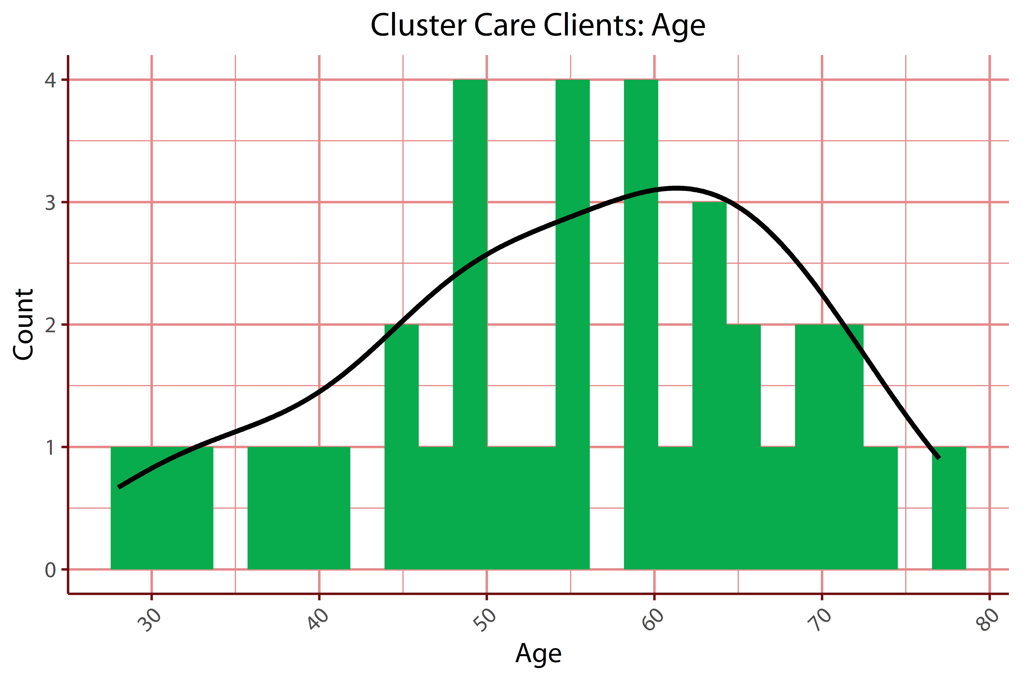
Pilot Implementation
39 enrollments to date
24 currently enrolled (April 2024)
Age: 55.2 (Average)/56 (Median)
Length of Stay prior to Cluster Care: 21.02 (Average)/11.5 (Median) months
Enrollment time: 4.58 (Average)/4 (Median) in months
Notes:
READY TO GO
Ever enrolled: 39
Currently enrolled: 24
Average and Median age of clients enrolled – READY TO GO
Average = 55.2
Median = 56
LOS in safe haven prior to Cluster Care enrollment (per person, report avg) READY TO GO
Average = 21.02 months
Median = 11.5 months
LOS in Cluster Care (avg) READY TO GO
Average = 4.58 months
Median = 4 months

Slide 23
Program Overview
Program Principles
Program Goals
Self-determination
Harm reduction
Trauma-informed care
Housing First
Non-medical intervention
Improve clients’ ability to live independently
Promote improved sense of self-efficacy
Reduce ER visits and longer than necessary inpatient stays for ADL-related issues
Reduce time to placement in permanent housing
Decrease site facility damage caused by clients’ ADL issues
Reduce strain on staff who are unable to provide increased level of support

Slide 24
Budget/Funding
Expenses
Funding
Almost exclusively staffing expenses
1 supervisory position
Scalable line positions
Additional housekeeping staffing/coverage
Not dependent on Medicaid funding/eligibility
Currently, philanthropic funding
Proof of concept builds case for incorporation into existing contracts
Potential funding under new Medicaid 1115 waiver in New York

Slide 25
Staff Training
Motivational Interviewing
Harm reduction
Basic housekeeping/operations functions
Basic Home Health Aide training
CPR/First Aid
De-escalation and Crisis Intervention (using Crisis Prevention Institute’s Nonviolent Crisis Intervention curriculum)
Maintaining appropriate client/staff boundaries
Universal precautions/blood-borne pathogens
EMS activation and working with hospitals

Slide 26
Referral Process
Case Management staff completes referral form and Barthel Index
Referral information provided to Cluster Care Team Leader
Added to Cluster Care schedule
Site Assistant Program Director (clinical staff) reviews and determines eligibility
Initial three-way meeting (Referral source, Cluster Care Team Leader/Coach, Client)

Slide 27
Services
Notes:
Really what the program is trying to do bigger picture is reduce barriers to housing.
ADL Coach
Team Leader Role
SWAT
Examples of Services Provided
● Reminders, Guidance and Coaching on ADLs/IADLs:
○ Showering
○ Grooming
○ Housekeeping
○ Medication adherence
○ Eating/grocery shopping
○ Laundry
○ Delousing
○ Bed bug protocol support
○ Toileting
○ Preparing for independent living/move into housing
● Reminders about case management/onsite medical/psych/other appointments
● Providing escort to appointments when needed
● General psychosocial support
● General advocacy (e.g., at appointments)
● Encouraging participation in groups/other activities
● Transition planning and skills practice
○ Depending on need and plan for housing permanency, staff may also work to
set up Home Health Aide servic

Slide 28
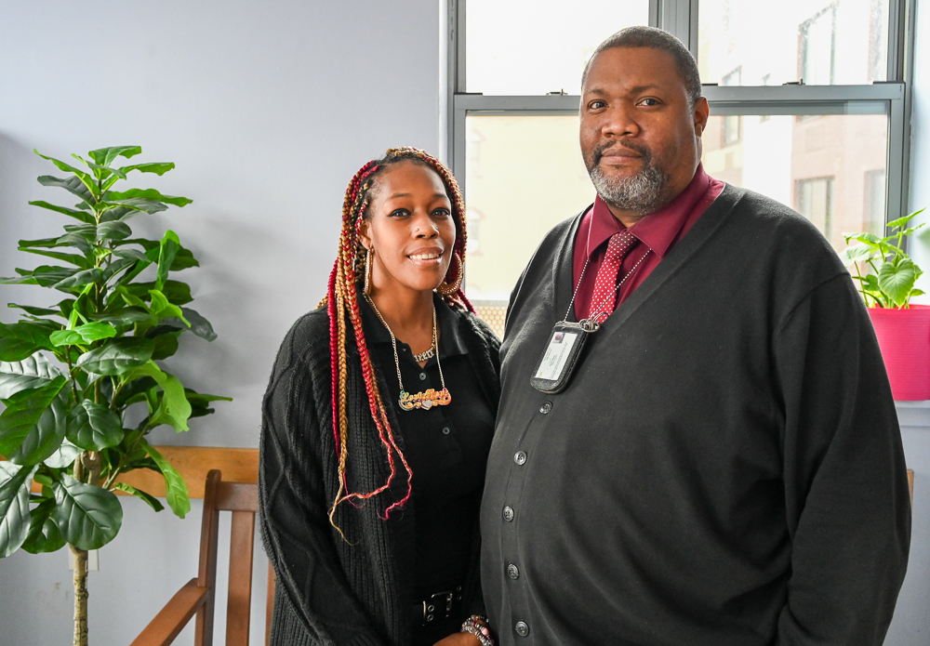
Ongoing Service Delivery
Service Delivery Tools
Service Planning
Progress Notes
Re-Assessments
Care alerts

Slide 29
What other needs would a program like this in your agency/geography need to address?
ⓘ Start presenting to display the poll results on this slide.

Slide 30
EMS Calls

Slide 31
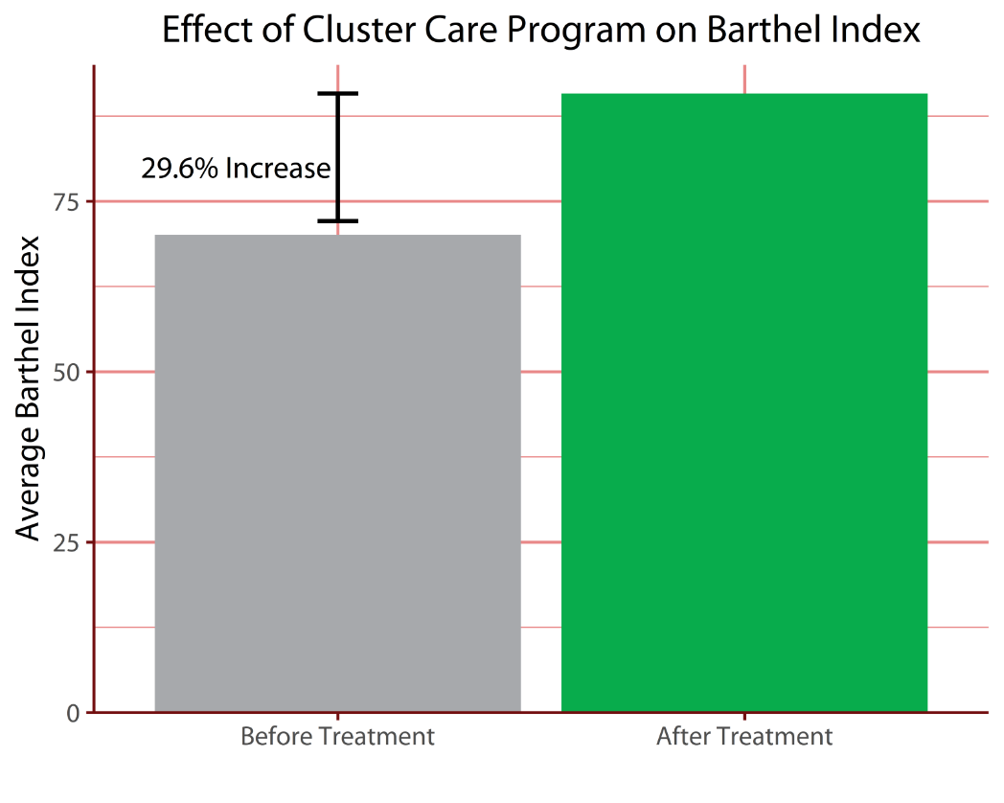
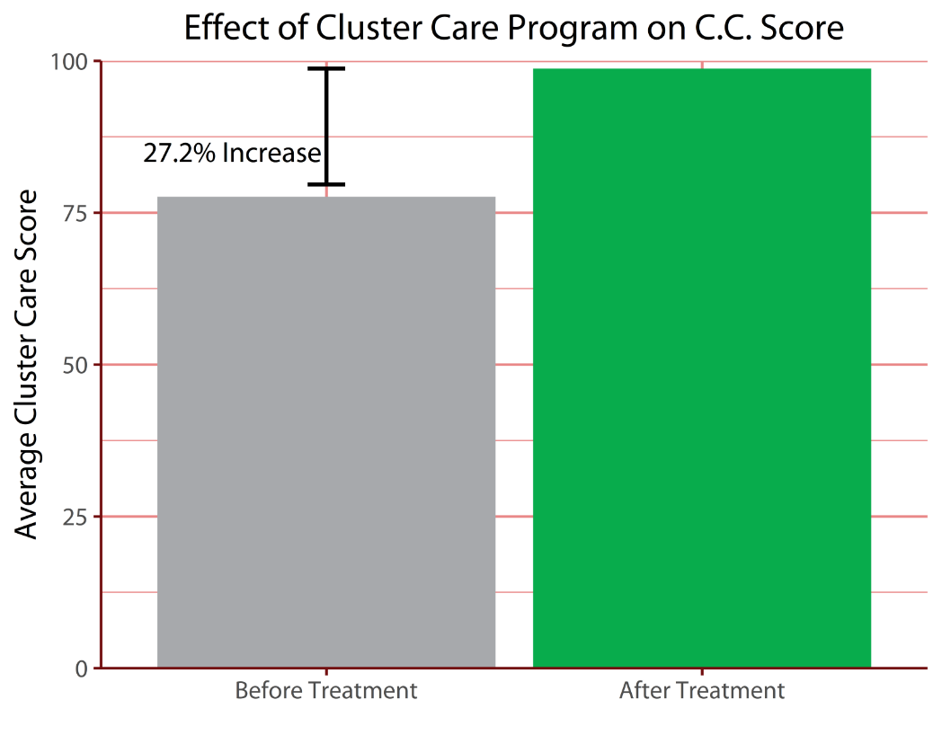
Change in Functioning

Slide 33
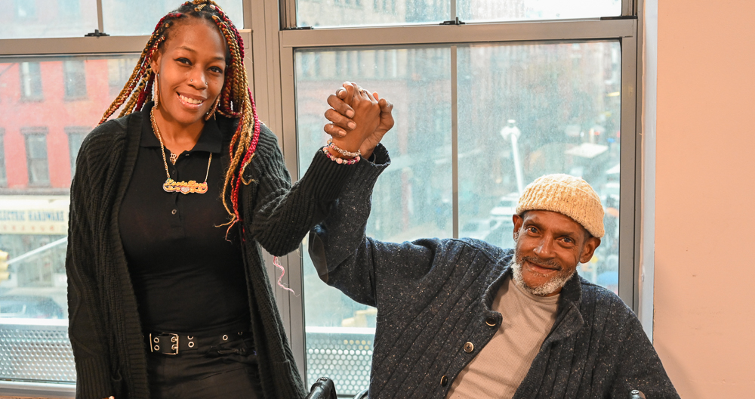
Dulla (McClinton)

Slide 34
Mr. Gomez

Slide 35
Challenges & Future Directions
Challenges
Future Directions
Substance use
Mental health
Continuity of care
Expanded to a second site early 2024
Medicaid 1115 waiver?

Slide 36
If you were interested in starting a program like this, where might you look for funding?
Join at slido.com #2334111

Slide 37
Thanks to:
The Fan Fox & Leslie R. Samuels Foundation, Inc.
Health and Housing Consortium
Janian Medical Care
Hearst Foundation

Slide 38
Q&A
emadden@breakingground.org
jbetts@breakingground.org
khines@breakingground.org

