Slide 1
Maximizing the Synergy of Health Care and Housing
Kevonya Elzia, National Health Care for the Homeless Council
Rachel Briegel, Community Health Plan of Washington
Lowel Krueger, Yakima Housing Authority
Rhonda Hauff, Yakima Neighborhood Health Services
HCH2024
PHOENIX, AZ • MAY 13-16, 2024

Slide 2
Land Acknowledgement
I would like to begin by acknowledging that we are gathered on the traditional territory of the Yavapai-Apache Nation people past and present and honor with gratitude the land itself and the​ Yavapai-Apache Nation.
Go to native-land.ca to find who are the original stewards of the lands you occupy.
Notes:
Yavapai-Apache Nation

Slide 3
Labor Acknowledgement
We recognize the immigrant and American-born workers of African, Asian, and Central and South American descent whose labor remains hidden in the shadows but still contributes to the wellbeing of our collective community.
https://www.solid-ground.org/labor-acknowledgement/
Notes:
I want to acknowledge the reason why we are having this conversation today is a result of the legacy of theft, genocide, & slavery that started with the colonization of this land. The Indigenous People of Turtle Island aka colonized America teach that soul wounds are the cumulative historical trauma that has been passed down through generations. America’s Soul wounds encompass the historical & current injustices that skew our perceptions of ourselves & those with whom we share this land and show up in every clinic or patient room across America. Every story of being judged, dismissed or blamed for one’s medical and social condition stems from these wounds. And although we are clearly not the creator of these wounds, we do own them through inheritance. When it comes to addressing health equity, the manifestation of these soul wounds & subsequent skewed perceptions are what we are tasked with navigating & healing in the ways that we can by being able to acknowledge, hold & address these truths.

Slide 4
NHCHC….What We Do
Notes:
Grounded in human rights and social justice, the NHCHC mission is to build an equitable, high-quality health care system through training, research, and advocacy in the movement to end homelessness.
Training, Research, Advocacy

Slide 5
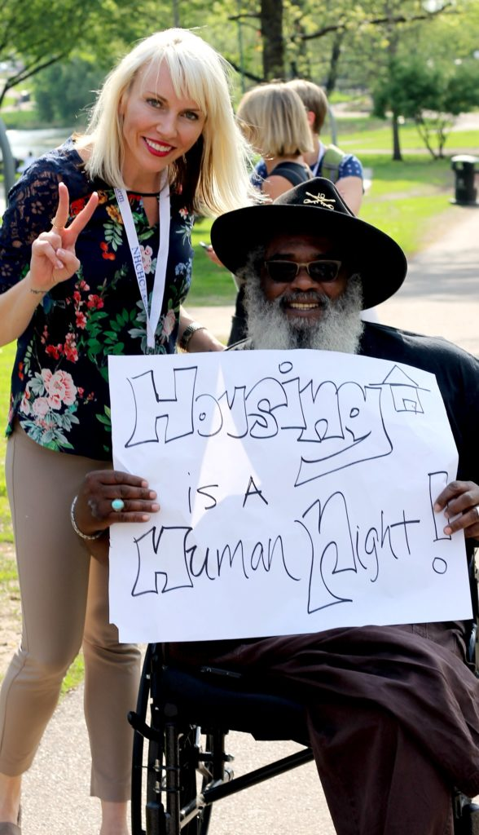
Agenda
The National Health Care for the Homeless Council Kevonya Elzia
Brief overview of the connection between health & housing
Introductions
Community Health Plan/Community Health Network of Washington Rachel Briegel
Yakima Housing Authority Lowel Krueger
Yakima Neighborhood Health Services Rhonda Hauff
Action Items Kevonya Elzia
Question and Answer Session Kevonya Elzia

Slide 6
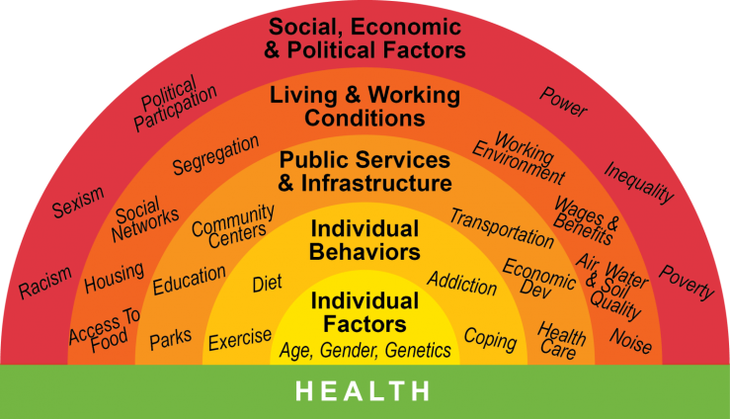
What Do They All Have In Common???
Notes:
Interconnected that all impact and influence each other.
A disruption in any of these can contribute to PTSE especially for identities that are systematically marginalized in our society.

Slide 7
Housing Insecurity Is A PTSE
Persistent Traumatic Stress Environments (PTSE)
Trauma & crisis have become commonplace in our neighbors, communities and workplaces.
Such trauma can be experienced directly, secondarily, or collectively.
Has a negative impact on our mental, emotional, & physical wellbeing
Notes:
Persistent traumatic environments are innate to SDOH work, it’s innate to healthcare work, the intergenerational legacy of colonization has made a healing centered approach a requirement as evidence by the simple facts that despite being a 1st world country with medically advanced technology the well-being of our citizens isn’t even in the top 20 when compared to other countries.
We know that persistent stress has a negative impact on learning, healthy behaviors & mental health. The fact that a person’s zip code is a greater predictor of life expectancy than biology clearly lets us know that having to live and navigate PTSE is detrimental to achieving a consistent state of wellbeing.
Our patients don’t exist in a silo, they don’t navigate life in a silo, social injustice is what is informing the SDOH needs we see. To not address health inequities & SDOH from approaches that intentionally name & address the root cause is to put a band-aid on a festering wound & expecting it to become healthy skin again.

Slide 8
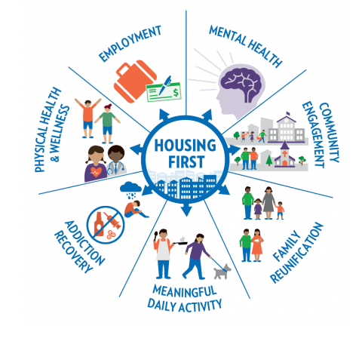
Landscape of Housing
Forming partnerships can only increase the likelihood that an unhoused person could become housed by increasing the size of their housing team and supports.
HUD (the US Department of Housing and Urban Development) in 2022 estimated close to 600,000 were homeless. – however, they also state that 1.2 million people seek shelter!
Notes:
Tanya de Sousa et al., “The 2022 Annual Homelessness Assessment Report (AHAR to Congress) Part 1: Point-In-Time Estimates of Homelessness, December 2022” (US Department of Housing and Urban Development, December 2022), https://www.huduser.gov/portal/sites/default/files/pdf/2022-AHAR-Part-1.pdf.
Meghan Henry et al., “The 2019-2020 Annual Homeless Assessment Report (AHAR) to Congress” (US Department of Housing and Urban Development, July 2022), https://www.huduser.gov/portal/sites/default/files/pdf/2020-AHAR-Part-2.pdf.

Slide 9
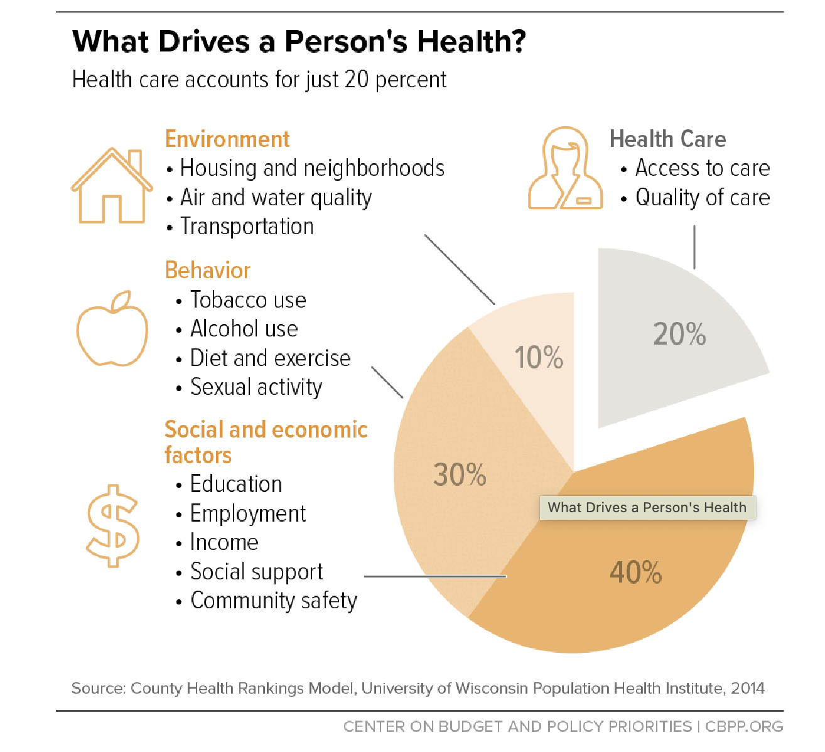
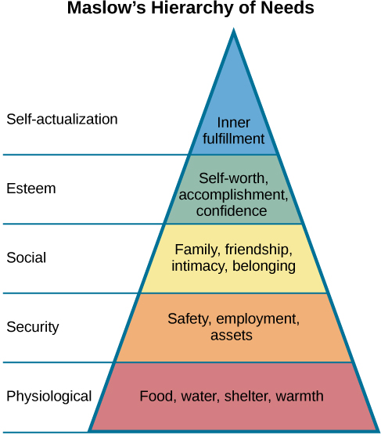
An Intuitive Partnership: Health Care & Housing
This Photo by Unknown Author is licensed under CC BY
Notes:
With healthcare only accounting for 20% and with out stable housing even for the person with the best intentions for prioritizing their health – non acute health needs go out the window.

Slide 10
Contact Information
Kevonya Elzia, MA, BS, RN
Director of Justice Equity Diversity Inclusion
National Health Care for the Homeless Council (NHCHC)
Email: kelzia@nhchc.org
NHCHC LinkedIn: https://www.linkedin.com/company/national-health-care-for-the-homeless-council/mycompany/

Slide 11
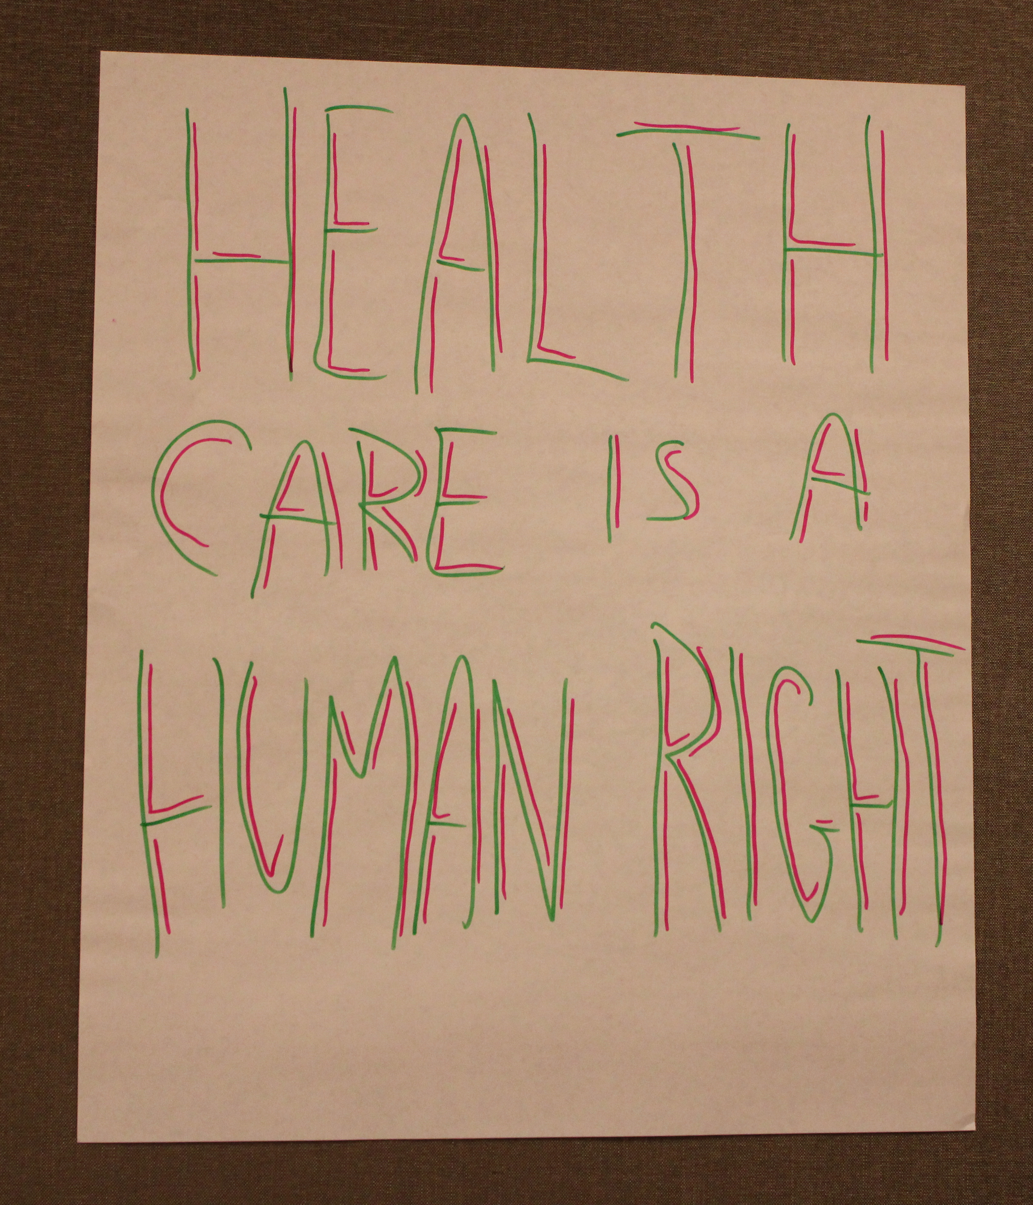
Healthcare
Health Center staff are advocates for their patients housing RIGHTS and needs.
Taken from 2015 UDS data, 1,159 health centers served 1,191,772 individuals that self-identified as unhoused.
Health Centers provide an alternate avenue to resources
Resource: According to the Uniform Data System (UDS) Of the 1375 Health Center Program Grantees in 2015, 1159 reported serving at least one person experiencing homelessness. The number of homeless individuals served by a health center varies greatly and ranges from 1 to 31,093. Of the remaining health centers, 45 left this value blank in UDS and 171 reported ‘0.’ “Anecdotally, not all health centers reported this information consistently, so the number can potentially be underreported at some health centers.

Slide 12
Maximize the Synergy of Health Care and Housing
Moderator: Kevonya Elzia, National Health Care for the Homeless Council
Presenters:
Rachel Briegel, Community Health Plan of Washington
Lowel Krueger, Yakima Housing Authority
Rhonda Hauff, Yakima Neighborhood Health Services
Research | Training & Technical Assistance | Policy & Advocacy | Consumer Voices

Slide 13
An MCO’s Role in Health and Housing Partnerships
Rachel Briegel, MSW (she/her)
Rachel.Briegel@chpw.org

Slide 14
Who we are?
Equity: In CHPW's DNA
Equity: In CHPW's DNA
Founded by Community Health Centers with roots in the social justice movement
Founded and governed by Washington’s Community Health Centers (CHC) in 1992
We are rooted in Washington State
Provide Medicaid, Medicare Advantage/DSNP, and Cascade Select Coverage Options to 300,000 Washingtonians
The whole health of our members
is our primary concern and focus
Our staff and board are local and
part of the fabric of the communities
we serve
The whole health of our members is our primary concern.
Notes:
Community Health Plan of Washington and our parent organization Community Health Network of Washington were created by Community Health Clinics across the state to address access and coverage issues for peoples being left out of mainstream healthcare.
We take our duty seriously to advocate with our members and provide holistic care that address SDOH and other barriers to health
We approach every singe member with cultural humility

Slide 15
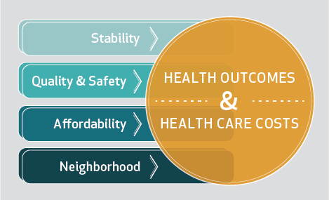
The evidence is clear: Housing is Healthcare
Source: Adapted by the author from Gibson et al. 2011, Sandel et al. 2018, Maqbool et al. 2015, and Braveman et al. 2011.
Notes:
Housing And Health: An Overview Of The Literature | Health Affairs

Slide 16
SDOH Needs Across the CHPW Membership
Notes:
Of the members that engaged in CHPW’s Community Supports Services, Housing and Financial assistance were the highest two categories of need in 2023.

Slide 17
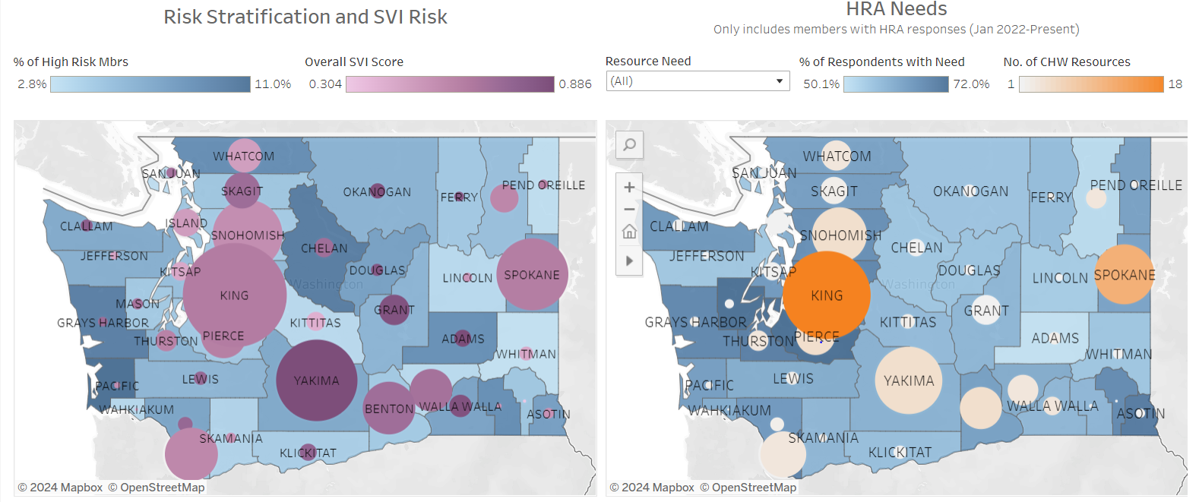
SDOH Needs and Gaps Analysis

Slide 18
SDOH Strategic Position
SDOH Strategy:
We seek to reduce upstream causes of health inequities and remove unjust barriers to health and well-being by leveraging our deep community roots and catalyzing change through local and state-wide cross-sector partnerships.
SDOH Strategy Supporting Statements:
We advance this strategy by focusing on housing and school-based partnerships as channels to support whole person health.
We advance this strategy by leveraging the community health centers’ whole-person care model, their local partnerships with community-based organizations, and the pivotal role CHCs play as leaders within their respective communities.
We advance this strategy by leveraging CHPW/CHNW’s centralized resources to provide data and analytic support, advocacy, dissemination of best practices, funding support, and other functions required to effectively plan and implement interventions to achieve strategic goals.

Slide 19
What is CHPW and CHNW doing to address housing insecurity?
Working at the intersection of addressing social needs and system change and centering equity
1. Integration of health and housing supports
Engaging, facilitating and supporting partnerships across community health centers, housing providers, and state agencies.
Act as an accelerator
2. Housing Services and Supports Capacity Development
Support and coordination for individuals, families that are unhoused and/or those that are housing insecure with multi-disciplinary teams with CHWs, peers, case managers, and health coaches
Supporting providers and CHPW staff to understand the housing systems of care and building out tools to support contracting with “non-traditional” providers.
Advancing Medical Respite and coordination around 1115 waiver.
3. Housing Policy Framework
Working at a State and Local level to advance housing
Power of coalitions in communities and at the state level
Notes:
Integration of Health and Housing Supports
This initiative aims to integrate physical and behavioral health services into affordable housing locations to support increased access to health services and strengthen partnerships with housing providers.
Relationship building with systems level statewide partners (like Commerce, HCA, NIMRC) as well as more local organizations. Act as a convener/facilitator for learning opportunities and to support building connections with health and housing ex: Commerce work. Elevate the needs of our network health centers.
Housing Services and Supports Capacity Development
This initiative aims to build CHPW and CHNW capacity to manage and deliver housing supports and services notably medical respite services and supportive housing or supported employment services to our members and patients across all lines of business. This connects directly to the state 1115 waiver and the housing support services approved last year. Also involves building out support for “non-traditional” providers ie housing providers who have not worked with Medicaid or health systems before via formalizing our own internal structures as well as external facing tools.
Affordable Housing Framework
This initiative aims to improve affordable housing in Washington State by adopting an affordable housing advocacy frameworks for CHPW and CHNW to support statewide. Involves advancing work of advocacy partners like the Washington Low Income Housing Alliance, as well as creating tools to create more housing opportunities at the local level ie CHC local housing policy overview.

Slide 20
Supporting Health and Housing Partnerships
Gain an understanding of Washington state’s health and housing landscape
Familiarity with steps and processes for developing health and housing partnerships
Build relationships and network with other CHC partners engaging in housing related work.
Use tools and learnings to develop or strengthen partnerships with local housing providers.
CHNW Toolkit: https://www.chpw.org/wp-content/uploads/content/provider-center/bulletinboard/CHNW_Health_and_Housing_Toolkit.pdf
Cooperation Supportive Housing: https://rise.articulate.com/share/iGJ8YN6IHylH0_by6PAnX_Q-EAk1Cp74#/lessons/83AFv7To_zJveBh3SInyAN8IB0Y9PeFn
Notes:
Rachel
CSH structure
First stage- making the case: awareness, organization self assessment, identifying goals and values in partnership.
2. Make it happen- identifying, approaching, assessing and selecting partners.
3. Make it work: involves more formalization. Creating partnership plans, establishing roles/responsibilities, shared visions.
4. Make it Last: how to sustain- manage relationships, build momentum, flexible with changing environments, celebrate wins, weaving funding, sharing data.
Key takeaways
Relationship building with community partners takes time- not always defined by agreements
At the same time, sharing tools/resources to help structure relationship building processes was helpful.
Feedback for what to include in agreements (ex HRSA requirements, healthcare privacy).
Areas of the Strategic Plan Partnership Components Guide that stood out most included start up planning, funding strategies, and roles and responsibilities. (Additional input around landlord relationships)
What other topics would participants like to learn about included Responses included FCS, HRSA, Scope of Sites, FQHC, CCBHC, data and data sharing, financing/funding streams, and rural housing approaches.
Feedback included in the development of the toolkit.

Slide 21
Maximizing the Synergy of Health Care, Housing, and Value Based Care
Lowel Krueger, Executive Director
lowel.krueger@yakimahousing.org

Slide 22
What is Public Housing?
History of Public Housing
1935 – Techwood Homes build in Atlanta
1937 – U.S. Housing Act of 1937
1965 – HUD becomes Cabinet-level agency
1972 – Pruitt-Igoe public housing buildings demolished in St. Louis
1973 – President Nixon declares moratorium on housing and community development assistance
1998 – Faircloth amendment limits construction of new public housing
2012 – Rental Assistance Demonstration created to redevelop public housing

Slide 23
Public Housing Programs
HUD Programs
Public Housing (Section 9)
Housing Choice Vouchers (Section 8)
Project Based Vouchers
Specialty Vouchers (FUP, FYI, VASH, NED, Stability)
Mainstream Vouchers
Emergency Housing Vouchers
Project Based Rental Assistance (also Section 8)
Family Self-Sufficiency
USDA Rural Development Programs
Farm Labor Housing (Section 514/516)
Rural Housing (Section 515)

Slide 24
About the Yakima Housing Authority
Established in 1977 by the City of Yakima Resolution No. D-1575
Operates in accordance with Washington State Revised Code Chapter 35.82
Resources received from U.S. Departments of Housing and Urban Development and Agriculture’s Rural Development
Annual budget of approximately $17 million
Serving nearly 3,000 residents throughout Yakima and Kittitas Counties

Slide 25
Housing Choice Voucher Program
Over $8 million invested in our community through housing assistance payments
Approximately 1,400 individuals served
Administer 1,312 vouchers (Annual Contributions Contract)
Mainstream – 115 vouchers
Veteran Affairs Supportive Housing – 113 vouchers
Non-Elderly Disabled – 15 vouchers
Foster Youth Initiative – 10 vouchers
Stability – 10 vouchers

Slide 26
Rentals Owned by the Agency
Farmworker Housing – 198 rental units
Seasonal Farmwork Housing – 20 rental units (252 beds)
Elderly/Disabled Housing – 139 rental units
Family Housing – 246 rental units
Permanent Supportive Housing – 41 rental units

Slide 27
Additional Agency Programs
Other Service Provided to Residents
Self-Sufficiency Program – 115 residents enrolled
Supported Employment – 15 residents enrolled
Housing Development and Preservation
New Affordable Housing Development
Fruitvale Housing – 54 rental units
Cosecha Court II, Phase III – 64 beds for seasonal farmworkers
Acquisition and Preservation
Rainier Vista – 40 rental units
Zillah Gardens – 24 rental units
Meadows Annex – 20 rental units

Slide 28
Partnering with YNHS
Washington Families Fund
Resident Health Clinics
Winter Shelter – Cosecha Court
Foster Youth Initiative
Onsite Clinic – Chuck Austin Place
Referrals for Emergency Housing Vouchers
Stability Vouchers

Slide 29
Why Partner with a Health Center?
Housing – Healthcare – Education
Serving the same clients
Long-term sustainability
Limited Resources
Housing is Healthcare

Slide 30
Thank you!
Any questions?

Slide 31
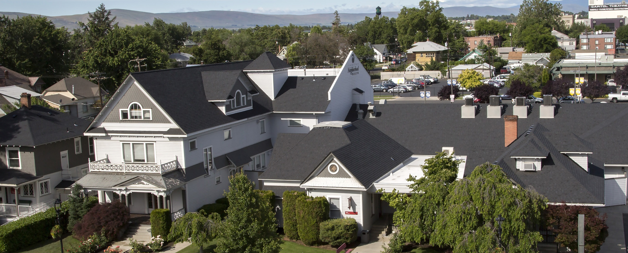
Our mission is to improve quality of life and equity in our communities by providing accessible and integrated health and social services, ending homelessness and offering unique learning opportunities for students of health professions.
Notes:
Everyone here is proud of their efforts – clearly should be ! What would our communities be without us and our partners, right ?
Let me tell you about the Yakima Valley.
Agriculture, forestry and fishing represent 28% of all employment in Yakima County.
Our 2nd largest industry BTW is health care. And 3rd tourism and retail – you have to do something with all the wonderful hops and grapes wee grow.
In Yakima County, we grow -
70% of the nation's apples.
42 % of the nation's pears.
50% of Washington State's mint and spearmint.
75% of the nation's hops
50% of Washington State's wine grapes.
As we like to say, we’re a very happy valley…
So back to why we’re here…
if you don’t know who we are – CHCs part of the Civil Rights Movement / war on Poverty in the 60s.
one of the founding fathers, Dr Jack Geiger started a CHC in Mount Bayou Mississippi, when he saw children who were malnourished he wrote prescriptions for food… that’s how we
at least half our board members are users of our services
no one is denied services based on ability to pay
uninsured patients and families less than 200% of the poverty level receive services on a sliding fee scale.
Lots more

Slide 32
2023 Profile Health Care and Housing
ALL YNHS Patients and Clients
All Patients | 29,260
All Visits (medical, dental, mental health, outreach, case management, care coordination) | 151,611 (avg 5.18/pt)
Youth Served at “The Space” (LGBTQ Youth Resource Center) | 140 Youth 1,722 Visits
Women, Infants & Children Nutrition Program | 3,855 Clients
Affordable Care Act Applications | 7,651 People 13,698 Apps. 19,535 Assists
People Experiencing Homelessness
People Experiencing Homelessness (PEH) | 4,229
All Visits to PEH (medical, dental, mental health, outreach, case management, care coordination) | 36,377 Visits (avg 8.60/pt)
Permanent Supportive Housing | 232 Clients 134 Households
Medical Recuperative Respite (Average Length of Stay 11 nights) | 200 Patients 2,222 bednights
Neighborhood Showers (mobile hygiene) (Operates 2/days per month March – October) | 493 People 1,915 Showers
Health Literacy (Telehealth Access) and Basic Needs (food, clothing, transportation, life skills, employment help, etc.) | 13,367 visits
Unaccompanied Homeless Youth | 154 Youth Served Age 13-24
MSAWs | 7,913 Patients 37,287 Visits (avg 4.71/pt)
Notes:
This is who we are…
Why I don’t like being called a FQHC
We are a FQHC – that’s a Payment Methodology that was created in the 90s for certain visits, but we are so much more than that !
Vulnerability is in the handoff
The more we have to send offsite the less we can rely
we have developed our service lines based on the needs of our community – Community Health Center

Slide 33
Medical Respite & Permanent Supportive Housing Our North Star
Patients
Medical Respite Care – “We Need a Place to Be When We’re Sick”
Providers
Permanent Supportive Housing – “If You Want Us to Make a Difference in their Health…”
Notes:
2005 – United Way / City and County – asked to participate in needs assessment on homelessness; initial CoC
we learned we did have a significant unhoused population that was not coming into our clinics for care and we needed to develop a robust outreach effort to build those relationships to bring them in
2005 – our first federal funding with Bureau of Primary Health Care
Primary care Funding –
Chc
Hch
MSAW
Residents of public housing

Slide 34
Recuperative Care for Unhoused not Sick Enough to be in hospital; and those being discharged from the hospital but not well enough to return to the streets.
Medical Respite Care
Care Transition from Primary Care or Hospital
Medication review
Case management
Wound care
Daily checks & health education
Access to medical support 24/7
Behavioral Health assessment & intervention
Assessment of Social Needs
Assist w/ Follow up to PCP and Specialty Care
Determine functional status – communication, cultural and ethnic factors
Provide meals
Provide & arrange transportation
Facilitate family unification and/or housing stabilization at exit
Establish ongoing relationship with PCP at respite exit
Notes:
Reached out to the National Health Care for the Homeless council to develop medical respite – logical place to start
Recuperative housing with medical oversight – anybody have medical respite in their communities ?

Slide 35
Medical Respite Care Program at YNHS: Patient Length of Stay & Medical Conditions
2023
Length of Stay | People | Reason for Respite Admission
One Week or Less | 50% | Cellulitis, Covid, Abscess, MOUD, Wound Care, Hypothermia, Burn, Edema, Fracture
One to Two Weeks | 33% | MOUD, Abscess, Surgery recovery, Wound care, Frostbite, Covid, Stab wound, Cellulitis, Tracheostomy care, Hypoxia
Two to Three Weeks | 11% | Stab wound, Frostbite, Necrosis, Amputation recoveries, Hernia repair, Cellulitis
Three to Four Weeks | 2% | Surgery recovery
More than Four Weeks | 4% | Congestive Heart Failure, Cancers, COPD, Amputations
200 patients – 2,222 nights (ALOS = 11 nights)
Notes:
Why they come
Referrals from providers and hospitals
Supported by our Managed Care organizations, Continuum of Care, now in our Medicaid waiver,
Goal to exit to housing

Slide 36
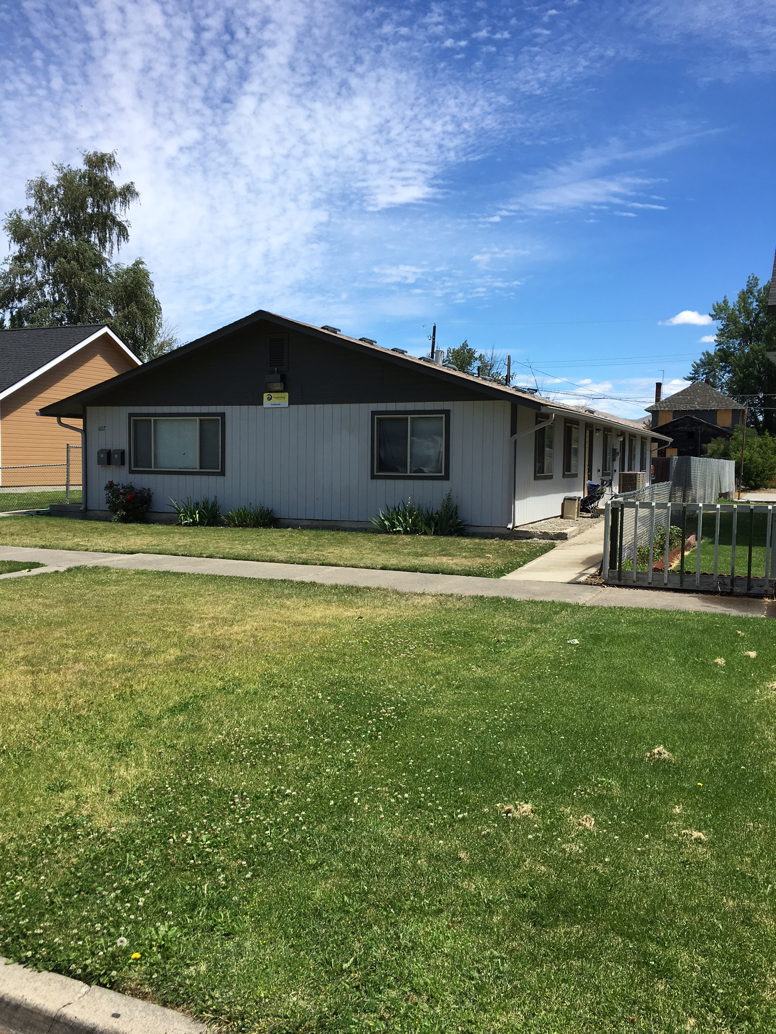
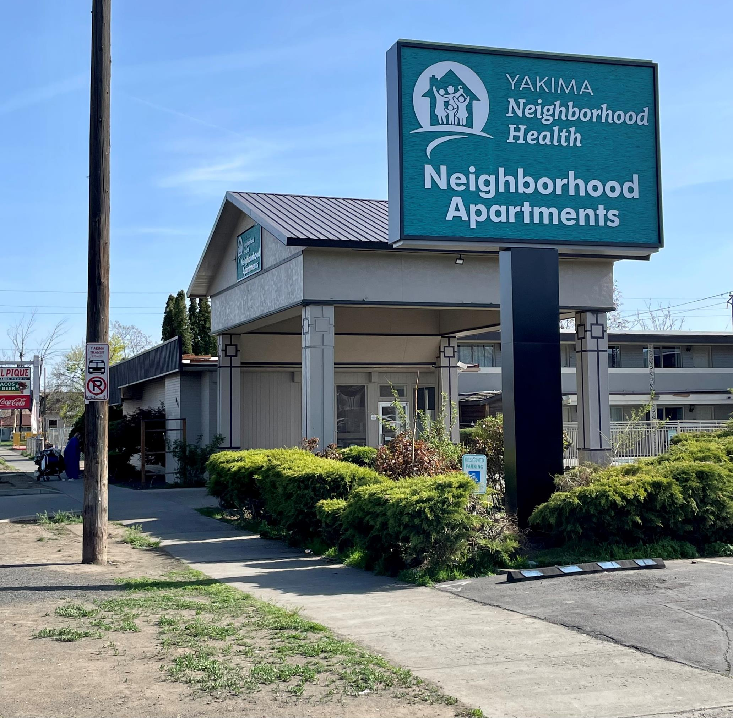
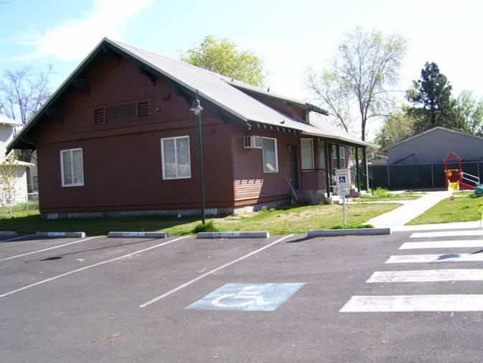
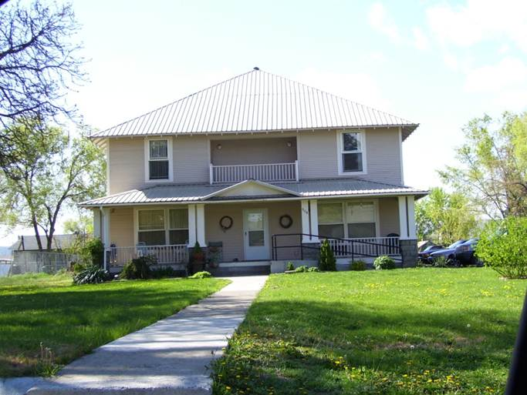
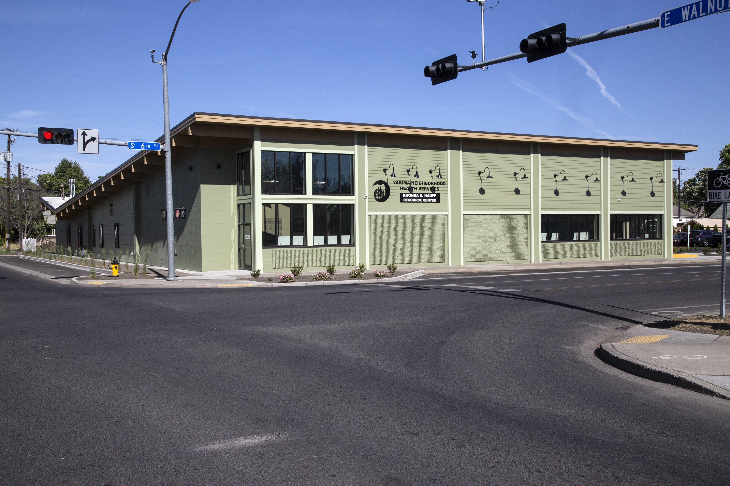
“It’s What’s On the Inside That Matters”
Housing First
Trauma Informed Care
Mental Health First Aid
Motivational Interviewing
Notes:
Progression of PSH –
2008 – first partnership with Lowel and the Yakima Housing Authority…
Partnership with Yakima County Human Services, Triumph, YWCA, Building Changes, Housing Authority, Private Landlords
Named a Promising Practice by ASPE (Asst Sectray Planning & Evaluation) of HHS in 2011 for our community collaboration.
Shared case management model
Shared evaluation of social determinants (Arizona Self Sufficiency)
Shared information system
YHA continues to be one of our landlords – master leasing for PSH and emergency shelter, and of course we provide health services onsite at some of his facilities,
These are examples of what our buildings look like now – our service models are the same . From single family to congregate. The bottom right corner is actually a former grocery store built in the 30s we renovated to a congregate living.

Slide 37
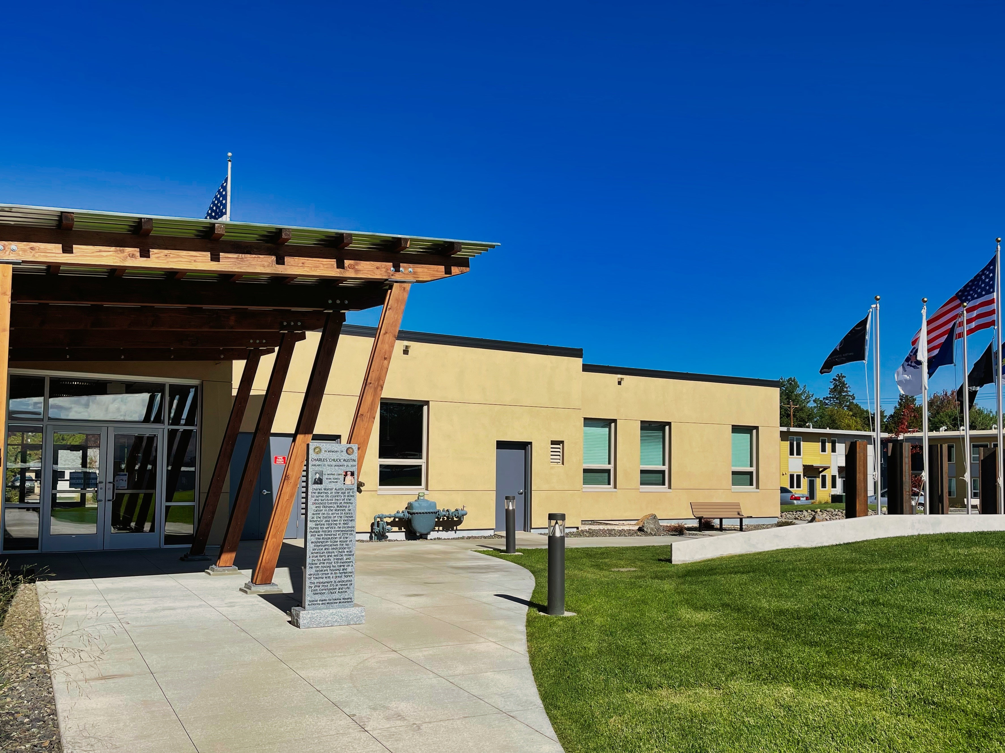
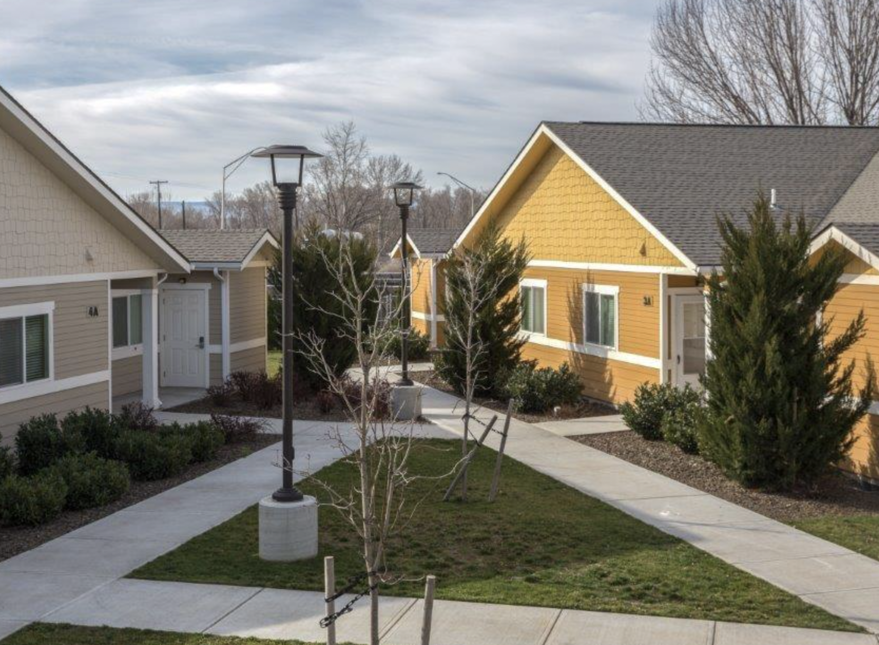
Partnerships Serve Special Populations
Notes:
Chuck Austin – describe our clinic in the armory – there are 40+ units of housing on this campus for formerly homeless veterans. Veterans from across the county also come to the clinic for services – it’s small, intimate, 2 exam rooms, 2 dental operatories, BH staff come as needed.
We share the costs of a Care Coordinator at this location – to manage the needs of the residents.
Medical / dental / BH on call
Digital literacy efforts – particular highlights are the Community Health Workers providing Smart Phones and working with the Veterans to help them connect to health care – patient portals, video visits, etc. One of our CHWs is himself a veteran
Cocecha Court – YHA’s farmworker housing from April – November; and from November to March they lease to us for Winter Weather shelter
rural populations – families needing entry to housing.
Here our case managers are providing case management, access to health care and other social services, for many access to supportive housing

Slide 38
Who We Served in 2023
238 People (153 Adults)
85 Children < 18
45 Seniors > 55
134 Households
Chronically Homeless
At least one chronic disability
55 physical disability
24 developmental disability
53 chronic health disability
123 Mental Health disorders
75 SUD disorders
58 People have 3 or More Chronic Conditions
51 People are on SSI or SSDI
Notes:
When it comes to PSH,
Our niche is serving the chronically homeless with significant health issues
911 calls are no longer for property and vandalism
They are for health related calls to the hospital

Slide 39
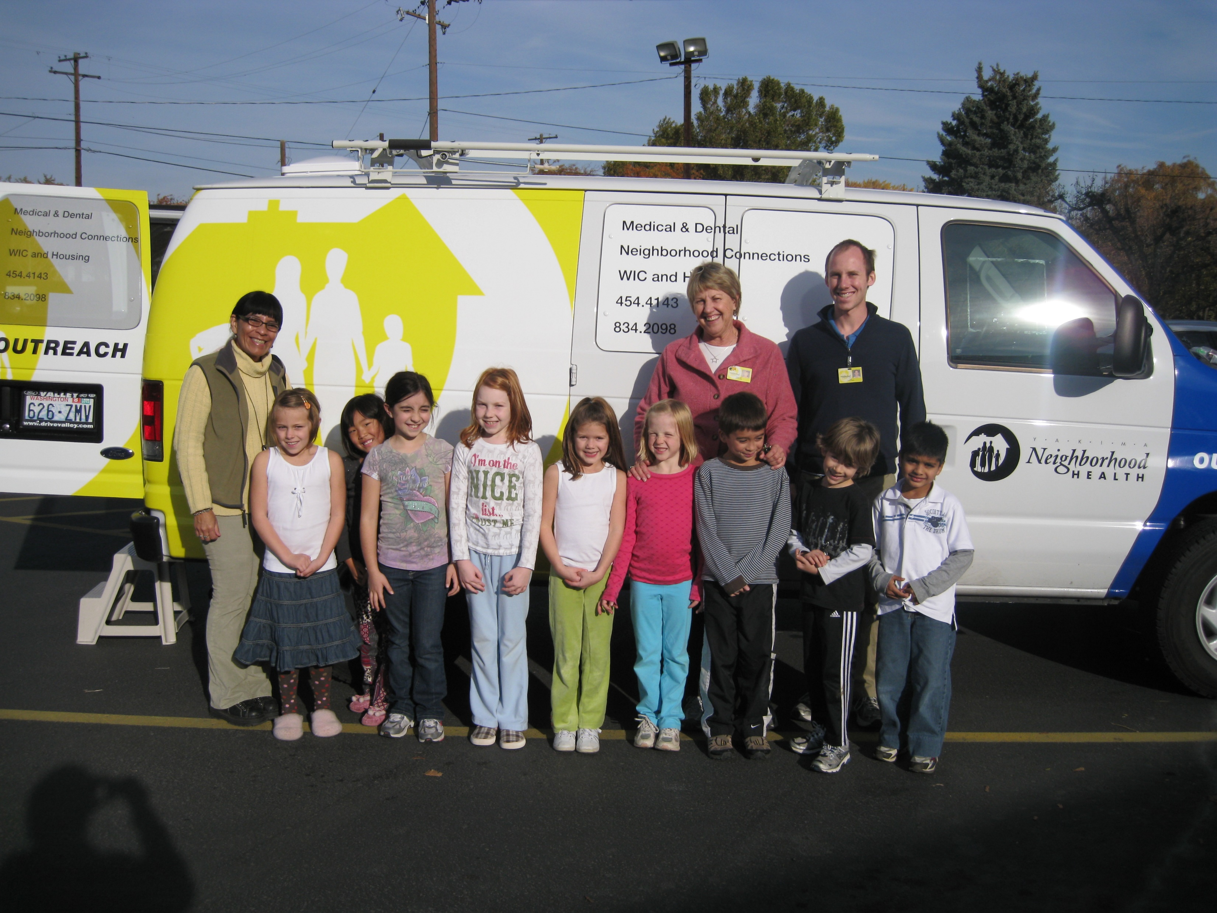
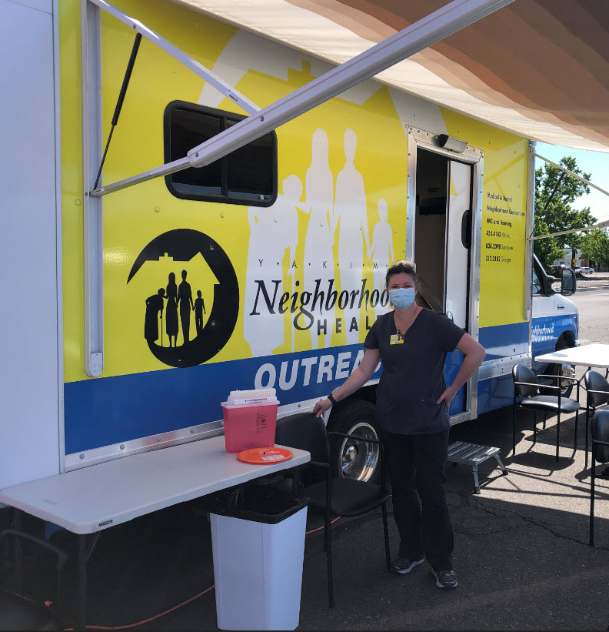
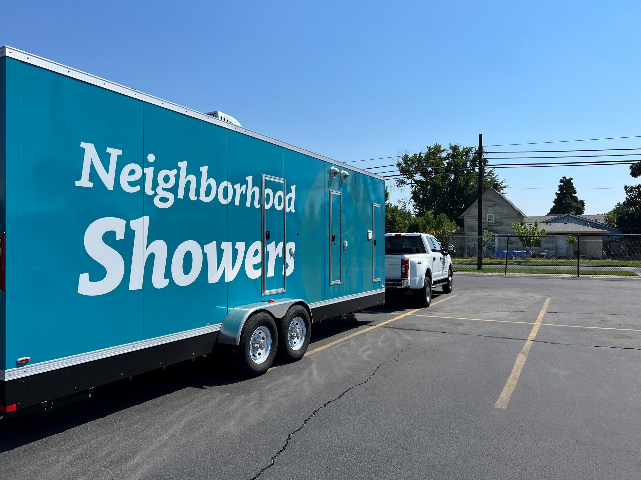
How We Served Them
Supportive Housing Case Manager
Supported Employment Specialist
Nurse
Behavioral Health Specialist
Substance Use Disorder Professional
Community Health Worker
Peer Support Specialist
Outreach Workers
Primary Care
*Medical
*Dental
*Behavioral Health
*Pharmacy
Continuum of Care / Coordinated Entry
HEN / ABD
Street Outreach
Health Home
Supportive Housing / Supported Employment
Medication for Opioid Use Disorders (MOUD)
Medical Respite Care
Notes:
We are 20 years into this now – at the heart of who we are is improving access to primary care
Before somebody else took our name, I called this our Everything Everywhere All at Once team
vulnerability is in the handoff
Highlight Coordinated Entry
Foundational Community Supports
MOUD

Slide 40
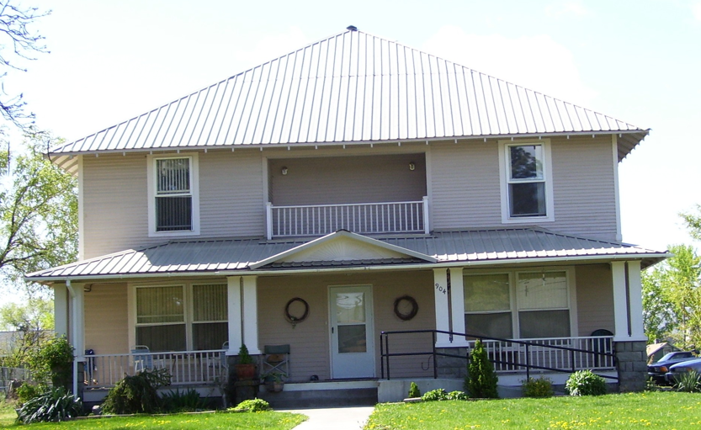
Permanent Supportive Housing in 2023

Slide 41
Housing First Then On to Primary Care
Notes:
Case managers help reduce barriers to care –

Slide 42
PSH Patients vs General YNHS Population
88% insured
(81% general population)
46 % received flu shots
( 47 % general population 2023)
70% had controlled diabetes
( 80% general population)
63 % had controlled hypertension
(70% general population)
Notes:
our goal is to have our PSH patients be at least as healthy as our general CHC patients
We have about 8 measures we compare to our general health center population every year

Slide 43
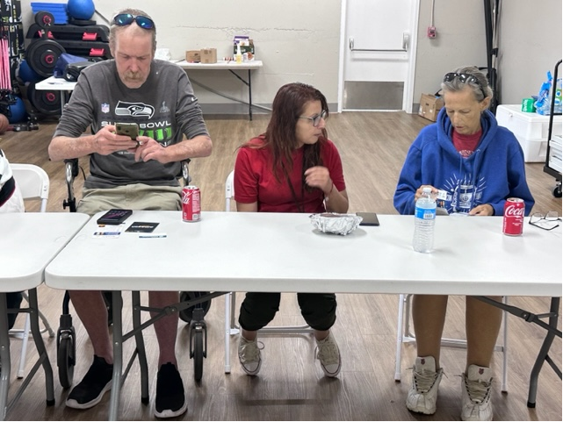
Digital Literacy Doesn’t Come Naturally for All
Notes:
This reflects the growth of our residents in PSH
Growth in digital literacy at CAP – MCO owned by CHCs has provided significant support for housing initiatives – in fact, as a health plan our strategic plan the last couple years has been
Housing
Education
Digital inclusion
Sound familiar ? CHPW provides “Apple Bundles”, blood pressure monitors, and 800# support, in addition to supporting our CHWs to help support our patients

Slide 44
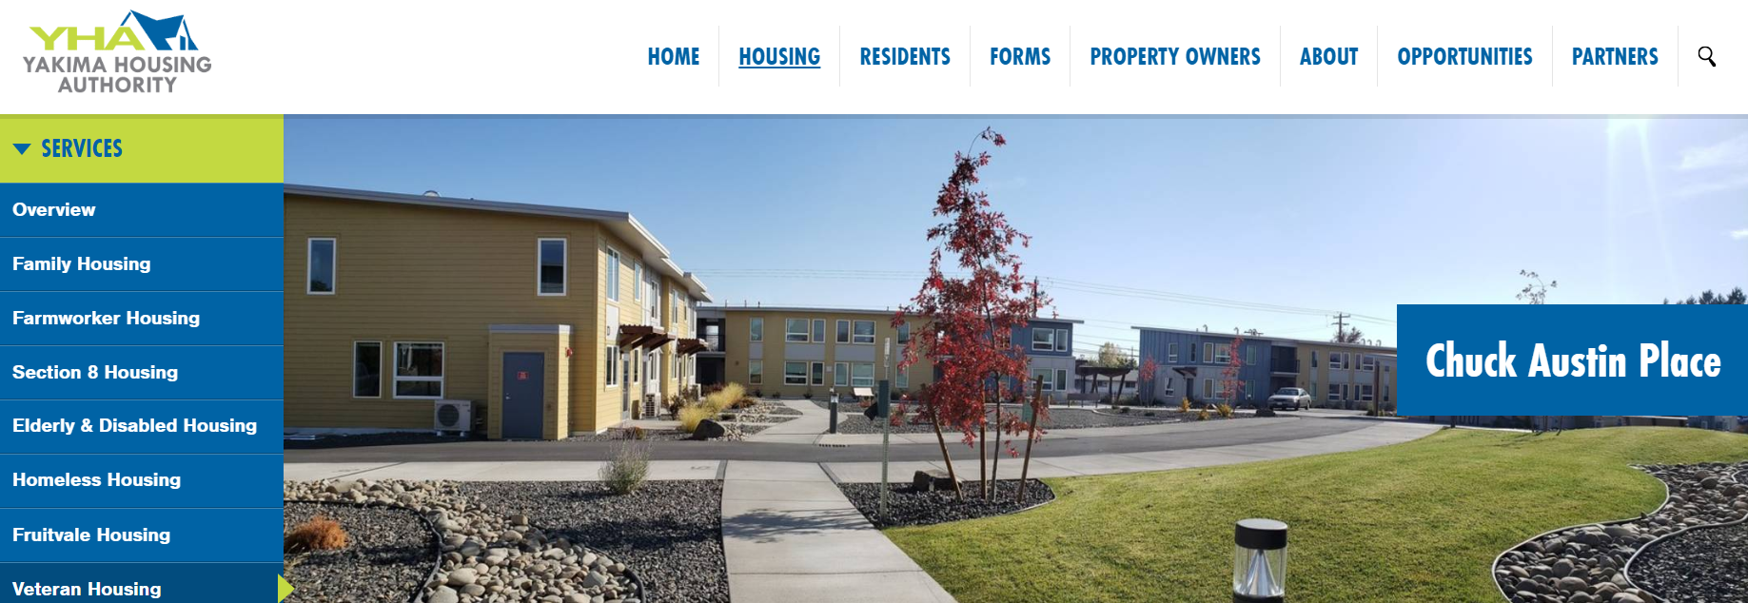
Our Strength is Always in Our Partnerships
Questions ?
Rhonda Hauff , CEO
Rhonda.hauff@ynhs.org
Notes:
Our partnerships are crucial -
Great thing about being part of a community our size -
Synergy
In WA we have an initiative with CHPW,
Building Changes,
National HCH Council

