Slide 1
Integrating ADL Support into Medical Respite Services
Carli Fullerton, RN, BSN, PHN
Nurse Manager,
San Francisco Medical Respite

Slide 2
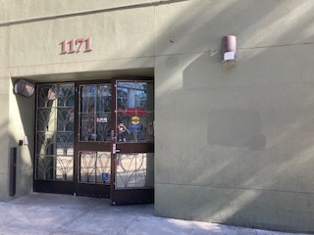
-Carli Fullerton, RN, BSN, PHN San Francisco Medical Respite
Integrating ADL Support into Medical Respite Services
Notes:
Hi Everyone. My Name is Carli Fullerton and I am the Nurse Manager of San Francisco Medical Respite. We are located on Mission Street in San Francisco, in the South of Market Neighborhood. I’ll be presenting on our experience integrating ADL Support into Medical Respite Services.

Slide 3
Agenda
Introduction
Challenges of lack of ADL support in a Respite setting
Our Solution
Implementation
What this looks like today
Communication with Hospitals & Community Partners
Lessons Learned
Case Studies
Summary
Questions
Notes:
This is our agenda for this talk.

Slide 4
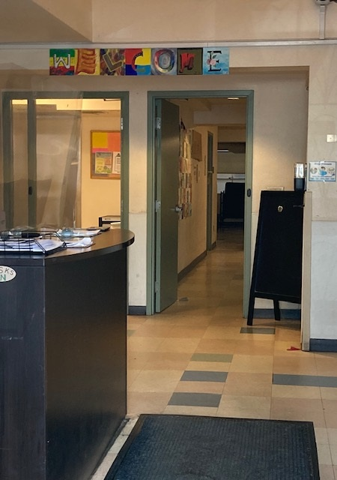
Introduction to our Program San Francisco Medical Respite
Opened in 2007 at 45 beds, expanded to 75 in 2018
Provides Post-acute recuperative care for People Experiencing Homelessness who are too sick or frail to be on the streets or in the shelters of San Francisco
Clients Referred through SF Hospitals and through Community (Shelter Health Program)
Clients from hospitals with acutely resolvable need and clients from community with an acutely resolvable medical need and/or need for ADL support
Average Length of stay is 2-6 months
Notes:
First, a little background on our Medical Respite program. In the early 2000s, inpatient teams at San Francisco General were noticing a cycle in homeless clients. People experiencing homelessness would be discharged after a hospital stay to street or shelter. They would not have adequate resources to take care of their post hospital needs or attend follow up. They then were back in ED, then another inpatient stay to stabilize, and so on and so on.
San Francisco Department of Public Health wanted to stop this cycle, and San Francisco Medical Respite was born.
Our program first started in a 12-bed area inside one of San Francisco’s homeless shelters. The need for more beds was quickly recognized, and in March 2007 we moved into a new facility with 45 beds. San Francisco was the first Respite program in the US that was publicly funded by a public health department. There are now over 145 Respite programs across the US.
We expanded our program to 75 beds in 2018, and added an additional referral resource, the shelters in San Francisco. Clients can now be referred to us from hospitals and from the Community via the Shelter Health Program. Clients can be referred from hospitals if they have an acutely resolvable medical need and clients from the Community can be referred if they have a medical need and/or need for enhanced ADL support.
In our program, the DPH provides the clinical care such as nursing, social work and case management. We partner with a CBO named Community Forward who provides our non-clinical, “hospitality” services.
Our average length of stay was 1-5 months prior to COVID but increased to 2-6 months during and after COVID due to a decreased amount of shelter beds in San Francisco. Our length of stay has also increased as we get a large percentage of clients who are elderly, who cannot care for their own ADLs, or who have cognitive impairment, so are not safe to discharge to shelters. They stay with us until we can find a safe housing option.

Slide 5
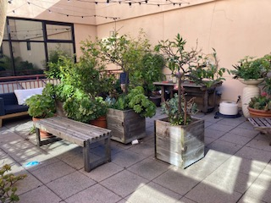
Mission Statement
The mission of the Medical Respite and Sobering Center is to provide Medical and Social Services to promote stabilization, hope and healing to adults experiencing homelessness in
San Francisco.
Notes:
Every 5 years at our Staff Retreat we ask our team to revisit our Mission Statement and update it as times change and our Mission grows. We are due for a new Mission Statement (COVID put on hold our staff retreat) but this is our current mission.

Slide 6
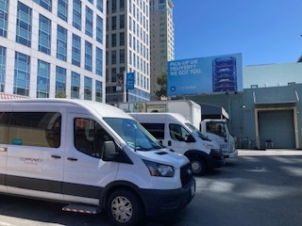
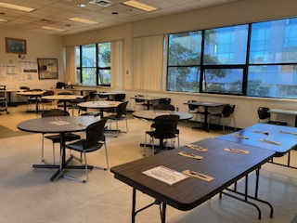
A Day in the Life at Medical Respite
Sleeping Arrangements
Open door policy
Transportation
Weekly Linen and Laundry Service provided on site
Meals
Activities
A Client’s Team
Medications
Wrap Around Services
Social Service Community Meeting
Notes:
Some logistics of our Respite program:
Our male clients sleep in dorms that range from 6 beds to 27 beds and female clients sleep in semi-private 2 to 3 bed-rooms. Transgender clients are offered our 1 single private room if available (it is also used for COVID isolation) or their choice of the female floor or the male floor.
-We have an open-door policy at respite. Clients can come and go as they wish during the day, but we do ask they are in by 10pm at night, and then stay in until 7am the next morning
-We provide the hospitality and daily living services that everyone, homeless or not, requires through our CBO, Community Forward. Community Forward runs our dining room and provides 3 hot meals a day plus snacks in the evening. Community Forward provides transportation via van to and from all medical and social services appointments, and our case managers escort clients to appointments if needed. Community Forward provides weekly laundry and linen service, janitorial services to maintain a clean and hygienic environment, and safety and security of the facility.
-The Activities Room is open 24/7 for TV, books, games, and daytime activities like Acupuncture, Art Group, Exercise Group, and BINGO
-Each client is assigned a team of a Medical Provider, Nurse, and Social Worker shortly after intake.
-Medications to last the entire are distributed by our nursing staff at Med Pass ever morning. We can provide Direct Observation Therapy to clients that are unable to manage their own meds
-We have a robust support staff team of Health Workers, Medical Assistants, Eligibility Workers, and now Patient Care Assistants that provide wrap around support services 7am-11:30pm daily
-Our Social Services team holds a monthly Community Meeting for client announcements, concerns, and questions.

Slide 7
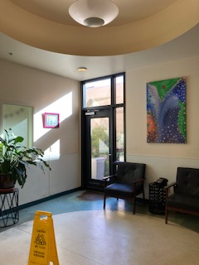
What Respite Offers
Medical Services
Safe, clean place to stay while recuperating from an acute medical or surgical condition
Successful resolution of acute conditions and stabilization of chronic conditions
Linkage and bridging to primary care
Linkage to specialty medical care
Linkage to Coordinated Entry Housing List
Urgent care services as needed
Care coordination for development of treatment plans focused on positive long-term change
Psych NP on Staff to help Bridge clients to Mental Health
Social Services
Linkages to social services and entitlements:
General Assistance
Housing applications / Coordinated Entry
Bus passes
Immigration Clinic
Medi-Cal/Medicare enrollment
Substance use treatment programs
Alcohol Treatment programs
Mental health Service connection
Notes:
Medical Respite provides a safe space for Recuperation from the emotional distress and isolation associated with homelessness and illness.
So how do we provide this?
Our Medical Team provides medical and nursing services directly on site. We offer nursing care and Providers (such as a nurse practitioner or physician assistant) with a goal of successful resolution of the medical or surgical condition that brought the client to Respite. We also provide a place that offers enough stabilization and help to manage things such as chemotherapy and radiation for cancer patients, or transport and support for clients on dialysis. We provide care coordination with specialty care clinics such as cardiology, orthopedics, and trauma.
We connect every client to a PCP prior to discharge.
We are a nurse driven program.
Our Social Service/Behavioral Health team focuses on long term and sustainable discharge plans through a full psychosocial assessment of both the short-term needs (such as an ID) and the long-term goals (such as housing). Social Workers connect clients to treatment programs, work training programs, in home support services, and intensive case management, as well as ensure clients are on the Coordinated Entry list for housing. In fact, of those clients who engage in our program, more than 20% are discharged directly to permanent supportive housing.
Finally, Respite really offers a place to recuperate from the emotional distress and isolation associated with both homelessness and with illness. Our clients experience both and Respite provides a community and a respite from life on the streets.

Slide 8
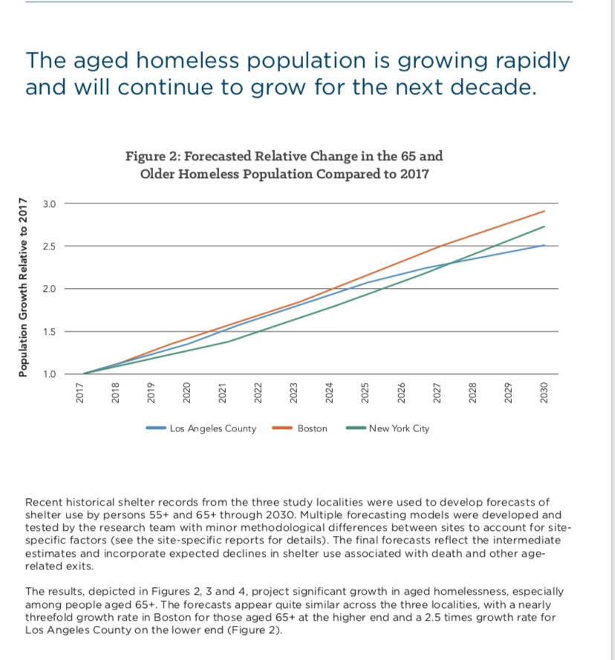
Trends – Aging Population
-Currently, 30% of our Respite clients are over the age of 60. Of those, 50% of clients that come from Community Referral (Shelter) are 60+
-Numbers of seniors experiencing homelessness are expected to triple by 2030
From “The Emerging Crisis of Aged Homelessness in the US: Could Cost Avoidance in Health Care Fund Housing Solutions?”
November 2019 International Journal for Population Data Science 4(3)
by
Dennis P Culhane, Dennis P Culhane, Kelly Doran, Maryann Schretzman, Kuhn Randall Kuhn
Notes:
Respite programs across the country are seeing an increase in our Aging Population. Recent numbers anticipate senior homelessness tripling by 2030. Currently 30% of our clients are over the age of 60. Of our aging clients, 50% come from Shelter and Community referrals.
Of course, with an aging population comes an increase in need for help with ADLs. Shelters and Respite programs across the county are experiencing this and struggling with how to meet the need. We saw an increase in ADL needs in shelter and at Respite prior to 2018.

Slide 9
Notes:
In 2018 we gathered date on how many clients in shelter were aging, vs. clients in the hospital.
The Average age for a hospital client was 49. The Average age at Shelter was 55
But look at this 70-79 group and see how the distribution is different. It really highlights the population aging in shelters
Also, historically, 3% of our clients from the hospital have some known cog impairment. 29% of our Shelter Health referrals do.
These clients come with an increasing need for help in managing their ADLs. We saw this prior to 2018 and felt the need to address it.

Slide 10
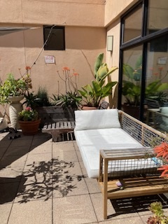
The Problem
-rapidly increased aging population in SF shelters and at Medical Respite
-increased amount of clients who arrived with ADL needs despite criteria
-increased number of clients sent back to the hospital
-hospital had no places to send folks and often sent them to shelter
-A cycle, over and over, all due to clients needing ADL support
-We needed a new solution to address the needs of these clients and the system in SF
-Planned with Shelter Health to help meet these clients needs
-changed our system and staffing at Respite to begin to accept clients with ADL needs
Notes:
So what was the problem? We saw a rapidly aging community in SF shelters and at Respite, with an increased ADL need despite admission criteria. We were sending an increased number of clients back to the hospital who could not manage ADL needs. The hospital had no where to send folks and would often discharge back to shelter. This became a cycle, over and over again, all due to clients needing ADL support. We needed a new solution to address the needs of these clients and the system in SF. We met with Shelter Health, also part of SFDPH, and came up with a plan. We changed our system and staffing at Medical Respite to begin accepting clients with ADL needs.

Slide 11
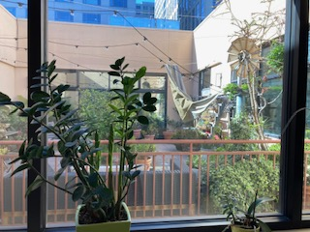
Challenges of lack of ADL support in our Respite setting prior to PCAs
Clients sent back to hospitals frequently for inability to care for themselves
Hospital Referrals declined for lack of independence in ADL management
Respite Nurses pulled from panel management to help clients with ADL support
Support Staff (Health Worker 1s) working out of scope to provide ADL support
Burden on the system, staff overworked and burned out,
-clients being sent to Shelter and receiving ROS for inability to care for self.
All Gumming up the System!
Notes:
-Lack of ADL support produced challenges in our milieu.
-As we have already discussed. Clients were sent out to hospitals frequently for inability to care for themselves, then hospitals must keep clients without a hospital need (LLOC) at a high cost
-We also declined Hospital Referrals for lack of independence in ADL management, again increasing LLOC clients in hospital at high cost
-Our Respite Nurses were pulled from panel management to help clients with showering, cleaning up after accidents, putting on clothing, etc.
-Our Support Staff (Health Workers) were working out of scope to provide ADL support to clients during weekends and off hours.
-Of course, all this leading to a burden on the system, staff overwork and burnout
-In addition, clients were being sent to Shelter and receiving ROS for inability to care for self.
This Was All Gumming up the System!

Slide 12
Notes from staff prior to PCAs
#32 Staff helped client with a diaper. Client was not able to do it herself.
#33M. accident again, clothing & linens were all washed.
#41 T. BED area cleaned up by Staff again!!!!! (shows frustration-staff were provided feedback for language)
#27 V. - incontinent in his bed, staff changed his linens & cleaned his bed
#5 bag burst client cleaned himself up clothes were washed returned to client
** Feces found from #37 M.’s bed to the bathroom (bed linens stripped, clean & washed twice. bathroom mopped) The entire third floor smelled of feces.
#2 B. is extremely wobbly; I assisted him to his bed
#41 P. was assisted in taking a shower and clothes was washed
”I just wanted to acknowledge the increase in workload for our nurses that has occurred. Thank you for your help in giving clients showers, doing laundry, and helping clients with their ADLs when urgent situations arise on day shift.” –Charge Nurse Message
Notes:
These are examples of notes from our staff over the years, prior to when we had PCAs. Our non-clinical staff, our Health Workers 1s, and our CBO staff were often called in to provide ADL support to our clients, which was outside of their scope of practice.
This is an example of how frustrating this was to staff this really comes through in some of these notes – though we did have a conversation with staff about using appropriate and professional language in shift notes. We also understood and did our best to provide support.
Give folks time to read these

Slide 13
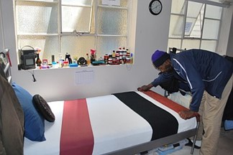
Our Solution
San Francisco Supervisor Jane Kim spent a night at a local homeless shelter
Worked with Director of Shelter Health to discuss options
Advocated for an expansion of Respite services to include referrals from Shelter
Former Mayor Ed Lee mandated 30 new beds for Shelter Respite services.
Expansion targeted shelter residents who were failing in a shelter setting due to medical conditions or functional impairments
Expanded into the adjoining building to increase capacity for the hospital and dedicate 30 beds for shelter referrals (including clients with respite need of Custodial Care/ADL support).
Created a new position at Respite, PCA
Notes:
In 2015 Supervisor Jane Kim spent a night at our largest shelter in San Francisco, MSC South. She noticed the trend of many people in shelter with Medical and ADL Needs and who were actively ill. With the Director of Shelter Health and Medical Respite and DPH leadership, it was advocated for an expansion of our Respite program. Mayor Ed Lee mandated that 30 new beds be created for Shelter Respite Services, targeting specifically the shelter residents who were failing in shelter due to medical conditions or functional impairments. The idea was to add 30 additional beds earmarked for clients coming from shelter and made a total of 75 beds in our Respite program.
As luck would have it, the building next to us was vacated by St. Anthony’s clothing program as they moved into a new facility in 2015, and SFDPH took over that building and started a 2+ year long renovation project with us moving into the new space in 2018.
So how could we support clients with ADL needs? How could we handle clients with functional impairments, incontinence, ADL needs? Incontinence of course was a main reason frail clients were at high risk of DOS from shelter. Who better to provide this support than PCAs?
We decided to add the position of PCA (CNA) to our staffing pattern and create a workflow to provide custodial care.

Slide 14
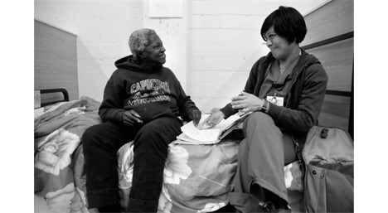
Benefits of Providing ADL Support at Respite
-Promotes a safer and healthier shelter environment
-Provides a unique period of intense engagement
-Lower Level of Care Support to offload SFGH
-Clients are cared for in an appropriate supportive environment
-Decreased the burden on Shelter Staff and Respite support staff
-Decreased in DOS’s (Denial of Service) at Shelter for inability to self care/medical need
Notes:
The Benefits of Providing ADL support at a Respite setting?
-We could Promote a safer and healthier shelter environment for all individuals living in shelters
-We could Provide a unique period of intense engagement for very vulnerable people for whom it has been historically difficult to provide medical care
-We would provide Lower Level of Care Support to San Francisco General, Offloading LLOC clients during times of hospital overcrowding
-Clients are cared for in an appropriate supportive environment
-There is a Decreased burden on Shelter Staff and Respite support staff who are not medically trained
-there would be a Decrease in DOS’s (Denial of Service) at Shelter for inability to self care/medically inappropriate

Slide 15
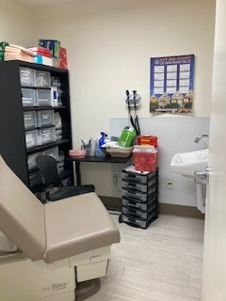
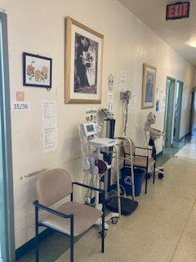
Licensing
-San Francisco Medical Respite is Licensed as a primary care clinic (FQHC) and functions under that license.
-Other Licenses possible: RCFE and ARCF in California
-The Licenses differ from State to State
-Look into your state’s Nurse Practice Act:
-what level of care is allowed,
-how much ADL assist is allowed
-what job classifications can fill that role
Notes:
So the question was, how do we license a facility and still maintain Medical Respite’s place in the continuum of care? We looked into licensing in general in the State of California (it differs from State to State). We could have pursued 2 different types of licenses: RCFE (Residential Care Facility for the Elderly – over 60) or ARCF (Adult Residential Care Facility – ages 18-59).
In the end, because our official designation is a homeless shelter with a Primary Care Clinic on site, we decided to not pursue a new license and work within our Primary Care License (FQHC-Federally Qualified Health Center).
What can be done can differ state to state under your state’s Nurse Practice Act. My advice is to go back to your home agency, see what level of care is allowed, how much ADL assist is allowed, and what job classifications can fill that role. Then decide the license that will best work for you.
.

Slide 16
Defining ADL support in Respite
-1 person assist to and from exam table
-1 person assist to help people dress and undress
-arrived at 1 person assist (minimal assist-25% of the work) in general was appropriate in our setting
-Took that 1 person assist and applied it to our facility.
-included basic ADL tasks that are done at Primary Care clinics
Notes:
Next we needed to define what ADL support would look like in respite, if provided by PCAs.
We are licensed as a Primary Care Facility so we had to define ADL support as what as would be allowed in the Primary Care Scope of Practice. Think helping a person put on and take off clothes, helping a person to and from the exam table, helping a person with a lice treatment. ADL support at Primary Care Clinics is primarily 1 person assist, or minimal assist. Minimal assist is defined as when the assisting person(s) or device(s) are required to perform approximately 25 percent of the work of a mobility task while the patient performs 75 percent of the work. This is what our PCAs could provide within our FQHC license.
We also needed to consider the basic ADL tasks needed to make our clients successful in our environment, in which they lived. We included things like 1 person assist shower help, grooming, incontinence care.
This is how we arrived at the amount of ADL support our PCAs would provide.
If questions about levels of care – slide at the end.

Slide 17
Funding
-program budget Comes from the general fund of the City and County of San Francisco
-PCA funding originally came from the hospital registry budget, then later our budget
-Today we have 3 full time PCA positions and 4 part time PCA positions (shared with Sobering and Managed Alcohol) in our budget
Notes:
For Funding,
-San Francisco Medical Respite’s budget comes through General Fund of CCSF, and funding is offset by Cal-AIM.
-The system recognized the problem and the lack of a place in the system for clients with ADL needs to go and be supported.
-We were initially budgeted $500,000 by SFDPH to use the hospital registry to provide ADL support to clients coming from Shelter Health.
-We were allowed 4 full time PCAs to our budget for Medical Respite (2 day, 1 swing, 1 overnight).
-Today we have 3 full time PCA positions at Respite and 4 PCA part time PCAs that we share with Sobering and Managed Alcohol in our budget.

Slide 18
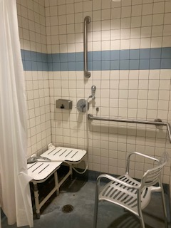
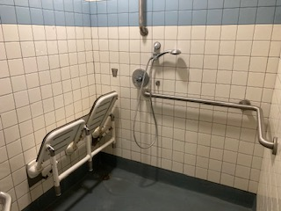
How we implemented Enhanced ADL Support
-Planned staffing patterns with our new PCAs
-Created job description and tools for PCAs for charting and organization – see slides
-Our hours of support are 7 days a week from 7am to 11pm
Notes:
So how did we implement enhanced ADL support?
- We Planned staffing patterns with our new PCAs-Our hours of support are 7 days a week from 7am to 11pm
- We Created a job description and tools for PCAs for charting and organization – see future slides

Slide 19
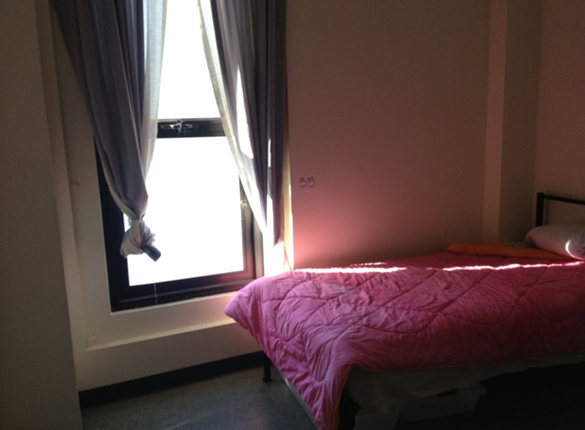
Creating a Training Plan
-Whole new position. had nothing to base our training and documentation
-Identified the PCA tasks
-Identified training plan and supervision
-Created clear outlines of job duties/charting tool
-Creating a supervision and training program
Notes:
We needed to create a whole new training program for our PCAs.
-We had nothing to base our training and documentation on because this was a new idea to use CNAs in a Shelter-Like setting so we started fresh.
-We identified the tasks our PCAs could complete: Showering, Dressing, Grooming, Incontinence Care, 25% transfer, vital signs support, lice treatments, laundry, linen changes, wellness checks.
-We identified who would direct our PCAs (the Charge and panel nurses initially)
-We knew our PCAs were coming from hospitals and care facilities and that this would be very different for them. We created clear outlines of job duties a checklist, and charting tools to ease the transition.
-We identified who would direct our PCAs (the Charge and panel nurses initially)
-We met with the teams to explain the job responsibilities and supervision structure
-We set up a 2+ week period of shadowing for each new PCA with a more experienced PCA, and regular 1 on 1 meetings with the Charge Nurse
.

Slide 20
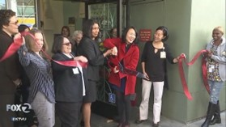
Opening of Expanded Building
May 2017: Completed $3.78 million expansion
30 new beds earmarked for clients coming from shelter
Now 75 total Respite beds: 21 female, 54 male
Notes:
This is the ribbon cutting ceremony with Mayor London Breed when we opened our newly renovated space in 2018

Slide 21
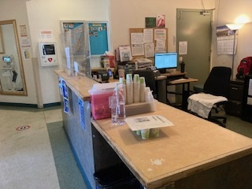
Implementation, Tools, and Documentation
-Our very first PCA started 2 weeks before we moved
-We identified clients that needed ADL support on our client board directly
-Once other PCAs came on board, our first PCA was able to help
with the training and transition
-we learned as we went and adjusted the program as needed
-We soon were able to take intakes with ADL support needs.
-we initially needed a nurse on site whenever we had a PCA working
Notes:
-Our very first PCA started with us 2 weeks before we moved into our expansion site. She was able to be actively involved in creating our job description, tools, and responsibilities.
-We identified clients that needed ADL support on our client board directly and instructed our PCAs to add those clients to their charting sheet.
-Once other PCAs came on board, and our first PCA was able to help with the training and transition
-we learned as we went and adjusted the program as needed to fit our unique facility
-Soon we had PCAs staffed on every shift, and we were able to take intakes with ADL support needs. We updated our intake criteria.
-we initially needed a nurse on site whenever we had a PCA working, but now this is no longer the case. PCAs can work independently.

Slide 22
Notes:
This is an example of our shower chart that the PCAs use to make sure clients are showered regularly

Slide 23
PCA Charting Tool / Kardex
Notes:
This is an example of the charting tool we created for the PCAs so they could keep track of the care they provided. They then send a shift note via email to staff at the end of their shift.
I’m happy to provide any of these documents to anyone interested. Just email me to request at carli.fullerton@sfdph.org

Slide 24
Notes:
This is part of a checklist provided our PCAs so they understood their responsibilities each shift.

Slide 25
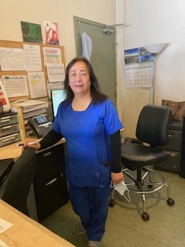
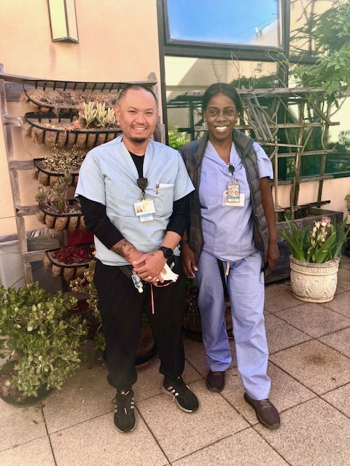
What this Looks like in our facility today
-Today we have 3 full time PCAs and 3 part time PCAs (shared across 3 programs).
-Our PCAs have created their own space at the facility and are independently driven and confident.
-Our PCAs help with a variety of ADL needs
-PCAs provide overdose response, communication to the teams about a client’s condition, input about a client’s ability to care for themselves.
-PCAs work in the dorms and in the community and keep eyes on our clients.
-PCAs escort blind clients to and from meals and throughout the facility
-One of our PCAs offers “Haircut Sundays” where he spends time setting up as though at a salon to cut clients hair
-Our PCAs keep, along with our Nursing Desk Health Worker, a clothing closet of donated
clothes, and provide clothing to clients as they need it.
Notes:
-Today we have a strong PCA team of 3 full time PCAs and 3 part time PCAs (shared across 3 programs).
-Our PCAs have created their own space at the facility and are independently driven and confident. They provide wonderful care to our clients and provide things that we could never imagine prior to starting using PCAs:
-Our PCAs help with a variety of ADL needs
-Our PCAs work in the dorms and in the community and are able to keep eyes on our clients. They are our on the ground eyes and ears towards clients who may need a higher level of care.
They provide overdose response, communication to the teams about a client’s condition, input about a client’s ability to care for themselves.
-PCAs escort blind clients to and from meals and throughout the facility – we were not able to accept blind clients previously
-One of our PCAs offers “Haircut Sundays” where he spends time setting up as though at a salon to cut clients hair
-Our PCAs keep, along with our Nursing Desk Health Worker, a clothing closet of donated clothes, and provide clothing to clients as they need it.
-These are our current fulltime PCAs: our swing PCA started as a registry PCA in our first 3 months with the program and stayed with us. Our 2 PCAs on day shift came to us from hospital programs. They are amazing in the wonderful care they provide, with a trauma informed and harm reduction lens. Our clients love our PCAs and constantly provide positive feedback for them. They are an integral part of our team and make our program better.

Slide 26
PCA shift notes example
Vital signs checked.
Wellness checked.
Restocked towels at the nursing station and 1st floor.
Bed 5. B.- Emergency laundry done.
Bed 7. Prepared bed for new intake.
Bed 14. C.- Gave towels, toiletries and emergency laundry done.
Bed 17. S.- Assisted in linen change.
Bed 20. P.- Assisted in linen change.
Bed 23. H.- Gave towels, toiletries and showered.
Bed 27. B.- Assisted in linen change.
Bed 37. Prepared bed for new intake.
Bed 44. H.- Emergency laundry done.
Bed 47. Prepared bed for new intake.
Bed 48. A.- Emergency laundry done.
Bed 59- HC. Shower set up with stand by assist, assisted apply body ointment and emergency laundry done.
Bed 63. T.- Gave towels, toiletries, and showered.
Bed 67. Prepared bed for new intake.
Notes:
This is an example of our PCA shift notes today. Our PCAs accomplish a lot in their shifts. Missing from this are many notes that often appear: Haircut provided to client, lice treatment provided to client and bedding/clothing washed, helped client put on pull up before bed, etc.

Slide 27
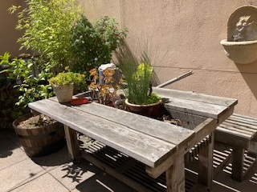
Case Studies
JH – a 67 y/o admitted to Respite with L side hemiparesis, gout, evidence of cognitive impairment.
CP – a 64 y/o with metastatic prostate cancer – on chemo, obstructive AKI – s/p L sided nephrostomy tubes, #CVA with Left sided deficits, HFrEF, AUD
GW – 66 y/o, 1. TBI/Major neurocognitive d/o, NOS, Ogilvie's syndrome, AUD, Epilepsy, NOS
OE – 43 y/o male monolingual Spanish speaker, Blindness due to Neovascular glaucoma of both eyes, severe stage, Type 2 diabetes mellitus with hyperglycemia. Client was completely blind. Our PCAs helped him to navigate to and from med pass and meals.
Notes:
JH is a 67 y/o admitted to Respite with L side hemiparesis s/p, gout, evidence of cognitive impairment. Had hx of polysubstance use but significantly decreased in recent years. Mr. H did not have the strength to get out of bed himself, though could do it with 1 person (25%) assist. With PCAs we were able to accommodate him. Our PCA switched her schedule to start at 6:30am.
CP is a 64 y/o with metastatic prostate cancer – on chemo, obstructive AKI – s/p L sided nephrostomy tubes, #CVA with Left sided deficits, HFrEF, AUD. This client’s ability to care for himself worsened with his cancer, to the point where this client was incontinent, and needed assistance with incontinence supplies (pullups or briefs). Our PCAs were able to help him put on his incontinence supplies before bed each night, and then help to replace them in the morning, providing stand by, 1 person assist, something we could not have done prior to PCAs, and something that would have landed this client back in the hospital.
GW is a 66 y/o with TBI/Major neurocognitive d/o, NOS, Ogilvie's syndrome, AUD, Epilepsy, NOS: Other relevant PMH: prior TBIs. This client became more and more cognitively impaired during his stay. Our PCAs could provide him with frequent orienting, and help navigating the facility as he would forget where things were. This extra assistance made this client feel at home and not want to leave the facility, and therefore not get lost in the community.
OE is a 43 y/o monolingual Spanish speaker, Blindness due to Neovascular glaucoma of both eyes, severe stage, Type 2 diabetes mellitus with hyperglycemia. Client was completely blind. Our PCAs helped him to navigate to and from med pass and meals, and throughout the facility, as well as provide him with shower assist and assist with ADLs. This was a service we did not have the ability to provide at Respite, prior to our PCAs.

Slide 28
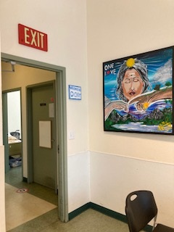
Communication with hospitals and Community Partners:
-We clearly document our inclusion and exclusion criteria, and provide this to the in-patient and shelter teams
-Clients referred via Ereferral
-Intakes coordinator communicates directly with hospital and shelter teams
-Intakes coordinator works with the nurse manager of shelter health and with leadership for clients that don’t fit in the box
-We partner with the DOCC at SFGH when there is a client that is questionable, or when they have a client that they would like us to try.
-Intake Coordinator communicates clearly the ability of our PCAs to provide ADL support as 1 person assist
-We offer tours to referring partners so they can understand our unique set-up
Notes:
We recognize clear communication with hospitals and Community Partners is crucial to making our program work. To do this:
-We clearly document our inclusion and exclusion criteria, and provide this to the in-patient and shelter teams
-We communicate with the hospital our limitations, ie: clients need to transfer to and from the toilet themselves, clients need to get themselves to and from the dining room, the nursing desk, the van pick up, the bathroom.
-All Intakes are referred via EReferral from hospitals and from shelter health teams to ensure criteria are met and explain our limitations.
-Our Intake Coordinator communicates directly with the teams-hospital and Shelter
-Our Intake Coordinator works closely with the nurse manager from Shelter Health around Shelter referrals to ensure they can manage in our shelter type setting.
-We work closely with the DOCC (Department of Care Coordination) at SFGH. They help us on the ground at the hospital to verify if clients are appropriate for Respite, when we are concerned, they also work with us when they have a special case of a client that doesn’t quite fit the box but would do okay at our setting, and there is no other option.
-Our Intakes Coordinator communicates clearly to the teams the ability of our PCAs to provide ADL support as 1 person assist, and the services we provide
-Our Intakes Coordinator communicates that clients need to be independent in getting to and from the dining room and to and from the bathroom.
-We offer tours to referring partners so they can understand our unique set-up and see for ourselves

Slide 29
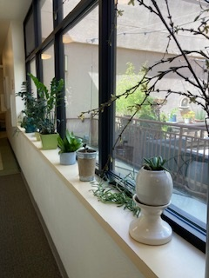
Lessons Learned
-Some Issues with Registry
-PCAs needed a lot of training and support initially and on-going
-Overnight PCA coverage was more trouble than it was worth
-We needed a point person for PCAs to report to
-Our PCAs do best when they collaborate on day shift
-PCAs should be included in team meetings
-PCAs can over-do, the manager/charge nurse needs to monitor for this.
-PCAs often first staff present for behavioral issues in the dorms.
Notes:
There have been many lessons learned over the years.
-We found early on that the registry could not provide us enough staff to meet our staffing needs. We struggled with the registry being able to provide consistent staffing in a non-traditional setting. PCAs are trained for a very traditional hospital setting so it was hard to retain PCAs that understood our Harm Reduction and Trauma Informed community and would stay.
-Our PCAs also need a lot of training and support initially and on-going – most PCAs are used to work on a hospital unit, usually under the direction of a specific nurse. In our setting, the PCAs are based out of our dorm areas where clinical staff are not stationed. They benefit from regular check-ins from nursing staff, and regularly rounding of nursing staff in the dorms where they work.
-Overnight PCA coverage was more trouble than it was worth. Initially, we started with a PCA overnight. During COVID, our overnight PCA was moved to our hotel site and a different program. In the end, it was better for our program to not have an overnight PCA. We found that the PCA really did not feel supported, was not closely supervised, and more easily had conflicts with our CBO staff on the overnight shift.
-Initially we had the PCAs report to the client’s assigned nurse for any issues or if they needed help. This meant they communicated with 5 different nurses at any given time. This got confusing for the PCAs. We instead had our Charge Nurse be the go-to for the PCAs, and then the Charge Nurse would be the liaison between the teams and the PCAs.
-We found that Our PCAs work together on day shift – we have 2 PCAs 3 days week – and this collaboration works the best as the work can be different day by day, and from dorm to dorm. PCA assignments are hard to manage. We have assigned PCAs to different dorms, though, occasionally when we had staff conflict.
-We found that PCAs should be included in team meetings as they serve an important perspective about a client’s well being.
-There are times when PCAs are overdoing, and the manager/charge nurse needs to monitor for this. I stress to my PCAs quite a bit that clients need to participate in their care. Clients should not be provided care in their beds, for instance, as we are not a hospital unit and our beds are not hospital beds. This can lead to staff hurting their backs. There are times when our amazing PCAs are providing more support than we should do in a traditional Primary Care setting.
-PCAs are often the first staff present when behavioral issues occur in the dorms. Let the PCAs know they are not security and it is not their job to monitor that clients aren’t breaking the rules or to intervene and to call appropriate staff to take this on.

Slide 30
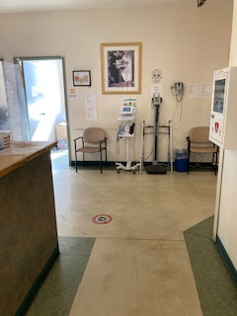
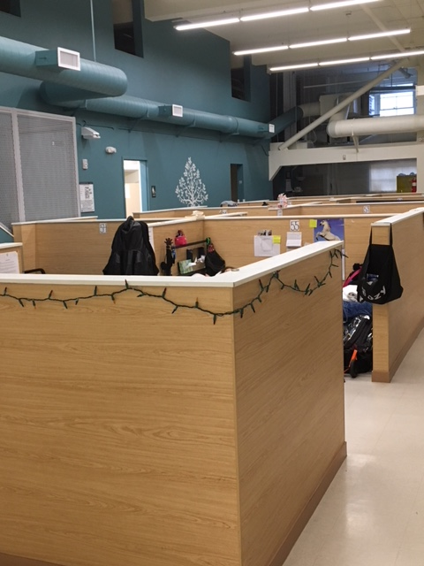
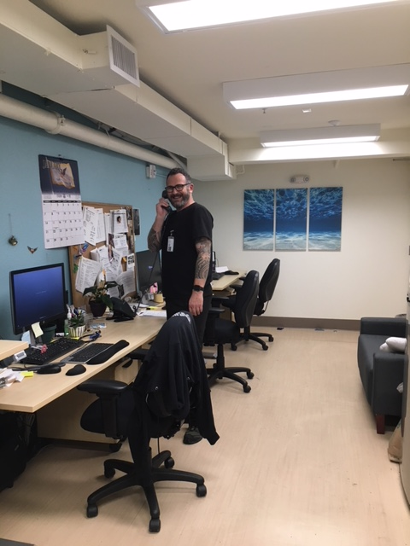
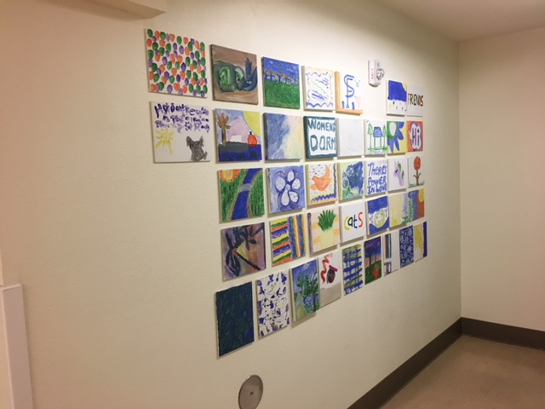
Notes:
Just A few more pictures of our facility…..

Slide 31
Questions? My email: carli.fullerton@sfdph.org
Notes:
Okay, and now I will open it up for questions.
Please feel free to email me if you have any other questions that occur to you. I am also happy to share our PCA tools with you via email.
Thank you so much for coming. Thanks also to my colleagues at San Francisco Department of Public Health of attending in support!

Slide 32
Table 3.3 General Levels of Assistance
Level of Assistance Terminology | Criteria
Independent | The patient: is able to transfer independently and safely.
Standby Supervision / One Person Assist | requires no physical assistance but may require verbal reminder. may also be learning to transfer independently using a wheelchair, walker, or cane.
Minimal Assist / One Person Assist | is cooperative and reliable, but needs minimal physical assistance with the transfer. requires minor physical exertion from healthcare worker during re-positioning, assisting to stand / sit, and when ambulating. can consistently fully weight bear when standing. is able to perform 75% of the required activity on their own.
Two Person Assist | requires more than minor physical assistance. often needs equipment to assist with transfers or mobilization. is able to perform 50% of the required activity on their own.
Total Assist | requires full physical assistance for re-positioning, standing, turning, transfers, and/or mobility. may be unpredictable and uncooperative. requires equipment to assist with re-positioning and transfers is able to perform 0-25% of the required activity on their own.
Data sources: South Island Alliance, n.d.; Winnipeg Regional Health Authority (WRHA), 2008; Worksafe BC, 2006
Notes:
This shows the different levels of assistance provided by caregivers in general

