Slide 1
Improving equitable access to palliative care for structurally vulnerable populations: How to incorporate health navigation into your palliative care program
Trevor Morey, MD, CCFP (PC)
Palliative Care Physician, PEACH, Inner City Health Associates
Naheed Dosani, MSC, MD, CCFP (PC)
Lead, PEACH, Inner City Health Associates
Palliative Care Physician, St Michael’s Hospital, Unity Health Toronto
HCH2024
PHOENIX, AZ • MAY 13-16, 2024

Slide 2
Land acknowledgement
Notes:
We acknowledge that this is sacred land upon which we are privileged to live and work.
We recognize the deep connection and the long-standing relationship between Indigenous peoples and the land known as Phoenix O’Odham and Piipaash
This land has supported human beings for at least the past 10,000 years.
We recognize that due to a long standing history of settler colonialism that there are significant social and health disparities for first nations, metis and inuit Canadians, which leads to an increased rate of incarceration, early mortality and homelessness.
This land is the traditional territory of:
Toronto:
the Anishinaabeg
the Haudenosaunee
the Mississauga of the new credit

Slide 3
Canadian Medical Association, 2015
Notes:
Trevor

Slide 4
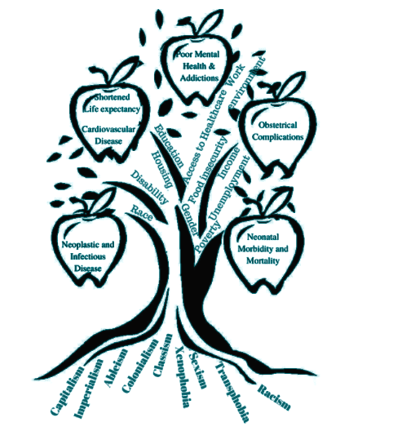
Social determinants of health
Digging at the roots,
not just low hanging fruit:
The reproduction of the social determinants of health when the structural determinants’ are left untouched
~Dr Nanky Rai
Notes:
Trevor

Slide 5
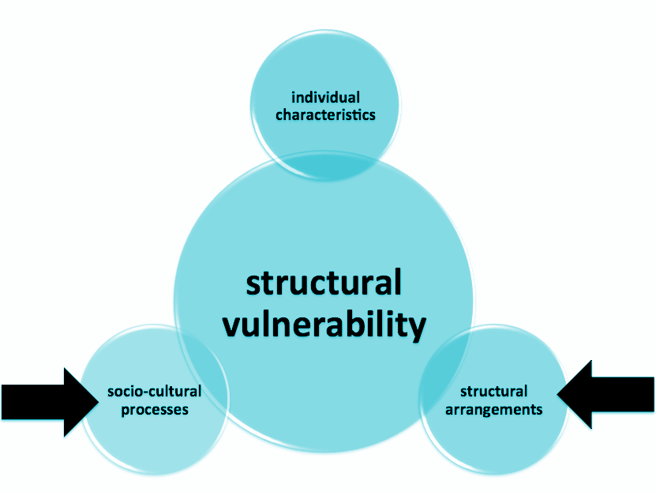
McNeil, 2015
Notes:
Trevor

Slide 6
Structural vulnerability
“An individual’s or a population group’s condition of being at risk for negative health outcomes through their interface with socioeconomic, political, and cultural/normative hierarchies. Patients are structurally vulnerable when their location in their society’s multiple overlapping and mutually reinforcing power hierarchies (e.g., socioeconomic, racial, cultural) and institutional and policy-level statuses (e.g., immigration status, labor force participation) constrain their ability to access health care and pursue healthy lifestyles.”
Notes:
Trevor

Slide 7
Examples of structural vulnerabilities
Homeless & vulnerably housed
Homelessness
Poverty
Social isolation
Substance use
Trauma
Poverty
Social isolation & trauma
Racialized communities
Substance use disorders
Mental illness
New Canadians, immigrants, refugees
Non-status populations
Notes:
Trevor

Slide 8
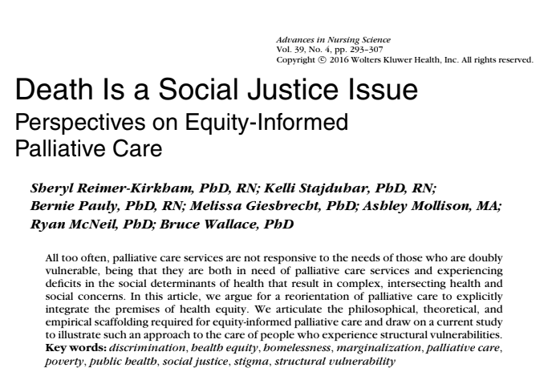
Death is a Social Justice Issue
Notes:
Trevor

Slide 9
Death is a social justice issue
People living with life-limiting illness
Affected by deficits in the social determinants
DOUBLE
vulnerability
Reimer-Kirkham et al, 2016
Notes:
Trevor

Slide 10
The health of people who are homeless
75% with one or more chronic disease
HCV: 28x
Heart Disease: 5x
Cancer: 4x
Acute care:
ED: 8x
Hospital admission: 4x
The elderly
St Michael's Hospital, 2014 Podymow et al, 2006 Cagle, 2009 Plunkett, 2016
Notes:
Trevor

Slide 11
The health of people who are homeless
Highest all-cause mortality rate in Canada
Life expectancies:
34 - 47 years old
Mortality rates: 2.3x - 4x
Location at EOL
St Michael's Hospital, 2014 Podymow et al, 2006 Cagle, 2009 Plunkett, 2016
Notes:
Trevor

Slide 12
50%
Notes:
Trevor

Slide 13
Notes:
Trevor

Slide 14
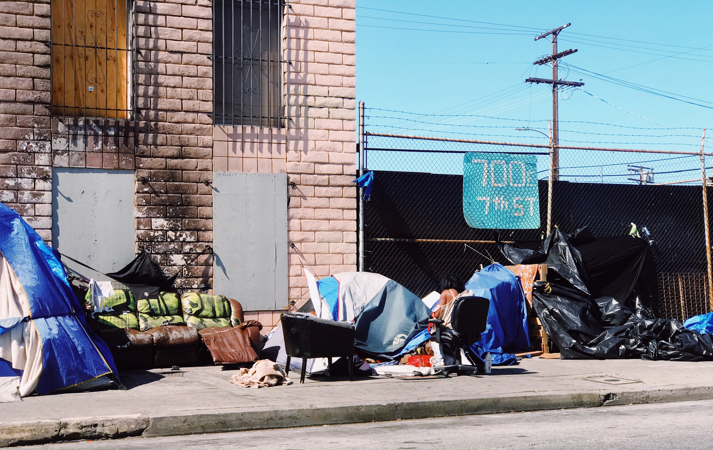
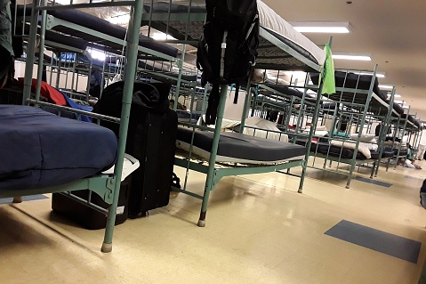
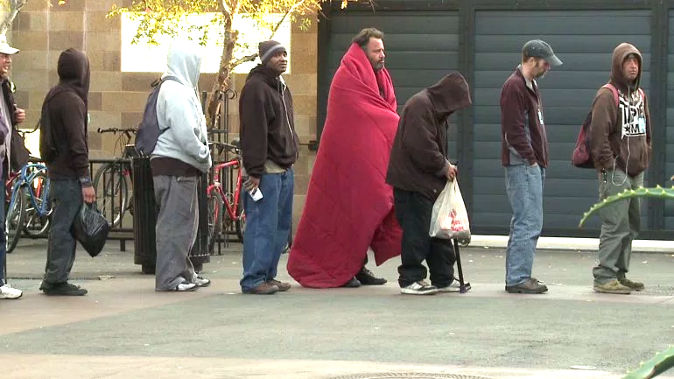
Notes:
Naheed

Slide 15
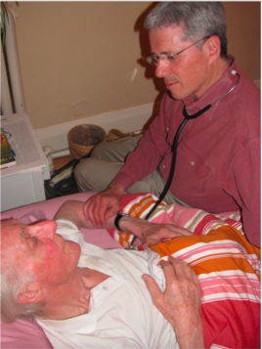
Best Practices: Homeless Health
Outreach
Case management
Interdisciplinary approach
Care across settings
Harm reduction
Integration with housing sector
Leading with lived experience
Notes:
Naheed

Slide 16
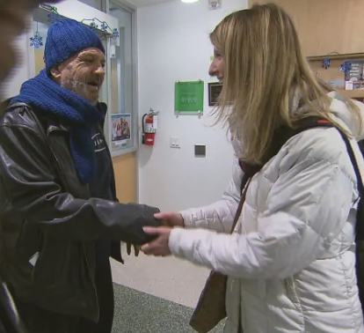
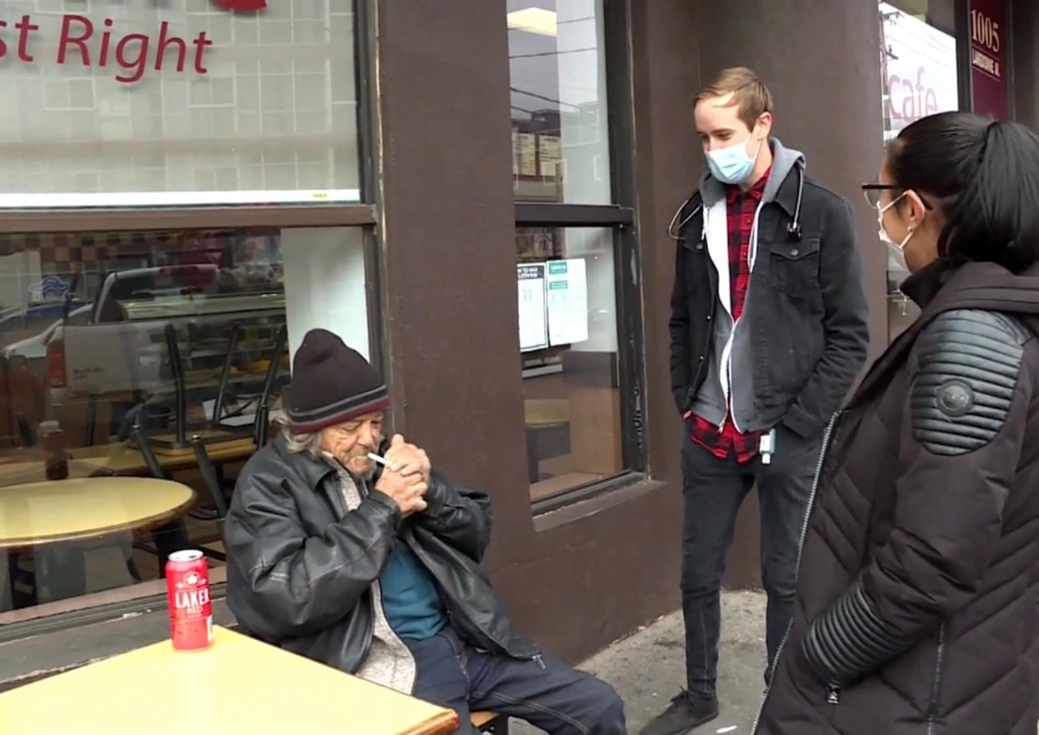
The Palliative Education And Care for the Homeless (PEACH) model of care
Notes:
Naheed
And so on July 1 2014, the PEACH Program (Palliative Education And Care for the Homeless), was born - as Canada’s first mobile, street & shelter based palliative care program aiming to provide healthcare to unhoused people with serious life limiting illnesses, so that no person would die alone or fall through the cracks. Whether on the street, in a shelter or under a bridge.
The program started out the back of my Honda Civic 1 day a week (no joke, I literally just got rid of that civic recently) with my colleague, nurse Namarig Ahmed and I, driving around the streets…

Slide 17
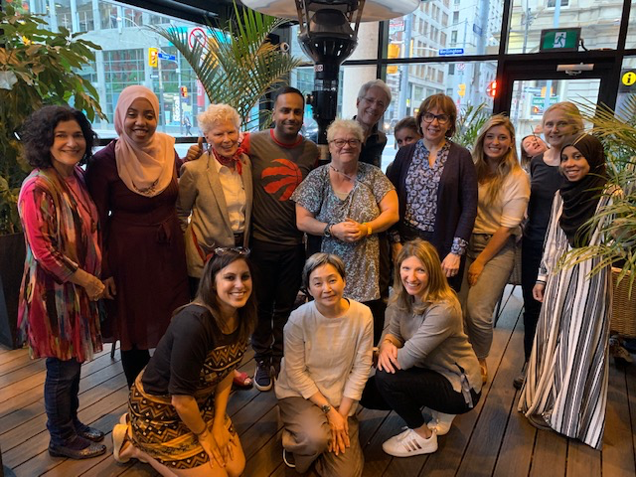
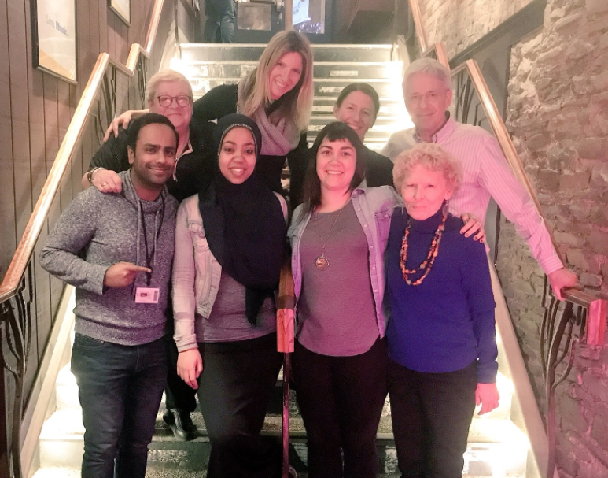
The PEACH team
Notes:
Naheed
…and fast forward to 2023, PEACH has grown to become the largest community-based palliative care program for unhoused people in the world.
Our team today, features a nurse coordinator, home care coordinator, social worker health navigator, 6 palliative care physicians, a PEACH psychiatrist and an interprofesional roster of home care professionals, providing home care in non-traditional home settings.
We have cared for over 1000 clients since our birth and carry between 110-120 patients who are living & dying on the streets & in shelters, on caseload, at any given time across the City of Toronto.
A 1 year retrospective chart review of our care showed that: 64% of patients never went to the hospital or ER. 80% died exactly where they wanted to, wherever they called home. And 83% were reconnected to family and friends.
In 2016 the University of Toronto named PEACH as a best practice in social accountability and has since created a formal relationship where every graduating palliative care resident physician must rotate with us as part of a core mandatory learning experience.
In 2018, PEACH was named as a best practice by the Government of Canada in their Palliative Care Framework (which I will talk more about later)
And finally, more recently, the PEACH Program has been recognized & honoured by Canada’s Governor General as a trailblazing practice in palliative care

Slide 18
PEACH: Core Values
Harm reduction
Trauma Informed care
Intersectionality and anti-oppression
Interprofessional approach to care
Notes:
Naheed
PEACH works because of our commitment to core values.
Harm Reduction - yes we prescribe opioids and other controlled substances to people who use drugs
Trauma informed care - we care for many people who shouldnt be dying, but are dying because healthcare has trauamtized them and that is why they didn’t access healthcare to begin with
An anti-ooppressive approach to care - we are not here to top-down deliver health resources, we are here to redistribute health resources to the people in an equitable way
And an IP approach to care - our team functions without a hierarchy
We do not negotiate on these values and never have, since our birth.

Slide 19
PEACH: Beyond Clinical Care
Education
Advocacy
Research
Social care
Notes:
Naheed
For those familiar with clinical practice in palliative care, PEACH works because we go much further than what traditional “palliative medicine” does.
Yes we provide a palliative approaches to medical care and pain/symptom management…but its much more.
As mentioned, we educate the next generation of health trainees through formal partnerships with health training programs like the one at the University of Toronto.
We advocate for a healthy to end homelessness.
We conduct advocacy-based research to raise the bar & give this work the credibility it deserves.
And finally like many of you, we are social prescribers. It isn’t good enough to treat the pain, the nausea and constipation: We prescribe housing. We prescribe income. And assist with things like healthcare navigation (even providing transportation and accompaniments for our clients when needed).

Slide 20
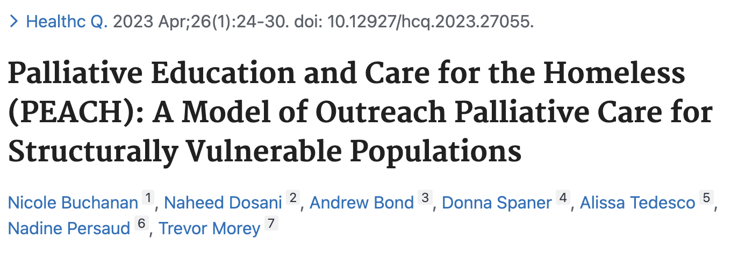
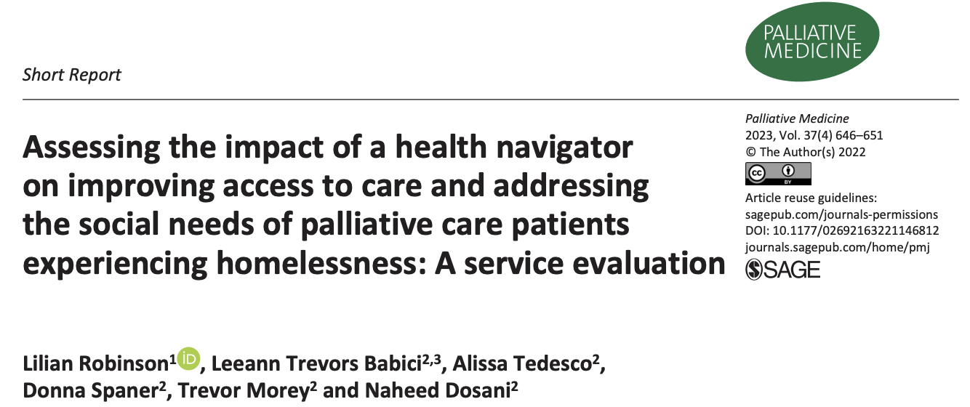
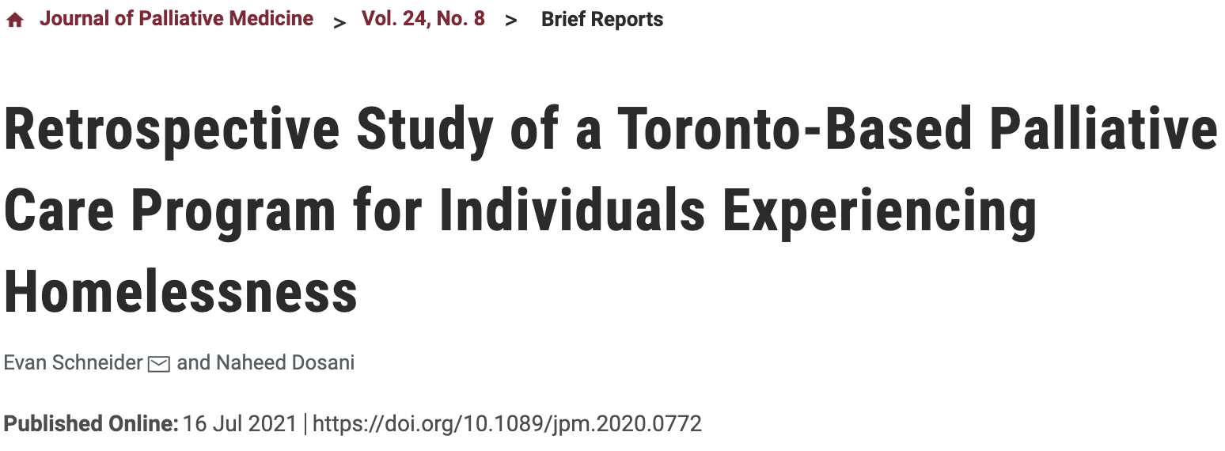
Why PEACH works
Notes:
Naheed
In truth, the PEACH Program works for 5 reasons:
We strive to integrate health & social services in every way
We bring a trauma informed approach to palliative care
Harm reduction as a human right to palliative care
Flexible/agile to “meet people where they are at” outside of hospitals and clinics
And we work from a place where we recognize that the system isn’t broken…it was literally built this way! Framing is everything.

Slide 21
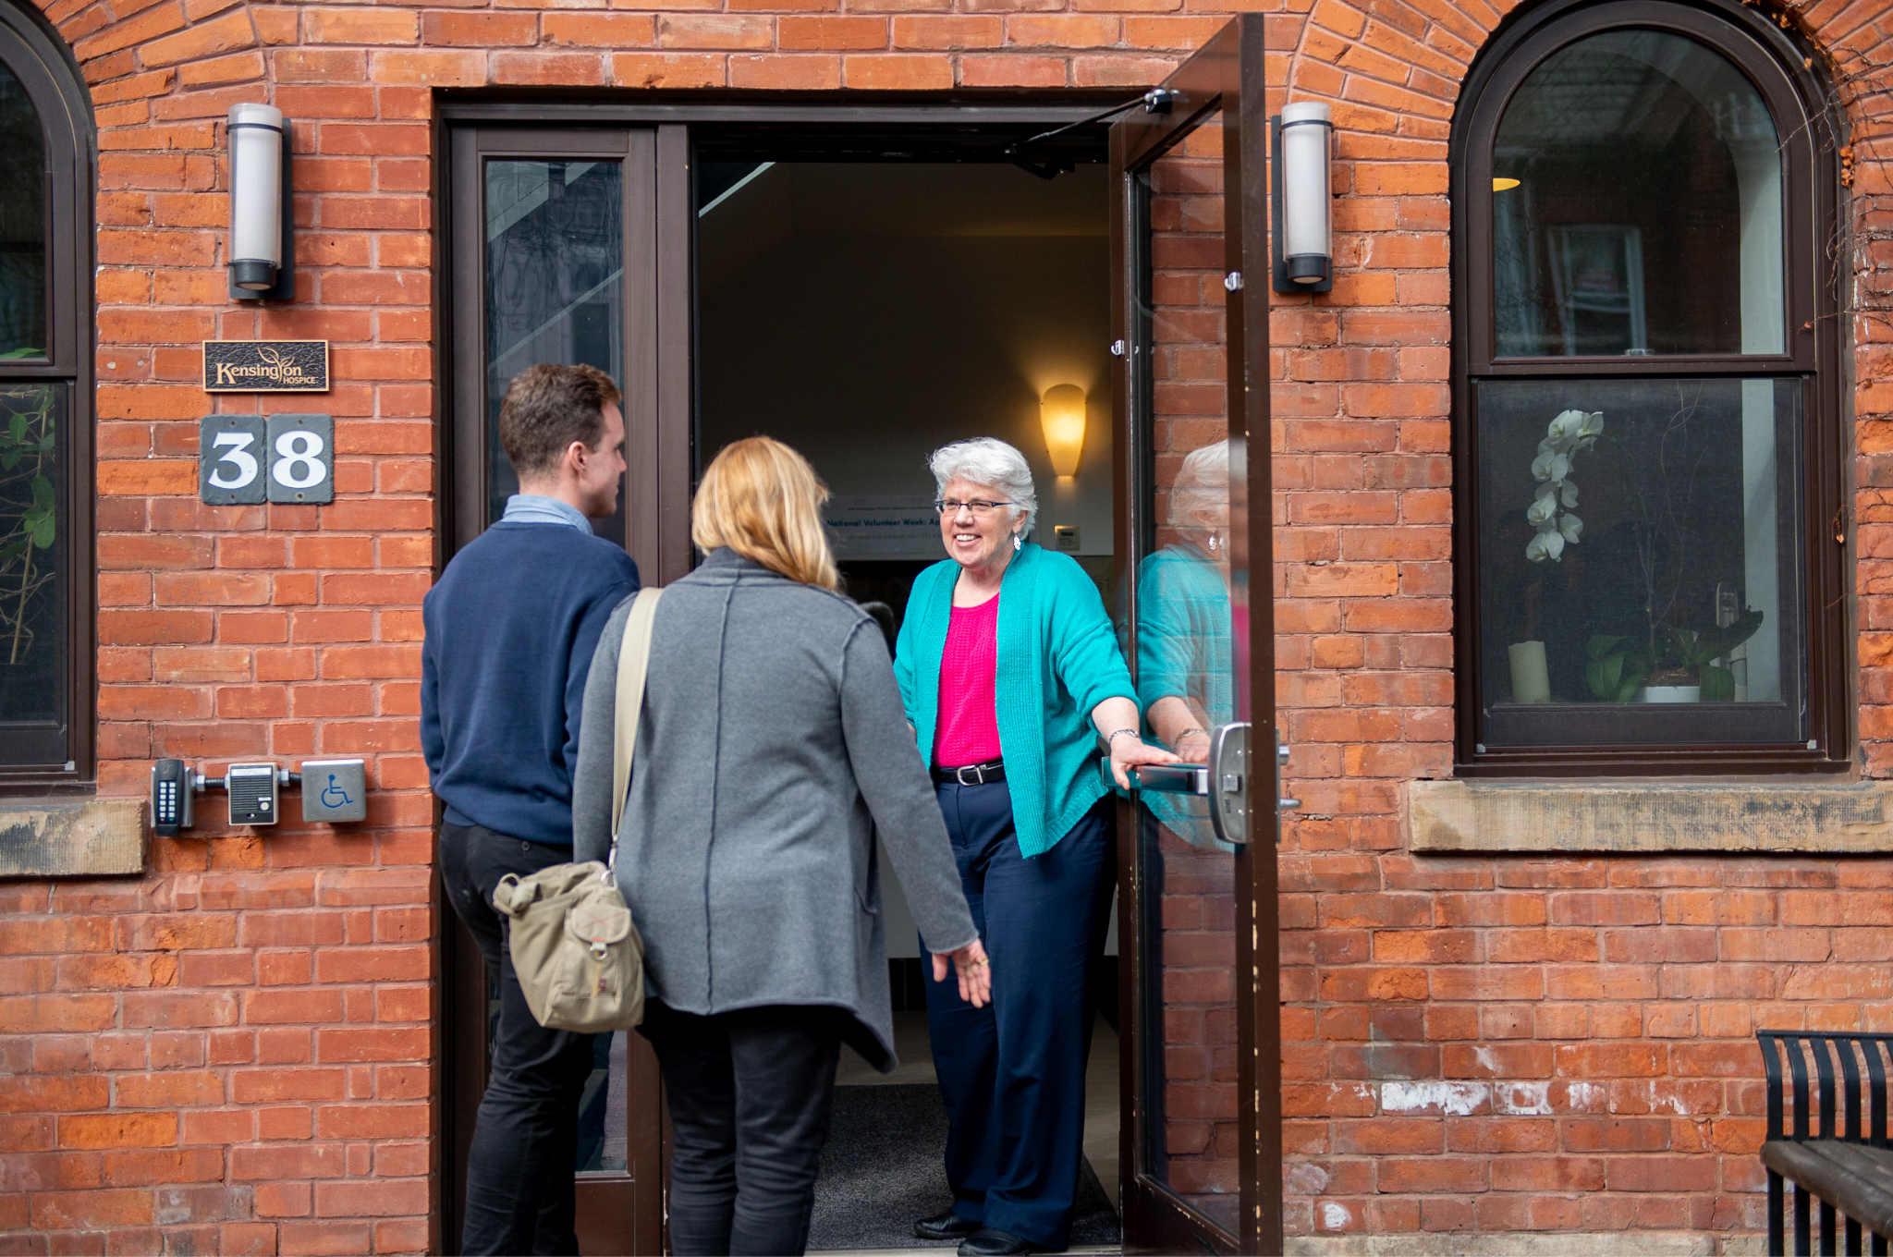
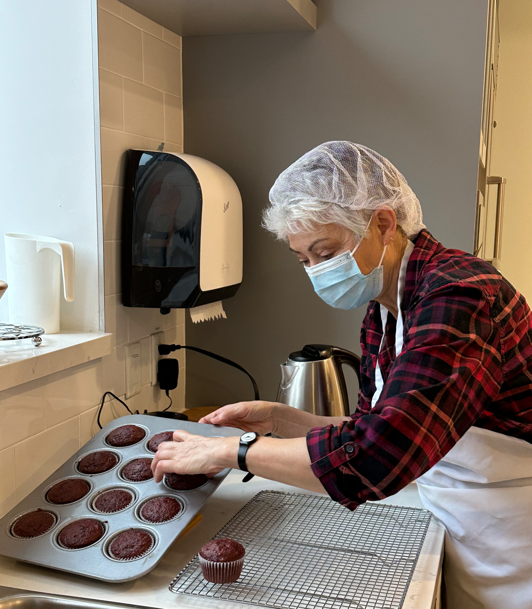
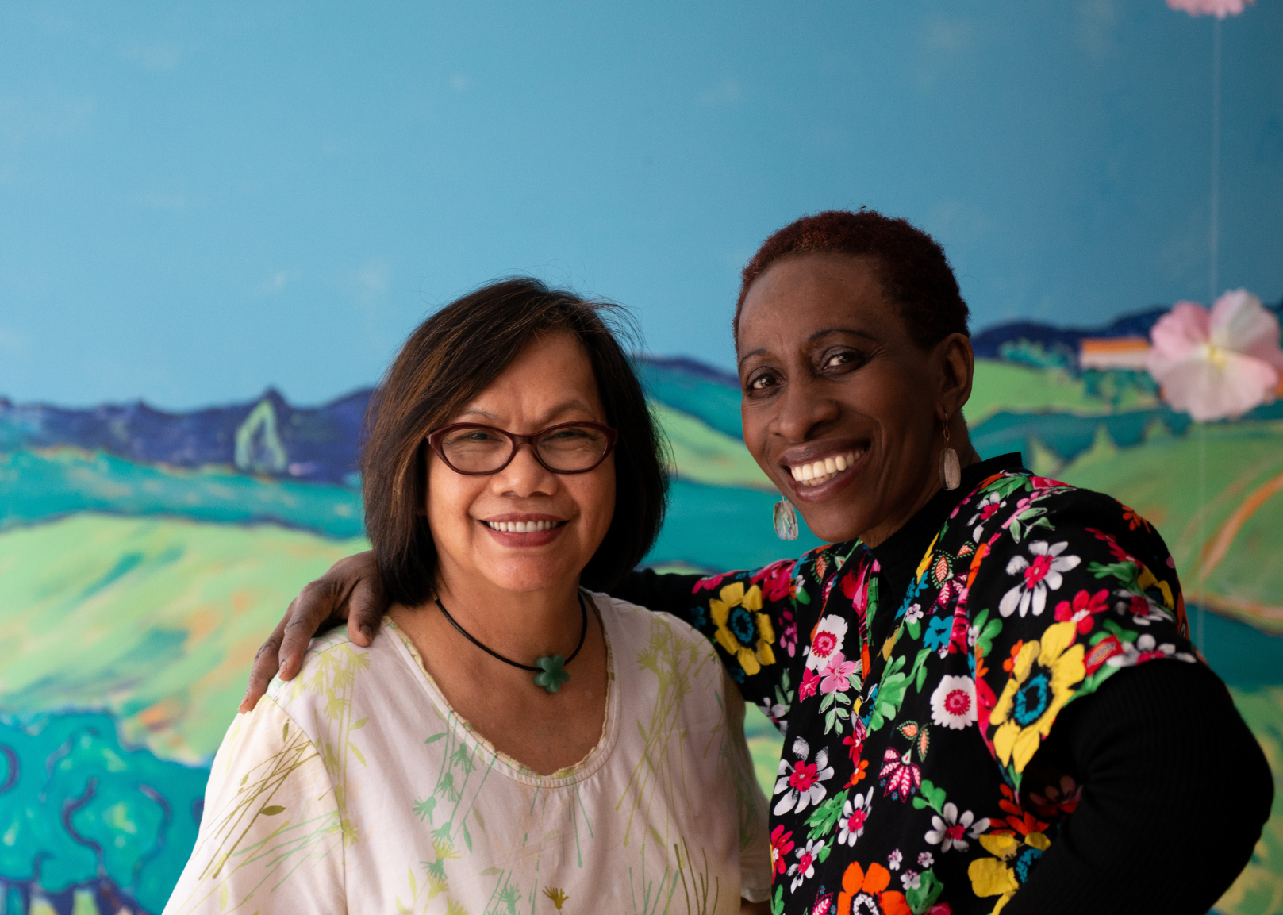
Notes:
Naheed

Slide 22
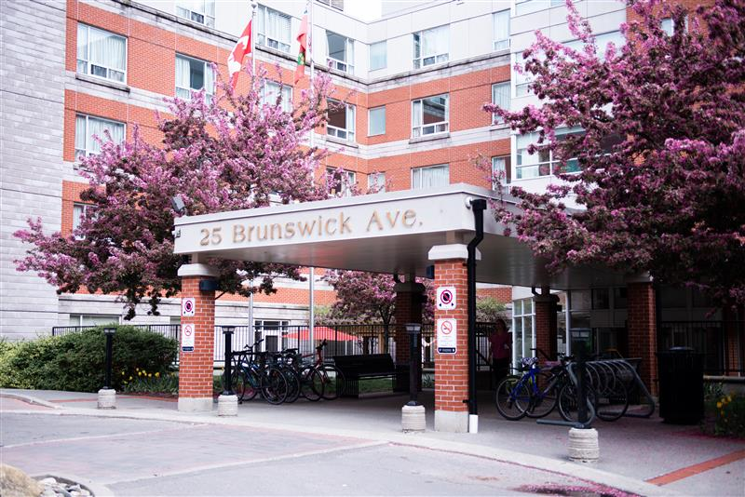
Kensington Gardens: A 350 long-term care home.
Kensington Hospice: A 19 bed hospice residence
The Second Mile Club of Toronto: A community support program that supports adults with disabilities and seniors in the community through five different program.
Ambulatory Care: Kensington Eye Institute, Kensington Vision and Research Centre, Kensington Screening Clinic, Kensington Diagnostic Imaging Centre, Kensington Research Institute and the Eye Bank of Canada.
Notes:
Naheed

Slide 23
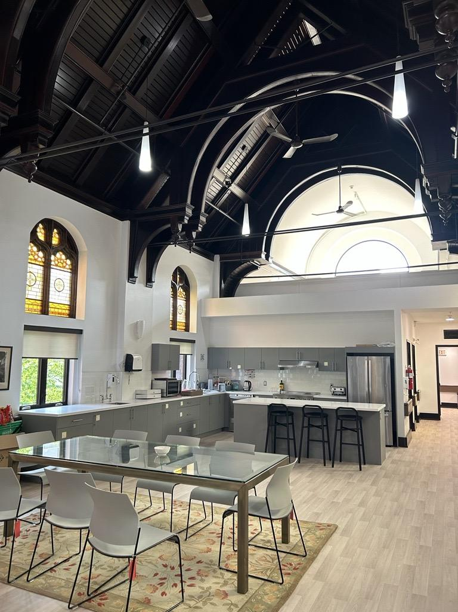
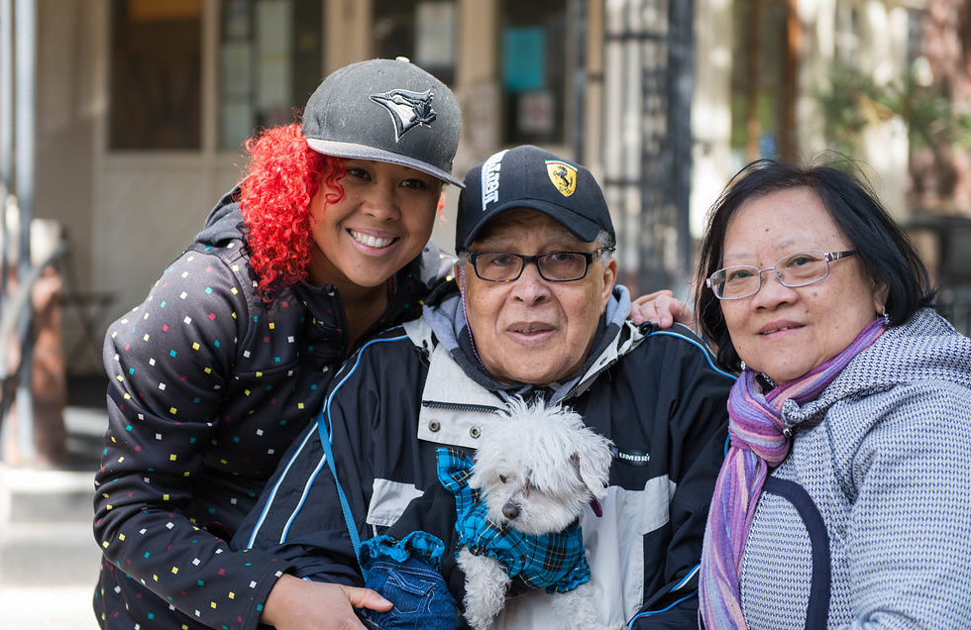
The Second Mile Club of Toronto:
Four Senior Active Living Centers
Day Hospice Program
Caregiver and Bereavement Support
Homemaking
Crisis Intervention and Support
Transportation
Notes:
Naheed

Slide 24
Why a Health Navigator at PEACH and The Second Mile Club
Complex social presentations becoming more common
To support handoffs with social care workers (eg hospital SWs) referring to PEACH
To decrease dependency on external organizations for social care support
To develop competency within the palliative care sector in addressing social care issues within the context of health navigation…and then to scale up!
To decrease moral injury among PEACH team members
Notes:
Naheed

Slide 25
What the Health Navigator role at PEACH and the Second Mile Club is all about
Lead community awareness and outreach through partnerships and networking
Manages a clinical caseload on the PEACH Team
Supporting clients with significant “social care” issues (eg homelessness, poverty, food insecurity etc)
Facilitate extra supports/services by “connecting” clients with care
Serve as a strong advocate while also providing extra supports (eg counselling)
Serve as a program ambassador externally
Notes:
Naheed

Slide 26
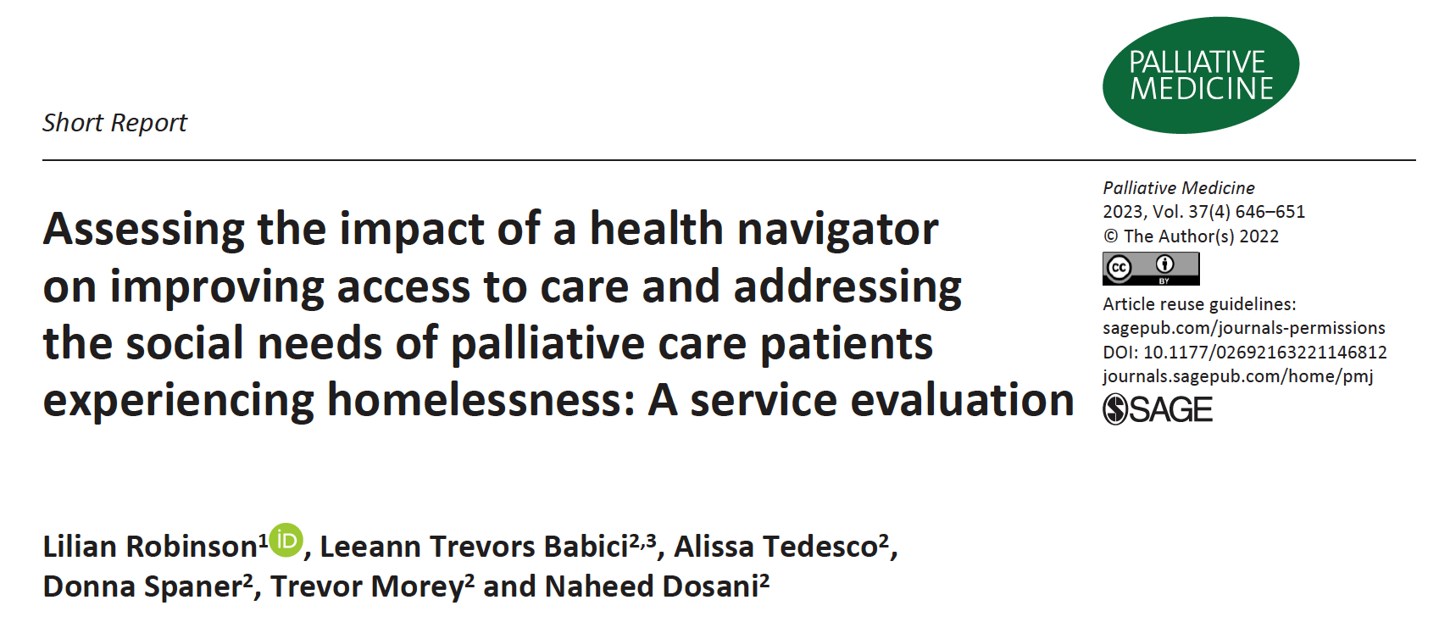
PEACH Health Navigator- Evaluation
Notes:
Trevor

Slide 27
PEACH Health Navigator- Job Description
Health Navigator in Palliative Care
Reduce barriers to care
Provide motivational and supportive counselling
Deliver health education
Help clients access social supports
Connect clients with culturally appropriate services
Connect network of interprofessionalism health care providers
For People Experiencing Homelessness
Attend case conferences and advocate for culturally competent care
Attend health appointments
Advocate for assessments, admissions, consults, OT/PT interventions, and addictions support
Conduct home and shelter visits
Perform health surveillance
Coordinate services to support clients in maintaining housing
Educate clients and community partners
Notes:
Trevor
A health navigator in palliative care will operate within a harm-reduction, person-centered framework to identify and reduce barriers to care, provide motivation and supportive counselling, deliver health education, help gain access to social supports, connect clients with culturally appropriate services, and ensure that clients and their network of interprofessional health care providers are connected and collaborating effectively.
A health navigator providing palliative care to people experiencing homelessness or who are vulnerably housed will focus on the granular detail primarily within the domains of reducing barriers to care and helping clients access social supports. They therefore also do the following: (text on the right side of the slide)

Slide 28
Our goal: Capture Celina’s Value
Evaluate the impact of a health navigator, Celina Dycke, on the quality and delivery of palliative care provided by the PEACH program, and leverage our findings to suggest how a health navigator can add value to community-based palliative care teams.
Notes:
Trevor
Multiple studies have demonstrated the positive impact of social workers on palliative care teams, [don’t say: including their capacity to improve quality of care, facilitate discussions about advanced care planning, educate patients and families, help patients achieve prognostic alignment, screen for bereavement needs, and lead team discussions.^{4,5.]}
However, there is little research to date on the impact of social workers as health navigators in the realm of palliative care, and to our knowledge there are no studies demonstrating the impact of a professional health navigator in community-based palliative care for individuals experiencing homelessness and housing insecurity
So this is what we wanted to do by examining Leeann’s impact on the PEACH team.

Slide 29
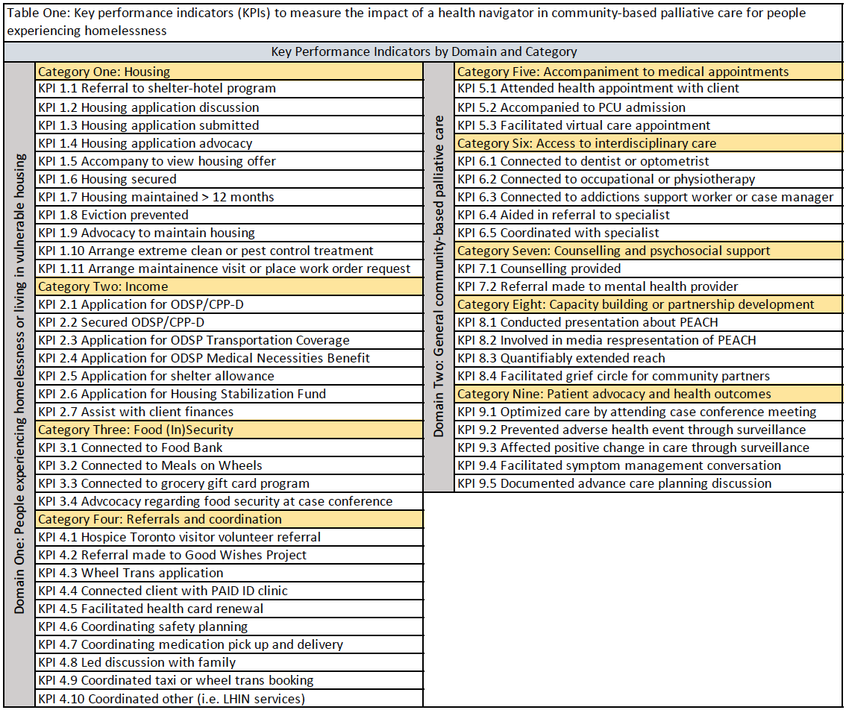
Key
Performance
Indicators
2013 Change Foundation approach to evaluating health navigation in Ontario
Direct link to indicators that measure health outcomes, patient experience, and health care efficiency¹
¹Health system navigators: band-aid or cure? https://changefoundation.ca/wp-content/uploads/2016/05/TCF_Panorama_Navigator_final.pdf. Published September 2013. Accessed Oct 2020.
Notes:
Trevor
In 2013, Change Foundation assembled a panel of 32 Ontarian patients and caregivers to understand the anticipated value of lay and professional health navigation in Ontario’s health care system. The panel expressed that evaluation of the health navigator role should be directly linked to indicators that measure health outcomes, patient experience, and health care efficiency.¹ In the proposed study, impact will be measured using key performance indicators (KPIs) designed to capture these important areas of care.
KPIs will be categorized into one of two domains: (1) palliative care for people experiencing homelessness and (2) community- and home-based palliative care in general. KPIs in domain one are formulated to reflect the roles and responsibilities of Leeann Trevors on the PEACH team. KPIs in domain two are reflective of the current literature pertaining to palliative care as a whole, and therefore apply to both community-based and home-based palliative care. Depending on the demographics of clients served, some KPIs in domain two may not be readily measured in the proposed study.

Slide 30
Data Analysis
Total number of events tabulated per KPI at interim analysis (June 2020 - April 2021) and final analysis (June 2020 - June 2021)
Impact measured using several different methods:
Method One: Total number of events per KPI category then organized by KPI frequency
Method Two: KPIs categorized by frequency then measurement type (output vs. outcome)
Method Three: Total number of events per KPI category then per measurement type
Notes:
Trevor
Looking at the data we devised three different ways to break these numbers down to make sense of the story it’s telling

Slide 31
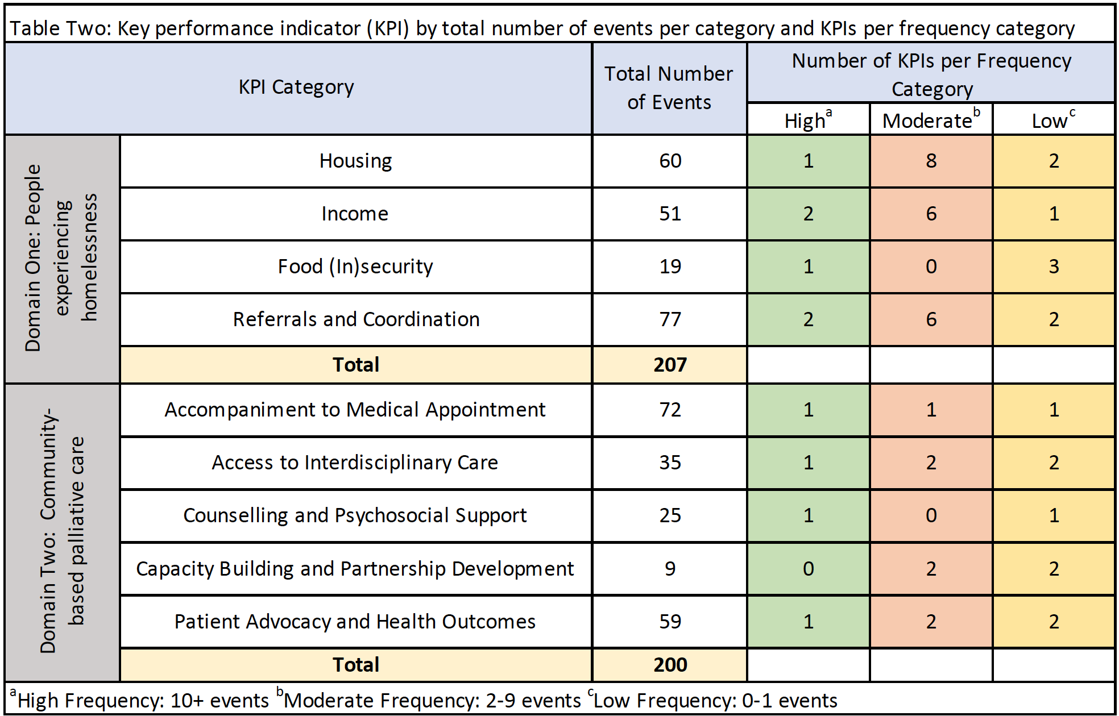
Findings
PEACH Health Navigator role essentially split between domains
Highest frequency categories are housing, referrals and coordination, medical appointments, and patient advocacy
Many low and moderate frequency KPIs are not within Celina’s job description
Moderate and high frequency KPIs are broadly represented by all categories
Coordination: Taxi or Wheel Trans booking (10)
Applied for ODSP transportation coverage (11)
Applied for ODSP medical necessities benefit (12)
Housing application advocacy (14)
Connected to Hospice Toronto Grocery Program (17)
Coordination with Specialists (23)
Counselling Provided (25)
Coordination: Medication Pick Up and Delivery (32)
Optimized Client Care by Attending Case Conference Meeting (52)
Attended Appointment (69)
Notes:
Trevor
Method one: Total number of events per KPI category then organized individual KPIs within each category by frequency (either low moderate or high)
First draw your attention to the total number of events per Domain … tells us that Leeann has skills that allow her to be effective in both domains
The highest frequency KPI categories are housing, referrals and coordination, medical appointments, and patient advocacy
On the right here you can see the number of KPIs within each category that fall into low, moderate, and high frequency categories, where low frequency KPIs are those that occurred 0-1 times….
Directing our attention first to low and moderate frequency KPIs, we can see that they come from all KPI categories. Although not shown on this slide many of these low and moderate frequency KPIs are activities that are not necessarily listed in Leeann’s job description but were activities that we were interested in tracking throughout this study such as media involvement and initiating referrals as two examples. Certainly these activities that are completed with low frequency represent opportunities for growth within the role, but the fact that they are completed at all also point to the fact that Leeann is able to leverage her diverse skill set and slide into domains that are outside of the formal scope of her role. [Dont say Some examples include (1) capacity building and partnership development, with Leeann having some but not very much involvement in media outreach and extending the reach of the organization, as well as (2) initiating referrals to mental health providers and specialists as she is more often involved in bridging communication rather than initiating the referral process.]
Turning our attention to the highest frequency category which includes the following KPIs from 8 of 9 categories. This really brings home that a Leeann as a health navigator is wearing multiple hats across multiple domains in order to facilitate holistic and dignifying palliative care for socially and medically complex individuals.
She’s doing that through (1) facilitating access to care by applying for and securing transportation coverage and medical necessities benefit, and picking up medications (2) coordinating care through connections with specialists (3) advocating for patients in their care through attending appointments and case conference meetings (4) providing direct support to patients through one-on-one counselling, and (5) meeting the social needs of patients through advocacy related to housing applications and addressing food insecurity.

Slide 32
Findings
Output KPI = an action in service of an outcome (i.e submitting a housing application) vs. outcome KPI = an achievement that occurred because of the activity completed (i.e. securing housing)
KPIs completed with low frequency are mostly outcome type (75%), whereas KPIs completed with high frequency are skewed toward output type (70%)
High levels of output will correspond to a smaller number downstream high impact outcomes
Notes:
Trevor
Frequency is one thing, what about impact?
This is our second method of data analysis. We assigned each individual KPI with a measurement type, either output or outcome. As you can see on the slide, in the world of impact measurement, output is defined as …. whereas an outcome is defined as….
If we look at the distribution of output vs. outcome KPIs within low, moderate, and high frequency KPI categories, we see the following [...] report low, then high, then moderate. If we actually pool low and moderate categories together we see that low and moderate KPIs are 60 per cent outcome, and 40 per cent output, compared to that 70% output and 30% outcome in the high frequency category.
This really supports what is probably obvious to all of us that high levels of output will correspond to a smaller number of downstream outcomes. Some examples of high impact downstream outcomes that are completed with low to moderate frequency include securing housing, preventing evictions, securing ODSP and other income support streams, quantifiably extending media reach or engaging in community partnership through facilitating grief circles, and some others that are perhaps more difficult to track such as preventing a poor outcome, changing the trajectory of someone’s care.
In the context of the Health Navigator role this may suggest that it requires a large investment of energy, time, and resources to have an impact at the systems level. To us this is a strong indicator of why continued and adequate funding is needed to support this full time role for a health navigator such as Leeann to reach their impact potential.

Slide 33
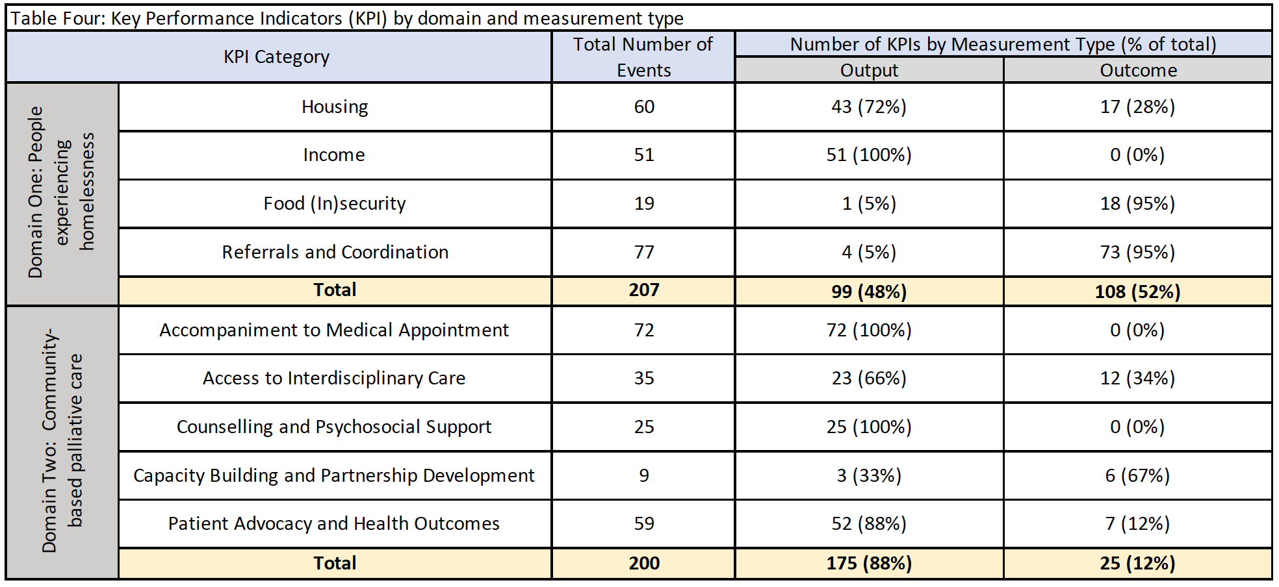
Findings
A higher percentage of KPI events in Domain One are categorized as outcome type (52%) than in Domain Two (12%)
High rates of output with varying degrees of outcome in both domains suggests versatility
Notes:
Trevor
This is our third and final method of data analysis.
Here on the left side… these are numbers we’ve seen before, so again drawing your attention to a fairly even split of Leeann’s activities between Domain one and Domain two. And then we’ve broken down these total events by how many of them were output vs. outcome.
For domain one, which is specific to people experiencing homelessness, we can see that 48% of the total events correspond to output, and 52% a slight majority, correspond to outcome. Looking at domain two, which includes KPIs that pertain more so to general community-based palliative care for all populations, there is quite a different distribution with 88% of total events corresponding to output (or activities in service of an outcome), and only 12% corresponding to an actual outcome.
What does this tell us that a higher percentage of KPI events in Domain One are categorized outcome type than in Domain Two? This likely represents the distribution of Leeann’s priorities, since as a health navigator on the PEACH team she is first and foremost attempting to make a quantifiable impact in the lives of people who are experiencing homelessness. Also worth noting that when we devised these KPIs we may very well have simply generated more outcome type KPIs in the category of people experiencing homelessness since that’s what we’re most interested in capturing and what we know best.
In addition though this also shows us that a health navigator can achieve high rates of outcomes in a niche area of palliative care while also achieving high rates of output in areas that are broadly applicable to community-based palliative care in general, once again speaking to the versatility and flexibility that a professional health navigator with a background in social work brings to this role.

Slide 34
Implications
Professional health navigators have an important role to play in the palliative care of marginalized and vulnerable populations
Our study clearly demonstrates the impact of a professional health navigator not only in the palliative care of individuals experiencing homelessness but also for community-based palliative care teams in general
An argument for enhanced funding for a health navigator on the PEACH team
Supports health navigators as a value add for your community-based teams
Provides a framework for formally evaluating the impact of a health navigator in palliative care settings
Notes:
Trevor
Professional health navigators traditionally have a background in social work, and they have a uniquely important role to play in the palliative care of marginalized and vulnerable populations as members of these populations often face complex psychosocial challenges, encounter systemic barriers to equitable care, experience communication or language barriers, and may be unable to advocate for themselves.
From the perspective of the PEACH team, this has certainly confirmed what we already know to be the critical impact of a professional health navigator in community-based palliative care for individuals experiencing homelessness and facing complex psychosocial challenges and systemic barriers when accessing care.
But we also hope this has demonstrated that a health navigator with a background in social work can be a huge value add not only to a team such as PEACH but also to any community-based palliative care team, and we hope you feel excited about the possibility of bringing a health navigator onto your team if you’ve identified a gap that could be filled by someone with this skill set
And finally we’ve provided what we hope is a helpful framework to formally evaluate the impact of a health navigator on your team, and certainly if anyone is interested in doing the same on their team and would like to leverage any of our resources I will leave my email in the chat and you can reach out anytime.

Slide 35
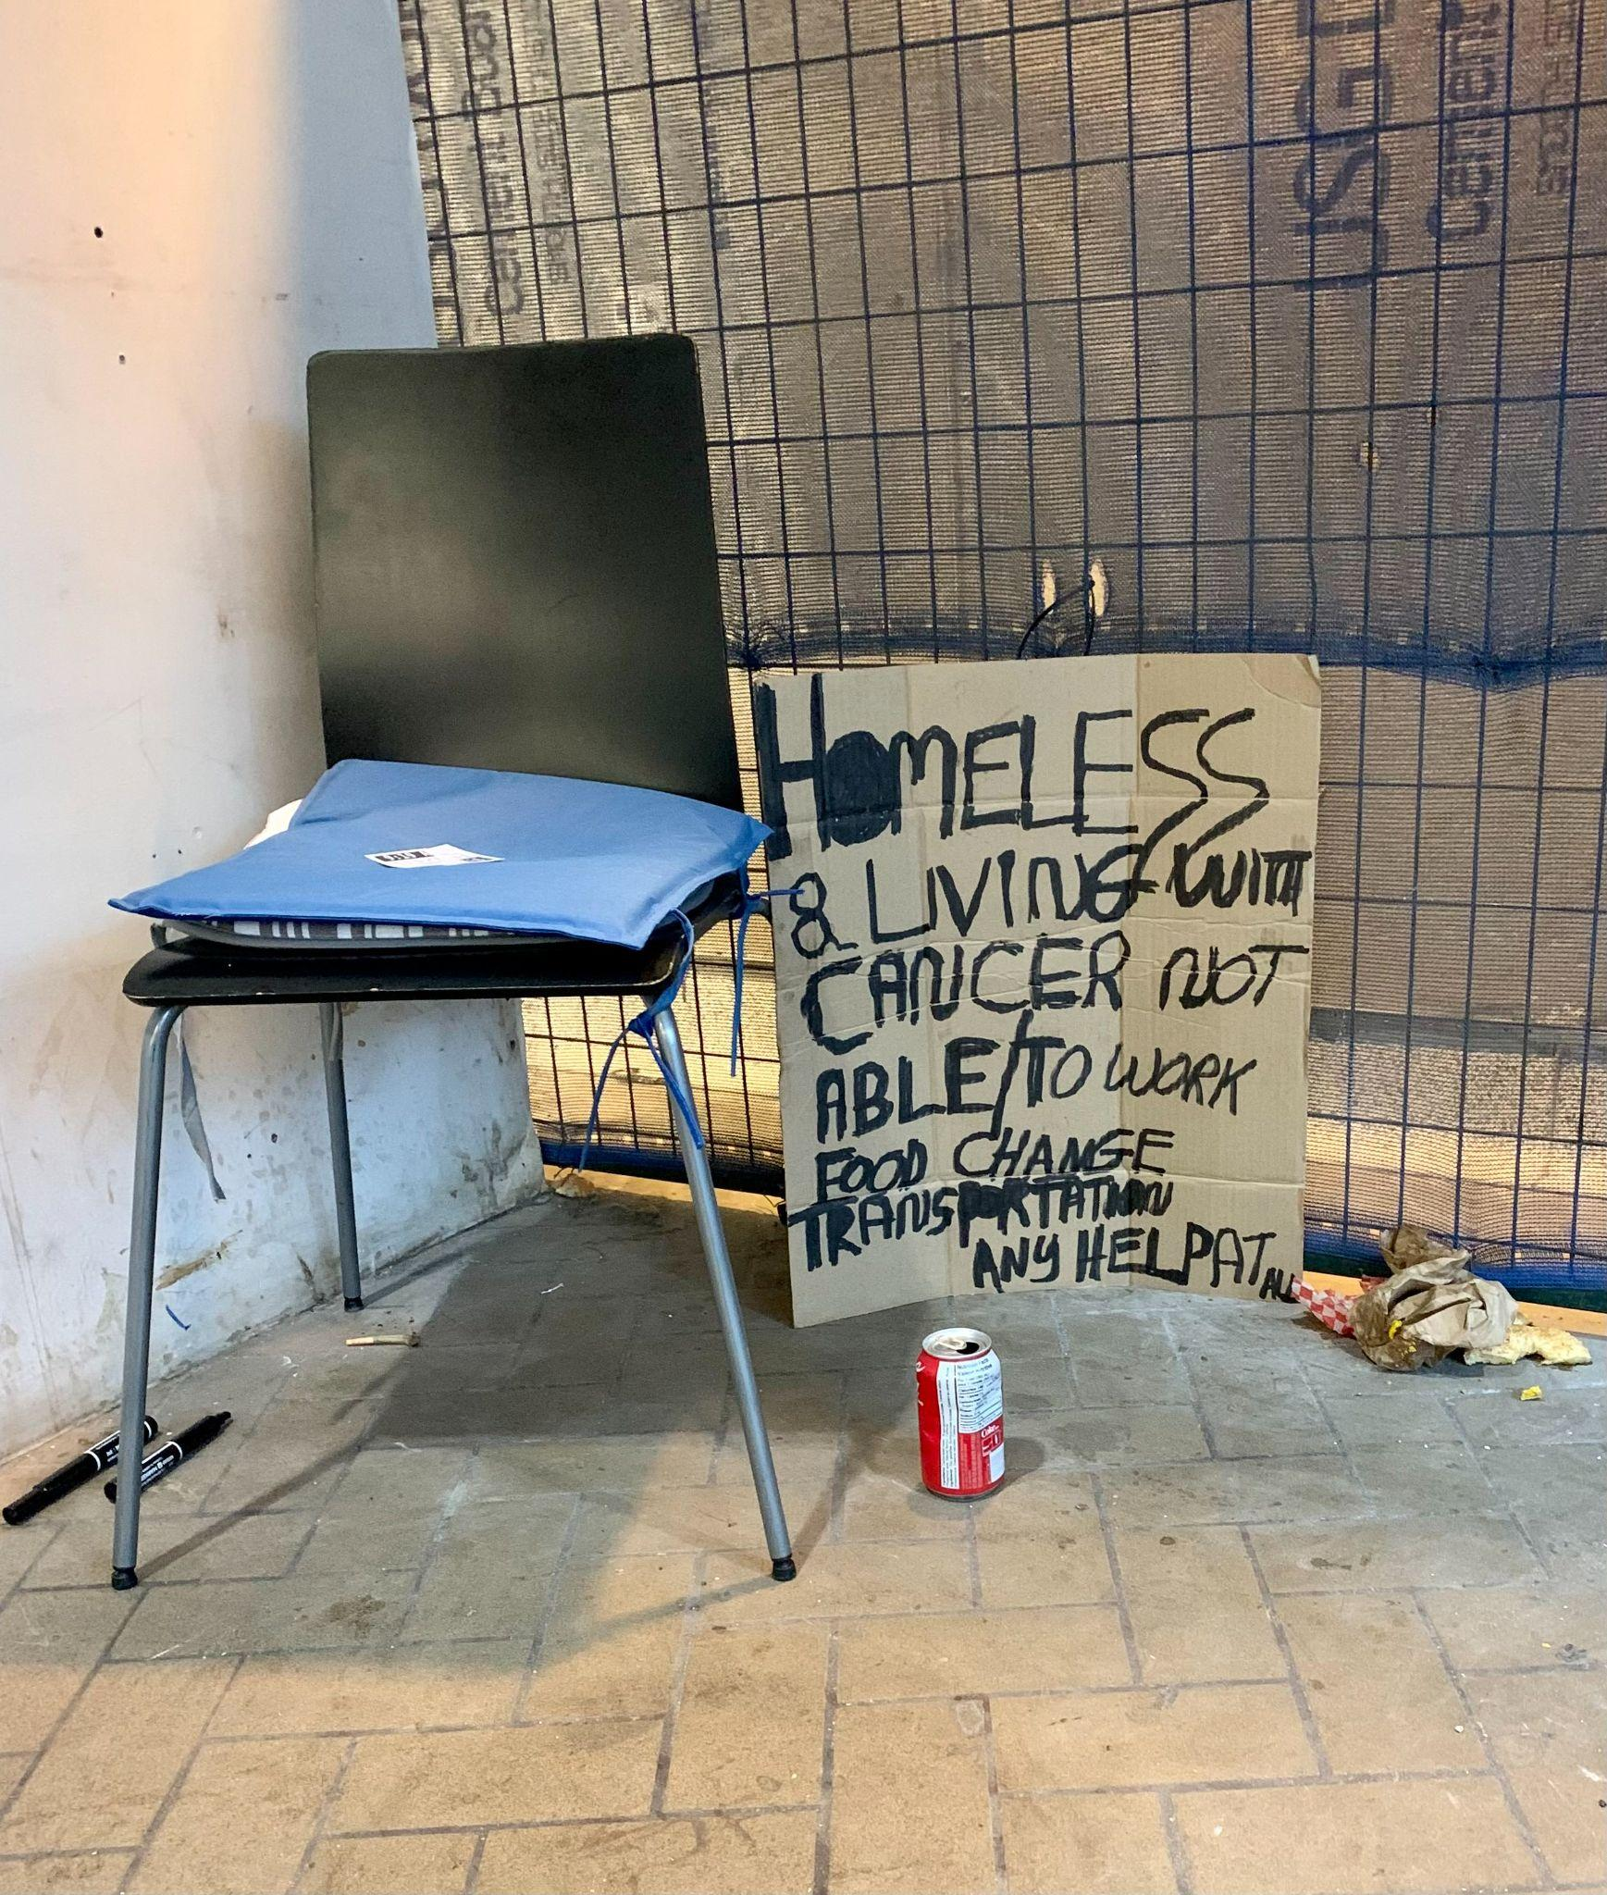
What It’s Like To Be A Health Navigator
SDOH
Person Centred Approach
Modeling Behaviours and Challenging Misconceptions.
Harm Reduction
Relationship Building
Notes:
Naheed
What’s It Like to be a HN

Slide 36
PEACH Health Navigator- Job Description
Health Navigator in Palliative Care
Reduce barriers to care
Provide motivational and supportive counselling
Deliver health education
Help clients access social supports
Connect clients with culturally appropriate services
Connect network of interprofessionalism health care providers
For People Experiencing Homelessness
Attend case conferences and advocate for culturally competent care
Attend health appointments
Advocate for assessments, admissions, consults, OT/PT interventions, and addictions support
Conduct home and shelter visits
Perform health surveillance
Coordinate services to support clients in maintaining housing
Educate clients and community partners
Notes:
Naheed
A health navigator in palliative care will operate within a harm-reduction, person-centered framework to identify and reduce barriers to care, provide motivation and supportive counselling, deliver health education, help gain access to social supports, connect clients with culturally appropriate services, and ensure that clients and their network of interprofessional health care providers are connected and collaborating effectively.
A health navigator providing palliative care to people experiencing homelessness or who are vulnerably housed will focus on the granular detail primarily within the domains of reducing barriers to care and helping clients access social supports. They therefore also do the following: (text on the right side of the slide)

Slide 37
We want to hear from you!
How do you currently deal with these issues?
Do you think this is applicable to the population that you serve?
Notes:
Naheed

Slide 38
PEACH and Tiffany: A Case Study Part I
Tiffany is a 50 yo female from Jamaica. She came to Canada 9 months ago as an undocumented non-status refugee. She fled Jamaica as she, and her son, were persecuted financially, physically and sexually, for being members of the LGBTQ2S+ community. You meet her while she is living in a shelter for families experiencing homelessness. She has just been diagnosed with metastatic colon cancer.
As she is uninsured, she has been told by the registration desk at the ambulatory oncology service in the hospital, that she cannot see a doctor because “uninsured healthcare is no longer covered, so she is not covered for cancer care treatments.”
Further to this, her cancer has led her to becoming increasingly immobile. While she can still ambulate around her room and the shelter, it is becoming increasingly difficult to walk longer distances. Even if she is able to be offered cancer treatments as an outpatient, she will need access to transportation supports to get there.
Regarding her OHIP card and status, the process has stalled. Mostly because her son is having difficulty with the vocational training program he is in and has started to use drugs, perhaps to cope with the trauma he experienced while in Jamaica. As a result, she has no time to move forward in
The shelter is doing all they can to support, but the staff feel increasingly uncomfortable with the medicalization of her room which includes wound care, supplies, IVs and other treatments. In addition, they are worried about how other families are feeling about all the medical professionals coming in and out all the time. They want her to find housing as soon as possible.
Finally, she is experiencing a Major Depressive Episode. Despite this, she is not open to anti-depressant medications. However she wishes there was “someone around to talk to.”
To add to all this, Tiffany has no idea where she will have her end-of-life, and she is very scared about this.
Notes:
Naheed

Slide 39
Access
Screening/identifying barriers to access
A series of engagements/discussions
Assessing for current resources
A thorough financial and resource history
Connecting with health providers involved in patient’s care
Primary care, consultants, home and community care
Developing a plan to address barriers to care, depending on outcomes of above assessments
Notes:
Naheed

Slide 40
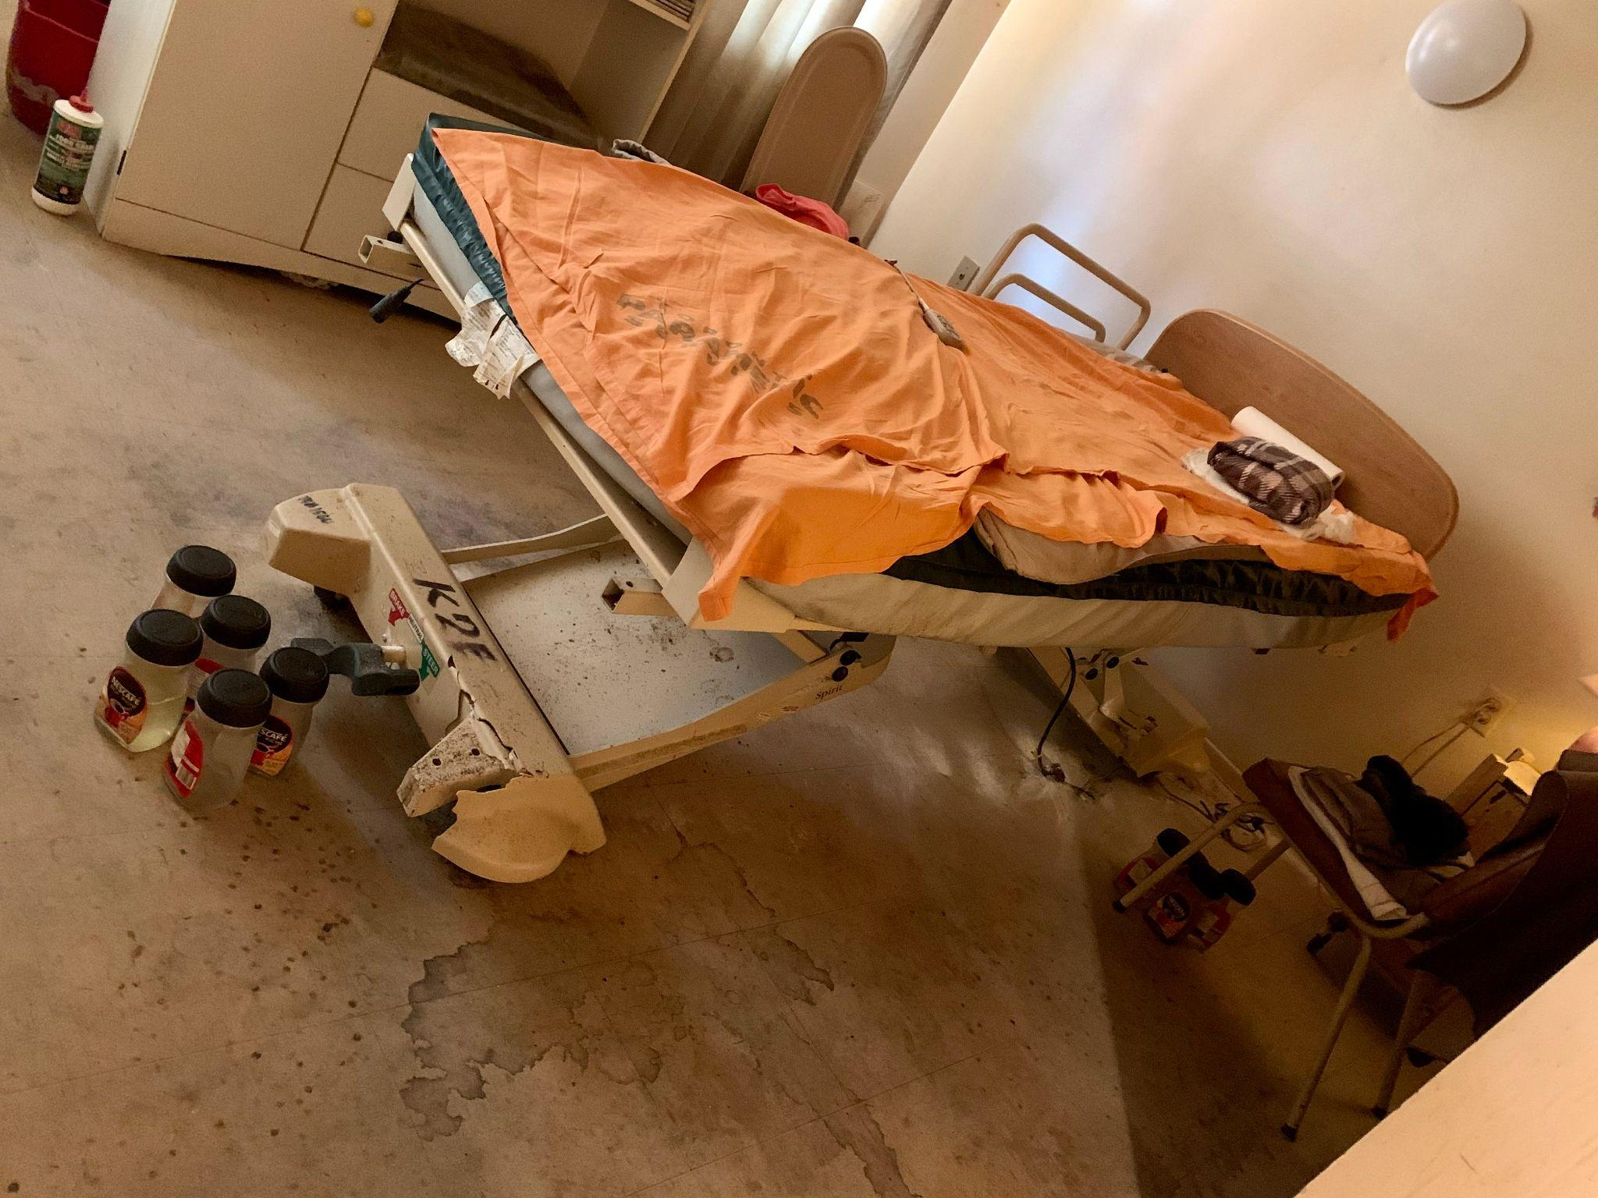
Notes:
Naheed

Slide 41
Care Coordination
Deep dive into appointments
Facilitating access to transportation
Supporting the delivery of equipment
Coordinating visits of PEACH clinicians (and other clinicians involved in circle of care)
Facilitating schedule for client to keep track of their own appointments on ongoing basis
Routine review (often on weekly basis) of all of the above
Notes:
Naheed

Slide 42
SDOH
Income
ODSP
CPP/OAS
ODB
Housing
Access Point
Terminally Ill Housing Pathway TCHC
MSN Form
Getting Medical Supplies
Special Diet
Notes:
Trevor
Professional health navigators traditionally have a background in social work, and they have a uniquely important role to play in the palliative care of marginalized and vulnerable populations as members of these populations often face complex psychosocial challenges, encounter systemic barriers to equitable care, experience communication or language barriers, and may be unable to advocate for themselves.
From the perspective of the PEACH team, this has certainly confirmed what we already know to be the critical impact of a professional health navigator in community-based palliative care for individuals experiencing homelessness and facing complex psychosocial challenges and systemic barriers when accessing care.
But we also hope this has demonstrated that a health navigator with a background in social work can be a huge value add not only to a team such as PEACH but also to any community-based palliative care team, and we hope you feel excited about the possibility of bringing a health navigator onto your team if you’ve identified a gap that could be filled by someone with this skill set
And finally we’ve provided what we hope is a helpful framework to formally evaluate the impact of a health navigator on your team, and certainly if anyone is interested in doing the same on their team and would like to leverage any of our resources I will leave my email in the chat and you can reach out anytime.

Slide 43
Advocacy
Health Treatment Accommodations
Advocating for Assistive Devices
Accommodations in Shelter and Housing Programs
Right to Safe Housing and to Die in Place of Choice
Notes:
Trevor
Talking to LOFT housing about medications getting letter from physician
Advocated for accommodation with treatment
Professional health navigators traditionally have a background in social work, and they have a uniquely important role to play in the palliative care of marginalized and vulnerable populations as members of these populations often face complex psychosocial challenges, encounter systemic barriers to equitable care, experience communication or language barriers, and may be unable to advocate for themselves.
From the perspective of the PEACH team, this has certainly confirmed what we already know to be the critical impact of a professional health navigator in community-based palliative care for individuals experiencing homelessness and facing complex psychosocial challenges and systemic barriers when accessing care.
But we also hope this has demonstrated that a health navigator with a background in social work can be a huge value add not only to a team such as PEACH but also to any community-based palliative care team, and we hope you feel excited about the possibility of bringing a health navigator onto your team if you’ve identified a gap that could be filled by someone with this skill set
And finally we’ve provided what we hope is a helpful framework to formally evaluate the impact of a health navigator on your team, and certainly if anyone is interested in doing the same on their team and would like to leverage any of our resources I will leave my email in the chat and you can reach out anytime.

Slide 44
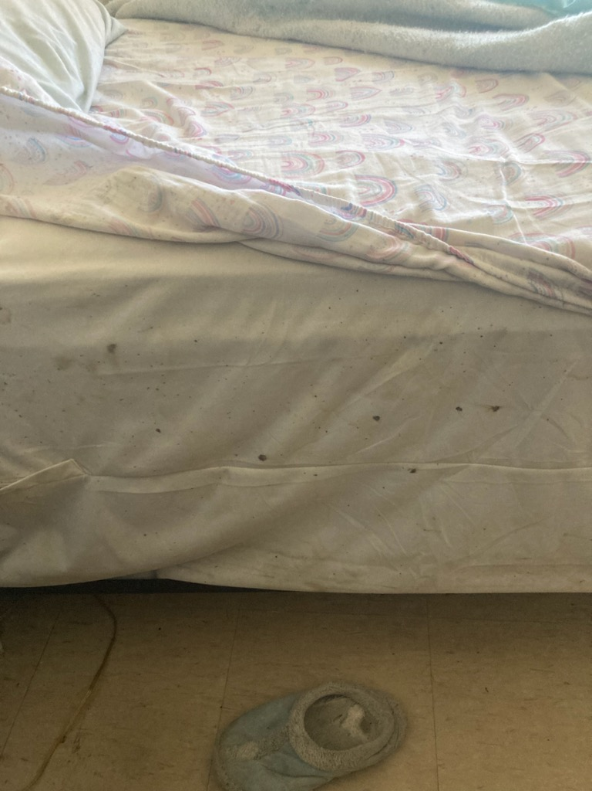
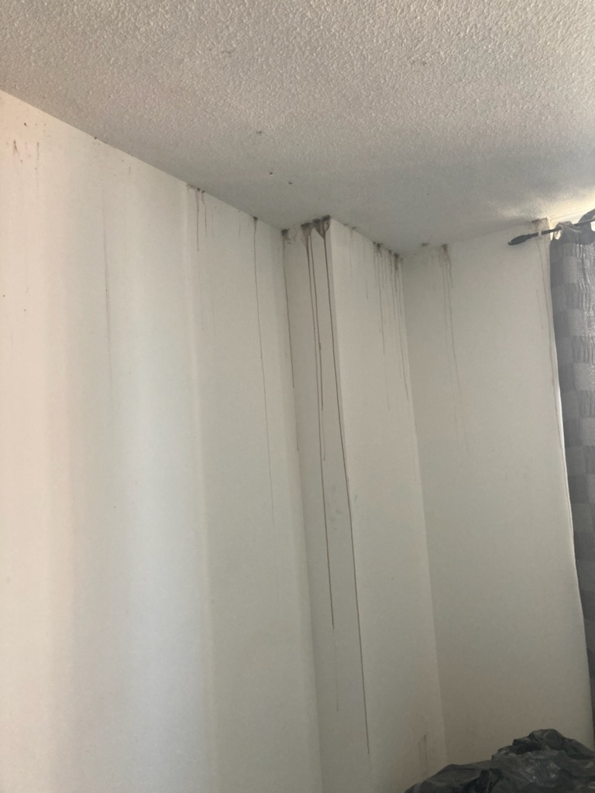
Notes:
Trevor

Slide 45
Counselling
Recognizing where mainstream health system can and cannot offer supports and filling voids where needed
Counselling techniques utilized
DBT, CBT, Narrative Therapy, Crisis Intervention, Brief Solution Focused Therapy
Arrange for more formal Psychiatry support where needed as well
Provide guidance to social care workers in the homelessness sector about how to provide this kind of support
Notes:
Trevor

Slide 46
Administrative Considerations for the Health Navigator Role
Funding
Relationship Building
Interdisciplinary Team Support
Training and Education
Notes:
naheed

Slide 47
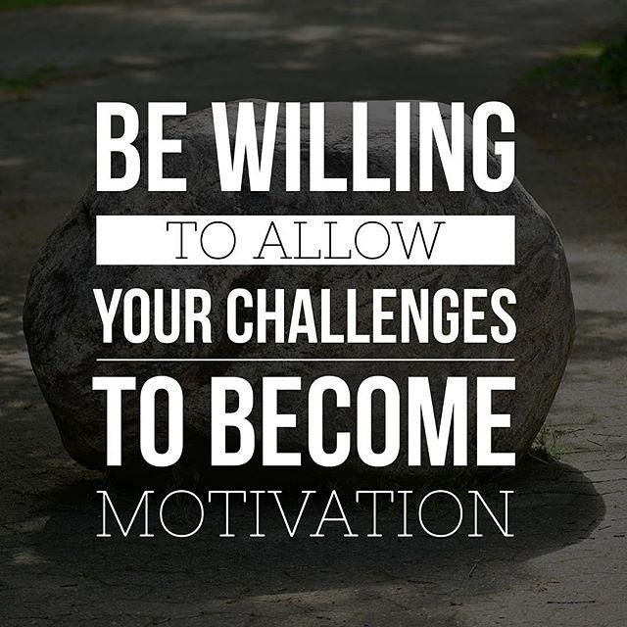
Challenges of the Health Navigator Role
Sustainable funding
Increased caseload
Balancing workload
Silo community work
Supervision and support
Lack of resources and supports
Notes:
naheed

Slide 48
PEACH and Tiffany: A Case Study Part II
The PEACH Health Navigator set up a meeting with the local oncology program (admin assistant, medical director) to discuss the case and obtained approval for “compassionate care”, despite the fact that Tiffany was noted to be uninsured.
Further to this, the PEACH Health Navigator worked with the case worker at the shelter to get Tiffany’s son into a case management program to support his mental health and drug use. This freed up Tiffany’s time, so they could collaboratively apply for PR status as well as OHIP status. Housing applications were urgently sent out as well using the Terminal Illness housing pathway. A transportation service was arranged via a local charitable service.
In the meantime, the PEACH Health Navigator facilitated a series of education sessions conducted by the PEACH nurse and physician team, to provide education to shelter workers around how best to support people with serious, limiting illness and how best to support conversations about end-of-life. These sessions were well received and led to the shelter being more comfortable with Tiffany being there.
Finally, the PEACH Health Navigator arranged for a PEACH Psychiatrist to join her for visits to provide psychosocial support as well as for structured counselling sessions. Her number was made available for Tiffany to call anytime and they would continue to have many informal chats as well as formal chats in the coming months.
As Tiffany proceeds to end-of-life, she is transferred to Kensington Hospice, where she dies peacefully surrounded by her son and an interprofessional team that really cares about her.
Notes:
Naheed

Slide 49
We want to hear from you!
Are there any reflections, comments, or questions about what we have presented on today?
Notes:
Naheed

Slide 50
Moving Forward
Metrics show that a PEACH Health Navigator makes a difference…now time to scale up!
People with lived expertise, leading with experience
Thinking of the best ways to efficiently structure the role for maximum impact
Education/training and mentoring other clinical teams
How do we standardize the Health Navigator role in community-based palliative care?
Notes:
Naheed/Trevor

