Slide 1
Sheryl Recinos, MD, Family Medicine hospitalist physician, first alumni board member of My Friend’s Place (homeless youth drop in program in Hollywood, CA), award-winning author, member of NHCHC, NN4Y, NCH
Sabra Boyd, HHS / NHTTAC certified trainer for hospitals developing human trafficking and homelessness prevention protocols, OVC Standards of Care consultant, HHS Joint Forced Labor Working Task Group Addressing Forced Labor in the Healthcare Supply Chain consultant, SWSU co-founder, Freedom Network steering committee member, AMP advisory board member, award-winning writer, media relations consultant and peer mentor for survivors of homelessness and human trafficking, Housing Justice Project board member
Lefty, BSW, a disabled Navy veteran, has been deeply involved in activism since the murder of George Floyd in 2020. Motivated by her experiences and veteran status, she sold her house and relocated to downtown Phoenix in late 2021 to live with Sophia Dancel, her partner and fellow activist. Together, they work on various projects for "Unsheltered Phoenix” Sophia Dancel has been a fervent community volunteer and activist since 2018, starting with Food Not Bombs and No More Deaths Phoenix. In 2020, she founded "Unsheltered Phoenix" to combat the distressing sweeps practice where homeless individuals' belongings are discarded, and they are forcibly displaced. Under Sophia's leadership, Unsheltered Phoenix has launched impactful aid projects, including delivering over half a million pounds of ice and distributing more than 10,000 coolers to those in need across 2022 and 2023. Despite facing legal challenges, including two arrests during the final sweeps of The Zone in late 2023, and subsequently completing probation after charges were dropped, Sophia remains dedicated to her advocacy. She continues to address the ongoing issue of unjust displacement and legal challenges faced by the community members in The Zone
Homelessness Is Not a Binary:
The Continuum of Care
When Homelessness
is a Chronic Comorbidity

Slide 2
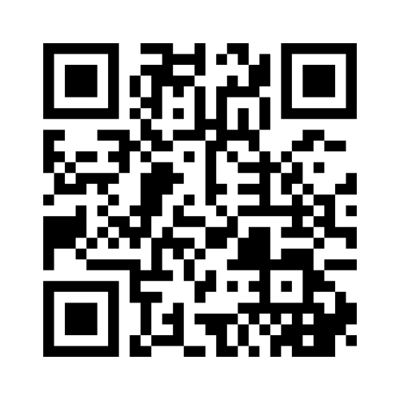
Q&A
Please submit questions for the Q&A here before the end of the presentation
Notes:
Briefly explain name of presentation – because homelessness is a continuum – even after you’re stably housed again, the health implications follow you
Mentimeter Q&A Link: https://www.menti.com/al6dz78yxhhr
Land acknowlegement

Slide 3
Sheryl Recinos (she/her) - Family Medicine hospitalist physician (California), first alumni board member of My Friend’s Place (homeless youth drop in program in Hollywood, CA), youth homelessness, TTI, and juvenile justice system survivor, award-winning author, member of NHCHC, NN4Y, NCH, advocate for ending youth homelessness and protecting all children
Sabra Boyd (she/they) – HHS / NHTTAC certified trainer for hospitals developing human trafficking and homelessness prevention protocols, OVC Standards of Care Consultant, HHS Joint Forced Labor Working Task Group Addressing Forced Labor in the Healthcare Supply Chain, Award-Winning Writer, Child Trafficking and Homelessness Survivor, Former Hospital Admin, Survivor Leader and Peer Coach, Open Democracy Editor, Sex Worker Outreach Organizer, SWSU Founder, Housing Justice Project Board Member, Freedom Network Steering Committee Member
Sophia Dancel has been a fervent community volunteer and activist since 2018, starting with Food Not Bombs and No More Deaths Phoenix. In 2020, she founded "Unsheltered Phoenix" on Instagram to combat the distressing sweeps practice where homeless individuals' belongings are discarded, and they are forcibly displaced. Under Sophia's leadership, Unsheltered Phoenix has launched impactful aid projects, including delivering over half a million pounds of ice and distributing more than 10,000 coolers to those in need across 2022 and 2023. Despite facing legal challenges, including two arrests during the final sweeps of The Zone in late 2023, and subsequently completing probation after charges were dropped, Sophia remains dedicated to her advocacy. She continues to address the ongoing issue of unjust displacement and legal challenges faced by the community members in The Zone.
Lefty, a disabled Navy veteran with a Bachelor of Social Work, has been deeply involved in activism since the murder of George Floyd in 2020. Motivated by her experiences and veteran status, she sold her house and relocated to downtown Phoenix in late 2021 to live with Sophia Dancel, her partner and fellow activist. Together, they work on various projects for "Unsheltered Phoenix," with Lefty leveraging her disability income and personal experiences to bolster their joint efforts in supporting the community.

Slide 4
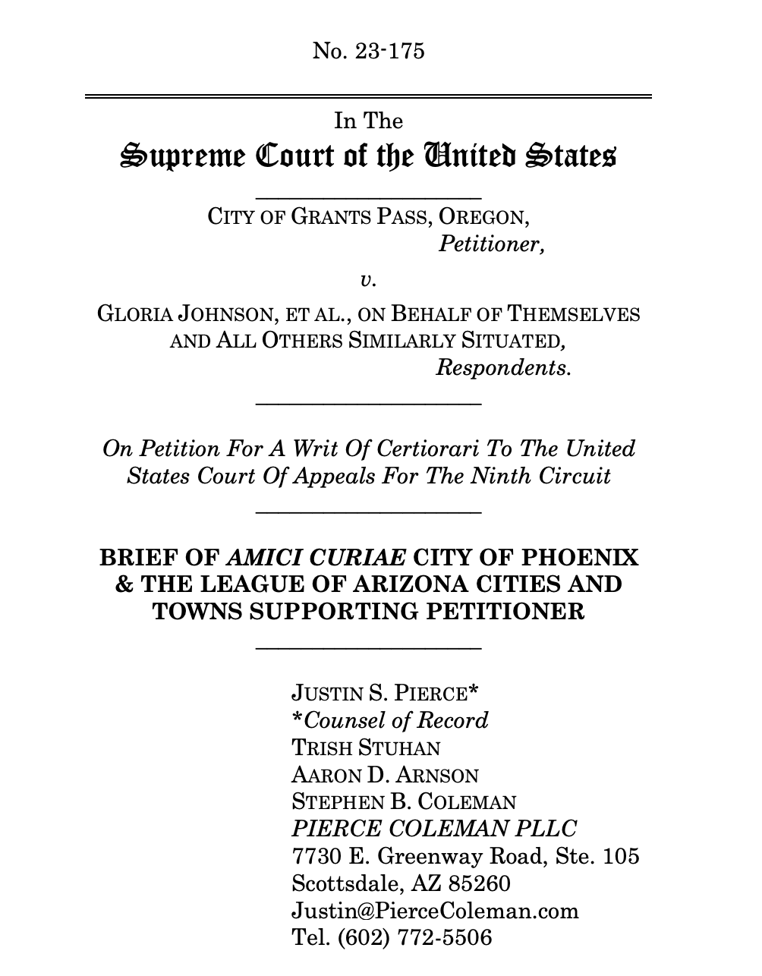

Slide 5
Residual Health Impacts of
Housing Trauma

Slide 6
Clinicians rarely ask patients about their health history related to recovering from homelessness.
Through case studies, lived experience, oncological and epigenetic research, and group discussions, we will explore the importance of evaluating chronic health issues with homelessness as a comorbidity even after patients have regained housing stability and recovered from homelessness.
There are huge gaps in research and longitudinal data on the health impacts of homelessness after becoming housed (again).
Notes:
We will also explore how chronic health conditions are created and exacerbated by housing instability, how this impacts the health care system, and how housing first (housing as healthcare) improves the healthcare system both for patients and providers.

Slide 7
“Stable housing is a protective factor for better health, both primary and behavioral health, which creates opportunities to better manage and recover from illness without the distraction of finding a place to sleep and be safe.” - Colorado Department of Public Health & Environment
Notes:
https://cdphe.colorado.gov/sites/cdphe/files/PSD_SDOH_Homelessness_long.pdf

Slide 8
Homelessness Is Not a Binary
Preventing homelessness in the first place is the most effective measure. Studies have found that there are lasting economic and health impacts even after individuals and families are re-housed.
Sleep Deprivation
Podiatry
Privacy
Access to Hygeine
Exposure to the Elements
Access to Water and Nutrition / Hot Food
Chronic Stress and Autoimmune Impact
Mental Health Impact (Lasting)
Cancer + Epigenetics
Data Gaps
Geriatrics
Dental Care
ACEs
Chronic Stress
Wound Care
Access to Healthcare
The Continuum of Care When Homelessness is a Chronic Comorbidity
Notes:
https://www.seattle.gov/documents/Departments/SeattleWomensCommission/LosingHome_9-18-18.pdf

Slide 9
Language
Homeless
Houseless
Roofless
Unsheltered
Somewhere safe from sweeps

Slide 10
Systemic Racism in Services &
Racial Inequity in Referrals to Services
A 2019 study found that in many American cities, a disproportionately higher number of Black, Indigenous, Latine/x/a/o, Asian and Pacific Islander people experienced homelessness. However they routinely scored significantly lower than their white counterparts on Coordinated Entry System (CES) surveys with case workers and outreach workers, making it a longer and harder process to access permanent supportive housing.

Slide 11
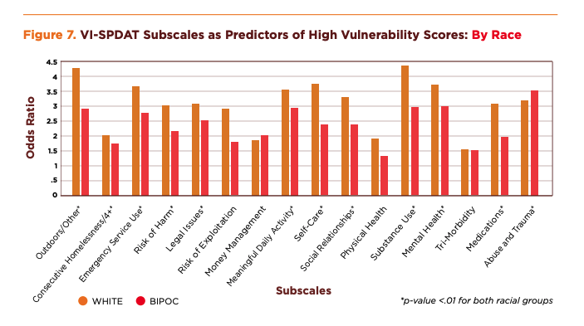
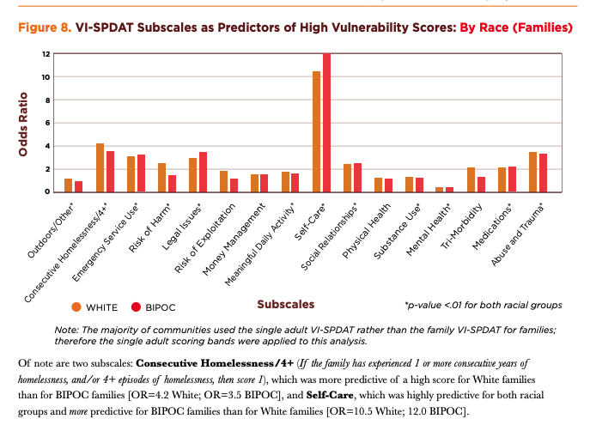
The VI-SPADT survey tool scores vulnerability on a scale of 0-17 to assess housing placement for people. Depending upon how people self-report, they are more or less likely to receive housing
Scale of Scores:
0-3: Recommendation for No Housing Intervention
4-7: Recommendation for Rapid Re-Housing
8+: Recommendation for Permanent Supportive Housing / Housing First
Notes:
https://c4innovates.com/wp-content/uploads/2019/10/CES_Racial_Equity_Analysis_2019-.pdf
THE VI-SPADT – “Since its release in 2014, the Vulnerability Index–Service Prioritization Decision Assistance Tool (VI-SPDAT), developed by OrgCode and Community Solutions as a coordinated entry triage tool, has been positioned as the most HUD-compliant and effective, subsequently growing in popularity among CoCs. The VI-SPDAT merged two existing tools—the VI as a pre-screening tool and the SPDAT as an in-depth assessment—to provide a less intensive and more accessible approach for frontline agencies. Following its administration with an individual or family, wherein the client is asked to self-report a number of risk factors, including length of homelessness, various medical conditions, substance use and mental health, and “daily functioning,” the tool scores vulnerability on a scale of 0-17. A score of 0-3 will result in a recommendation for “no housing intervention,” a score of 4-7 will result in a recommendation for Rapid Re-Housing, and a score of 8 or more will result in a recommendation for Permanent Supportive Housing/ Housing First and a score of 8 or more will result in a recommendation for Permanent Supportive Housing/ Housing First, according to the single adult VI-SPDAT scoring summary recommendations.”

Slide 12
5 Example Survey Questions with Disproportionate Racial Disparity in Housing Referrals Based on Aggregate Vulnerability Data
Where do you sleep most frequently? If the person answers anything other than “shelter”, “transitional housing”, or “safe haven,” then score 1. [Odds Ratio (OR)=4.3 White; Odds Ratio (OR)=2.9 BIPOC.]
Are you currently able to take care of basic needs like bathing, changing clothes, using a restroom, getting food and clean water and other things like that? If “no,” then score 1 for self-care. [OR=3.8 White; OR=2.4 BIPOC.]
Is your current homelessness in any way caused by a relationship that broke down, an unhealthy or abusive relationship, or because family or friends caused you to become evicted? If “yes,” then score 1 for social relationships. [OR=3.3 White; OR=2.4 BIPOC.]
Has your drinking or drug use led you to being kicked out of an apartment or program where you were staying in the past? Will drinking or drug use make it difficult for you to stay housed or afford your housing? If “yes” to any of the above, then score 1 for substance use. [OR=4.4 White; OR=3.0 BIPOC.]
Are there any medications that a doctor said you should be taking that, for whatever reason, you are not taking? Are there any medications like painkillers that you don’t take the way the doctor prescribed or where y

Slide 13
Epigenetics, Aging, and Homelessness

Slide 14
Population Ages Faster
Median age of death (64.6yo)
*increased premature mortality
Geriatric conditions 20 yo or younger
Incontinence
Impaired vision
Memory loss
Falls
Difficulty with ADLs (activities of daily living)
Accelerated aging more prevalent among homeless veterans
Housing interventions focus on housing people who are the most dysfunctional
Life expectancy 42-52 yo
Many won’t survive long enough to receive interventions (which are available at 65yo)
Mobility, caring for medical equipment, wound care, post discharge recovery
Cancer, epigenetics, telomere length
“50 is the new 75”

Slide 15
“If we really want to put a dent in cancer susceptibility, we must make sure that people aren't homeless and people get medical care, and so on. It’s simple stuff.” - Dr. Karl Kelsey, MD
Notes:
Epigenetics and epidemiology – Dr. Karl Kelsey, MD, MOH, is Professor of Community Health and Pathology and Laboratory Medicine at Brown University. He is the founding Director of the Center for Environmental Health and Technology and was the first Head of the Environmental Health Section in the Departemnt of Epidemiology
https://www.futuremedicine.com/doi/full/10.2217/epi-2022-0008

Slide 16
Privacy is a
public health issue

Slide 17
Epigenetics, Cancer, Telomere Length, and Homelessness

Slide 18
Dental Care
Disabled veterans don’t get dental care unless classified disabled 100%
Risks of abscess
Impact on nutrition

Slide 19
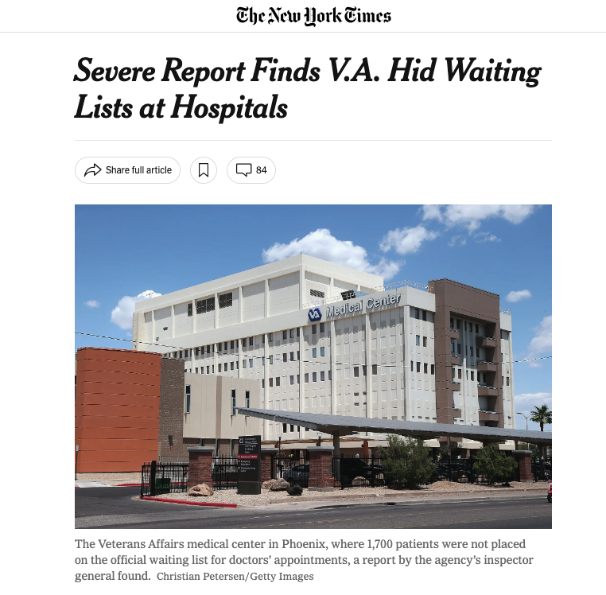
Unhoused Veterans

Slide 20
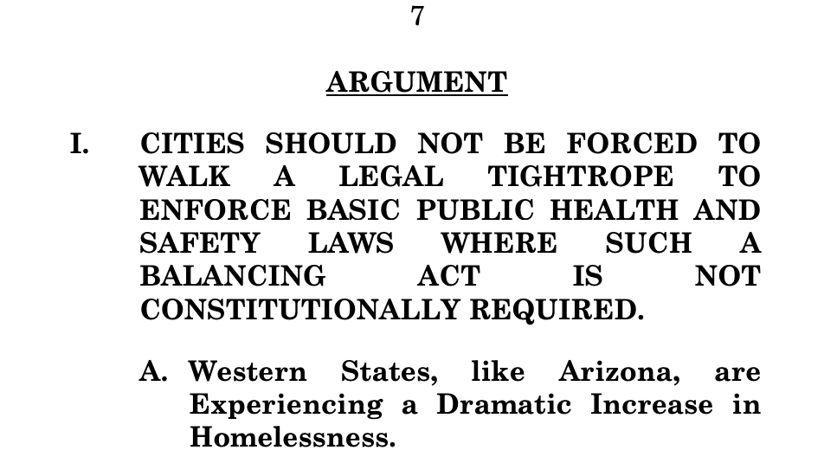
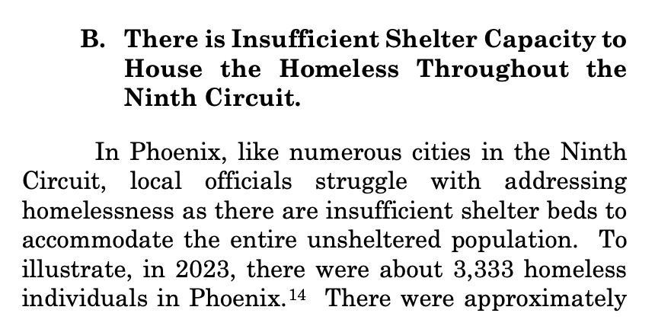
Policing and the Criminalization
of Poverty
The City of Phoenix recently filed an amicus brief petitioning the Supreme Court to rule that sweeps are legal in the Grants Pass v. Johnson case to criminalize homelessness

Slide 21
The Health Implications of Sweeps
Losing medications
Losing ID to replace medications
Compounded trauma
Sleep deprivation
Exposure to the elements
Fines
Jail (and the fees that come with it)

Slide 22
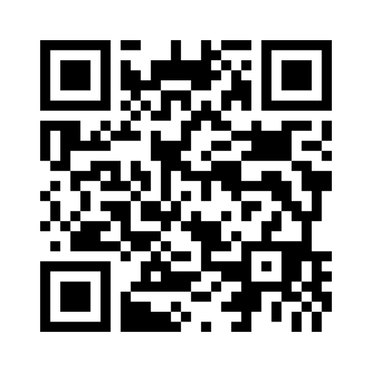
Pragmatically, what does
trauma-informed care look like?
Notes:
https://www.menti.com/alt56um3ogfh

Slide 23
Trauma-Informed Care
Ability for informed consent
Language
Don’t make assumptions – use motivational interviewing methods
Offer a cup of water
Consider transportation issues
Consider food and cooking restrictions
Patients may not want to disclose housing status or may define it in different terms (i.e. couch surfing, etc)
Currently housed patients may not disclose that they are formerly unhoused as part of H&P
Culturally responsive
Unhoused patients are likely surrounded by friends who are dying
Seizures from police lights

Slide 24
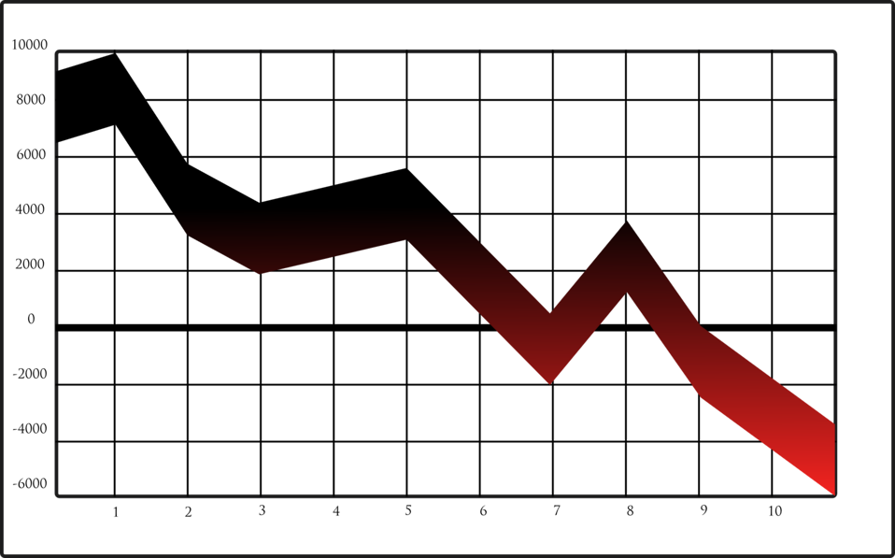
Fluctuating continuum of poverty, housing, and trauma

Slide 25
Societal and individual costs of not implementing
Housing First / Permanent Supportive Housing
Notes:
United Health housing
EndHomelessness.org study

Slide 26
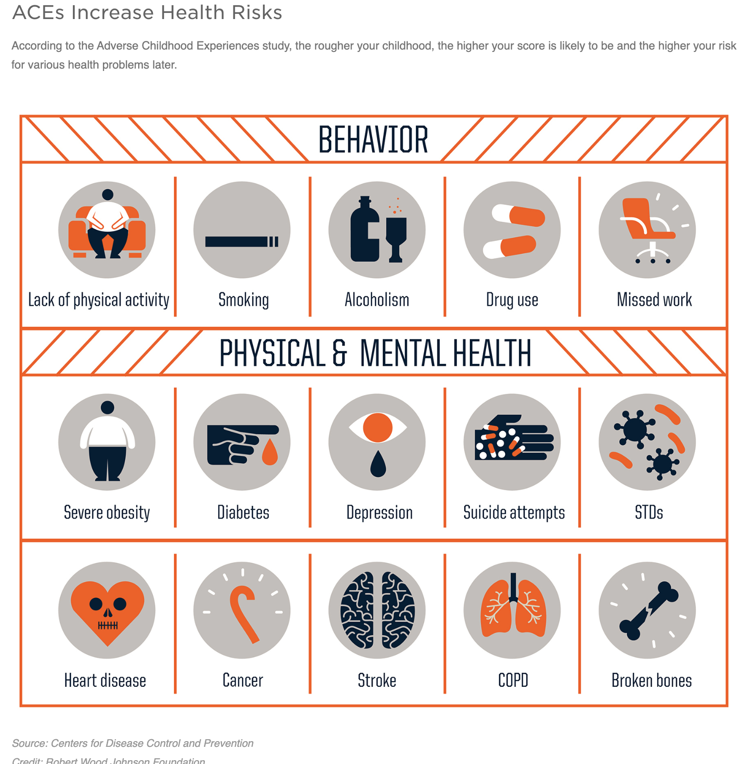
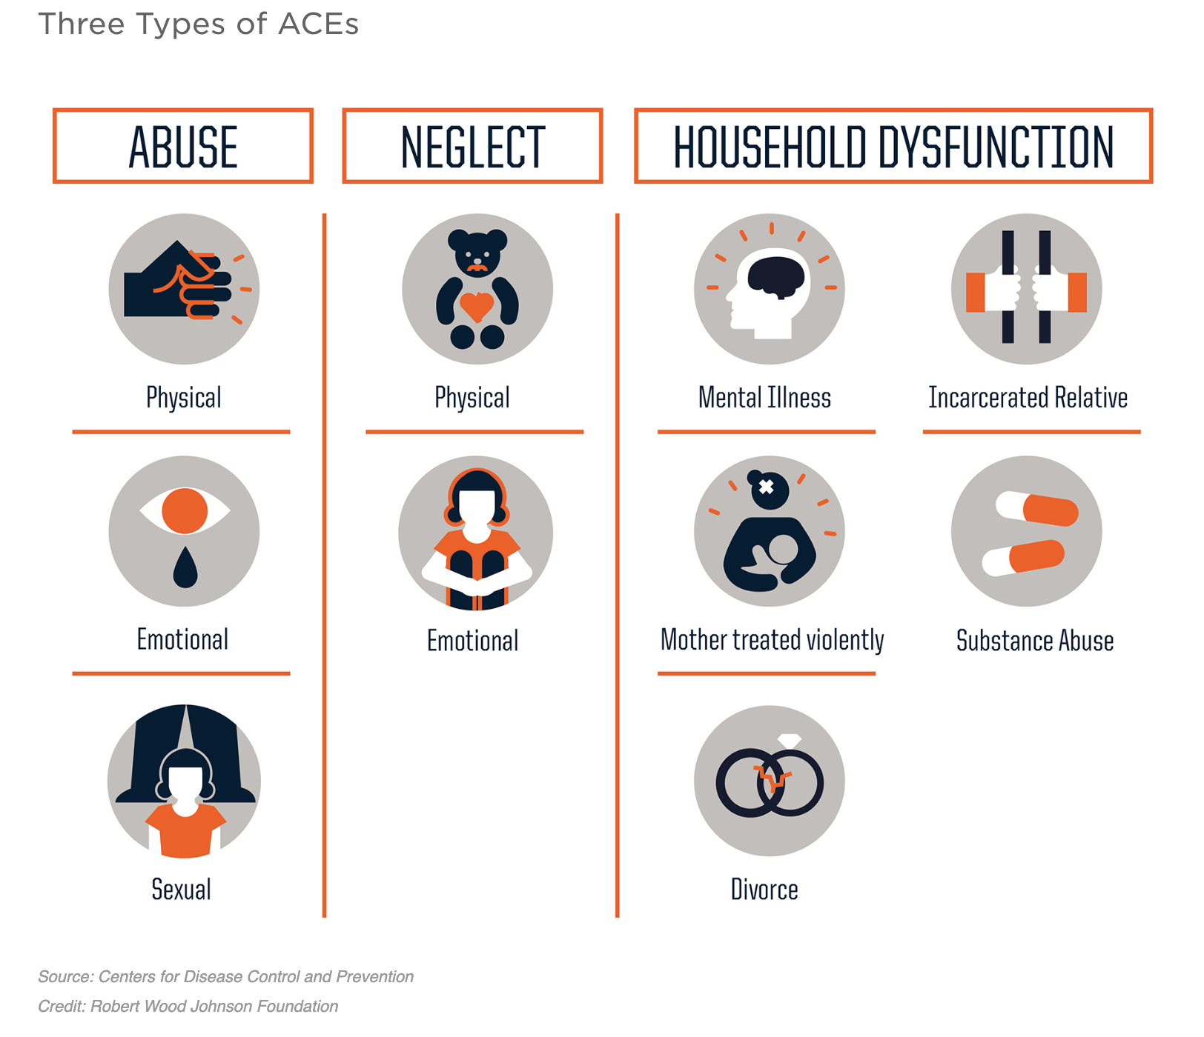
What are ACEs?
An ACE (Adverse Childhood Experience) score is a 10 point tally of different types of abuse, neglect, and other hallmarks of a traumatic childhood.
*It is important to note that positive childhood experiences and stability can help buffer the effects.
Source: CDC and NPR

Slide 27
Youth with an ACEs score of 4 or higher were 3x more likely to be arrested and sentenced to juvenile detention or have a felony before age 24. - Journal of the American Academy of Pediatrics
Longitudinal studies show that poverty can exacerbate the damage of a high ACEs score (4 or above). - Journal of the American Academy of Pediatrics
A high ACEs score can cognitively damage us. It can even impair our ability to process facial recognition and recognizing emotions.
- Child Maltreatment Journal
ACEs
Preventing ACEs could reduce a large number of health conditions. For example, up to 1.9 million cases of heart disease and 21 million cases of depression could have been potentially avoided by preventing ACEs.
There is a strong correlation to an ACEs score over 3 (out of 10) increasing the risk factors for disease, well-being, and early death throughout the life course.
Diseases such as COPD, heart disease, cancer, and autoimmune diseases show a strong correlation to ACEs scores of 4 or higher.
Research suggests that child sex abuse puts survivors at higher risk for cancer. Although many of these ACEs-Cancer studies only captured instances of cervical cancer and more research is needed into the effects of a high ACEs score and a diminished immune system response to cancers.
Source: Texas Juvenile Justice Department (TJJD) and CDC

Slide 28
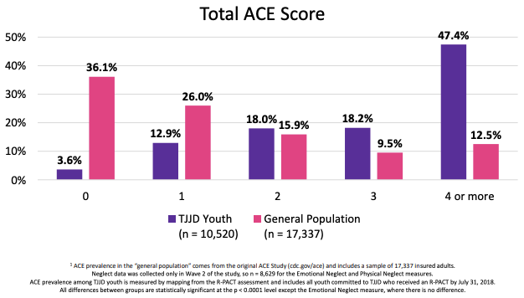
ACE Prevalence Among Texas Juvenile Justice Department (TJJD) Youth Compared to the General Population
Source: Texas Juvenile Justice Department (TJJD)

Slide 29
Positive Childhood Experiences (PCEs)
Positive childhood experiences can offset the effects of a high ACE score.
Adults who reported a high risk ACE score (4-10), contrasted with Positive Childhood Experiences had lower odds of suffering from depression and poor mental health as adults according to a 2019 cross-sectional study published in JAMA.
Source: Bethell, Christina et al. “Positive Childhood Experiences and Adult Mental and Relational Health in a Statewide Sample: Associations Across Adverse Childhood Experiences Levels.” JAMA pediatrics, vol. 173,11 e193007. 9 Sep. 2019, doi:10.1001/jamapediatrics.2019.3007
https://www.ncbi.nlm.nih.gov/pmc/articles/PMC6735495/

Slide 30
Homelessness as a Comorbidity:
Death Certificates, CODs, and Data
heart disease
cancer
drug overdose
chronic lower respiratory disease
chronic liver disease
Notes:
Inaccurate CODs

Slide 31
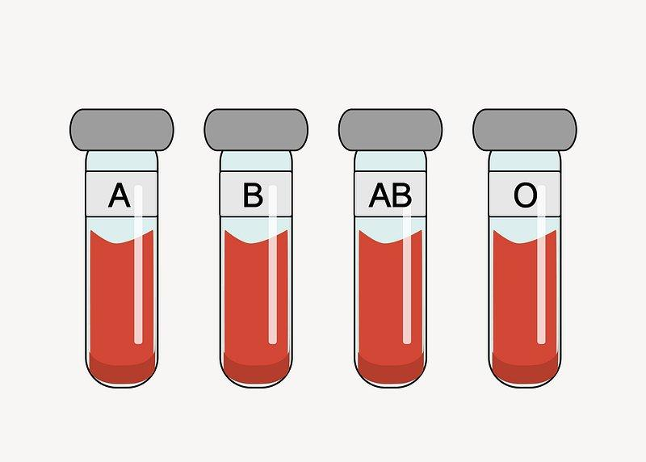
The sordid history of medical research and exploitation of the poor
Notes:
Coercive Plasma Donation
Cadaver Donor Pool Skewed (history of pituitary gland research)

Slide 33
Q&A
Please submit questions for the Q&A here
Notes:
https://www.menti.com/al6dz78yxhhr

Slide 35
References
Notes:
https://docs.google.com/document/d/1UAQZFSzqT2ag2k1IImjcJ53S6yxLYyWJ/edit?usp=sharing&ouid=107434034594842811837&rtpof=true&sd=true

