Slide 1
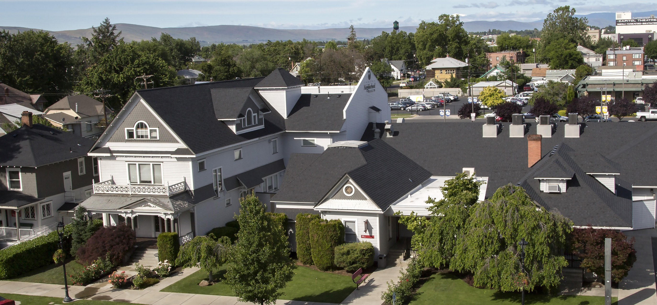
Our mission is to improve quality of life and equity in our communities by providing accessible and integrated health and social services, ending homelessness and offering unique learning opportunities for students of health professions.
Notes:
For those who don’t know us, Yakima Neighborhood Health Services is first and foremost a community health center.
We have 10 fixed primary care sites across the Yakima Valley, in Yakima, Granger, and Sunnyside.
We have Resource Centers in all 3 of those towns providing enrollment assistance and other basic needs like health insurance, childcare applications, rental and utility assistance.
The integration of housing and health care is part of our daily life at YNHS – very near and dear to our hearts. that integration can be much harder to do when people are without health coverage so we work hard to assure they have coverage as they enter our housing programs.

Slide 2
Medical Respite & Permanent Supportive Housing Our North Star
Patients
Medical Respite Care – “We Need a Place to Be When We’re Sick”
Providers
Permanent Supportive Housing – “If You Want Us to Make a Difference in their Health…”
Notes:
In 2005, after we received our first HCH grant, two drivers became our North Star for our Board of Directors:
Board member conducting focus groups was told “we need a place to be when we’re sick”
Our Street Outreach Teams became successful bringing people into the clinics and providers said “if you want us to make a difference in people’s health, you need to help put a roof over their heads”

Slide 3
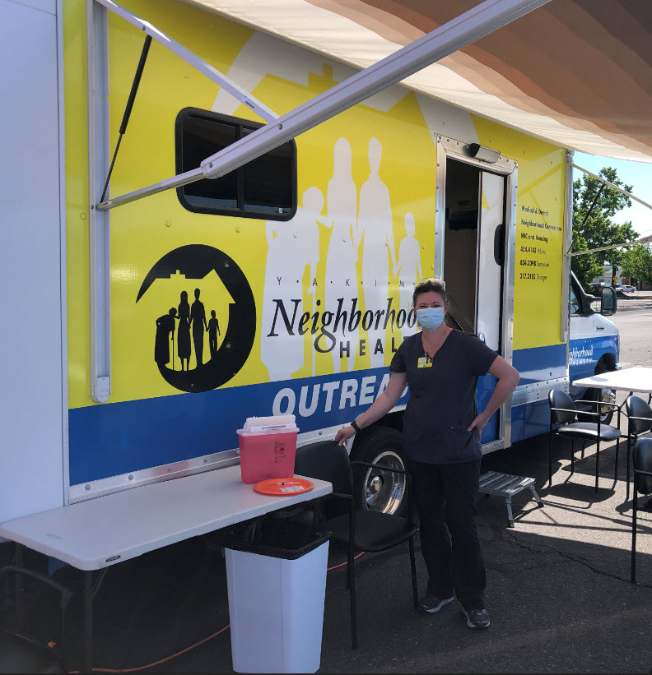
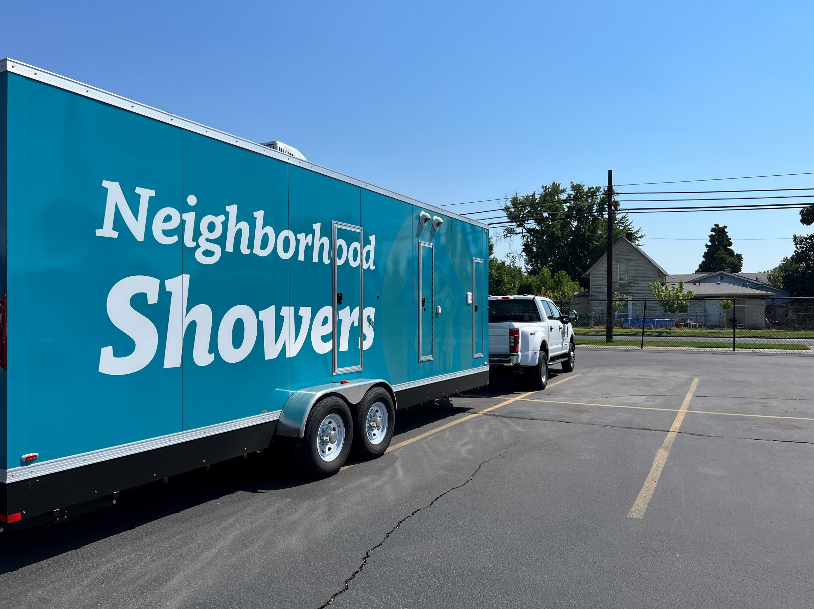
Housing & Health Integration
Primary Care
*Medical
*Dental
*Behavioral Health
*Pharmacy
Continuum of Care / Coordinated Entry
HEN / ABD
Street Outreach
Health Home
Supportive Housing / Supported Employment
Medication for Opioid Use Disorders (MOUD)
Medical Respite Care

Slide 4
Respite staff closely aligned with CHC staff (1-2 blocks from each Respite site)
Respite Staff:
Registered Nurse
Behavioral Health Specialist
Case Manager
Housing Specialist
Community Health Center Sites
Family Nurse Practitioner
Dentist
Health Insurance Navigator
Health Home Care Coordinator
Supportive Housing / Supported Employment Specialists

Slide 5
Scope of Care at Medical Respite
Care Transition from Primary Care or Hospital
Medication review
Case management
Wound care
Daily checks & health education
Access to medical support 24/7
Behavioral Health assessment & intervention
Assessment of Social Needs
Assist w/ Follow up to PCP and Specialty Care
Determine functional status – communication, cultural and ethnic factors
Provide meals
Provide & arrange transportation
Facilitate family unification and/or housing stabilization at exit
Establish ongoing relationship with PCP at respite exit

Slide 6
Medical Respite Care Program at YNHS: Patient Length of Stay & Medical Conditions
2023
Length of Stay | People | Reason for Respite Admission
One Week or Less | 50% | Cellulitis, Covid, Abscess, MOUD, Wound Care, Hypothermia, Burn, Edema, Fracture
One to Two Weeks | 33% | MOUD, Abscess, Surgery recovery, Wound care, Frostbite, Covid, Stab wound, Cellulitis, Tracheostomy care, Hypoxia
Two to Three Weeks | 11% | Stab wound, Frostbite, Necrosis, Amputation recoveries, Hernia repair, Cellulitis
Three to Four Weeks | 2% | Surgery recovery
More than Four Weeks | 4% | Congestive Heart Failure, Cancers, COPD, Amputations
200 patients – 2,222 nights (ALOS = 11 nights)

Slide 7
85% of Referrals to Respite Came from PCPs (Preventing Unnecessary Hospitalizations)
Preventing initial hospitalization

Slide 8
Expenses and Revenue of Medical Respite

Slide 9
2023 Medical Respite Care Saves $$ Hospital Staff Report a Saving of 15 Inpatient Days in 2023 ($57,000 for 15 patients referred by hospitals – Avg $3800 / day)
Respite care reduces public costs associated with frequent hospital utilization.
 | Avg Cost Per Day
Hospital Inpatient | $3800
Respite Care – Nursing, Case Mgmt, Care Transitions (not including Primary Care) | $104
Respite Care (including Primary Care) | $430.49
2021 US averages per KFF @ average LOS of 5.9 nights
Respite care based on 2023 average LOS of 11 nights per patient
Primary care average of 8 visits per patient (medical/ behavioral health) and based on current APM rate added on to respite cost.

Slide 10
2023 Referrals Not Served = 123
Chronic vs. acute condition
Needs higher level of care
Not homeless
44% from YNHS providers
54% from others

Slide 11
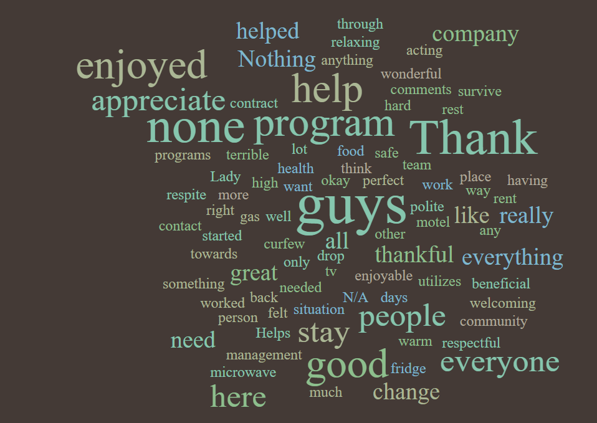
“What Comments Would You Like to Share About Your Time in Respite?”
Notes:
Survey Monkey Exit Surveys to gage patient satisfaction.

Slide 12
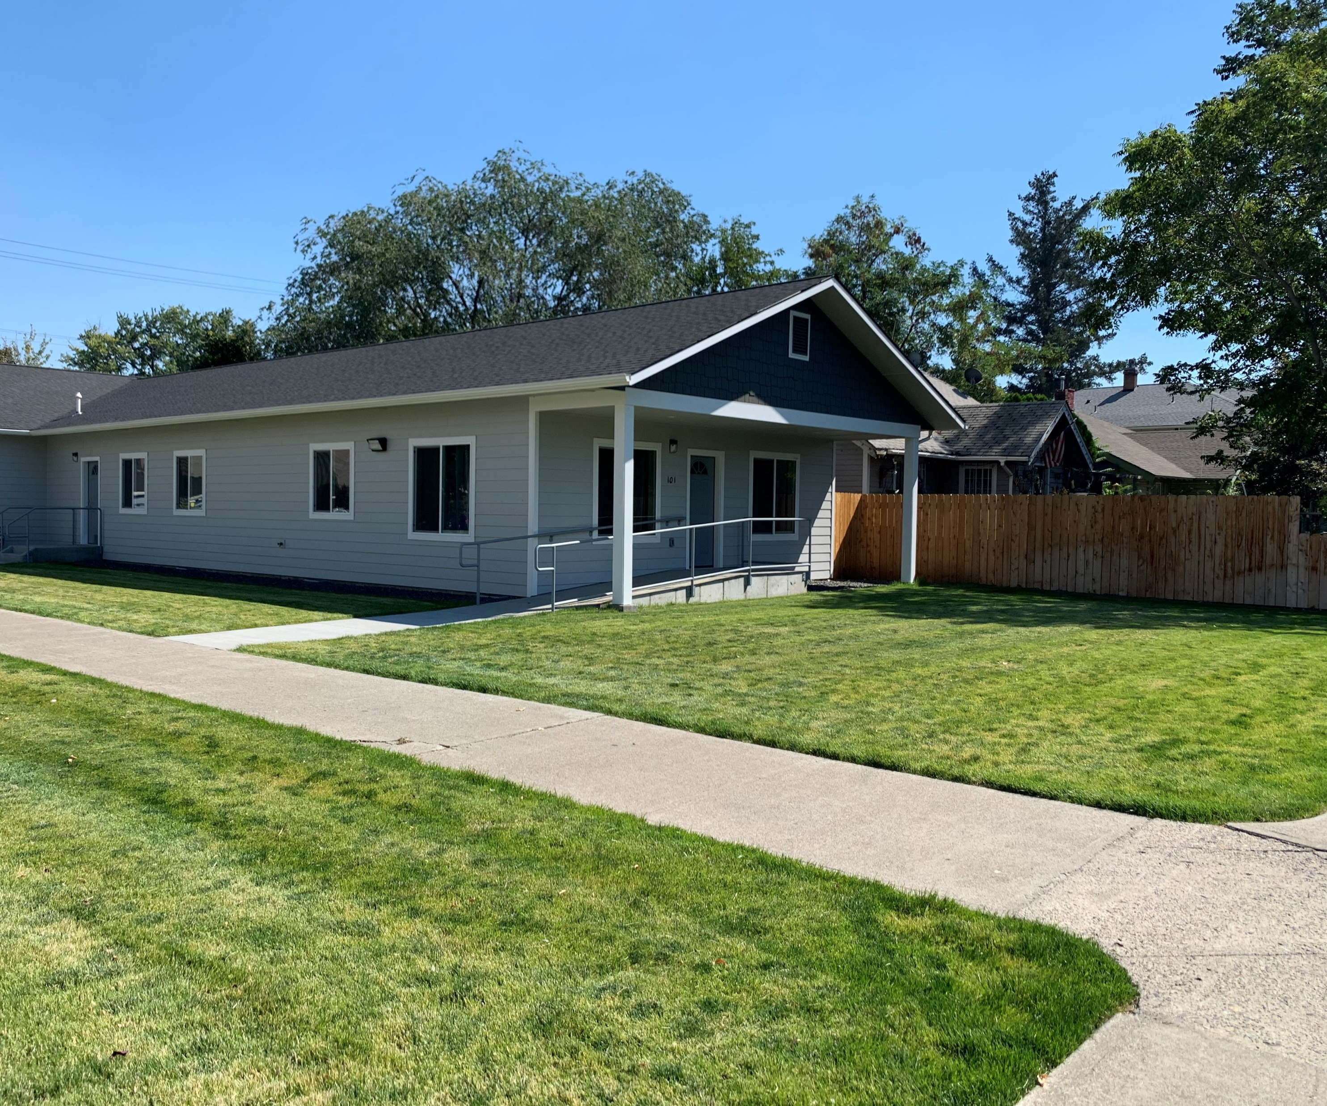
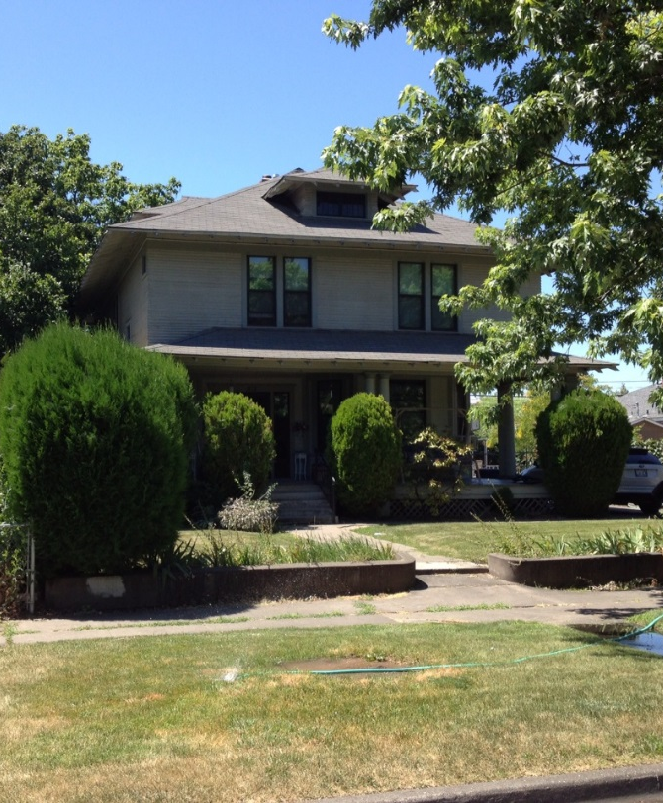
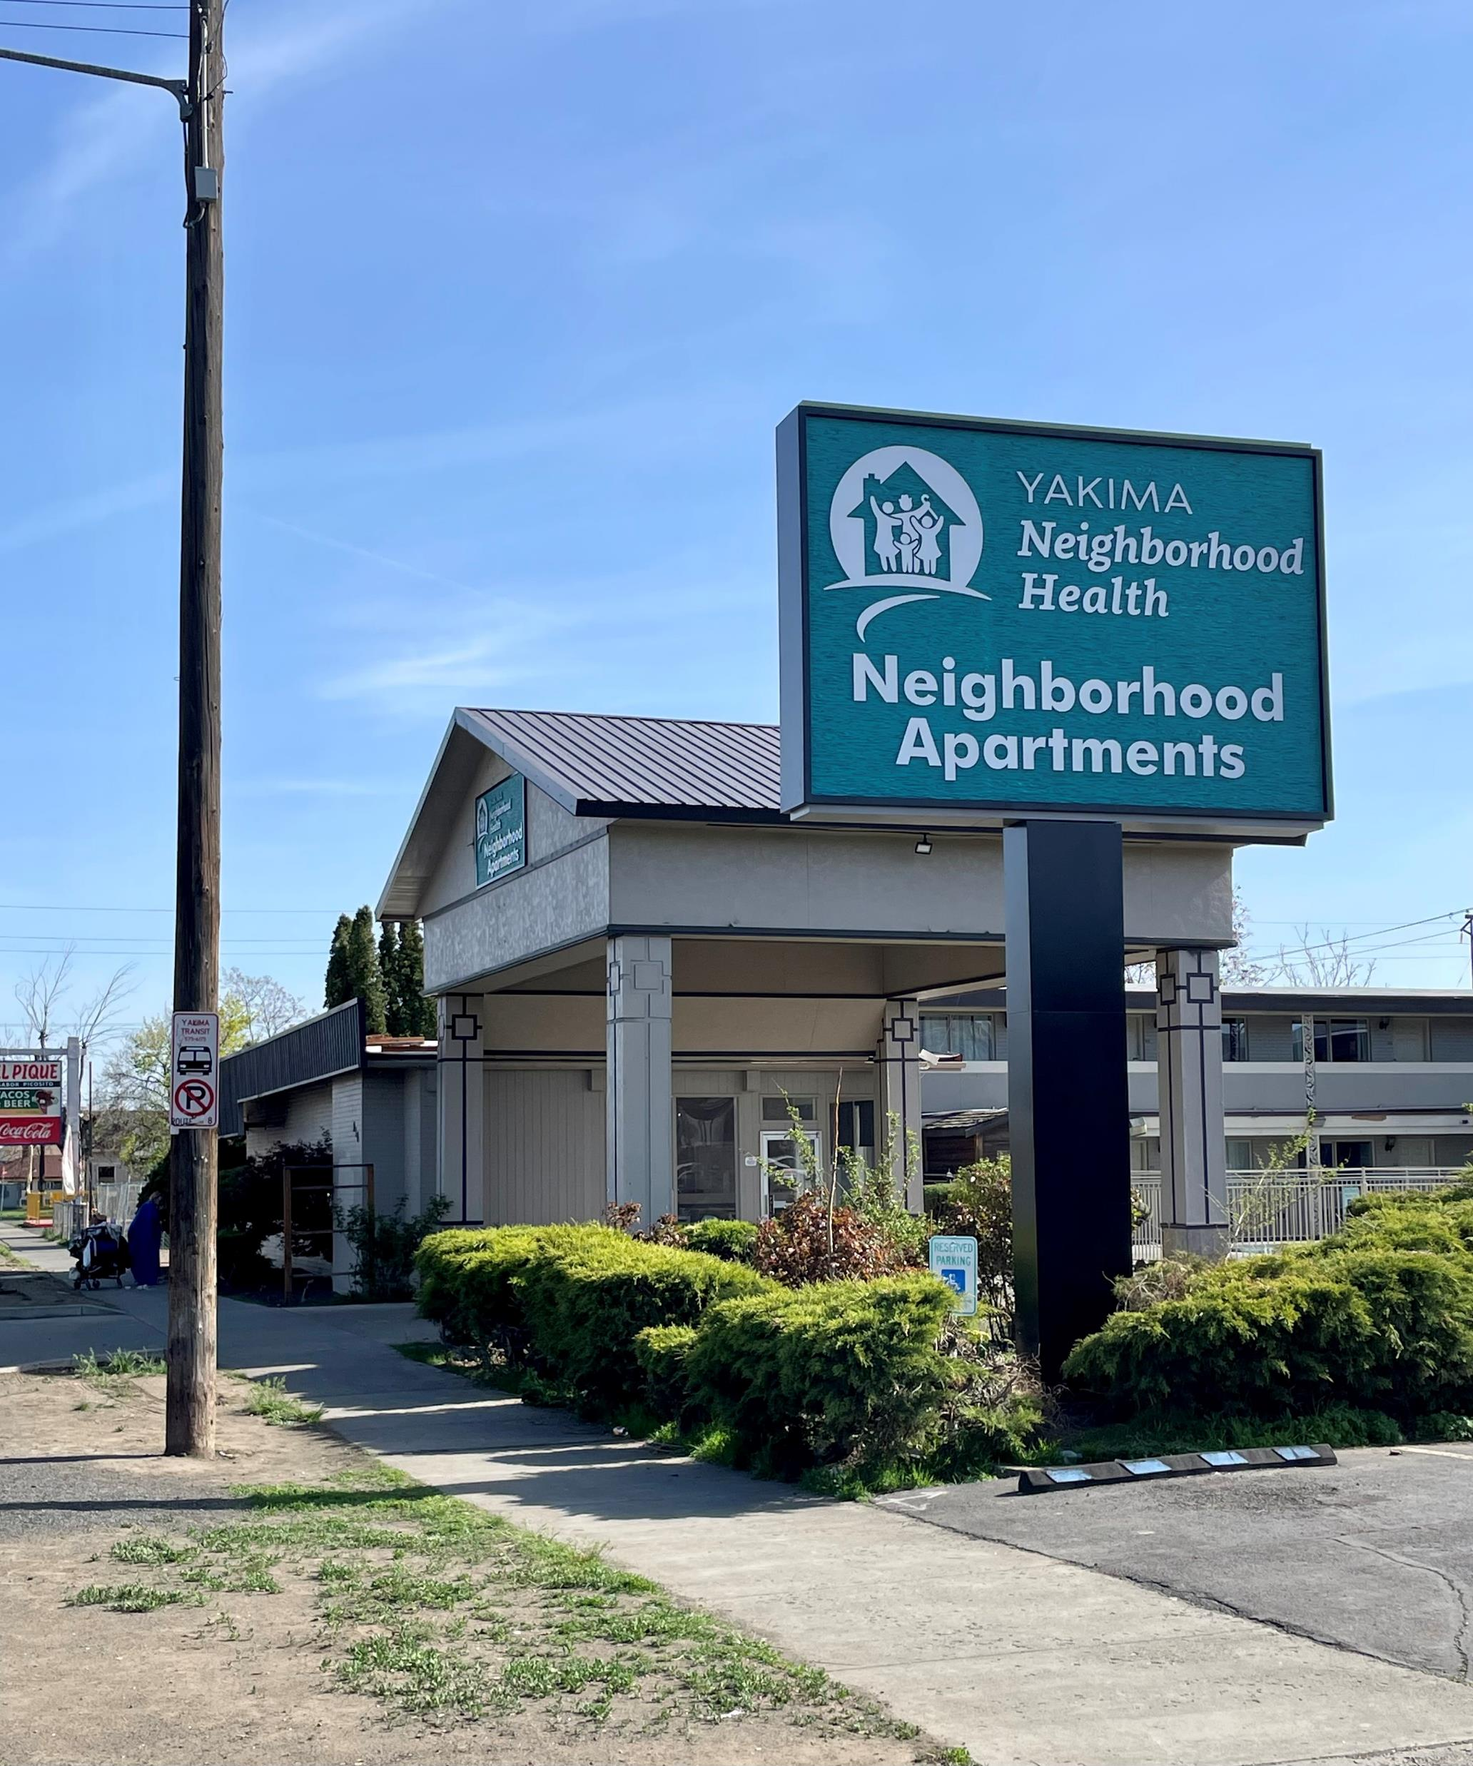
Medical Respite Care (NHCHC virtual tour) https://www.youtube.com/watch?v=lIRfjN3-yCM
Rhonda Hauff, Chief Executive Officer
Annette Rodriguez, Chief Housing & Homeless Officer
Rhonda.hauff@ynhs.org Annette.Rodriguez@ynhs.org

