Slide 1
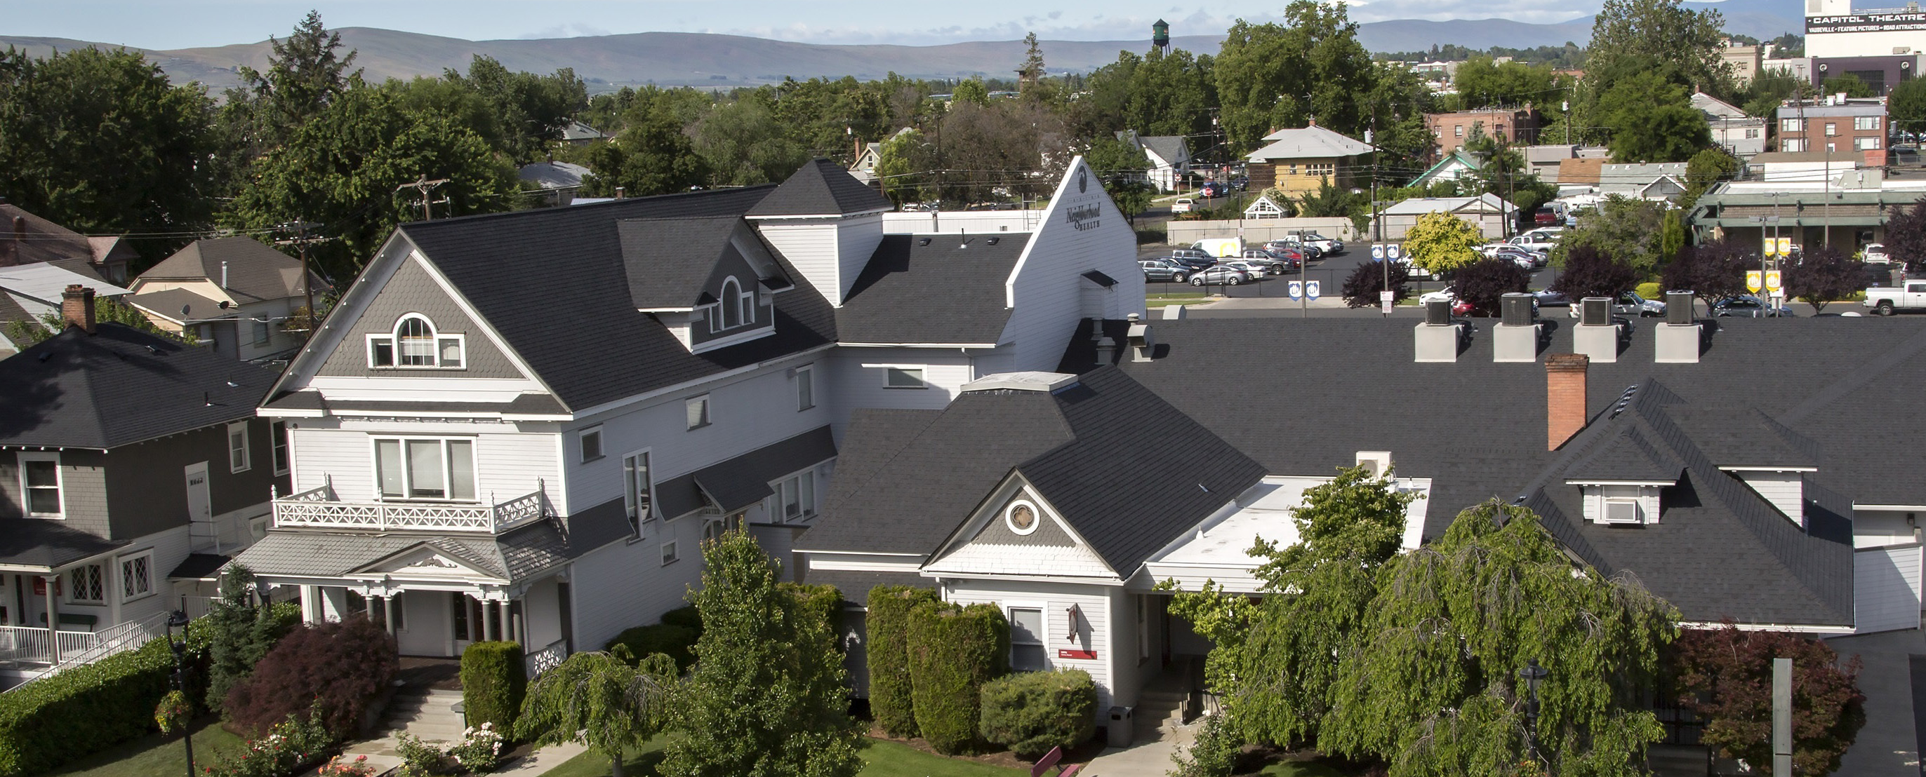
Our mission is to improve quality of life and equity in our communities by providing accessible and integrated health and social services, ending homelessness and offering unique learning opportunities for students of health professions.

Slide 2
2023 Profile Health Care and Housing
ALL YNHS Patients and Clients
All Patients | 29,260
All Visits (medical, dental, mental health, outreach, case management, care coordination) | 151,611 (avg 5.18/pt)
Youth Served at “The Space” (LGBTQ Youth Resource Center) | 140 Youth 1,722 Visits
Women, Infants & Children Nutrition Program | 3,855 Clients
Affordable Care Act Applications | 7,651 People 13,698 Apps. 19,535 Assists
People Experiencing Homelessness
People Experiencing Homelessness (PEH) | 4,229
All Visits to PEH (medical, dental, mental health, outreach, case management, care coordination) | 36,377 Visits (avg 8.60/pt)
Permanent Supportive Housing | 232 Clients 134 Households
Medical Recuperative Respite (Average Length of Stay 11 nights) | 200 Patients 2,222 bednights
Neighborhood Showers (mobile hygiene) (Operates 2/days per month March – October) | 493 People 1,915 Showers
Health Literacy (Telehealth Access) and Basic Needs (food, clothing, transportation, life skills, employment help, etc.) | 13,367 visits
Unaccompanied Homeless Youth | 154 Youth Served Age 13-24
MSAWs | 7,913 Patients 37,287 Visits (avg 4.71/pt)

Slide 3
Medical Respite & Permanent Supportive Housing Our North Star
Patients
Medical Respite Care – “We Need a Place to Be When We’re Sick”
Providers
Permanent Supportive Housing – “If You Want Us to Make a Difference in their Health…”

Slide 4
Recuperative Care for Unhoused not Sick Enough to be in hospital; and those being discharged from the hospital but not well enough to return to the streets.
Medical Respite Care
Care Transition from Primary Care or Hospital
Medication review
Case management
Wound care
Daily checks & health education
Access to medical support 24/7
Behavioral Health assessment & intervention
Assessment of Social Needs
Assist w/ Follow up to PCP and Specialty Care
Determine functional status – communication, cultural and ethnic factors
Provide meals
Provide & arrange transportation
Facilitate family unification and/or housing stabilization at exit
Establish ongoing relationship with PCP at respite exit

Slide 5
Medical Respite Care Program at YNHS: Patient Length of Stay & Medical Conditions
2023
Length of Stay | People | Reason for Respite Admission
One Week or Less | 50% | Cellulitis, Covid, Abscess, MOUD, Wound Care, Hypothermia, Burn, Edema, Fracture
One to Two Weeks | 33% | MOUD, Abscess, Surgery recovery, Wound care, Frostbite, Covid, Stab wound, Cellulitis, Tracheostomy care, Hypoxia
Two to Three Weeks | 11% | Stab wound, Frostbite, Necrosis, Amputation recoveries, Hernia repair, Cellulitis
Three to Four Weeks | 2% | Surgery recovery
More than Four Weeks | 4% | Congestive Heart Failure, Cancers, COPD, Amputations
200 patients – 2,222 nights (ALOS = 11 nights)

Slide 6
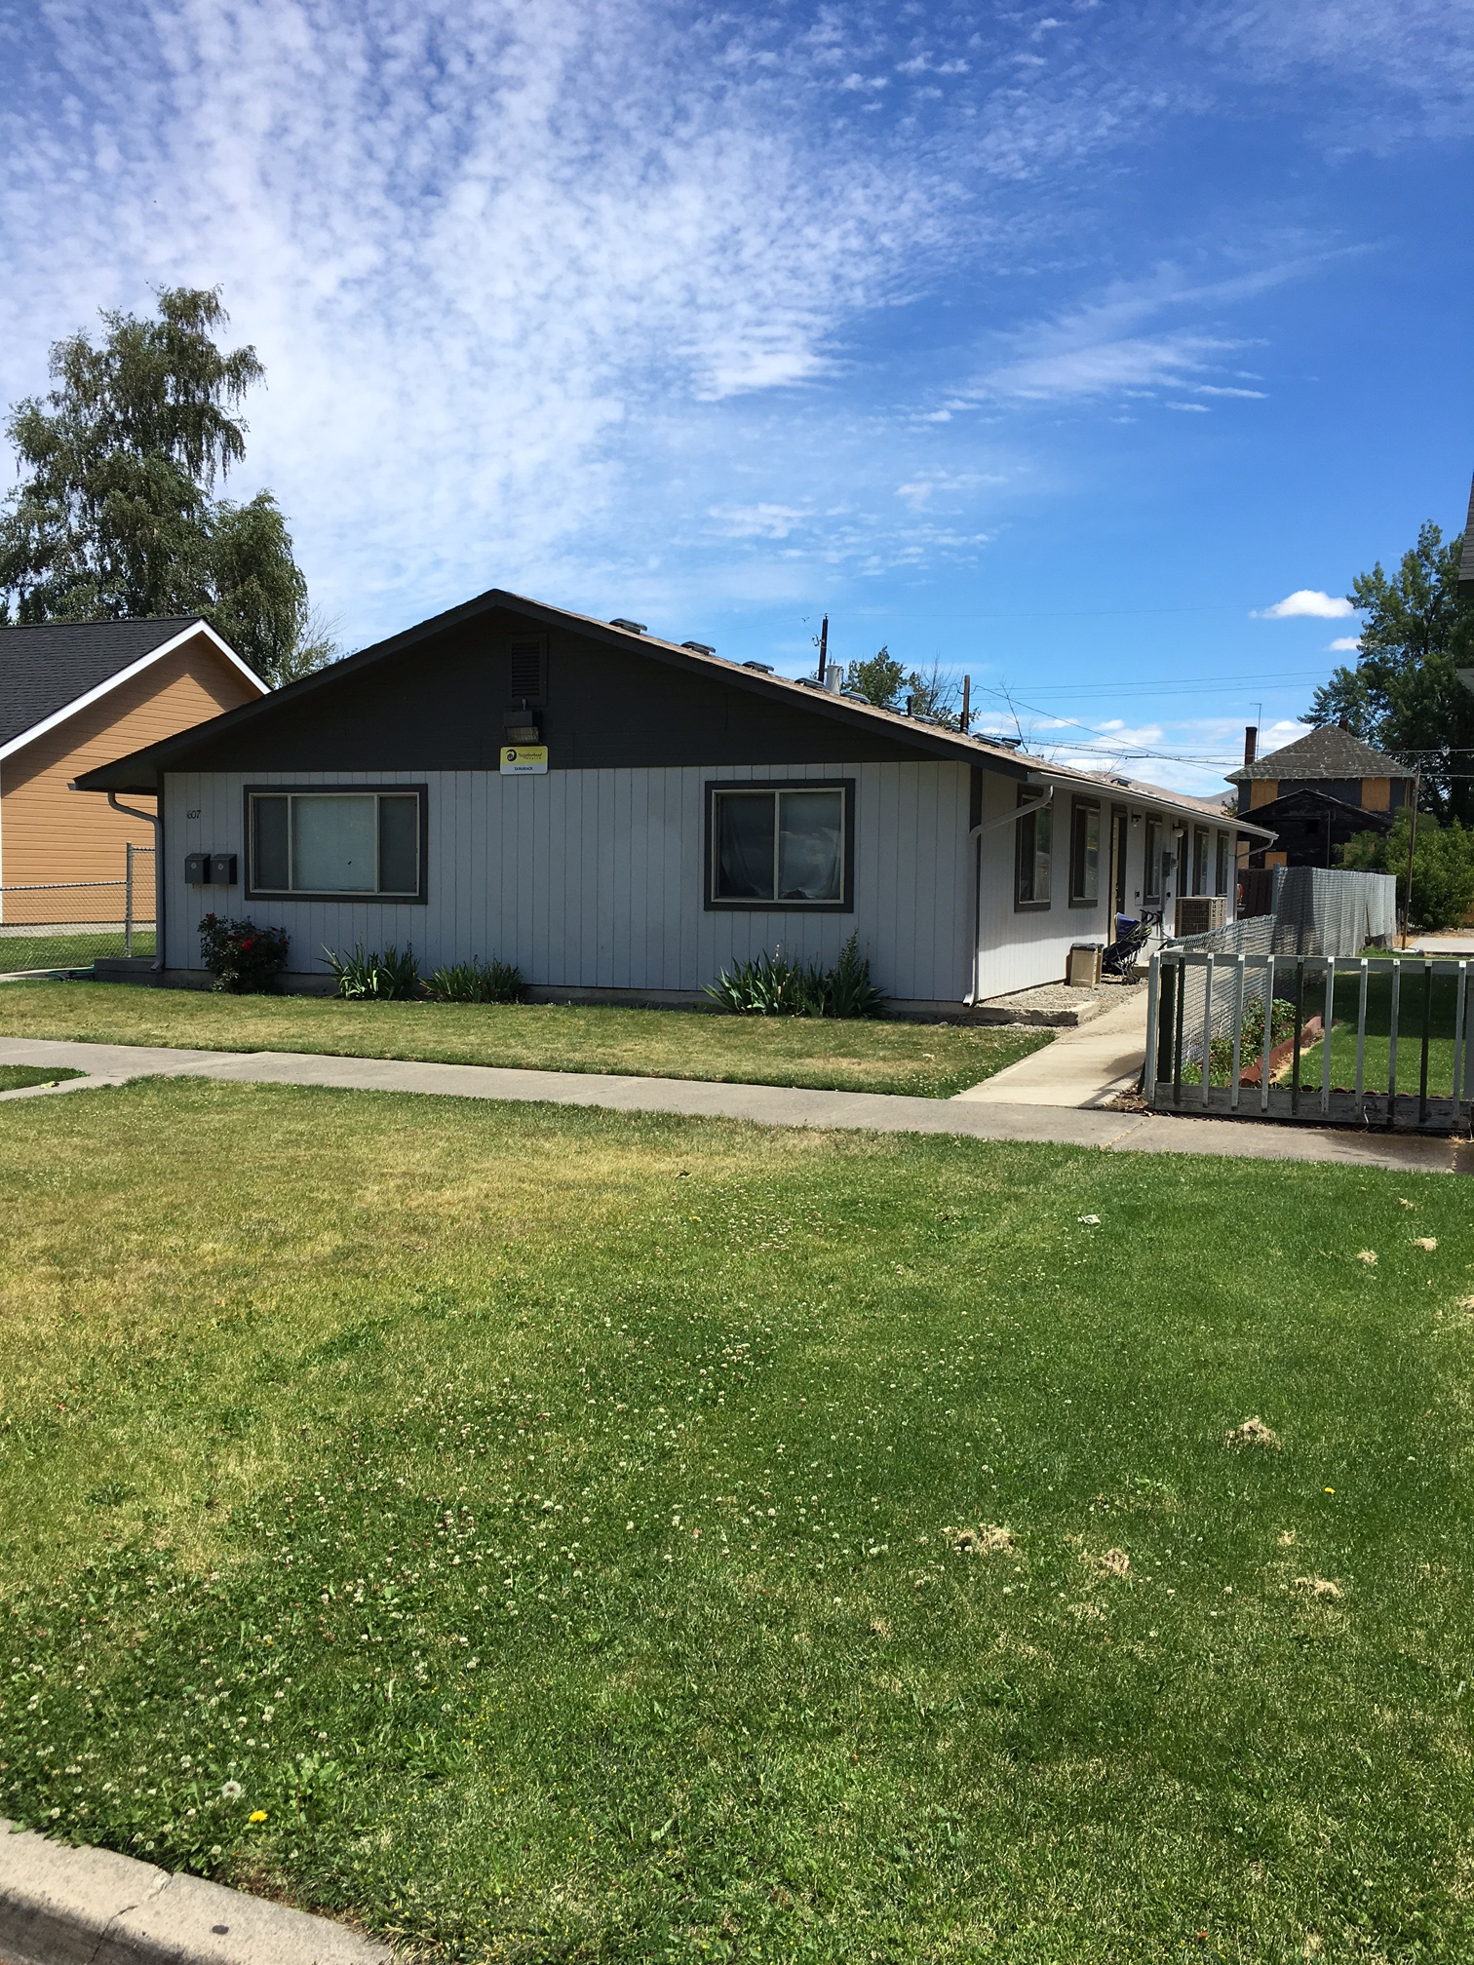
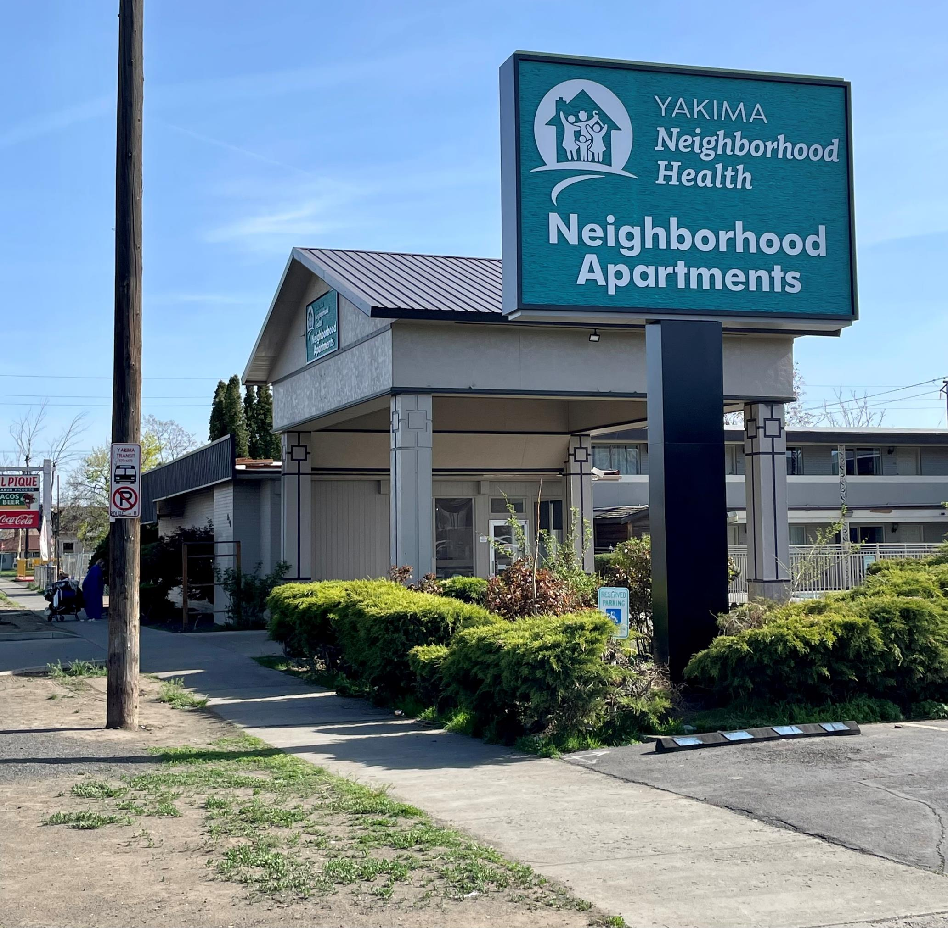
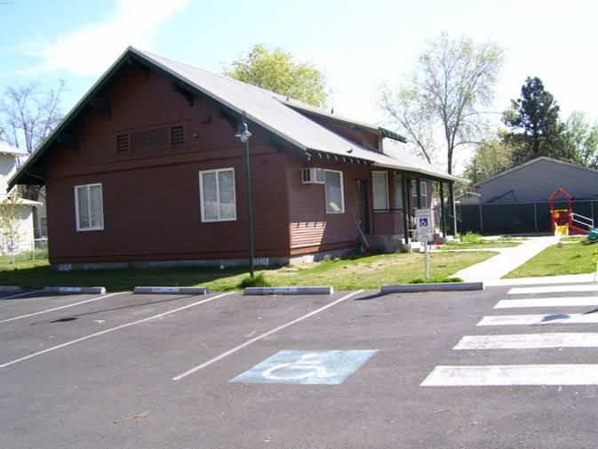
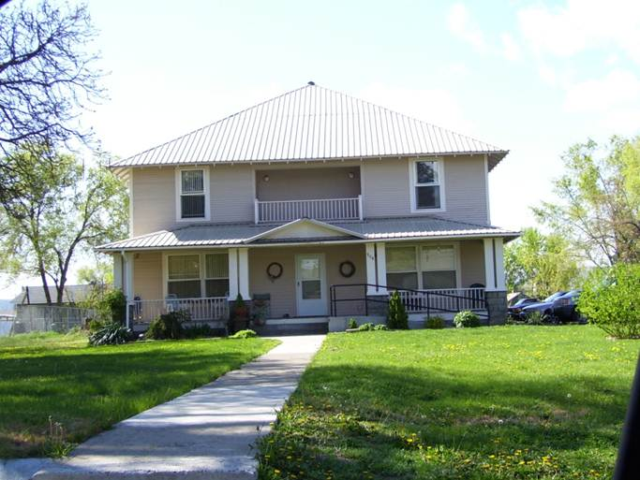
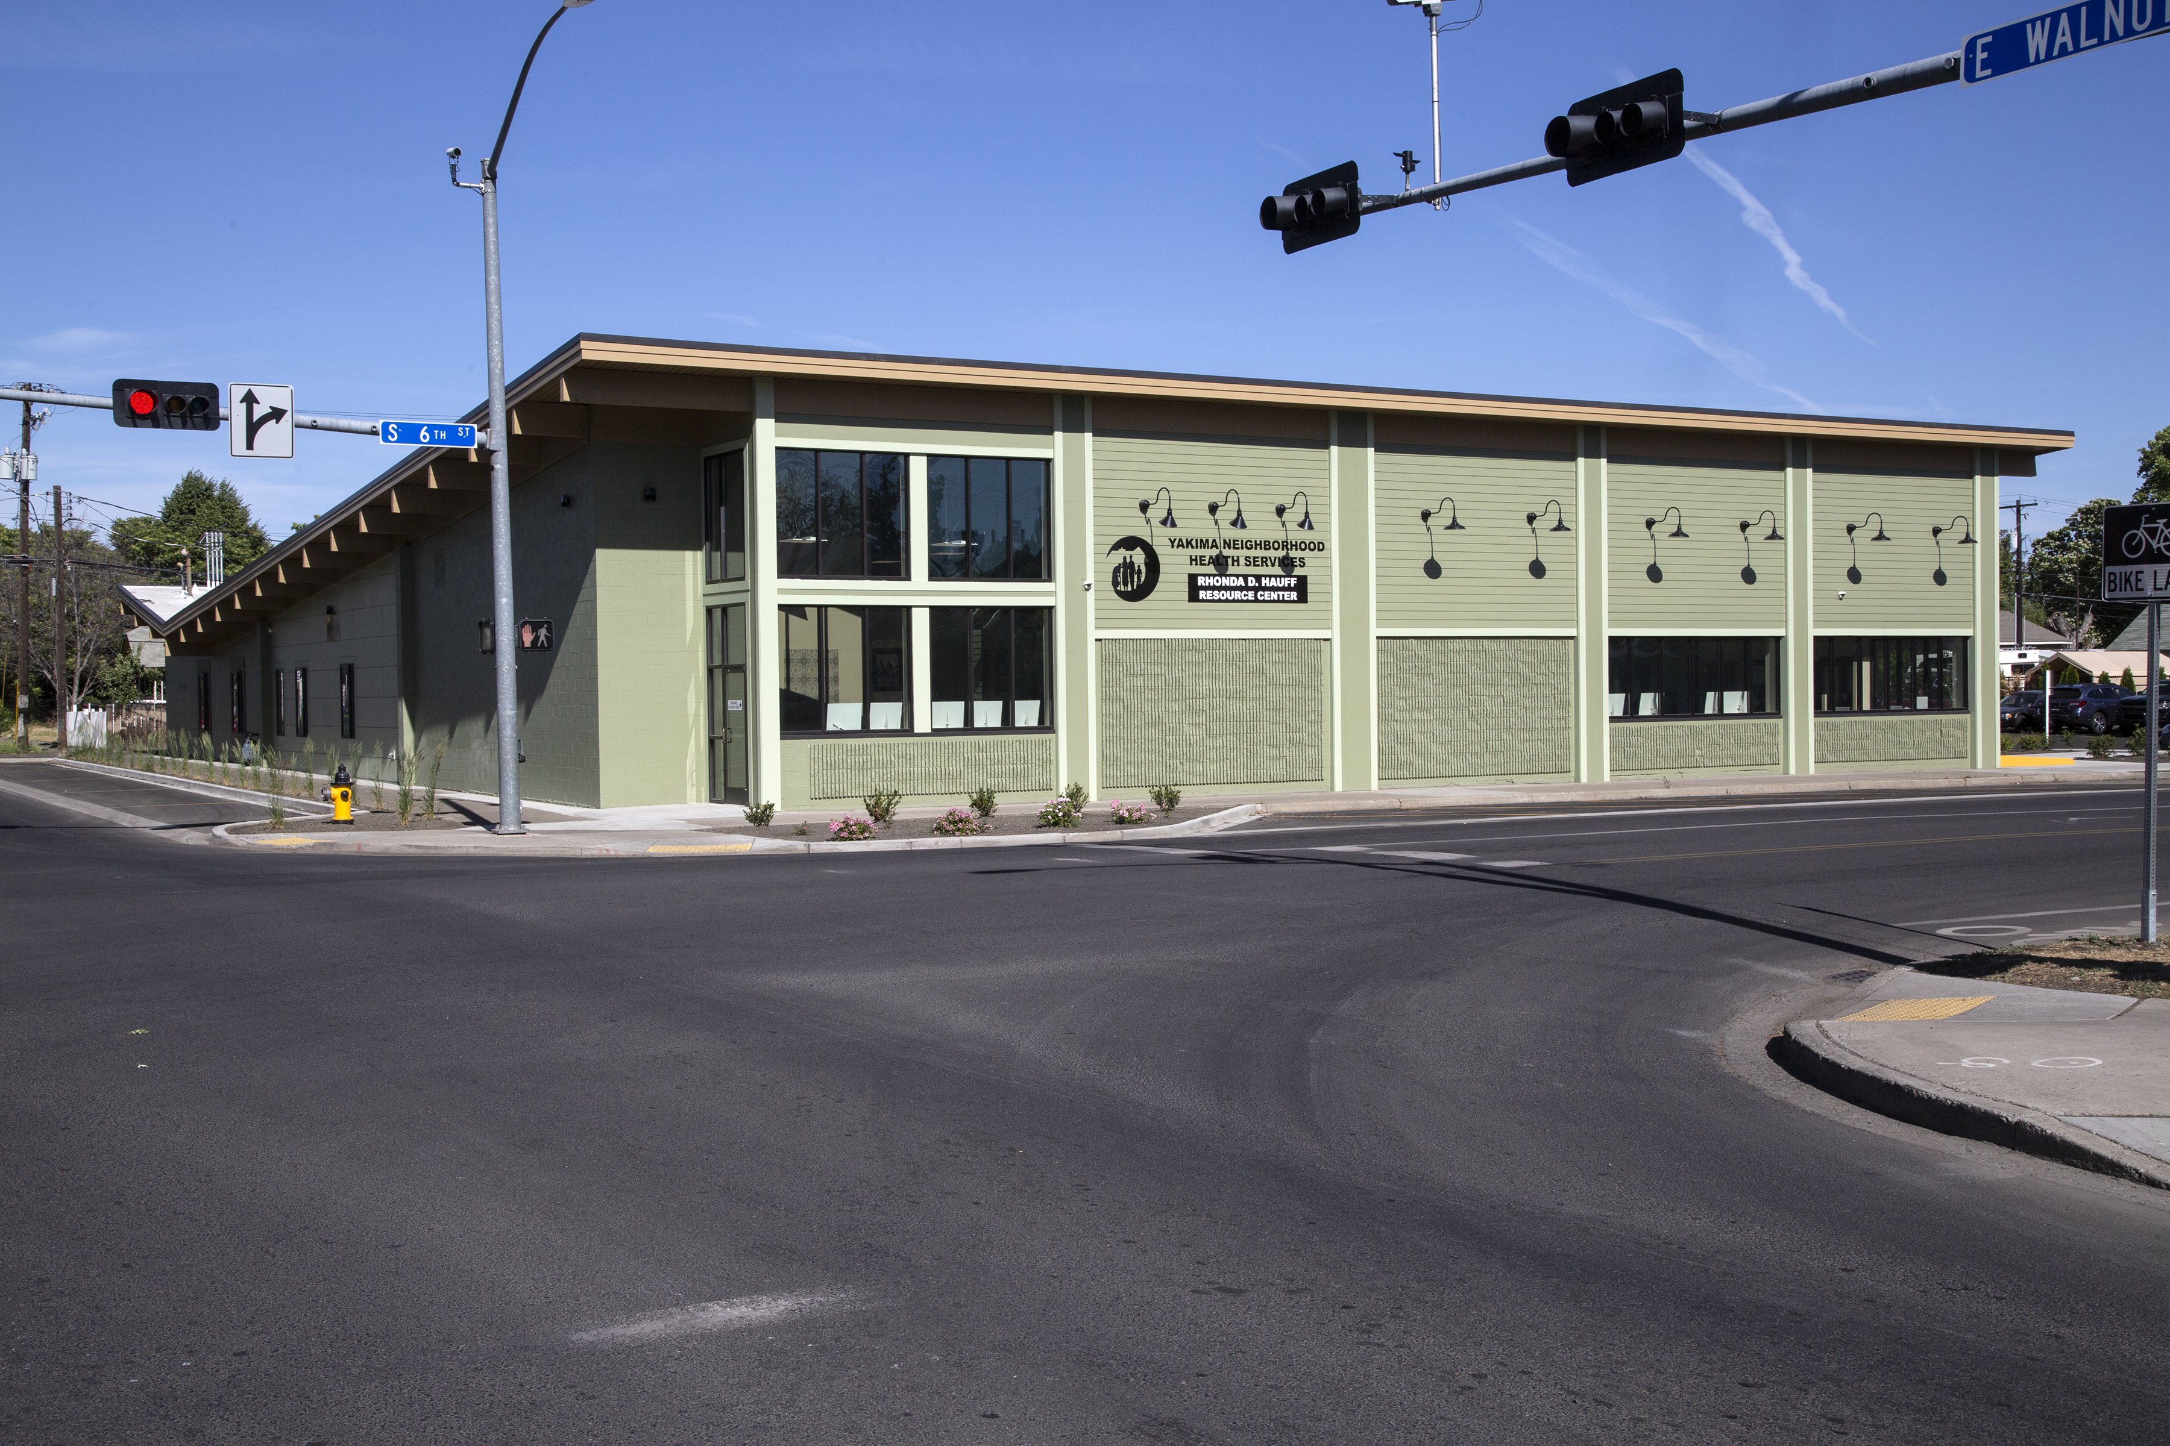
“It’s What’s On the Inside That Matters”
Housing First
Trauma Informed Care
Mental Health First Aid
Motivational Interviewing

Slide 7
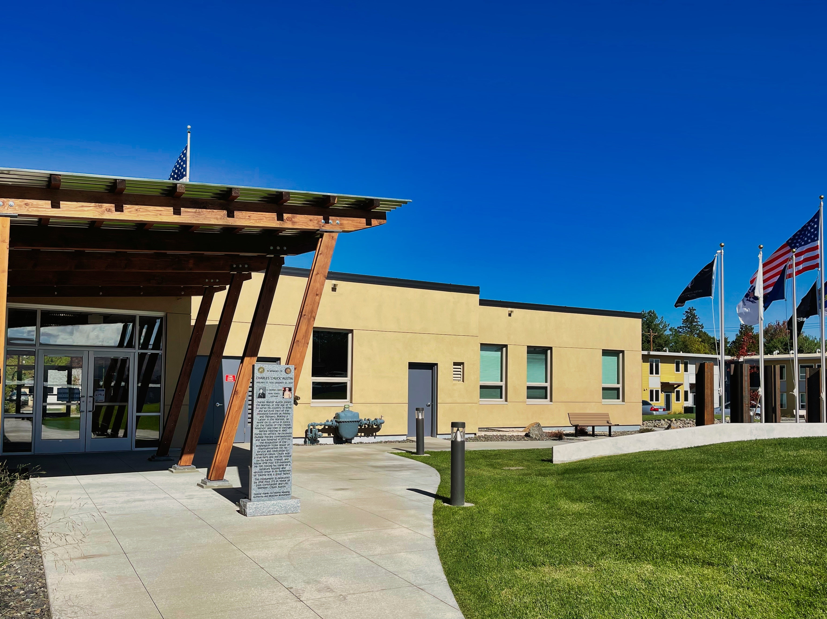
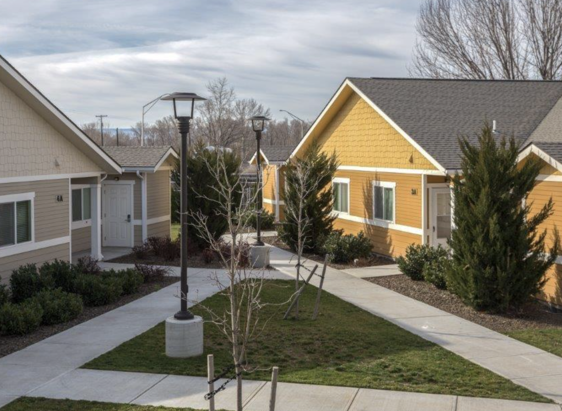
Partnerships Serve Special Populations

Slide 8
Who We Served in 2023
238 People (153 Adults)
85 Children < 18
45 Seniors > 55
134 Households
Chronically Homeless
At least one chronic disability
55 physical disability
24 developmental disability
53 chronic health disability
123 Mental Health disorders
75 SUD disorders
58 People have 3 or More Chronic Conditions
51 People are on SSI or SSDI

Slide 9
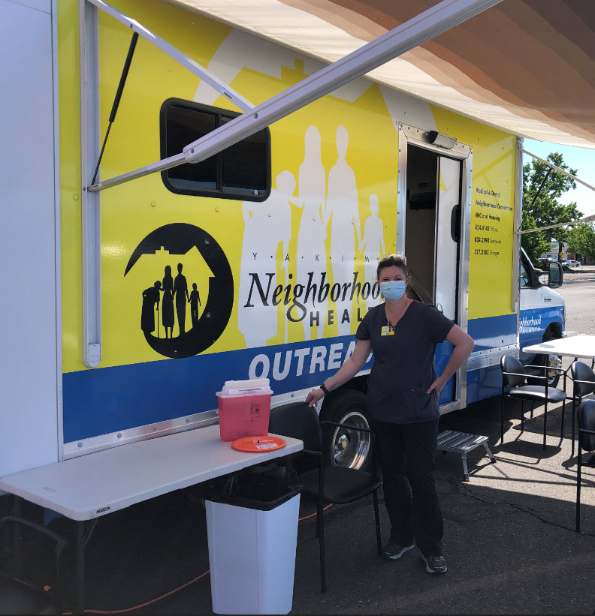
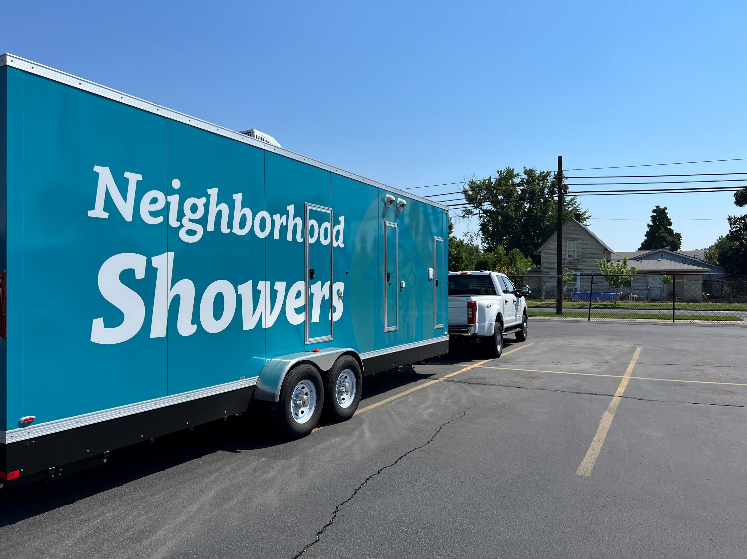
How We Served Them
Supportive Housing Case Manager
Supported Employment Specialist
Nurse
Behavioral Health Specialist
Substance Use Disorder Professional
Community Health Worker
Peer Support Specialist
Outreach Workers
Primary Care
*Medical
*Dental
*Behavioral Health
*Pharmacy
Continuum of Care / Coordinated Entry
HEN / ABD
Street Outreach
Health Home
Supportive Housing / Supported Employment
Medication for Opioid Use Disorders (MOUD)
Medical Respite Care

Slide 10
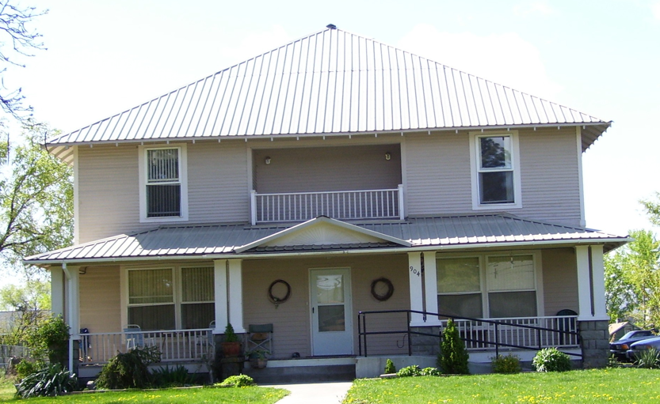
Permanent Supportive Housing in 2023

Slide 11
Housing First Then On to Primary Care

Slide 12
PSH Patients vs General YNHS Population
88% insured
(81% general population)
46 % received flu shots
( 47 % general population 2023)
70% had controlled diabetes
( 80% general population)
63 % had controlled hypertension
(70% general population)

Slide 13
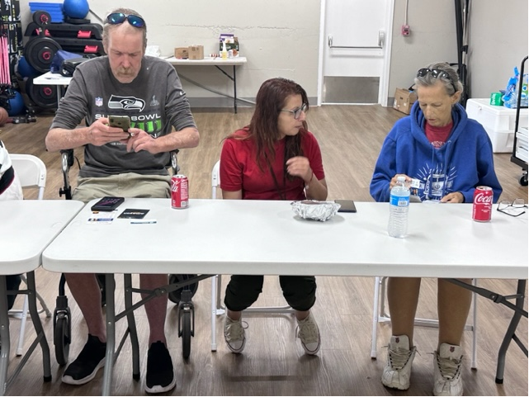
Digital Literacy Doesn’t Come Naturally for All

Slide 14
Our Strength is Always in Our Partnerships
Questions ?
Rhonda Hauff , CEO
Rhonda.hauff@ynhs.org

