Slide 1






From Feasibility to Facility:
The Journey to Establish a Medical Respite
Donna Zazworsky, RN, MS, FAAN - Board Member,
Catholic Community Services
Peg Harmon, MS – CEO Emeritus, Catholic Community Services
Jennifer Biggs, RN, MS – Regional Director El Rio Community Health Centers
HCH2024
PHOENIX, AZ • MAY 13-16, 2024

Slide 2
Acknowledgements
On behalf of Catholic Community Services and El Rio Health, we recognize we are on the unceded lands of the Tohono O’odham and Pascua Yaqui people who have been ongoing stewards of these lands. We honor their love and commitment to these lands.
We honor the enslaved people, immigrants, refugees, and others who built the wealth and foundation of the United States.
We acknowledge the benefit we have received from these lands and the labor of our ancestors.

Slide 3


This Presentation will address the three phases in establishing Casa de Respiro
Feasibility: Building a community coalition to determine need and size.
Funding: Establishing site location, fund raising and sustainability
Implementation: Confirming the medical and social service components through community partnerships.

Slide 4

MEDICAL RESPITE
What is the value of Medical Respite?
Medical Respite provides humane treatment of a vulnerable population in a cost effective clinical setting with a system of services that will increase the likelihood of continued stabilization
REDUCTION …
In excess utilization of costly hospital emergency rooms and inpatient services
REDUCTION …
• In 911 calls to emergency medical system
• In 911 calls requiring a law enforcement response and a possible booking in the County jail
EVIDENCE-BASED SUCCESS
LA County Continuity of Care program - $32,000 per person savings year over year after entering stable housing with a 96% retention in permanent housing
Reduction of 77% in both ED visits and inpatient admissions and 85% in inpatient hospital days

Slide 5
Medical Respite Community Advisory Task Force
TITLE | ORGANIZATION
CEO | Catholic Community Services
Faculty/Chair | UA Family & Community Medicine/Banner South Campus
Board Member | Catholic Community Services
Consultant | Pivirotto Consulting
Chair | Hope of Glory Ministries
MD/MPH Student | UA College of Medicine & College of Public Health
Owner | Z Mansion
Director | Pima County Health Department
CEO | St. Mary’s Hospital
Director, Special Populations | El Rio Health Center
CEO | Old Pueblo Community Services
Medical Director | Cenpatico/ Regional Behavioral Health Authority
Director, Housing Administration | Cenpatico/ Regional Behavioral Health Authority
Vice President, Community Benefit | TMC
Senior Director: Case Management | St. Mary’s Hospital
Case Management | TMC
Housing Liaison | Cope
Community Engagement Coordinator | Pima County Health Department
Architect | GHLN Architects & Engineers
Policy | Tucson Hispanic Chamber
CPA | Beach Fleischman & Co
Director for Southern AZ | AZ Builders Alliance
CEO | El Rio Health Center
CEO | Primavera
CEO | Casa de la Luz Hospice
Director of Case Management | Banner University
CMO | Circle the City Medical Respite for the Homeless in Phoenix
Sister | Sisters of St. Joseph of Carondelet
CEO | Marana Health Center
CMO | El Rio
VP | Mercy Care
Director | Healthy Together/UA Health Plan

Slide 6
TUCSON VS. OTHER RESPITE SITES
Pima County has a large unmet need
SANTA ROSA
Population: 488,000
AHAR 2014: 4,300
Percent < 100% poverty: 13%
Respite beds = 26
BOSTON
Population: 4,628,000
AHAR 2014: 23,187
Percent < 100% poverty: 21%
Respite beds = 104
TUCSON
Population: 1,004,516
AHAR 2014: 9,195
Percent < 100% poverty: 25.8%
Respite beds = 0
PHOENIX
Population: 4,087,191
AHAR 2014: 18,126
Percent < 100% poverty: 17%
Respite beds = 50 + 50 waiting
(Need for 100)

Slide 7
WHAT HAS TUCSON LEARNED INITIALLY?
Start = November 2015
1
2
3
4
CCS Convenes Task Force
Initial brainstorming with key leaders in November 2015; first Task Force meeting in January 2016
Consensus 1
Group requests a Feasibility Study to determine need and whether a center is financial sustainable
Consensus 2
3 stages of work needed:
Needs Assessment, Capital Expenditures Budget and Operational Budget
Research
Needs Assessment begins with expertise of a Clinical Subcommittee
5
6
7
8
Research
Designed a process to leverage commitment of a third year medical student to undertake this work as his MPH project
Research
Preceptors: Circle the City MD
Chair, Family Medicine, U of A
Research
Housing Subcommittee chaired by Chair of Tucson Pima Coalition to End Homelessness,
Executive Briefing
Confidential draft presentation prepared for designated community partners

Slide 8
METHODOLOGY
Used for estimating homeless population in Tucson in need of MR Program
Annualize Hospital 1 numbers
45 individuals with one Ed visit per quarter • 77 with 3 or more visits captured
3 individuals per quarter with > 3 ED visits only accounted for in a given quarter
Estimate Hospital 2 data based on preliminary look forward
71 individuals in look forward (first two months) • Subtract for estimate of > 3 ED visits (110)
10% overlap
Adjust Hospital 3 & Hospital 1 data based on homeless population interview data
20-25% overlap between St. Mary’s and Banner ED visits • 70% individuals not captured by St. Mary’s look back
85% not captured in Banner look back • Subtract 10 % of above for conservative estimate • Add 10% of overlap
Estimate for 3 hospitals not included in this study
Account for proportion of individuals that would enter respite outside of hospital systems
CTC 2015: 6% of respite beds utilized for pre-procedure
6% guaranteed for Hospice of Valley plus others used for palliative care

Slide 9
TUCSON NEED ESTIMATES
Annual need based on acuity
Moderate Acuity
51%
774 people
M
Low Acuity
26%
395 people
L
High Acuity
23%
349 people
H
Total estimated annual volume of individuals needing MR in Tucson is: 1,518
NOTE: Acuity distribution is based solely on acute medical condition qualifying for medical respite care; acuity distribution does not reflect adjustments upward to reflect intensive services needs associated with unstable mental health and/or substance abuse

Slide 10

OTHER KEY FINDINGS
From the Tucson preliminary study
High acuity medical conditions:
Septicemia, pneumonia, acute liver related, acute coronary related
Moderate acuity medical conditions:
Cellulitis/abscess, pneumonia, fracture
Low acuity medical conditions:
Wound/laceration, musculoskeletal/fracture, pain control, respiratory (COPD, asthma)
• Substance abuse disorder was present in 75% and 80% of the target population
• Mental health disorders were present in 45% and 50% of the target population
HIGH NEED FOR ALL ACUITIES
High rate of substance abuse and mental health disorders

Slide 11
DATA LIMITATIONS
Research limitations were many
Interviews with 80 homeless persons Many of whom signed medical records releases permitting the MPH candidate to request their records from various hospitals.
Ultimately this medical record review determined that people known to be homeless were not recognized and coded as such by the hospitals
Their claims were not included in those used to evaluate acuity and prepare preliminary estimates.
For one hospital, only 2 of the 25 individuals’ records were found
In files for population flagged as homeless by the hospitals.
Time constraints required for completion of data compilation and analysis by April resulted in narrowing data collection.
Data excluded for: 3 hospitals, Hospices and Pima County Adult Detention Center health care provider
Collection of 2 week discharge summaries is in process by Discharge Planning nurse at the jail where 122 individuals self reported homelessness at intake in March 2016.
Unique patient identifiers were not available to eliminate duplicates of patients across multiple hospitals.
Estimates were made for those individuals who might enter respite to prepare for an operation or diagnostic procedure such as a colonoscopy when it is not likely such prep could be done in a shelter or on the street
PERSONAL INTERVIEWS
Found homeless status was not recognized
TIME & DATA ISSUES
Resulted in narrowing data collection
PATIENT IDENTIFIERS
Were missing allowing for data duplication

Slide 12

VOLUME OF BEDS NEEDED
Assuming LOS comparable to Circle the City
Bed Estimate | 30 day average LOS (Individuals/Year) | 40 day average LOS (Individuals/Year) | 45 day average LOS (Individuals/Year) | 50 day average LOS (Individuals/Year)
30 | 365 | 274 | 244 | 219
35 | 426 | 319 | 294 | 256
40 | 487 | 365 | 324 | 292
45 | 543 | 411 | 365 | 329

Slide 13
NEXT STEPS
From May 2016
01
Refine the need methodology
to the extent possible by compiling and analyzing additional datasets
02
Solicit input of senior leadership
of providers, justice system, county government, municipalities with a focus on City of Tucson
03
Partner with key payers
on additional work effort and assumptions essential to determine medical respite for the homeless is a sustainable project for a Tucson provider to operate.
• Develop a team to examine in greater depth the likely availability of permanent supportive housing over the next 5 to 10 years.
• Engage a programmatic and fiscal expert to develop pro-formas for the capital budget, operating budget and working capital requirements over the first 3 years.

Slide 14
ASSISTANCE CCS REQUESTED: EVER EVOLVING
We need your help
PARTNERS
Recommendations on who and what to include in next steps (including home health services, ACT teams and other service providers)
FINANCIAL
Participation in the development of financial proformas for medical respite in Tucson (including assumptions on rates and housing availability)
HOUSING
Input and resources to address permanent supportive housing options
DOT CONNECTION
Thoughtful feedback on level of interest, target populations (SMI, justice involved), and strategies for accelerating the project?

Slide 15
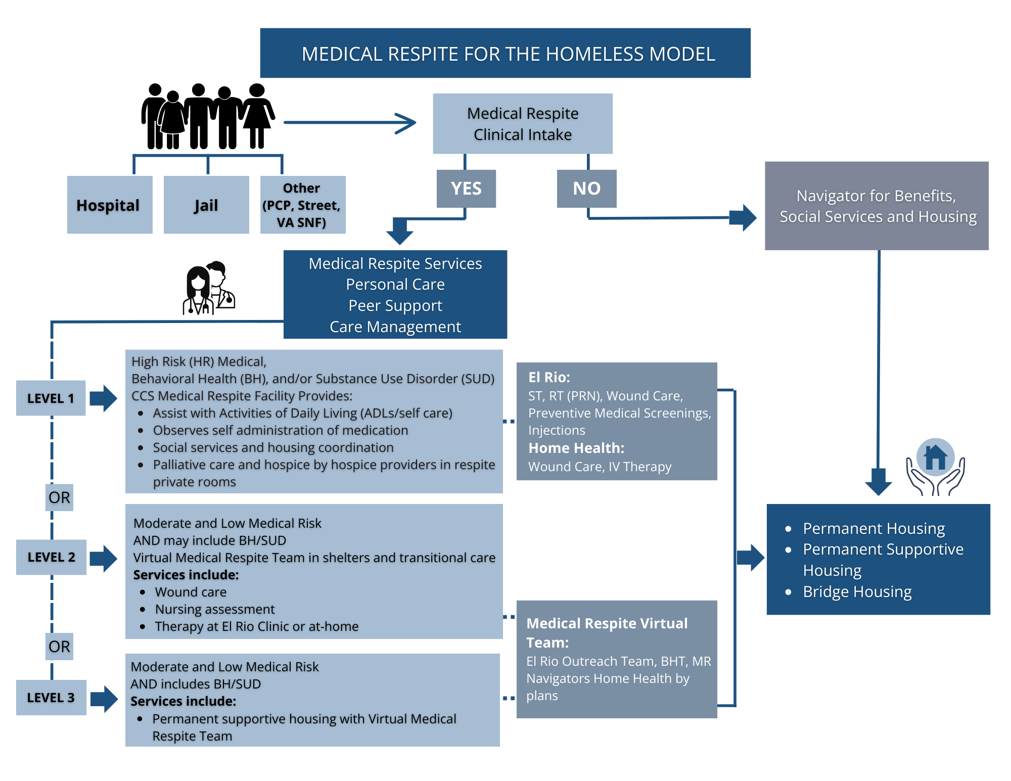

Slide 16
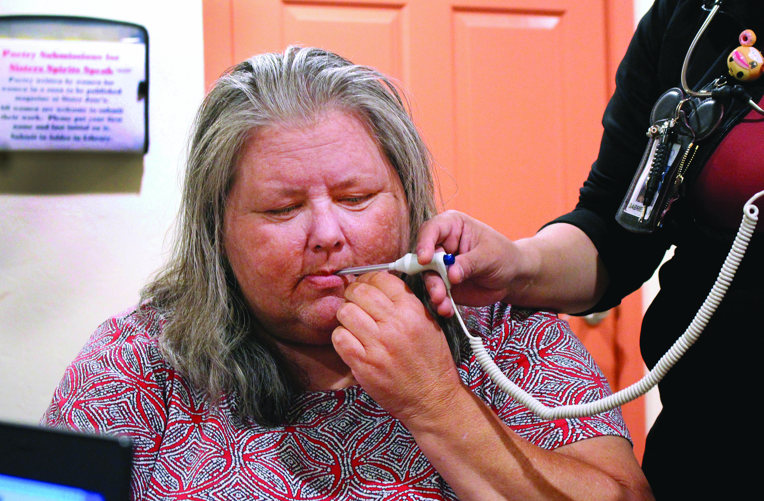
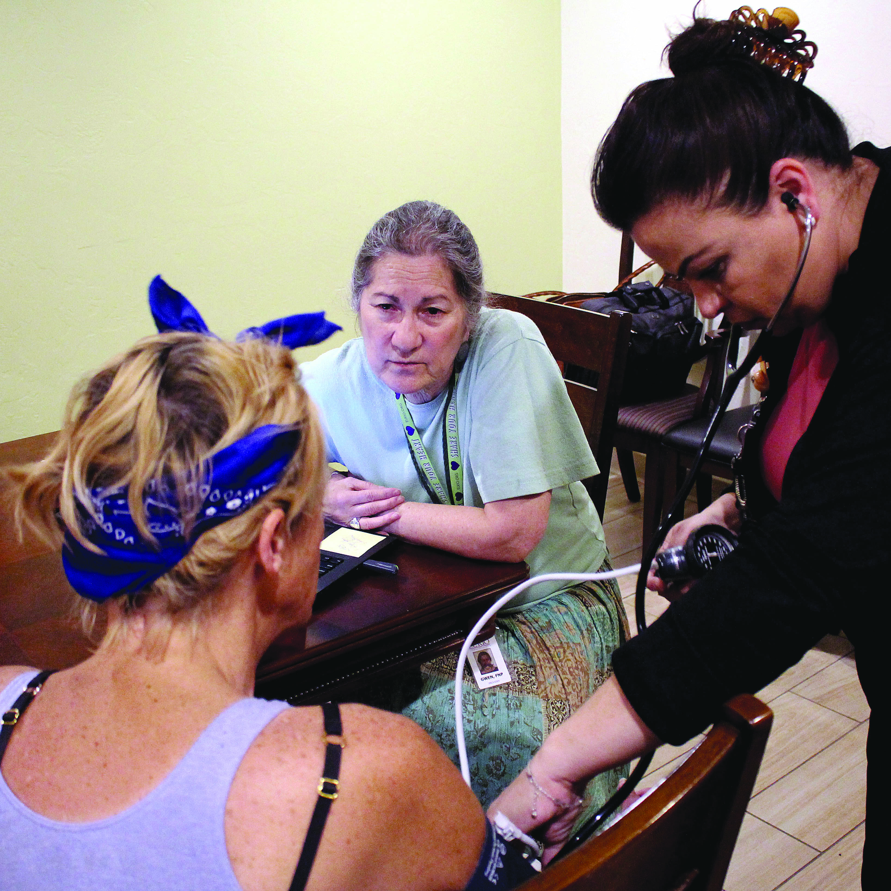
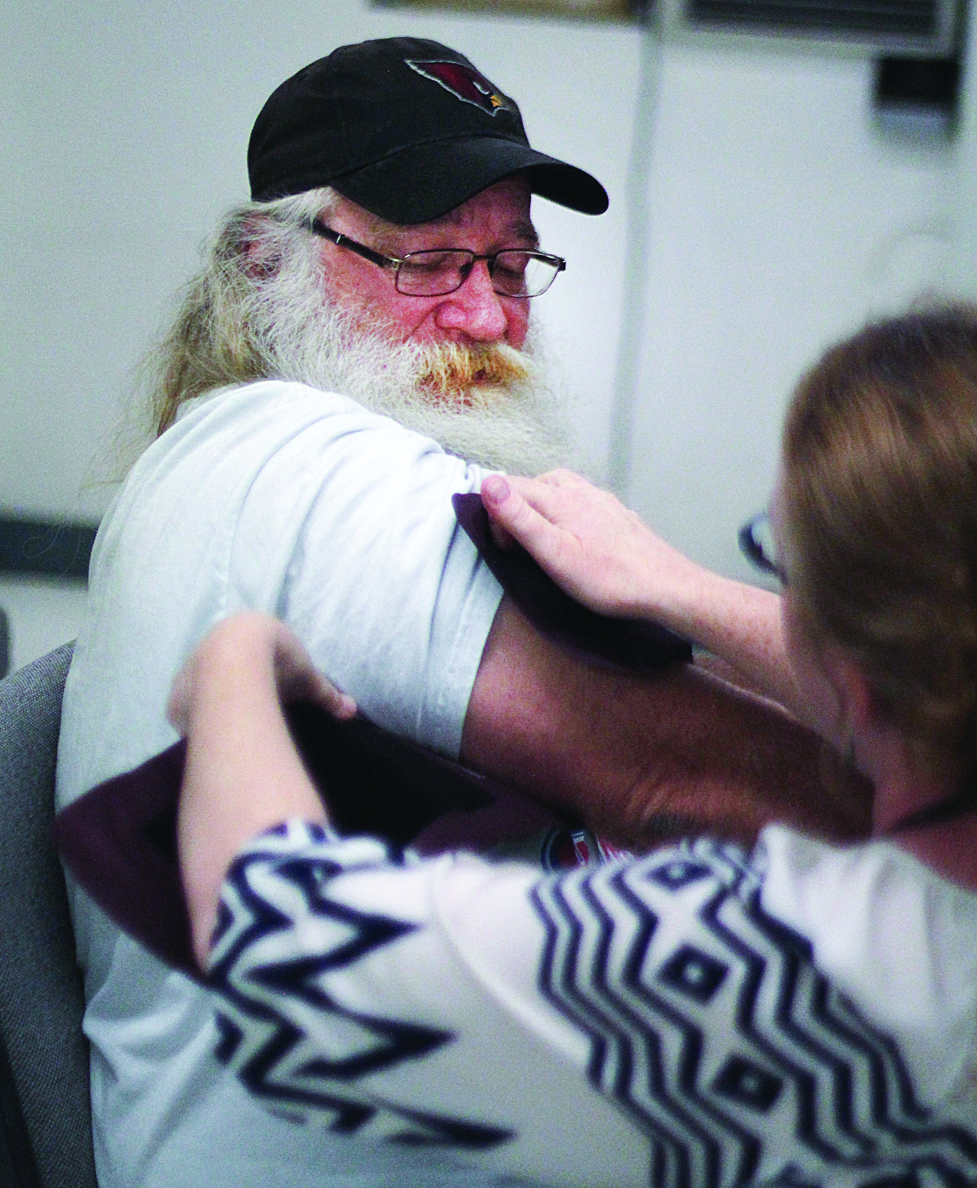
MEDICAL RESPITE
What is the value of Medical Respite?
Outcome from Literature Review: March 2021
Medical Respite has the capacity to reduce the leading causes of hospitalization and death in populations experiencing homelessness.
Cardiovascular Disease highest risk for hospitalization readmission and comorbidities and death of all patients
Diabetes: high rates of uncontrolled disease, hospitalization and emergency room visits
Human Immunodeficiency Virus (HIV): three times the rate of the general population, high rates of hospitalization and uncontrolled symptoms at time of referral.
Acute Respiratory Tract Infections: During winter months diagnosed in 47% of patients referred and co-occur with chronic conditions, high rates of hospitalization and poor outcomes post discharge.

Slide 17
OTHER KEY FINDINGS
Homelessness In Pima County
Point In Time Results 2020
Pima County is 15% of the state population but 23% of the homeless population
The point in 2020-time count for 2020 is 1044 people who were sheltered, 578 who were not sheltered and 246 identified as chronic homeless.
Persons considered chronically homeless at the point in time count 42.6 % have a disability, 27.2% have a chronic health condition 42.6 were reported to have a mental health disorder, 65%, a substance abuse disorder of 38% are veterans and 67% are men.
THE CURRENT HOUSING CRISIS IS CREATING EVEN GREATER NEED AND DEMAND

Slide 18

CCS was founded in 1933 as Catholic Social Services of Arizona with services primarily in Tucson, to respond the needs of families and children during the depression.
CCS expanded for the next 90 years to address challenges for communities across the 9 southern counties in Arizona.
Our History:
Catholic Community Services of Southern Arizona

Slide 19
Providing Help. Creating Hope. Serving All.
100,800 people assisted in 2023
400 staff, 929 Volunteers
Services address children and youth, individuals and families, people in crisis, refugees and migrants, people with disabilities, with education, training, housing and shelter, legal services, counseling, foster care, family reunification, financial assistance, food, adult day health care, and in 2024 medical respite.

Slide 20
Creating and Financing A Facility
How do we model a facility that addresses the characteristics of care prioritized in the needs assessment?
How do we align the need to create a dignified place of residence and care with competing demands of regulation and operational costs?
Who are the stakeholders and how do we engage them?
  People who have lived experience of being unhoused and unhoused and ill
  Providers in healthcare facilities who treat people who are unhoused and ill.
  Staff of shelter and other housing options
  First Responders
  Staff and volunteers who support people living on the street
  Create a community commitment across government, community members, health systems business, educational institutions, nonprofits and faith groups to medical respite.

Slide 21
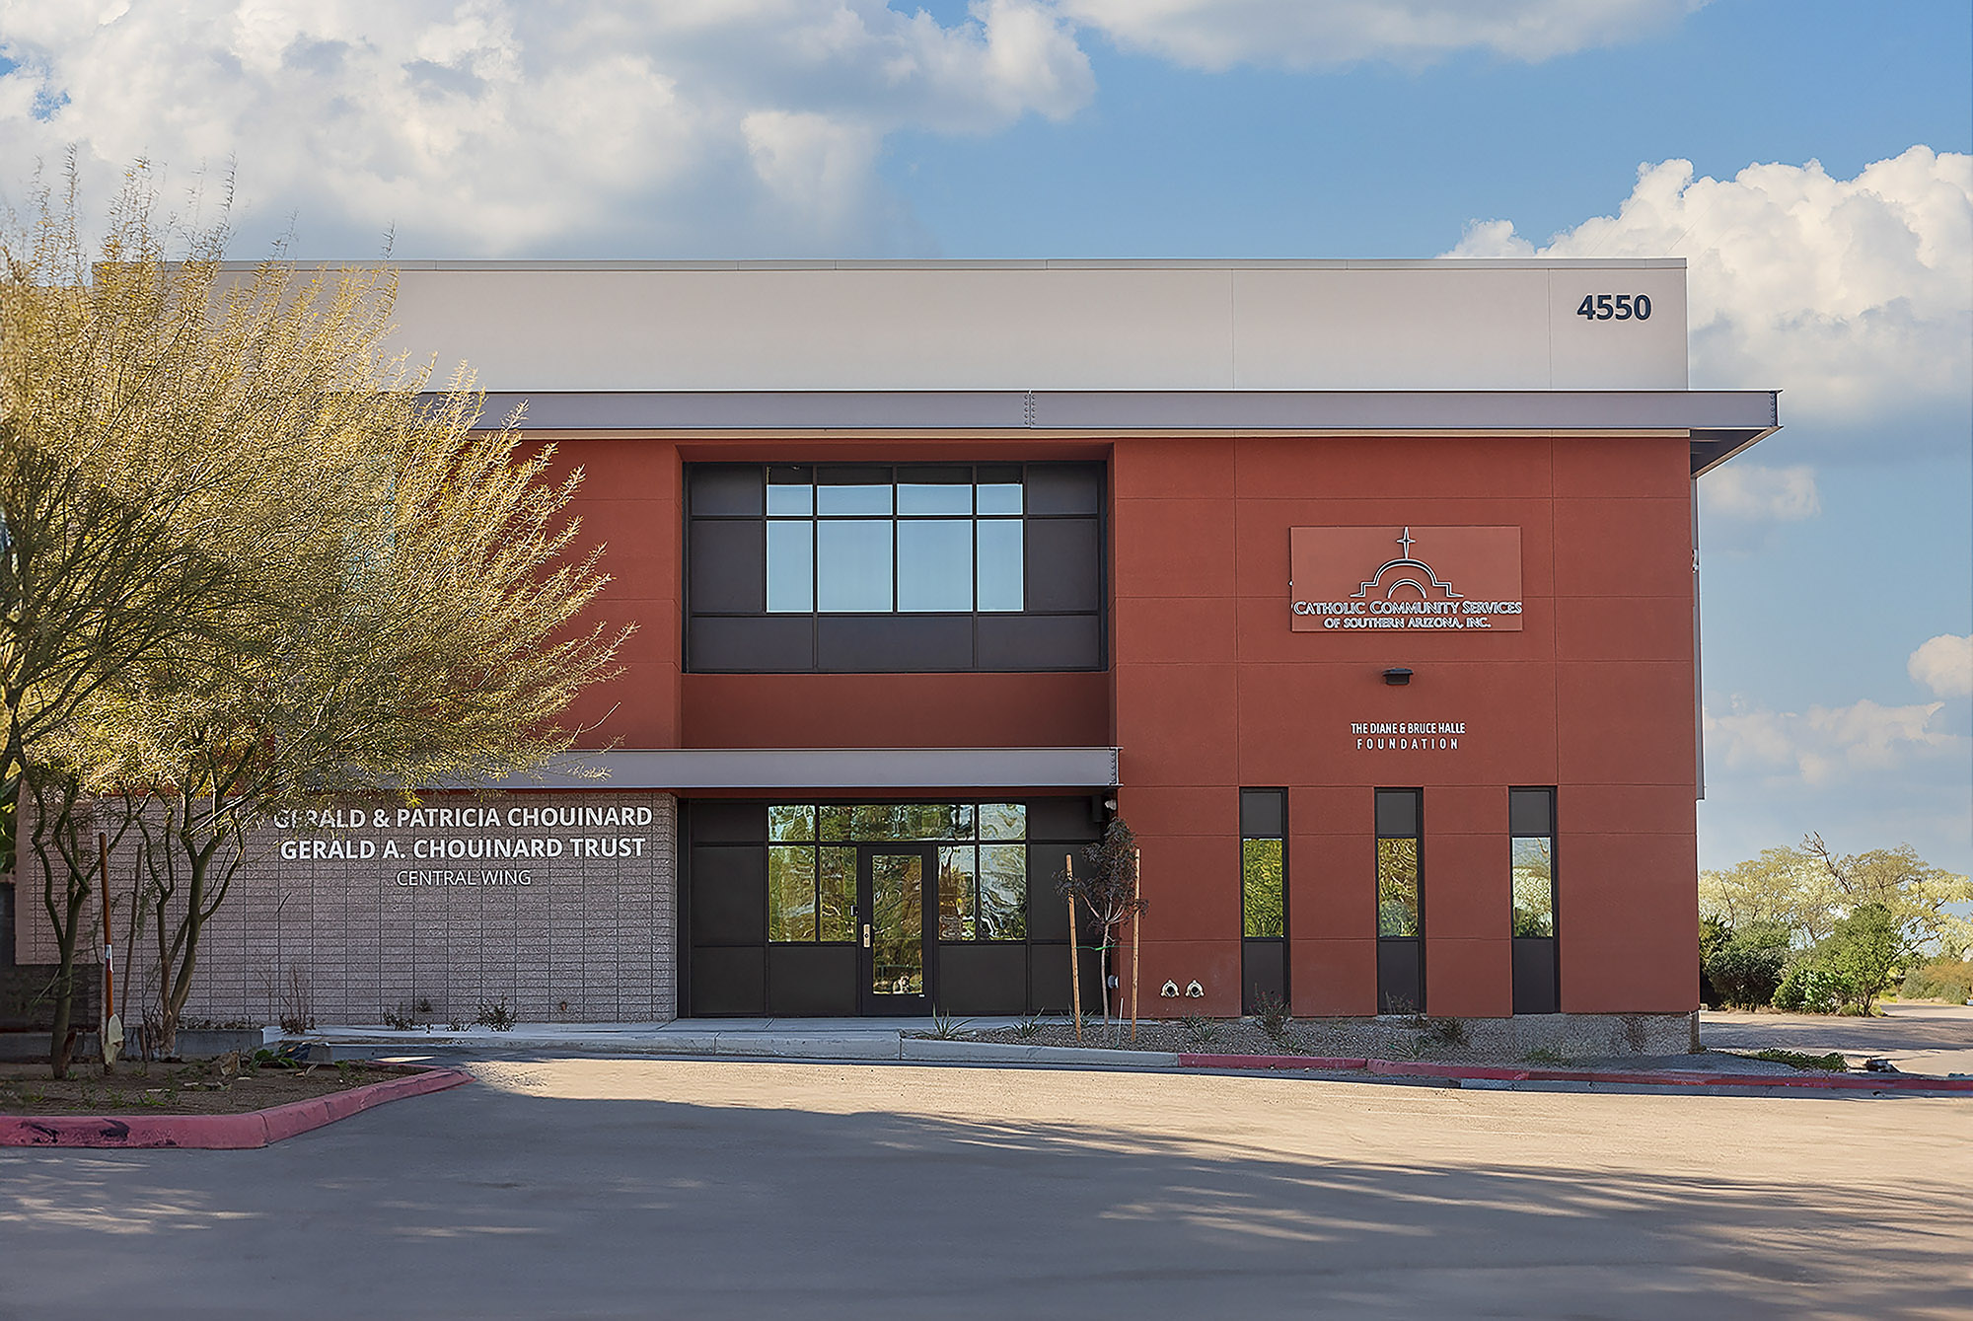
Casa De Respiro Medical Respite Center

Slide 22
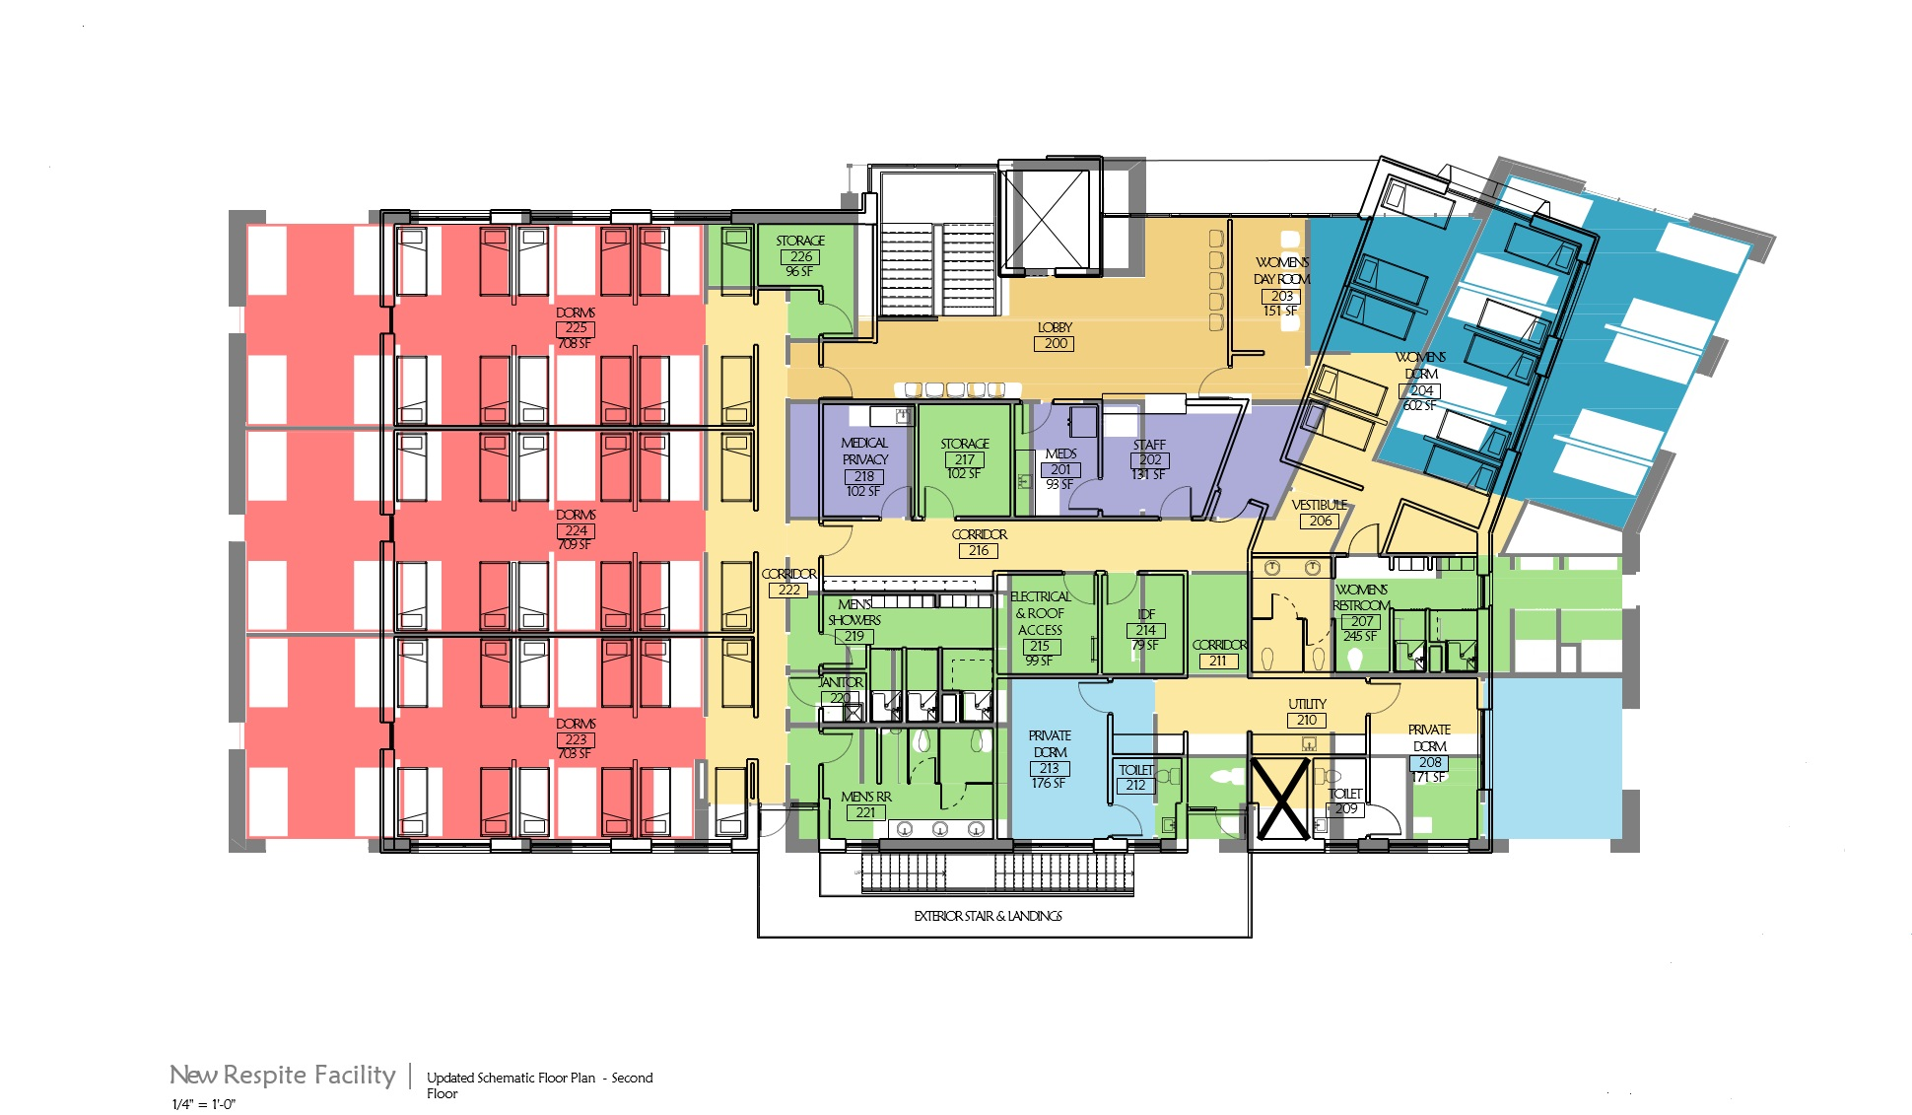

Slide 23
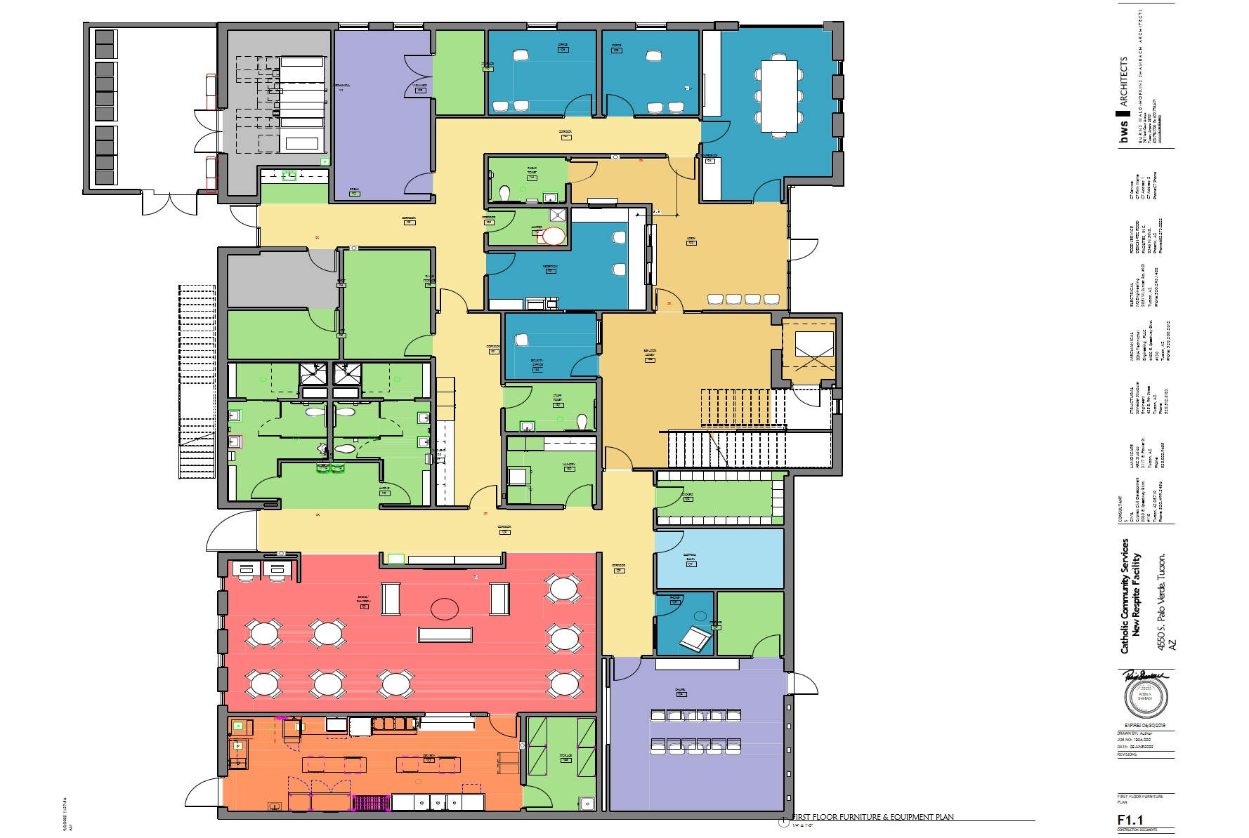

Slide 24
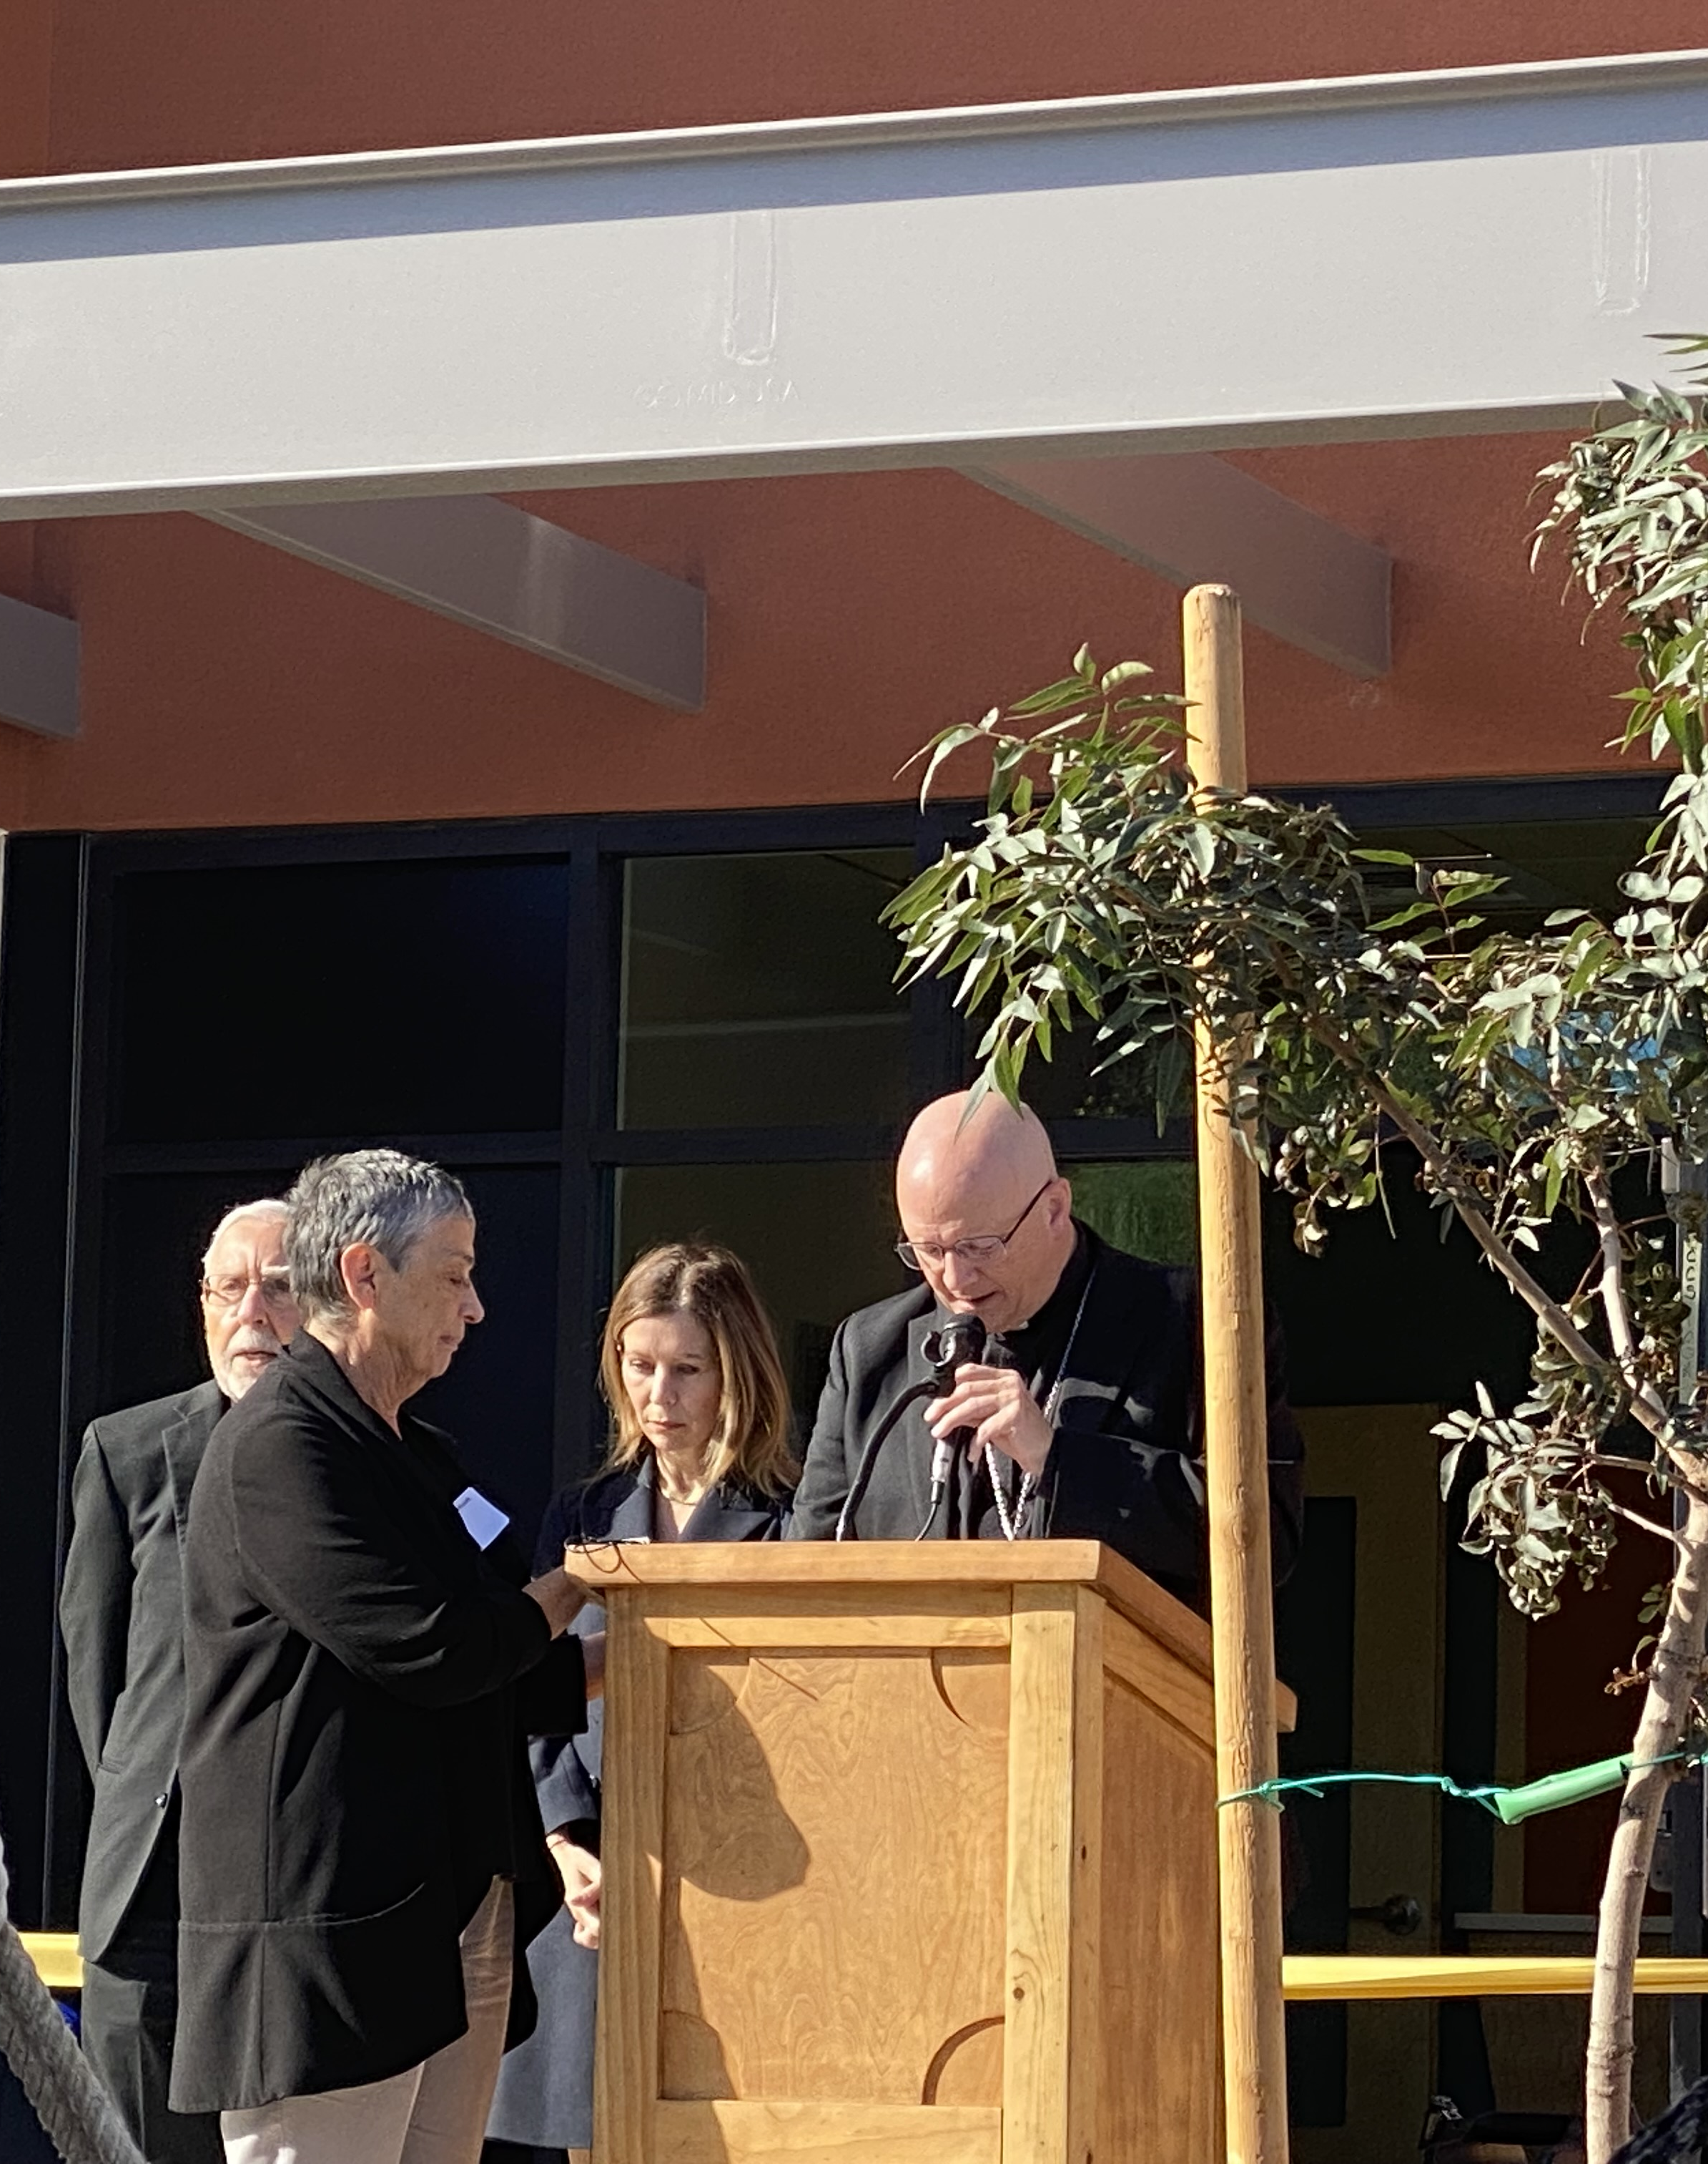
Steps in the Process
Commitment from the Board of CCS to complete a capital campaign for the facility and provide the supportive services needed for people to recover
Commitment from the Board of El Rio Health Community Health Center to co-locate with the Medical Respite facility to provide medical services to people housed in the medical respite facility
Challenges in the journey
Neighborhood issues with original location
Difficulty identifying an alternative location for facility construction adjacent to an El Rio facility
COVID Happened
Cost escalation due to multi-year delays due to the need for relocation and redesign
Capital Campaign was successful and the new location at the Center of Opportunity has created some program synergy and cost savings
Facility was dedicated December 2023 with expected opening of Spring of 2024

Slide 25
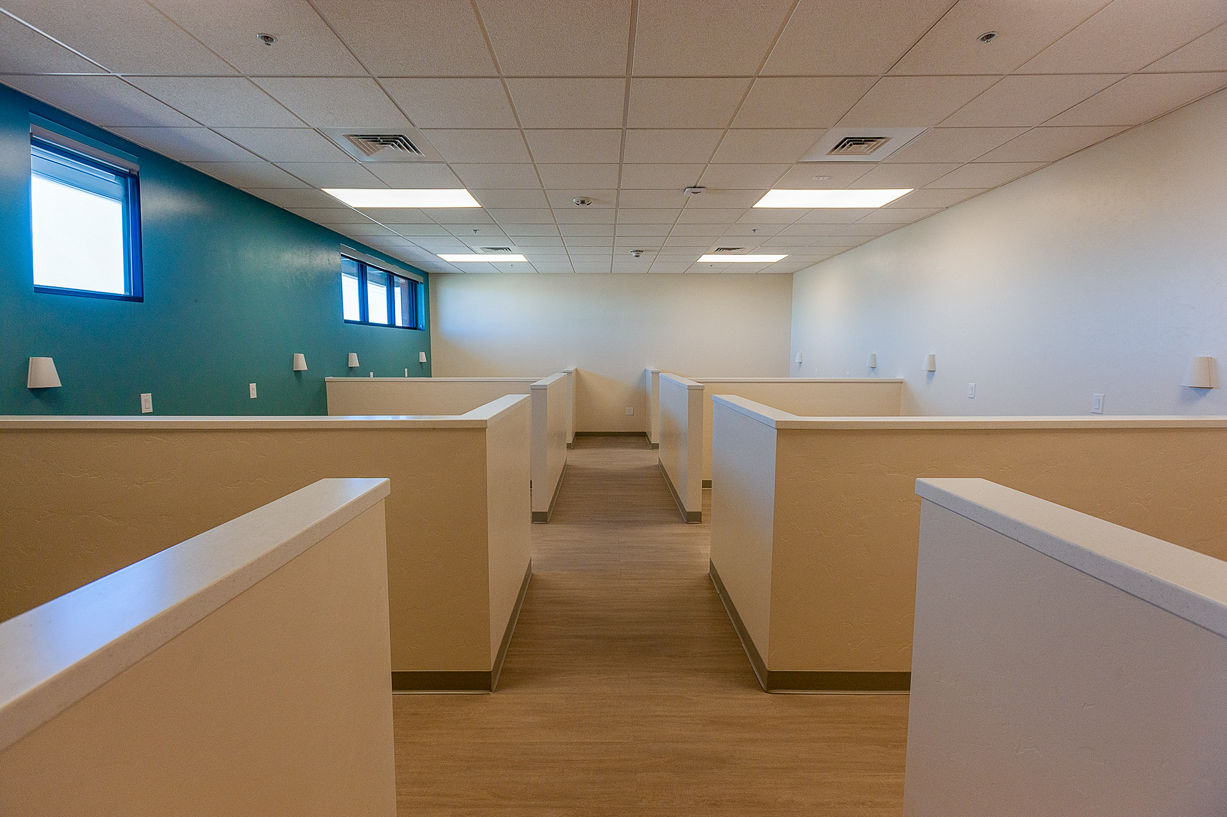
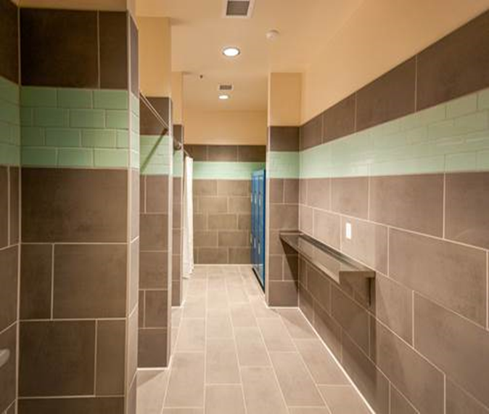
Sleeping and Private Area and Bathroom

Slide 26
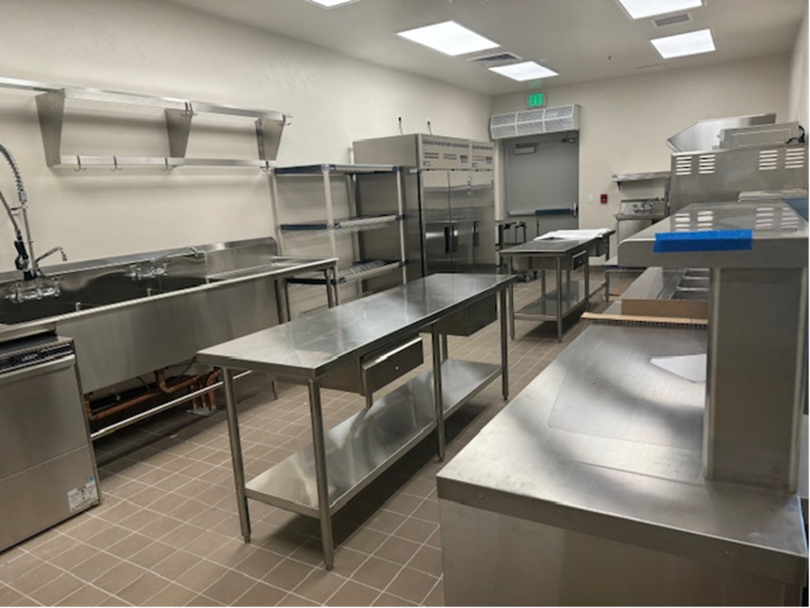
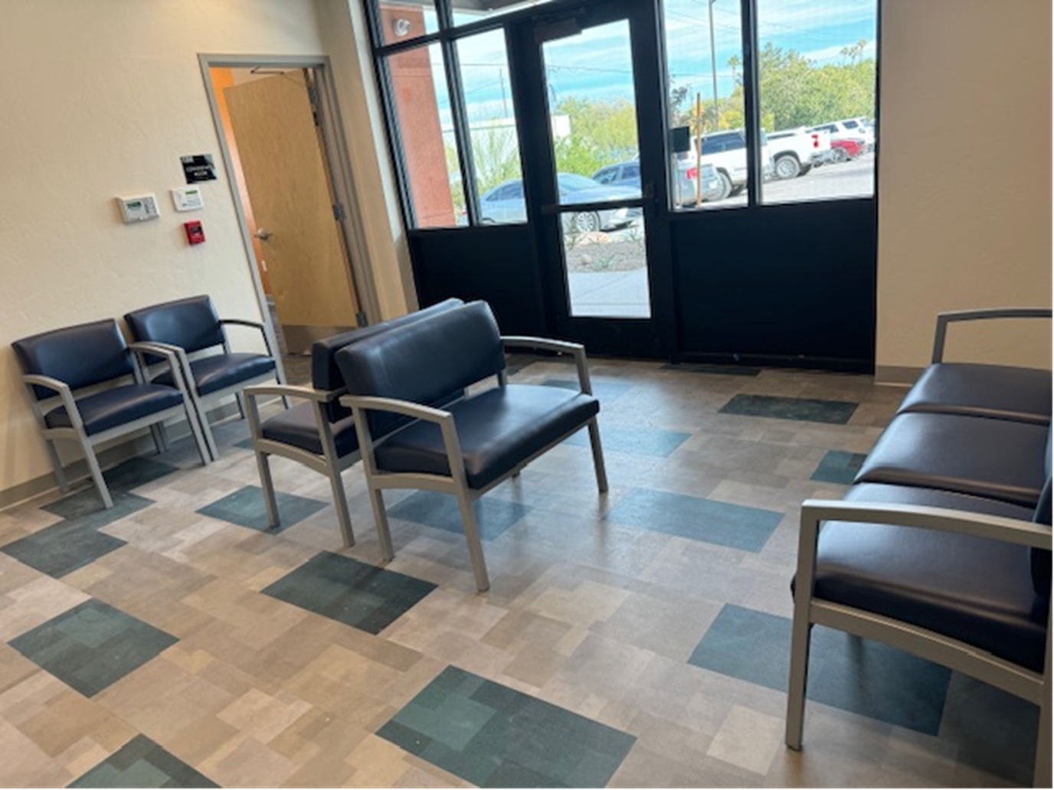
Kitchen and Waiting Area

Slide 27
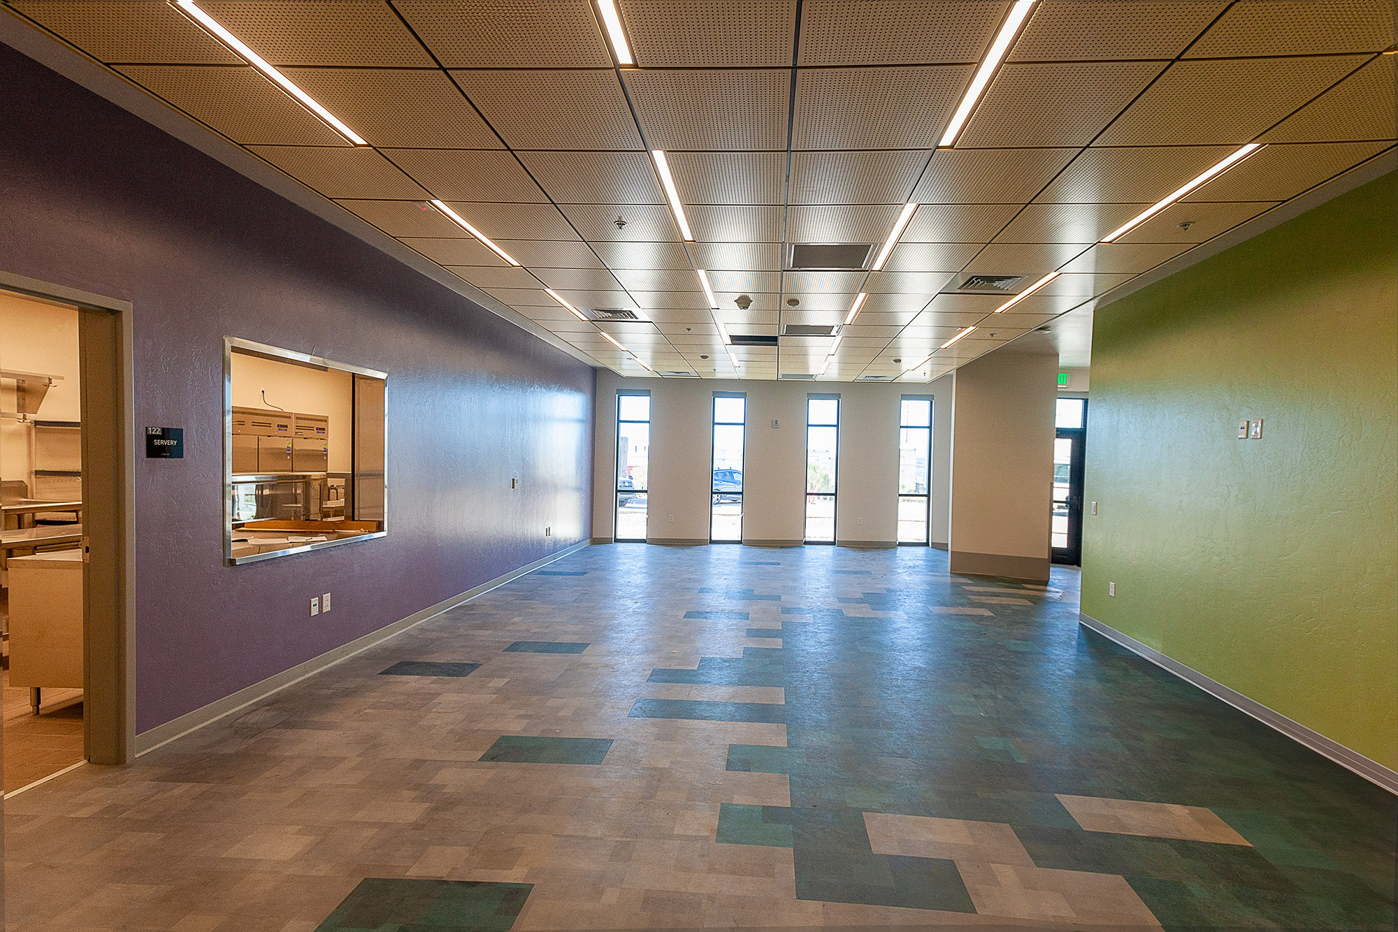

Common Area/Dining Room and Chapel

Slide 28
Operational Funding Considerations
Role of Hospitals
Role Of Managed Care Organizations and Reimbursement Models
Veterans Administration
Role of Philanthropy
Local and State Government / Continuum of Care
Relationship with housing providers for post program housing resources.

Slide 29
Operational Funding Considerations
Regulatory Considerations
  Licensing
  Accreditation
  Credentialing
Arizona Specific Funding Considerations
  Managed Care Model- Arizona Healthcare Cost Containment System-Federal Waiver Program.
  Integration of health and behavioral healthcare.
  Implementation of Housing and Health Opportunities Model with Third Party Administrator.

Slide 30
Other Considerations and Challenges:
The creation of proformas for revenue and expense that integrate the diverse funding relationships, eligibility considerations, regulatory limitations, services to people who are uninsured, end of life care needs with the goal of moving to the most appropriate post program living situations.
The need to advocate for a billable code in Arizona and other states for medical respite services.
How medical respite services may fit into value-based purchasing models.

Slide 31
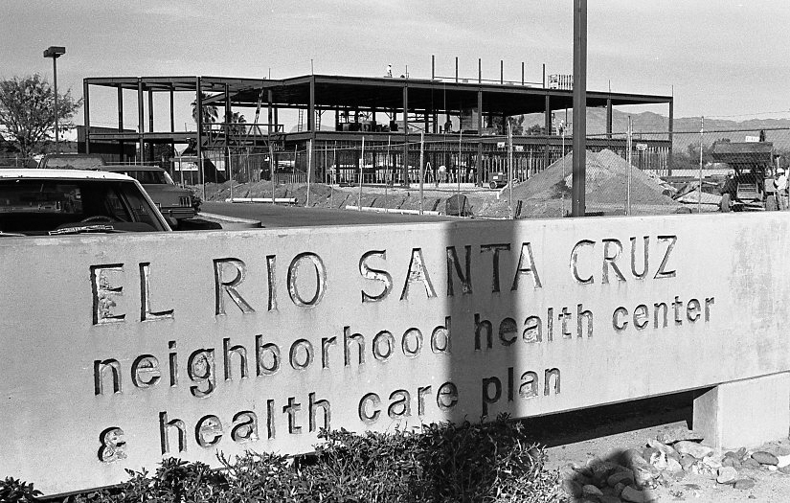
El Rio Health Our History
El Rio Community Health Center opened to serve patients in October 1970 as El Rio Santa Cruz Neighborhood Health Center.
The original target population was limited to several Westside neighborhoods in Tucson.
El Rio was incorporated in 1974 as a private non-profit corporation.

Slide 32
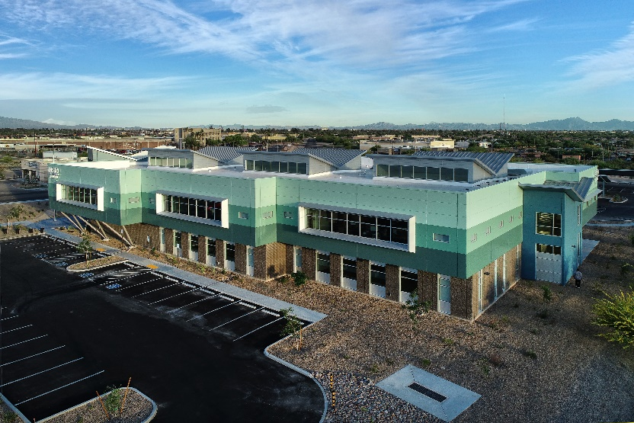

Our Organization
El Rio is a Federally Qualified Health Center (FQHC)-a non-profit institution governed by a Board of Directors representative of the community served.
We do not refuse to care for patient regardless of ability to pay
Utilize a sliding fee discount scale for self-paying patients

Slide 33
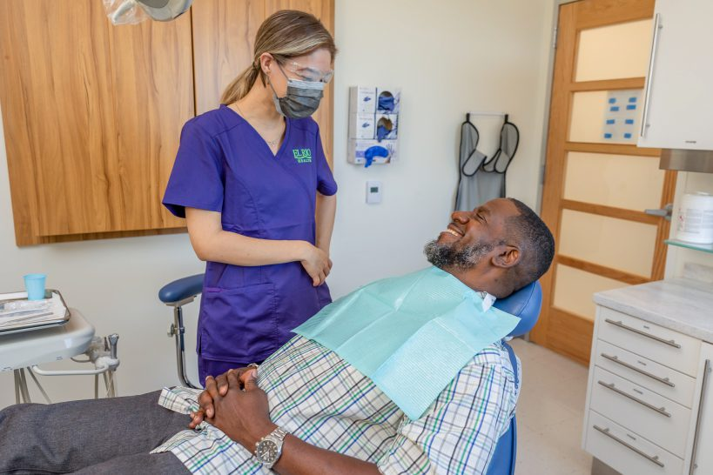
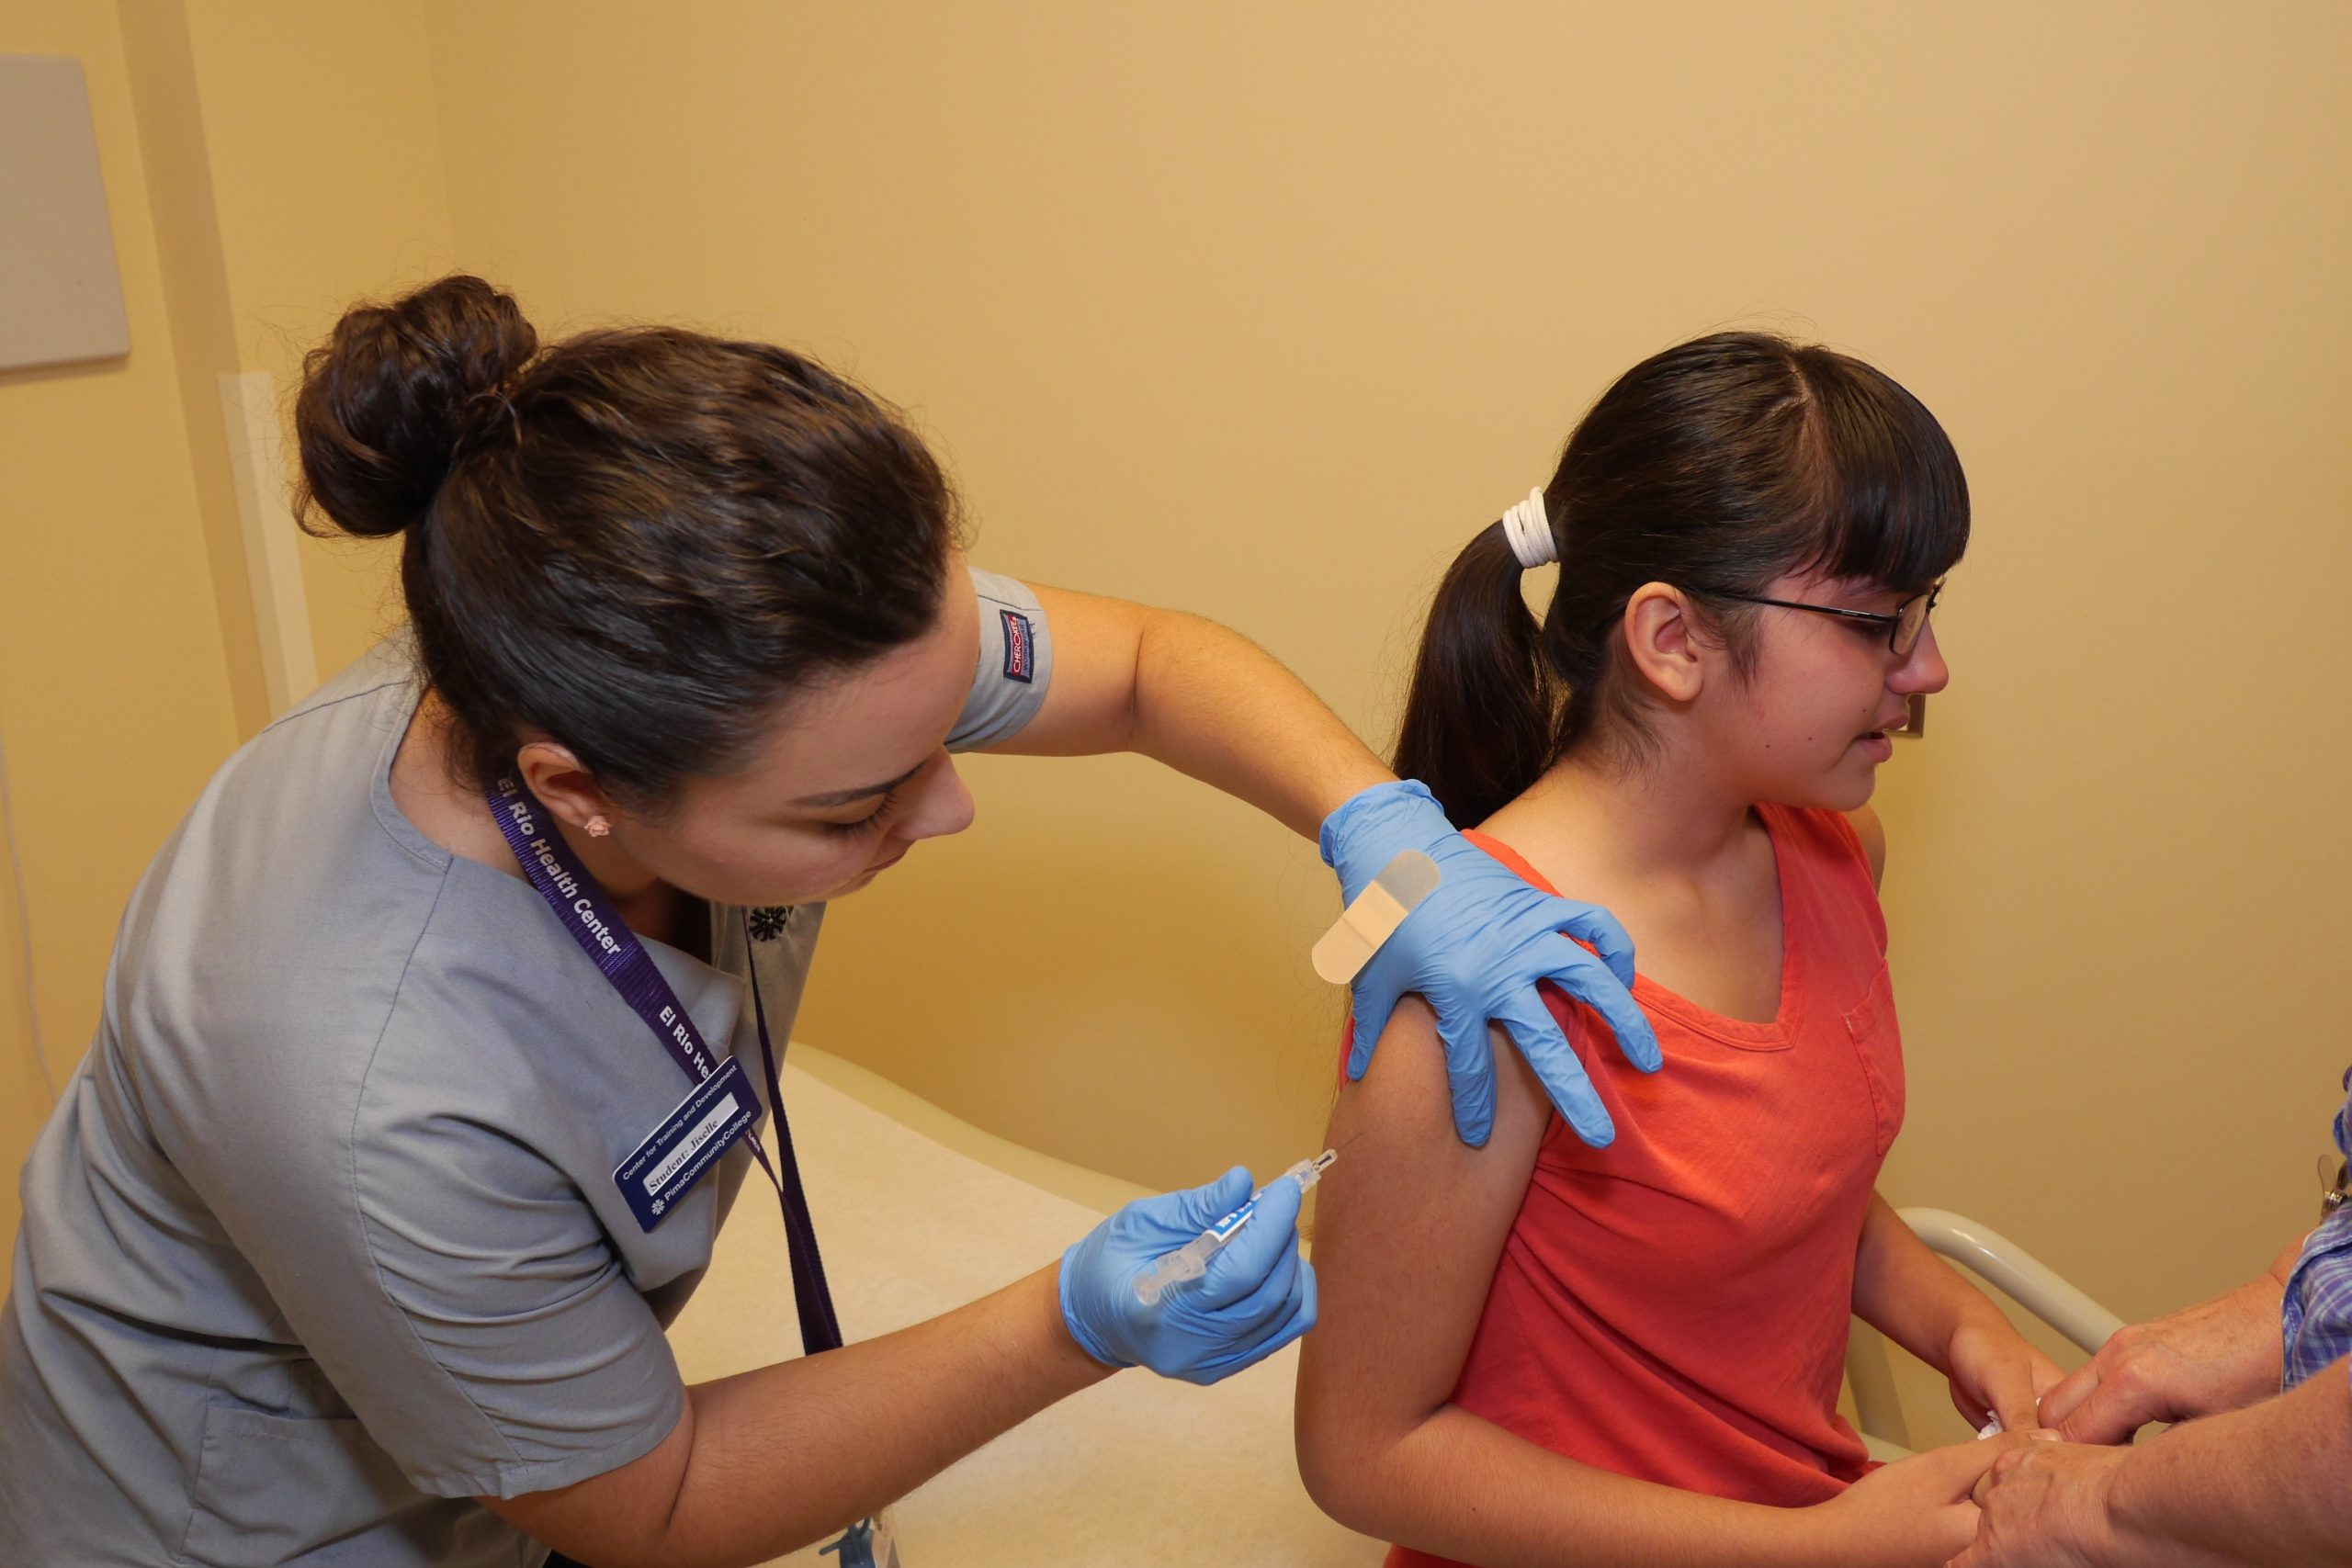
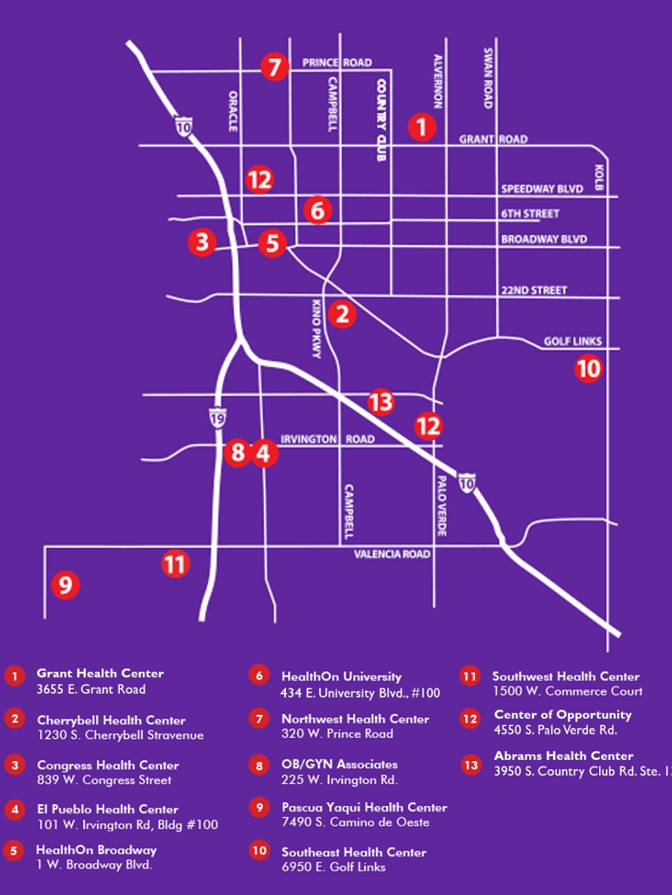

More than just Healthcare

Slide 34

Patient Services Provided

Slide 35
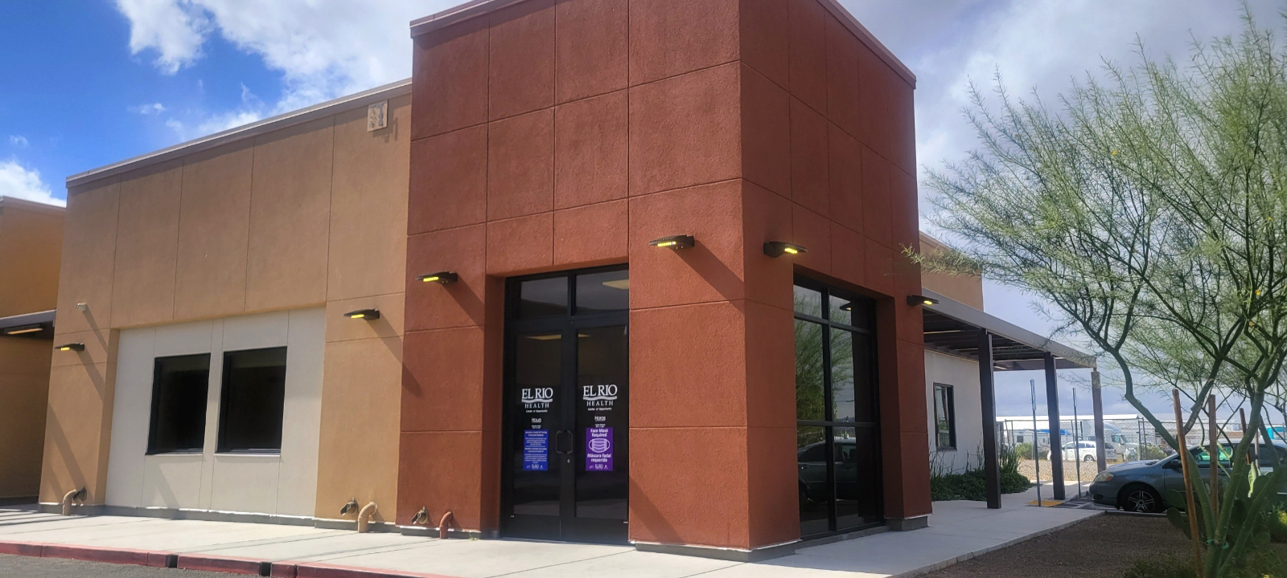
El Rio Health Center of Opportunity (COO)

Slide 36
COO
6 medical exam rooms
4 dental operatories
Laboratory draw station
X-ray
Two physicians, 4 family nurse practitioners, medical assistants, front office staff, 4 Care Coordinators
Medical teams provide in clinic and street medicine services

Slide 37
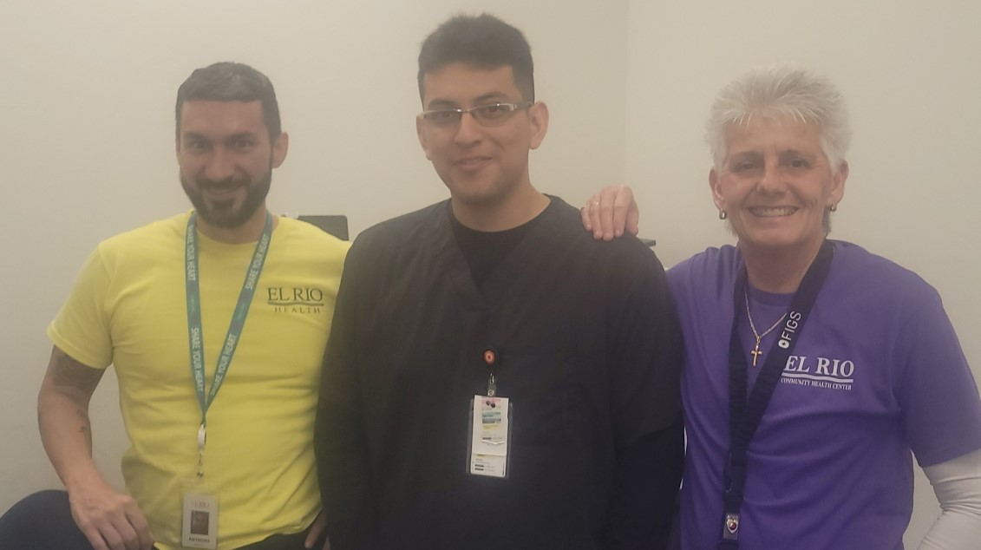
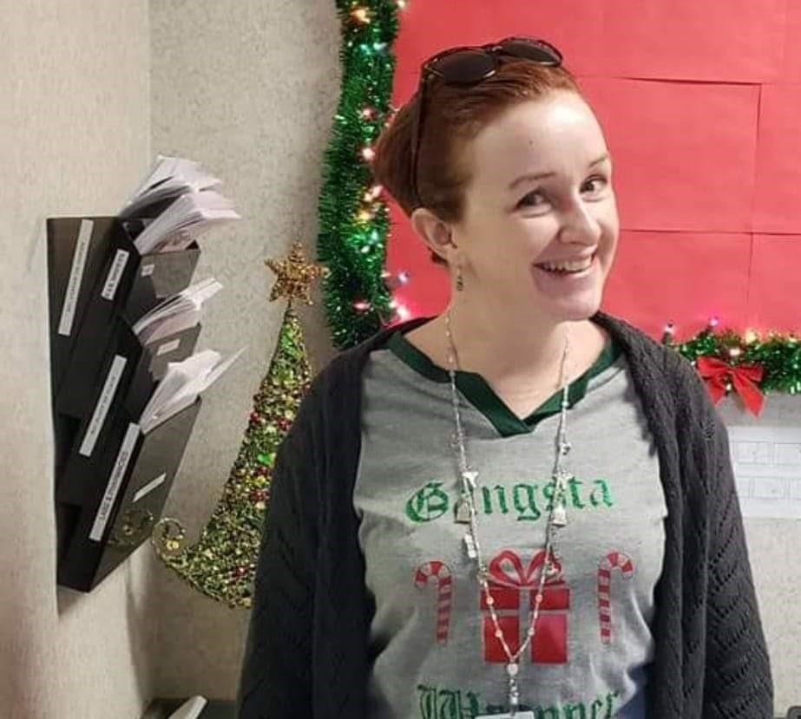
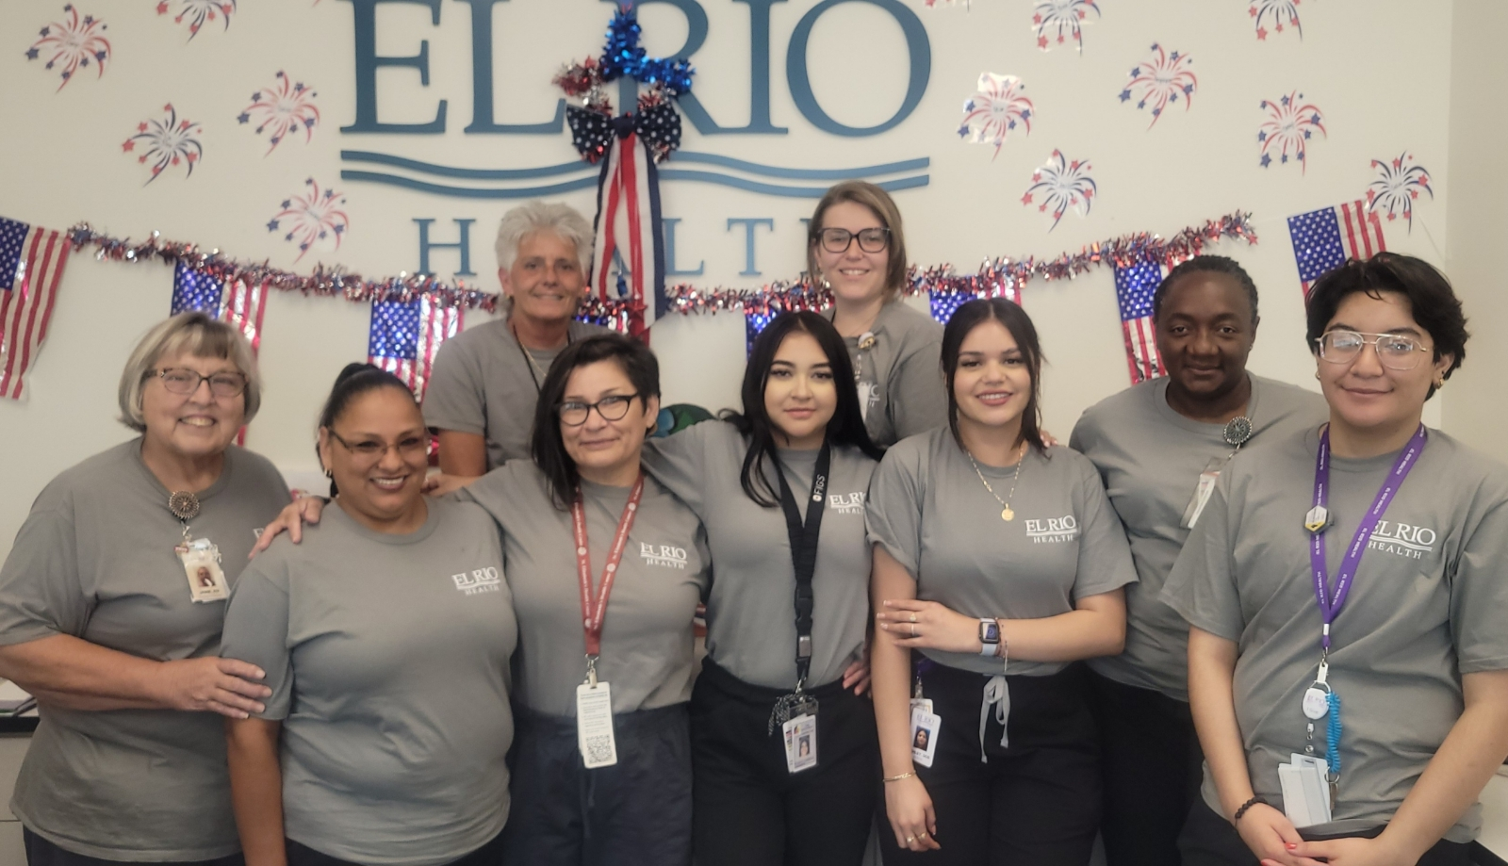
Outreach Team Members

Slide 38
History of Caring for the Unhoused
El Rio has provided medical, dental and behavioral health services for 22 years to persons experiencing homelessness.
In 2023, El Rio Health served over 10,000 unduplicated patients experiencing homelessness. Our street medicine / homeless outreach program is a team-based approach of a Family Nurse Practitioner, Medical Assistant and Care Coordinator, and sometimes a Behavioral Health professional.

Slide 39
Medical Respite
El Rio committed to partnering with Catholic Community Services from the inception of a medical respite for persons experiencing homeless.
El Rio leadership serves on the Medical Respite Advisory Board.

Slide 40
El Rio Health
Provide primary care and preventative care to medical respite guests with initial provider visit within 3-5 days of arriving at the respite.
Provide an oral health evaluation and dental referral as needed
Patients will receive the follow up care at COO while in the respite.
Patient can choose El Rio Health as their patient centered medical home after they leave the respite.

Slide 41
Determination of Medical Respite Admission Criteria
Considerations
  Medical respite staffed by respite assistants 24/7
  El Rio Health COO Clinic is open M-F 8a-5p
  El Rio Health provides RN triage 24/7 with a provider on-call via phone
  Medical respite is a shelter. No medical facility licensure
  Medical respite is the guest’s “home” and services delivered are the same as if in their own home

Slide 42
Admission Process
Intake form developed
Medical respite staff does in person visit with patient in hospital prior to accepting the patient
Intake form reviewed by Medical Respite and El Rio Care Coordinator for approval

Slide 43
Admission Criteria
Primary medical diagnosis
Secondary behavior diagnosis including substance use disorder
Able to complete all activities of daily living, adhere to medical regime and self administer medications

Slide 44
Key Stakeholder Needs
Met with hospitals to determine the needs of the patients for medical respite
  IV antibiotic therapy
    Home infusion company
  Complex wound care including wound vac
    Home Health
    Wound Healing Center
  Oxygen
    DME and Home Health
  End Stage Renal Disease and Dialysis
    Must have fistula or graft; no catheters

Slide 45
Care Delivery Decision Making
Service | El Rio | Respite Facility | Other
ADLs /Self Care
Bathing |  | x
Dressing |  | X
Grooming |  | X
Oral Care |  | X
Toileting |  | X
Transferring |  | X
Walking (must be ambulatory) |  | X
Climbing Stairs |  | X
Eating |  | X
Managing Medications |  | X Observes self admin of medications | Medication Security Plan
Doing Laundry |  | X Consider respite staff doing the laundry
Managing Finances |  | X
Using the Phone |  | X

Slide 46
Behavioral Health Supports
Licensed Behavioral Health Outpatient Treatment Center located on first floor of medical respite.
CARF Accredited
Case Managers (low CM to guest ratio)
Case management services will provide goal-oriented and individualized supports focusing on improved self-sufficiency for the persons served.
Navigation for Benefits, Social Services and Housing (transitional, permanent supportive and permanent housing).
If guests have a Behavioral Health Home, they can continue with their provider.

Slide 47
Goal Self Management
All medical and dental services will be provided at the COO clinic.
  Encourages guests to make and keep their appointments
Encourage self management of their physical and mental health

Slide 48
El Rio Funding
Bill insurance
Sliding Scale Discount Fee
Stewart McKinney funding

Slide 49
Outcomes
Unique patients served
Encounters medical and dental
HEDIS Measures

Slide 50
Inclusivity and Diversity and Justice
Low-barrier shelter
El Rio team experienced in working with persons experiencing homelessness.
Philosophy of “meet me where I am”

