Slide 1
Estimating Youth Homelessness: Multiple Sample Estimation
Matthew Y Westfall, MD
Elysia V Clemens, PhD
Joshua A Barocas, MD
Notes:
MATT: Thank you all so much for coming. We are excited to present our work and especially excited to facilitate a discussion about how to improve prevalence estimates for this vulnerable population and how you may take the lessons we've learned back to your communities and populations served

Slide 2
Presenters
Matthew Westfall, MD
Resident, University of Colorado Internal Medicine Residency Program
He/Him/His
Matthew.westfall@cuanschutz.edu
Notes:
MATT: My name is Matt Westfall. I’m a second year internal medicine resident and have a particular interest in homelessness and housing instability and the profound impact it has on my patients

Slide 3
Presenters
Elysia Versen Clemens, PhD, LPC
Executive Deputy Director, Colorado Evaluation & Action Lab at the University of Denver
Co-Principal Investigator: Estimating the Prevalence of Youth Homelessness (HUD Funded)
Elysia@ColoradoLab.org
Notes:
MATT: My co-presenters include Dr. Elysia Versen. Elysia is the executive deputy director of the Colorado Evaluation and Action lab at the university of Denver which you’ll hear more about later. she is also the Co-PI of the Housing and urban development funded project that underlies this entire work.

Slide 4
Presenters
Josh Barocas, MD
Associate Professor of Medicine
University of Colorado School of Medicine, Divisions of General Internal Medicine and Infectious Diseases
Director, Social Determinants of Health and Disparities Modeling Unit
Medical Director, Wellness, Opportunity, Resiliency Through Health (WORTH) Program
Principal Investigator and Director, The Missing US Project https://themissingus.org/
Joshua.Barocas@CUAnschutz.edu
Notes:
MATT: Additionally, Dr. Josh Barocas is an associate professor of medicine at the Univ of Colorado School of Medicine. Josh is a clinician-investigator with a specific interest in homelessness and how we can use data to inform decision-making.

Slide 5
Additional Collaborators
Pranav Padmanabhan
Jianing Wang
Samantha K. Nall
Sarah A. Stella
Margot Kushel
Christian Belcher
Lanae Davis
Whitney LeBeouf
Linked Information Network of Colorado (LINC)
Colorado Evaluation and Action Lab at the University of Denver
The Missing Us Project
University of Colorado Anschutz Medical Campus
Notes:
MATT: As you can see, a lot of other folks were part of this work and it really has been a multi-institutional collaboration.

Slide 6
Funding
National Institute on Drug Abuse: DP2DA051864 (Barocas) and K01DA051684 (Barocas)
U.S. Department of Housing and Urban Development: FR-6400-N-59 (Clemens)
Notes:
MATT: We received funding for this work from the National institute on drug abuse as well as the US Dept of Housing and Urban Development and are grateful for their support.

Slide 7
Disclosures
No conflicts of interest to report
Notes:
MATT: We have no conflicts to report

Slide 8
Land Acknowledgement
We would like to acknowledge that we are giving this presentation on the ancestral lands of the O'Odham and Piipaash peoples and their ancestors. We honor all 23 native tribes in Arizona and their many contributions to this land that continue today.
Notes:
AS citizens of Colorado, we would also like to acknowledge and honor the legacy of Colorado's indigenous people (the pawnee, araphaoe, cheyenne, apache, and osage). We recognized that displacement, colonialism, and oppression of Native people's have a long and ongoing history (one that we see play out in much of the work of this conference and our own). We pay respect to these historic stewards of Colorado and Arizona and commit to honoring their legacy and seeking reconciliation into the future.
MATT:
Land Acknowledgement | Project Humanities (asu.edu)
Tempe campus, Arizona State University, is situated on the ancestral lands of Indigenous people past, present, and future. We thank and honor the Native American tribes and sovereign nations of the Salt River Valley—including the Akimel O’odham, Onk Akimel O'odham, and Piipaash nations—whose knowledge and stewardship of the land and waterways allow us to be here now. In addition, we honor all 23 tribes in Arizona and their continued and many contributions today:
Land Acknowledgement Language.pdf (phoenix.gov)
The Parks and Recreation Department acknowledges the City of Phoenix is located within the homeland of the O’Odham and Piipaash peoples and their ancestors, who have inhabited this landscape from time immemorial to present day. The landscape is sacred and reflects cultural values central to the O’Odham and Piipaash way of life and their self-definition. This acknowledgment demonstrates our commitment to work in partnership with the Ancestral Indigenous Communities to foster understanding, appreciation, and respect for this heritage.
In countries such as New Zealand, Australia, Canada, it is commonplace, even policy, to acknowledge the traditional Indigenous inhabitants of the land that we now occupy. Acknowledgment is a simple, powerful way of showing respect and a step toward correcting the stories and practices that erase Indigenous people’s history and culture and moves us toward inviting and honoring the truth. As such, we would like to acknowledge the ancestral lands of the XX tribal nation on which we’re here today. We acknowledge the forced removal from this territory, and hope to honor and show respect the many diverse Indigenous peoples still connected to this land.
Made up labor acknowledgement
We also recognize that much of the culture, economic growth, development and more in Arizona, Colorado, and throughout the US has historically been built by enslaved, marginalized, and victimized persons. We acknowledge the victims of the transatlantic slave trade, historical predatory or exploitative labor practices, and all marginalized workers for their contributions and suffering. We commit to advancing more diverse, equitable, and inclusive labor practices and communities into the future.

Slide 9
Main objectives
To describe the landscape of youth homelessness in the US
To outline problems and inadequacies of traditional surveillance
To introduce multiple system estimation as a process
To understand the scope of youth homelessness in Denver as a case study for the process
To encourage discussion and thoughtful discourse on how to apply lessons learned in other locales or for other parts of the population
Notes:
MATT: Now onto the meat of this presentation. As you can see, We have 5 main objectives for this presentation. These objectives are interwoven throughout the presentation and during our discussion. Overall, we hope that you walk away from this presentation having an understanding of the landscape of youth homelessness in the US,
the problems or inadequacies of traditional surveillance methods,
A basic understanding of the process of multiple system estimation and how it can be applied in different contexts and across different populations.
A sense of what that looks like in Denver as a case study
Finally, to encourage discussion and discourse

Slide 10
Discussion Questions
Questions to "Noodle On"
What does the homelessness landscape look like in your community?
What is unique about the homelessness crisis in your community?
Notes:
MATT: A little bit of orientation here. when you see a green slide, this is an opportunity to be both an active thinker and active participant. We call these questions to noodle on. During these stopping places, as time permits, please feel free to fill in your perspective and context from your community, those you serve etc.

Slide 11
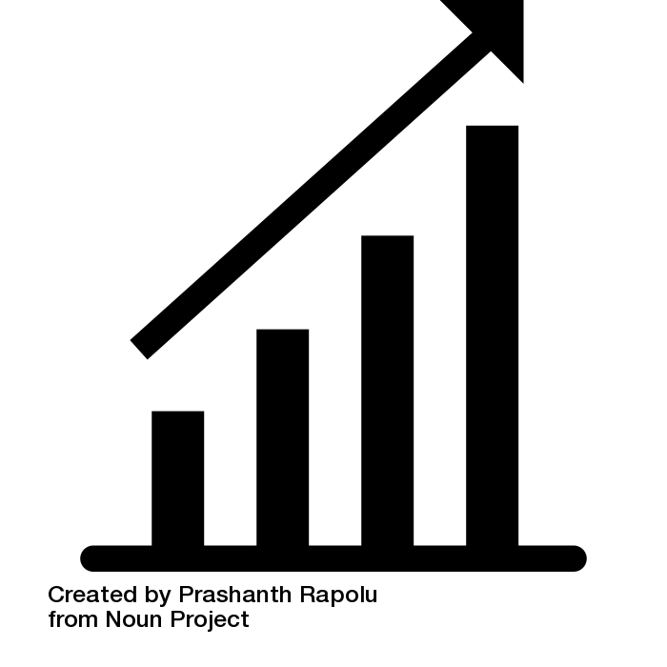
Homelessness is a local and national public health crisis
2023 nationwide point in time (PIT) count reported 653,000 persons experiencing homelessness (PEH)
Homelessness is associated with significant negative health impacts
Chronic conditions and infections, injuries, substance use and overdose, mental and psychiatric illness, mortality
Life expectancy amongst PEH is ~20 years less than general population
All-cause mortality is increasing (especially since COVID-19)
Notes:
MATT: Ok, now the real meat. This audience is well aware that homelessness is a public health crisis – both nationally and locally.
At least 650000 people were experiencing homelessness according to the Jan 2023 nationwide point in time count
As a physician, I'm particularly interested in the health effects of homelessness—which again are well known to this audience—chronic conditions, infection, SUD, OD, mental health and psychiatric concerns, and most of all mortality. A wealth of data suggest that LE is 20 years less for those experiencing homelessness compared to the average housed American...the life expectancy of someone born in 1900.

Slide 12
Children and youth are especially vulnerable to the negative effects of homelessness
Child and youth specific outcomes
Prenatal and childhood development, pediatric specific health concerns
Adverse childhood events (ACEs)
Family separation
Absenteeism and school disruption
Mortality 10x that of the general youth population
Experiencing homelessness as a child increases risk of experiencing homelessness as an adult
Notes:
MATT: And it should come as no surprise that Children and youth are especially vulnerable when it comes to the negative effects of homelessness
Children and youth suffer from unique conditions: increased rates of low birth weight, respiratory problems like asthma, iron deficiency.
Homelessness poses unique challenges and risks psychosocially: ACEs, family separation, schooling disruption
Multiple studies in North America have showed that mortality is about 10 times greater among homeless youth than their housed peers.
Finally, and sadly, experiencing homelessness as a child increases the risk of experiencing homelessness as an adult.
_______________________-
Boivin et al (Canadian Journal of Public Health, 2005):
Mortality is about 11 times the expected rate based on age and sex
Auerswald et al (PeerJ, 2016):
Mortality in excess of 10 times that of general youth population

Slide 13
Accurate prevalence/count estimates are necessary
To appropriately allocate resources
To decrease disparities and increase health equity
To understand if size of population is larger than expected
Notes:
MATT: We know this is a serious public health crisis. But how can we really address the crisis of homelessness—among youth or otherwise—without accurate information about the size of the affected population?
Having accurate counts is necessary to appropriately and equitably allocate resources, decrease disparities and increase health equity, and understand if the size of the population in crisis is changing or larger than we expected. Why? Because ultimately, we cannot reach people who we do not know exist.

Slide 14
Estimating youth homelessness prevalence ripe with opportunity
Multiple sources of data
Point in time (PIT) counts
Public school systems (McKinney Vento data)
Shelter systems (HMIS)
Child protective services
Healthcare and administrative claims
Notes:
MATT: Luckily, estimating youth homelessness prevalence is ripe with opportunity. We are rich in data sources. Point in time. Public schools. Shelters. HMIS. CPS. and healthcare administrative claims are among these systems that are:
These data sources are designed to ”count” the number of youth experiencing homelessness
They do so via service delivery in which they recognize and document when a youth is experiencing homelessness.
Unfortunately These data systems don’t typically connect with each other—which is a problem we’ll get to.

Slide 15
Estimating youth homelessness prevalence ripe with challenges
Stigmatized conditions are challenging to estimate and quantify
Social desirability bias
Limitations in currently employed methods
Single point prevalences (vs annual)
Heterogenous methods and implementation
Missing people who are hidden or homeless at different times of the year
No cross talk
Individual systems that provide services, recognizing homelessness is not their primary purpose
Health care administrative claims data includes only those who receive healthcare services
Child welfare includes only those who were referred for safety concerns
Notes:
MATT: while there is a wealth of data we can use to estimate prevalence, it is also an area ripe with challenges.
First: we know in general stigmatized conditions like homelessness are challenging to quantify, in part because of the role of social desirability bias and similar factors
Currently employed methods are imperfect
-point in time counts are just that- point in time counts, not an annual prevalence
-even within a given method- a PIT or public school assessment, there is huge variability and heterogeneity in methodology, implementation, funding. Even for individual interviewers or service providers there is variation.
PIT and other sources may miss people who are hidden or experiencing homelessness at different times of the year
Additionally, certain data sources are not built to recognize homelessness with great fidelity, in part because homelessness identification is not their primary goal
-from personal experience we do a terrible job with this in healthcare administrative claims data

Slide 16
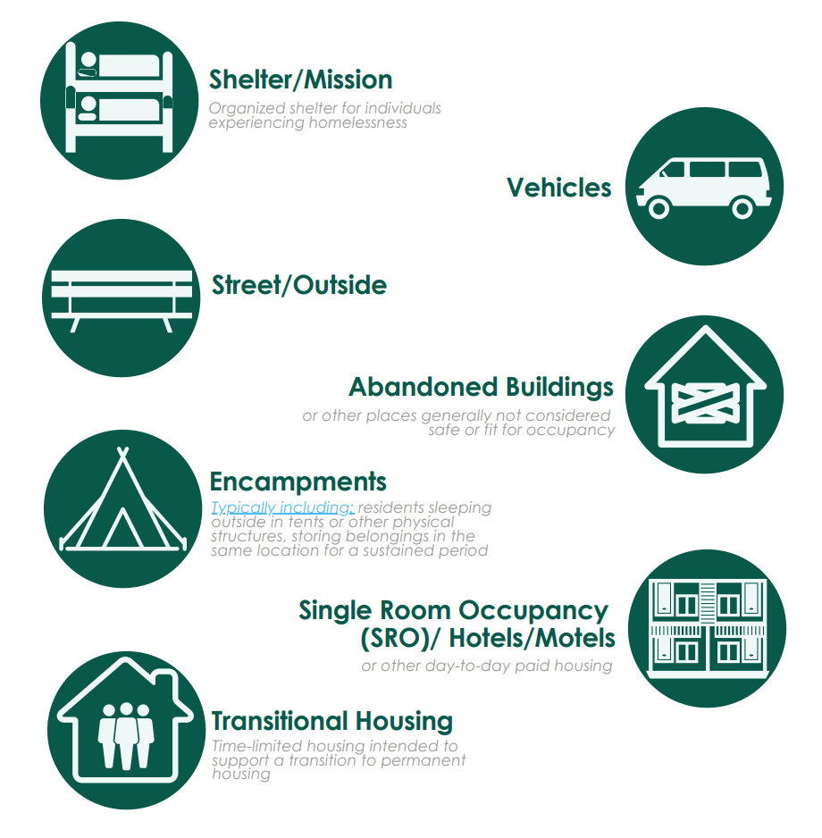
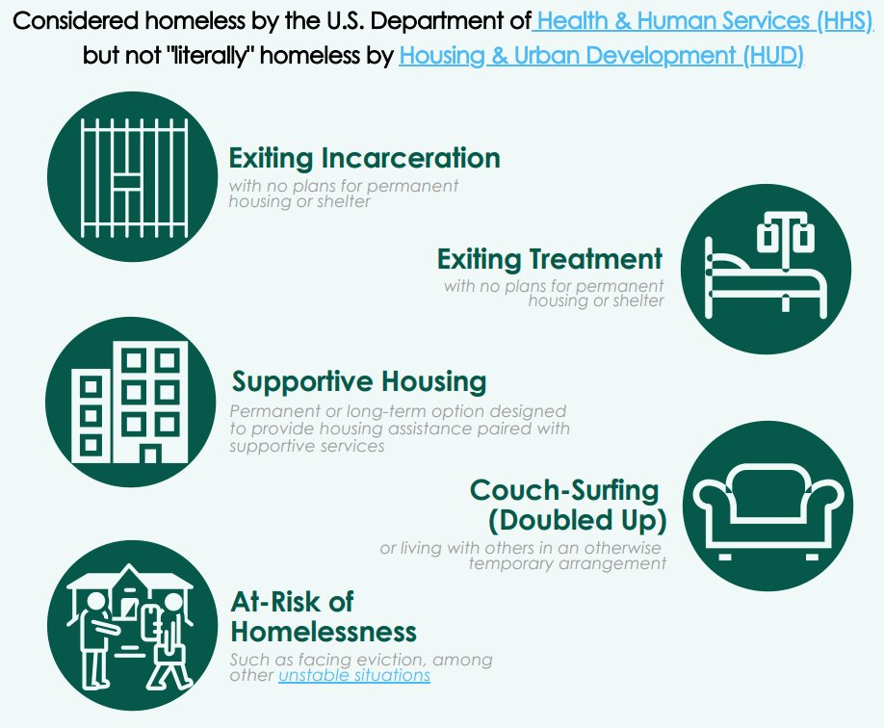
Estimating youth homelessness prevalence ripe with challenges continued
Challenges related to the complicated spectrum of youth homelessness
Notes:
MATT:
Furthermore, estimating homelessness is challenging because of the spectrum of homelessness and finding reliable data sources that count people where they are. We know, for example, that something like 80+% of youth who experiencing homelessness experience it as doubling up or in temporary hotels/motels, parts of the spectrum of homelessness that are not readily counted by traditional means of surveillance (like pit). This is further complicated by the fact that homelessness is defined more broadly among youth than among their adult counterparts.

Slide 17
Our observation, our questions, and our big idea
Observation: Discrepancy in local estimates
Denver Metro Area (50% of the state's population)
2022 Point in Time Count: 799 children and youth (ages 0-17 years) experiencing homelessness
2021-2022 McKinney Vento: 16,540 students through grade 12 experiencing homelessness in Colorado
Questions:
Why are these so discrepant? Which one is the truth? Is there a better truth out there?
Our idea
Get better estimates
Notes:
MATT: What do these discrepancies and estimation pitfalls look like? Well in the Denver metro area for example, the PIT counted about 800 children and youth experiencing homelessness in 2022. DOE counted 16 thousand kids in K-12. Order of magnitude difference
Which is the truth? Are either of these numbers accurate? are there better numbers, numbers that potentially combine these estimates? If so, how do we get them
So our big idea: get better estimates.

Slide 18
Stop relying on single system estimations
Mitigate the problem of when data does not sync up
Each system that provides data on the “scope of the problem” uses:
Different definitions
Age ranges for public reporting
Data collection methods
So that policy-makers have data to decide “what number” to use.
So that resource allocation can be based on more rigorous and comprehensive data.
Notes:
ELYSIA: When estimating the prevalence of youth homelessness, consider how each system defines homelessness. These three examples illustrate some of the differences in definitions across systems:
Definition
For example, the Runaway and Homeless youth Act focuses on UNACCOMPANIED youth, whereas McKinney Vento definitions of homelessness include youth who are with a caregiver but not in a permanent, fixed, night time residence.
Age Range
Publicly available data from our local HMIS system, for example, is 0-17 year olds or 18-24, but if we try to compare that to McKinney Vento data that’s school age children and youth
Data Collection Methods
The PIT count approach is very different than school-based identification of youth experiencing homelessness, and as such who that recognize will be different. You’ll see more about that when we talk about overlap in identification later in this presentation.

Slide 19
Youth may not touch all systems in all years
“Kai” is 17 years old and unhoused. They dropped out of school at 14, and they were involved in the child welfare system on and off. They currently receive services through the Runaway and Homeless Youth providing agency in Denver.
“I completed 9th grade, but the schools I went to couldn’t handle my mental health, so I didn’t want to go to school anymore”
Notes:
ELYSIA: Kai is 17 years old and is unhoused. They attended school until they were, 14 when they dropped out after changing schools many times across the metro area. They have been involved with child welfare in the past but are not currently receiving services and are unclear if or when they were ever recorded as homeless by a caseworker. They currently only receives services through the Runaway and Homeless Youth providing agency in Denver.
Kai experience is illustrative of why single system estimates are not sufficient.

Slide 20
Discussion Question
Questions to "Noodle On"
What are the “numbers” that are used in your community to inform resource allocation and investments in preventing youth homelessness or lessening the duration?
Notes:
ELYSIA:

Slide 21
DENVER!
Notes:
ELYSIA: Enter Denver. Our home. Where we work and play. Could we do something locally that could translate to a change nationally?

Slide 22
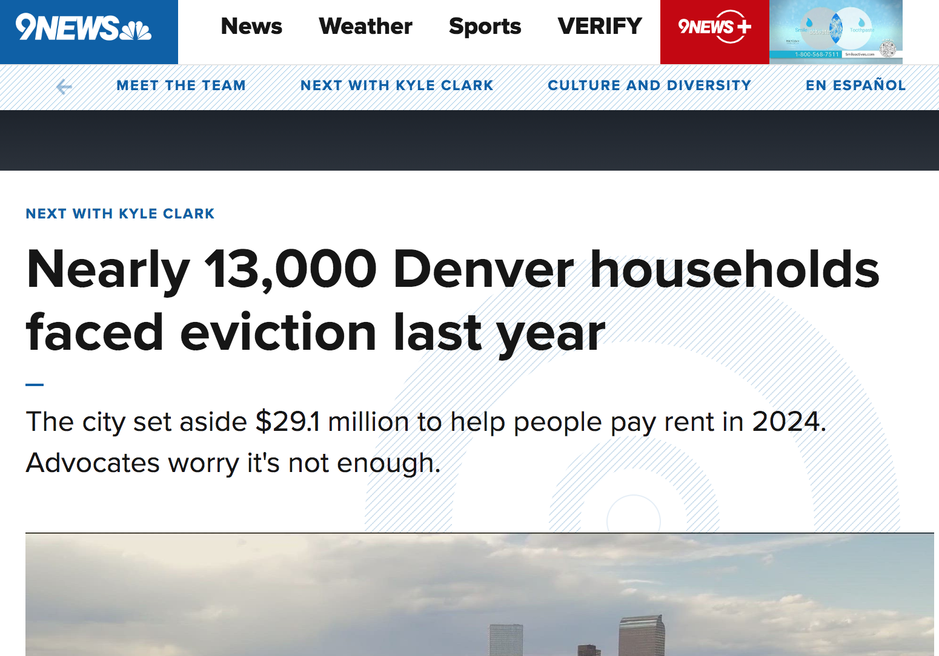
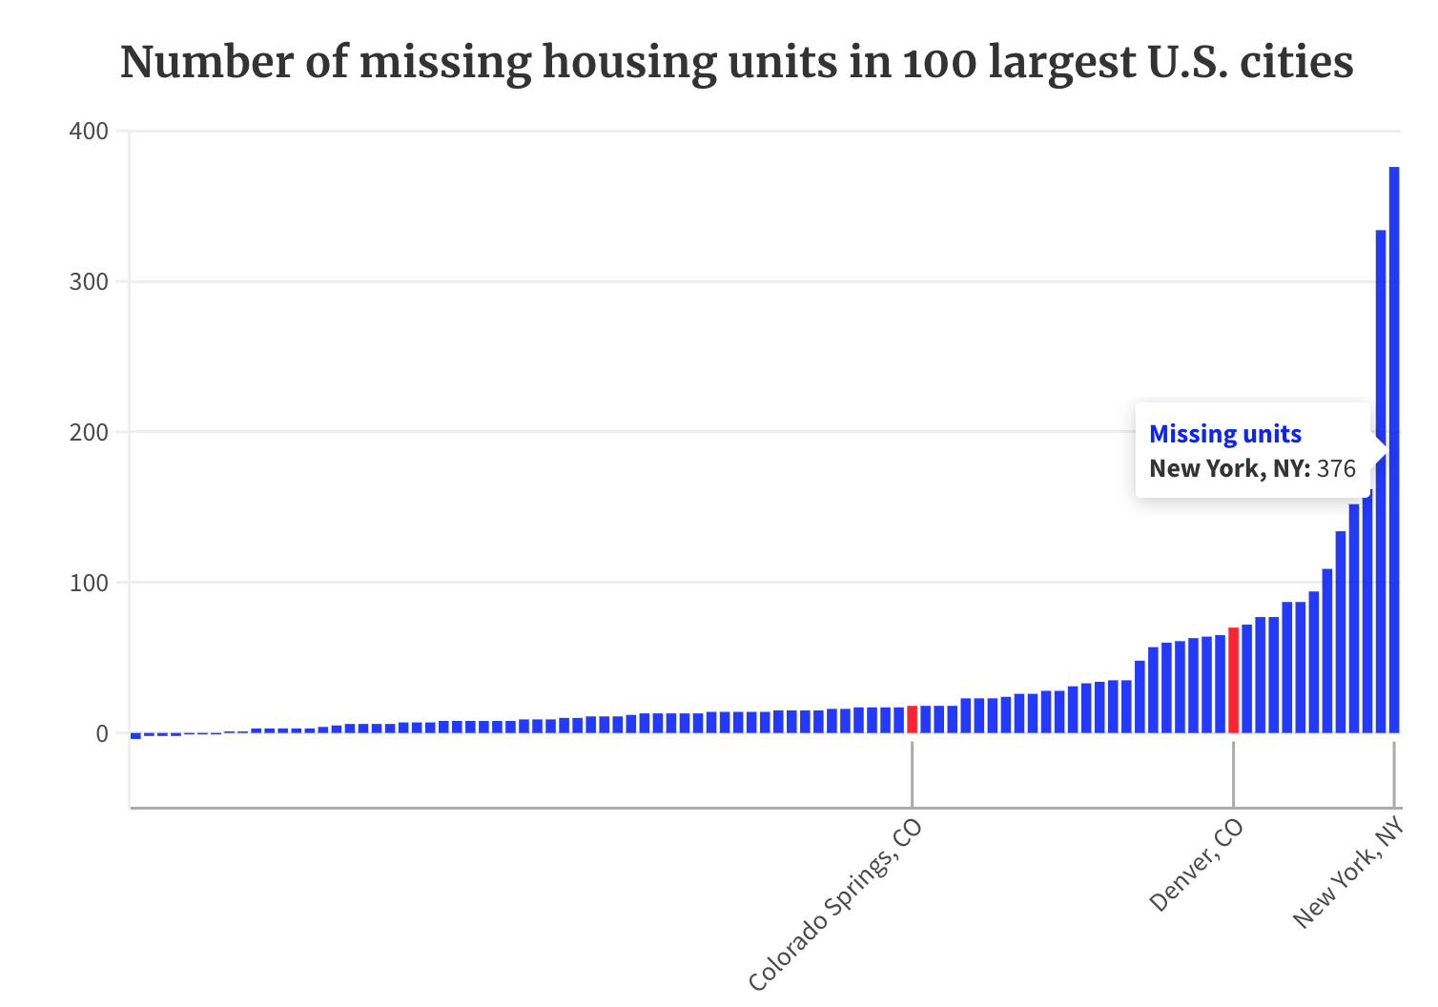
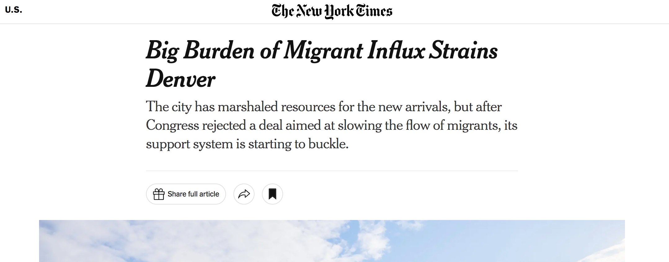
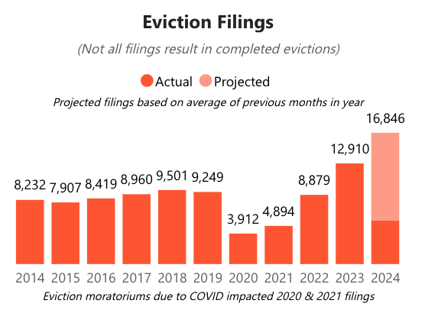
What does the homelessness crisis look like in Denver?
Notes:
ELYSIA: Our team – based in Denver – was particularly interested in investigating this for our community.
As in most places, Denver is in the midst of a homelessness crisis that is driven by a confluence of factors.
Enormous affordable housing shortage with close to 100k missing housing units
Ongoing eviction crisis that has ramped back up following COVID
Influx of migrants with around 40K having arrived in the last year, further stretching homelessness resources and city budgeting
https://kdvr.com/news/data/denver-has-one-of-the-worst-housing-shortages-in-us/
https://www.9news.com/article/news/local/next/next-with-kyle-clark/nearly-13000-households-denver-faced-eviction-2023/73-142aec8d-9fae-45df-81fb-8fcb4789c1a6
https://app.powerbigov.us/view?r=eyJrIjoiMjY4Nzc1ZDUtMjU0My00MzZkLTlhZTEtMGQwZmY4MmFhYzZiIiwidCI6IjM5Yzg3YWIzLTY2MTItNDJjMC05NjIwLWE2OTZkMTJkZjgwMyJ9
https://www.nytimes.com/2024/02/12/us/denver-colorado-migrants.html

Slide 23
Building a better estimate of youth homelessness in Denver
Colorado Evaluation and Action Lab: Building a Sustainable and Replicable Approach to Estimate Youth Homelessness
Leveraging local data sources
Homeless Management Information System (HMIS) from the Metro Denver Homeless Initiative (MDHI)
McKinney Vento data from Denver Public Schools (DPS)
Colorado Statewide Automated Child Welfare Information System (TRAILS)
Notes:
ELYSIA: Despite the many common challenges of the homelessness crisis, we in Denver are also making progress, especially in the area of estimating homelessness prevalence among youth.
We have to thank the Colorado Evaluation and Action Lab (or the Colorado Lab), for much of this work
As part of a grant funded by the department of housing and urban development the colorado lab started to leverage the wealth of local data sources
Namely XYZ data sources

Slide 24
Notes:
ELYSIA: Leverage as many unique identifiers as practical that overlap across one or more systems (i.e., more than Names and DOB)
Apply a rigorous identity resolution process to link data across systems (e.g., Senzing)

Slide 25
Notes:
ELYSIA: Selected

Slide 26
Utilizing Multiple System Estimation
HMIS
McKinney Vento
Child Welfare
Improved Estimates of Homelessness
Multiple System Estimation
Senzing
Linking data sets at individual level
Notes:
ELYSIA: Through this grant, Colorado lab linked data from the public schools, child welfare, and shelter services at the individual level, de-duplicated this data and through this union of data sources created a new and improved estimate of youth homelessness in Denver county from 2017-2021.
Linking data sets at the individual level
De-duplicating data sets to identify unique individuals
Creation of combined data set to improve estimates of local youth homelessness
Opportunity to employ new methods of estimation using combined data sets

Slide 27
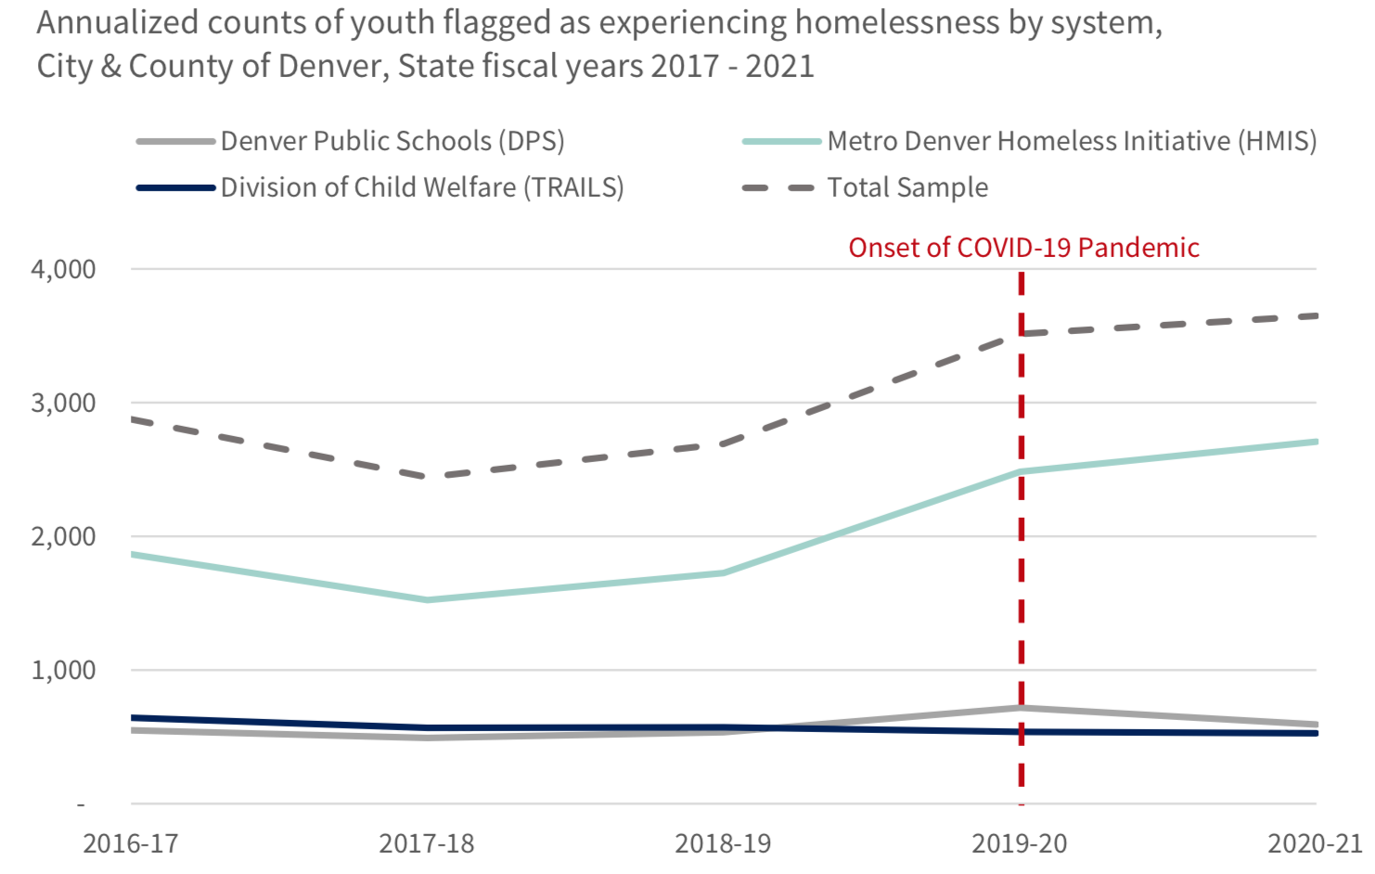
Colorado Lab made substantial progress in understanding the prevalence of youth homelessness
Notes:
ELYSIA: What this work makes clear is that combining and harmonizing data sets can lead to improved estimates of homelessness
We can create better estimates of those who counted, those who are accessing services, those who are present in any of our multiple amazing data resources

Slide 28
This can't be everyone, can it?
Stigmatized conditions are challenging to estimate and quantify
Social desirability bias
PIT and other direct estimation methods do no identify the whole spectrum of homelessness
Survey (Point-in-time) and service data (McKinney Vento, HMIS)
Single point estimations with annual importance and impacts
Heterogeneous methods, funding, implementation
Miss people who are hidden or experiencing homelessness at other times of year
Miss people who experience homelessness somewhere other than in shelters or on the street (cars, motels, doubling up etc.)
Miss those experiencing unstable housing or risk of (even impending) homelessness
Limited by resources, scope of the organization collecting the data
Notes:
ELYSIA: But going back to a previous slide—this can’t be everyone, can it? No matter how good each of these datasets is, they are limited by who they find and who the are able to reach. There are a wealth of data sources on homelessness estimates, each of them useful but imperfect in their own way
In colorado, we have been able to combine data sources to improve estimates

Slide 29
Multisystem involved but invisible in many “counts”
“Jesse” is 17 years old and is staying at a shelter. Child welfare involved until age 10, kinship adoption. Juvenile justice involved multiple times/locations, preventing school enrollment.
“I spent a total of about 6 months in and out of detention, which is why school didn’t work out.”
Notes:
ELYSIA:

Slide 30
Can we figure out how many people are missing?
Notes:
ELYSIA: BUt what about if people are missing from the data altogether?

Slide 31
Direct estimation vs indirect estimation
ESTIMATION
Notes:
JOSH: What it ultimately comes down to is having two different methods of trying to estimate people. We’ve talked a lot about the direct counting of people through separate data sets and through combining them. This next part is where we expect to have some good confused looks!

Slide 32
Notes:
JOSH: Let’s start with our friend waldo. Our current methods of homelessness estimation work well if waldo is present in the picture.
Our traditional surveillance methods for homelessness – what I have been calling "direct estimation" methods are the same methods and general paradigm we have used for disease processes for over a century. Cholera, HIV, hepatitis, diabetes and homelessness.
Direct estimation requires we count people, more or less by hand. We walk around on the streets or count people staying in shelters like in PITs. We count children via public schools if they are eligible for services.
Direct estimation methods find people who access services. They work well if waldo is in the picture

Slide 33
Notes:
JOSH: But what do we do if waldo isnt in the picture?
What do we do if our PIT and other direct estimations miss entire parts of the population.
Or if Waldo is not seeking services

Slide 34
Use of indirect estimation methods for homelessness prevalence
Basic multiplier methods
Multiple sample estimation
Bayesian benchmark multiplier methods
Notes:
JOSH: enter indirect estimation methods. a number of methods in this framework exist. long used for estimating the size of populations that might be difficult to find using direct estimation. it is only within the past several years that these methods have gained some popularity for estimating the size of the population with substance use disorders, but remain underutilized. our goal is to change that.

Slide 35
Multiple System Estimation (previously known as capture-recapture) for estimating youth homelessness
Notes:
JOSH: Our discussion is going to focus on multiple system estimation—previously known as capture recapture but for vulnerable populations, that name is not very appropriate.

Slide 36
How does this work? Let’s talk about deer
Time 1: capture 60 deer and tag them
Time 2: capture 30 deer, how many have been tagged?
Let them go
$$\frac{60 tagged time 1}{Total population of interest}= \frac{15 tagged time 2}{30}$$
Total population = 120 deer
Notes:
JOSH: So how does this work? I love talking about this method because I’m from Colorado, where outdoor life, wildlife is central to our life…and this method actually originated in fish/wildlife management. We’re going to use the example of deer.
Imagine needing to estimate the size of a deer population. At time 1, you humanely capture 60 deer, tag them and let them go. (click)
Some short while later, you capture 30 deer. Within that second capture, you note that 15 have been tagged and 15 have not.
So using basic laws of probability we assume that the fraction of tagged deer in the “recapture”
(15/30) is proportional to the fraction of deer initially captured in the total population (60/n). (click) Thus the total population can be estimated: 120. (click) With 60 of them being ”known” and 60 of the being “unknown”
Of course, people are not deer. There are complex interactions and behaviors. A single dataset is not enough.

Slide 37
Multiple System Estimation analytic steps
Link available datasets at the individual level
Identify individuals with known homelessness (each dataset will have own unique variable or identification scheme)
Construct contingency tables (this will give you the known population)
Gives the absolute numbers of known people and the overlap of data
Construct multivariable statistical models to estimate unknown population
Poisson or Negative Binomial as these are count models, with interaction terms
Hierarchically included
Select model with best fit based on lowest Akaike Information Criteria (AIC)
Estimate confidence intervals
Notes:
JOSH: A MSE analysis using multiple data sources has a few easy to follow, difficult to pull off steps.
First, we link datasets at the individual level. Elysia talked about our process for this analysis already but we’re retracing some of the steps in an ordered way.
Next, we identify individuals who fit the characteristic/definition that we are trying to estimate. in this case, people who are homeless.
Third, we construct contingency tables. this gives you the absolute numbers of known people and how they overlap with each data source.
Fourth, using the overlap as a guide, we construct multivariable statistical models – which are simply fancy probabilistic equations going back to the deer which account for the overlap and where people are found.
Finally, confidence intervals.

Slide 38
Using Multiple System Estimation with linked datasets has rules
Assumptions in MSE with linked datasets:
Identification probabilities from each data source are independent
Identification probability by a given source is the same for each individual in the population
Closed population, no mortality or immigration between identification periods
One identification should not impact an individual's probability of future identification
Notes:
JOSH: Important to point out that there are rule for using this method. When we violate these completely then our estimates are thought to be skewed.

Slide 39
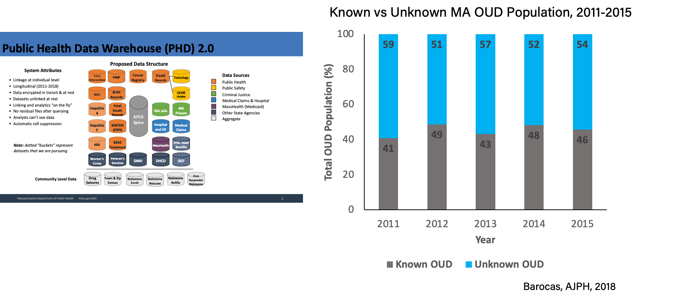
Where have you done this in the past? Massachusetts, OUD
Notes:
JOSH: It’s at this point that you might be asking yourself, “how on earth did you come up with this?”
we didn’t but we have used it in the past. way back in the last decade, we were able to utilize a large data warehouse to try to estimate the population of people with opioid use disorder in MA. on the left are all of the data sets that were linked across the years at the individual level. on the right, are not the estimates but the proportion following a MSE approach of the total population that was found in the data (grey) and those who were estimated in blue.
briefly, in 2015, NSDUH estimated that the total population in MA with OUD was less than 1%. Using only the know population, we found a prevalence of about 2% and then using a MSE we estimated that the prevalence of OUD in MA in 2015 was 4.6%.

Slide 40
But how do you know it works?
Notes:
JOSH: Sure Josh, you can say this is all great but how do you know your numbers are in the ballpark of realistic?

Slide 41
Massachusetts Reprise
Total and Stratified Prevalence Estimates for OUD Population Among MA Residents in 2015
Wang, Epidemiology, 2023
Notes:
JOSH: I’m glad you asked.
Enter MA again. , we compared a somewhat refined mse approach for MA residents in 2015 with a Bayesian benchmark multiplier approach for that same year. two totally different methods with very different assumptions. We stratified by age and sex. for the Bayesian approach, we used the APCD and the death data—as well as treatment data that we have available. The results have been encouraging.
As you can see in the red box, the total prevalence using a mse is 4.62 and using a Bayesian approach is 4.29 with the CIs overlapping. The same is true across the board for ages and for sex. These results help us build the case that 1) there are a multitude of methods that can help us estimate and 2) that these methods are likely closer to the truth than our direct estimation.

Slide 42
Ok, you've convinced me. Show me what you did for youth homelessness in Denver.
Notes:
JOSH:

Slide 43
Our Analysis
To estimate the prevalence of youth experiencing homelessness (along the spectrum) ages 14-17 years in Denver City and County from 2017-2021
To provide sex and race stratified estimates to understand disparities in homelessness
Notes:
JOSH: As we said, our objective was to estimate the prevalence of youth ages 14-17 in Denver rom 2017-2021. We also wanted to understand dispariaties and thus stratified our estimates by sex and race.

Slide 44
Multiple System Estimation Analytic Steps
Link available datasets at the individual level
Identify individuals with known homelessness (each dataset will have own unique variable or identification scheme)
Construct contingency tables (this will give you the known population)
Gives the absolute numbers of known people and the overlap of data
Construct multivariable statistical models to estimate unknown population
Poisson or Negative Binomial as these are count models, with interaction terms
Hierarchically included
Select model with best fit based on lowest Akaike Information Criteria (AIC)
Estimate confidence intervals
Notes:
JOSH: : Following those same steps that we outlined earlied…we linked available datasets—check. Thank you Colorado lab!

Slide 45
Multiple System Estimation Analytic Steps
Link available datasets at the individual level
Identify individuals with known homelessness (each dataset will have own unique variable or identification scheme)
Construct contingency tables (this will give you the known population)
Gives the absolute numbers of known people and the overlap of data
Construct multivariable statistical models to estimate unknown population
Poisson or Negative Binomial as these are count models, with interaction terms
Hierarchically included
Select model with best fit based on lowest Akaike Information Criteria (AIC)
Estimate confidence intervals
Notes:
JOSH: : Next, we identified individuals who were considered homeless in each of our datasets. Thank you Colorado Lab! Check

Slide 46
Data Sources
Homeless Management Information System (HMIS) from the Metro Denver Homeless Initiative (MDHI)
McKinney Vento data from Denver Public Schools (DPS)
Colorado Statewide Automated Child Welfare Information System (TRAILS)
Notes:
JOSH: As a reminder those datasets included the HMIS, DPS, and child welfare systems.

Slide 47
Discussion Question
Questions to "Noodle On"
What other data sources do you have at your fingertips?
What resource questions do you have so far?
Notes:
JOSH:

Slide 48
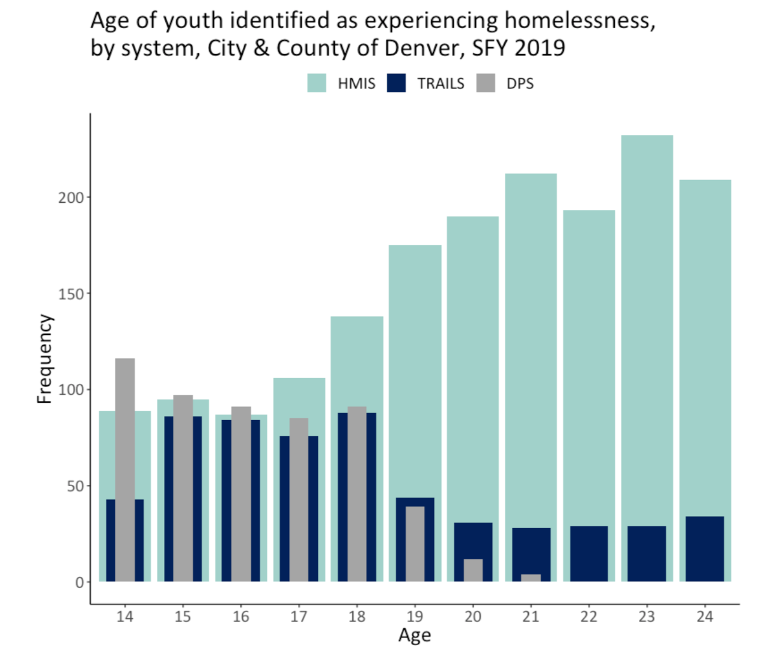
Evaluation of data sources for multiple system estimation study design
Notes:
JOSH: A quick note of best practices. What you can see very clearly here is that there was not – nor did we expect – equal identification-ability among the datasets for all ages. This makes sense because there are not a ton of 24 year olds still in high school. This is one of the reasons that we limited our analysis to high school aged kids.

Slide 49
Multiple System Estimation Analytic Steps
Link available datasets at the individual level
Identify individuals with known homelessness (each dataset will have own unique variable or identification scheme)
Construct contingency tables (this will give you the known population)
Gives the absolute numbers of known people and the overlap of data
Construct multivariable statistical models to estimate unknown population
Poisson or Negative Binomial as these are count models, with interaction terms
Hierarchically included
Select model with best fit based on lowest Akaike Information Criteria (AIC)
Estimate confidence intervals
Notes:
JOSH: next step: construct contingency tables.

Slide 50
Contingency tables
Notes:
JOSH: Now that we have linked data sets we can create contigency tables
Contingencies tables are a way of assigning an individual a ”identification" profile which is to say which combinations of data sets were they present in in a given year. while the numbers are not terribly important, you can see the patterns of identification over time. [SPEAK A LITTLE ABOUT ANY NUMBERS THAT JUMP OUT]

Slide 51
Multiple System Estimation Analytic Steps
Link available datasets at the individual level
Identify individuals with known homelessness (each dataset will have own unique variable or identification scheme)
Construct contingency tables (this will give you the known population)
Gives the absolute numbers of known people and the overlap of data
Construct multivariable statistical models to estimate unknown population
Poisson or Negative Binomial as these are count models, with interaction terms
Hierarchically included
Select model with best fit based on lowest Akaike Information Criteria (AIC)
Estimate confidence intervals
Notes:
JOSH: Finally, we’ve gotten to the fun part. I promise, we won’t put up our super nerdy equations for you. but here is where we get to estimate the unknown.

Slide 52
Modeling the unknown
Poisson and negative binomial log-linear models
Annual
Non-stratified
Stratified by race and sex
Up to two-way interaction terms
Akaike Information Criteria (AIC) to determine best fit
Notes:
JOSH: To model the unknown population, we tested both poisson and negative binomial log-linear models. These were done for each year not stratifying (looking at the entire population) and stratified by race and sex. We included up to two-way interaction terms because we have found that including more than two –way become unintelligible. We figured out which model fit each strata best using AIC.

Slide 53
Calculating the total
Known (present in data set)
McKinney Vento
Child Welfare
HMIS
Unknown
Non-stratified model
Stratified model
Total =
known + unknown
Notes:
JOSH

Slide 54
Multiple System Estimation Analytic Steps
Link available datasets at the individual level
Identify individuals with known homelessness (each dataset will have own unique variable or identification scheme)
Construct contingency tables (this will give you the known population)
Gives the absolute numbers of known people and the overlap of data
Construct multivariable statistical models to estimate unknown population
Poisson or Negative Binomial as these are count models, with interaction terms
Hierarchically included
Select model with best fit based on lowest Akaike Information Criteria (AIC)
Estimate confidence intervals
Notes:
JOSH: finally, we estimated confidence intervals using a bootstrapping method.

Slide 55
Results
Notes:
Will turn it back over to Matt to discuss the results

Slide 56
Known counts and prevalence of youth experiencing homelessness
Notes:
MATT: We’re going to start with the overall population and then move into the stratified analyses. As you can see, the known count from 2017-2021 increased over the time period from 840 to about 1040. Corresponding with a prevalence ranging from 2.7 to 3.7%. Again these are known individuals identified by at any of our three data sets

Slide 57
Unknown (estimated) counts and prevalence of youth experiencing homelessness
Notes:
MATT: The red box here demonstrates the number youth that our models estimated were missing – the so called unknown youth experiencing homelessness .

Slide 58
Total counts and prevalence of youth experiencing homelessness
Notes:
MATT: Putting that together, we have the total youth ages 14-17 experiencing homelessness fomr 2017-2021. And we can there is a substantial increase from 10% in 2017 to 25% in 2021.

Slide 59
Total count of youth (ages 14-17 years) experiencing homelessness in City and County of Denver, 2017-2021
Notes:
MATT: here we compare our results (as demonstrated by the previous slide) to the Denver PIT for ages 0-17yrs.
Orient
We show that even if we can’t wrap our heads around the estimated total number, even the known number that we have about 14-17 year olds
Is much higher than the PIT alone for all ages 14-17

Slide 60
Key takeaways from the unstratified analysis
Known counts for ages 14-17 years identified by our three data sets exceeded PIT counts for all youth by up to 3 times
Known youth accounted for only 15-29% of total identified
Prevalence ranged from 10-25% during the study period
Between 1 in 10 and 1 in 4 youth ages 14-17 in Denver City and County experienced the spectrum of homelessness from 2017-2021
Notes:
MATT: The key takeways from this analysis are listed here.

Slide 61
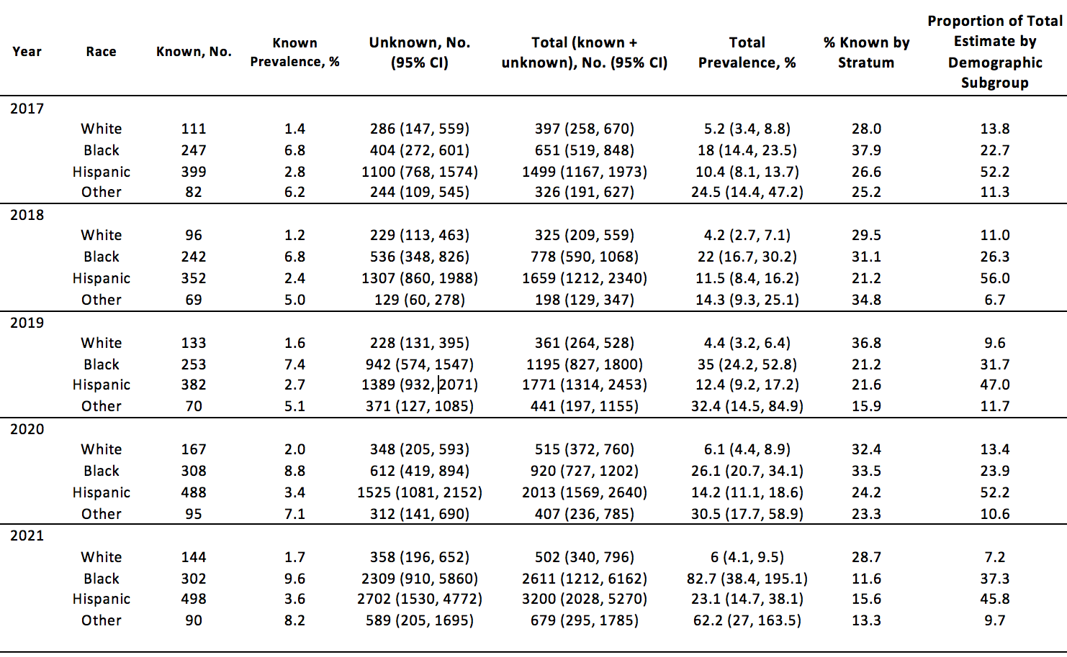
Total counts and prevalence of youth experiencing homelessness, by race
Notes:
MATT: taking into account the unknown estimates as well, those numbers skyrocket up.

Slide 62
Total counts and prevalence of youth experiencing homelessness, by race
Notes:
MATT: taking into account the unknown estimates as well, those numbers skyrocket up.

Slide 63
Known and total count, by Race
Notes:
MATT:
White known and unknown: low total count
Rising known and unknown counts of black, hispanic, and other

Slide 64
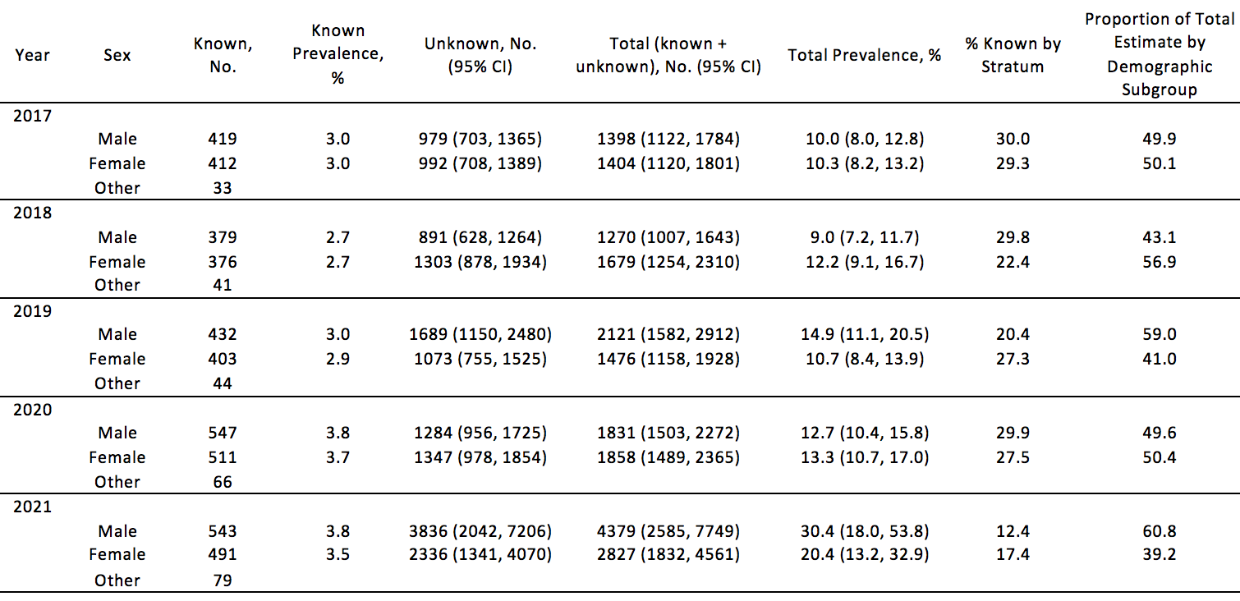
Total counts and prevalence of youth experiencing homelessness, by sex
Notes:
MATT

Slide 65
Total counts and prevalence of youth experiencing homelessness, by sex
Notes:
MATT

Slide 66
Total counts and prevalence of youth experiencing homelessness, by sex
Notes:
Notably also: we were unable to complete estimates for trans, non-binary, any individual that did not identify as cis male or female, which is obviously a major limitations. However, we did note a greater than 2 fold increase in the known count of these individuals

Slide 67
Key takeaways from stratified analyses
Prevalence of homelessness among Black, Hispanic, and other racial minorities far exceeded prevalence among white youth
Known prevalence among non-white youth was 2-5x higher than among white youth
Total prevalence among non-white youth was 2-8x higher than among white youth
Prevalence between male and females was relatively similar until 2021 when male prevalence increased notably
Notes:
MATT

Slide 68
Discussion Question
Questions to "Noodle On"
What populations are you concerned about that could be their own strata?
Notes:
MATT

Slide 69
Main objectives
To describe the landscape of youth homelessness in the US
To outline problems and inadequacies of traditional surveillance
To introduce multiple system estimation as a process
To understand the scope of youth homelessness in Denver as a case study for the process
To encourage discussion and thoughtful discourse on how to apply lessons learned in other locales or for other parts of the population
Notes:
MATT: Over the course of the presentation, we have—hopefully—accomplished 4 of our five goals. We’ve tried to lay out the full landscape and scope of youth homelessness in the US
We’ve made arguments about the strengths and inadequacies of traditional surveillance for this population.
We’ve introduced and worked through the case study of multiple system estimation as a process using Denver as the case.
Now we’ve come to the part the all three of us were most looking forward to: the discussion and thoughtful discourse.

Slide 70
Discussion Objectives
To encourage open discourse and discussion about the process and results presented.
Notes:
MATT: In the next part of this session, we’d like to encourage an open discourse and discussion about the process and results. We have questions on the next slide to stimulate discussion if they are needed but we hope first that there are sufficient questions from all of you to spark the discussion.

Slide 71
Stimulating discussion
What makes sense? What doesn’t make sense?
What do you believe about this study? What don’t you believe?
Does anything resonate?
How have you pulled stakeholders together in the past?
Can we functionally replace the estimation system that we have?
What are the lessons we can learn from this case study and apply to other communities?
What do you need to be able to do this in your community?
Notes:
MATT: Some questions that we have in our back pocket to stimulate discussion.

