Slide 1
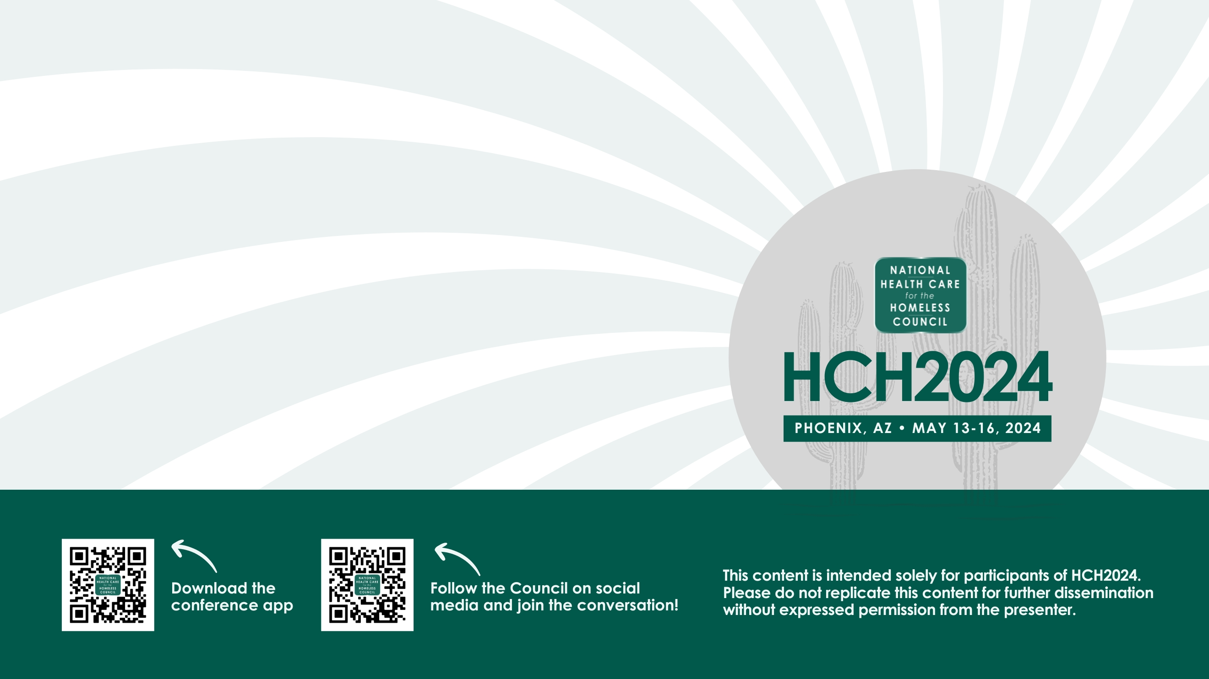


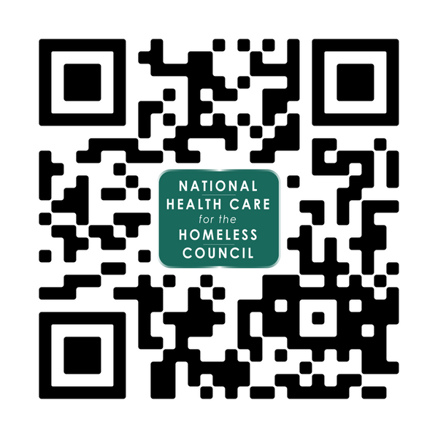

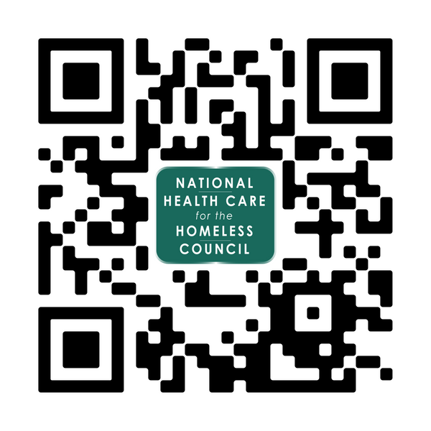
REST: Low Barrier Respite Care
Raven Scrivner (they/them), Interfaith Works Homeless Services
Ti’eri Lino (she/her), Interfaith Works Homeless Services
HCH2024
PHOENIX, AZ • MAY 13-16, 2024

Slide 2


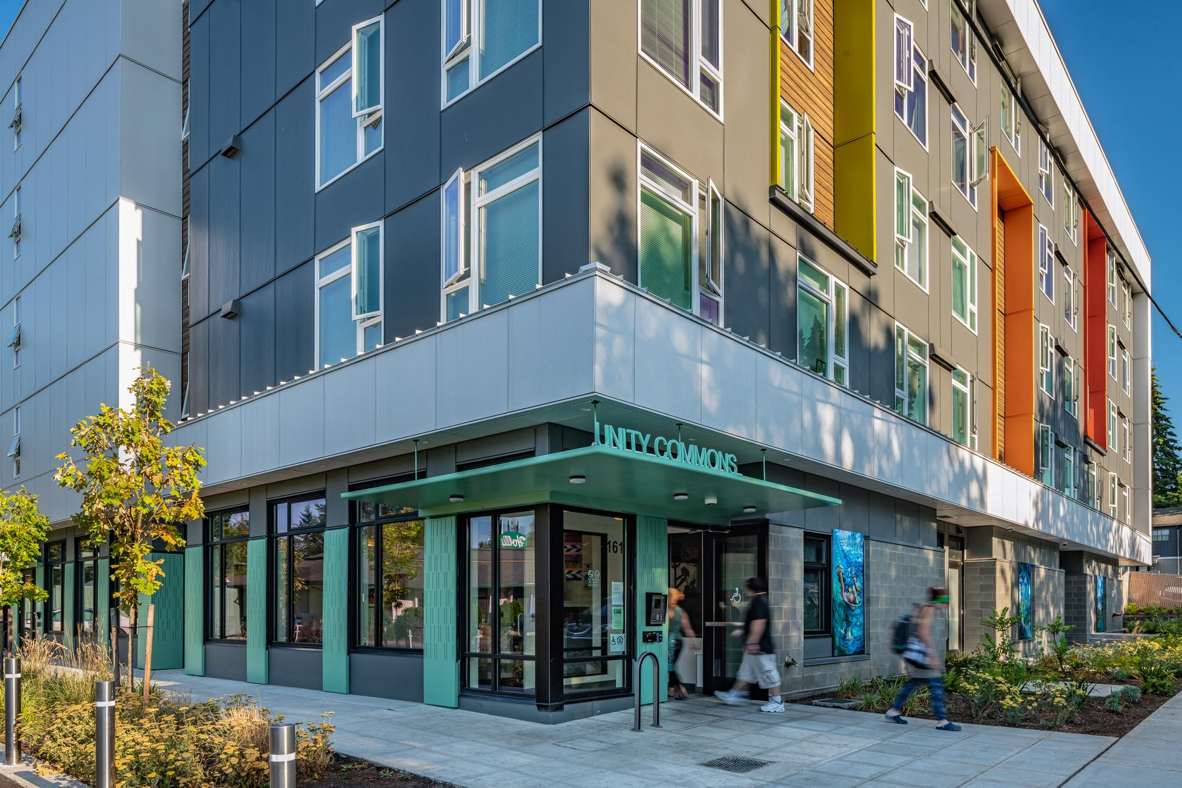
INTERFAITH WORKS HOMELESS SERVICES
REST: Low Barrier Respite Care
RAVEN SCRIVNER, CPC (THEY/THEM)
TI’ERI LINO (SHE/HER)
Notes:
Welcome, thank you for coming to our session!
Names::::::::
I wanted to start off by telling a story:
We have a vet that had broke his foot a bunch of years ago. It never healed correctly. He is 68 and now and is giving him trouble. He came to us with an unrelated acute medical condition. He wated to get surgery on his foot and get housed. One of our case managers took him to his va dr. He asked for opiod pain medication and the dr did not answer directly and made a roundabout way of saying no. Our case manager was with him and she asked him if she could help. He said yes so she asked the dr directly. Are you going to yes or no? He said no citing his patients hx of meth and drinking and was afraid he was going to get addicted to fentanyl. But after the advocay, made a referral to a pain clinic.

Slide 3

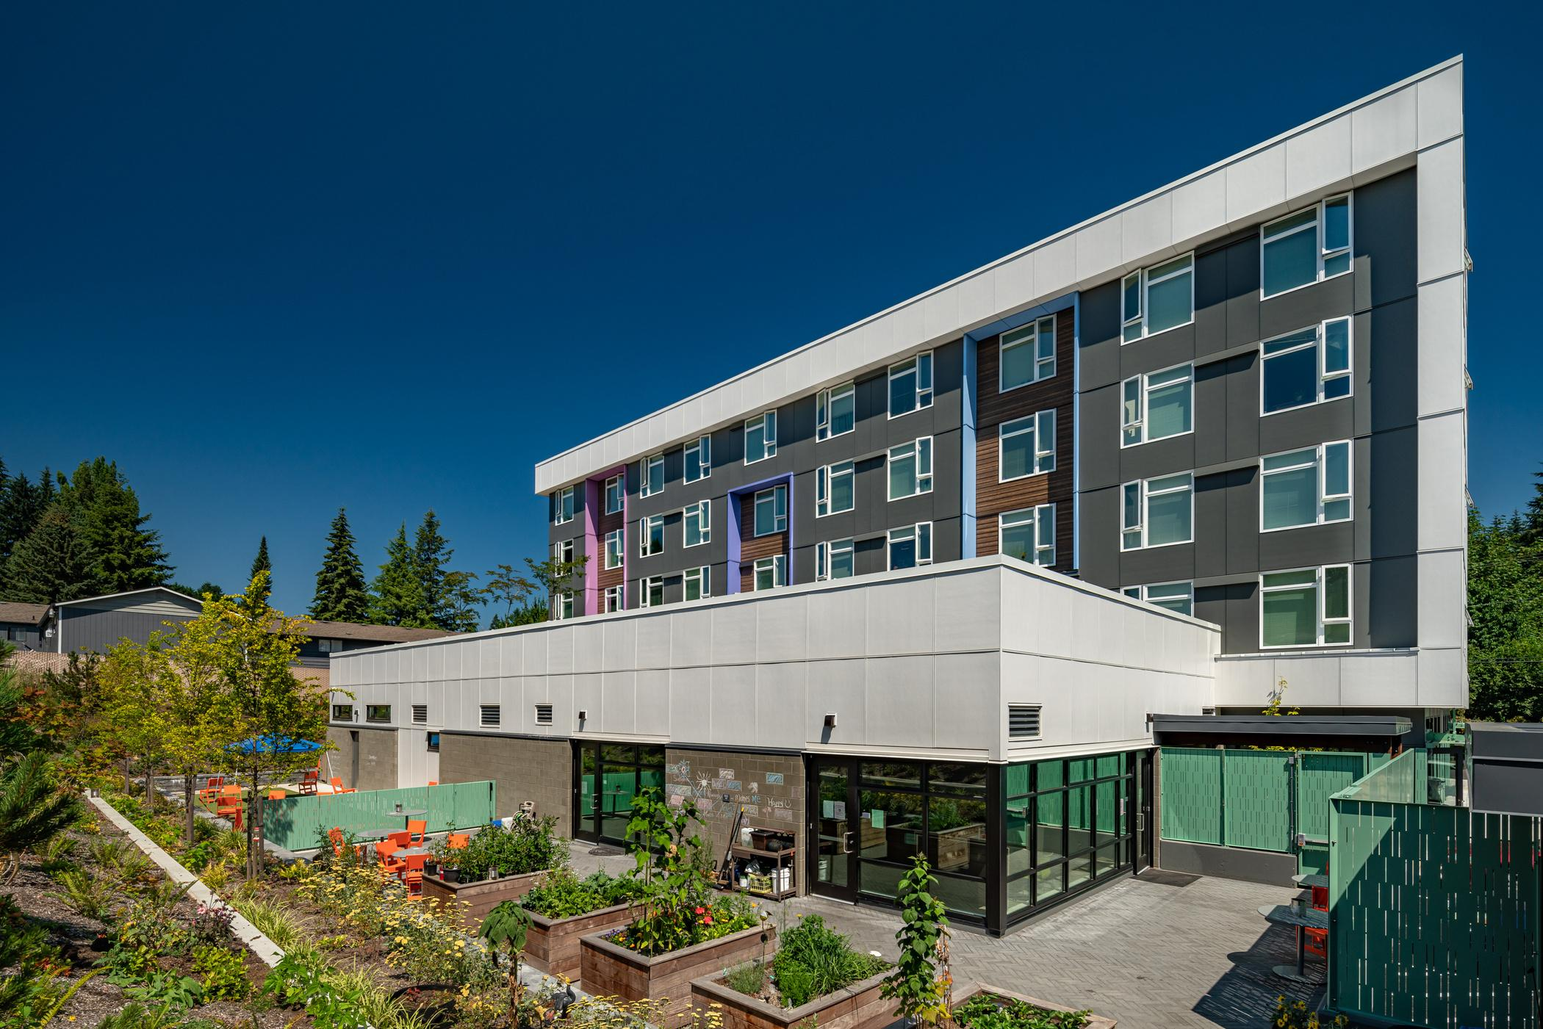
REST
Restorative Experience for a Safer Transition
  Based in Olympia, WA
  Started in 2021
  Medical respite program in partnership with local hospitals
  Funded by ACH
  6 discharge beds for individuals with acute medical conditions who otherwise would be discharging to the streets
  30 to 90 day length of stay
  Located in a “dorm” within our congregant shelter
  Staffed using a peer model
  No medical staff
  Trauma informed model
Notes:
Interfaith Works has been sheltering homeless folks in Olympia for almost 10 years. We launched the respite about 3 years ago
REST is co-located in t our shelter
We have 6 beds in a 58 bed facility. The other 52 beds are basically permenant – can stay as long as they want -- showers, laundry, meals
We are up to 90 days generally but our 6 beds are 30 days generally. We don’t have enough beds to keep up with the demand from hospital
We do not have any medical staff on site, no nurse, mhp. So all our guests have to be independent in their ADLs. We are staffed by case managers that do referrals, intake, make beds, and are peer navigators

Slide 4
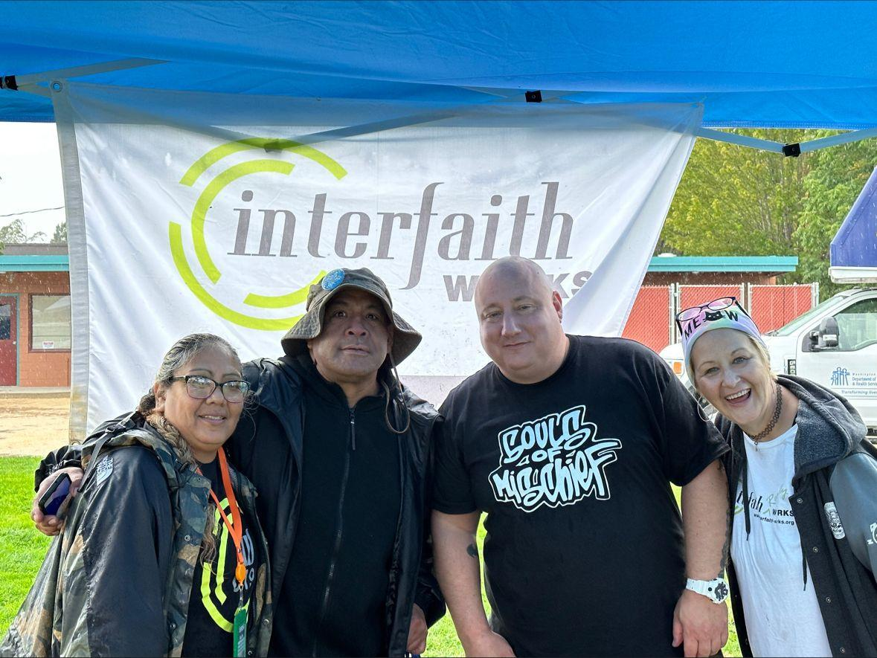
Peer Navigation Model
  Certified Peer Counselors
  Coordinate hospital referrals to REST
  Intensive Case Management
  Client-Centered Approach
  Frequent goals:
    ID replacement
    Connection to PCP or Specialists
    Housing/Shelter
    Transportation to Medical Appointments
    Re-Connection with Families
    Connection to Homeless Services in Community
    Medicare/Medicaid Navigation
    Medical Literacy
Notes:
One thing I love about our org is we have a high ratio of staff to client. I know a lot of social workers that have 30 people on their caseload and we have around 3.
We are all certified peer councilors and all have direct experience with homeless and/or substance use and/or mental health challenges
And our intensive approach allows us to really make things happen for people. One of my favorite things is working out a very complex insurance or benefit situation. That had taken us 20 hours in a dry heated office where we were on hold for hours at a time and had internet access and education and professional language. Idk how a person living in a tent was going to do that.
We are client led -- meaning we support guests without dictating their needs
-we build trust with us and within the health care system
-We support choices we don’t agree with – we don’t have quotas

Slide 5
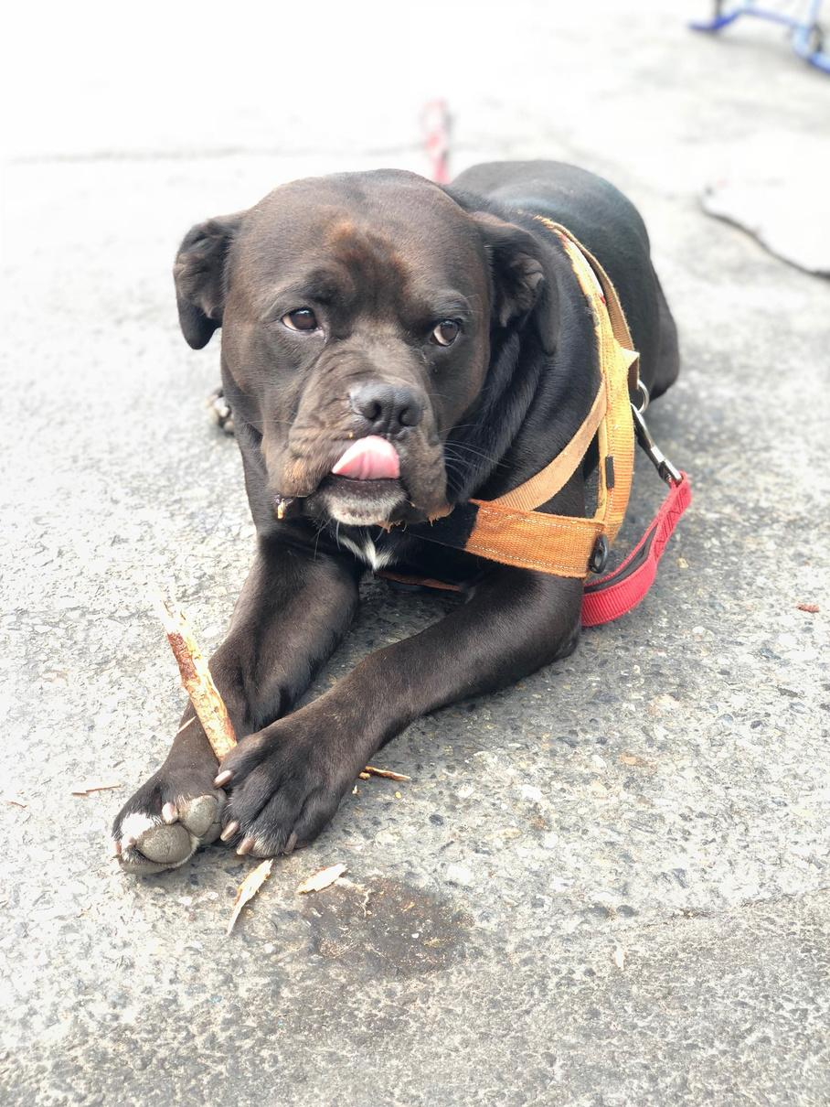
What low barrier means to us
We aim to provide the lowest barriers to our guests to screen people “in” rather than “out”
A few aspects of our services that we see as low barrier:
  No sobriety requirements
  No ID or verification required
  Freedom to come and go during the day
  24/7 facility
  Pets allowed
  Always offer a path to return
  Peer support
Notes:
This is not a stock photo
We would love to be a safe use site. But due to agreements made with the city for permitting, with the neighbors and the overall world we live in we cannot allow drug use in the shelter.
And what it means to do peer led harm reduction, truama informed work looks like this:
We have rules around drug use in the shelter ok. People can’t use. We catch people using all the time. Generally we don’t kick people out for that. We give a lot of chances. When someone gets barred, its usually because of flagrant disregard for the rules. So ok you gotta leave.
One of the things I love about working here is that when someone gets barred, we will welcome them back with open arms

Slide 6

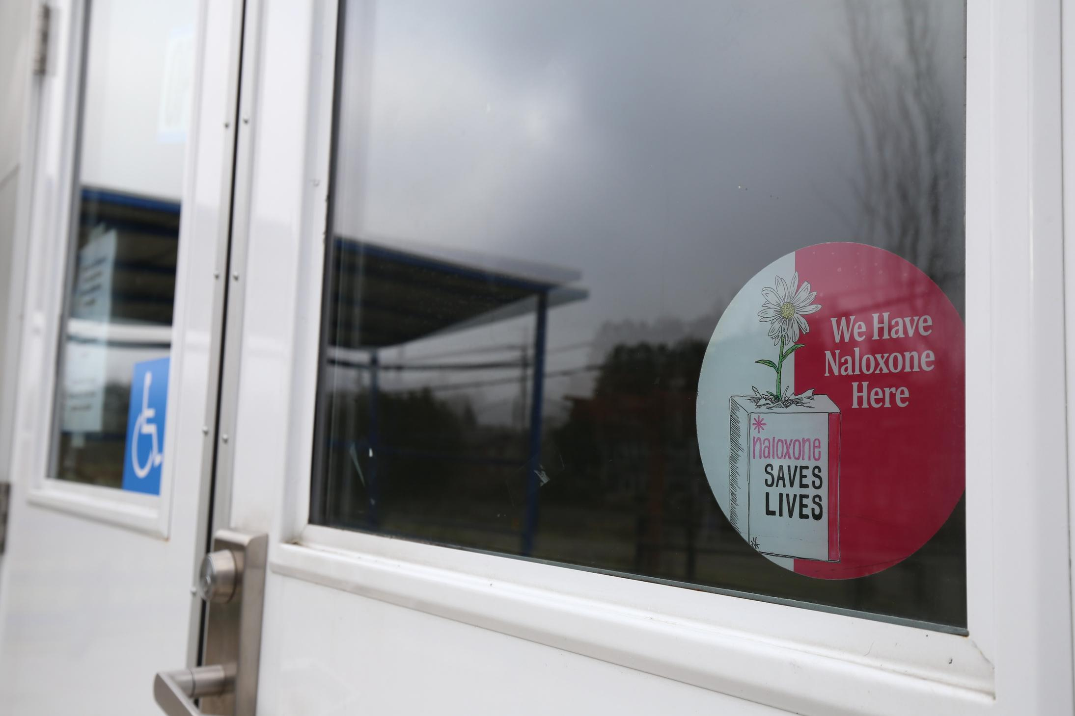
Serving Active Drug Users in Respite Care
  Harm reduction model of services
  Trauma informed
  Support individuals not interested in seeking sobriety
  Assist guests in navigating treatment when wanted, including medical interventions (suboxone, methodone, etc)
  Advocate with our hospital partners for better care and treatment for drug users
  Training in safety planning and CPR; naloxone administration, distribute kits
  Advocacy in the healthcare system
Notes:
One of the things that is really difficult with this work is that the we and the hospitals are not really on the same page when it comes to drug users. It can be very difficult to make changes in the hospital system. Drs and hospital administrators are not going to listen to me.
Substance use is often listed as a medical condition as something that needs to be fixed.
Cant get pain meds for pain
Hospital cm will think that the person has to be sober or talk about them like they are troublemakers
Forced abstinence and precipitated withdrawal
It has been changing tho. Just in the last couple of years partly due to the work from all of you. The language and treatment of drug users. Now its like:
Getting on suboxone or methadone with no plan afterward
I love advocating hard for our folks

Slide 7

Challenges
  Forced abstinence and withdrawal symptoms from hospital stay
  Stigma around drug users
  Methadone or suboxone prescriptions without discharge coordination
  Pain management for guests
  Lack of mental health treatment options
  Timing issues: referrals, specialists, prescriptions, exit referrals
  Up to 90 day length of stay means some people are discharged to the streets
Notes:
Drug Use is often a symptom of Trauma
We see all the time where a cardiologist will tell a pt that “you need to stop using meth”
So on the drive back we will talk about that. Sometimes people have had both chf (conjestive heart failure) and sud for many years.
So how can we support your heart health as well as support your coping with trauma—whatever that looks like
One thing I love and one thing I hate:
----I hate discharging someone to the streets with multiple organ failure and a debilitating drug addiction and or mental health challenge. We do not have adequate resources for our folks
----I love it when we can treat people with respect and dignity and honor their choices. When people come back through multiple times and see our methods work and someone is more inclined to seek medical intervention

Slide 8
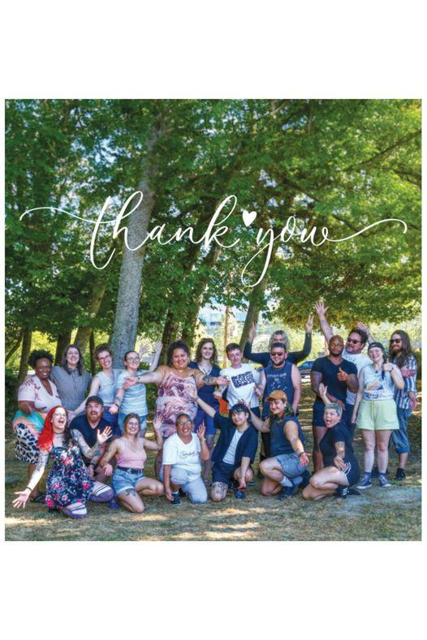
Thank you!
Raven Scrivner:
raven.scrivner@iwshelter.org
Ti’eri Lino:
tieri.lino@iwshelter.org
iwshelter.org

