Slide 1
Disclaimers
Stefan Kertesz owns stock in 2 health care related companies: DexCom (glucose monitoring) & Thermo Fischer (lab equipment)
Stefan Kertesz receives royalty from the publisher of UpToDate, Wolters-Kluwer
Views expressed by Stefan are his own and do not reflect positions or views of the US Department of Veterans Affairs

Slide 2
Q: What are plausible benefits of combining “Housing First” with programs for Intimate Partner Violence¹?
A) Improved safety from abuse
B) Better housing stability
C) Improved clinical symptoms like anxiety
D) All of the above
1. I am thinking of conventional domestic violence shelters and similar

Slide 3
Domestic Violence Housing First Model and Association With Survivors' Housing Stability, Safety, and Well-being Over 2 Years Sullivan CM, Simmons C, Guerrero M, Farero A, López-Zerón G, Ayeni OO, Chiaramonte D, Sprecher M, Fernandez AI JAMA Network Open; 2023 Jun 1;6(6):e2320213 .

Slide 4
Background
For persons fleeing intimate partner violence,:
Family/friends, motel, shelters, “DV shelters”, Transitional Housing
A “Domestic Violence Housing First” model
Housing as a basic right, flexibility in $
Funding: for a myriad of expenses, not limited to rent, car repair, employment-related expenses, moving expenses, and safety measures
Mobile advocacy, personalized safety planning
Emotional safety, Empowerment (including practical skills)
Does a DVHF model enhance safety, housing stability or reduced mental health symptoms over 24 months?

Slide 5
Methods
Washington state (2017-2021),
406 survivors-> 375 retained in study (sample studied 344)
Compared DVHF vs “services as usual”
Not a randomized trial
But service package not consistently available (quasi-random)
Follow-up with interviews over 2 years
Housing Instability Scale (7 questions)
Scales for interpersonal abuse, depression, anxiety, PTSD, etc
1. 30 received no service at all and 1 had incomplete study data

Slide 6
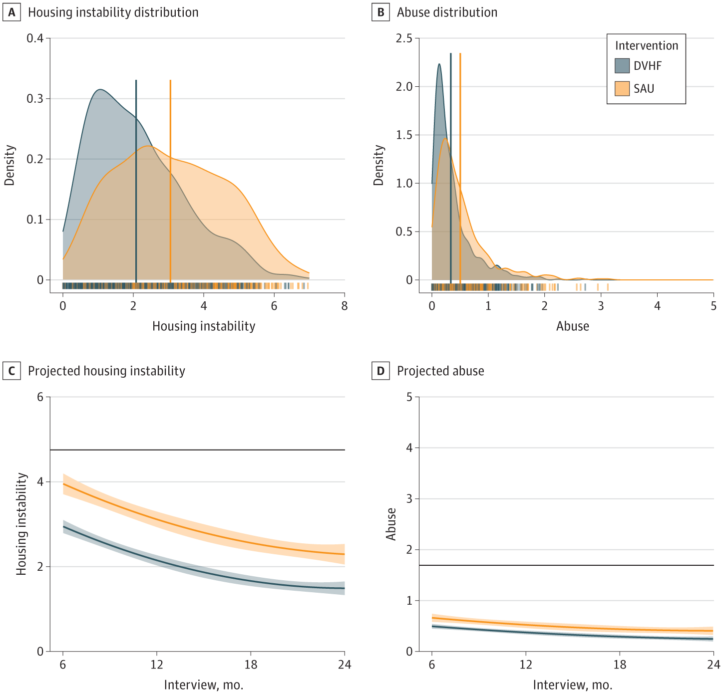
What did they find?
For both groups: improvements in domestic violence, housing, depression, anxiety and PTSD severity over 24 months
Better for DVHF, worse for Services as Usual
SAU had moderately greater:
housing instability (mean difference, 0.78)
DV exposure (mean difference, 0.15),
Depression (mean difference, 1.35)
Anxiety (mean difference, 1.15)
Posttraumatic stress disorder (mean difference, 0.54)
Higher: the x-axis is a score on housing instabilit of abuse. The y is a probability a person’s score is at that level
Lower: x-axis is time. The y is the model-projected level of the score

Slide 7
Implications Why is this important?
A flexible ”Domestic Violence Housing First” seems to confer benefit for safety, housing stability and clinical symptoms
Limitations
Not a randomized trial
Persons in DVHF turned out to be persons with fewer barriers, greater assets
Statistical adjustments are not ever perfect to mitigate that
Implication: Survivor-driven “inclusive advocacy” and high flexibility in use of funds are likely to be helpful, above and beyond standard IPV programs

Slide 8
Q: What are plausible benefits of combining “Housing First” with programs for Intimate Partner Violence?
A) Improved safety from abuse
B) Better housing stability
C) Improved clinical symptoms like anxiety
D) All of the above

Slide 9
Q: Case management for persons experiencing homelessness. What is it good for?
A) Absolutely Nothing (hat tip: Edwin Starr)
B) Helps with housing stability & well-being
C) Helps with addiction recovery
D) Helps with employment gains
E) All of the above

Slide 10
Exploring the effect of case management in homelessness per components: A systematic review of effectiveness and implementation, with meta-analysis and thematic synthesis Weightman AL, Kelson MJ, Thomas I, Mann MK, Searchfield L, Willis S, Hannigan B, Smith RJ, Cordiner R. Campbell Systematic Reviews. 2023 May 17;19(2):e1329

Slide 11
Question: Is Case Management effective for persons experiencing homelessness?
A case manager or team can (1)
“Assess, plan, and facilitate acess to a range of services for a participant”
Participant-driven, flexible, practical, anticipatory
Models vary
“Broker” (buys services), Standard, Intensive, Assertive Community Treatment, Critical Time Interventin
1. Summary of multiple sources cited by Weightman A, 2023.

Slide 12
Methods
Quantitative studies and qualitative, 1990-2021
Quantitative:
effectiveness & cost-effectiveness
effectiveness of components
effectiveness for distinct groups and populations
Qualitative: factors that influence implementation
Housing (i.e. days housed, time on streets)
Physical Health
Mental Health
Substance Use
Criminal Justice
Employment
Capabilities or well-being (i.e. self-efficacy, community function, quality of life survey)

Slide 13
Results and My Take
64 Intervention studies, 41 qualitative reports
Effective or close to effective for: Housing and well-being
Housing First, Assertive Community Treatment and Critical Time
No proven benefits:
Influential factors: fewer conditions on services helps, in-person meetings help, team approach helps
I say: hard to prove in a trial if something helps when impact depends on a many personal and community factors

Slide 14
Q: Case management for persons experiencing homelessness. What is it good for?
A) Absolutely Nothing (hat tip: Edwin Starr)
B) Helps with housing stability & well being
C) Helps with addiction recovery
D) Helps with employment gains
E) All of the above

Slide 15
Pick the single most innovative response to unsheltered persons who use drugs attempted in your community
A) A police intervention
B) Starting methadone immediately, in a shelter space
C) A nurse monitoring clients in a recliner, after over-intoxication
D) A shelter room with a downstairs locker to store the drugs you can’t bring upstairs
E) I kinda’ don’t know what to make of this

Slide 16
Facilitating exit from encampments: combining low-barrier transitional housing with stabilizing treatment for substance related problems Komaromy M, Stone A, Peterson A, Gott J, Koenig R, Taylor JL Addiction Science and Clinical Practice. 2023. 18(66)

Slide 17
What was the Question
For a new tent encampment …
After demolition, policing and incarceration both
Don’t succeed
Reduce services
Can a health system response enhance entry to housing, addiction treatment and clinical care

Slide 18
What did They Do (methods)
Boston Med Center, collaborating with state, city & more:
”Crisis housing” in vacant hotel with 60 beds
No contingencies for treatment entry (but no drug use upstairs)
Walk-in clinic for medical & addiction treatment
“Bedded” recliners for RN/NP intoxication recovery
Partnered agencies for
Housing navigation & Legal services
Medical, Mental and Addiction Care
Transitional housing & employment service

Slide 19
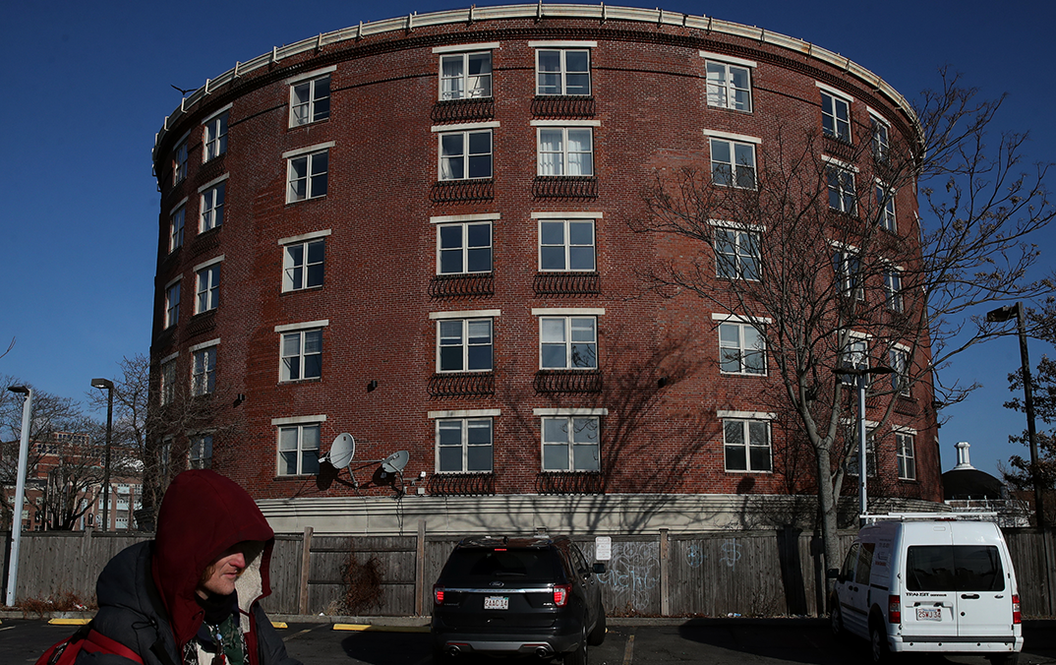
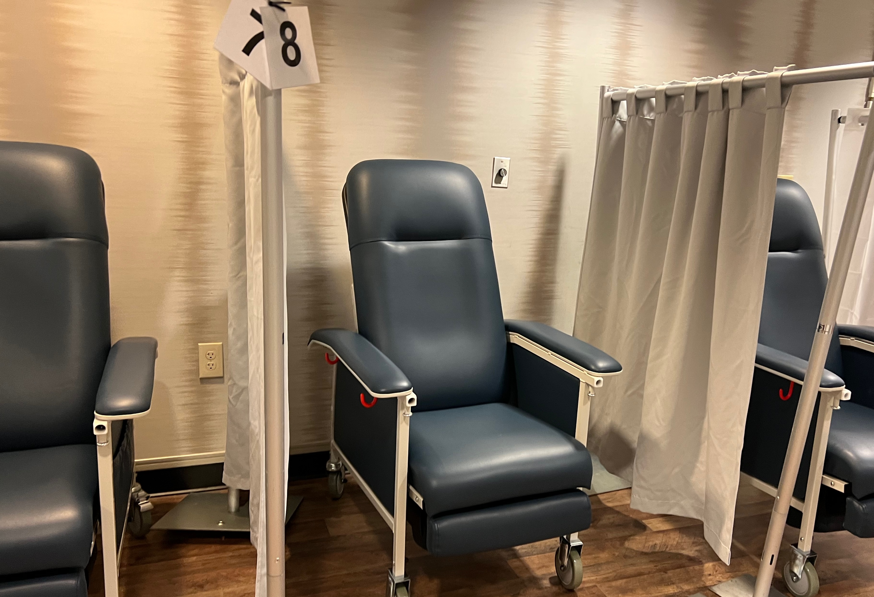
Service Delivery Over 12 months
Admitted 100 to 60 beds (50 from encampment)
Mean duration in hotel: 247 days
49 of 100 engaged in substance use treatment
25 of 100 transitioned to housing
8 of 100: administratively discharged, 4 incarcerated, 4 died (2 OD)
5140 case management visits
Clinics: 1722 patients made 7468 visits (walk-in & stabilization recliners)
704 episodes in which methadone was offered
Among 641 not in methadone program, 590 (88%) joined one
Program ended in late 2023 due to lack of funding

Slide 20
Pick the single most innovative response to unsheltered persons who use drugs attempted in your community
A) A police intervention
B) Starting methadone immediately, in a shelter space
C) A nurse monitoring clients in a recliner, after over-intoxication
D) A shelter room with a downstairs locker to store the drugs you can’t bring upstairs
E) I kinda’ don’t know what to make of this

