Slide 1
Telehealth in a Street Homeless Clinic: Improving Care and Access
Tina Gustin DNP, CNS, RN
Emily Horvath DNP, FNP-C

Slide 2
Disclosure
The presenter has no real or potential Conflicts of Interest.
This project was funded through HRSA Grant # 100857-0202
There is no relationship with drugs or specific devices addressed.

Slide 3
Objectives
Discuss strategies for planning/implementing a telehealth program within a clinic caring for those living in homelessness.
Identify
Identify telehealth equipment that can be used for delivering telehealth services to community specialists.
Identify
Identify strategies for preparing providers and patients for telehealth in a free and charitable clinic setting.
Discuss

Slide 4
Academic Community Partnership Model Est – 2021 Through Grant Funding
Faith based organization providing services to those experiencing homelessness in Virginia Beach
4 Pillars: Medical, Housing, Recovery, Training
EST. 2002
Nurse-led, student-run, and patient and community centered project
Meet the health needs of vulnerable community members.
EST. 2021
Notes:
Meeting clients where they are at

Slide 5
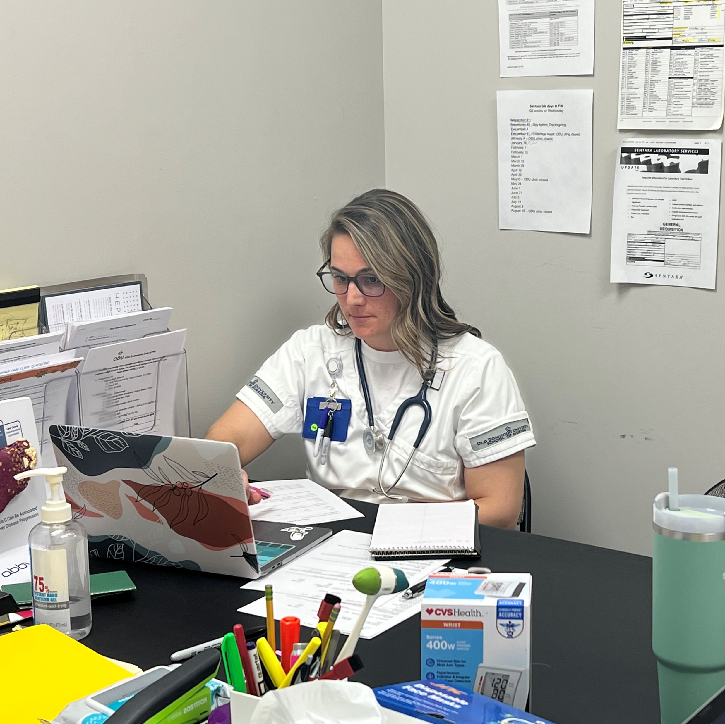
Purpose
Create and implement a free nurse-led, student run interprofessional clinic
Develop student expertise in working as part of an interprofessional team
Prepare nurses for leadership roles in running clinics
Enhance student comfort in working with disadvantaged populations such as those living in homelessness
Identify needs and provide quality interprofessional care to homeless populations
Utilize telehealth to connect clients to specialist and other allied health professionals

Slide 6
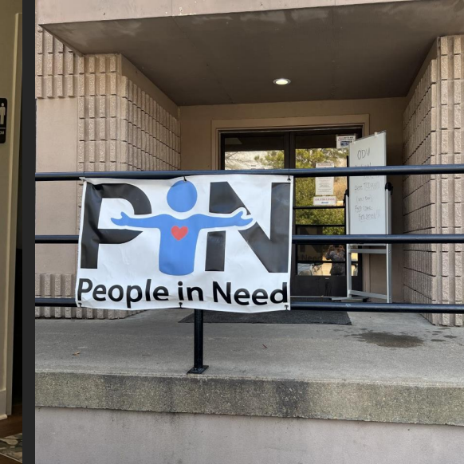
Clinic Goals
Establish an Academic Practice Partnership
Create a Doctor of Nursing Practice (DNP) faculty led free clinic
Prepare students to care for this vulnerable population
Provide care while addressing SDOH
Serve as a clinical site
Address needs of the population
Provide interprofessional experiences
Utilize telehealth

Slide 7
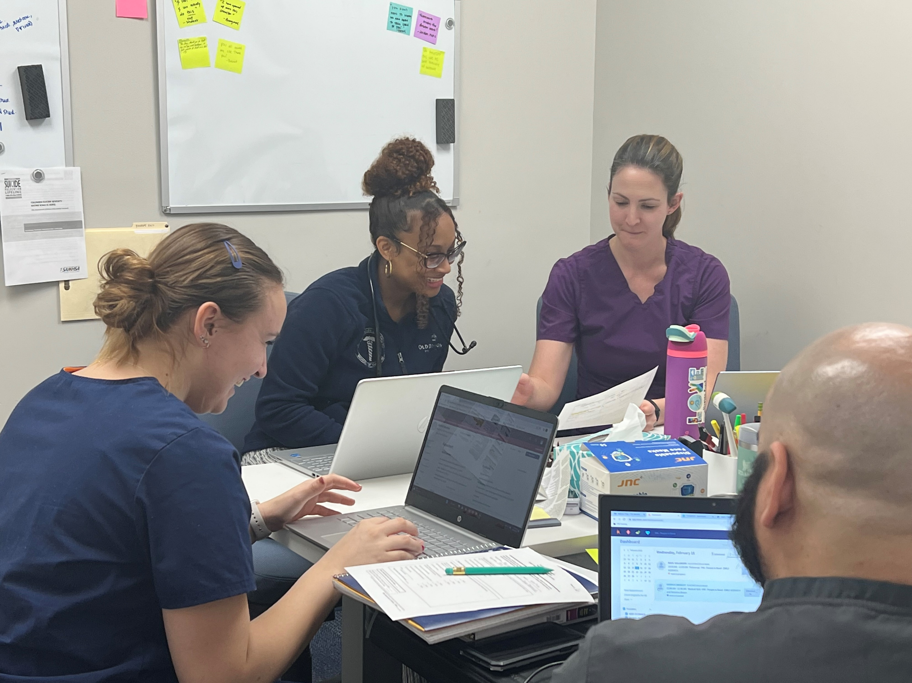
Faculty Led Clinic
DNP prepared Nurse Practitioner (NP) faculty led the clinic
NP faculty guided the integrated model
Students were assigned to the clinic for additional mentoring and observation
Students were assigned based on need, interest, role

Slide 8
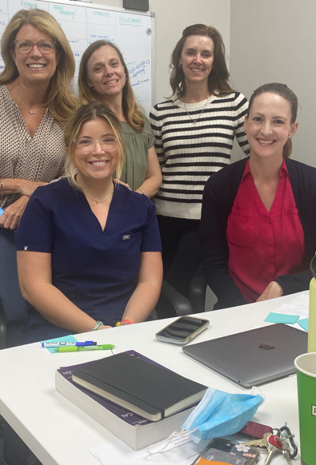
Interprofessional Team
Doctor of Nursing Practice
APN/Executive
Family Nurse Practitioner
Clinical Nurse Specialist
Psychiatric Mental Health Nurse Practitioner
BSN students
Medical Social Worker
Health and Human Services
Dentist
Dental Hygiene Physical Therapy
Animal Assisted Therapy Team

Slide 9
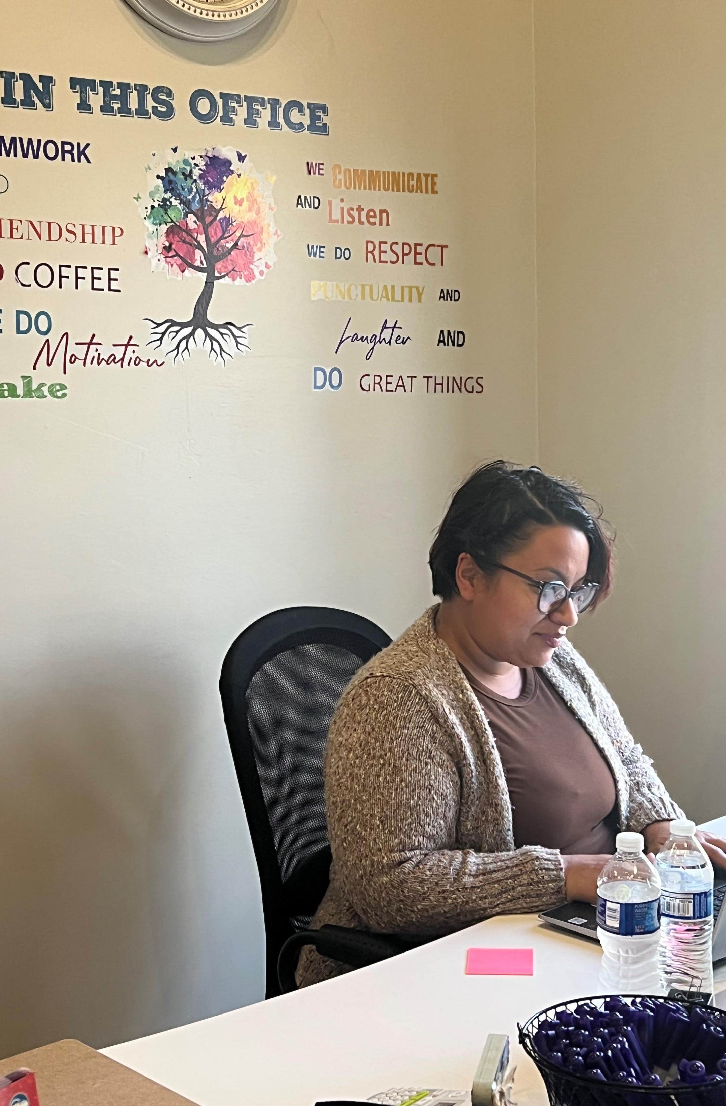
Key Team Members Employed by PiN
Medical Coordinator
Case Manager
Grant Manager

Slide 10
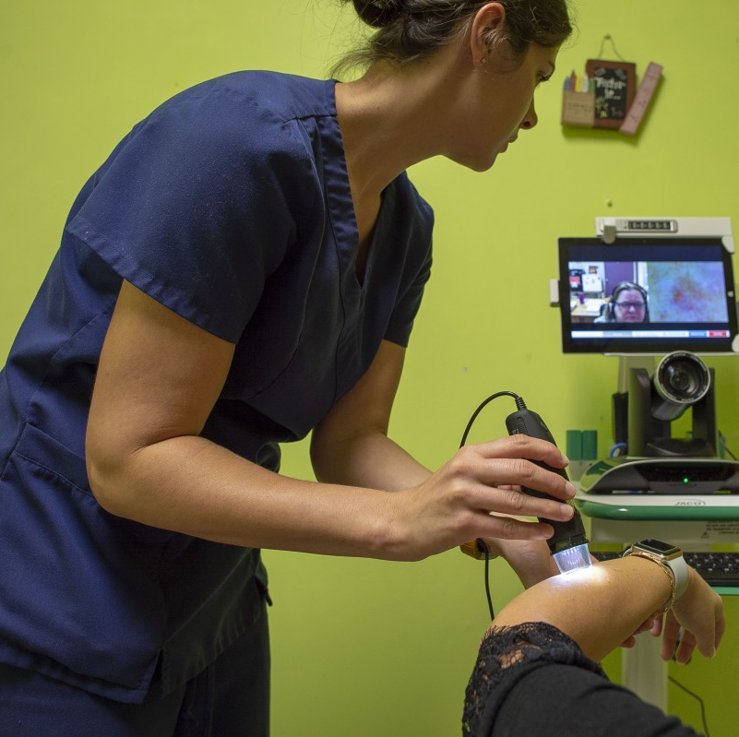
Why Telehealth
Increases access
Convenient
Improves health outcomes
Decreases cost
Supports patient engagement
Improves Care Coordination
This Photo by Unknown Author is licensed under CC BY-ND

Slide 11
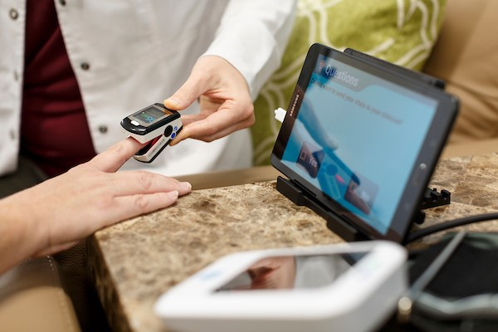
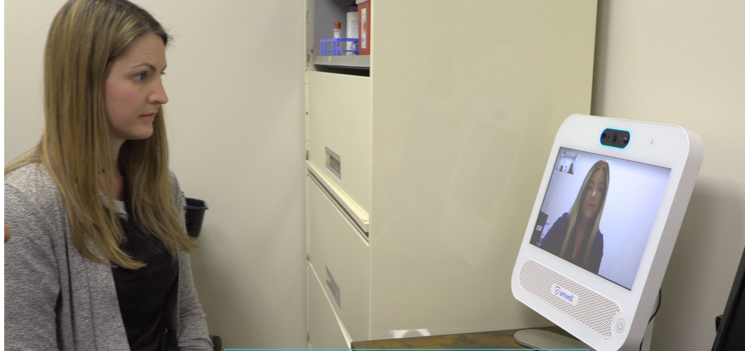
What is Telehealth
Virtual “real time” visits
Store and forward
Sharing of medical images through an electronic health record
Monitoring physiologic data remotely

Slide 12
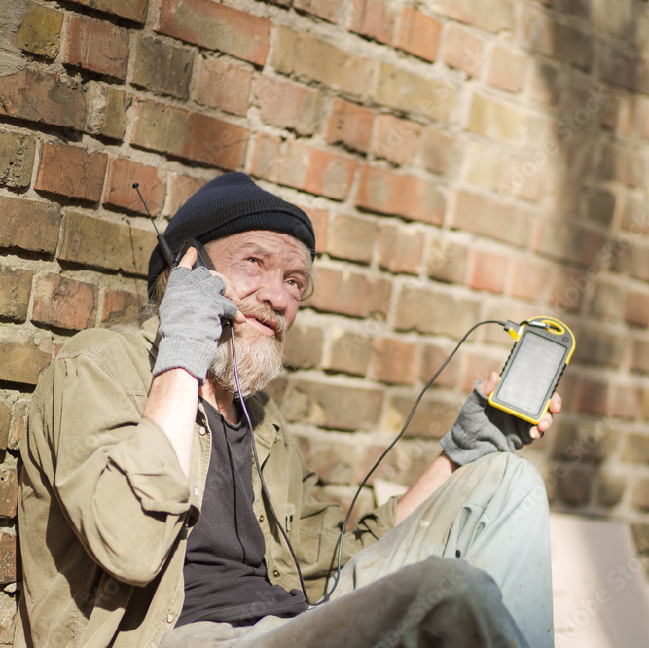
Telehealth the new Social Determinant of Health
Limited phone access
Limited minutes or service
Creates a digital divide
Creates barriers to health
Creates barriers to well-being

Slide 13
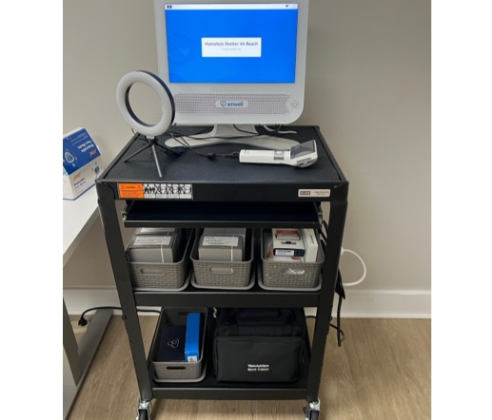
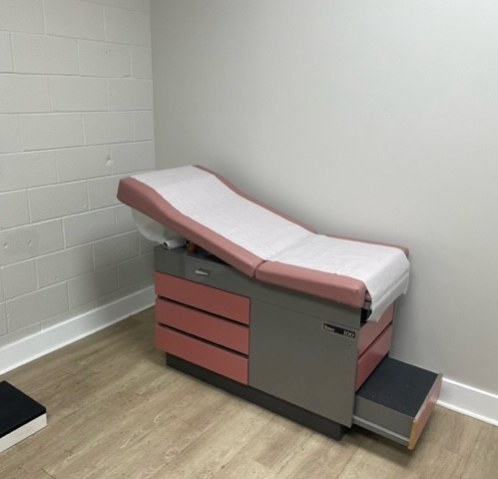
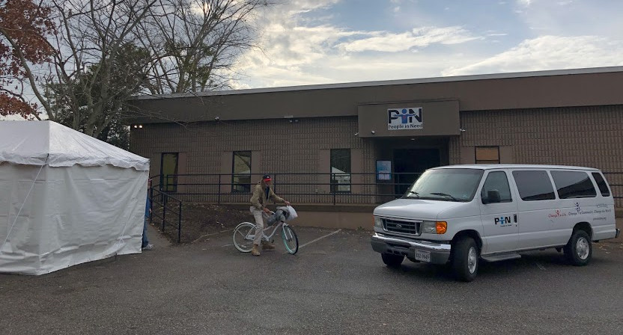
Imbedding Telehealth within the Clinic
Increased patient access to specialists
Allowed patients to see providers in a comfortable place
Allowed the clinic staff the opportunity to present the patient to the specialists
Allowed patients to visit with established community providers
Minimized transportations

Slide 14
Strategies for Success

Slide 15
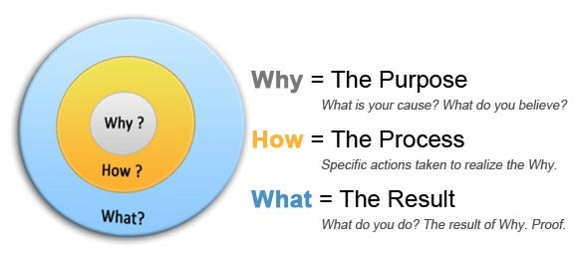
Strategies
Determine your “why”
Find your champion
Establish funding for equipment (grants, foundations, donations)
Know your state policies and regulations
Resources:
Telehealth Resource Centers
Center for Connected Health Policy
Center for Telehealth eHealth Law
American Telehealth Association

Slide 16
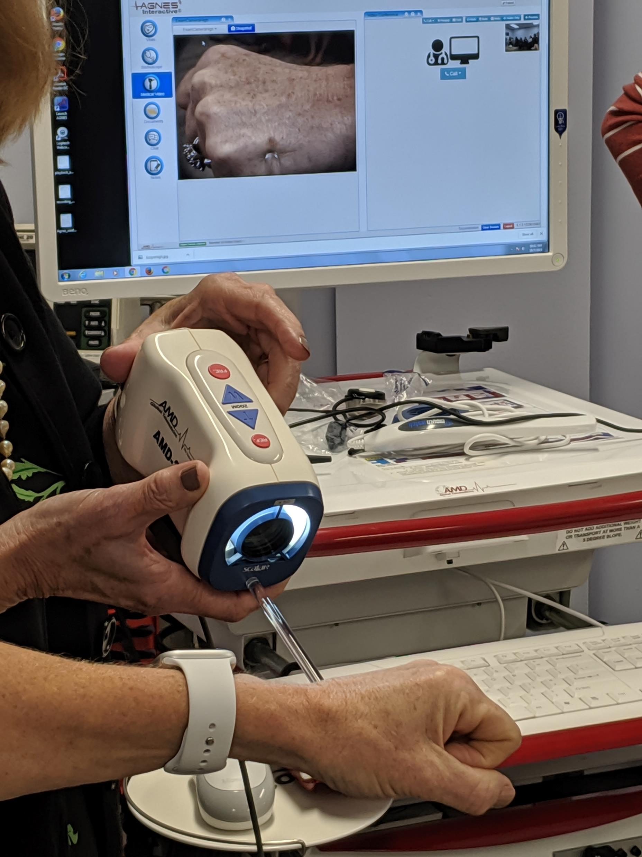
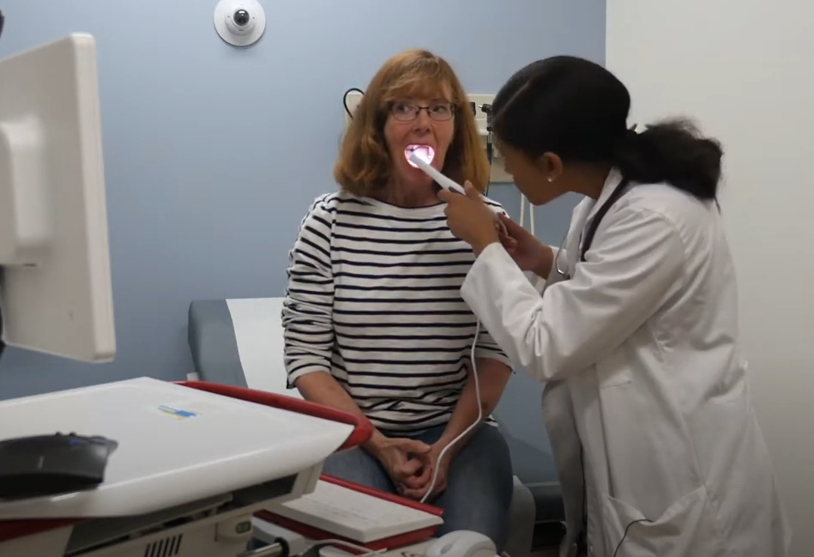
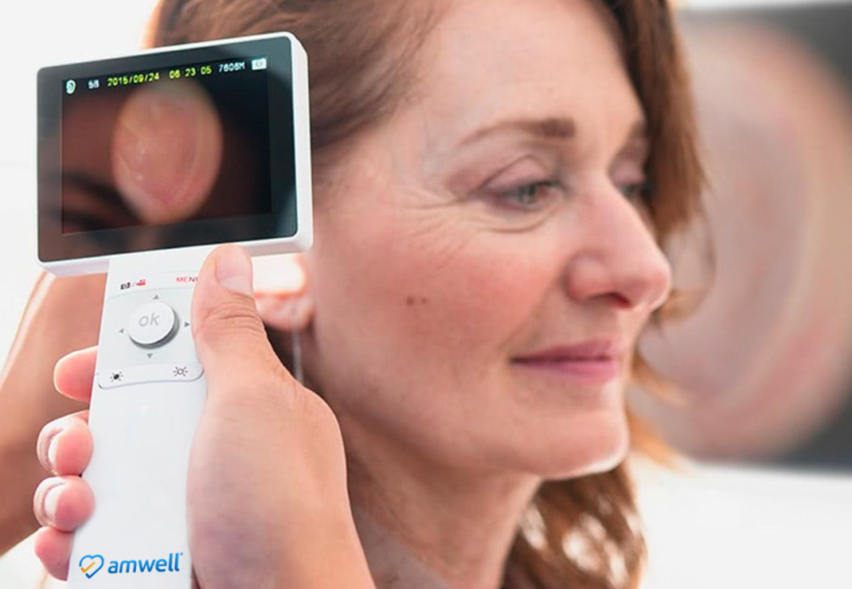
Strategies
Evaluate Equipment (cost/functionality)
Amwell® cart
Connect everywhere platform
Peripherals
Oral Camera
Derm Camera
Otoscope
Ophthalmoscope
Stethoscope
Ultrasound
Phone applications

Slide 17
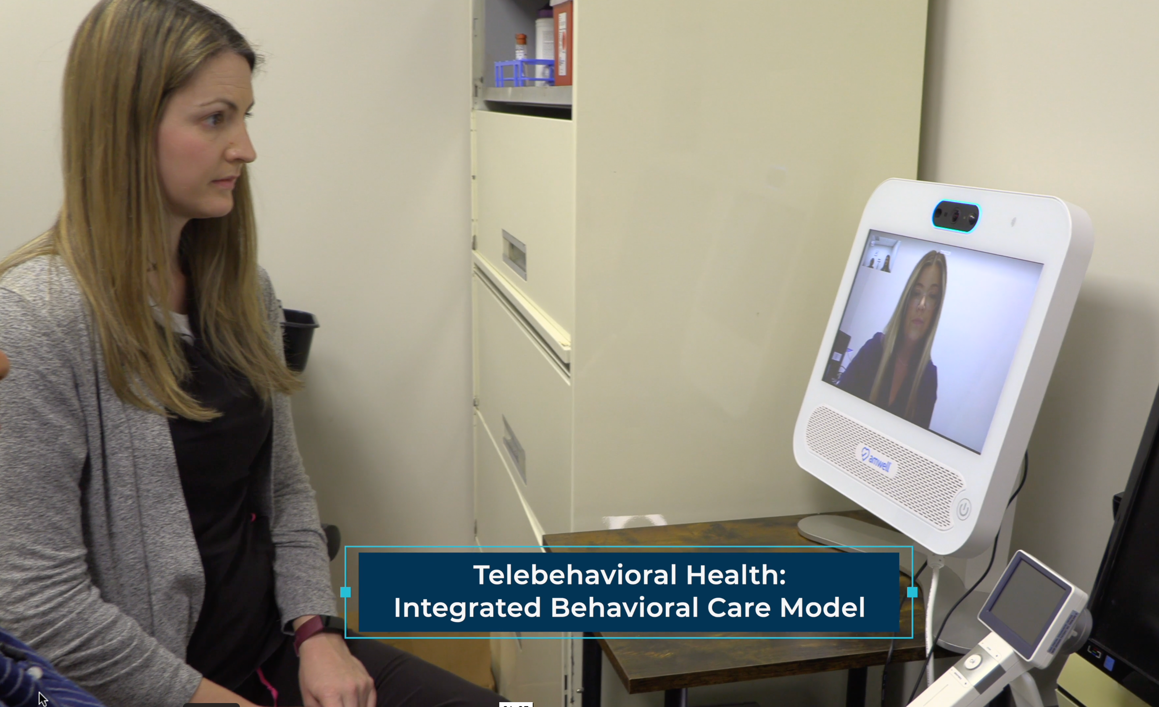
Strategies
Train the providers!
Our University developed a series of Telehealth Certification Courses
All care team members completed a certification prior to attending the clinic
Telehealth Provider Certification
Telehealth Presenter Certification
Behavioral Health Certification
Practiced with Standardized Patients first!

Slide 18
Strategies
Assure all patients are Medicaid or Medicare insured
Virginia is a full parity state
This encouraged local specialists and providers to schedule virtual visits from our clinic

Slide 19
Outcomes

Slide 20
Patients Served
Since 2021 1,226 patients have been served
A total of 685 visits were both medical and behavioral
Of these 68 were successfully completed using telehealth
Disciplines in the following services have provided telehealth services
Dental hygiene
Dentist
Physical therapy
Social work
Psychiatric Mental Health Nurse Practitioner

Slide 21
Student Experiences
143 students from 7 professions have participated in the clinic
Many have served as presenters or providers in telehealth visits
Experiences are moving knowledge into action for future healthcare professionals

Slide 22
Patient Experiences
Overwhelmingly positive
No missed appointments for telehealth visits
No apprehension
Like having a provider, they are comfortable with, stay with them for the visit
Request telehealth over “getting a ride” to the appointment

Slide 23
Successes
Telehealth has assured the integration between the Nurse Practitioner and Social Worker when not on site together.
Students have been able to practice their telehealth skills with patients.
The clinic has served as a model for other clinics

Slide 24
New Projects

Slide 25
Telephone Usage Research
In collaboration with Center for Telehealth e-Health Law (CTeL)
Evaluated client’s phone access
Identified whether the phone is shared
Assessed phone plans
Assessed if they would use the phone for healthcare
Data will be used at the federal level for policy change

Slide 26
Dental Care
Volunteer dentist
Mobile dental care twice a month
Extractions
Dentures
Utilizing oral telehealth camera for pre-planning patients
This Photo by Unknown Author is licensed under CC BY-SA

Slide 27
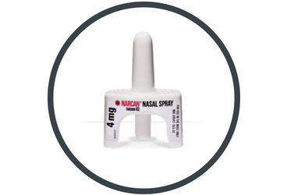
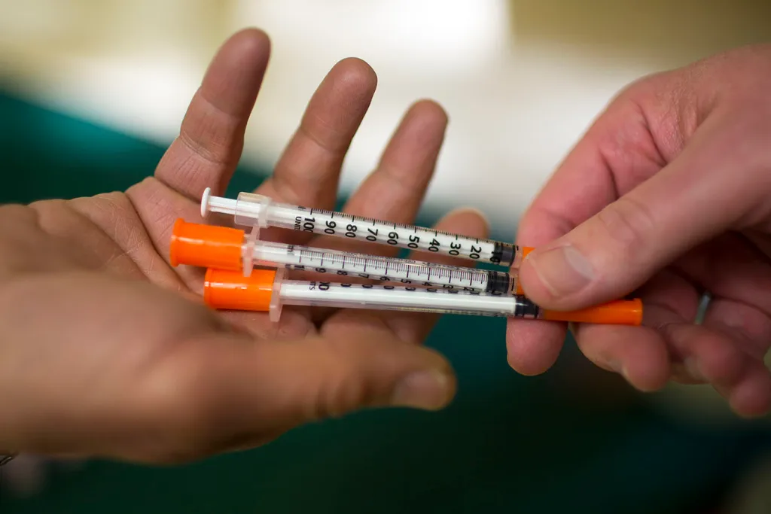
Harm Reduction Program
Student is working with the public health department of VA Beach, VA
First Harm Reduction Program in the city
Needle exchange
Narcan distribution and training
Will utilize telehealth for counseling services

Slide 28
Partner with Local Hospital
Hospital President visits
ED director visits
Provided education to discharge planners and nursing staff
Working with hospital IT
Work with Hospital research team and Magnet team
Launching telehealth visits with Hospital Specialists

Slide 29
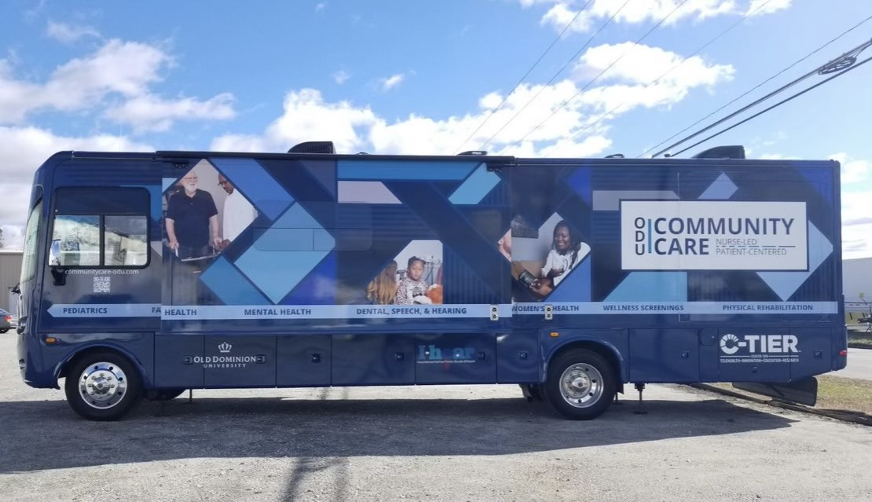
ODU Community Care Van in Rural VA

Slide 30
Virginia Beach Housing Resource Center

Slide 31
Conclusion
Telehealth has the potential to increase access to healthcare services and improve access for individuals living in unstable conditions
The lack of a phone should not be a barrier
Telehealth technologies should be embedded in free and charitable clinics
Telehealth expands access to specialists and mental health providers

Slide 32
Limitations

Slide 33
Limitations or Opportunities
Building a stainable model beyond grants
Locating specialists that will provide telehealth to new patients
Fear of change is our greatest limitation
Telehealth is better than no care!
Artwork by Tina Gustin and Grace Barthold

Slide 34
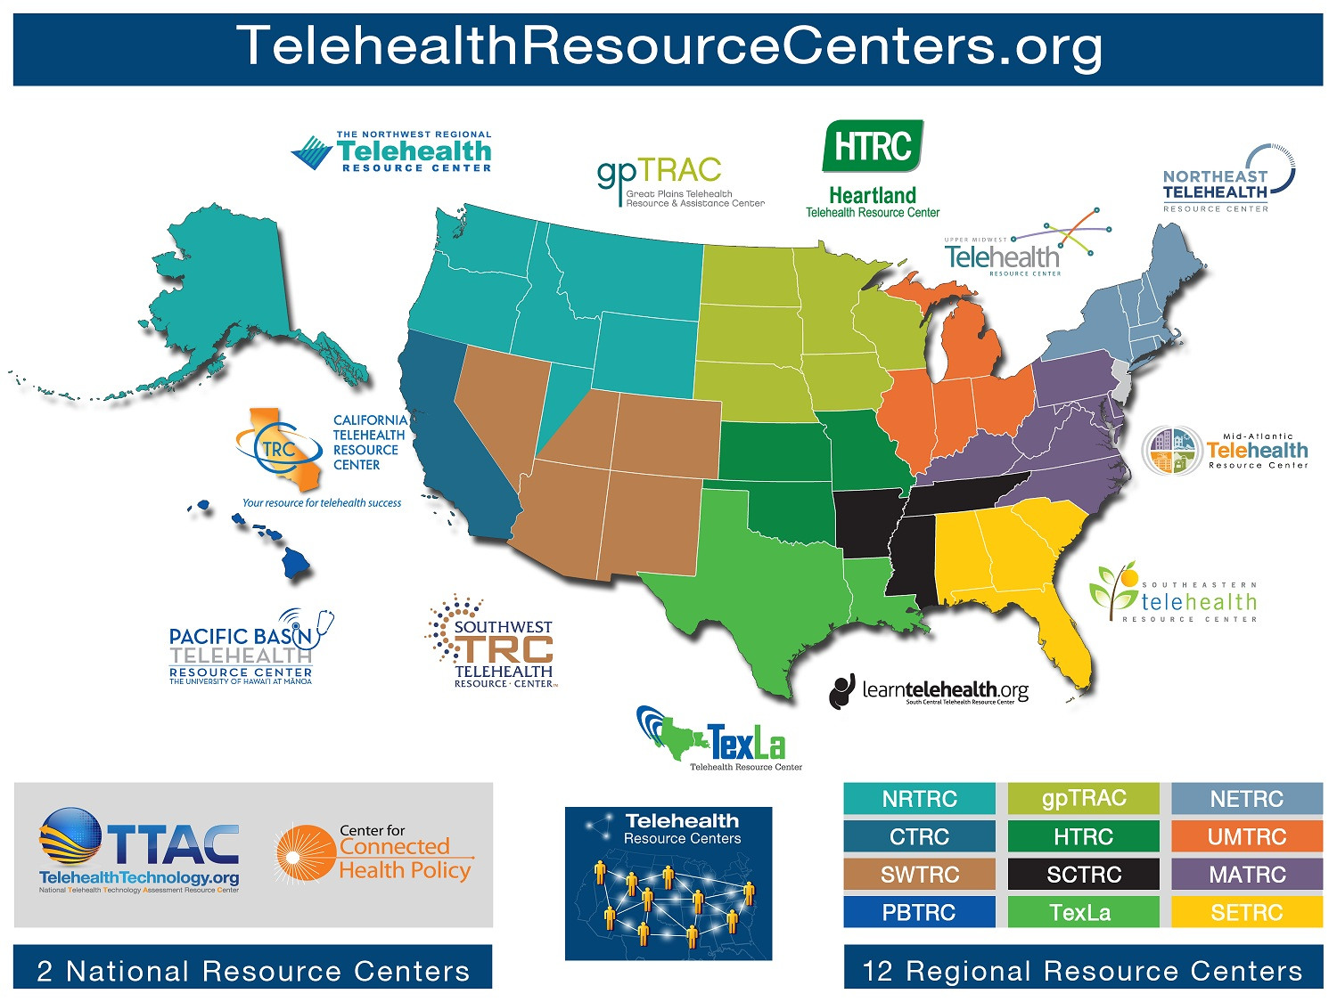

Slide 35
Resources
American Telemedicine Association (ATA)
americantelemed.org
Center for Telehealth and e-Health Law (CTeL)
CTeL.org
Society for Education and the Advancement of Research in Connected Health (SEARCH)
searchsociety.org
Center for Connected Health Policy
hhtps://www/cchpca.org
Telehealth.HHS.gov
Center for Telehealth-Innovation, Education and Research (C-TIER)
https://telehealtheducation-ctier.com

Slide 36
Questions
Tina Gustin DNP, CNS, RN
tgustin@odu.edu
757-285-6215

