Slide 1
Fent to Bupe: Paths to Success from Camp to Clinic
National Health Care for the Homeless Council
2024 National Conference
Fentanyl and For a Health
Andrea Chiavarini
Lifeline Connections, Vancouver WA
Eowyn Rieke
Fora Health, Portland OR

Slide 2
Starting with LOVE
Think of something that you love (non romantic): an activity, a place, a person
How do you SHOW that love?

Slide 3
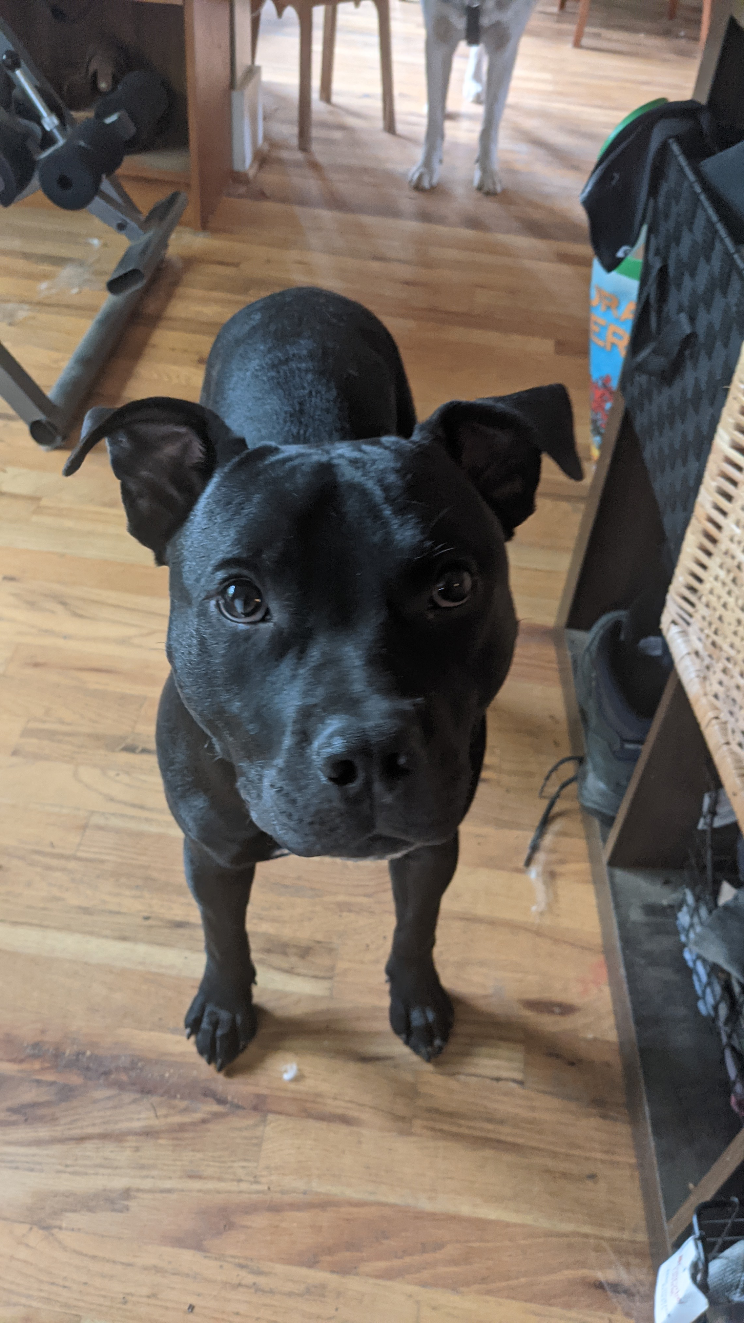
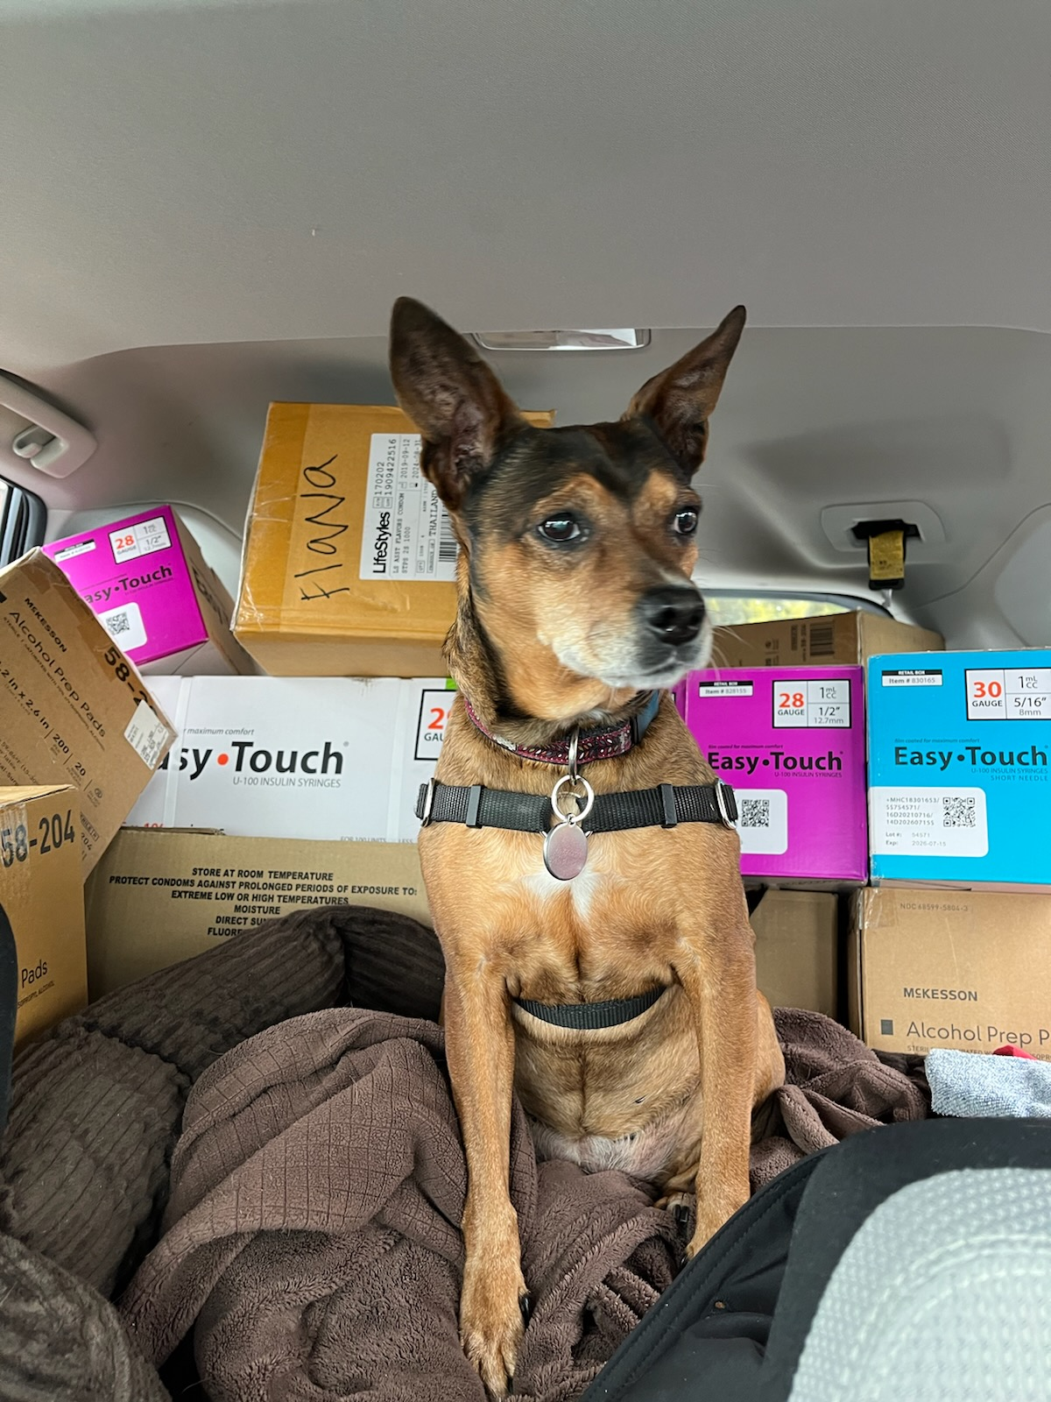
Intros and Disclosures
Eowyn Rieke, she/her/ella
Nothing to disclose
Family doc, passionate about raising my non-binary kid Raine and rescue pitbull Toad Macaroni, vegetarian cooking, and creating loving, respectful, low-barrier buprenorphine programs
Andrea Chiavarini, she/her
Nothing to disclose
Ob/Gyn, passionate about harm reduction, neurodiversity, radically person-centered care, and reproductive justice. Also musical theatre.

Slide 4
Intros (continued)
Who are you?
Every one of you has valuable information and experiences that I hope you will share

Slide 5
Learning objectives
Review the different options for transitioning from fentanyl and other high potency synthetic opioids to buprenorphine.
Understand the importance of preparation for transition when possible and recognize when it isn’t possible.
Discuss the various tools and strategies needed to support someone as they transition from fent to bupe.
Appreciate the critical role that heart and humanity play in supporting people through this challenging process.

Slide 6
Why is this so damn hard?
What is your experience?
Changing supply
Bupe short/long acting: quick onset withdrawal, have to wait a while before starting bupe (lipophilic)
Self-mgmt: patients trying it on their own and having bad experiences
Intense anxiety about previous attempts to get on bupe
Misconception of what causes precipitated withdrawal (naloxone)
Old school ideas of max bupe dose

Slide 7
Options for fent to bupe

Slide 8
Standard Induction
Wait as long as possible after last fent use, ideally >24 hours
Start 4 mg, gradually go up to 16 – 24 mg within 3 – 4 days
Minimal adjunctive meds
Worked well with heroin!

Slide 9
Low Dose Transition
Start with very low dose
Can start with up to 2 mg, standard is 1 mg
Use films if you can
Write Rx very clearly, ideally 2 different Rxs
Increase dose daily until reach 16 mg/day around day 6
Can keep going up to 32 mg/d
Continue full agonist until about day 6
Opioid receptors are sufficiently occupied by bupe to significantly reduce withdrawal and cravings

Slide 11
Low dose transition (cont.)
Can adjust timeline to go slower if needed
But not toooooo slow!
Days 3 – 4 often most difficult
Consider adjunctive meds throughout, esp days 3 – 4 or if have anticipatory anxiety
Cohen, 2021

Slide 12
High Dose Transition
Set a time/date to discontinue fentanyl use
Adjunctive meds
Work with patient to see what they think is most helpful.
Maximize adjuncts before first dose.
Wait 24+ hours or until patient has objective signs of opioid withdrawal in addition to anxiety and restlessness
Enlarged pupils
Runny nose, watery eyes
Yawning, goosebumps
Take 16 mg in a single dose
Take additional 8 mg doses every 30 min up to 48 mg

Slide 13
High/Low Protocol
Start 2 mg ASAP
Potentiates opioid receptors
Take 2 mg every 6 hours until taking high dose (usually about 24 hours)
Start adjunctives anytime
Max adjunctive meds before taking high dose
Take 16 mg in a single dose
Take additional 8 mg doses every 30 min up to 48 mg
Hartley 2023

Slide 14
Quick Start
Careful patient selection
Setting extra important
Caution with significant mental or physical health conditions
Wait as long as possible after last fent use
Load up on adjunctive meds
Administer naloxone (usually nasal)
Take 16 mg – 24 mg bup ASAP
Take additional 8 mg bup every 30 min up to 40 mg
Randall, 2023

Slide 15
Transition Protocols
Standard
Low dose
High dose
Low/high
Quick
Medically managed (inpatient)
Which is best?

Slide 16
Which is best? It depends. . . .
Tolerance for withdrawal
Time available
Ability to manage complexity
Willingness/ability to continue fent (or other full agonist opioid)

Slide 17
Differences: Fent->Bupe Protocols
 | Withdrawal Symptoms | Duration | Complexity | Keep using?
Standard | ++++ | ++ | ++ | no
Low Dose | + | +++++ | +++++ | yes
High Dose | +++ | ++ | ++ | no
Low/High Dose | ++ | ++ | +++ | no
Quick | +++++ | + | + | no
Withdrawal Management/Detox | + | ++++ | + | no

Slide 18
Note on the evidence
Lots of different transition protocols
Lots of research
No clear consensus on best approach
CA Bridge Project has GREAT resources
See references and additional resources at end of slides

Slide 19
Adjunctive Meds

Slide 20
Adjunctive Meds
Clonidine or Lofexidine^{5,6,7}
Tizanidine^{5,6} or Methocarbamol
Gabapentin^{8,9,10}
Benzodiazepines
Acetaminophen and ibuprofen
Hydroxyzine
Olanzapine
Trazodone, Doxepin, Quetiapine or Zolpidem
Ondansetron
Bismuth or Loperamide
Individualized care: what has worked best for this person in the past?
Srivastara, 2020; Kosten, 2019; Kuszmaul 2020; Kheirabadi 2008; Salehi 2011; Sanders 2013

Slide 21
Other preparation

Slide 22
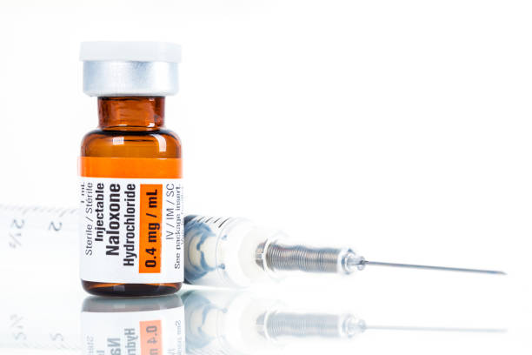
Safety: Prevent Poisoning (Overdose)
Especially if continuing full agonist while starting buprenorphine
Discuss risk
Prescribe Naloxone
Some patients prefer injectable
New high dose (8 mg/dose) controversial
No evidence that it works better

Slide 23
If you have the luxury of time
Reduce fentanyl use
Stabilize mental and physical health conditions
Build a community of support

Slide 24
General Prep
Patient experience
Have they tried this before? What happened?
What worked well? What didn’t work?
Supports
Friends and family
Peer mentors/coaches
Setting
Where is this going to happen? Tent? Shelter?
What is the weather like?
How safe are they there?
Can they find a short-term place to stay?

Slide 25
Plan for comfort
Safe, ideally comfortable, place to rest
Easy access to bathroom
Stay hydrated!
Small sips frequently – aim for 6-8 oz an hour
Water, tea, Gatorade
Bendable straws!
What helps this person feel calm and safe?
Music, company, solitude, particular clothing

Slide 26
Prepare for discomfort
Profound restlessness and back pain
Movement on the skin can help!
a battery powered fan
patting down arms and legs
rubbing back/legs
adding vicks or icy-hot if possible
Hot shower or bath if possible
alternatives: hot water bottle, warm washcloths, spray bottles in warmer weather

Slide 28
What happens if none of these strategies work?

Slide 29
Inpatient Withdrawal Management
May be a safe space
Depends on person’s past experience
All needs met
May include extensive scheduled adjuncts including higher dose benzos
Medically monitored so can use more sedating meds

Slide 30
Once they are on. . . What happens?
Can be really hard to stay on meds
Ongoing withdrawal and craving
Anxiety
Social pressures
Barriers to follow up care
High potency opioids increase tolerance so much that sublingual buprenorphine may not be enough

Slide 31
What if sublingual bupe isn’t enough?
Wait a bit: sublingual bupe doesn’t reach steady state until 5 – 10 days
PAWS: post acute withdrawal symptoms
Continue adjuncts
Consider
High dose (32+ mg)
XR injectable (sublocade or brixadi)
Methadone

Slide 32
Back to basics: LOVE
Whenever you can, bring in the love
People who use drugs need to feel seen, appreciated, and supported unconditionally
People who use drugs are smart, skilled, hard working, and know themselves better than we ever will
Love them, love yourself, love the work

Slide 33
Learning objectives
Review the different options for transitioning from fentanyl and other high potency synthetic opioids to buprenorphine.
Understand the importance of preparation for transition when possible and recognize when it isn’t possible.
Discuss the various tools and strategies needed to support someone as they transition from fent to bupe.
Appreciate the critical role that heart and humanity play in supporting people through this challenging process.

Slide 34
Q&A

Slide 35
References and Resources, page 1
The ASAM National Practice Guideline for the Treatment of Opioid Use Disorder: 2020 Focused Update, DOI: 10.1097/ADM.0000000000000633
Cohen SM, Weimer MB, Levander XA, Peckham AM, Tetrault JM, Morford KL. Low Dose Initiation of Buprenorphine: A Narrative Review and Practical Approach. J Addict Med. 2022 Jul-Aug 01;16(4):399-406.Hill LG, Zagorski CM, Loera LJ. Increasingly powerful opioid antagonists are not necessary, International Journal of Drug Policy, Volume 99, 2022, Lancet
Hartley J, Rieke E, Blazes C, Smith B, Gregg J. Successful Transition from Fentanyl to Buprenorphine in a Community-based Withdrawal Management Setting. J Addict Med. 2023 Jan-Feb 01;17(1):117-118.
Herring AA, Vosooghi AA, Luftig J, Anderson ES, Zhao X, Dziura J, et al. High-dose buprenorphine induction in the Emergency Department for treatment of opioid use disorder. JAMA Netw Open 2021;4:e2117128Kosten TR, Baxter LE. Review article: Effective management of opioid withdrawal symptoms: A gateway to opioid dependence treatment. Am J Addict (2019). Mar; 28(2): 55–62.
Kheirabadi GR, Ranjkesh M, Maracy MR, Salehi M. Effect of add-on gabapentin on opioid withdrawal symptoms in opium-dependent patients. Addiction. 2008
Kuszmaul AK, Palmer EC, Frederick EK. Lofexidine versus clonidine for mitigation of opioid withdrawal symptoms: A systematic review. J Am Pharm Assoc 2020 Jan-Feb;60(1):145-152
Randall A, Hull I, Martin SA. Enhancing Patient Choice: Using Self-administered Intranasal Naloxone for Novel Rapid Buprenorphine Initiation. J Addict Med. 2023 Mar-Apr 01;17(2):237-240.

Slide 36
References and Resources, page 2
Salehi M, Kheirabadi GR, Maracy MR, Ranjkesh M. Importance of gabapentin dose in treatment of opioid withdrawal. J Clin Psychopharmacol. 2011 Oct;31(5):593-6
Sanders NC, Mancino MJ, Gentry WB, Guise JB, Bickel WK, Thostenson J, Oliveto AH. Randomized, placebo-controlled pilot trial of gabapentin during an outpatient, buprenorphine-assisted detoxification procedure. Exp Clin Psychopharmacol. 2013 Aug;21(4):294-302
Snyder H, Chau B, Kalmin MM, Speener M, Campbell A, Moulin A, et al. High-dose buprenorphine initiation in the emergency department among patients using fentanyl and other opioids. JAMA Netw Open 2023;6:e2315724
Srivastava AB, Mariani JJ, Levin FR. New directions in the treatment of opioid withdrawal. Lancet. 2020;395(10241):1938-1948
Weimer MB, Herring AA, Kawasaki SS, Meyer M, Kleykamp BA, Ramsey KS. ASAM Clinical Considerations: Buprenorphine Treatment of Opioid Use Disorder for Individuals Using High-potency Synthetic Opioids. J Addict Med. 2023 Nov-Dec 01;17(6):632-639. doi: 10.1097/ADM.0000000000001202. Epub 2023 Jul 28. PMID: 37934520.
California Bridge Project: https://bridgetotreatment.org/addiction-treatment/ca-bridge/
Provider Clinical Support System https://pcssnow.org/about/

