Slide 1
Patching the Safety Net: Review of a Rapid Post Hospitalization Shelter Program
Catherine Hayes, BSN, MPH, FNP-BC
Elizabeth Torkington, BSN, PHN

Slide 2
Learning Objectives
Introduction to Cardea Health and Alameda County, California
Discuss the problem of unsheltered hospital discharges and limitations on current options
Introduce pilot rapid post hospitalization shelter program in Alameda County.
Discuss outcomes of pilot model
Challenges and lessons learned
Opportunities for replication of program

Slide 3
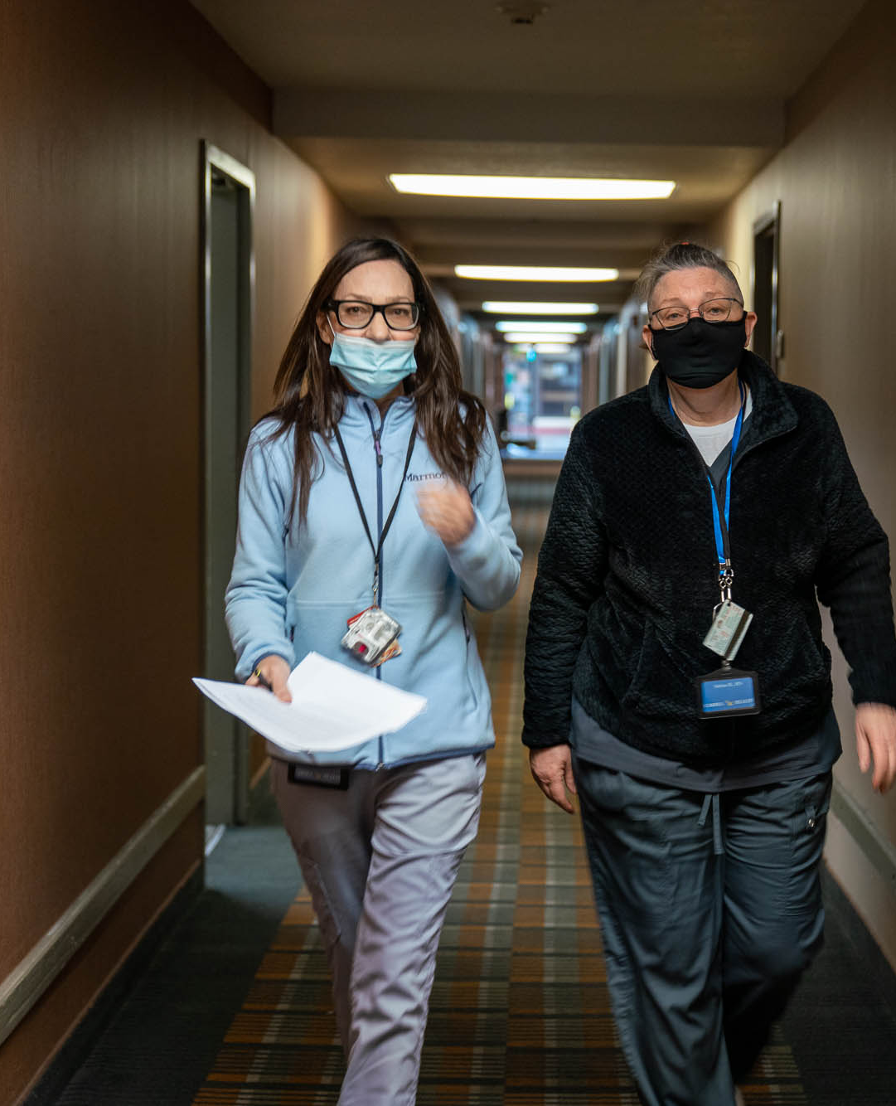
Cardea Health is a nonprofit organization in Oakland, California
Founded to connect marginalized populations to the clinical services required to improve health, remain stably housed in their community, and age in place.
Cardea Health offers integrated medical/social care models and compassionate, culturally competent care
Cardea Health operates certified Home Health Agency
Notes:
We are a new organization, founded in early 2021
Worth saying that we were founded by nurses, myself and my co-founder are NPs
We have between 60 and 70 employees now, mostly clinical staff
Really focus on people who have been chronically homeless and are experiencing severe illness, either acute or chronic
We work in an environment where health care and housing work for marginalized people are often separate and siloed and we have tried to create solutions to that problem
Provide clinical care at two respite facilities in the county, as well as two large Permanent Supportive Housing centers that are home to some very sick people. We do some less intensive clinical work at a couple of emergency shelters in the county and we do quite a bit of clinical consulting for agencies working with the unhoused population.

Slide 4
Cardea Health programs
Clinical support in Emergency Shelters
Rapid post hospitalization shelter
Medical Respite
Medically Frail housing program
Home Health services
Housing and Community Supports (Housing Navigation)
Notes:
Cardea Health is primarily a clinical organization, although this year we will start providing Housing Navigation services.
We operate clinical programs in a variety of homeless service settings including emergency shelter and medical respite programs
Cardea Health also operates clinical services at a program known as the Medically Frail Model in Oakland, which is a novel program that supports individuals who have experienced chronic homelessness and complex medical conditions. These spots are extremely limited but do offer an option for people who have become so ill and compromised on the street that they would not be able to live independently if housed.
Cardea Health is a new non profit, and still building programs. Our goal is to create a spectrum of integrated shelter and health, and housing and health services that can serve people no matter their clinical needs and once people are in that continuum of care they don’t cycle back out to the street where medical conditions get worse. One of the pain points that we have identified is hospital discharge: options for safe discharge from the hospital (including respite) are limited and difficult to access, making hospital discharge a moment of extreme vulnerability for someone who is unhoused.
In response we developed a rapid post hospitalization shelter model.

Slide 5
Homelessness in Alameda County, CA
2022 Point in Time county surveyed 9747 homeless individuals in the county: a 17% increase from 2019
27% are sheltered (emergency shelter or transitional housing), 73% are unsheltered (vehicles, tents abandoned buildings, other places not intended for habitation)
Notes:
The vast majority of our population is street homeless
The number of shelter beds is not increasing in proportion to our homeless population.
Such a large street homeless population leads to an overburdened hospital system.
Very large burden of complex chronic illness
Clients seek primary care needs in the emergency department, or present for a variety of social needs

Slide 6
Challenges of using hospital systems as a safety net for PEH
Hospitals have limited capacity to treat social drivers of utilization
Few community resources provide medically supported shelter following ED discharge
PEH admitted to the hospital often face extended hospital stays due to a lack of supported discharge options
The lack of appropriately supported discharge options for unsheltered patients,
causes emergency department congestion
extends the length of stay for admitted patients,
increases risk of readmission
negatively impacts post-discharge health outcomes.

Slide 7
Medical Respite in Alameda County
Medical Respite is a CalAIM covered benefit that provides up to 90 days of medical respite care (as of January 2022)
Intended to be a safe discharge option for PEH leaving the hospital
Admission criteria:
Unhoused individuals at risk for hospitalization
Unhoused individuals with a medical need that cannot be met in an unsheltered environment
Notes:
In concept, respite

Slide 8
Challenges with the medical respite model
Respite care is often the only option for people experiencing homelessness with complex medical conditions.
Respite facilities are often asked to take on clients with chronic and serious conditions as well as care needs that are out of the intended scope of respite care
More complex clients who are difficult to safely discharge lead to delayed bed turnover and limited bed availability
Different respite care models lead to inconsistency in available levels of care and can make appropriate placement challenging
Respite programs are often not equipped for same day hospital discharge admission
Notes:
SNF options are very limited: beds are limited, tend to decline PEH with SUD or SMI, Medi-CAL provides poor SNF reimbursement.
With so many people being admitted from the street (demographics of the county) there is often limited space for hospital discharges.
Hospitals are often looking for an immediate discharge option and unwilling to hold patients for safe discharge.
Lack of knowledge about respite care inside of hospitals.
Lack of good infrastructure in respite programs (EHRs, electronic referral platforms) lead to barriers for referrals and admissions.
Recognition that this is a growing and changing model and there is a lot of work to standardize respite care.

Slide 9
Landscape of Medical Respite Care in Alameda County
Currently 150 beds in the county that are considered respite.
Different funding sources, referral processes, clinical scope of practice and service providers.
No process for matching the right referral with the right setting
Delayed acceptance and admission time often not compatible with hospital discharge timeline
Siloed referral pathways leave many entities in the county without a direct referral option to respite.
Notes:
Some funded by specific hospitals, some by managed care, some receive government funding
Referral processes are hard to access, often on paper, every agency has a different form
If you need an ADA room or isolation, or female bed for a client and there are none available at one respite, there is no way to find out what else might be open in the county.
Hospitals want to discharge RIGHT NOW.
There are beds designated for certain hospital systems, while other hospitals have no options.

Slide 10
There is limited information on the number of safe discharge beds needed in Alameda County
In 2017 there were 3,792 homeless discharges from Alameda County hospitals.
There was a 43% increase in homelessness in Alameda County between 2017-2019 – assume 5422 discharges (43% increase)
There was a 17% increase in homelessness in Alameda County between 2019-2022 – assume 6343 discharges
2024???
Assume 30% of homeless discharges would benefit from respite
Assume average LOS is 45-60 days

Slide 11
Alameda County operated a low barrier access same day admission isolation and quarantine program through the COVID-19 pandemic.
Hospitals often used the I&Q program instead of medical respite to discharge PEH
Closed in February 2022 left a gap in safe discharge options for PEH in Alameda County.
Notes:
Hospitals would often find a way/excuse to send people to I&Q, especially from ED….and we let them

Slide 12
Examining only hospital discharges does not give a complete picture of the need for medically supported beds
Respite Referral Source | %
Hospitals | 35%
Street teams | 15%
Outpatient settings | 18%
Other homeless service providers | 12%
External respite facilities | 8%
Internal transfers | 12%
Notes:
Given the number of people sleeping outside in the county, the need for respite
This is data from one of our respite programs: hospital referrals only count for 35% of the referrals we receive. Others come from our street medicine teams, community clinics, shelters, or other respite programs that receive people that are out of the scope of the clinical services we provide.

Slide 13
Summary of the problem
Steady and significant increase in homelessness in an already resource-stretched county
Majority of PEH are on street: overall lack of safe shelter options
# of available respite beds not increasing proportionally with the PEH population
Wide variation in respite models leads to inconsistent referrals from area hospitals
Respite facilities are frequently holding individuals too compromised to discharge to available options.
Closure of the COVID-19 I&Q site left a further gap in discharge options for PEH

Slide 14
Eddie’s Place: concept (say yes and figure it out)
Stand up a rapid post-hospitalization shelter with referral and turnover process based on isolation and quarantine model
Make as low barrier as possible.
Combine with in house respite program
Include discharge planning specialist for appropriate placement and service connection

Slide 15
Eddie’s Place: A partnership with Alameda Health System
Alameda Health System is the “safety net” hospital system in Alameda County
3 acute hospitals in Alameda County
1 psychiatric hospital
5 post acute facilities
126,000 patients served annually
AHS funded a 1-year pilot in which 20 medically supported shelter beds will be reserved for unhoused AHS hospital discharges
The program is combined with a 31 bed medical respite program for a total of 51 beds.

Slide 16
Alameda Health System contract
Flat rate for beds, regardless of occupancy
Monthly reports including demographics, admissions, length of stay, incidents, and rehospitalizations
Includes collaboration on complex care
Funds must cover staffing, lease of facility, daily amenities

Slide 17
Partnership with Alameda Health System
On-site nursing care for direct service provision and medical case management, including intake assessment and daily wellness checks
Meals
Transportation to site, and for medical appointments during admission
Housing and shelter placement assistance
Clients discharged from AHS are offered a 7 day stay when discharging from the Emergency Department, 30 day stay from inpatient discharge.
Depending on severity of need, clients may qualify for up to an additional 90 day through medical respite.

Slide 18
“Rapid referral & admission process”
Online platform for referral accessible by link: Eddie's Place Referral
Commitment to Alameda Health System to respond to referral in < 1 hour
Eddie’s Place accepts 7 days/week, 12-16 hours/day
Cardea Health provides client pick up and transportation
Notes:
Referral is linked: take a look if you want
Rapid referral system and link is based on I&Q referral system: known by every discharge planner in the county.
Even if clinical staff isn’t there we can accept the patient as long as they aren’t complicated.

Slide 19
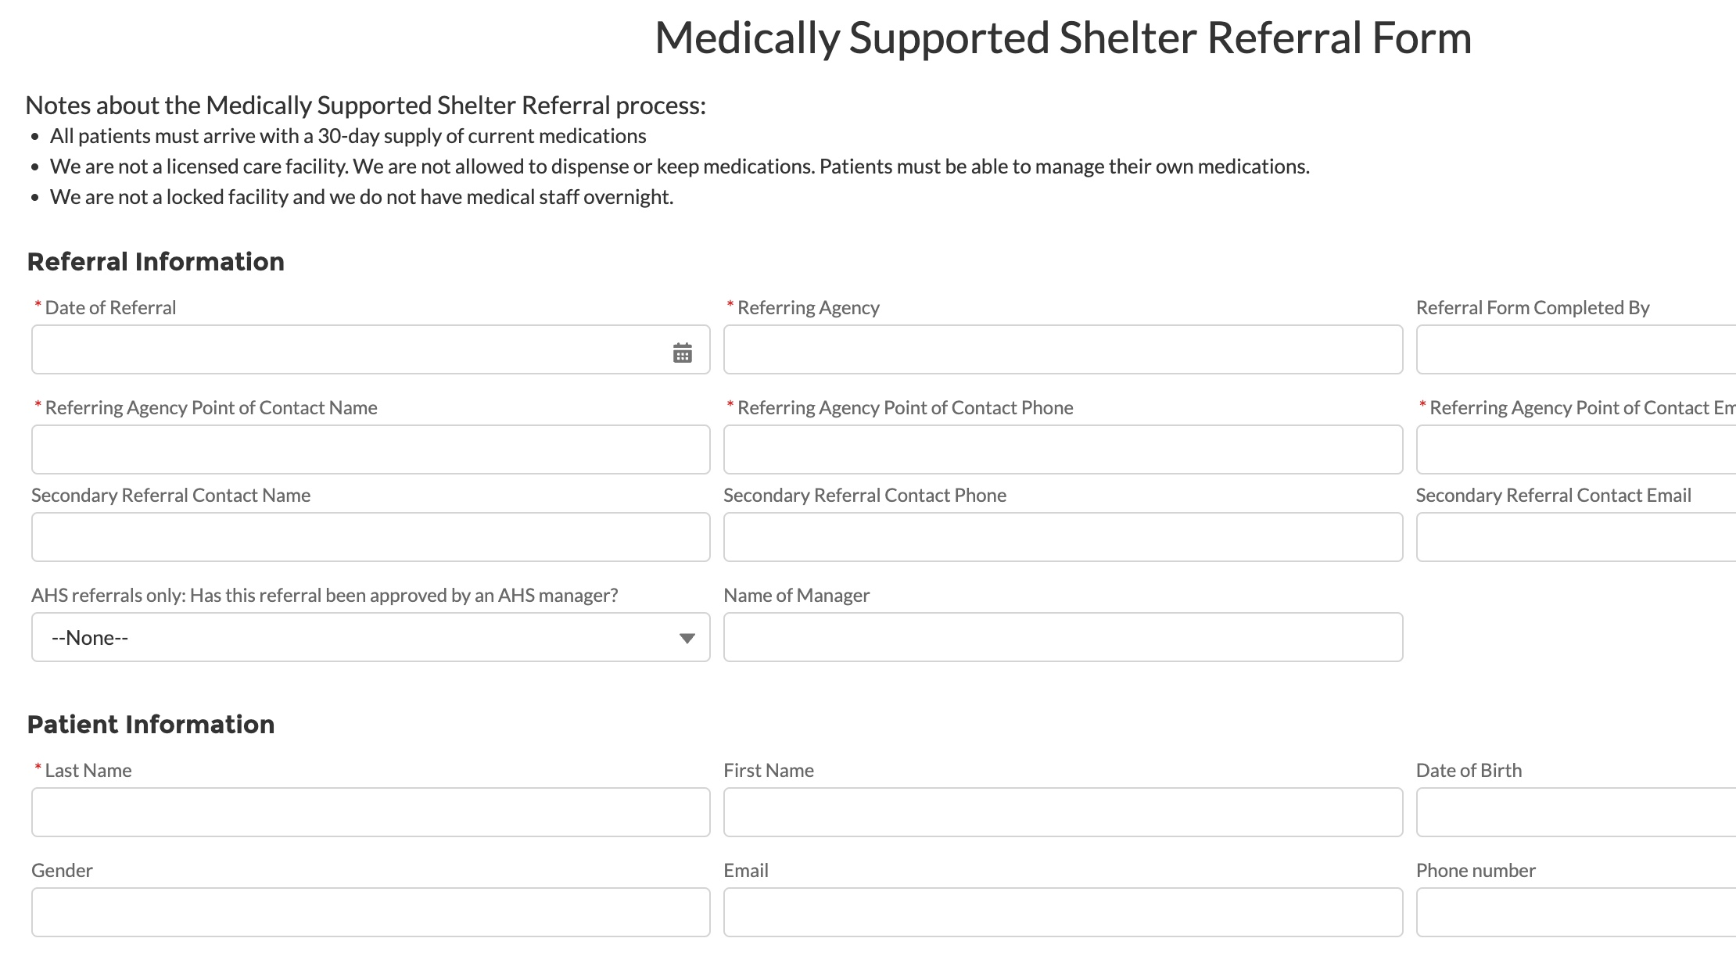

Slide 20
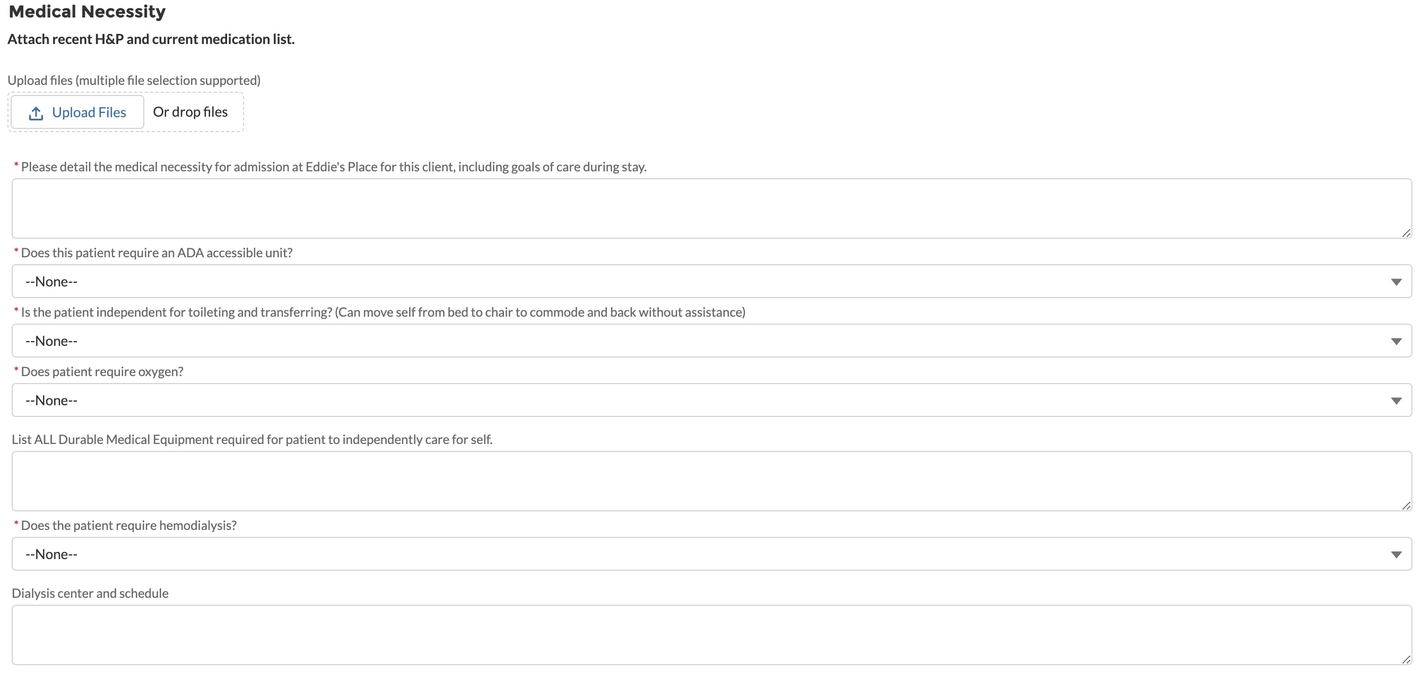
Notes:
Only basic information needed

Slide 21
“As low barrier as possible”: very high bar for exclusion
Exclusion criteria:
Recent suicide attempt
Dependent for toileting and transfer
Dementia with wandering behaviors
The following clients may be accepted at the discretion of Cardea’s medical directors:
Recent release from involuntary hold
BAL < 0.3

Slide 22
Eddie’s Place Inclusion criteria:
Exclusion from other programs often counts as inclusionary criteria for Eddie’s Place
Clients with high-risk active SUD
Clients with Severe Mental Illness
Individuals lacking active benefits
Those needing ADL or iADL support
Clients requiring isolation
Clients who cannot independently manage medications
Clients who are enrolled in hospice/palliative care or are at the end of life.

Slide 23
“As low barrier as possible”: accommodate high needs clients
2 RNs/LVNs/day
Caregiving support: unlicensed and licensed
Caregivers assist with ADLs as needed for each individual client
Perform other tasks such as accompany patients to appointments, housekeeping, pet care, laundry
Will do up to full/end of life care
Care coordinators: provide medical case management
All of this is meant to support clients with functional compromise who need assistance managing daily life.
Notes:
Caregiving is essential to keeping people who have experienced chronic homelessness and complex illness safely sheltered, yet the need for caregiving support often excludes individuals from shelter or respite care.

Slide 24
“As low barrier as possible”: harm reduction approach
Lived experience: Cardea Health prioritizes the employment of individuals with lived experience of homelessness, incarceration, and substance abuse
Client led care: shelter and services are never contingent on participation in medical interventions
Clients with pets and family members
Robust harm reduction program

Slide 25
“Include discharge planning”
Commitment to never involuntary discharge to an unsheltered setting
Discharge planning starts at admission
Simultaneous planning for program discharge and advancing permanent housing plan.
2 full time housing navigators

Slide 26
“Combine with in-house respite program”
Eddie’s Place is located in a 51 bed facility (leased hotel)
20 beds are dedicated to rapid post hospitalization shelter, 31 beds for medical respite care.
PHS clients may transfer to in-house medical respite bed for additional 90 days of stay
Notes:
Qualifications for Cardea Health Respite:

Slide 27
Discharge options (where can people go from post-hospitalization shelter?)
Congregate shelter: extremely limited bed space, often lottery based.
Specialty shelters:
Family shelters,
Behavioral health beds,
Veteran programs,
Shelter for Interpersonal Violence (IPV victims)
Transitional/Interim Housing: temporary housing with intensive housing navigation services.
Medical respite programs
Medically frail housing: Permanent Supportive Housing for individuals with complex chronic illness, functional compromise and high hospital utilization
Board and Care facilities, Residential Care Facilities for the Elderly
Skilled Nursing Facilities

Slide 28
Triaging post-hospitalization clients
Clients with low level needs and eligible for housing services
Connect with Housing Navigation services
Safe shelter
Clients with the need for light clinical support
Transfer to external respite program with lower clinical scope of care
Clients who have clinical and Activities of Daily Living support needs
Admit to Cardea Health Respite
Transitional housing program

Slide 29
Triaging post hospitalization clients
Clients with primary Substance Use Disorder/Behavioral Health needs
Residential treatment program
Cardea Health respite
Clients who will require comprehensive clincial and social support to live independently
Medically Frail Housing
Those incapable of living independently
Board and care
SNF
Behavioral Health residential program
Residential Treatment Facility for the Elderly

Slide 30
How do we measure success at Eddie’s Place?
Ability to accept admissions (are we really low barrier?)
How many of our clients become re-hospitalized?
Where do people go from Eddie’s Place?
Client satisfaction

Slide 31
Are we really low barrier?
654 referrals, 238 declined
Unable to accommodate ADA needs | 4%
Medical/psychiatric needs exceed program capacity | 14%
Client placed in alternative discharge setting | 37%
Referral closed after 72 hours | 26%
Incomplete referrals | 3%
No bed available | 5%
Other | 11%
Notes:
The majority of referrals declined/closed were because hospital patients ended up in a different discharge option (often SNF) or the referring discharge planner did not respond to outreach (likely because the patient had another discharge options)
Only a total of 18% clients were declined because we couldn’t accommodate needs
Limited ADA rooms and no elevator to the second floor. The new building has elevators and many more ADA rooms.
Medical/psychiatric needs exceeding capacity often included clients with the few exclusion criteria in other slides.
Other reasons we couldn’t accept clients: had minors, under police custody, required a 24 hour “watch”

Slide 32
Rehospitalizations
Rate of rehospitalizations (with no return to Eddie’s Place) for both post-hospitalization shelter and respite care is 14%. Factors to consider:
Accepting high complexity patients will lead to more hospitalizations
Unbenefited patients cannot follow up with primary/specialty care or get appropriate medications and risk rehospitalization
Eddie’s Places does not gatekeep access to the hospital

Slide 33
Eddie’s Place post-hospitalization bed exits
Post hospitalization exits
Shelter | 15%
Permanent Housing | 3%
Residential Recovery | 2%
Family members | 2%
Hotel/Motel | 1%
Street/Vehicle/Tent | 6%
Re-hospitalized | 14%
External Respite | 6%
Internal (Cardea) Respite | 19%
SNF/long term care facility | 1%
Death | 1%
Self Exit | 29%
Total of 25% post-hospitalization residents are channeled into respite programs
Notes:
External respite programs are often a pathway to transitional housing programs.

Slide 34
Eddie’s Place medical respite program exits
24% of clients admitted to medical respite at Eddie’s Place discharge to permanent housing placement.

Slide 35
Client experience
In May 2023 a researcher from Columbia University conducted a qualitative evaluation of Eddie’s Place
Cardea Health requested an evaluation to discover how their performance compared to resident expectations.
Interviewed 40 Eddie’s Place clients

Slide 36
Overall rating of Eddie’s Place
“Thirteen (13) respondents had heard of Eddie’s Place and said it had been recommended because it was safe and “they treated you good.” They were not disappointed. But almost half of those interviewed either had no expectations or low expectations based on bad experiences in other short term care facilities or bed and boards. They were pleasantly surprised by what they found at Eddie’s Place.”*
- MEETING EXPECTATIONS AT EDDIE’S PLACE Report on interviews and observations by Ann W. Martin, Ed.D. Columbia University
Overall rating of Eddie’s Place | # of responses
So-so | 5
All right | 15
High praise | 20

Slide 37
"Would you recommend Eddie’s Place for care?”
“As stories unfolded, they did not always leave space for me to ask whether the patient would recommend Eddie’s Place for respite, but of those I asked (28), all but two said “yes” with enthusiasm, including some who had expressed dissatisfaction with an aspect of Eddie’s. I probed for reasons”
- MEETING EXPECTATIONS AT EDDIE’S PLACE Report on interviews and observations by Ann W. Martin, Ed.D. Columbia University
REASON | # of respondents
Peaceful and safe | 7
Freedom/independence “They leave you alone.” | 4
Bathroom, shower, laundry | 4
Food | 4
Shelter | 3
“It’s not hard to follow the rules.” | 3
Staff | 2
Rides | 2
Feel accepted | 1

Slide 38
Client experience at Eddie’s Place
“A lot better than I expected. Been great. Nothing but the best.”
“A ok. Nice. I can walk outside...Have a roof over my head...They never leave anyone unsatisfied.”
“Everything here is very good. Help me very good. “
“Very lucky to stay here.”
“Grateful for this now. For me this place is very good.”
“Everybody should come here…Best thing that’s ever happened to me. Better than being homeless on the street.”
“Helping me get my diabetes under control. Lifesaver.”
Notes:
Our amazing staff make this possible

Slide 39
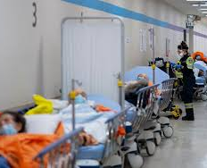
Challenges to rapid post-hospitalization shelter
Easier access than skilled nursing facility: leads to many referrals that require SNF level care
Challenges working with a very large health system
Complications with mixed model sites: different lengths of stay can cause confusion with clients
Notes:
Because it can be a lot easier to get clients into Eddie’s Place than into a SNF, case managers often discharge clients who would really benefit from SNF level care to post hospitalization shelter.
Working with a system as big and complicated as Alameda Health System brings challenges around passing information, trying to integrate into their systems,

Slide 40
Case study: RJ
Post Hospitalization Shelter (7 days from Emergency Department)
RJ: a 48 year old homeless male with schizo-affective disorder and insulin dependent diabetes presented to the Emergency Department every day for 6 months.
Often sat all day and night in the waiting room without checking in. Referred to Eddie’s Place during AHS JCAHO survey.
RJ was deeply paranoid, refused to take medications or participate in Behavioral Health services.
After his 7-day post hospitalization stay he was “transferred” to a Cardea Health medical respite bed.
RJ stayed for 3 months before taking any medication. Encouraged to take his meds using incentives (chocolate and notebooks)
Nurses and care coordinators worked with Alameda Health System complex care team to enroll RJ in an Intensive Case Management team
Once enrolled in ICM, he was eligible for housing in a residential Behavioral Health facility (board and care).
RJ remains housed at the new location.
Medical Respite care at Cardea Health: 2 ninety day stays authorized by managed care
Permanent Housing: Behavioral Health board and care

Slide 41
Case study: AJ
Post Hospitalization Shelter: 30 days from inpatient stay
50 year old Latino man with ulcerative colitis, bipolar disorder and Alcohol Use Disorder.
Admitted to post hospitalization shelter post inpatient stay at Alameda Health System
At Eddie’s Place, connected with Substance Use Disorder services at AHS and consistently participated in outpatient treatment
Was able to connect with all specialty referrals for ulcerative colitis, including new immunomodulator therapy
After stabilization, AJ was transferred to external respite program for lower acuity patients, with in house intensive housing navigation services.
AJ was housed in Alameda County and lives independently.
External low acuity respite with housing navigation services

Slide 42
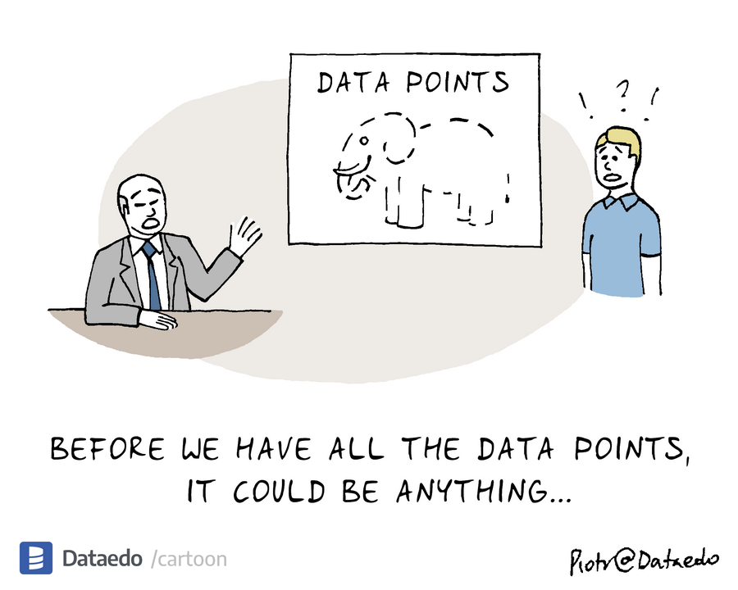
How to stand up rapid post hospitalization shelter
Form relationships with respite programs
Capacity for clinical and social services
Referral process
Current challenges
Gather data
# of unhoused hospital discharges in county vs. available resources
Discuss with local safety net hospital
Number of administrative bed days and cost
Burden of social needs Emergency Department visits

Slide 43
Tips for success
Rapid referral is key for safe hospital discharges
Communication and collaboration with other homeless services is crucial
Caregiving services are crucial to PEH with illness.

Slide 44
Who was Eddie?

Slide 45
Questions or comments?
Catherine.hayes@cardeahealth.org
Elizabeth.torkington@cardeahealth.org
www.cardeahealth.org

