Slide 1
Equity, Diversity, Inclusion, Belonging Strategies
Advancing Equity by Way of your Employee Lifecycle: Creating a Culture of Equity
Irwin Batara, Lakay Batara, LLC
Kevonya Elzia MA, BS, RN - Director of JEDI at NHCHC
HCH2024
PHOENIX, AZ • MAY 13-16, 2024
Notes:
Good morning, Sowbona {saow-bona} & Namaste My name is Kevonya. And this is Irwin. Thank you for joining us today. Today we will be exploring tangible ways we can cultivate & advance a culture of equity for staff and indirectly patients via infusing equity into the employee life cycle.

Slide 2
Advancing Equity by Way of your Employee Lifecycle: Creating a Culture of Equity
Irwin Batara
Lakay Batara, LLC
irwinbconsulting.com
Email : lakayb@outlook.com

Slide 3
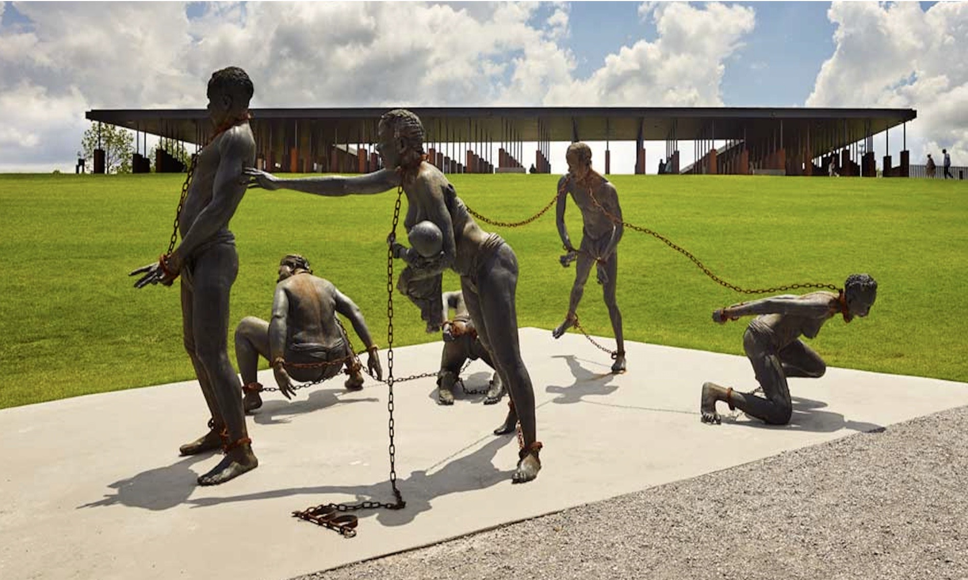
Land and Labor Acknowledgement
Go to native-land.ca to find out who are the original stewards of the lands you occupy
Notes:
“I honor & acknowledge the original stewards of this occupied land. We stand on the unceded ancestral lands of the Pascua Yaqui & Yavapai Apache, people past and present and honor with gratitude the land itself and the Pascua Yaqui & Yavapai Apache.” I honor & acknowledge the indigenous wisdom of my ancestors & other tribes of Indigenous people which has contributed to my work. My work is committed to uplifting & celebrating the wisdom held by indigenous communities here & aboard.
* We acknowledge the labor of Black & African-American people—ancestors and their descendants. I recognize that the United States’ and global economies historically and currently rest on the ingenuity, cultural treasures and stolen labor of African-Americans and Black people throughout the diaspora.
We honor the brilliance and humanity of all immigrant labor, including voluntary, involuntary, trafficked, forced, and undocumented peoples who contributed to the building of this country and continue to serve within our labor force and express my heartfelt gratitude for their infinite contributions. By recognizing the land that was taken from the First nations of Indigenous People and the forced labor that was provided by enslaved Africans and black & brown people, I strive to take steps towards creating a more equitable and just world for all of us.*
I want to acknowledge the reason why we are having this conversation today is a result of the legacy of theft, genocide, & slavery that started with the colonization of this land. The Indigenous People of Turtle Island aka colonized America teach that soul wounds are the cumulative historical trauma that has been passed down through generations. America’s Soul wounds encompass the historical & current injustices that skew our perceptions of ourselves & those with whom we share this land and show up in every organization & patient room across America. Every story of being judged, dismissed or blamed for one’s social & medical condition stems from these wounds. And although we are clearly not the creator of these wounds, we do own them through inheritance. Thank you dear ancestors lol.

Slide 4
Introduction
Welcome everyone to our in-depth session on advancing equity throughout the employee lifecycle.
Over our time today, we'll delve into strategies for cultivating a culture of equity that permeates every stage of the employee journey.
Let's embark on this journey together!
Notes:
Irwin introduce himself first.
My name is Kevonya Elzia, I’m currently the Director of Justice, Equity, Diversity, Inclusion at the NHCHC but my background is 20 years as a RN & 23 years in healthcare in general. I have work in various specialties from Peds ICU to home-based dialysis to gyn-onc to community health & street outreach. I approach this work as a nurse that has had to fight for my patients to be heard and their needs honored. The daughter of a person with a complex medical history and absolutely NO trust in the medical system as a result of her experiences. The wife of a veteran who trust NO vaccines, A patient who’s been in a medical visit where someone was knocking on the door to tell my doctor to hurry up. And as a staff member who has had to fight organizational bureaucracy, hierarchy & ego to get my patient & fellow staff members needs met. I do this work to heal wounds generations of old & generations yet to come. I do this work to honor the stories of survival, resilience and heartache that have been shared w/ me through the years. I do this work as a legacy to my mother & a gift to my niece. I intentionally introduce myself this way for two reason 1) to show that this is not just my work, it is my lived experience & the lived experience of my patients & those I hold dear. Secondly, my journey as it represents one of the millions that exists in our world that has to navigate & mitigate the barriers we’re fighting against through EDIB work & is part of my why for doing this work.

Slide 5
SCAN ME FOR
HANDOUTS

Slide 6
Notes:
This is an tool we want to offer for use as you identify challenges within your organization that you would benefit from being addressed from an equity, diversity, inclusion and belonging approach.
This tool is included in the handout that have been provided via the QR code on your table. This is an example of how the template can be adapted to fit your proposed project needs. By the end of our time together today you will be able to answer the questions associated with the first 3 steps of the chart. Identify your challenge statement, intended audience, & factors to consider.
Present at beginning of the PCI
Explain how to use the change map to develop an intervention plan based on what is learned during the session today.

Slide 7
Understanding Equity
Define equity and its importance in fostering a fair and inclusive workplace.
Discuss the intersectionality of equity and how it intersects with diversity, inclusion, and belonging.
Notes:
From an anti-racist lens, equity refers to the fair distribution of resources, opportunities, and outcomes to address historical and systemic injustices and to ensure that all individuals and communities have the support they need to thrive. Unlike equality, which aims to treat everyone the same regardless of their circumstances, equity recognizes that different groups may require different levels of support and intervention to achieve equitable outcomes.
Key components of equity from an anti-racist perspective include:
Acknowledgment of Historical Injustices: Equity acknowledges the historical and ongoing impact of racism, discrimination, and colonialism on marginalized communities. It recognizes that systemic barriers have disproportionately affected certain racial and ethnic groups, resulting in disparities in areas such as education, employment, healthcare, housing, and criminal justice.
Focus on Structural Change: Equity efforts prioritize structural change to address root causes of inequity and dismantle systems of oppression. This may involve advocating for policy reforms, challenging discriminatory practices and policies, and promoting institutional accountability and transparency.
Centering Marginalized Voices: Equity centers the voices, experiences, and perspectives of marginalized communities in decision-making processes and resource allocation. It prioritizes the leadership and agency of those directly impacted by racism and discrimination and involves them in the design, implementation, and evaluation of equity initiatives.
Intersectional Approach: Equity recognizes that individuals hold multiple intersecting identities and experiences of privilege and oppression. It takes an intersectional approach to address the unique challenges faced by individuals at the intersections of race, gender, class, sexuality, ability, and other social categories.
Redistribution of Resources: Equity involves the redistribution of resources, opportunities, and power to promote greater fairness and inclusivity. This may include targeted investments in underserved communities, affirmative action policies to address historical disparities, and initiatives to address systemic barriers to access and participation.
Accountability and Transparency: Equity efforts prioritize accountability and transparency in decision-making processes, resource allocation, and outcomes. They involve mechanisms for monitoring progress, evaluating impact, and addressing disparities to ensure that equity goals are met and sustained over time.
Overall, equity from an anti-racist lens seeks to challenge and transform systems of oppression, promote fairness and justice, and create conditions where all individuals and communities can thrive free from discrimination and structural barriers. It requires ongoing commitment, collaboration, and action at individual, institutional, and societal levels to achieve meaningful and sustainable change.

Slide 8
What Do We Want The Impact of Equity To Be
Equity is the absence of unfair, avoidable or remediable differences among groups of people, whether those groups are defined socially, economically, demographically, or geographically or by other dimensions of inequality (e.g. sex, gender, ethnicity, disability, or sexual orientation). Health is a fundamental human right. Health equity is achieved when everyone can attain their full potential for health and well-being. (World Health Organization)
Notes:
Figure out what equity means for your organization. It is common to see orgs approach this work as a plug and play situation. When really for it to be meaningful and have the impact that we are stating that we want we need to identify and adapt what a definition of equity that serves the goals we state we are committed to achieving.
These are my two favorite definitions of equity because they clearly name how health equity isn’t an us vs them game nor can it be achieve via a single task. We are all at risk for experiencing health inequities. And the more categories you find yourself fitting into the greater the risk.

Slide 9
Downstream vs. Upstream
Notes:
https://youtu.be/qarQXqKbmLg?si=YVgUWjzRhJlMP546

Slide 10
Downstream vs. Upstream
Notes:
https://youtu.be/qarQXqKbmLg?si=YVgUWjzRhJlMP546

Slide 11
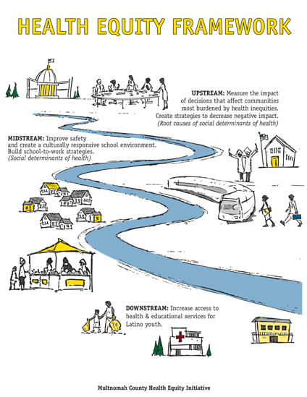
Upstream vs. Downstream
Notes:
In anti-racism work, the terms "upstream" and "downstream" refer to different approaches to addressing systemic racism and its effects:
1. Upstream Approach:
The upstream approach focuses on addressing root causes and systemic issues that contribute to racism and inequality. It involves examining and challenging policies, structures, and institutions that perpetuate racism and discrimination. This approach seeks to enact systemic change by advocating for policies and practices that promote equity and justice for marginalized communities. Examples of upstream interventions include advocating for legislative reforms, promoting diversity and inclusion initiatives in organizations, and challenging discriminatory practices in institutions such as education, healthcare, and criminal justice systems.
2. Downstream Approach:
The downstream approach focuses on addressing the immediate and visible effects of racism and inequality, such as individual acts of discrimination, disparities in outcomes, and the impact of historical injustices on marginalized communities. This approach often involves providing direct support and services to individuals and communities affected by racism, including resources for education, healthcare, housing, and employment. Downstream interventions may include community organizing, providing social services, offering cultural competency training, and promoting awareness and education about racism and its impacts.
In summary, the upstream approach aims to dismantle systemic barriers and address root causes of racism, while the downstream approach focuses on providing immediate support and addressing the visible effects of racism on individuals and communities. Both approaches are important and complementary in anti-racism work, and effective strategies often involve a combination of upstream and downstream interventions to achieve meaningful and lasting change.

Slide 12
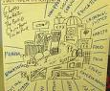
Power Analysis
Bing Videos
https://www.youtube.com/watch?v=db-iFczqgB8
ttps://www.youtube.com/watch?v=Z6NjHOSoh1s&feature=youtu.be&list=UUlo2HJKa2yW7KfzA3ZqHrYg
Tim Wise 3:48-6

Slide 13
Power Analysis Video 1
Notes:
In the context of undoing institutional racism, a power analysis involves examining the distribution of power and privilege within systems and institutions to understand how they contribute to racial disparities and inequities. Here are key components of a power analysis:
1. **Identifying Power Structures:**
- Identify the key actors, institutions, and systems that hold power and influence within society. This includes government agencies, corporations, educational institutions, media outlets, and other entities that shape policies, practices, and norms.
2. **Examining Power Dynamics:**
- Analyze the distribution of power and privilege across different racial groups and within various sectors of society. Examine how historical legacies, institutional practices, and cultural narratives reinforce power differentials and perpetuate racial hierarchies.
3. **Understanding Intersectionality:**
- Recognize that power operates intersectionally, meaning that individuals may experience different forms of privilege and oppression based on their intersecting identities, such as race, gender, class, sexuality, and ability. Consider how multiple systems of oppression intersect and reinforce each other to create unique experiences of marginalization and privilege.
4. **Assessing Structural Barriers:**
- Identify the structural barriers and institutional policies that perpetuate racial inequities and limit access to resources, opportunities, and decision-making processes for marginalized communities. This may include discriminatory laws and practices, unequal access to education and healthcare, and disparities in wealth and employment.
5. **Examining Cultural Hegemony:**
- Examine the dominant cultural narratives, ideologies, and norms that reinforce racial hierarchies and justify existing power structures. Consider how stereotypes, biases, and representations in media, education, and popular culture shape perceptions of race and influence attitudes and behaviors.
6. **Identifying Points of Intervention:**
- Identify strategic points of intervention where efforts to challenge and transform power dynamics can be most effective. This may involve advocacy for policy changes, community organizing, coalition-building, grassroots activism, and efforts to shift cultural narratives and public discourse around race.
7. **Centering Voices of Marginalized Communities:**
- Center the voices, experiences, and perspectives of marginalized communities in the power analysis process. Listen to and learn from those directly impacted by institutional racism, and prioritize their leadership and agency in efforts to dismantle oppressive systems and build more equitable alternatives.
Overall, a power analysis is a critical tool for understanding the structural foundations of institutional racism and identifying strategies for challenging and transforming power dynamics to achieve racial justice and equity.

Slide 14
Power Analysis Video 2

Slide 15
Power Analysis Video 3

Slide 16
Laying the Foundation
Mission
Vision
Values
Goals
Strategies
Strategies
Strategies

Slide 17
What Type Of Organization Do We Aspire To Be…
Shared Values
Culture
How do we normalize talking about these issues
How do we institutionalize the language and processes
Everyone has to start with the same language
Are all lenses/viewpoints allowed
Who you are and how you show up
What are you going to do about it?
Notes:
Analyzing Power
As a society, we often believe that individuals and/or their communities are solely responsible for their conditions. Through the analysis of institutional power, we can identify and unpack the systems external to the community that create the internal realities many people experience daily.
Developing Leadership
Anti-racist leadership needs to be developed intentionally and systematically within local communities and organizations.
Gatekeeping
Persons who work in institutions often function as gatekeepers to ensure that the institution perpetuates itself. The gatekeeper becomes an agent of institutional transformation by operating with anti-racist values and networking with those who share those values and maintain accountability in the community.
Identifying and Analyzing Manifestations of Racism
Acts of racism are supported by institutions and are nurtured by societal practices that reinforce and perpetuate racism.
Learning from History
History is a tool for effective organizing. Understanding the lessons of history allows us to create a more humane future.
Maintaining Accountability
Organizing with integrity requires that we be accountable to the communities struggling with racist oppression.
Networking
We recognize that the growth of a movement for social transformation requires networking – “building a net that works.” Networking means building principled relationships based on humane values.
Sharing Culture
Culture is the life support system of a community. If a community’s culture is respected and nurtured, the community’s power will grow.
Undoing Internalized Racial Oppression
Internalized Racial Oppression manifests itself in two forms:
Internalized Racial Inferiority The acceptance of and acting out of an inferior definition of self given by the oppressor is rooted in the historical designation of one’s race. Over many generations, this process of disempowerment and disenfranchisement expresses itself in self-defeating behavior.
Internalized Racial Superiority The acceptance of and acting out of a superior definition is rooted in the historical designation of one’s race. Over many generations, this process of empowerment and access expresses itself as unearned privileges, access to institutional power, and invisible advantages based upon race.
Undoing Racism®
Racism is the single most critical barrier to building effective coalitions for social change. Racism has been consciously and systematically erected, and it can be undone only if people understand what it is, where it comes from, how it functions, and why it is perpetuate

Slide 18
It starts with community
How do you build this community
Free your mind
Listen for Understanding
Intent vs. Impact
Are we being authentic
Recognize and examine biased systems and processes
It’s okay to be uncomfortable.

Slide 19
Aligning your organizational values to Equity Diversity and Inclusion
2 WAY ACCOUNT-ABILITY
LEADERSHIP DEVELOPMENT
COMMITMENT TO ANTI RACISM AND ANTI OPPRESSION WORK
Notes:
How are your organizational pillars/values lighting up with DEI principles

Slide 20
COMMITMENT TO Equity Diversity Inclusion and Belonging / EDIB GOALS
Commitment to Changing the Culture of the organization
Leadership buy in
Include commitment by every employee/board to work Equity Diversity and Inclusion/DEI project
Using Racial Equity Tool Kit to develop policies
Make it normal to talk about Anti Racism/Anti Oppression work
Creating Caucuses to work on Internalized Superiority/Inferiority Oppression
Train the staff on anti racism
UIR Training
Trauma Informed Care Training
Neurodivergent Training
Connect/Partner with other like- minded agencies to do the work
Partner with organizations / National Leaders on Anti Racism/Oppression

Slide 21
The Employee Lifecycle Framework
Explore the employee lifecycle model, detailing each stage from recruitment to offboarding.
Highlight how equity considerations can be integrated into each phase to create a more equitable workplace.

Slide 22
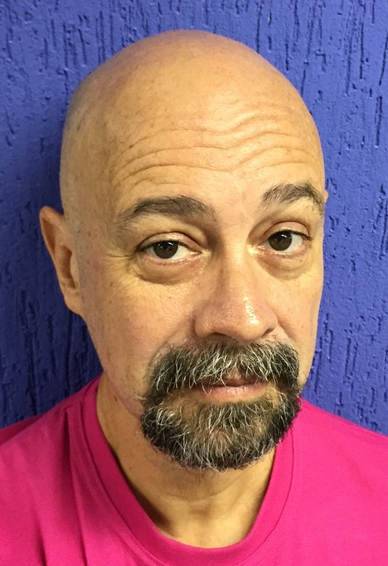
Staff Persona: Meet Brian
Brian is a 39 year old trans gendered white male living in supportive housing after being incarcerated in federal prison for 6 yrs for a possession charge due to having marijuana. Marijuana is now legal in your state. He is looking to apply as a peer support specialist at your CHC.
This Photo by Unknown Author found via Google Search
Notes:
As we are discussing concepts we want you to keep Doris in mind.
Consider how what we are discussing would impact her.
I choose Doris because she could easily be a staff member or a patient.

Slide 23
Staff Persona: Meet Tucker
Tucker is a 49 yo Black male, married with a 2 year old daughter from current marriage, grown children from a previous marriage. Works as a medical assistant at a HCH. And serves as Board Chair for the FQHC where he is a patient (different from where he works).
Tucker was for the most part healthy without significant medical concerns. Then one day was in the shower when he had a sharp pain in his back, fell down, and could not get up. Went to the ER where he was told that he had just strained his back and was going to be discharged. Because of persistence from family members, was able to convince the hospital to admit him, and an orthopedist saw him and determined that he had a severe disc herniation with spinal cord compression and needed immediate surgery. Pt had multiple lumbar surgeries and was hospitalized for nearly 6 months. Lost significant strength in his lower body, so had to start rebuilding this through PT/OT.
His FMLA is coming to an end, and he is hoping he can come back to work with accommodations as he continues to build up his endurance.
This Photo by Unknown Author is licensed under CC BY-NC
Notes:
As we are discussing concepts we want you to keep Doris in mind.
Consider how what we are discussing would impact her.
I choose Doris because she could easily be a staff member or a patient.

Slide 24
Staff Persona: Meet Doris
Doris is a single 57-year-old Puerto Rican cis-gendered woman who is the mother of two & grandmother of 4 & helps her daughter financially with the kids. She is also the eldest daughter of her 80-year-old mother who lives alone in the mid-west home where she was raised.
She has fibromyalgia, Degenerative joint disease of the neck & spine plus moderate arthritis in her right hip & bilateral knees that frequently flairs up if she works more than 10-hour days as a lab tech, especially in the winter due to the cold. She generally tries to listen to her body & use integrative health practices to support her well-being.
Doris struggles with her baseline pain which prevents her from resting well at night. She is unable to obtain adequate support from her primary care provider. Her untreated chronic pain problem has resulted in her falling to sleep while at work due to not being able get a good night's sleep & now she might lose her job.
This Photo by Unknown Author found via Google Search
Notes:
As we are discussing concepts we want you to keep Doris in mind.
Consider how what we are discussing would impact her.
I choose Doris because she could easily be a staff member or a patient.

Slide 25
Notes:
As we go over strategies This is the cycle that we are faced with and as your in the session looking to dismantle.
As we go over various scenarios, I want you to identify what level of the cycle is at play & what is the best EDIB approach to dismantle it.

Slide 26
Understanding the Shift
The traditional HR mindset focuses on compliance and administrative tasks.
Transitioning to a People & Equity mindset involves prioritizing equity, inclusion, and diversity.
It requires a shift in perspective from managing resources to valuing and investing in people.

Slide 27
Employees In The Past
Worked fixed hours like 9-5
Work was mainly done in the office
Hierarchical Decision Making
Long Term employment mindset/ one specific skill or field
Less emphasis on flexibility of work
Simple technology for simple task and communications
In your lane( focused on individual task/goals)
Job descriptions that never changed
Collaboration was set on main teams/department

Slide 28
Employees Today (1 of 2)
Results based (for work times) not 9-5
No home base( work from anywhere)
More Team input in decisions
More Changing jobs for diverse experience
Learning and applying range of skills
Integrating personal life at work
Using AI and new technologies for better efficiencies
Emphasis on contributing to team success
Changing roles to meet new challenges
Working with diverse teams
Notes:
1.Results-based Work Times:
·Ensure that flexible work schedules accommodate the diverse needs and responsibilities of employees, including those from marginalized communities who may face additional barriers to traditional work hours.
·Implement policies that prioritize productivity and outcomes over strict adherence to traditional work hours, recognizing that different individuals may have different peak productivity times.
2.No Home Base (Work from Anywhere):
·Ensure that remote work opportunities are accessible to all employees, regardless of their location or personal circumstances.
·Provide resources and support for remote workers to overcome potential barriers, such as access to technology, internet connectivity, and suitable workspace environments.
3.More Team Input in Decisions:
·Promote inclusive decision-making processes that actively solicit input and perspectives from all team members, ensuring that diverse voices are heard and valued.
·Implement strategies to mitigate power imbalances within teams, such as rotating leadership roles and providing training on inclusive leadership practices.
4.More Changing Jobs for Diverse Experience:
·Encourage and support career mobility and job rotation opportunities for all employees, including those from underrepresented backgrounds, to gain diverse experiences and skills.
·Implement transparent and equitable processes for internal job postings and promotions, ensuring that opportunities for advancement are accessible to all employees.
5.Learning and Applying a Range of Skills:
·Provide equitable access to training and development opportunities for all employees, including those from marginalized communities, to acquire and apply a diverse range of skills.
·Implement strategies to address systemic barriers to skill development, such as mentorship programs, skills training subsidies, and career development pathways.
6.Integrating Personal Life at Work:
·Foster a culture that recognizes and respects the diverse personal identities and experiences of employees, including their cultural, familial, and community affiliations.
·Implement policies and practices that support work-life balance, such as flexible scheduling, parental leave, and remote work options, to accommodate the diverse needs of employees.
7.Using AI and New Technologies for Better Efficiencies:
·Ensure that the development and implementation of AI and new technologies prioritize equity, fairness, and accountability, with mechanisms in place to mitigate biases and discriminatory outcomes.
·Promote diversity and inclusion in the technology sector by actively recruiting and supporting individuals from underrepresented groups in AI and technology roles.
8.Emphasis on Contributing to Team Success:
·Foster a collaborative and supportive work environment where individual contributions are recognized and valued within the context of team success.
·Implement performance evaluation processes that assess both individual contributions and collaborative efforts, ensuring that recognition and rewards are distributed equitably.
9.Changing Roles to Meet New Challenges:
·Proactively identify and address systemic barriers that may prevent employees, particularly those from marginalized communities, from transitioning into new roles or career paths.
·Provide support and resources for skill development, career planning, and mentorship to facilitate smooth transitions between roles and career trajectories
.
10.Working with Diverse Teams:
·Promote inclusive team dynamics and communication practices that celebrate diversity and foster a sense of belonging for all team members.
·Provide training and resources for effective cross-cultural communication, conflict resolution, and allyship to support collaboration within diverse teams.
By aligning each statement with an anti-racist lens, we can ensure that our organizational practices and policies promote equity, inclusion, and justice for all employees, contributing to a more just and equitable workplace culture.

Slide 29
Employees Today (2 of 2)
We need to ensure that the practices and policies support equity, inclusivity, and justice for all individuals, particularly those from marginalized and underrepresented groups. Here's how we can align each statement with an anti-racist perspective:
Results-based Work Times
No Home Base (Work from Anywhere):
More Team Input in Decisions:
Notes:
Results-based Work Times:
Ensure that flexible work schedules accommodate the diverse needs and responsibilities of employees, including those from marginalized communities who may face additional barriers to traditional work hours.
Implement policies that prioritize productivity and outcomes over strict adherence to traditional work hours, recognizing that different individuals may have different peak productivity times.
No Home Base (Work from Anywhere):
Ensure that remote work opportunities are accessible to all employees, regardless of their location or personal circumstances.
Provide resources and support for remote workers to overcome potential barriers, such as access to technology, internet connectivity, and suitable workspace environments.
More Team Input in Decisions:
Promote inclusive decision-making processes that actively solicit input and perspectives from all team members, ensuring that diverse voices are heard and valued.
Implement strategies to mitigate power imbalances within teams, such as rotating leadership roles and providing training on inclusive leadership practices.

Slide 30
Employee Lifecycle
Recruitment: a good job description will bring mission-driven applicants; don't let job requirements exclude good candidates​
Selection: understand what qualities matter most; ask the right questions​
Hiring: follow HR practices for equitable decision-making ​
Onboarding: create a plan and work with your team to make new staff feel welcome​
Performance Evaluation: create a plan for success- Are you lifting up and giving opportunities for POCs.
Rewards and Recognition: Relationship Building via stretch assignments
Retention: something managers can always work on; build your communication skills and find creative ways for staff to develop and grow​
Notes:
Recruitment and Hiring:
Implement equitable recruitment and hiring practices by using diverse sourcing channels, removing biased language from job descriptions, and ensuring diverse hiring panels.
Conduct blind resume reviews to minimize unconscious bias and focus solely on qualifications and experience.
Offer targeted outreach and support to underrepresented groups to ensure a diverse pool of candidates.
Onboarding and Orientation:
Provide comprehensive and equitable onboarding programs that introduce new hires to the organization's culture, values, and expectations.
Offer cultural competency training to all employees to foster understanding and respect for diverse perspectives and backgrounds.
Assign mentors or buddy systems to support new hires, especially those from underrepresented groups.
Performance Management:
Establish clear and transparent performance evaluation criteria that focus on job-related competencies and outcomes.
Provide ongoing feedback and coaching to all employees to support their professional development and growth.
Offer training on bias mitigation and equitable performance assessment for managers and supervisors.
Compensation and Benefits:
Conduct regular pay equity analyses to identify and address any disparities based on gender, race, ethnicity, or other protected characteristics.
Provide equitable access to benefits and perks, such as healthcare, parental leave, flexible work arrangements, and professional development opportunities.
Offer financial wellness programs and resources to support employees in building long-term financial stability.
Career Development and Advancement:
Implement structured career development programs that provide equitable access to training, mentorship, and advancement opportunities for all employees.
Establish clear pathways for career progression and promotion based on merit and performance rather than nepotism or favoritism.
Create inclusive leadership development programs that identify and nurture talent from underrepresented groups.
Workplace Culture and Climate:
Foster an inclusive and supportive workplace culture where all employees feel valued, respected, and empowered to contribute their ideas and perspectives.
Promote diversity, equity, and inclusion through employee resource groups, affinity networks, and cultural celebrations.
Implement zero-tolerance policies for discrimination, harassment, and retaliation and provide mechanisms for reporting and addressing incidents promptly and effectively.
Offboarding and Exit Interviews:
Conduct exit interviews to gather feedback from departing employees on their experiences within the organization, including any concerns related to equity or inclusion.
Use exit interview data to identify trends, address systemic issues, and make improvements to policies and practices to enhance equity throughout the employee lifecycle.
By infusing equity into every aspect of the employee lifecycle, organizations can create a more inclusive and equitable workplace where all employees have the opportunity to thrive and succeed.
Top of Form

Slide 31
Slide Title
Budget Process
Recruitment
Selection Process
Benefits
OFFER AND HIRE
Compensation Analysis
Onboarding
Performance Management
Surveys /Engagement
Rewards /Recognition
Retention/
Career Choice Separation
Separation
Advancement
Training and Development

Slide 32
A Trip to the Grocery Store
Notes:
This is a video on bias & unequitable application of an org policy
How was bias at play here despite the clerk just doing her job?
https://youtu.be/Wf9QBnPK6Yg?si=A5iafqn4MzczMLOZ
Video length 3:50

Slide 33
Recruitment
Exercise
Exercise: Unconscious Bias Simulation
Engage participants in immersive scenarios that simulate real-world biases in recruitment.
Facilitate discussions on recognizing and mitigating unconscious biases in the hiring process.
Discuss
Discuss best practices for promoting diversity in recruitment strategies and fostering inclusive hiring practices.

Slide 34
Unconscious Bias (1 of 3)
Affinity Bias:
Example: A hiring manager feels an instant connection with a candidate because they attended the same university. As a result, they overlook other candidates who may be more qualified but don't share the same alma mater.
Confirmation Bias:
Example: A recruiter believes that candidates from a certain demographic are less competent based on stereotypes. They subconsciously seek out information that confirms this belief and overlook evidence that contradicts it.
Halo Effect:
Example: A candidate has an impressive resume with prestigious work experience. The recruiter automatically assumes that they possess all desirable qualities, such as intelligence and competence, without thoroughly evaluating their skills and fit for the role.
Name Bias:
Example: A candidate with a name that sounds foreign or non-traditional may be overlooked for interview selection compared to candidates with more common names, even if they have identical qualifications and experiences.

Slide 35
Unconscious Bias- Continued (2 of 3)
Similarity Bias:
Example: A hiring team tends to prefer candidates who share similar backgrounds, interests, or personality traits with them. They may unconsciously favor candidates who mirror their own demographics, leading to a lack of diversity in the hiring process.
Beauty Bias:
Example: A recruiter may subconsciously perceive physically attractive candidates as more competent or suitable for the role, leading them to prioritize their applications over others who may be equally or more qualified.
Stereotyping Bias:
Example: A recruiter holds preconceived notions about certain groups based on stereotypes, such as assuming that older workers are less adaptable to change or that women are less assertive in leadership roles. These biases can influence their evaluation of candidates from these groups.

Slide 36
Unconscious Bias- Continued (3 of 3)
Maternal Bias:
Example: A female candidate of childbearing age is assumed to have family responsibilities that may interfere with her job commitment. The recruiter may unconsciously discriminate against her, fearing potential maternity leave or work-life balance issues.
Attribution Bias:
These examples illustrate how biases can manifest in various aspects of the recruitment process, leading to unfair treatment and missed opportunities for qualified candidates. Recognizing and addressing these biases is essential for promoting diversity, equity, and inclusion in recruitment practices.
Example: A candidate from an underrepresented group receives less credit for their accomplishments compared to candidates from privileged backgrounds. Their successes may be attributed to luck or external factors rather than their own skills and efforts.

Slide 37
Danger Of A Single Story
Notes:
Video only play first 9:30 minutes
What are some of the single stories that get activated when you come into work with your coworkers/leadership?
How can the pitfalls of the single story show up during the recruitment or onboarding process?
How many of us default into a single story of:
what health & well-being is?
what a good patient is?
what leadership looks like?

Slide 38
Onboarding
Exercise: Identity Mapping
1
Encourage employees to reflect on their identities and experiences that shape their worldview.
Facilitate small group discussions to promote empathy and understanding among team members.
Share strategies for designing onboarding programs that welcome employees of all backgrounds and ensure a sense of belonging from day one.
2

Slide 39
Onboarding Discussions (1 of 3)
Objective: The objective of this exercise is to promote empathy and understanding among team members by encouraging them to see situations from different perspectives.
Instructions:
Divide the team into pairs or small groups, ensuring diversity in each group.
Provide each group with a scenario or situation that may arise in the workplace. These scenarios should be relatable and relevant to the team's experiences.
Instruct each group to discuss the scenario from the perspective of different stakeholders involved. Encourage them to consider how each person might feel, think, or react based on their unique circumstances, backgrounds, and roles.
After discussing the scenario, ask each group to share their insights and observations with the larger team.
Facilitate a group discussion to reflect on the exercise. Encourage team members to share their thoughts, challenges, and learnings from considering different perspectives.
Summarize key takeaways and encourage team members to apply empathy and understanding in their daily interactions and decision-making processes.

Slide 40
Onboarding Discussion Continued (2 of 3)
Example Scenarios:
Scenario: A team member consistently arrives late to team meetings, causing frustration among their colleagues. Perspectives:
The late team member: They may have personal or family obligations that make it difficult for them to arrive on time. They may feel stressed or overwhelmed by their responsibilities.
Colleagues: They may feel disrespected or inconvenienced by the late arrival, especially if it disrupts the flow of the meeting or delays important discussions.
Team leader: They may feel responsible for addressing the issue and maintaining team productivity. They may also feel torn between supporting the late team member and holding them accountable for their actions.
Scenario: A project deadline is approaching, and team members have differing opinions on the best approach to meet it. Perspectives:
Proponents of one approach: They may believe strongly in their proposed solution and feel confident that it will lead to success. They may be eager to implement their ideas and may feel frustrated by resistance from others.
Proponents of another approach: They may have valid concerns about the proposed solution and may advocate for an alternative approach that they believe will yield better results. They may feel unheard or dismissed by those advocating for a different approach.
Neutral team members: They may feel caught in the middle of the debate and may struggle to navigate conflicting viewpoints. They may prioritize consensus-building and collaboration to ensure that all perspectives are considered.

Slide 41
Onboarding Discussion Continued (3 of 3)
Scenario: A new team member joins the department, and existing team members have mixed reactions to their presence. Perspectives:
New team member: They may feel excited and eager to make a positive impression on their new colleagues. They may also feel anxious or uncertain about fitting in and proving themselves in a new environment.
Existing team members: They may feel curious about the new team member's background and skills. Some may welcome the new addition and offer support, while others may feel threatened by the newcomer's potential impact on team dynamics or workload distribution.
Team leader: They may feel responsible for integrating the new team member into the group and ensuring a smooth transition. They may also be mindful of potential challenges, such as cliques or resistance to change, and may take proactive steps to address them.
Reflection Questions:
How did considering different perspectives change your understanding of the situation?
What challenges did you encounter in empathizing with others' perspectives?
How can we use empathy to improve communication and collaboration within our team?
This exercise helps team members develop empathy by encouraging them to consider different viewpoints and understand the complexities of interpersonal dynamics in the workplace.

Slide 42
Development
Exercise: Equity in Action
Lead participants through case studies or simulations that illustrate equity challenges in career development.
Guide discussions on addressing systemic barriers and promoting equitable access to opportunities.
Discuss the role of mentorship, sponsorship, and career advancement programs in fostering equity and inclusion.

Slide 43
Equity Simulations (1 of 3)
Three examples of case studies or simulations that illustrate equity challenges in career development:
Case Study: Promotion Disparity Scenario: In a company with a diverse workforce, two employees, John and Sarah, have been working in similar roles for the same duration and have consistently received positive performance reviews. When a promotion opportunity arises, John, who is male and from a majority ethnic group, is promoted to a higher position. Sarah, who is female and from an underrepresented ethnic group, is overlooked for the promotion despite having comparable qualifications and performance.
Discussion Points:
Identify potential biases or barriers that may have influenced the promotion decision.
Discuss the impact of systemic inequities on career advancement opportunities for underrepresented groups.
Explore strategies for promoting fairness and transparency in promotion processes to address disparities and foster inclusivity.
Simulation: Career Development Workshop Scenario: During a career development workshop, participants are divided into groups and given different scenarios representing employees at various stages of their careers. Each scenario presents challenges related to gender, race, age, or other diversity dimensions, such as unequal access to training opportunities, biased performance evaluations, or limited mentorship support. Participants are tasked with brainstorming solutions to address these challenges and promote equity in career development.

Slide 44
Equity Simulations Continued (2 of 3)
Discussion Points:
Analyze the barriers and biases depicted in each scenario and their implications for career advancement.
Discuss the importance of inclusive career development practices, such as mentoring, sponsorship, and skill-building opportunities.
Identify strategies for creating a supportive and equitable work environment where all employees have equal access to resources and opportunities for professional growth.
Case Study: Succession Planning Dilemma Scenario: In a company preparing for leadership succession, the executive team is predominantly composed of older, white males. Despite efforts to promote diversity and inclusion, there is limited representation of women and BIPOC groups in senior leadership positions. The HR team is tasked with developing a succession plan that addresses the need for diverse leadership talent while ensuring continuity and effectiveness in leadership transitions.

Slide 45
Equity Simulations Continued (3 of 3)
Discussion Points:
Examine the demographic composition of the current leadership team and its implications for diversity and inclusion efforts.
Discuss the challenges and opportunities associated with succession planning in a diverse workforce.
Explore strategies for identifying and developing high-potential talent from underrepresented groups to fill leadership roles and drive organizational success.
These case studies and simulations provide participants with opportunities to explore real-world equity challenges in career development and brainstorm solutions to promote diversity, equity, and inclusion in the workplace. Through facilitated discussions and reflection, participants can gain insights into the complexities of equity issues and develop strategies for creating more inclusive career development practices.

Slide 46
Retention
Exercise: Equity Audit Workshop
Conduct a comprehensive review of organizational policies, practices, and culture through an equity lens.
Collaboratively identify areas for improvement and develop action plans to address disparities.
Explore strategies for creating a supportive and inclusive work environment that promotes employee retention and satisfaction.
Notes:
Use of Racial Equity Toolkit to develop policies and procedures
Engagement Surveys

Slide 47
Separation/Offboarding (1 of 4)
Separation/Offboarding (1 of 4)
Exercise: Exit Interview Redesign
Reimagine the exit interview process to gather valuable feedback on equity and inclusion efforts.
Brainstorm ways to improve the offboarding experience and leverage departing employees' insights for organizational growth.
Discuss the importance of conducting exit interviews as a tool for continuous improvement and learning.

Slide 48
Separations/Offboarding (2 of 4)
Reimagining the exit interview process to gather valuable feedback on equity and inclusion efforts involves creating a more comprehensive and inclusive approach to offboarding. Here are some brainstormed ways to improve the offboarding experience and leverage departing employees' insights for organizational growth:
Expanded Exit Interview Questionnaire:
Develop a tailored exit interview questionnaire that includes specific questions related to equity and inclusion initiatives.
Inquire about the departing employee's perceptions and experiences regarding diversity, equity, and inclusion efforts within the organization.
Ask open-ended questions to encourage departing employees to share candid feedback, suggestions, and recommendations for improvement in areas related to equity and inclusion.
Anonymous Feedback Channels:
Offer departing employees the option to provide anonymous feedback on equity and inclusion efforts through online surveys or anonymous feedback platforms.
Ensure confidentiality and anonymity to encourage honest and unfiltered responses from departing employees who may be hesitant to speak openly.

Slide 49
Separations/Offboarding Continued (3 of 4)
Exit Interview Focus Groups:
Conduct focus group discussions with departing employees to delve deeper into their experiences with equity and inclusion initiatives.
Facilitate open and inclusive conversations where departing employees can share their perspectives, challenges, and suggestions for fostering a more inclusive workplace culture.
Departing Employee Interviews:
Schedule one-on-one interviews with departing employees to explore their experiences with equity and inclusion efforts in greater detail.
Use a semi-structured interview format to cover relevant topics and allow departing employees to elaborate on their feedback and insights.

Slide 50
Separations/Offboarding Continued (4 of 4)
Post-Exit Follow-Up Surveys:
Implement post-exit follow-up surveys to gather additional feedback from departing employees after they have had time to reflect on their experiences.
Use these surveys to capture insights on the long-term impact of equity and inclusion efforts and identify areas for ongoing improvement.
Data Analysis and Action Planning:
Analyze the feedback collected from exit interviews, surveys, and focus groups to identify common themes, trends, and areas of concern related to equity and inclusion.
Develop action plans to address identified issues and implement targeted initiatives to enhance equity and inclusion efforts based on departing employees' insights.
Continuous Improvement and Engagement:
Commit to ongoing monitoring and evaluation of equity and inclusion initiatives based on feedback from departing employees and other stakeholders.
Foster a culture of transparency and accountability by sharing updates on progress and outcomes related to equity and inclusion efforts with current and future employees.
By reimagining the exit interview process to gather valuable feedback on equity and inclusion efforts, organizations can gain valuable insights to inform continuous improvement and drive positive change in their workplace culture.

Slide 51
Non vs Anti
Notes:
Video: https://youtu.be/jm5DWa2bpbs?si=XTRIkRM6sdRObFmZ
Video length 2:15
Passive vs action
As you engage in this work are you looking to coast in the lane of being non or march in the lane of being anti?

Slide 52
Discussion
How do you see the non vs anti dynamic being played out at your organization?
How you you see the non vs anti dynamic being played out on your team?
What is something you can do at the internalized & interpersonal level to challenge this dynamic?
What is something you want to see being done at the organizational level to challenge this dynamic?
Notes:
Goes with the non vs anti video
Have groups report out on themes that come up

Slide 53
Building a Culture of Equity
Explore the role of leadership in driving cultural change and fostering accountability for equity initiatives.
Introduce strategies for embedding equity principles into organizational values, policies, and practices.
Encourage participants to commit to specific actions for advancing equity within their teams and departments.

Slide 54
Discussion
How does white gaze show up at the institutional, interpersonal & internalized levels for you & at your org?
What single story of patient’s exist in your organization?
What single story of staff roles exist in your organization?
What are the ways our program & policies continue to perpetuate whiteness & reinforce marginalization?
In what ways do we ask those we serve & employ to sacrifice one aspect of themselves for the sake of uplifting another aspect?
Notes:
“Culture is the life support system of a community. If a community’s culture is respected and nurtured, the community’s power will grow” – Peoples Institute for Undoing Racism
It’s important that we look at how culture contributes to our assumptions & understanding of the world around us as well as how we engage.
A story & the perception it projects depends on who is the narrator & what beliefs they hold of their own culture & the culture of others.
This is where we can get lost, we are so programmed to think of dominant culture as the default setting that we miss the fact that it is actually just one of many cultures that make up American society. Remember White Gaze: means we all have been socialized to consider white perspective & formulate our behaviors with the opinion of white people in mind.
A great example of this is the narrative that has been attached to the student protest against injustices that have occurred over the last couple of weeks compared to the narrative that was spun around the Jan 6 insurrection that was clearly an attempt at a government takeover.
When applying in EDIB practices & strategies its important to check to see whose cultural perspective is being centered & who’s voice & cultural perspective is being left out? And ask yourself why?
At your table discuss the questions on the slide

Slide 55
"WHITENESS" Organizational Norms
Perfectionism
Perfectionist Culture
Worship of Written Word
Concentration of Power
Power Hoarding
Paternalism
Individualism
Individualism
I'm the Only One
Progress is Bigger/More
Right to Comfort
Right to Comfort
Progress is Bigger/More
Only One Right Way
Either/Or Thinking
Defensiveness
Fear of Open Conflict
Objectivity
Quantity over Quality
Sense of Urgency
Notes:
When working to apply & embody EDIB practices & strategies these are the specific behaviors within ourselves & our orgs that we are trying to disrupt. All of these practices/socialized norms when used to the exclusion of other ways of operating reinforce ”the system of whiteness“ which is rooted in the oppression & marginalization of others. For example when building a house or piece of furniture making sure measurements are exact is important & needed. Yet, applying a perfectionist mindset to all things without exception is oppressive.
When looking at institutional racism/ bias & its manifestations within organizations its extremely helpful to understand how “the system of whiteness” tends to manifest itself within these spaces.
For example:
An adherence to perfectionism can cause an organization to develop a punitive work culture
An adherence to concentration of power reinforces toxic hierarchy culture which does not support equity practices, & gets in the way of truly embracing & supporting a diverse workforce
An adherence to right to comfort is highly likely to contribute to a lack of psychological safety within interpersonal dynamics throughout the org
An adherence to individualism gets in the way of seeing the value to collaboration & teamwork
An adherence to Progress being bigger/more skews how we define & acknowledge success & contributes to an imbalance between what is expected vs resources available
At the Internalized level:
How does these norms show up when I’m engaging with co-worker or providing care/services?
What assumptions am I making?
Think of our persona’s
For the staff how do you think they are impacted by these norms in your organization
In the handouts provided I’m sharing two handouts with you that goes into details about the various ways these practices & behaviors show up in organizations as well as antidotes for them. As we look at these in our table discussions, I encourage you to look how when they are applied without exception or not braided into empowering practices, they cause harm.
At your table. Focus on how you see the whiteness org norm being manifested at your org & what are some antidotes that can be applied.
Remember be mindful of the ways intersectionality also influences how these norms are experienced.

Slide 56
Discussion
Whiteness Norm | Organizational Example | Antidote Actions
Those with power feel threatened when anyone suggests changes to how things could or should be done in the organization. Leaders perceive suggestions for change as a criticism of their leadership and fail to recognize this response as part of power hoarding;
Things are either/or: good/bad, right/wrong, with us/against us. There is reduced capacity for recognizing multiple or co-existing truths and complexity. Lots of sentences start with “but;"
Notes:
Go to the Whiteness Org Norm Table Tent that you want to explore they are more than one table for a theme
At your table. Focus on how you see the whiteness org norm being manifested at your org & what are some antidotes that can be applied.
Remember be mindful of the ways intersectionality also influences how these norms are experienced.
Think of our 3 persona’s
How do you think they are impacted by white gaze, single stories, whiteness org norms present within your org

Slide 57
Racial Equity Tools
Internal Policies & Procedures
Patient & Community Engagement
Reinvestment Into Both
Staff Engagement
What
a systematic examination of how different racial & ethnic groups will likely be affected by a proposed action or decision
Why
are used to minimize unanticipated adverse consequences in a variety of contexts, including the analysis of proposed policies, institutional practices, programs, plans & budgetary decisions.
How
can be a vital tool for preventing institutional racism & for identifying new options to remedy long-standing inequities.
Notes:
Equity tools are one what we can disrupt the “single story mindset” from manifesting in our work
These tools are NOT plug and play and should be customized to your org/culture get project for the equity alphabet committee to engage in customizing.
We are going to review a policy/practice together using the tool that is on the table – there is also a QR code so you can pull in up on your phone or computer. Then you will do it as a table using one of the sample policies provided.
Resources:
https://www.racialequityalliance.org/wp-content/uploads/2015/10/GARE-Racial_Equity_Toolkit.pdf
https://www.raceforward.org/resources/toolkits/racial-equity-impact-assessment-toolkit
See documents files

Slide 58
Policy Review Activity
Notes:
Take them through policy review with one of the sample bereavement policy
Things to keep in mind:
Use persona as example of key stakeholder
When thinking of how policy is used at your organization reflect:
At the Interpersonal level: Reference ”grocery store” video
When do I find myself not adhering to org polices or practices & why?
When I make exceptions to the policy what identities does the person hold when I’m making these exceptions?
What are my blind spots when it comes to engaging with my co-workers and/or patients?
At the Institutional level:
How are we opening the door to be informed on how to best support health & well-being of the people in front of you?
Are we making it easier for them meet their health needs or are we instilling road blocks/amplifying challenges?
What assumptions are our org culture or clinical policies & practices pushing us to make?
Are we looking at how our polices &/or practices impact various patient populations differently? Think about:
Bereavement policy – how this leaves out the LGBTQIA, & others estranged from biological family but has chosen family
Holiday policy
Salaried Employee Policy – use NHCHC
Are we looking at how our polices &/or practices impact various staff identities/roles differently? (role issue can up during covid via who could work remotely vs was required to come in vs laid off)
Are we including of an equity question as part of your organization’s staff engagement & patient satisfaction survey.

Slide 59
Conflict Resiliency Tools
Conflict Resiliency Protocol: how to center our values when addressing challenges with another or with the team
Define: What is a conflict?
Self-reflection prompts
1:1 or interpersonal conversations
Facilitated circle process
This Photo by Unknown Author is licensed under CC BY
Notes:
Conflict is change waiting to happen!
Turning Towards Other: A Conflict Workbook: https://communityresourcehub.org/resources/turning-towards-each-other-a-conflict-workbook/
As for Irwin’s input

Slide 60
Implementation and Action Planning
Provide time for participants to develop personalized action plans for advancing equity within their respective areas of influence.
Offer guidance and resources for translating insights from the session into tangible steps for change.
Facilitate peer feedback and support to reinforce accountability and collaboration.

Slide 61
Resistance Pivots
Adopting a Legacy mindset.
Release the all or nothing mentality.
Nonlinear nature of this work, hairpin turn ahead. “Relapse Warning”
“The proof is in the puddin” Sometimes we show better than we can tell.
Fragility derailments: What’s not mine to hold.
Notes:
What we are doing is legacy work, If this work was easy it would have ben done already. This also means that it won’t be completed in our lifetime, although I’m still holding out hope that we will collectively sow so many seeds of healing that I & others will be able to retire early. In the meantime we know the road will get rough, before it gets smooth. It’s important to be pivot ready, & that we don’t allow perfectionism or fragility derail nor exhaust you. With this in minds I want to acknowledge that sometimes a pivot looks like stepping back & prioritizing your well-being. This is a great time to tag in one of your solidarity partners. Being mindful that there is a difference between an ally with interest and a solidarity partner who has interest plus capacity/ovaries to do this work when the fire gets turned up
You will encounter resistance both internally as well as externally. Internally when resistance arises that means self-reflection work needs to be done, what internalized narrative is feeding the resistance, if we are about equity & community well-being. Go back to why the CHC & HCH movement started in the first place. Identify what self reflection practice can we support our leads/ teams to engage in that will highlight the disconnect between being committed to community health work which exist because of inequity & and internalized narratives that derail equity. Don’t fall into the I’m the only one trap – which is a whiteness norm & undermines our work
Its important that we don’t let this work be a joy suck, as this will displace us from a mindset of healing & growth which will undermine the very work we are trying to do.
Because this is legacy work sometimes a pivot stepping away because you have done as much as you can, due to the restraints being placed on you, it can look like focusing on the programs your org offers rather than changing the entire organization.
All we can do is sow seeds where we can, we can’t control whether they take root or not. It’s important that we learn the intricate dance of fighting while not exhausting ourselves.
Relapse Warning – people are gonna relapse in times of stress, time crunch, fatigue
Self Reflection tools:
RAIN by Ruth King (chapters & handout)
Self Knowing handout

Slide 62
Reflection and Commitment
Lead a reflection session where participants share insights, challenges, and commitments to advancing equity.
Encourage individuals to articulate specific goals and timelines for implementing their action plans.
Reinforce the importance of ongoing learning, adaptation, and collaboration in the journey towards equity.
Notes:
Be sure to collect themes that have come up as a result of the content/exercises today.

Slide 63
Conclusion
Summarize
Summarize key takeaways and highlights from the session.
Express
Express gratitude to participants for their engagement, insights, and commitment to creating a more equitable workplace.
Invite
Invite continued dialogue, collaboration, and action towards building a culture of equity.

Slide 64
Q&A and Closing Remarks
Open the floor for questions, comments, and reflections from participants.
Provide closing remarks, reiterating the importance of collective effort in advancing equity and creating lasting change.
Thank participants for their participation and dedication to equity initiatives.

Slide 65
Thank You!
Notes:
We will be offering tailor TTA in the upcoming year for org who are interested.

Slide 66
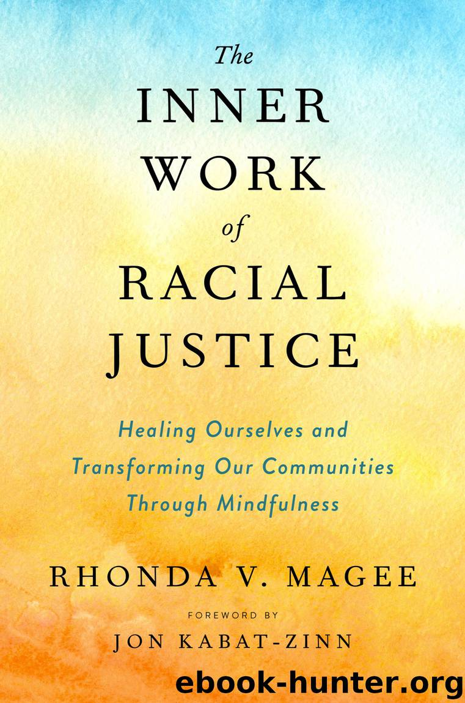
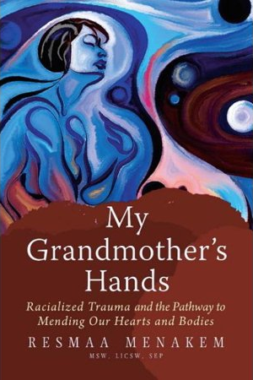
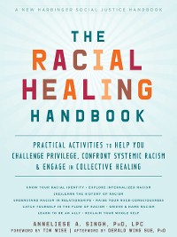

Slide 67
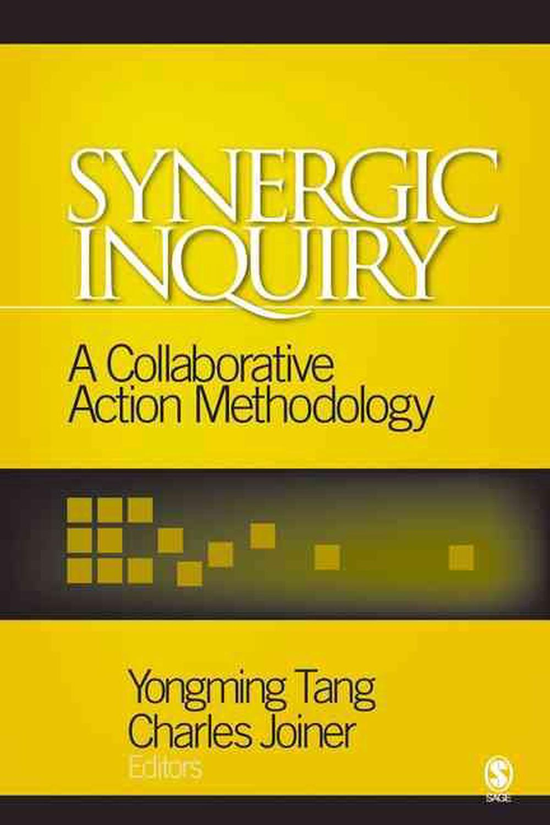

Slide 68
Practices To Support Your EDIB Journey
Notes:
Each of these could be full day trainings and the Council offers some and are developing trainings for the rest.

Slide 69
Trauma Responsive
Recognize & Respond to the need for safety, trustworthiness & transparency
Respond to the need for meaningful peer support
Recognize & Respond to the need for collaboration that results in change & mutuality while nurturing empowerment & choice
Avoid re-traumatizing cultural, historical & gender issues.

Slide 70
When providing care, how are we incorporating the fact that trauma influences how both staff & patient’s show up, engage & respond
How are we adapting the care provide to incorporate the patient needs based on their lived experiences & social drivers of health.
How are we demonstrating to staff & patients are sites are mentally, emotionally & physically safe space.
Let go of either/or mindset & Engage in narrative disruption practices (cultural humility, healing centered engagement, cultural safety)
Trauma Responsive Engagement
Notes:
I use the term trauma responsive in place of trauma informed to show that this is action not just the understanding of knowledge.
For Staff
For Patients
Does away with the either/or & all or nothing mind-set that is historically inherent in modern medicine
Why do we assume a care plan must be all or nothing?
How are we thinking outside the box of conventional medical training to find ways to reduce harm while allowing the person to maintain their self identified definition of well-being?

Slide 71
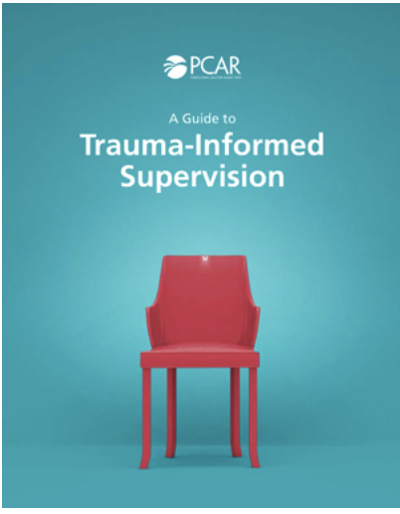
Trauma Informed Supervision Resources
https://pcar.org/resource/guide-trauma-informed-supervision
https://youtu.be/3008V1IaKYU?si=wypXeXhXD5wg1HO0

Slide 72
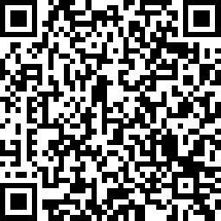
Join the TACHC TIC Movement!
Organizational change through inclusive healing
Innovative Practice Transformation
Inquiry and evidence-based curriculum
Value-focused strategy
Aligned for advancement & integration
Significant Shifts in Outcomes:

Slide 73
Cultural Humility
Commit to self-reflection & cultivating awareness through lifelong learning
Create a structure & process that requires institutional accountability occurs
Acknowledging Power Imbalances and Balancing those power imbalances.
Practice of empathy & compassion to open your perspective to include being “other oriented”
Notes:
Cultural humility in action is seeing our shared humanity while acknowledging our difference & not requiring the person to change to fit our narrative.

Slide 74
Cultural Humility Resource
https://nhchc.org/resource/cultural-humility/
Notes:
Use old HCE handout

Slide 75
Healing Centered Engagement
A strengths–based process that transforms individual practices, advances healthy interpersonal connections and improves institutional culture in order to create healthy outcomes for patients and the staff who serve them.
Provides insight to the intricate factors that informs/impacts the choices people make throughout life & how they engage with themselves & others – in clinic, hospital, school, workplace, etc.
Supports us to expand from the traditional view of addressing trauma & well-being as something that happens solely at the individual level & interrupting a person’s ability to function well for a period of time to understanding the individual, collective & cumulative impact of harm that our patients are actually navigating.
Helps us see how inequity is intentionally structured & reproduced in our society, particularly across race, social class, gender & sexual orientation as a result of the mental map models of our founding systems. And provides process that aligns institutions with a perspective, approach and strategy that addresses harm & restores wellbeing.
Notes:
In combination with Cultural Safety, Healing centered engagement
Read Slide
It helps us expand from the traditional view of addressing trauma & well-being as something that happens solely at the individual level & interrupting a person’s ability to function well for a period of time to understanding the individual, collective & cumulative impact of harm that our patients are actually navigating.
Helps us see how inequity is intentionally structured & reproduced in our society, particularly across race, social class, gender & sexual orientation as a result of the mental map models of our founding systems.
Provides insight to the intricate factors that informs/impacts the choices people make throughout life & how they engage with themselves & others – in school, workplace, clinic, hospital, etc.

Slide 76
Healing Centered Engagement Principles
Culture
Agency
Relationships
Meaning
Aspirations
Notes:
Culture: Values & norms that connect us to a shared identity & community value {a culture of seeing each other through the lens of our shared humanity} – this is not to provide a way to bypass the realities that people must navigate but rather an understanding that as long as the soul wounds of colonization & it’s relatives (imperialism, racism, classism, sexism, & capitalism) remain unhealed we all will continue to suffer.
Agency: The individual & collective power to act, create, & change personal conditions as well as external systems
Relationships: Transformational relationships where we are vulnerable & transparent in our interactions, share pieces of our humanity, & work toward sustaining healthy relationships within our community
Meaning: Profound discovery of who we are, why we are, & what purpose we are meant to serve
Aspirations: Capacity to imagine, set, & then accomplish goals both for personal & collective advancement
All of which are important whether we are looking to address a person’s health 1:1 or impact it through addressing the social drivers of health

Slide 77
How Does HCE Differ From Trauma Informed Care?
Focuses on fixing symptoms & patching up problems at the individual level
Focuses on fixing people but doesn’t address the root cause of the trauma
Runs the risk of focusing on the trauma rather than fostering long-term wellbeing
Fails to consider the social-ecological factors , collective trauma, & aspirations
Trauma Informed Care
Notes:
Focuses on fixing symptoms & patching up problems at the individual level
Fails to take into account or address collective trauma experienced as a result of socially toxic environments.
Focuses on fixing people but doesn’t address the root cause of the trauma
Fails to consider the social-ecological factors (ie systems, policies, process, practices) contributing to the trauma being experienced.
Runs the risk of focusing on the trauma rather than fostering long-term wellbeing
Important that we also look at aspirations. We are more than the violence, trauma & negative circumstance we are forced to navigate.

Slide 78
How Does HCE Differ From Trauma Informed Care?
Is culturally grounded & views healing as the restoration of identity, sense of meaning, purpose & allows us to also incorporate joy..
Healing Center Engagement
Believes that healing from trauma & restoring wellbeing is found in an awareness AND actions that address the conditions that created the trauma in the first place.
Supports the healing & wellbeing of those we serve as well as those that we employ
Is assets driven & focuses the well-being we want, rather than symptoms we want to suppress. We are more than the struggles & strife we experience on the individual & organizational level.
Notes:
Focuses on fixing symptoms & patching up problems at the individual level
Fails to take into account or address collective trauma experienced as a result of socially toxic environments.
Focuses on fixing people but doesn’t address the root cause of the trauma
Fails to consider the social-ecological factors (ie systems, policies, process, practices) contributing to the trauma being experienced.
Runs the risk of focusing on the trauma rather than fostering long-term wellbeing
Important that we also look at aspirations. We are more than the violence, trauma & negative circumstance we are forced to navigate.

Slide 79
Ecosystem of Harm
Institutional
Medical training, Practices & Policies
Interpersonal
How we engage with patients and co-workers.
Individual/Internal
Internalized narratives, beliefs, bias & societal wounds.
Systemic
Culture of "Whiteness" that informs healthcare
What we support at the institutional level.
Notes:
Here is how HCE views the ecosystem of harm that cultivate the Persistent Traumatic Stress Environments we are forced to navigate. Again because this ecosystem of harm allows the soul wounds of this colonized land to remain infected & open. We can’t keep applying band-aid to an infected wound. We must focus our efforts on removing what is keeping the wound infected so we can collectively heal and move forward. That is what Cultural Safety & HCE looks to do
Systemic – It’s important that we see “whiteness” as a system rather than a group of people. It is this system of whiteness that defines and determines the terms of who is seen as worthy, who is valued and thus deserving of resources including Meaningful work & wealth – including informing how work should be done & by whom which totally has it roots in southern plantation management. Lifelong learning – who are we building up; Health & Safety – who’s wellbeing & safety is prioritized above others – this changes depending on what privileges you hold; a sense of belonging & civic muscle to inform the world we must navigate- this is continuously under attack as demonstrated by the political foolery that has been going on for years; Humane Housing – who can afford housing; Reliable transportation- who are we isolating in under resourced areas; access to a thriving natural world - who has access to clean air & water. Who resides in asthma parkways.
Institutional – Our institution’s values, policies, processes, & practices are informed by the system in which it exists. And because of the systemic societal waters we are forced to navigate it is not unusual for organizations to produce their own form of social toxicity which are informed by the individual/internal narratives we carry and the processes, practices and policies that we develop & support which our staff & those we serve must deal with to get their needs met. Whose narrative of wellbeing does our best practices center? Who does our medical algorithms harm despite having evidence that they are at greater risk? Who’s voices are consistently ignored when they attempt to receive care.
Am Heart Ass - Get w/ the Guidelines -Heart Failure Risk Score
it predicts the risk of death in patients admitted to the hospital.
it assigns 3 additional points for any patient identified as “nonblack” meaning that Blacks are seen as being a lower risk, because we are identified as a lower risk this mean their can be delays in getting referred to cardiology & yet heart disease is the #1 killer of Black men & women per the CDC
this algorithm is currently under review d/t to the bias.
Kidney function is determined by a calculation called eGFR, if your eGFR is higher it is an indication of better kidney function
this calculation adjusts for race, providing Blacks with a higher reading than Whites. Unfortunately this mean that Black must have poorer kidney function than their White counterparts, this can delay needed referrals to kidney specialist to help manage their condition. And yet Black already have higher rates of end-stage kidney disease which requires dialysis & death due to kidney failure. Per the CDC it is the #8 killer of Black men & women.
some institutions no longer separate the GFR by race but the transplant scoring algorithm still does. Which means Af Am must be sicker than their white counterparts in order to be eligible for transplant.
And the STONE algorithm used in urology predicts the likelihood of kidney stones in pts who present to the ER with flank pain. The origin race factor add 3 points for pts identified as non black
Vaginal Birth after Cesarean (VBAC) algorithm predicts the risk posed by a trial of labor for someone who has previously had a C-section.
the algorithm predicts a lower likelihood of success for anyone identified as Black or Hispanic
although other factors such as marital status & insurance type were found to have a correlation similar to race these factors are not use in the algorithm.
Vaginal births are known to have multiple benefits yet this algorithm lowers the opportunity for WOC who have had C-sections to be given a try. This is especially troubling considering Black women already have a high maternal mortality rate regardless of education or social class when compared to their white counterparts.
These and similar decisions reflects a default assumption in medicine: it’s acceptable to use race adjustments without even understanding what race represents in a given context. I would also add when using these race-based science principles it doesn’t even acknowledge the physical, mental, and emotional toll that exists for marginalized populations. This toll clearly carries a health impact as evidence by the Black maternal-infant mortality rate, regardless of class, & education, the numbers are the worse for Black women. Next are Native Hawaii/Pacific Islander & Indigenous People respectively.
Interpersonal – our colonized history & the subsequent societal narratives have been & continue to be used to justify the crimes against humanity this country engages in, which skews our perceptions of ourselves & those with whom we share this land (Duran p18 & DeGury). Negatively impacting how we view & engage with each other.
A 2016 medical study found that In a survey of 222 of tomorrow’s doctors–white medical students and residents–about half endorsed false beliefs about biological differences between blacks and whites.
40% of first- and second-year medical students endorsed the belief that “black people’s skin is thicker than white people’s.”
A 2019 study that asked subjects to identify pain expressed in photos found that white participants more readily recognized pain on white faces than on black faces.
Think back to Dr. Sims, he too had similar beliefs about Blacks & pain. Here we are over a 170 years later & still this biased belief remains.
Dr. Susan Moore died of covid due to racial bias despite being a physician
Serena Williams despite being a world renowned tennis player almost died due to not being believed that her shortness of breath after having an emergency c-section was due to blood clots which she has a hx of. Black women in the U.S. have nearly three times the risk of dying from pregnancy related complications than white women, according to a report from the CDC.
WOC and the elderly are frequently not heard or believed when engaging with the medical system. When it comes to elders race does not protect you but it can make it worse.
LGBTQIA+ patients report delaying care due to fear of discrimination & cost
1 in 5 Transgender patients have been turned away by a healthcare provider
Story from Stacie 2023 Sacramento – black male youth appendicitis as dx by Black female pediatrician at community clinic, sent to ER with call from provider to charge nurse. Patient & family sent home. Blk provider had to have Chair of pediatrics call the ER to have patient admitted, her dx was correct & his care was delayed because of bias & ego, which resulted in him needing to be hospitalized longer.
Individual – we live & work in environments were depending on our intersecting identities we experience structural forms of inequities such as racism, classism/poverty, patriarchy, xenophobia, homophobia/transphobia, language injustice, ableism, etc. In an effort to survive some of us have assimilated to the socieital narratives of this colonized land, others have internalized these harmful narratives – replicating the harms within ourselves and all we engage with, we all have wounds related to systemic societal waters we swim in daily. And it informs & influences the care we provide.

Slide 80
Addressing the Ecosystem of Harm via Healing Centered Engagement
Institutional
Walking our talk, Growing Pains Support, Partnerships
Interpersonal
Applying lessons learned to our engagement with other people.
Individual/Internal
Self- Reflection, Transparency & Growth Mindset
Systemic
Instituting a Culture of Equity & Wellbeing for All
Notes:
If we are harmed on 3 levels we must address healing on these 3 levels as well, which Cultural Safety & Healing Centered Engagement gives us the skills & tools to do.
Individual – Self- Reflection: Exploring, what are our internal narratives, beliefs, bias, & unhealed wounds? How does our internal perception of ourselves mirror our actions & other people’s experience of us. What social toxic traits have we internalized as our own causing us to model practices of against ourselves and all we engage with. Transparency – with ourselves & others about what we discover through our self reflection process. Growth Mindset – willingness to change our thought patterns, behaviors & methods of engagement
Interpersonal – taking what we learned at the individual/internal level & applying it to our engagement with others. Walking our talk with other people.
Institutional – Taking the interpersonal a step further & applying it to the policies, processes & practices we develop & support within our organization/community/system of care. Using it to inform the development of best practices for partnership/collaboration, leadership, developing a supportive org culture & practicing accountability
Systemic – Creating a new norm that is grounded in Equity principles and practices. And that fosters wellbeing for all without decentering our mission.

Slide 81
Systems Thinking Iceberg
Systems Thinking is a way of approaching problems that asks how various elements within a system, such as the ecosystem of harm that can exist within organizations that we talked about.
When using systems thinking rather than being reactionary to individual problems/events, we pause and step back to consider the bigger picture. We view the problem or event in relationship to the various pieces that influenced & contributed to the event occurring.
Photo credit: Flourishing Agenda
Notes:
Systems Thinking is a way of approaching problems that asks how various elements within a system, such as the ecosystem of harm that can exist within organizations that we talked about.
When using systems thinking rather than being reactionary to individual problems/events, we pause and step back to consider the bigger picture. We view the problem or event in relationship to the various pieces that influenced & contributed to the event occurring.

Slide 82
Events
These are the visible, felt, and/or experienced symptoms of an opportunity for growth/ teachable moment.
Photo credit: Flourishing Agenda
Notes:
What is a common SDOH need manifestation/symptom/event that occurs in clinic or hospital setting
It’s important that we don’t assume that every issues can be properly addressed by only treating the presenting symptom Symptoms by their very nature are manifestations of something else & likely bigger.

Slide 83
Trends & Patterns
This is stepping back to look at what made the environment fertile for the event / problem to occur.
We need to ask ourselves, “what are the patterns/trends at play that are contributing to the presenting symptom /opportunity for growth/ problem?”
By tending to patterns/trends it can help us forecast or in some cases prevent events / problems from arising.
Photo credit: Flourishing Agenda
Notes:
What are the patterns/trends at play that are contributing to the presenting event/symptom/problem
So in our example of ___________ what would be considered contributing trends or patterns in your experience.
Event examples:
Staff frequently reporting feelings of burnout
What are the work practices can could be contributing to this?
Ongoing exposure to secondary trauma
need for secondary trauma support implementation
Need for ongoing training to support staff’s skills related to providing care to complex/ high needs patients
Frequent confusion around an org process that is shared by multiple staff
What are the work practices can could be contributing to this?
Lack of diversity in leadership
What are the work practices can could be contributing to this?
Subjective hiring practices
By tending to patterns/trends it can let us forecast or prevent events from occurring

Slide 84
System Structures
This is looking at/exploring what is contributing to/ informing the patterns and trends we identified in the previous section.
“What is informing/ contributing to the patterns/ trends we have observed as a factor of the event
Photo credit: Flourishing Agenda
Notes:
What’s fueling/ causing the patterns we are observing
So in our examples of ___________ what is informing/ contributing to the pattern/trends identified
Event examples:
Staff frequently reporting feelings of burnout
What are the work practices can could be contributing to this?
Ongoing exposure to secondary trauma
What is informing/ contributing to the pattern/trends identified
need for secondary trauma support implementation
Need for ongoing training to support staff’s skills related to providing care to complex/ high needs patients
Frequent confusion around an org process that is shared by multiple staff
What are the work practices can could be contributing to this?
Lack of diversity in leadership
What are the work practices can could be contributing to this?
Subjective hiring practices

Slide 85
Mental Model Maps
We are all influenced by the narratives, beliefs, socialization we carry within us.
“What attitudes, beliefs, narratives, mindset, values are informing/ influencing the system structure present or lack thereof to work as they do?”
Photo credit: Flourishing Agenda
Notes:
Attitudes beliefs morals values that allow structures to work as the way they do.
So in our examples of ___________ what attitudes, beliefs, assumptions, narratives, mindset are informing/influencing the system structures identified.

Slide 86
Cultural Safety
Is a framework that understand colonization’s role in the health inequities we see & the disparities present within social drivers of health. It is grounded in a social justice framework & holistic engagement approach. Offers a pathway to decolonize healthcare
It requires us as health care professionals to reckon with our own complicit practices & develop critical awareness of our personal/institutional bias as well as the positionality & power imbalances inherent to the current medical model.
Allows the patient to define what level of cultural safety is felt/experienced when seeking care.
Notes:
So how do we reckon with all of these realities as we are trying to provide care for our patients.
Read slide
When patient’s are seen by use they are forced to assimilate to the western medical model which was NOT made for them. Whose knowledge came at the expense of many who use the system. The very legacy of the medical system makes it lack cultural safety. Everything from the care team to our medical algorithms make assumptions. Cultural Safety can help us take the steps necessary to change this legacy. And help people like my mother who engage with the health care system as a last resort.
Engaging in the practice of cultural safety it becomes not only possible but inevitable that an exploration of the assumptions underlying practices can lead to the identification of the specific assumptions & preconceptions that are structuring marginalizing & disparity reproducing practices within our current model.

Slide 87
Learn More
Cultural Safety
Healing Centered Engagement
Frontier Nursing University: New Introduction to Cultural Safety Course - Free
Healthcare for Humans Podcast - "This show is dedicated to educating you on culturally diverse communities so you can be better healers."
VacciNative
Creating Cultural Safety
Cultural Safety: Respect and Dignity in Relationships
White Supremacy Culture
Understanding Intergenerational Trauma
Cultural Safety Education as the Blueprint for Reconciliation
Flourishing Agenda: Healing Centered Engagement Practitioner
Tufts: Ctr of Enhancement of Learning & Teaching

