Slide 1
Managing Challenging Behaviors in Respite Settings
Prevention vs. Intervention
Catherine Hayes, BSN, MPH, FNP-BC
Omar Marrero, LICSW
Carol Benner, BSN, RN

Slide 2
Agenda
Introduction to Cardea Health
Introduction to BHCHP’s Barbara McInnis House
Comparing Admission Criteria
Managing challenging behavior in a low barrier respite setting
Managing challenging behavior in a high acuity respite setting

Slide 3
Catherine Hayes, BSN, MPH, FNP-BC

Slide 4
Cardea Health is a nonprofit organization founded to connect marginalized populations to the clinical services required to improve health, remain stably housed in their community, and age in place.
Cardea Health offers integrated medical/social care models and compassionate, culturally competent care.
Cardea health aims to help our most vulnerable neighbors thrive in the community by closing service gaps, particularly through provision of intensive community-based nursing and personal care services.
Mission and Vision

Slide 5
Homelessness in Alameda County, CA
2022 Point in Time county surveyed 9747 homeless individuals in the county: a 17% increase from 2019.
27% are sheltered (emergency shelter or transitional housing), 73% are unsheltered (vehicles, tents, abandoned buildings, other places not intended for habitation).

Slide 6
Homelessness in Boston, MA
42nd annual homeless census in 2022- Overall, the number of individuals experiencing homelessness decreased by 2.4 percent, from 1,659 individuals in 2021 to 1,545 individuals in 2022.
The number of unsheltered persons staying on the street on the night of the census decreased by 30 percent, or 51 individuals, from 170 individuals in 2021 to 119 individuals in 2022.
After two years of increased unsheltered homelessness, 2022's street count was slightly lower than the total of 121 in 2019. The number of veterans experiencing homelessness decreased by 15.5%, from 213 veterans in 2021 to 180 veterans in 2022.
Boston has one of the lowest percentages of unsheltered people living on the street of any major city conducting a census with under 4% of Boston’s homeless population sleeping on the street in 2021 (the most recent year for which HUD has published national data)

Slide 7
Medical Respite in Alameda County
Medical Respite is a CalAIM covered benefit that provides up to 90 days of medical respite care (as of January 2022)
Admission criteria:
Unhoused individuals at risk for hospitalization
Unhoused individuals with a medical need that cannot be met in an unsheltered environment.
Respite care is often the only option for people experiencing homelessness with complex medical conditions.
Respite facilities are often asked to take on clients with chronic and serious conditions as well as care needs that are out of the intended scope of respite care.

Slide 8
Cardea Health Medical Respite Programs
Fairmont Respite
34-bed mixed model site.
Clients are admitted for respite and may be eligible to remain on site if they are deemed medically complex or eligible for housing navigation services.
Cardea Health provides clinical services (Medical Directors, RN, home health aides, and caregiving support).
Eddie’s Place
31 beds dedicated to respite care.
Nursing care and caregiver services are available 7 days a week, 16 hours a day.

Slide 9
BHCHP’s
The Barbara McInnis House
Omar Marrero, LICSW
Carol Benner, BSN, RN

Slide 10
Our Services (BHCHP)
Mission: Provide and assure access to quality health care for all homeless individuals and families in the greater Boston area.
Family Team
DV shelters
Motels/Hotels
Family Shelter
Youth Shelter (Bridge Over Troubled Water
Respite Programs
The Barbara McInnis House
The Stacy Kirkpatrick House
Outpatient Clinics:
BMC Clinic
MGH Clinic
Dental Clinic
Street Outreach
Harm Reduction
SPOT
BOLT team
HRTs in shelter
Nurse run clinics in Boston area shelters
Pine Street Inn
Woods Mullen Shelter
South Hampton Street Shelter
New England Center for Homeless Veterans
St. Francis House (day shelter)
Shattuck Shelter
Kingston House

Slide 11
Medical Respite Care at BMH
Acute and post acute medical care for homeless persons who are too ill or frail to recover from a physical illness or injury on the streets or in shelter, but who are not ill enough to be in a hospital.

Slide 12
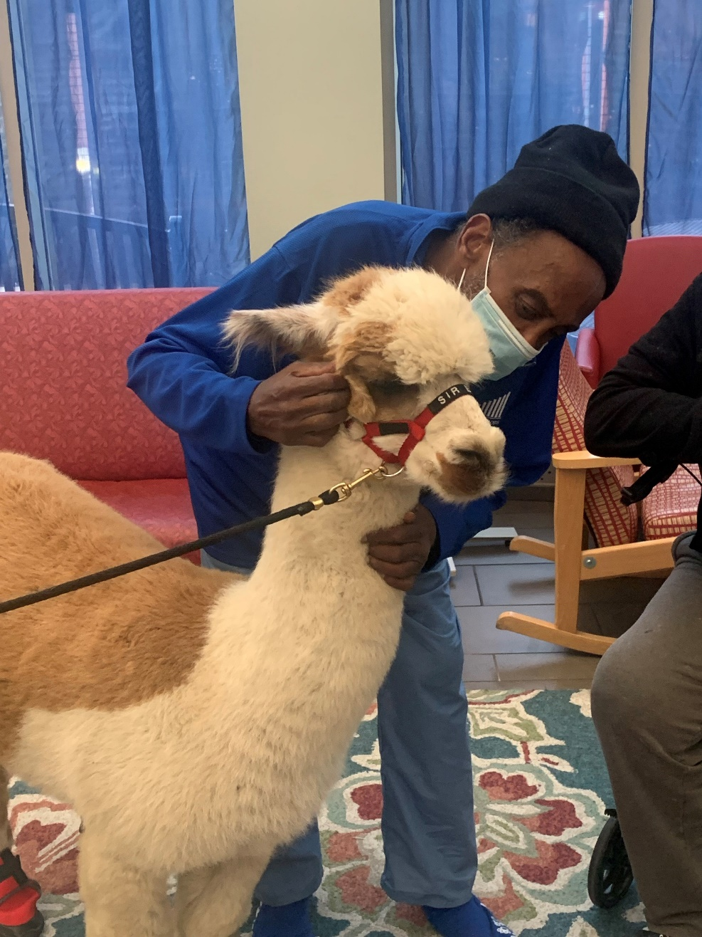
Overview of BMH
103 beds
24 hr nursing care
Behavioral health & psychiatric consultations
On-site pharmacy services
Palliative care
Substance use and harm reduction services
CAT teams
Tx program specialist
Recovery groups
Safer use kits
Case management services
Transportation to appointments
3 meals a day
Cigarette smoking is permitted on our Serenity Deck. Lighters are provided during smoking hours.
Non-clinical services
Spiritual care
Laundry
Benefits management
Recovery groups
Arts & crafts
Group activities like bingo
Weekly pet therapy
Access to clean, unused clothes
Security staff on site 24 hr/day
Patients scanned with metal detector and belongings searched on admission and return from appointments.
Patients may leave the building to attend scheduled medical appointments or appointments set up by their case managers relating to housing or benefits. Patients may not come and go as they please.
Rooms are spacious and may be shared between 4-6 people. Bathrooms are located within patient rooms.
Each bed has its own TV and patients receive a pair of headphones to use.

Slide 13
The Barbara McInnis House
Average LOS: 14-21 days
Nurse: Patient = 1:13
Overnight = 1: 26
Wound Care
Including complicated dressings (i.e. wound vacs).
Oxygen
Oxygen dependent patients considered on case-by-case basis.
We can wean patients off O2.
IVs - PICC/MID/Tunneled Cath
Abx
Fluids on case-by-case basis.
PSUD
We have protocols for ETOH, Opioid, and benzo detox.
Suboxone -induction, microdosing
CAT teams, HRTs
MMT
Confirmed clinic
Can start under 72-hour rule
Satellite MMT clinic on site (Coming soon...)

Slide 14
Client Led Care
All Cardea Health programs emphasize the autonomy of the patient: shelter and services are never contingent on participation in medical interventions.
Harm reduction approach to medical care.
Focus on what is most important to the client, right now.
Consent is extremely important, especially when working with clients with trauma and SMI.

Slide 15
How do our programs stand out?
Exclusion criteria:
Recent suicide attempt
Dependent for toileting and transfer
Dementia with wandering behaviors
The following clients may be accepted at the discretion of Cardea’s medical directors:
Recent release from involuntary hold
BAL > 0.3
Will admit:
Clients with high-risk active SUD
Clients with Severe Mental Illness
Individuals lacking active benefits
Those needing ADL or iADL support
Clients with pets
Clients requiring isolation
Clients who cannot independently manage medications
Clients who are enrolled in hospice/palliative care or are at the end of life

Slide 16
BMH Admission Criteria
Based on referrals from hospitals, shelters, clinics, and other various healthcare service providers.
Have an acute medical need
within BMH’s medical and psychiatric level of care
Behaviorally appropriate for a group setting
no recent attempts of suicide or violence
Need short term care*
Independent with ADLs*
Independent with mobility
Homeless/ unstably housed in city of Boston
Doesn’t have care established care outside of Boston
Continent of urine and feces*
*there are exceptions to every rule

Slide 17
Managing Behavioral Challenges in Low Barrier Respite Settings

Slide 18
Commitment to Client Retention
Eddie’s Place exited <5 clients in it’s first year of operation (total clients admitted (~300 admissions)).
Reasons for exit: possession of weapons, assault, or extensive destruction to property.
Few external resources to address behavioral challenges.
Creativity with behavioral contracts and solutions.
Prevention is key
Programs rely on:
Low barrier model
Peer support program and lived experience of employees
Community building
Patient led care
Taking care of our staff

Slide 19
Reducing Barriers to Care
Cardea Health respite programs allow pets.
Respite programs are single-client occupancy.
Non-congregate shelter allows for the presence of family members/caretakers.

Slide 20
The Importance of Lived Experience
Cardea Health prioritizes the employment of individuals with lived experience of homelessness, incarceration, and substance abuse.
Program housing partners include re-entry employment providers.

Slide 21
Peer Harm Reduction Specialists
Cardea Health operates a peer harm reduction specialist program.
Individuals with lived experience provide overdose prevention, safe use supplies and education, and resource and referral guidance.
Peer specialists often build rapport with challenging clients, provide behavior coaching and de-escalation interventions.

Slide 22
Community Building
Client centered events and celebrations.
Client inclusion in program changes.
Monthly “town halls”.
Behavior expectations are set by the community.

Slide 23
Staff Care
Reducing challenging behavior on site also includes caring for clinical and support staff.
Mental health days
Regular debriefs on challenging situations (behavior and other).
Celebrate the wins together: staff outings and team building
Recognize improvement, teamwork, and leadership.
Allow participation in hard decision making.
Notes:
here or at beginning next to client led care??

Slide 24
Managing Behavioral Challenges in High Acuity Respite Settings

Slide 25
How we previously managed risk in respite:
How we manage risk program wide
Safety and Security Committee
The goal is to Identify safety issues and have the power and resources to solve the problems that arise.
The safety and security committee will often serve as an executive or steering committee, driving the development and implementation process for a security plan. Additionally, it will set a strategic agenda, goals, and objectives on the behalf of the organization, or entire community.
Approached SUD more punitively
Long bar lengths
Quicker to discharge
Less standardized, more subjective

Slide 26
Rationale
Patients admitted to respite facilities often have a significant history of trauma as well as distrust in the medical field.
In creating guidelines for behavioral management, we felt the need to acknowledge that respite is a medical facility and that patients have varying degrees of medical needs to stay in respite.
Patients’ medical needs will be weighed in determining the supports that will be put in place to allow for a patient with challenging behaviors to remain in respite until the goal of their stay is reached.
We also recognize that difficult patient behaviors have an impact on the wellness of the milieu, as well as the safety of other patients and staff.
The risk associated with difficult patient behaviors will also be weighed in determining what behaviors can be accommodated in respite and for how long.
Risk management approach
Tools are research and data supported

Slide 27
Guidelines for Challenging Behaviors at BMH
Patient behaviors divided into two categories:
Immediate safety risk
Non-immediate safety risk
Immediate Safety Risk: Patient behaviors that create an unsafe situation or environment for other patients, staff, or the overall milieu.
Ex: Physical harm, threats determined to be high risk, possession of weapons, sexual assault or harassment, significant disruption to the milieu that is unable to be redirected with appropriate therapeutic intervention,
Non- Immediate Safety Risk: Patient behaviors that are disruptive and difficult to sustain in respite, however there is no immediate threat of harm to staff, other patients, or the overall milieu.
Ex: Behaviors around substance use, challenging patient communication, difficulty engaging in care, altercations between patients, derogatory language, unsubstantiated threats of violence
Any patient causing an immediate safety risk to themselves, or others, can be immediately discharged at the discretion of the involved staff. If leadership is available, they will be notified as soon as possible that there is a patient posing an immediate safety risk.
For patients with challenging behaviors that are a non-immediate safety risk, we created a workflow to address these behaviors.

Slide 28
Risk Assessment Tools
3 new tools to assist with assessing the risk associated with challenging behaviors.
Incident report form
DMRA - decision matrix risk assessment
MOAS - modified overt aggression scale

Slide 29
A little about the research...
The Modified Overt Aggression Scale (MOAS) is a four-part behavior rating scale used to document the frequency and severity of aggressive/challenging episodes.
A risk matrix method, also called “decision matrix risk assessment (DMRA) technique”, is a systematic approach used in the risk assessment process to determine and to rank the risk level.
Level depends mainly on two variables: severity of harm and occurrence probability of this harm or likelihood.
In this study 3 different valid, reliable, and evidenced based practice tools were implemented on an inpatient psychiatric unit. Effectiveness was determined based on the measurement of patient assaults and violence towards others. By increasing accuracy identification of patients assault potential, by using the behavior assessment tool, appropriate interventions could be implemented.
Study went on to project that with the implementation of one of the 3 risk assessment tools, including the MOAS, assaults would decrease by 25%, 6 months after implementation.
Identifying the magnitude of a risk means understanding the consequences that could result if that threat occurs, to separate the acceptable minor clinical risks from those judged unacceptable. Ranking a risk by multiplying consequences for likelihood is a simple way to assign a numerical value to each risk. Risk matrix becomes a useful tool to assess the likelihood, the consequence levels and determine whether the risk rating is very low or extreme.
Risk matrices are extensively applied and suggest risk management guidance for healthcare organizations.The overall level of risk assigned to an event helps identify the urgency and extent of the control measures needed. Consequently, different control measures will be put in place to counter it, with a different urgency level.
Alvano, Manuel, “Implementation of Violence Risk Assessment Tool on In-patient Psychiatric Unit” (2016). Master’s Projects and Capstones. 359.
Pascarella, G., Rossi, M., Montella, E., Capasso, A., De Feo, G., Botti, G., Nardone, A., Montuori, P., Triassi, M., D'Auria, S., & Morabito, A. (2021). Risk Analysis in Healthcare Organizations: Methodological Framework and Critical Variables. Risk management and healthcare policy, 14, 2897–2911.

Slide 31
Decision Matrix Risk Assessment
To assess risk to the patient based upon their need to be in respite: DMRA.

Slide 32
The Modified Overt Aggression Scale
To assess risk to self, other patients, and staff: MOAS

Slide 33
Work Flow
If the patient requires an IMMEMDIATE discharge due to an imminent safety risk, the following steps may not be able to occur, but should be attempted when possible.
Identify risk/ challenging behavior
Risk to be identified per guidelines. Immediate safety risks vs. non-immediate safety risks.
If the behavior is determined to be an immediate safety risk, immediate administrative discharge is appropriate.
If the behavior is determined to be a non-immediate safety risk, continue to step 2.
2. Per guidelines, issue a verbal redirection and/or submit incident report to respite leadership.
Incident reports will be reviewed every weekday morning, and leadership will designate a representative to follow up with the patient and appropriate team members.
Reports will also be filed in the leadership office, therefore repeat behaviors can be tracked without documenting in the patient’s electronic medical record.
An e-mail will be sent after each report is followed up on to close the loop and communicate with the appropriate people.
Challenging behaviors should also be discussed in interdisciplinary huddle.

Slide 34
Work Flow
3. Risk Analysis
When applicable, risk assessment will be performed to evaluate the risk of discharge to the patient vs. the risk of keeping the patient in respite. Clinical risk to patients will be assessed using a decision matrix risk assessment and risk to safety to others will be assessed using the modified overt aggression scale (see attached).
Scores to be compared if both scales are required to decide. Patients who score less than 4 on the DMRA, can be discharged expeditiously. Patients scoring 5-12, should be discharged as soon as a safe discharge plan can be put in place. Patients scoring 15-25 will require additional supports to remain in respite until there is a change in score or situation.
If their MOAS score is greater than their DMRA score, the patient will be discharged. If the patient’s MOAS score is greater than nine, the patient will be considered for discharge regardless of their DMRA score.
Team provider or medical director on call should perform DMRA to determine medical risk to patient.
Behavioral health clinician, Nurse Manager, or member of Leadership to perform MOAS.
4. Risk Treatment
A plan will be put in place to support challenging patient behaviors and communicated with appropriate staff.
Recurring challenging behaviors will prompt the medical team to put a contingency plan in place.
Contingency plans will be set up for patients at high risk of administrative discharge during team rounds.
Persistent challenging behaviors will be considered for discharge per the non-immediate safety risk protocol.
5. Monitoring and Review
Reach out to the outpatient team (if applicable) to put community support in place when possible.
Send e-mail to CRIT list if patient is eligible for a restriction/ readmission criterion when returning.

Slide 35
Example #1
Situation:
52 y/o F admitted to respite s/p below the knee amputation. Sutures remain in place and the site is healing normally. Patient is closely followed by ortho/vascular and the wound is requiring daily and PRN dressing changes. The patient is at the end of a pain medication taper.
The patient is often unable to follow the respite routine, asks for extra smoke breaks, occasionally has angry outbursts directed toward staff, does not get dressing changed daily as ordered.
It is becoming increasingly challenging to redirect this patient. Her only discharge option is shelter.

Slide 36
According to this assessment -patient should remain in respite until a safe discharge plan can be made.
This may mean that the patient stays until condition improves such that the risk of harm is decreased.
Behavioral interventions should be put into place to support both the patient and staff.
No immediate safety threat
Multiple Behavior Complaints submitted through the incident report
BH does MOAS- Verbal Aggression :2 Aggression against property (2 with weight =) 4= 6
DMRA 6 (Improbable (2) Moderate (3) = 6

Slide 37
Example #2
Situation:
66 YOM admitted to respite iso dislocated jaw, pending surgical reduction. Patient’s care also complicated by dysphagia 2/2 hx of SCC of proximal esophagus. Due to this patient required all meds to be crushed and given in applesauce. Patient also had a significant cognitive impairment iso TBI. All of these complex needs made placement for this patient difficult.
Patient became agitated and difficult to redirect at times due to his TBI. This behavior was frequently tolerated due to the complexity of the patient’s medical needs, the understanding of the medical reason behind his behavior, and the lack of safe d/c options.
About 2 months into this patient’s respite stay, the patient smacked another patient across the face and put his hands around his throat.

Slide 38
Immediate safety threat identified
Immediately brought to leaderships attention --> patient brought into private space and de-escalated by behavioral health director.
BH does MOAS- Weighted Score = 11
DMRA = 16
Determined the patient needed to be discharged immediately. Unfortunately, no safe plan was in place at this time. Pt offered to d/c to the ED, which he refused. D/c'd to the community.

Slide 39
Expectations vs. Reality
Follow up not needed on every report.
Consistent communication more difficult than anticipated.
Not everyone made aware of behaviors
Not enough specifics in forms
Tools not required for every situation
DMRA used more consistently than MOAS
Easier to compare behavior without MOAS score to DMRA score than anticipated. We are frequently looking at the severity of the medical need, severity of the behavior/ consistency of the behavior, and if there is a safe plan in place.
Next Steps:
Continued work on consistency
Continued data collection
Behavioral form changes

Slide 40
In the absence of robust resources, prevention is key.
Thorough prevention includes clients and staff
Reducing simple barriers to care pays off in the end

Slide 41
Questions?
Thank you for your time!

