Slide 1
Heat and its Effect on
HEALTH
Dr. Pia Valvassori
Health Care Center for the Homeless

Slide 2
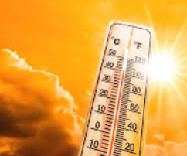
Mortality
The World Health Organization estimates:
125 million people were exposed to extreme heat stress between 2000-2016
Globally, 5 million deaths were associated with extreme heat between 2000-2016
Deaths due to extreme heat outnumber other natural disasters
Mortality is under-reported. Most deaths are associated with pre-existing conditions that are exacerbated by extreme heat.

Slide 3
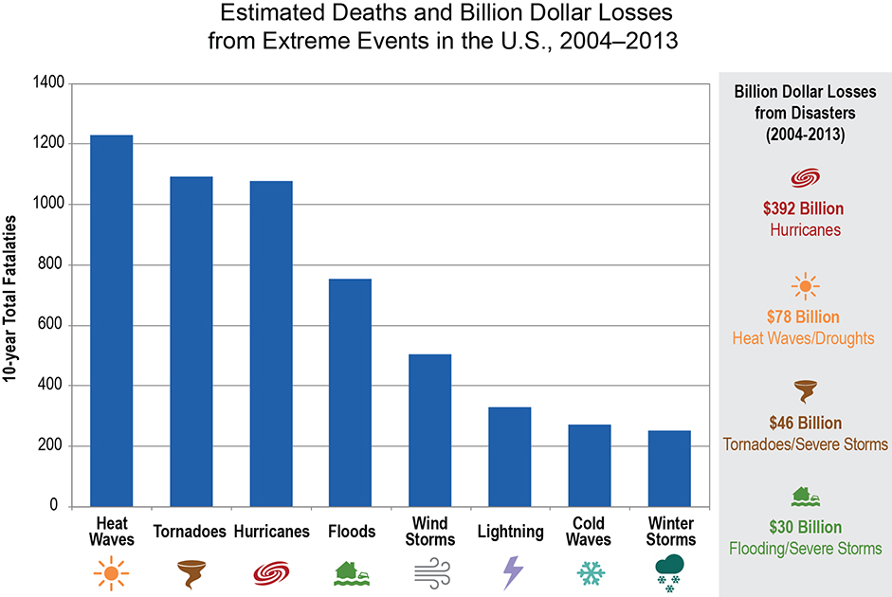
Extreme Event Comparisons

Slide 4
United States Heat-Related Fatalities

Slide 6
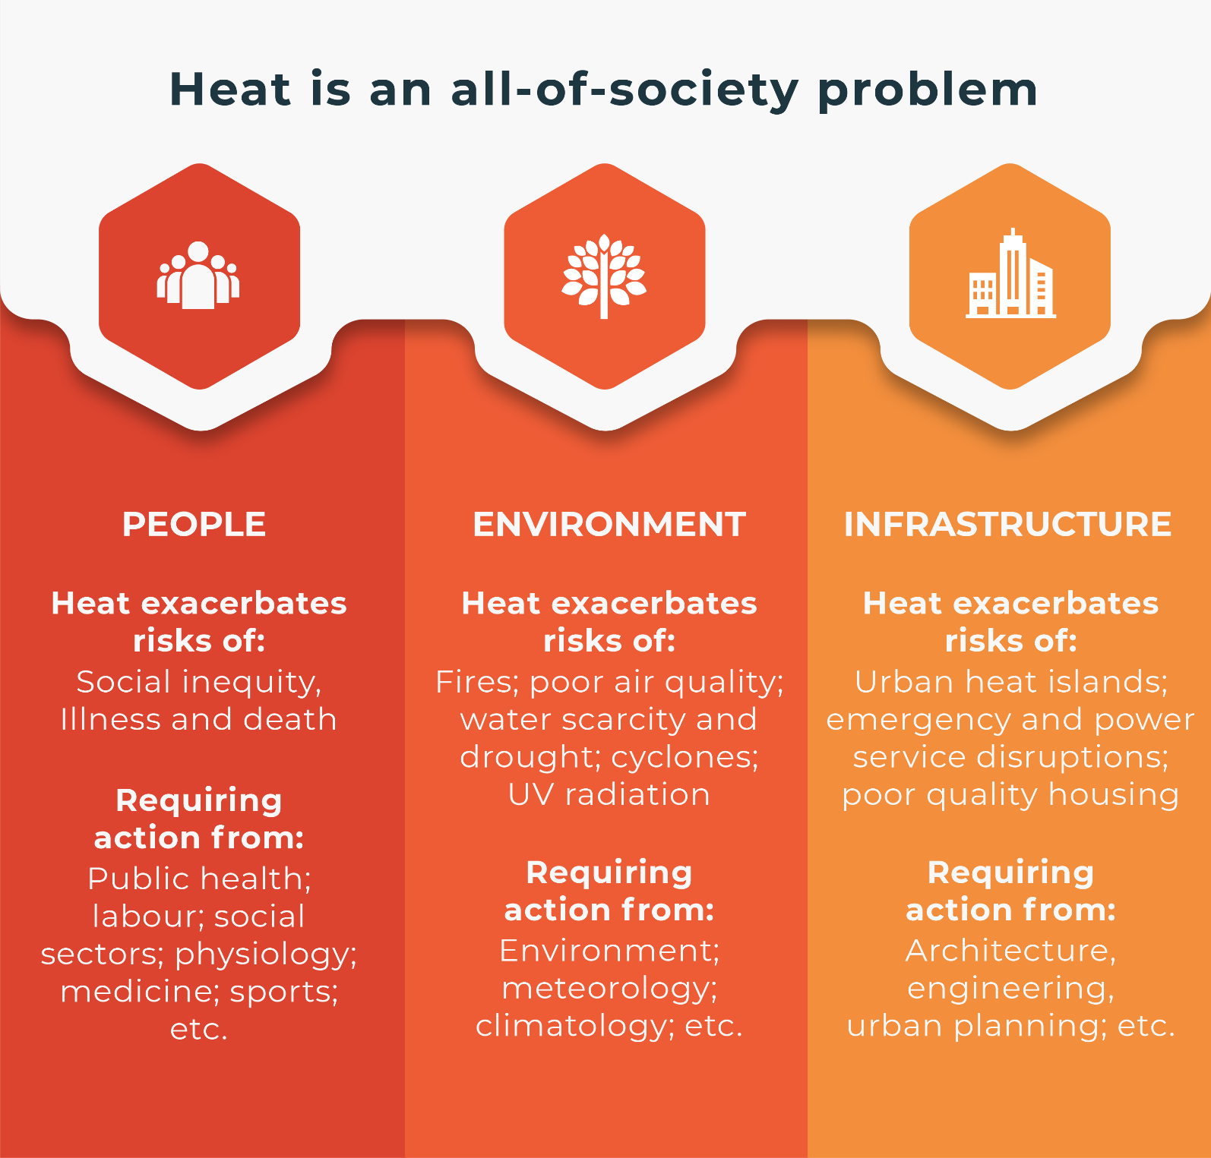
Extreme Heat Trends
Three hottest years on record
Increased frequency, duration of extreme heat days
Heat intensity is greater in urban areas where people experiencing homelessness congregate to access services
Humidity exacerbates heat effects

Slide 7
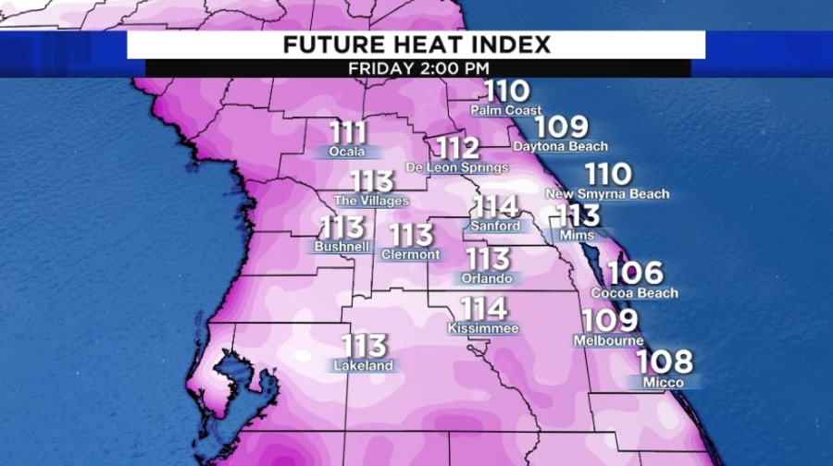
Extreme Heat Events
Orlando had 32 days of heat index exceeding 100 degrees
Orlando experienced a 20% increase in heat-related illness
115% increase in the number of visits to urgent care centers
---------------------------------------------------------------------
Phoenix went from 28 days of extreme heat in 2002 to 53 days in 2020
Heat-related ER visits increased 65% from 2011 to 2020
580 heat-related deaths in 2023, more than half of them among people experiencing unsheltered homelessness

Slide 8
Extreme Heat Events
Houston:
16 days in 2023 with temperatures over 100 degrees
1,400 heat-related emergency room visits
334 heat-related deaths in Texas, more than any other year

Slide 9
How Extreme Heat Affects Health
Prolonged heat exposure exacerbates existing illnesses
Increase in cardiovascular mortality
Exacerbation of chronic respiratory disease
Exacerbation of mental illness and increased suicidality
Increased confusion, decreased sleep
Increased accidents, including overdose
Increased preterm deliveries and stillbirths
Food/medication storage challenges

Slide 10
Implications for Persons Experiencing Homelessness (PEH)
Unsheltered population nationally has increased over 35% in the last 7 years. There is an acute shortage of emergency shelter beds.
Central Florida has had a 75% increase in unsheltered PEH since 2019 due to increase rents, lack of affordable housing and stagnant wages.
Laws criminalizing public camping create more obstacles for PEH, including moving them farther from existing centralized services and jobs.

Slide 11
Symptoms of Heat Exposure
Heat cramps: muscles tighten from lack of fluid and electrolytes
Heat exhaustion: body temperature over 100 degrees, profuse sweating, nausea, vomiting, headache
Heat stroke: most severe — no sweating, skin is dry, body temperature over 104 degrees, nausea, vomiting, seizures
Effects profound with minimal nighttime cooling, especially in urban areas

Slide 13
Ways to Mitigate Heat
Reduce greenhouse gas emissions
Prioritize investments for vulnerable populations
Expand training on heat-related illness for healthcare/shelter workforce
Enhance early-warning system
Provide water
Distribute cooling packs
Direct/transport to cooling centers

Slide 14
Best Practices
Houston has 3-digit number (like 211) for information related to cooling center locations
City collaborates with local CoC, faith community and parks department to create heat action plan allocating space/staffing
Target outreach to high-need localities
Extend cooling center hours when nighttime cooling is minimal
Focus on sustainable solutions, especially affordable housing

Slide 15
Best Practices
Phoenix:
Has developed heat action plan that coordinates programs/policies to mitigate heat exposure and protect the public
Tracks trends, collects data
Collaborates with faith community, academic partners, medical examiner’s office
Miami:
City appoints a ‘Chief Heat Officer’ responsible for improving coordination with partners, accelerating heat-protection efforts

Slide 16
Recommendations
Develop Heat Action Plan incorporating the following:
Appoint an agency to recruit and collect list of safe spaces for people to go
Leaders work with local weather authorities to expedite information sharing
All municipalities appoint someone responsible for issues relating to homelessness who
Attends homeless Continuum of Care members meetings
Collaborates with stakeholders on heat response

Slide 17
Recommendations (cont.)
Develop data collection with emergency management on heat related calls and intervention
Improve reporting on heat related ER visits, hospitalizations and mortality
Increase public awareness
Provide emergency utility assistance
Engage academic partners to study issues and assist with compiling necessary data
Opening low-barrier cooling centers
Use of existing public facilities – libraries, community centers, churches, schools
Hours contingent on heat index
Staffed by peer support, case management
Provide water stations and air conditioning
Locate near most vulnerable areas
Low-barrier – no IDs, allowance for pets

Slide 18
“I feel like I’m in Hell” - N.Y.T. Video

Slide 19
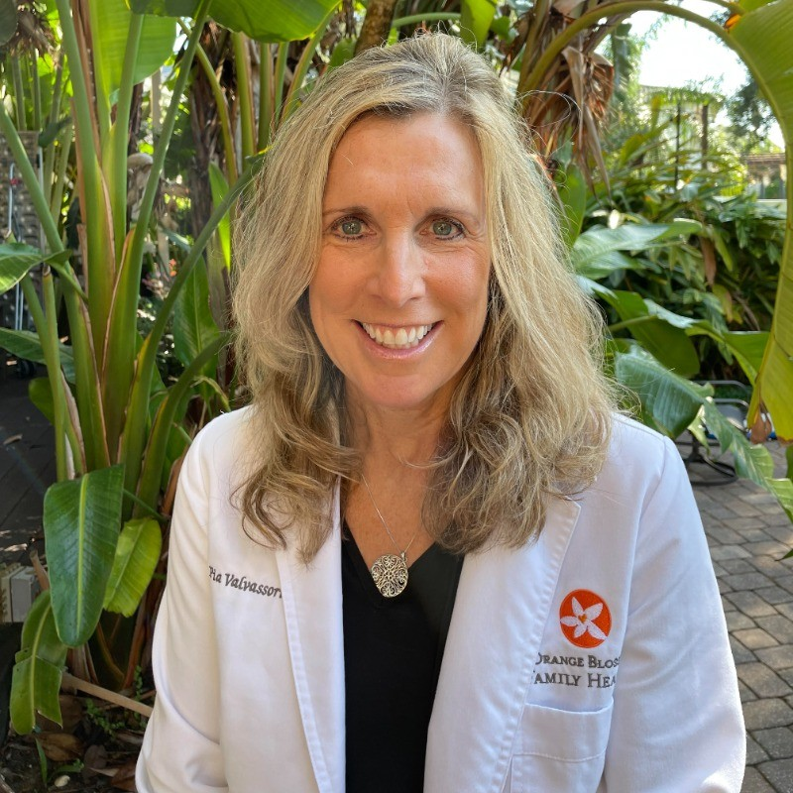
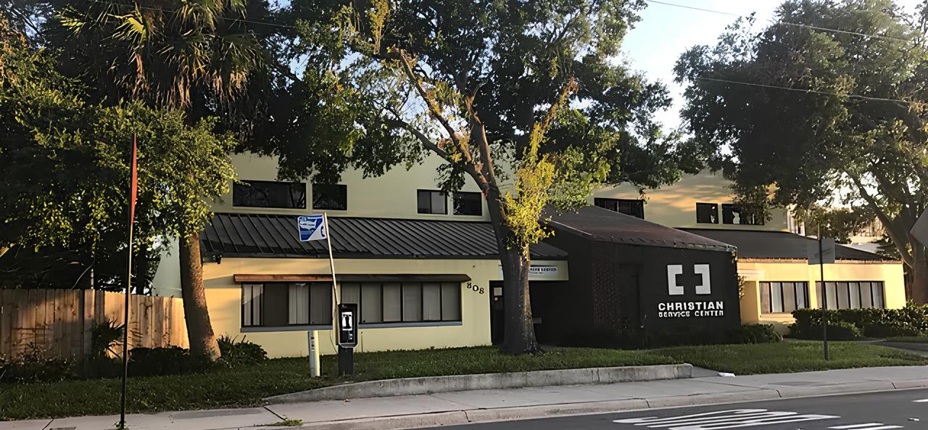
Thank You
Dr. Pia Valvassori
Pcval33@gmail.com
407-428-5751
Christian Service Center
808 W. Central Blvd.
Orlando, FL 32805

