Slide 1
“This is the Longest I’ve Ever Stayed Here:” Implementation of Specialized Complex
Addiction Teams in a Medical Respite Facility
Carol Benner, Associate Director of Nursing, Medical Respite Programs
Hannah Matheson, Associate Director of Nursing, Medical Respite Programs
Joanna D’Afflitti, Medical Director of Medical Respite Programs
Boston Health Care for the Homeless Program

Slide 2
BHCHP PROGRAM OVERVIEW
MISSION: To provide and assure access to quality healthcare for all homeless individuals and families in the greater Boston area.
Outpatient Clinics:
BMC Clinic
MGH Clinic
Dental Clinic
Street Outreach
Harm Reduction
SPOT
BOLT team
HRTs in shelter
Nurse run clinics in Boston area shelters
Pine Street Inn
Woods Mullen Shelter
South Hampton Street Shelter
New England Center for Homeless Veterans
St. Francis House (day shelter)
Shattuck Shelter
Kingston House
Family Team
DV shelters
Motels/Hotels
Family Shelters
Youth Shelters (Bridge Over Troubled Water
Respite Programs
The Barbara McInnis House
The Stacy Kirkpatrick House

Slide 3
MEDICAL RESPITE CARE
THE BARBARA MCINNIS HOUSE
Acute and post acute medical care for homeless persons who are too ill or frail to recover from a physical illness or injury on the streets or in shelter, but who are not ill enough to be in a hospital.
103 beds
24/hr nursing care
Daily medical provider visits
On-site pharmacy services
Oxygen -Oxygen dependent patients considered on case-by-case basis.
IV ABX - PICC/MID/Tunneled Cath
PSUD
Protocols for ETOH, Opioid, and Benzo detox.
MOUD
Buprenorphine -induction, microdosing
MMT
can initiate under 72-hour rule
Satellite MMT clinic on site (Coming soon...)
Average LOS: 14-21 days
Nurse: Patient = 1:13
Overnight = 1: 26
Wound Care
Including complicated dressings (i.e. wound vacs).

Slide 4
AGENDA
We will describe the design, implementation, and launch of two interdisciplinary Complex Addiction Teams (CAT) in a residential medical respite facility, including the incorporation of patient feedback into the development of the model.
We will share early data around patient retention in care, patient and staff experience, and overdose response management.
Lastly, case examples will illustrate early successes of this model.

Slide 5
BACKGROUND
People who use drugs are at increased risk for adverse health outcomes including life-threatening infections, overdose, and death. People who use drugs are also at risk of administrative or self-directed premature discharge, creating an equity gap in access to optimal care. ^{1,2}
The Barbara McInnis House (BMH) is Boston Healthcare for the Homeless Program’s (BHCHP) medical respite program, which operates in a team structure, with 8 teams, each having up to 13 patients. Over 75% of patients admitted to BMH have Substance Use Disorder (SUD) as an active diagnosis.
Drug overdose is the leading cause of death among patients receiving care at BHCHP.
Few recommendations exist for improving retention in care among people who use drugs within residential and inpatient facilities. To this end, BMH launched its first Complex Addiction Team (CAT) in June 2023 specializing in the care of people with active substance use by employing evidence-based addiction medicine practices, as well as harm reduction and trauma informed models of care.

Slide 6
CAT GOALS
1. Improve retention in care.
50% of CAT patients will complete their clinical goal before discharge.
2. Decrease stigma through harm reduction education and maintaining patients in care.
3. Connect patients to additional SUD treatment based on readiness.

Slide 7
Team RN providing 1:1 patient monitoring in addition to caring for 12 other patients.
Increased ED send outs for sedation and overdose.
Previously was part of our Narcan order to send out post-Narcan administration.
Non-standardized Narcan administration
Increased patient directed discharges without meds or notice.
Less tools and supports for patients engaged in active use, made it difficult to complete their stay.
More punitive approach towards drug use (used to be grounds for discharge under any circumstance).
Immediate confiscation of illicit substances.
Made it more challenging for patients to remain engaged in care.
BMH PRE-CAT

Slide 8
OVERDOSE AND SEDATION EVENTS AUGUST 2022-JANUARY 2023 (PRE-CAT)
Notes:
12 total events per period
2 sedation, 10 overdose
18 doses of Narcan per period, rate of 1.5 doses per event
11 out of 12 events resulted in an ED send-out
2 out of 11 send-outs resulted in a hospital admission

Slide 9
Description of the Project
In January 2023, we began the process of developing and implementing two Complex Addiction Teams at the Barbara McInnis House, incorporating feedback from patients and staff in the development of the model.
Part of this initiative included installing reverse motion sensors for bathrooms: installation started July 2023 and completed October 2023.
The first CAT opened on June 5, 2023; the second on September 1, 2023.
We added two new resources to these teams, to better support our patients who were struggling with active use:
CAT techs (also referred to as Harm Reduction Techs), who are EMT certified and work in concert with the behavioral health teams, and clinical team to provide sedation monitoring; harm reduction education and patient support.
A dedicated low simulation space for patients requiring additional monitoring and support.
Equipment purchased via a grant for harm reduction services (chairs, VS machines, safer use kits)

Slide 10
MAR 2023
Announce plan for CAT teams to staff
Create CAT screening process
Determine CAT tech responsibilities
Determine metrics to measure
Timeline
SEPT 2023
JUN 2023
2nd CAT team launched September 1st, 2023
1st CAT team launched June 5 2023
JAN 2023
APR 2023
JUL 2023
OCT 2023
Leadership began the process of developing CAT teams, incorporating feedback from patients and staff
Respite Leadership began meeting with project manager
Staff trainings
Installation of reverse motion sensors in patient bathrooms began
Installation of reverse motion sensors in patient bathrooms completed

Slide 12
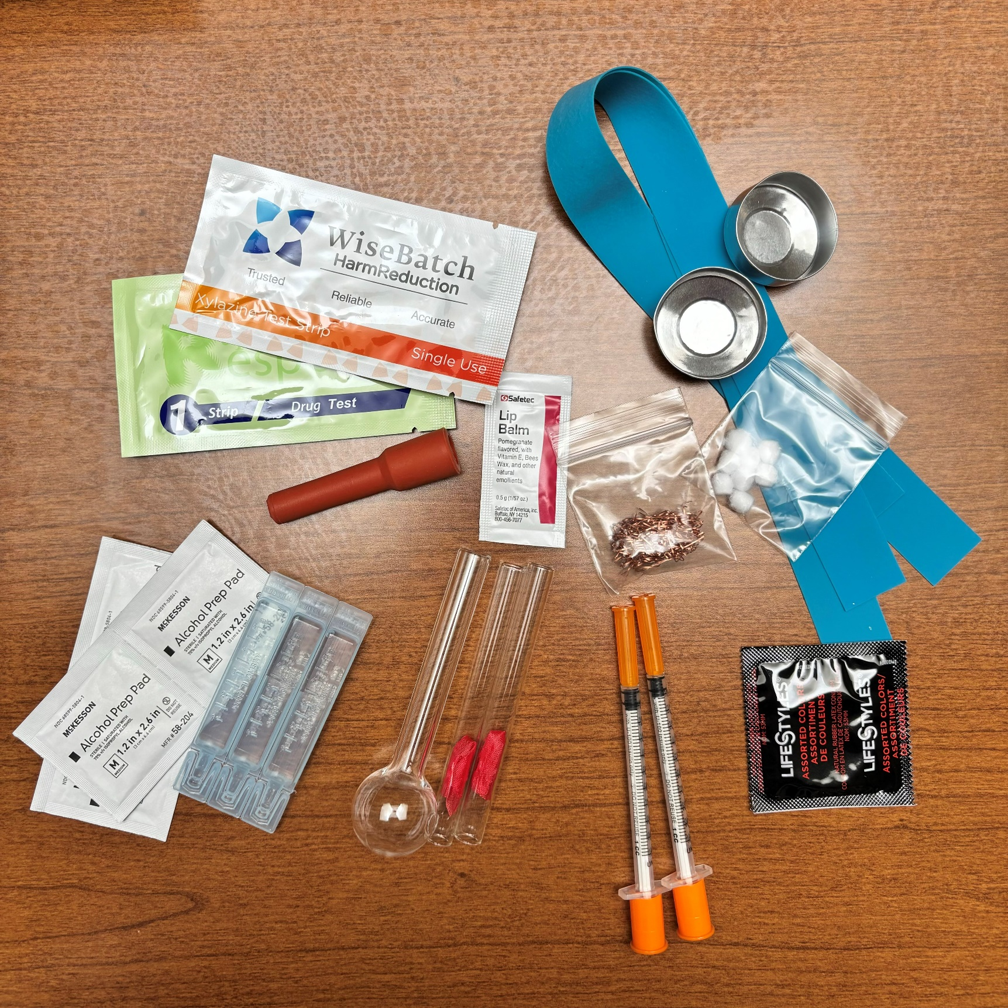

Slide 13
Behavioral Health Clinician
Treatment Program Specialist
Peer Recovery Coach
Medical Provider
CAT Tech
Nurse
TEAM STRUCTURE

Slide 14
ADMISSIONS PROCESS
3 PATHWAYS TO CAT TEAM
Self- Select via Screening Tool
Transfer per BMH provider
Admissions Triage

Slide 15
ADMISSIONS TRIAGE
TEAM TRANSFER
Admissions Staff can pre-select patients for the CAT team based off the following criteria:
Patient has required sedation monitoring at BMH in the last 6 months.
Patient has overdosed at BMH in the last 6 months.
Patient has been actively using substances at BMH (or in community per referring provider) in the last 6 months.
Some patients may be transferred to the CAT team during their BMH stay per provider/ nursing request.
This would be due to the patient requiring additional supports regarding their substance use during their admission.

Slide 16
We are expanding our services at the Barbara McInnis House so we can better support our patients. Please complete this questionnaire so we can place you on a team to best fit your individual needs.
Screening Tool
Please check the box if any of the following statements apply to you:
I would like additional support with my substance use.
I have experienced an overdose in the past month.
I have recently returned to use after a period of abstinence
Anything else you would like us to know? __________________________________________________________________________________________________________________________________________________________________________________________
Name: ________________________
Signature: ________________________

Slide 17
Patient Rooms:
Initial goal was for admissions to cohort patients on CAT teams in same rooms, close to sedation monitoring room.
This was to keep these patients close to supports/ resources.
This idea was also to try and keep patients engaging in active use and patients who were trying to maintain sobriety as separate as possible to support different patients goals/needs throughout their stay, and help them avoid potential triggers. .

Slide 18
“ARE WE ALLOWED TO USE DRUGS HERE?”
We are not a safe consumption site. Drugs are not legally allowed in our facility.
Monthly town hall meetings with patients to reiterate policies and hear their concerns and questions.
We strive to support all patients in completing the goal of their respite stay, including those who are struggling with active substance use. Our objective is to provide equitable, quality care to all patients.
If patients are suspected of using or discovered to be using, focus on safety and harm reduction education rather than being punitive.
We want the patients to remain in care and feel supported, not stigmatized.
If a patient is found with illicit substances or paraphernalia on their person, they are given the option to keep it and discharge or turn it in to staff to be disposed of and remain in respite.
We want to give patients the autonomy to make this decision because it is their property.

Slide 19
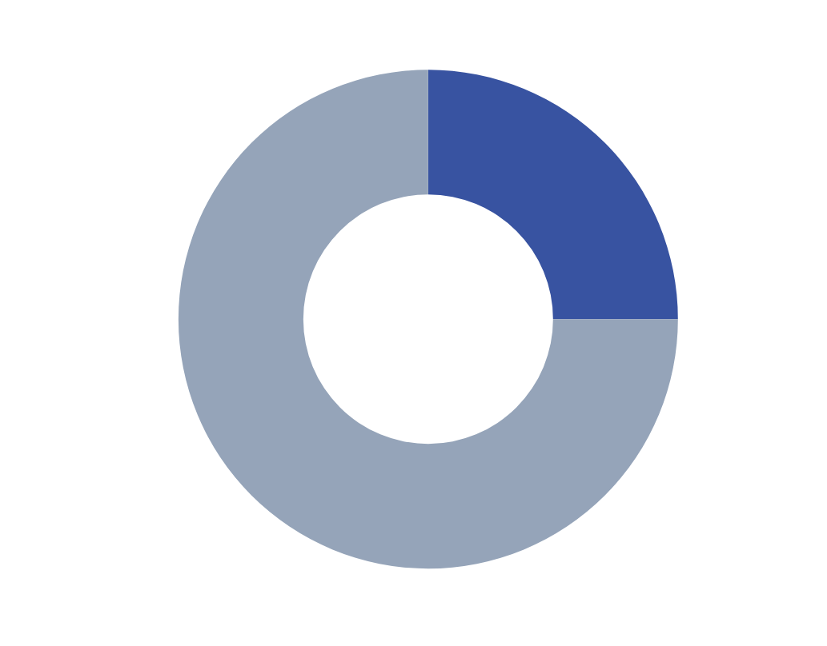
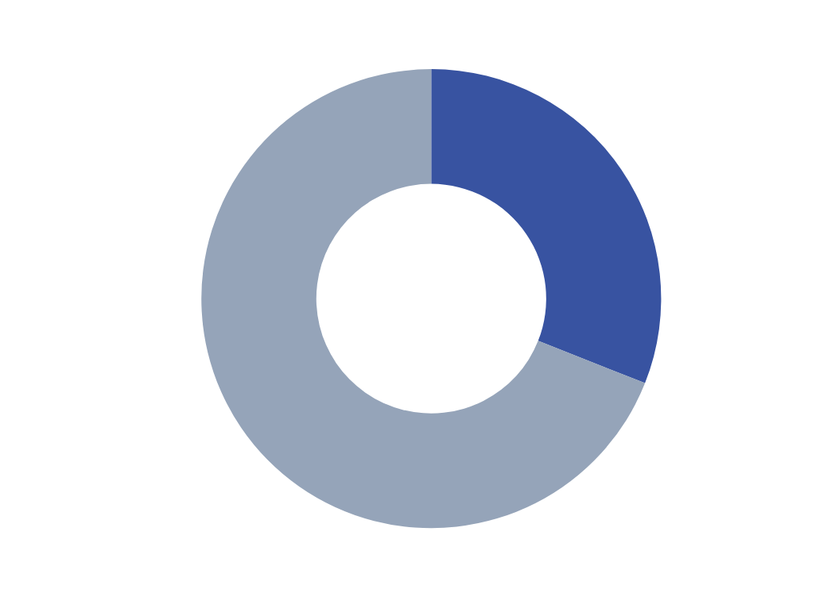
FIRST YEAR STATS
6/5/23-5/7/24
*Second CAT team didn’t open until September 1st, 2023
336 unique CAT patients (31% of all 1090 BMH patients)
415 distinct admissions (25% of all 1662 BMH admissions)
Notes:
TOTAL (CAT + other teams):
1,090 unique patients
1,633 discharges
ALOS 17.6
So, during the period 6/5/2023 to 5/7/2024, CAT patients represented
31% of unique patients
25% of discharges
21% of total days
Or looking at it another way, non-CAT patients represented
754 unique patients
1,218 discharges
ALSO 18.6

Slide 20
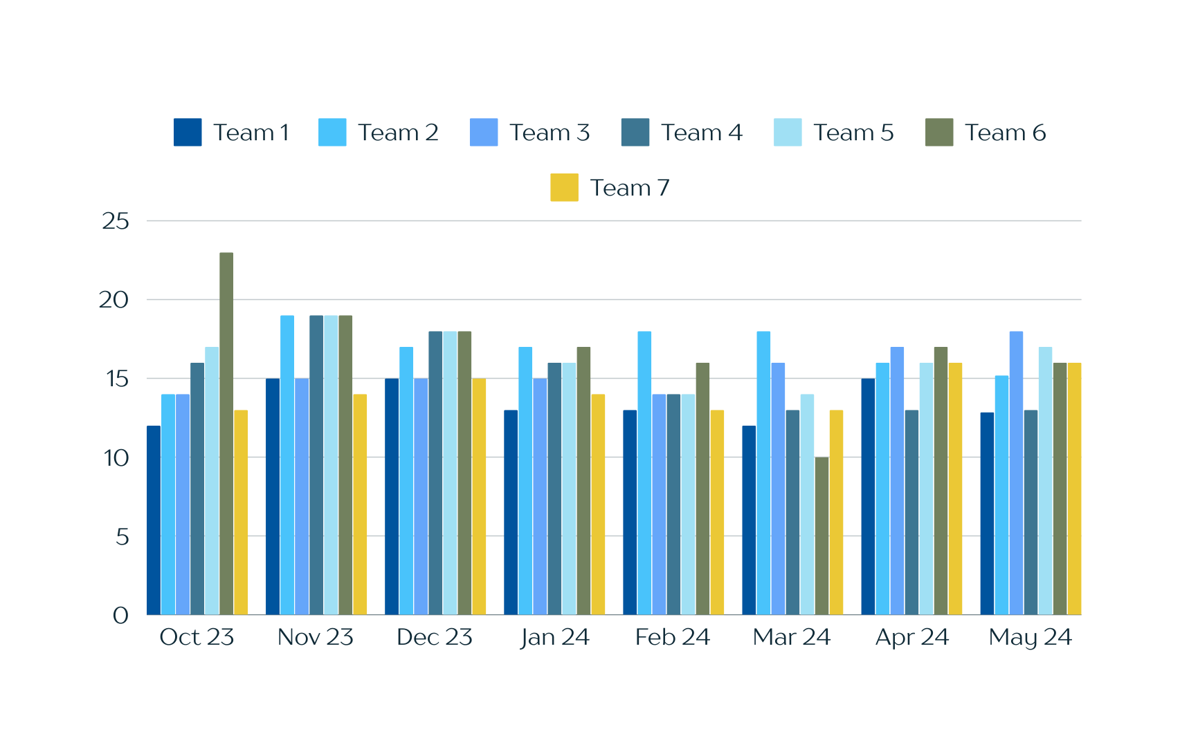
AVERAGE LENGTH OF STAY
Average length of stay on the CAT team = 14.6 days (see yellow bar)
Average length of stay on standard patient teams 18.6 days.

Slide 21
AVERAGE LOS FOR CAT TEAMS
Max LOS for Team 6 was 144 days.
Max LOS for Team 7 was 80 days.

Slide 22
CAT/ BOLT TEAM
BHCHP Infectious Disease Outreach Team
Serving patients with SUD experiencing homelessness with serious or recurrent injection related infections requiring additional support to complete their antibiotic course.
This team can be supportive for CAT patients who are at risk of leaving prior to completing antibiotics or creating a contingency plan should they not be able to remain in care.
Explains the longer LOS on this team (vs. other CAT), as these patients frequently have extensive course of IV abx, and stay for further monitoring if possible.
Additional CAT supports have helped retain these patients in respite to complete their antibiotic courses.

Slide 23
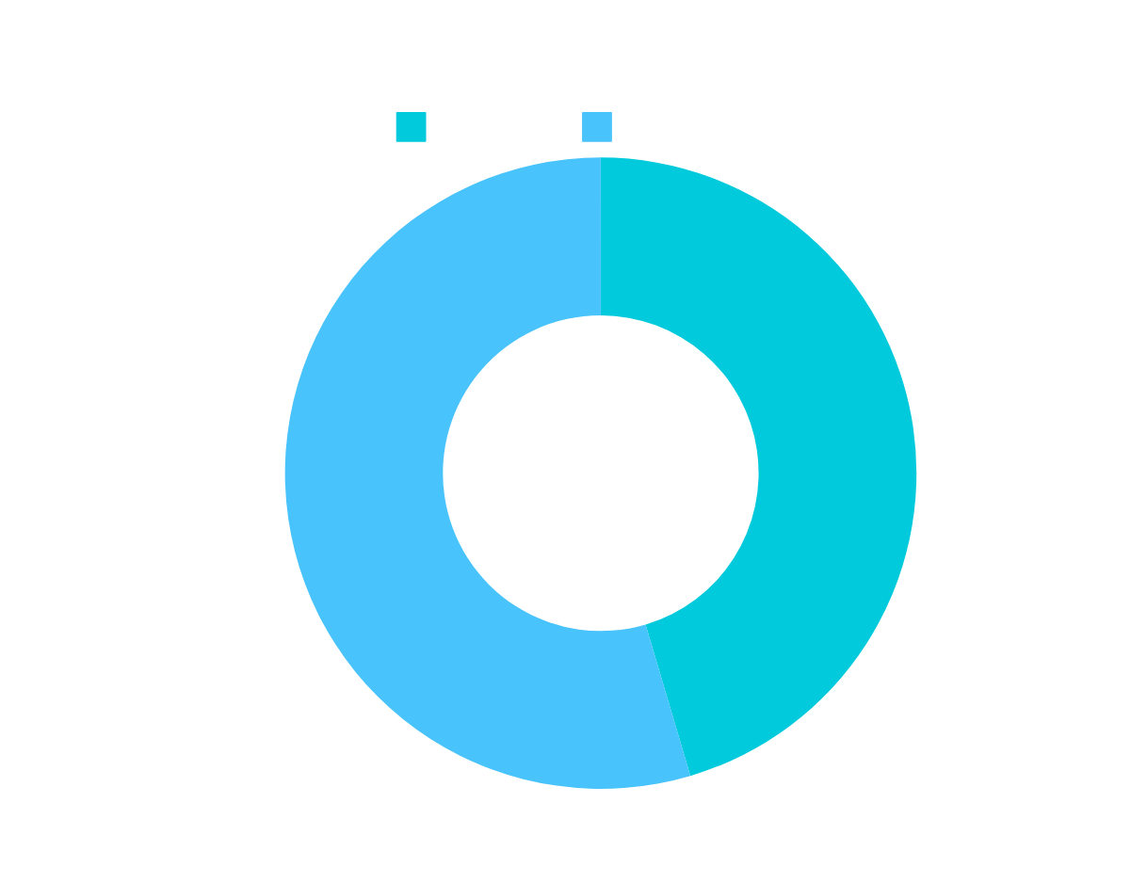
SEDATION MONITORING
6/5/23-5/7/24
114 CAT patient sedation monitoring encounters
137 non-CAT patient sedation monitoring encounters
251 sedation monitoring encounters total

Slide 24
CAT SEDATION MONITORING
6/5/23-5/7/24
Overall, for CAT patients, 50 had sedation monitoring during at least one of their stays (50 patients, 57 distinct stays)
14.9% of patients had sedation monitoring at some point during the patient’s stay.
Sedation monitoring was higher for Team 7 than Team 6
Since Team 6 didn’t open until September, this data is skewed.

Slide 25
CAT SEDATION MONITORING
6/5/23-5/7/24
23 unique patients admitted to a CAT initiated methadone for acute opioid withdrawal under the 72-hour rule with connection to ongoing treatment at an OTP.
Only have this data through March at this time.
Notes:
Data through March: on 74 distinct occasions, preventing that number of send outs to the Emergency Department

Slide 26
NARCAN PROTOCOL

Slide 28
OVERDOSE AND SEDATION EVENTS AUGUST 2023- JANUARY 2024 (POST CAT)

Slide 29
KEY FINDINGS
Overall overdose and sedation monitoring events increased from 12 (2 sedation, 10 overdose) to 16 (3 sedation, 13 overdose).
ED send-out rate for overdoses and sedation events decreased from 91.67% to 56.25%.
Narcan administration decreased from 1.5 doses per event to 1.06 doses per event.

Slide 30
COMPLETION OF CLINICAL GOAL PRIOR TO DISCHARGE

Slide 31
CASE EXAMPLES
44 y/o man with a history of significant childhood trauma and early onset of substance use as an adolescent, OUD on methadone, and chronic HCV, admitted to BMH on 8/16/23 from the street for cellulitis and abscess of LLE with I&D 2 weeks prior.
Multiple past BMH admissions < 1 week with administrative and patient directed discharges.
Recent death of his partner in a traumatic accident.
Treated with oral antibiotics and daily wound care with resolution of LLE infection.
Connected with HCV team to start treatment process.
Discharged to an inpatient treatment program on 9/12/23 after completing a 28-day BMH admission.
Expressed gratitude for the CAT techs and CAT room, as well as not being discharged for use.
“This is the longest I’ve ever stayed here!”

Slide 32
40 y/o man with OUD on methadone and end stage liver disease admitted to BMH on 2/6/24 after hospital admission for volume overload in the setting of decompensated cirrhosis and scrotal cellulitis.
When patient first started coming to respite, he couldn’t stay more than 48-72 hours due to cravings.
He was stabilized on his diuretics and completed antibiotics for his infection successfully during this admission.
Patient expressed gratitude for CAT team and safety he felt in 499.
Near the end of his stay he came into 499 to talk about his wishes for the end of his life with staff he trusted.
He left via patient directed discharge after 35 days on 3/11/24.
Prior to leaving, he came to staff and asked for them to prep a safer use kit and give it to his nurse, because he knew he frequently felt the urge to leave on the weekends.
CASE EXAMPLES

Slide 33
CASE EXAMPLES
52 y/o man w/ OUD admitted to BMH on 12/11/23 after a prolonged hospitalization for complex L2-L3 osteomyelitis-discitis with epidural abscess requiring spinal decompression and surgical debridement, followed by 6 weeks of IV abx and 3-6 mos of oral abx.
He was on high doses of opioid analgesics for pain control and had been attempting to start Suboxone via a microdose induction for several weeks. Not on MOUD at time of BMH admission.
Multiple overdoses requiring Narcan in his first week at BMH; found injecting into his PICC line and flushing it with tap water on several occasions by team nurses. Harm reduction education performed.
Sent to the ED on 12/17 for AMS and fevers, found to have VRE bacteremia and candida albicans fungemia. Admitted to the hospital from 12/17-12/21. PICC removed. No evidence of endocarditis. Treated with appropriate abx and antifungals.
Returned to BMH, completed abx. He continued to try transition to Suboxone at BMH but was not successful, eventually decided to start MMT. No additional overdoses. Supported by entire care team, engaged in art. Discharged to an inpatient substance use treatment program on 3/7/24.

Slide 34
39 y/o woman with OUD on MMT and recurrent MV endocarditis in the setting of IVDU and partial treatment due to self directed discharges from hospitals.
She underwent bioprosthetic valve replacement on 12/15/22. Several reinfections caused severe prosthetic valve stenosis and moderate MR causing NYHA class III-IV HF.
Admitted to a nearby hospital on 10/7/23 (left 10/14 but returned 10/15) with fevers and AMS. Found to have MV endocarditis with aortic root abscess, B/L endophthalmitis, septic emboli causing CVA with hemorrhagic transformation, splenic infarct, and LLE embolism causing limb ischemia and requiring embolectomy/fasciotomy.
She was admitted to BMH on 11/9/23 to complete an 8-week IV abx course. Her infections and her opioid use stabilized.
She underwent a successful surgical repair of her prosthetic mitral valve on 4/3/24 and is still at BMH.
CASE EXAMPLES

Slide 35
EXPECTATIONS VS. REALITY
Patients were very quick to trust CAT techs and utilize CAT room.
Less sedation monitoring than expected, CAT techs’ role is much broader
Methadone connection
Sublocade connection
Groups w/ BH team
Harm reduction education and supplies
Mindfulness and meditation
Bio-psych social evaluations for treatment program referrals
Wound care and phlebotomy for CAT patients
Not all use is the same – varying levels of use in one room can be challenging for patients
Cohorting was not as realistic as we thought it would be.
More sedation monitoring of non-CAT patients.

Slide 36
NEXT STEPS
Re-evaluate the admissions screening process.
How can we better support patients with varying levels of use?
Changes in cohorting patients with active use
Gather patient and staff experience data
Methadone satellite site – ability to titrate dosing, decrease in opportunities for drugs to enter the building
Collecting data on completion of respite goal
Determine other metrics that would be helpful to measure in order to gauge success of CATs.

Slide 37
CONCLUSION
Providing medical and behavioral health care to patients with active substance use in a residential respite facility is a novel and innovative approach to caring for patients with SUD and acute medical co-morbidities. In the past, active drug use was grounds for discharge from BMH, regardless of completion of medical treatment.
Providing on-site sedation monitoring, harm reduction education, and behavioral health and medical support through the addition of two Complex Addiction Teams has allowed us to decrease patient send outs to the ED and retain patients in care for an average of 14 days, a length of time previously unthinkable for many of them.
Continued work remains in measuring completion of medical goals, connection to treatment, and patient and staff experience.

Slide 38
Sources
1.Carusone SC, Guta A, Robinson S, et al. “Maybe if I stop the drugs, then maybe they’d care?” – hospital care experiences of people who use drugs. Harm reduction Journal 2019; 16:16.
2.Eaton E, Westfall AO, McClesky B, et al. In-hospital illicit drug use and patient-directed discharge: barriers to care for patients with injection-related infections. Open Forum Infectious Diseases 2020; 1-7.

Slide 39
QUESTIONS?
THANK YOU!

