Slide 1
Workforce Development: Meeting Multiple Needs in One Program
National Health Care for the Homeless Council
Annual Conference, May 2024
Mia Arias, Director, Operations , Medi-Cal & CalAIM, CalOptima Health
Mark Loranger, CEO, Chrysalis

Slide 2
Agenda
Introductions and Background
Who is in the audience?
The Opportunity in Orange County
The Steps Program & Successes
Discussion & Questions

Slide 3
Who is here today?
Who works at an organization that hires individuals with lived experience?
Practitioners? Administrators?
Funders? Health plans?
Other nonprofits?

Slide 4
Introductions & Background
CalOptima Health
Chrysalis
The Member/People we serve
Notes:
Could you each do a quick introduction of yourselves and also describe the other stakeholders you engage in this effort?

Slide 5
Mission: To serve member health with excellence and dignity, respecting the value and needs of each person
Founded as Orange County’s community health plan for low-income families, seniors and people with disabilities
Serves 1 in 4 adults and 1 in 3 children in Orange County
Has 1,500 employees and an annual budget of $4 billion
Notes:
The Managed Care Organization in OC….Kaiser added this past year as an option in the County.

Slide 6
Chrysalis serves people navigating barriers to the workforce by offering a job-readiness program, individualized supportive services, and paid transitional employment. We empower our clients on their pathway to stability, security, and fulfillment in their work and lives.

Slide 7
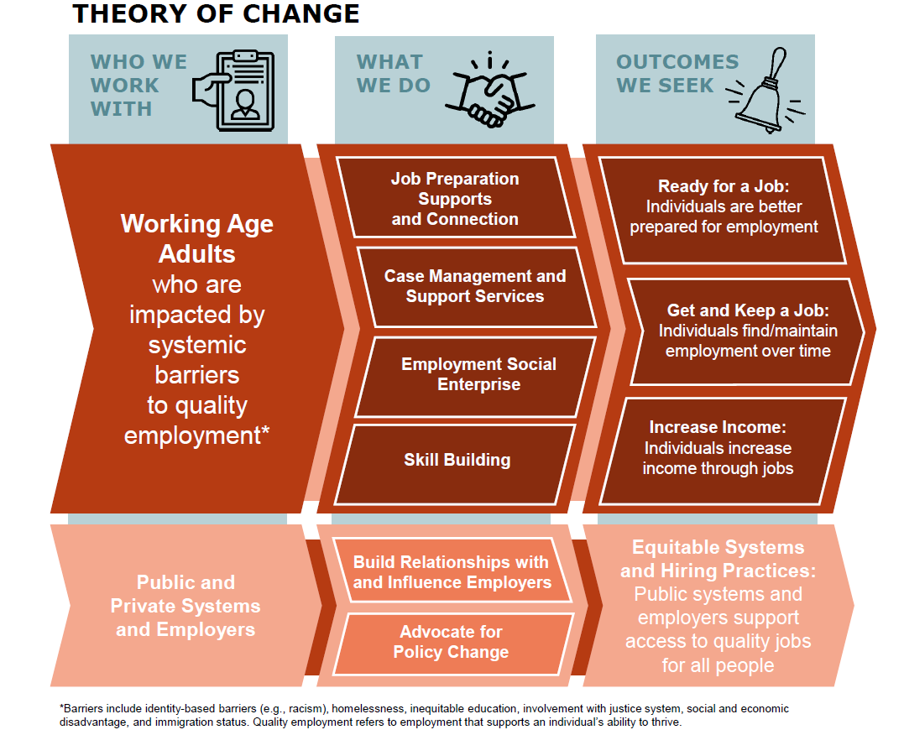
We envision a community where everyone has the opportunity to work and thrive!

Slide 8
1,683 clients secured employment, Earning an average hourly wage of
$18.80
2023 program results

Slide 9
1,859
individuals worked a transitional job with Chrysalis, making an average of
$17.50
an hour, for a cumulative
sum of
$20 M⁺
in wages earned by
Chrysalis clients.
*2023 program data
OUR SOCIAL ENTERPRISE
Chrysalis has four employment social enterprise business divisions which offer transitional jobs to clients, giving them the opportunity to earn a paycheck and develop marketable experience and occupational skills within a supportive work environment as they continue to search for employment.
A transitional job with one of our business lines is often the steppingstone clients need to move on to employment outside of our organization.
Staffing & Direct Hire
Works
Roads
Safekeeping

Slide 10
CalAIM Transforming Medi-Cal
Five-year broad transformation effort to make Medi-Cal a more coordinated, person-centered, and equitable health system.
The Incentive Payment Program supports the implementation and expansion of CalAIM initiatives by investing funds to:
Increase ember engagement and service delivery, including reaching new members
Build sustainable infrastructure and capacity, including​ health information technology, workforce, and provider networks
Promote program quality, with measurable impacts on utilization
Create equitable access for ECM Populations of Focus (PoFs), includi​ng those newly becoming eligible for services in 2023 and 2024

Slide 11
Medi-Cal Transformation

Slide 12
The Opportunity in Orange County
Lack of employment opportunities for people with lived experience and other employment barriers.
Lack of trained job applicants to increase the capacity of the homeless services continuum in the County.
Lack of service providers reflective of the community and population being served.

Slide 13
The STEPS Program
A workforce development training program that builds a pipeline for trained personnel to build the capacity of homeless service providers in Orange County.

Slide 14
Play Video…need to embed…
https://youtu.be/KGTPq3khl38?si=SIV3fVN8osg98rLZ

Slide 15
Partnership and Program Overview
Notes:
Describe what role each of our orgs play in the partnership/program….
Describe shelter other employer involvement…
Share any outcomes we have to-date…

Slide 16
Challenges and Lessons Learned
Notes:
Wage discrepancies across employers
Effort to build a career pathway beyond entry-level employment
Supporting employers to reduce employee barriers

Slide 17
Table Discussions
Notes:
After learning more about how this program is designed to enable community members with lived experience to find meaningful careers, what barriers or challenges do you see making that happen in your organization/sector? How would you try to overcome them?
If you were to design a small test or pilot (what we just described was a pilot—maybe a bit larger than most, but still a test), what might that look like for your organization?​

Slide 18
Questions

Slide 19
Thank you

