Slide 1
“One Stop Shop” Viral Hepatitis Treatment for Hennepin County Healthcare for the Homeless Clients
How to set your image in the placeholder
Right click image and select “format picture”
Select “Picture” tab
Select Crop from the drop down menu
Under Picture Position, use the Offset X and Offset Y to position your image within the frame
delete this when no longer needed
Dr. Amy Gordon, DNP, NP-C
Amy.Gordon@hennepin.us
resenter name here
This Photo by Unknown Author is licensed under CC BY-SA-NC

Slide 3
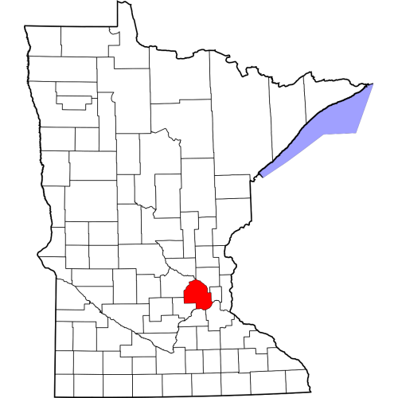
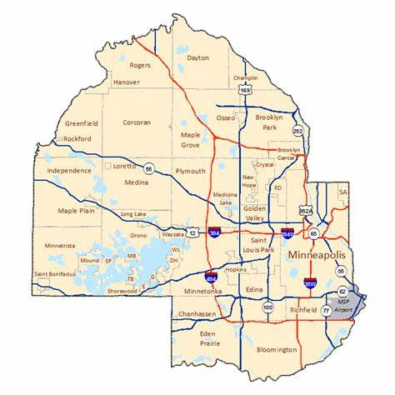
Hennepin County, Minnesota
Population, Census, April 1, 2020 1,281,565

Slide 5
Objectives:
Name Hennepin County (HC) and Health Care for the Homeless (HCH) hepatitis C (HCV) data
Highlight the process Hennepin County HCH took in building the viral hepatitis program
Identify general barriers to HCV care
Investigate medication adherence in a population experiencing homelessness
Recommend healthcare practices

Slide 6
Presentation Context
Hennepin County Healthcare for the Homeless (HCH) started in the 1980s
Services provided but not limited to: mental health, medical, medications for opioid use disorder (MOUD), harm reduction education/supplies and insurance coverage access
Clinics: 2 single adult, family, youth drop center, KOLA, Simpson, outreach and street facing
Hennepin County Medical Center (HCMC)/Hennepin Healthcare (HH)
Viral Hepatitis Clinic and hepatitis C (HCV)
Direct Acting Antivirals (DAAs)
Sustained Virologic Response (SVR)

Slide 7
Presentation context 1/6
Hennepin County Healthcare for the Homeless (HCH) started in the 1980s

Slide 8
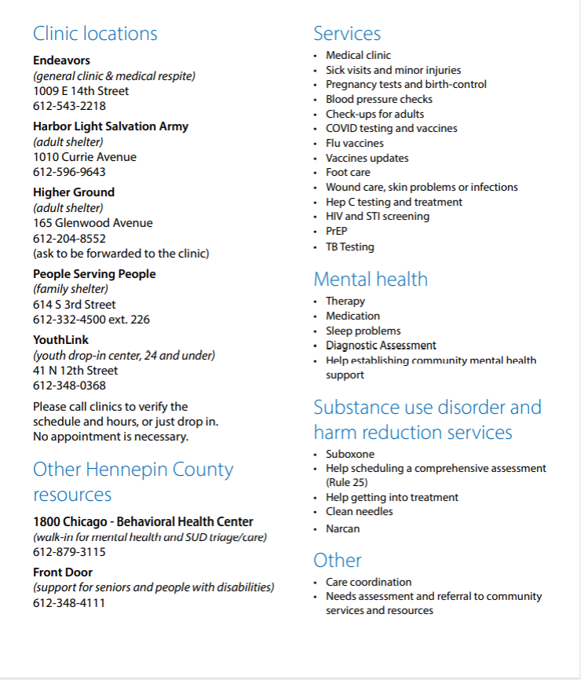
HCH services provided but not limited to:
Mental health
Medical/medical respite
Outreach services
Medications for opioid use disorder (MOUD)
Harm reduction education/supplies
Insurance coverage access
Presentation context 2/6
Presentation context 2/6

Slide 9
Presentation context 3/6
https://img.apmcdn.org/64bd8ca78aff2ff36b2ae948e661a7ab98865769/uncropped/ed0890-20120511-051412tornadohcmc04.jpg

Slide 10
Presentation context 4/6
Viral Hepatitis Clinic
Hepatitis C (HCV)

Slide 11
Prior Authorization (PA)
Presentation context 5/6

Slide 12
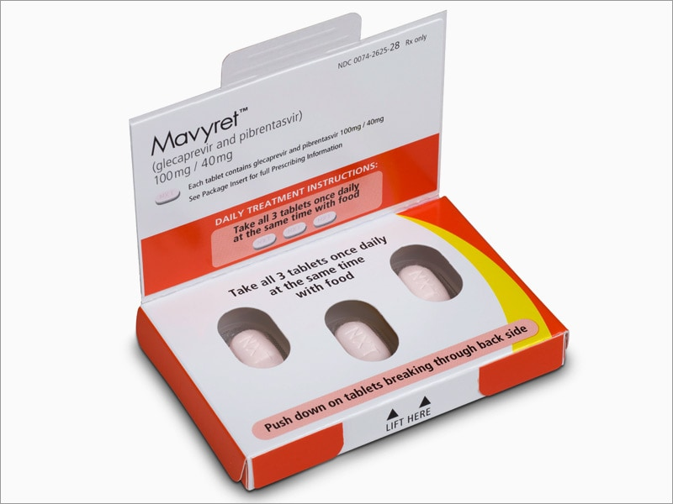
Presentation context 6/6
Direct Acting Antivirals (DAAs)
Sustained Virologic Response (SVR)
CURE
AbbVie Receives FDA Approval of MAVYRET™ for the Treatment of Chronic Hepatitis C - Scipreneur (thescipreneur.com)

Slide 13
Relevant HCV Data

Slide 17
HCH Viral Hepatitis Clinic Beginning
[8/2018
2018
1/2021]
5/2020
End of 2017
HCMC Research started
Collaboration with HCH
49 testing sessions
340 single adults screened in 2 shelters
59 Hep C antibody +
47 PCR +
22 started on treatment
17 achieved SVR (4 not tested)
No treatment failures!
Pandemic

Slide 18
HCH Viral Hepatitis Clinic Progression
9/2021-6/2022
5/2020-12/2021
7/2022
10/2023
Present
Pandemic HCH High Risk Hotels
8 HCV treatments with CURE!
HCH Opportunity Center hepatitis clinic (4 hrs)
HCH Endeavors Viral Hepatitis Clinic (8 hrs)
HCH Viral Hepatitis RN started internal PA process
Upward trend in treatment starts and CURES!!

Slide 19
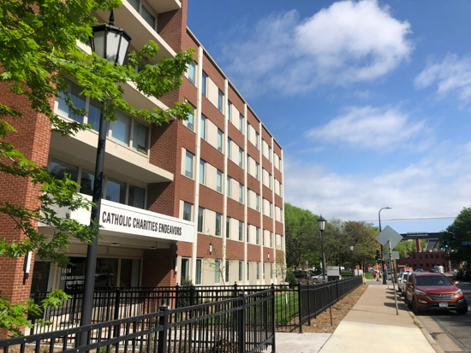

Slide 22
General Barriers of Care:
in a population where histories of mental illness and substance abuse are often the norm.
to incorporate daily basic needs
Unique Obstacles
Building trusting relationships
Finding appropriate prescribing patterns and education techniques
https://www.aafp.org/afp/2006/1001/p1132.html#afp20061001p1132-t1

Slide 23
Trajectory of connection to HCV Care
Initial Engagement
Client Engagement
Takes interest in their medical care
Clinic visit
Treatment
End of treatment
This can look slow and steady, not even talking about Hep C cares
Set up cab ride
Start initially, stop randomly, re-engage in care. TREAT!
Helping to engage in other cares

Slide 24
Strategies to Support Medication Adherence
Address acute patient needs first
Build relationships
Medication storage
Weekly clinic visits (if supportive to patient needs)
HCH Viral Hepatitis team approach (NP, outreach RN, harm reduction specialist)
Weekly outreach medication drops with syringe service exchange

Slide 25
Practice Recommendations
Adapt practice with individualized care plans and self-directed targets
Motivational interviewing (open questions, affirmation, reflective listening and summarizing)
Universal HCV antibody screening with conditional PCR
Vaccination updates

Slide 26
Questions

Slide 27
Dr. Amy Gordon, DNP, NP-C
Amy.Gordon@hennepin.us

Slide 28
References:
Dan, Corrina. (2017). Viral Hepatitis In the News: Fighting Hepatitis C by Providing Treatment at Homeless Shelters. Retrieved July 7, 2020, from U.S. Department of Health and Human Services Web site: https://www.hhs.gov/hepatitis/blog/2017/07/18/fighting-hepatitis-c-by-providing-treatment-at-homeless-shelters.html
Dorr, F., Hennepin County Public Health, personal communication, May 3, 2024.
Health Resources & Services Administration. Health Center Program Terms and Definitions. (n.d.) Retrieved June 30, 2020 from https://www.hrsa.gov/sites/default/files/grants/apply/assistance/Buckets/definitions.pdf
Heineman, J. and Gerrard, M. (2020). 2018 Minnesota Homeless Study: Hennepin County: Characteristics and Trends of Those Experiencing Homelessness in Minnesota. Retrieved June 30, 2020, from Wilder Research Web site: https://www.wilder.org/sites/default/files/imports/2018_HennepinCountyHomelessFactSheet_1-20.pdf
Khalili M, Powell J, Park HH, Bush D, Naugle J, Ricco M, Magee C, Braimoh G, Zevin B, Fokuo JK, Masson CL. Shelter-Based Integrated Model Is Effective in Scaling Up Hepatitis C Testing and Treatment in Persons Experiencing Homelessness. Hepatol Commun. 2022 Jan;6(1):50-64. doi: 10.1002/hep4.1791. Epub 2021 Oct 10. PMID: 34628726; PMCID: PMC8710795.
Minnesota Department of Health Viral Hepatitis Surveillance System, Keavney, S.J., personal communication, May 12, 2022.
Montauk, Susan Louisa, M.D., University of Cincinnati College of Medicine, Cincinnati, Ohio, Am Fam Physician. 2006 Oct 1;74(7):1132-1138. https://www.aafp.org/afp/2006/1001/p1132.html#afp20061001p1132-ot1
National Health Care for the Homeless Council. Understanding homelessness: frequently asked questions. Nashville, TN: National Health Care for the Homeless Council. https://nhchc.org/understanding-homelessness/faq/external icon
Pericot-Valverde, I., Rennert, L., Heo, M., Akiyama, M.J., Norton, B. L., Agyemang, L., et al. Rates of perfect self-reported adherence to direct-acting antiviral therapy and its correlates among people who inject drugs on medications for opioid use disorder: The PREVAIL study. J. Viral Hepatitis, 2021:28:548-557. https://doi.org/10/1111.jvh.13445
Strehlow, A.J., Robertson, M.J., Zerger, S., Rongey, C., Arangua, L., Farrell, E., et al. (2013). Hepatitis C Among Clients of Health Care for the Homeless Primary Care Clinics [Electronic version]. J Health Care Poor Underserved, 2, 811-833.
Tibbetts, K. Hennepin County Public Health, personal communication, May 26, 2022.

