Slide 1
A New Syndemic Approach: Domestic Violence, Homelessness and Harm Reduction
Tanagra M. Melgarejo, MSW, National Director of Capacity Building and Engagement, NHRC
HCH2024
PHOENIX, AZ • MAY 13-16, 2024

Slide 2
National Harm Reduction Coalition creates spaces
for dialogue and action that help heal the harms caused
by racialized drug policies.
Policy & Advocacy
National & Regional
Conferences
Trainings &
Technical
Assistance
Overdose
Prevention
Resources &
Publications

Slide 3
THE HARM REDUCTION APPROACH. ..
Harm reduction utilizes a spectrum of strategies to reduce the negative consequences associated with drug use, sex work, and other behaviors.
SAFER TECHNIQUES
MANAGED USE
ABSTINENCE
Notes:
Pursues a model of public health as social justice Understands the interlocking struggles against inequality and oppression central to both health and liberation
Combats the forms of racism, stigma, marginalization, and criminalization that place people in harm’s way
Affirms the wisdom, dignity, and leadership of those most impacted by these harms as the keys to transformative change.

Slide 4
THE HARM REDUCTION MOVEMENT. ...
Public Health
=
Social Justice
Racism, stigma, and criminalization
cause harm
Ending inequality and oppression, fostering health and liberation
Leadership of the most impacted is key to transformative change.

Slide 5
Personal Autonomy
An individual’s capacity for self determination or self-governance.
Working with people who use drugs requires respect for the choices of the people with whom you are working. It may not be the choice you would make but it is ESSENTIAL you respect the choices of the person as their right.
Recognize that most often, people are making the best choices they can with the tools and resources they have
NASTAD, 2021
Notes:
Being able to decide for oneself a course of action in life, often regardless of any particular moral content, and having one's decisions respected, honored, and heeded within a social and political context

Slide 6
Radical Neutrality and Acceptance
Providing Harm Reduction services requires a willingness to:
“practice radical neutrality; grapple with ethical gray areas; tolerate, accept, and understand difficult behaviors; be taught by our clients; relinquish the role of authority, judge, or expert; [and] partner with clients”.
-Pat Denning and Jeannie Little, co-Founders of the Center for Harm Reduction Therapy

Slide 7
.PRINCIPLES OF HARM REDUCTION
Health and Dignity
Participant Centered Services
Participant Involvement
Participant Autonomy
Sociocultural Factors
Pragmatism and Realism

Slide 8
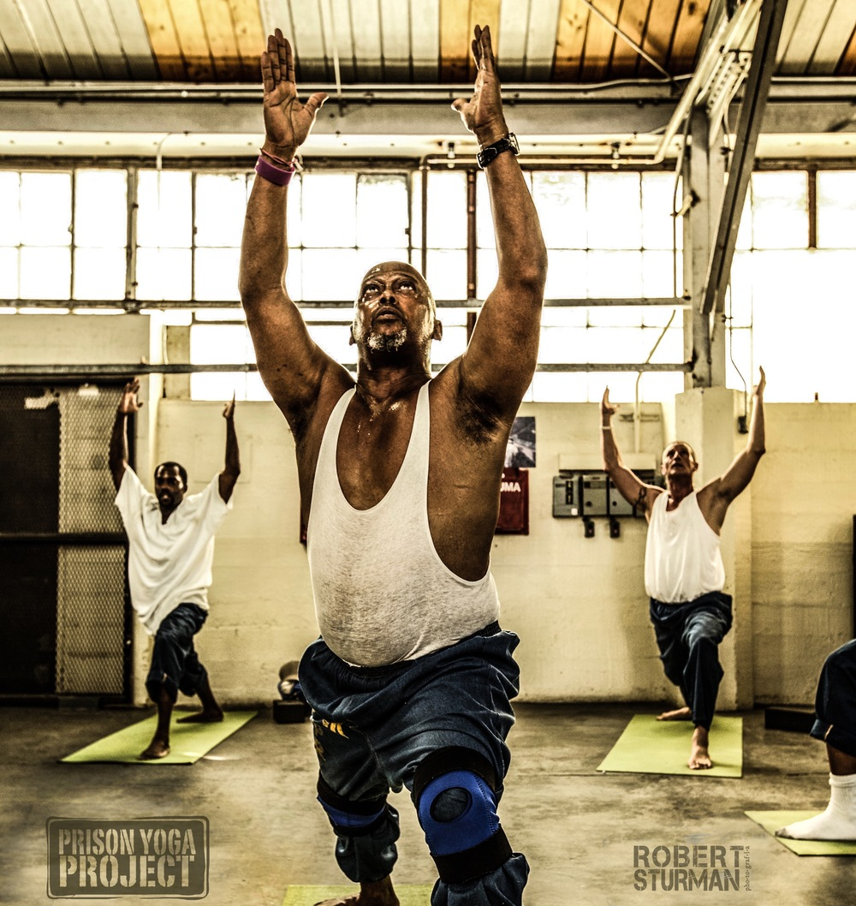
WHAT IS TRAUMA?
Notes:
While on this slide, do group brainstorm of what is trauma, if appropriate at this moment, ask them to look at the photo and remember it for later when we are talking about trauma recovery or practicing HR/TI in our work—open body language, gaze is up or eyes closed signaling vulnerability and safey, body language is not closed, yogis are in balancing poses and strength poses

Slide 9
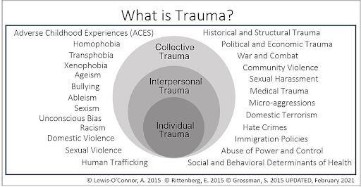

Slide 10
THE THREE “E’S” OF TRAUMA: EVENTS, EXPERIENCE OF EVENTS, AND EFFECT
From SAMHSA’s Concept of Trauma and Guidance for a Trauma-Informed Approach, July 2014
“Individual trauma results from an event, series of events or a set of circumstances that is experienced by an individual as physically or emotionally harmful or life threatening and that has lasting adverse effects on the individual’s functioning and mental, physical, social emotional, or spiritual well-being.’”

Slide 11
Examples of trauma include, but are not limited to:
Experiencing or observing physical, sexual, and emotional abuse.
Childhood neglect.
Having a family member with a mental health or substance use disorder.
Experiencing or witnessing violence in the community or while serving in the military.
Poverty and systemic discrimination.

Slide 12
STRUCTURAL/HISTORICAL/INTERGENERATIONAL TRAUMA:
From SAMHSA’s Concept of Trauma and Guidance for a Trauma-Informed Approach, July 2014
Communities as a whole can also experience trauma.
Natural disaster (e.g., a flood, fire, hurricane).
Circumstances inflicted by one group on another (e.g., the “war on drugs,” usurping homelands, forced relocation, servitude, or mass incarceration, ongoing exposure to violence in the community).
The resulting trauma is often transmitted from one generation to the next in a pattern often referred to as historical, community, or intergenerational trauma.
Notes:
At this point, revisit what they defined trauma as—did they mention structural historical and intergenerational traumas? Elaborate on these if not and get them thinking about it. If you haven’t read Homegoing—maybe choose a different story (but read this!) to discuss an example of the effects to trauma (in this case slavery) through generations

Slide 13
Stigma
Stereotypes (Ideas)
Prejudice (Beliefs)
Discrimination (Actions)
“They are scary, shameful, and less than”
Social
Structural
“People with (________) are incapable, fragile, dangerous, and cannot recover.”
Employers do not hire/support, recovery education lacks effective supports, health insurance doesn’t provide equal coverage
I don’t want them to live next door, be a coworker, or marry into the family
Source: wisewisconsin.org/blog/what-is-stigma/
Notes:
What are the ways that stigma shows up in your clients’ lives, specifically when they are engaging in SUT
v

Slide 14
A social process which can reinforce relations of power and control.
Leads to status loss and discrimination for the stigmatized.
Link and Phelan
Conceptualizing Stigma, 2001

Slide 15
WOMEN USING DRUGS

Slide 16
WHAT ARE SOME HARMS THAT CAN COME FROM USING DRUGS?
SPECIFIC HARMS TO SURVIVORS OF DOMESTIC VIOLENCE?

Slide 17
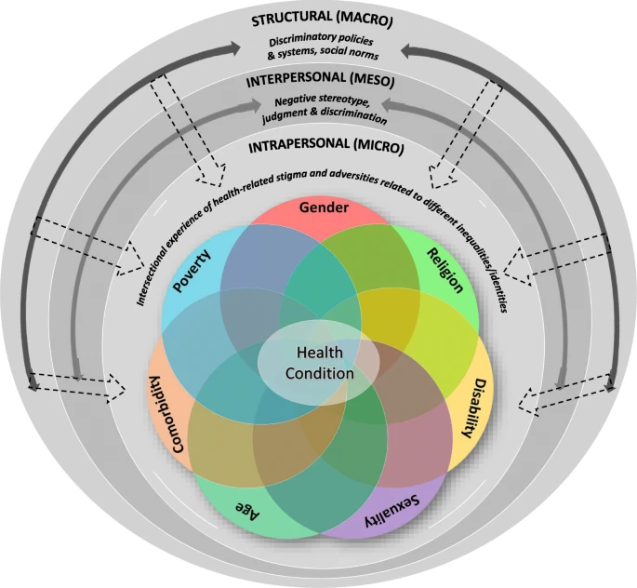
“Sexism, inequality, and discrimination against women in general all intersect with, and exacerbate, the harms to which people who use drugs.”
Notes:
https://equityhealthj.biomedcentral.com/articles/10.1186/s12939-020-01318-w
https://www.unodc.org/documents/ungass2016/Contributions/Civil/INPUD/DUPI-A_War_on_Women_who_Use_Drugs-Web.pdf

Slide 18
COMPOUNDING FACTORS

Slide 19
EXPERIENCES OF VIOLENCE
Reluctant to access harm reduction services even if they are available
Police abuses, including physical and sexual violence
Higher rates of intimate partner violence
Notes:
https://www.unodc.org/documents/ungass2016/Contributions/Civil/INPUD/DUPI-A_War_on_Women_who_Use_Drugs-Web.pdf

Slide 21
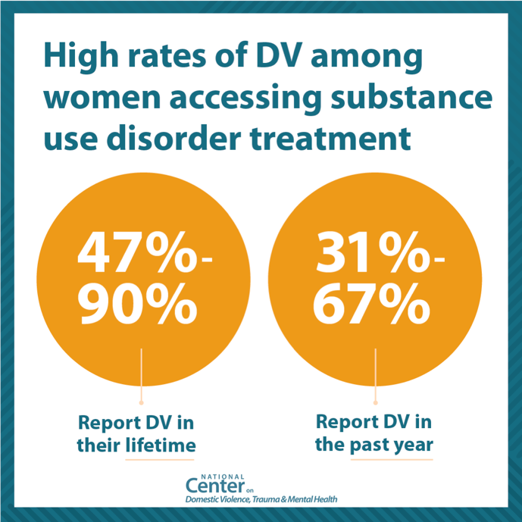

Slide 22
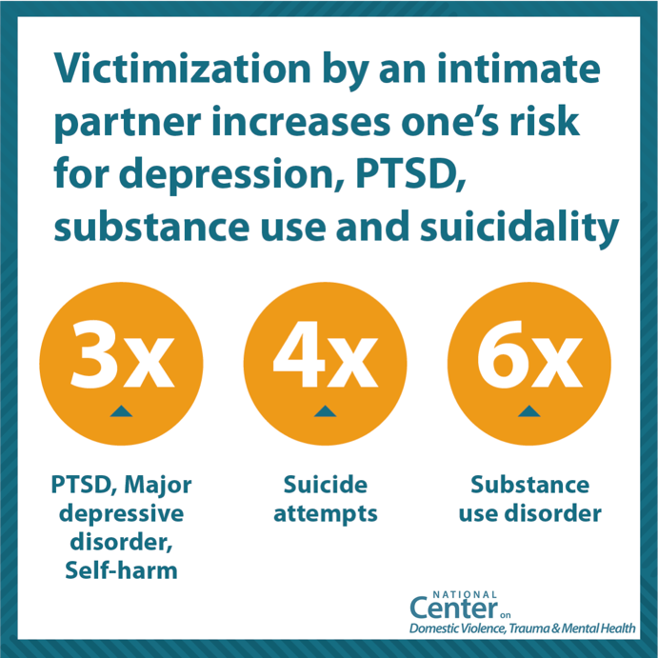

Slide 23
Substance Use Disorder and Survivors
Substance Use Disorder (SUD), often referred to as substance abuse or drug addiction, is a disease that affects one’s brain and behavior. It creates an inability to control the use of substances, like drugs or alcohol, despite the potentially harmful consequences.
Survivors are at particular risk for developing SUD due to the high rate of PTSD within the community. PTSD, coupled with the lack of positive coping skills often leads to substance use for relief. Survivors are 13 times more likely to abuse alcohol and 26 times more likely to abuse drugs than those who have not experienced sexual abuse, according to the American Addiction Center.

Slide 24
Substance Use Disorder and Survivors
Understanding that SUD is a disease developed after trauma, rather than a choice, is fundamental to supporting survivors who are using substances to cope with trauma. SUD creates a neurological change that makes it incredibly difficult to stop substance use.
It’s never as simple as just quitting cold turkey. It is never the survivor’s fault.

Slide 25
Substance Use Disorder and Survivors
Survivors often turn to substances for several reasons:
A coping mechanism or escape from trauma
Reducing feelings of isolation or loneliness
Self-medication
Boost confidence and self-esteem
Self-harm or self-destructive behavior

Slide 26
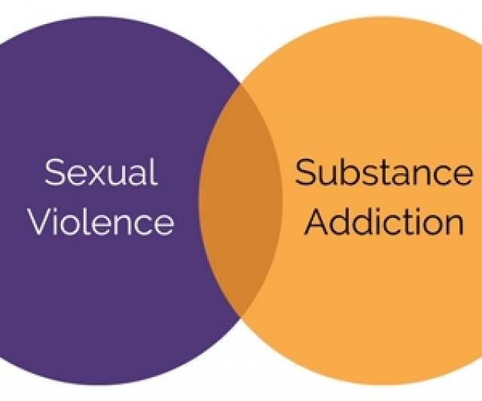

Slide 27
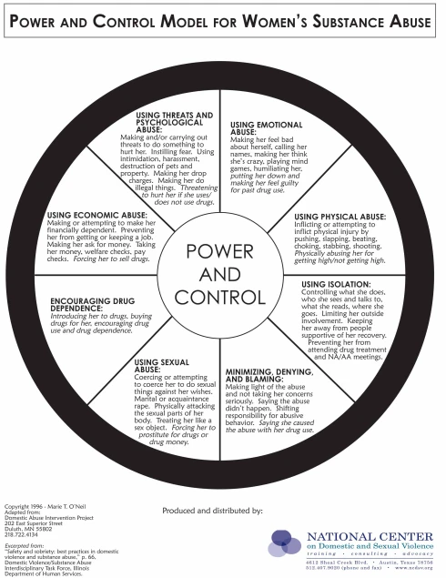

Slide 28
BARRIERS TO SERVICES
STRUCTURAL BARRIERS
Lack of child-care
Unsafe or indiscreet locations
Rigid service schedules, long waits, bureaucratic hurdles
Lack of sufficient services provisions
PERSONAL BARRIERS
Fear of partner violence
Fear of losing their children to government bodies
Personal financial concerns
Fear of losing their partnership

Slide 29
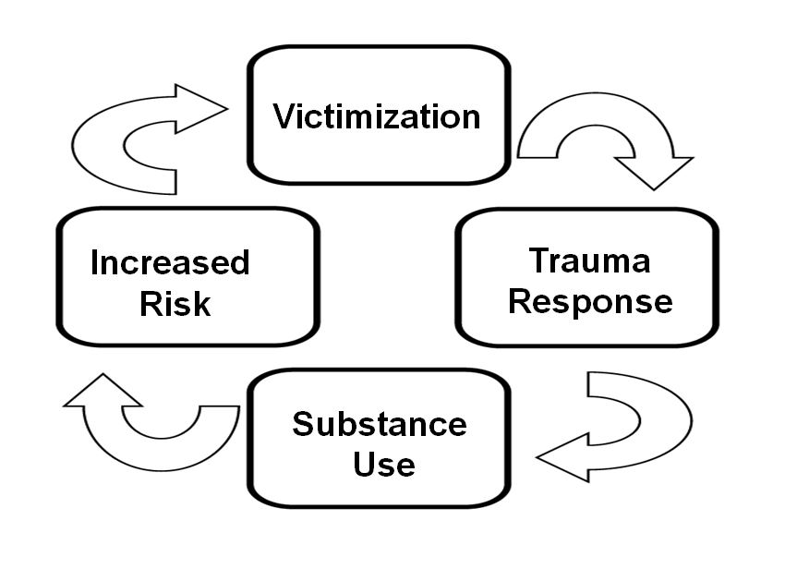

Slide 30
DISCUSSION
WHAT COMPOUNDING FACTORS DO YOU SEE YOUR PARTICIPANTS WHO ARE SURVIVORS EXPERIENCE THE MOST?
WHAT ARE THE IMPACTS?
WHAT OTHER DISPARITIES DO YOU SEE MOST?

Slide 31
Housing and Survivors who Use Drugs
Opportunities for Engagement
and Harm Reduction

Slide 32
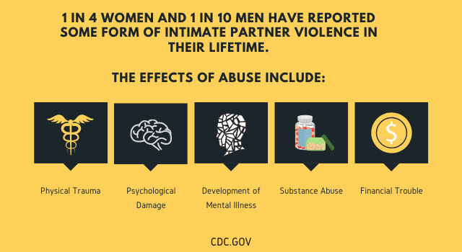

Slide 33
WOMEN AND DRUG USE
Women face unique obstacles to services and treatment
Discrimination and stigma
Lack of child care
Prescribed treatments often have been tested on men
Men are more likely to use drugs and women are more likely to be diagnosed with substance-use disorder
Does more diagnosis = more chaotic use?
Notes:
https://www.unodc.org/documents/ungass2016/Contributions/Civil/INPUD/DUPI-A_War_on_Women_who_Use_Drugs-Web.pdf
https://nida.nih.gov/download/18910/substance-use-in-women-research-report.pdf?v=b802679e27577e5e5365092466ac42e8

Slide 34
THINGS TO KEEP IN MIND
Not enough data on drug use and women
Data assumes women are cisgender
Not enough data on queer women who use drugs
Studies often group LGBTQIA+ all together
Data is not inclusive of trans* women
Studies often group together “transgender people or sexual minorities”

Slide 35
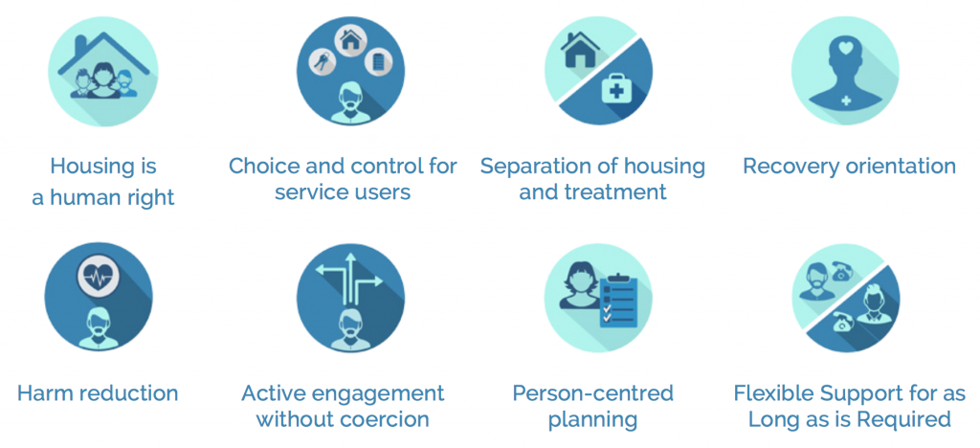

Slide 36
HOUSING FIRST, not HOUSING ONLY
Harm reduction centered housing services is both a philosophy and a practice that values flexibility, individualized supports, participant choice, and autonomy. It never has been housing only, and it never should be.
Supportive services are part of this philosophy & practice and might include formal support services, like a doctor, therapist, or social worker or might involve informal supports, like connecting with family, friends, or faith groups.

Slide 37
HOUSING FIRST, not HOUSING ONLY
Supports are not prescribed - people have the agency to select the supportive services they need and want, tailoring their supports to their own unique situation.
It is not a ONE SIZE fits all approach. We respect and believe in every participant’s autonomy and resilience.

Slide 38
HARM REDUCTION HOUSING CENTERED PRINCIPLES
Health and Dignity
Participant Centered Services
Participant Involvement
Low-Threshold Access to Housing
Individualized, Client-Driven, Voluntary Services
Client Choice and Self Determination

Slide 39
WHAT CAN WE PROVIDE?
Trauma Informed Housing Services
Harm Reduction

Slide 40
What is Trauma Informed Care?
Trauma informed approaches to care shift the focus from “What’s wrong with you?” to “What happened to you?”

Slide 41
Trauma Informed Care
Trauma-Informed Care (TIC) is an approach in the human service field that assumes that an individual is more likely than not to have a history of trauma.
Trauma-Informed Care recognizes the presence of trauma symptoms and acknowledges the role trauma may play in an individual’s life - including program staff.
The intention of Trauma-Informed Care is not to treat symptoms or issues related to sexual, physical or emotional abuse or any other form of trauma but rather to provide support services in a way that is accessible and appropriate to those who may have experienced trauma.
SAMHSA, 2019

Slide 42
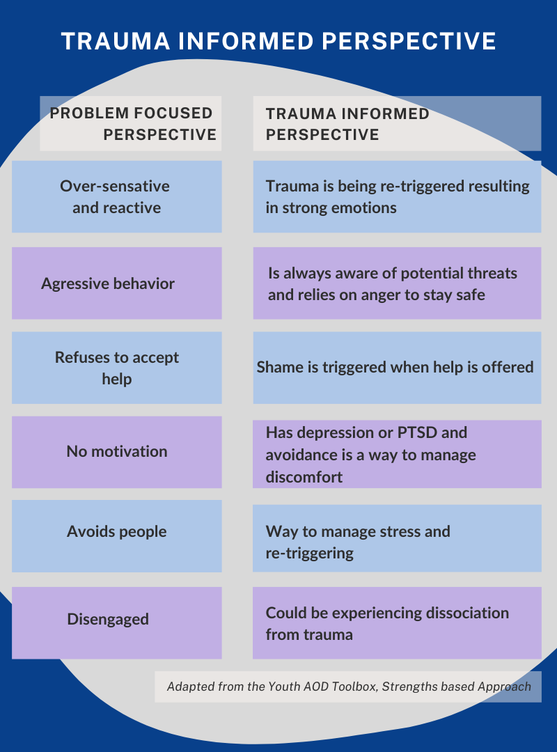

Slide 43
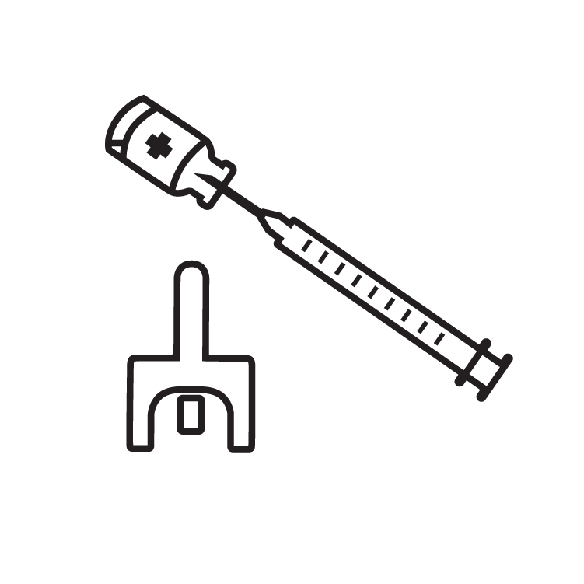
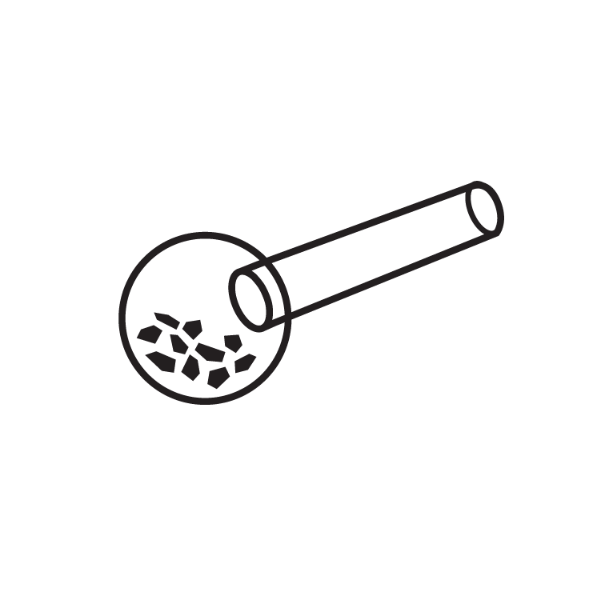
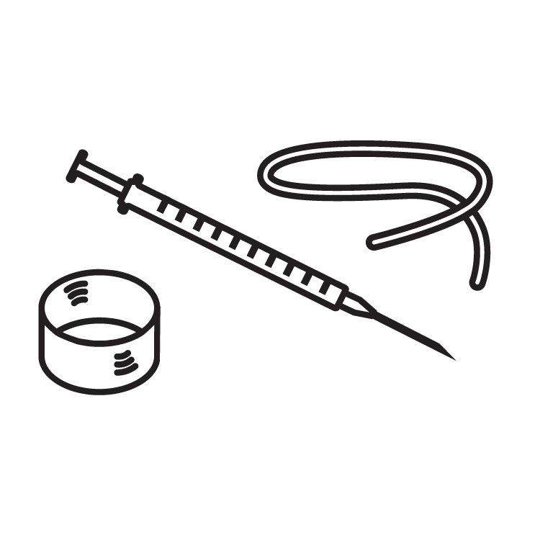
Community Organizing & Policy Change
Drop-In Centers
Housing and Legal Services
Safer Drug Use & Overdose Prevention Materials
Intra Community Skills Sharing
Comprehensive Medical & Health Services
Bad Date Sheet
Safer Sex Materials & Education

Slide 44
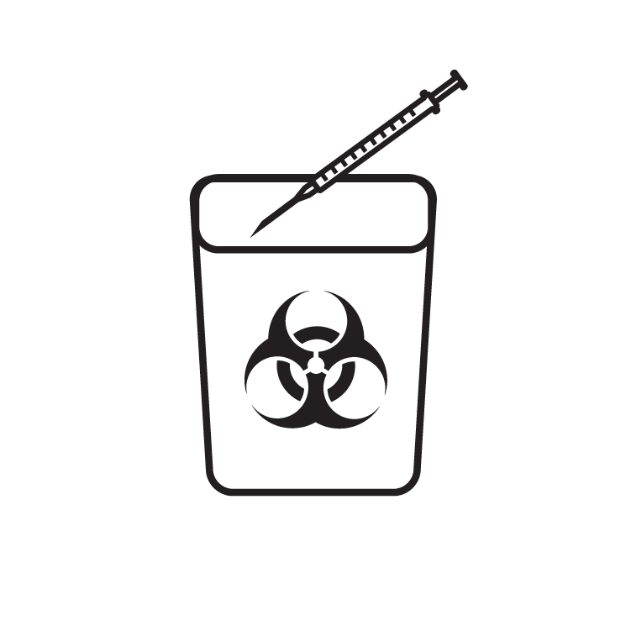
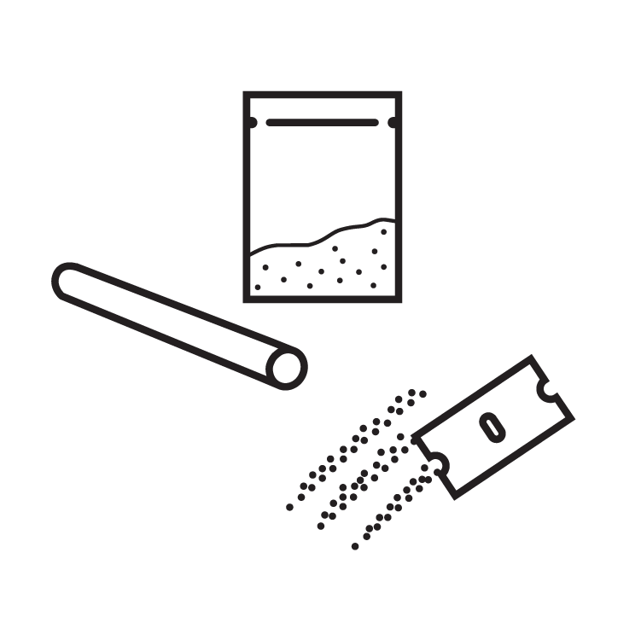
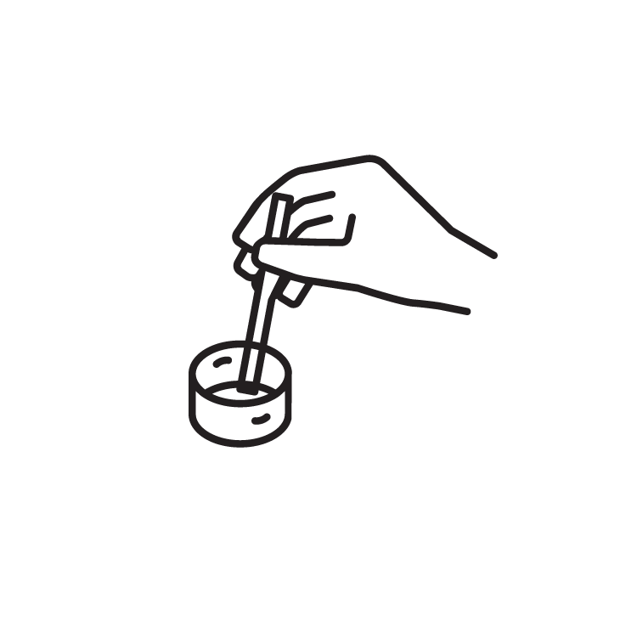
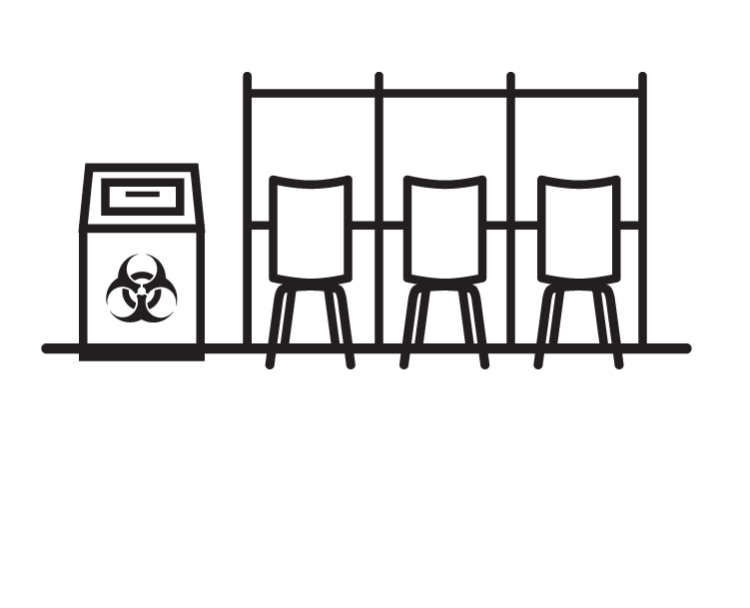
HARM REDUCTION SERVICES.
Syringe Access & Disposal
Safer Drug Use Supplies
Overdose Prevention
Safer Sex Materials
Medication for Opioid Use
Safer Consumption Services
Drop-in Centers
Housing First
Referrals

Slide 47
FROM TRAUMA TO HEALING:
HEALING CENTERED ENGAGEMENT
“A healing centered approach to addressing trauma requires a different question that moves beyond “what happened to you” to “what’s right with you” and views those exposed to trauma as agents in the creation of their own well-being rather than victims of traumatic events.”
Recognizes resiliency, self-efficacy and autonomy.

Slide 48
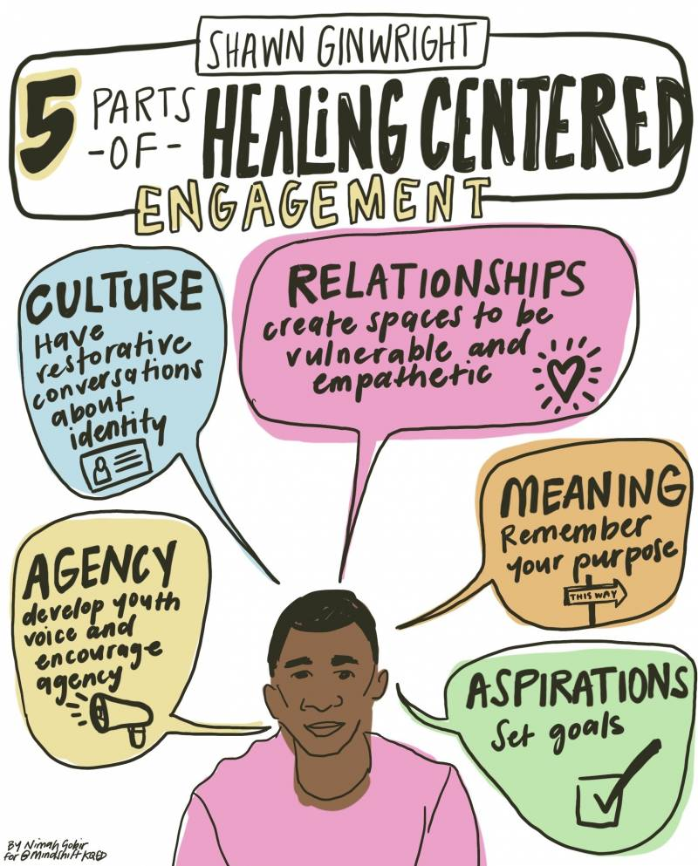

Slide 49
SIX PRINCIPLES OF A HEALING CENTERED APPROACH:
Safety
Trustworthiness and Transparency
Peer Support
Collaboration and Mutuality
Empowerment, Voice, and Choice
Cultural, Historical Issues
From SAMHSA’s Concept of Trauma and Guidance for a Trauma-Informed Approach, July 2014

Slide 50
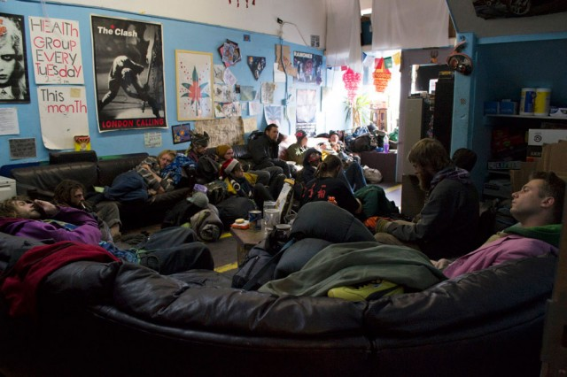
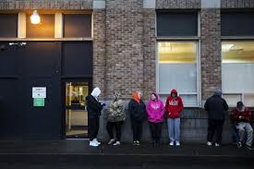
HEALING CENTERED ENVIRONMENTS:
The environment we create communicates our beliefs about the people we serve as well as the way we offer services.
Most of us understand what it feels like to be welcomed (a sense that people want to have us around and that the environment is set up in a way that is comfortable for us).

Slide 51
PATIENT CENTERED CARE, HEALING CENTERED ENVIRONMENTS AND HARM REDUCTION
In person-centered care, people who use services work in partnership with their health and social care professionals.
They are treated with dignity, empathy and respect.
They are supported to develop the knowledge, skills and confidence they need to make informed decisions about and to better manage their own health and care and their care is coordinated and tailored to their individual needs.

Slide 53
Practicing the principles of Harm Reduction and healing centered engagement provides us tools to:
Release ownership over other people’s process and outcomes
Honor any positive change
Center the autonomy and self-determination of every person
Harm Reduction gives us freedom.

Slide 54
THANK YOU FOR ATTENDING THIS WORKSHOP
harmreduction.org
Copyright 2023 National Harm Reduction Coalition
Notes:
Alixe’s eval form: https://forms.gle/RHst6mgt34pc5aeP7

