Slide 1
Utilizing Health Related Patient Data to Advance Health Equity in Clinical Care
Naomi Windham, DNP, APRN, FNP-C (She/Her)
Family Nurse Practitioner & Clinical Quality Improvement Manager, Health Care for the Homeless
Emily Thompson, MPH, BSN (She/Her)
Principal Planning Analyst, Health Analytics
HCH2024
PHOENIX, AZ • MAY 13-16, 2024

Slide 2
Utilizing Health Related Patient Data to Advance Health Equity in Clinical Care
National Health Care for the Homeless Conference & Policy Symposium
Phoenix, AZ May 14th, 2024
Naomi Windham, DNP, APRN, FNP-C (She/Her)
Family Nurse Practitioner & Clinical Quality Improvement Manager, Health Care for the Homeless
Emily Thompson, MPH, BSN (She/Her)
Principal Planning Analyst, Health Analytics

Slide 3
Objectives
Explain structure and demographics of Hennepin County Health Care for the Homeless program
Detail how current program summary reports were prioritized, were created and how they are used in practice
Describe future goals of data reporting for desired improved health monitoring/knowledge and clinical practices
Notes:
Emily

Slide 4
Hennepin County, Minnesota
Largest county (population) in Minnesota, 1.25 million (2023 estimate)
Median income $92,595 (~$18,000 above national average of $74,580) (2022 census estimate)
10.8% of population in poverty (2022 Small area income and poverty estimate)
Home to Minneapolis, 44 other cities and 356 lakes, University of Minnesota
67.2% White, 14.5% Black/African American, 7.7% Asian, 1.1% American Indian and 7.2% Hispanic or Latino
Unemployment rate as of January 2024-2.7% (not seasonally adjusted) (Deed, Labor market information office, local area unemployment statistics)
Notes:
Emily

Slide 5
Wilder Homeless Study
2023- 7% decrease in Statewide Homeless population since 2018, but an increase in the number of older adults (age 55+) experiencing homeless. In Hennepin County total count was 3897 in 2023 a 4.3% decrease from 2018.
In 2023, Four out of every 10 PEH were 24 and under
People in families (with children under 18) accounted for 47% of PEH statewide
In Hennepin County, in the 2018 study:
59% of study respondents in Hennepin reported having a chronic physical health condition
47% reported a physical or mental health condition that limited the kind or amount of work they can do (compared to 22% of Hennepin Residents)
57% reported being told by a doctor or nurse in the past 2 years they had a mental health condition such as major depression, schizophrenia, PTSD, or Bipolar disease
Notes:
Emily- Wilder Homeless Study is a point in time study aimed at better understanding the prevalence of homelessness in Minnesota and understanding the circumstances of those experiencing homeless-done every 3 years
Those include Asthma, TB, Hypertension, cancer, severe chronic pain, chronic heart or circulatory problem, diabetes

Slide 6
Hennepin Health Care (HCH) for the Homeless History
Began in 1988 – celebrated 30 years in 2018!
Joint effort - HC Community Health Dept. in collaboration with MDH and MVNA
Service delivery evolved with homelessness advocacy; from two sites in 1988 to eight clinic sites. Added portable clinical care in 2020
Notes:
Naomi
One of the very first homeless only programs funded in the nation, since 1988
Started small – really grown our program.
Added portable clinical care in 2020 to quickly adapt and provide services where needed (I’ll talk more about)

Slide 7
HCH Service Delivery
5 clinic sites
Street outreach team
Medical Respite team
Employ approximately 60 staff
Services offered: Medical services, Mental health services. Substance use disorder and harm reduction services, and Care coordination and referrals to community resources
Notes:
Naomi
Easy access, shelter-based/drop-in based model
All walk-in, no appointment needed – competing needs. When they need us, we want to be available to them.
Clinic spaces vary, we’ll go on a virtual tour of two of our larger clinics. We also have clinics in church basements – one room.
Hours vary – have had to adjust quickly during COVID, but in general 8a – 8p.

Slide 8
HCH Service Delivery
HCH TANF and PATH work
HCH Recuperative “Medical Respite” Care
Care for people too sick to recover on the streets, but not sick enough to stay or continue to stay in the hospital
Notes:
I mentioned the outreach team. We also have staff who are TANF funded, so they do work with families, mothers, and babies at the family homeless shelter. Perinatal and safe sleep educational classes for example.
Recuperative = Respite Care: You and I might be discharged to received home care, but not possible for people without a home. Literally “home” care for homeless.
People are being discharged from the hospital sooner and sicker these days – this program prevents prolonged lengths of stay in the hospital, prevents readmission, and ensures CoC after our patients are discharged from the hospital.

Slide 9
2022-2023 HCH (UDS) visits by HCH staff (2022-16,467 total visits 2023-18,178 total visits)
Not included are immunizations only, lab draws, wound checks and medication refills
Notes:
Naomi

Slide 10
Hennepin County HCH patient demographics
Serve approximately 4000-4800 patients a year across 5 sites plus street outreach
Approximately16-19,000 visits per year
Average age is 38.5 years
Notes:
Emily

Slide 11
Audience Question #1
What organizations are in the room?
Local Government
Private industry
Health Care
Non-Profit
Other
Notes:
Emily
General population, patients served

Slide 12
Improvement and Innovation
Quality improvement (QI): use of a deliberate & defined improvement process, focused on responding to community needs & improving population health
Continuous improvement (CI) AKA continuous quality improvement (CQI): ongoing, incremental changes resulting in improvements that your stakeholders value
Innovation: implementing something new to make a positive impact
Notes:
Naomi
Def of CI: The act of improving customer satisfaction through continuous and incremental improvements to processes by removing unnecessary steps or activities. The word “improvements” requires data, qualitative, quantitative – to know whether improvement happened. This is a LEAN definition of CI.
It’s focusing on removing things > some definitions are about control how things vary – some definitions focus on how quickly things are functional.
We can continue to refine our own understanding of the definitions of CI and how they align and support the work we do (and our own approach to them).
all the core values are related – interconnected to each other- all the core values support and are supported in continuous improvement
when culture of continuous improvement is there, values the employee input = employee engagement > when you can decide what your work looks like, you’re engaged, invested in the outcomes
Customer Service is lean principle to guide changes we make
Diversity and Inclusion continuous improvement values innovative and unique ideas from diverse perspectives
Workforce Development CI seeks to empower the workforce to develop skills, process, methods to improve; those who do the work, make the solutions
So really, the core values are all tools for us – and in fact,
The county also has “core value behaviors” that we’ve outlined as a tool and that is…..

Slide 13
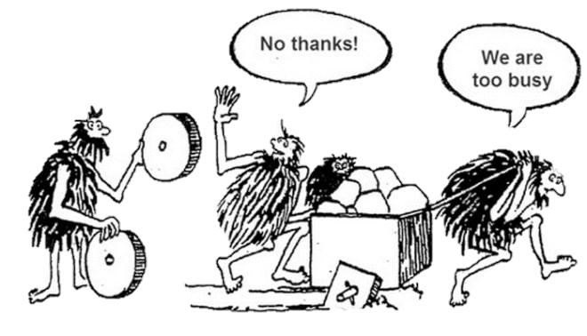
Improvement principles
Meet needs of those you serve
Breakdown barriers, combat racism, & reduce disparities
Use data
Engage stakeholders
Make small, quick, incremental changes
Notes:
Naomi
124
As we go about improving and innovating there are some fundamentals we try to keep in mind

Slide 14
Improvement principles
Don't reinvent the wheel – steal shamelessly, share senselessly
Prioritize
Communicate
Integrate improvement & innovation into the way you work
Most problems are found in processes not in people
Notes:
Emily
125

Slide 15
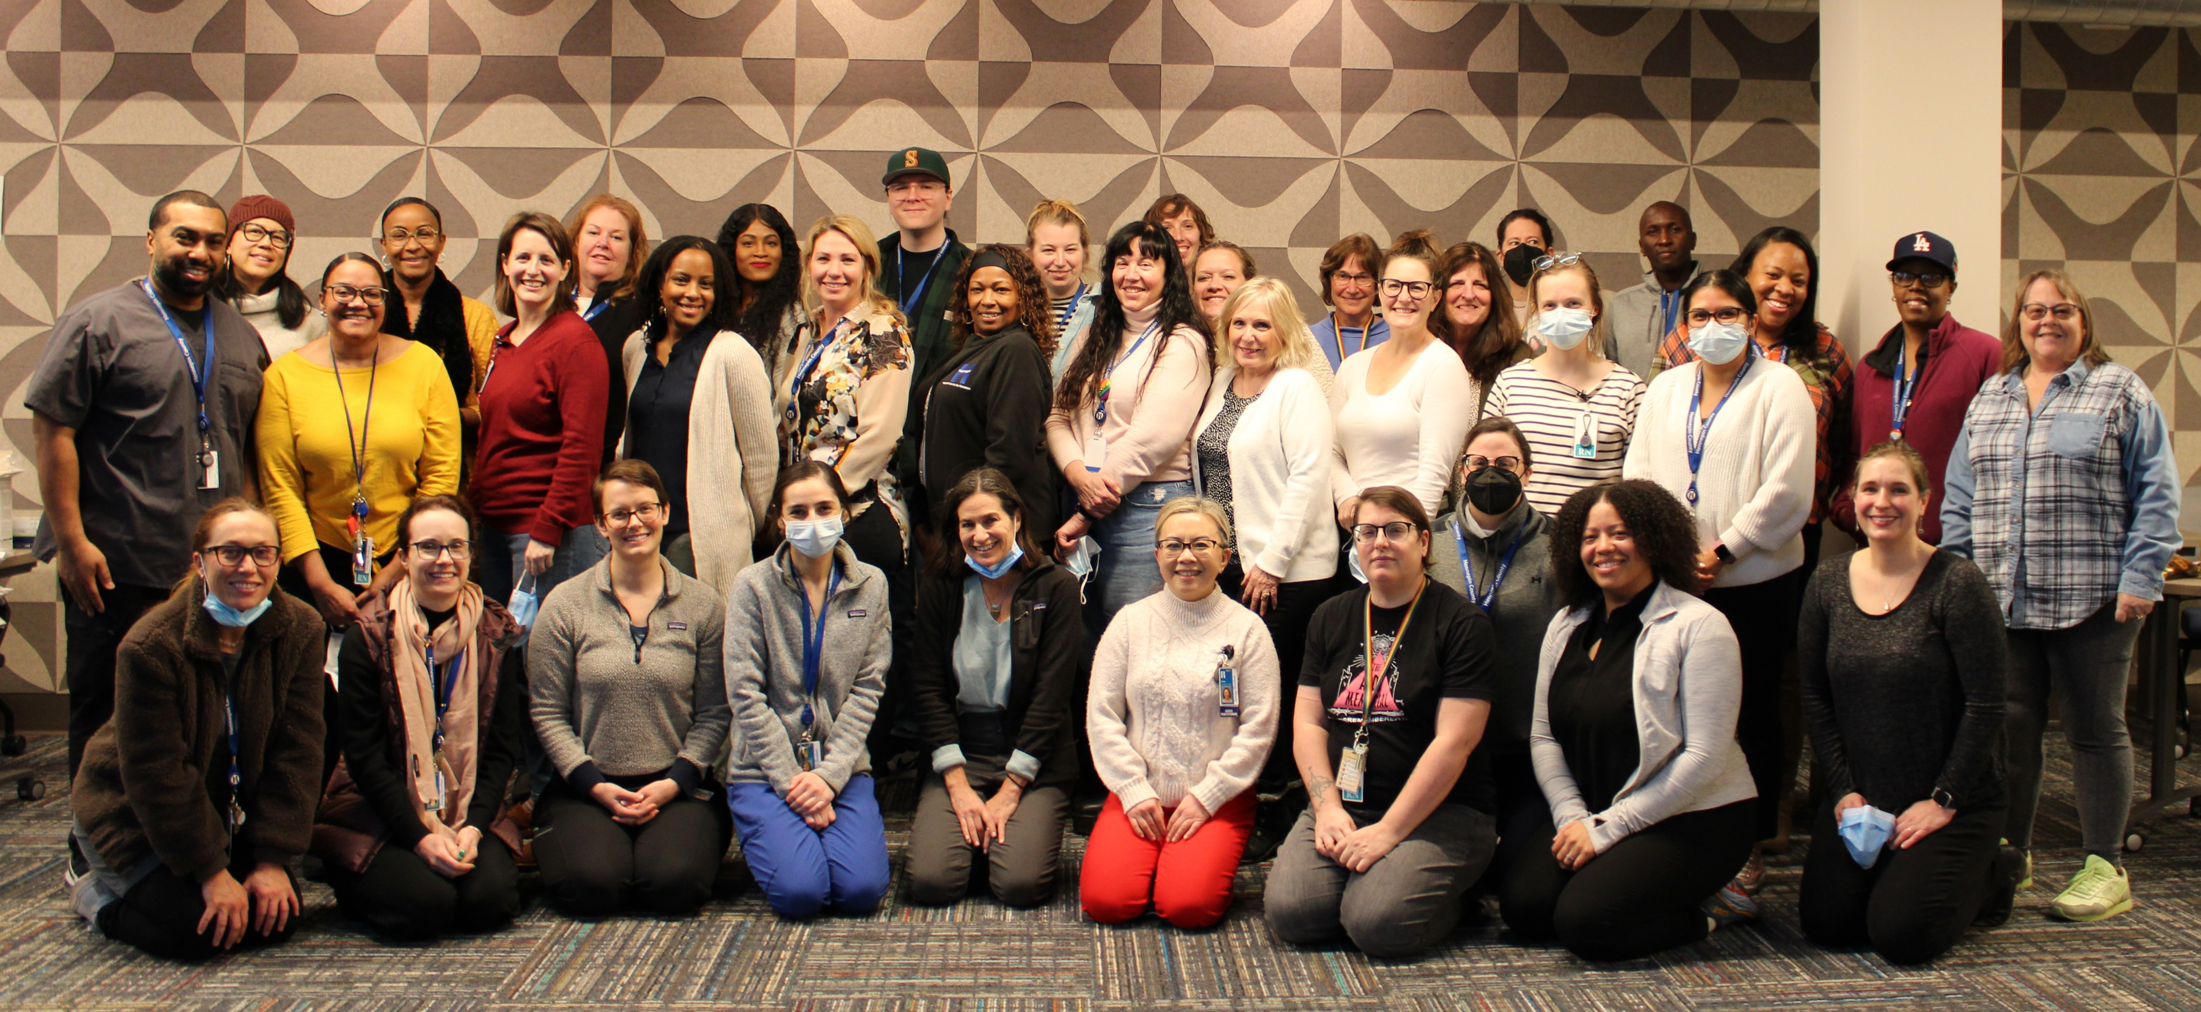
History of Quality Improvement at HCH
Quality improvement work has always been a requirement of being a Federally Qualified health center
2014: New program manager hired -goal to build a robust QI/QA program-started in 2015
Since 2015 some QI/QA projects included:
Increasing on time Hba1c testing for diabetic patients
Increasing HIV testing
Improving tobacco cessation counseling documentation
Sexual orientation and Gender identity documentation
TB testing in shelters
Improving rooming protocols across clinics
Notes:
Emily

Slide 16
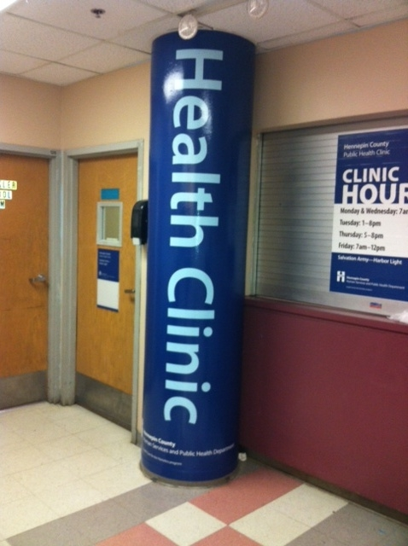
Quality Improvement at HCH
Team-Based Quality Improvement
Each Clinic site and team (Outreach, Ryan White, Respite, Harm Reduction) has at least 1 yearly QI project
Supported by the Hennepin County Public Health Department: Innovation and Improvement
Projects are:
Lead by clinic supervisors & HCH site leaders
Determined and agreed upon by site staff (buy-in)
Focused on health equity and improving patient care
Incorporate patient engagement
S.M.A.R.T.I.E
Data driven (qualitative & quantitative)
Notes:
Emily
SMARTIE= Specific, Measurable, Achievable, Relevant and Timebound goals that also include Inclusion and Equity

Slide 17
Current Hennepin County Data Analytics structure
Clinical Services Data reporting structure
Overall 5 goals for all County Analytics
Ensure all county strategies are data informed
County programs and investments are informed by robust impact and return on investment insights (including standards for demographic data that enable consistent approaches to monitor and evaluate equitable impacts)
County data are of high quality, relevant, well understood, and accessible to those who need it
Innovative data solutions are being developed to support creative responses to local government challenges
HC is a national leader in attracting and retaining high performing data and analytics professionals
Data analysts are from the Hennepin county data and health analytics area in Health and Human Services
One analyst for each of the 4 clinical areas, work with program staff to respond to data requests, grant reporting and build desired reports.
Analysts use Clarity, SQL to extract EHR data from EPIC for reporting in Excel or Powerbi
Notes:
Emily

Slide 18
Data Implementation Process- HCH
Data within HCH
JEDI focus: All data initiatives are centered around advancing justice, equity, diversity and inclusion
Realistic: Every data project needs to include data we can realistically obtain and have a goal that is likely to improve some aspect of HCH practice
Work within Hennepin County’s resources
Utilize data we already collect (at least initially): minimize redundancy
Plan for dissemination and transparency within the initial stages
Notes:
Naomi

Slide 19
HCH Strategic Plan
Notes:
Naomi

Slide 20
Audience Question #2
If your organization has a strategic plan, do you have the following as part of this plan:
Data
Health Equity
Improvement
If not, have there been conversations within your organization around the incorporation of these topics into strategic planning.
Notes:
Naomi

Slide 21
Three HCH reports to highlight
Access Dashboard
Rooming Report
Health Equity measures
Notes:
Emily

Slide 22
HCH Patient Access Report
Weekly report- Started in January 2023
Desire to create a data visualization of what HCH patients are being diagnosed with, differences by demographics, by clinic site, by provider type, what are we seeing for trends over time?
Based on patient encounter diagnoses-brings in all diagnoses in a visit.
Have added a Primary diagnosis and number of diagnoses on visits
Includes demographic information including:
Race
Sexual orientation
Gender identity
Transgender
Age Group
Patient Sex
Notes:
Emily

Slide 23
HCH Patient Access Report
Summaries/Counts are based on visit diagnoses, not individual patients or individual visits-use caution when interpreting
Categories of diagnoses codes were determined using UDS categories, ECQMs, in consultation with HCH
Example: Depression and other mood disorders is comprised of over 38 ICD-10 codes
Data is dependent on provider accuracy when charting
Use report and data for further exploration. Is what you are seeing a trend? An issue with charting? What is the explanation behind the numbers
https://app.powerbigov.us/Redirect?action=OpenApp&appId=4520fbda-0115-4dac-a844-5397853d07f3&ctid=8aefdf9f-8780-46bf-8fb7-4c924653a8be
Notes:
Emily

Slide 24
HCH Rooming report
Monthly Powerbi report-Purpose is to review rooming protocols by staff to identify areas for improvement and success
For all patients reviews how consistent the following are collected:
Height, weight, BMI
Blood pressure,
Temperature, respirations
External allergy reconciliation,
Medication reviews
For special populations reviews how consistent the following occur:
On time HbA1c testing for diabetics
Sexual orientation and gender identity collection-18+
OB Status for females 13-59
Tobacco use age 13+
Oxygen saturation-18+
Head circumference for patients 0-3 years
Annual HIV screening for 15-65 years
Notes:
Emily

Slide 25
HCH Rooming report
https://app.powerbigov.us/Redirect?action=OpenReport&appId=4520fbda-0115-4dac-a844-5397853d07f3&reportObjectId=4ad6f544-3b4d-4eef-b78f-281079b447e9&ctid=8aefdf9f-8780-46bf-8fb7-4c924653a8be&reportPage=ReportSectiondea252d6044008baea23&pbi_source=appShareLink&portalSessionId=956b4b39-0c03-4056-8695-a9d3199cee12
Notes:
Emily

Slide 26
HCH UDS Health Equity Measures
Quarterly Powerbi report-Purpose is to review select UDS measures on a quarterly basis by a variety of demographics and providers
Measures created:
Most recent Blood pressure controlled for persons with Hypertension
Annual HIV screening for 15-65 years
In development:
On time HbA1c testing for people with diabetes
Future development:
Tobacco cessation
Statins for persons with ASCVD
Cervical Cancer screening
Colorectal Cancer Screening
Potentially others
Notes:
Emily

Slide 27
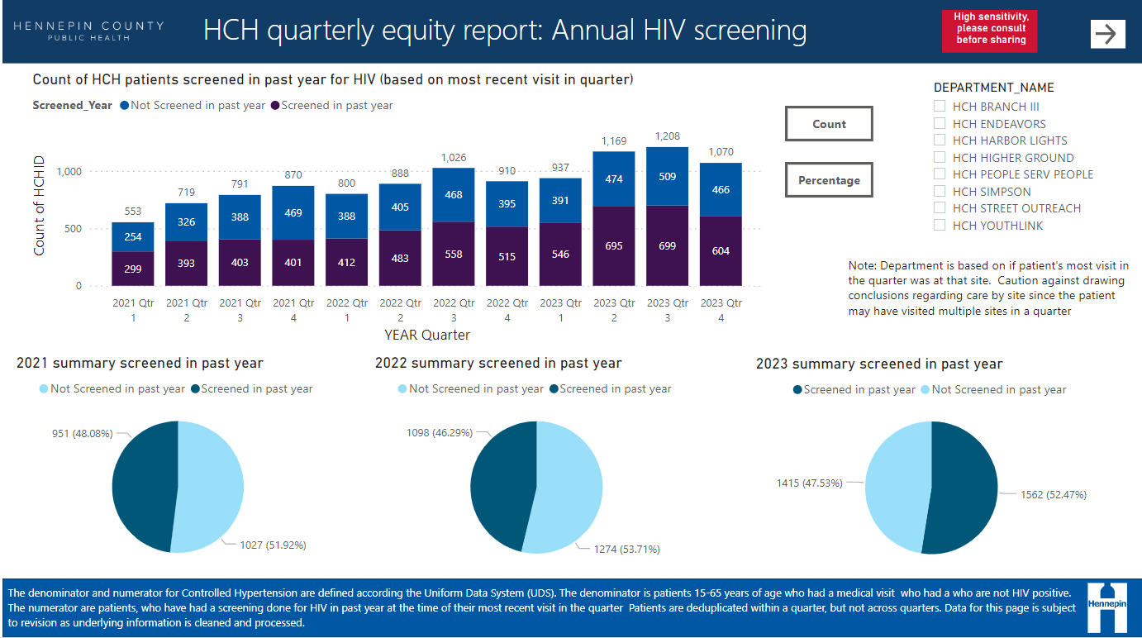
HCH UDS Health Equity Measures
https://app.powerbigov.us/Redirect?action=OpenReport&appId=4520fbda-0115-4dac-a844-5397853d07f3&reportObjectId=b3c08457-58a4-413a-b5f6-628e51fa1fdd&ctid=8aefdf9f-8780-46bf-8fb7-4c924653a8be&reportPage=ReportSection7d1edf422225c0047556&pbi_source=appShareLink&portalSessionId=956b4b39-0c03-4056-8695-a9d3199cee12
Notes:
Emily

Slide 28
Audience Question #3
What types of data visualization tools do you use for data reporting?
What types of data are you reporting on a regular basis?
Notes:
Emily

Slide 29
QI and Implementation
HCH QI Process
Site Teams
Project Determination and SMARTIE goal
Implement PDSA (Involve site staff)
Implement Improvement
Report Project
HCH Supervisors begin by discussing project ideas with staff
Staff Teams work with QI manager to determine project aim & initial interventions
Supervisors take the lead reporting measures, providing feedback to the team and managing documentation
Site staff “share the load” and work together to implement interventions and determine the final act portion of the cycle
Supervisors work with QI manager to document the sites’ project and implement the dissemination plan
Notes:
Naomi
Implementation: Supervisors are responsible for reporting measures

Slide 30
QI and Implementation- Ryan White
Plan :By the end of FY 2023 HCH will develop and implement a workflow for non-nursing staff to deliver medications to Ryan White participants.
Participants on ART: 21 (16 unsheltered, 5 housed, 1 emergency shelter)
Participants on PrEP: 4 (3 unsheltered, 1 housed )
We still love you: 10
Do:
Wrote and approved a policy to allow non-medical staff to deliver meds in the field
Developed process for medication storage and med set up at Endeavors Clinic
Continually adjust process
Documentation in EPIC
Locked bags during transport for added security
Storage option at Kola drop-in
Non-nursing staff trained to administer INSTI HIV tests for PrEP folx with low med adherence
Notes:
Naomi
As you might imagine the panel of people receiving meds from us can be very fluid. We are currently delivering ART to 21 participants who are HIV positive, PrEP to 4 participants who are at high risk of HIV and we have 10 people on our “We still love you” list. This list is a combination of folks who may have previously been on our med panel but we’ve been unable to locate recently or people who we are aware of having a positive HIV test that we have not been able to engage in care. We try to keep these names in our minds so when they pop up we can reengage as quickly as possible. We also don’t want to cut off support for our participants who have been recently housed, so we will continue to deliver meds as long as needed, with the goal that they are eventually stabilized enough to transition away from our team as the primary medical point of contact.

Slide 31
QI and Implementation- Ryan White
Check
Successes:
Freed up nurses to be able to work towards the high end of their licenses
Expanding team: We have recently hired 2 new nurses, an outreach manager and will hire another outreach worker to be able to expand coverage
Partnership with Red Door DI’s
Challenges:
Encampment clearings
Current viral load data
Stigma
Trust based work
Notes:
Naomi

Slide 32
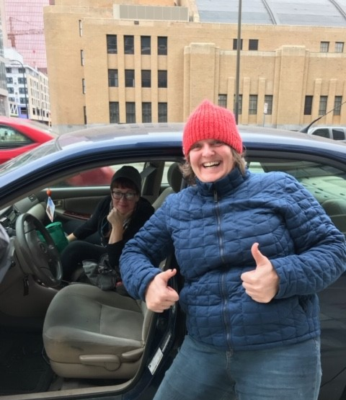
QI and Implementation- Ryan White
Act
Interventions Implemented!
Notes:
Naomi

Slide 33
QI and Implementation-LMP vs OB Status Reviewed
Problem identified- staff felt data for last menstrual period date was lower than it should be and wanted an audit of the data.
Solution- Reviewed with Nurse Practitioner what field they wanted data from using screen shares. Discovered the LMP field is a subset of OB Status. Fuller picture using OB Status reviewed compared to LMP date. Restructured query to pull OB Status
Result- Looking at non-street outreach office visits, percent where OB Status was reviewed was 73.4% compared to 27.6% where LMP date was listed. LMP date may not be completed for a variety of reasons and using that to indicate OB status was not capturing the full picture.
Notes:
Emily

Slide 34
QI and Implementation- Patient Feedback
Example of clinical staff driving data improvements
Setting: In the first 6 months of opening, very few patient feedback surveys were being collected at a new clinic site.
Plan: Improve Patient feedback survey completion by 200% in 6 months as measured by monthly survey counts
JEDI: Minimal patient feedback diminishes the patient “voice” in their care and in the operations of the site
Notes:
Naomi

Slide 35
QI and Implementation- Patient Feedback
Do:
Education was provided to all clinic staff regarding the importance of gathering patient feedback increasing awareness and responsibility
Feedback on the process was obtained from patients
Increased survey efficacy: Surveys were places in easy to access locations (attached to the rooming sheets)
Collection containers
Check:
Monthly recording of survey response rates
Patient feedback on the process:
Patients felt supported in filling out surveys when providers were involved in the process
Act:
Decision: Implement the changes and to focus next on utilization of feedback
Date collected | > 200% improvement? | Comments
5/31/23 | Yes
6/20/23 | Yes
7/31/23 | No | Inconsistent staffing (front and rooming staff)
8/31/23 | No | Inconsistent staffing (front and rooming staff)
9/29/23 | Yes
10/31/23 | Yes

Slide 36
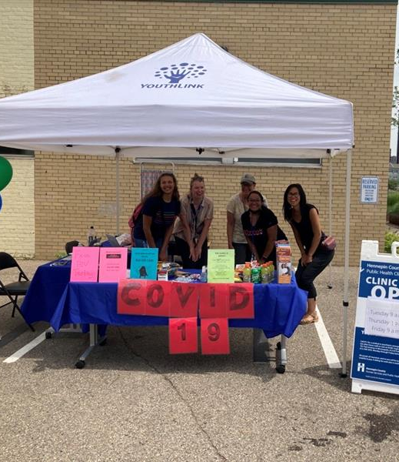
QI and Implementation- COVID Vaccinations
Clinical staff driving data improvements
Problem Identified: January 2021- COVID vaccines were newly available to high-risk populations including people experiencing homelessness. As vaccine clinic began to emerge, many of these clinics were not accessible to PEH despite efforts and that the access rates of Black and Native American people were significantly lower than the White population.
Solution: Staff worked using limited resources (excel, word, and PowerPoint) to compare the rates of vaccinations among PEH by race with the total population of the vaccine clinics, displaying disparities. This information was presented to program leadership
Improvement: The vaccination model for PEH changed from a vaccine “POD” or vaccine clinic model to an HCH site and outreach-based model which allowed HCH to utilize trauma responsive and relationship-based care to engage patients around COVID vaccinations. Vaccinations increased!
Notes:
Naomi

Slide 37
QI and Implementation-Care Everywhere access
Problem identified- missing Care Everywhere data (lab results and procedures) when using Clarity for data reporting. Could see available results in EPIC, but could not access for reporting. Hand audit all patients to determine if there was data-time intensive
Solution- Worked with EPIC to make Care Everywhere tables available and worked with affiliates and as a team to determine correct sql code to extract care everywhere data in queries
Result- More complete/timely data used in UDS reporting and in other reports. Example- found timely HBA1c tests for 40 more diabetic patients using sql vs hand audits of 40 charts. Expanded to HIV screening, colorectal screening, mammograms and cervical screening
Notes:
Emily

Slide 38
Audience Question #4
How are you involving staff in data review?
How are you using data for QI improvements?
Notes:
Naomi

Slide 39
Future of HC data analytics
Overall County Goals for Analytics
Ensure all county strategies are data informed
County programs and investments are informed by robust impact and return on investment insights (including standards for demographic data that enable consistent approaches to monitor and evaluate equitable impacts)
County data are of high quality, relevant, well understood, and accessible to those who need it
Innovative data solutions are being developed to support creative responses to local government challenges
HC is a national leader in attracting and retaining high performing data and analytics professionals
All areas in County will have a Head of Analytics including:
Health
Human Services
Resident services
Law, Safety and Justice
Disparity Reduction
Public Works
Operations
Notes:
Emily

Slide 40
Future of HCH dashboard development
Continue to Expand UDS Health Equity measures
Added a dedicated Opioid analyst to analytics team
Continue to refine current dashboards
Work to apply data standards from current participation in HC Public health data workgroup.
Potential new dashboards to develop:
Respite
MOUD and Opioid use
Hepatitis C
Maternal and child health
Mental Health
Notes:
Emily

Slide 41
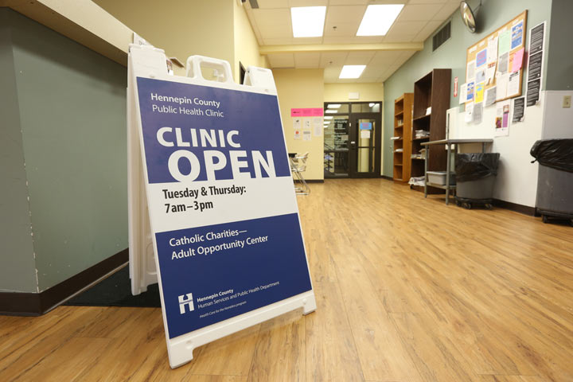
Future of HCH Data implementation
Strengthening site-based QI
Focusing our all-HCH implementation on equity
HIV
Substance Use Disorder
Mental Health Care
Hepatitis C
UDS Clinical measures
Hypertension
A1C
Harm Reduction
Parent and Child Health
Notes:
Naomi

Slide 42
Using JEDI to Drive Improvement
What is HCH JEDI at Hennepin County?
HCH Staff working towards justice, equity. diversity and inclusion
Intentionally focused on HCH’s patient population
Centered projects focused on traditionally marginalized populations
Clinical Improvement
Work Groups
Patient Feedback
Staff and Patient Education
Hiring, Onboarding, Exit Interviews
Notes:
Naomi

Slide 43
Audience Question #5
How do you see the use of data driving decision making impacting clinical practice ?
How could you use the data your organization already gathers to improve or impact clinical practice?
Notes:
Emily

Slide 44
References
Blackhouse, A.; Ogunlayi, F. (2020, March 31). Quality Improvement into Practice. BMJ. https://www.bmj.com/content/bmj/368/bmj.m865.full.pdf
Wilder Research. (2023). Minnesota Homeless Study
U.S. Census Bureau (2022,2023) American Community Survey population estimates
U.S. Census Bureau (2022) Small Area Income and Poverty Estimates (SAIPE) Program
Deed (2024), Labor market information office, local area unemployment statistics

Slide 45
Questions?

