Slide 1
Environmental Emergencies: We Can Help, The Lived Experience Perspective
HCH2024
NATIONAL CONSUMER ADVISORY BOARD (NCAB), STEERING COMMITTEE
PHOENIX, AZ • MAY 13-16, 2024
Download the conference app
Follow the Council on social media and join the conversation!
This content is intended solely for participants of HCH2024. Please do not replicate this content for further dissemination without expressed permission from the presenter.
Notes:
How to use this template:
1. Access the slide's template link, which will allow you to make a copy in your own Canva account.
2. Edit the presentation details on your new copy of the slide.
2. Download the slide by clicking "share," then clicking "download," and choosing which format to download in. NOTE: For
Make your changes here in Canva, or download as a PowerPoint file type and make your changes in PowerPoint!
To download, click "share," "download," and select the PPTX file type.

Slide 2
Land Acknowledgement
I acknowledge that the land where we are standing, Phoenix, Arizona, now stands in the traditional territory of the O’odham Jewed, Akimel O’odham, and Hohokam people I recognized that these Indigenous people have been stewards of this land for centuries, nurturing its resources and sustaining their communities through a deep connection to the earth. I honor their enduring presence and resilience, and acknowledge the ongoing relationship between these Indigenous nations and this land. I pay my respects to their elders, past and present, and commit to learning from their histories and perspectives as I strive to be a responsible steward of this land for future generations.

Slide 3
Labor Acknowledgement
By recognizing the land that was taken from First Americans and the forced labor that was provided by enslaved Africans and black & brown people, we strive to take steps towards creating a more equitable and just world for all of us.
Source: https://www.solid-ground.org/labor-acknowledgement/

Slide 4
AGENDA
8:30am-9:00am: Welcome & Ice Breaker
9:00am-9:15am: Importance of Environmental Emergency Topic
9:15am-9:40am: Alissa’s Experience: An Environmental Emergency & Unsheltered Homelessness
9:40am-10:05am: Key Learnings from Regional Community Conversations
10:05am-10:30am: Miami CERT & Lived Experience Leadership
10:30am-11:00am: Break
11:00am-12:00pm: Community Conversation
12:00pm-12:25pm: What have we learned?
Regional Community Conversations + Learning Lab Community Conversation
Comments
12:25pm-12:30pm: Thank you & Wrap-Up

Slide 5
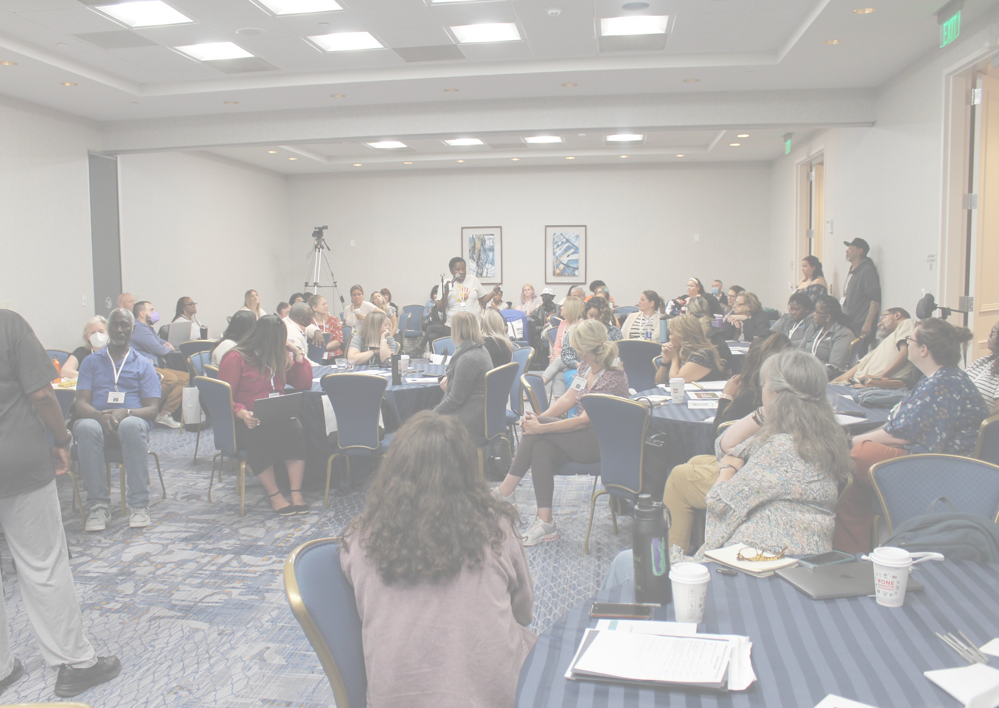
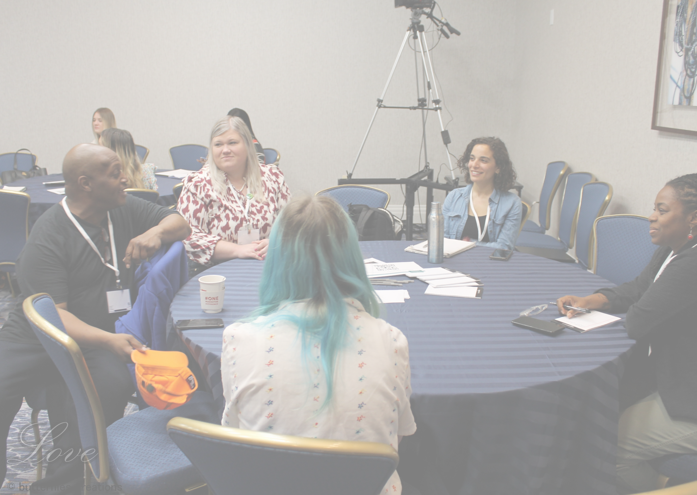
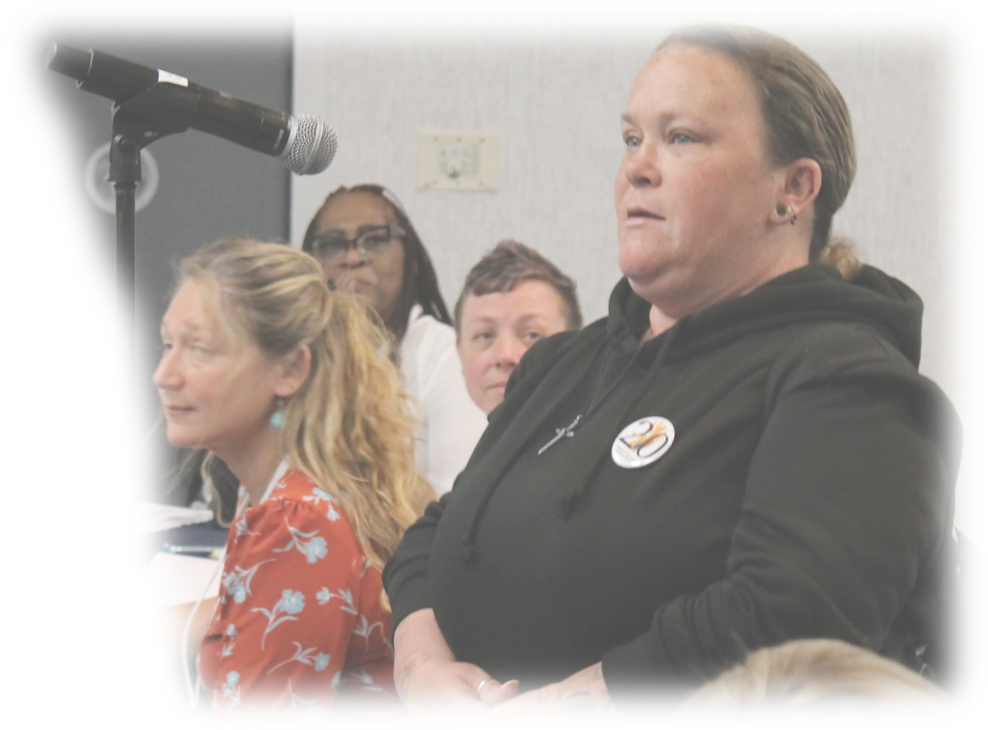
Ice Breaker

Slide 6
The Importance of Environmental Emergencies & Involving People with Lived Experience in Preparedness & Relief Efforts
WHY IS THIS CONVERSATION IMPORTANT?
WHY DID THE NCAB STEERING COMMITTEE SELECT THIS PROJECT & LEARNING LAB TOPIC?
This Photo by Unknown Author is licensed under CC BY-SA
This Photo by Unknown Author is licensed under CC BY-SA

Slide 7
WHY IS THIS CONVERSATION IMPORTANT?
You can only advocate when there is a future to advocate for.
Environmental emergencies are becoming more frequent and more severe.
Humans are dying in environmental emergencies.
Even when there is not an environmental emergency, people experiencing homelessness are dealing with a lot of problems and a lot of stress.
Our neighbors without addresses – where do they go?
Notes:
People who are unsheltered are especially vulnerable.
Stress is amplified and trauma is often occurs during environmental emergencies, only exacerbating problems.

Slide 8
WHY DID THE NCAB STEERING COMMITTEE SELECT THIS PROJECT & LEARNING LAB TOPIC?
People experiencing homelessness have the right to safety and should be prioritized in environmental emergency preparedness and relief efforts.
NCAB Steering Committee members have observed that environmental emergency response efforts often do not prioritize people experiencing homelessness.
In October 2023, the NCAB Steering Committee decided to collaborate with the National Health Care for the Homeless Council and consumers across the 10 HRSA regions to identify promising practices for environmental emergency relief efforts as well as to explore the impact of these environmental emergencies on people experiencing homelessness and their access to care.
Since October, the NCAB Steering Committee has helped conduct 10 Regional Community Conversations with consumers across the country. These discussions focused on the participants’ experiences with environmental emergencies and their efforts to assist individuals who are unhoused during such emergencies.

Slide 9
Alissa’s Experience: An Environmental Emergency & Unsheltered Homelessness

Slide 10
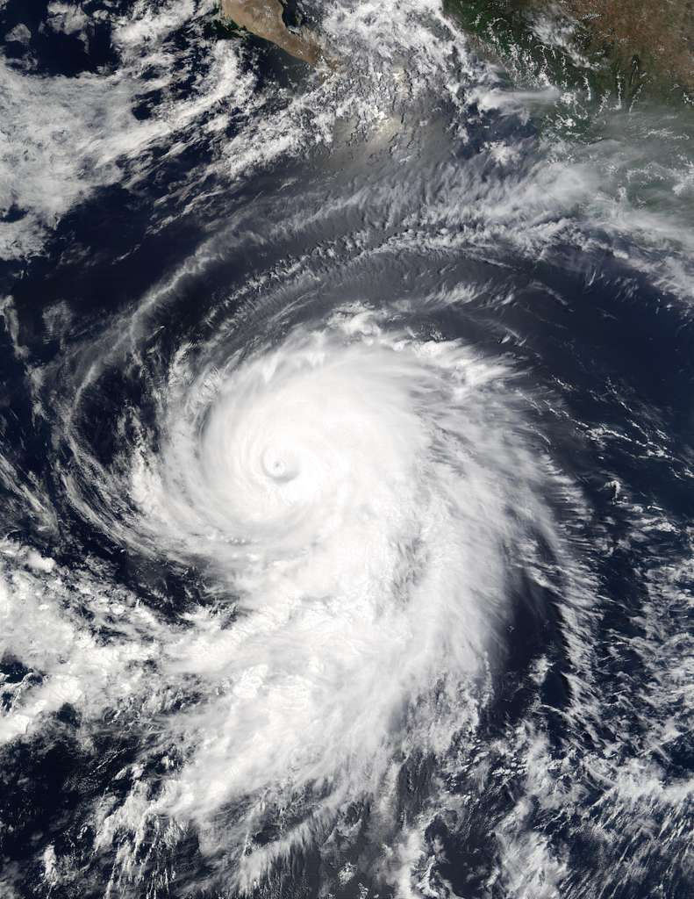
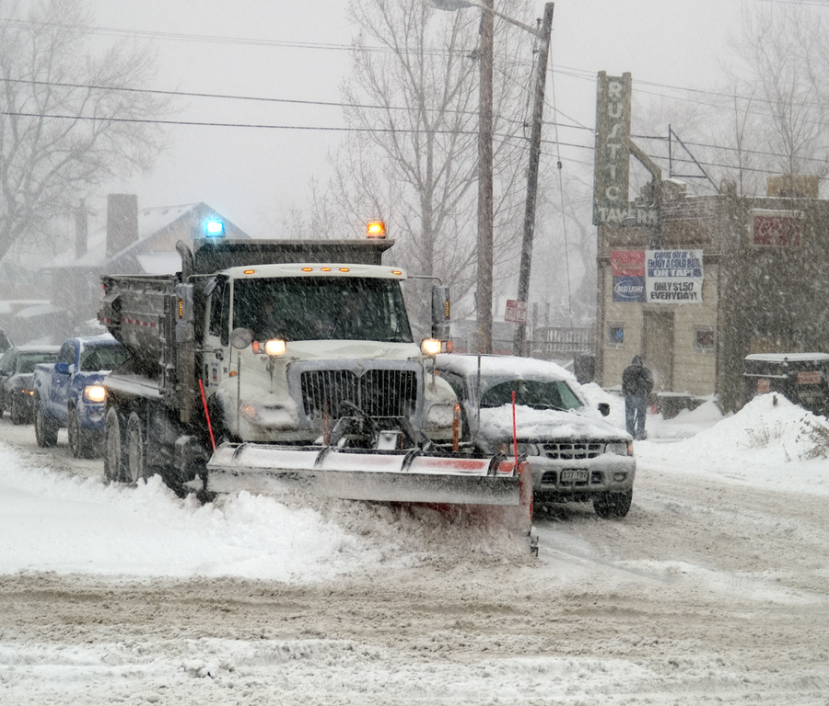
Key Learnings from Regional Community Conversations

Slide 11
Key Learning # 1
Facilitating and participating in the Environmental Emergency Regional Community Conversations expanded our understanding of the definition of an environmental emergency.
Environmental Emergencies are not restricted to weather events – like a hurricane or a tornado. In some places, the weather is hostile and dangerous for extended periods of time.

Slide 12
Key Learning # 1
For example, Regional Community Conversation participants located in a region where extreme temperatures last for many months described some of the impacts of prolonged severe weather.
“Up here, every winter there’s an environmental [emergency]. I mean last year we got down to 45 below zero for a week and a half…so I mean, we face it like every winter…we just deal with it as best we can. I’ve froze my ass off many a days and many a nights in a tent or a sleeping bag.”
“I remember walking the streets and being exhausted and wanting to sleep and being kicked out of everywhere and having blisters on my feet and my feet bleeding because I had to keep walking. And it was so cold that if I tried to lay down, I didn’t have the equipment to not freeze to death.”

Slide 13
Key Learning # 2
It is important that environmental emergency preparedness and relief efforts, in particular outreach services, prioritize people with disabilities.

Slide 14
Key Learning # 2
For example, one participant described some factors that impact people experiencing homelessness with a disability during a winter storm.
“You or anybody else for that matter that is wheelchair bound, what if they don’t have a shelter to get to or a family member to come get them out of that situation. It bothers me because we’re losing bodies left and right, and winter season is the worst season to be homeless – the worst season imaginable, especially if you are disabled.”
“I wasn’t in the chair that I am in now. I was in a different chair and, even though I was able to get through the snow and stuff, it wasn’t easy. It was like I had to literally drive damn near in the middle of the streets. And that’s crazy. Anyone with a wheelchair, especially a power chair like I have…I feel sorry for the ones who just have scooters, they can’t even move… and anybody that has a chair like mine…you can get but so far before you get stuck on a sheet of ice.”

Slide 15
Key Learning # 3
In some environmental emergency response efforts, individuals with housing may be prioritized over those experiencing homelessness. This practice raises concerns about equitable access to critical resources.
Negative perceptions and discriminatory attitudes towards people experiencing homelessness may lead to their exclusion from vital emergency response resources and services and/or unjust emergency response practices.

Slide 16
Key Learning # 3
For example, two Regional Community Conversation participants discussed unjust treatment of people experiencing homelessness during environmental emergencies.
“One of the injustices that I saw that was really upsetting to me was that those individuals [experiencing homelessness] during an environmental emergency were pushed back in line for those that were already housed and newly unhoused, so they got pushed to the back of the line. I have seen it firsthand…they were addressing the individuals that just lost everything and put them first over the people that were already unhoused.”
“You have people who are housed who choose not to evacuate and no one is coming in their doors taking them away because of that, so it is significantly unjust for that to be a practice.”

Slide 17
Key Learning # 4
People with lived experience (PWLE) can provide helpful and accessible assistance to people who are experiencing homelessness during an environmental emergency because:
PWLE are likely to be able to relate and to be seen as a trusted person, so people experiencing homelessness may be more comfortable being vulnerable and voicing their needs
PWLE know where people experiencing homelessness are in their community and know proper camp etiquette
PWLE are aware of the pitfalls of "saviorism"
PWLE can listen, share time, and have meaningful conversations
The way PWLE communicate is informed by their lived experience – they speak the same language and share the quality of resourcefulness as well as recognize the unique survival capabilities and strengths of people experiencing homelessness
PWLE can help facilitate soul healing through compassion, empathy, reassurance, and understanding
PWLE inspire hope

Slide 18
Key Learning # 4
For example, two Regional Community Conversation participants discussed the value of lived experience leadership to effectively supporting people who are unhoused during an environmental emergency.
“I feel like people with lived experience can relate more and gain a little bit more access as for them being more vulnerable with us as opposed to a service provider who may not understand the emotions and the mental trash that you have to go through while we are out here…Us being involved, I feel like people will be more vulnerable – allow us that information we need to know to help people get support”
“A lot of providers go out with that intention - ‘Let’s save them, let’s just make this better, let’s get them dry. It’s that ‘I am going to save you’ perspective versus somebody who has been there. Some people just want to stand and talk to somebody, ‘I can’t believe this just happened’. They don’t need to be saved and they don’t want to be saved. It is a matter of just being there and being present with them…Because in an environmental crisis you are completely hopeless…you just need to know that you matter.”

Slide 19
What is Miami Community Emergency Response Team [CERT]?
Prepares individuals to care for themselves, their family members, and their neighbors during an emergency until professional responders arrive
CERT members are encouraged to participate in emergency preparedness projects in their community
CERT members participate in training

Slide 20
HISTORY OF CERT
In 1985, CERT was developed by the Los Angeles City Fire Department in response to widespread concern about earthquakes
CERT identified the need to train civilians to meet the needs of their community
CERT became a national program in 1993

Slide 21
WHAT DO YOU LEARN IN CERT?
Triage procedures
Hazmat
Fire
Search marking

Slide 22
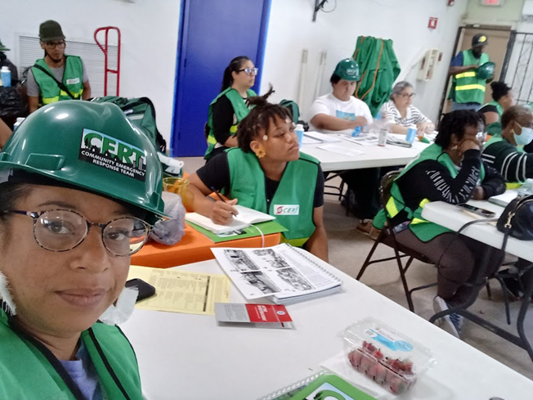
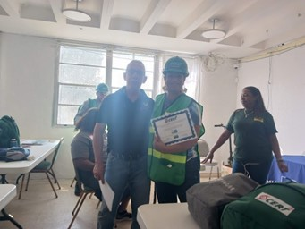
HOW DOES CERT PARTNER WITH LIVED EXPERIENCE LEADERS?

Slide 23
CERT & THE BENEFITS OF PARTNERING WITH LIVED EXPERIENCE LEADERS

Slide 24
BREAK

Slide 25
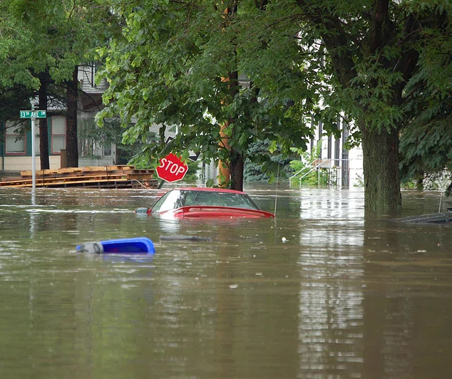
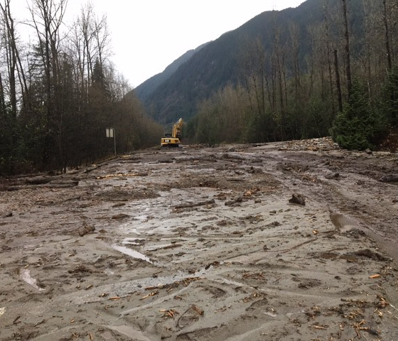
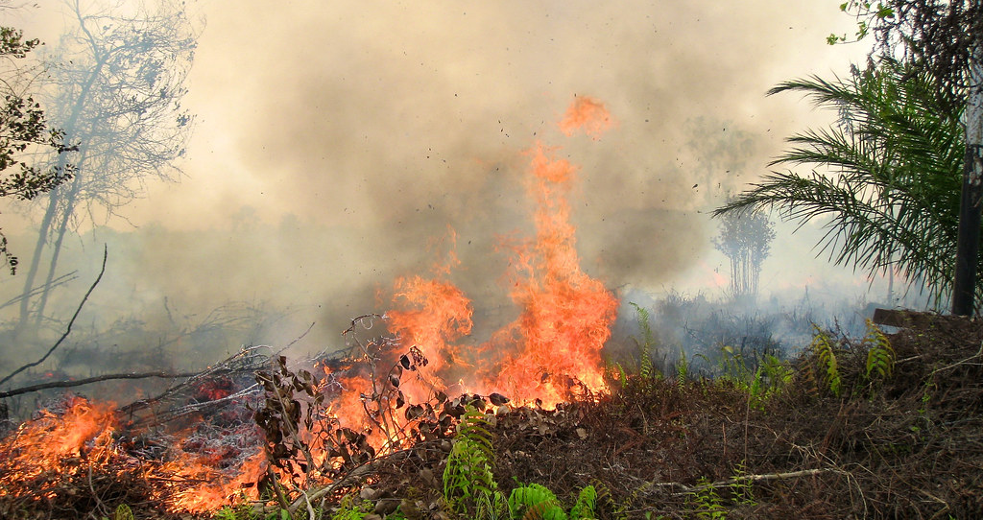
Learning Lab Community Conversation

Slide 26
In 1-2 minutes, please tell us about environmental emergencies that have occurred in your area.

Slide 27
How could a person with experience of homelessness provide more effective assistance to individuals who are unsheltered during an environmental emergency, compared to a person without that lived experience?

Slide 28
Describe how you have helped community members who were unhoused during an environmental emergency.
What type of support did you offer first?
What types of support were most needed?
What was the most important thing you did to support people who were unhoused during the environmental emergency?

Slide 29
Describe some of the challenges you faced.
Who did you work with to address these challenges?
What resources were most important to overcoming the challenges you faced?

Slide 30
Did you experience challenges related to justice, equity, diversity, and inclusion?
Consider people with behavioral health needs, Black and Brown people, Indigenous people, people who are LGBTQIA+, people living with a disability.
Were there particular barriers people with these identities and/or other historically excluded identities faced?

Slide 31
Who did you work alongside when supporting people who were unhoused during an environmental emergency?
WHAT IMPORTANT PARTNERSHIPS WERE FORMED?
DID YOUR HEALTH CENTER PLAY A ROLE?

Slide 32
Did the environmental emergency create any new or useful opportunities in terms of support and/or resources for people who were unhoused?

Slide 33
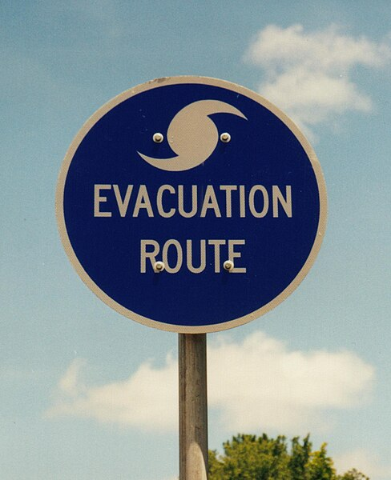
If evacuation was recommended, did you interact with folks who decided not to evacuate?
What kind of assistance and support was provided to those who elected not to evacuate?
What do you think about mandatory evacuation laws?

Slide 34
Is there anything you feel is important to share that we didn’t ask about?

Slide 35
TAKEAWAYS: Challenges & Barriers
Needs exceed available services [e.g. shelters fill up, long lines for limited resources]
Lack of consistency, especially with food distribution
Lack of knowledge of available resources and/or lack of clarity about the process for accessing services
Accessibility concerns [e.g. discrimination or barriers in accessing services based on one’ location or neighborhood]
Aftereffects of the trauma derived from having valuables, belongings, and community "ripped away“
Forced evacuations are detrimental, deepen mistrust
Notes:
Shelters fill up
Long lines for limited resources

Slide 36
TAKEAWAYS: Recommendations
Housing can keep people alive
Put yourself in the shoes of those you are serving

Slide 37
TAKEAWAYS: Recommendations
Outreach workers, service providers, and people with lived experience should have easily accessible, in-depth information about available resources
People with lived experience should conduct outreach to direct people experiencing homelessness to available services
Assist immediate neighbors – teams can conduct outreach by neighborhood and should include those with lived experience
Forge partnerships between people with lived experience and community emergency response teams, local business owners and law enforcement
Teach people experiencing homelessness about a resource with the idea that they can teach others in the unsheltered community about it.
Notes:
example of a resource card was given –people with lived experience teach a person experiencing homelessness about the resource card, so they can teach other people experiencing homelessness in their community about the card/get the information to others who may need/want it

Slide 38
TAKEAWAYS: Importance of Health Centers
Specialize in building connections between people experiencing homelessness and needed services
Relationships with providers support people experiencing homelessness, especially those with mental health needs who must have access to their providers to be safe
Health centers are known for always being there
Folks know health centers have information
Environmental emergencies can be an opportunity for providers to show up for people experiencing homelessness and can be an important opportunity to build trust
HEALTH CENTERS, ESPECIALLY THOSE WITH MOBILE OUTREACH VEHICLES, ARE A VALUABLE RESOURCE

Slide 39
Next Steps
Year 1: Regional Community Conversations
Year 2: Create an Online Course for Consumers
Year 3: Consumer Participatory Outreach Survey
3-year project

Slide 40
Thank You + Closing

