Slide 1
Talking About Suicide
Lynea Seiberlich-Wheeler, LCSW
Notes:
In this presentation, I use information from national resources as well as resources local to where I live and work, in Sonoma County, CA. Some of these local resources may benefit you where you live and work, and some may need modifications.

Slide 2
Setting the Tone
I am a safe person to talk to about this
Awareness of cultural and social context
Consider:
Gender
Race
Language
Religion
Local bias
Risk assessments that include these additional factors will help determine how to approach the appropriate life-saving next step
Asking about Suicide does not increase Risk of Suicide
Notes:
Risk assessment regarding racism as well - some areas people die by law enforcement intervention more often than suicide
Provide the foundation Internal Family Systems therapy provides - not my fault, it's my responsibility. Intergenerational and community shared burdens and traumas. Not always appropriate to unburden or "feel better"
Address turnover – tools that are easy to reference

Slide 3
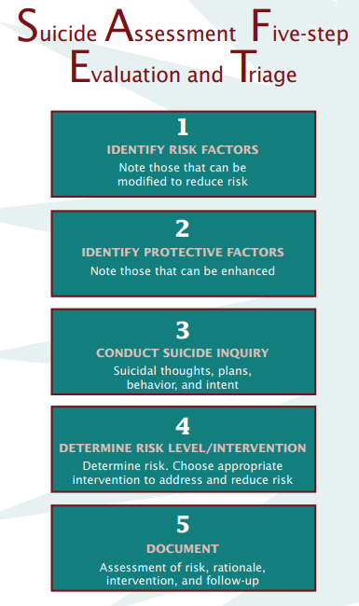
Assessment Strategies
Ask about thoughts and behaviors related to suicide
Assess for danger and protective factors
Notes:
Take the person seriously, even if you think they are attention seeking.

Slide 4
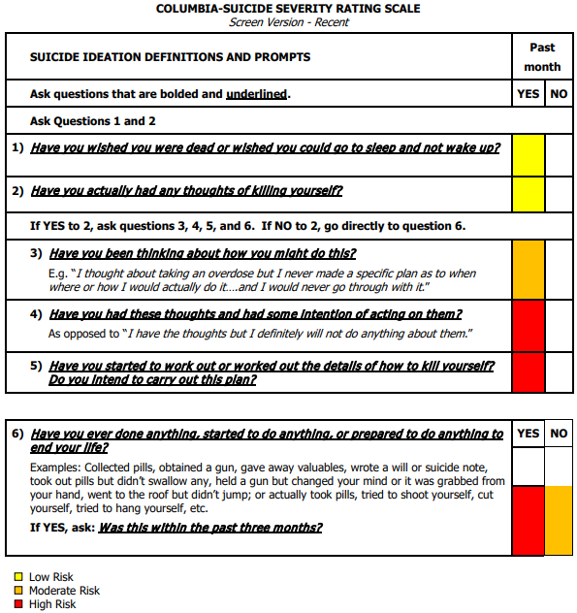
Columbia Screen

Slide 5
Protective Factors
Individual
Effective coping and problem-solving skills
Reasons for living
Strong sense of cultural identity
Relationship
Support from partners, friends, and family
Feeling connected to others
Community
Feeling connected to school, community and other social institutions
Availability of consistent and high quality physical and behavioral healthcare
Societal
Reduced access to lethal means of suicide among people at risk
Cultural, Religious, or moral objections to suicide
Notes:
Resource building for people experiencing homelessness – how to wrap folks into community as a preventative action

Slide 6
Intervention Strategies
Immediate Safety
Mandated Reporting
Peers

Slide 7
Safety Planning
Warning Signs
Internal Coping Strategies
Social Contacts Who may Distract from the Crisis
Family Members or Friends Who May Offer Help
Professionals and Agencies to Contact for Help
Making the Environment Safe
App examples:
Stanley Brown Safety Plan: https://apps.apple.com/us/app/safety-plan/id695122998
https://iamsober.com/
Notes:
Who is the safety plan for? Insurance company? Auditor? Patient? The form is not for the patient.

Slide 8
Mandated Reporting
Am I a mandated reporter?
https://mandatedreporterca.com/who-should-report
School Personnel
Child Care Providers
Medical Professionals
Mental and Social Health
Law Enforcement
Clergy
Volunteers
Other Professionals
Your County or Region may have their own list
Notes:
To prevent death during a police response to a mental health crisis, the following scripts were created in partnership between our County’s behavioral health department and a local behavioral health non-profit. Parking lot this idea: (say it outloud) Ethical grey areas: Suicide in some situations may make sense? Continuum of viewpoints. Lily will say this

Slide 9
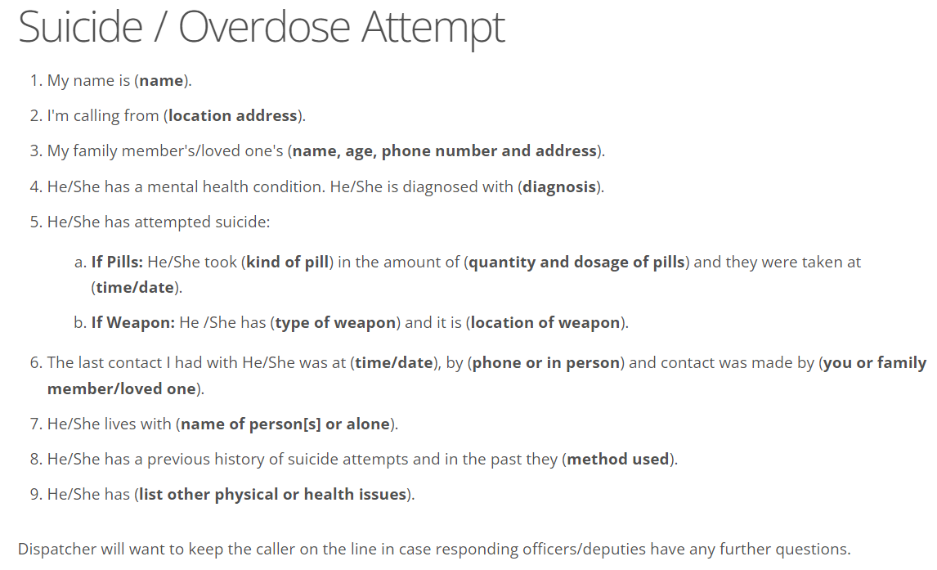

Slide 10
Role of Peers
People often defer to professionals to have conversations that should happen among peers.
Screening tools and mandated reporting rules require clinical and other professional teams to address safety concerns and intervene on behalf of the safety of others.
Guidance for Peer-led conversations:
https://www.suicideispreventable.org/
https://lifelineforattemptsurvivors.org/
Notes:
Speak to trust. Professional – clarity of role from the beginning. Peer – I will help you ask for help. Loop back to protective factors. Peers can help increase protective factors more effectively than other professional roles. How are peers a part of the conversation where you are? (ask the group).

Slide 11
Let’s have the conversation.
Notes:
The best way to feel comfortable is to already have ask these questions before, so we are going to do that now. So that when you are out in your world, you have asked these questions before.
Practice Columbia Screen and Safety Plan. – Handouts of Columbia Screen and Safety Plan questions

Slide 12
Resources
Having the Conversation:
Know the Signs (California Initiative) https://www.suicideispreventable.org/
With Help Comes Hope https://lifelineforattemptsurvivors.org/
SAFE-T assessment strategy:
https://store.samhsa.gov/product/SAFE-T-Pocket-Card-Suicide-Assessment-Five-Step-Evaluation-and-Triage-for-Clinicians/sma09-4432
https://store.samhsa.gov/sites/default/files/sma09-4432.pdf
Columbia Screen (available in multiple languages)
http://cssrs.wpengine.com/the-columbia-scale-c-ssrs/cssrs-for-communities-and-healthcare/#filter=.general-use.english
https://www.cms.gov/files/document/cssrs-screen-version-instrument.pdf
Risk and protective factors (and more)
Centers for Disease Control and Prevention (CDC) https://www.cdc.gov/suicide/index.html
Creators of the safety plan tool used today:
Suicide Prevention Resource Center https://sprc.org/
Western Interstate Commission for Higher Education (WICHE) https://www.wiche.edu/behavioral-health/suicide-prevention-toolkits/
Another Safety Plan tool: https://suicidesafetyplan.com/forms/
Scripts for calling emergency response teams: https://sonomacounty.ca.gov/health-and-human-services/health-services/divisions/behavioral-health/911-scripts

