Slide 1
Building Service Capacity Through a Model Workforce Development Program
National Health Care for the Homeless Council
Annual Conference, May 2023
Kelly Bruno Nelson, Executive Director, Medi-Cal & CalAIM, CalOptima Health
Mia Arias, Director, Operations , Medi-Cal & CalAIM, CalOptima Health
Danielle Cameron, Director, Program Development, Medi-Cal & CalAIM, CalOptima Health
Adam Hirsch, Director of Business Development, Chrysalis

Slide 2
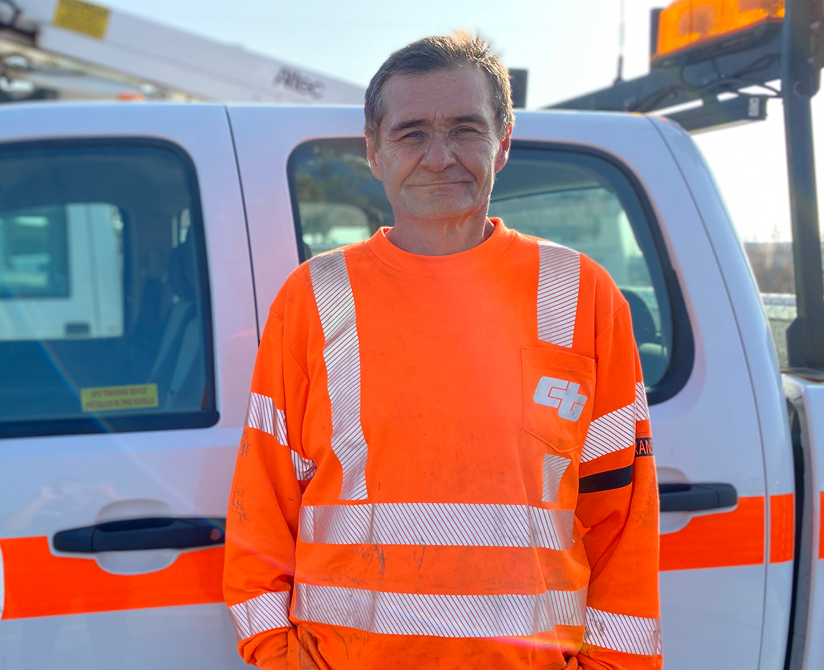
Agenda
Introductions and Background
Who is in the audience?
Panel Discussion
Partnership and Program Overview
Opportunities and Successes
Local Assets and Anticipating Challenges
Discussion and Questions

Slide 3
Introductions & Background
CalOptima Health
Chrysalis
American Family Housing and other service providers
The Member/People we serve
Notes:
Could you each do a quick introduction of yourselves and also describe the other stakeholders you engage in this effort?

Slide 4
Who is here today?
Who works at an organization that hires individuals with lived experience?
Practitioners? Administrators?
Funders? Health plans?
Other nonprofits?
Notes:
Could you each do a quick introduction of yourselves and also describe the other stakeholders you engage in this effort?

Slide 5
Partnership and Program Overview
A partnership between a managed care plan, workforce development CBO and shelter operators designed to effectively meet staffing needs and employ individuals with lived experience and other barriers to integrate into the workplace.
Notes:
Kelly, can you give us a bit of background on CalOptima Health and your relationship with Chrysalis?
Healthplan, CalAIM, past experience as service provider partner w Chrysalis and having the knowledge of what they do and can accomplish
Adam, can you describe Chrysalis’ services and history of success?
Mia, can you talk about the issues CalOptima Health was facing and why this was an interesting concept to support?
Workforce issues and opportunity to use IPP funding
Individuals come with lived experience; could have had experience being in these actual programs that they now work for; this enhances the quality of care that organizations can provide their guests; responsibility form organization’s side to nurture those employees from a different way

Slide 6
Chrysalis’ Workforce Development Services and Successes
Notes:
Adam, can you talk a bit more about how your program achieves what Mia is describing?
Let’s show a video to give everyone an even better idea.

Slide 7
Opportunities & Successes
It is critical to understand, value, and commit to the experience of identifying, training, employing, and supporting people with lived experience and other employment barriers.
Notes:
Mia, can you talk about the experience of working with Chrysalis from a provider perspective? What details were critical to program success?
Balance of empathy and gaining best employment experience
Person-centered approach; focus is the person not the employing organization
Lots of communication and trust between Chrysalis and the employing organization
Example situations of these issues; conversation and interventions
This is why the design process is so critical; voice of person, employer org, Chrysalis, etc; so that issues are identified earlier on and can be addressed in the design process
Adam, can you speak to these key factors, as well?
Key is to engage providers so that your placements are effective and people are supported
Kelly, as a local leader in Orange County, how are you presenting these opportunities to the local community?
Barriers like low pay; hiring practices that need to be systemically addressed
Opportunity to meet multiple needs in one program, if we do it the right way
Innovative use of incentive dollars from state

Slide 8
Anticipating Challenges and Identifying Local Assets
Just as important to the process is evaluating the potential for a workforce development program in your community, and identifying key challenges, but also local assets, that can be brought to the table as early as possible.
Notes:
So, how can others do it the right way? Design thinking – how did each of you approach that piece of the process?
Mia - Our ECM/CS technical assistance efforts and how they led us to this project
Kelly –Survey of some of the key issues – wage limitations; number of positions being filled; policies around hiring practices
social norms and stigmas that hold these hiring policies in place; organizations have to be willing to take a stand; confront the systems
Using nontraditional resources - IPP funding; CalAIM has made so much more possible to integrate social and physical health approaches
Adam, how is this partnership setting you up for success? What would be your key recommendations for others looking to engage in this work?

Slide 9
Questions & Discussion

Slide 10
Thank you

