Slide 1
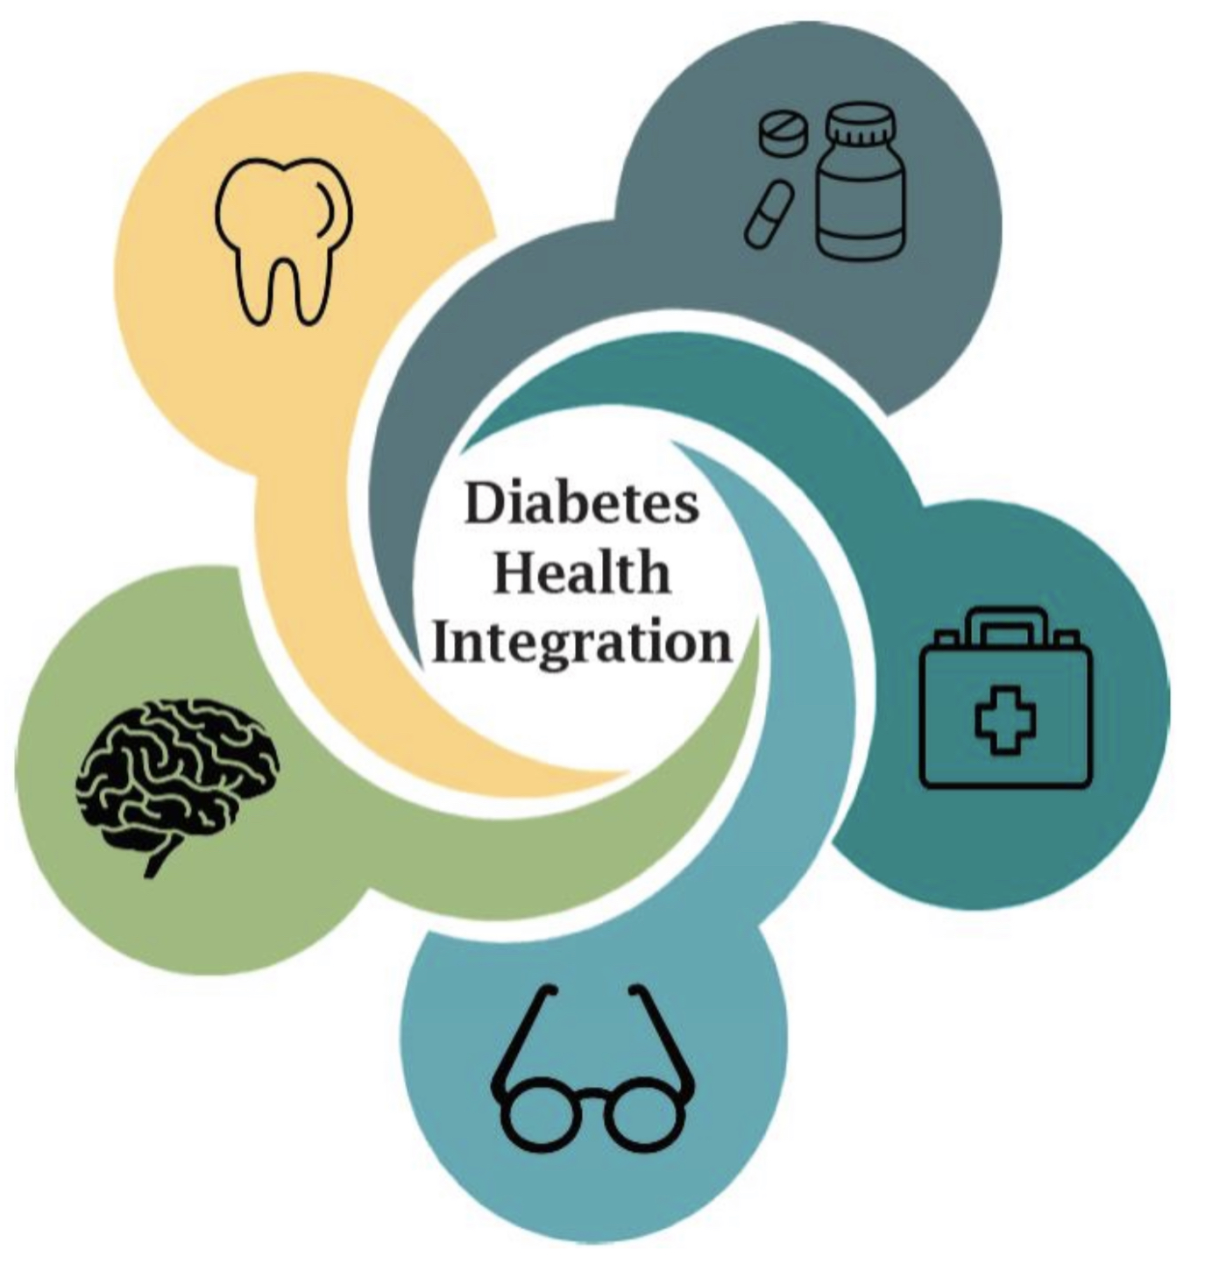
DCVDOHI-Yesterday, Today and Tomorrow
Diabetes and Cardiovascular Disease Oral Health Integration
Colorado Coalition for the Homeless
March 30, 2023
Carol Rykiel, MS, RDH
Carol Niforatos, DDS

Slide 2
Introductions
Carol Niforatos, DDS- Dental Director Carol Rykiel, MS, RDH- RDH Manager of Integrated Dental Services Colorado Coalition for the Homeless (CCH)
Notes:
Holly

Slide 3
Acknowledgments
This project is supported by Grant 5 NU58DP001009 from the Centers for Disease Control and Prevention (CDC). Its contents are solely the responsibility of the presenters and do not necessarily represent the official views of CDC.
Notes:
Holly
We are grateful for the support of the Centers for Disease Control and Prevention for this project.

Slide 4
Colorado Caveats
Same day billing for medical and dental - can bill both encounters on one day
Registered dental hygienists are billable providers and have an extensive scope of practice
Adult Medicaid dental benefit - $1,500 cap
Diabetes point of care testing is reimbursable by Medicaid (D0411)
Notes:
Just a few things to note about the landscape in CO that may help provide some context.

Slide 5
Why this project? ?
Alignment with CCH clinical quality priorities
Opportunity to connect dental patients with a medical home
Benefits of an integrated health system
Notes:
CCH clinical quality priorities include improved prediabetes/diabetes screening, effective education and follow up for these individuals
Open system: 30% of patients seen at CCH Dental have not accessed CCH Primary Care for any needs and may not have a medical home
Individuals experiencing homelessness frequently have neglected their health due to overwhelming social concerns. They are likely to access dental services more often than primary care due to urgent needs
Integrated health system provides a unique opportunity to coordinate care across departments
CCH has a unique approach to homelessness by providing integrated health care and affordable housing with strong case management support.
This is an image of our largest Health Center. The lower two floors provide full care the upper three floors are residential, with 10 units of affordable housing for singles and families experiencing homelessness.

Slide 6
Challenges with our Patient Population at CCH
Food instability and insecurity.
Medications often stolen or misplaced.
Limited technology.
Ability to eat diminished due to poor or compromised oral health.
Ability to consistently arrive at scheduled appointments.

Slide 7
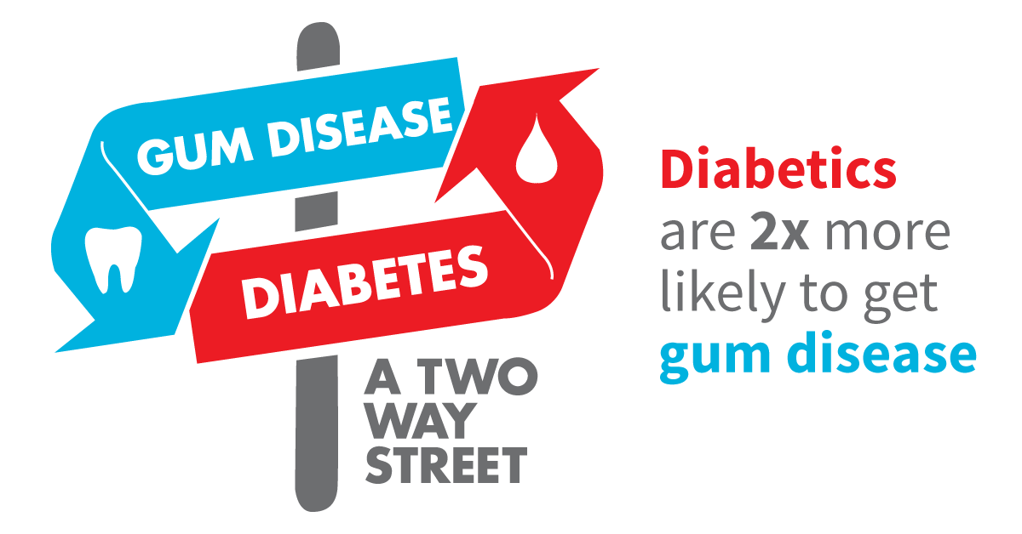
Diabetes and Oral Health
Diabetes can influence oral health and vice versa
Poorly-controlled blood glucose can contribute to periodontal disease
Untreated periodontal disease can contribute to elevated blood glucose
Integrating oral health and diabetes prevention/management is one tool to advance the patient-centered medical home
Diabetes is a HRSA priority for Community Health Centers and Primary Care Associations

Slide 8
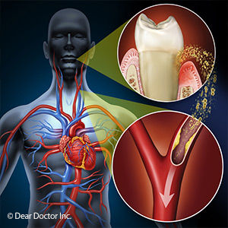
Cardiovascular Disease and Oral Health
The bacteria that infect the gums and cause gingivitis and periodontitis also travel to blood vessels elsewhere in the body where they cause blood vessel inflammation and damage; tiny blood clots, heart attack and stroke may follow.
Supporting this idea is the finding of remnants of oral bacteria within atherosclerotic blood vessels far from the mouth.
Rather than bacteria causing the problem, it's the body's immune response – inflammation - that sets off a cascade of vascular damage throughout the body, including the heart and brain.

Slide 9
The Past-DOHI and DCVDOHI at CCH
Started DOHI grant work with CDPHE and CCHN in April 2017, began new workflows of screening and checking chair side A1Cs at dental exam appointments.
In the first seven months of the implementation period, 461 diabetes risk assessment were given and 100 POC tests were administered

Slide 10
Yesterday’s Barriers to Improving Care
Electronic Dental Record (EDR) templates were not supportive of diabetes screening
Dental workflow did not include A1c point of care or risk assessment for diabetes/prediabetes
No tool for tracking referrals between health center teams (i.e. dental to medical and vice versa)
Lack of practical support for clients - transportation, financial, emotional, etc.
Facility-based Diabetes Group curriculum
Notes:
NDPP and other curricullums challenging to complete for our homeless population

Slide 11
Lessons Learned: Compliance and Logistics
CLIA waivers may be needed to do point-of-care (POC) A1c testing; waiver is test- and site-specific
Patient consent process for POC test
Documented policies and procedures for risk assessment, POC test, referrals, and follow-up
Coordinating with billing department to ensure needed documentation is complete for D0411 and how this test will be handled for sliding fee scale patients
State scope of practice considerations for utilizing POC test
Staff compliance and training
Notes:
In addition to the HIT and workflow changes described above, there were several logistical and compliance-related changes that had to be made.
These are some things you may want to consider if you’d like to do something similar in your clinic.
Ensure you have the correct CLIA waivers to be able to do point of care testing
Consider policies and procedures for all aspects of risk assessment and POC test, referrals
Ongoing training for staff

Slide 12
Consistent Workflow Changes to Implement Effort and Produce Desired Outcome – Dental to Medical
Instituted point-of-care A1c screening
Extensive meetings, deliberation, and training for entire dental team of 34
Terms and language borrowed from primary care teams, who are accustomed to creating and receiving trackable referrals on a regular basis
EDR Analyst and Oral Health Patient Navigator provided insight on structuring referrals
Notes:
There were also significant workflow changes to implement this effort.
Incorporation of risk assessment and point of care test
Testing different ways to do the workflow
Required extensive meetings, deliberation, and training
Learning from primary care to implement referral documentation and tracking
Medical to dental – workflow mostly in place already

Slide 13
Medical Provider Messages
Part of health screening to determine the last dental visit the patient has had and connecting them with a dental provider if the patient has questions or is due for a dental visit.
The oral systemic connection is important, and this is communicated to all stakeholders
Medical team does the following
facilitate communication with treating dental provider if patient has complicated medical issues.
be available to offer immediate advice on medical management issues or acute problems that may arise before dental treatment.
Notes:
Pamela Allweiss MD, MPH-Diabetes and Dentistry: The Mouth/ Body Connection or What is the Sixth Complication of Diabetes- CDC Division of Diabetes Translation pca8@cdc.gov (2018).

Slide 15
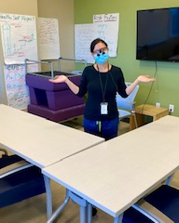
Impact of Covid on managing Chronic Disease
Chronic disease groups cancelled
Medical and Dental visits were severely limited and have not reached full capacity.
Access to the facility was limited, especially in March and April
For our population, zoom was not a good option, but people still needed and wanted care

Slide 16
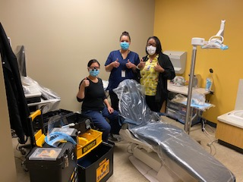
“Improvise, Adapt, Overcome” – Bear Grylls
Limited opening of the dental clinic helped us to be creative and pivot when necessary to deliver quality services
Outreach to CCH Protective Action Respite sites scattered throughout Denver.
Set up dental equipment in unused medical exam rooms to provide denture and emergency services
To our surprise this has utilized existing efficiencies to improve integration and referrals
Notes:
Covid challenges of continuing to treat our high needs patients – mobile, portable equipment set up in non-traditional care delivery spaces

Slide 17
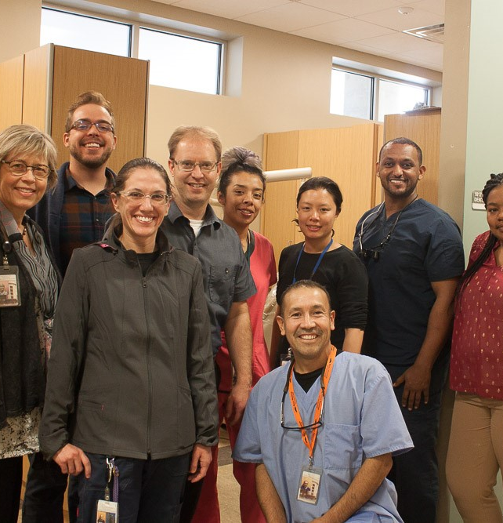
The Present - A Snapshot
DOHI evolved into DCVDOHI in 2019, where we targeted patients for (pre)diabetes and cardiovascular disease such as hypertension. This involves checking for blood pressures at each appointment and reporting vitals for tracking purposes
Project champions and training of all dental staff in correct BP monitoring and documentation.
Frequent internal team meetings to discuss new documentation, internal and external referrals. (Data Capture/Audits internally and external data reporting with help from BI team).
QI Coaches meet monthly via zoom.
Continuing training and education surrounding Cardiovascular disease and diabetes to be remain compliant current standards .

Slide 18
Project Challenges
Supporting an at-risk homeless population with few resources
Coordinating Dental and Medical staff to attend meetings
Maintaining buy-in from clinical staff to keep meeting schedules and prioritize project
Difficulty identifying options for (pre)diabetes education and time spent managing staff training
Errors in screening results with initially-selected A1c device
Maintaining focus and shared understanding with new CCH leadership
Notes:
Many of these were particularly difficult in the first 12 months of this project, and they have lessened over time
CCH has a new leadership team so getting them oriented to the project and developing a shared understanding with competing priorities has been a more recent challenge

Slide 19
Changes to Support Implementation
Health Information Technology
EHR: NextGen
EDR: QSI
AZARA population health
Health Promotion Plan
Workflows
Assessment, screening for (pre)diabetes, and referral from dental to medical
(Pre)diabetes diagnosis and referral from medical to dental
Diabetes/prediabetes education curriculum
American Association of Diabetes Educators training
Notes:
To support those goals, CCH focused on several areas for change:
Health Information Technology - documentation of screening and POC test, documentation of referrals and closing the loop on referrals, automation of workflow
This project benefited from dedicated IT support from the EDR analyst and business intelligence analyst
The ability to modify templates was essential, and the EDR analyst provided critical training to staff and offered input on workflow
Workflow design for assessment, screening, referrals, and closing the loop on referrals
Infusing diabetes education throughout the work of the organization by training a wide variety of staff on the American Association of Diabetes Educators training

Slide 20
Digital Diabetes Risk Assessment Questionnaire
http://main.diabetes.org/dorg/PDFs/risk-test-paper-version.pdf
Notes:
This is a digital copy of the diabetes risk assessment questionnaire.
This was offered to all dental patients without a diabetes or pre-diabetes diagnosis, at exam appointments and at dental hygiene triage

Slide 21
Yesterday or Today?
“Because periodontal disease is associated with diabetes, the utility of screening in a dental setting and referral to primary care as a means to improve the diagnosis of prediabetes and diabetes has been explored…Further research is needed to demonstrate the feasibility, effectiveness and cost-effectiveness of screening in this setting”.
Notes:
Journal of Clinical and Applied Research and Education Diabetes Care .Jan 2023 Vol 46, Supplement 1. Standards of Care in Diabetes-2023. P. s28-29.
What are we waiting for? In a 291 page update dental has one paragraph.

Slide 22
What a “Normal” Year Looks Like 2019 DOHI Data
1312 given diabetes questionnaire
12 denied questionnaire
346 POC tests completed
527 POC tests offered
181 declined POC
142 had an A1C score greater than or equal to 5.7
279 D0411 codes billed
77 medical referrals made
17 medical referrals were completed

Slide 23
2020 DCVDOHI Annual Data
Diabetes Data
Hypertension Data
5004 were screened for hypertension
3884 were high BP readings
1425 had a HBP Diagnosis previously
On average, 43% of our patients we see each month have a high blood pressure
22 medical referrals for HTN were made
0 BP referrals were completed**
1066 were screened for diabetes
14 questionnaires declined
198 POC test were completed
111 scored greater than or equal to 5.7
100 clients denied the POC test
113 D0411 codes billed
116 clients seen with a DM or Pre DM diagnosis
46 were referred to medical
7 referrals were completed
Notes:
Add new data for 2022 here

Slide 25
What does the medical profession see?
Short survey to 125 incoming internal medicine trainees, 115 responded (92% response rate)
81 % never ask patients if they have been diagnosed with periodontal disease
76 % never screen patients for periodontitis
90 % did not receive any training about periodontal disease in medical school
17 % agreed that physicians should discuss about / screen for periodontal disease
44 % felt that discussing/evaluating the periodontal status of their patients is peripheral to their role as physicians
22 % stated that they never refer patients to dentists
Notes:
Quijano A et al, J Periodontol 2010

Slide 26
Benefits of Pharmacy Integration
Patients offered a same day appointment with a clinical pharmacist.
Dental able to schedule directly with a pharmacist thereby creating a quality visit with improved access to care.
Data has shown that a patient who sees clinical pharmacist, over time, lowers A1c.
Creates more value-based encounters and relevant data.

Slide 27
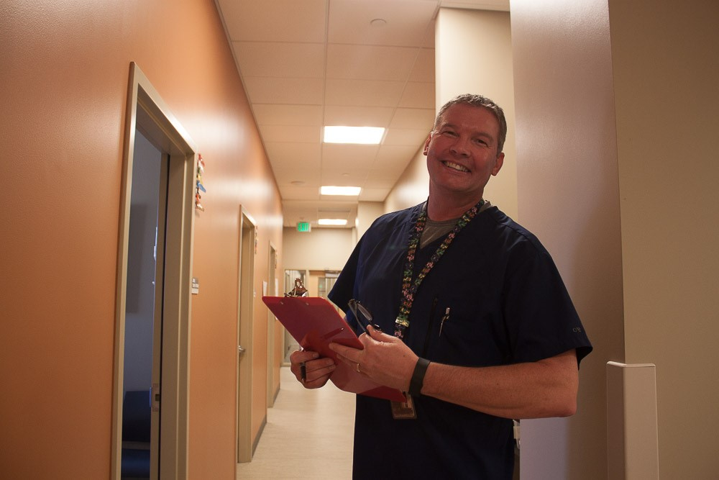
Future- Next Steps - CCH
Integration may be expanded to include other chronic diseases.
Expanded/expanding to mobile clinic sites
In process of creating workflow for Behavioral Health integration to further patient success and bidirectional referrals.
Taking action towards capturing Pharmacy referral data.
Initial discussion in how CGM may be appropriate in the future for some clients to help prevention or delay of Type 2 Diabetes especially those with polymeds or comorbidities.
More attention paid to vaccines and medication reconciliation and perhaps include that in dental workflow.

Slide 28
References
Pamela Allweiss MD, MPH-Diabetes and Dentistry: The Mouth/ Body Connection or What is the Sixth Complication of Diabetes- CDC Division of Diabetes Translation pca8@cdc.gov (2018).
IDF (International Diabetes Federation) and FDI (World Diabetes Federation) are working together to address periodontal diseases as the main oral health problem in people with diabetes. Guideline on Oral health for people with diabetes http://www.idf.org/guidelines/diabetes-and-oral-health
Cochrane Review: investigated relationship of treating gum disease on blood sugar control in people with diabetes and suggest a future strategy for resHarvard Health Publishing. (2018, April). Gum disease and the connection to heart disease. Harvard Health. https://www.health.harvard.edu/diseases-and-conditions/gum-disease-and-the-connection-to-heart-disease
earch and medical/dental practice. The evidence gathered suggested that there may be small but significant improvement in blood sugar control from treating pre-existing gum disease in people with Type 2 diabetes. The Cochrane Library, 2010, Issue 5 http://www.thecochranelibrary.com

Slide 29
References
IDF (International Diabetes Federation) and FDI (World Diabetes Federation) are working together to address periodontal diseases as the main oral health problem in people with diabetes. Guideline on Oral health for people with diabetes http://www.idf.org/guidelines/diabetes-and-oral-health
Cochrane Review: investigated relationship of treating gum disease on blood sugar control in people with diabetes and suggest a future strategy for research and medical/dental practice. The evidence gathered suggested that there may be small but significant improvement in blood sugar control from treating pre-existing gum disease in people with Type 2 diabetes. The Cochrane Library, 2010, Issue 5 http://www.thecochranelibrary.com

