Slide 1
Wound care in Age of Xylazine: Practical and Ethical Considerations
Lydia Williams, MSN, FNP-BC, CWOCN
Kara Cohen, MSN, AGPCNP-BC
Project HOME, Philadelphia, PA
With adapted slides from Kate Gleason Bachman and Máire St. Ledger

Slide 2
Financial Disclosures
We have nothing to disclose

Slide 3
Objectives
After participating in this session, attendees will be able to explain effect that xylazine use has on the development of wounds.
1
Attendees will be able to formulate a plan for management of xylazine-related wounds via a harm reduction lens.
2
Attendees will be able to discuss how medical ethics needs to be considered when providing wound care for people experiencing homelessness who use substances.
3

Slide 4
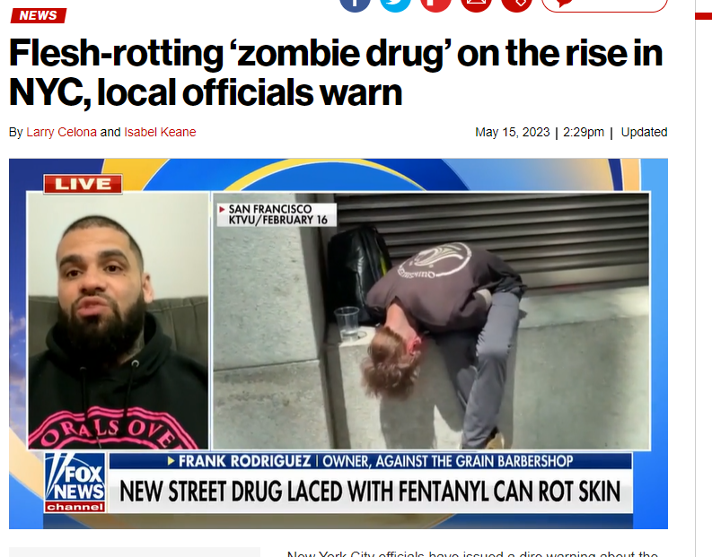

Slide 5
So...How bad is it really?
Wound are necrotic, but not necessarily necrotizing
The wounds do not inevitably lead to limb loss
Not everyone gets wounds
They ARE treatable without grafts and surgery (and in fact, that often works better for our folks than surgeries!)

Slide 6
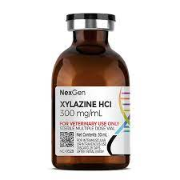
What is Xylazine?
Alpha-2 adrenergic receptor
Powerful sedative and CNS (central nervous system) depressant that can cause drowsiness & amnesia, as well as decreased respiration, heart rate, and blood pressure. Profound mental status depression may impact a person's airway.
Used as sedative and analgesic in veterinary medicine
Originally approved by the FDA in 1972 for veterinary use
NOT approved for human use
Increased risk of overdose when used in combination with opioids or benzodiazepines.
Xylazine overdose DOES NOT respond to Narcan
Not detected on routine toxicology screens, although xylazine test strips are now available.

Slide 7
Xylazine Statistics
First illicit use of xylazine was reported in Puerto Rico in 2001.
First appeared in drug supply prior to 2010, US rapidly increased starting in 2016/17
Philadelphia and Puerto Rice epicenter of use
Xylazine present in 91% of fentanyl/heroin samples in 2021.
2010-2015: present in 2% of unintentional OD deaths
2019: increased to 31% of all unintentional OD deaths.
This is a 1,238% increase!!
Nationwide, 23% of the fentanyl powder seized by the DEA in 2022 contained xylazine.
As of March 2023, fentanyl/xylazine has been found in drug seizures in 48 out of 50 U.S. states

Slide 8
Xylazine in Philadelphia

Slide 9
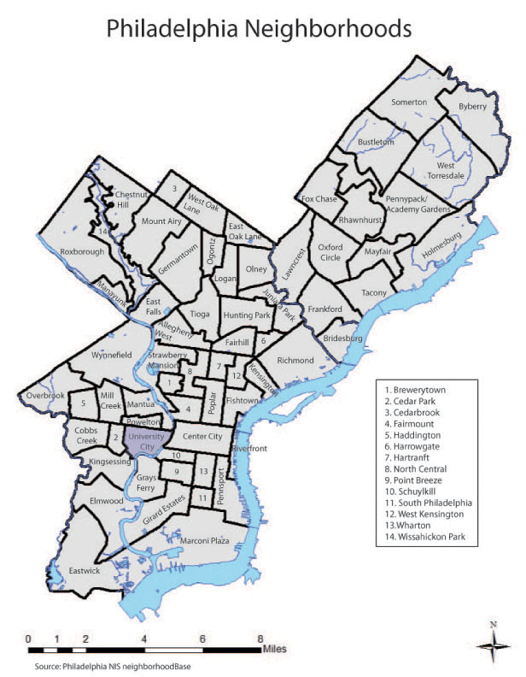
Xylazine in Philadelphia
From 2020 to 2021
39% increase in hospitalizations for SSTI related to injection drug use
14% increase in bacteremia
26% increase in osteomyelitis
4% increase in endocarditis

Slide 10
Xylazine wound presentation/evolution
Wounds may vary widely in appearance, from very small wounds with appearance similar to cigarette burns, to large deep necrotic ulcers.
Can occur anywhere on the body, regardless of injection site
Often worse when shooting in combo with powder coke (speedballs)
Can occur even when dope is smoked or snorted

Slide 11
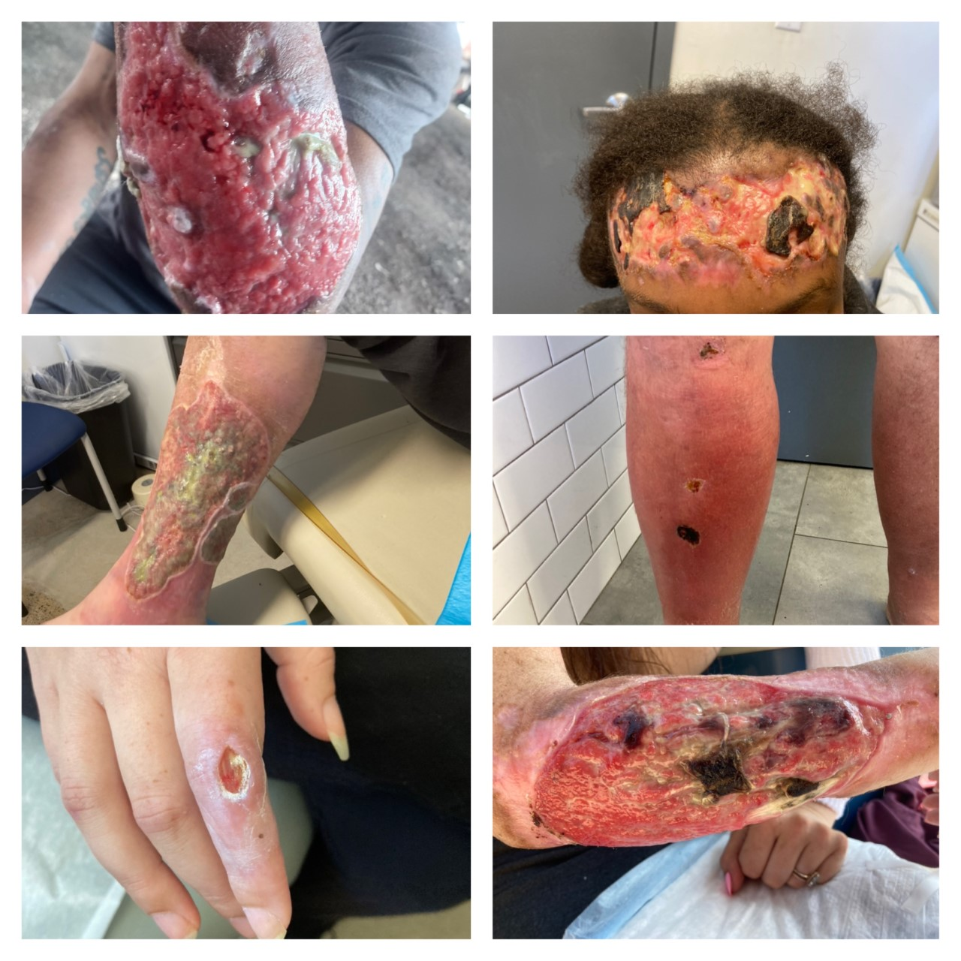

Slide 12
Medical Ethics and wound care
Remember principles of medical ethics:
Beneficence (Do good)
Non-maleficence (Do no harm)
Justice (Ensuring Fairness)
Autonomy (Ensuring patient may choose freely, when they able to do so)

Slide 13
How does this relate to wound care: What does "Do No Harm Actually Mean?"
Proliferation of large necrotic ulcers has led many providers and non-clinical community members to scramble to provide supportive services
Points to consider:
Increasing access
Gatekeeping?
Inappropriate dressing selection (Tip: Don't use a dressing if you don't know what it does)
Legal Ramifications
Standing orders

Slide 14
Longitudinal wound management
Point in time wound care is important, but not the only thing
Careful of overuse of antibiotics
Inflammatory vs. infection
“can’t antibiotic your way out of a poor quality, inconsistent wound care”
Community organizations and collaborations
identify your community partners
continuity of care- asking patients what they are using already
May be to order wound care supplies from insurance

Slide 15
Wounds can improve, limb loss avoided with consistent outpatient management

Slide 17
Harm reduction
Decreasing injection into wound (amount and frequency)
Changing method of ingestion will decrease chronic traumatic wounds but will not eliminate risk for wounds
Educate re: persistent trauma/necrosis if continue to inject into wounds
Cleaning agents- AVOID cleaning wounds with sanitizers, bleach, iodine, alcohol wipes
**Dakins solution (very diluted bleach)
MOUD
Emphasize importance of keeping wound clean and covered (even with a maxi pad if that's all the patient has available)

Slide 18
Important Components of Xylazine Wound Management Plan
Patient centered goals
Address the underlying cause and assess for impact of chronic disease
Regular assessment and determination of wound healing status
Evidenced-based topical care that assists with decreasing unnecessary dressing changes.
Interdisciplinary team

Slide 19
Wound History
Onset
History of similar wounds
Current/ prior treatment and outcomes
Who is caring for the wound?
When was the dressing last changed?
Are they seeing a specialist for care to the wound?

Slide 20
Key Components of Good Wound Assessment
Wound history and level of injury
Wound location, measurements, description of the tissue inside of the wound and pain
Assess the surrounding skin for signs of infection or other issues
Assess for chronic conditions that can affect wound healing

Slide 21
Topical Wound Care for Xylazine Wounds: STEP 1 Cleansing
Goal is to remove as much nonviable tissue, bacteria, and drainage without causing further damage to wound.
Periwound tissue should be cleansed as well
Type of cleansing agent used will depend on the status of the wound.
Ideally should be done using a technique that is 4-15 psi
Hand hygiene and clean wound technique imperative to decreasing the risks of infection

Slide 22
Topical Wound Care for Xylazine Wounds: Step 1: Cleansing
CLEAN WOUND
Gentle flush of cleansing agent to remove drainage while avoiding damage to healthy tissue
Saline
Commercial wound cleansers
Potable Tap water
NECROTIC WOUND
Low pressure irrigation to reduce bacteria and assist in removal/loosening of nonviable tissue
Saline in pressurized container
Diluted Dakin’s solution
Vashe

Slide 23
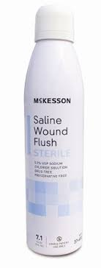
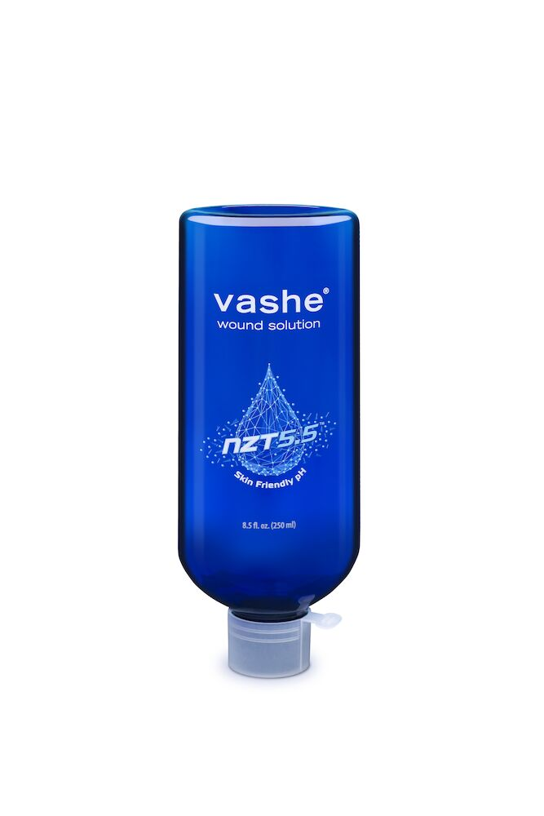
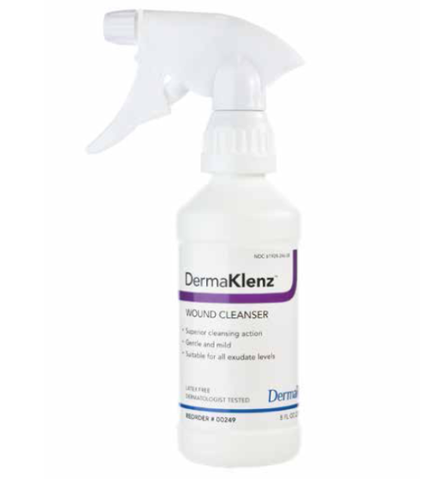
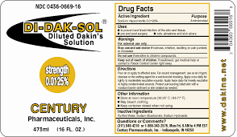
Topical Care for Xylazine Wounds: STEP 1 Cleansing NON CYTOTOXIC CLEANSING AGENTS
Notes:
Vashe, PHMB wi

Slide 24
Topical Wound Care for Xylazine Wounds: Step 2: Topical Care
NO HARM INEXPENSIVE WOUND CARE:
Non-Stick Gauze Pads
Abdominal Pad
Conforming Gauze Roll/Bulky Gauze roll
Tape
Notes:
If you don’t know what to do, you can always do this. Wounds need to be covered, if its draining even intermittently it needs to be covered. NEEDING AIR IS A MYTH. If the wound is macerated then the topical care is in- appropriate.

Slide 25
Topical Wound Care for Xylazine Wounds: Step 2: Topical Care
MINIMAL DRAINAGE
Dressings that provide moisture AND decrease/impede bacterial growth, while avoiding surrounding skin damage
Medical grade honey gel
Xeroform NON- OCCLUSIVE gauze
Triad paste
HEAVY DRAINAGE
Dressings that absorb excess exudate while maintaining moisture balance and decreasing/impeding bacterial growth
Triad paste
Medical grade honey impregnated foam/gauze
Polyurethane Foam
Notes:
. Medical honey gels and xeroform require daily dressing changes. Triad can stay in place for up 7 days. Save your money on the specialty on the specialty dressing if you don’t what they are for

Slide 26
Topical Wound Care for Xylazine Wounds: Step 2: Topical Care
MINIMAL DRAINAGE
Secondary Dressings
Non-adherent gauze pads
ABD pads
Roll gauze
Elastic retainer net
HEAVY DRAINAGE
Secondary Dressings
ABD pads
Waterproof Adhesive Foam
Roll gauze
Elastic retainer net
Notes:
. Medical honey gels and xeroform require daily dressing changes. Triad can stay in place for up 7 days. Save your money on the specialty on the specialty dressing if you don’t what they are for

Slide 27
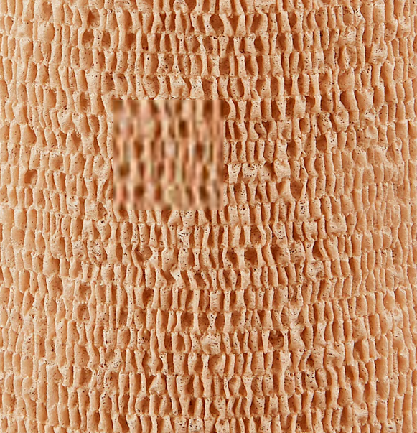
To Coban or not to Coban
Frequently used to keep dressings in place on limbs
Can be constrictive if too tight
Caution with
Infection
Possible DVT
Somnolence and decreased sensory awareness
Wound underneath cohesive bandage should be checked at least every 24hrs

Slide 28
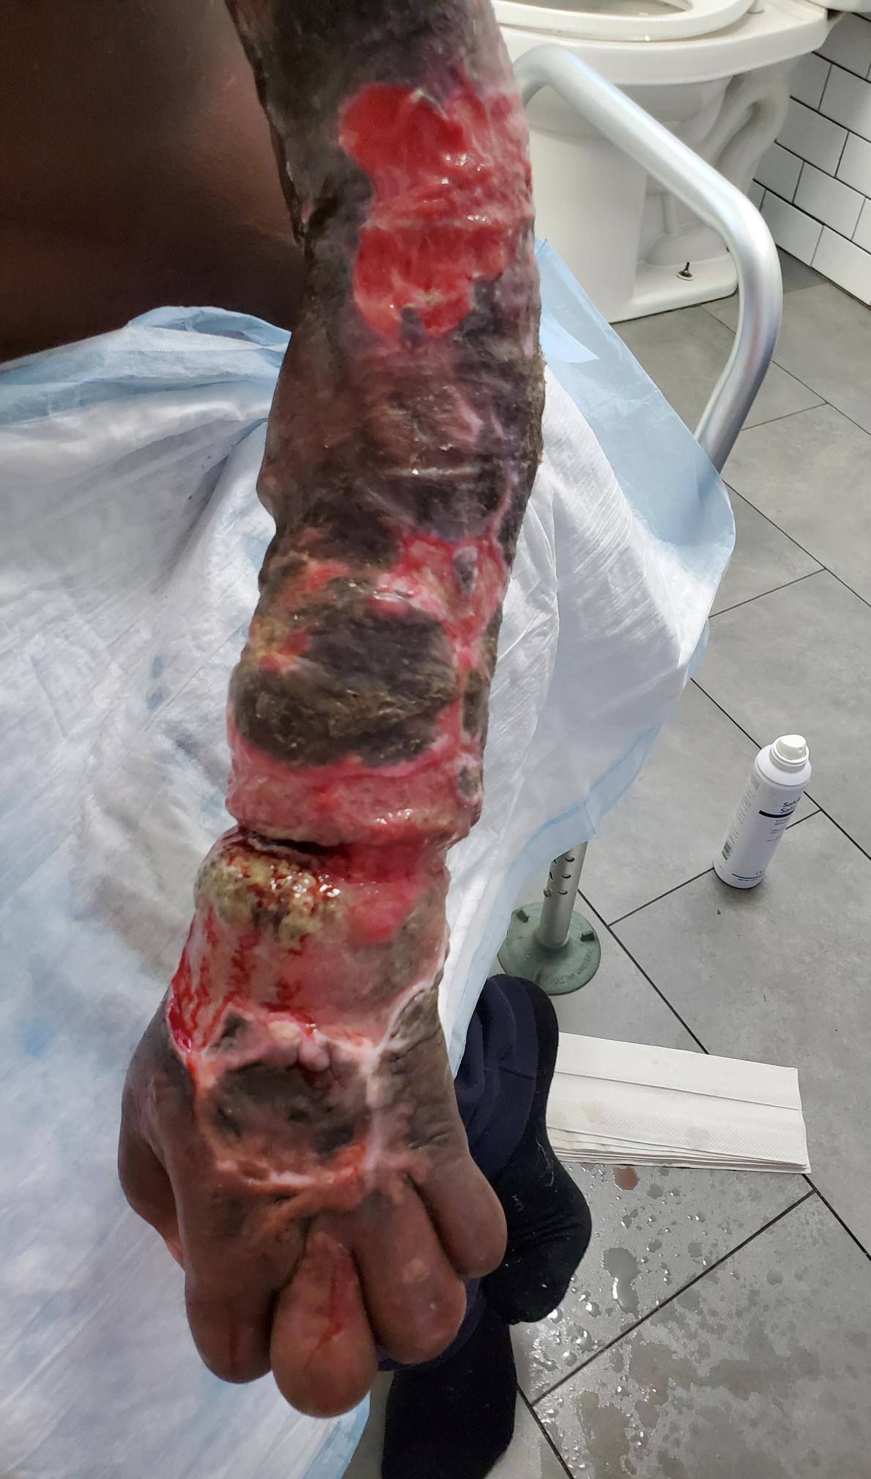
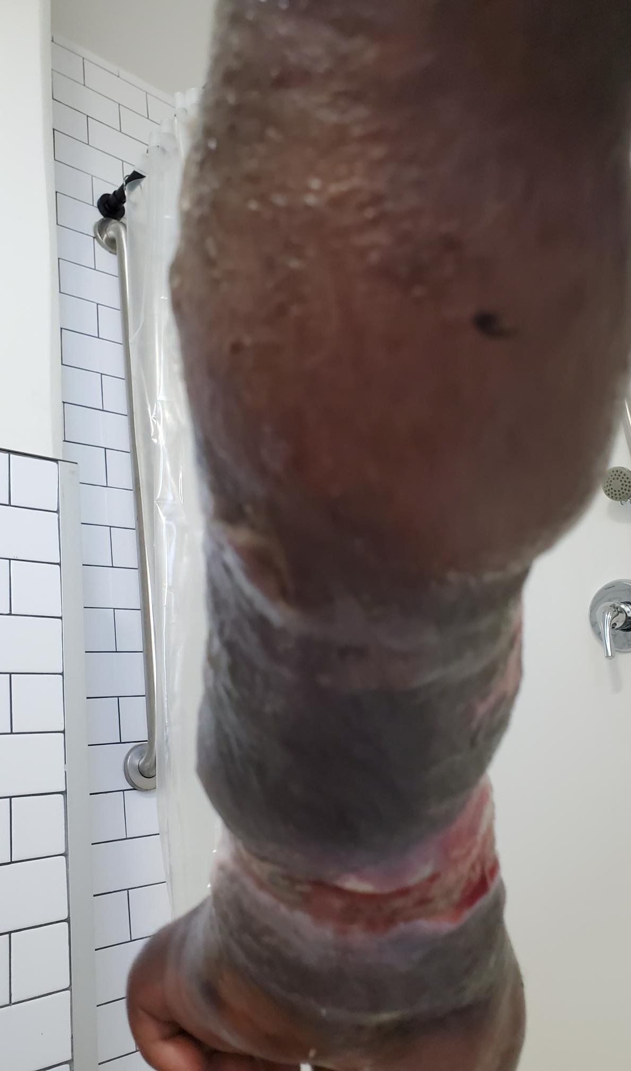
Example of Cohesive Bandage Constriction
Patient left dressing in place for several months
Edematous hands
Maceration
Lacerations from Coban

Slide 30
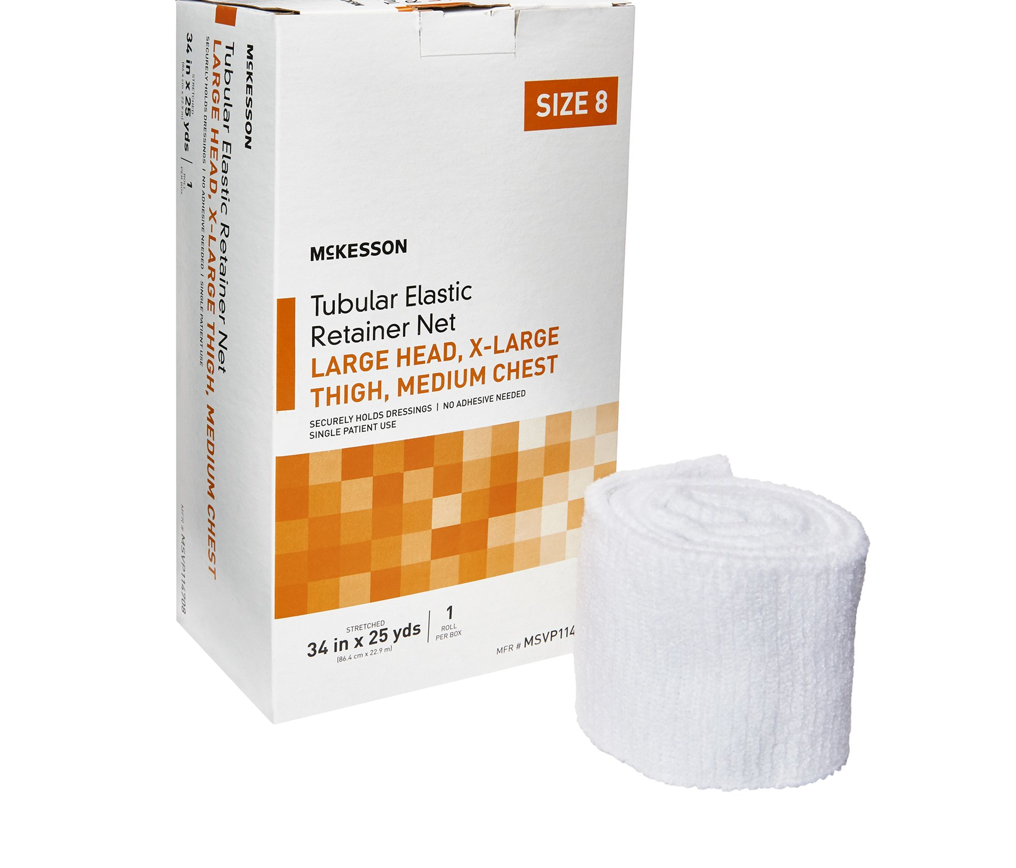
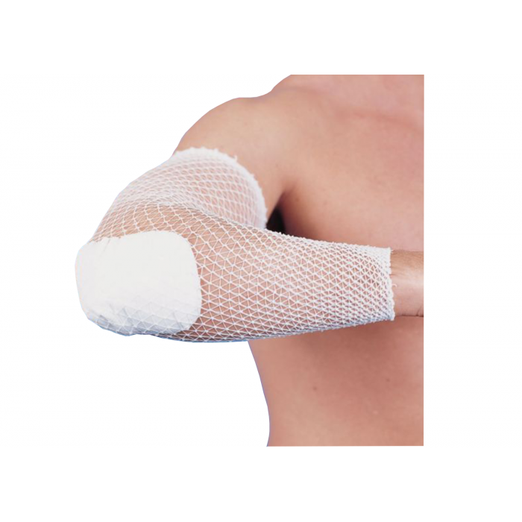
Alternative: Tubular netting
Allows patients to secure their own dressings
Can pull down to inject and pull back up to keep wound covered
For most arms: sz 4 or 5
For most legs/head: sz 8

Slide 31
Identifying Systemic/Spreading Infection in Xylazine Wounds
Diagnose based on multiple signs/symptoms vs a single sign/symptom
Wound cultures should only be done to guide treatment
May have more subtle signs in those with concomitant diabetes, arterial disease or any disease/disorder that compromises the immune system.
Notes:
IE redness, or pus
Wound cultures should only be done for failed antibiotic treatment, signs of spreading infection or to assess for the presence of bacteria that would prevent surgery.

Slide 32
Identifying Infection in Xylazine Wounds
Local Infection- treated with topical antimicrobials
Common signs/symptoms
Slough/necrotic tissue
Foul odor after cleansing
Purulent drainage
Increase in wound size
Increasing pain
Local erythema <2cm
Spreading/Systemic Infection- treated with systemic antibiotics AND topical antimicrobials
Common signs/symptoms
Local erythema and induration >2cm
Satellite lesions or wound breakdown
Fever
Fatigue
Crepitus
Lethargy
Poor appetite
Notes:
Spreading infection I.e. Cellulitis, erysipelas . Systemic Infection- Sepsis

Slide 33
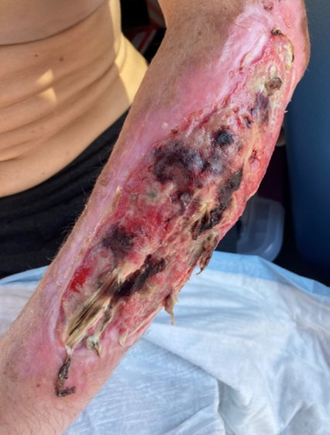
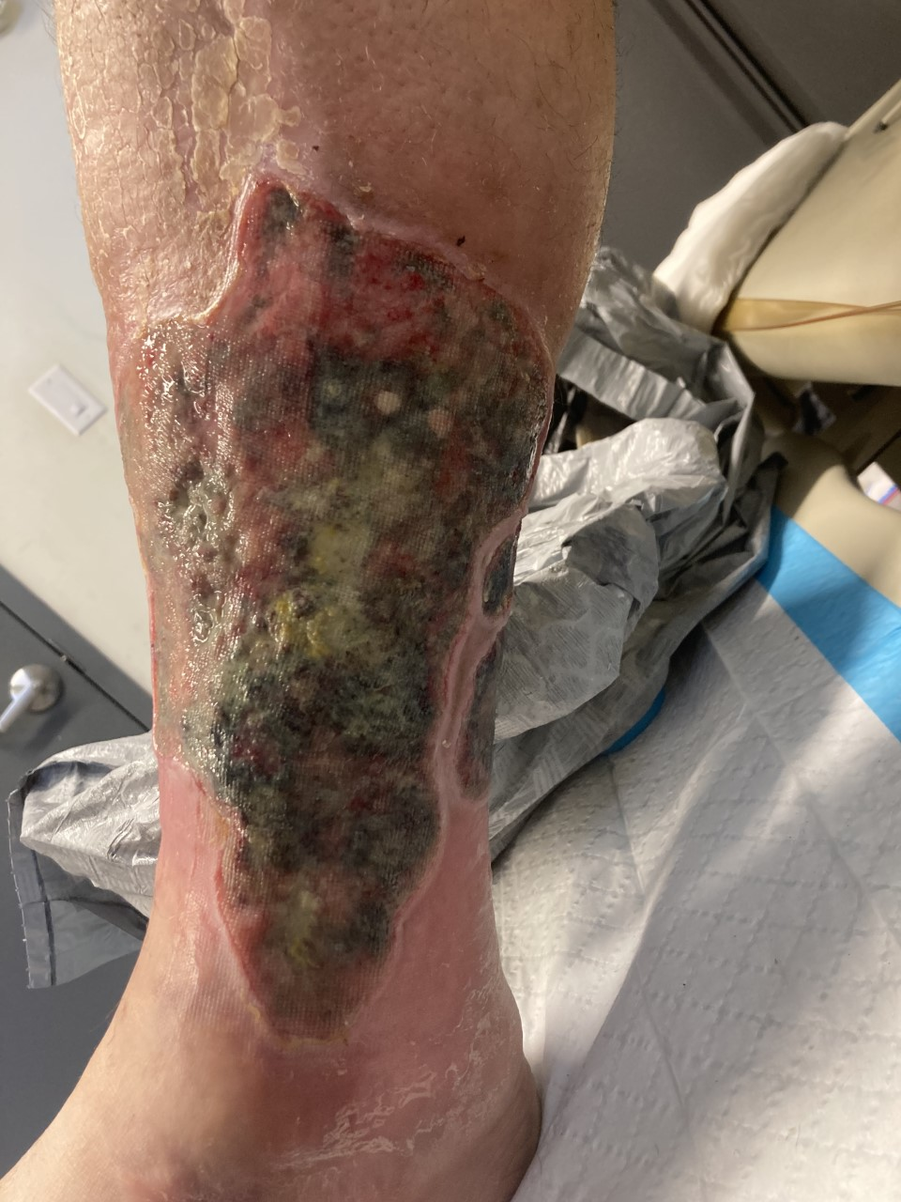
Local Infection

Slide 34
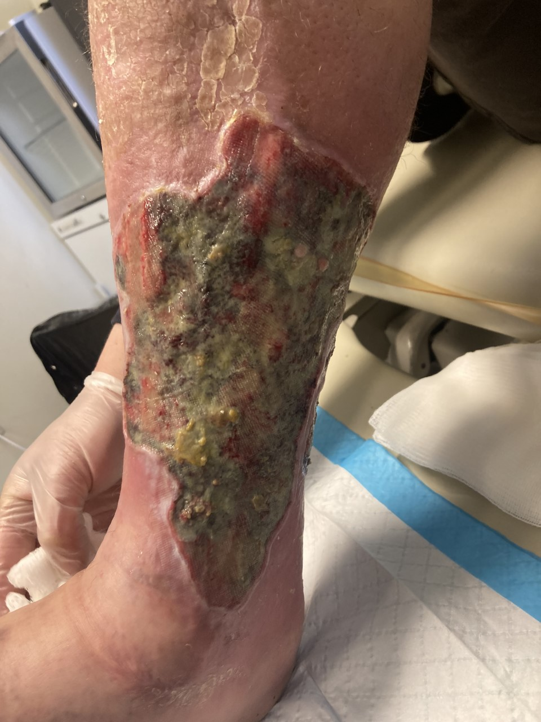
March 10

Slide 35
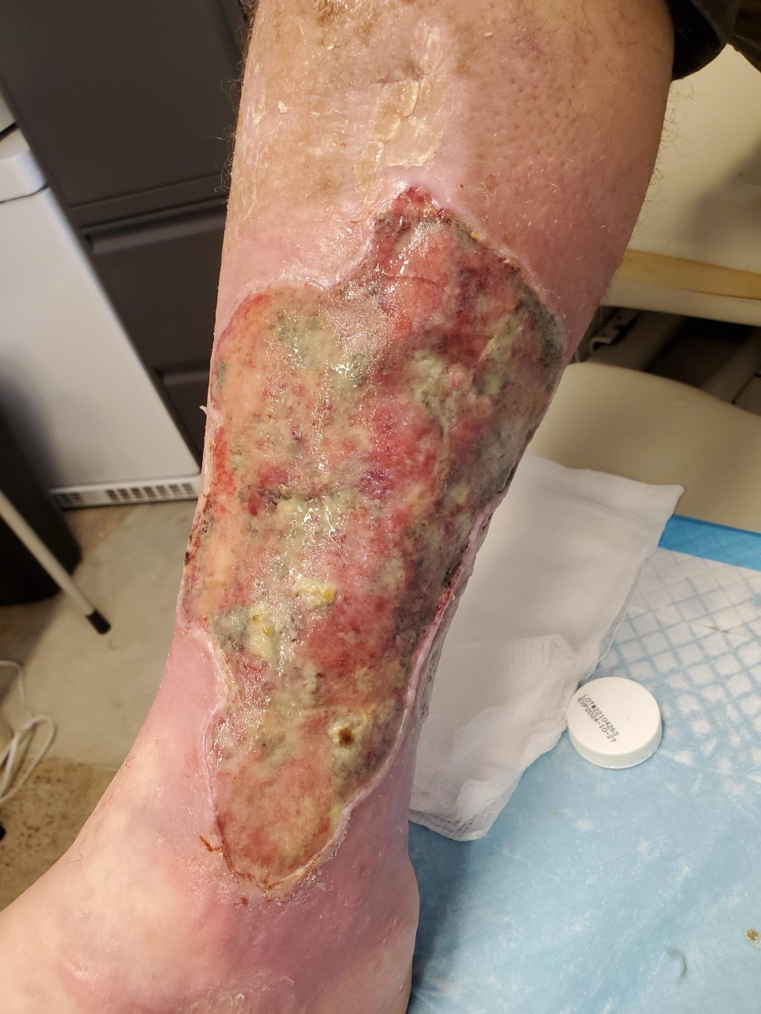
March 15

Slide 36
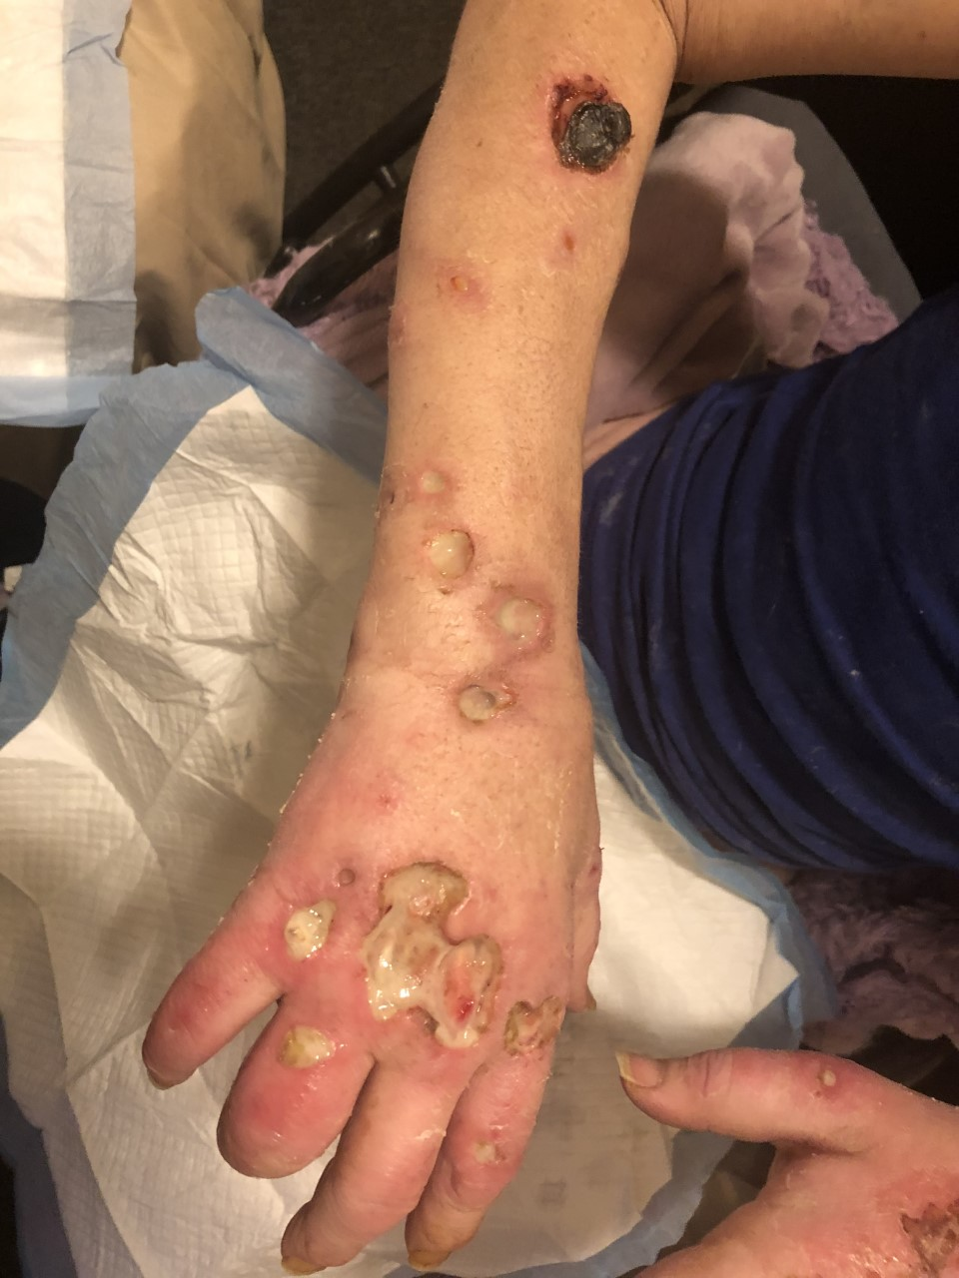
Spreading infection

Slide 37
When to Refer or Consult a Specialist
Any wound probing to the bone or blood vessel
Wound decline or improvement after 2 to 4weeks appropriate topical treatment
Wound decline or no improvement after appropriate oral antibiotic therapy
A lower extremity wound in a person with peripheral arterial disease (PAD)
A wound on the foot or any area that is subjected to continuous pressure
Notes:
Do not assume patients won’t be open to seeing a specialist or going to other wound providers.

Slide 38
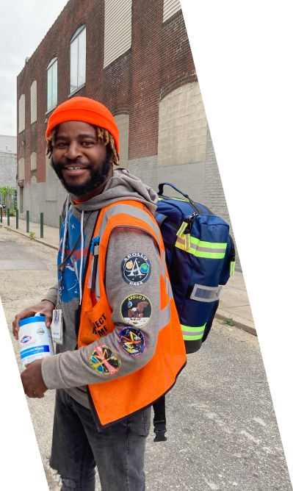
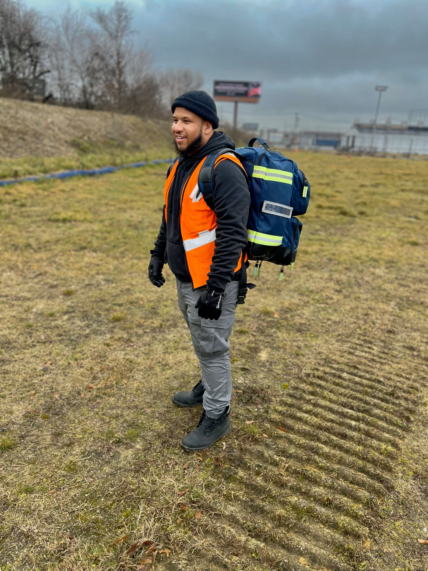
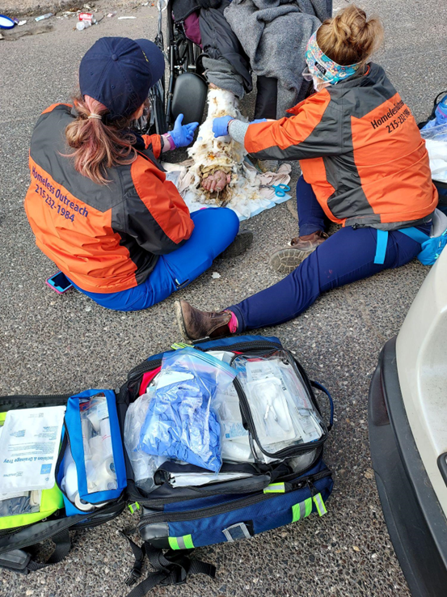
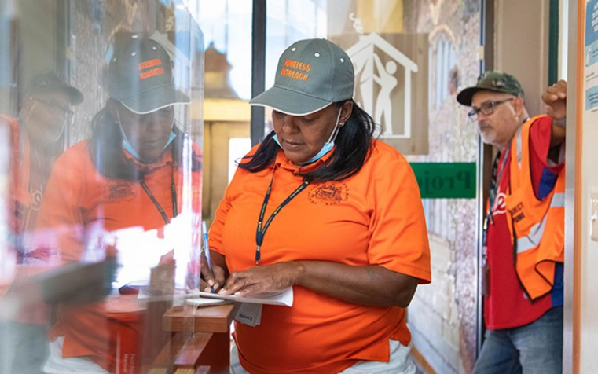
Team approach
Importance of relationship-based care
Utilize CPS/CRS/outreach workers
Trauma informed care

Slide 39
General Wound/SSTI Care
u DO
uClean wound with non-cytotoxic cleanser such as saline or bottled water
uCover open, draining wounds without signs of severe infection with dry sterile dressings.
uReplace skin flaps/tears and secure in place with steri strips
uReinforce signs/symptoms of cellulitis, abscess and importance of prompt f/u with PCP, local clinic, ED
uProvide and instruct in use of warm compresses for small abscesses or phlebitis
uProvide information about local clinics that can provide f/u care
uReinforce safe injection practices and provide information on local organizations to get clean “work

Slide 40
General Wound/SSTI Care
DON'T
uCleanse with iodine, peroxide or bleach *
uAttempt removal of embedded foreign objects
uProvide apply or provide specialty dressings such as alginates, hydrocolloids, coban, ace bandages, compression stockings, etc if you are not sure what they do

Slide 41
Questions?

Slide 42
References
Andrews, MPH, A., Puleo, MPH, M., Johnson, MPH, J., & Higgins, MPH, D. (2021). Philadelphia Department of Public Health, Division of Substance Use Prevention and Harm Reduction Annual Report (pp. 1–48). Philadelphia, PA: City of Philadelphia.
The City of Philadelphia. (2022, December 8). Philadelphia department of public health substance use prevention and harm reduction.
Division of Disease Control, P. D. of P. H. (2023, January 4). Health advisory.
Malayala SV, Papudesi BN, Bobb R, Wimbush A. Xylazine-Induced Skin Ulcers in a Person Who Injects Drugs in Philadelphia, Pennsylvania, USA. Cureus. 2022 Aug 19;14(8):e28160. doi: 10.7759/cureus.28160. PMID: 36148197; PMCID: PMC9482722.
McNichol, L. L., Ratliff, C. R., & Yates, S. S. (2022). Wound, ostomy, and Continence Nurses Society Core Curriculum. Wolters Kluwer.
Swanson, T., Ousey, K., Haesler, E., Bjarnsholt, T., Carville, K., Idensohn, P., Kalan, L., Keast, D. H., Larsen, D., Percival, S., Schultz, G., Sussman, G., Waters, N., & Weir, D. (2022). IWII wound infection in Clinical Practice Consensus Document: 2022 update. Journal of Wound Care, 31(Sup12). https://doi.org/10.12968/jowc.2022.31.sup12.s10

