Slide 1
Wound Care Learning Lab
Basic Principles of Wound Management For Clinicians

Slide 2
Anatomy of Skin
Epidermis- Top layer made up of 4-5 layers.
Dermis
Subcutaneous Tissue
Muscle

Slide 3
Financial Disclosures
We have no disclosures

Slide 4
Functions of Skin
Protect underlying structures
Regulates body temperature
Insulation
Immune function
Synthesize Vitamin D

Slide 5
Phases of Wound Healing
Acute Wounds
Hemostasis- vasoconstriction of small vessels to control bleeding
Inflammatory phase- clean the wound bed
Proliferative phase- develop healthy scar tissue close the wound
Maturation/Remodeling- Strengthen scar tissue to 80% original strength
Usually complete in about 4wks
Notes:
Heals in an orderly, timely, fashion without the need for long-term f/u. Full thickness ulcers

Slide 7
Phases of Wound Healing
Chronic wounds
Extended inflammatory phase
Healing commonly plateaus
Recurrent/persistent infection
Biofilms
Unable develop new vessels/tissue

Slide 8
Long-term Goal Approach

Slide 9
Longitudinal Wound Care Management
Frequency of care
Ease of care
Supplies
Supports
Monitoring/measuring progress
Goals of patient

Slide 10
When building a care plan consider :
How often does the care need to be done?
Consider how many times per week will the patient actually be able to change dressing vs. ideally be able to change dressing.
e.g.- may lead you to select Triad vs. Medihoney, or a foam dressing vs. Telfa/ABD
How easy will it be for the patient to perform care?
Pt should be educated on how to self-perform dressing changes, even if someone else will be assisting

Slide 11
Supplies
Choose supplies that can be obtained in large enough quantity to be consistent
Covered by insurance?
Can give at least several days to the patient?
**THERE IS NO SPECIALTY DRESSING THAT CAN BE GIVEN FOR A SINGLE APPLICATION THAT WILL BE MORE EFFECTIVE THAN CONSISTENT, ONGOING WOUND CARE, EVEN WITH MORE CONSERVATIVE/BASIC DRESSINGS.

Slide 12
Supports
Friends/family who can assist?
Access to running water?
Provide bottled water, saline
Ability to store supplies?
If staying in shelter, can they keep a box there?
Access to water-tight storage?
Provide ziplock bags
Local wound care clinics, skilled nursing agencies?
Who can help support the ongoing care?
Consider in Care Plan

Slide 13
Managing wounds and monitoring progress
Measuring
Photos
Frequency of looking at wounds
Evaluation if products given are working
Has the patient been able to perform the suggested care plan or have they had to "mix and match" care

Slide 14
Goals of Patient
Close the wound?
Reduce risk of infection?
Avoid limb loss?
Keep at center of plan of care !

Slide 15
Patient Centered Approach

Slide 16
How do we usually offer wound care services?
THE USUAL IN OUTPATIENT, COMMUNITY-BASED SPACES:
Varying or inconsistent wound care supplies (quantity, supplies, specialty supplies, pre-packaged kits sold from various medical supply websites)
Clinical staff not trained or certified in wound care
Inconsistent clinical staff in community-based settings willing to provide wound care
Non-clinical staff wanting to provide more wraparound services like wound care but not trained

Slide 17
Consistently offering services/reliantly able to provide those services
Easy to understand (photos/pictures/clear language) handouts
Clearly labeled wound care supplies of what they are and how to use them
Offer hands off (education, on-demand videos, handouts, supplies) and hands-on care (clinical and non-clinical staff)
Clinical staff who are willing and able to provide wound care (educate all clinical staff)
Other services to promote healing (management of acute and chronic conditions, nutrition, housing, case management)
Patient-Centered Approach To Wound Care Services

Slide 18
Care Setting and Care Coordination Part 1

Slide 19
Street and Community Settings
SAFETY
Is the area safe for patient and wound care provider to remain in for an extended period?
Caution re: paraphernalia (uncapped needles, broken glass)
Know your surroundings (who is around, where you are, how to leave)
Work with partners (360 view)

Slide 20
Street and Community Settings
Setting up a clean space (Chucks? Tables? Chairs?)
Privacy? (may or may not be possible, may need plan for treating wounds on body parts people do not want to expose in public)
Plan for waste disposal
Double bagging/biohazard bags
If inside- ventilation?
Ability for take home dressings?
Zip lock bag, 2-3 day supplies if possible

Slide 21
Clinic Settings
Possibly challenging setting due to the flow of the clinic and staff capacity
There can be resistance to providing regular wound care services due to the need for time, privacy, and regular supplies
Ordering supplies to be regularly stocked can be challenging

Slide 22
Principles of Medical Ethics and Wound Care
Beneficence (Do good)
Non-maleficence (Do no harm)
Justice (ensuring fairness)
Autonomy (ensuring patient has the ability to choose freely, when they are able)
https://www.themedicportal.com/application-guide/medical-school-interview/medical-ethics/?v=7516fd43adaa

Slide 23
Medical Ethics and Wound Care
What does it mean to "Do good"?
What does it mean to do no harm?
Is doing nothing doing good or doing harm?
What if the patient prefers a treatment that you think may cause more harm than good?
How do you respect autonomy and promote justice while simultaneously upholding all of these principles?
There is no one right answer to any of these questions, but we need to keep the core medical ethics in our minds and at the forefront of care at all times as we consider treatment options.

Slide 24
Care Setting and Care Coordination Part 2

Slide 25
Relationships With Community Partners
Communicate
Network
Shadow their spaces
Exchange needs
Training opportunities from both sides
Funding opportunities
Clinical staff needs (including part-time needs) and recruitment

Slide 26
Working with wound care clinics, home care, hospitals, etc.
Insurance
Supplies
Discharge paperwork
Educating on escalation or downgrade of care
Referrals
What can our patients expect

Slide 27
Hospital Inreach
Identify interested/aligned individuals in the ERs or inpatient units of your local hospitals
Educate on discharging with
2-3 days of supplies
Education on how to self-perform care
Signs and symptoms when to return
Resources/instructions other than "return to ER daily for wound care"
Educating on avoiding "scare tactic" language such as "you'll lose your leg if you don't stay" (this is different than informed consent)

Slide 28
Wound Care Basics

Slide 29
Universal precautions were introduced by the CDC in 1985, mostly in response to the HIV epidemic. Standard precautions apply to the care of all patients, irrespective of their disease state.
These precautions apply when there is a risk of potential exposure to
(1) blood;
(2) all body fluids, secretions, and excretions, except sweat, regardless of whether or not they contain visible blood;
(3) non-intact skin, and
(4) mucous membranes.
This includes hand hygiene and personal protective equipment (PPE), with hand hygiene being the single most important means to prevent transmission of disease
Transmission-based Precautions
Contact Precautions (Gloves and contact gowns)
Airborne Precautions (N95, gloves, and contact gowns)
Droplet Precautions (Mask, gloves, and contact gowns)
Universal or “Standard” Precautions

Slide 30
Non-sterile (vs sterile="seeks to eliminate every potential microorganism in and around a sterile field while also maintaining objects as free from microorganisms as possible")
Preventing direct contamination of materials and supplies
Examples:
Changing gloves often after touching surfaces
Change when switching from working with “dirty” materials to “clean” materials
Opening packages but keeping in the package until ready to use
Rinsing the wound with tap water as opposed to sterile water
Cutting supplies for multiple uses
Clean Technique

Slide 31
Wound Assessment
•The foundation for treatment plan and determining healing
•Holistic, including review of chronic conditions, medication, nutritional status and overall health of patient
•Should be conducted and documented at regular intervals
•Assure adequate lighting and equipment

Slide 32
Wound Assessment: HPI
•Onset
•History of similar wounds
•Current and prior treatment and the outcomes
•Who is caring for the wound
•When was the dressing last changed
•Are they seeing a specialist for care to the wound
•Patient’s treatment preferences

Slide 33
Wound Assessment : Wound Status
Anatomic Location
Size; should be measured
Appearance of wound edges and surrounding skin/periwound area
Presence of necrotic tissue
Presence of wound odor even after cleansing
Amount of exudate/drainage
Describe the appearance of tissue in the wound bed
PAIN

Slide 34
Wound Classification
Partial thickness- skin damage into epidermis and/or dermis
Full thickness- skin damage through the dermis to underlying structures
Deep/wet- wound with depth, tunnels or undermining with moderate/large amounts of exudate
Deep/dry- wound with depth, tunnels or undermining minimal/no exudate
Shallow/wet- wound with no depth, no tunnels or undermining, moderate/large exudate
Shallow/dry- wound with no depth, no tunnels or undermining minimal/no exudate
Notes:
Exudate- drainage

Slide 35
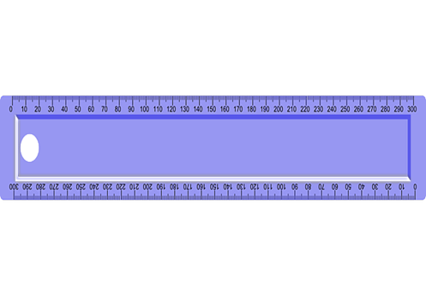
Wound Assessment: Measurement
Standardized:
Length x width x depth in CM
OR
Surface area CM
(L X W)

Slide 36
Wound Assessment: Tunneling/Sinus Tract
Single direction from the edge of the wound
Note depth and direction using the face of a clock
Example: 2cm tunnel at 6 o'clock

Slide 37
Wound Assessment: Undermining
Along the periphery of the wound
Documented using location of the deepest depth and direction using the clock face
Example:
Up to 2.5cm of undermining from 10 o’clock
To 2 o’clock, deepest at 12 o’clock

Slide 38
Wound Assessment: Wound Bed Descriptions Quantify by %
Granulation Tissue: Bright, beefy red, granular/bumpy
Slough: Usually stringy, mucoid yellow/tan note color, consistency, adherence to wound bed
Eschar: Black, grey, brown. Loosely adherent or firmly adherent to wound bed
Clean non-granular: pink/red smooth
Epithelial tissue: Pink, dry

Slide 39
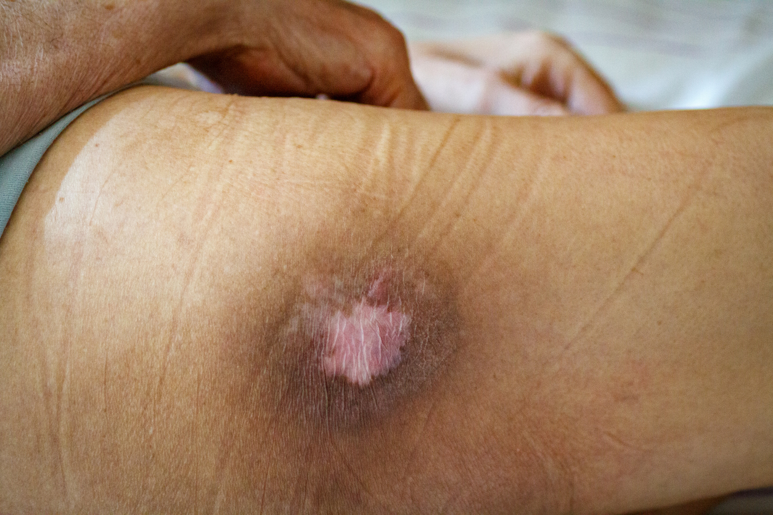
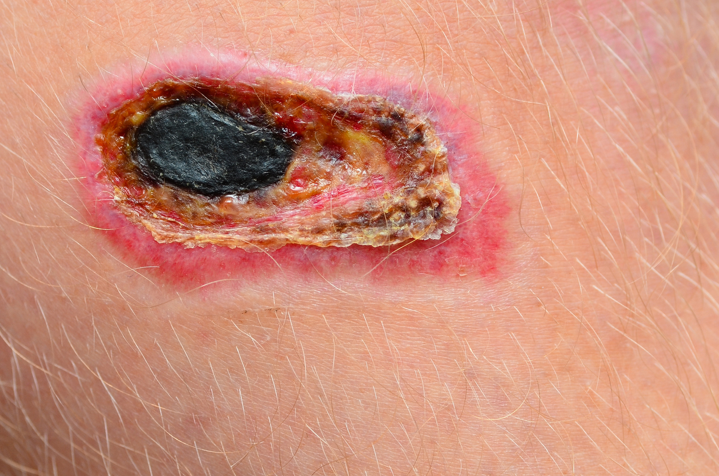
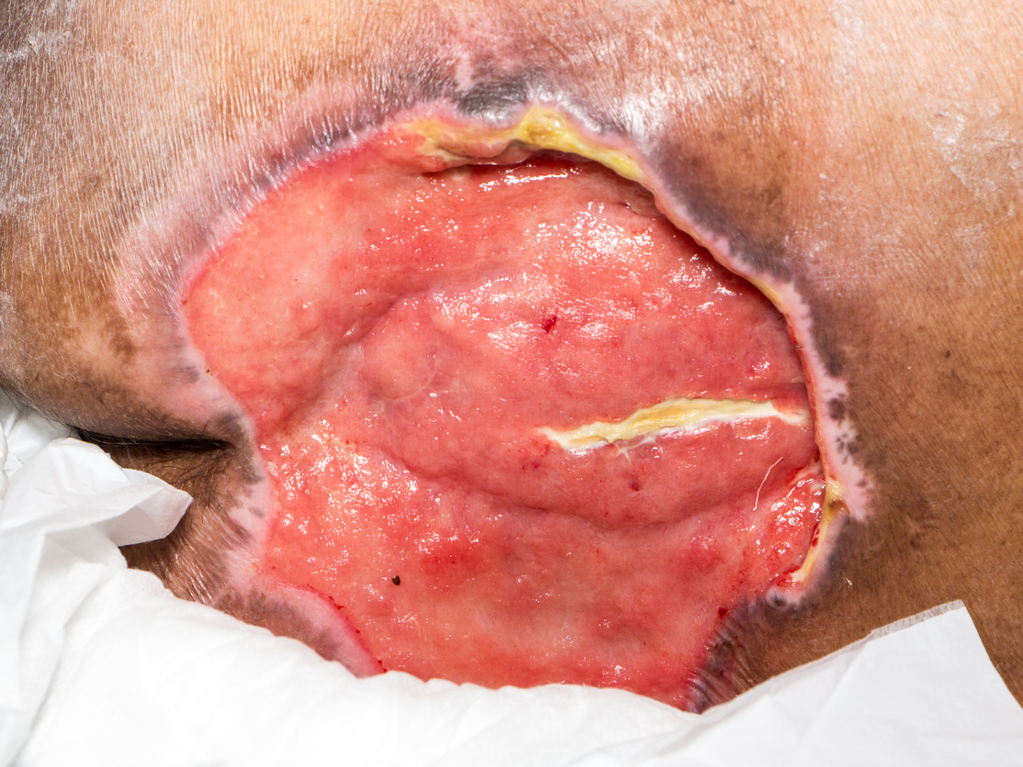
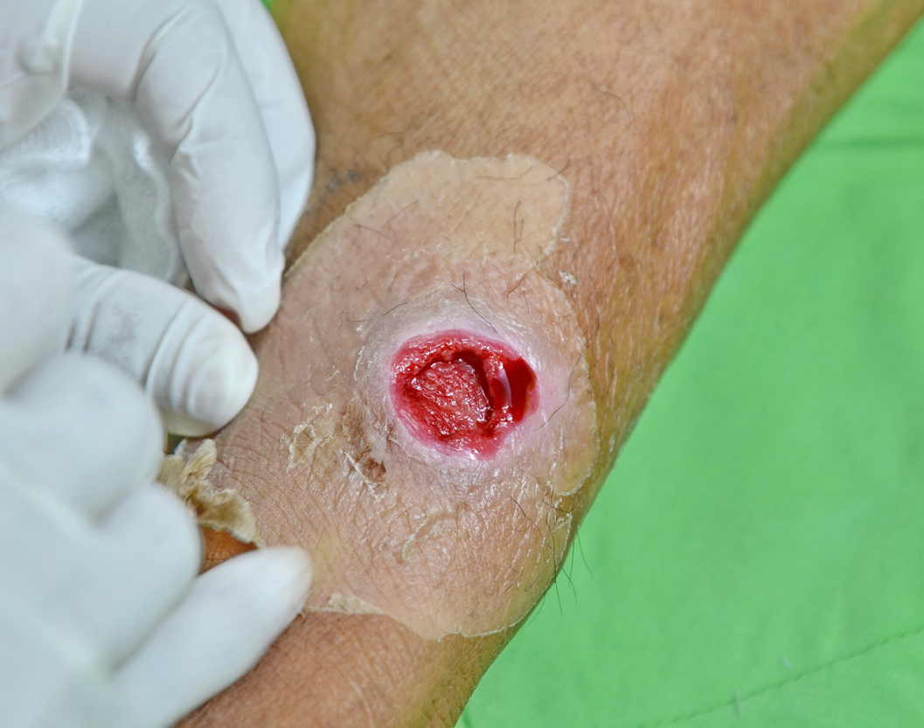
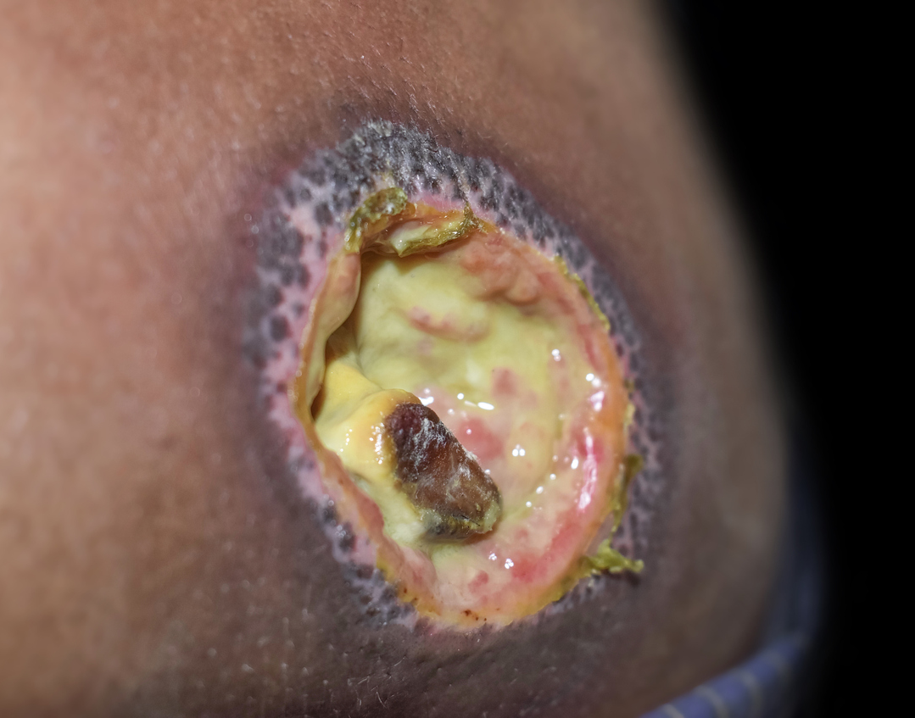

Slide 40
Wound Assessment: Wound Drainage Descriptions Quantify scant, small, moderate, heavy
None
Serousanguineous
Bloody
Purulent- thick, thin, bloody, yellow, tan, green, w/wo, odor
Serous

Slide 41
Sample Wound Assessment
R forearm full thickness traumatic ulcer 7cm x 3.5cm x 0.5cm, 40% clean non granular 60% yellow slough, periwound area macerated. Large amount of tan thin purulent exudate. No induration, erythema or excess warmth.

Slide 42
Identifying Wound Infection
Diagnosed based on multiple signs/symptoms vs a single sign/symptom
Wound cultures should only be done to guide treatment
May have more subtle signs in those with concomitant diabetes, arterial disease or any disease/disorder that compromises the immune system.

Slide 43
Identifying Wound Infection
Local Infection
Treated with topical antimicrobials
Common signs/symptoms:
Slough/necrotic tissue
Foul odor after cleansing
Purulent drainage
Increase in wound size
Increasing pain
Local erythema <2cm

Slide 44
Identifying Wound Infection
Spreading/Systemic Infection
Treated with systemic antibiotics AND topical antimicrobials
Common signs/symptoms:
Local erythema and induration >2cm
Satellite lesions or wound breakdown
Fever
Fatigue
Crepitus
Lethargy
Poor appetite

Slide 45
Basic Principles of Wound Management
The most important principle... TREAT THE UNDERLYING CAUSE
Correct/improve systemic factors that impact healing
Evidenced-based topical therapy congruent with wound healing goal
Patient-centered
Promote moist wound healing and protects periwound skin
Regular assessment of healing status
Notes:
Most wounds healing in a moist environment heal 2-3 times faster, have less infections, less scarring

Slide 46
Topical Care STEP 1: Cleansing
Goal is to remove as much nonviable tissue, bacteria, and drainage without causing further damage to wound.
Periwound tissue should be cleansed as well
Type of cleansing agent used will depend on the status of the wound.
Ideally should be done using a technique that is 4-15 psi
Hand hygiene and clean wound technique imperative to decreasing the risk of infection

Slide 47
Topical Care Step 1: Cleansing
CLEAN WOUND
Gentle flush of cleansing agent to remove drainage while avoiding damage to healthy tissue:
Saline
Commercial wound cleansers
Potable Tap water
NECROTIC/INFECTED WOUNDS
Low pressure irrigation to reduce bacteria and assist in removal/loosening of nonviable tissue:
Saline in pressurized container
Diluted Dakin’s solution
Vashe

Slide 48
Topical Care Step 2: Debridement
Eschar and slough impede wound healing, increase risk of infection and increase wound odor and must be removed for wound to heal
Debridement contraindicated in uninfected wounds that are poorly perfused and a heel wound of an immobile patient
Method depends on amount, status of infection and patient/wound goals
Notes:
Several methods autolytic, enzymatic, larval therapy, chemical debridement, surfactants, hydrotherapy, ultrasound, wet to dry, surgical debridement, conservative sharp debridement.

Slide 49
Topical Care Step 2: Debridement
Types of debridement:
Autolytic debridement:
The body's WBCs and naturally occurring enzymes digest necrotic tissue. Occurs naturally when wound is moist and when person has good immune response. Good for noninfected wounds and in combination with other treatment for wounds that are infected.
No damage to healthy tissue
Usually cause increase drainage initially important to protect periwound skin and provide patient education
Medical grade honey
Hydrogels
Hydrocolloids
Any other item that maintains moist wound environment

Slide 50
Topical Care Step 2: Debridement
Types of debridement:
Enzymatic Debridement:
Application of topical enzymatic debriding agent to wound bed. Collagenase (Santyl) is the only one currently on the market.
Ointment bases
Breaks down denatured collagen in wound bed
Does not harm healthy tissue could possibly cause irritation to periwound skin
Good in patients who are not surgical candidates or have poor perfusion

Slide 51
Topical Care Step 2: Debridement
Types of debridement:
Chemical Debridement:
Chemical agent used to loosen necrotic tissue
Dakin Solution 0.0125% most common, effective against most bacteria, yeast, and viruses. No damage to healthy tissue in 0.0125% concentration
Great control of odor
Typically used, in heavily necrotic, infected, malodorous wounds
Need to be changed every 12 to 24 hours
Should be used 7-10 days or less.
Peri-wound skin needs protection, can cause mild irritation

Slide 52
Topical Care Step 3: Dressing Selection
Support wound healing, not solely responsible for wound healing
Based on the findings from the wound history and assessment
Deep/tunneling wounds need a dressing to fill dead space and likely another dressing overtop (secondary dressing)
Dry/low exudating wounds need dressing to donate moisture to wound bed
Moderate/heavy exudating wounds need dressing to absorb moisture while maintaining moist wound bed
Consider the need for periwound protection

Slide 53
Topical Care Step 3: Dressing Selection
CATEGORIES:
Gauze:
Woven/non-woven with/without antimicrobial
Woven should be used as a secondary dressing
Nonwoven may be used as a primary dressing.
Hydrogels:
Donate moisture to wounds
Can be used in shallow or deep wounds
See manufacturer guidelines for specific considerations as formulations may vary
Hydrocolloids:
Made of gelatin, pectin and cellulose gum
Ingredients react with exudate to form a gel that keeps wound moist
May have odor upon removal which is normal
Semi-occlusive/ occlusive
Notes:
Doing basic, tons of other dressings too many categories to discuss always changing. Other categories for more advanced use/wound care training. Learn the categories vs brand names. 1) insurance/place of employment may not cover brand you know 2) you will always have a general idea of how to use

Slide 54
Topical Care Step 3: Dressing Selection
Categories
Impregnated Gauze: Woven/nonwoven saturated various agents. Bismuth, petrolatum, zinc, iodine, etc
Alginates: Polysaccharide fibers, derived from seaweed. Some gel while others wick moisture. Atraumatic removal. Avoid over bone, tendon etc due to risk of desiccation.
Hydrofibers: Cellulose gel, dressing gel when in contact with exudate. Atraumatic removal
Foams: Polyurethane with small open cells that absorb exudate. Multiple shapes/sizes, with adhesive borders/without adhesive borders
Notes:
Doing basic, tons of other dressings too many categories to discuss always changing. Other categories for more advanced use/wound care training. Learn the categories vs brand names. 1) insurance/place of employment may not cover brand you know 2) you will always have a general idea of how to use

Slide 55
Topical Care for Dry Wounds

Slide 56
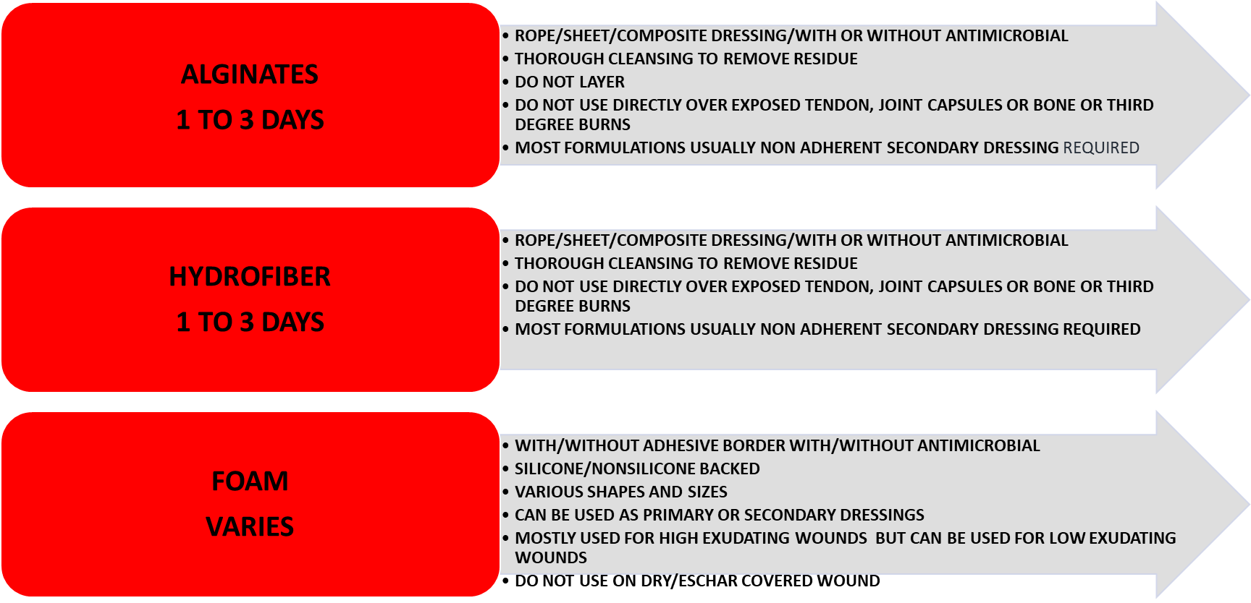
Topical Care for Wet Wounds

Slide 57
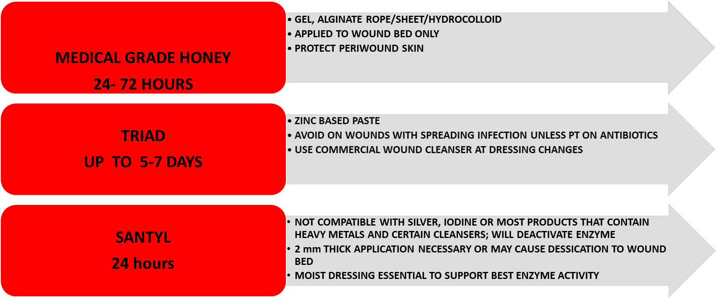
Topical Care for Wounds with Necrotic Tissue

Slide 58
What topical Care should you chose?

Slide 59
When to Refer or Consult a Specialist
Any wound probing to the bone or blood vessel
Wound decline or no improvement after 2 to 4 weeks appropriate topical treatment
Wound decline or no improvement after appropriate oral antibiotic therapy
A lower extremity wound in a person with peripheral arterial disease (PAD)
A wound on the foot or any area subjected to continuous pressure

Slide 60
Wounds related to Xylazine

Slide 61
Xylazine Related Wounds- Basics of Assessment and Care

Slide 62
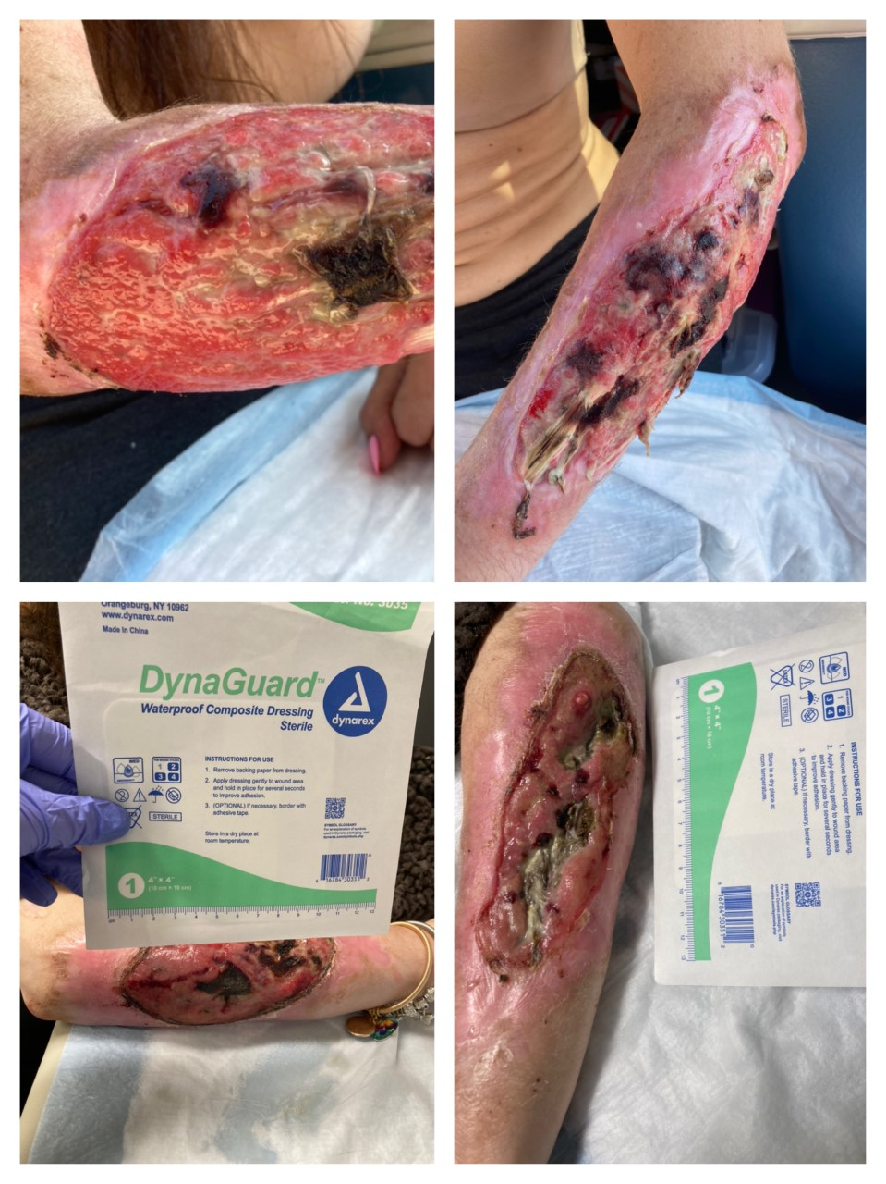
Wounds related to xylazine
Etiology is not well understood- May have to do with vasoconstriction and extravasation
May occur at site of injection, but may also occur in areas where people are not injecting, or in people who snort/smoke substances with xylazine
Wounds can become larger/more severe from repetitive trauma to area (needles/picking)
Do not always require grafts/surgery to close
Can improve with basic, high-quality, consistent wound care

Slide 63
May vary greatly in size and appearance

Slide 64
Remember inflammation doesn't necessarily equal infection
Inflammation is a stage of wound healing
Chronic wounds are stalled in the inflammatory phase
If wound is not infected, or you do not suspect underlying osteo, oral antibiotics are not indicated
ORAL ANTIBIOTICS DO NOT TAKE THE PLACE OF CONSISTENT, HIGH QUALITY WOUND CARE

Slide 65
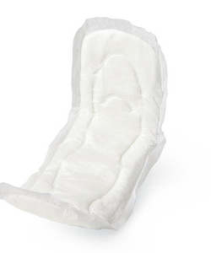
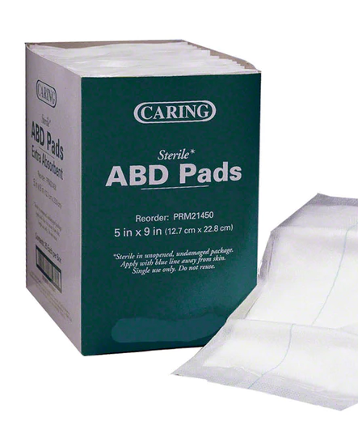
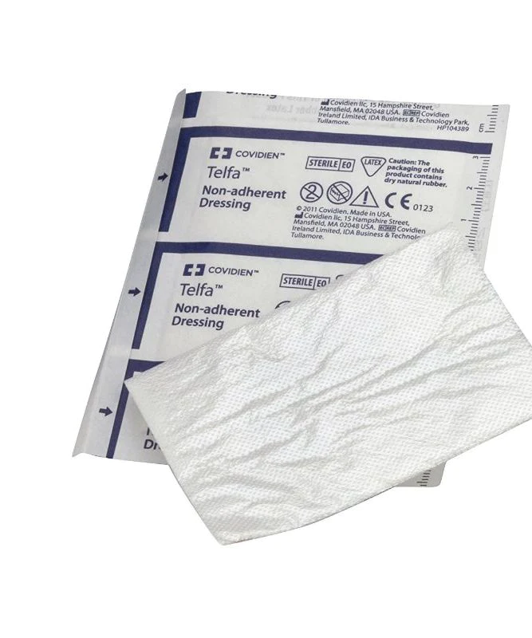
The "Do No Harm Dressing"
When In Doubt Cover the Wound with a Clean Dry Dressing.
Covered better than not covered
Gauze, non-adherent dressing, ABD, Maxi pad
If you have no idea what to do--> clean dry dressing and refer

Slide 66
Xylazine Wound Dressing Selection
There is not one universal dressing for xylazine-related wounds
Manage similarly to wounds that are not xylazine related
Treat the underlying cause
Select the appropriate dressing indicated by wound assessment
Follow longitudinally to monitor progress and adjust regimen as needed

Slide 67
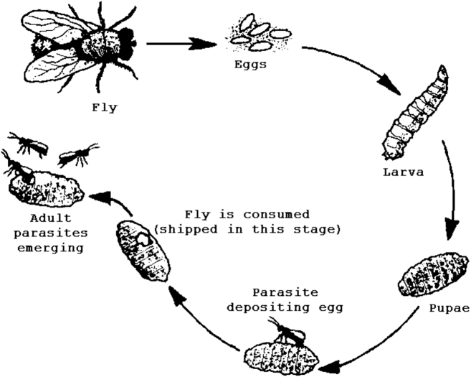
A word about finding maggots in wounds
Not uncommon in xylazine wounds due to amount of necrosis
Wound myiasis (maggot infestation)-occurs when eggs are layed in decaying flesh or wounds draining pus
Different than sterile maggots used in hospital settings and ideally should be removed
Irrigate with Dakins' solution or saline
Cover with dressing that will protect wound from additional flies on wound bed and prevent migration of remaining maggots to other parts of the wounds

Slide 68
Test your drugs and encourage others to do so
Use your own sterile or clean supplies each time you use
Regular Skin Checks
Identify an initial xylazine injury
Let the area of concern rest, don't use in the same area
Measure, outline, and/or take a photo with your phone
Clean the area
Retain moisture to the skin, do not let the area “dry out”
Keep the area covered
Maintain supplies to keep it clean and covered
Reach out to any local harm reduction organizations to stay connected to services
Xylazine Wounds: Self-Management

Slide 69
Self-Care
Avoid use of cytotoxic cleansers (no iodine, alcohol, peroxide)
Use saline, bottled water, or soap and water to clean wounds
Clean hands with sanitizer or soap and water before and after wound care
Keep wounds clean and covered (no "letting the air get to it")
Avoid overly constricting wraps (unless prescribed)
Avoid injecting in wound whenever possible, reduce amount into injecting into wound
Avoid picking at wounds (can introduce bacteria from hands/fingernails)

Slide 70
Venous Ulcers

Slide 71
DD
LVED Affects 7 million people worldwide
2 million people with LVED will develop a venous leg ulcer
Venous leg ulcers account for 80-90% of all leg ulcers
Venous leg ulcer care estimated to be 14 billion per year with estimated mean direct cost to be over $15,000
The Stats

Slide 72
DD
Lower extremity venous disease (LEVD)
Chronic venous disease
Chronic venous insufficiency
Venous hypertension causes by ineffective emptying of the venous system which leads to capillary bed congestion and extravasation of fluid/molecules in the surrounding tissue. This impaired venous return results in pathological changes in the superficial venous system and the microvascular system such as hyperpigmentation, dermatitis, tissue fibrosis and ulcers
Pathology

Slide 73
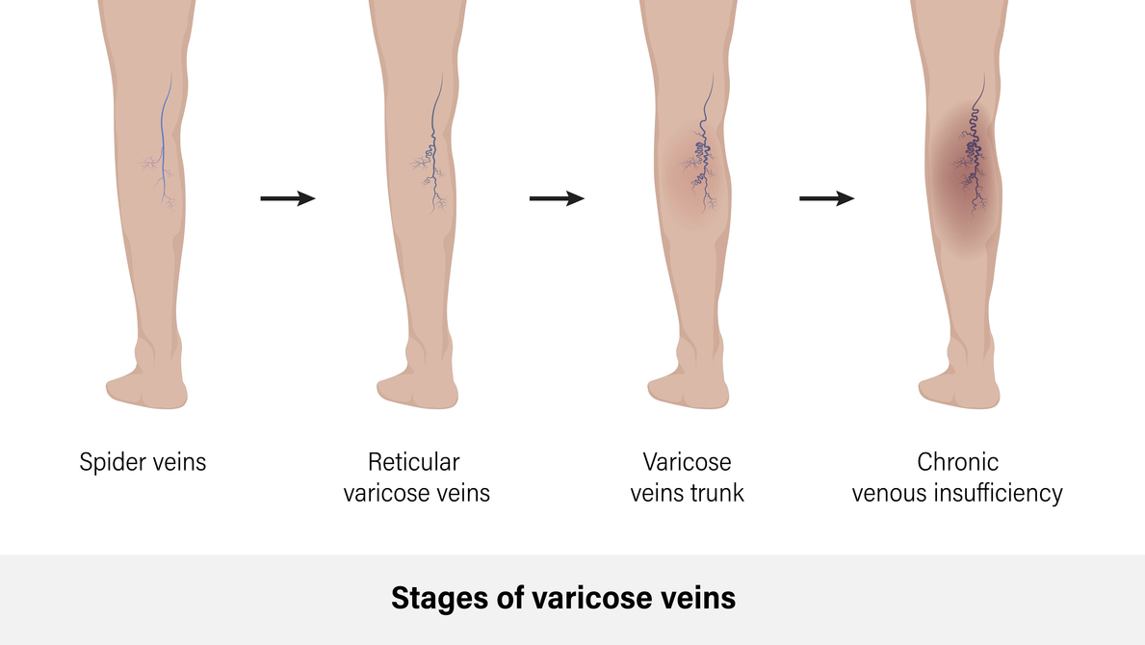

Slide 74
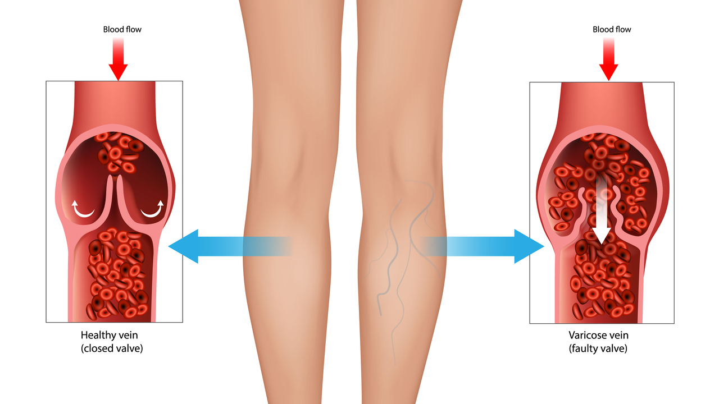

Slide 75
DD
Female sex
Family history
Multiple pregnancies
Prolonged sitting/standing
VTE/DVT
Previous legs surgery
>50 yrs old
Obesity
Risk Factors
For
Venous Ulcers

Slide 76
DD
Assess risks/causative factors for valvular or calf muscle pump malfunction
Prior history venous leg ulcer, treatment history, prior venous procedures, biopsies, failure etc.
Assess cardiovascular disease PAD, DM and other conditions that can affect healing
Assess for triggers such as cellulitis, trauma, rapid edema, contact dermatitis
Assess for symptoms of LEVD such as aching of legs, swelling, heaviness, tightness, dry/itchy skin, pain worsening with dependency improved with elevation
Assessment

Slide 77
DD
Most signs will be in ankle area of lower extremities
Telangiectasias/spider veins
Reticular Veins
Varicose Veins
Hemosiderin staining
Atrophie Blanche
Lipodermatosclerosis
Edema (needs to be distinguished from other causes)
Dermatitis
Wound appearance
Located above medial ankle but may be anywhere along the lower leg
Shallow
Moist, with heavy drainage
Periwound scaling/dry/macerated
Yellow slough
Painful
Physical Exam

Slide 78
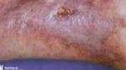
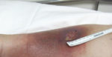
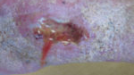
Atrophie Blanche
Hemosiderin Staining
Spider Veins, Varicose Veins, Reticular Veins

Slide 79
DD
Antimicrobial absorbent dressings (foams, alginates, super absorbers)
COMPRESSION * Ankle Brachial index testing prior *
Multilayer wraps
Stockings
Pneumatic compression device
Management
*SHOULD BE REFERRED TO WOUND CLINIC/WOUNDSPECIALIST/VASCULAR*

Slide 80
DD
Exercise regularly, eat healthy, lose weight
Avoid prolonged periods of standing/sitting
Prevent trauma
Moisturize with emollients regularly
Elevated legs
Use compression stockings
Decrease of abstain from smoking
Patient Education

Slide 81
Diabetic/Neuropathic Ulcers

Slide 82
DD
An ulcer that develops due to sensory, motor or autonomic nerve dysfunction which may be caused by acquired or inherited disorder.
Pathology

Slide 84
The Stats
More than 1million people with diabetes suffer limb loss yearly and 80% had a diabetic foot ulcer (DFU) prior to limb loss
African Americans four times more likely to have an amputation irrespective of socioeconomic status or age
At least 50% of all amputations due to DFU and peripheral neuropathy are preventable with early intervention

Slide 85
Risk Factors
Family History of or inherited neuropathic disease
DM
HIV
Exposure to neurotoxins/chemo
Hansen Disease
Chronic alcohol abuse
Trauma causing nerve damage
Lyme disease
B12 deficiency
Hypothryoidism

Slide 86
DD
Comprehensive foot exam B/L- nails, callus, skin moisture, muscle strength/tone, joint deformity, pulses
Wound pertinent history/prior treatments
Assess footwear for signs of friction
Sensory testing with 10-g monofilament
Vibratory testing with 128 –Hz tuning fork
Position sense testing
Reflex testing
Assessment

Slide 87
Physical Exam
May have other joint deformities such as hammer toes, bunions, chartcot foot deformity
Dry cracked, scaling, flaking feet
Wound appearance
Rounded, oblong, well defined
Over bony prominence
Necrotic or pale wound base
Varied depth
Macerated or callused wound edges
Small to moderate serous drainage

Slide 88
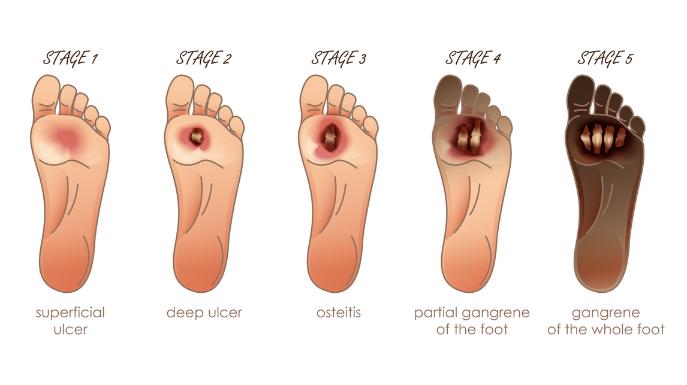
Wagner Classification System

Slide 89
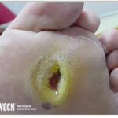
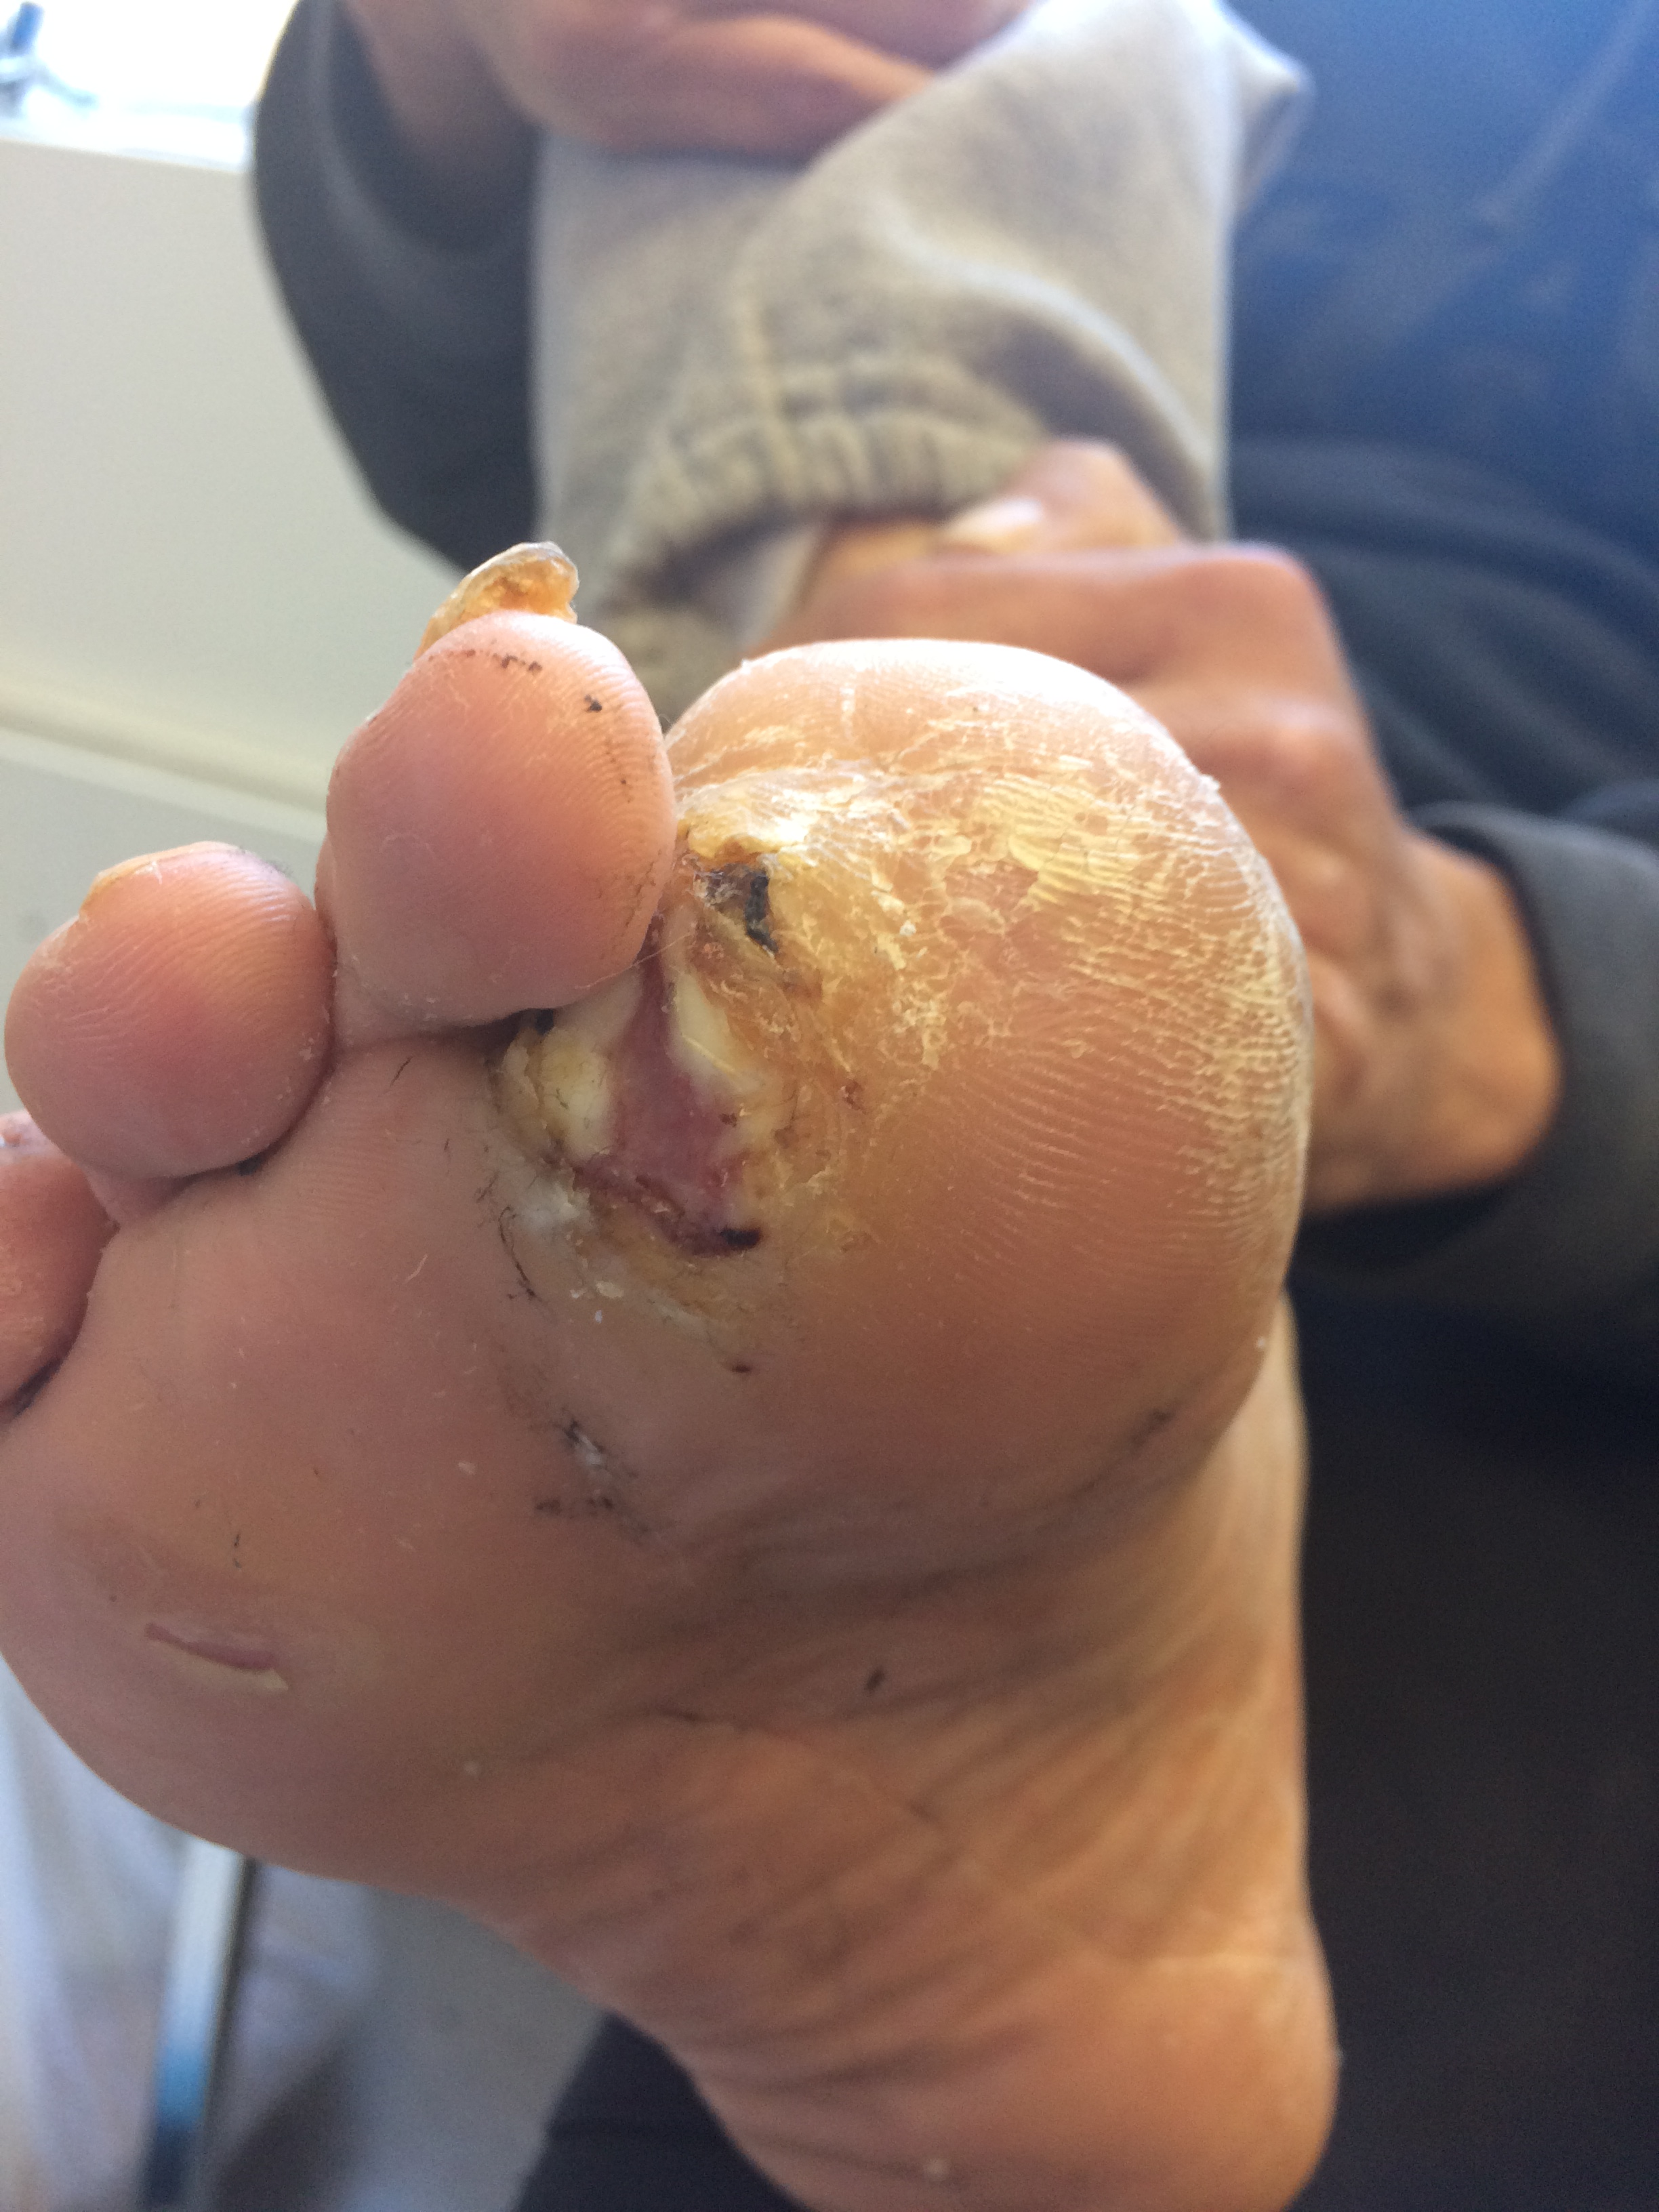
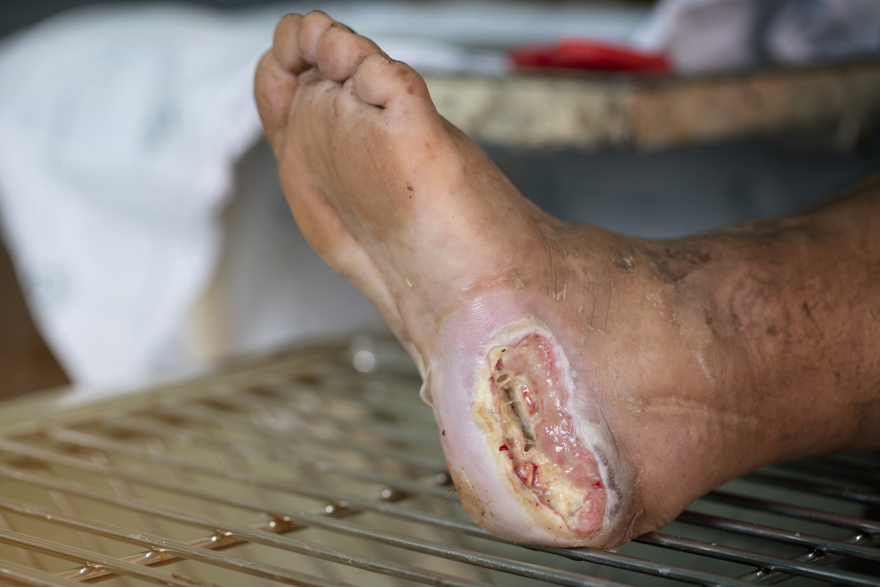

Slide 90
DD
Dressings with/without antimicrobial to promote moist wound healing and compatible with offloading device
May need advance therapies such as skin substitutes, hyperbaric oxygen therapy, Negative pressure wound therapy
Offloading device/shoe
Total contact cast (gold standard)
Removable cast walker
Darco peg assist shoe
Offloading shoe
Offloading adhesive felt pads
Management
*SHOULD BE REFERRED TO WOUND CLINIC/WOUND SPECIALIST/PODIATRIST*

Slide 91
DD
Daily foot exam and inspection of shoes
Regular foot care
Orthotic shoes/insoles
Wear socks and well fitted shoes
Do not walk barefoot
Seek professional care for calluses, corns
Notify provider promptly for any skin abnormalities
Quit smoking
Control chronic condition that causes neuropathy or impede healing
Avoid using heating pads/soaking feet in very hot water
Patient Education

Slide 92
Need additional wound care training?
Wound Treatment Associates Program Your Way https://wocn.digitellinc.com/wocn/conferences/192/view
Molnycke Clinical Learning Hub (Free) https://www.molnlycke.com/education/
Wound Care Education Institute https://www.wcei.net/courses
Notes:
WOCN site allows you to select individual coarse and pay approx $10-$20.
Molnycke site is free, webinar, e-learning, podcast etc

Slide 93
References
Andrews, MPH, A., Puleo, MPH, M., Johnson, MPH, J., & Higgins, MPH, D. (2021). Philadelphia Department of Public Health, Division of Substance Use Prevention and Harm Reduction Annual Report (pp. 1–48). Philadelphia, PA: City of Philadelphia.
Bonham, P. A., Brunette, G., Crestodina, L., Droste, L. R., González, A., Kelechi, T. J., Ratliff, C. R., & Varnado, M. F. (2022). 2021 guideline for management of patients with lower-extremity wounds due to diabetes mellitus and/or neuropathic disease. Journal of Wound, Ostomy & Continence Nursing, 49(3), 267–285. https://doi.org/10.1097/won.0000000000000860
The City of Philadelphia. (2022, December 8). Philadelphia department of public health substance use prevention and harm reduction.
Davide Vincenzo Verdolino, Helen A. Thomason, Andrea Fotticchia, Sarah Cartmell; Wound dressings: curbing inflammation in chronic wound healing. Emerg Top Life Sci 29 October 2021; 5 (4): 523–537. doi: https://doi.org/10.1042/ETLS20200346
Division of Disease Control, P. D. of P. H. (2023, January 4). Health advisory.
Kelechi, T. J., Brunette, G., Bonham, P. A., Crestodina, L., Droste, L. R., Ratliff, C. R., & Varnado, M. F. (2020). 2019 guideline for management of wounds in patients with lower-extremity venous disease (LEVD). Journal of Wound, Ostomy & Continence Nursing, 47(2), 97–110. https://doi.org/10.1097/won.0000000000000622
McNichol, L. L., Ratliff, C. R., & Yates, S. S. (2022). Wound, ostomy, and Continence Nurses Society Core Curriculum. Wolters Kluwer.
Ratliff, C. R., Yates, S., McNichol, L., & Gray, M. (2016). Compression for primary prevention, treatment, and prevention of recurrence of venous leg ulcers. Journal of Wound, Ostomy & Continence Nursing, 43(4), 347–364. https://doi.org/10.1097/won.0000000000000242
Sen, C. K. (2021). Human wound and its burden: Updated 2020 compendium of estimates. Advances in Wound Care, 10(5), 281–292. https://doi.org/10.1089/wound.2021.0026
Sunny B, Sulthana L, James A, Sivakumar T. Maggot Infestation: Various Treatment Modalities. J Am Coll Clin Wound Spec. 2018 Mar 30;8(1-3):51-53. doi: 10.1016/j.jccw.2018.03.002. PMID: 30276127; PMCID: PMC6161638.
Swanson, T., Ousey, K., Haesler, E., Bjarnsholt, T., Carville, K., Idensohn, P., Kalan, L., Keast, D. H., Larsen, D., Percival, S., Schultz, G., Sussman, G., Waters, N., & Weir, D. (2022). IWII wound infection in Clinical Practice Consensus Document: 2022 update. Journal of Wound Care, 31(Sup12). https://doi.org/10.12968/jowc.2022.31.sup12.s10

