Slide 1
Suicide Prevention Learning Lab
Treatment, Intervention, and Support
May 18, 2023

Slide 2
Learning Objectives
Cultural Perspectives on Suicide
Treatment Planning
Common Interventions
Supporting clients after a suicide attempt
Supporting providers as they support others

Slide 3
Cultural Perspectives on Suicide

Slide 4
Cultural Perspectives
The call upon clinicians to provide culturally responsive interventions is higher than ever before.
Understandings of suicide are often influenced by culture
Oppression, racial trauma, displacement and perfectionism as an influencer of suicidal behaviors is not always well understood
Suicide may not be viewed as taboo in all cultures
This is particularly true within cultures where family honor is highly regarded and centered as more important that individual needs

Slide 5
Cultural Considerations
Indigenous Communities
Unexamined Assumptions | New Possibilities
Suicide expresses underlying psychological problems | Suicide expresses historical, cultural, community and family disruptions
Suicide is primarily an agentic expression of personal volition | Suicide is primarily an enacted consequence of social obligation
Suicide prevention is best achieved by mental health professionals | Suicide prevention is best achieved by nonprofessional community members
Suicide prevention most properly falls within the purview of formal mental health service delivery systems | Suicide prevention most properly falls within the purview of locally design decolonization projects

Slide 6
Culturally Responsive Interventions
African American Communities
Reluctance to seek help is valid, and spending the time to explore it is critical.
Use words that are non-pathologizing, i.e. “counseling” vs. “therapy”. The latter seems more serious and more commonly associated with being “crazy”.
If psychotropic drugs are indicated, it helps to compare the medication to those used for diabetes or high blood pressure. Talk about medications as a means to stabilize, rather than treat.
Engage spiritual supports and fictive kin in care and treatment planning.

Slide 7
Treatment Planning

Slide 8
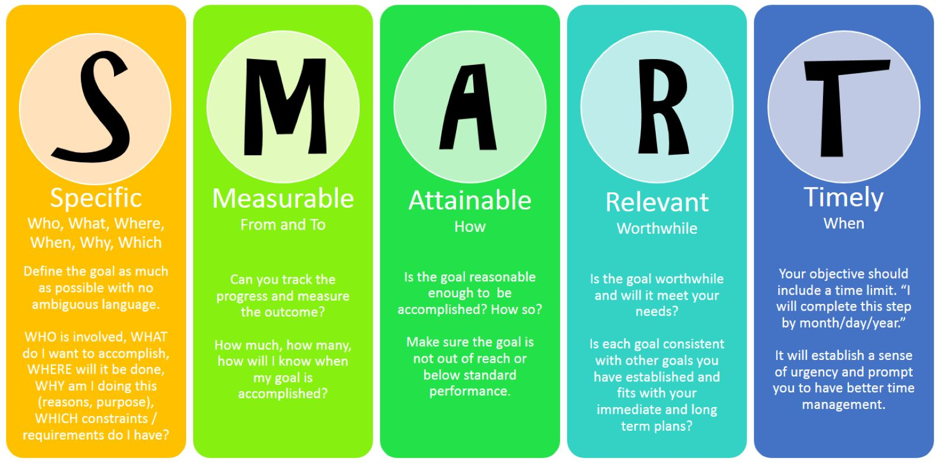
Developing a Treatment Plan
Managing our own emotional responses to suicidal ideations
Establishing a therapeutic alliance
Honoring and centering lived experience
SMART Goals

Slide 9
SMART Goals
Specific—The goal should be based on exactly what they wish to accomplish
Measurable—The goal can be monitored for progress, through smaller tasks leading to completion, due dates or collecting data
Attainable—The goal should not be so challenging that it is impossible to achieve
Relevant—The goal should be appropriate for the individual and the situation
Timely—The goal should have clear time limits that are realistic

Slide 10
SMART Goal Examples
“Kelly will engage in learning more about her depression by completing homework assignments 1-2 times per week over the next 30 days.”
“Sam will download the free Mood Tracker app by next therapy session on 6/1/2023.”
“Dana will attend group therapy session 3-4 times per month over the next 3 months in order to build community and decrease shame that leads to suicidal thoughts.”

Slide 11
Interventions

Slide 12
Common Interventions
Brief Interventions
Safety Planning Intervention
Lethal Means Counseling
Emergency Petitions
Warm Hand-Offs

Slide 13
Safety Planning Intervention (SPI)
Developed by Drs. Barbara Stanley and Gregory Brown and centers collaboration between an individual and a mental health care provider.
The Safety Plan is personal, unique and includes the client’s identification of the thoughts, feelings and experiences just prior to decompensation that they can learn may signal an impending suicidal crisis .
It also identifies actions they have found helpful at earlier times of distress in their life.

Slide 15
Lethal Means Counseling (LMC)
Means reduction (reducing a suicidal person’s access to highly lethal means) is an important part of a comprehensive approach to suicide prevention.
The basic goal of LMC is to reduce risk of suicide by engaging the individual and/or family in securing and reducing access to every form of lethal means possible.
A suicidal crisis can escalate quickly and the time between the decision to end one’s life and taking action is often brief.
If a person does not have access to lethal means they will not die from self-harm behavior.

Slide 16
Lethal Means Counseling (LMC)
Lethal Means Counseling involves these steps:
Express concern for safety
Let them know what they can do to create a safe environment
Remove or secure any type of lethal means from the home (or work) environment
This can include items such as firearms, medications (prescribed and over-the- counter), toxic substances like cleaning supplies, sharp objects
Explain how lethal means safety works
Can’t predict crises
During moments of acute risk, need to reduce access to lethal means they have focused on
People usually don’t switch quickly to a different method since thinking is less flexible in that moment
If attempt does occur, other methods are likely to be less lethal

Slide 17
The Power of the Warm Hand-Off
Providers have enormous influence on how a client will perceive and respond to the offer of behavioral health intervention.
With a warm hand-off, the provider directly introduces the client to behavioral health resource at the time of need.
The warm hand-off is most powerful when done face-to-face. It establishes initial contact between the client and referral source and confers the trust and rapport the client has developed with the provider to the referral source.

Slide 18
Warm Hand-Off Guidelines
Know your referral sources in advance
Approach the client with your concerns
Follow your agency’s procedure for making the referral
Follow up with the referral source to determine outcome
Follow up with the client within 48 hours of referral

Slide 19
Care After a Suicide Attempt

Slide 20
Care Transitions
Inpatient psychiatric care is designed to mitigate immediate risk, begin treatment, and prepare individuals for continuing care after hospitalization.
Hospitalization is not intended to be the only care a person requires to return to a state of wellness.
The first week after discharge from inpatient treatment carries extraordinary risk for suicide, with suicide deaths occurring during this week at a rate 300 times higher than the global suicide rate (Chung et al., 2019).
The transition from inpatient to outpatient care represents a tremendous gap in the health care delivery systems and is challenging to close for myriad reasons.

Slide 21
Care Transitions-Best Practices
Considerations for Inpatient Providers:
Begin discharge planning upon admission, preferably within 24 hour
Develop collaborative protocols
Electronically deliver copies of essential records to aid the outpatient provider post-discharge
Encourage family participation, keeping in mind that family is self-defined
Include Peer Specialist whenever possible
Engage community supports
Collaboratively develop a safety plan and offer a discharge planning meeting
Schedule an outpatient appointment, ideally within 24-72 of discharge and no longer than 7 days
Create innovative ways to connect the client to the outpatient provider
Make a follow-up call to the client after discharge and utilize “caring contacts”

Slide 22
Care Transitions-Best Practices
Considerations for Outpatient Providers:
Cultivate a transformative, rather than transactional, relationship with inpatient providers in your community
Accept shared responsibility for achieving a safe, and successful transition
Work together with the inpatient provider to obtain copies of essential documents
Arrange a care transition call prior to discharge
Train staff on suicide prevention
Meet with the client and family members during the inpatient stay whenever possible.
Narrow the transition gap
Notify the inpatient provider if the initial appointment is missed

Slide 23
Supporting Providers

Slide 24
Impact of Suicide on Providers
Suicide as a type of loss often not spoken about.
It can be detrimental to the mental health worker providing care to the client.
Suicide can result in both personal and professional responses.
Personal responses can include shock, anger, sadness, intrusive thoughts of the suicide and disrupted sleep.
Professional responses can include feelings of incompetence, self-blame, professional isolation and fear of blame or litigation.

Slide 25
Supporting Providers
The importance of addressing client loss through a variety of supportive interventions can not be understated.
Individual supervision
Group supervision
Critical Incident Stress Debriefing (CISD)

Slide 26
Critical Incident Stress Debriefing
CISD is a 7-phase method of group discussion to help process traumatic events
Typically utilized in work settings that have high exposure to traumatic events
Best when held within 24-72 hours of the suicide (or becoming aware of it)

Slide 27
Resources
Unique cultural factors (apa.org)
The cultural distinctions in whether, when and how people engage in suicidal behavior (apa.org)
Brief interventions for managing suicidal crises | AFSP
Culturally Responsive Suicide Prevention in Indigenous Communities: Unexamined Assumptions and New Possibilities
Best Practices in Care Transitions for Individuals with Suicide Risk: Inpatient Care to Outpatient Care (samhsa.gov)
Effects of Patient Suicide on Professional Practice Among Mental Health Providers (nih.gov)

