Slide 1
It Takes a Village: An Integrated Safety Net for Housing Insecure Older Adults in a Health Plan
May 16, 2023

Slide 2
Who is SCAN?

Slide 3

For 45 years, SCAN has been keeping seniors & older adults healthy and independent.
Through our health plan
and Independence At Home (IAH) community services.

Slide 4


Founded by seniors, for seniors
In 1977, a group of “twelve angry seniors” in Long Beach,
California got together to improve care and services for older adults. These pioneers had the simple desire to remain healthy and to age independently. So they consulted with experts in medicine and social services and formed the not-for-profit Senior Care Action Network, now known as SCAN.
Since those early days, SCAN has been a loose-knit group
of activists, a federally recognized Social HMO, and an
award-winning Medicare Advantage Plan. But through it all we have remained steadfastly committed to our original mission:
TO KEEP SENIORS HEALTHY AND INDEPENDENT.

Slide 5




About SCAN
SCAN is one of the largest not-for-profit Medicare Advantage Prescription Drug plans in the country, serving more than 285,000 members in California, Arizona, Nevada and Texas. Our mission is to keep seniors healthy and independent.
All SCAN plans build upon the strong foundation built over 45 years of senior-focused service, recognized in California with:
Recognized Brand
“Best” MAPD in CA
Five years in a row!
91% Satisfaction
(Medicare & You, 2023)
Member Rating of Health Plan
4.5 Stars
Quality care & service
Six years in a row†
Employer of Choice
Great Place to Work Certified
†4.5 out of 5-star rating applies to all plans offered by SCAN Health Plan in California from 2018 to 2023 except SCAN Healthy at Home (HMO SNP) and VillageHealth (HMO-POS SNP) plans. Every year, Medicare evaluates plans based on a 5-star rating system.
Confidential and proprietary information. All rights reserved.

Slide 6
The Growing Crisis of Older Adult Homelessness

Slide 7
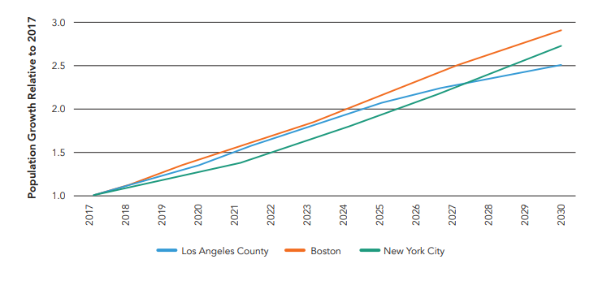
Forecasted Relative Change in the 65 and Older Homeless Population compared to 2017
1Culhane, D., Doran, K., Schretzman, M., Johns, E., Byrne, T., Metraux, S. & Kuhn, R. (2019). The Emerging Crisis of Aged Homelessness: Could Housing Solutions Be Funded by Avoidance of Excess Shelter, Hospital, and Nursing Home Costs? International Journal for Population Data Science 4(3) DOI:10.23889/ijpds.v4i3.1185
7
Notes:
Older adults are fasttest growing demographic of people experiencing homelessness. Indications that older adult homelessness set to triple by 2030

Slide 8
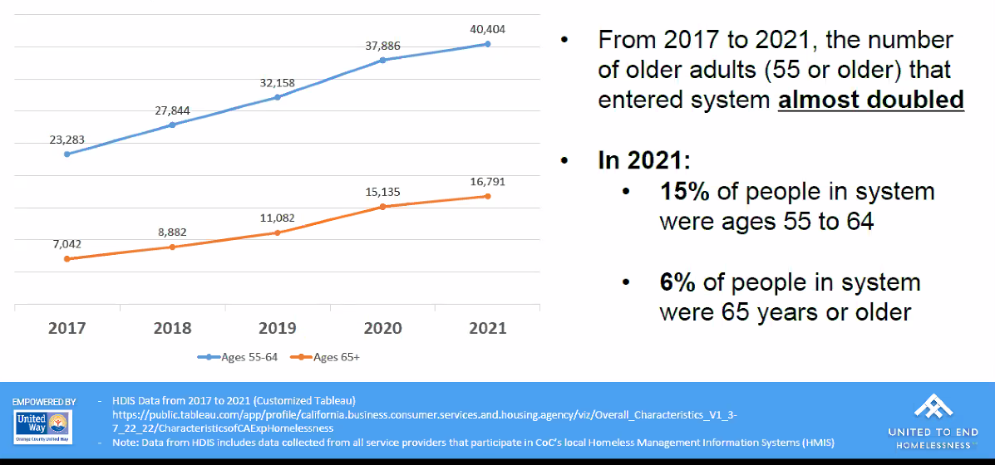
Age of People Experiencing Homelessness in CA

Slide 9
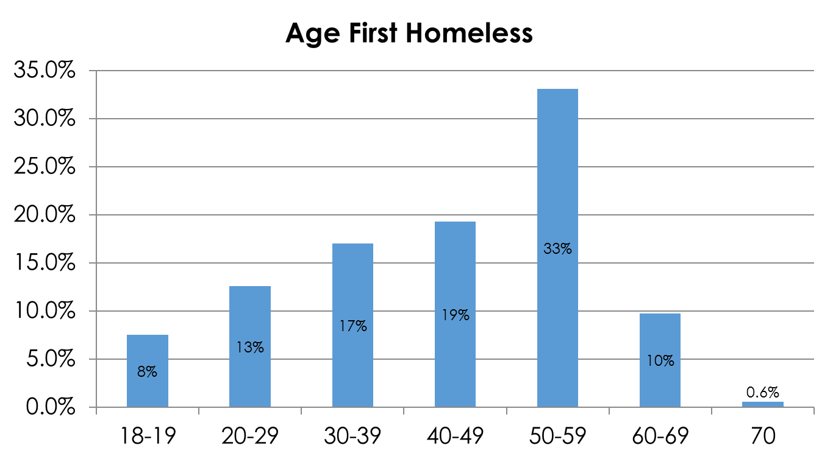
Late Onset Homelessness
44% with first episode of homelessness after age 50
Causes
Low wage work throughout life
Crisis: Job loss, marital breakdown, illness (self, spouse), death (spouse, parent)
Brown RT, Goodman L, Guzman D, Tieu L, Ponath C, Kushel M. Pathways to Homelessness among Older Homeless Adults: Results from the HOPE HOME Study. PLoS One. 2016; 11(5):e0155065. PMID: 27163478.

Slide 10
The State of homelessness in older adults
Housing insecurity and homelessness (H&H) is a significant driver of health inequities
H&H is associated with poorer self-rated physical health and an increased number of chronic conditions
Housing insecurity among this population is projected to triple in Los Angeles, costing $450M by 2026, an 80% increase since 2011. ¹
¹Culhane, D., Doran, K., Schretzman, M., Johns, E., Byrne, T., Metraux, S. & Kuhn, R. (2019). The Emerging Crisis of Aged Homelessness: Could Housing Solutions Be Funded by Avoidance of Excess Shelter, Hospital, and Nursing Home Costs? International Journal for Population Data Science 4(3) DOI:10.23889/ijpds.v4i3.1185
Notes:
Economic hardship in the older adult population is unique due to limited pathways to increasing income Enrollment into public assistance programs, e.g. housing, must be completed online

Slide 11
Causes of Homelessness in Older Adults
50%
Economic hardship
20%
Weak social ties
10%
Disabling health conditions
Notes:
Purpose of this case series is to describe best practices used by SCAN Health Plan to address H&H in older adults in Los Angeles.

Slide 12
SCAN Homeless Services

Slide 13
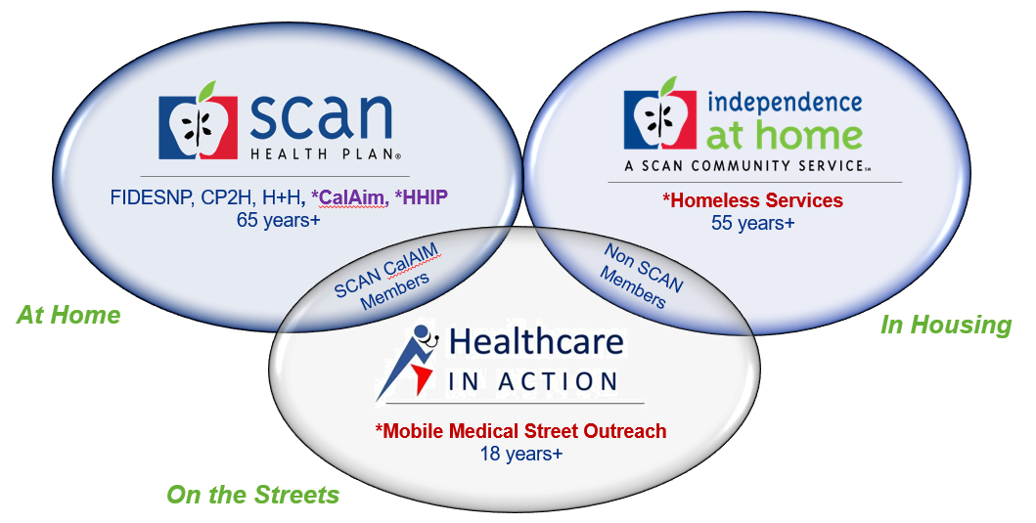
Ecosystem at SCAN that supports Older Adults Experiencing Housing Insecurity (OAEH)
Bringing Services to Where They Are… * 2021 Launch *2022 Launch

Slide 14
SCAN Health Plan
Notes:
the purpose of this case series is to describe best
practices used by SCAN Health Plan to address H&H in older adults in Los Angeles.

Slide 15
Our 5 Principles
1) Member Led Care
2) Build an Empowered Team
3) Build a Complete Ecosystem of Formal and Informal Partners
4) Practice Harm Reduction
5) Age-Friendly Solutions
Notes:
Put the patient first-know your population-first step towards creating a successful program is to identify the patient population and work to understand individuals and concerns-let the m
br set the goals—What can I do to help you?. Understanding and addressing those challenges will enable the team to create system to meet the needs of our members
2) Build an empowered team-keep the hierarchy flat-our team is made of CHW and CM-our multidisciplinary team honors each member’s clinical expertise irrespective of degree or title. Engage each team member in all aspects of the program every team member is empowered to support the member to the best of their abilities in each moment of engagement. The members have a clear understanding of what decisions they can make in the moment, & know when to ask for additional support
3) Build complete ecosystem of formal & informal partners-build a relationship with CBO’s-biweekly huddles to discuss and problem solve –
Show up where your member are-we operate at locations where our member are already comfortable
4) Practice harm reduction-embrace harm reduction principles-we believe in respecting the dignity of our members, in doing so we can help them achieve their health related goals & transition to a more healthy state of life, build a trusting relationship, in other words –ve very patient and very persistent-it may take several visits over a period of months to establish rapport w/ members.
5) Take a new approach-meet member where they are patient goal seeting as well as tactical location strategy-meet the patients where they are physically

Slide 16

Member Identification
SCAN Health Plan identified 71 members who were housing insecure in Los Angeles by referral from providers and the SCAN Personal Assistance Line.
Inclusion criteria:
  Members with closed cases OR
  Members who had been in the program for 60+ days
16
Notes:
Method: SCAN Health Plan’s housing insecurity program served 120
members in 2021. Demographically, 58% of members were
between the ages of 65 and 74 and 32% are between the
ages of 75 and 84. 57% of members were women and 43%
were men. 38% of members were Hispanic, 31% were White,
9% were Black, and 22% were “Other.” One case manager and
one community health worker led whole-person
interventions that included establishing care with a primary
care physician, securing mental and behavioral supports,
enrolling members into public benefits e.g. Medicaid and
food stamps, connecting members to legal aid, and assisting
members in receiving housing vouchers.

Slide 17
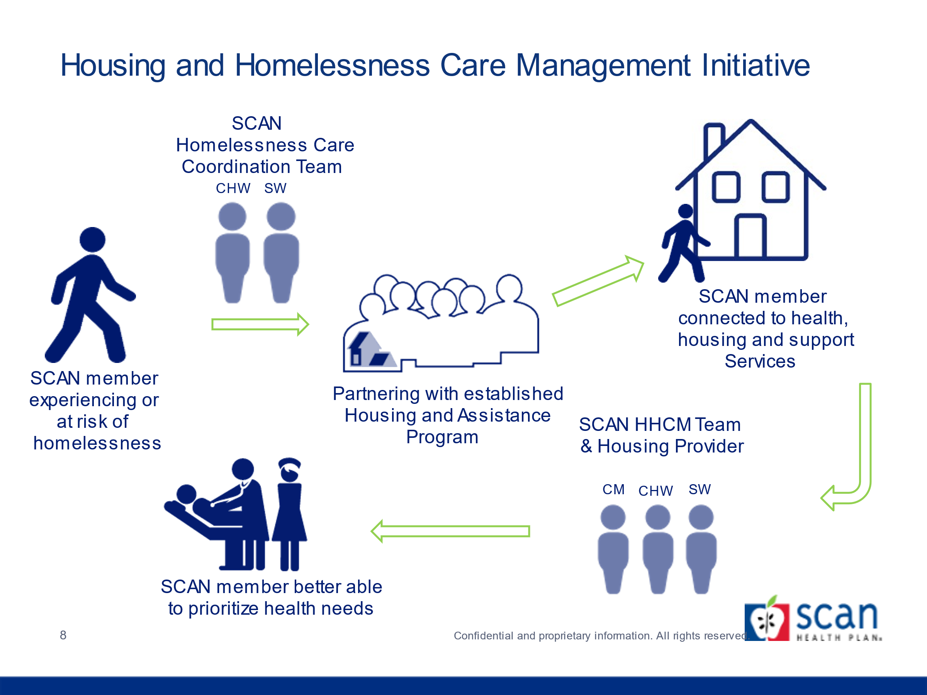
Housing and Homelessness Care Management

Slide 18
Member Led Care
By using a ‘What Matters to You’ approach to goals, the team was able to build rapport with members.
Top Goals
1) Housing
2) Access to Food
3) Caregiver & Social Support
4) Health Concerns

Slide 19
Using a whole-person care perspective, the improvement team addressed needs with the following interventions:
Areas of Focus | Interventions Deployed
Housing | Court support (Connected to Legal Aid Benefits advocacy Secure available resources to assist with subsidizing rent Arranging for supporting the details of the move Ensuring housing is accessible (Adult Protective Services Home Safe Program
Social | Food Insecurity (Food stamps, Meals on Wheels) Caregiver Support (IHSS, SCAN LTSS) Financial literacy and budgeting Financial assistance (Supplemental Security Income) Utility assistance (electricity grants) Home modification programs (Habitat for Humanity) Social isolation (social programs, connecting to existing social network)
Medical | Health Promotion (SCAN disease management programs, Silver Sneakers) Provider Appts (Advocacy, understanding treatment plan in layman terms, navigating referrals and the health system) Access to Care (Enrolled members in Medi-Cal, Connecting members to PCP, Specialty Care and Care Team) Safe discharge; addressed gaps in care and medication and adherence ADLs and IADLs support- transitional housing is not often able to support

Slide 20
Demographics: Gender, Age, and Race/Ethnicity
Notes:
Client demographics:
58% of members were between the ages of 65 and 74 and 32% are between the ages of 75 and 84.
57% of members were women and 43% were men.

Slide 21
Results
Housing & Social Results
Medical Results
22 (31%)
Received PSH
15 (21%)
Connected to family or a friend
15 (21%)
Received temporary or transitional housing
12 (17%)
7 (10%)
Received housing vouchers
Prevented from eviction
95% members were connected to their care team
The team addressed access to care needs by connecting members to the following:
Notes:
RESULTS
Of these 120 members, 71 had received a significant duration
of intervention (>60 days or goals met). Post-intervention, all
71 members were connected to programs and 83% of
members were housed or prevented from being homeless. 22
older adults (31%) received permanent housing, 15 (21%)
were connected to a family member or friend, 15 (21%)
received temporary or transitional housing, 12 (17%) received
housing vouchers, and 7 (10%) were prevented from being
evicted.
HOUSING RESULTS
The team helped 83% of members get re-housed or prevent
homelessness and connect all members with housing
programs by performing a constellation of interventions to
ensure members did not need to choose between rent and
other necessities.

Slide 22

Lessons Learned
Best practices for addressing H&H in older adults include:
Develop patient-driven action plans
Robust advocacy
Learning members’ life stories and understanding their social needs
Providing personalized 1-on-1 assistance to navigate the housing support and healthcare systems
Working collaboratively with county housing officials and landlords to ensure housing remains accessible
1
2
3
4
5
Notes:
It’s critical to address older adults’ medical needs, e.g. many members identified as homeless due to interpersonal issues often had untreated cognitive decline/behavioral concerns that benefited from medical treatment.
1) It’s critical to address older adults’ medical needs, e.g. many members identified as homeless due to interpersonal issues often had untreated cognitive decline/behavioral concerns that benefited from medical treatment.
4) The older adult’s primary goals must be taken into account. For example, an older adult experiencing homelessness can be connected to a housing unit but if it is not in a neighborhood or community they are familiar with, they will likely decline.
Discussion:
DISCUSSION
As a result of SCAN’s efforts, we believe that best practices
for addressing H&H in older adults include 1) addressing both
H&H and medical needs, 2) providing personalized
one-on-one assistance to navigate the housing support and
healthcare systems, and 3) working collaboratively with
county housing officials and landlords to ensure housing
remains accessible.

Slide 23
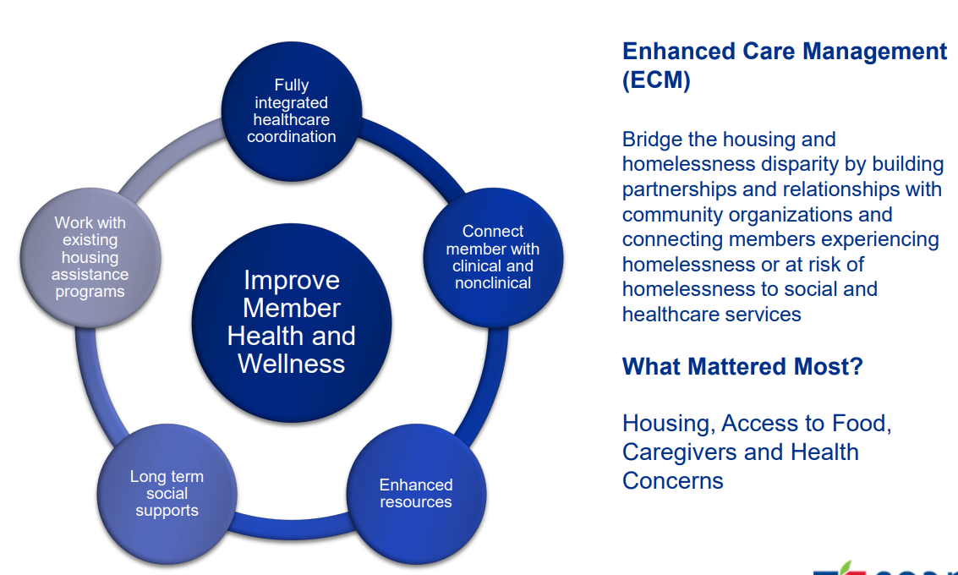
CalAIM Enhanced Care Management
Notes:
In 2022
CalAIM is a Medi-Cal benefit available to “populations of focus”:
Individuals and families experiencing homelessness.
Adults, youth, and children who are high utilizers of avoidable emergency department, hospital, or short-term skilled nursing facility services.
Adults with serious mental illness or substance use disorder.
Children and youth with serious emotional disturbance, identified to be at clinical high risk for psychosis or experiencing a first episode of psychosis.
Adults and youth who are incarcerated and transitioning to the community.
Adults at risk of institutionalization and eligible for long-term care.
Adult nursing facility residents transitioning to the community.
Children and youth enrolled in California Children’s Services (CCS) with additional needs beyond CCS.
Children and youth involved in child welfare (including those with a history of involvement in welfare, and foster care up to age 26).
California is transforming Medi-Cal to provide members with more coordinated, person-centered , & equitable care. ECM & CS are two major new Medi-Cal programs that launched in 2022-
ECM is a comprehensive care management benefit to address clinical and non-clinical needs for the highest need members enrolled in Medi-Cal managed care plans (MCPs)

Slide 24
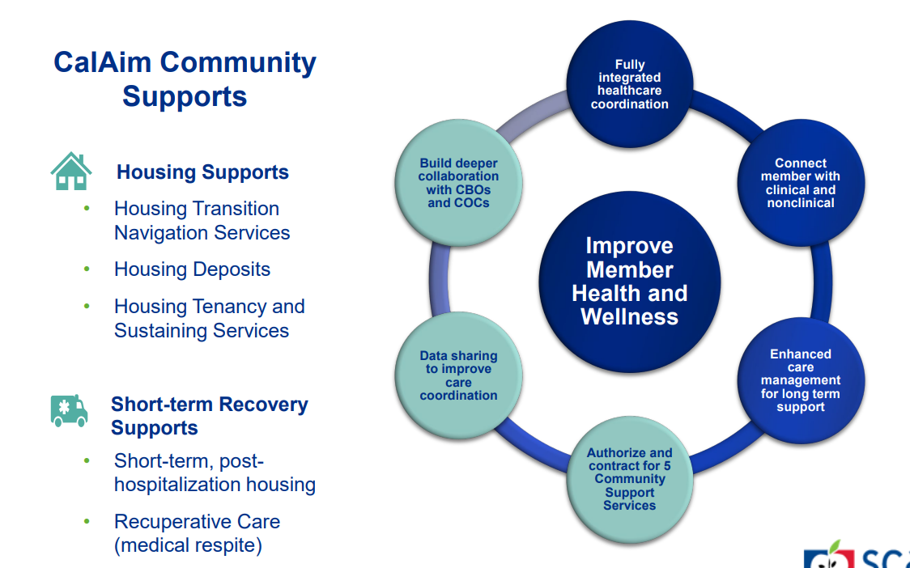
CalAIM Community Supports
Notes:
CS are 14 services to help members address health-related social needs. MCPs are highly encouraged, but not required to provide these supports.
DHCS is working with MCPs to enable more widespread provision of services to members, including those with the most complex challenges affecting health, such as homelessness and unstable and unsafe housing. As of September 2022, 18 MCPs offered all three housing Community Supports services (Housing Transition/Navigation, Housing Deposits, and Housing Tenancy & Sustaining services), and 659 provider organizations were contracted to provide at least one of these three housing supports. During this time, 23,195 members received at least one housing support. Statewide, 74 recuperative care centers were contracted to provide Community Supports as of September 2022. DHCS has seen growth in the number of Community Supports offered by MCPs since Q3 2022.

Slide 25
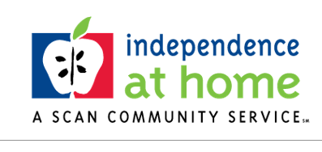
Independence at Home (IAH)
Housing and Care Coordination Services for Older Adults
Experiencing Housing Insecurity

Slide 26
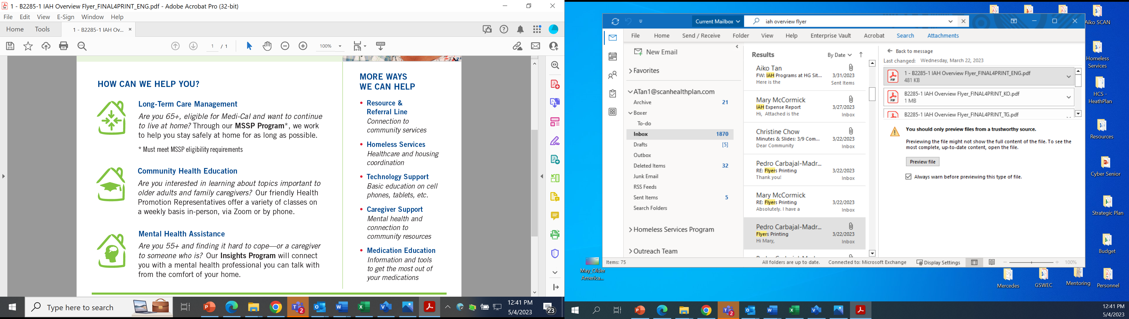
Independence At Home (IAH)
Provided to Older Adults (55+ and caregivers) at no cost

Slide 27
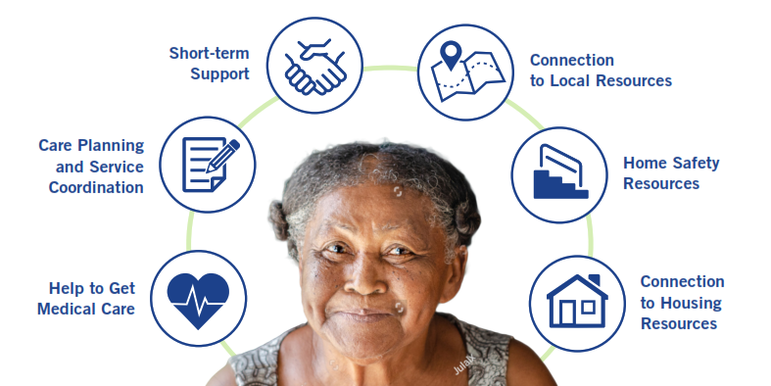
IAH Homeless Services

Slide 28
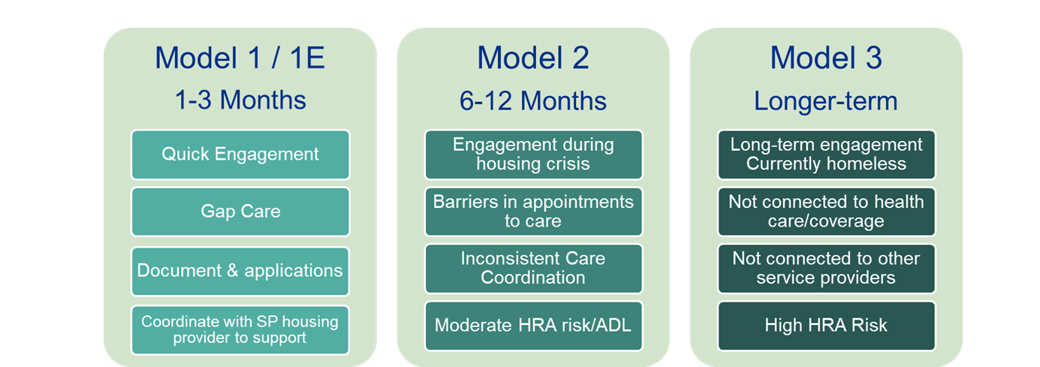
Housing Insecurity & Homelessness
Focus: Care Coordination for Older Adults (55 years+ and caregivers) with a focus on Housing Stabilization (prevention, retention) and Social Supports
Launched in 2022

Slide 29
Outcomes
7
Partnership Agreements
61
Service Agencies
347
Unique Clients Served
7
Clients Housed
96%
Stabilized in Housing
Infrastructure & Core Competency
Notes:
Results & counting

Slide 30

Healthcare In Action (HIA)

Slide 31
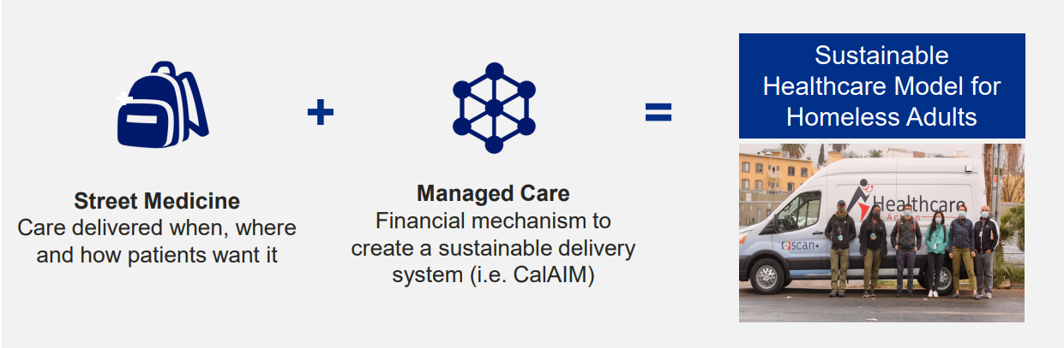
Healthcare in Action Introduction
A non-profit, value-based, payer agnostic medical group with integrated primary care, mental health, substance use, and social work services. Serves patients in six counties across Northern and Southern California.
Notes:
HIA is a new medical group that combines managed care with "street medicine," providing health care services to people where they are.
Serve patients experiencing homelessness, Street medicine approach, Meeting patients where they are, Creating a sustainable model through innovative funding models

Slide 32






What does HIA do?
Primary Care (ex: wound care)
Psychiatric Evaluations
Medication Management
Housing
Referrals (ex: to dental)
Documentation (ex: housing)
Notes:
Meet patients where they’re at

Slide 33
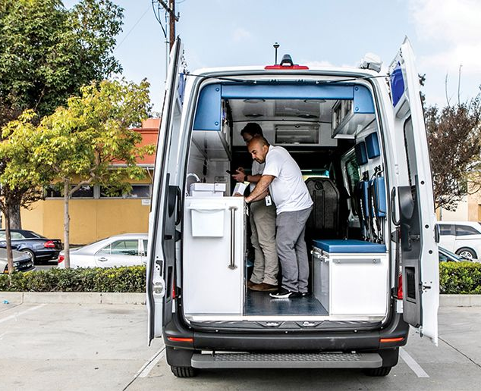
HIA Street Medics Help Formerly Homeless Woman Rebound

Slide 34



HIA Team Structure: Delivering Care via Interdisciplinary Team
Consulting Psychiatrist
Supervisor, Care Management
Coordinator
Regional Director
Supervising Physician
PA/MD Clinical Support Peer Navigator
1 per Teamlet 1 per Teamlet 6 per Teamlet
Primary Care Teamlet
• Wound care
• Medications
• Triage
• Care planning
• Acute and chronic medical issues
• Substance use
• Mental health
• Individual with lived experience
• Patient engagement
• Case management
• Housing navigation
1 Teamlet per 200 patients
Notes:
More peer navigators- go to 6 peer navigators
Remove Manager, Care Management/same as Supervisor, Care Management
Add Consulting Psychiatrist
1 teamlet per 200 patients

Slide 35
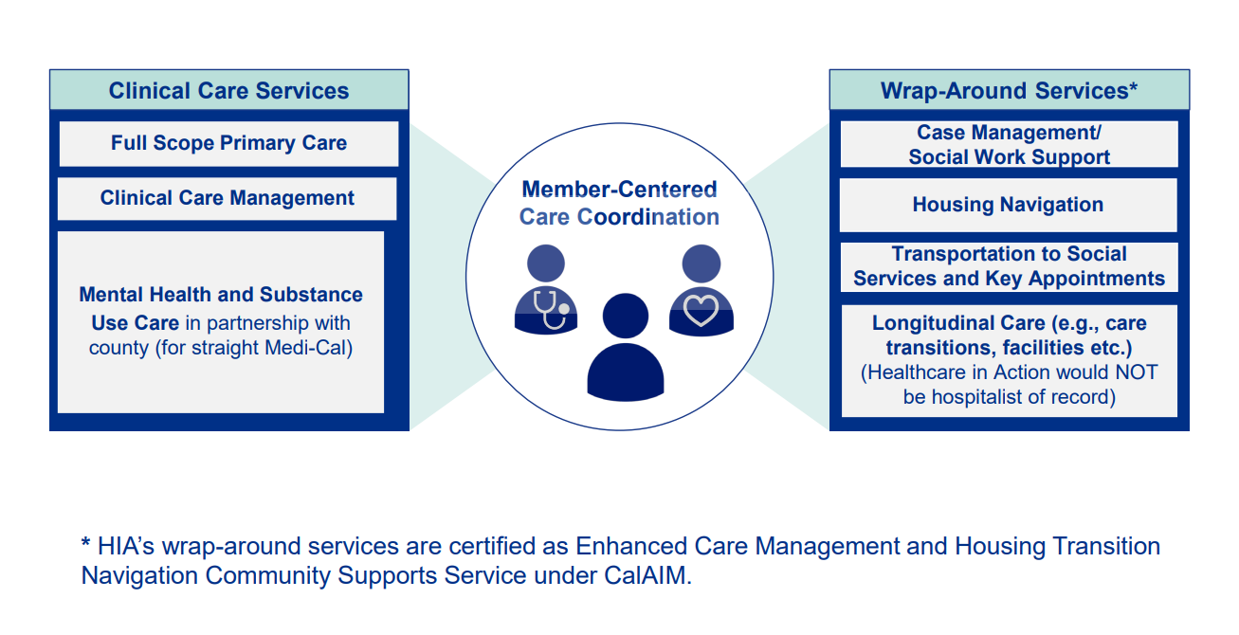
Model 1: Clinical Care + Wrap-Around Services

Slide 36
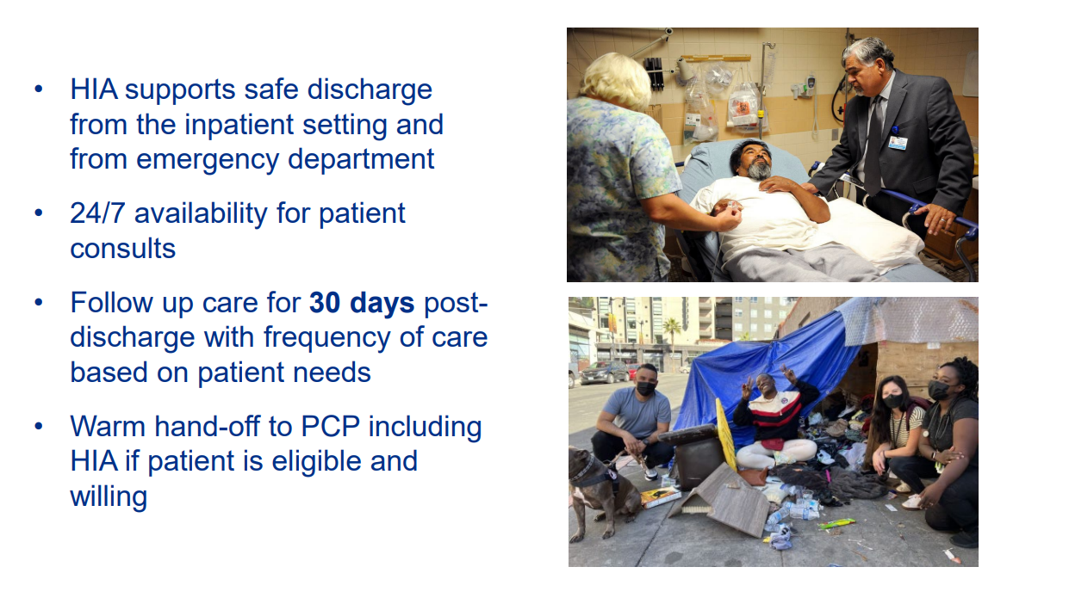
Model 2: Concierge Service

Slide 37
Empathetic Peer Navigation
Peer Navigator experience
Full wrap-around care
Came through on a promise
Observed patient’s needs in her own context
Resources to provide key non-medical supplies
Developing trust through shared experiences

Slide 38
HIA Success
4 Health Plans
2 Private Contracts
2180 Unique Patients Served
35 Patients Housed
50% reduction in 30-day hospital readmission rates
More than 90% of clients into CES for housing
Notes:
Results & counting

Slide 39
Innovations
GPS Trackers
Solar Chargers
24/7 Answering Service
Notes:
24/7 answering service- get back to patients within 4 hours and helps build trust with patients

Slide 40
Collaboration and Successes
Notes:
Collaborate quickly and cosupport each other with clients

Slide 41
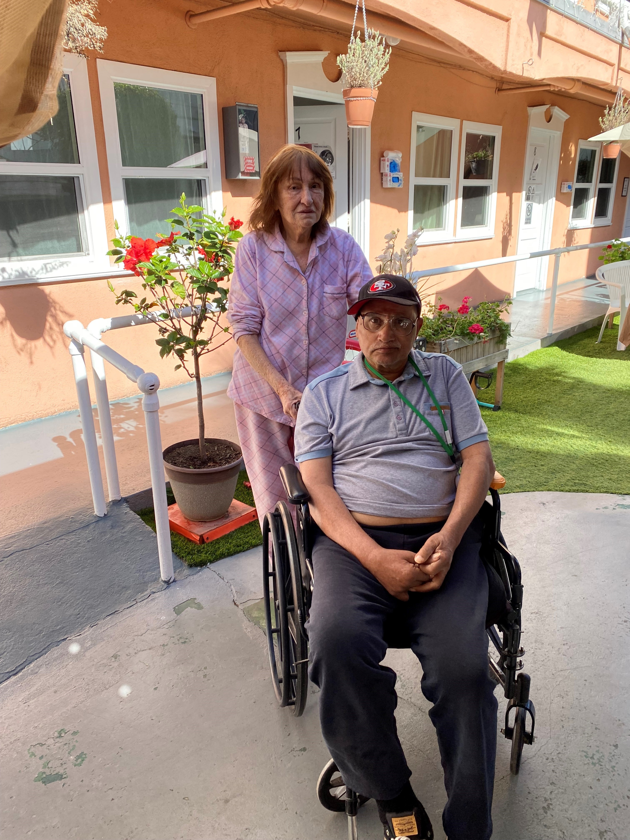
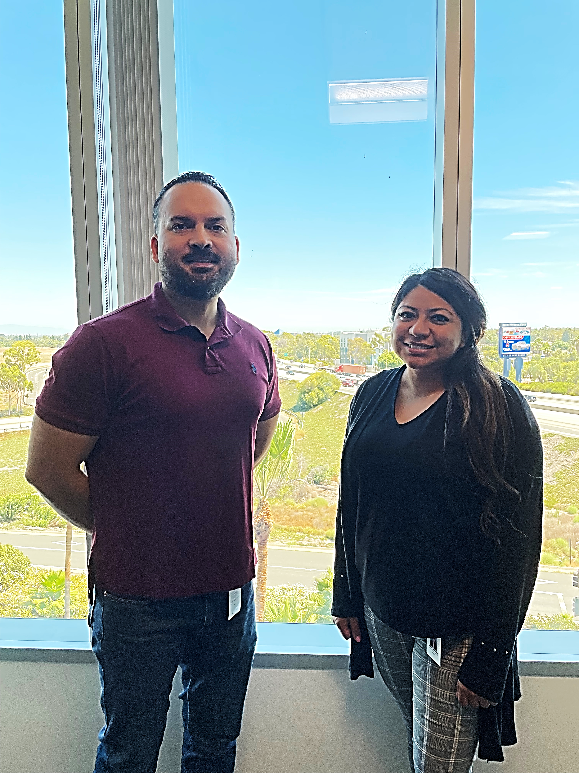
Mr. & Mrs. F At Risk of Homelessness
82-year-old and 76-year-old couple facing eviction and now safely placed at an ALF.
Mr. F w/c bound d/t CVA with L side paralysis & aphasial and now connected with their medical tea​m.
Mrs. F is cognitively impaired and has difficulty providing care to Mr. F and now receiving the appropriate level of care.
Carlos (CHW) & Blanca (CM)
Notes:
Per members friend,, member is at risk of homelessness. The Landlord sold property where member resides, and the buyer will be renovating the home. There is no eviction date yet. Member is very confused about situation and Susan Green is assisting member.

Slide 42
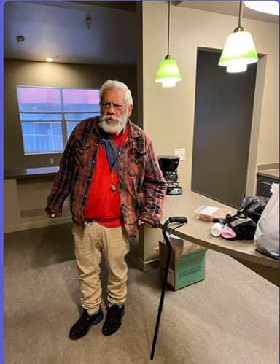
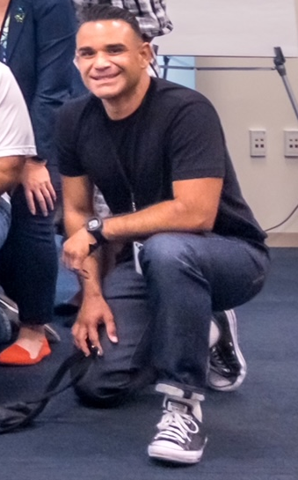
Mr. P Unhoused & Medically Unstable
72-year-old living in the streets of LA County and now housed.
Experiencing Mental Health issues and cognitive impairment and now connected with BH services, housing tenancy & sustainability.
Last seen by his PCP +2yrs and now receiving routine medical care.
Monthly Income of $670 and now receiving rental assistance.
Eric (Peer Navigator)
Notes:
Journey of member and collaboration story, peer support (add picture of Eric)

Slide 43
Questions

Slide 44
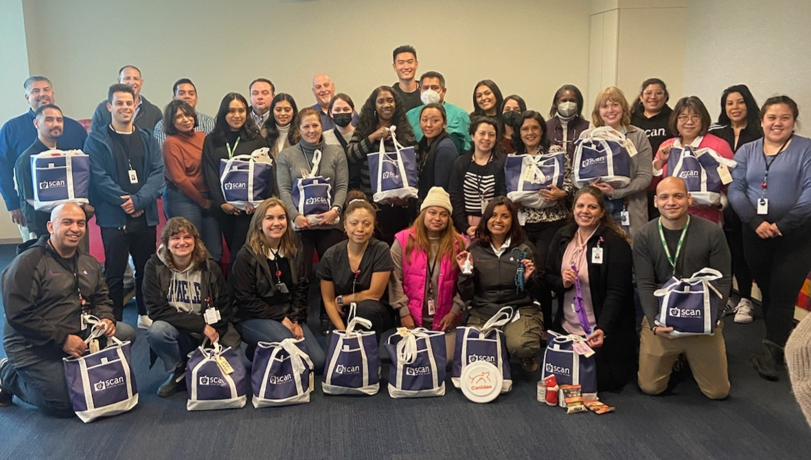
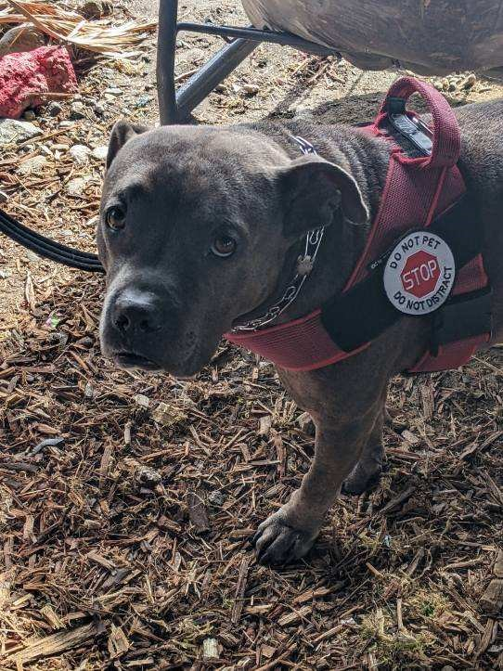
SCAN Homeless Team 2023
Keeping Older Adults Experiencing Housing Insecurity, Healthy & Independent
Mondo

Slide 45
Aiko Tan
Senior Director, Homeless Strategy & Community
Independence at Home (IAH), a SCAN community service atan1@scanhealthplan.com
Rosaneli Loza
Manager, Connecting Provider to Home
SCAN Health Plan rloza@scanhealthplan.com
Michael Jordan
Regional Director, Clinical Operations
Healthcare in Action mjordan@healthcareinaction.org
Onward!

Slide 46
Appendix

Slide 47
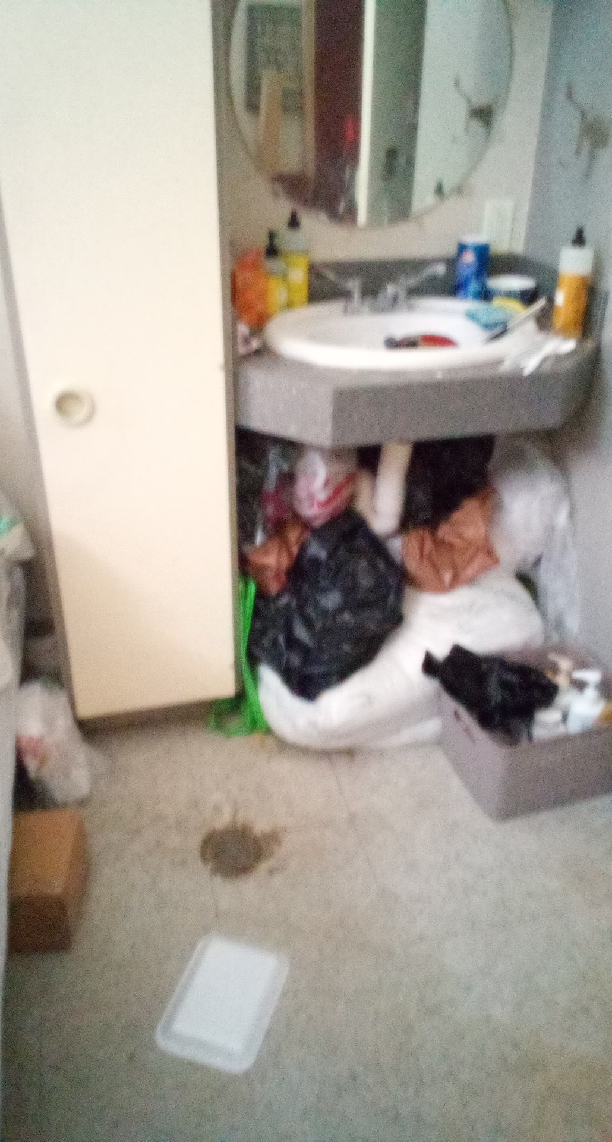
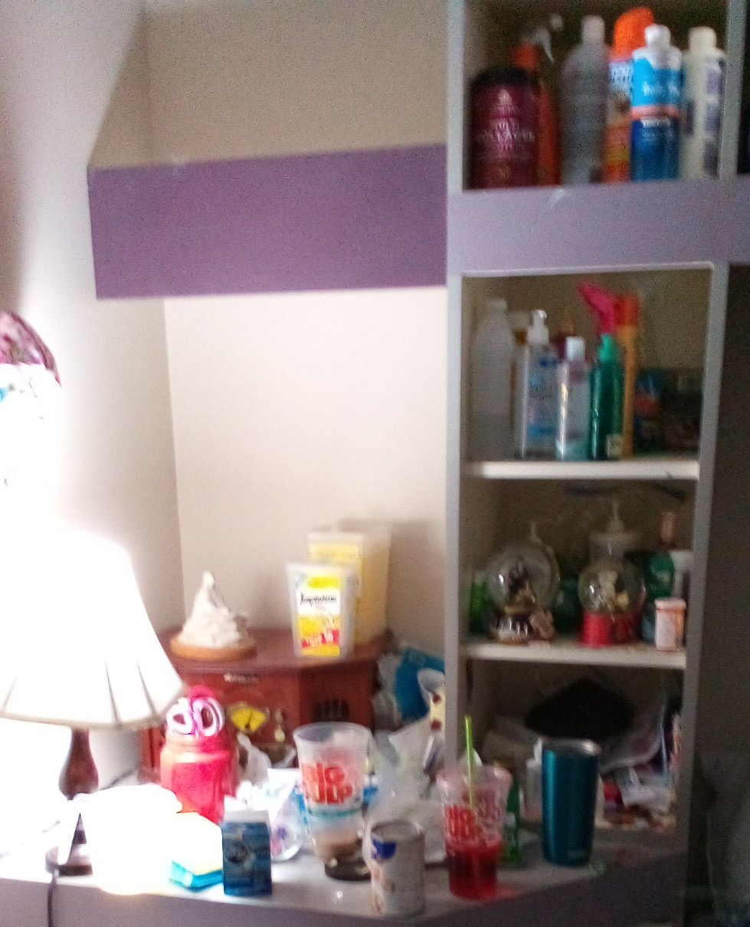
Ms. SG’s story Housing Retention
Ms. SG is 64 years old and spent many years of her adult life living on the streets. She exited homelessness into the Downtown Women’s Center permanent supportive housing program, thinking her ordeal was over. Unfortunately, over time, her unit fell into an uninhabitable state; Ms. SG was at high risk for falls due to the clutter, and the filth was affecting her lung condition. Out of compliance with her lease, Ms. SG was threatened with eviction and returning to the street. It was at this point that she was referred to IAH Homeless Services.
  Deep cleaning of her apartment to prevent eviction and readdress the health concerns associated with her living conditions. (EAF Funds)
  Reapplication for IHSS and strongly advocated for the maximum number of hours and used the Personal Assistance Services Council to identify a provider that Ms. SG has been very happy with.
  Connection to IAH Insights program to manage her depression and anxiety. Ms. SG has improved her mood and outlook
  Resolved a medication issue through advocacy with Pharmacy /LA Care PCP; Ms. SG has the medicine she needs to support her COPD
After eight months with Homeless Services, Ms. SG’s housing has been stabilized, her medical and mental health conditions have been supported, and she has the tools she needs to remain independent at home.
47

Slide 48
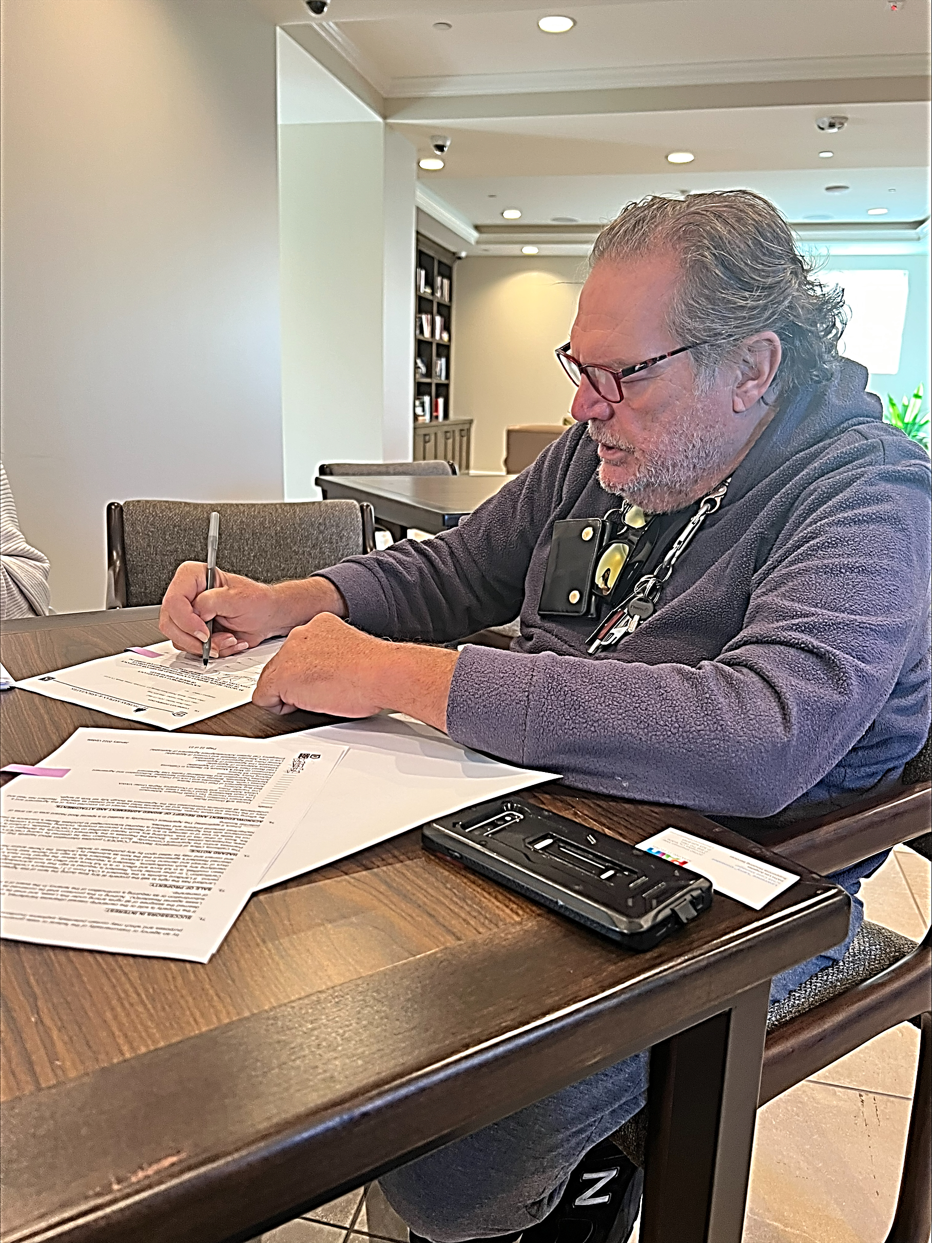
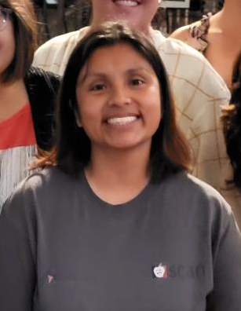
Mr. L Housing Stabilization
69-year-old living in his van since 2010 and
BA degree in Music and 3 courses away from completing his master’s program and
Monthly income of $1028 and
Suffering from Degenerative Disc Disease and
Jessica (Peer Navigator)
Notes:
Jessica Soto’s photo

Slide 49
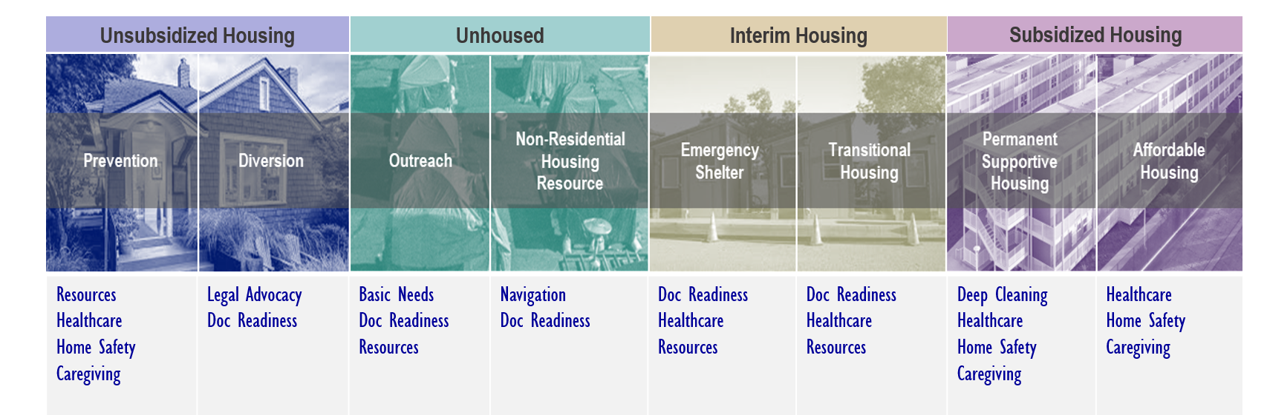
IAH Homeless Services supports clients through the whole continuum
What matters to our clients depends on where they are at…
Key Activities
Easy access to Care, Cultural Competency (Harm reduction, Housing First)
Resource and Problem Solving: resource optimization and interim needs
Document Readiness & Enrollment (Housing, Insurance)
Caregiving Services: IHSS, EAF Funded Temporary in-home care
Eviction Prevention: deep cleaning, healthcare resources

