Slide 1
Expanding Medical Respite Care: Breaking Down Silos through
Multi-Sector Collaboration
May 17th, 2023
Julia Dobbins, NIMRC
Ashley Brand, CommonSpirit Health
Jesse Gelwicks, Kaiser Permanente
The National Institute for Medical Respite Care is a special initiative of the National Health Care for the Homeless Council.

Slide 2
Workshop Overview
Introductions
National Institute for Medical Respite Care (NIMRC)
Kaiser Permanente and CommonSpirit Health
The History and journey of coming to the MRC table
The current work completed through KP, CommonSpirit Health, and NIMRC
The intersection between systems and how we can be good partners
Philosophy and Strategies
Medical Respite Care (MRC) Foundation Information
What are some strategies for building relationships with hospital and MCP providers?
What does it mean to be a partner?
How do we create a noncompetitive environment?
What do you see as the future of MRC as a billable service?
What are the biggest challenges and how do you hope to expand learnings?
Notes:
What are some strategies for building relationships with hospital and MCP providers?
What does it mean to be a partner?
How do we create a noncompetitive environment?
With the launch of CalAim what do you see as the future of MRC as a billable service?
What are the biggest challenges and how you hope to expand learnings?

Slide 3
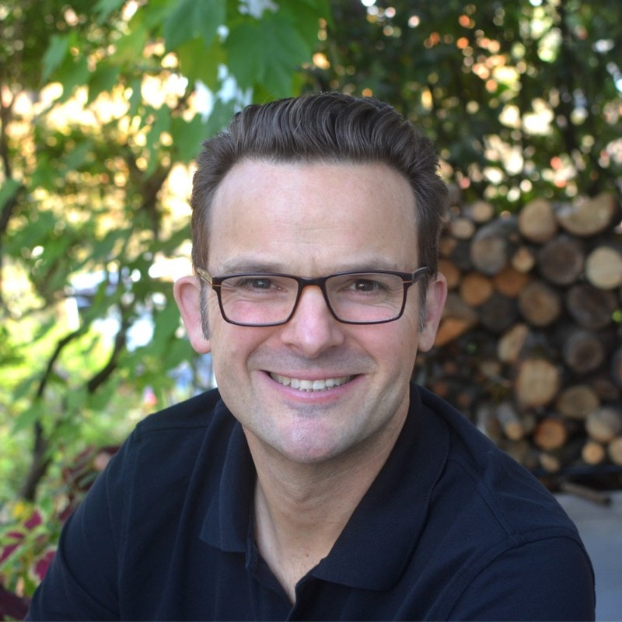
Speakers
Julia Dobbins
NIMRC
Ashley Brand
CommonSpirit Health
Jesse Gelwicks
Kaiser Permanente

Slide 4
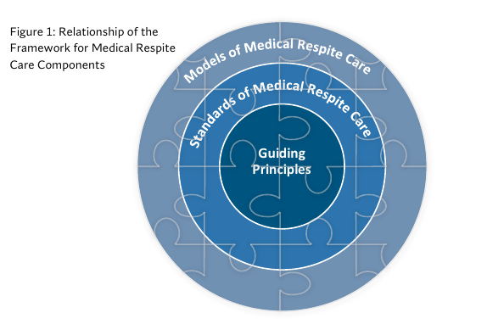
Medical Respite Care (MRC) Foundation Information
Medical Respite Care Components
What is Medical Respite Care?
Medical respite care (sometimes called recuperative care) is acute and post-acute care for people experiencing homelessness who are not ill enough to remain in a hospital but are too ill to recover on the streets.

Slide 5
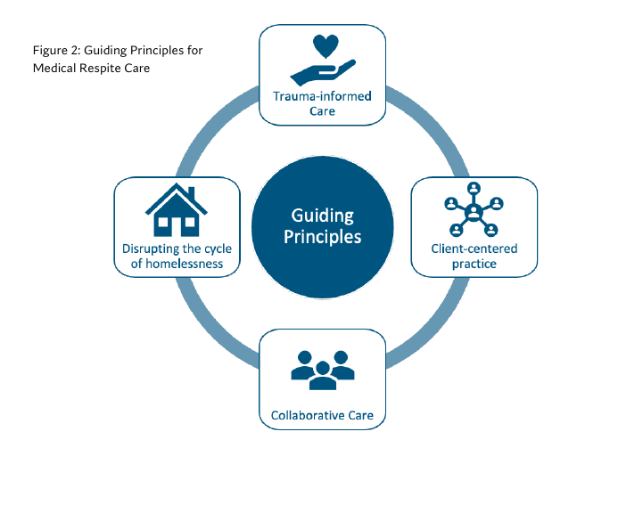
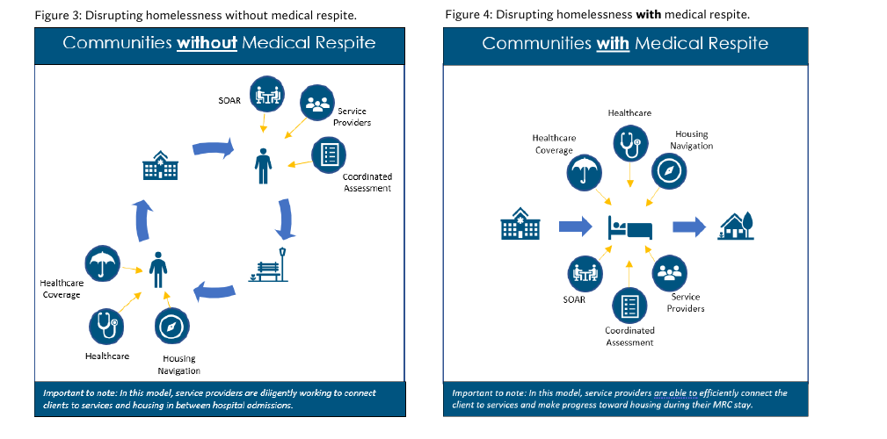
Medical Respite Care (MRC) Foundation Information
Medical Respite Care Guiding Principles
Disrupting the Cycle of Homelessness

Slide 6
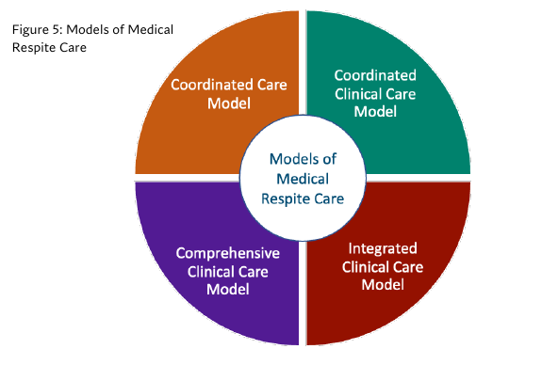
Medical Respite Care (MRC) Foundation Information
The Standards
Standard 2:
Standard 3:
Standard 4:
Standard 1:
Medical respite program provides safe and quality accommodations.
Medical respite program provides quality environmental services.
Medical respite program manages timely and safe care transitions to medical respite from acute care, specialty care, and/or community settings.
Medical respite program administers high quality post-acute clinical care.
Models of Medical Respite Care
Standard 6:
Standard 7:
Standard 8:
Standard 5:
Medical respite program assists in health care coordination, provides wrap-around services, and facilitates access to comprehensive support services.
Medical respite program facilitates safe and appropriate care transitions out of medical respite care.
Medical respite care personnel are equipped to address the needs of people experiencing homelessness.
Medical respite care is driven by quality improvement.

Slide 7
The history and journey of Kaiser Permanente and CommonSpirit Health coming to the MRC table
Long standing partnership between Kaiser Permanente and CommonSpirit Health across our California markets (specifically in Sacramento)
Shared focus on incorporating our investments and strategies into the larger homeless continuum of cares across our footprints
Medical Respite/Recuperative Care seen as a priority on both the clinical side as well as the community health side
Leadership at both health systems served on the NIMRC Advisory Council
Collectively identified the need to leverage experts that could provide technical assistance to our community providers/operators
Ongoing collaborative efforts to learn from each other and creating learning communities across our local markets
Notes:
Long standing partnership between Kaiser Permanente and CommonSpirit Health across our California markets (specifically in Sacramento)
Example of what that means at the community and national level
Shared focus on incorporating our investments and strategies into the larger homeless continuum of cares across our footprints
Medical Respite/Recuperative Care seen as a priority on both the clinical side as well as the community health side
Leadership at both health systems served on the NIMRC Advisory Council
Collectively identified the need to leverage experts that could provide technical assistance to our community providers/operators
Ongoing collaborative efforts to learn from each other and creating learning communities across our local markets

Slide 8
Current work being completed in partnership with NIMRC
Kaiser Permanente
CommonSpirit Health
Purpose
Programs
21
Opportunity
Funding Technical Assistance Peer Learning Cohort
These projects aims to strengthen the ecosystem of medical respite providers and advance best practices, expert services, and state-of-the-field knowledge in medical respite care.
7

Slide 9
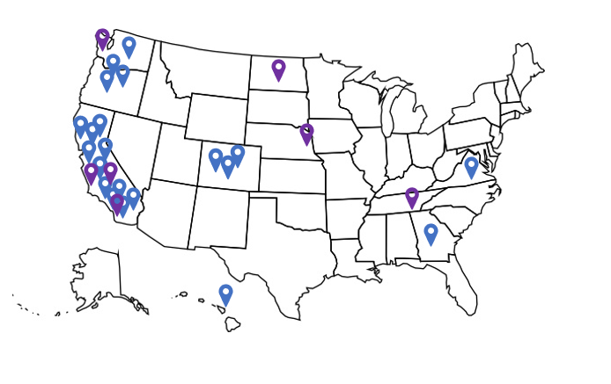
Current Map of Programs Participating in KP and CommonSpirirt Health Cohorts
CalAIM
CommonSpirit Health Kaiser Permanente
Notes:
19 Letters of Intent from 7 KP Market Regions

Slide 10
Analysis: Mitigation Requested by MRC Programs

Slide 11
Analysis: Technical Assistance and Training Requested by MRC Programs

Slide 12
Learning Topics Covered in Cohorts
Medication Support
Housing and the Homelessness Response System
Behavioral Health in MRC
Developing Partnerships with Hospitals
Demonstrating Quality in MRC: The Importance of Data
Gender Affirming Care in MRC
Referrals and Admissions
Developing Relationships with MCO’s

Slide 13
The intersection between systems and how we can be good partners
Passive Engagement > Active Engagement
Shallow Time Investment > Deep Time Investment
Singular Vision > Collaborative Vision
Grantee Problem Solving > Collective Problem Solving
Top-Down Partnership > Bi-directional Partnership
One-Time > Ongoing
Shifting the Paradigm from Funder to Partner

Slide 14
Q&A
Notes:
What are some strategies for building relationships with hospital and MCP providers?
What does it mean to be a partner?
How do we create a noncompetitive environment?
With the launch of CalAim what do you see as the future of MRC as a billable service?
What are the biggest challenges and how you hope to expand learnings?

Slide 15
www.nimrc.org
Follow us on social media!
National Health Care for the Homeless Council
National Institute for Medical Respite Care
Copyright © 2021 National Health Care for the Homeless Council, Inc.

