Slide 1
Acceptability of a Minimally Invasive Blood Collection Device for Use in an Mpox Seroprevalence Survey
Caroline Waddell, PhD
May 23, 2023
Epidemic Intelligence Service
Special Populations Team
Notes:
Good afternoon. I am Caroline Waddell and I am happy to share with you the results of an effort to understand the acceptability of a minimally invasive blood collection device that we used in a recent mpox seroprevalence survey.

Slide 2
Agenda
Background
Study objective
Methods
Results
Conclusions and public health implications
Notes:
The agenda for this talk includes some background on mpox, previously known as monkeypox, as well as an overview of seroprevalence surveys and their purpose and challenges in the context of homelessness.

Slide 3
Notes:
During emergency responses to infectious disease outbreaks it is important to quickly assess the impact on disproportionately affected populations like people experiencing homelessness. However, since few health data sources routine collect information on housing we have to rely on pieced together information to inform prevention and intervention- this often includes working with our partners and deploying to the field to collect primary data. This was the case during the 2022-2023 outbreak of mpox, an orthopoxvirus that is spread primarily by direct skin to skin contact.

Slide 4
CDC provided clinical consultation for 57 hospitalized patients with severe mpox…
>20% patients were experiencing homelessness
Notes:
We know that mpox disproportionately affected some populations, including racial, ethnic, sexual, and gender minorities as well as people experiencing homelessness. During the mpox outbreak, CDC provided clinical consultation for patients with severe mpox. An MMWR that we published in late 2022, described 57 of these hospitalized patients with severe mpox that CDC provided consultation between August and October 2022. 23% of these patients were experiencing homelessness.

Slide 5
There isn’t a way to count how many mpox cases among people experiencing homelessness
Notes:
Though we learned about these severe cases among people experiencing homelessness, It was difficult to understand if there were disproportionately more mpox cases among this population because the mpox case report form does not collect information about housing status so there not a way to count cases among PEH

Slide 6
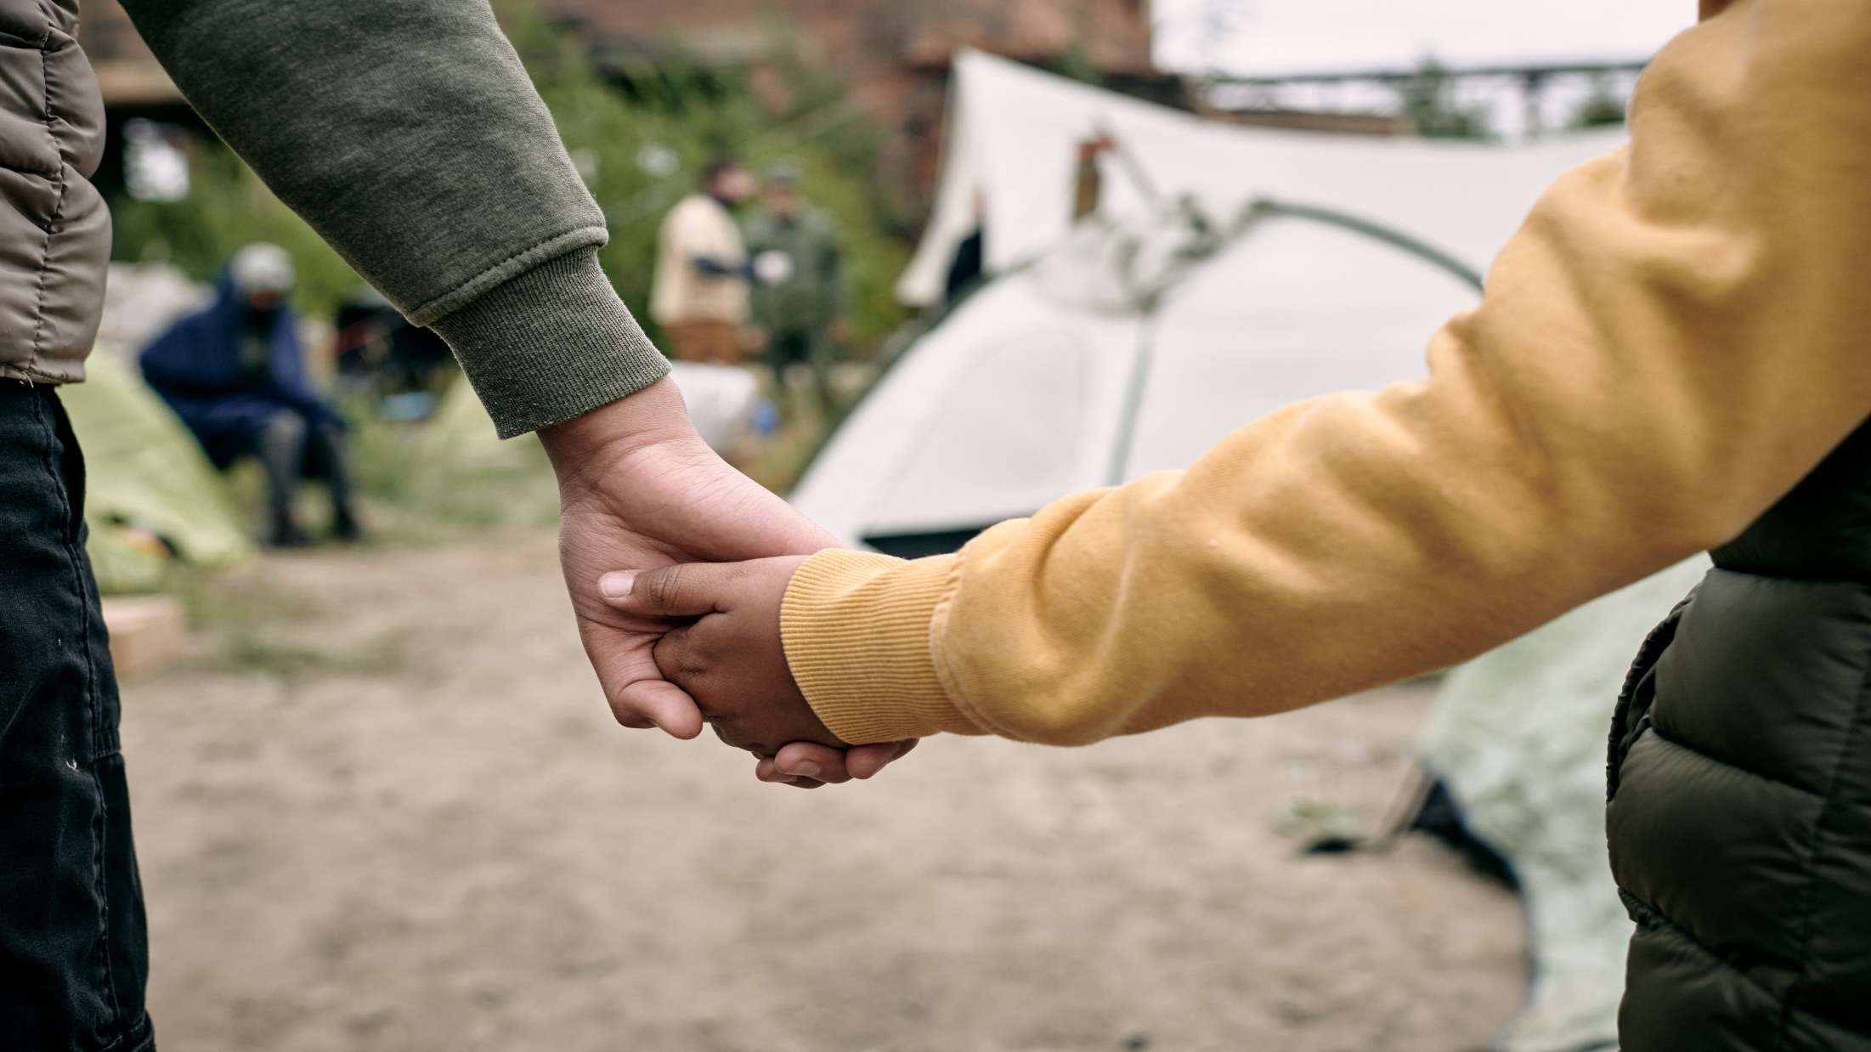
Partnering with health departments to understand how people experiencing homelessness (PEH) were being affected by mpox
Notes:
Since there was no formal data source that could help us count the number of mpox cases among people experiencing homelessness, we instead we had to gather data though our partnerships with health departments across the US

Slide 7
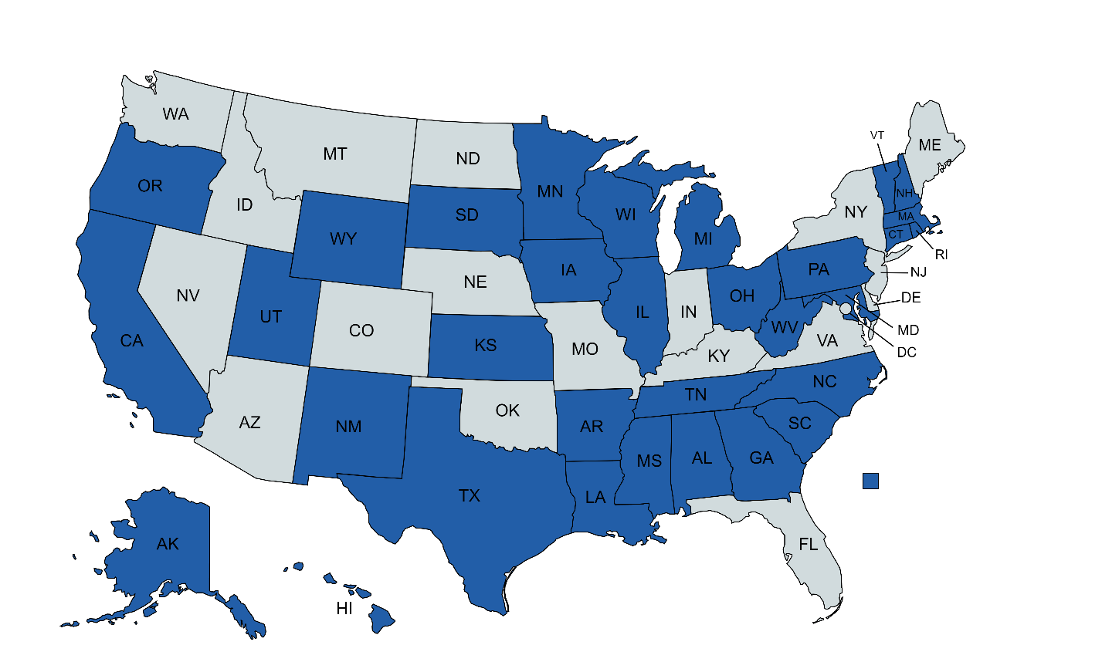
35 jurisdictions responded to informal mpox survey
High number of cases among PEH
Notes:
As a member of the multinational mpox response, we informally surveyed jurisdictions (marked here in blue) to get an idea of the prevalence of mpox among people experiencing homelessness and were informed of a high number of cases occurring compared to the population size

Slide 8
Cases were elevated in California
Notes:
Cases were particularly elevated in California

Slide 9
San Francisco invited CDC to conduct an mpox survey among people experiencing homelessness
Notes:
One of the partners in our informal survey who identified elevated mpox cases among PEH was the San Francisco Department of Public Health. And in October 2022, they invited CDC to conduct an mpox survey among PEH in their jurisdiction.

Slide 10
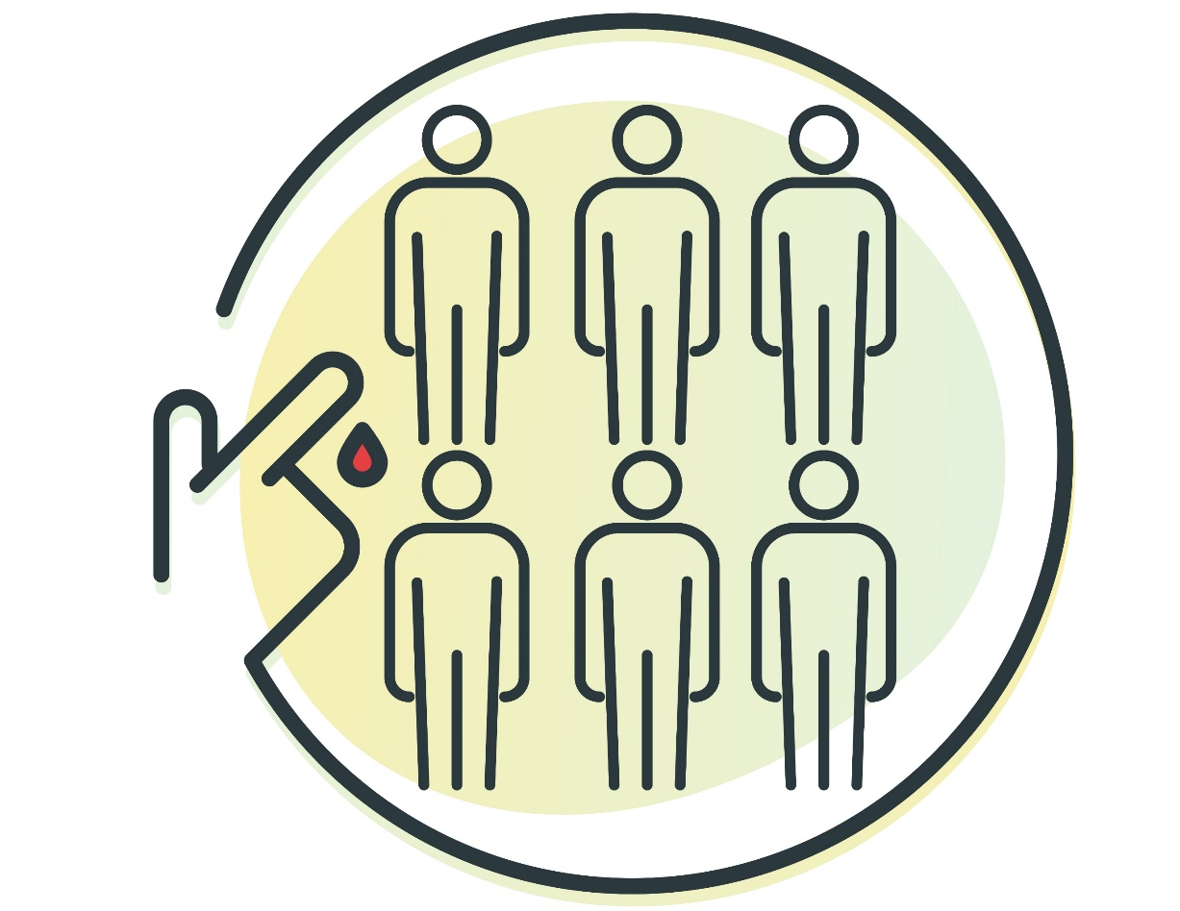
Seroprevalence Surveys
Notes:
A common approach to estimate disease burden in a population is to collect and test a blood sample from part of a population to estimate the disease burden among the wider population. Commonly we use serology (or testing patient samples for antibodies against a certain pathogen) as a tool to estimate the prevalence (or seroprevalence) of that pathogen within the population.

Slide 11
Prior Seroprevalence Surveys for Other Pathogens Among PEH
West Nile virus
Bartonella spp.
Mpox
HIV
COVID-19
Hepatitis
Notes:
There have been many prior seroprevalence studies among people experiencing homelessness that were used to estimate the burden of disease of the pathogens listed as well as others. And in the current study we focused on mpox seroprevalence

Slide 12
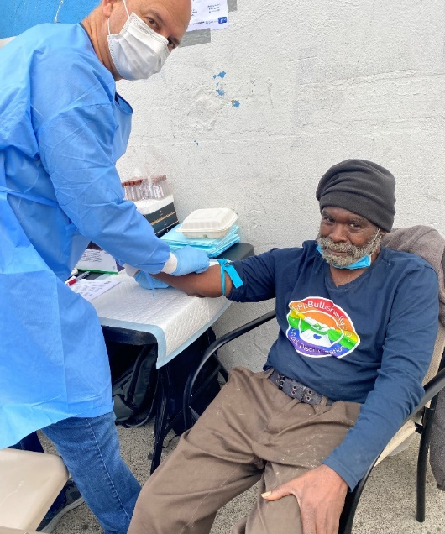
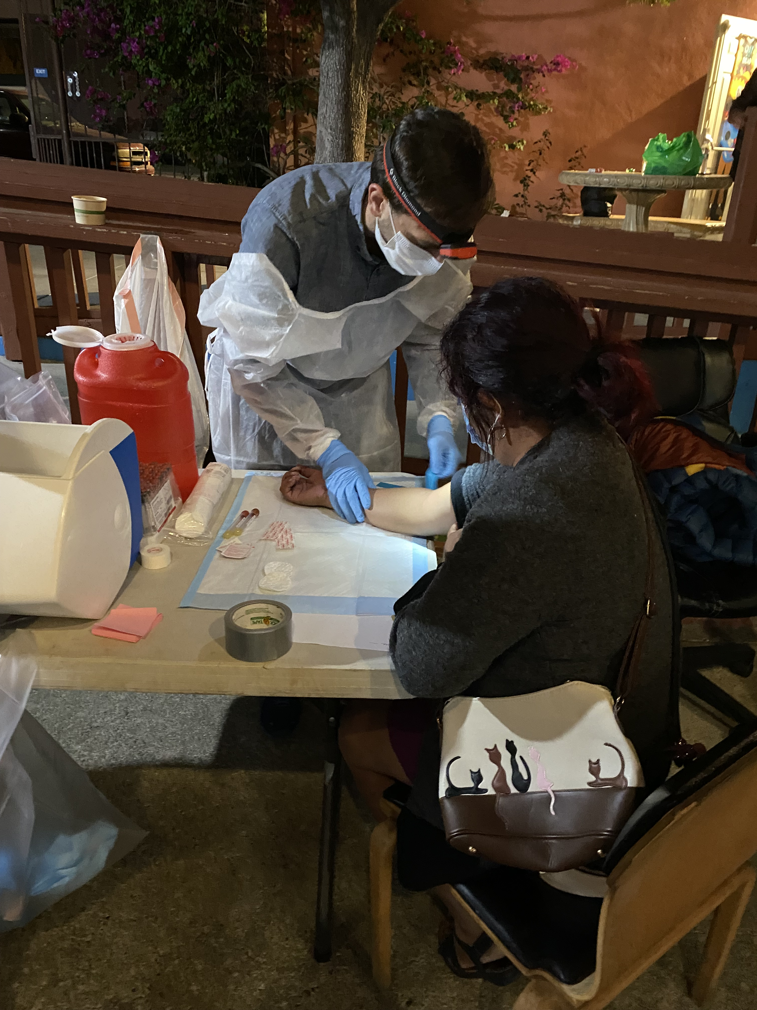
Challenges of Seroprevalence Surveys
Injection drug use
Scarring
Invasiveness
Needle aversion
Notes:
However, there are some challenges that come with seroprevalence surveys in the field and in the context of homelessness. First, you need a trained phlebotomist and these trained professionals might not always be readily available, second due to the prevalence of injection drug use and potential for vein and skin scarring it may be difficult to access or visualize veins for venipuncture.
-Some people may have needle aversion or be uncomfortable with the invasiveness or pain associated with venipuncture
-Lastly, seroprevalence surveys require supplies and sterile techniques which can be difficult in settings such the picture on the right where we were at a homeless shelter that primarily serves people who are transgender, we were outside, at night, and needed to use headlamps

Slide 13
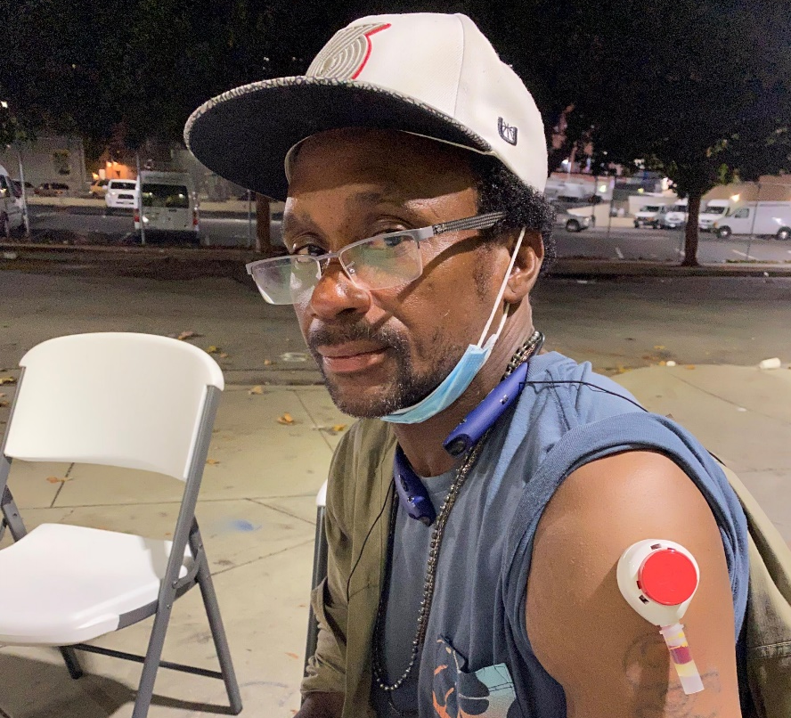
Overcoming Challenges of Seroprevalence Surveys
Notes:
To overcome some of these challenges to venipuncture, we were given 91 microneedle devices from our mpox laboratory that passively collect capillary blood from the deltoid. While these devices were approved by the FDA for clinical use in September, 2022, the CDC had not used them before during field serosurveys. We decided to offer them as an alternative to venipuncture for participants, with the hopes of using this device or similar devices to improve the inclusion of underrepresented populations in future surveys.

Slide 14
Objective: Assess the acceptability of a minimally invasive blood collection device during a seroprevalence survey among people experiencing homelessness in San Francisco, CA 2. Determine the prevalence of mpox
Notes:
In addition to the seroprevelance survey component, we also aimed to assess the acceptability of this minimally invasive blood collection device among survey participants who were experiencing homelessness in San Francisco, CA and this is what I’ll primarily focus on for this presentation

Slide 15
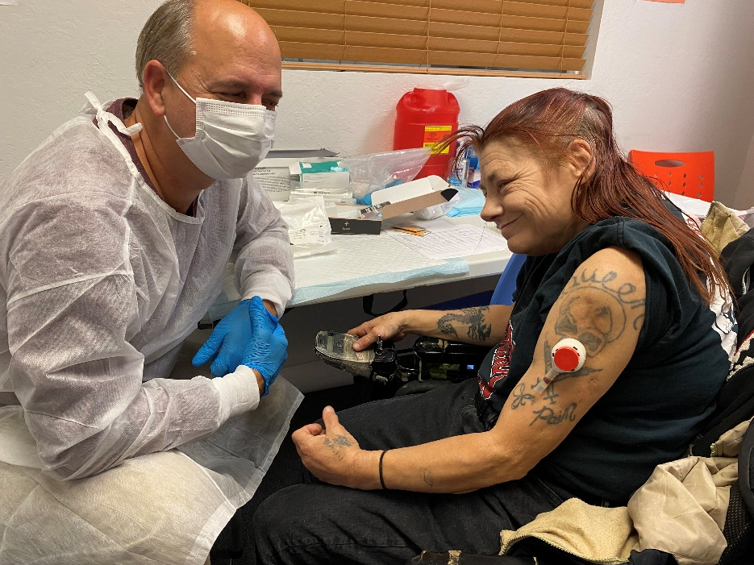
Methods: Blood Collection
Phlebotomist attempting venipuncture with a survey participant
Phlebotomist assisting participant administer blood collection device
Notes:
As mentioned, there were two methods in which participants could provide a blood sample, the first (pictured on the left with a participant and our phlebotomist) was venipuncture and the second way (pictured on the right) was the microneedle device that passively collected capillary blood from the upper arm. The device was offered if veins were damaged or could not be adequately visualized, or if the participant had needle aversion.

Slide 16
Device Administration
Notes:
Now, I’ll walk you all through a visual explanation of the device administration. The device comes with instructions and can be administered by the patient themselves but we had CDC clinicians walk each participant through the process and assist with administration for this survey.

Slide 17
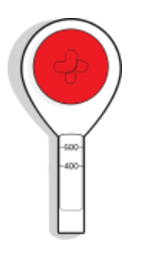
Blood Collection Device
The device has a lancet which punctures the skin upon release of the button and is then retracted into the device
Once the button is pressed it will not activate the lancet if pressed again
Notes:
A couple of notes on the device activation: The device has a lancet which punctures the skin upon release of the button and is then retracted into the device. The lancet will not activate again once the button is pressed.

Slide 18
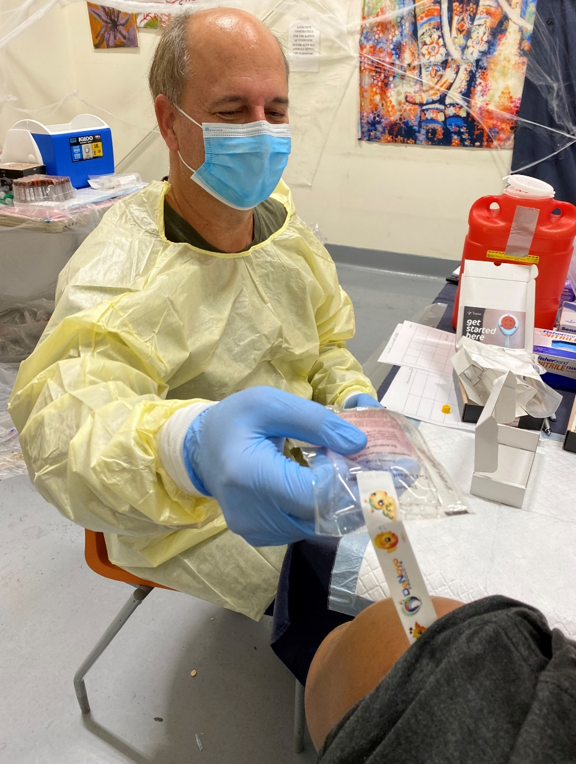
Site Preparation
Choose deltoid muscular site with minimal adipose tissue
Clean site with included alcohol pad
Notes:
For the site preparation, you have to choose a deltoid muscular site with minimal adipose tissue and then clean the site with included alcohol pad

Slide 19
Site Preparation
Lightly massage the site with heat pad for one minute to increase blood flow to area
Notes:
Then, lightly massage the site with a heat pad for one minute to increase blood flow to the area

Slide 20
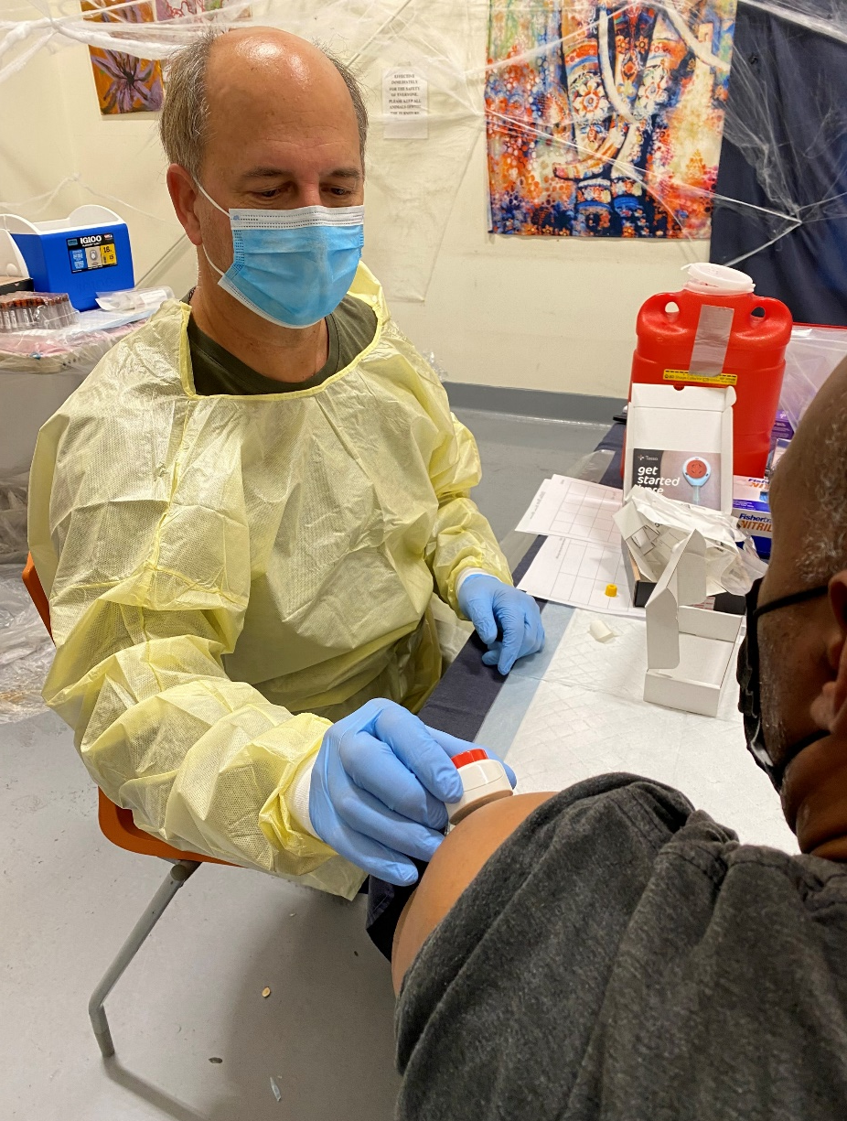
Device Application
Remove cover sheet from adhesive pad and apply device to the selected site
Note: The device adheres to skin and can be left in place without holding it during the collection process
Notes:
Then for application, remove the cover sheet from the adhesive pad and apply to device to the selected area. The device adheres to the skin and can be left in place without holding during the collection process.

Slide 21
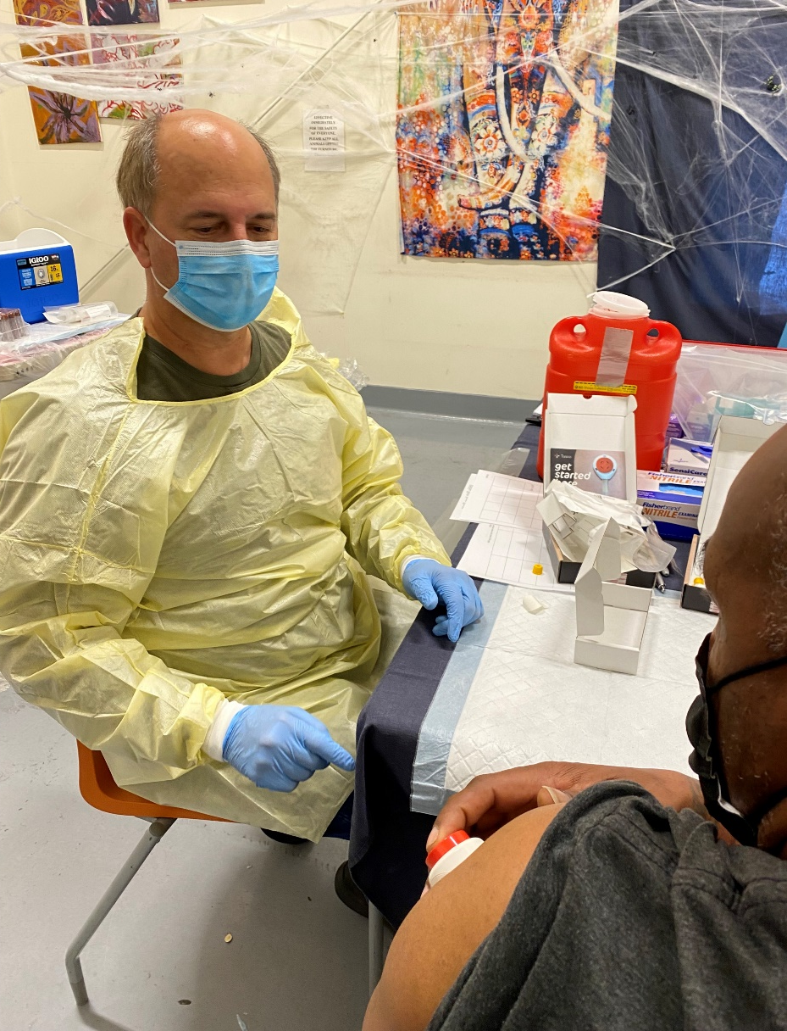
Device Activation
Encourage patient to relax arm then push the red button until it clicks and fully release
Notes:
For the device activation we encouraged the patient to relax their arm then push the button until it clicked and fully released

Slide 22
Device Activation
Note: Many participants requested us to push the button because they were either apprehensive or couldn’t exert enough pressure to fully depress the button
Notes:
Many participants requested for us to push the button because they were either apprehensive or couldn’t exert enough pressure to fully depress the button.

Slide 23
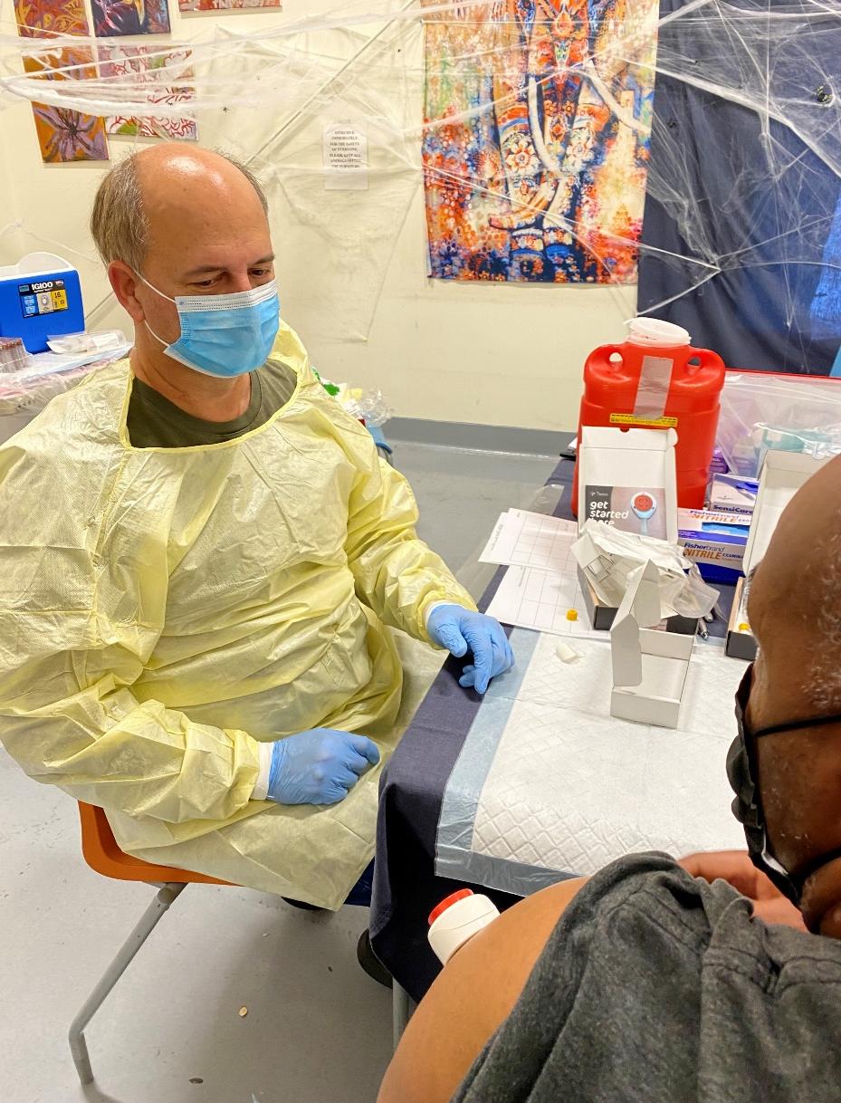
Sample Collection
~One minute for blood flow to begin (but up to 5 minutes was observed)
Usually 5 – 10 minutes to collect an adequate sample volume (200ul)
Keep collection arm relaxed in vertical position
Notes:
Regarding sample collection: It usually took one minute for blood flow to begin (but up to 5 minutes was observed), it usually took 5 – 10 minutes to collect an adequate sample volume (around 200uL), the patient was encouraged to keep the collection arm relaxed in vertical position

Slide 24
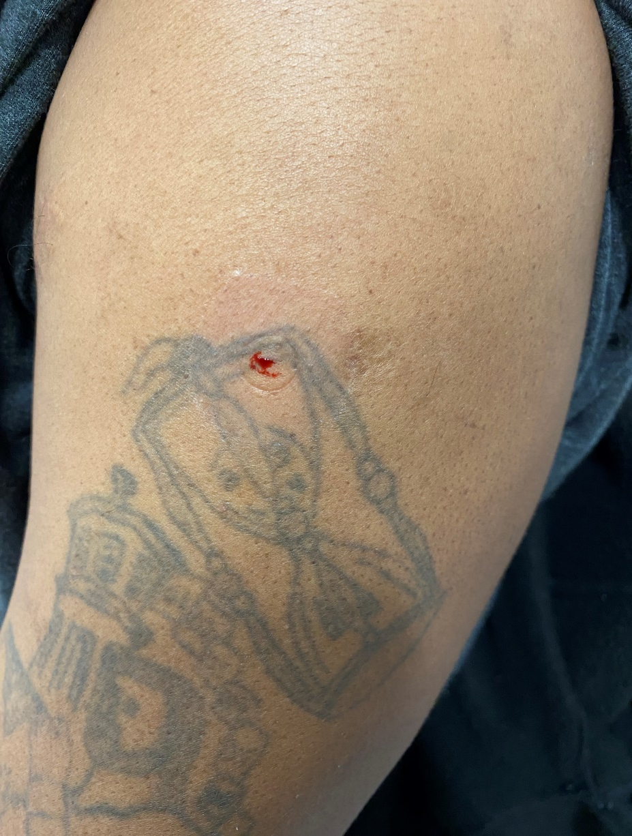
Ending Collection
Slowly peel device from patient
Remove collection tube from the device by slowly twisting it off
Snap cap onto the collection tube and apply label to the tube
Place Band-aid at puncture site (usually minimal blood flow)
Dispose of device as biological waste (not sharps waste)
Notes:
To finish the collection, you slowly peel the device from the patient, remove the collection tube from the device by slowly twisting it off and snap the cap one to the collection tube and apply an identifying label onto the tube. Place a band-aid at the puncture site. There was typically minimal blood flow. Then dispose of the device as biological waste.

Slide 25
Brief post-collection survey
“Did you find the device to be an acceptable way to take a blood sample?”
“In the future, would you prefer this device over standard venipuncture for a blood draw?”
Notes:
We administered a brief post-collection survey and asked participants if they found the device to be an acceptable way to take a blood sample and if they would prefer this device over venipuncture for a blood draw.

Slide 26
Results
Notes:
Now, for the results.

Slide 27
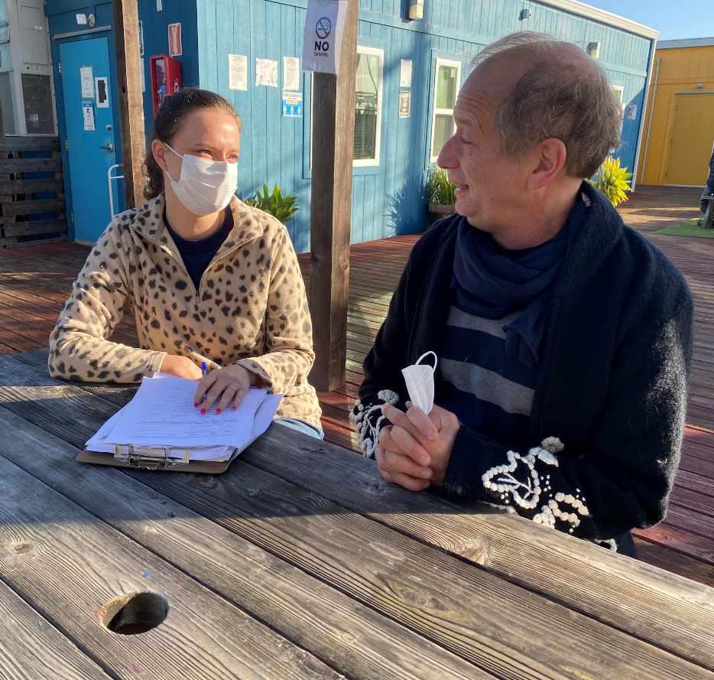
participants consented to blood collection
238
Notes:
Between October-November 2022, across two weeks a team from CDC recruited people from 16 unique sites including Homeless shelters, permanent supportive housing, service centers, and a encampments. There were 238 participants who consented to blood collection

Slide 28
Participant demographics:
Median age: 46 years
Notes:
The median age of participants was 46 years old

Slide 29
Participant demographics: Sex at birth
Notes:
69% of participants reported male sex at birth, 30% reported female sex at birth. Less than 5% of people reported being intersex or unknown

Slide 30
Participant demographics: Gender Identity
Notes:
9% of participants identified as transgender women, 60% identified as cisgender men, 31% identified as cisgender women. Less than 5% identified as nonbinary, and no one reported being a transgender man

Slide 31
Participant demographics: Sexual orientation
Notes:
77% of participants reported being heterosexual, 7% reported being gay or lesbian and 11% reported being bisexual

Slide 32
Participant demographics: Race and Ethnicity
Notes:
4% of participants were non-Hispanic Asian, 29% of participants were non-Hispanic black or African American, 28% of participants were Hispanic or Latino, 7% were multiracial, and 28% were non-Hispanic white
Fewer than 5 participants were American Indian or Alaska native or Native Hawaiian or Pacific Islander so the data is suppressed per data privacy policies by the San Francisco Department of Public Health.

Slide 33
209
total successful blood collections
Phlebotomist attempting venipuncture with a survey participant
Phlebotomist assisting participant administer blood collection device
Notes:
In total, There were 209 successful blood draws

Slide 34
Successful Blood Collections
137 (75%)
72 (79%)
Phlebotomist attempting venipuncture with a survey participant
Phlebotomist assisting participant administer blood collection device
Notes:
There were 137 (or 75%) successful blood collections by venipuncture and 72 (or 79%) successful collections using the device

Slide 35
42 (24%) instances where venipuncture was unsuccessful
Notes:
Of the 42 instances where venipuncture was unsuccessful.

Slide 36
42 (24%) instances where venipuncture was unsuccessful
31 (74%) of these participants opted to use the device as an alternative method
Notes:
31 participants opted to use the device as an alternative

Slide 37
42 (24%) instances where venipuncture was unsuccessful
31 (74%) of these participants opted to use the device as an alternative method
71% had a successful blood draw
Notes:
And of those 71% had a successful blood draw

Slide 38
Use of the device as an alternative when venipuncture failed increased the number of successful blood collections by 12%
Notes:
Increasing the number of successful blood collections by 12%

Slide 39
Use of the device increased overall blood collection participation by 53%
Notes:
Increasing the number of successful blood collections by 12%

Slide 40
Objective: Acceptability of Blood Collection Device
“Did you find the device to be an acceptable way to take a blood sample?”
“In the future, would you prefer this device over standard venipuncture for a blood draw?”
Notes:
As a reminder these are the questions we asked

Slide 41
100% found the device to be an acceptable method of blood collection
Notes:
Of the 72 participants who had a successful blood draw using the device, 100% found it to be an acceptable method of blood collection

Slide 42
94% preferred the device to venipuncture
Notes:
And 94% preferred the device to venipuncture

Slide 43
Takeaways
Patients loved it
“It’s amazing … It didn’t hurt at all!”
“Easy, less invasive, doesn’t hurt. I’d choose this every time.”
“No digging around for my veins – this was easy!”
“Super cool. Why don’t they use this in the hospital?”
Downsides
Sometimes it just didn’t work
“It takes too much time.”
Some patients with fear of needles not willing to try
Lots of packaging / bulky waste
Notes:
As for the takeaways, patients loved the device. Here are a few of the positive quotes we recorded from participants
However, there were downsides. Sometimes it didn’t work and the lancet didn’t deploy.
One participant said it took too much time. Others had a fear of needles and were not willing to try the device. Lastly, the device comes with bulky packaging that can lead to waste.

Slide 44
Takeaways
Strengths
Less painful than venipuncture
Good adhesive attachment to arm
High participant acceptability
Allowed for self-deployment
Weakness
Small blood volumes obtained may limit some diagnostic purposes
Rapid clotting stops the collection
Firm pushing of the button against the arm is required
Exposed participant arm to colder ambient temperatures
Notes:
Some of the strengths include that it was less painful than venipuncture, had good adhesive attachment to the arm, had high participant acceptability and allowed for self-deployment.
However, some weaknesses include that the overall volume or serum is smaller compared to traditional serum separation tubes used for venipuncture. Sometimes rapid clotting stopped the collection. Also, it was necessary to firmly push the button against the arm and some patients were hesitant to push the button, limiting the possibility for self-collection. Lastly, using the device exposed the participants arm to colder ambient temperatures which can be uncomfortable and also slow the collection process.

Slide 45
Takeaways
When it didn’t work
User error (removed before 5 minutes)
Slow flow / clotting early / low volume
Cold ambient environments
Heat pack activated prior to opening device box
When it worked well
Scarring (from “muscling”)
Venous damage preventing venipuncture
Warm ambient temperature
Notes:
When it didn’t work it was usually due to user error. We also saw slow blood flow or quick blood clotting that led to device failure or low volume. The device was more frequently unsuccessful in cold ambient temperatures. In some instances the heat pack that came with the device was activated prior to opening.
The device worked well in instances where the patient had scarring or venous scarring. Or when venous scarring prevented venipuncture. It also worked best in warm ambient temperature

Slide 46
Takeaways
When it didn’t work
User error (removed before 5 minutes)
Slow flow / clotting early / low volume
Cold ambient environments
Heat pack activated prior to opening device box
When it worked well
Scarring (from “muscling”)
Venous damage preventing venipuncture
Warm ambient temperature
Notes:
Specifically, looking into cold ambient environments

Slide 47
Takeaways
Cold ambient environments
15/24: 62.5% success rate
Indoor/ normal ambient environments
57/67: 85% success rate
Statistically lower success in cooler environments (p = 0.029) by chi-square test
Notes:
Statistical testing showed a lower success rate of the device in colder environments with a success rate of 62.5% compared to 85% in warmer ambient environments

Slide 48
Takeaways
When it didn’t work
User error (removed before 5 minutes)
Slow flow / clotting early / low volume
Cold ambient environments
Heat pack activated prior to opening device box
When it worked well
Scarring (from “muscling”)
Venous damage preventing venipuncture
Warm ambient temperature
Notes:
Specifically, looking into a factor where the device worked well for people with arm scarring. This was one of the reasons why we wanted to use this device to see if it worked well when a participant had deltoid scarring

Slide 49
Takeaways
Participant with deltoid scarring
5/7: 71.4% success rate
Participant with no scarring
67/84: 79.8% success rate
Statistically similar success between participants with and without deltoid scarring (p = 0.61) by chi-square test
Notes:
Statistical testing showed a similar success rate of the device between people with deltoid scarring at 71.4% compared to 79.8% success for people without scarring

Slide 50
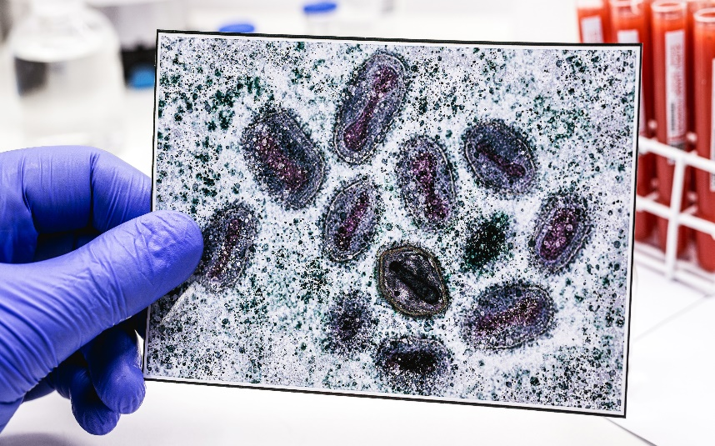
3
possible undetected mpox infections
Notes:
Briefly, we also looked at the results of the serologic testing among these participants to understand how often participants had evidence of prior mpox infection without prior vaccination or known mpox disease. Out of the 209 participant samples, we identified antiorthopoxvirus antibodies for 3 participants, resulting in 3 possible previously undetected mpox infections.

Slide 51
Limitations
Convenience sample
Notes:
There were several limitations to our study.
First, participants were recruited as a convenience sample at prioritized locations; therefore, the findings are not generalizable to the entire population of people experiencing homelessness or accessing homeless services in San Francisco.

Slide 52
Limitations
Convenience sample
Serology sensitivity/specificity
Notes:
Second it is possible for antibody testing to produce false-positive or false-negative results though efforts were taken to improve specificity.

Slide 53
Limitations
Convenience sample
Serology sensitivity/specificity
Acceptability of the device was only asked of people for who had a successful collection
Notes:
Third, Acceptability of the device was only asked of people for who had a successful collection. Therefore, not everyone for whom blood draw was attempted with the device answered the questions

Slide 54
Limitations
Convenience sample
Serology sensitivity/specificity
Acceptability of the device was only asked of people for who had a successful collection
Not all participants were given the option between venipuncture and the device, as <100 devices were available for this project
Notes:
And not all participants were given the option between venipuncture and the device, as <100 devices were available for this project

Slide 55
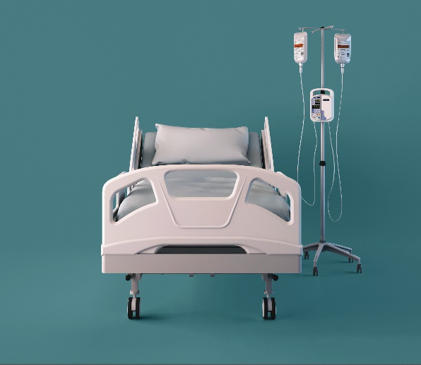
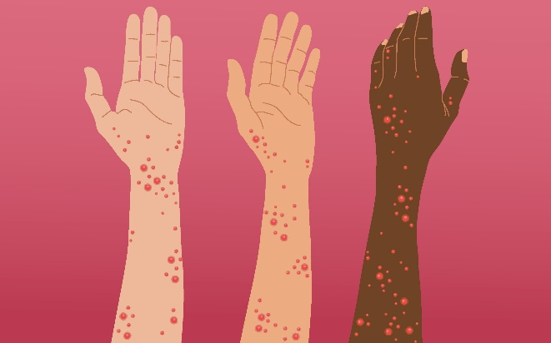
+
Prior severe disease and known mpox cases among people experiencing homelessness
Notes:
In conclusion, we knew going into this project that people experiencing homelessness had disproportionately high numbers of mpox cases, especially including severe disease.

Slide 56
+
+
Prior severe disease and known mpox cases among people experiencing homelessness
+
Possible undetected mpox infections
Notes:
And now the findings of our study add knowledge of possible undetected mpox infections as among this population as well

Slide 57
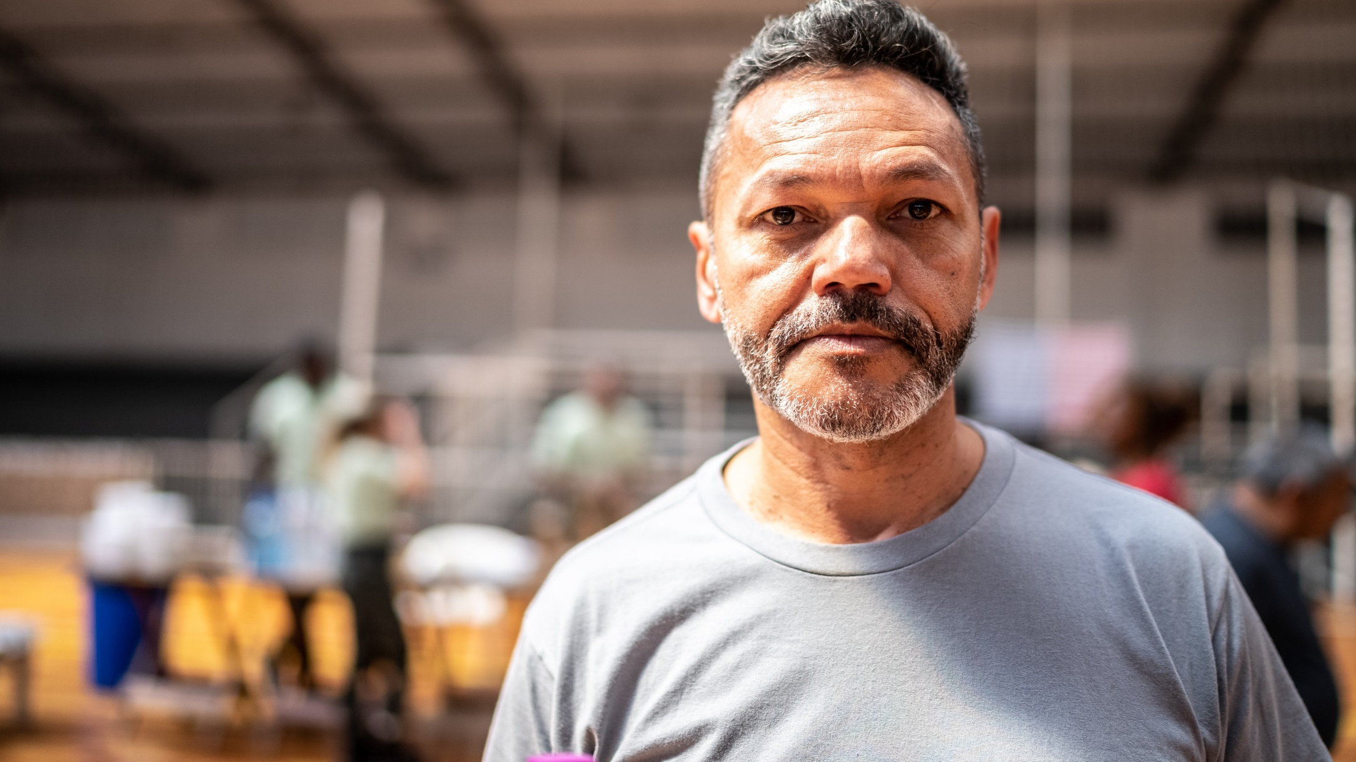
Accessible prevention measures are needed
Notes:
Given these findings of possible undetected infections, we highlight the importance of accessible prevention measures for people experiencing homelessness in future infectious disease outbreaks.

Slide 58
Offer unique approaches to expand participation
Notes:
Specifically, We highlight a need for public health to consider using unique or alternative approaches that make it easier for people experiencing homelessness to be included in surveys, like seroprevalence surveys, by offering multiple options for sample collection such as the microneedle device we used that had high acceptability and success rates for participants. Here are just a few of the quotes we recorded from participants

Slide 59
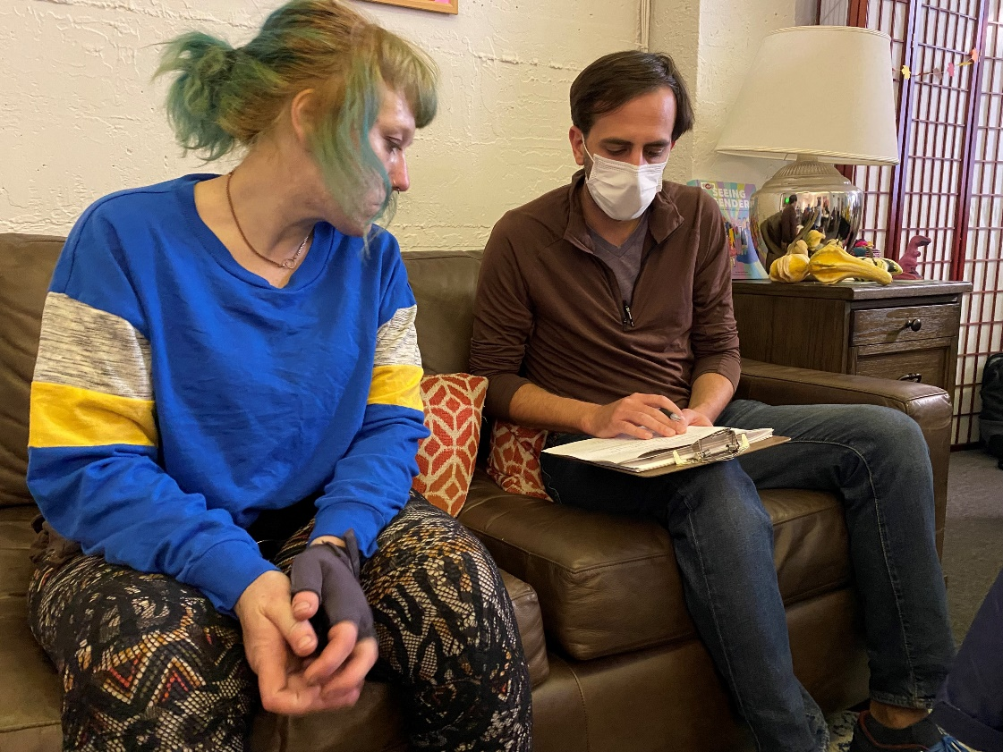
Consider potential barriers when designing surveys
Notes:
And finally, we can all work to include disproportionately affected groups, like people experiencing homelessness in surveys and take the initiative to overcome barriers to participation

Slide 60
The Project Participants and Community-based Organizations or Agencies that Provided Services
CDC Foundation
US Centers for Disease Control
Field Team & HQ support
The Mpox Laboratory and Testing Taskforce
Community Engagement Taskforce
State, Tribal, Local, and Territorial Taskforce
Poxvirus Lab
San Francisco Department of Public Health
Mpox Response
Whole Person Integrated Care Street Medicine Team
Shelter Health Team
San Francisco Department of Homelessness and Supportive Housing
San Francisco Public Health Laboratory, Specimen Receiving Team
California Department of Public Health
Notes:
Thank you some much for your attention. I’m happy to take any questions.

Slide 61
5 minute break-out
What additional barriers should we consider to improve the inclusion of people experiencing homelessness in surveys that can support public health action?
What kind of data would be helpful in your work to better understand/address the health needs of people experiencing homelessness?
Examples might include better chronic disease, drug use, health care access/utilization, demographic data for PEH

Slide 62
Extra Slides

Slide 63
Recruitment Sites
Recruitment Sites (Unique)
Shelter | 7 (44%)
Service Center | 5 (31%)
Permanent Supportive Housing | 2 (12%)
Encampment | 2 (12%)
Total | 16
Notes:
SFDPH created a list of potential candidate sites based on whether there was a known mpox case previously and if the site was high density or served a high priority population. On October 18th, SFDPH held a focus group call with candidate sites to explain the purpose of the study, review study protocols, and provide an opportunity to provide feedback and ask questions. Interested sites completed a survey and from that, sites were organized into four main buckets, those that: (1) had 1 or more known mpox cases, (2) served LGBTQIA+ populations, (3) high density sites, or (4) sites that do not fit into the prior categories. Sites within each list were then randomly ordered and CDC staff reached out to sites in the order they appeared for each bucket. Twenty candidate sites expressed interest and six encampments were identified by the Street Medicine team as potential recruitment locations.
This ultimately resulted in a total of 17 visits being made to 16 unique sites during October 24–November 3, 2022; sites included 7 shelters, 5 service centers, 2 permanent supportive housing sites, and 2 encampments. Among the 16 sites, 7 (44%) had previously reported mpox cases among residents or clients.

Slide 64
Objectives: 1. Assess the acceptability of a minimally invasive blood collection device during a seroprevalence survey 2. Estimate the prevalence of mpox
Among people experiencing homelessness in San Francisco, CA…
Notes:
And second was to determine the prevalence of mpox among people experiencing homelessness in San Francisco California.

Slide 65
Objective 1: Serology
2.5% IgG+ (2/80)
1.4% IgM+ (1/73)
Notes:
For our first objective, of the 80 participants without prior vaccination history and who were under the age of 50 years old, 2 had detectable IgG…for a seroprevalence of 2.5%
Of the 73 people without prior mpox vaccination history, 1 had detectable 1gM for a seroprevalence of 1.4

Slide 66
Limitations
IgG and IgM ELISA assays are orthopoxvirus generic assays
Not all serum samples were tested for IgM, which may have resulted in missing possible undetected infection
Due to small numbers of participants with potential undetected infection, we were not able to conduct statistical analyses
Notes:
We also had several limitations for the serologic component of our survey. First, the serologic assays that we used were Orthopoxvirus generic assays, not specific to mpox. However, we do not think this was a major limitation as we restricted our analysis to people who did not report prior mpox or smallpox vaccination and to people who did not report prior mpox disease.
Second, not all serum samples were tested for IgM, which may have resulted in missing possible undetected infection.
And lastly, due to the small numbers of participants with potential undetected infection, we were not able to conduct statistical analyses to identify potential participant factors that were associated with possible undetected mpox infection.

Slide 67
Overall Seroprevalence Survey Participation
74% (209/284) participants had a successful blood collection
84 reported history of mpox or smallpox vaccination
85 (41%) were aged >50 years

Slide 68
Participants With Possible Undetected Mpox Infection (n = 3)
Survey Results:
None of the possible infections occurred among people assigned male at birth who identify as gay, bisexual or transgender
No reported sexual contact in prior month
No rashes at time of survey
1 reported having immunocompromising conditions
2 reported spending time around/touching someone with a rash, lesion, or sores
2 reported sharing smoking devices and cups/spoons/forks
Notes:
Of the three participants with possible undetected mpox infections, none identified as MSM. One was in a bisexual African American female and two were in heterosexual White males.
None reported sexual contact in the prior month or having a rash at the time of the survey. One reported having immunocompromise.
However, 2 of the 3 reported spending time around and touching someone with a rash, lesion, or sores. And 2 reported sharing smoking devices and cups/spoons/forks
Regarding limitations, these data rely on self-reported vaccination history and behaviors, and responses could be subject to recall and social desirability bias.
<<Next slide please>>
[recruited from a shelter (2) and a service center (1)]

