Slide 1
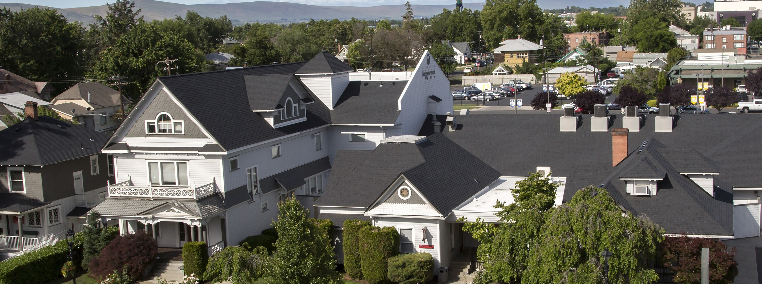
Yakima Neighborhood Health Services
Our mission is to provide accessible, affordable, quality health care, provide learning opportunities for students of health professions, end homelessness and improve quality of life in our communities.
Leveraging Policies in Washington State to Address Health & Housing Insecurity
Notes:
Yakima Neighborhood Health Services is a CHC with 10 sites in the Yakima Valley. First & foremost a Community Health Center, we developed a robust street outreach team in 2005 to reach PEH and bring them in for care. Two drivers emerged in our program development:
First focus group – “we need a place to be when we’re sick”
Providers said “If you want us to make a difference in health, help put a roof over their heads”

Slide 2
2022 Profile Health Care and Housing
ALL YNHS Patients and Clients
All Patients | 29,941
All Visits (medical, dental, mental health, outreach, case management, care coordination) | 145,363
Youth Served at “The Space” (LGBTQ Youth Resource Center) | 140 Youth 990 Visits
Women, Infants & Children Nutrition Program | 4,400 Clients / Month
Affordable Care Act Applications | 9,843 Visits 16,841 Assists
People Experiencing Homelessness
People Experiencing Homelessness | 3,770
All Visits to PEH (medical, dental, mental health, outreach, case management, care coordination) | 29,416
Permanent Supportive Housing | 109 households 191 people
Medical Recuperative Respite (Average 12 days each) ============================= Covid Isolation / Quarantine (Average 7 days each) | 150 People 1,853 nights ================= 122 People 970 nights
Basic Needs (rent, food, utility assistance, education, legal, childcare, employment, etc.) | 1,964 People 921 Households
Unaccompanied Homeless Youth | 85 Youth Served Age 13-24
MSAWs | 6,389 Patients 22,720 Visits
Notes:
Last year , YNHS saw over 29,000 people , and you can see here what we did.
Our special populations include MSAW, PEH, and Residents in Public Housing. Our outreach teams include a nurse, behavioral health specialist, case manager, outreach worker and serve whoever they find out in the streets and in the communities.
Over the years , learned to be successful we needed to bring thing in – closer to the patients, so we kept adding services when they weren’t easily accessible to our patients.
Biggest lift of course was supportive housing.

Slide 3
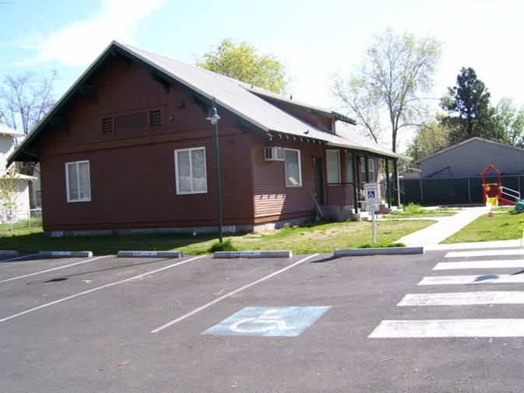
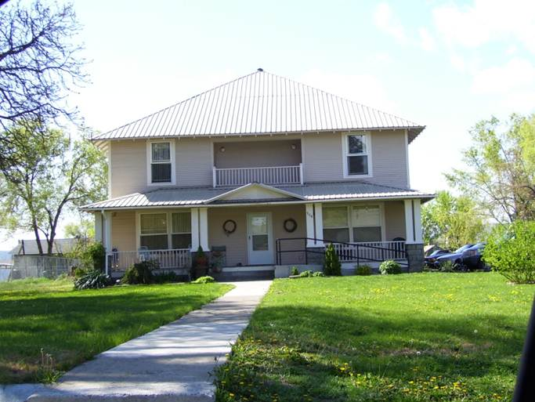
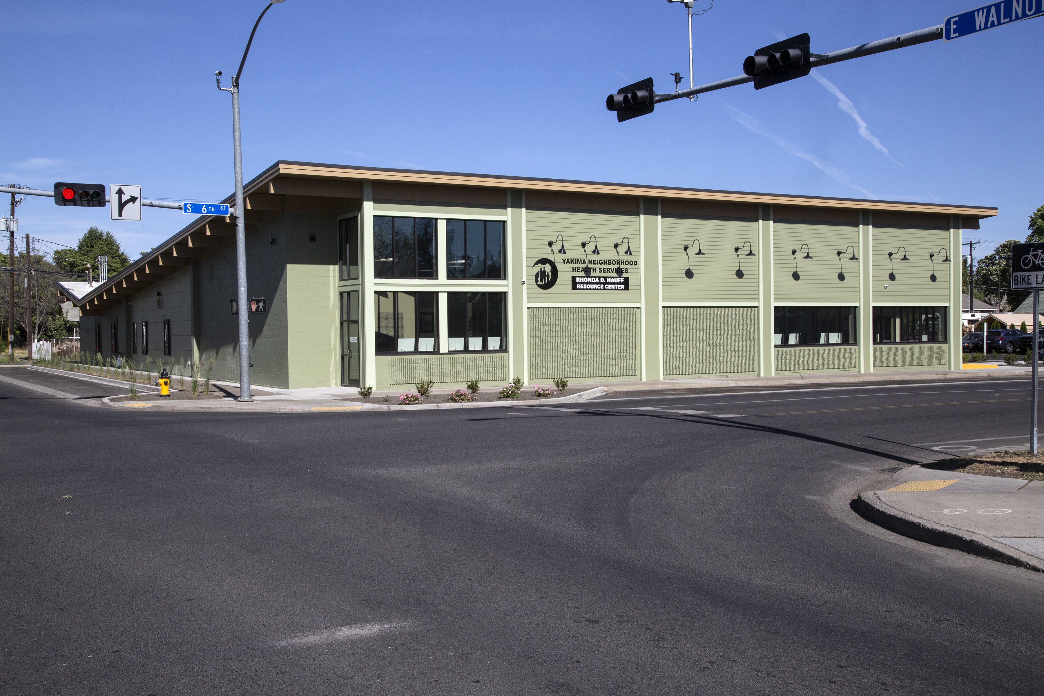
“It’s What’s On the Inside That Matters”
Notes:
YNHS owns or master leases 141 units of PSH
All shapes and sizes
Houses, duplexes, congregate houses –
What’s important to the participant – near schools, groceries, parks, and what

Slide 4
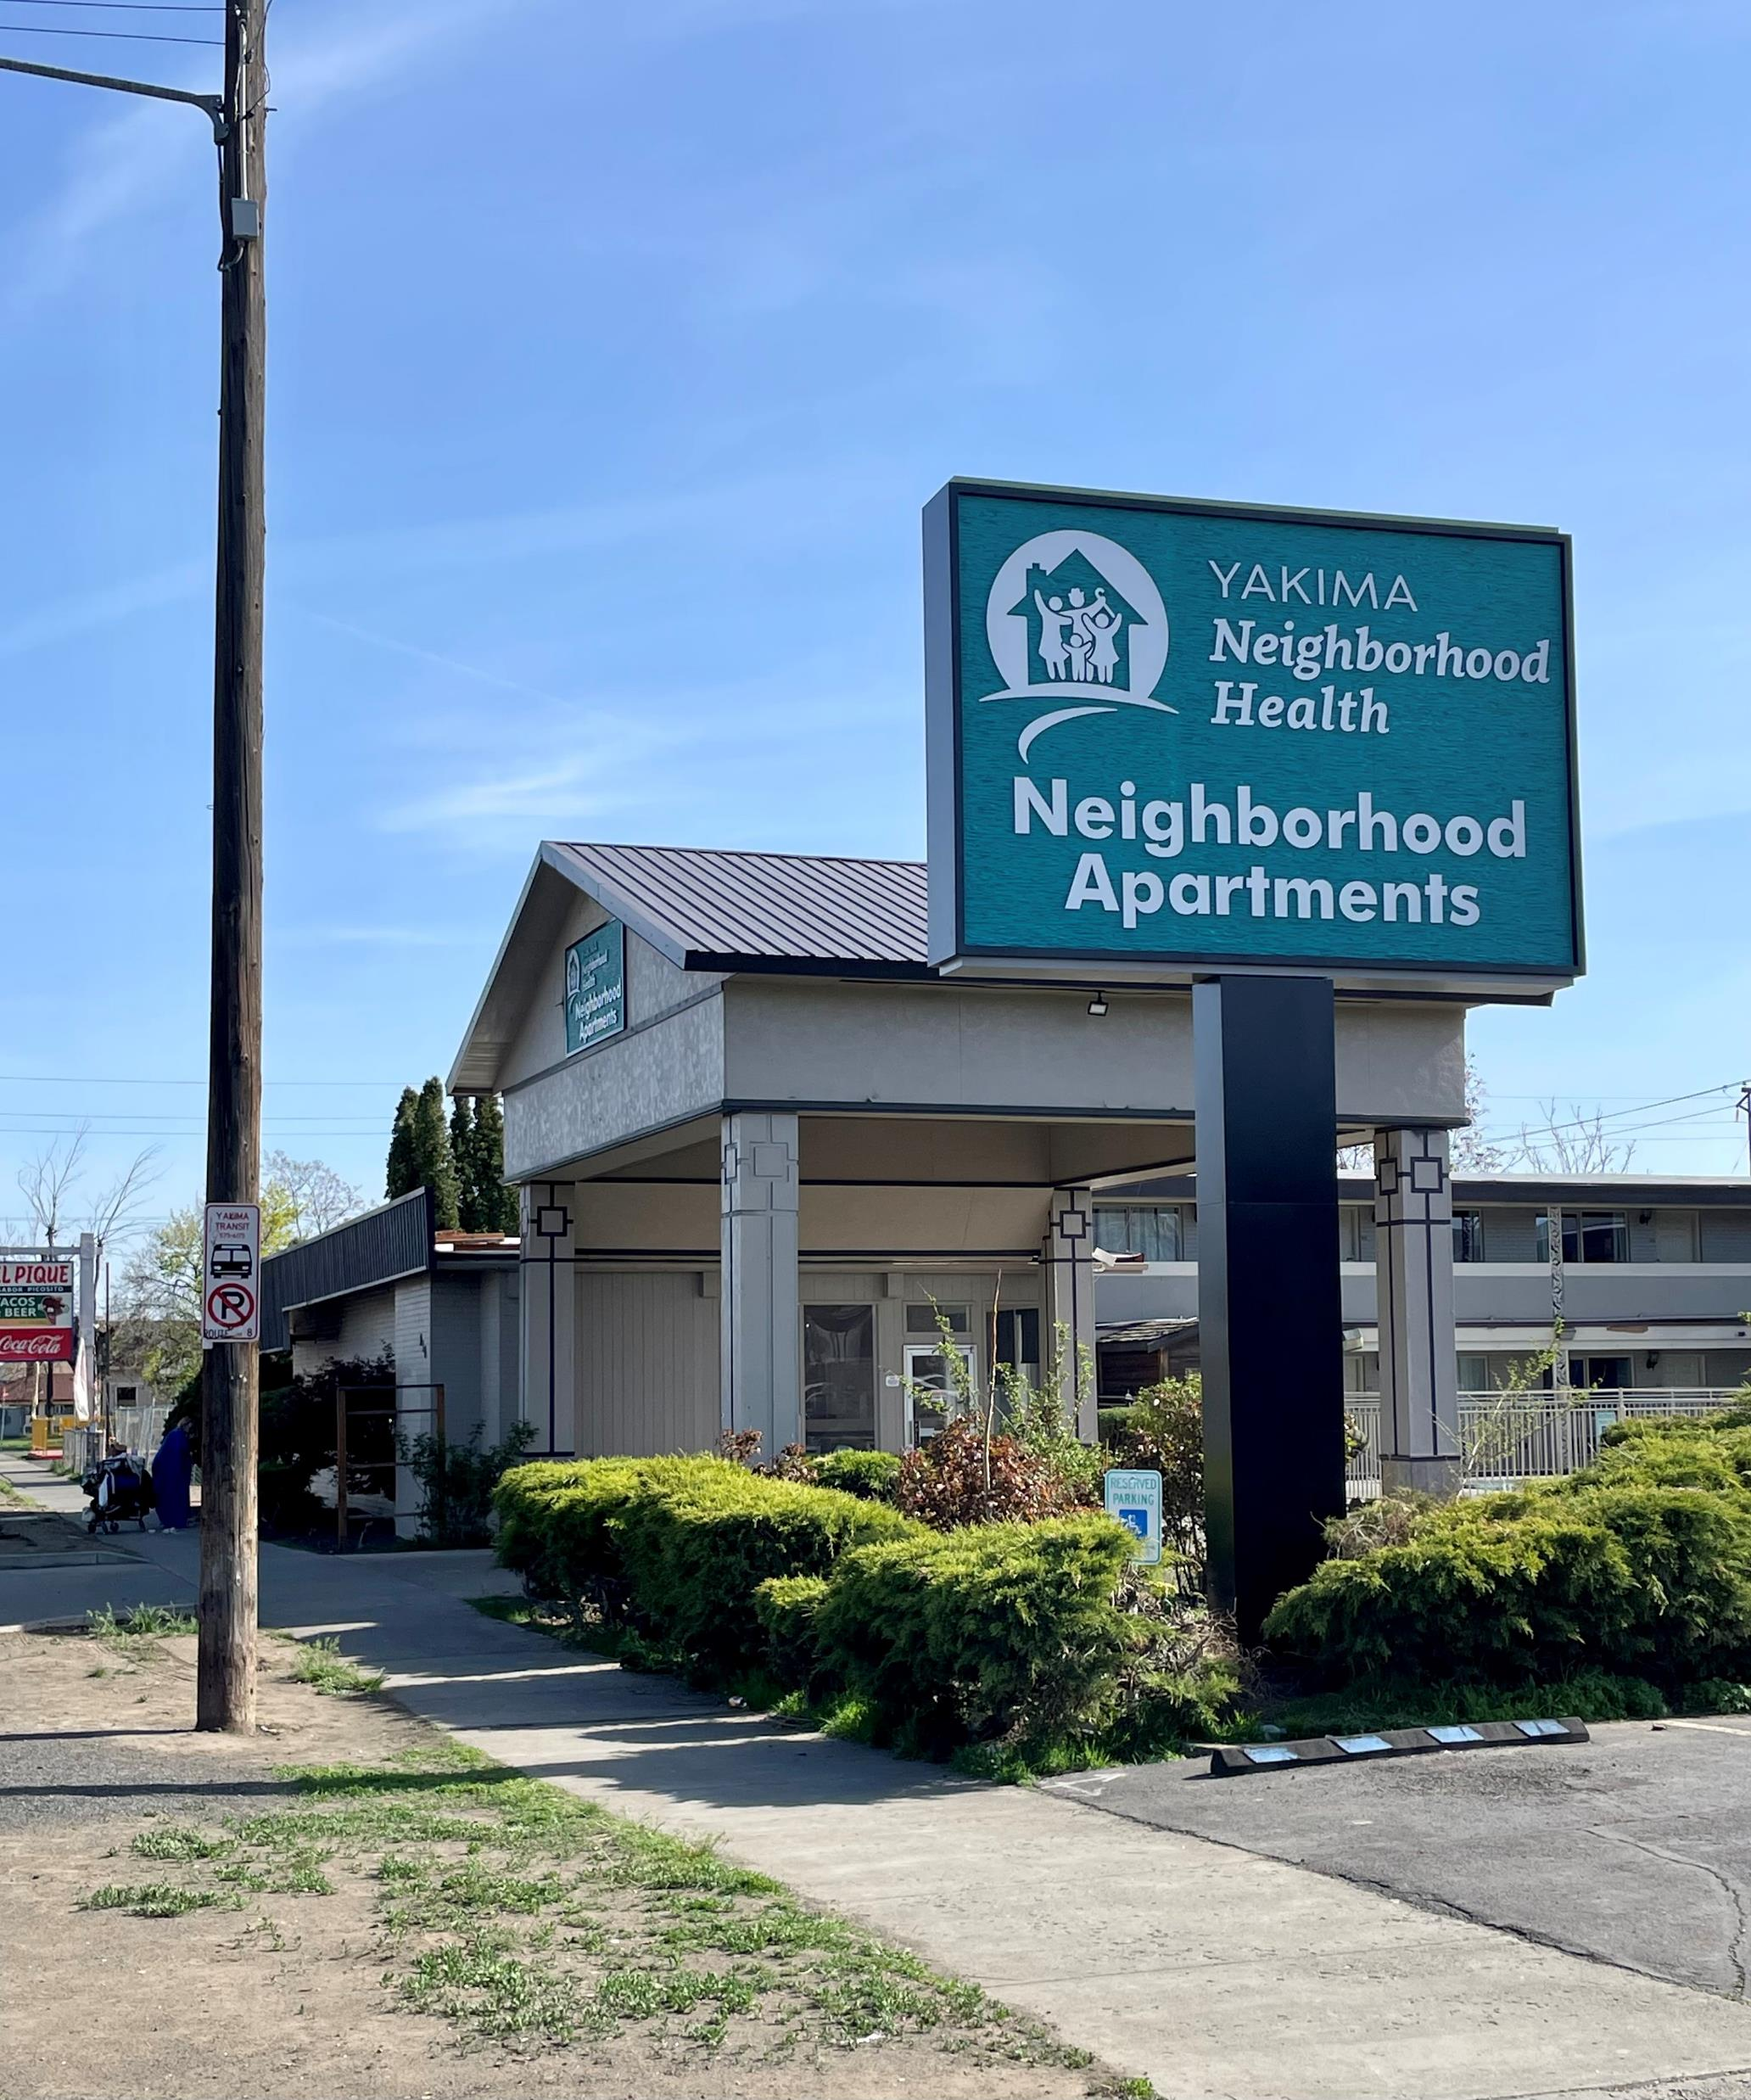

Slide 5
Housing IS Health Care
Avg 46 visits per year per participant
(6 medical visits per year avg)
Better diabetes control (76%)
(General CHC rate = 70%)
Better hypertension control (57%)
(General CHC rate = 64%)
Increase in flu vaccines (32%)
(general CHC rate = 21%)
Fewer behavioral health crises needing EMS response
Greater success in medication adherence
Improving rate of successful connection to primary care
Increasing rate of compliance with care plans
Improvement in chronic disease measures (e.g. A1c scores, BP measure)
Reduction in behavioral health crisis episodes
Medications are better managed
More likely to obtain and maintain employment or education
Reduction in communicable disease (e.g. Influenza, TB, STDs, Hep C)
Greater success for recovering SUD recovering patients in supportive housing
Notes:
Several years ago, when The Institute for Health Improvement adopted the Quadruple Aim, we identified 8 measures we believed we could improve by housing our chronically homeless. So this is what we measure. We compare our participants in supportive housing against our general health center population, and these are the outcomes we had for 2020.
We put a HMIS identifier in our Electronic Medical Record.
Our participants have much higher rates of medical and behavioral health visits than our general population and of our unhoused .
Housing and shelter alone are not enough without the support services that promote health.
Evidence based practices like Trauma Informed Care, Motivational Interviewing, and Harm Reduction make a difference in meeting people where they’re at, and they are the foundation of our supportive housing programs.

Slide 6
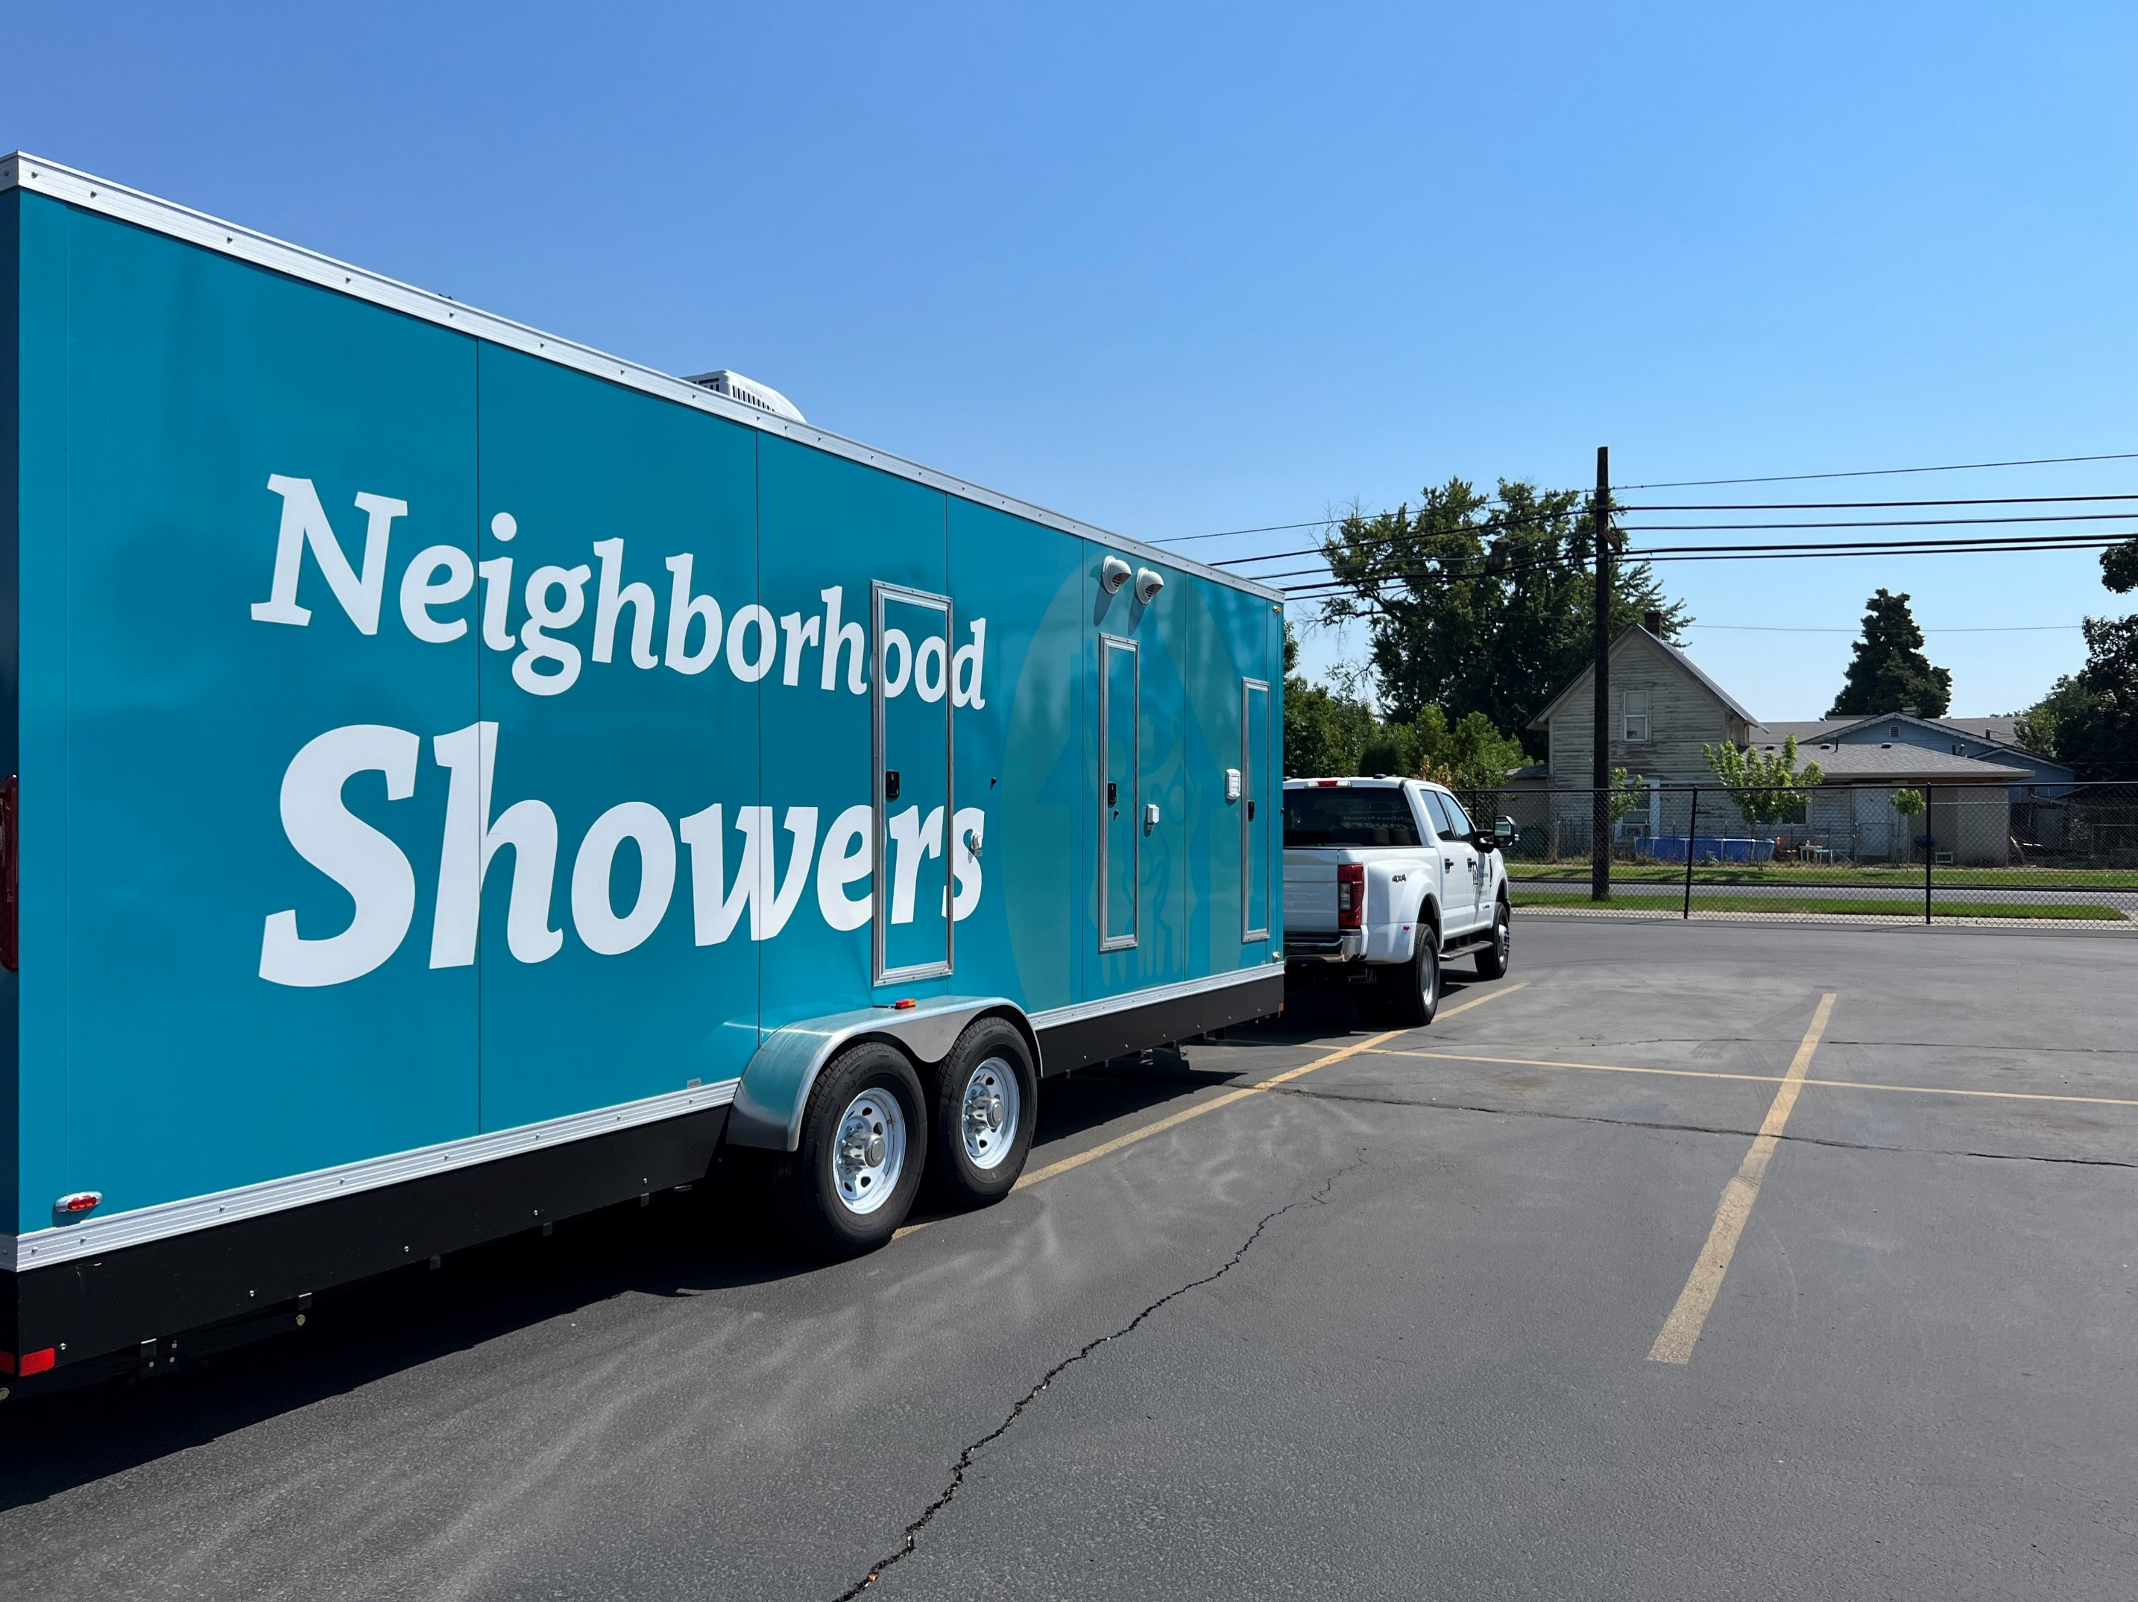
Housing & Health YNHS Internal Integration
Primary Care
*Medical
*Dental
*Behavioral Health
*Pharmacy
Continuum of Care / Coordinated Entry
HEN / ABD
HCH Street Outreach
Medical Respite Care
Health Home
Supportive Housing / Supported Employment
Medication for Opioid Use Disorders (MOUD)
Notes:
Over the years, we have developed this continuum of services. In order to support chronically homeless stay stably housed, it takes all of these things.
We have built this honeycomb to meet the needs of our chronically homeless.
We are the largest access point for Coordinated Entry, and again, as a health care provider, have introduced chronic illness as a major factor into our Coordinated Entry assessment process. Our work on the streets and through our medical respite program are the heart of outreach and engagement where we often make our first touches and trust opportunities.
With our state’s Foundational Community supports program through the Medicaid Waiver, we can provide more intensive Supportive Housing & Supported Employment services – with some clients, daily contacts, to support self-sufficiency and health improvement.
On of our greatest successes in recent years has been our rapid response when a patient expresses interest in Medications for Opioid Use Disorder. Through our SAMHSA project, nearly 200 patients have entered our program in the last 4 years, usually the same day they say they’re ready. Many of the unhoused spend their first 2 weeks in our medical respite program to support that initial induction period, and almost half of our SAMHSA clients have been successfully housed – not necessarily before starting treatment. What we’ve learned over the years, is a client may say “No” today, but tomorrow’s another day…
Happy to answer any questions you might have.

Slide 7
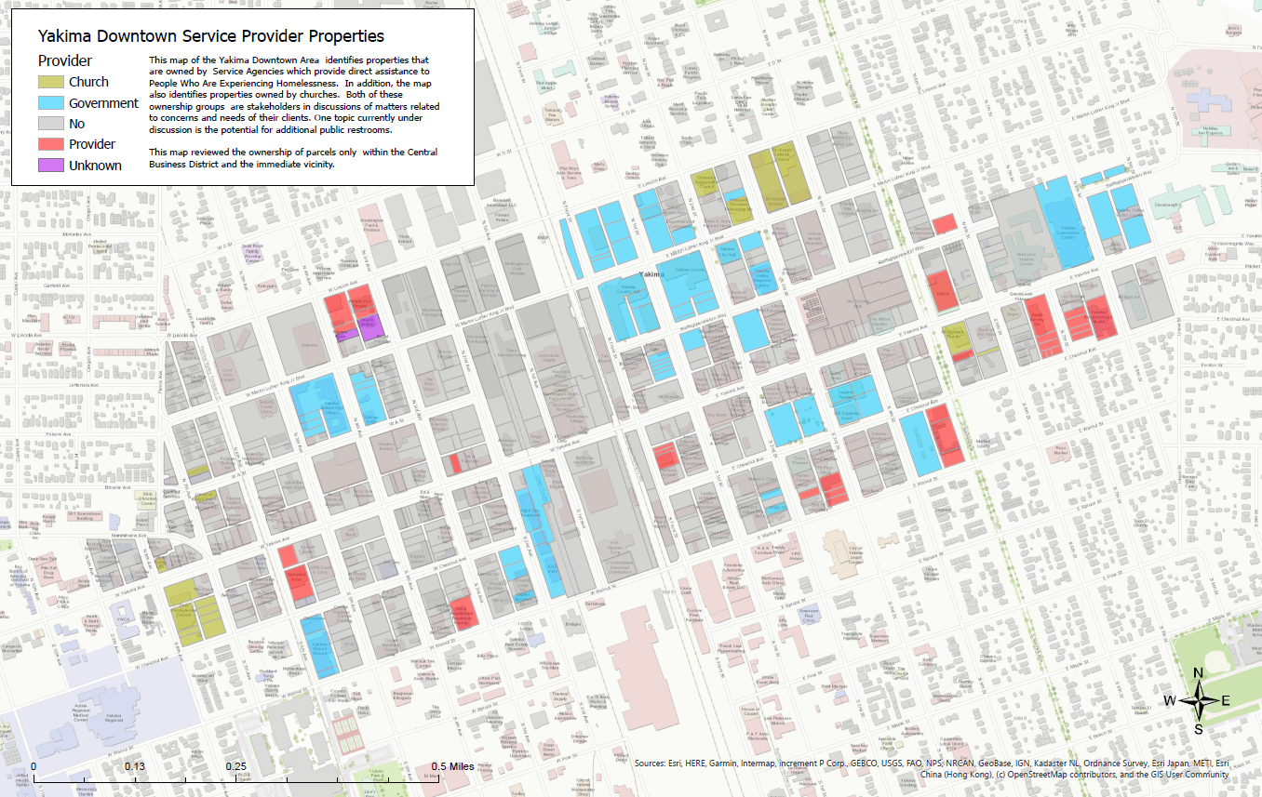

Slide 8
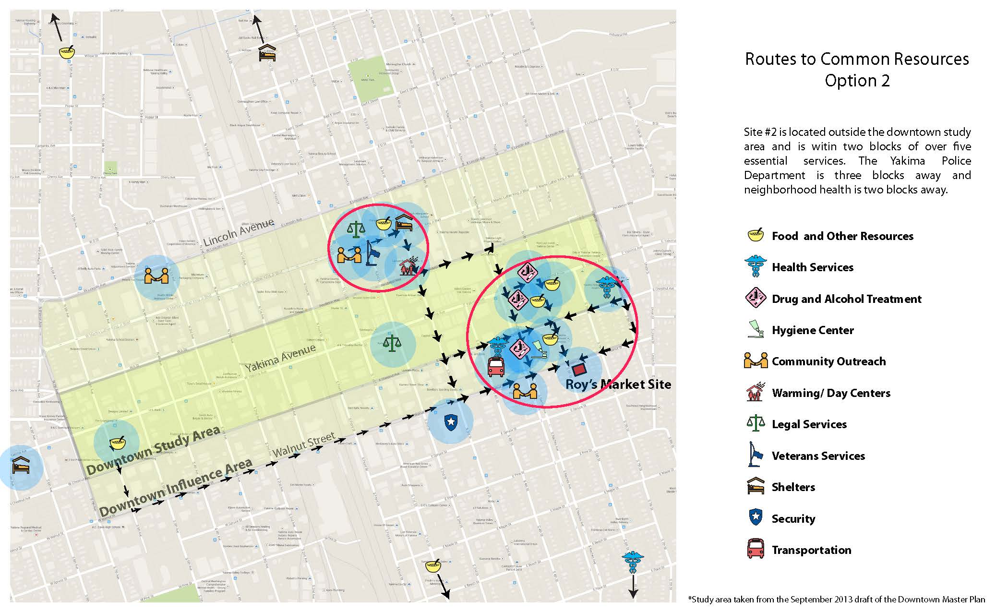
Roy’s Market Site

Slide 9
What Goes Around…
Neighbors were complaining
Problem solvers saw a solution
Neighbors reported a menace
City saw the problem
City solved the problem
Neighbors were complaining

Slide 10
Possible Leverage – Low Police Motivation
Notes:
Customers with eligible medical conditions to use employee restrooms in retail establishments, must be verified by a health care provider. Includes any permanent or temporary medical condition requiring immediate access to a restroom (Crohn’s disease, IBS, etc.)

Slide 11
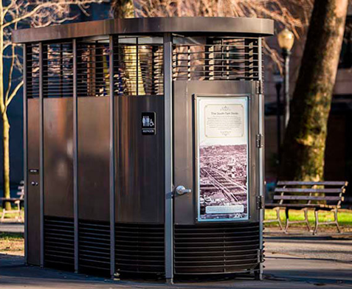
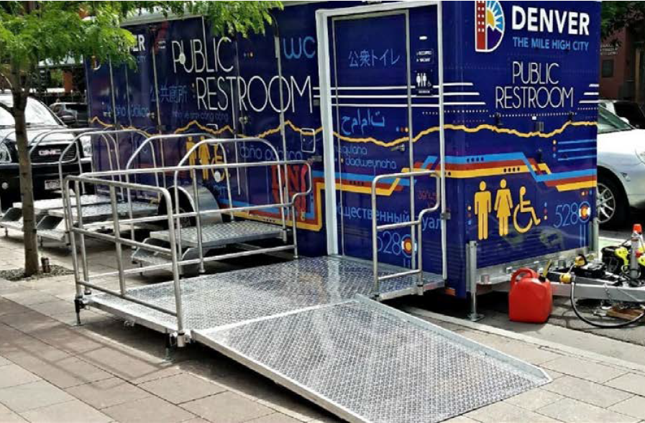
Deliberations
Studies, studies, studies
Permanent or Mobile
Needs assessment !
Unsheltered people don’t wash very often
Find it hard to access facilities to wash hands
Find it hard to access facilities to access toilets
Can’t find public bathrooms

Slide 12
Revised Code of Washington

Slide 13
Neighborhood Showers
Notes:
Finally I wanted to tell you about Neighborhood Showers, our hygiene trailer we deployed last fall.
Partnered with St. Michael’s and are talking with other churches and non-profits in the valley
We’ve seen 162 unduplicated people – ages 14-65, most have been back
Almost all living on the streets or doubling up
Mostly single individuals
Everyone gets a clean set of clothing, a snack and some hot coffee.
The showers are the carrot to bring them .
The staff of nursing, bh, CHWs meet with them before and after their showers and connect them to primary care and other services like those we talked about earlier.

Slide 14
Addressing Human Needs
Notes:
Yakima County doesn’t have any public hygiene facilites. We have been trying to get this done for more than a decade.
This is another one of those services that we decided we needed to do for our patients – and the valley. As part of the American Recovery Program, we ordered ”Neighborhood Showers” , a 28 foot van that’s ADA accessible for people living outdoors to take showers, go to the bathroom once a week, and get health care, education, and other basic needs.
We stopped at 28 feet so it could be drivin without a certified drivers license.
A hot shower will be the carrot to engaging in other health care services – medical and behavioral health

Slide 15
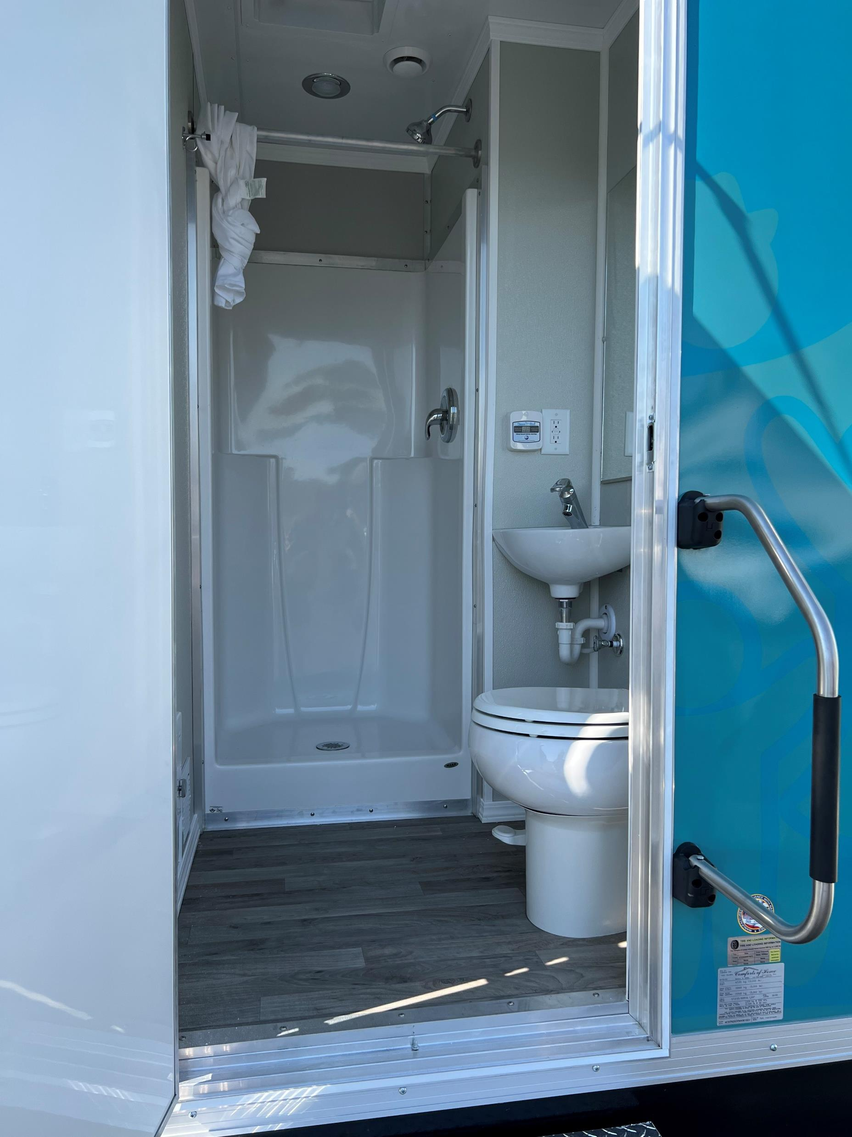
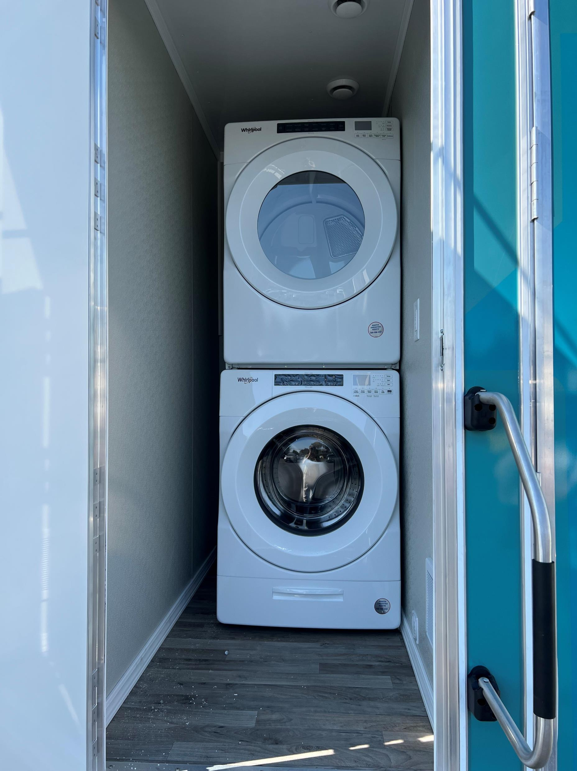
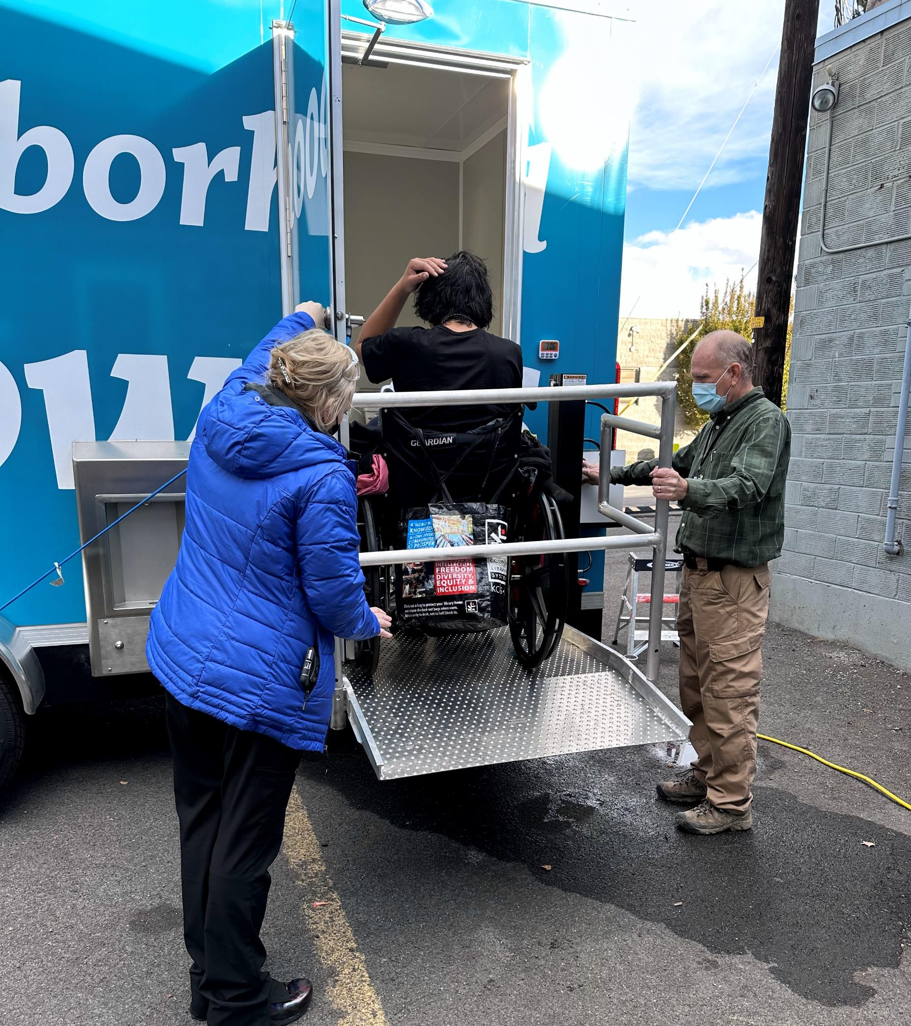

Slide 16
The Process
Welcome !
Registration / PHQ-2
Wandering RN
Timed Shower
Decompress with CHWs
PRAPARE
Hygiene Kit, Snack, Fresh Clothes
Available on Demand
SUD Provider
LMHC
Housing Case Managers
Emergency Services Staff

Slide 17
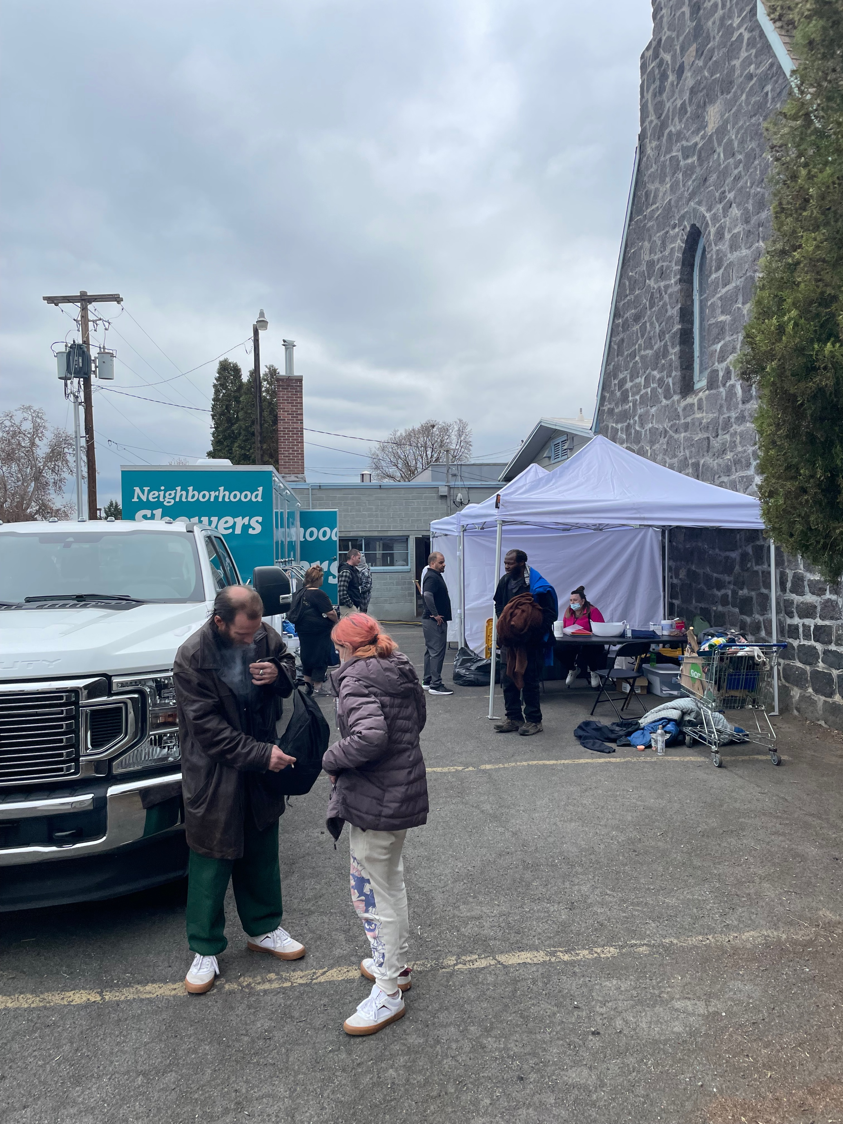
”It’s the Water… And a Lot More ”

Slide 18
Primary Care is a to SUD Treatment
Barrier
Busters
Notes:
The 2022 President’s Omnibus Act passed the “Mainstreaming Addiction Act” which removed the administrative requirement for primary care providers to get a waiver from the DEA to prescribe Buprenorphine
PEH are our smalled line of business at YNHS and getting them to care for their chronic needs can be a challenge being able to go to your provider for your diabetes or hypertension and your MH and SUD treatment at the same time takes down huge barrriers..
It’s so important to be at the Right Place at the Right Time – Last week we had
57 year old Hispanic man came in an injured finger; as part of her intake, the MA did a depression screen (PHQ-9); the patient scored a 27 (highest score possible)
The MA Called our BH director who came into the room ; patient told him he’d lost his job, had been prescribed fentanyl some months before for pain and got addicted, took to the streets to get more;
Was ashamed of himself, suicidal; after our provider suturing his finger, the BH Director went back in the room, with the practitioner started the patient on our MOUD program THAT DAY.
The man left in tears, has followed up daily with the care coordinator, committed to taking back his life.
This man has been in trouble with the law, (yet) probably would not have found his way to a treatment program.
The more we can meet people where they’re at, the better chance we have at getting ahead of this from both an individual and community level.
Becky our nurse

Slide 19
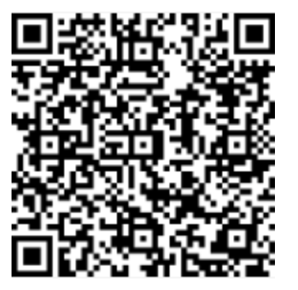
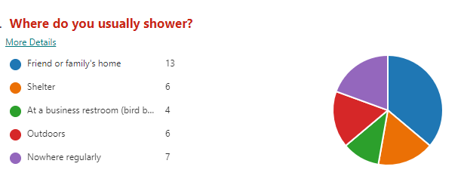
Survey Says…

Slide 20
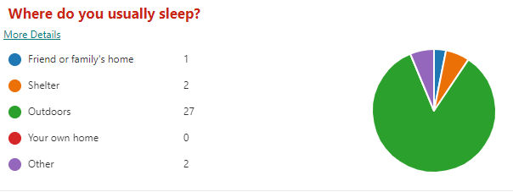
Survey Says…

Slide 21
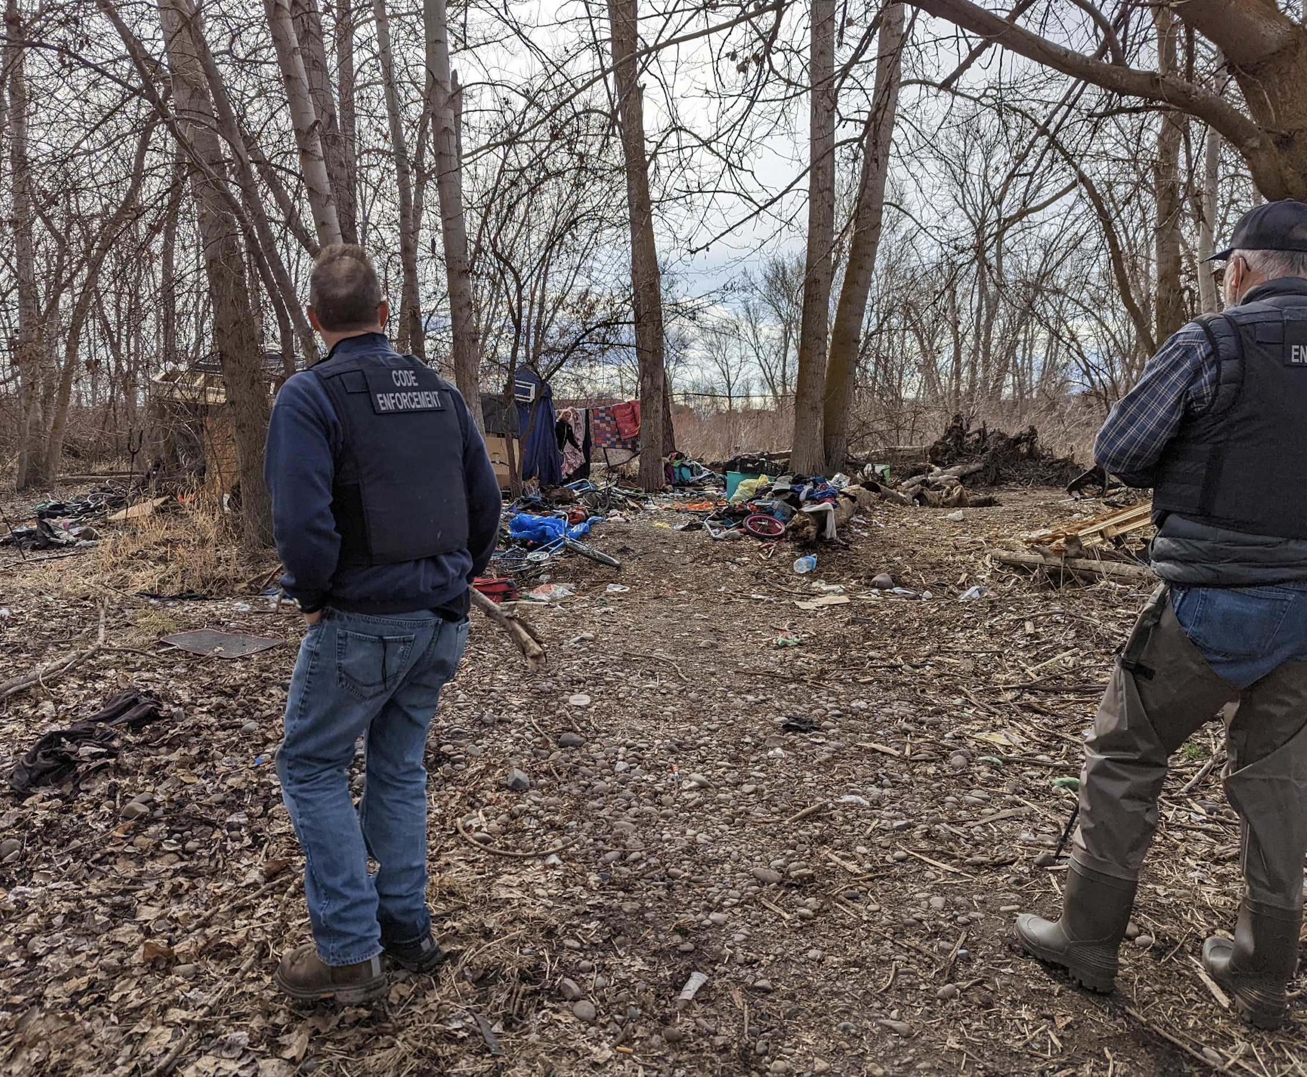
Location, Location, Location
Notes:
What part of Yakima do you Live in ? Yakima probably means Yakima Ave or

Slide 22
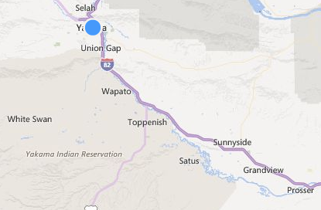
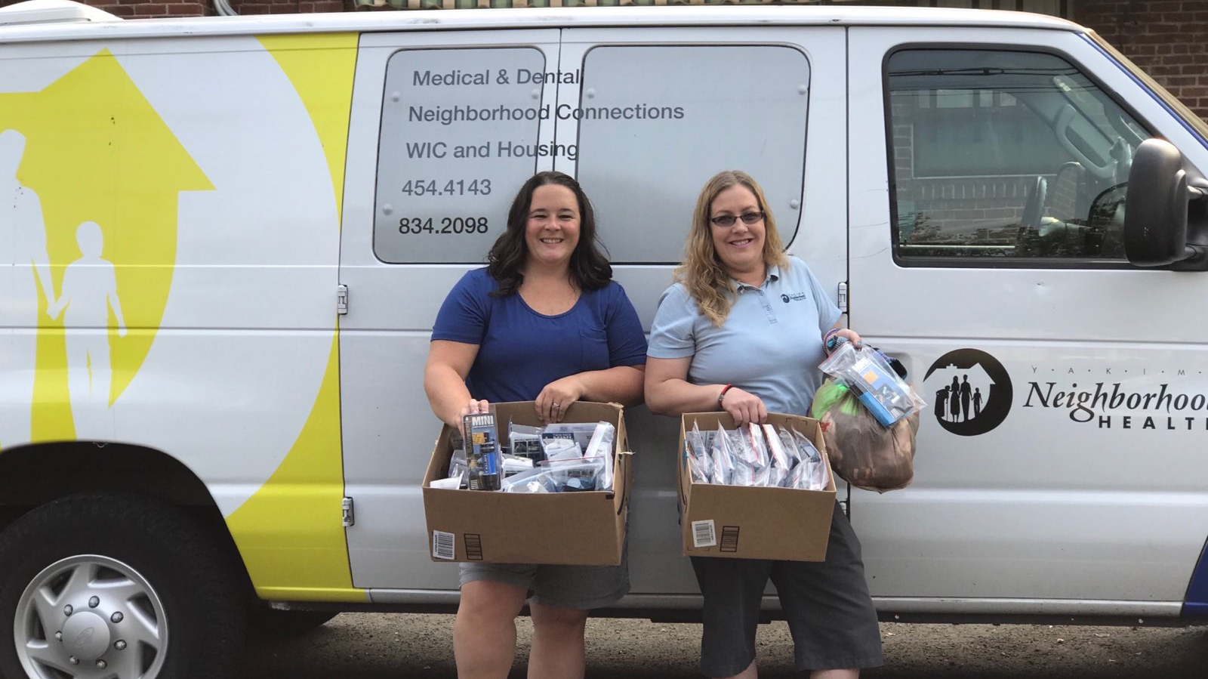
Survey Says…

Slide 23
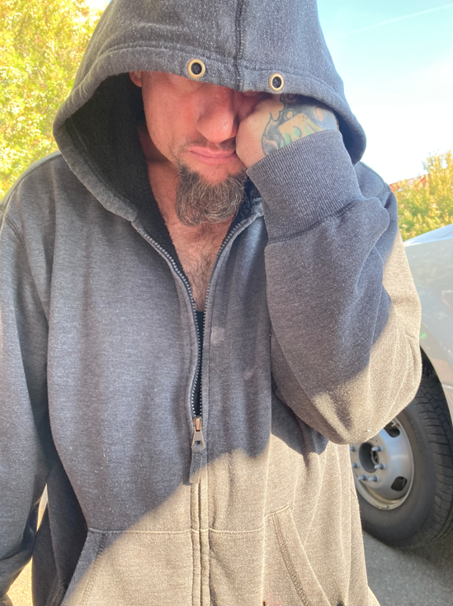
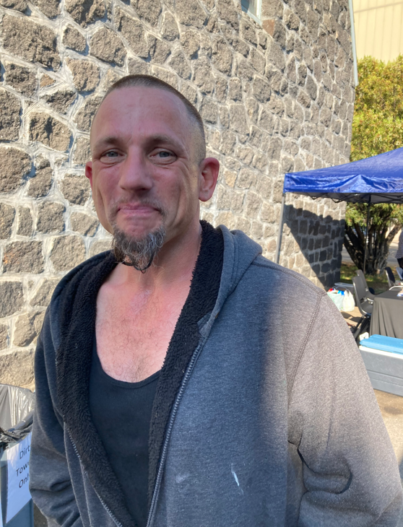
Survey Says…
“ 1 STAR”
“ 5 STAR”

Slide 24
What Other Survey Questions Would You Suggest ? What Are We Missing ?

Slide 25
A Story -
40 year old male
No previous services
After decompression visits –
Food supply from pantry
Cell phone / broadband access
Met with SUDPT
Entry to MOUD Program
Working on housing

Slide 26
A Story -
29 Year Old BIPOC
Previously seen for suicidal tendencies
Clearly battered / beaten when arrived at showers
Met with RN during decompression; disclosed they’d been assaulted the night before – looking for a clean start
SUD called in. Warm handoff to treatment -

Slide 27
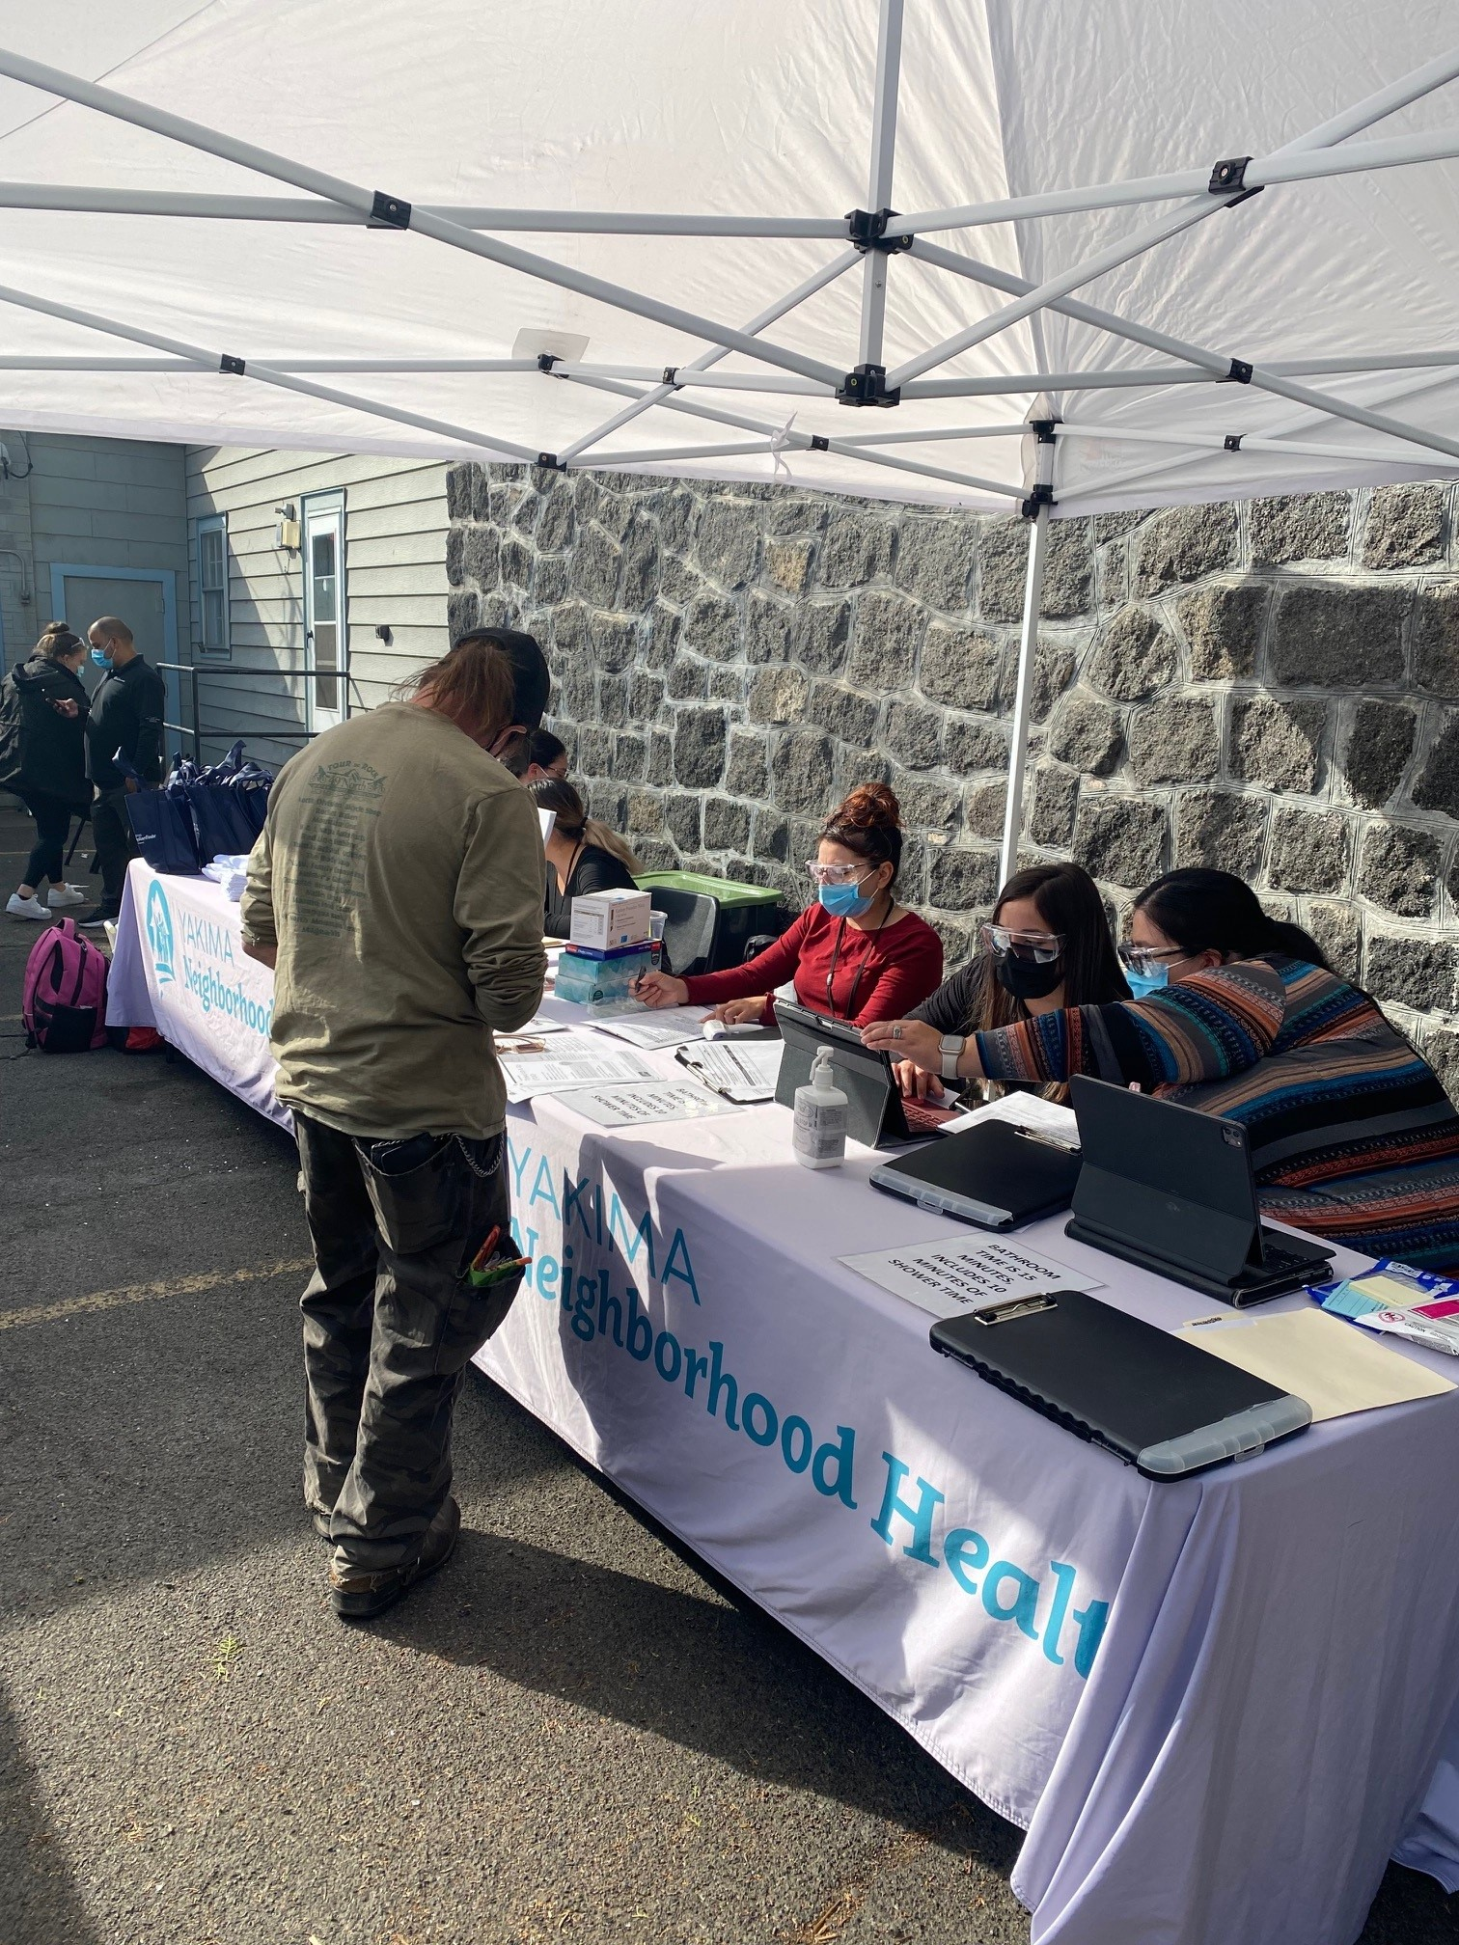
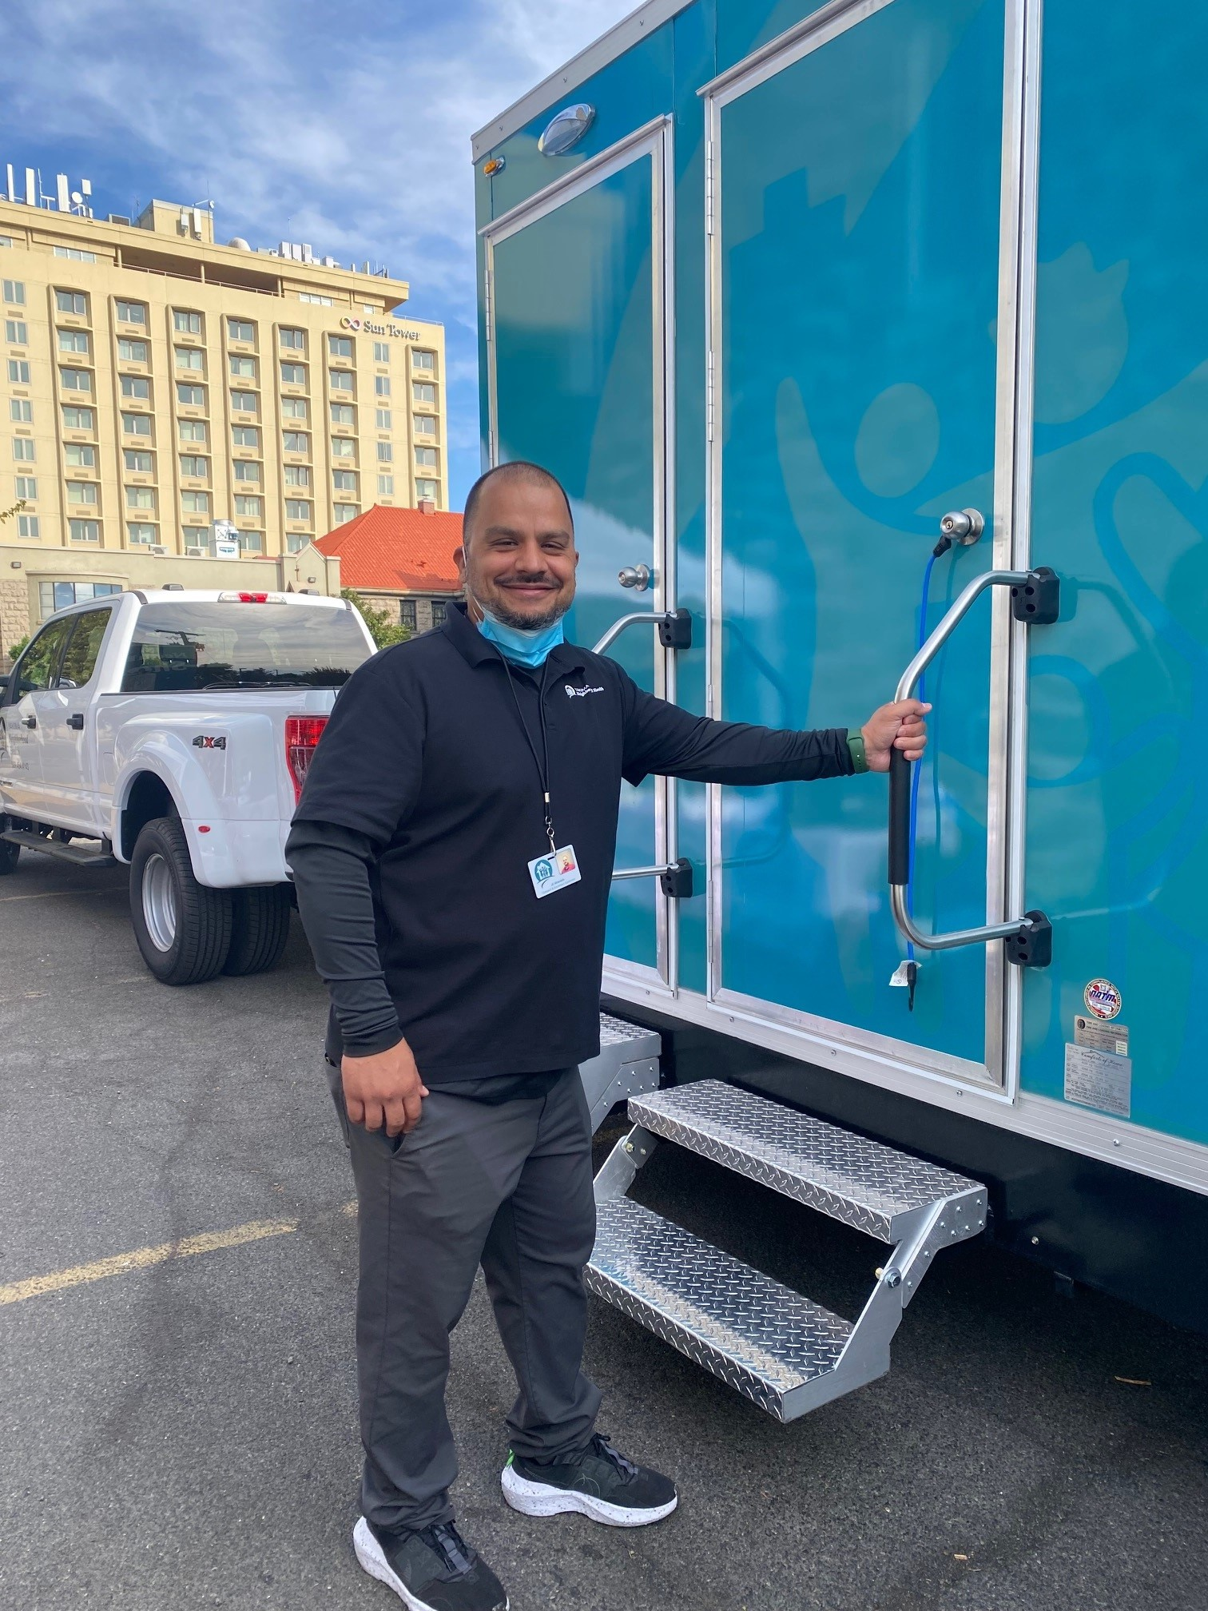
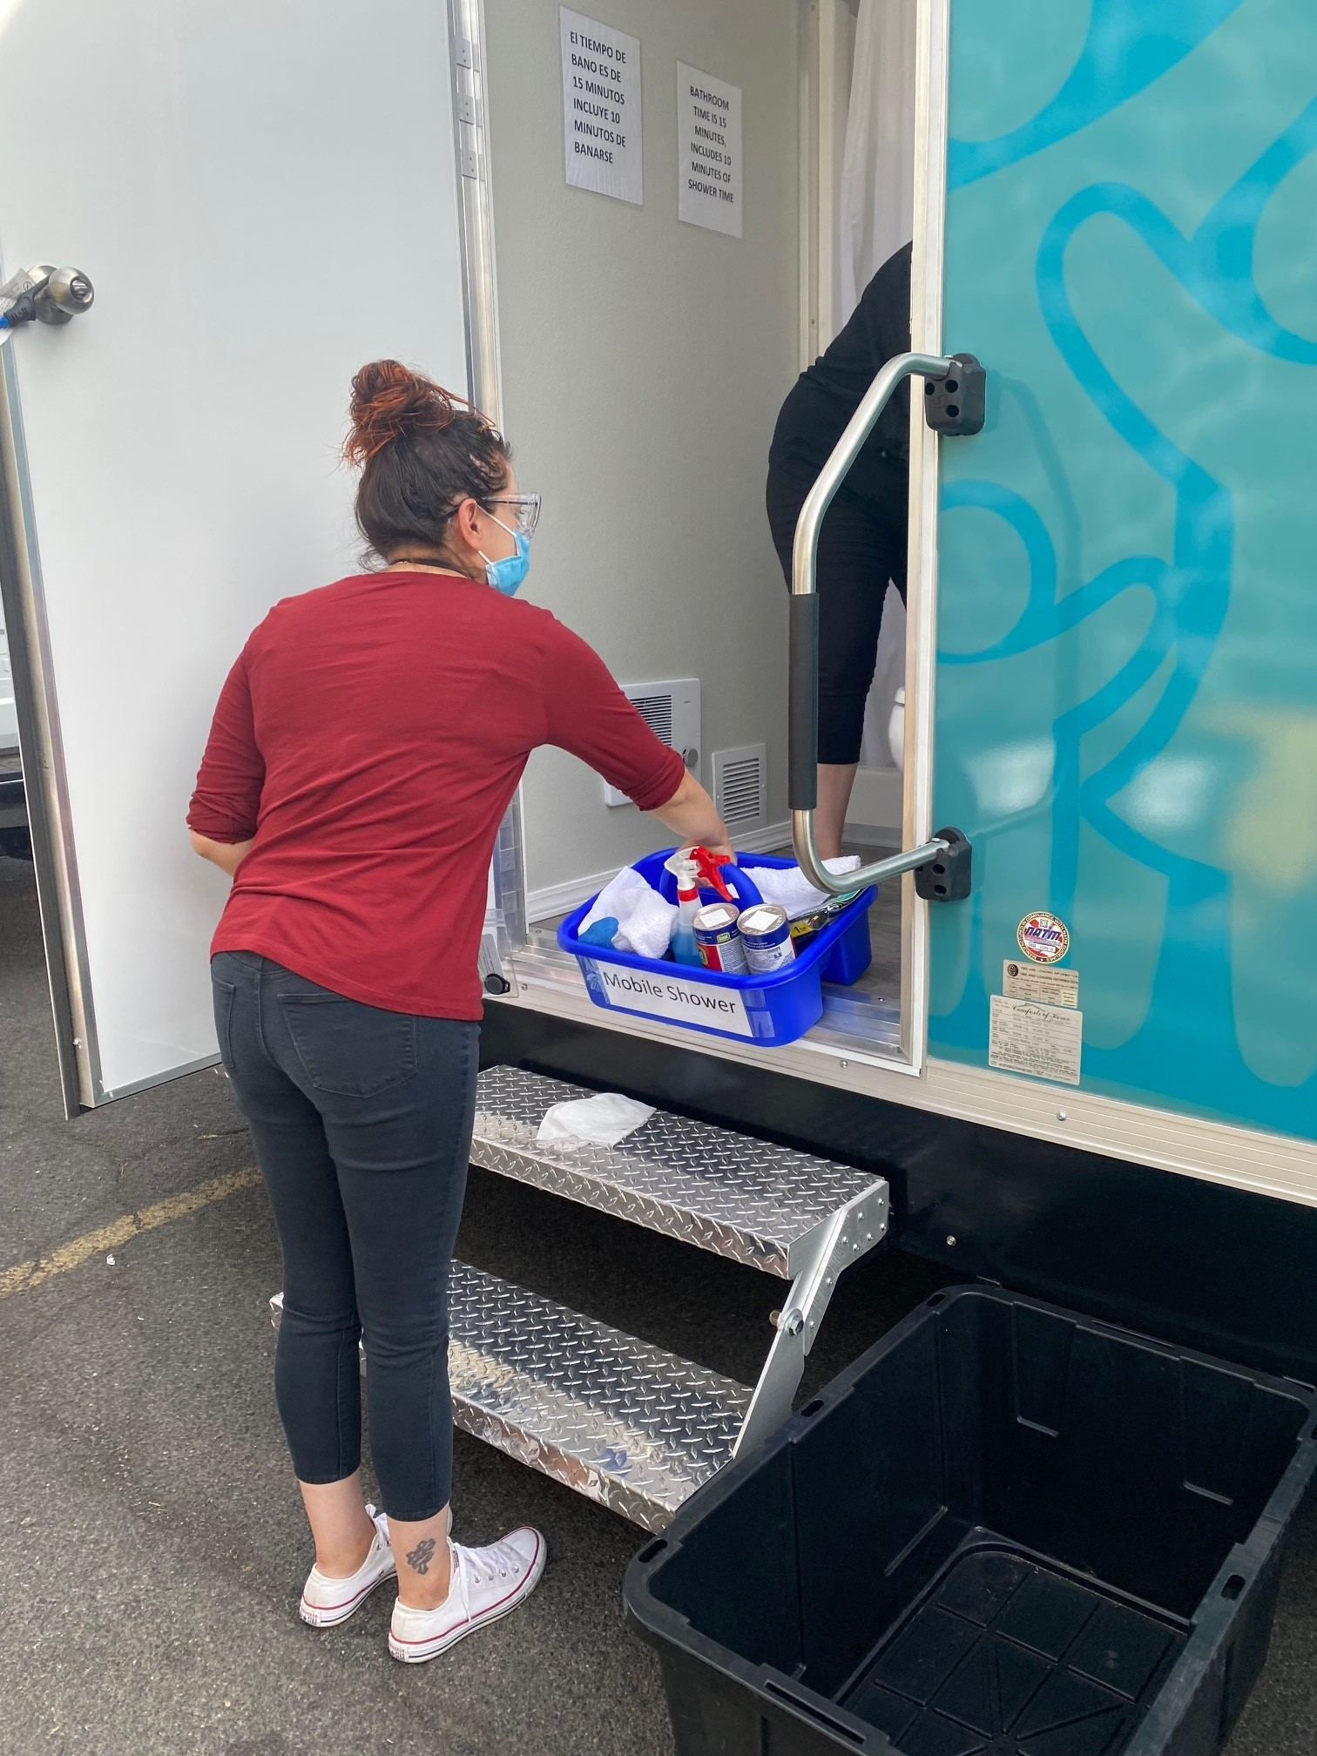
Notes:
Cost –
NRT Unit cost with all bells and whistles $100k
Electric lift and hydraulics
Gas

