Slide 1
Emerging Health Care Concerns Among People Experiencing Homelessness Who Use Xylazine
Jovan Cosby
Monique Taylor
Máire St. Ledger
Project HOME, Philadelphia, PA
With adapted slides from Kara Cohen, Kate Gleason Bachman, Hillary Miller, and Lydia Williams

Slide 2
Financial disclosures
We have no disclosures

Slide 3
Objectives
After participating in this workshop, attendees will be able to name at least (3) emerging health concerns that have been noted to increase with the influx of xylazine into the opioid supply.
Attendees will be able to describe how people with lived experience are essential to creating response plans to health concerns brought on by novel substances.
Attendees will be able to identify possible resources with whom they can partner to address the emerging health concerns related to xylazine use.

Slide 4
Quick Poll
How many folks are familiar with xylazine?
How many have seen it in your community?

Slide 5
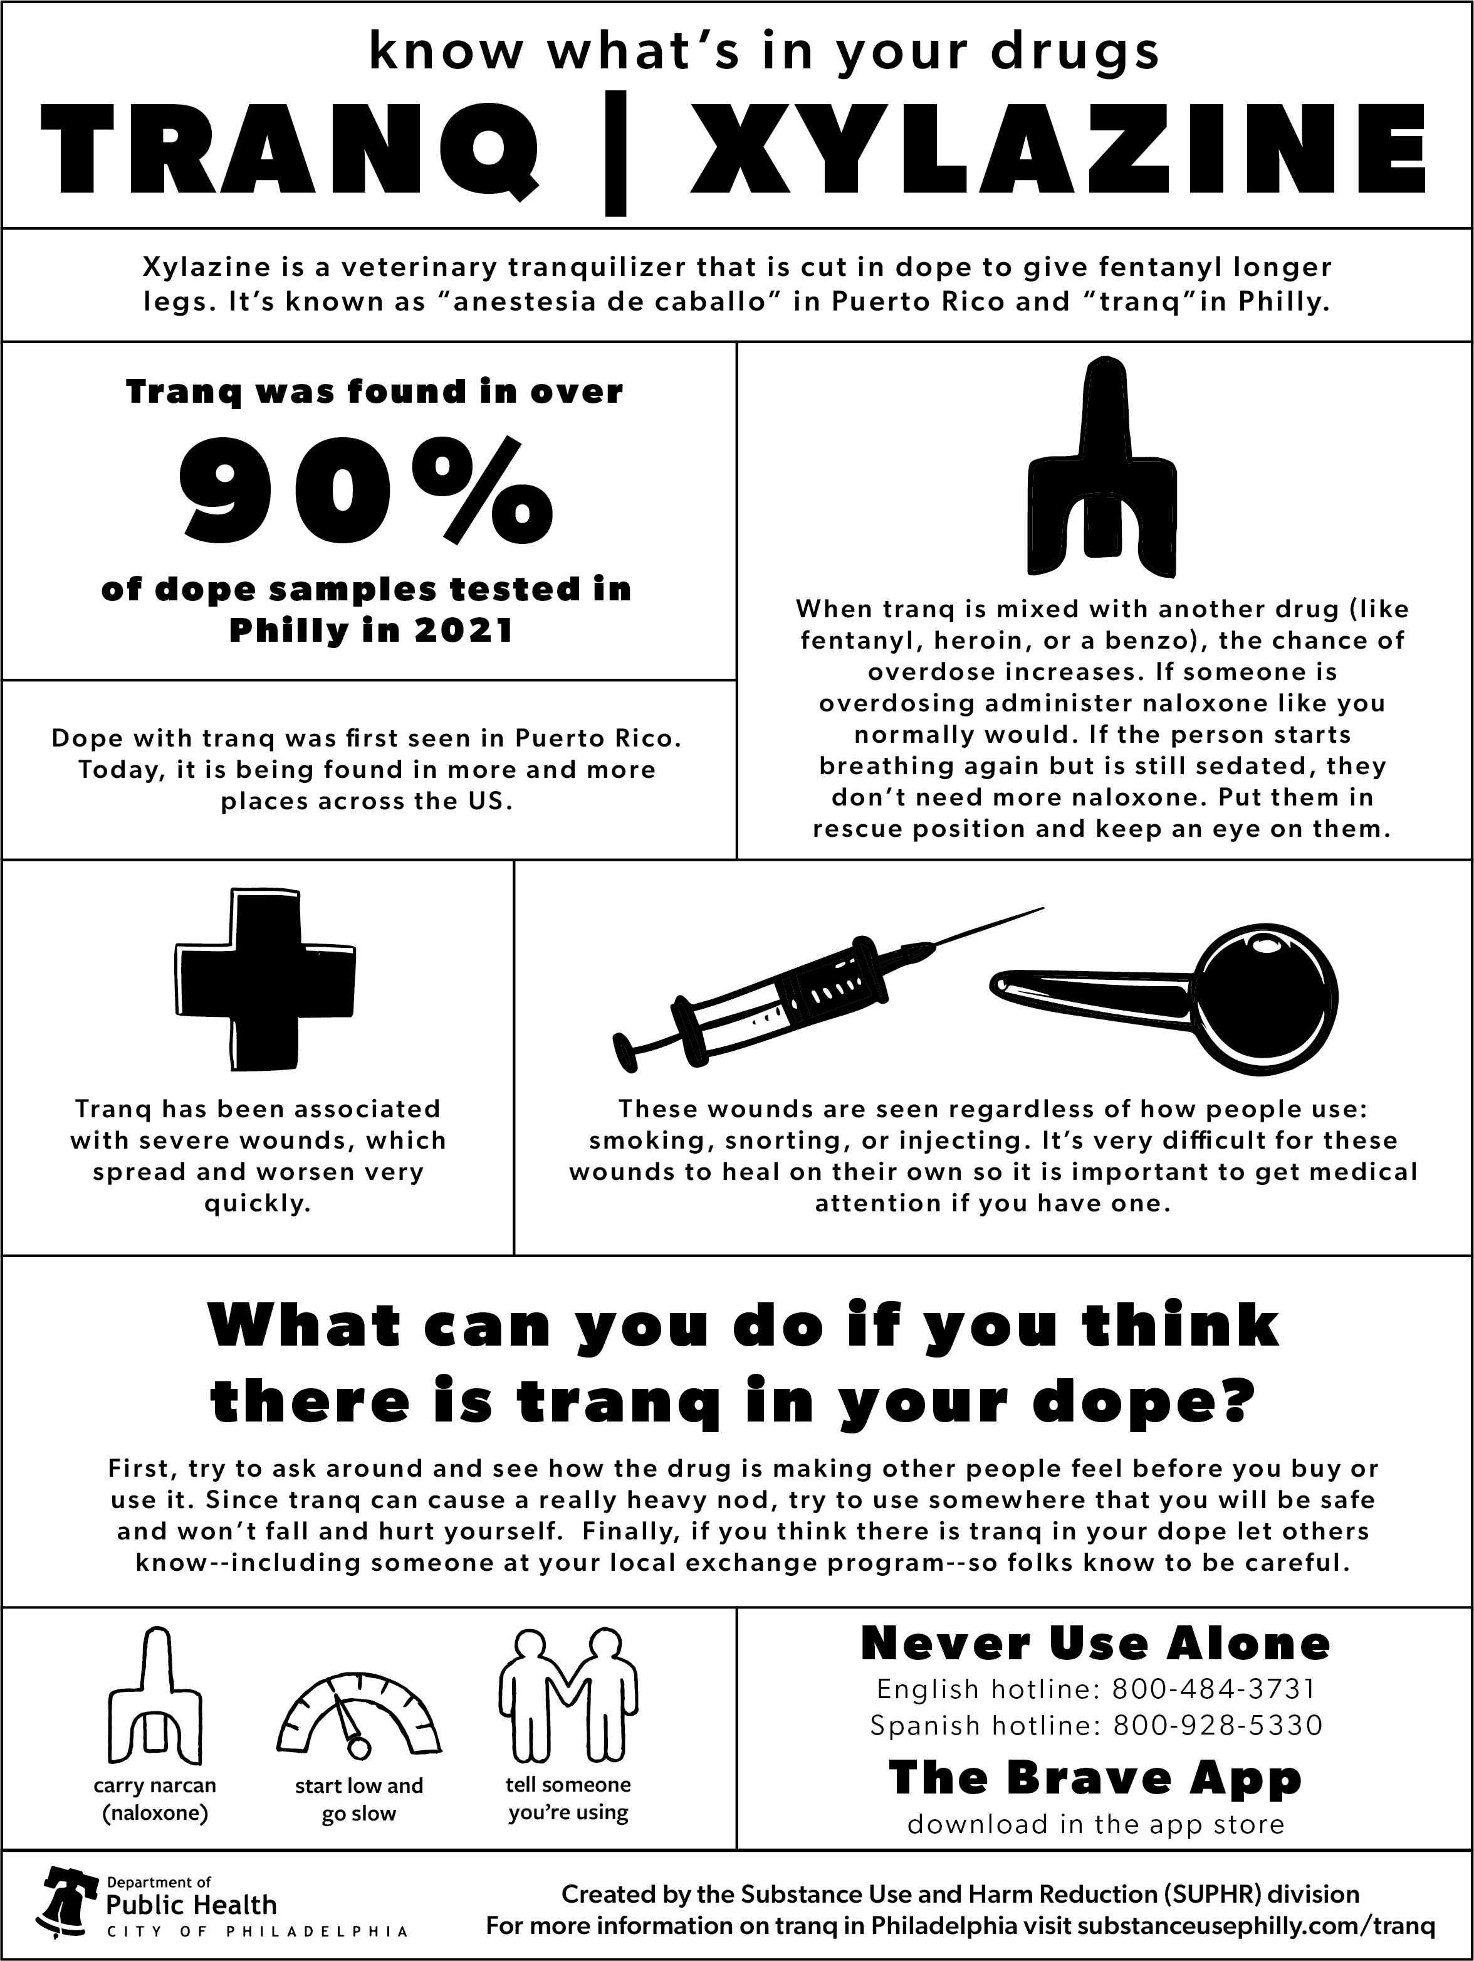
What is Xylazine?
Powerful sedative and CNS (central nervous system) depressant that can cause drowsiness & amnesia, as well as decreased respiration, heart rate, and blood pressure. Profound mental status depression may impact a person's airway.
Originally approved by the FDA in 1972 for veterinary use
NOT approved for human use
Increased risk of overdose when used in combination with opioids or benzodiazepines.
Xylazine overdose DOES NOT respond to Narcan
Not detected on routine toxicology screens, although xylazine test strips are now available.
https://www.substanceusephilly.com/tranq

Slide 6
Xylazine statistics
First illicit use of xylazine was reported in Puerto Rico in 2001.
Street names: "anestesia de caballo," "tranq"
Xylazine was intermittently found in drug samples from 2006-2018 in the U.S., with Philadelphia and Connecticut becoming the epicenter of its use.
In 2021, > 90% of opioid drug samples tested in Philadelphia contained xylazine.
Nationwide, 23% of the fentanyl powder seized by the DEA in 2022 contained xylazine.
As of March 2023, fentanyl/xylazine has been found in drug seizures in 48 out of 50 U.S. states

Slide 7
Xylazine in Philadelphia
First appeared in drug supply prior to 2010, rapidly increased starting in 2016/17
Xylazine present in 91% of fentanyl/heroin samples in 2021.
2010-2015: present in 2% of unintentional OD deaths
2019: increased to 31% of all unintentional OD deaths.
This is a 1,238% increase!!
Philadelphia Department of Public Health, 2021

Slide 8
Estimated Xylazine-Involved Drug-Poisoning Deaths in the United States, 2018–2021.
Data are from the Centers for Disease Control and Prevention WONDER data set and include drug-poisoning cases with codes T42.7 or T46.5 in the International Classification of Diseases, 10th revision.

Slide 9
Symptoms of xylazine withdrawal
Tachycardia/hypertension
Irritability
Anxiety/panic
Restlessness

Slide 10
Does Xylazine "give dope legs?"
Depends who you ask...
Previous reports were that people who used tranq found that "it gave the dope legs," meaning they could go longer without using.
Anecdotally, our team is seeing people withdraw faster and harder than with fentanyl/opioids alone (e.g., can't go more than 2-3 hours without withdrawal, vs. 4-8 hours before)
Implications for addressing health issues?

Slide 11
Health issues caused/exacerbated by xylazine
Pregnancy/prenatal care issues
Wounds/SSTI (skin and soft tissue infections)
MOUD treatment

Slide 12
Maternal Mortality in Philadelphia: Philadelphia Maternal Mortality Review Committee Report-2021

Slide 13
Xylazine and Pregnancy/prenatal care
Anecdotally, our team has noticed an increase in the number of unhoused clients who use dope/tranq and are also pregnant
Challenges engaging in care:
Delayed care
Shame/embarrassment
Fear of legal ramifications
Inability to tolerate long waits in a clinic due to short half-life of fentanyl
Effects on the developing fetus & withdrawal in the neonate
Neonatal abstinence syndrome

Slide 14
Xylazine and Pregnancy
Increase in fentanyl/xylazine decrease in ability to access prenatal care
Our patients have reported that it is harder to leave the areas where they buy and use drugs due to sudden and severe withdrawal symptoms
Increase in violence across all of Philadelphia and especially Kensington area
Specifically, an increase in the reports of IPV (to our staff) within the past year
>10 reported cases of street deliveries in the past 12 months
Ex) Delivery at the corner of Kensington and Allegheny intersection
Many additional “close calls” to street deliveries
In several of those cases, the individuals who delivered were back in their usual areas within a few hours, and received no postpartum care

Slide 15
Lessons learned- Pregnancy Care
Earlier identification of pregnant individuals (collaboration with other outreach teams/organizations)- very important for options counseling.
Connecting patients with trauma-informed healthcare professionals (offering training for how to better engage with pregnant folks who use substances)
In Philadelphia, Neonatal Abstinence Syndrome is reportable to the Dept of Public Health but there are no legal ramifications (this may vary from state to state)
Low barrier services whenever possible (walk-ins are ideal)
Incentivization for well visits and postpartum f/u (gift cards, etc.)
Peer support!!
Birth control access (if desired)

Slide 16
Xylazine and wounds
Xylazine can cause severe, necrotic skin ulcerations on any part of the body, regardless of the method or mode of use.
Wounds may occur far from site of injection
Pathophysiology is not entirely understood, but it is probably multifactorial
Vasoconstriction, extravasation.
Increase in number of patients with disability as a result of untreated wounds, especially noticeable with very young people.

Slide 17
Please be advised: Graphic Images Ahead

Slide 18
Xylazine and wounds (cont'd)
These are challenging wounds to heal. Why?
Depth and size are much larger than previous wound due to necrosis -- patients need more supplies to self-manage
Lack of access to regular, consistent, quality wound care
Lack of access to regular medical care – undiagnosed/untreated underlying pathologies (e.g., diabetes, venous insufficiency, etc.)
Misinformation
Continuing to inject into the wounds causes ongoing trauma and delays wound healing
Shame/embarrassment (odor, maggots, etc.)
Fear of medical establishment
Fear of withdrawal if inpatient
Resignation to the idea that "I'm just going to lose my arm anyway, so why should I bother?"

Slide 19
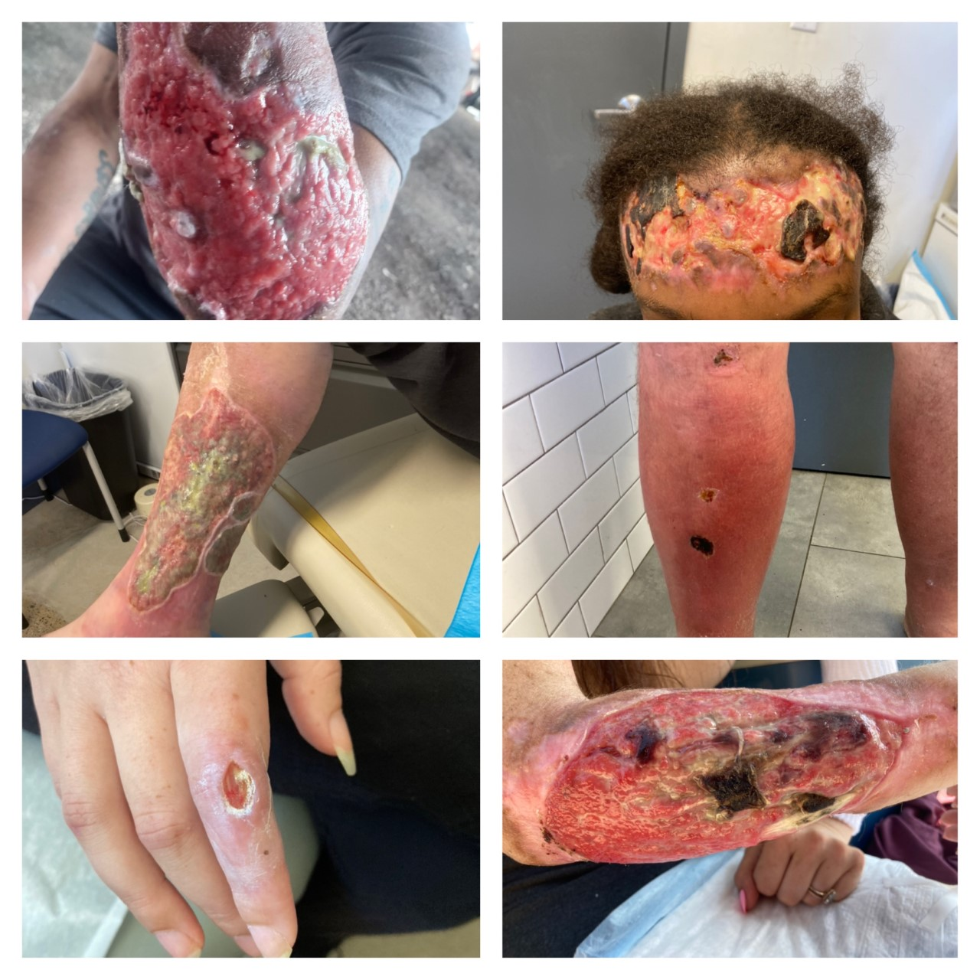
Xylazine and Wounds

Slide 20
Lessons learned: Xylazine wounds
Importance of access to high quality, low barrier wound care
Importance of trauma informed patient care (building rapport, establishing trust, reassurance)
Inflammation does not necessarily equivalent to infection
Avoidance of scare tactics (don't use threat of limb loss as means to promote engagement)

Slide 21
Xylazine and MOUD treatment
Methadone, buprenorphine, naloxone – do not work for xylazine withdrawal
Many treatment facilities and hospitals are still trying to figure out the best way to manage tranq withdrawal symptoms
Patients who are in dire need of hospitalization (e.g. endocarditis, cellulitis, osteomyelitis, etc.) are hesitant to go to the hospital because of fear of withdrawal
Patients who are interested in an inpatient drug treatment facility might not be accepted if they have xylazine-induced wounds
Chart credit to Dr. Joseph D'Orazio, Temple University Hospital

Slide 22
Lessons learned: Xylazine and MOUD treatment
Adjust treatment strategies: MMT/buprenorphine/injectable naloxone alone do not address Xylazine
Identify hospitals and rehabs in area familiar with xylazine
Educate patients re: signs and symptoms of tranq withdrawal
Educate community partners re: how xylazine may affect treatment access

Slide 23
Interventions
Certified Peer Specialists and Certified Recovery Specialists
Relationships with hospitals & health centers
Educating others in the community
Other outreach & street med resources

Slide 24
Certified Peer Specialist
Role of the CPS
Meeting people where they are
Can offer hope to people who often feel that there is no way out
Accompaniment

Slide 25
Relationships with hospitals & health centers
Utilizing hospital peers/CPS
Addiction medicine providers – warm handoff in the ED
Street med ride-alongs & the 2-way referrals that have come from these relationships
Importance of having contacts in multiple hospitals/clinics so that patients have choices

Slide 26
Educating others in the community
Emergency department providers
Hospitalists
Amtrak police
Wound care trainings

Slide 27
Other outreach & street med resources
Shelters
Treatment centers
Other outreach teams

Slide 28
Case Study # 1: "Bobby"
48 year-old male with bilateral leg and foot wounds 2/2 injection drug use
Recently confined to wheelchair due to complications of leg wounds
Outreach team first encountered him in October 2022.
Street med RN first encountered him in November 2022
Panhandling in a wheelchair outside of the train station
Sleeping outside in the wheelchair with legs always in a dependent position

Slide 29
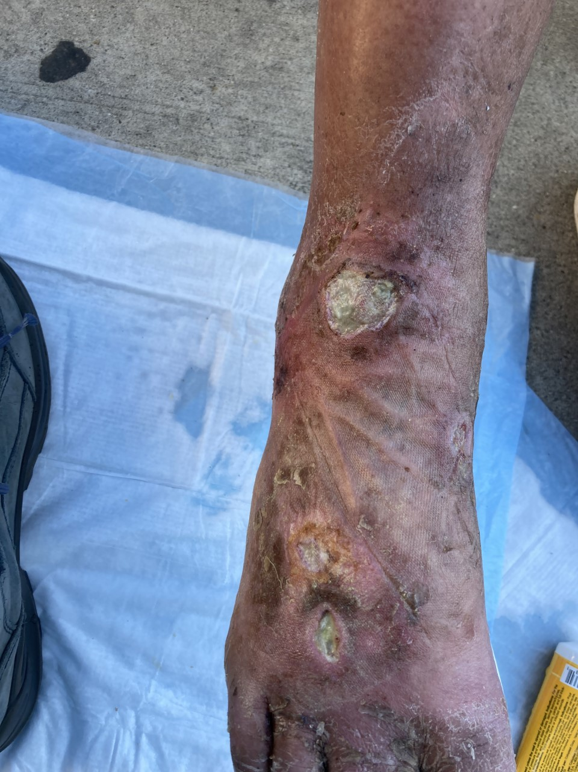
"Bobby," continued

Slide 30
"Bobby," continued
Continued providing wound care several times a week
Outreach continued to discuss shelter options
Negative encounter with police

Slide 31
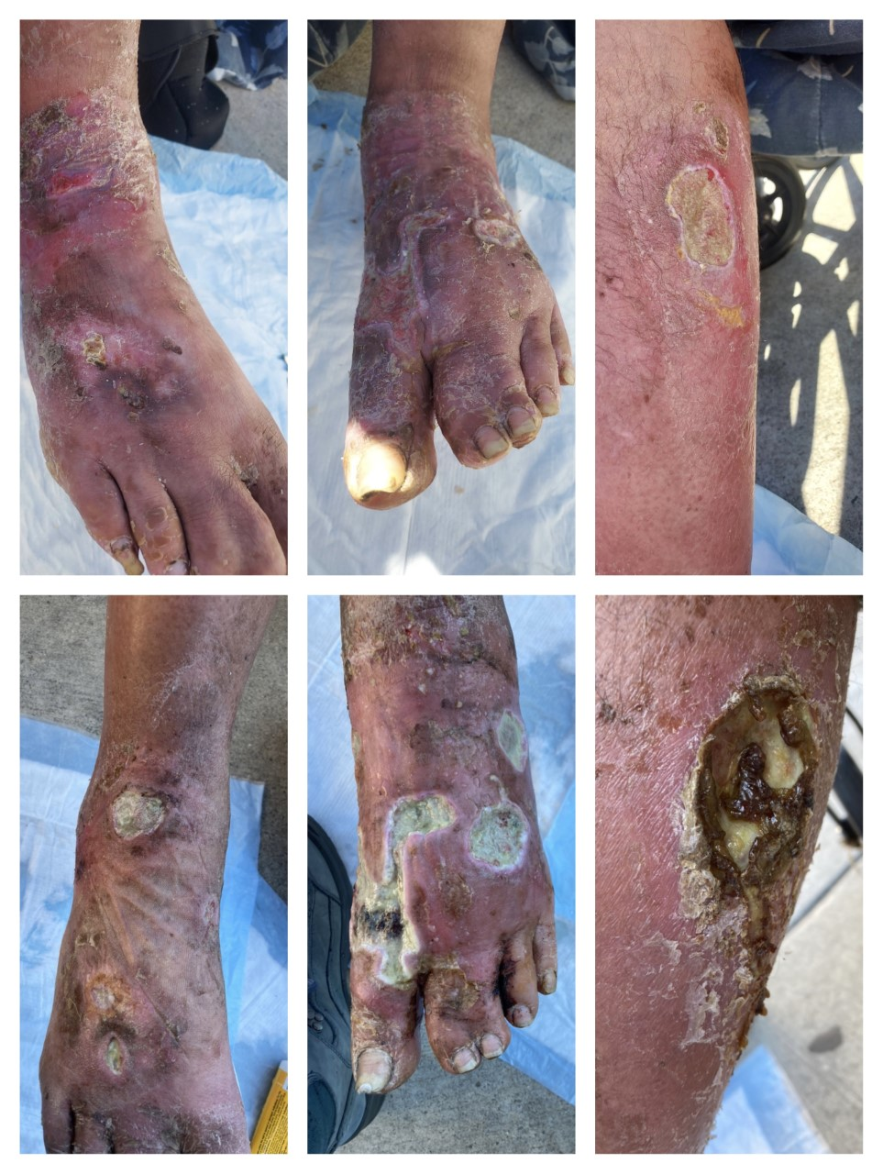
"Bobby," continued
Less than 3 months after our first meeting, Bobby entered a shelter!
Fentanyl/tranq use decreased dramatically
Is considering starting methadone
Has been engaging in one of our clinics now for regular PCP care

Slide 32
Case study # 2: "Esther"
32 year old female, unhoused, injecting fentanyl/xylazine & smoking crack cocaine daily.
Hx of sex work to support her drug habit
Had many encounters with another outreach team in the city.
We learned of her pregnancy when she was approximately 11 weeks; other outreach team had known about it for a month but did not reach out to street med because of confidentiality concerns
G3P2 with 2 prior C-sections
Two living children with her parents out of state

Slide 33
"Esther", continued
After several attempts, we got her to a prenatal appointment at our clinic where she was able to get a dating scan.
She started experiencing withdrawal & left before completing routine prenatal labs
She then declined to return to this clinic because of the distance from where she buys/uses drugs.
We scheduled an appointment at another clinic in her neighborhood, but they were extremely busy that day, and she left after sitting in the waiting room for 45 minutes.

Slide 34
"Esther", continued
Continued to look for her during street outreach
Were able to get her into a shelter at 32 weeks
Discussion of methadone, detox.

Slide 35
"Esther", continued
Weeks 38-40: the most stressful game of cat vs mouse ever!
She became our top priority!
40 weeks: APB to all local hospitals.

Slide 36
"Esther", continued
Reported contractions to shelter staff on a Saturday
Eventually agreed to go to the hospital where she had a successful C-section
Nexplanon inserted prior to discharge
Postpartum follow up

Slide 37
Case study # 3: Matthew
29 year old-male, injecting 1 bundle of fentanyl/tranq daily
Unhoused
He had a few sporadic visits with our team for abscesses/wounds but was not interested in MOUD.
Lost to care for several months.
4 months ago, another patient asked us to look for him; she reported that he had "bad wounds" and that she was really worried about him.

Slide 38
Case study # 3: Matthew
We located him that week; he was in a wheelchair (prior to this had been fully ambulatory)
He had been hospitalized the month prior for a groin abscess but self-discharged due to insufficient management of pain and withdrawal symptoms
We were able to get him a bed in the shelter that day

Slide 39
Case study # 3: Matthew
Physical exam: Distal tips of all 5 toes of the R foot with necrosis. R foot dusky, cold to touch. Diminished pedal pulses on the R. Multiple open wounds of R leg; R groin wound with adherent gauze.
Review of hospital records showed that he had undergone an I & D of a R groin abscess and subsequently was found to have a thrombus in the R femoral artery.

Slide 40
Case study # 3: Matthew
Street med NPs saw him 3 more times over the next week, and with each visit, the gangrene had spread even more.
Patient repeatedly declined to return to the hospital
CPS spoke to patient after NP finished talking to him for the 3rd time, and then the patient agreed to go!

Slide 41
Case study # 3: Matthew
CPS drove back to our office to get the wheelchair van
We stopped at McDonald's along the way as he had not eaten that day
Warm handoff to addiction med provider in the ED; NP stayed with patient until he was in a bed.
A few days later, it was determined that the leg could not be salvaged, and he had surgery to amputate above the knee.

Slide 42
Summary
As if the regular opioid crisis wasn't bad enough, xylazine has further complicated care for people who use drugs, especially among those who are unhoused.
Complex wounds, delayed and suboptimal pregnancy care, and challenges with MOUD treatment are three of the most urgent consequences that we see
As the drug supply continues to change, health care workers and outreach teams need to be ready to adapt their own tactics in order to provide the best care for this vulnerable population
CPSs play an integral role in assisting people who use substances access needed healthcare

Slide 43
Questions?

Slide 44
References
Centers for Disease Control and Prevention. 2021. WONDER data set. https://wonder.cdc.gov/Deaths-by-Underlying-Cause.html
Friedman J, Montero F, Bourgois P, et al. Xylazine spreads across the US: A growing component of the increasingly synthetic and polysubstance overdose crisis. Drug Alcohol Depend. 2022;233:109380. doi:10.1016/j.drugalcdep.2022.109380
Gupta, R., Holtgrave, D., & Ashburn, M. (2023). Xylazine – Medical and Public Health Imperatives. New England Journal of Medicine. https://www.nejm.org/doi/full/10.1056/NEJMp2303120
Johnson J, Pizzicato L, Johnson C, Viner K. Increasing presence of xylazine in heroin and/or fentanyl deaths, Philadelphia, Pennsylvania, 2010-2019. Inj Prev J Int Soc Child Adolesc Inj Prev. 2021;27(4):395-398. doi:10.1136/injuryprev-2020-043968
National Institutes of Health. (n.d). Xylazine. https://nida.nih.gov/research-topics/xylazine
United States Drug Enforcement Administration. (n.d.). DEA Reports Widespread Threat of Fentanyl Mixed with Xylazine. https://www.dea.gov/alert/dea-reports-widespread-threat-fentanyl-mixed-xylazine
United States Food and Drug Administration. (2022, November 8). FDA warns about the risk of xylazine exposure in humans. Retrieved May 5, 2023, from https://www.fda.gov/media/162981/download

