Slide 1
Using Research to Advocate
for Housing as a Better Solution
Lessons from the Denver Supportive Housing Social Impact Bond Initiative
Notes:
SARAH To give you a brief overview of what I’m going to cover today. We are going to start with some background on the Denver SIB, including a high-level description of the program, the program structure, and target population. Then I’ll give a brief overview of the evaluation and talk through our findings in more detail. And finish up with some closing thoughts.

Slide 2
Chronic and unsheltered homelessness is increasing across the country
Body of work
Population | Total | Sheltered | Unsheltered
Overall (% Δ 2010-2022) | 582,462 (-8.6%) | 348,630 (-13.6%) | 233,832 (0.1%)
Individuals (% Δ 2010-2022) | 421,392 (+6.6%) | 204,774 (-3.4%) | 216,146 (+18.2%)
People in Families (% Δ 2010-2022) | 161,070 (-33.4%) | 143,733 (-24.9%) | 17,337 (-65.7%)
Individuals Experiencing Chronic Homelessness (% Δ 2010-2022) | 127,768 (+20.5%) | 78,615 (+13.4%) | 49,153 (+25.3%)
Veterans (% Δ 2009-2022) | 33,129 (-54.8%) | 19,565 (-54.9%) | 13,564 (-54.7%)
Unaccompanied Youth (% Δ 2017-2022) | 30,090 (-21.4%) | 17,104 (-7.8%) | 12,986 (-34.3%)
HUD, 2022 Annual Homelessness Assessment Report

Slide 3
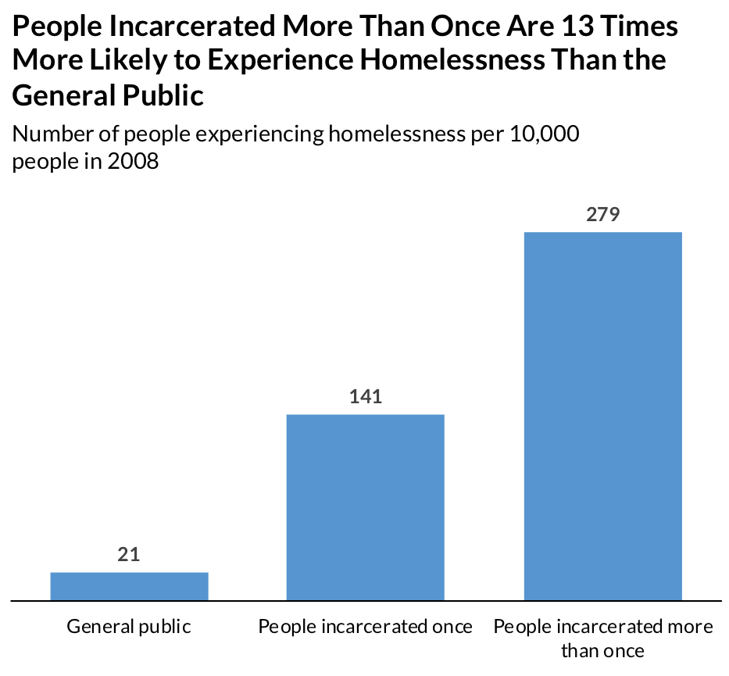
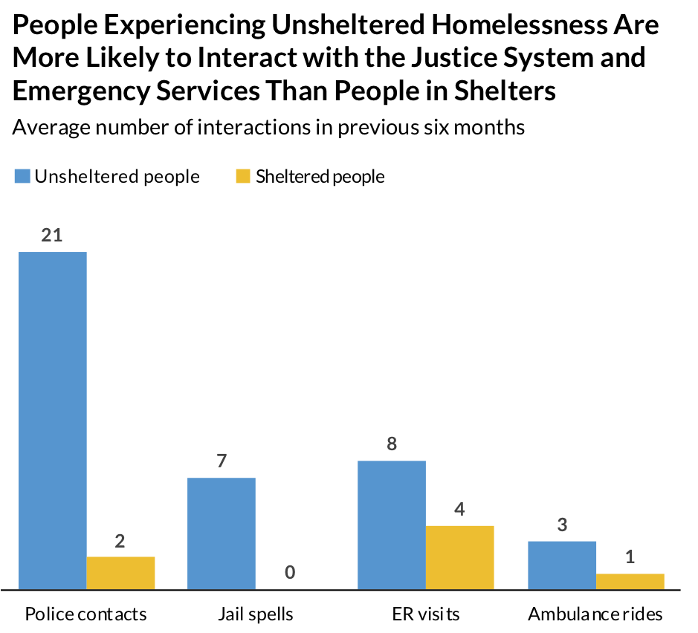
Chronic and unsheltered homelessness is linked to police contacts, jail stays, and ER visits
Body of work

Slide 4
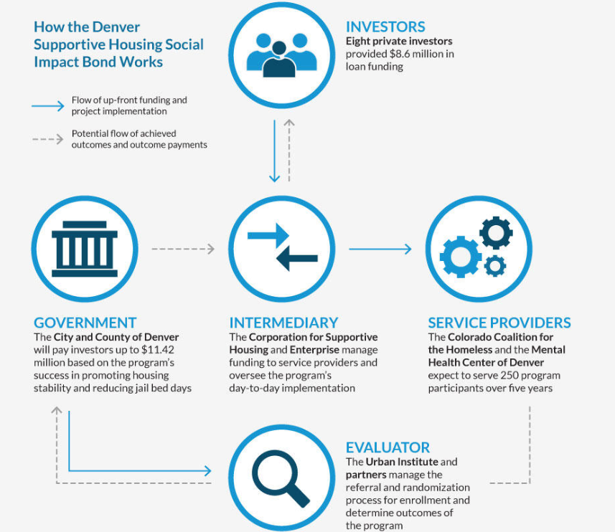
Denver designed the SIB to break the homelessness-jail cycle
Approach

Slide 5
When people experiencing homelessness were offered housing, most took it and stayed for the long term.
Overview
After three years in the supportive housing program, 77 percent of participants remained in stable housing.
Notes:
DEVLIN The Denver SIB results debunk the false narrative that people experiencing homelessness choose to live on the streets, showing that people can stay in housing even after living outside or in shelters for years and grappling with mental health and substance use challenges.
We found that, after entering supportive housing, participants maintained high housing stability rates. Of those who were housed through the program, 86 percent of participants remained in stable housing at one year. At two years, 81 percent remained in stable housing, and at three years, 77 percent remained.
Next slide.

Slide 6
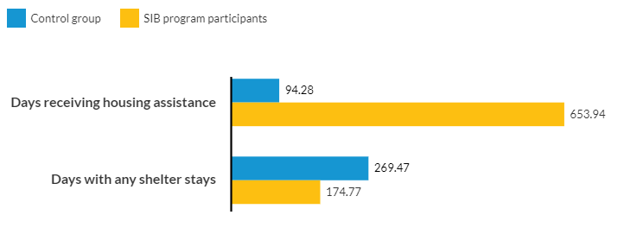
People in supportive housing received more housing assistance and spent fewer days in shelters on average than people receiving usual services.
Findings
+594%
-35%
Notes:
DEVLIN Usual care does not include housing assistance outside of this program.
The Denver SIB significantly increased participants’ access to housing assistance. Over three years, people referred to supportive housing received an average of 560 more days of permanent housing assistance per person than those who received usual services in the community. This shows the scarcity of housing assistance for people who aren’t connected to a supportive housing program.
Denver SIB participants also spent significantly less time in shelters. Over three years, those referred to supportive housing had an average 40 percent reduction in total shelter visits and 35 percent reduction in days with any shelter visits because of supportive housing.
Next slide.

Slide 7
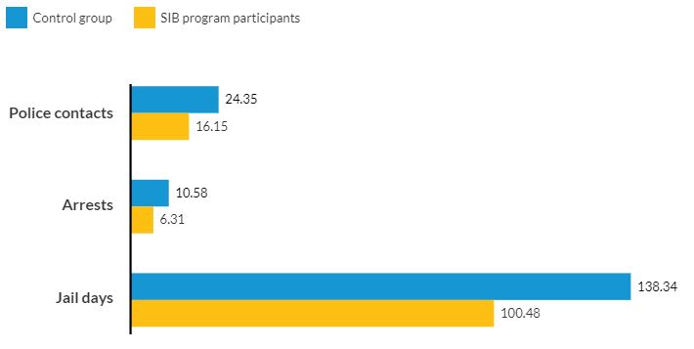
People in supportive housing had fewer interactions with the criminal justice system on average than people receiving usual services.
Findings
-34%
-40%
-27%
Notes:
DEVLIN People experiencing homelessness are more likely to interact with police and to face citations, arrests, and incarceration. And I discussed earlier, Denver SIB participants were selected based on a history of 8 or more arrests and long-term homelessness.
The Denver SIB shows that supportive housing reduces interactions with the criminal justice system among people experiencing homelessness and with a history of arrest. Over three years, people referred to supportive housing had an average 34 percent reduction in police contacts and 40 percent reduction in arrests because of supportive housing.
SIB participants also spent less time in jail. Over three years, participants referred to supportive housing had an average 30 percent reduction in unique jail stays and 27 percent reduction in total jail days.
Next slide.

Slide 8
People who were referred to supportive housing services had four fewer visits to a detoxification facility than those who received services as usual in the community.
Findings
-65%
Notes:
DEVLIN The Denver SIB also helped reduce the use of short-term or city-funded detoxification facilities. These detox services were primarily used for short-term sobering and aren’t intended (and don’t have the resources necessary) to provide long-term and follow-up care, in contrast with the services available to participants in supportive housing.
Over three years, participants referred to supportive housing had an average of four fewer visits to these detox facilities, or a 65 percent reduction in the use of these services.
I’ve also included the differences between the two groups’ use of emergency medical services. Participants referred to supportive housing also experienced fewer EMS responses from the public safety system three years after referral to the program. Although it is important to note that the differences were not statistically significant
Next slide.

Slide 9
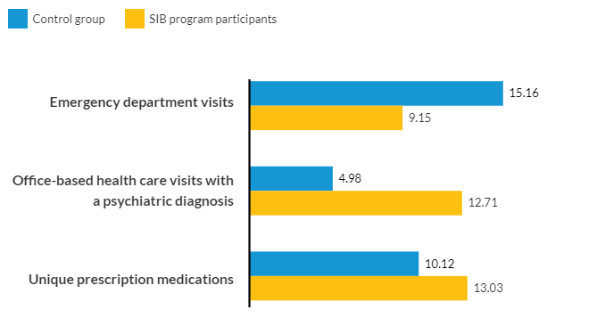
People in supportive housing used less emergency health care and received more office-based care on average than people receiving usual services.
Findings
-40%
+155%
+29%
Notes:
DEVLIN People experiencing chronic homelessness are more likely to have physical or mental health challenges, but the homelessness-jail cycle does not connect them with the health services they need. As a result, they often use emergency services like detoxification facilities and emergency rooms for their health problems.
The Denver SIB initiative broke this harmful pattern. Over two years, participants referred to supportive housing had an average 40 percent decrease in emergency department visits, a 155 percent increase in office-based health care visits for a psychiatric diagnosis, and a 29 percent increase in unique prescription medications.
Next slide.

Slide 10
Approximately half of the total per person cost of the Denver SIB was offset by avoided costs for emergency public services.
Notes:
SARAH As we know, supportive housing is an intensive intervention that carries significant costs across local, state, and federal funding sources. But as the Denver SIB shows, supportive housing also helps people avoid costly outcomes, such as jail stays and emergency room visits, which offsets a large share of the cost.
Denver SIB participants had almost $7,000 less in total annual, per person costs associated with emergency public services compared with the control group. The biggest avoidances were in reduced jail, ambulance, and emergency department costs.
Based on our analysis of what it cost to implement the SIB, which we analyzed in detail in the cost report, approximately half of the total per person annual cost of the Denver SIB was offset by cost avoidances in other public services.
In the cost report, we also get into the details of which systems paid for different components of supportive housing and which systems benefited from the cost offsets associated with better outcomes because of supportive housing.
Finally, we analyzed what it would cost to scale the Denver SIB supportive housing program to realize the maximum cost benefit. Our analysis showed that to serve all 1,209 people experiencing chronic homelessness in Denver County, according to the latest point in time count, would cost between $14.6 million and $18.7 million annually, but $8.3 million of that total cost could be offset by savings in emergency public services.
Next slide

Slide 11
Myth #1
Evaluation
363 individuals referred to supportive housing
from January 2016 to December 2017
Of those in treatment, 325 people (89.5%) were located
Average time to location: 49 days
Of those, 299 people (92.0%) engaged in the program
Average time from location to engagement:
13 days
Of those, 286 (95.7%) had housing applications approved
Average time from engagement to application approval: 52 days
Of those, 285 (99.7%) leased up
Average time from application approval to lease-up: 15 days
Notes:
Super impressive because these were not folks who were in the system
Providers got a name and the street corner where they were last arrested and they had to go out and find them and engage them
This is one of the big reasons we see the impacts across the board
DEVLIN The teams at CCH and MHCD assisted participants in moving from homeless to housed. Urban tracked the four key milestones in that participant engagement process: location, engagement in the program, approval of the housing application, and lease up in housing. The figure on the right shows the number of people in the treatment group at each milestone and the average time it took to move from stage to stage.
Of the people who were enrolled in the treatment group, 285 people (about 79 percent) were located, engaged, and housed.
participant location (the date that CCH or MHCD made initial, direct contact with the participant)
participant engagement in the program (the date CCH or MHCD conducted a housing screening to verify the participant’s homelessness status and the participant agreed to move forward in the housing process)
housing application approval (the date a participant received approval for housing)
lease-up in housing (the date a participant moved into a housing unit)
Next slide.

Slide 12
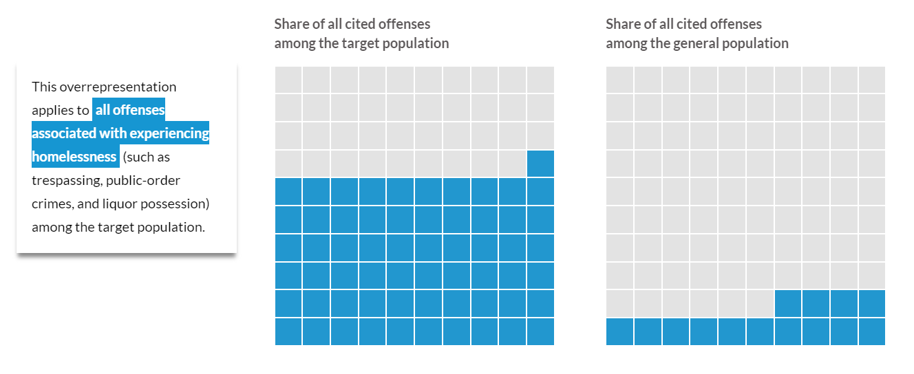
Myth #2
AUDIENCES

Slide 13
Myth # 3
There was no significant difference in mortality between the treatment (10 percent) and control group (9 percent)
Causes of death:
While overdose was the most common cause of death, it represented less than 20 percent of the causes of death.
Other more common causes include liver disease, circulatory disease, alcohol use disorder, and exposure.
The only significant difference we found among these causes was exposure with control group being more likely to die of exposure.

Slide 14
The SIB’s results contributed to population level impacts and more housing for people experiencing homelessness
IMPACT
New line item in Denver city budget
$3M/year
245 units of housing for people
Commission on Social Impact Partnerships
$5.5M from U.S. Treasury Dept.
$5.5M from private investors
125 units of housing for people
American Rescue Plan Act- Colorado
$13.4M
250 units of housing for people
625 people
housed

Slide 15
Discussion More on the Denver SIB evaluation can be found on urban.org Sarah Gillespie sgillespie@urban.org
Notes:
SARAH The findings from the Denver SIB show that the initiative was a remarkable success.
The outcomes offer an important lesson and an alternative to the status quo, that supportive housing, provided with a Housing First approach, can break the homelessness-jail cycle. And that investment in supportive housing can decrease police interactions and arrests, disrupt jail cycling, and reduce the use of emergency detox facilities.
Expanding investments in supportive housing could end homelessness, break the jail cycle, and shift resources away from policing and other costly emergency services toward services that focus on housing, well-being, and the prevention of negative outcomes for residents and communities.
NEXT STEPS IF YOU WANT TO DISCUSS:
The City of Denver and their partners continue to work on increasing and maintaining program slots for people experiencing chronic homelessness in Denver.
Based on interim findings from the SIB, in 2018, the City of Denver added 75 slots to the program through a direct performance-based contract with one of the providers.
For these contracts, funding is provided upfront and if the provider exceeds performance expectations, they are given a bonus. If they do not reach certain performance benchmarks, some of the advance funding must be returned.
After the program ended in December 2020, the City of Denver agreed to fund all 325 program slots, including the Denver SIB and the expansion, on an ongoing basis through the same type of performance-based contracts as the SIB expansion.
In 2021, the City of Denver received the Social Impact Partnership to Pay for Results Act (SIPPRA) award letter from the Department of the Treasury. If approved by council, the program would include: 125 new program slots and additional outcome measure for Medicaid cost savings.
The City is also currently exploring opportunities to use recovery funds to pair Emergency Housing Vouchers with Service funding through the American Rescue Plan Act (ARPA).
Next slide

