Slide 1
Mental Health Services in Mobile Street Medicine
An Alternative to Policing Homelessness
Emma Tasini
Mental Health Specialist at Healthcare in Action
Registered Associate MFT #135217, Associate PCC #12440
National Healthcare for the Homeless Council
Baltimore, MD May 2023

Slide 2
Rather, positing decarceration as our overarching strategy, we would try to envision a continuum of alternatives to imprisonment-demilitarization of schools, revitalization of education at all levels, a health system that provides free physical and mental care to all, and a justice system based on reparation and reconciliation rather than retribution and vengeance.
- Angela Davis, Are Prisons Obsolete (2003)

Slide 3
Street Medicine & Behavioral Health
“Street Medicine includes health and social services developed specifically to address the unique needs and circumstances of the unsheltered homeless delivered directly to them in their own environment”
- Street Medicine Institute, 2023

Slide 4
LA County Context
An LA Times Article in April 2023 explained:
“examined more than 100 lethal police encounters throughout the country and found that at least 40% involved a mental health crisis” (Seidman 2023)
“In Los Angeles, police reported a similar figure in 2022: 39% of the people their officers shot were in the midst of a mental health crisis” (Seidman 2023)

Slide 5
Healthcare In Action
Mission: To improve the lives of people experiencing homelessness through quality holistic care
Vision: That all people experiencing homelessness have access to quality healthcare that addresses their mental and physical health needs.

Slide 6
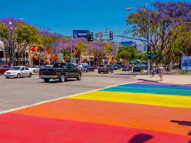
West Hollywood Pilot Program

Slide 7
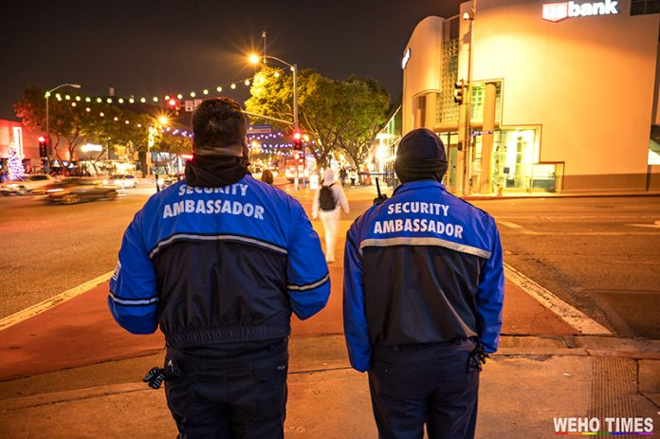
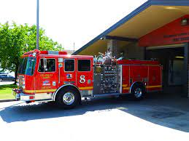
How it works?
Concierge- Style 7am-7pm, 7 days/week
15-minute response to page
1 hour in person- response to patient
Q1 71 patients attended to within the city of West Hollywood
Q2 88 new patients
Partnership with fire department, sherriff’s department, and community organizations

Slide 8
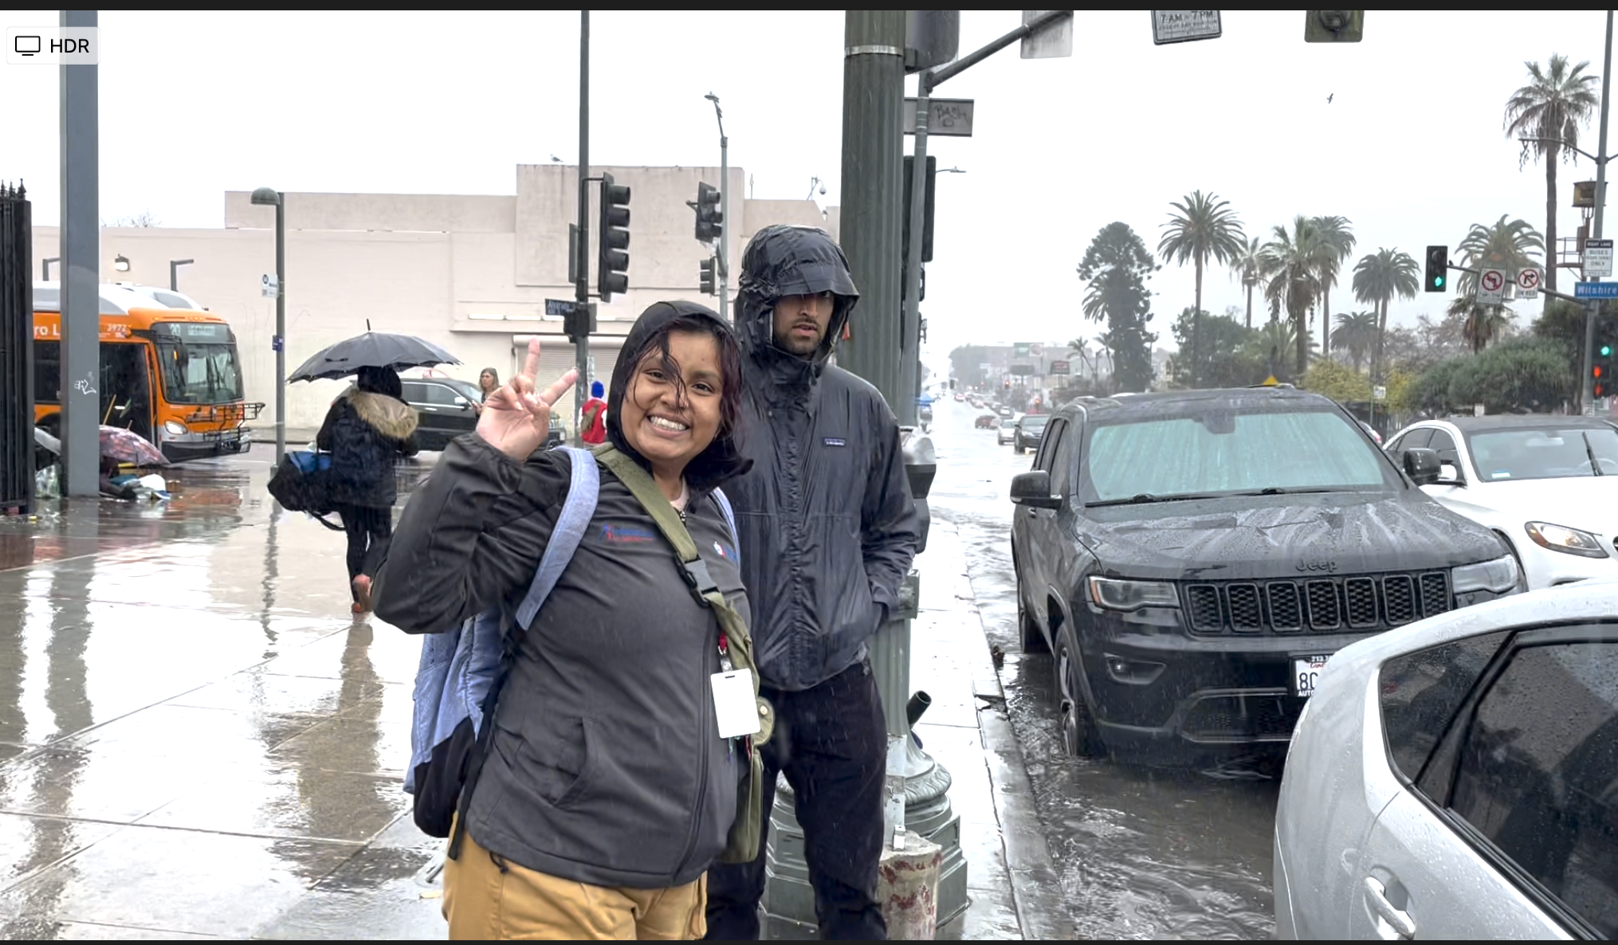
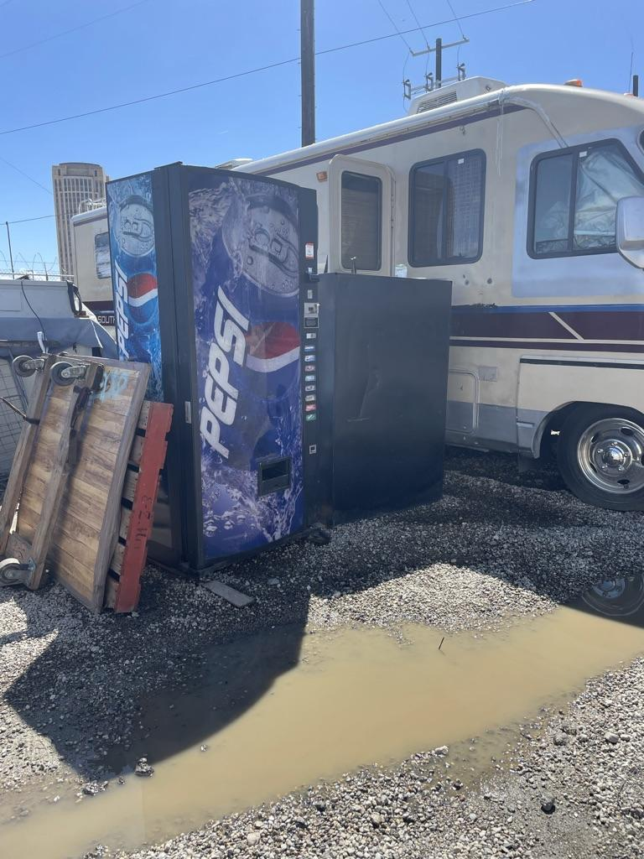
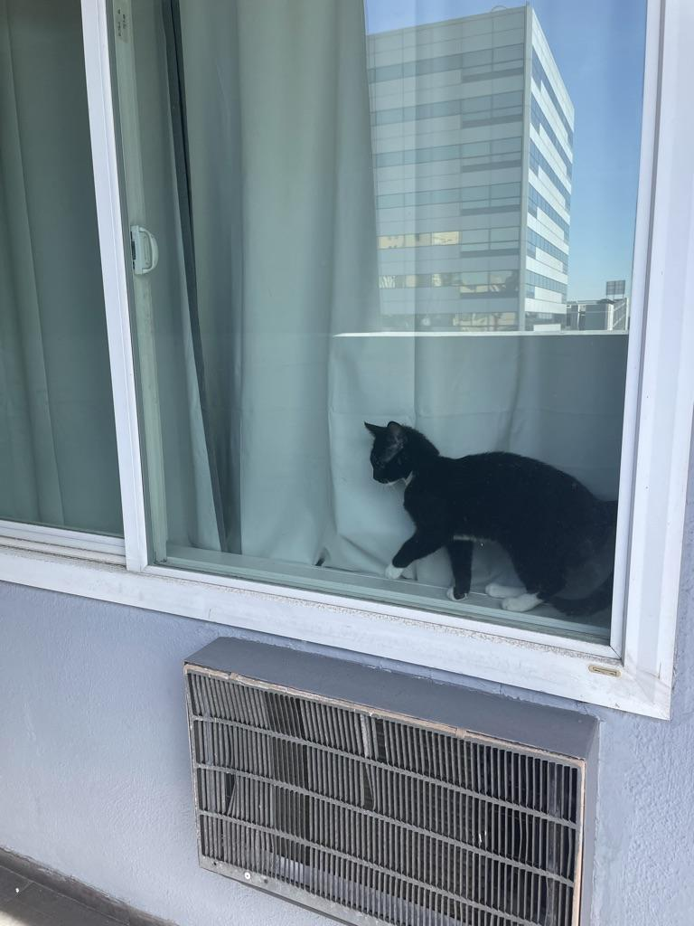
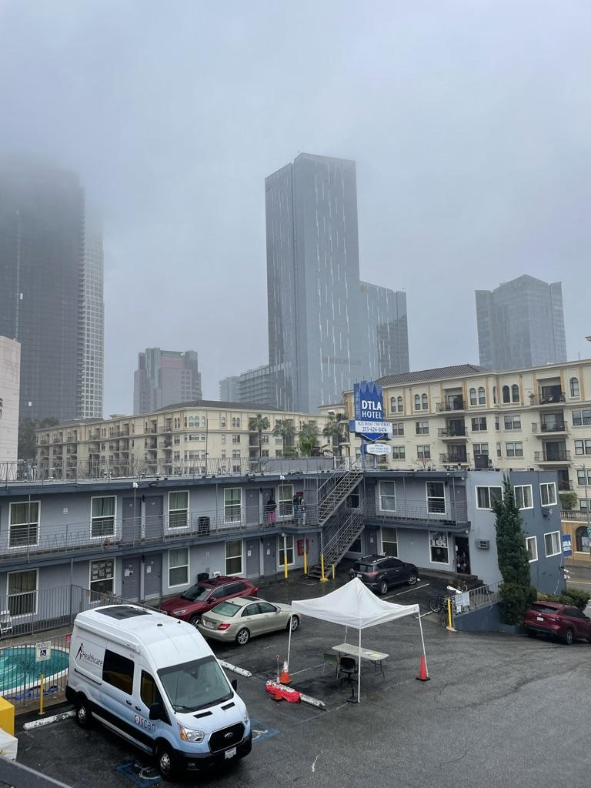
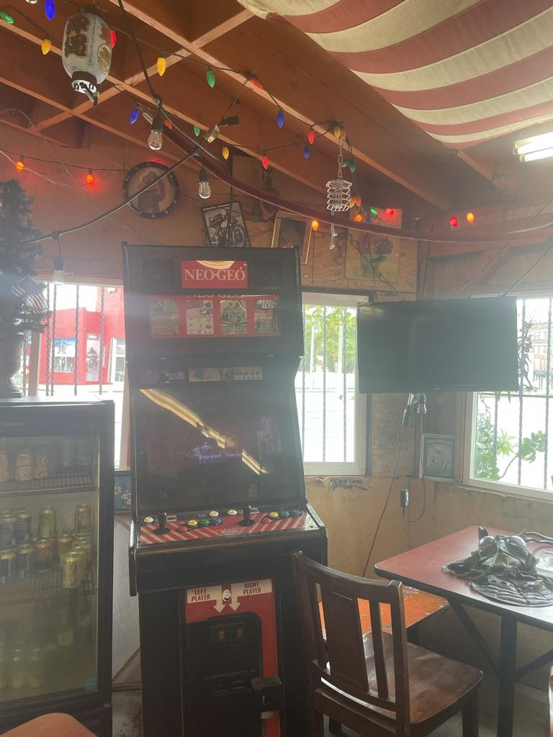
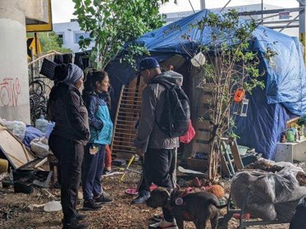
What Does Street Medicine Psychotherapy Look Like?

Slide 9
3 Branches of Mental Health Services
ASSESSMENTS & TRANSITIONS
OUTREACH
PSYCHOTHERAPY
BRAINSPOTTING
DBT
ARC
TF-CBT
HARM REDUCTION

Slide 10
“Robert”
Ct has hx of experiencing homelessness and described “couch surfing” and housing instability since 1990
PHQ-9 score of 17- moderately severe depression
GAD-7 score of 12- moderate anxiety symptoms

Slide 11
“Robert” Outcomes
Placed in permanent ADA housing
1st patient housed as part of the pilot program
Found a love for volunteering
PHQ-9 of 8
GAD-7 of 6
Reconnected with LGBT Center
Restarted life saving medication

Slide 12
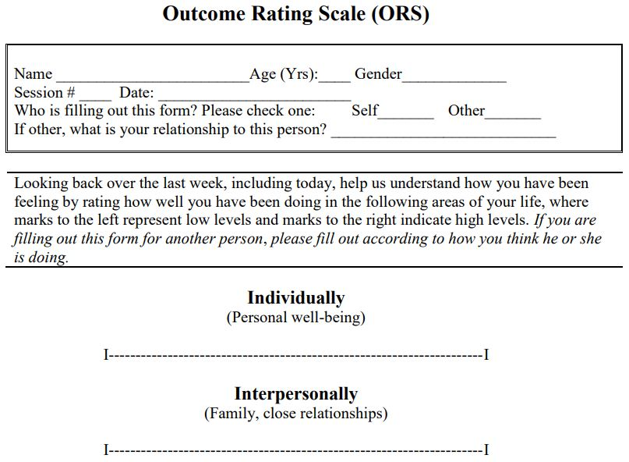
Collecting Data Throughout Treatment
-Mental Health Intake
-GAD-7
-PHQ-9
-Therapist-client rapport scaling: Outcome Rating Scale

Slide 13
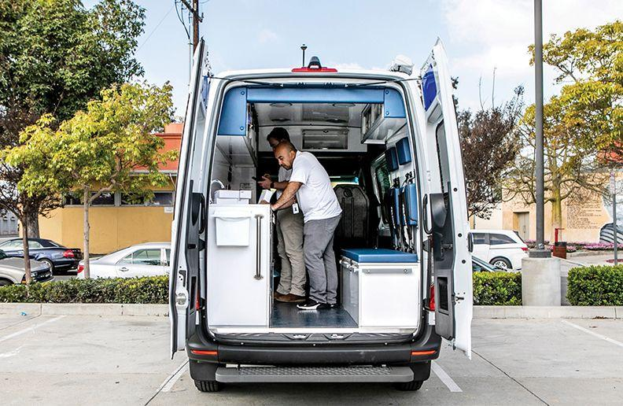
Expanding Behavioral Health in a Mobile Setting
Building relationships with local sheriffs/ police to collaborate and divert calls
Community Organization outreach & in-services
Rapport building, rapport building, and more rapport building.
Connecting to appropriate services

Slide 14
Challenges to Implementation

Slide 15
References
Barham, P. (1997). Closing the asylum: The mental patient in modern society. Process Press Ltd.
Biography.com Editors. (2021, April 23). Angela Davis. Biography.com. Retrieved April 11, 2023, from https://www.biography.com/activists/angela-davis
Davis, A. Y. (2003). Are Prisons Obsolete? Publishers Group Canada.
Hochman, M. (2022). Healthcare for patients experiencing homelessness. Healthcare In Action. Retrieved April 11, 2023, from https://www.healthcareinaction.org/
John, F. (2016). The man who closed the asylums: Franco Basaglia and the Revolution in Mental Health Care. The Man Who Closed the Asylums: Franco Basaglia and the Revolution in Mental Health Care | Reviews in History. Retrieved April 11, 2023, from https://reviews.history.ac.uk/review/1883#t2
Rafalski, C. (2023). About Us. Home. Retrieved April 11, 2023, from https://www.streetmedicine.org/about-smi

