Slide 1
Incorporating Long-Acting Injectable Buprenorphine (LAI-Bupe) in MOUD Practice as a Harm Reduction Tool Kara Cohen, CRNP Máire St. Ledger, CRNP Project HOME Philadelphia, PA

Slide 2
Financial Disclosure
No disclosures to report

Slide 3
Objectives
After participating in this session, attendees will be able to list potential candidates for Long-Acting Injectable Buprenorphine.
Attendees will be able to describe how LAIB can be an integral part of a harm reduction oriented MOUD program.
Attendees will be able to design a system to incorporate LAIB into their own MOUD practices.

Slide 4
Quick Poll: How many of you have you been using LAI bupe in your practices?
For those who are still thinking about starting, what info do you need to get started?
For those who are experienced with LAI bupe, what questions do you have, or what challenges have you encountered?

Slide 5
Identifying candidates for LAI Bupe
More research on people with substance use issues who are stable in recovery
Participants who are working full time/inflexible schedules
Participants who don’t need as frequent contact with a provider
Participants who feel stable on current regimen
Participants who want to get away from “daily dosing”

Slide 6
Identifying candidates for LAI Bupe (cont’d)
However, LAI bupe can also be a great option for participants who are struggling with their recovery
History of lost/stolen prescriptions
History of prescription diversion
History of missed appointments
History of overdose
UDS negative for buprenorphine, but positive for opioids

Slide 7
When to begin convos about LAI bupe?
As early as possible!
Present to participants early on in treatment plan as one option for MOUD
May take several months for them to be ready
Be sure they understand the difference between LAI bupe and injectable naltrexone

Slide 8
Before the initial injection
If patient is unstable on bupe, assess patient’s concern about precipitated withdrawal as that will guide the initiation regimen
Obtain baseline CMP if possible
Have a locked refrigerated storage unit
Identify a specialty pharmacy that stocks LAI bup
Be sure that your DEA address matches the address where you need the med delivered/administered (can be tricky for providers who float between sites)

Slide 9
Initiation: stable vs. unstable
Initiation: stable vs. unstable
For all participants, try to have baseline CMP (although not a dealbreaker if you can’t)
IF STABLE on bupe→ can initiate as soon as they want
If maintenance SL dose >10mg/day, would bridge with at least another 1-2 films x 1-2 weeks, until they adjust to new dose
May continue supplemental films longer if needed, and many insurances will cover this to some degree, with or without prior authorization.

Slide 10
Initiation: continued
If unstable on current dose (actively using opioids) there are several options:
Inpatient to stabilize on bupe, then transition to LAI-bupe (need to coordinate d/c date)
Get to a point where pt can tolerate a half a film a day*, and then do test dose (~8mg the morning of or in office)
*with certain fentanyl analogues, precipitated withdrawal symptoms may not occur until doses of 24mg or greater
Microdosing over the course of 1-2 weeks
If no precipitated withdrawal, ok to administer
Butrans patches (off label use, must have dx of Chronic Pain for insurance coverage)
***Caution with precipitated withdrawal in patients with cardiac hx

Slide 11
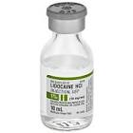
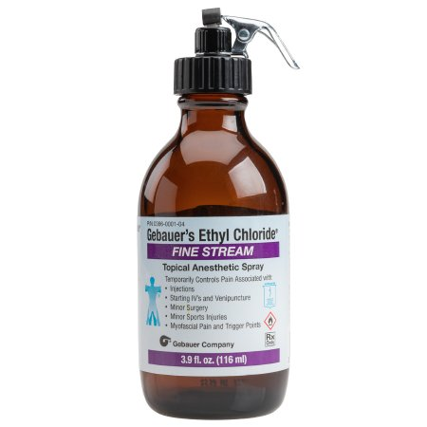
Tips for reducing Pain with injection
Can be painful injection, but the discomfort CAN be significantly decreased with numbing prior to injection (ice, ethyl chloride, or lido)
Ethyl Chloride Method
Lidocaine Method
ICE
Ethyl Chloride spray
Loud music of participant’s choice (more important than you may realize!)
Firmly tent the skin, 45 degree angle, avoid injecting too shallow
ICE
Loud music
Using a fine gauge (~25G) inject 1-2ml of Lido subcut
Firmly tent the skin, 45 degree angle, avoid injecting too shallow
It’s a subcutaneous injection (Don’t overthink it)
Try to get the air bubble out; just make sure no liquid leaks out past the bevel

Slide 12
LAI-Bupe Administration

Slide 13
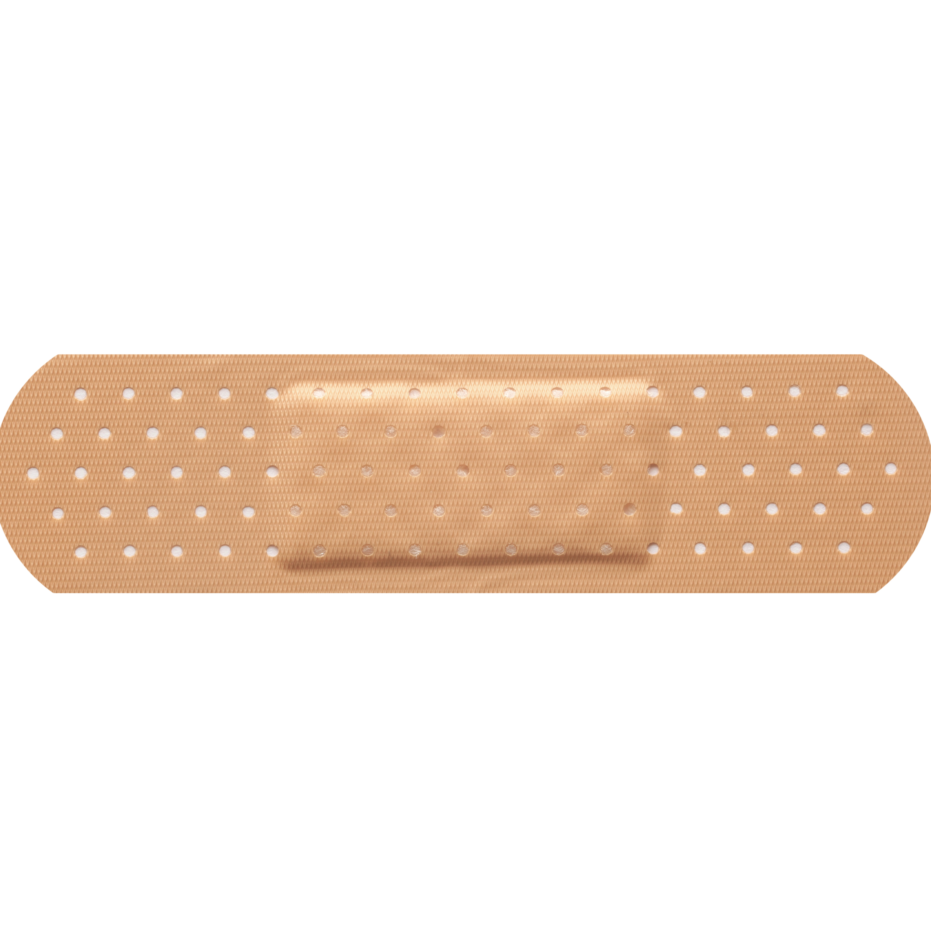
Post-injection
May be a little leakage
Cover with band-aid
Don’t massage
Ice if needed
Rotate injection sites each month

Slide 14
Possible adverse reactions
Injection site pain/swelling
Precipitated withdrawal if patient is still active in their use
Active use is NOT a contraindication to initiating LAI bupe; just make sure you have a detailed conversation and plan about what to expect/how to manage
Subcutaneous necrosis (wound at site of injection)
Tent skin more than you think you need to, especially in thin folx, and avoid injecting at too shallow of an angle

Slide 15
Most important part of 1st injection is setting up 2nd injection
Try to avoid precipitated withdrawal
Discuss possibility of discomfort while making sure to provide options for analgesia
Talk about "the bump"- how long it will take for gel matrix depot to dissolve
Risk of precipitated withdrawal with both heroin/fentanyl and tranq (provide comfort meds)
Make sure patient knows when second injection is due (and window)
Low barrier access if patient is unable to keep initially scheduled date of next injection

Slide 16
Supplemental films
Many people: 1-2 films SL q d x 7-14 days, then taper
If active use: can supplement up to BID and continue indefinitely, but might need prior auth
***Unconventional, but preferable to OD
Bupe (and LAI bupe) were not designed for fentanyl, xylazine/tranq, so people may need more than the injection to feel stable, and that’s ok

Slide 17
Patient testimony

Slide 18
Patient Testimony

Slide 19
Lessons learned
Sometimes patients report they aren't sure if it's working anymore, can't tell until they stop getting injection
Try to introduce people to other providers, team approach
Low barrier scheduling so if someone misses their injection they can get it as soon as possible

Slide 20
Withdrawal and Xylazine ("tranq")
Even if a person has no symptoms of opioid withdrawal, we can't forget about xylazine!
Offer comfort meds
Clonidine, Zofran, Benadryl, tizandine
Call patient to follow up the next day

Slide 21
Oral tox swabs
Sometimes negative in saliva with patients receiving LAI-bupe.

Slide 22
Statistics: (Current participants)
Retention in LAI-Bupe program (Sept 2022 until present):
Length of time since starting LAI-Bupe | # of participants
< 1 month | 5
1 month | 5
3 months | 8
6 months | 7
>12 months | 8
Stopped injections | 3
TOTAL | 36

Slide 23
Statistics
Number of overdoses within 6 months of last LAI-Bupe:
Zero!!!

Slide 24
Case Study- microdosing to LAI Bupe in patient with active use
Pt is male in 30s, hx of lung abscess and R lobectomy, no cardiac hx or other acute health concerns
Began using at 17 yo, IVDU since 21
Had a goal of getting on LAI bupe
Began at 2 bundles per day, cut back over the course of 2 months to 6 bags but experienced significant tranq w/d when he tried to stop completely
Could not tolerate more than1 film daily, and not every day

Slide 25
Began Microdosing, using transdermal buprenorphine (Butrans patch) **off label, dx of chronic pain required
We started via Butrans 20mcgpatch x 2 applied in office (alternatively use 0.5mg or ¼ of bupe 2mg SL film)
Day 1: 20mcg 2 patches transdermally (equivalent to bupe 0.5mg daily), and then slowly uptitrate SL.
Day 2: Leave patch in place
day 3: 1 mg SL
day 4: 1.5mg SL
day 5: 2.0mg SL
day 6: 2.5mg SL
day 7: 3mg SL
day 8: 4mg SL (remove patch)
Then began to go up 2mg day until 16 mg
added clonidine TID while uptitrating

Slide 26
Injection given at day 21 after microdosing
Was still using 3 bags daily, but was up to 24mg bupe daily
Increased risk of precip w/d with certain fentanyl analogues in pts taking <24mg daily
Very minimal precipitated withdrawal
Continued supplemental films at BID

Slide 27
Update
Patient continued on Sublocade from December 2021-April 2022
8/3/22 UDS:
Norbupe: 358
Bupe: 142
(no SL bup in 4 + months)
3/22/23: +POC (concentration >5ng/mL)- no bupe in ~11 months
Using 1 bundle daily, thinking about restarting SL bupe and getting back on LAI bupe

Slide 28
Summary
LAI-bupe is a very effective and safe option for patients with OUD, whether stable or unstable in their recovery
Education is key! Talk about LAI-bupe at every visit, unless there is a really compelling reason not to do so
Be sure to prepare for and take care of precipitated withdrawal
Testimonials from other participants can often help an uncertain patient agree to try LAI-bupe
A negative experience with the first injection might deter a second shot, so be sure to prepare patient and use proper analgesia.
Low-barrier care is a really good way to make sure patients continue to get their injections consistently

Slide 29
Questions?

