Slide 1

Medical Mobile Unit:
Quality and Innovation
Dr. Pia Valvassori
Health Care Center for the Homeless

Slide 2
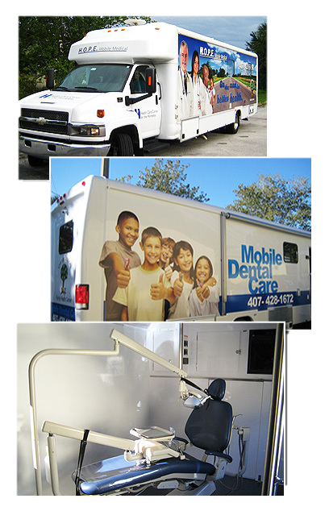
Overview
Description and Rationale
Advantages
Limitations
Barriers
Describe HCCH program
Blended Service Delivery model
Consumer survey findings
Modifications in service delivery

Slide 3
Description
Low barrier Mobile services/extension of street outreach
Patient centered -Tailored approach
Consumer informed
Extension of Services at fixed site
Engages most marginalized/isolated
Culturally sensitive
Services delivered in challenging environments
Leverages resources

Slide 4
Rationale
Access/Alleviate health disparities
Address other social determinants: food, clothing, employment,housing
Cost effective approach to service delivery/alternative to ER/Jail
Service delivery without fees/ complex paperwork
Engage in therapeutic/sustainable relationship
Platform to engage in more convoluted health care systems
Recent encampment outreach pilot: 247 surveyed, 36% no ID, 48% first time homeless, 58% disabling condition
Greatest need: housing and healthcare

Slide 5
Advantages
Reach those with little access/most marginalized
Low barrier delivery model/overcome stigma
No Cost/ID
Interdisciplinary delivery model
Location provides other essential services
Flexible, patient-centered
Location where PEH congregate
Partnerships

Slide 6
Limitations:
Inability to conduct extensive exams/procedures/fragmentation
Billing
Pharmaceutical access
Limited diagnostics/POCT
Limited staff
Constraints by space
Sustainability of program/cost
Drivers
Safety

Slide 7
Barriers to TraditionalCare
Lack of insurance/underinsured
Cost of visit/pharmaceuticals
Transportation
ID-secondary care/entitlements
History of mental illness/SUD/DV
Lack of trust/trauma
Stigmatization
Competing priorities
Literacy
Appointments/wait times
Lack of staff diversity

Slide 8
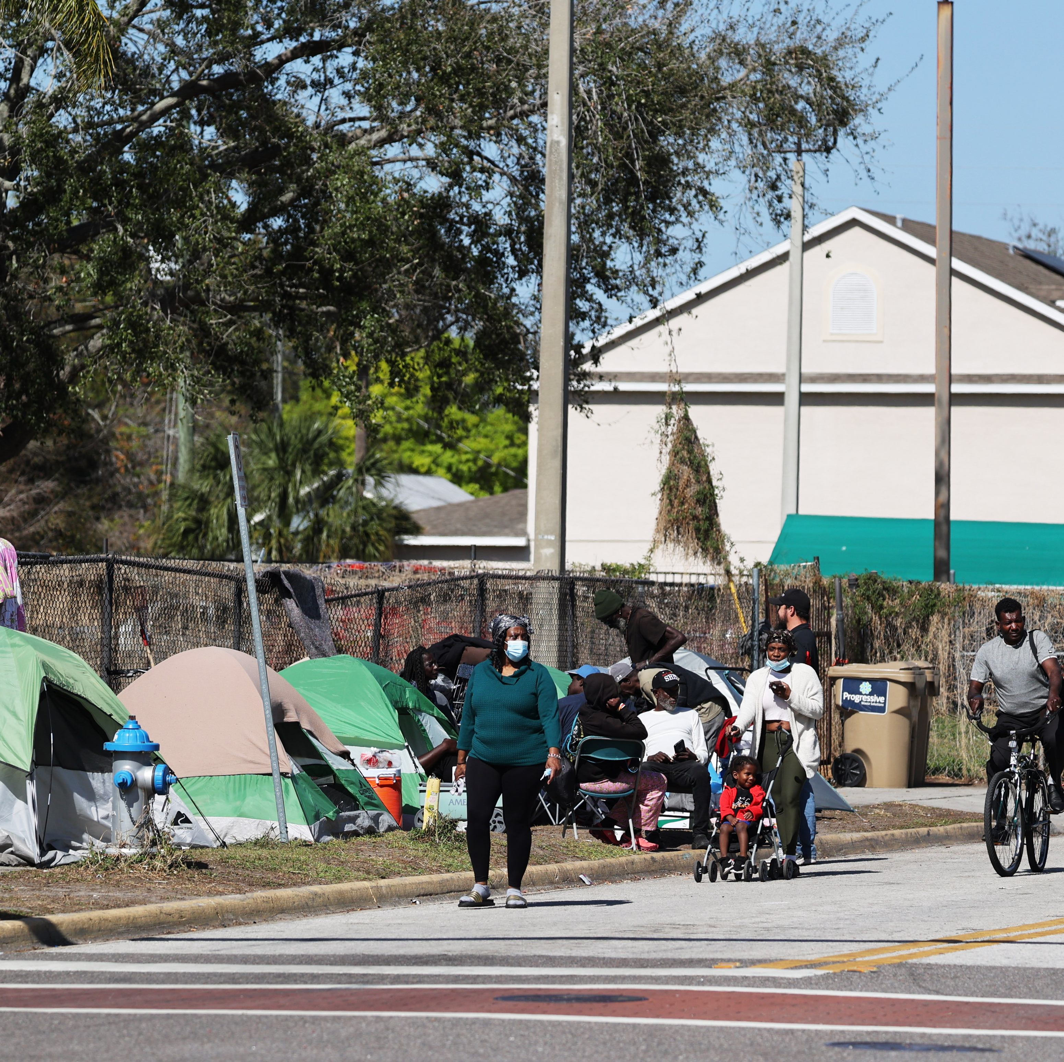
HCCH program/partnerships
HCCH Clinic
Outreach Team
Permanent Supportive Housing Team
Christian Service Center Day Center
Shelter Providers

Slide 9
Survey
Are the services provided adequate?
Is this a convenient location for you?
Do our hours sufficiently address your needs?
Would you recommend us to other PEH?
Are you able to access your medications in a timely manner?
Is there anything preventing you from coming to see us again?
Do you go to the ER less since coming to our clinic?

Slide 10
Results

Slide 11
Goals
Expansion of diagnostic services/POCT
Care coordination presence
Expansion of therapy services
Collaboration with PSH provider/medical vulnerable expedited placements
Expanded hours of operation
Harm reduction services on site: safe injection/needle exchange/Narcan/counseling

