Slide 1
Housing the “Impossibles”: How to House the Medically Frail Homeless Population
Dr. Alexis Chettiar, PhD, MSN, AC-NP, RN
Catherine Hayes, BSN, MPH, FNP-BC

Slide 2
Presentation Overview
Background information
Defining the problem
Overview of the Cardea Health medically frail housing model
Introduction to Home and Community Based Services
Discussion of Outcomes
Replication: challenges and opportunities

Slide 3
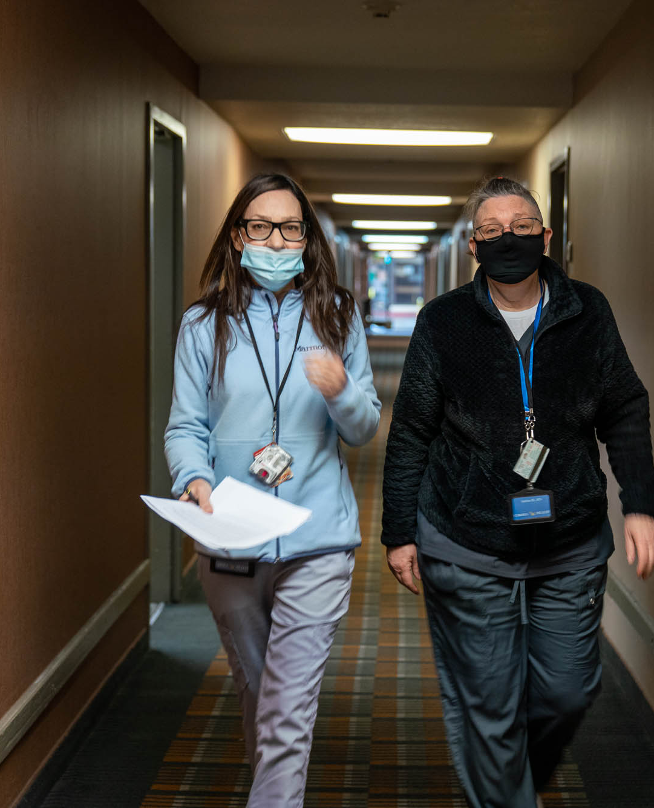
About Cardea Health
Cardea Health is a nonprofit organization in Oakland, California
Founded to connect marginalized populations to the clinical services required to improve health, remain stably housed in their community, and age in place.
Cardea Health offers integrated medical/social care models and compassionate, culturally competent care
Cardea Health operates certified Home Health Agency
Notes:
We are a new organization, founded in early 2021
Worth saying that we were founded by nurses, myself and my co-founder are NPs
We have between 60 and 70 employees now, mostly clinical staff
Really focus on people who have been chronically homeless and are experiencing severe illness, either acute or chronic
We work in an environment where health care and housing work for marginalized people are often separate and siloed and we have tried to create solutions to that problem
Provide clinical care at two respite facilities in the county, as well as two large Permanent Supportive Housing centers that are home to some very sick people. We do some less intensive clinical work at a couple of emergency shelters in the county and we do quite a bit of clinical consulting for agencies working with the unhoused population.

Slide 4
Homelessness in Alameda County, CA
2022 Point In Time count surveyed 9747 homeless individuals in the county: a 17% increase from 2019
27% are sheltered (shelters or transitional housing), 73% are unsheltered (vehicles, tents, abandoned buildings, other places not intended for habitation)
Notes:
Oakland is the center of the county. Alameda County is the second most populated county in CA, second to LA. Larger than SF, orange county, San Diego… other places you hear from quite a bit.
The shelters we do have are largely disconnected, which is to say they are run by independent operators and there are almost no medical or clinical resources in the shelters.
Lack of shelter options in our community. This leads to poorer health outcomes for our homeless community.

Slide 5
Homelessness in Alameda County, CA
Alameda County 2022 Point In Time Count and Survey
Notes:
This information comes from the Point In Time Survey: self reported data.
We have lots of sick and disabled people on the streets in our community.

Slide 6
Notes:
Alameda County participated in Project Roomkey, an enormous emergency housing effort that sheltered thousands of PEH during the COVID-19 Pandemic. The program targeted people who were thought to be at high risk for COVID – 19, and to decompress shelters and encampments. Also included an isolation and quarantine program
Myself and the other co founder of Cardea Health were hired by Alameda County to be the medical directors
A lot of this was pretty chaotic…not a lot of screening, list of risk factors was unclear. Ended up with well over 3000 people in several hotels, and we provided over 12000 Isolation/Quarantine stays.
This was an enormous opportunity to house people, and our county put forth a truly amazing effort, with housing navigation services in every hotel, housed thousands of people from the program.
But, as Alexis and I took over medical directorship and began to understand the population in the hotels we identified many people who were really, really ill. Needed ADL support, needed intensive clinical services, were “ICU eligible at baseline” or truly belonged in a SNF. Not housable

Slide 7
Declining Health
Hospital
SNF
Street
Shelters
Transitional Housing
Independent Living
Notes:
In any other situation, outside of the COVID-19 pandemic, those people would be excluded from shelter. What we see is that living on the street accelerates the aging process, accelerates chronic illness, people get sicker and sicker and a cycle develops where they show up in emergency departments, get hospitalized, maybe get sent to a skilled nursing facility where best case they get to stay 90 days, more likely they AMA or they have a short stay, they end up back on the street, they don’t have their meds, can’t get to their follow ups, get sick again, and repeat cycle and every time they get sicker and sicker.
As people need more help, become more functionally compromised to the point where they really require clinical support they become ineligible for housing options. Shelters won’t take you if you have weeping wounds or you are incontinent, if you need help with meds that excludes you from housing, and eventually they get to the point where they wouldn’t succeed in independent housing because they are too sick, and sticking them in a studio apartment by themselves is almost a guarantee that they will fall right back into homelessness.

Slide 8
Individuals with complex chronic illness and personal care needs who have experienced homelessness (PEH) are rarely able to live successfully long-term in the community, due to a high level of medical and social instability
Many PEH prefer not to reside in an institutional setting
Programs designed for individuals with skilled care needs or personal care needs can be difficult for PEH to access
Individuals with a need for intensive, long-term care needs are often unable to reside successfully in housing
Municipalities across the county struggle to successfully support this high-risk, high-needs population
Notes:
First bullet is what I just described:
Second: the population is younger than those typically found in custodial care or a SNF, they want to be able to come and and go, do what they want to do, enjoy the lack of restrictions that everyone else has.
The options that are out there for housing, like Residential Care Facilities, or Board and Cares (housing that often has some level of clinical services) are really hard to access, you have to be savvy and know how to navigate the system and have all your benefits and documents in order….not something PEH are set up to succeed with.
This is problem across the county

Slide 9
Traditional Care Model
What doesn’t work about this system for people who have experienced homelessness?
People are forced to move through different systems of care as their needs change
Individuals with behavioral health issues and substance use disorder often struggle in institutional settings
Care is difficult to access and coverage may be limited
Notes:
More things about how the system set up for people who need clinical support doesn’t serve the unhoused poplution.
They struggle in institutional care but they are also not wanted there, lets be honest.
It’s hard to find a SNF bed in our county even if you are housed, medi-caid is not a good payer, and it’s short term.

Slide 10
Case study
Q is a AA male in his late 40’s with paraplegia secondary to GSW to the spine ~15 years ago. He is incontinent of stool and urine.
Chaotic SUD
Unstageable wounds to sacrum and bilateral lower extremities with chronic antibiotic resistant osteomyelitis. Recent AKA.
Cycled in and out of hospitals, SNFs, the street and incarceration.
Eventually barred from every SNF due to behavior related to SUD
Street homeless in wheelchair for 10+ years
Notes:
What do we do with someone like this?

Slide 11
Creation of the Medically Frail Housing Model: Enhanced Permanent Supportive Housing
Defined Eligibility Criteria for Medically Frail Residents (must satisfy all)
Currently homeless
High healthcare utilization: >7 ED visits or >1 hospital admission in the prior year
Functionally compromised
Complex chronic Illness
Cohorted those qualifying as medically frail at a future Permanent Supportive Housing site (Oak Days)
Medical Complexity
High utilization of ED/inpatient services
Compromised Functional Status
Notes:
Back to the Roomkey Program
Alameda County gave Cardea Health the opportunity to define the sickest folks and put them in one former hotel that was designated to transition into Permanent Supportive Housing. So we set about reviewing every single one of the thousands of people in the Roomkey hotels to pick out the ones that we thought needed intensive support and services.
Very high bar: eligibility
Bouncing in and out of hospitals
Functionally compromise meant in a wheelchair or using a walker, or bed bound. It could also mean such severe mental illness or traumatic brain injury that one is unable to care for themselves.
Complex chronic illness: meaning disease that would progress to severe disability or death if left untreated, or essentially, end stage disease process. These were folks with metastasized cancer, requiring dialysis, cardiovascular disease that has resulted in events that have left permanent damage, liver failure, often all complicated by untreated behavioral health issues.

Slide 12
Funding the Medically Frail Housing model
Seed funding provided by Alameda County for 1st year of operation
Intended as a pilot site to assess feasibility, efficacy, and impact
Enhanced on-site services allow these institutionally-frail residents to live successfully in a community- based setting through the end of their lives, regardless of how care needs change over time
The program is sustainable, replicable and cost saving: How do we do this?
Notes:
The county gave us a year of funding, we staffed the site with nurses, Home Health Aides and a lot of unlicensed personal care: people who helped clean rooms, get groceries, helped escort people to appointments, and basic unskilled ADL support. But, this is housing, not an institution. People can come and go as they please, they can refuse care, they can have visitors, they can decide what they want to participate in and what they don’t.
Different than “compliance contingent” care that we find elsewhere.
This was a pilot program we aimed to create a place where these folks could live in a community based setting no matter how sick they got or how much help they needed up to and including end of life care.

Slide 13
Introduction to Home and Community Based Services
Within broad Federal guidelines, States can develop home and community-based service waivers (HCBS Waivers) to meet the needs of people who prefer to to get long-term services and supports in their home and community, rather than an in an institutional setting.
Nearly all states and DC offer services through HCBS Waivers.
Eligible individuals must demonstrate the need for a Level of Care that would meet the state’s eligibility requirements for services in an institutional setting.
The waiver enables states to tailor services to meet the needs of a particular target group.
Notes:
States have the ability to develop programs that serve people in the community, and keep them out of nursing homes and insitituions.
Third point: you basically have to be sick enough for long term nursing home care.
States can tailor services within waiver programs to meet the needs of certain groups, will show examples of this within CA
Biden talks about this!

Slide 14
HCBS waivers can provide…..
Case management
Homemaker services
Respite Care
Personal Care
Skilled Nursing
Attendant care
Meals and nutritional services
Crisis intervention
PT/OT
Family support services
Specialized medical equipment
Home adaptions
Behavioral health care
Transportation
Counseling and therapeutic services
Notes:
Not all waivers provide all these things, but it’s an example. The total list is actually much longer.

Slide 15
California HCBS Waivers
Assisted Living Waiver: targets individuals 65 years or older or individuals ages 21-64 who meet a nursing facility level of care
Waiver for Californians with Developmental Disabilities: Provides services for individuals with intellectual and developmental disabilities
Home and Community Based Alternatives Waiver: for individuals who are medically fragile and meet a nursing facility level of care
Medi-Cal Waiver Program: Targets individuals with HIV/AIDS
CA Multipurpose Senior Services Program: for individuals 65 or older
Program for Individuals with Developmental Disabilities: for individuals with intellectual and developmental disabilities.
Notes:
This is what CA offers, different states offer variations. Example of tailored programs.
Two different waivers that target folks who are medically frail the Assisted living Waiver, and the Home and Community Based Alternatives waiver: that’s in bold because I’m going to talk more about that.
There are two different waivers for people with intellectual or developmental disabilities that would meet the standard for an Intensive Care Facility
One that targets seniors specifically, the Multipurpose Senior Services Program
And one specifically for people living with HIV/AIDS
If you’re interested: google HCBS waivers, your state. You’ll get an explanation of what your state offers, and it probably looks something like this.

Slide 16
The CA Home and Community Based Alternative Waiver
The Home Care Based Alternatives waiver provides unlicensed care (known as Waiver Personal Care Services) as well as skilled nursing services.
Assistance in Activities of Daily Living
Habilitation Services: care coordination and management provided by a LCSW
When approved, HCBA services are coordinated by the authorized waiver agency. HCBA waiver agency conducts 6-month assessments to address new or unmet needs
Clinical care must be provided by a certified Home Health Agency
Skilled nursing services including:
Assessment and skilled observation
Wound care and dressing changes
Injection administration
IV monitoring
Tube feeding
Catheter insertion/monitoring
Tracheostomy care
Medication administration
Patient and caregiver education
Notes:
The HCBA WAIVER is what we enroll our Oak Days residents in and what we leverage to provide care. This waiver can be provided anywhere, and provides up to 24 hours of skilled nursing care.
ADL support in the form of HHA care
Also provides “Habilitation Services” which anywhere else would be called medical case management, but in practice means that each HCBA enrolled client has a licensed LCSW that tracks appointments, hospitalizations and helps coordinate care as well as some other social services.
Side bar shows everything skilled nursing services cover, up to including someone on a home vent if needed.
Each county in California has a waiver agency that processes these applications and then coordinates the services once approved. So the waiver agency may approve 40 hours a week of ADL support, 8 hours a week of nursing services, and 4 hours a week of habilitation (this is an example) for an applicant, and then every 6 months that gets reassessed to evaluate if needs have changed.

Slide 17
Referral made from the Community
Defined as medically frail
Moved into MF PSH for immediate care and services
HCBA waiver application done on intake
Upon HCBA enrollment billing for services commences
Resident is reviewed every 6 months to adjust authorized services as necessary
Notes:
This is how we bring in eligible clients from the community now.

Slide 18
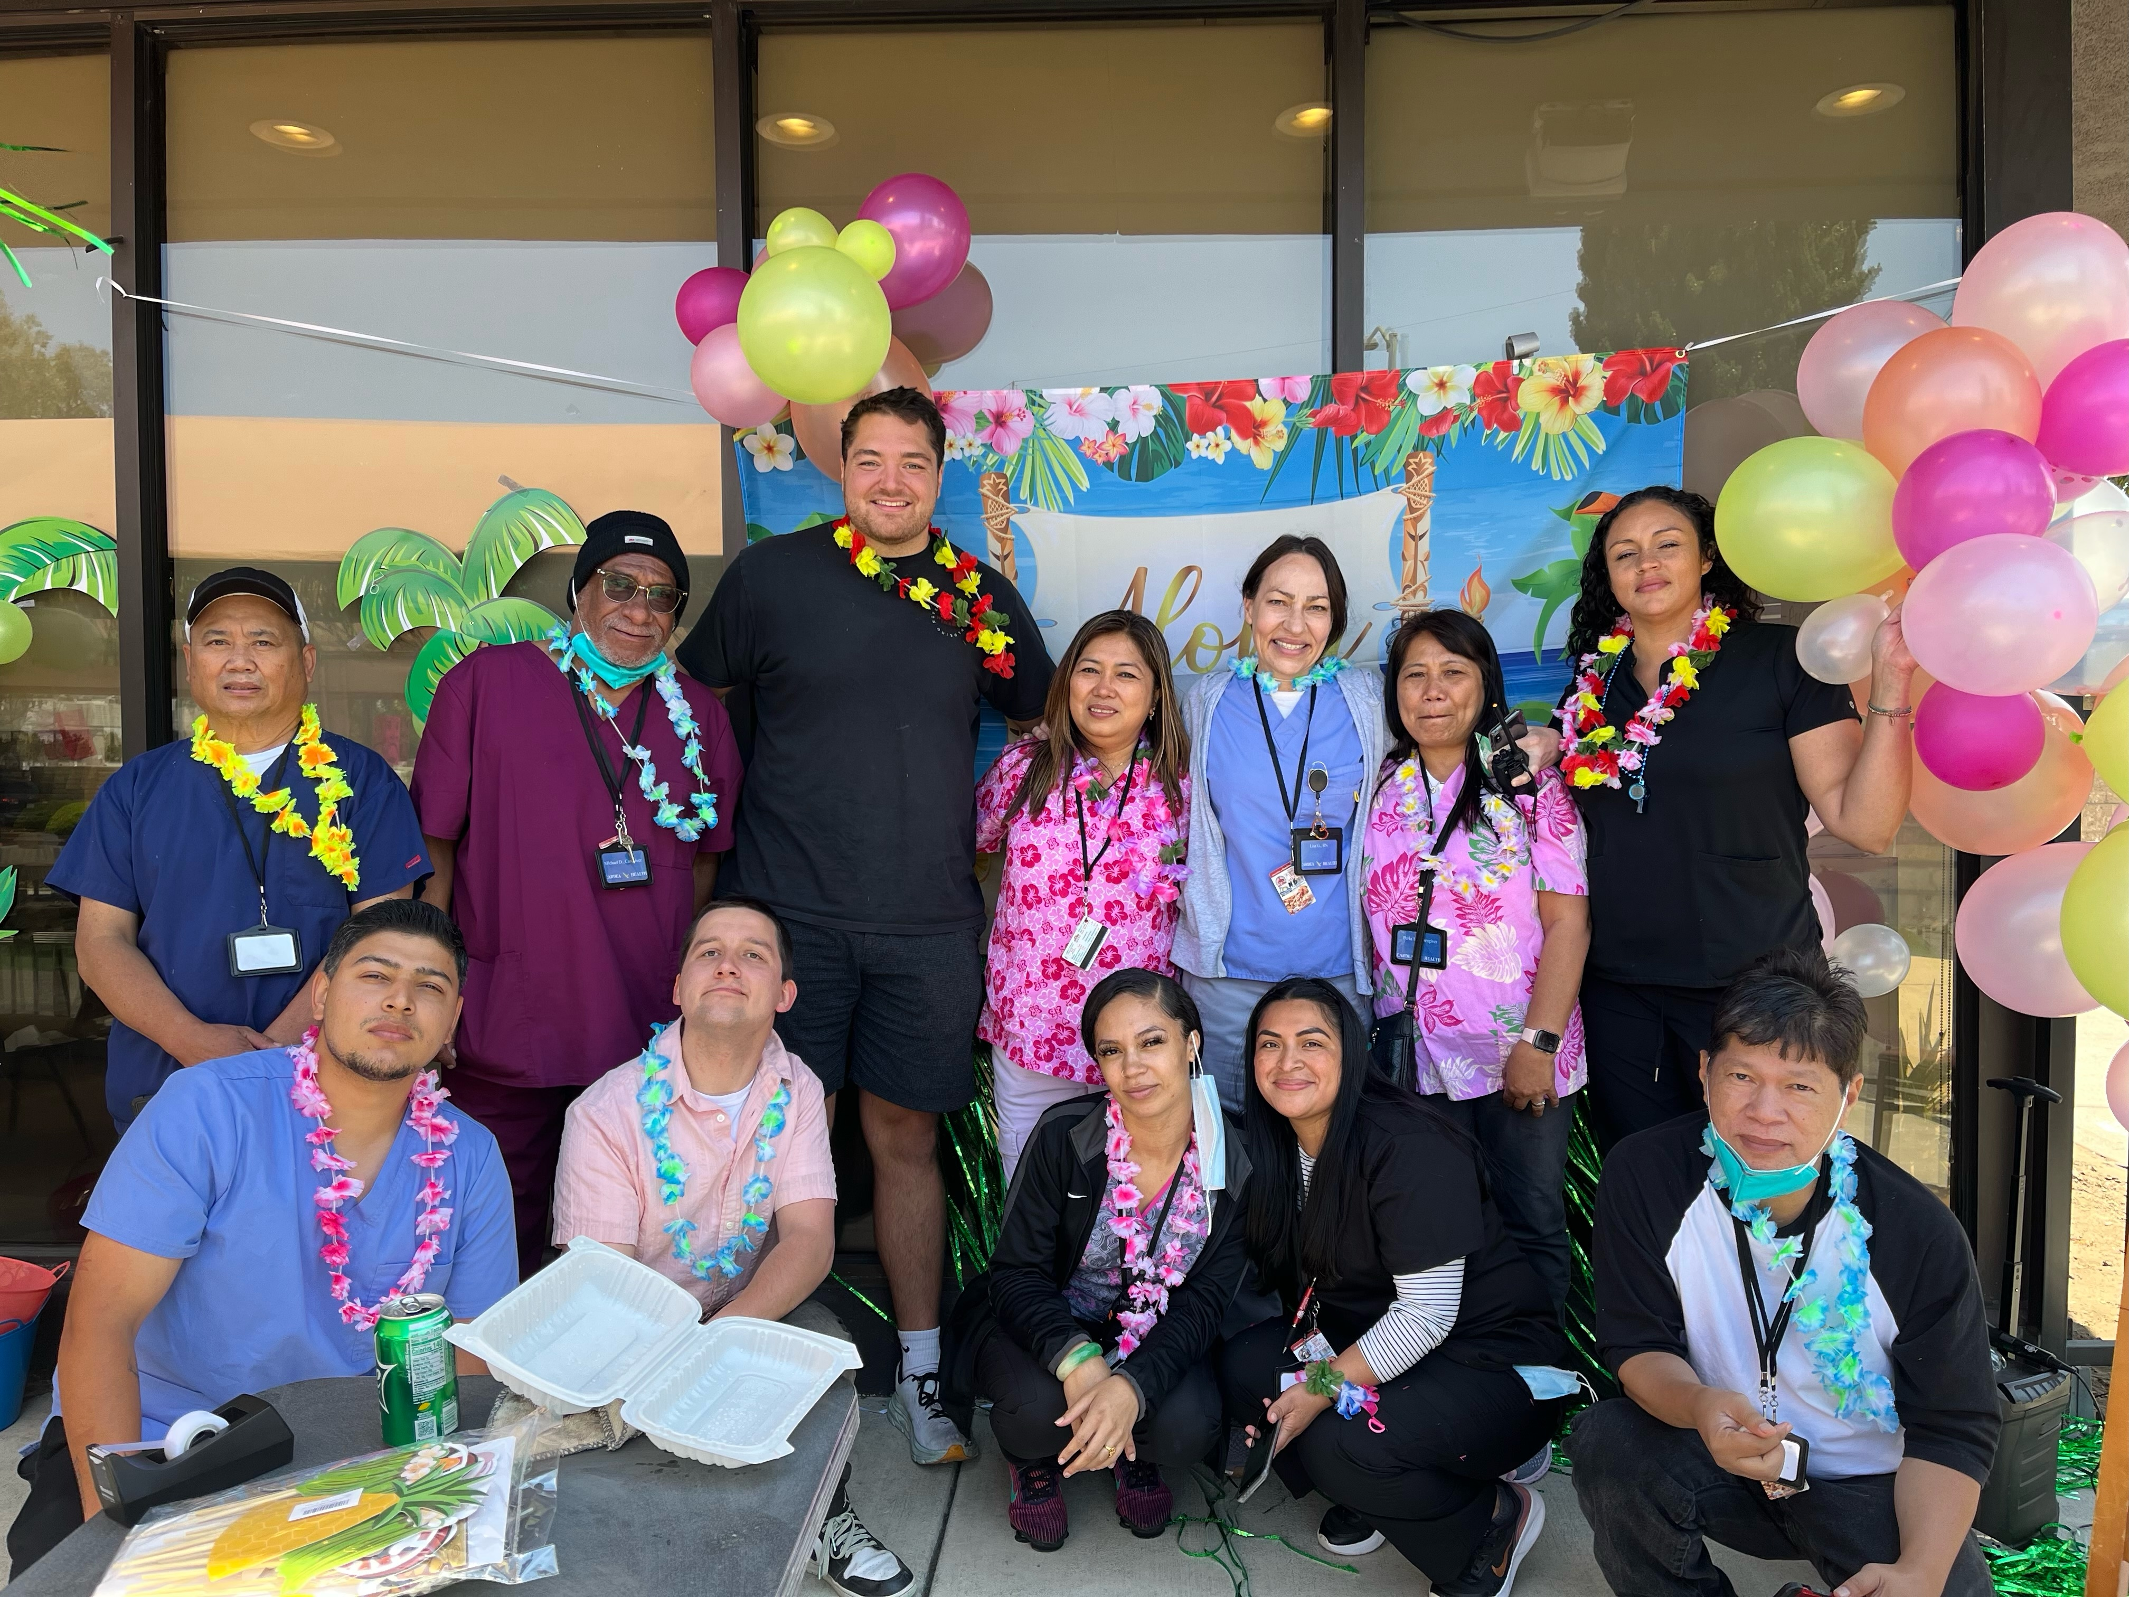
OakDays Program, Core Tenets
Harm reduction practice of medicine:
Provide care residents are ready to accept when they are ready to accept it
Until then, advise, inform, educate, encourage and respect resident choices
Unconditional care
No pre-requisites
Serve people who fall through the cracks
Home-based care model
No upper limit on intensity of care provided
Be creative, persistent, and flexible

Slide 19
Case Study
37 YO male with end stage kidney disease with no outpatient dialysis, heart failure, opioid use disorder, traumatic brain injury, seizure disorder, chronic pain, developmental disability, homelessness.
Referral Source : Mr. NW was referred to us by Alameda Health System's Complex Care Team. At that time, he was utilizing the Highland ED multiple times a week to receive dialysis.
Interventions: NW was started on methadone through a novel home-based program at the OakDays site and Cardea Health personnel trained to administer home hemodialysis. He now runs and plays basketball, and has not had a hospital admission for almost a year.

Slide 20
The Medically Frail model: key design points
Cohorted care: to succeed, the building needs ~25 HCBA eligible clients
HCBA care requires a certified home health agency to be the clinical provider
Start up funding: in CA waiver billing requires ~12 months of lead time
Partnership with a dedicated housing agency is key
Notes:
Reimbursement is bad. In CA nursing care is reimbursed at about 60 or 70 percent of what you could actually get away with paying a nurse in the Bay Area.
If we cohort clients in one place and pay nursing and HHA staff from pooled funds from billing, we have been able to reimburse nursing and other clinical staff at a rate that allows us to hire and retain people.
A certified home health agency has to be engaged.
It takes about 12 months to start billing for an individual. The application is complicated, the waiver agency is probably very backed up, billing is like learning a completely different language. It took us a little over 16 months to get off of county funds and become completely HCBA billing dependent.
We are not a housing agency, we partner with housing agencies who do all the housing stuff: security and logistics and food, etc. It’s important to find one that takes the same approach to radical compassion and harm reduction that we do.

Slide 21
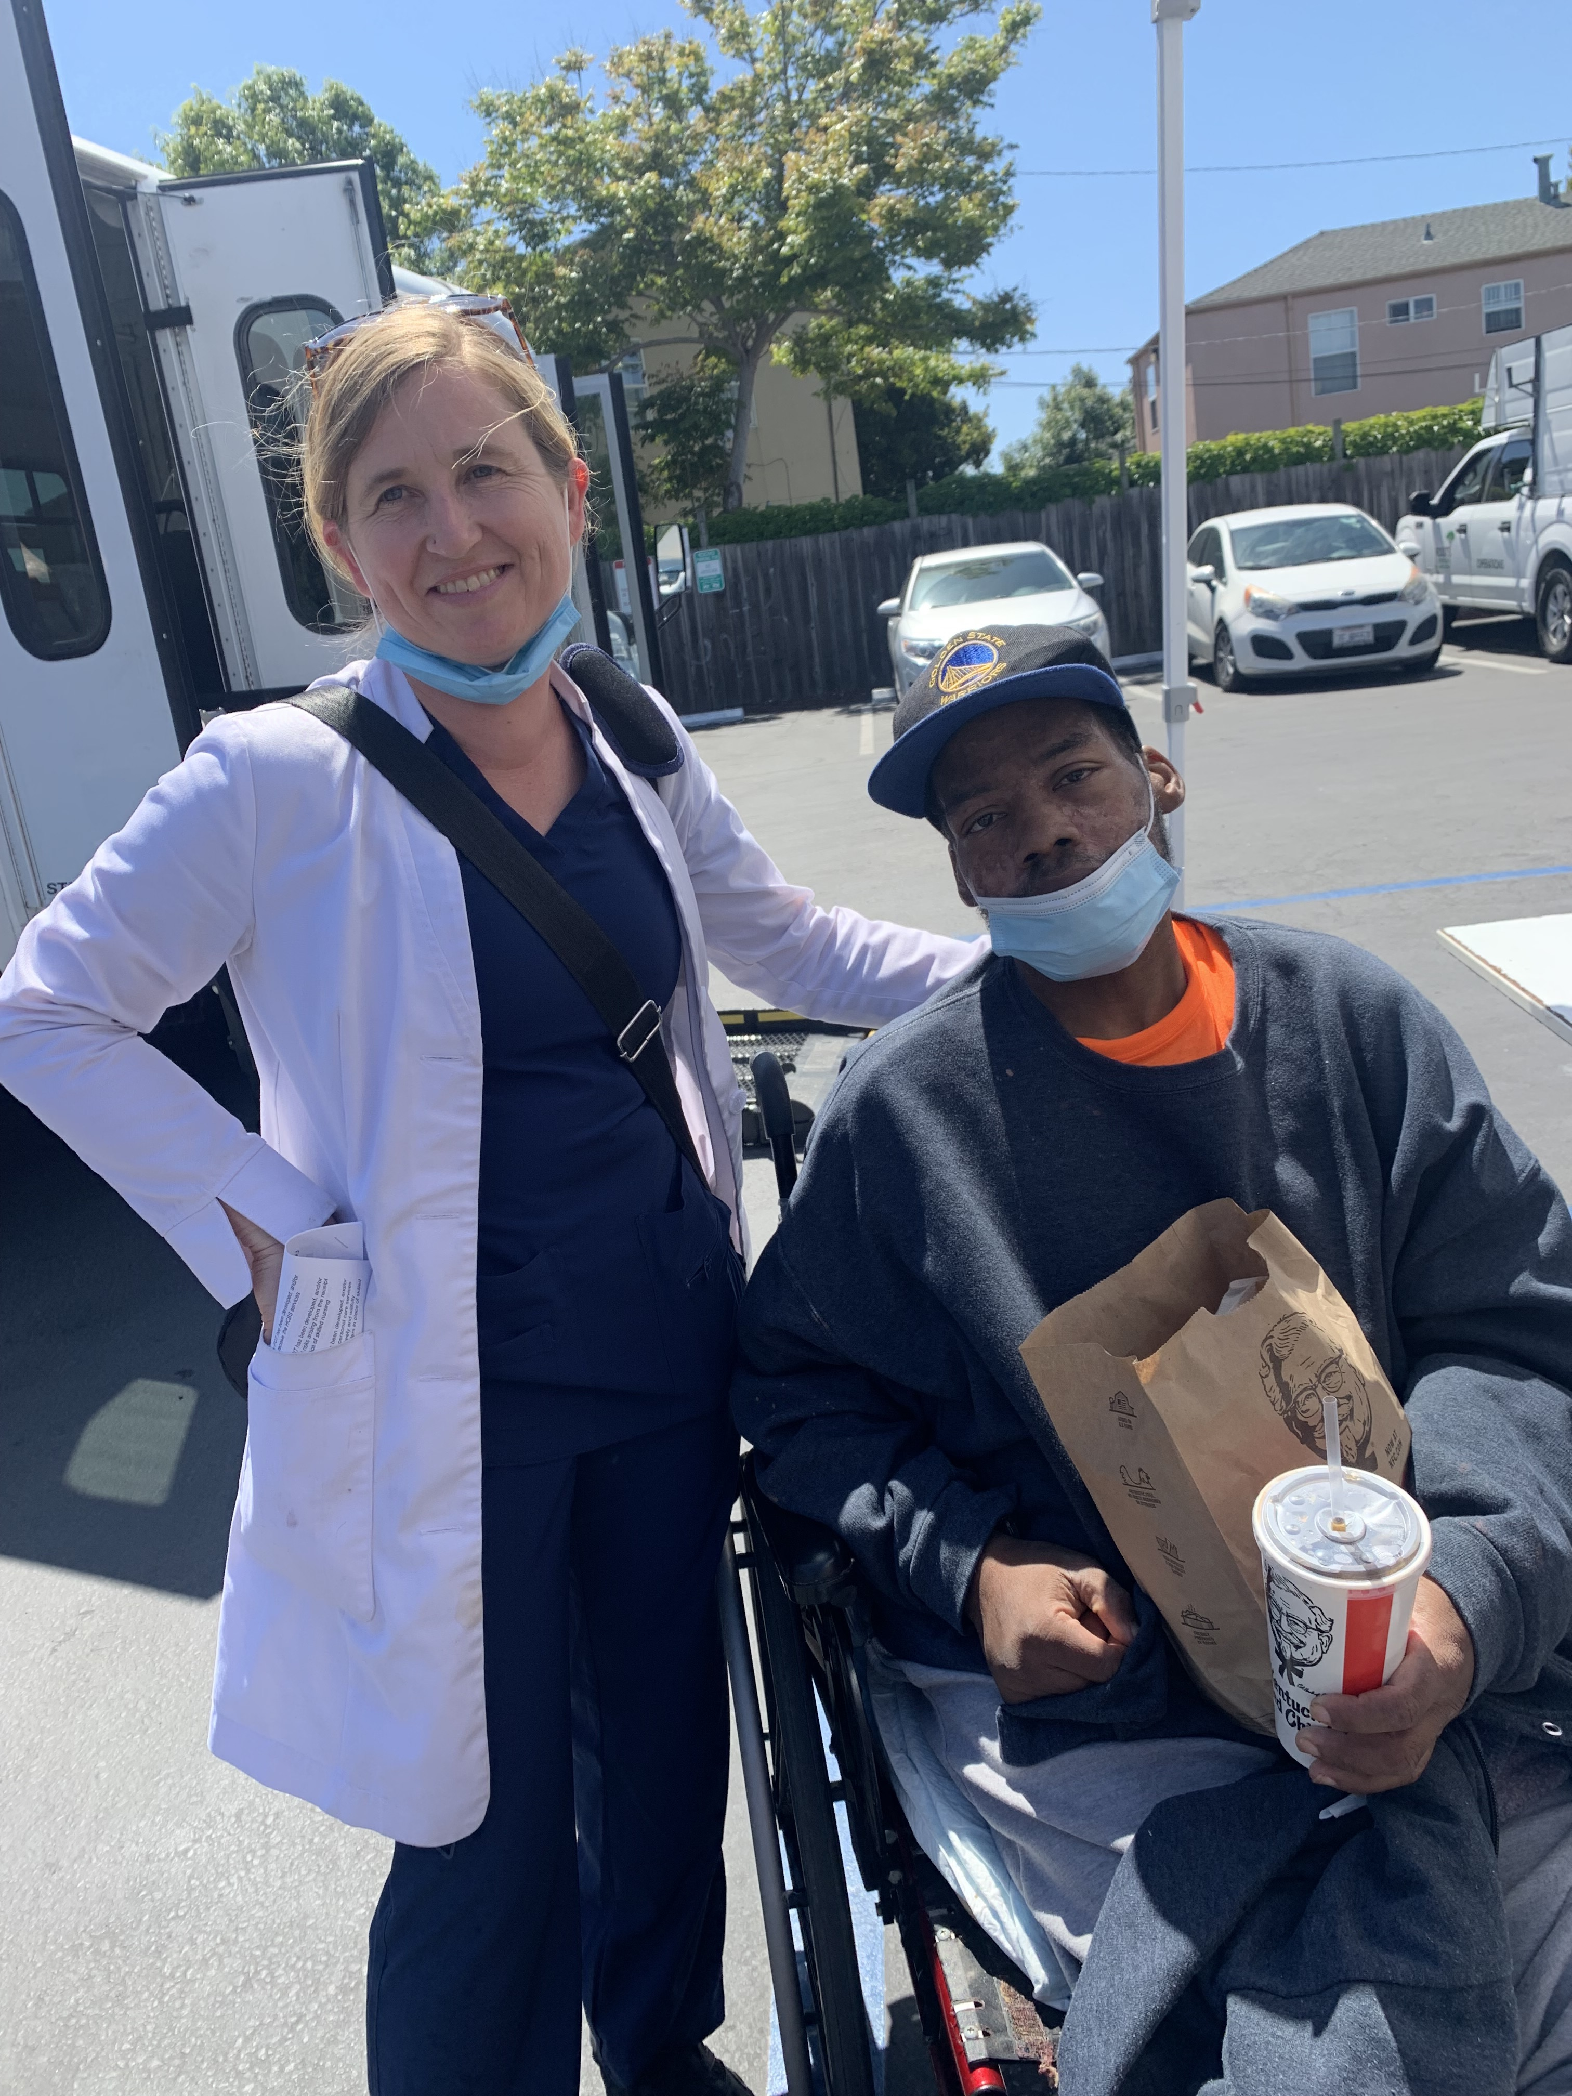
Outcomes of the Medically Frail Program
Among individuals who were housed for 180 days or more, OakDays residence was associated with ~80% reduction in
ED visits (psychiatric and medical)
Skilled nursing facility admissions
Inpatient admissions
Estimated $3.5 million reduction in healthcare spending for OakDays residents over a 180-day period
Estimated $8.4 million reduction in healthcare spending for OakDays residents between 1.1.2021 and 12.31.2022
Notes:
We examined utilization of tertiary care centers (ER, inpatient and SNFs, including psychiatric Ers) of our medically fragile homeless population 6 months prior to them moving into Oak Days and the 6 months after.

Slide 22
Project Homekey Oakdays Outcomes
Outcome | Assumptions | Estimated cost savings in 6 month post admission period*
Emergency Dept Utilization | *ED visit cost estimated at $1076. Assumptions: Medicaid pays 57% less than average ED visit charges (https://www.hcup-us.ahrq.gov/reports/statbriefs/sb268-ED-Costs-2017.jsp) Average ED cost to payer in California = $2960. (https://www.cbsnews.com/pictures/emergency-room-visit-cost-most-expensive-states/). | $532,620
Ambulatory Sensitive ED visits | Assumes that ambulatory-sensitive ED visit average cost is equivalent to ED visit average cost ($1076) | $35,508
Psychiatric ED visits | Psych ED visit cost estimated at $1076. Psych ED visit cost is roughly equivalent to ED visit costs nationwide¹, so ED visit average cost was used. | $26,900
Inpatient Admissions | Average IP cost estimated to be $13,200 (blended rate from all payers) | $2,244,000
SNF admissions | Average SNF LOS among PRK/PHK residents was 39 days. Cost/SNF stay assumes $410/day SF Bay Area Medicaid average for a shared room | $735,540
Including estimated costs to MCOs (Anthem, Alliance) Fee For Service Medi-Cal, and uninsured residents
Notes:
Who’s saving this money?
To some extent, the hospitals, who lose a lot of money on Medicaid patients, particularly if they have prolonged length of stay because of complicated discharge
But safety net hospitals do make up quite a bit of that lost money with federal dollars.
We are really saving Medi-caid money. In Alameda County we have two medi-caid providers, one primary one, and they are the ones really benefiting from this program from a cost savings perspective. When we think about who should pay for start up funding for more programs like this, they are the ones who, should be.
More importantly….the people

Slide 23
Challenges to Implementation
Service provider
Regulatory hurdles
Variance in programs across states
Notes:
I’ve mentioned a couple times that care has to be provided by a Home Health Agency: this is true for most waiver programs.
Our vision was to set up everything and engage a HHA
Instead….
The good news was that we got to still be the hands on providers of a population we genuinely care about.
Regulatory hurdles: you must engage a waiver agency, you must partner with another entity that is designated to provide Habilitation, Billing is ON PAPER,

Slide 24
If you want to implement something similar:
1
Contact your local healthcare service providers to assess interest/willingness
Home Health Agencies (nonprofit)
Federally qualified health centers
Street teams
2
Identify a site that has critical mass of high-needs individuals (threshold will vary by state and program streams)
3
Build relationships with Medicaid service providers and find someone with expertise in Medicare and Medicaid programs
4
Seek city/county/state support for program launch
5
Engage individuals/organizations with expertise in Medicare and Medicaid program design

Slide 25
Thank you!!!
www.cardeahealth.org
Catherine.hayes@cardeahealth.org
Alexis.Chettiar@cardeahealth.org

