Slide 1
Housing Transition Team 2022 Annual Report out
Partnership with the CU School of Medicine and UCHealth

Slide 2
Results of a Qualitative Program Evaluation of the Housing Transitions Team (HTT)
Barriers
Methodology:
Barriers to the team doing their work effectively include: a lack of resources in the community (housing in particular), team members’ values and goals do not always align with those of the hospital (which is focused on discharge/throughput)
Overall, clarity on the role of the HTT and the tier system, expansion of their efforts, and standardization around the referrals and feedback process are what came up most often.
Direct Quotes:
“They probably don’t have enough funding”
“Community barriers that exist just for unhoused individuals in general”
“Exposing it more to the rest of the UC Health system”
Note that we asked patients what we could do to improve the team/how they would design a team to help with housing issues. Without exception they said they would design a team exactly like the one in place, and that they had no suggestions for improvement.
Developed an interview guide using a dissemination and implementation research framework (PRISM)
Conducted semi-structured interviews with 15 stakeholders:
3 HTT social workers
3 non-HTT specialty social workers at UCH
3 community partners
3 members of administration
3 patients
Analyzed results using rapid qualitative methods

Slide 3
Results: Direct Quotes
Community Partners:
“They [the HTT team] collaborate on typically more complex individuals than just the folks that come in and out of our main clinic. There is usually a lot of advocacy and a lot of really intentional approach to coordination that they do. And that’s really the approach needed for some of our more complex folks … The HTT team really is able to kind of make traction on those individuals needing extra layers of resources.”
“I wish every hospital had UC Health’s HTT team.”
“They all are wonderful to work with. I really can’t say enough good things about that team.”
Administration:
“It's a huge value add to have a team that actually set the time and do a more thorough assessment and build that relationship [with a patient].”
“The team that has been hired is specifically a success. I think they're very passionate. They're very knowledgeable. I think that they understand the population. I also think that they have gone above and beyond to really do the relationship building with other community providers.”
Patients:
“I believe that at that point in time what I was going through, that they saved my life … They’re a godsend. I don't know how else to explain it.”
“They actually made sure that I was going to be okay. I mean, actually right now, today as I sit here and talk to you about it, it almost brings me to tears.”

Slide 4
Results: Direct Quotes
Non-HTT Social Workers:
“They get involved in a patient's care, but they are not just like, ‘Okay. We will only focus on housing, and then that's it.’ They partner with that social worker that they're working with … [They] really help make a plan around the whole patient and every kind of aspect of care, not just specifically housing, which is extremely helpful. And maybe[they] identify barriers that people may not be noticing.”
“Understanding and actually having the ability to follow those patients and to have seen a lot of those [community] sites in person … gives them a greater understanding of helping with that transition [at discharge].”
“I personally have loved the collaboration. I find it extremely helpful.”
“Their services are so greatly needed. They’re obviously filling a huge gap that we've had for a long time. I hope to continue to see this program grow.”
“When HTT came in, my population just was cut in half almost, because they weren’t just referring patients to Comitis, like I was, but they were meeting patients at Comitis and at all levels of care. And the patients really wanted to see them there and advocate, and build a relationship more than filling a role.”
“They’re valuable too. They teach you a ton. And they’re always willing to try to keep teaching.”
“I’m just really grateful for them.”

Slide 5
Qualitative Summary of the results
Summary of results:
Interviewees were overwhelmingly positive about the impacts of the HTT, both as it relates to patient care and in terms of positive benefits for members of social work at UCH, community partners, and other hospitals in the Denver and Aurora area.
The team is meeting needs for coordination of care, facilitating transitions of care, and preventing readmissions.
The team especially benefits people with complex healthcare and social needs.
Qualitative study completed in full by Erin Brendenberg, Mandy Johnson and Michael Castallarin and Team

Slide 6
Quantitative Data:
Annual Data for 2022:
238 patients enrolled into HTT
83% Medicaid
102 patients consulted to support but not enrolled in HTT (start date 4.1.2022)
40 patients housed
100+ community partnership meetings and collaboration

Slide 7
Quantitative Data Results:
238 total patients actively served < ED 12. IP 160. OP 66> <tier1 73. tier2.96. tier3 69>

Slide 8
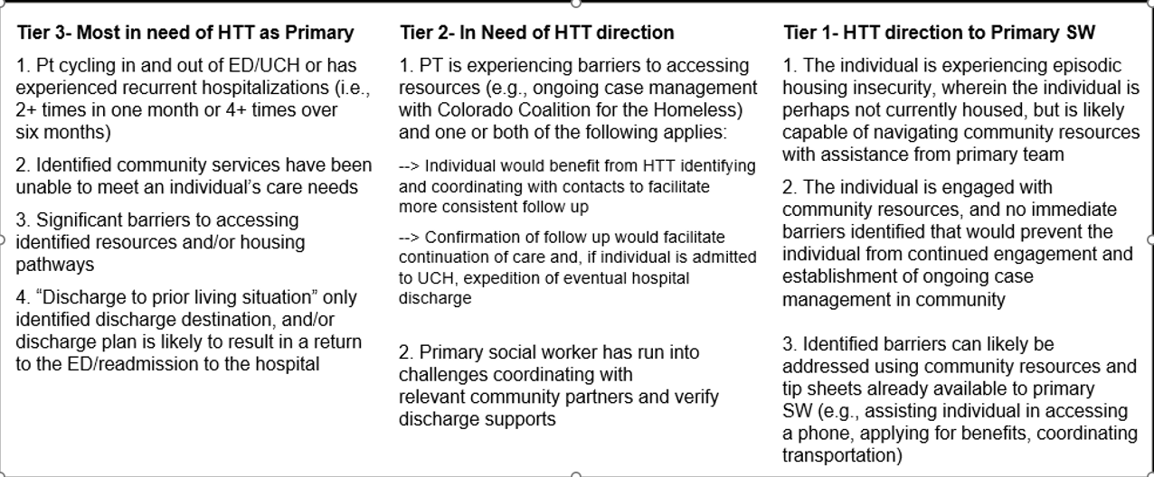
Tiered System for HTT Referrals

Slide 9
Community Partners
HTT has both contracted and non-contracted community Partners.
Mile High Behavioral Health Care
Denver Housing Authority
Colorado Coalition for the Homeless
Denver Rescue Mission
Recover Works
Salvation Army
City of Aurora
Delores Project
Colorado ID Project
Family Tree
The Gathering Place
Denver Street Outreach Collaboration
HOST
Housing Connector
Comitis – 5 beds April -October. 7 Beds November-March
CCH Beacon-3 beds
Recovery Works- 1 bed Contract started 7.1.2022
Pallet – 2 assigned starting 4.18.2022

Slide 10
HTT closed referrals in 2022:

Slide 11
Success v. Barriers
Successes
Barriers
Improved discharge planning for patients ​​
More dedicated time building rapport with patients and co-developing discharge plans to promote community stability.
Increased community partnerships & new resource pathways
Increased patient choice, trust, & participation ​
Built collaborative relationships with patients to help determine best fit for their housing needs and helped them link to alternative to congregate shelters when needed (e.g., Safe Outdoor Space sites, extended respite stays, etc.). ​
One consistent staff-advocate contact through the medical system (ED, inpatient, outpatient, and into the community). ​
Vouchers for housing access
Financial Support for Increased Staffing for HTT
Gaps in established resources that effectively exclude some populations or create ​prohibitive obstacles to access.
Resource Silos
In an effort to move away from territorial perspectives, HTT has been working to promote partnerships where a shared community patient mentality is practiced.
Community organizations not having a warm handoff or collaboration across systems
Unclear and effective workflow for those with a physical disability:
Lack of ADA units in and throughout the state
Systematic Barriers for the unhoused:
Medical stability (oxygen needs)
Personal identification status
Families
Past trauma
Any criminal record

Slide 12
Patient Story: https://www.uchealth.org/today/homeless-find-path-to-housing-and-better-health-in-denver/

