Slide 1
Enhancing the quality of life for PEH through providing quality dental care
Herman Ostrow School of Dentistry of USC
Presentation by:
Mehdi Mohammadi DDS MPH MS
Division of Public Dental Health and Pediatric Dentistry, Herman Ostrow School of Dentistry, University of Southern California, Los Angeles, California, USA.

Slide 2
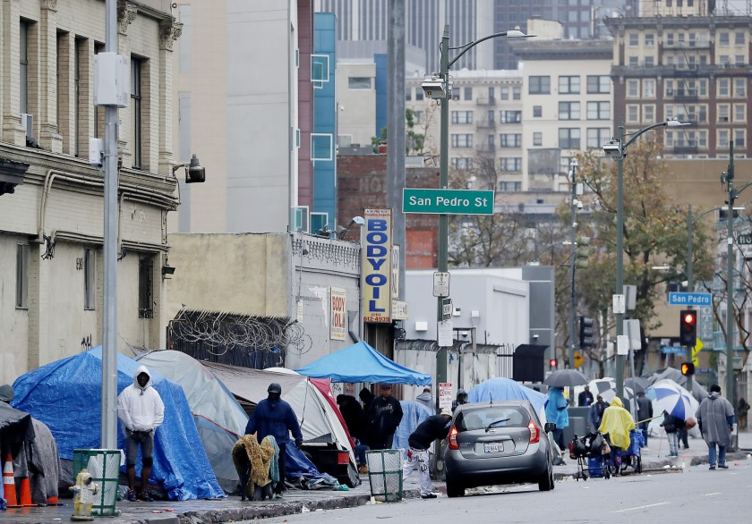
Homelessness in Los Angeles, CA

Slide 3
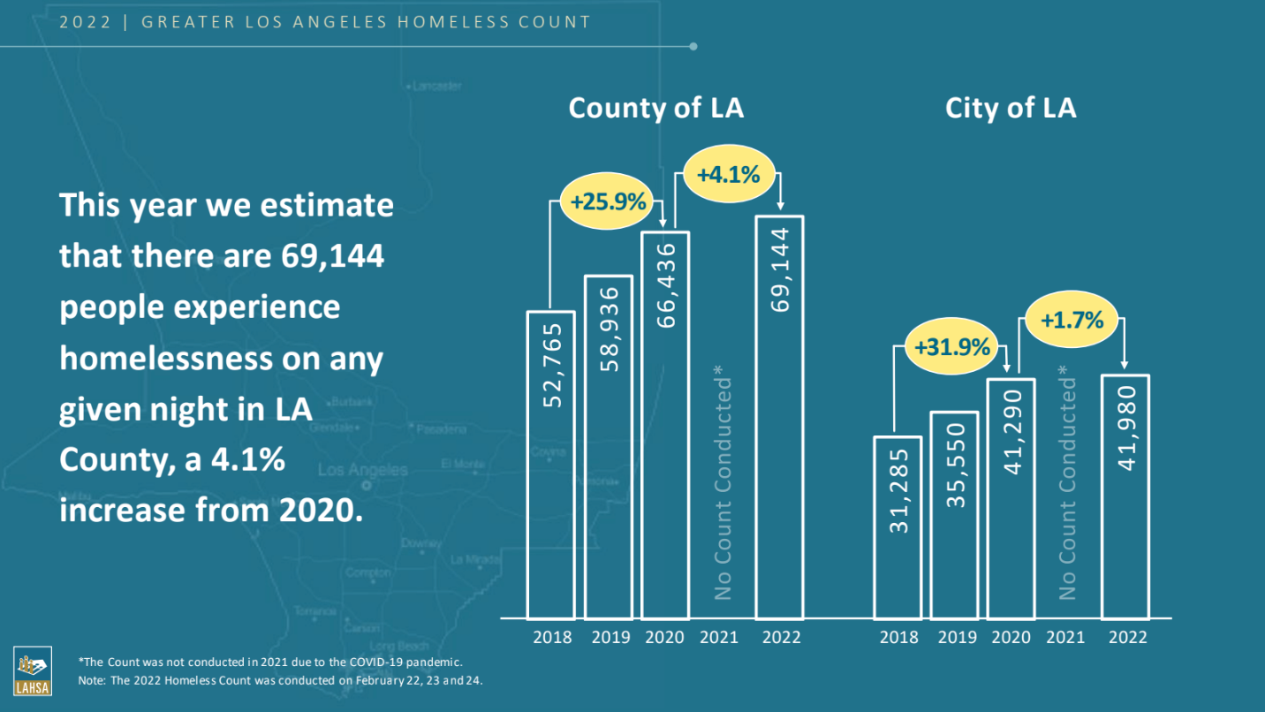
Homelessness in Los Angeles, CA

Slide 4
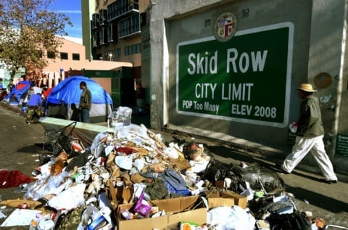
Homelessness in Los Angeles, CA
Skid Row: Approximately 2500 homeless individuals at any given time; located in a 52-block area east of downtown LA
This is the largest community in the US of indigent, transient, and low-income residents.

Slide 5
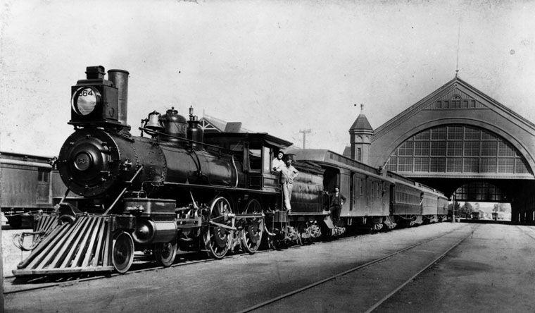
Exploring Skid Row: Understanding the Community and History
Skid Row's history is closely tied to Union Station, located nearby.
Union Station served as the last stop for trains to the West Coast, attracting diverse individuals.
Skid Row became a hub for transient people, offering affordable lodging and bars.
It became a community with limited resources and social challenges due to its continuous flow of people through Union Station.
In the 1970s, as homelessness became more of an issue, police restricted the homeless within the Skid Row area.

Slide 6
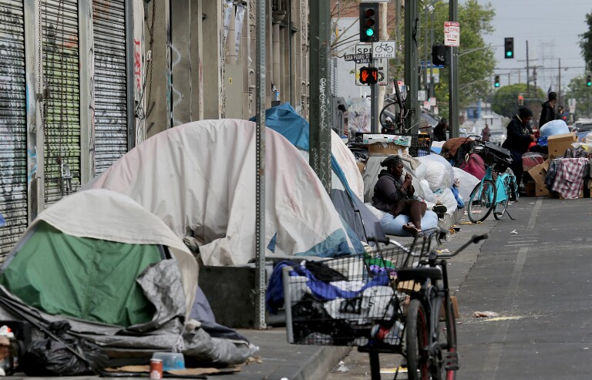
What is Skid Row?
Skid Row’s name comes from historical skid roads used to transport logs down hills, near low-cost housing and temporary shelters.
The term "skid row" now refers to the 54 city block area in Los Angeles with extremely high homelessness, poverty, and limited resources.

Slide 7
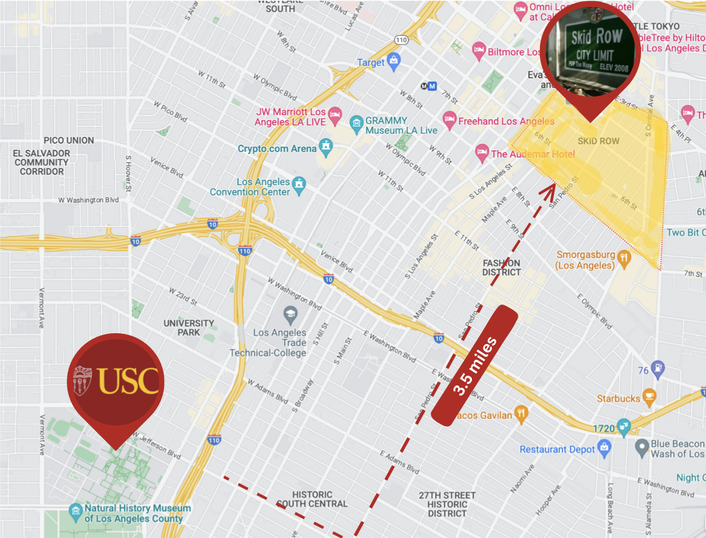

Slide 8
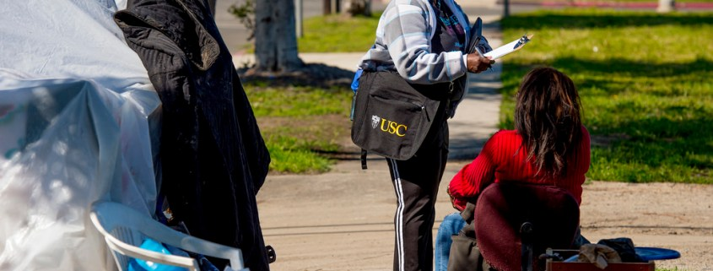
Understanding the Location of USC's Clinic in Skid Row
USC is 3.5 miles away from Skid Row, making it a neighboring community of the university.
Skid Row is part of the USC community, and the University is devoted to making a positive impact and providing aid to the area.
The dental school at USC became involved in the Skid Row area with the Union Rescue Mission clinic, offering dental care and support to those in need.

Slide 9
Union Rescue Mission
One of the largest mission of its kind in US
Founded by Lyman Stewart, president of union oil company 1891.
Helping individuals and families break the cycle of poverty and achieve self sufficiency.

Slide 10
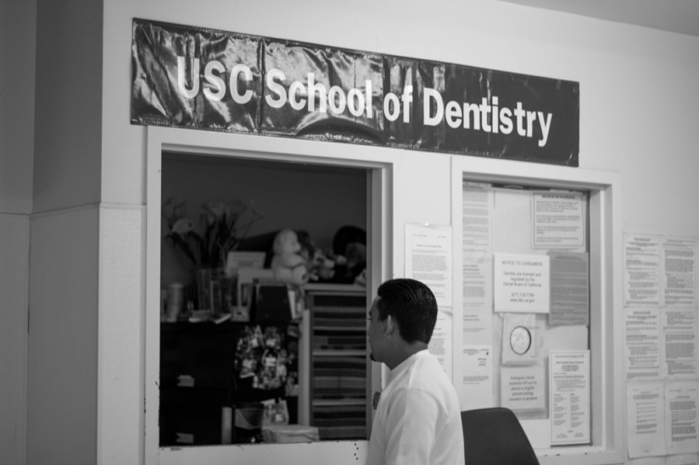
History of Campus-Community Partnership Building to Serve the Homelessness
Grant from Health Prof. Schools In Service to the Nation
Co-founder of Dental Coalition for Needy Children, 1991
Participate in Skid Row Health Fairs
Partner in LA County Health-Faith Project collaborate with LA Homeless Services Authority
Co-founder of LAC Coalition of Med. Mobile Units, 1995
USCSD & Union Rescue Mission Planning, Late 1990s
USC+URM Dental Clinic opened at URM in 2000
Notes:
https://www.yumpu.com/en/document/view/5752997/usc-urm-dental-clinic-national-network-for-oral-health-access

Slide 11
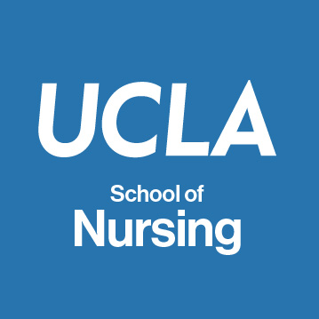
Union Rescue Mission Clinics
Local universities donate time and expertise for free services
Services include health, dental, psychological, and legal-aid.
Provides university students with an opportunity to expand their education.
Students serve the community by providing these services to guests.

Slide 12
After 5 years of discussion and planning
Through a joint effort between the University of Southern California School of Dentistry (USCSD) & the Union Rescue Mission (URM), a 6-chair dental clinic was opened in 2000 for individuals in L.A.’s Skid Row – 2 additional chairs were added in 2005.
1
3
Increase the number of PEH accessing dental care
Improve the oral health status of unhoused people.
Increase the number of the dental/ dental hygiene students providing care to unhoused individuals.
2

Slide 13
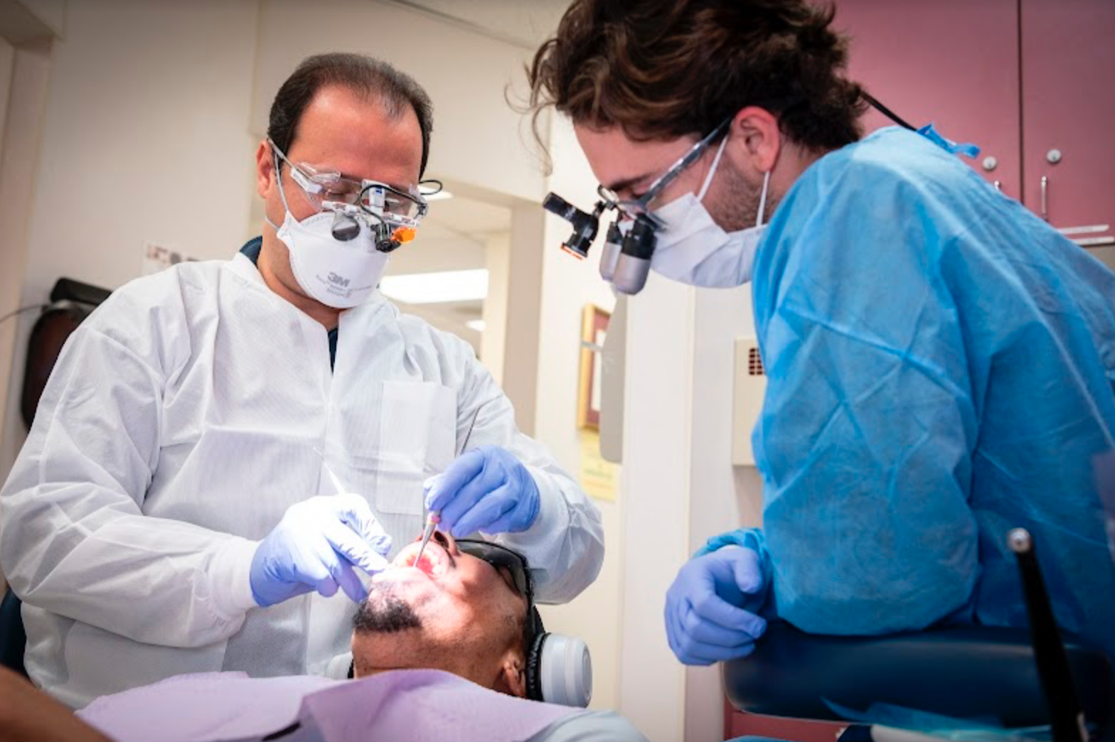
USC Dental Clinic at the Union Rescue Mission
USC School of Dentistry + URM 1999
Faculty, students, and interns from USC coordinate all patient services.
Eight-chair Clinic
Free of charge
8,000+ dental-care visits per year.

Slide 14
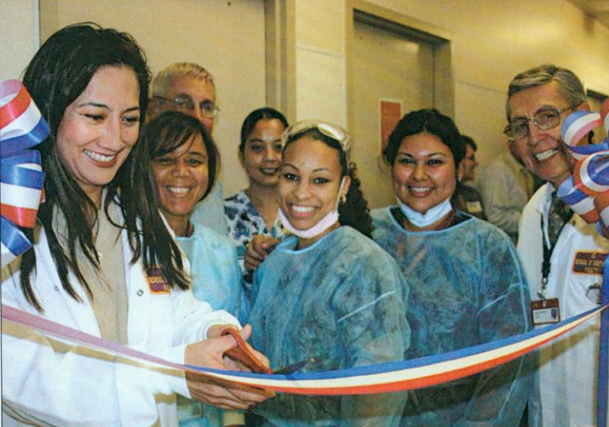
Administration & Evaluation
Evaluation
The program’s productivity is assessed from data on:
✌️ Numbers of homeless individuals receiving care & services rendered & patient feedback
✌️Number of students rotating through the clinic & faculty and student evaluation of the experience
Staffing
2-3 USCSD faculty members oversee the students work of 8 USCSD students provide care for 7 week rotations - comprehensive & emergency treatment
4 dental assistants and 1 office coordinator round out the team (two bilingual)
3 to 4 dentists volunteer their services part-time.

Slide 15
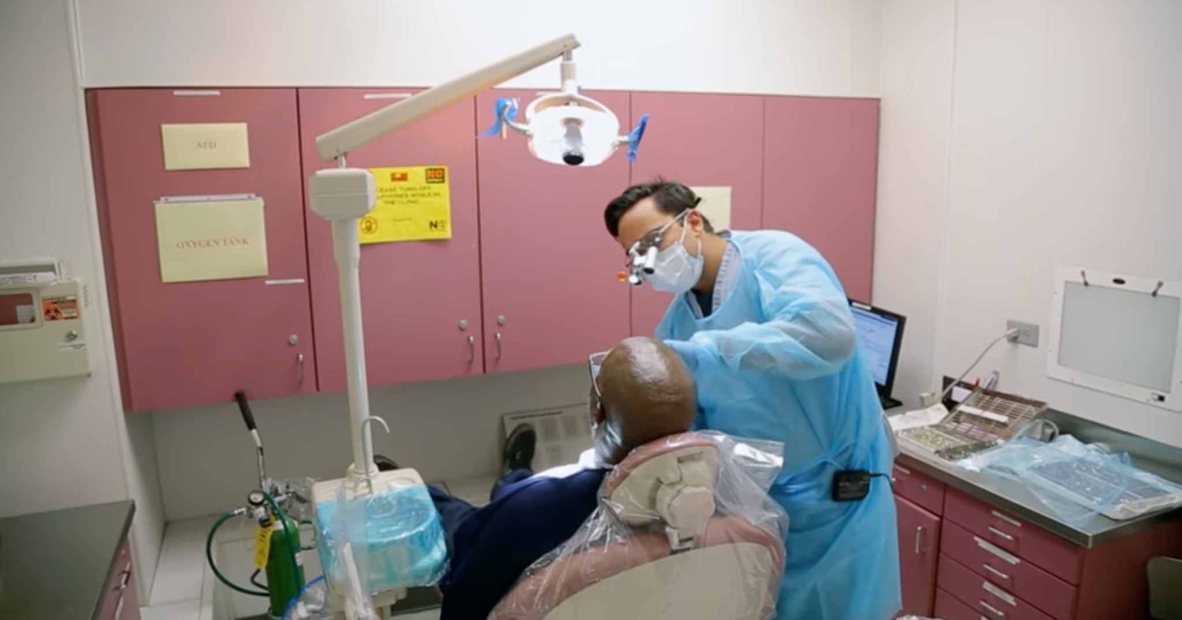
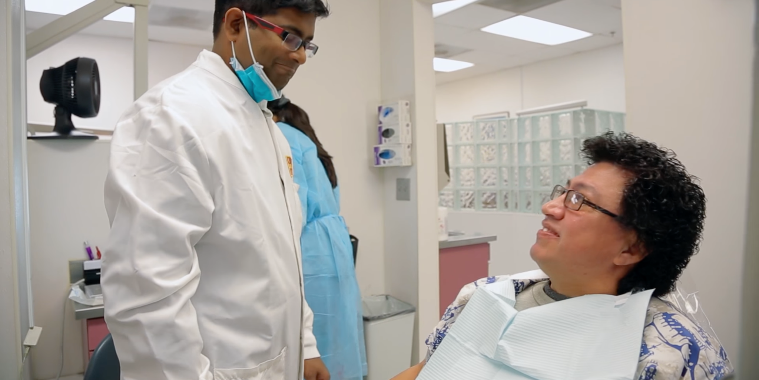
USC Dental Clinic at the Union Rescue Mission
Our Dental Clinic provides the following services:
✌️Cleanings
✌️Root Canals
✌️Fillings
✌️Tooth Extractions
✌️Complete & Partial Dentures
Notes:
Speaker note: URM also provides oral hygiene kits to patients

Slide 16
Outcomes
Root
Canals
10%
Annually 1350 + unhoused individuals receive care
All non-emergency patients receive:
✌️Comprehensive exam
✌️Radiographs
✌️Prophylaxis
✌️Oral hygiene instructions
Restorations 40%
Complete and Partial 25%
2022
✌️ ️ Over 17000 procedures
✌️ Monetary value: 3.5 million at no cost
. No cost
Extractions 25%
Notes:
Dr. mehdi will work on this

Slide 17
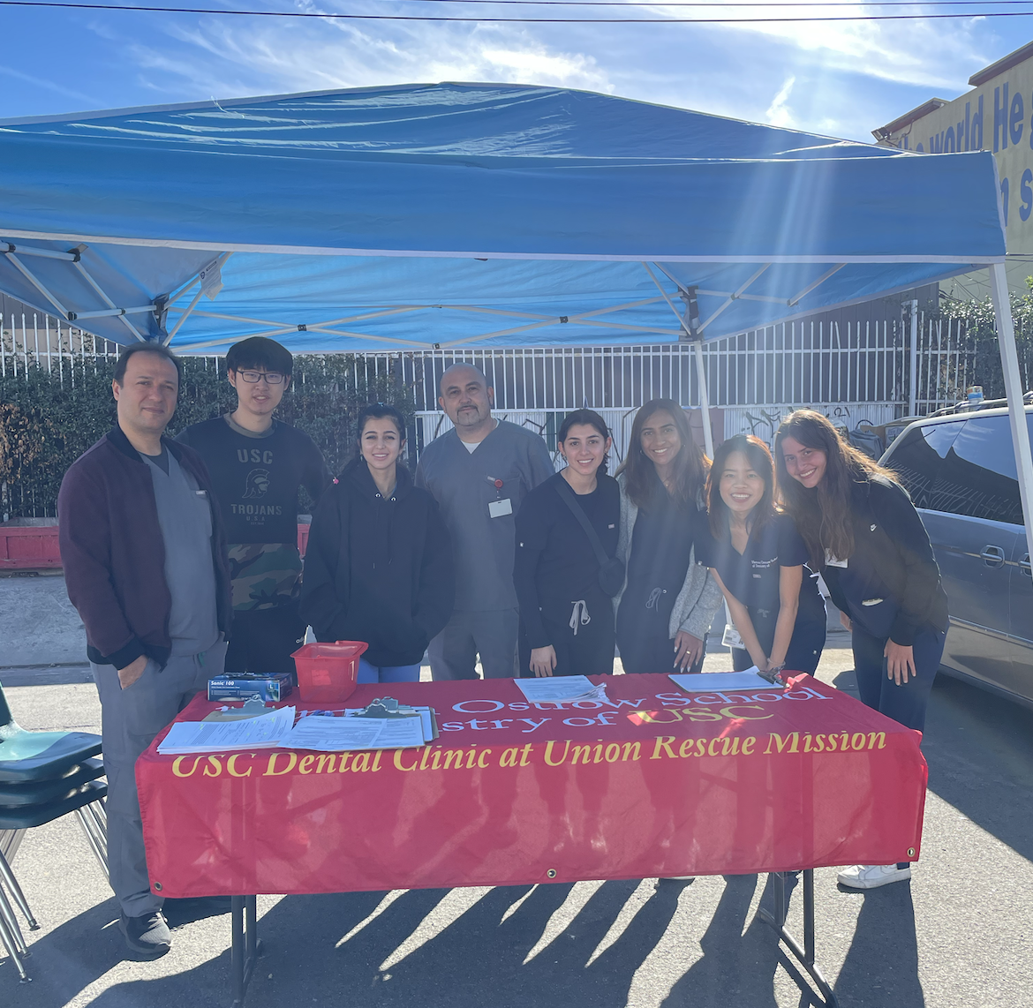
Outreach Events
Ostrow students volunteer at more than 20 health fairs each year in schools, agencies, churches, housing projects and other community locations in the Los Angeles area.
To promote oral health
Provide free screenings
Provide preventative care instructions and materials
Collaborates with other health-related, psychological, and social service organizations

Slide 18
Funding Resources
Northeast Valley Health Corporation
Covers almost 50%
Providers/staff Salaries
Material and supplies
Gift accounts, Denti-Cal and university
Remaining 50%
Lab charges, monthly internet server
Other charges.

Slide 19
Oral Health Disparities in People Experiencing Homelessness on Skid Row Sam Sheridan², Sarina Taylor², Mehdi Mohammadi¹ ¹ Division of Public Dental Health and Pediatric Dentistry, Herman Ostrow School of Dentistry, University of Southern California, Los Angeles, California, USA. ² Herman Ostrow School of Dentistry, University of Southern California, Los Angeles, California, USA.
The objective of our study is to provide updated information on the oral health of the Skid Row homeless population seen at the URM dental clinic.
Patients' demographics, dental history, oral pain, oral hygiene habits, and homeless status were assessed.
Faculty recorded various dental and oral health indicators
The rates found in national databases were compared to the rates reported in the Skid Row population.
URM patient population reports fewer dental visits within the past year compared to national databases.
URM patients have increased rates of oral and dental pain, more missing teeth, and higher rates of edentulism
These preliminary results suggest poor access to care and a lack of oral health literacy among the URM patient population
Notes:
Speaker notes: Homeless individuals are 12x more likely to have dental problems than those with stable housing but are less likely to visit a dentist.
All patients who signed a consent form for an initial examination at Union Rescue Mission dental clinic from 2016 to 2020 were included in the study and surveyed.
Dental and oral health indicators were missing teeth, decayed teeth, existing restorations, and caries risk.

Slide 20
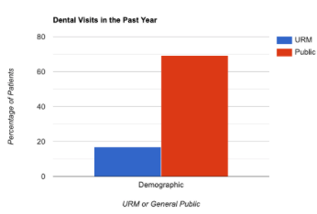
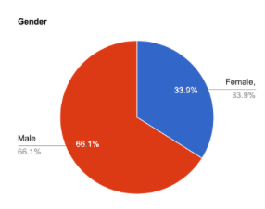
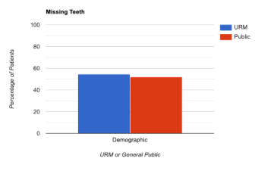
Oral Health Disparities in People Experiencing Homelessness on Skid Row Sam Sheridan², Sarina Taylor², Mehdi Mohammadi¹ ¹ Division of Public Dental Health and Pediatric Dentistry, Herman Ostrow School of Dentistry, University of Southern California, Los Angeles, California, USA. ² Herman Ostrow School of Dentistry, University of Southern California, Los Angeles, California, USA.
64.9%
17%
34.4%
21.7%
1c
1b
Figure 3. Comparison of patients with one or more missing teeth between URM and general public populations.
Figure 1. Comparison of gender in patients seen during screening at the Union Rescue Mission.
Figure 2. Comparison of dental visits within the past year between URM and general public populations.
52%
2.8%
2.2%

Slide 21
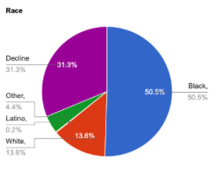
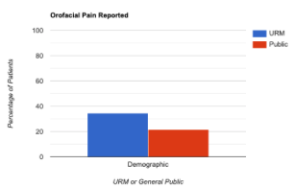
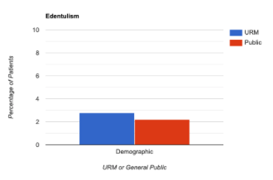
Oral Health Disparities in People Experiencing Homelessness on Skid Row Sam Sheridan², Sarina Taylor², Mehdi Mohammadi¹ ¹ Division of Public Dental Health and Pediatric Dentistry, Herman Ostrow School of Dentistry, University of Southern California, Los Angeles, California, USA. ² Herman Ostrow School of Dentistry, University of Southern California, Los Angeles, California, USA.
17%
34.4%
21.7%
21.7%
1c
1b
1c
1b
Figure 4. Comparison of race (black, white, latino, other, decline) reported during screening at the Union Rescue Mission.
Figure 5. Comparison of orofacial pain reported between URM and general public populations.
Figure 6. Comparison of edentulism (missing all teeth) between URM and general public populations.
52%
2.8%
2.8%
2.2%
2.2%

Slide 22
Patient Testimony
Ms. Sandra Crockett Union Rescue Mission USC Dental Clinic

Slide 23
Patient Testimony
Mr. Stephen Coats Union Rescue Mission USC Dental Clinic

Slide 24
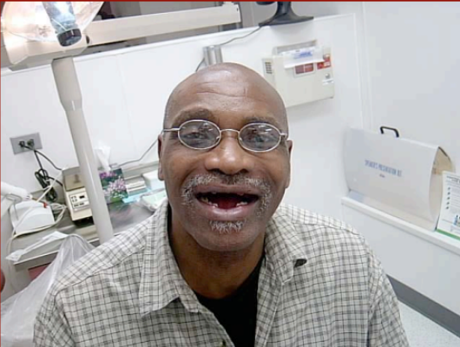
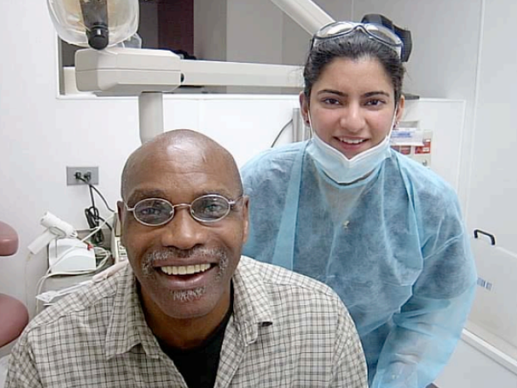
01
Providing exceptional care
Positively influencing students’ beliefs
USC Dental Clinic at Union Rescue Mission
03
02
Improving patients’ lives
“The dental clinic is our best mental health clinic” - CEO, URM

Slide 25
Voices of Resilience
“The Clinic not only fixed my teeth, but gave me the chance to create a life beyond the shelter.”
“I’m so grateful for this clinic. This is my first time receiving dental care in over 20 years.”

