Slide 1
Minnesota Homeless Mortality Study, 2017-2021
Katherine Diaz Vickery, Hennepin Healthcare Research Institute Jonda Crum, Minnesota Recovery Connection
Josh Leopold, Minnesota Department of Health

Slide 2
Agenda
Introductions/Icebreakers
Study Background
Methodology and Results
Community Engagement and Dissemination
Follow-up
Notes:
Josh

Slide 3
Icebreakers
Speaker intros
Who’s in the audience? Consumers, Clinicians, Administrators, Government, Research
Have you ever been involved in a homeless mortality study?
What are you hoping to get out of this session?
Notes:
Josh, Jonda, Kate
Kate will facilitate icebreaker questions

Slide 4
Center of Excellence on Public Health and Homelessness
MDH is one of three national centers
Center of Excellence on Public Health and Homelessness - MN Dept. of Health (state.mn.us)
Focus on reducing severe morbidity and death
Partnership with Hennepin Healthcare Research Institute
Creation of Advisory Group
Notes:
Josh

Slide 5
Advisory Group Representation Matrix
Notes:
Josh

Slide 6
Advisory Group
Defining scope and purpose of Advisory Group
Jonda Crum M
Notes:
Try to move on by 1:05

Slide 7
Motivation for mortality study
Further data integration
Establish priorities
Build public awareness of health impacts of homelessness
Notes:
Inspired by the National Healthcare for the Homeless Mortality Work Group and the need for local data. Used the HCH toolkit. Give space for Ashley

Slide 8
Minnesota Homeless Mortality Study, Methods and Findings
Notes:
By 1:15

Slide 9
-
Background - national
Estimates of premature mortality for people experiencing homelessness (PEH) vary:
All-cause mortality rates 4.5 to 9.6x the general population in the U.S.¹
5x higher mortality among homeless adults in Finland, esp. <50 yrs.²
Drugs, alcohol, and mental illness drove mortality among Canadian shelter residents³
In the U.S. select cities, counties, and some states conduct regular mortality reviews among PEH⁴
Wide variation in methods, quality, regularity
General assumption of under-estimation
Baggett et al., AMA Intern Med. 2013;173(3):189-195.
Stenius-Ayoade et al., Epidemiol Community Health 2017;71:841–848.
Hwang et al., BMJ 2009;339:b4036
NHCHC, Homeless Mortality Data Toolkit, 2021.
Notes:
Kate

Slide 10
Background - state
Minnesota conducts a survey of people experiencing homelessness every 3 years.
Minnesota conducts a homeless memorial each December honoring those who have died.
Minnesota systematically examines trends for opioid overdose mortality, maternal mortality, and more, but does not systematically examine homeless mortality.
Objective: To merge statewide homelessness data with mortality data to understand trends among people experiencing homelessness (PEH) relative to the wider Minnesota population.
Notes:
Kate

Slide 11
Methods
Data merge
Indirect age and gender standardization
Cause of death catalog (per Baggett, Stenius-Ayoade)
Mortality rates, rate ratios
Notes:
Tyler

Slide 12
Data
+
+
Minnesota state death data
Minnesota Homeless Management Information system (HMIS) data
Minnesota population data
Notes:
Tyler
State merge, (next slide for details)
Discuss ACS Census data here!
Mention 90% match rate, but some room for error

Slide 13
Timeframe
2017 2018 2019 2020 2021
Notes:
Tyler
Pooled data across 5 years
All deaths and HMIS service use entry date from 1/1/2017 to 12/31/2021
E.g.) Someone who used HMIS in Dec. 2016, but and then died in 2019

Slide 14
Results
 | PEH (n) | Minnesota (n)
Total unique people | 93,923 | 5,556,359
Total unique deaths (2017-2021) | 1,996 | 237,859
Notes:
Kate

Slide 15
Higher proportions of Black, Hispanic, Multirace, and American Indian Minnesotans experience homelessness than other races. If there were no disparities by race or ethnicity, the lines would be parallel.
Notes:
Kate

Slide 16
Data conclusion - 1
The rate of death is three times higher for people who experience homelessness (PEH) in MN compared with the general population.
20 yr. old PEH in Minnesota have the same rate of death as 50 yr. olds in the general population.
Notes:
Tyler

Slide 17
Unadjusted mortality rates
Unadjusted mortality rate per 100,000 person years | Mortality rate per 100,000 person years
 | PEH | Minnesota
Age, at entry
0-17 | 50.4 | 42.7
18-24 | 257.2 | 73.6
25-34 | 477.4 | 112.0
35-44 | 812.9 | 163.7
45-54 | 1284.2 | 311.9
55-64 | 2087.6 | 727.4
65-74 | 3190.0 | 1725.4
75+ | 4037.3 | 7836.4
Notes:
Kate – introduce MORTALITY RATE: the number of deaths per 100K person years.
An important measure that let’s us make apples-to-apples comparisons between populations and sub-populations in our data.
Here focusing on age, you see that the rate of death among 18-24 PEH is not found in the general population until you reach the 45-54 year olds!
So, this is why we NEED AGE adjustment to these data! And we also adjusted for gender.

Slide 18
Adjusted mortality rates – Take home 1
The rate of death is triple for people who experience homelessness (PEH) in MN than the general population.
Adjusted mortality per 100,000 person years
 | PEH | Minnesota
Total | 663.1 | 221.6
Mortality rate ratio
3.0
Notes:
Kate
So if we equalize the gender and age of PEH and the general MN population using adjustment, we find our main take home #1 we use what’s called a ”rate ratio”– or just dividing the rate of PEH by the mortality rate in the MN gen pop → 3.0. This is where we get take home 1.

Slide 19
Data conclusion - 2
2. American Indian PEH have substantially higher rates of death
than other PEH and the general MN population.
1.5x higher than PEH overall
5x higher than the general MN population
Notes:
Tyler
“Mortality across each racial and ethnic group is higher than racial/ethnic concordant counterparts in the general population.”
Note: Jackie Dionne, Director of American Indian Health at the Minnesota Department of Health,
“We now know from Advancing Health Equity in Minnesota: Report to the Legislature (2014) that there are many factors that impact the health of populations, including systemic problems, structural racism, historical trauma, health behaviors, biological differences, and social determinants of health (poverty, employment, housing)—we would like to recognize that all of these factors are a part of the story of health in American Indian communities.”^{i}
As we move thru our time together today, Josh L. will start our discussion about how we have already begun to partner with native leaders and community members to respond appropriately to this disparity. We welcome your input here as well during our discussion!
PAUSE – any one have comments/questions?

Slide 20
Adjusted mortality rates
Adjusted mortality per 100,000 person years
 | PEH | Minnesota
Total | 663.1 | 221.6
Mortality rate ratio
3.0
Race/ethnicity
American Indian or AK native | 1042.2 | 741.7
Black or African American | 550.6 | 378.2
White | 717.9 | 270.3
Hispanic | 411.9 | 154.6
Asian or Pacific Islander | 585.5 | 151.0
Multirace | 606.9 | 103.4
Notes:
Tyler
“Mortality across each racial and ethnic group is higher than racial/ethnic concordant counterparts in the general population.”
To understand the magnitude here we need to compare the mortality rate among AI/AK natives to other rates.
So Compared to the overall PEH, we see the rate among AI is 1.5 x higher
And compared to the general MN pop, the rate among AI PEH is 5 x higher

Slide 21
Mortality rates across each racial and ethnic group is higher among people experiencing homelessness than among the general Minnesota population.
American Indian PEH have a mortality rate that is 1.5 times higher than PEH overall and 5 times higher than the general MN population.
American Indians in the general MN population have higher mortality rates than any other racial and ethnic group including those experiencing homelessness.
Notes:
Tyler

Slide 22
Data conclusion - 3
3. Substance use death rate is 10x higher among PEH than the general MN population.
10% of substance use deaths in MN are among PEH, while only 1.7% of the population
1 in 3 of all deaths among PEH are caused by substance use, especially opiates including fentanyl.
Notes:
Tyler

Slide 23
Causes of substance use death
Adjusted mortality per 100,000 person years |  |  | Mortality rate ratio
 | PEH | Minnesota
Total | 663.1 | 221.6 | 3.0
Specific substances
Alcohol | 49.5 | 5.5 | 9.0
Alcohol + opioids | 22.6 | 1.6 | 13.9
Opioids | 117.6 | 10.6 | 11.1
Fentanyl | 103.0 | 8.4 | 12.3
Other opioids | 38.2 | 3.9 | 9.7
Methamphetamine | 78.1 | 5.4 | 14.4
Meth + opioids | 48.8 | 3.0 | 16.1
Cocaine | 19.9 | 1.6 | 12.5
Cocaine + opioids | 4.7 | 0.3 | 15.5
Notes:
Tyler
All people with SUD death, list any substance mentioned in death data
The rate ratio is especially with opioids alone or in combination with other substances.

Slide 24
All substance use
All non-alcohol substance use
All opioids
Fentanyl
Meth.
Alcohol
Meth. + Opioids
Other opioids
Alcohol +Opioids
Notes:
Tyler
Gen. introduction of axes
Lower L = less common, less disproportionate – mostly medical, fewer opioids
Upper L = more common, less disproportionate
Lower R = less common, more disproportionate –
Upper R = more common, more disproportionate
Blue dots (uncommon but more disproportionate):
HIV
Pedestrian injuries
Undetermined
Blue dots (more common and less disproportionate): Heart disease
Cancer

Slide 25
Discussion/Breakout Exercise
How do our findings compare to what you’re seeing in you region?

Slide 26
Community Engagement and Dissemination

Slide 27
Data Workshops
July and August workshops (prior to report release)
Small group discussions on dissemination, integrating stories
Presentations to other stakeholders
Notes:
Homeless service providers
Advocates
Syringe Service Programs
State Behavioral Health agency
Minnesota Indian Affairs Council

Slide 28
Lessons from Outreach
Don’t get bogged down in the technical details
Increasing empathy, avoiding stigma
Desire to share personal stories→ mortality brief

Slide 29
Mortality Brief
Interviews with people with lived experience
Key findings
Adverse Childhood Experiences
Need for safe, culturally responsive options
Multifactor relationships between homelessness and drug use

Slide 30
Report Release
January 2023 – Timed to coincide with state legislative session
Coordination with CDC, CDC Foundation
Press release
Press coverage

Slide 31
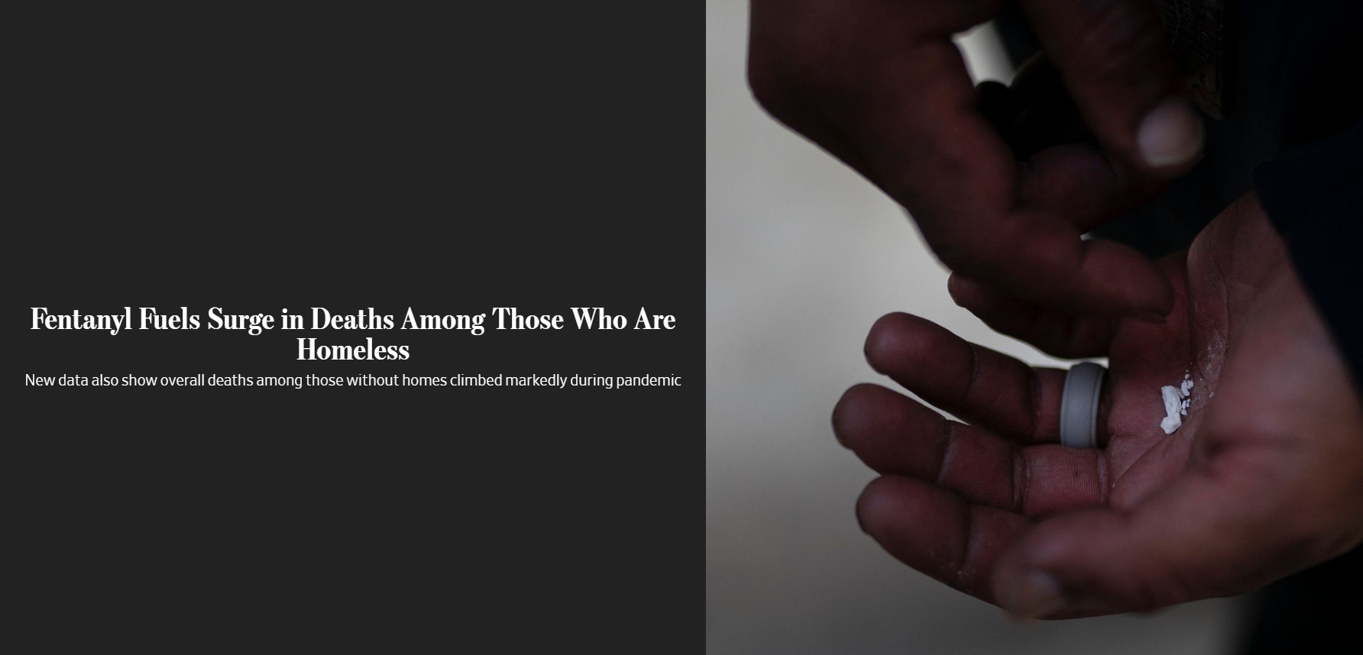
Coverage of Mortality Study

Slide 32
Discussion/Breakout Exercise
How have you, or would you, communicate results from a homeless morality study in your area?

Slide 33
Follow-up

Slide 34
MDH
State legislative proposals
Data integration
Information sharing and education

Slide 35
Kate

Slide 36
Jonda

