Slide 1
Progress to Life Transformation: A Quality Improvement Initiative for HoMeLESS Populations in Addiction Recovery
Dr. Mary Lashley
Towson University

Slide 2
Background/purpose
Persons experiencing homelessness have higher rates of substance abuse, poorer overall health, and higher mortality from opioid overdose than the general population (NHCHC, 2016).
outcome assessment is essential for informing the continued improvement of recovery programs and validating effectiveness of evidence-based interventions.
PURPOSE: To measure the impact of a residential faith-based recovery program on the self-sufficiency of persons experiencing homelessness as they work through the addiction recovery process.

Slide 3
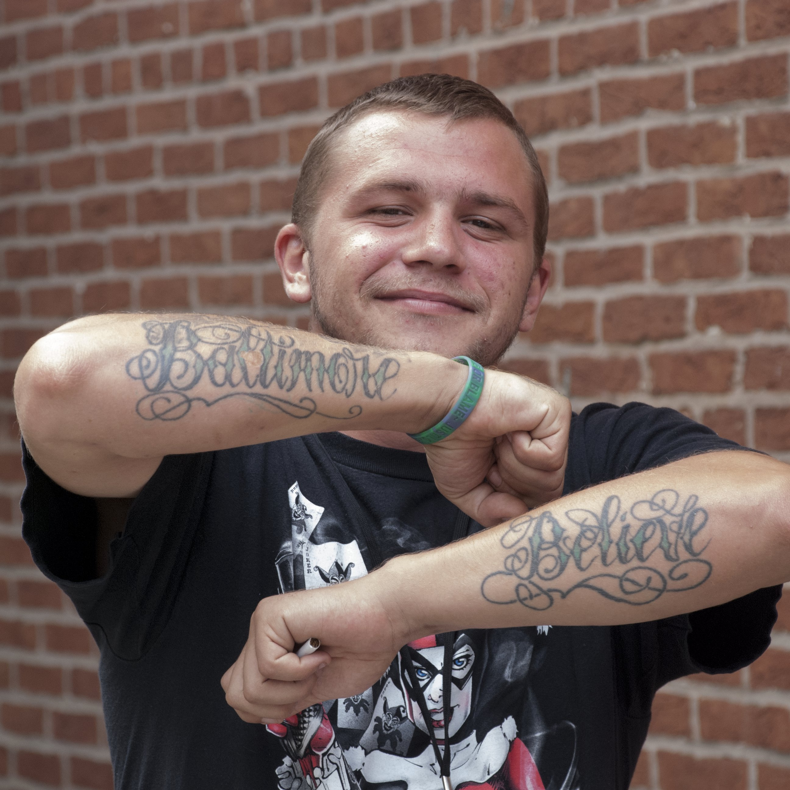
Helping Up Mission
https://helpingupmission.org/womens-video/
https://helpingupmission.org/2016/04/a-community-of-hope-video/

Slide 4
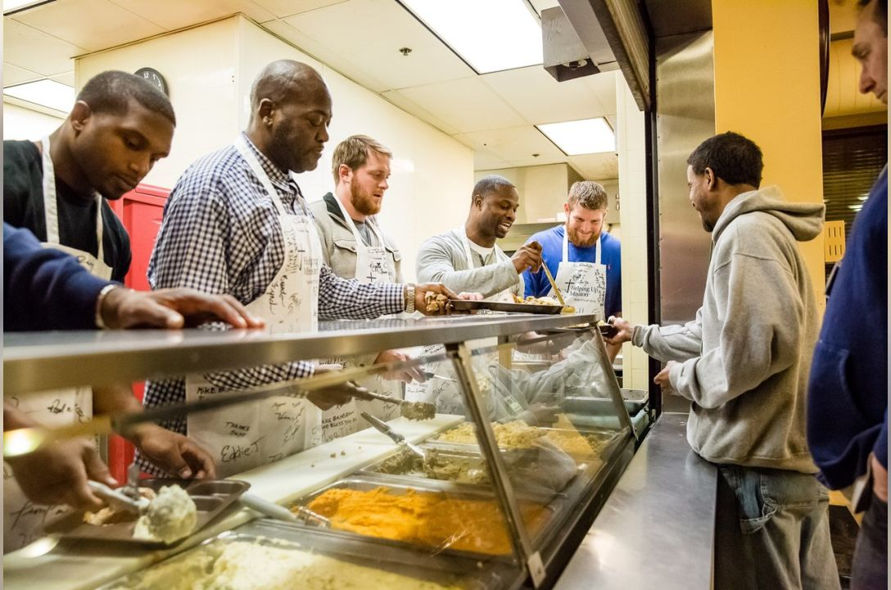
PROGRESS TO LIFE TRANSFORMATION: Self-Sufficiency MODEL
Self-sufficiency - the degree to which individuals are able to achieve an acceptable level of functioning either by themselves or through the help and support of others (Cummings & Brown, 2019; Lauriks et al., 2014).
The Self-Sufficiency Matrix is a matrix of scales that measures broad aspects of self-sufficiency including education, housing, life skills, relationships, sobriety and mental health.
The Self-Sufficiency Matrix measures life domains using a 5-point Likert scale ranging from “in crisis” to “vulnerable,”, “stable,” “safe,” and “thriving.”

Slide 5
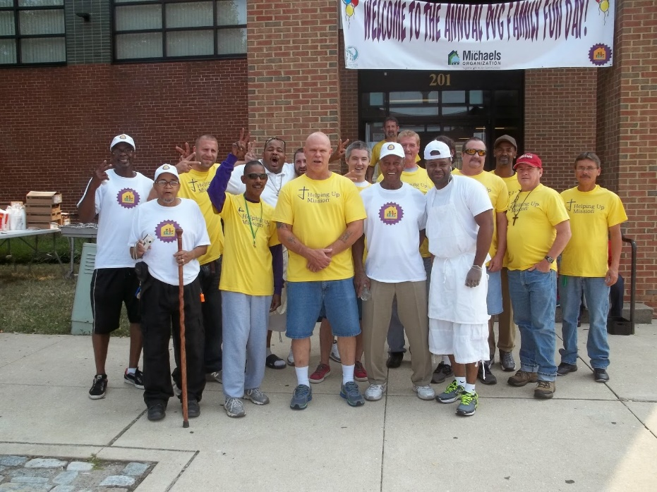
Progress to Life Transformation Domains
.
 | Domain I: Committed to Sobriety | Domain II: Introduced/Re-connected to God | Domain III: Renewed in Emotional and Physical Wellness | Domain IV: Restored Relationships | Domain V: Re-integrated into the Community
 | Recovery | Spiritual Formation | Domestic Safety | Healthy Friendships | Legal
 |  | Character Development | Self-Awareness | Family | Education
 |  |  | Physical Health |  | Employment
 |  |  | Mental Health/Trauma Care |  | Housing
 |  |  | Health Education |  | Finances

Slide 6
Domain V: Re-integrated into the Community
Standard | Sub-Domain | Sub-Domain | Sub-Domain | Sub-Domain | Sub-Domain
 | Legal | Education | Employment | Housing | Finances
In Crisis (1) | Experiencing a significant legal problem or missing vital documents but does not understand extent or impact and does not know what to do. | Severely limited in literacy and/or without a high school diploma/GED | Not employed | Homeless or threatened with eviction | Not receiving income and/or has debts in collection
Vulnerable (2) | Aware of legal issues but does not know what to do. | Enrolled in literacy and/or GED program and/or in sufficient command of English to where language is not a barrier to employment | Employed temporarily, part-time or seasonally; receiving inadequate pay, no benefits | In transitional, temporary or substandard housing; and/or unable to afford current rent/mortgage payment | Receiving inadequate income and/or engaging in spontaneous or inappropriate spending
Stable (3) | Has vital documents, legal information/advice; correctly identifying the problem as a legal problem; aware of what to do but lacking ability to proceed without legal assistance. | Has high school diploma/GED | Employed full time; receiving inadequate pay; few or no benefits | In stable housing that is safe but only marginally adequate | Able to meet basic needs with subsidy; spends appropriately and has a plan for debt re-payment
Safe (4) | Has legal representation and issues are moving towards resolution. | Pursuing additional education/training to improve employment situation and/or to resolve literacy problems | Employed full time with adequate pay and benefits | In safe, adequate subsidized housing | Able to meet basic needs and manage debt without assistance
Thriving (5) | No legal issues or legal issues fully resolved through litigation, negotiations, dismissal or other legal means. | Adequately educated/trained to become employable; and without literacy problems | Maintaining permanent employment with adequate income and benefits | In safe, adequate unsubsidized housing | Receiving and managing sufficient income; managing appropriate debt level, saving some income

Slide 7
Progress to Life Transformation across Program Phases Point in Time Population Data, Men’s Program, 1/14/2022
Program Phase | Entry/Seed of Hope | Alpha | Omega | Life-Prep | Graduation
# Responses | 607 | 385 | 320 | 242 | 115
Recovery Score | 1.32 | 2.22 | 2.67 | 3.10 | 3.37
Spiritual Formation Score | 2.06 | 2.49 | 2.83 | 3.02 | 3.04
Character Development Score | 1.71 | 2.24 | 2.63 | 2.96 | 3.10
Overall Introduced/Re-connected to God Average Score | 1.88 | 2.37 | 2.73 | 2.99 | 3.07
Domestic Safety Score | 2.93 | 3.03 | 3.08 | 3.18 | 3.22
Self-awareness Score | 1.58 | 2.23 | 2.56 | 2.93 | 3.12
Physical health score | 2.58 | 3.21 | 3.51 | 4.00 | 3.99
Mental health/Trauma care score | 2.58 | 3.01 | 3.28 | 3.69 | 3.92
Health education score | 1.82 | 2.83 | 3.23 | 3.48 | 3.52
Overall Renewed in Emotional and Physical Wellness Average Score | 2.30 | 2.86 | 3.13 | 3.46 | 3.55
Healthy Friendships Score | 1.57 | 2.12 | 2.55 | 2.90 | 3.14
Family Score | 1.58 | 1.97 | 2.39 | 2.59 | 2.70
Overall Restored to Relationships Average Score | 1.57 | 2.05 | 2.47 | 2.75 | 2.92
Legal Score | 4.06 | 4.29 | 4.48 | 4.68 | 4.82
Education Score | 2.75 | 2.87 | 2.92 | 3.25 | 3.31
Employment Score | 1.04 | 1.04 | 1.03 | 1.38 | 1.83
Housing Score | 1.83 | 1.94 | 2.11 | 2.08 | 2.46
Finances Score | 1.12 | 1.14 | 1.20 | 1.58 | 2.03
Overall Reintegrated into the Community Average Score | 2.16 | 2.26 | 2.35 | 2.60 | 2.89
OVERALL PROGRESS TO LIFE TRANSFORMATION –AVERAGE SCORE | 2.04 | 2.44 | 2.70 | 2.99 | 3.17

Slide 8
Progress to Life Transformation Matrix Aggregate Data May 13, 2021 – May 13, 2022

Slide 9
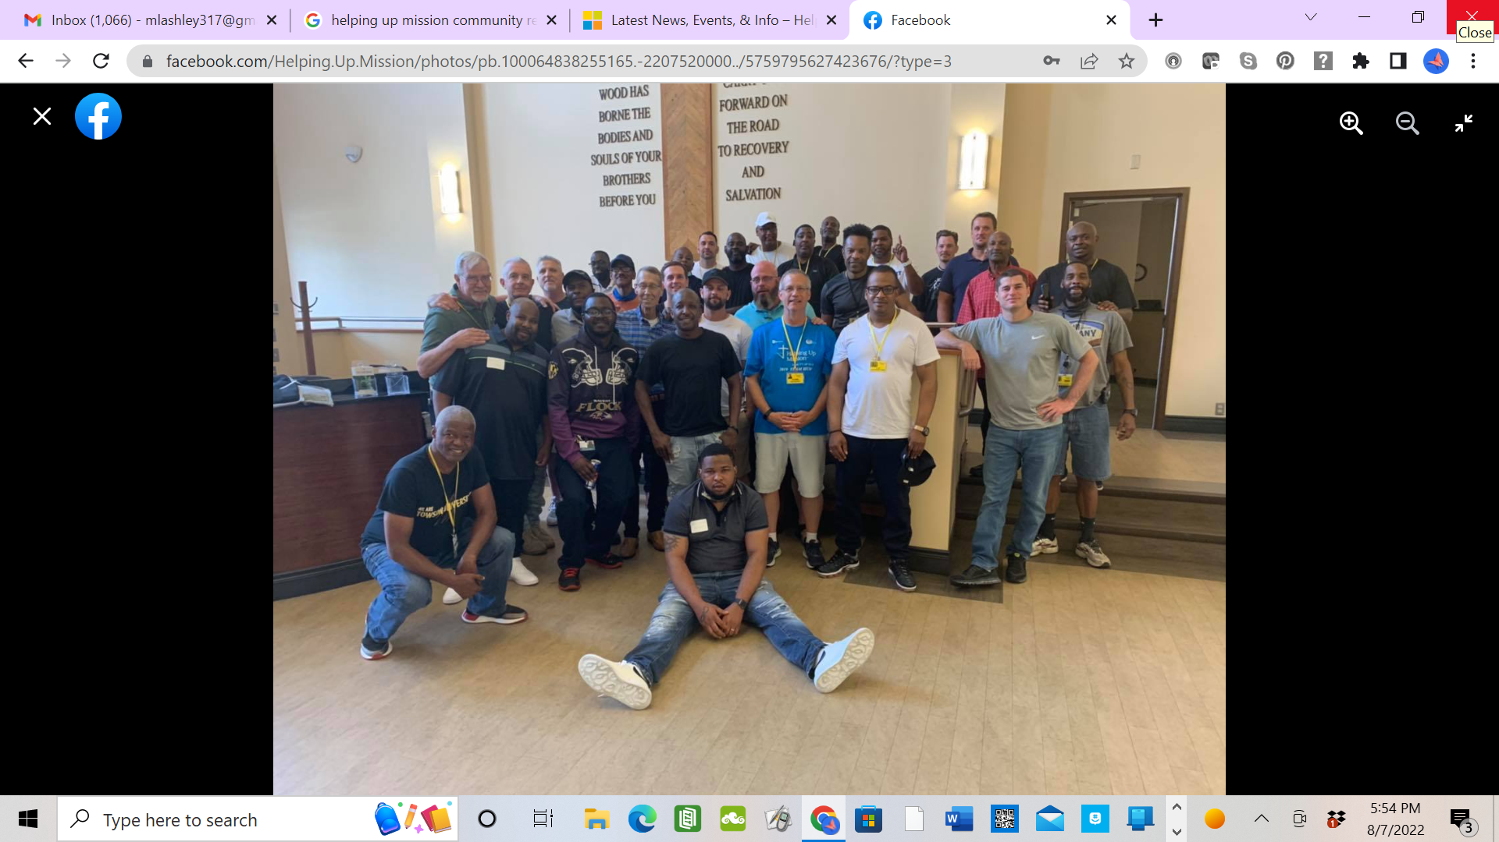
Program/Practice Changes
SOBER PEER
https://www.youtube.com/watch?v=o1lz1OhqdSg
ALUMNI NETWORK
COMMUNITY RE-INTEGRATION

Slide 10
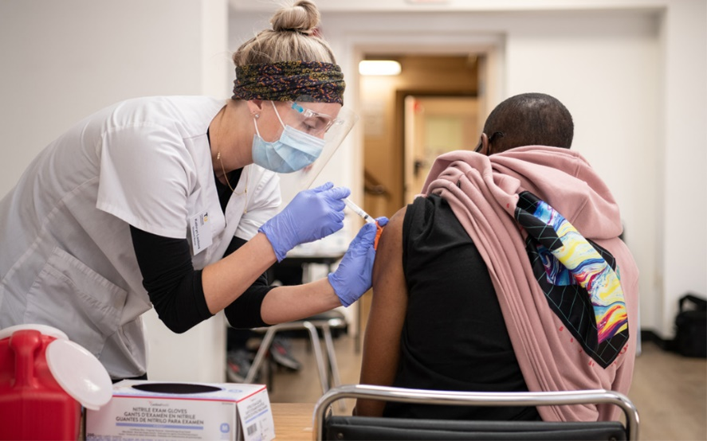
RECOMMENDATIONS/Conclusion
The Progress to Life Transformation Matrix provides a framework for formative evaluation of self-sufficiency in clients as they move through their recovery process.
Data trends generated from the matrix may be used to inform decision making, guide strategic planning, and critically evaluate organizational policies and practices.
Research Is needed to further validate the progress to life transformation matrix in different settings and contexts and with different client populations.
Nurses may use the information derived from this assessment to guide practice and to expand and improve the delivery of programs and services to better meet the needs of clients in recovery.

Slide 11
References
Costello, M., Sousa, S., Ropp, C., & Rush, B. (2020). How to measure addiction recovery? Incorporating perspectives of individuals with lived experience. International Journal of Mental Health Addiction 18, 599-612. https://doi.org/10.1007/s11469-018-9956-y
Cummings, C., & Brown, M. (2018). Psychometric properties of the Self-Sufficiency Matrix among homeless and vulnerably housed individuals and families. Journal of Community Psychology 47, 979-994.
deVet, R., Beijersbergen, M., Lako, D., van Hemert, A., Herman, D., & Wolf, J. (2019). Difference between homeless women and men before and after the transition from shelter to community living: A longitudinal analysis. Health and Social Care in the Community 27, 1193-1203. https://doi.org/10.1111/hsc.12752
Fassaert, T., Lauriks, S., van de Weerd, S., Theunissen, J., Kikkert, M., Dekker, J., Buster, M., & de Wit, M. (2014). Psychometric properties of the Dutch version of the Self-Sufficiency Matrix (SSM-D). Community and Mental Health Journal 50, 583-590. doi 10.1007/s10597-013-9683-6
Helping Up Mission (2021a). Spiritual Recovery Program. https://helpingupmission.org/recovery-programs/
Helping Up Mission (2021b). Progress to life transformation – SRP. Helping Up Mission.
Helping Up Mission (2022). Progress to life transformation data May 13, 2021 to May 13, 2022. Helping Up Mission.
Lauriks, S., de wit, M., Buster, M., Fassaert, T., van Wifferen, R., & Klazinga, N., (2014). The use of the Dutch Self-Sufficiency Matrix (SSM-D) to inform allocation decisions to public mental health care for homeless people. Community Mental Health Journal 50, 870-878. Doi:10.1007/s/10597-014-9707-x
Lei, Q., & Brown, M. (2021). Identifying a typology of homelessness based on self-sufficiency: Implications for rapid re-housing interventions. Journal of Community Psychology, 1-14. doi: 10.1002/jcop.22596
National Alliance to End Homelessness (2020). State of homelessness: 2021 edition. https://endhomelessness.org/homelessness-in-america/homelessness-statistics/state-of-homelessness-2021/
National Health Care for the Homeless Council (2019). Health, homelessness, and racial disparities. https://nhchc.org/wp-content/uploads/2019/08/health-homelessness-and-racial-disparities.pdf
National Health Care for the Homeless Council (2016). Medication-assisted treatment: Burprenorphine in the HCH community. https://nhchc.org/wp-content/uploads/2019/08/policy-brief-buprenorphine-in-the-hch-community-final.pdf
Quad Council Coalition (2018). Community/public health nursing [C/PHN] competencies. https://www.cphno.org/wp-content/uploads/2020/08/QCC-C-PHN-COMPETENCIES-Approved_2018.05.04_Final-002.pdf
Sober Peer (2022). How Sober Peer works. https://soberpeer.com
Richmond, M., Papel, F., Zarcula, F., Howey, V., & McChesney, B. (2017). Reliability of the Colorado Family Support Assessment: A self-sufficiency matrix for families. Research on Social Work Practice 27(6), 695-703. doi: 10.1177/1-49731515596072.
United States Department of Housing and Urban Development (2021). The 2020 Annual Homeless Assessment Report (AHAR) to Congress. https://www.huduser.gov/portal/sites/default/files/pdf/2020-AHAR-Part-1.pdf
Young, P. Hong, P., Hoge, D., & Choi, S. (205). Spirituality, hope, and self-sufficiency among low-income job seekers. Social Work 60(2), 155-164. doi:10.1093/sw/swu05

