Slide 1
Health Care For The Homeless Baltimore City
SYRINGE SERVICE PROGRAM ON A MOBILE CLINIC
May 16th , 2023

Slide 2
Introductions
Tyler Gray
John Lane
Justine Wright
Pam Ford
Katharine Billipp

Slide 3
Agenda
Who we are and what we do
Why did we feel SSP was needed on mobile
Approval of SSP at Healthcare for the homeless
How we deliver SSP as part of medical care on mobile
Looking to the future

Slide 4
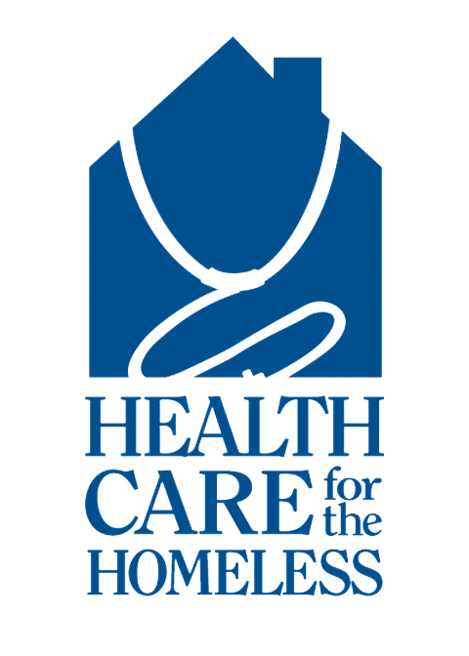
Healthcare for the Homeless
We work to end homelessness though racially equitable health care, housing and advocacy in partnership with those of us who have experienced it.
We operate:
3 fixed site multidisciplinary clinics
A medical respite program at an emergency shelter
A freestanding dental clinic
A mobile clinic
Notes:
3 buildings with permanent supportive housing developed with
partner agencies

Slide 5
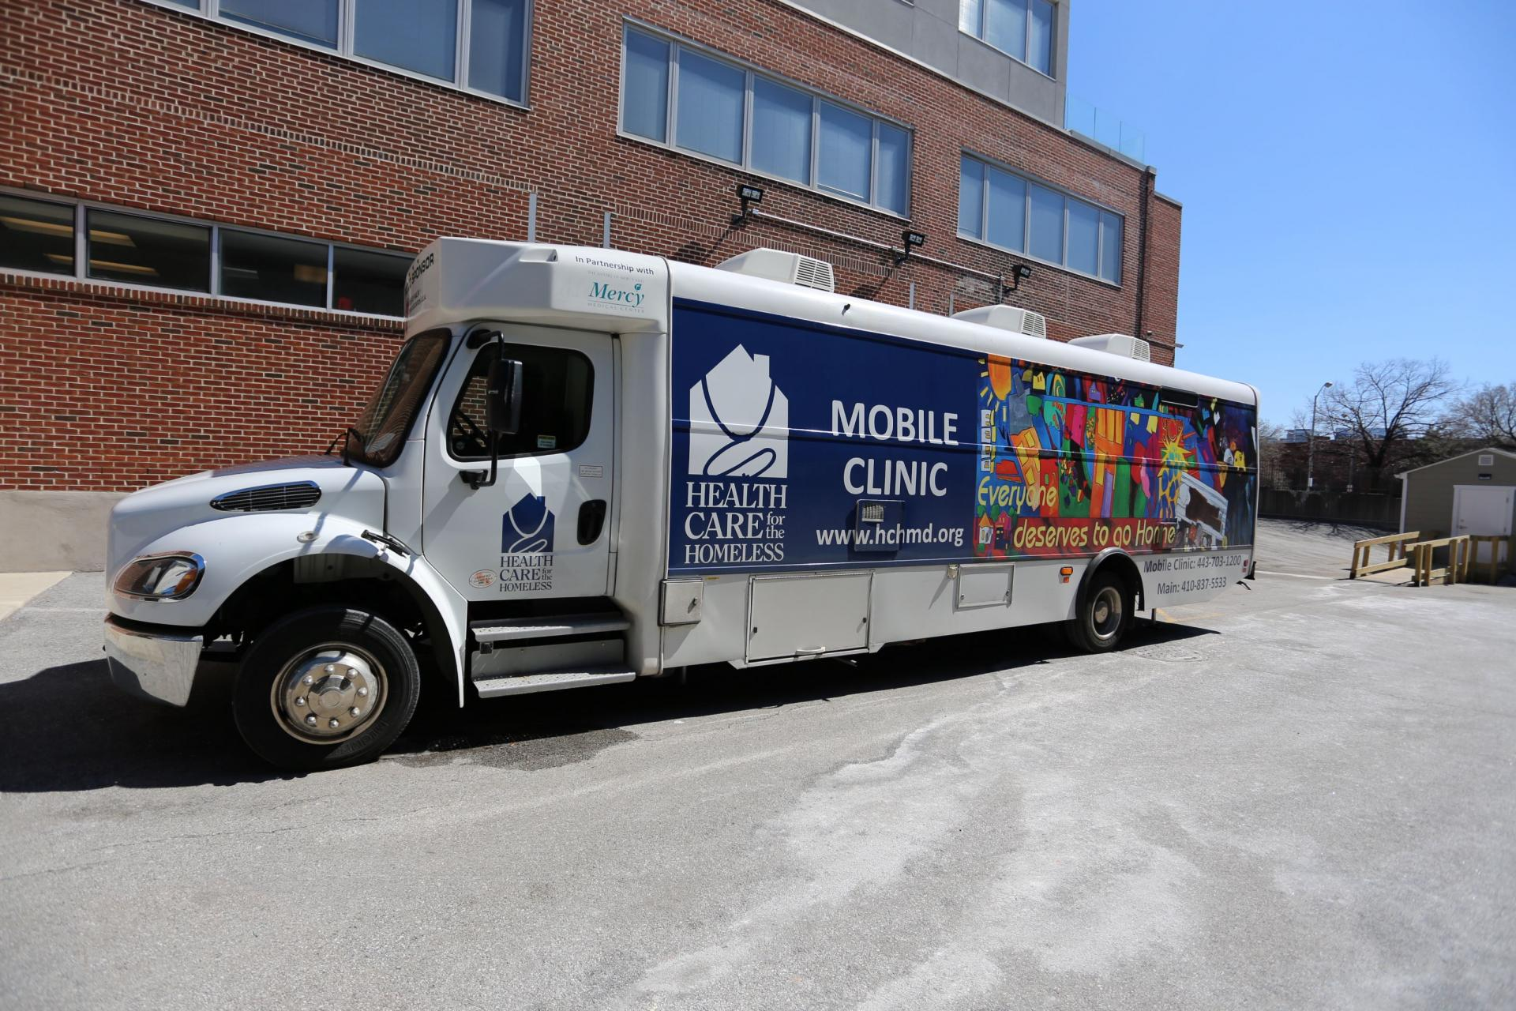

Slide 6
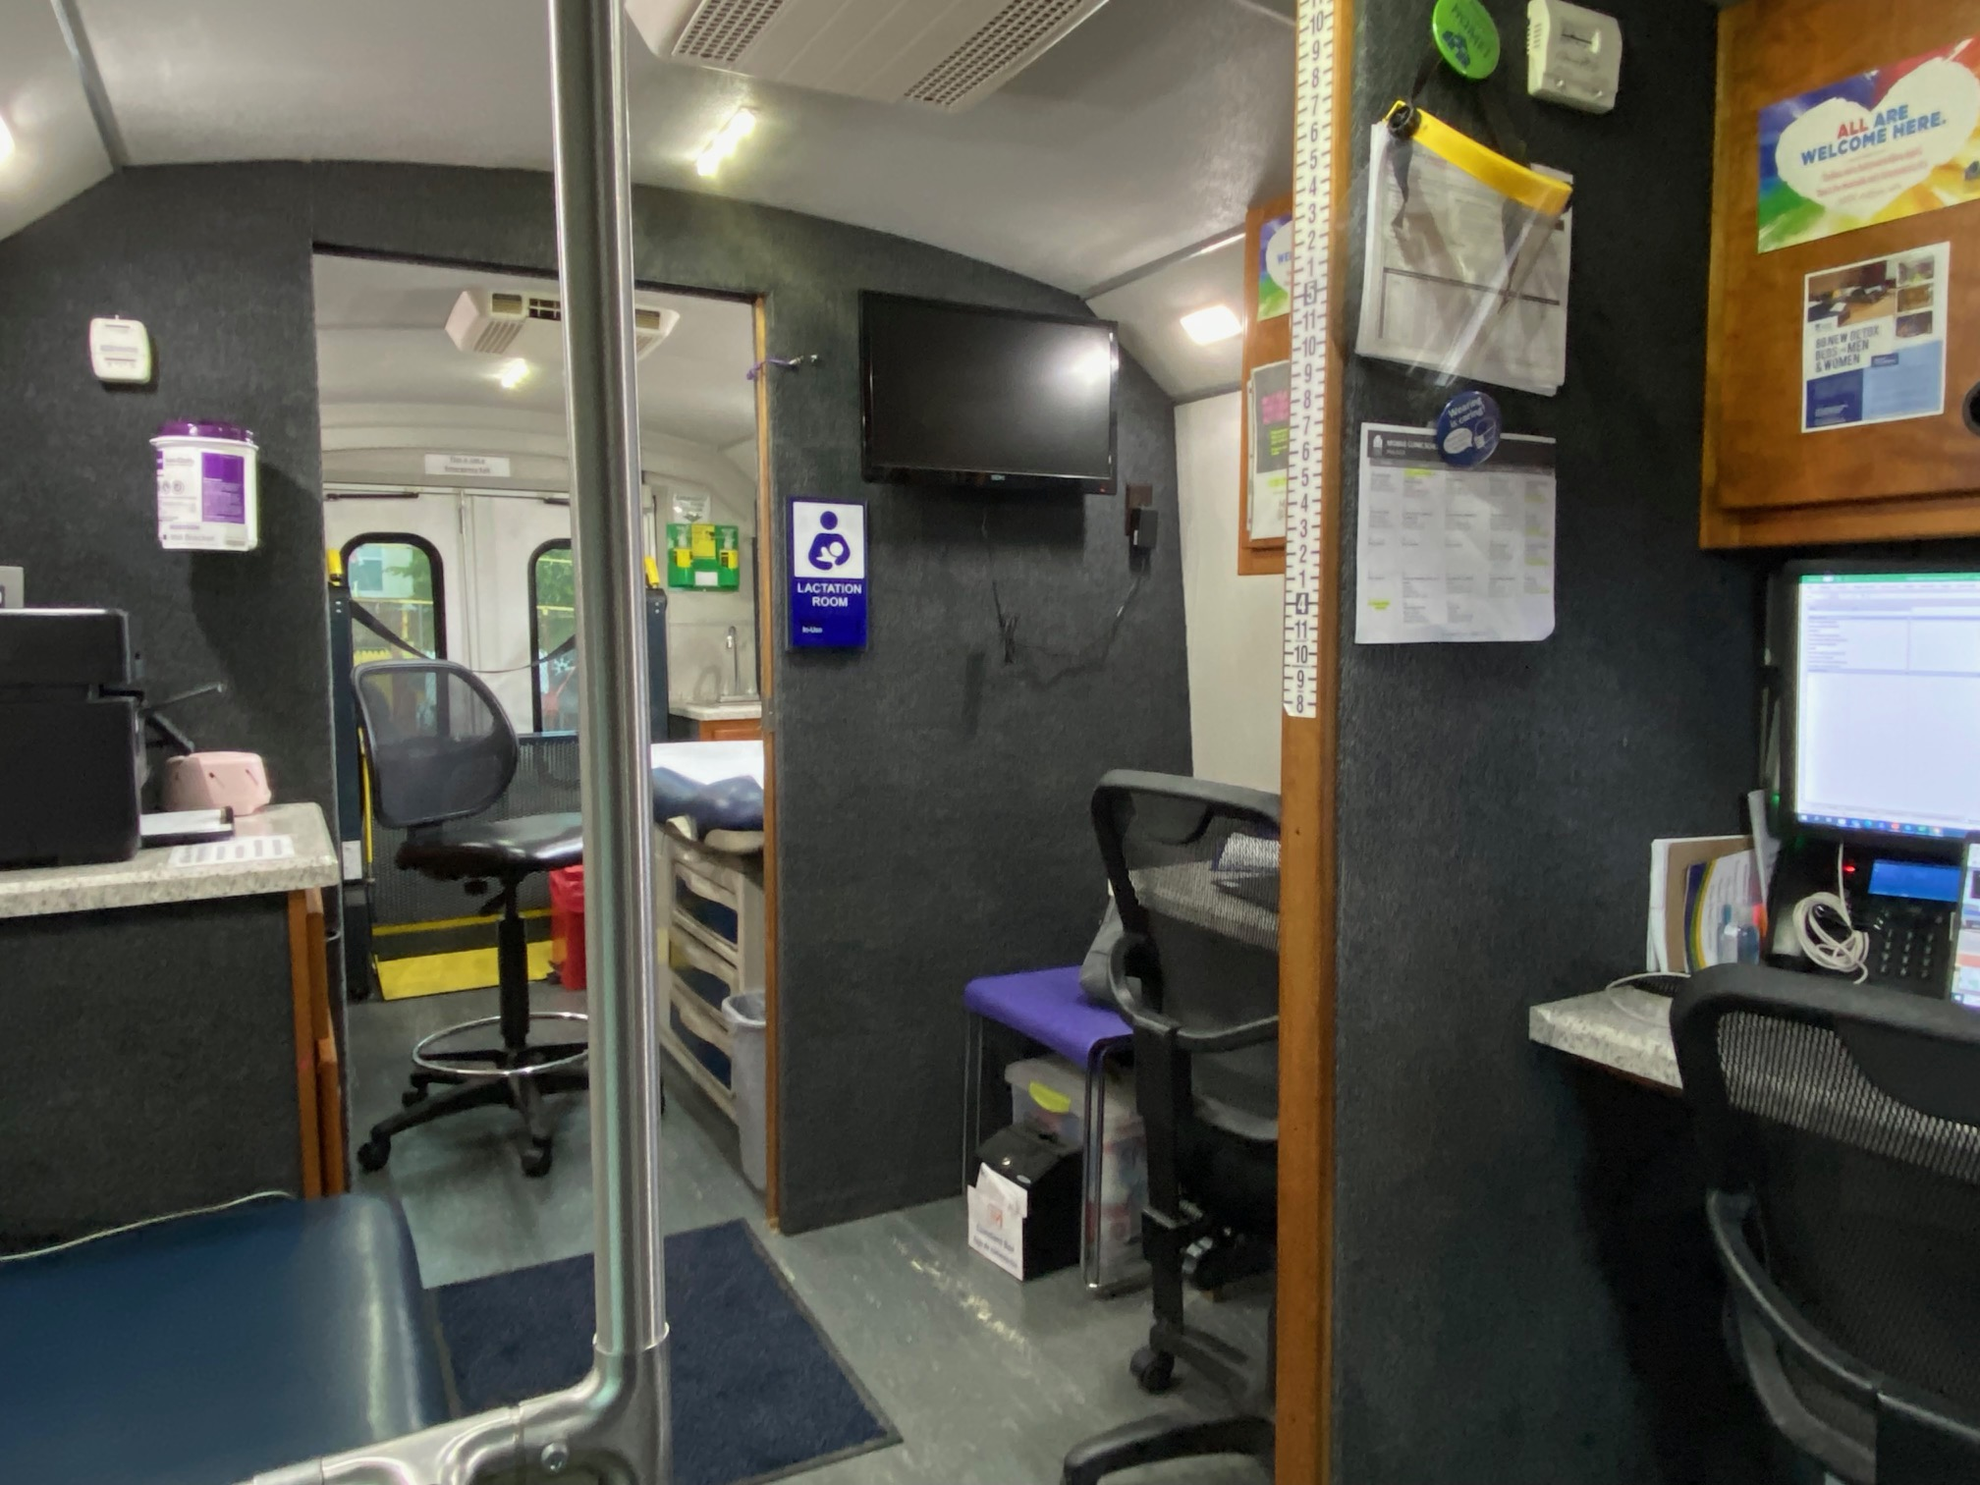

Slide 7
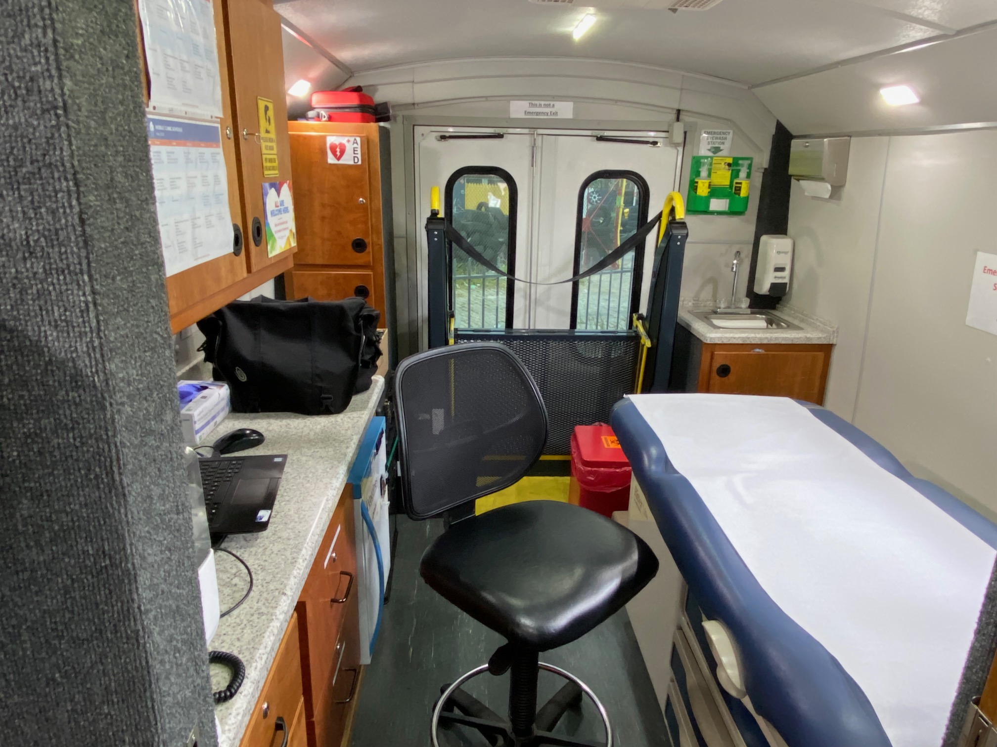

Slide 8
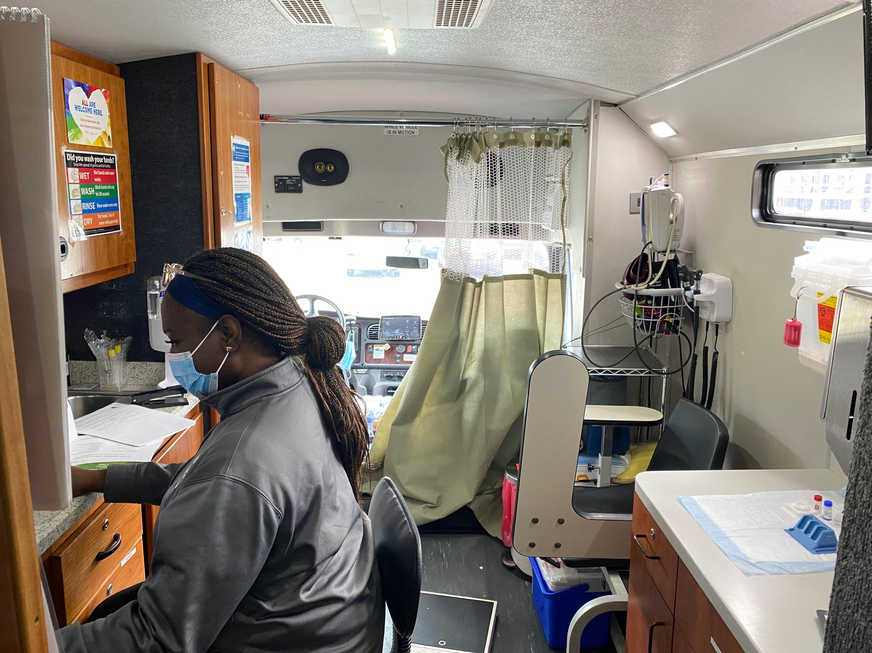

Slide 9
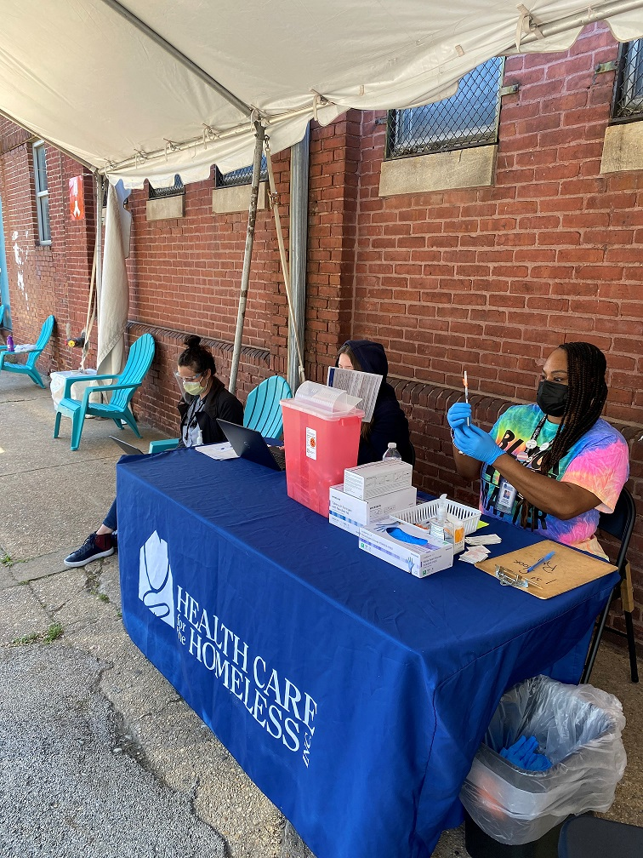
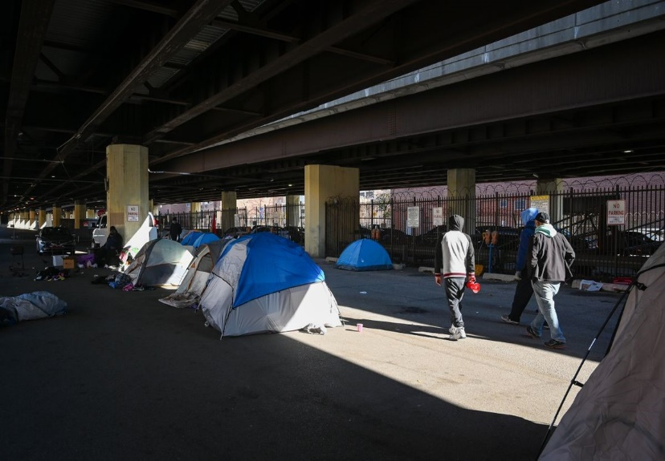
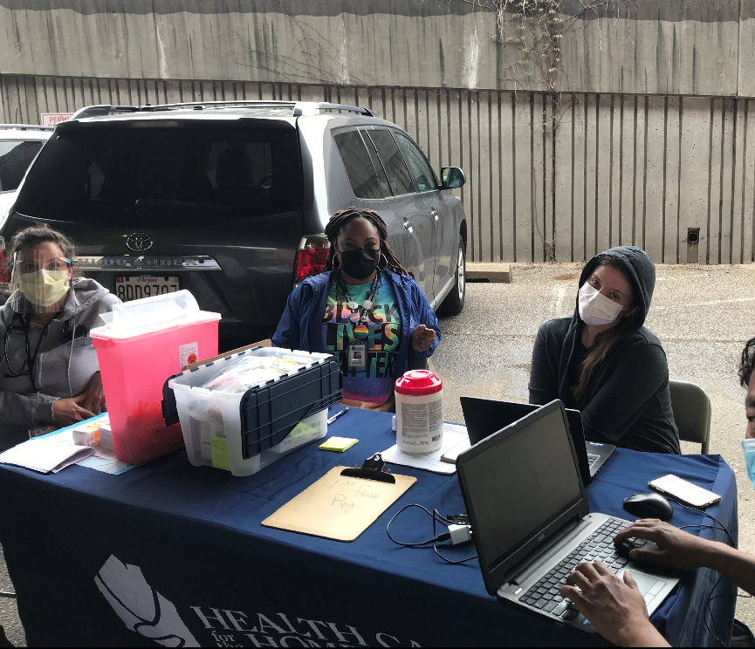
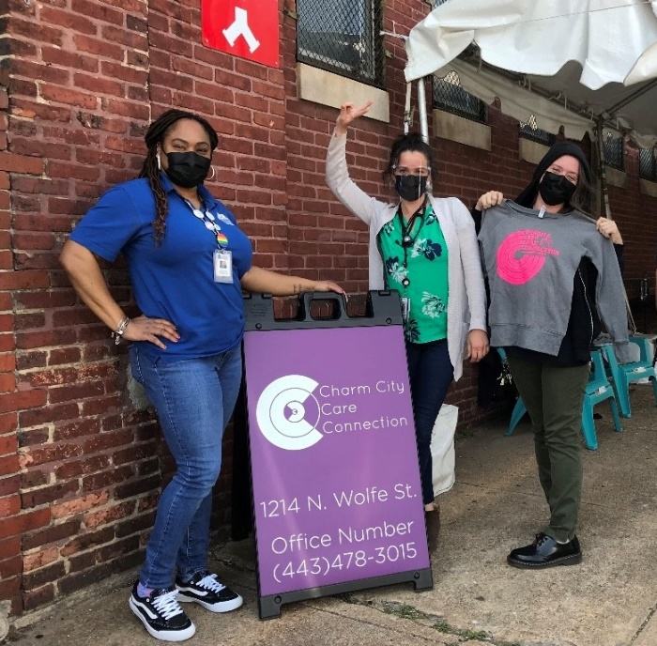
Service delivery locations
Encampments
Shelters
Feeding programs
Community Centers
Health fairs
Main thoroughfares
9

Slide 10
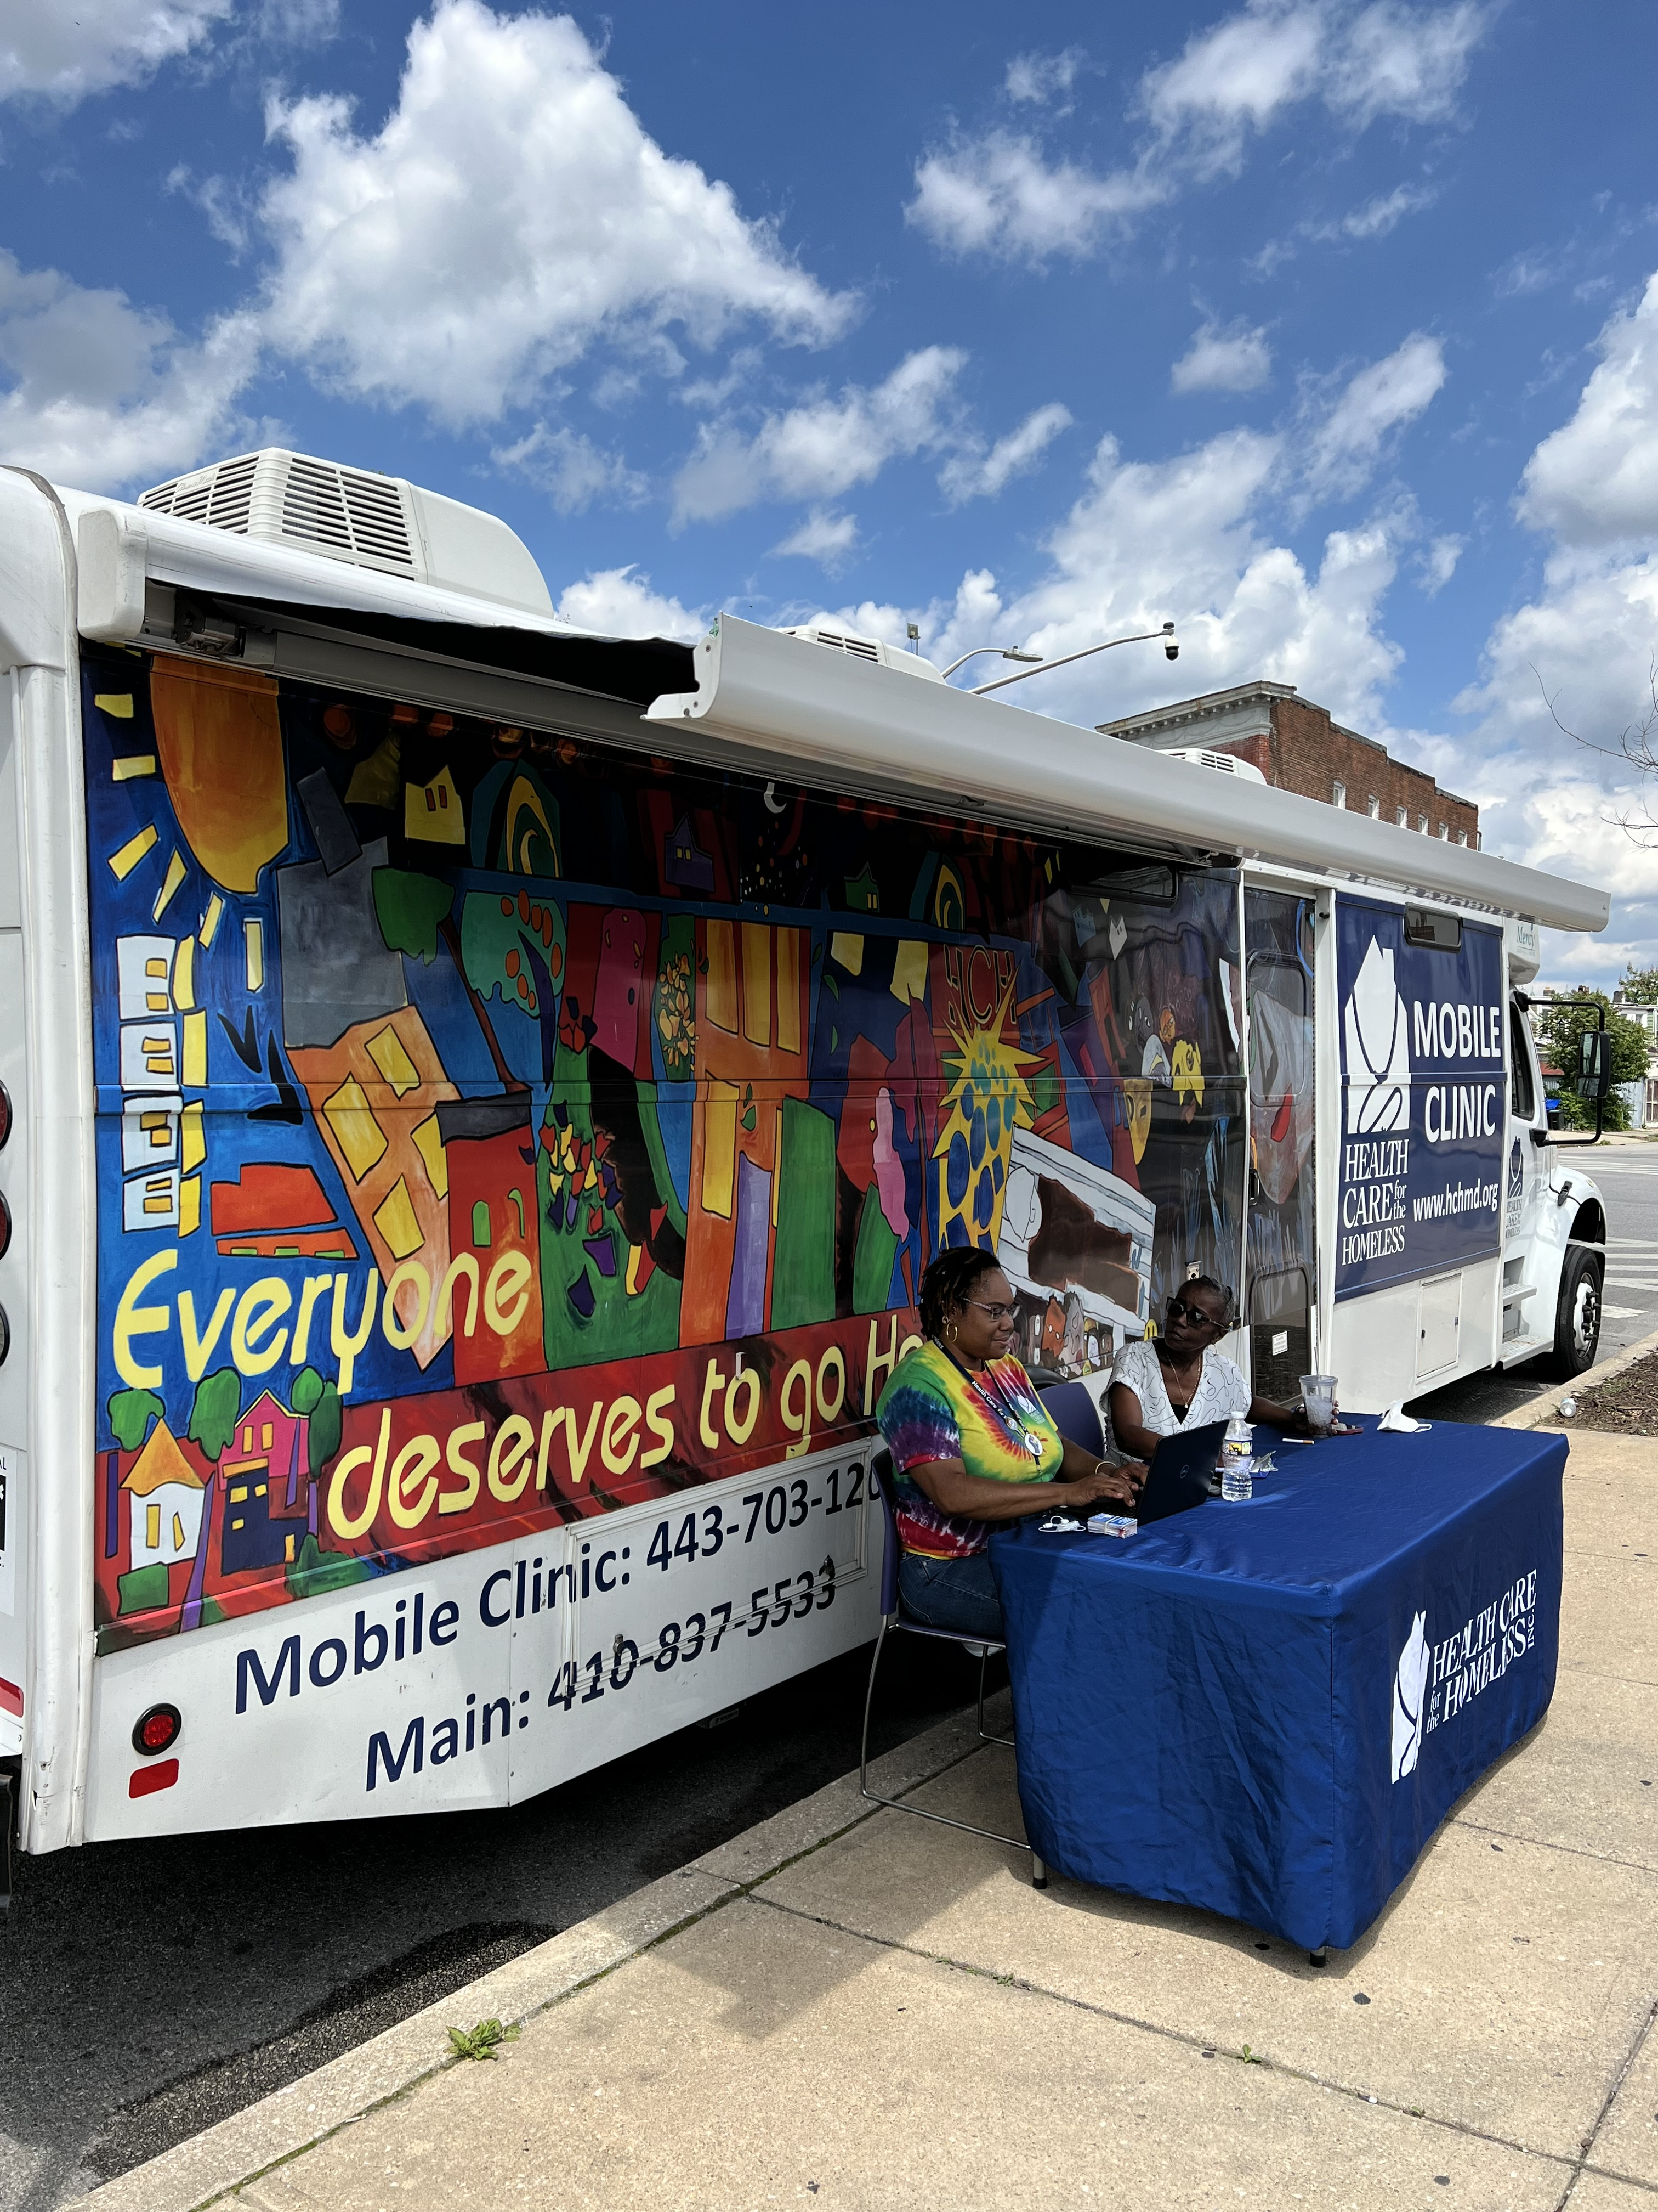
Our team
Certified Medical Assistant
Community Health Worker
MAT Registered Nurse
Driver/Clinic Operations Manager
HIV/HCV Care Advocate
Medical provider
Notes:
With occasional support from nurses or volunteers.
Exploring how to incorporate a case manager

Slide 11
Why did we want to become a syringe service program (SSP) and how did we do it?
Data showed need for continued intervention in the spread of infectious disease and rapid response to rapidly increasing overdose deaths
Baltimore City had a long standing SSP in operation prior to 2016 fed and state law amendments but SSPs curtailed service in COVID era --> local need
We hoped to combine SSP services with on-site medical care as well as linkage to wrap around services.
HCH first FQHC in Maryland to also act as SSP. Currently limited to Baltimore City, aims to increase to Baltimore County.
As of January 2023 there are 22 active SSPs in Maryland
Notes:
It was a years-long process of staff listening sessions and policy research.
Data showed need for continued intervention in the spread of infectious disease and rapid response to increasing overdose deaths.
In 2012 Maryland ranked 2nd in the nation for the rate of new HIV infections per 100,000 residents.
In 2012, 22% of Maryland HIV cases in men and 26% in women were a result of injection drug use. (
In 2018 Maryland had 3rd highest drug overdose rate in mortality in the US (Park et al. 2022).
Prior to 2016 Baltimore City had robust SSP through city health department and harm reduction coalition. Data showed their positive impact on reducing burden of infectious disease and overdose risk by lowering the likelihood of shared drug paraphernalia, as well as reducing mortality through distribution of naloxone and drug treatment services. Both SSP and primary care services were curtailed in context of COVID. We saw an opportunity to increase access to medical care and safe use supplies for community members who were in highest need.
There were no other FQHCs in the state that were SSPs, but MDH was interested in it happening
The application went through the state and was for a specific county (Balt city in our case) so we can only provide services in the city
>>>>>>> click on active link to show map <<<<<<<<<

Slide 12
SSP policy notes
2016 Federal law permits HHS funds to support syringe service programs unless state/local/tribal/territory health dept can prove to CDC significant risk for HCV or HIV infection/outbreak related to IDU
No federal funds may be used to purchase syringes or cookers
2016 Maryland passed Opioid-Associated Disease Prevention and Outreach Act (SB97 aka SSP bill) expanded CBO access to MDH-authorized "Access Grant" recipients w/ collaboration from SAC
In addition to MDH SSP requirements, FQHC needed to address malpractice & FTCA
Application with MDH started May 2020, "certified" SSP started dispensing Feb 2021
Syringes and ties are sourced from McKesson, cookers & cottons through North America Syringe Exchange Network (NASEN)/Dave purchase project
Notes:
2016 federal law permitted use of Department of Health and Human Services (DHHS) funds to support syringe service programs with the exception that funds may not be used to purchase needles or syringes. In order to use DHHS funds for this purpose, eligible state, local, tribal, and territorial health departments must first consult with CDC and provide evidence that their jurisdiction is experiencing or at risk for significant increases in hepatitis infections or HIV outbreak due to injection drug use. If CDC determines if there is sufficient evidence, eligible HHS grant recipients at state, local, tribal, and territorial health departments may then apply to their respective federal agencies (HRSA, CDC, SAMHSA) to direct funds to support approved SSP activities. Obviously what this looks like at the local level changes by state.
In Maryland, 2016 senate bill 97 aka SSP bill expanded access for community based organizations to provide SSPs so long as they were authorized by Dept Health and mental hygiene. Application process for the "access grant" was lengthy and reviewed by both health Dept and a "standing advisory committee" a group of harm reduction experts with the aim to improve technical assistance of application and program development.
We had to meet MDH requirements for any SSP and find a way to operate our malpractice coverage within the FTCA (federal tort claims act)
Part of Maryland law required an SSP participant to have an ID card, but that couldn’t be connected to the medical records in any way, which was a challenge. Ultimately we settled on a random code generator app to provide number on SSP card, this is completed when SSP kits are assembled.
All non injection-specific equipment from McKesson, rest through the Dave purchase project
"Access grant" application with MDH started in May 2020, after working with local collaborators in SAC, our "certified" SSP started dispensing from our brick and mortor clinic in Feb 2021; we expanded to mobile unit October 2022.

Slide 13
How do we incorporate SSP on mobile
Inform potential clients about all available services, from medical care to rapid HIV testing to SSP
See clients even if all they express interest in is clean syringes
Syringes must be distributed by a licensed provider (RN, NP, MD) in the context of a clinical visit
We also assess for interest in drug treatment, wound care needs, reproductive health needs, STI testing, overdose prevention, interest in fentanyl test strips

Slide 14
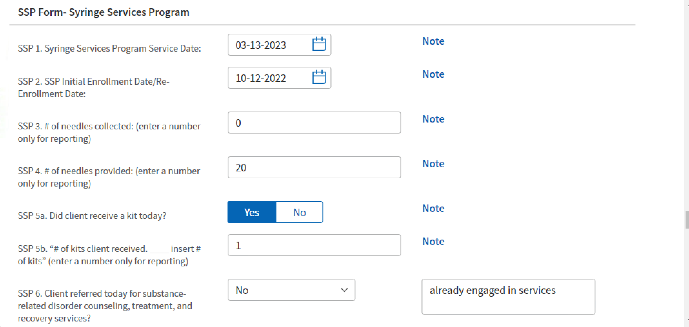
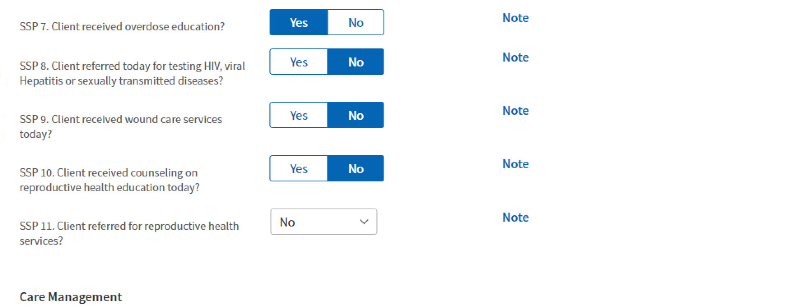
Since May 2022, we have distributed:
166 kits of 10 syringes each
180 fentanyl test strips
184 boxes of Narcan
150 sharps containers
61 unique SSP clients
67 return SSP client visits

Slide 15
SSP approval process more broadly (and briefly)
Reflect on why you want to start a program. How will you include people who inject drugs in your program development? How will you apply a racial justice lens as you build your program?
Check for an existing program nearby and consider partnering with them
Get to know the state-specific policy of your state, especially drug paraphernalia laws
Talk with other providers or experts like the harm reduction coalition for support
https://harmreduction.org/take-action/start-a-harm-reduction-program/

Slide 16
Looking to the future
Expand street outreach and street medicine
Expand to a neighboring county
Long-acting buprenorphine pilot
Explore expanding eligible staff members to dispense SSP
Adapting to ever changing landscape (xylazine)
Notes:
We need to remain flexible on in our delivery model to meet the needs of our communities. Unregulated drug supply and war on drugs means new product with novel side effects & risks. Ie Tranq dope (xylazine) --> increased OD risk & wounds and ID transmission

Slide 17
Adams JM. Making the Case for Syringe Services Programs. Public Health Rep. 2020 Jul/Aug;135(1_suppl):10S-12S. doi: 10.1177/0033354920936233. PMID: 32735192; PMCID: PMC7407057
Boeker K, Newman T. Maryland GOP Governor Larry Hogan Signs Syringe Access Expansion Legislation. Drug Policy Alliance. Epub 2016 May 16. https://drugpolicy.org/news/2016/05/maryland-gop-governor-larry-hogan-signs-syringe-access-expansion-legislation
Centers for Disease Control and Prevention. (2022, March 2). Determination of need for Syringe Services Programs. Centers for Disease Control and Prevention. https://www.cdc.gov/ssp/determination-of-need-for-ssp.html
National Harm Reduction Coalition. (2023, May 15). Start a Harm Reduction Program. https://harmreduction.org/take-action/start-a-harm-reduction-program/
Park JN, Owczarzak J, Urquhart G, Morris M, Weicker NP, Rouhani S, Sherman SG. HIV Risk Among Urban and Suburban People Who Inject Drugs: Elevated Risk Among Fentanyl and Cocaine Injectors in Maryland. AIDS Behav. 2022 Jan;26(1):277-283. doi: 10.1007/s10461-021-03381-y. Epub 2021 Jul 21. PMID: 34287755; PMCID: PMC8294217
References

